Slide 1
ARCSTONE: Calibration of Lunar Spectral Reflectance from Space
ESTO InVEST-2020-001
Cindy Young¹, M. Cooney¹, A. Thurston¹, L. Morrill², N. Ryan¹, M. Banchy¹, C. Stimson¹, B. Magill¹, C. Roithmayr², R. Swanson³, G. Kopp⁴, T. Stone⁵, C. Lukashin²
^{2026 GSICS Annual Meeting}
1 – NASA Langley Research Center, Hampton, VA
2 – Former NASA
3 – Resonon Inc., Bozeman, MT
4 – LASP University of Colorado, Boulder, CO
5 – USGS Emeritus, Flagstaff, AZ

Slide 2


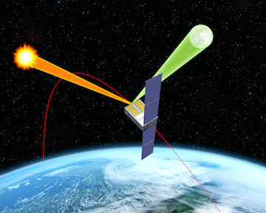

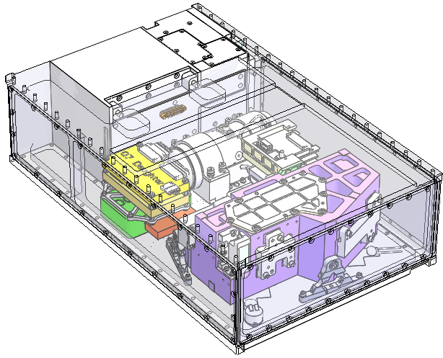
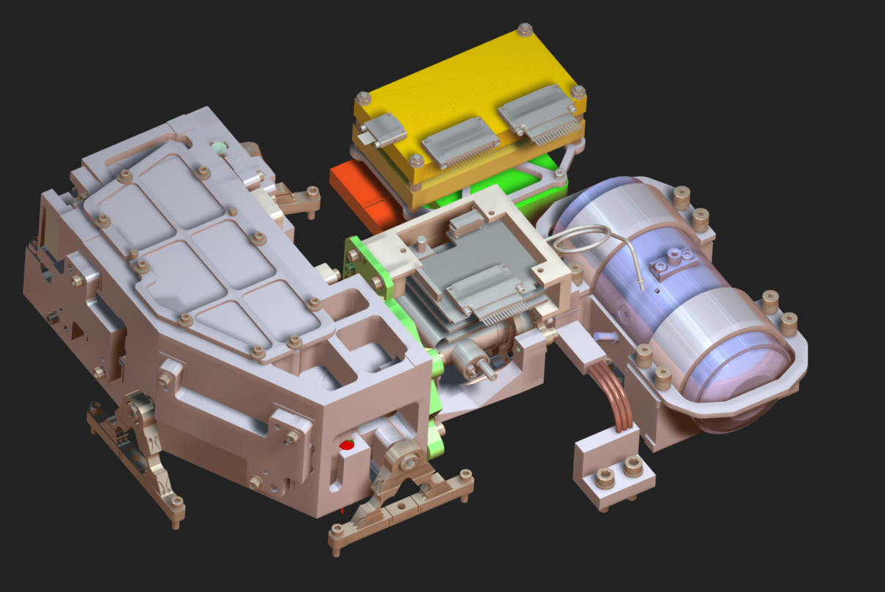




ARCSTONE InVEST: Team & Roles
CubeSat Launch Initiative:
SpaceX/Maverick
Tasks completed
LaRC
Integration with Dispenser
Integration with LV
Launch
Lunar calibration approach
Data validation
Project management
Engineering coordination
Instrument electronics
Mechanical, Thermal & Structural
Payload I&T
Flight and ground software
Science and data products
Payload Operations
Outreach
6U CubeSat Bus:
Mechanical
Power/Electric
Electronics/Data
Avionics
Bus Storage & Maintenance
System I&T
Support for ILS Validation A and B
Mission Operations
GSFC
Optical black coating
SMCE Cloud support
SPS development and Operations
Flight Calibration System
IDCA characterization
Instrument characterization
ILS Validation Testing
Uncertainty budget
Data validation
Opto-mechanical design
Radiometric modeling
Instrument fabrication
Instrument assembly
Functional testing
Support for inst. Modeling
Support for ILS Validation
Data characterization
Payload Analysis
Input to payload design
Flexure design

Slide 3
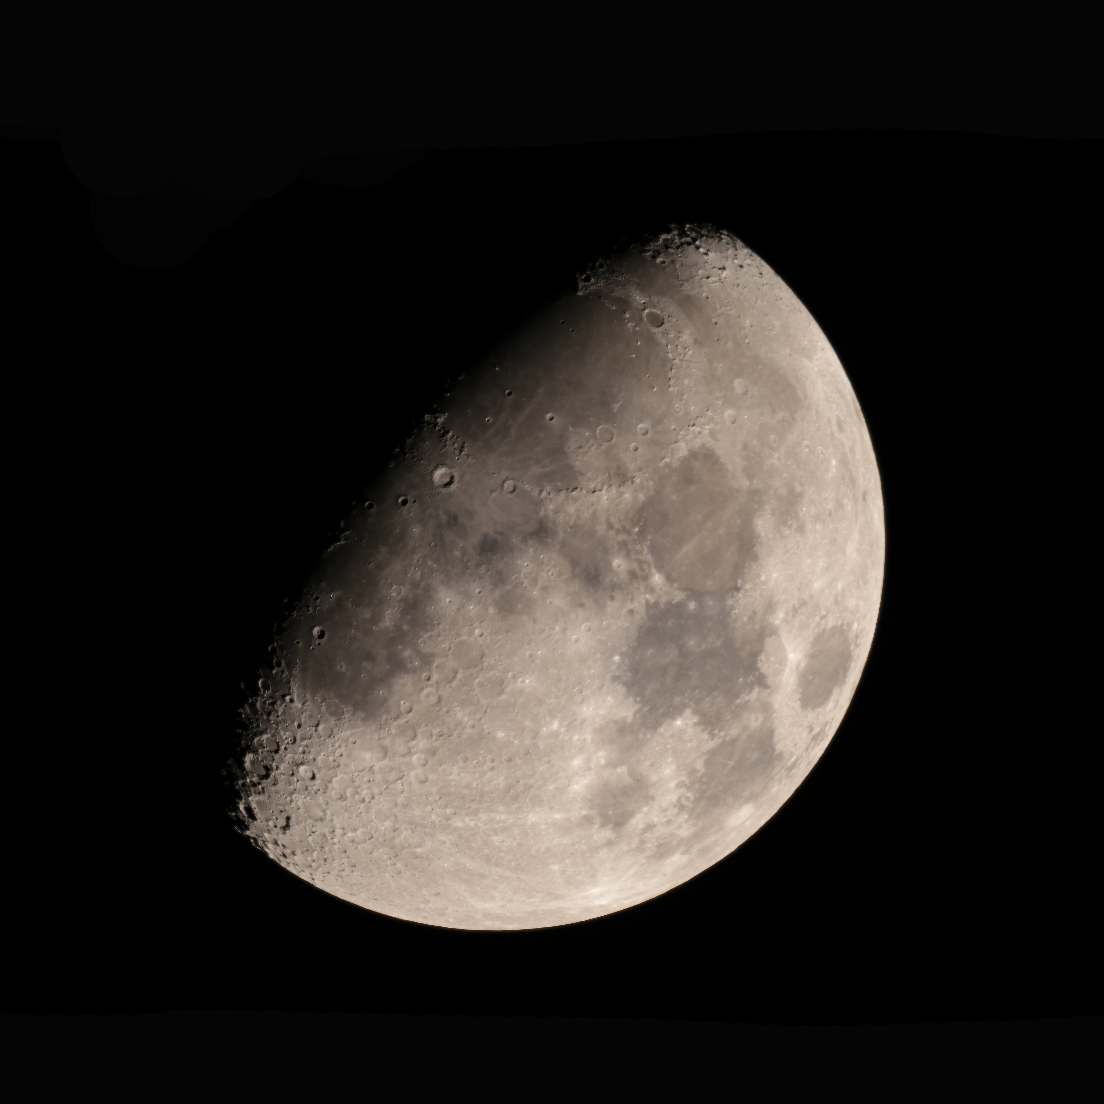

Moon: Accurate Source for Calibration On-orbit
For a small investment → a cost saving, enabling, and permanent solution
Calibration reference: Empirical model of Lunar Spectral Irradiance (entire disk)
On-Orbit Calibration Need:
Absolute accurate spectral irradiance for all lunar phase and libration states (lunar model).
Accurate data set of lunar spectral reflectance to enable new model development.
Expected Impacts:
Quality of data products
Long-term consistency
Inter-consistency
Handling data gaps
Reduced instrument SWaP
Reduced complexity
Accurate SmallSat sensors
Reflectance of Lunar surface stable to < 10⁻⁸ / year
Lunar image by SeaWIFS

Slide 4
THE ARCSTONE Solution:
Novel Concept for Vastly Improving Lunar Calibration:
Lunar reflectance from measuring signal from the Moon and Sun, using the same optical system to observe both bodies directly. Integration time is adjusted to reduce the solar signal.
Calibrated by referencing solar measurements to TSIS-1.
Pointing ability of spacecraft permits obtaining required measurements
with instrument integrated into spacecraft.
Long-term goal: New, highly accurate lunar model
InVEST Tech Demo Approach:
Data to collect: Lunar spectral irradiance every 12 hours
Data to collect: Solar spectral irradiance for calibration daily
Spectrometer with single-pixel field-of-view about 0.7º
Spectral range from 350 nm to 2300 nm
Sun synchronous orbit at average 525 km altitude
6U CubeSat Spacecraft Bus:
courtesy of Blue Canyon Technologies (BCT)
BCT 6U XB6 Spacecraft pointing:
Accuracy 0.002º (1-sigma) in 3 axis
Stability 1 arc-sec over 1 sec
First instrument dedicated to collecting the data needed for lunar calibration in space !

Slide 5
Project updates:
Launched by SpaceX Falcon-9 (Transporter-14 rideshare), June 23, 2025
Bus and Payload engineering commissioning completed on 7/1/25 → achieved TRL7
Commissioning phase concluded on 8/13/25
Nominal mission concluded December 2025
Approved for funding for extended mission operations through end of FY26
So far, we’ve collected 703 observations total.
354 of them were lunar events, totaling 283,179 seconds (78.7 hours) of integration time.
  Observations above atmosphere– no need for atmospheric correction
  Observations not dependent on having good weather
  Spaceborne instrument achieves the required temporal sampling, consistently sampling across a range of lunar phase and libration angles!

Slide 6
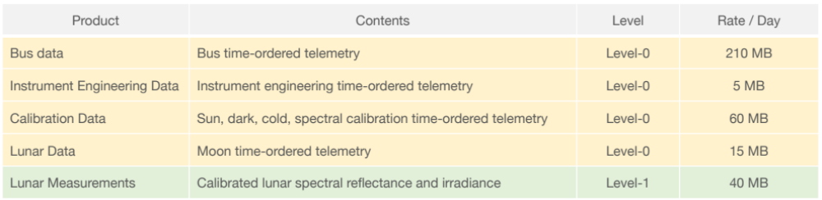
Planned Data Products
ARCSTONE data and algorithms → ATBD for Level-0 and Level-1 data products
Main approach: ratioing spectrometer to derive lunar spectral reflectance
Use TSIS-1/SIM SSI daily product to derive lunar spectral irradiance
Data Analysis and Validation:
- Focus on measurement uncertainty for lunar reflectance and irradiance
- Lunar modeling for data validation
Outstanding work: Correction factors need to be applied (and in some cases created)
        Need uncertainty budget and data validation

Slide 7
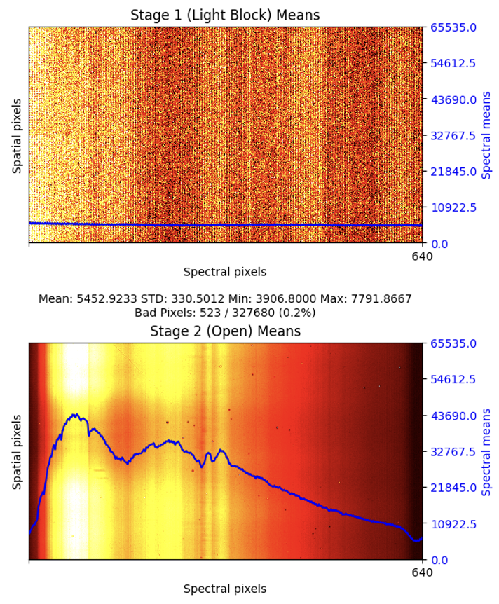
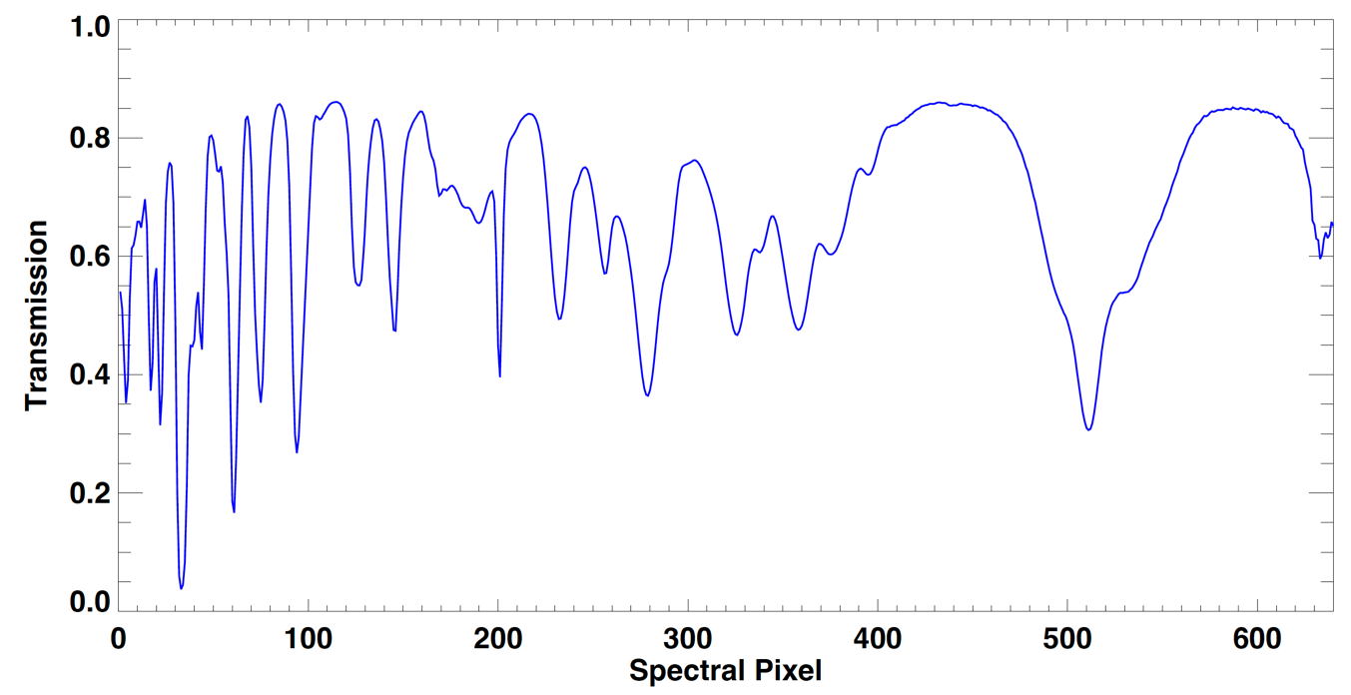
Project updates: Preliminary data analysis
Spectral calibration using Moon and NIST SRM2035b
Mean of 30 DARK FPA frames
Mean of 30 MOON FPA frames

Slide 8
Sun and Moon signals normalized by integration time
Quick-look Reflectance
Disclaimer: this is rough analysis of ARCSTONE first-light
Commissioning data, NOT Level-1 data product !
First-light data demonstrates that the measurement concept is viable!

Slide 9
Project updates: Preliminary data analysis
Quick-look reflectances for later observations from January 2026
Phase Angle = 59.9
Phase Angle = 67.8
Phase Angle = 74.7
Phase Angle = 80.6
Phase Angle = 87.5
NOT a Level-1 data product !
Later mission data looks as expected and is comparable to that taken at first-light

Slide 10
Project updates: Preliminary data analysis
NOT a Level-1 data product !
NOT a Level-1 data product !
ARCSTONE is collecting lunar data at a wide range of phase angles

Slide 11
A goal to vastly improve lunar calibration
We need at minimum 3 years of ARCSTONE data to understand and fit the libration angle variations (Moon’s wobble) with high accuracy.
When we talk about building a new lunar model that will offer an order of magnitude improvement in accuracy over ROLO, this 3 – 5 years of data is what we need.
Any data collected by ARCSTONE can go towards improving ROLO.
Extending the ARCSTONE InVEST mission past the end of FY26 would allow us to collect more of this data until natural deorbit of the satellite.
~3 years of data (at minimum) is needed to build a lunar model that is an order of magnitude better than the state of the art

Slide 12
Mission Performance Summary
On-Orbit Operations
  Expected 300km crossing between 20-Jun-2029 (10% confidence) and 10-Jun-2031 (90% confidence)
Dec 2025 Estimate from GSFC Space Situational Awareness and Navigation Branch
Blue Canyon Technology (BCT) performing orbital lifetime analysis Spring 2026
System Engineering
  Limited health/status reporting, extrapolate health based on available telemetry
  Hardware end-of-life expected Not-Earlier-Than 2029
Science
  Measurement quality expected to be maintained as long as instrument is healthy and controllable
    The team has observed no changes in key performance indicators since beginning of mission
    By measurement concept design, any long-term degradation cancels out in the L1 data product (since lunar reflectance is a ratio of the lunar and solar signals)
ARCSTONE has demonstrated the ability to continue producing viable science measurements until deorbit.

Slide 13
The Path Forward
Arcstone is in the process of attempting to transition to a flight project
  Funds requested to continue operations and to develop the data products
  Decision point will be after a meeting with Karen St Germain (Division Director of the Earth Science Division, in the Science Mission Directorate), currently scheduled for end of June
Preliminary data expected to be released in summer 2026
  L1b lunar reflectance ‘Beta’ product
  Uses ROLO to assess uncertainty
  Uncertainty will be large
Complete data products estimated by end of CY26
  Contains uncertainty budget and corrections
  L1b lunar reflectance and irradiance, L1b solar irradiance
  Goal accuracy is < 0.5% (k=1)

Slide 14
ARCSTONE: Calibration of Lunar Spectral Reflectance from Space
Publications:
Swanson, R., C. Lukashin, M. Kehoe, M. Stebbins, H. Courrier, T. Jackson, M. Cooney, G. Kopp,
P. Smith, C. Buleri, T. Stone, “The ARCSTONE Project to Calibrate Lunar Reflectance,”
IEEE Aerospace Proceedings, 2020
Available online: https://ieeexplore.ieee.org/abstract/document/9172629
Stone, T.C., H. Kieffer, C. Lukashin, K. Turpie,
“The Moon as a Climate-Quality Radiometric Calibration Reference,” Remote Sens.,12, 1837, 2020
Available online at https://www.mdpi.com/2072-4292/12/11/1837

Slide 15
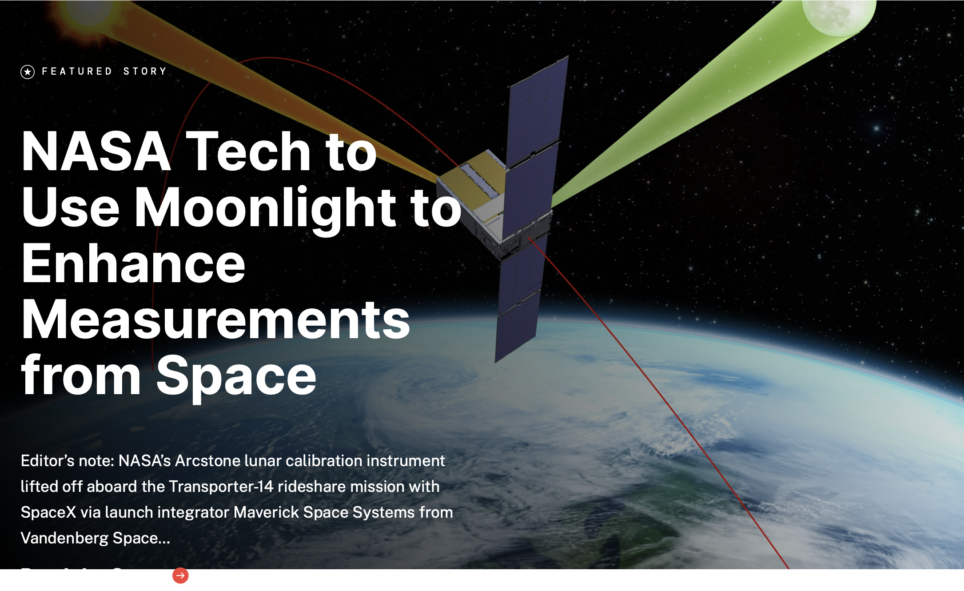
Website:
https://science.nasa.gov/mission/arcstone/
Contact for more information:
Emails:
PI: cindy.l.young@nasa.gov
PM: chad.m.stimson@nasa.gov
PSE: michael.p.cooney@nasa.gov
THANK YOU !
https://www.nasa.gov/blogs/smallsatellites/2026/01/28/nasas-arcstone-instrument-successfully-completes-primary-mission/

