Slide 1






The Lunar Irradiance Model of ESA (LIME)
C. Toledano (UVa), S. Adriaensen (VITO), A. Bialek (NPL), Á. Barreto (AEMET), R. González (UVa), P. De Vis (NPL) , J. Gatón (UVa) and M. Bouvet (ESA)
GSICS Annual and Executive Panel meeting, 23-27 March 2026, Ottawa, Canada.

Slide 2
Outline
LIME latest advancements
Toolbox
Polarisation
Next steps

Slide 3
LIME model approach
Lunar Irradiance Model of ESA
Strategy:
  Irradiance measurements
  SI traceable (NPL calibration)
  Langley plot method for atmospheric correction
  Include polarisation
Objective: 2% uncertainty (k=2)
Fit to ROLO equations for lunar reflectance
SI: International System of units

Slide 4
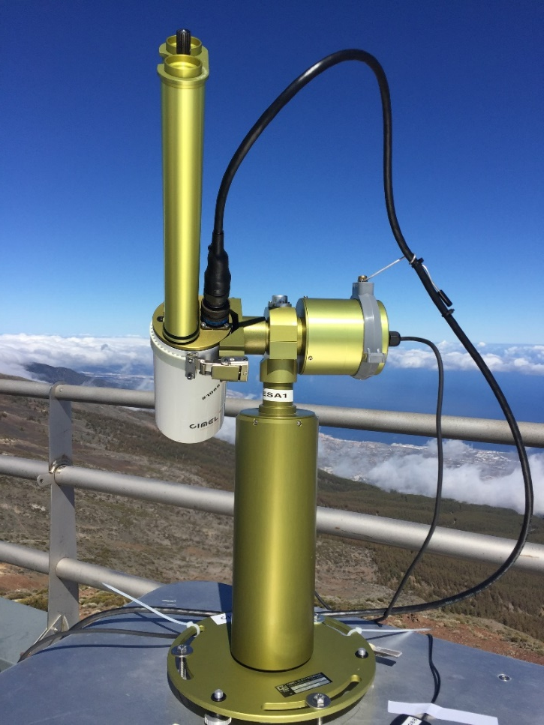
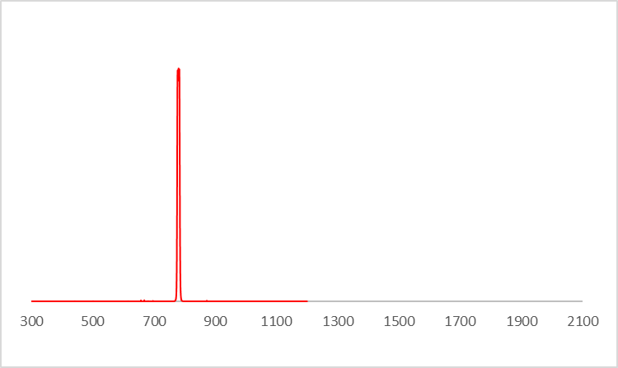
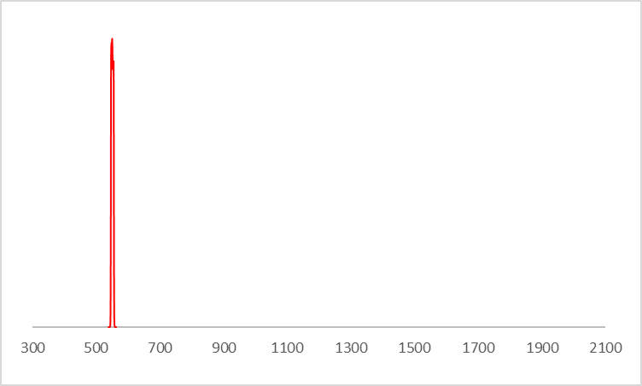
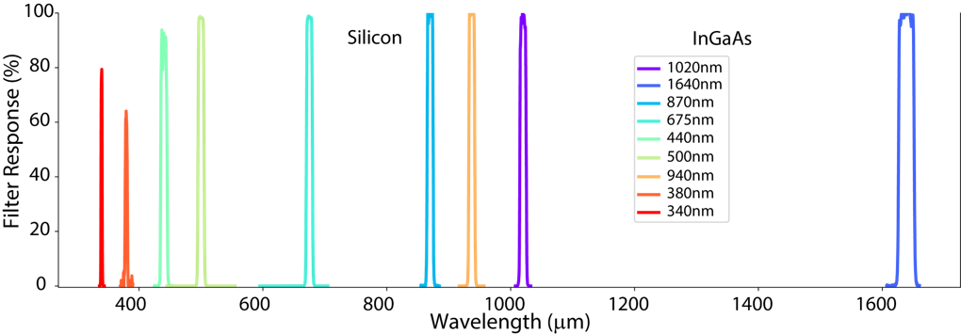
Instrument
Cimel CE-318TP, standard in AERONET
9 filters 440-1640nm
Modifications
- Bands: 440, 500, 550, 675, 780,
870, 935, 1020, 1640 nm
  Direct Moon polarization measurements

Slide 5

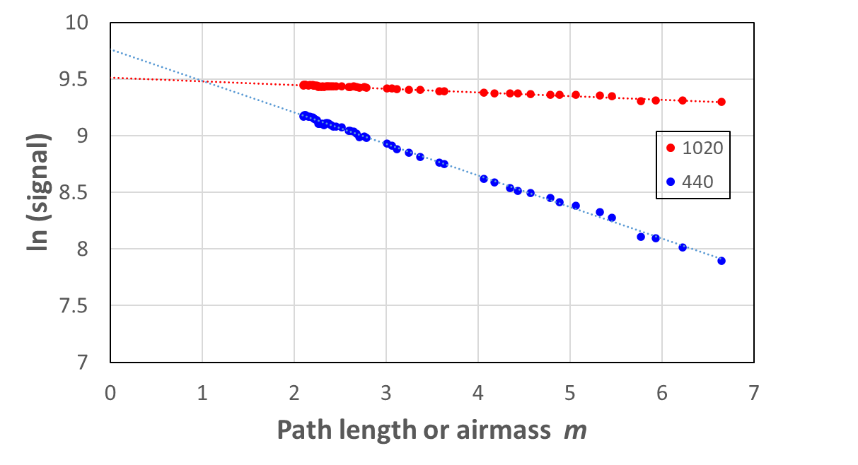
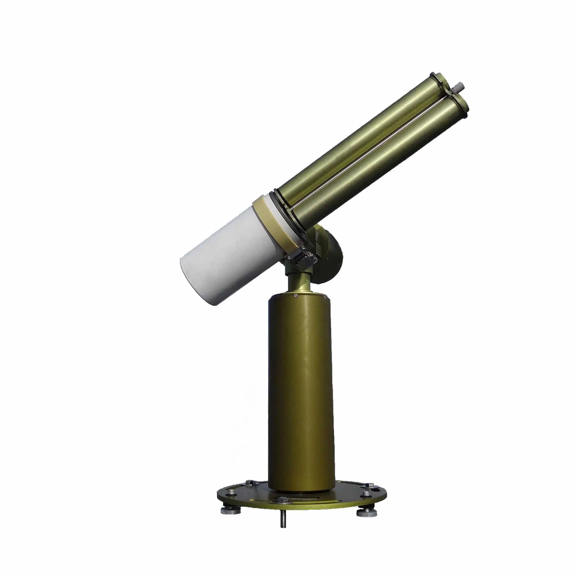

Langley plot method: TOA lunar irradiance
m=2
m=5
TOA signals
m=1
TOA signal x calibration = TOA irradiance

Slide 6
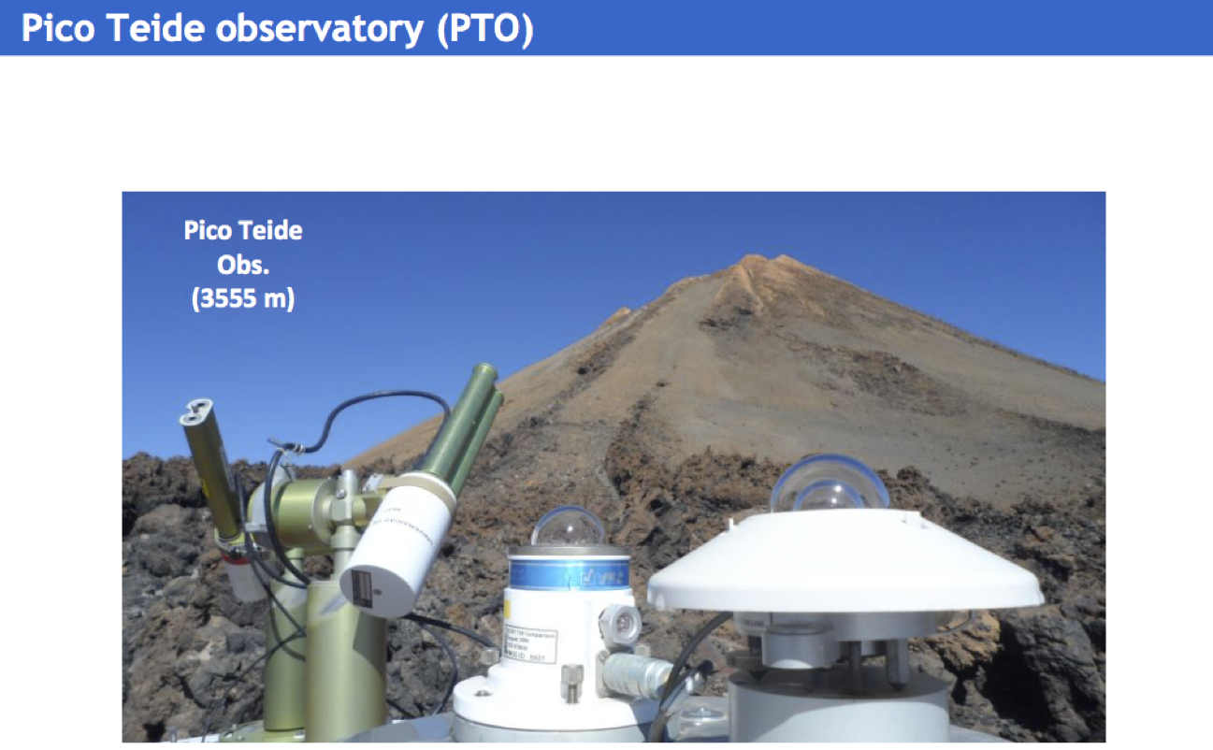
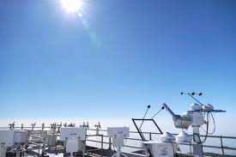
Sites
Since March 2018 (>600 nights)
Teide Peak Obs. (3555m a.s.l.)
Izaña Observatory (2400 m)
Izaña Obs. (2400m a.s.l.)
Toledano et al., ACP, 2018
Cuevas et al., ACP, 2022

Slide 7
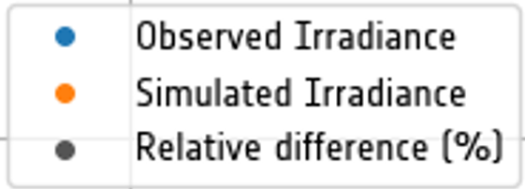
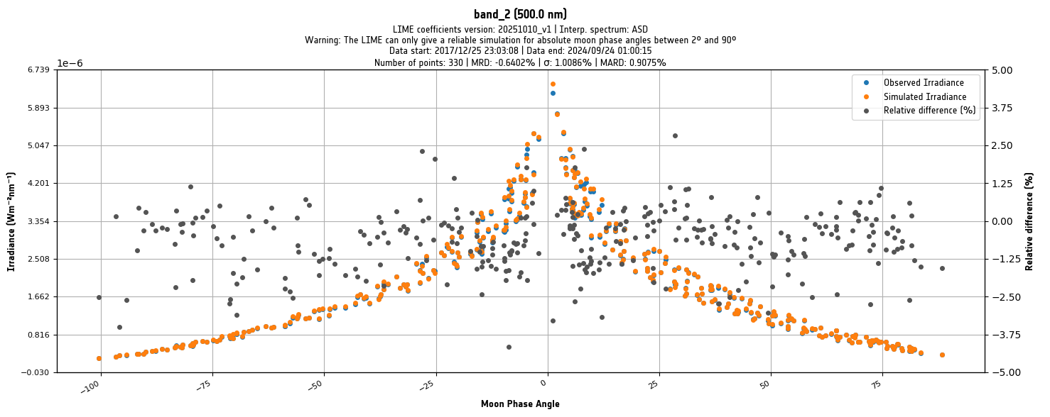
Model fitting
Relative difference
Irradiance (Wvm⁻²nm⁻¹)
Phase angle (degrees)

Slide 8
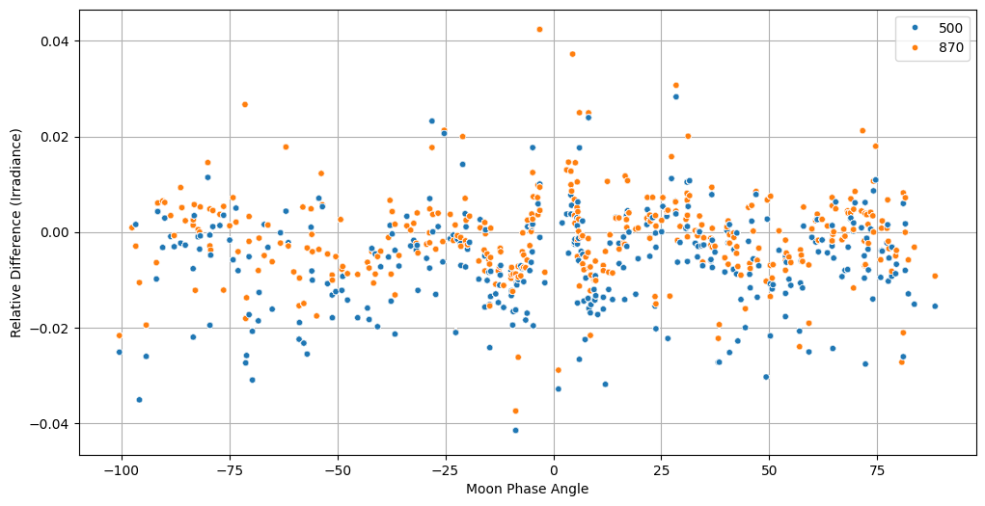
Model fitting
Residuals model-observations
Relative difference (Irradiance)
Phase angle (degrees)

Slide 9
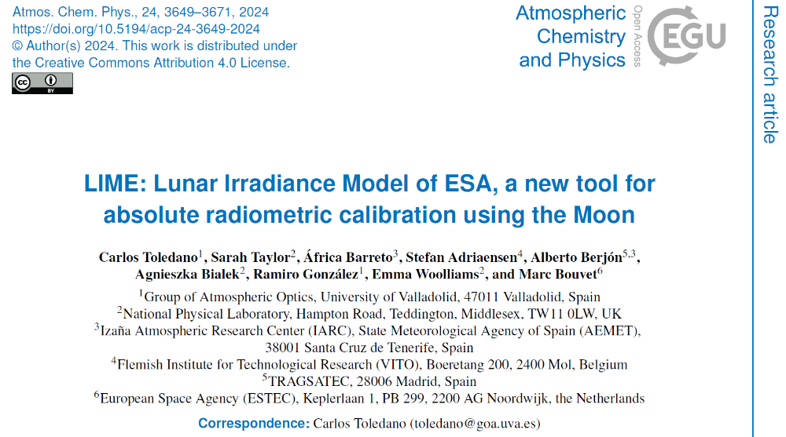

Slide 10
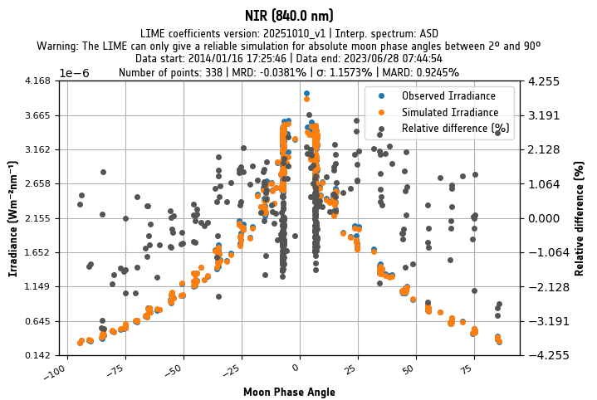
Comparisons
Comparison of LIME vs. Proba-V

Slide 11
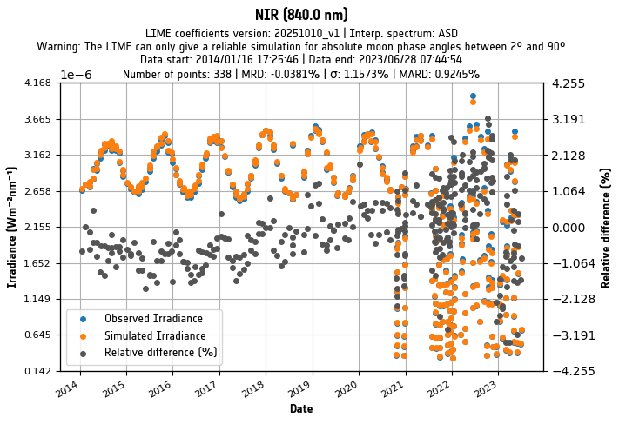
Comparisons
Comparison of LIME vs. Proba-V

Slide 12
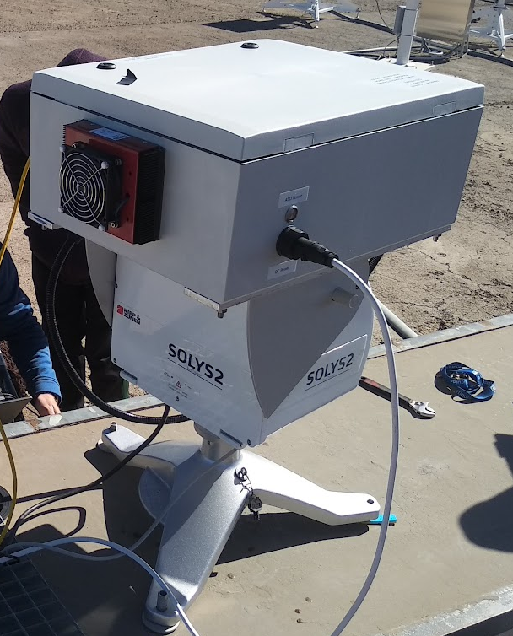
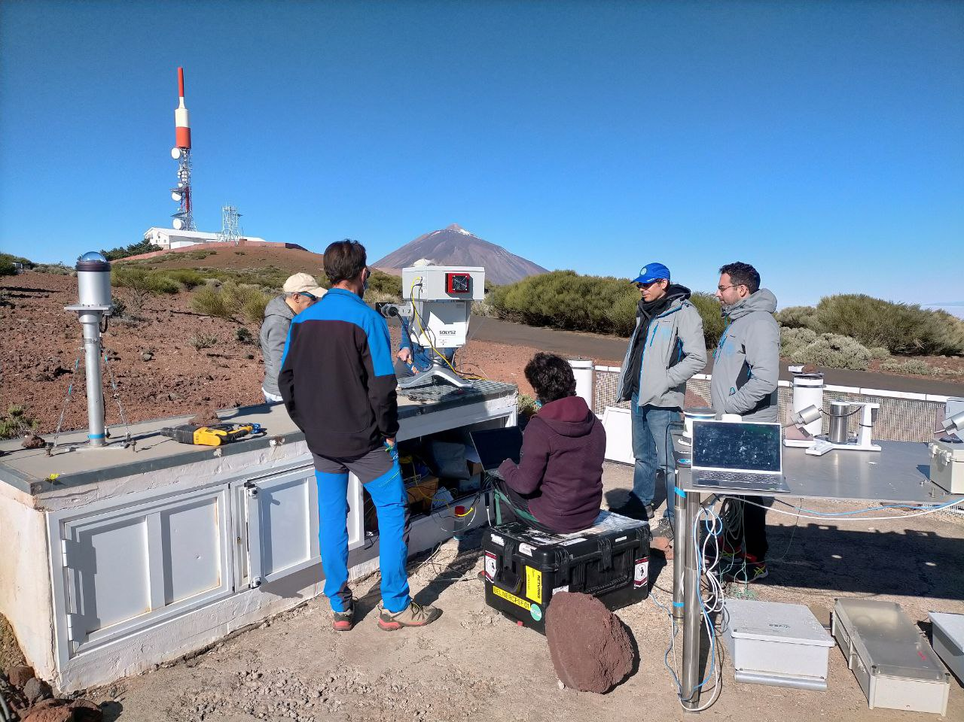
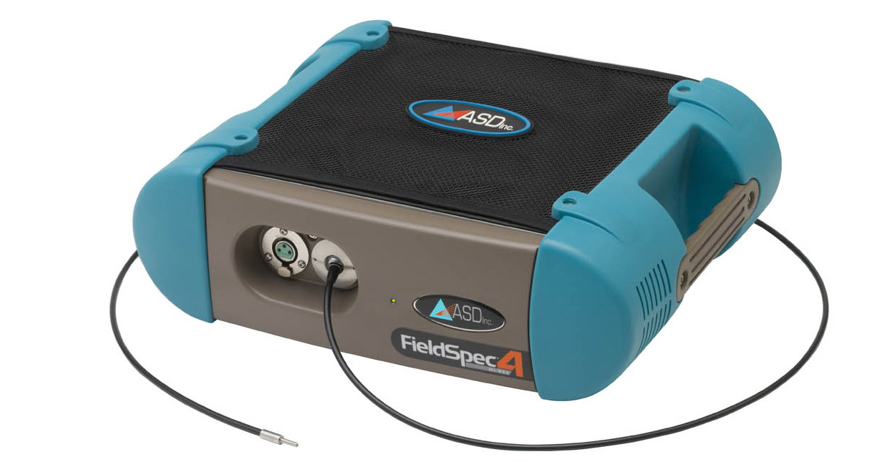
(Hyper)spectral reflectance
6 lunar cycles at Izaña
  2022 (Apr, May, Jun, Sep)
  2025 (Jun, Oct)
SOLYS2 tracker
ASD spectrometer

Slide 13
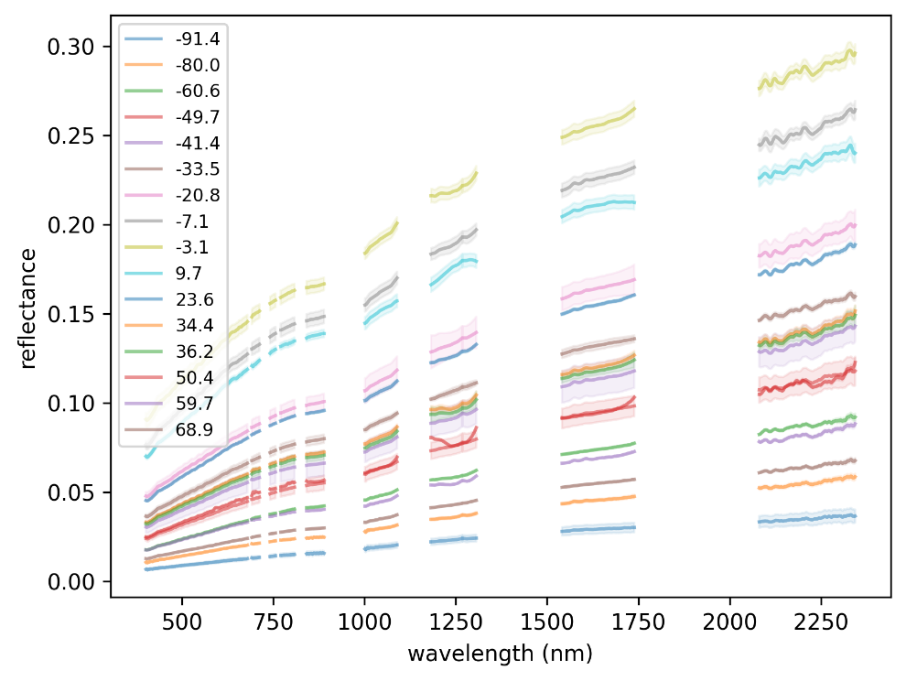
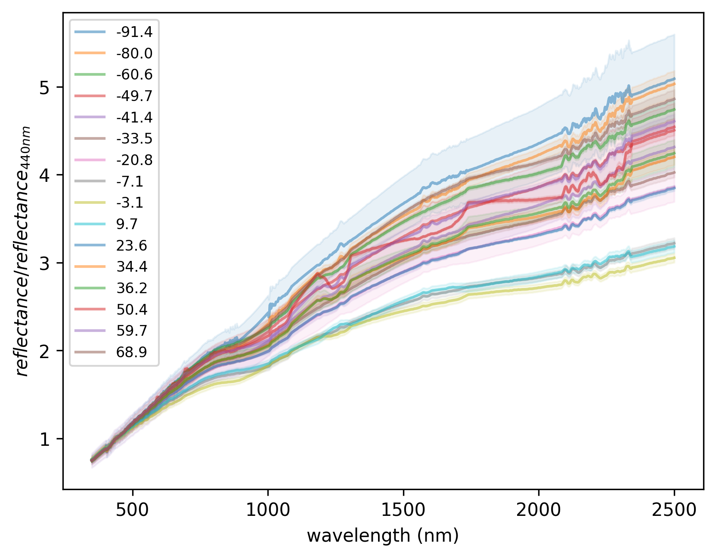
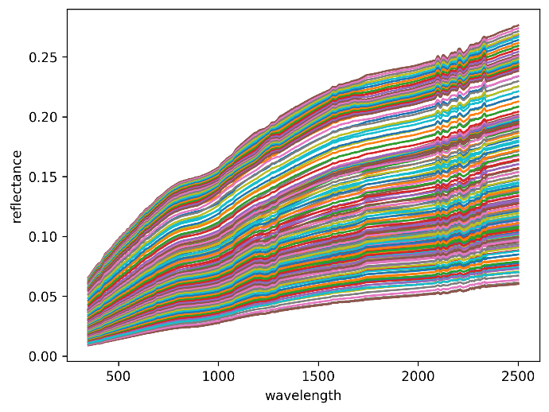
(Hyper)spectral reflectance
(A)
ASD measurements were taken over 6-month campaign in 2022 and 2025
Measurements in absorption features are too noisy and are omitted (replaced using spectral interpolation)
Data divided in bins of 10° spanning -95° to 95° (Fig A)
Dependence of spectral shape with phase angle (Fig B)
linearly interpolated with phase angle to phase angle required within the LIME-TBX (Fig C)
(B)
(C)
Dataset available on Zenodo
https://doi.org/10.5281/zenodo.10534235

Slide 14
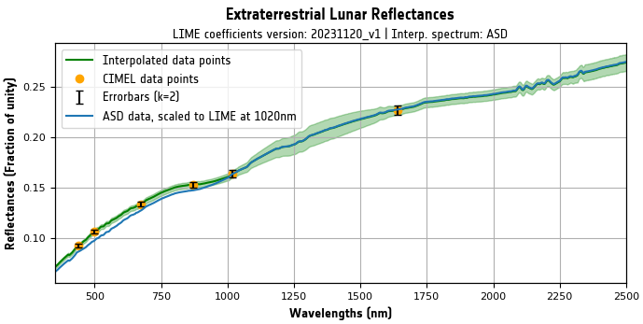
(Hyper)spectral reflectance
LIME MODEL: set of coefficients (from fitting to ground-based Lunar measurements)
+
curves for spectral interpolation (from hyperspectral Lunar measurements)
+
uncertainty estimates
Absolute irradiance
High spectral resolution

Slide 15
Latest updates
LIME coefficients computed with Cimel data until Nov. 2025.
ASD curves improved and updated.
  New masking algorithm has been developed to remove outliers
  New ASD dataset (new masking and data from 2025) provided to LIME-TBX and on Zenodo
  New ASD data consistent with 2022 data within the uncertainties, but removes spectral artefacts.

Slide 16
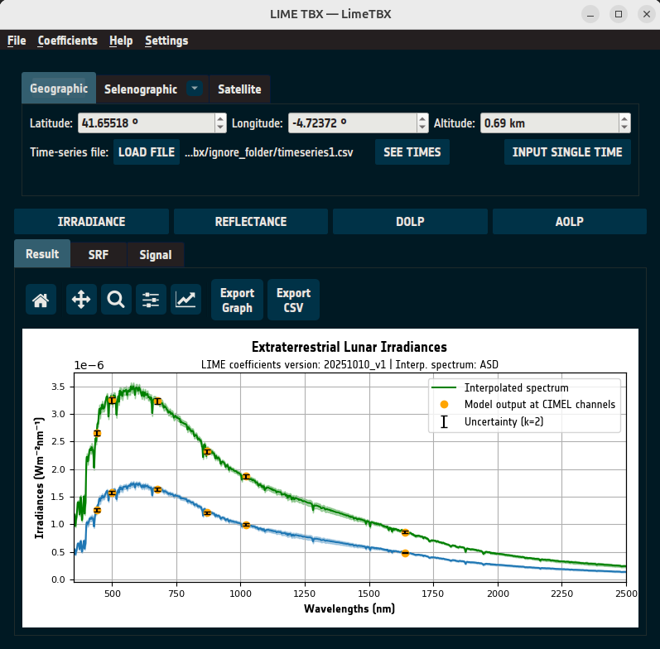
LIME Toolbox
Simulates:
  Irradiance
  Integrated Irradiance (Signal)
  Reflectance
  Degree of linear polarisation

Slide 17
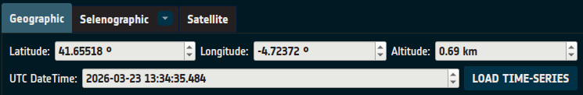
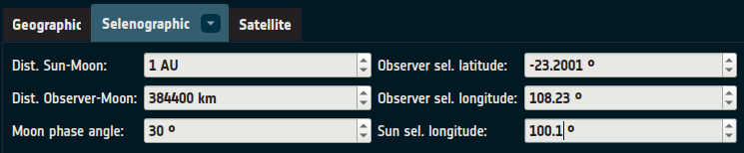
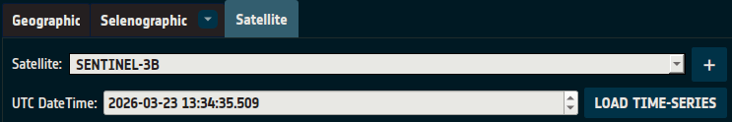
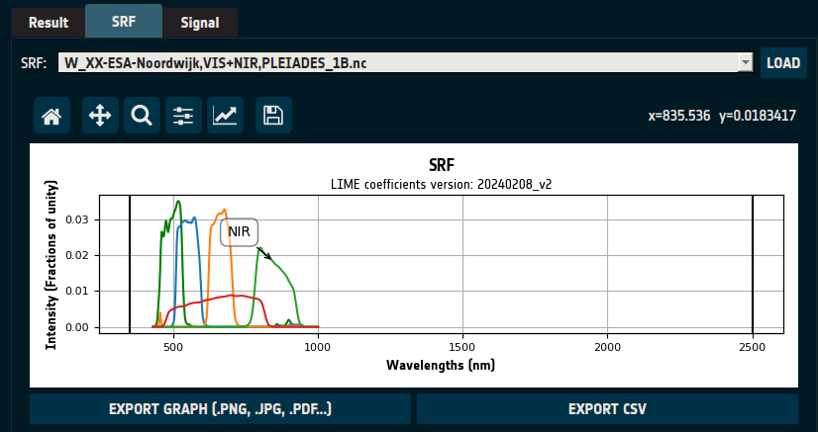
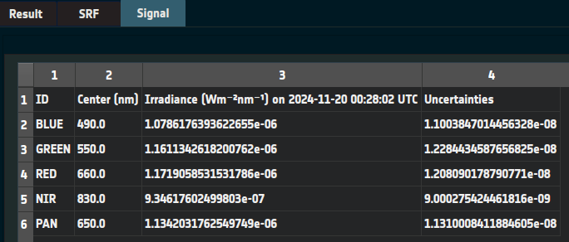
LIME Toolbox
Input:
  Geographic coordinates & datetime/s
  Selenographic coordinates
  Satellite name & datetime/s
    User may add satellites if they have .tle or .osf files.
  Optional: SRF file in GLOD format

Slide 18
Latest updates
LIME coefficients computed with Cimel data until Nov. 2025.
ASD curves improved and updated.
  New masking algorithm has been developed to remove outliers
  New ASD dataset (new masking and data from 2025) provided to LIME-TBX and on Zenodo
  New ASD data consistent with 2022 data within the uncertainties, but removes spectral artefacts.
Toolbox (applicator) updated
  New features (…)
  Version v1.4.1

Slide 19

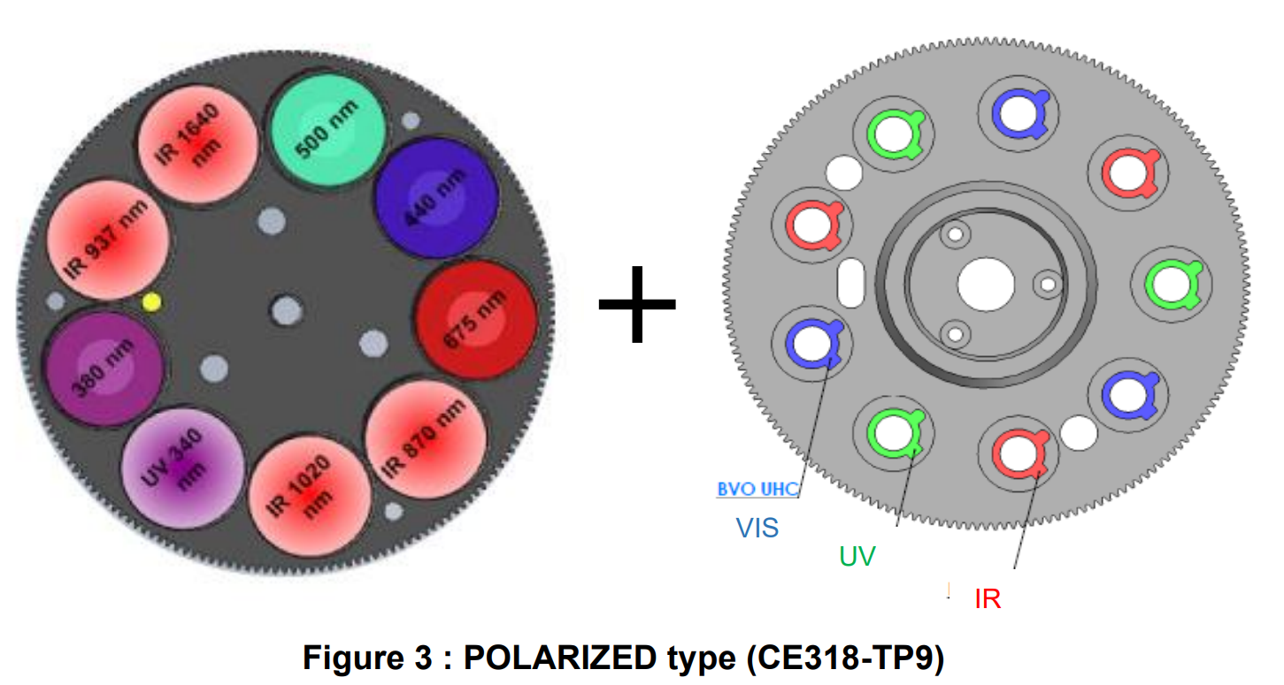
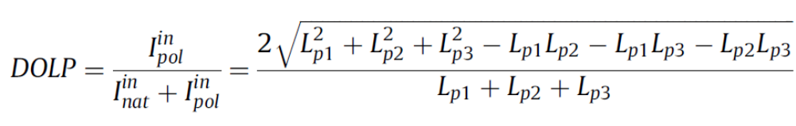
Polarisation
Cimel has 3 polarisers
0º, 60º, 120º
Degree of Linear Polarisation::
Li et al., 2009

Slide 20

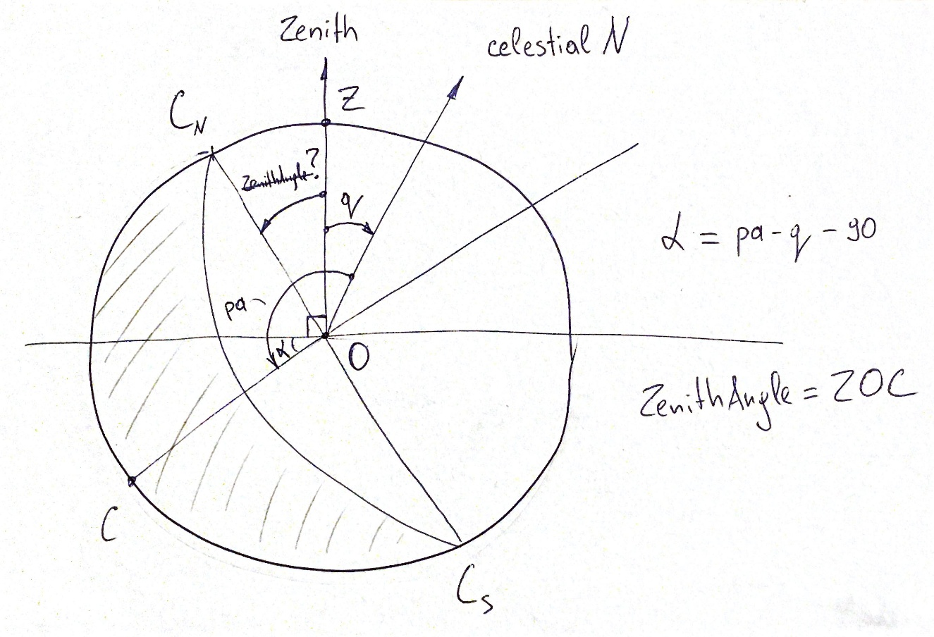
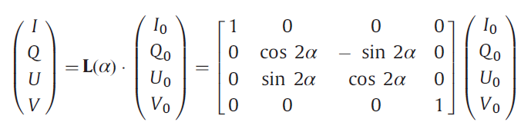
Polarisation
Polarisation (with sign):
Reference plane: Sun-Moon-observer
>> calculation of Moon tilt angle.
Stokes vector (Cimel reference):
  I=2/3 (I₀+I₆₀+I₁₂₀)
  Q=2/3 (2I₀-I₆₀-I₁₂₀)
  U=-2/ √3 (I₁₂₀-I₆₀)
Rotation to the scattering plane:

Slide 21
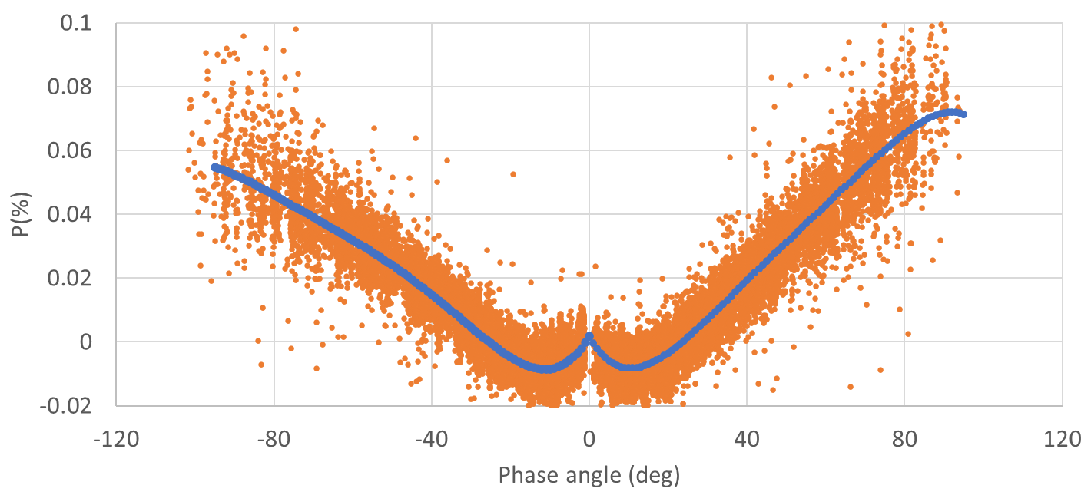
Polarisation
From Cimel data (500nm)

Slide 22
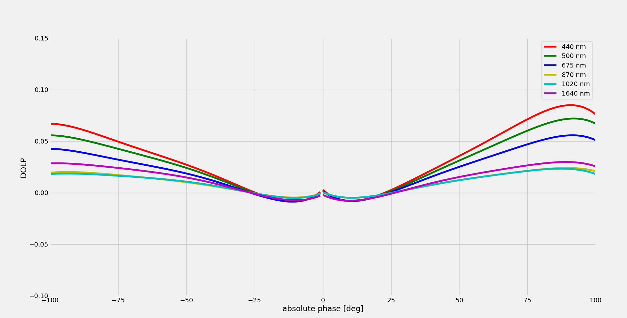
Polarisation
Fit for each wavelength – 5th order polynomial

Slide 23
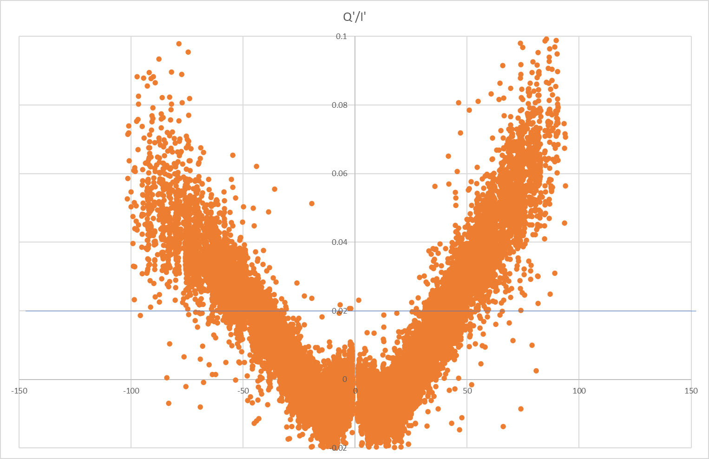
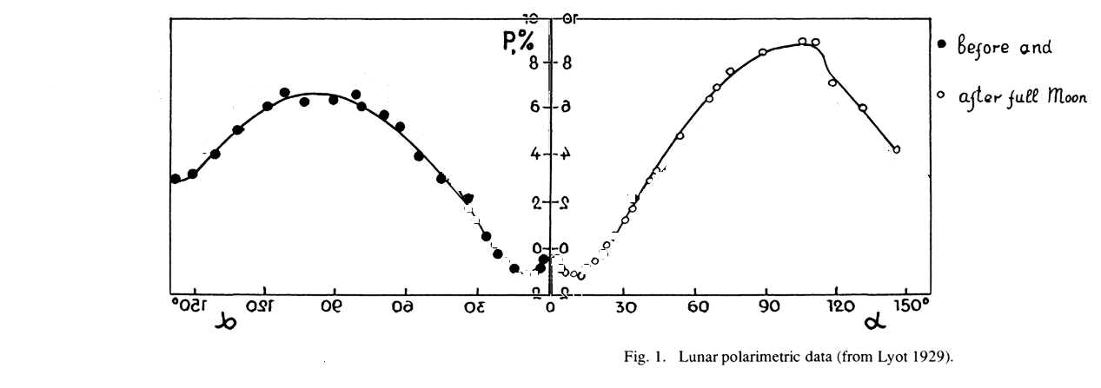
Polarisation
Comparison to Lyot (1929)
-150
-120
-90
-60
-30

Slide 24
Latest updates
LIME coefficients computed with Cimel data until Nov. 2025.
ASD curves improved and updated.
  New masking algorithm has been developed to remove outliers
  New ASD dataset (new masking and data from 2025) provided to LIME-TBX and on Zenodo
  New ASD data consistent with 2022 data within the uncertainties, but removes spectral artefacts.
Toolbox (applicator) updated
Polarisation model developed and included in the Toolbox

Slide 25
Next steps
New ESA contract (start April 2026)
Objectives:
  Include new VIS and SWIR channels
  Improve polarization model
  Improve fitting
  Comparison to datasets
  Use LIME to derive aerosol optical Depth
  Support to users

Slide 26
Next steps
  Include new VIS and SWIR channels:
1640
2060
2130
1550
1020
870
1240
675
780
500
440
550
26

Slide 27
Summary
LIME model updated (inc. polarisation)
Toolbox available
Improvements ongoing
https://lime.uva.es
http://calvalportal.ceos.org/lime
GSICS Annual and Executive Panel meeting, 23-27 March 2026, Ottawa, Canada.

Slide 28
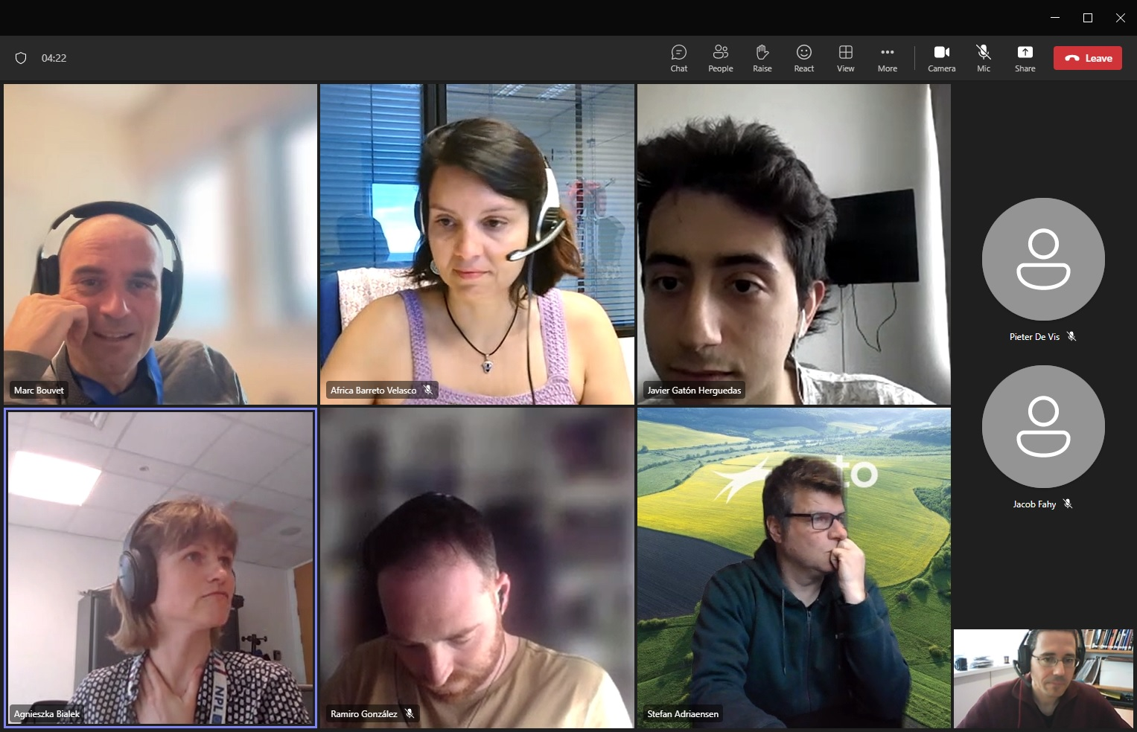
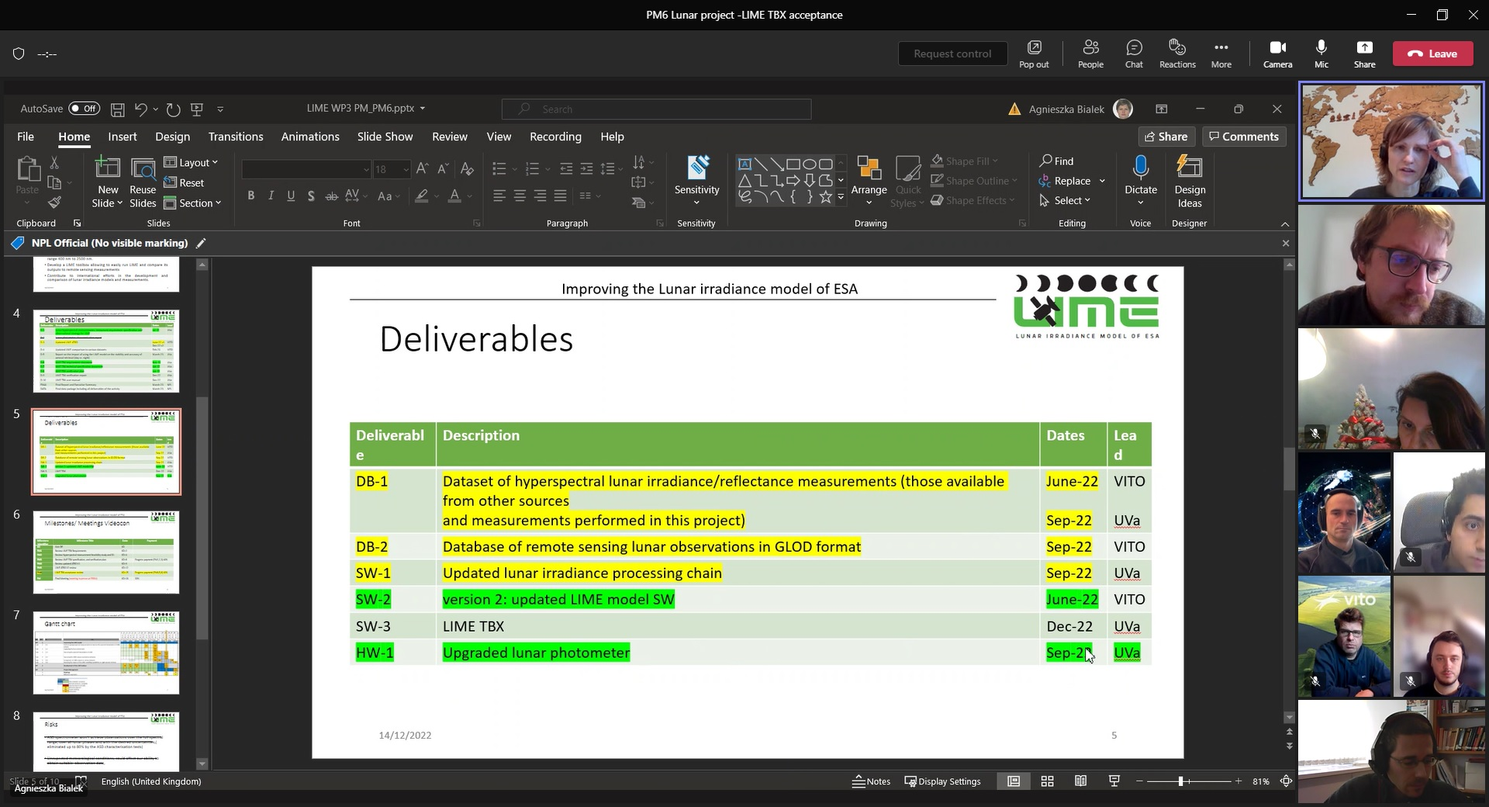
Acknowledgments

Slide 29
Thanks!

