Slide 1
LSICS status
Sebastien Wagner
EUMETSAT - Radiometric Calibration Team
With the support from V. Debaecker – Telespazio Toulouse
GSICS annual meeting – Ottawa, 23-27 March 2026

Slide 2
The LSICS project
  LSICS = activity within the GSICS Lunar Calibration subgroup
  Development group, roles and responsabilities:
    Project leader / coordinator : T. Stone (USGS)
    Main developers : NOAA (Bikash Basnet) till December 2024 / EUMETSAT (Seb Wagner with support from Vincent Debaecker) since January 2025
    Support: JMA (Masaya Takahashi), NOAA (Fangfang Yu, Fred Wu – till December 2024), Celestial Reasoning (Hugh Kieffer), Earth Space Solutions (Matthijs Krijger)
    Since end of October 2025, involvement of the LIME development team: Stefan Adriaensen (VITO), Javier Gaton (Univ. Valladolid), Marc Bouvet (ESA), Gunter Lichtenberg (DLR) ➔ implementation of LIME in LSICS
  Coordination and meetings:
    Regular meetings (every 2 or 3 weeks)
    Minutes are available
  Infrastructure
    Gitlab repository with main and development branch hosted by EUMETSAT
      “Main” to host the official version to be used
      “Development” branch for enhancements / new functionalities development and testing
      Project still in restricted access (version v1.0.0 in preparation)
    Confluence page made available by EUMETSAT but currently not used by the group ➔ option still available if need arises

Slide 3
Development status
Main functionalities for LSICS have been implemented
  SLIMM model
  Modular approach to integrate additional models
  Standard input / output formats following GSICS standards + recommendations
  Functionality to feed LSICS with GIRO input files ➔ integrated converter
  Possibility to start from any module, as soon as intermediate files are provided
  Complemented the information carried across (data quality ➔ helps with a posterior analysis)

Slide 4
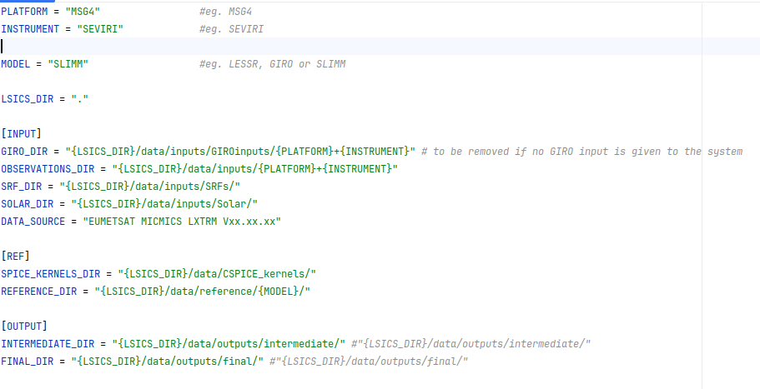
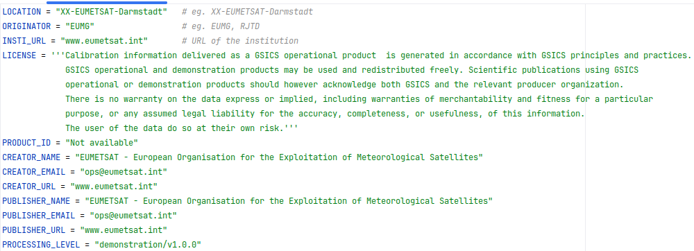
How does LSICS works?
Ingest GIRO input
Operation: concatenate the GIRO records in one LSICS file
Global attributes as required by LSICS
History
Variables as required by LSICS
Input
Dynamic configuration file
Static configuration file
GIRO_INPUT defined
Yes
No
LSICS input
Ingest and Geometry Calculation Module
Operation: compute Lunar Observation Angle Set (LOAS)
• Phase angle (signed)
• Sub-solar longitude and latitude
• Sub-observer longitude and latitude
Model Definitions
• Operating wavelength set
• Basis function coefficients
Lunar Disk Reflectance Module
Operation: compute lunar disk equivalent reflectance spectra
• set up basis functions
• reconstruct disk reflectance model
• compute model on operating wavelenghts
DER output
LOAS output

Slide 5
How does LSICS works?
Ingest GIRO input
Operation: concatenate the GIRO records in one LSICS file
Global attributes as required by LSICS
History
Variables as required by LSICS
Final Outputs
• Lunar spectral irradiances for input observations in sensor spectral bands
Input
Dynamic configuration file
Static configuration file
GIRO_INPUT defined
Yes
Spectral Irradiance Module
Operation: produce model irradiances in sensor bands
• Convolve disk reflectance, solar irradiance and SRF
• Apply distance corrections
No
LSICS input
Ingest and Geometry Calculation Module
Operation: compute Lunar Observation Angle Set (LOAS)
• Phase angle (signed)
• Sub-solar longitude and latitude
• Sub-observer longitude and latitude
Model Definitions
• Operating wavelength set
• Basis function coefficients
Reference Spectra
Lunar reflectance
Solar Irradiance
SRF file
SRF for each processed band
Lunar Disk Reflectance Module
Operation: compute lunar disk equivalent reflectance spectra
• set up basis functions
• reconstruct disk reflectance model
• compute model on operating wavelenghts
DER output
DER output
LOAS output

Slide 6
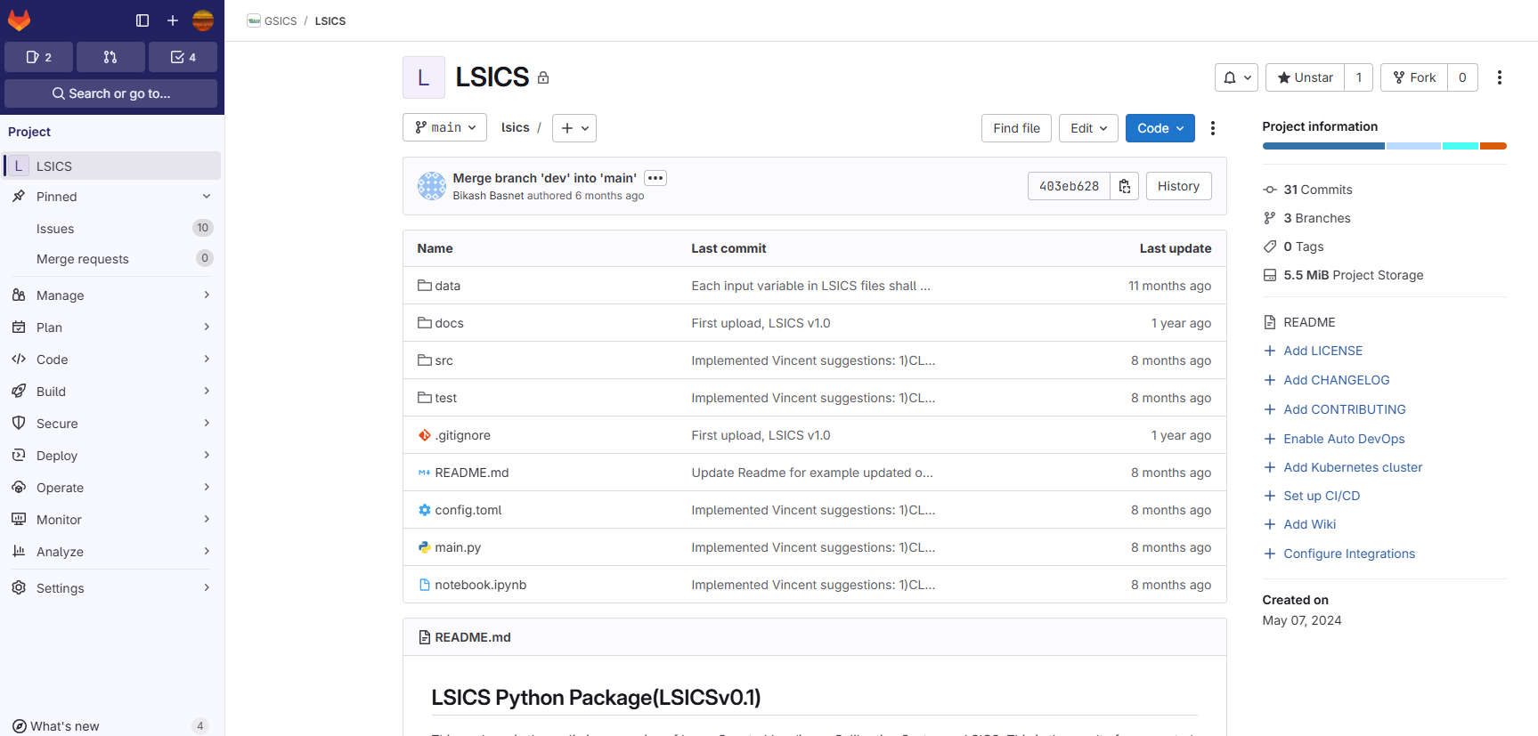
LSICS Gitlab

Slide 7
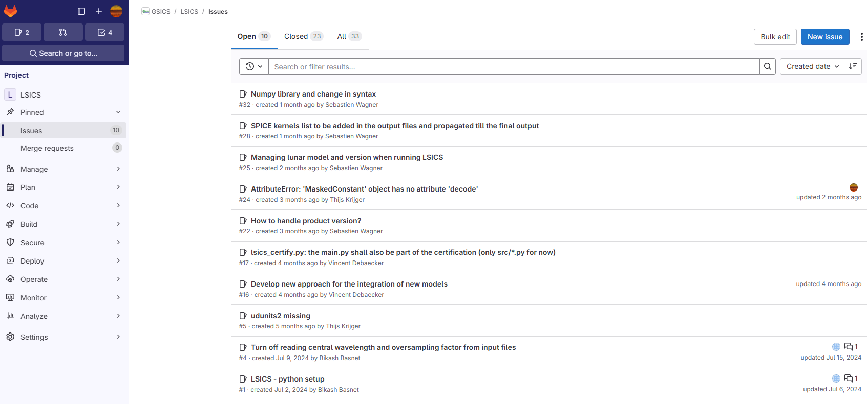
LSICS Gitlab
LSICS Gitlab

Slide 8
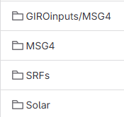
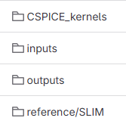

LSICS structure
$LSICS/
config.toml
static_config.toml
main.py
data/
src/

Slide 9
Distribution and usage
Public access to the official release (“main” branche) for users
Creative Commons license
  CC BY–ND — attribution required, no code derivatives allowed
  avoids having a formal usage agreement
Digital markers and public signature key
  to ensure that output products have been generated by the official agreed version of LSICS
  implemented using JSON tokens

Slide 10
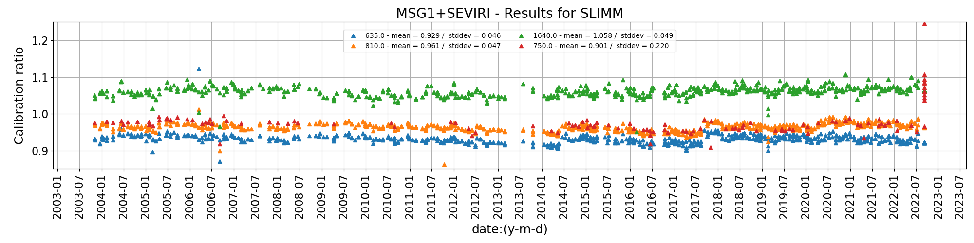
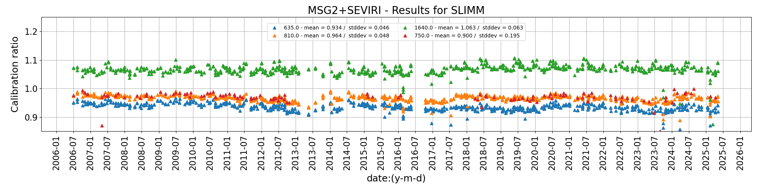
Some tests and results - MSG/SEVIRI

Slide 11
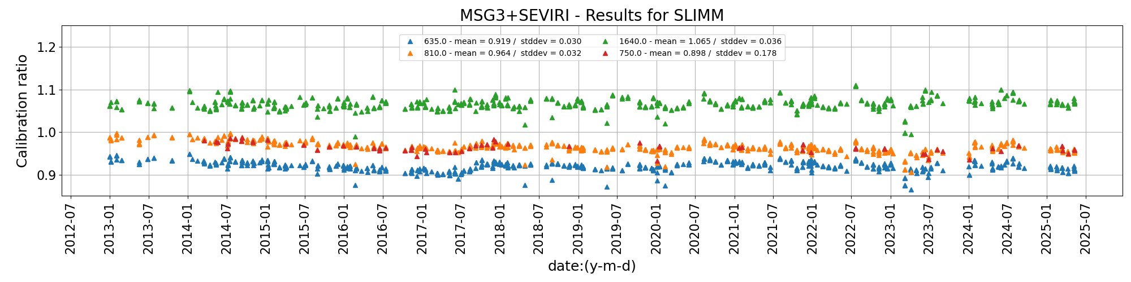
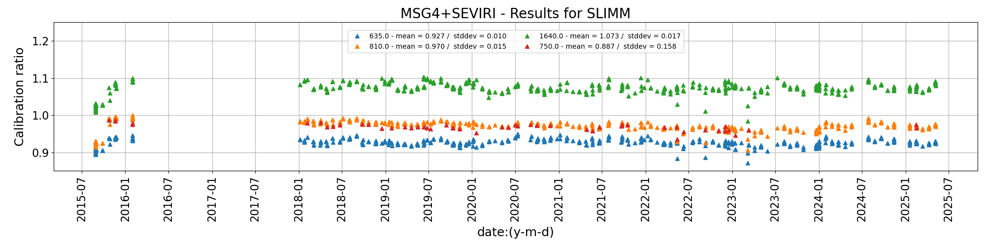
Some tests and results - MSG/SEVIRI

Slide 12
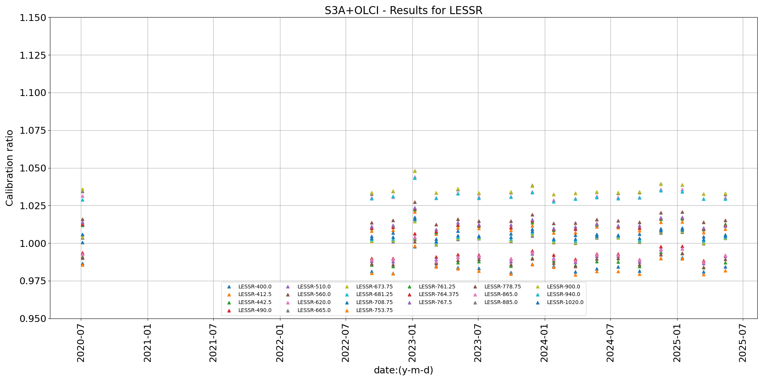
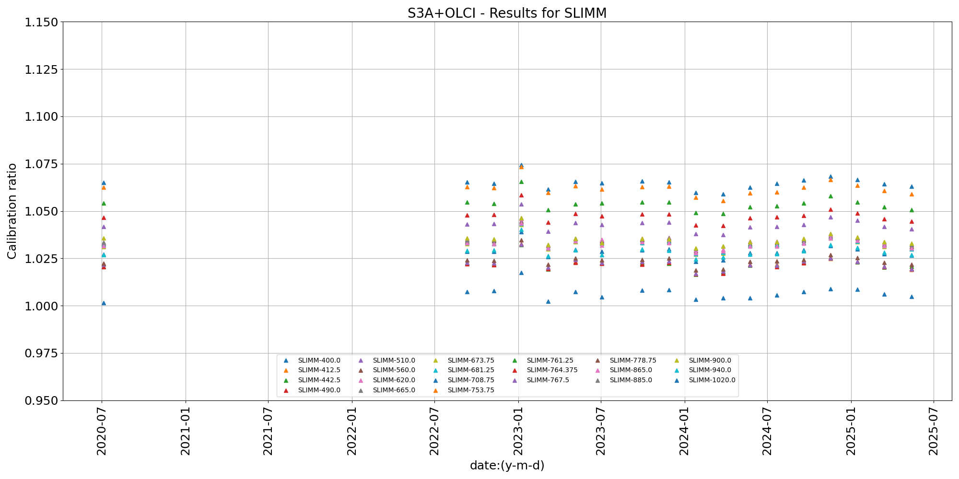
Switching lunar model / Inter-operability

Slide 13
Future work and release plan
Complement the system with a series of functionalities that were identified while developing (e.g. adding WGS84 to J2000 + ITRF93, consolidating the data and the run traceability, etc.)
Complete work on the definition of a benchmark + testing
  Validation against the original lunar model implemented in the DR module
  New enhancements implemented in LSICS (such the process for checking the versions in the runs by users)
Formal documentation
  Functional requirements, code structure, file and data formats (I/O, SRF and internal/intermediate files), module interfaces (Interface Control Document)
  Lunar model functional description
  Documenting the system validation
Development of a python-based toolbox to display the LSICS intermediate + final output, and extract relevant information such the run history (➔ traceability)
Release of version 1.0 expected in May 2026

Slide 14
Future work and release plan
Version 1.0 will include:
  Complete set of current functionalities
  SLIMM model
  Documentation + test report (including DER model implementation)
Version 1.0 = baseline for model developers to interface their models to LSICS in order to participate the 2nd lunar model inter-comparison exercise (target = LCWS#5 in Nov. 2026)
SLIMM v3.0 expected later in 2026 ➔ interface remains the same
Implementation of additional models (e.g. LIME, GIRO, LESSR)
Development of functionalities (as required) to handle hyperspectral instruments

Slide 15
Thank you!
Questions are welcome.

Slide 16
How does LSICS work?
Input
Dynamic configuration file
Static configuration file
Observations (GIRO/LSICS)
GIRO_INPUT defined
Ingest GIRO input
Operation: concatenate the GIRO records in one LSICS file
Yes
No
LSICS input
Ingest and Geometry Calculation Module
Operation: compute Lunar Observation Angle Set (LOAS)
Reference Solar Irradiance
SRF for each processed band
LOAS output
Model Definitions
• Operating wavelength set
• Basis function coefficients
Final Outputs
• Lunar spectral irradiances for input observations in sensor spectral bands
Spectral Irradiance Module
Operation: produce model irradiances in sensor bands
Lunar Disk Reflectance Module
Operation: compute lunar disk equivalent reflectance spectra
DER output

