Slide 1
The Status of Microwave Temperature Sounder –III onboard Fengyun-3H Satellite
Juyang Hu,
Xiuqing Hu, Na Xu, Jian Shang, Shengli Wu, Shi Liu
NSMC, CMA

Slide 2
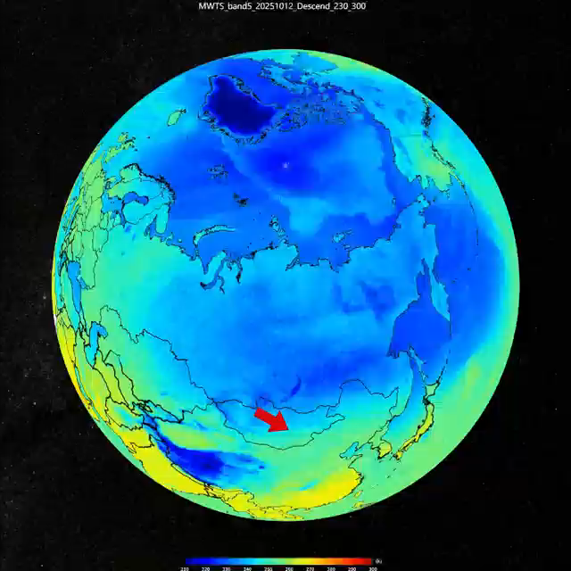
Outline
Instrument Review
Calibration for FY-3H MWTS-III
Calibration Accuracy Evaluation
Conclusion and Future plan
Cold Wave Processes in the Northern Hemisphere (FY-3H MWTS-III, 2025.10)

Slide 3
Outline
Instrument Review
Calibration for FY-3H MWTS-III
Calibration Accuracy Evaluation
Conclusion and Future plan

Slide 4
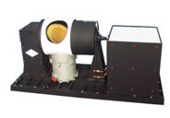
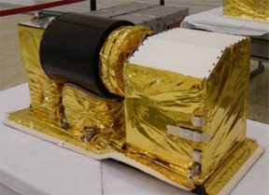
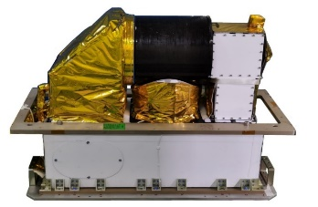
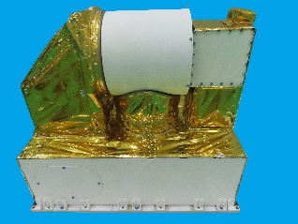
1. Instrument Review
MWTS: Microwave temperature sounders onboard FengYun -3
MWTS was first carried on the FY-3A satellite launched in 2008.
The newly launched FY-3H is equipped with the third-generation MWTS (MWTS-III).
Seven instruments have been launched, with four currently operating in orbit.
in orbit
FY-3A
FY-3B
FY-3C
FY-3D
FY-3E
FY-3F
FY-3H
2008-2018
2010-2020
2013-2024
2017.11-
2021.07-
2023.08-
2025.09-
MWTS-I
MWTS-II
MWTS-III

Slide 5
1. Instrument Review
Comparison of the core specifications across the three generations of MWTS
a significant increase in the number of channels, along with comprehensive optimization of key performance metrics such as the scan period and integration time.
These improvements have led to substantial gains in both detection efficiency and accuracy.
Item | MWTS-I | MWTS-II | MWTS-III
Viewing Angle | ±48.3° | ±49.5º | ±53.35º
Samples per scan | 15 | 90 | 98
Step Angle | 6.9° | 2.2° | 1.1°
Nadir Resolution | 50~75 km | 33 km | 33 km
Scan Period | 16s | 5245 ms | 5236 ms
Integration Time | 0.78s | 16 ms | 16 ms
Channels | 4 | 13 | 17
CH | Center frequency （GHz） | Band width （MHz） | NEDT （K） | FY-3D NEDT | ATMS | AMSU-A | Metop-SG-A1 MWS
1 | 23.8 | 270 | 0.3 |  | 1 | 1 | 1
2 | 31.4 | 180 | 0.35 |  | 2 | 2 | 2
3 | 50.3 | 180 | 0.35 | 1.2 | 3 | 3 | 3
4 | 51.76 | 400 | 0.3 | 0.75 | 4
5 | 52.8 | 400 | 0.3 | 0.75 | 5 | 4 | 4
6 | 53.246±0.08 | 140 | 0.35 |  |  |  | 5
7 | 53.596±0.115 | 170 | 0.3 | 0.75 | 6 | 5 | 6
8 | 53.948±0.081 | 142 | 0.35 |  |  |  | 7
9 | 54.40 | 400 | 0.3 | 0.75 | 7 | 6 | 8
10 | 54.94 | 400 | 0.3 | 0. 75 | 8 | 7 | 9
11 | 55.50 | 330 | 0.3 | 0. 75 | 9 | 8 | 10
12 | 57.290344(fo) | 330 | 0.6 | 0. 75 | 10 | 9 | 11
13 | fo±0.217 | 78 | 0.7 | 1.2 | 11 | 10 | 12
14 | fo±0.3222±0.048 | 36 | 0.8 | 1.2 | 12 | 11 | 13
15 | fo±0.3222±0.022 | 16 | 1.0 | 1.7 | 13 | 12 | 14
16 | fo±0.3222±0.010 | 8 | 1.2 | 2.4 | 14 | 13 | 15
17 | fo±0.3222±0.0045 | 3 | 2.1 | 3.6 | 15 | 14 | 16
Green: MWTS-I channels. Red: The channel addition from MWTS-II to MWTS-III.
5

Slide 6
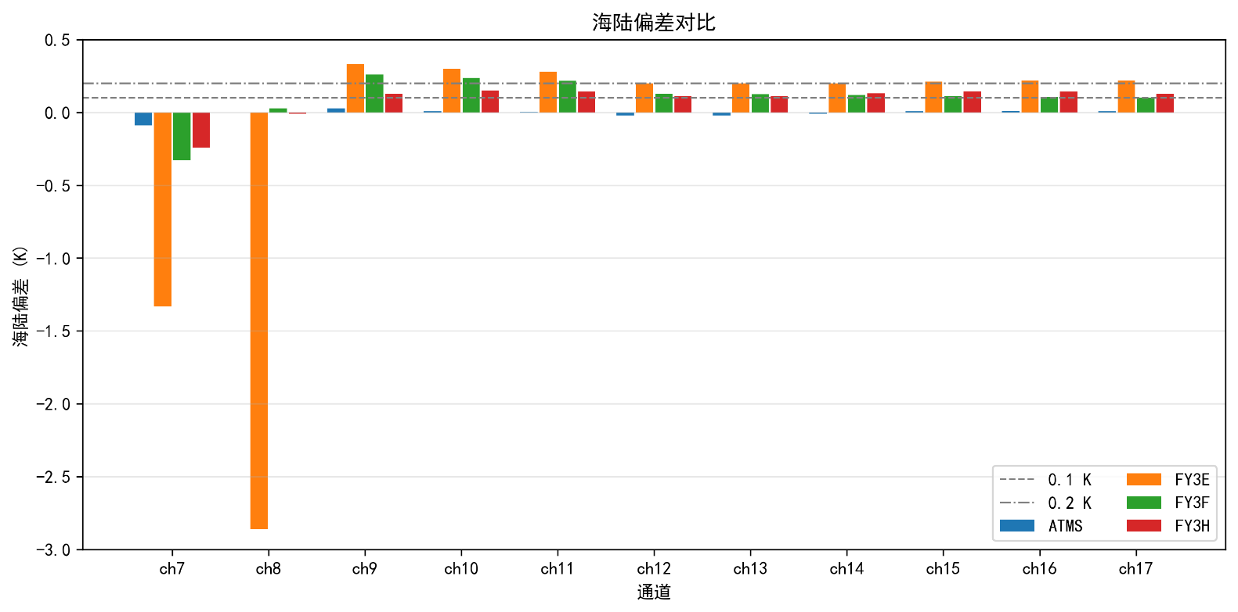
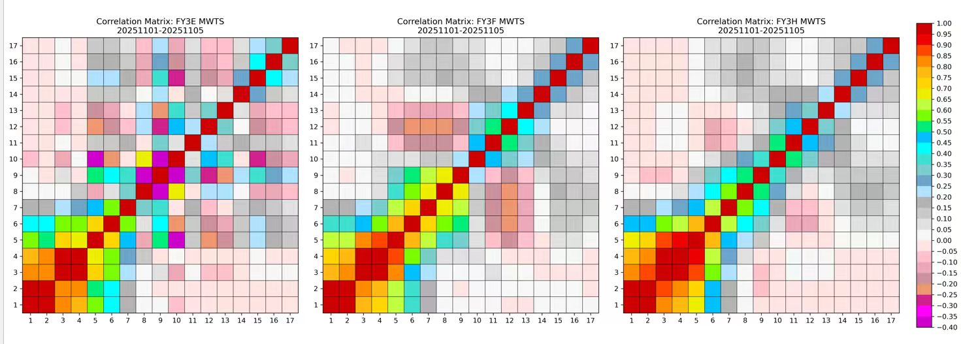
1. Instrument Review
FY-3H MWTS-III: Characteristics and improvements over predecessors
The antenna shield color changes from black to white to improve instrument temperature stability.
SRF standardization brings the measured SRF closer to the ideal box.
The channel crosstalk, in terms of land-sea bias in the sounding channels, is much better than that of the two predecessors. The channel correlation has also been significantly improved.
0.2K
0.1K
FY-3E/F
FY-3H
channel correlation (FY-3E/FY-3F/FY-3H)
Sea - land contrast bias

Slide 7
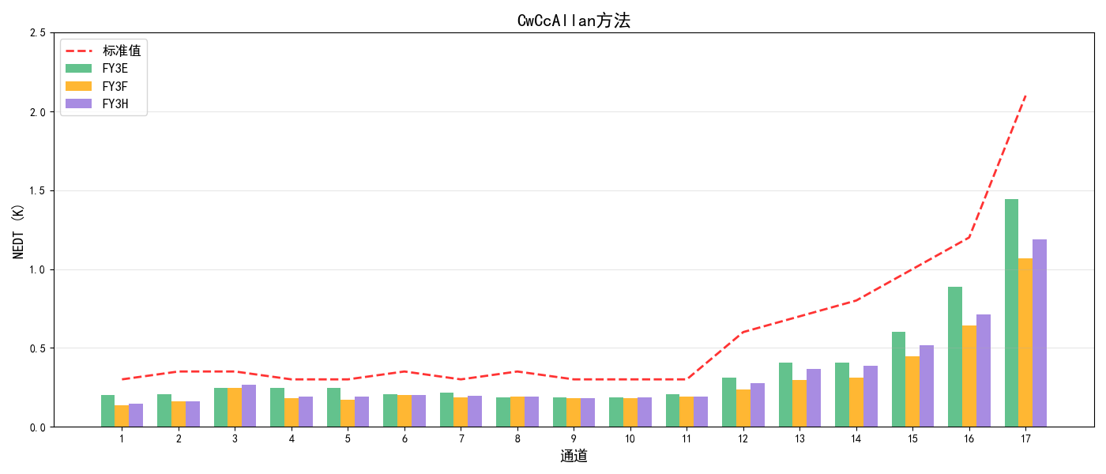
1. Instrument Review
Instrument Noise Status
All channels meet the requirement.
NEDTs of FY-3H MWTS-III are better than those of FY-3E, except for channel 3.
The NEDTs of channels 1–11 are comparable to that of FY-3F and FY-3H, whereas FY-3H shows slightly lower sensitivity for channels 12–17.
Allan Variance
requirement

Slide 8
Outline
Instrument Review
Calibration for FY-3H MWTS-III
Calibration Accuracy Evaluation
Conclusion and Future plan

Slide 9

Calibration for FY-3H MWTS-III
Receiver Calibration：
$$R_{TDR}=\left(R_{w}−\frac{C_{w}}{g}+\frac{uC_{w}C_{c}}{g^{2}}\right)+\left(\frac{1}{g}−\frac{u\left(T\right)\left(C_{w}+C_{c}\right)}{g^{2}}\right)∗C_{s}+\frac{u}{g^{2}}C_{s}^{2}$$
Antenna Calibration：
$$R_{SDR}\left(β\right)=\frac{1}{cof\left(β\right)} [R_{TDR}cof\left(β\right)−\left(1−cof\left(β\right)\right)∗R_{c}]$$
（1）Cold space Radiation Correction
${∆R}_{c}=∆R_{c}^{cosmic}+∆R_{c}^{earth}+∆R_{c}^{sat}+∆R_{c}^{refl}$= $∆R_{c}^{adjust}++∆R_{c}^{refl}$
（2）Antenna Pattern Correction
$$R_{A}\left(β\right)=\frac{1}{N_{η}} [{f_{e}\left(β\right)R}_{E}+{f_{c}\left(β\right)R}_{c}+η{f_{sat}\left(β\right)R}_{sat}]$$
$$R_{SDR}=\frac{1}{cof\left(β\right)} [R_{TDR}−\left(1−cof\left(β\right)\right)∗R_{c}]$$
（3）Channel Crosstalk Correction
$$R_{TDR_correct, ch=i}=a_{i}∗R_{TDR, ch=i}+b_{i}∗(R_{TDR, ch=i}−R_{TDR, ch=3})$$

Slide 10
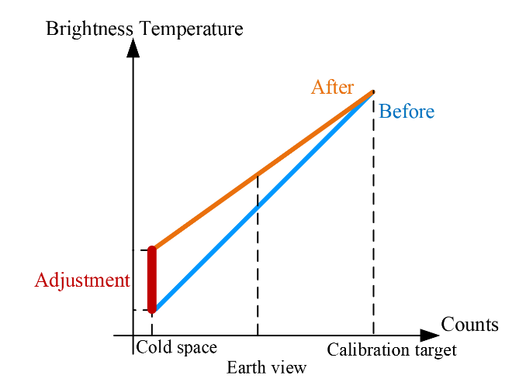
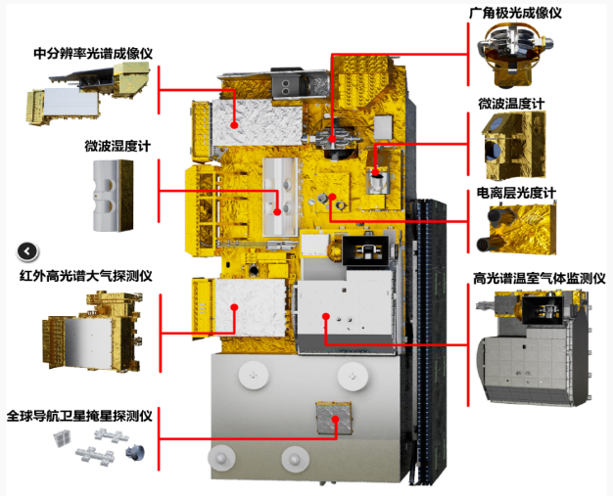

Calibration for FY-3H MWTS-III
Cold space Radiation Correction
$$∆R_{c}^{adjust}$$
Validation shows that all channels have negative biases.
Cold space observation is contaminated by platform radiation.
The cold space radiation was adjusted based on evaluation result.
The mean bias was improved after the adjustment.

Slide 11
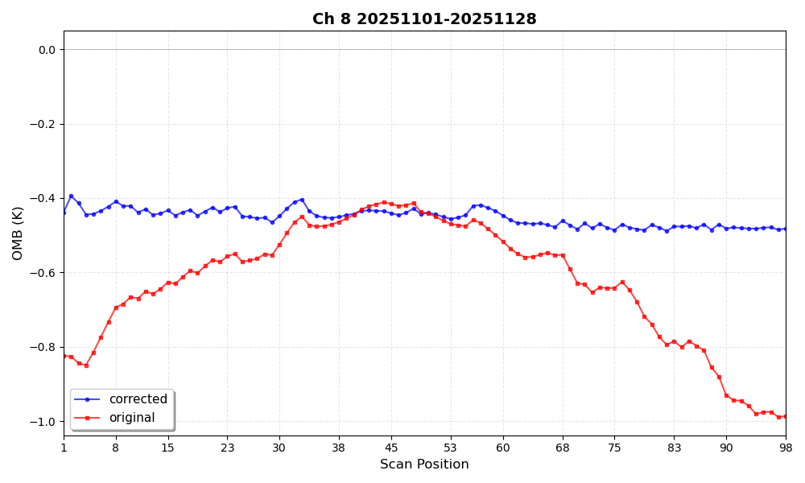
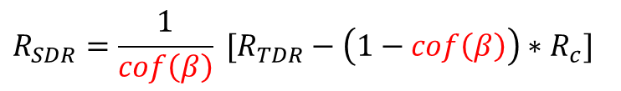
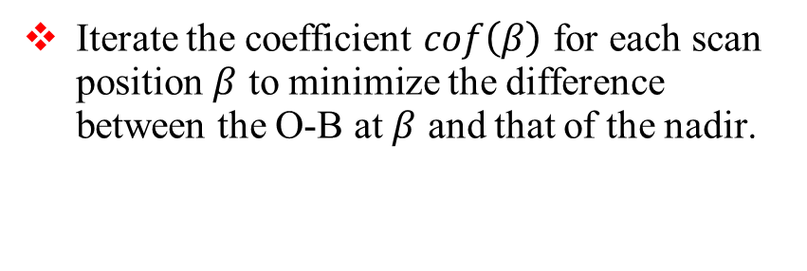
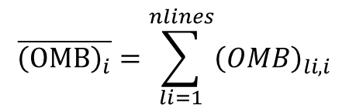
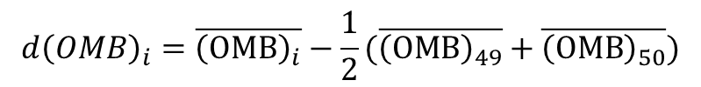
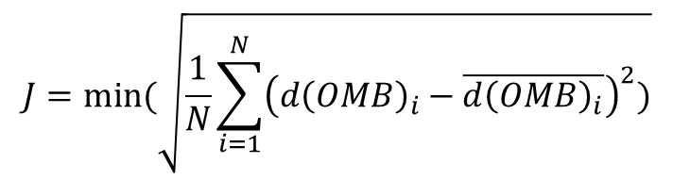
Calibration for FY-3H MWTS-III
Antenna Pattern Correction
Iterate the coefficient $cof\left(β\right)$ for each scan position $β$ to minimize the difference between the O‑B at $β$ and that of the nadir.
Before and after APC adjustment
$$R_{SDR}=\frac{1}{cof\left(β\right)} [R_{TDR}−\left(1−cof\left(β\right)\right)∗R_{c}]$$
$$\overline{{\left(OMB\right)}_{i}}=\sum_{li=1}^{nlines}{{\left(OMB\right)}_{li,i}}$$
$${d\left(OMB\right)}_{i}=\overline{{\left(OMB\right)}_{i}}−\frac{1}{2}(\overline{{\left(OMB\right)}_{49}}+\overline{{\left(OMB\right)}_{50}})$$
$$J=min(\sqrt{\frac{1}{N}\sum_{i=1}^{N}{{\left({d\left(OMB\right)}_{i}−\overline{{d\left(OMB\right)}_{i}}\right)}^{2}})}$$

Slide 12
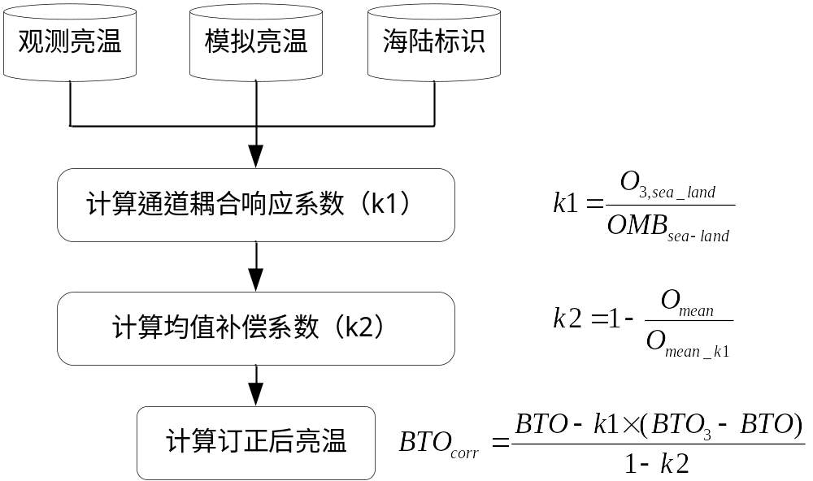
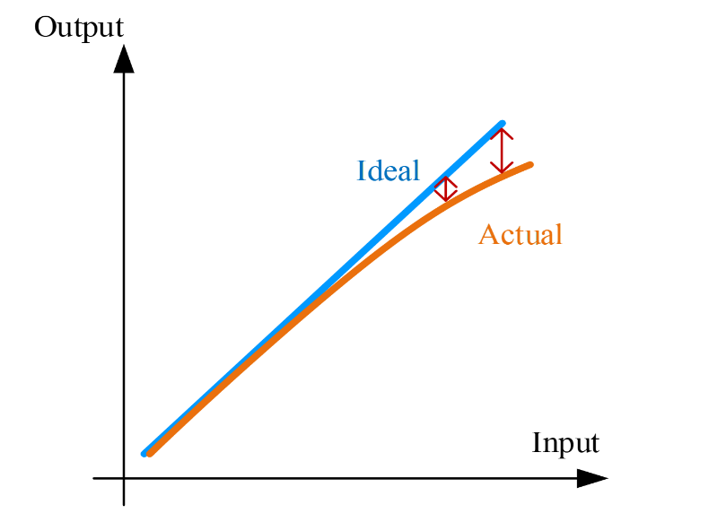
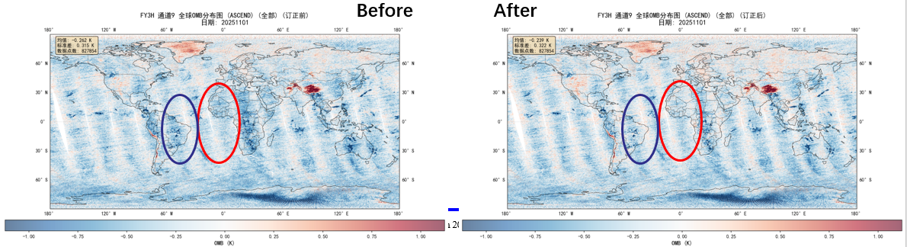
Calibration for FY-3H MWTS-III
Channel crosstalk Correction
Since FY-3C, the MWTS has exhibited channel crosstalk induced by P-1 compression, causing a land-sea bias in the temperature sounding channels, namely the bias over land is lower than that over ocean.
FY-3H MWTS-III has a sea-land bias of 0.12–0.15 K for channels 9–17.
The correction reduces the land-sea bias for all channels to within 0.05 K, while introducing negligible changes to the mean brightness temperature of the channels.
We plan to improve channels 9–11 of the FY-3E MWTS this year.
P-1 compression

Slide 13
Outline
Instrument Review
Calibration for FY-3H MWTS-III
Calibration Accuracy Evaluation
Conclusion and Future plan

Slide 14
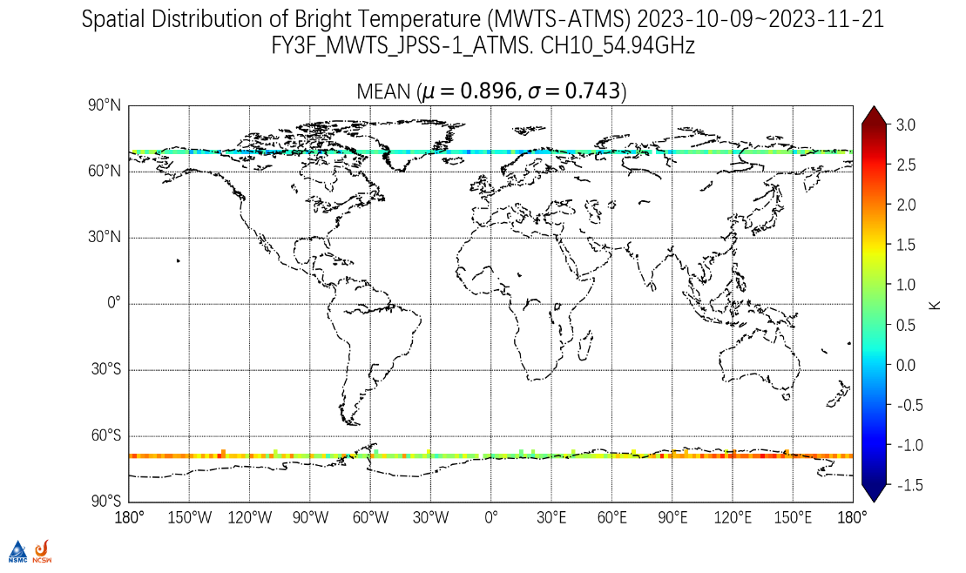
Calibration Accuracy Evaluation
SNO method: compared with NOAA-21ATMS
MWTS-III |  |  | ATMS |  | AMSU-A
Center frequency (GHz) | No. | Polarization | No. | Polarization | No. | Polarization
23.8 | 1 | QH | 1 | QV | 1 | QV
31.4 | 2 | QH | 2 | QV | 2 | QV
50.3 | 3 | QV | 3 | QH | 3 | QH
51.76 | 4 | QV | 4 | QH |  | QH
52.8 | 5 | QV | 5 | QH | 4 | QH
53.246±0.08 | 6 | QV
53.596±0.115 | 7 | QV | 6 | QH | 5 | QH
53.948±0.081 | 8 | QV
54.40 | 9 | QV | 7 | QH | 6 | QH
54.94 | 10 | QV | 8 | QH | 7 | QH
55.50 | 11 | QV | 9 | QH | 8 | QH
57.290344(fo) | 12 | QV | 10 | QH | 9 | QH
fo±0.217 | 13 | QV | 11 | QH | 10 | QH
fo±0.3222±0.048 | 14 | QV | 12 | QH | 11 | QH
fo±0.3222±0.022 | 15 | QV | 13 | QH | 12 | QH
fo±0.3222±0.010 | 16 | QV | 14 | QH | 13 | QH
fo±0.3222±0.0045 | 17 | QV | 15 | QH | 14 | QH
MWTS vs Reference data:
Observe time difference<20min
Distance<15km
Difference of satellite zenith angles < 1°
Two nadir pixels for Ch 1-5
Ten pixels near nadir for others

Slide 15
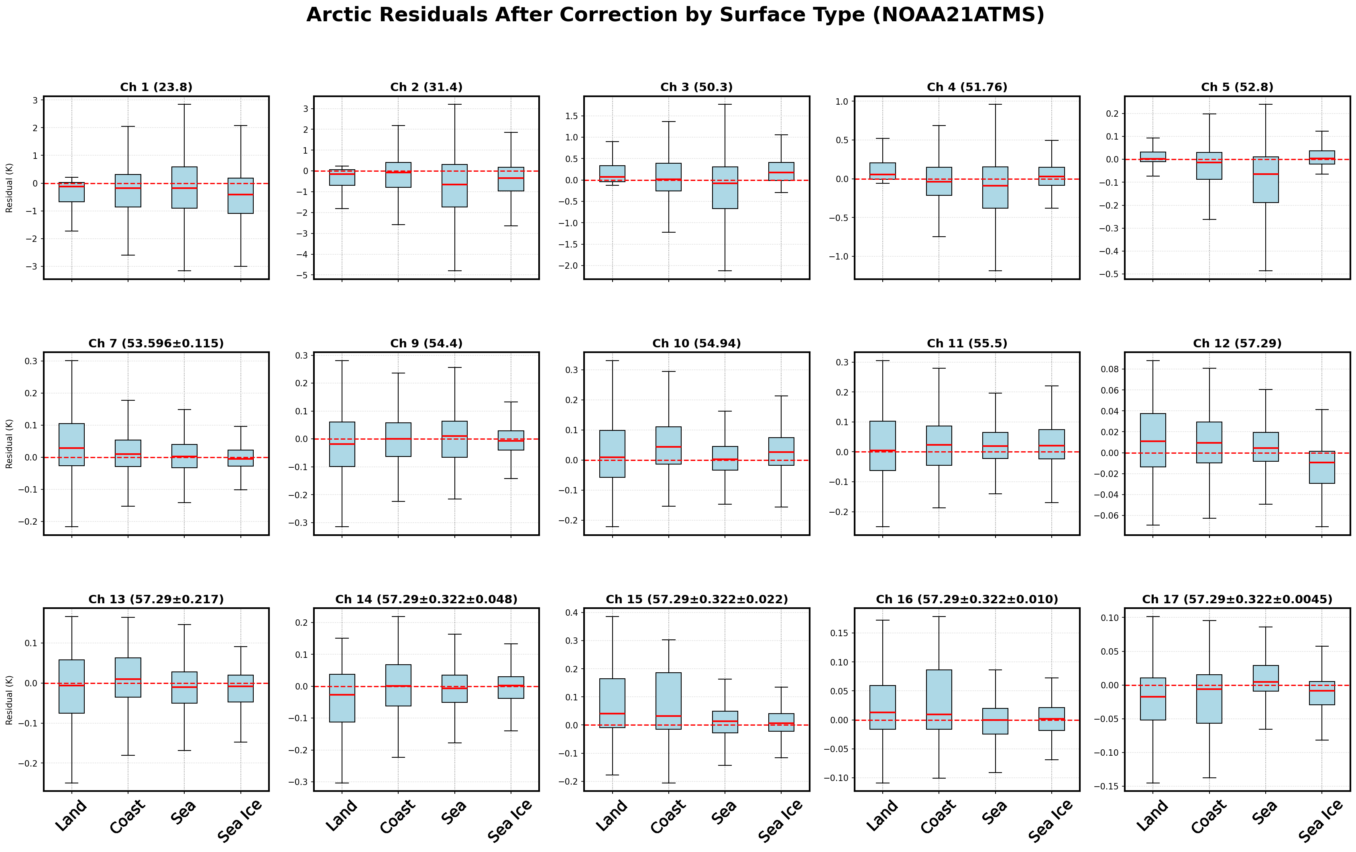
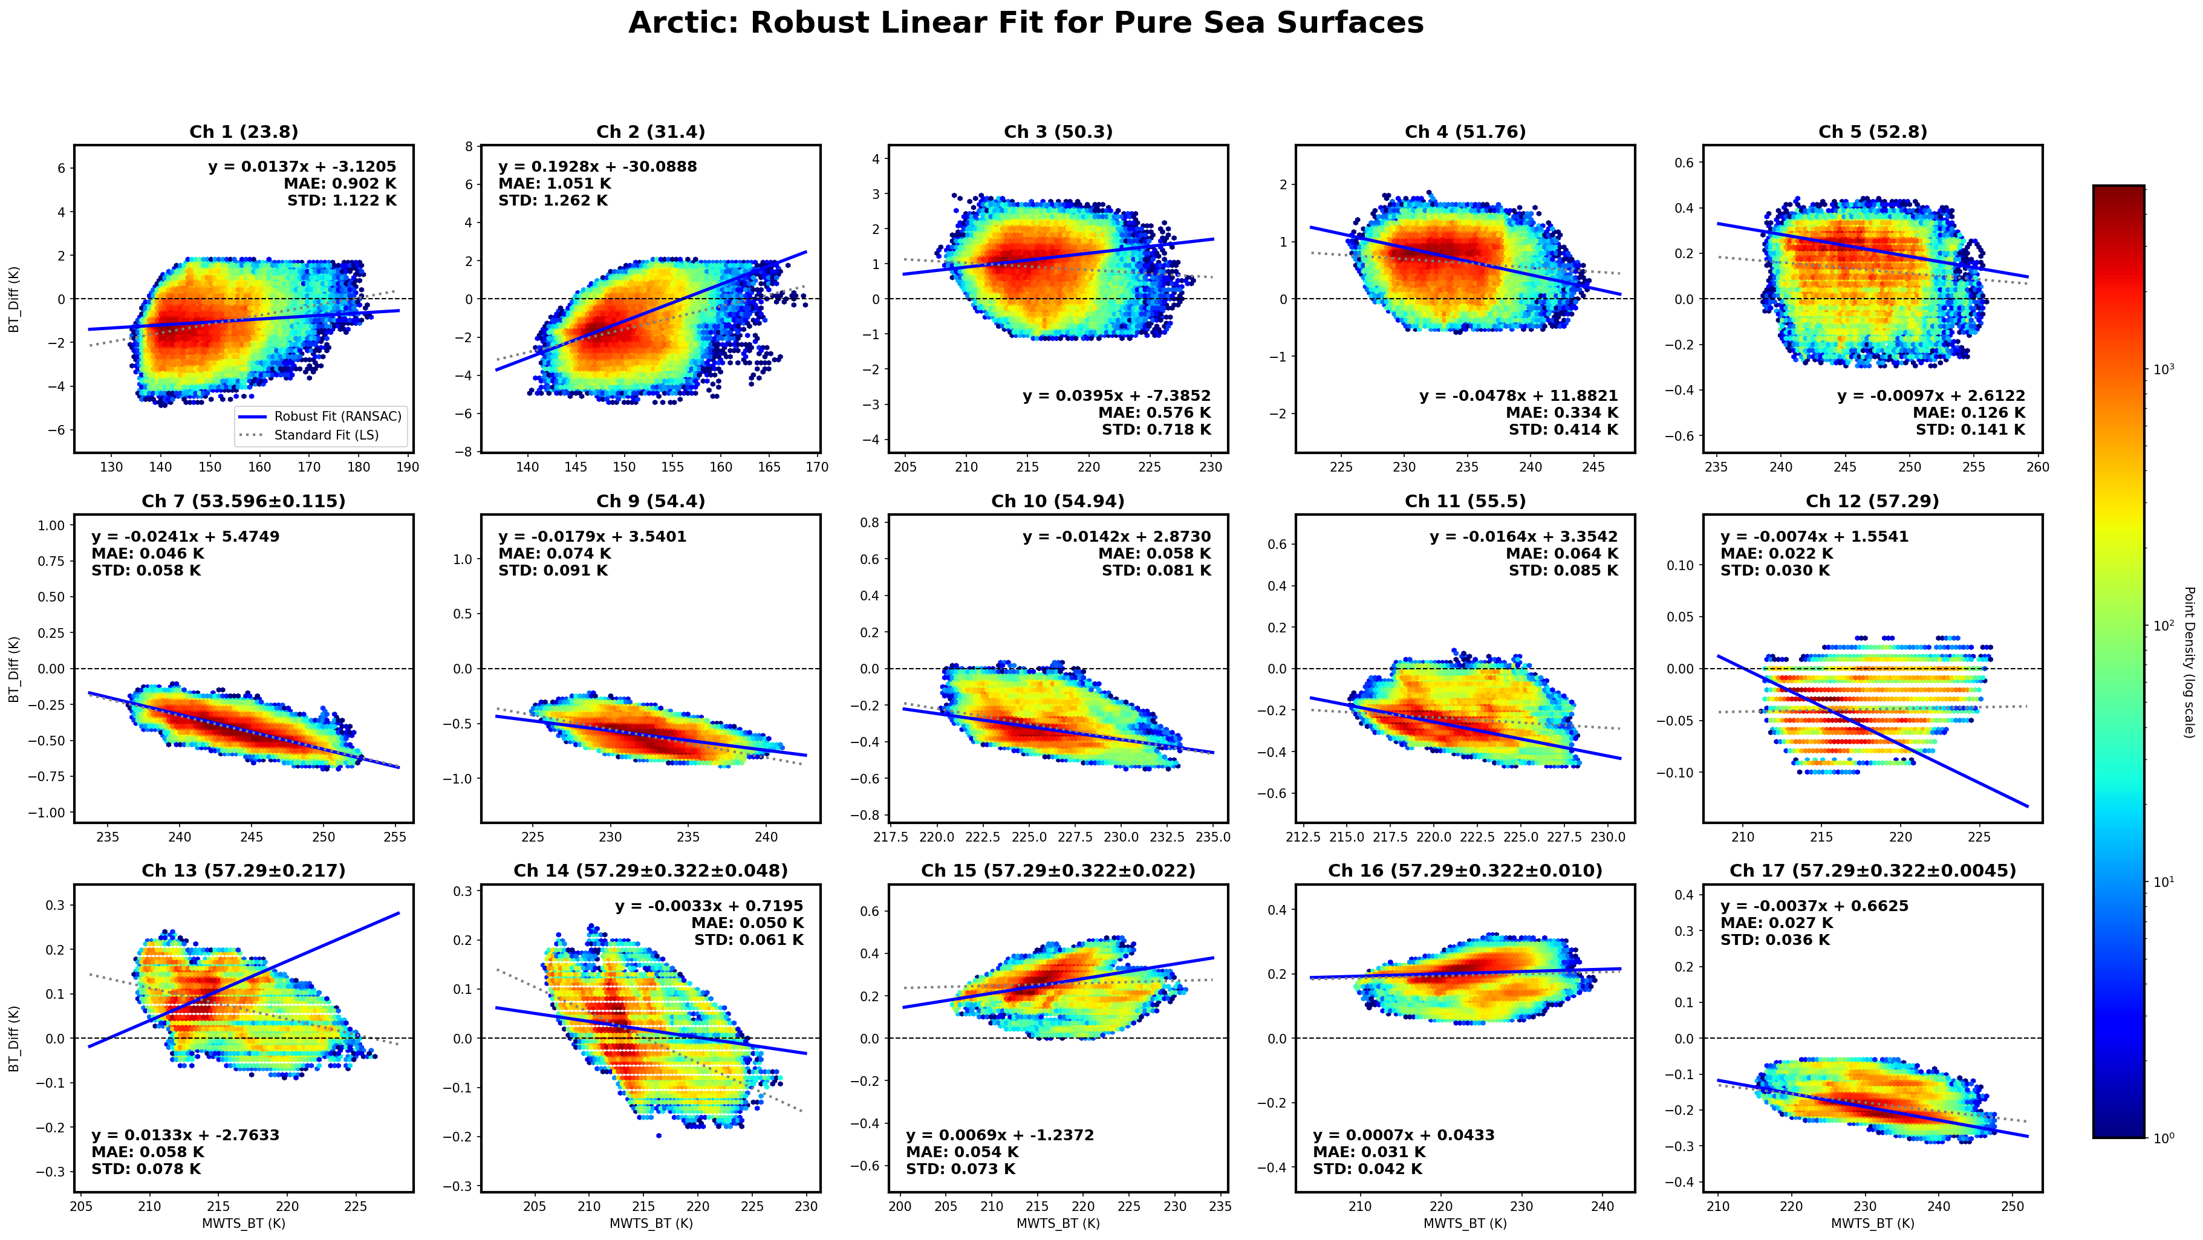
Calibration Accuracy Evaluation
SNO method: SRF difference handling
Simulation Study:
(RTTOV+ERA5+MWTS geo parameters)
BT_MWTS (MWTS coefficient) vs BT_MWTS (ATMS coefficient)
analysis BT difference under different zone and different land cover.
BT Comparison Scheme:
window channels 1-6: land pixels, BT compared directly
sounding channels 7-17: sea pixels, BT linear adjustment.

Slide 16
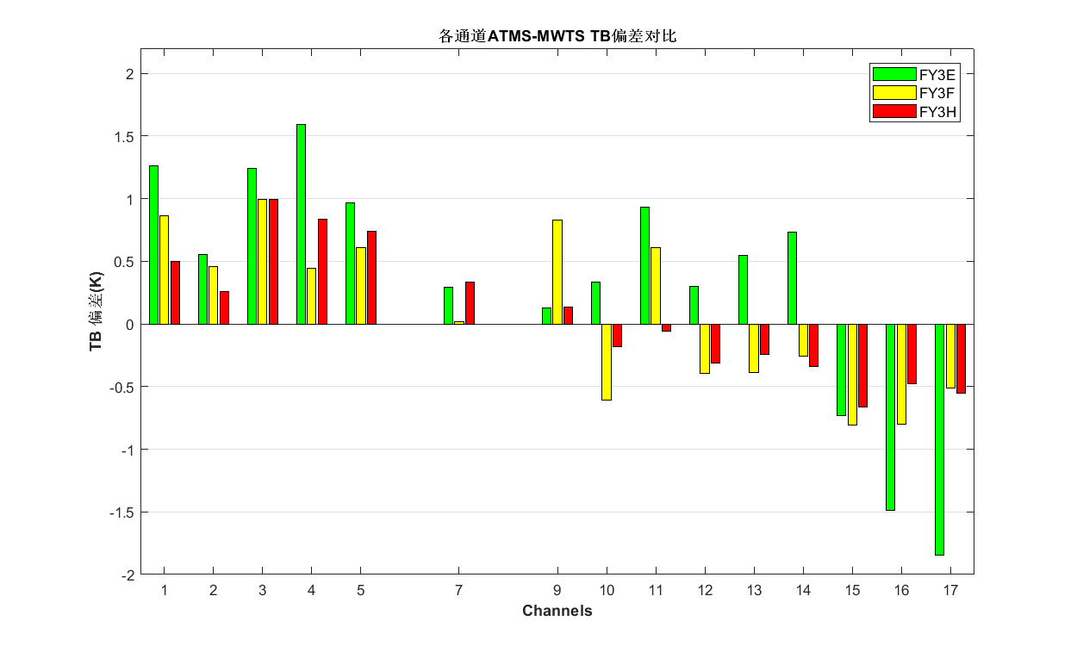
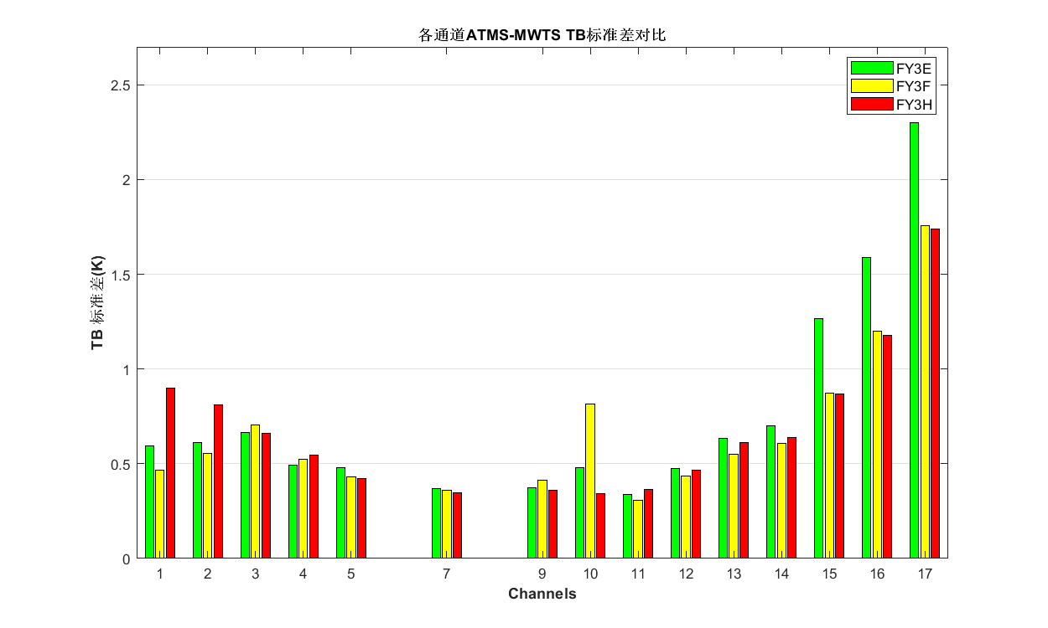
Calibration Accuracy Evaluation
SNO method: compared with NOAA-21ATMS (2025.12.17-2026.01.06)
For the FY-3H MWTS-III, the mean bias across all channels is below 1 K. The minimum bias occurs at channel 11 (less than 0.1 K), and the maximum bias occurs at channel 3 (approximately 1 K).
The error (both bias and STD) level is similar to that of FY-3F, while being better than that of FY-3E.
The SRF standardization of FY-3H MWTS-III leads to better SNO bias and STD for channels 9–11 than those of FY-3F.
Mean Bias
Bias STD

Slide 17
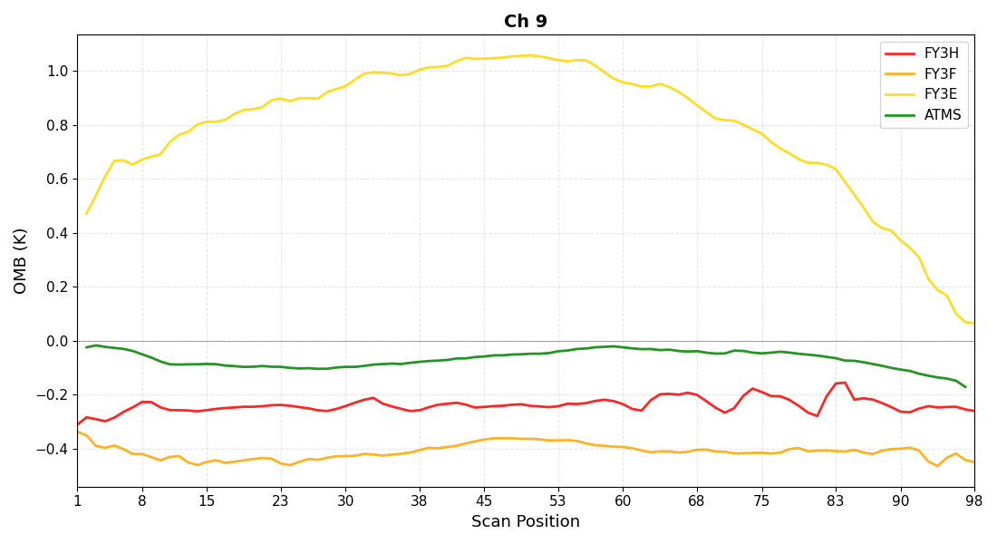
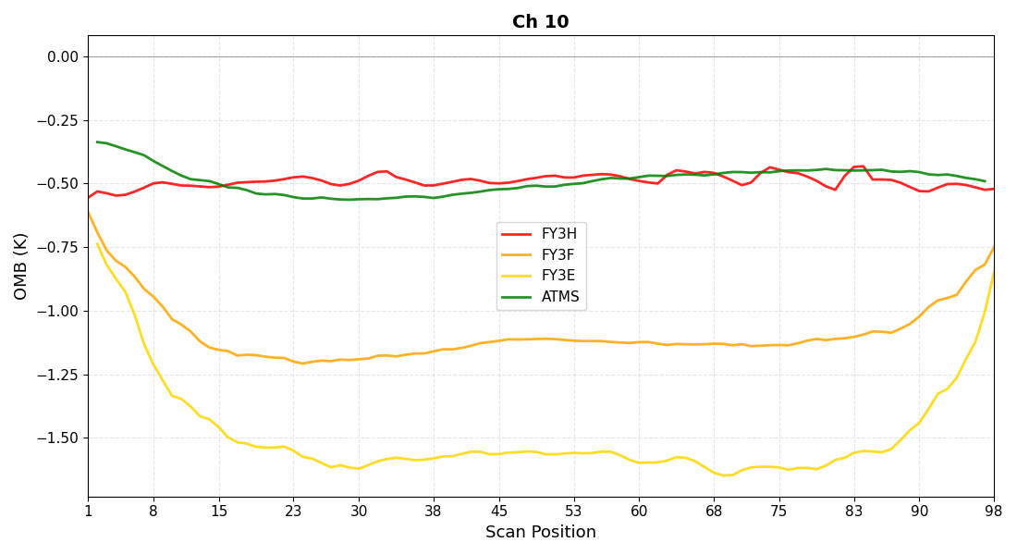
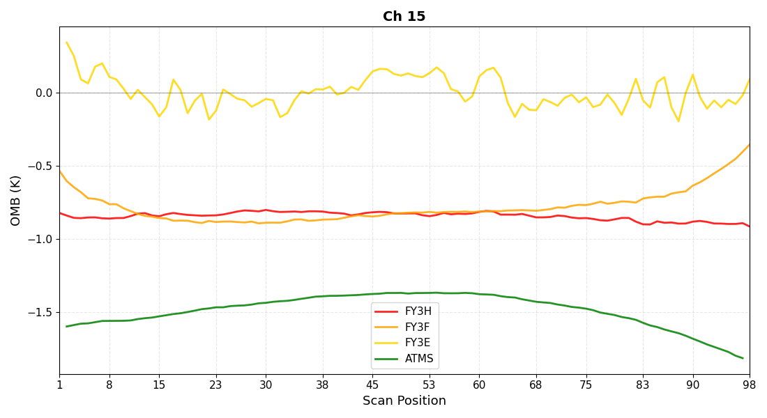
Calibration Accuracy Evaluation
O-B method: Along Scan bias
Simulation : using RTTOV+ERA5
Samples: 60°S ~60°N, sea pixels for all scanlines
After APC coefficient adjustment, the O-B differences across all 98 scan positions for all channels are less than 0.2 K.

Slide 18
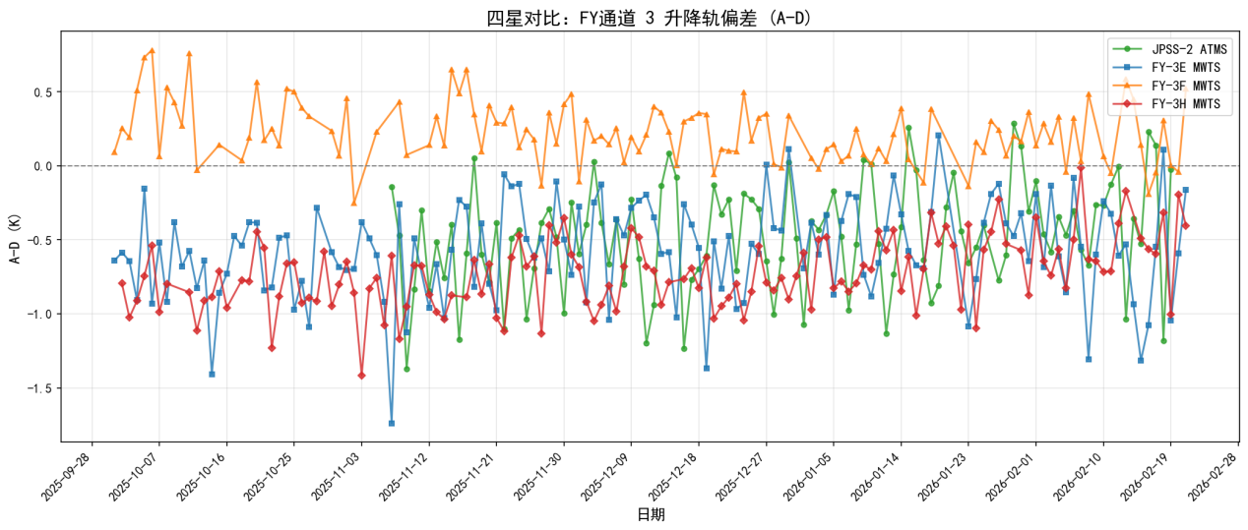
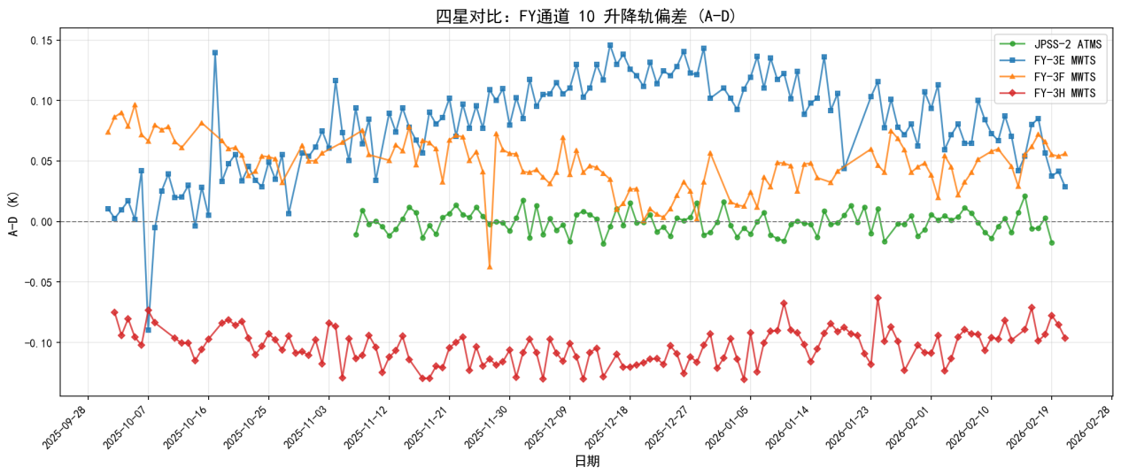
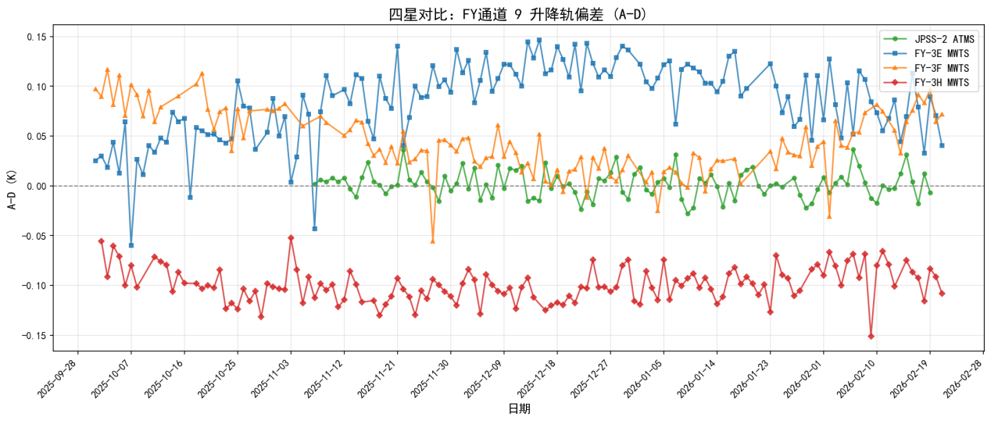
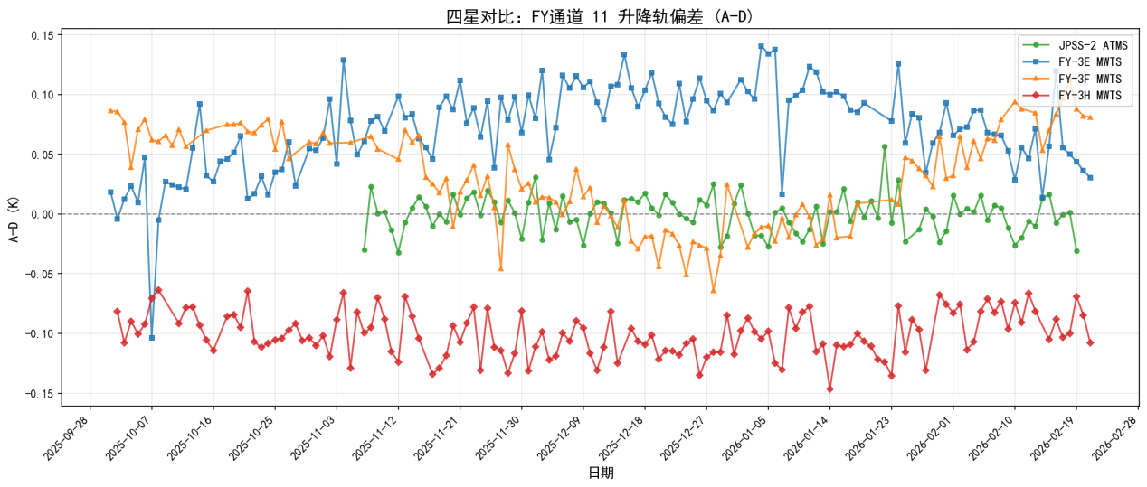
Calibration Accuracy Evaluation
O-B method: Ascend/Descend bias
Samples: 30°S ~30°N, sea pixels, ten pixels nearby nadir
Channels 7–13 are approximately 0.1 K, channels 6 and 14–17 range from 0.15 K to 0.2 K; window channels 1–5 are between 0.5 K and 1 K.
Different satellites exhibit seasonal variations in their A/D biases. FY-3H has shown a higher bias in descending orbits than in ascending orbits over the past six months.
ATMS
FY-3E
FY-3F
FY-3H
Ch3
Ch10
Ch9
Ch11

Slide 19
Outline
Instrument Review
Calibration for FY-3H MWTS-III
Calibration Accuracy Evaluation
Conclusion and Future plan

Slide 20
Conclusion and Future plan
FY-3H MWTS-III has several improvements, i.e. SRF standardization, channel crosstalk.
The platform environment of FY-3H is worse than that of FY-3F, with obvious radiation interference during cold space viewing and Earth-viewing observations.
The calibration accuracy of FY-3H is significantly better than that of FY-3E, and similar to that of FY-3F.
Prepare for FY-3 (10) satellite (will be launched this year).
Calibration quality improvement for FY-3 MWTSs, i.e. striping noise removing, orbital bias correction.

Slide 21
Thank you for your attention!
Email：hujy@cma.gov.cn

