Slide 1


2026.03.24
Two-Point Calibration and Nonlinearity Adjustment Optimization of FY-3D MWRI
Shi Liu, Shengli Wu
National Satellite Meteorological Center
(National Center for Space Weather)

Slide 2
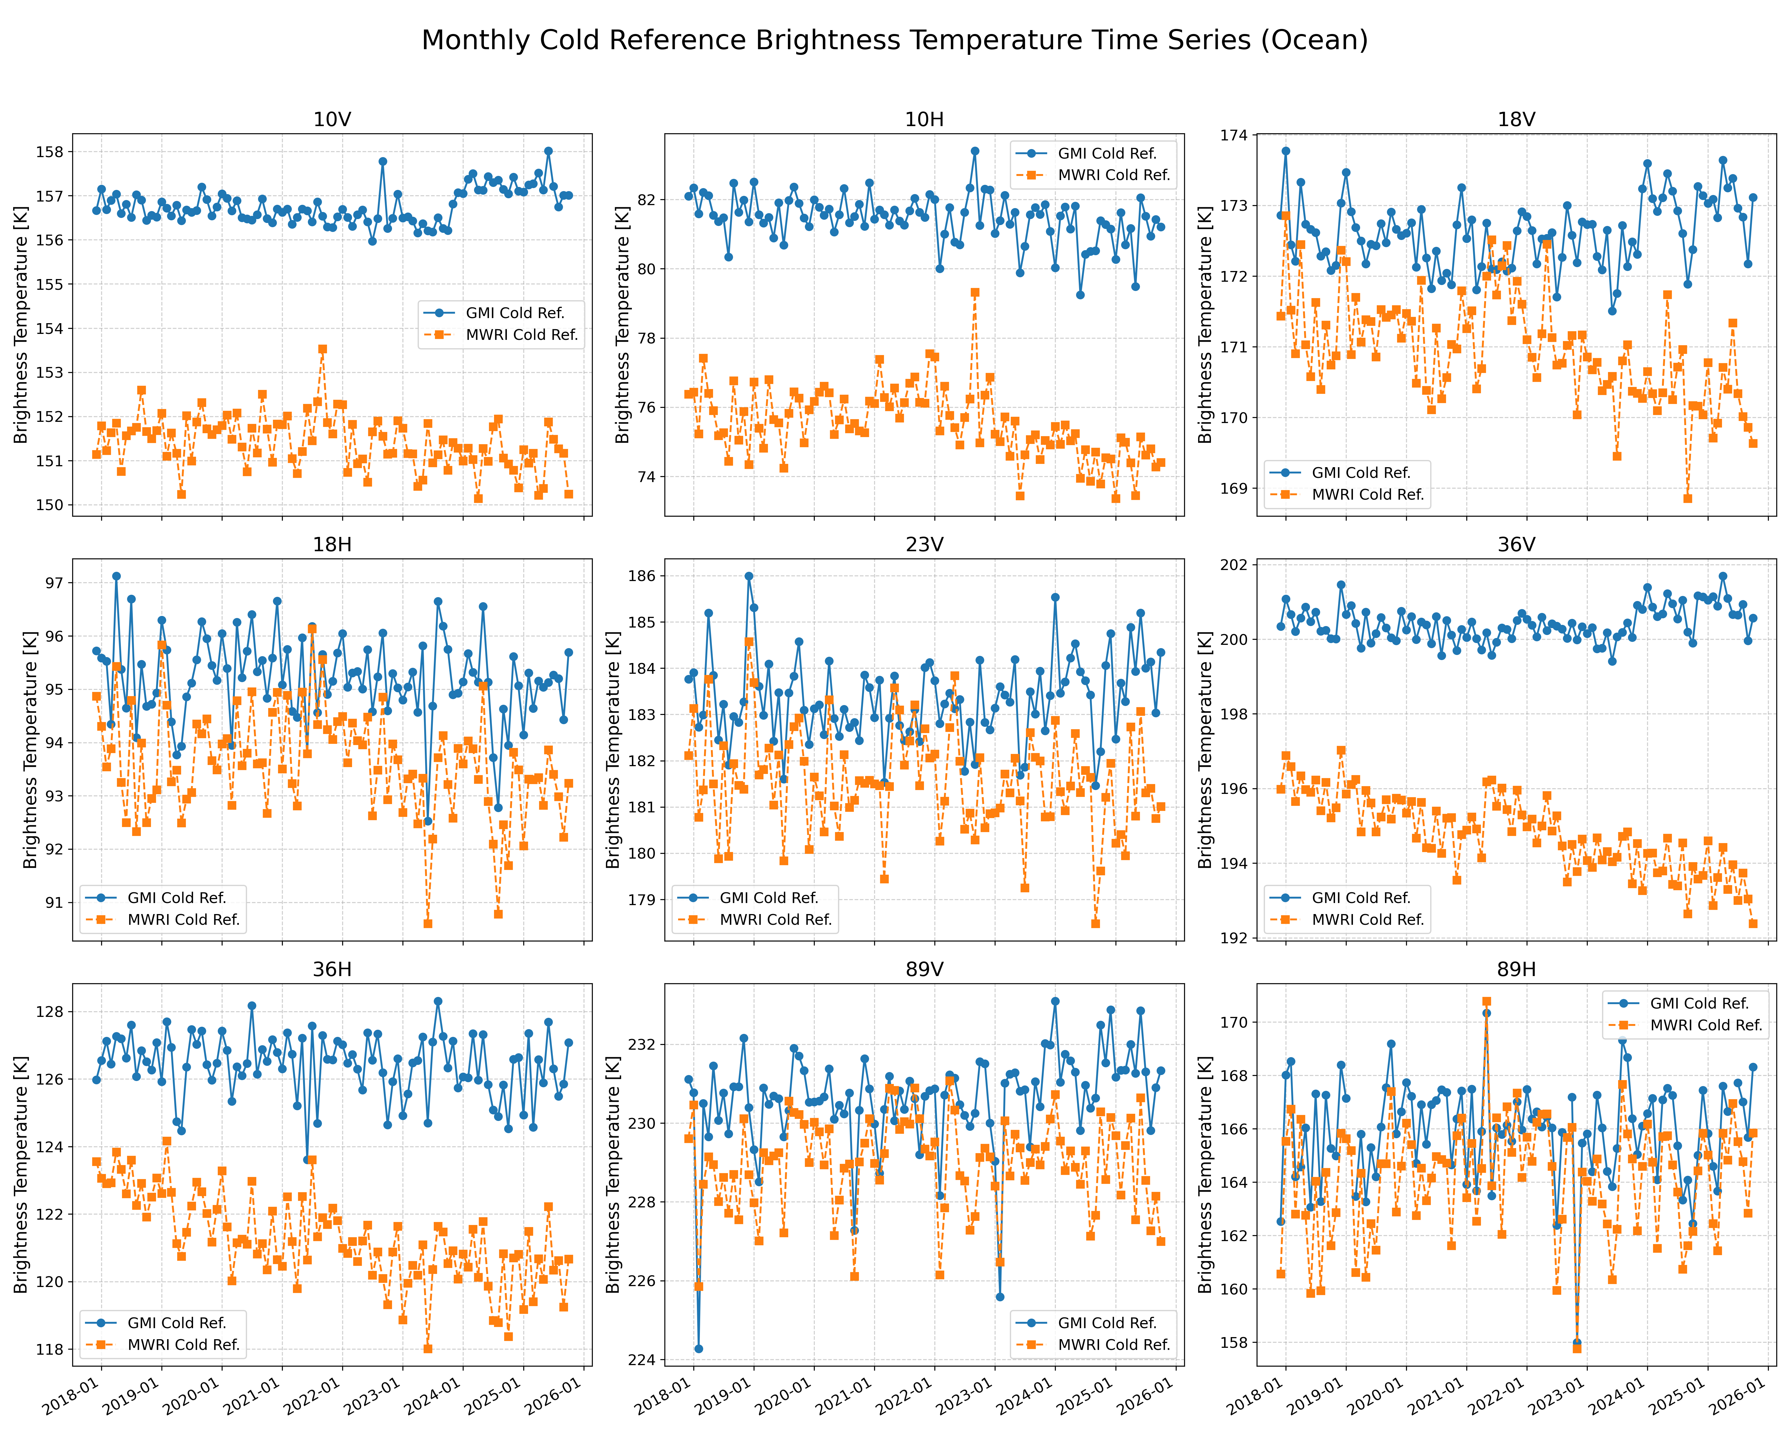
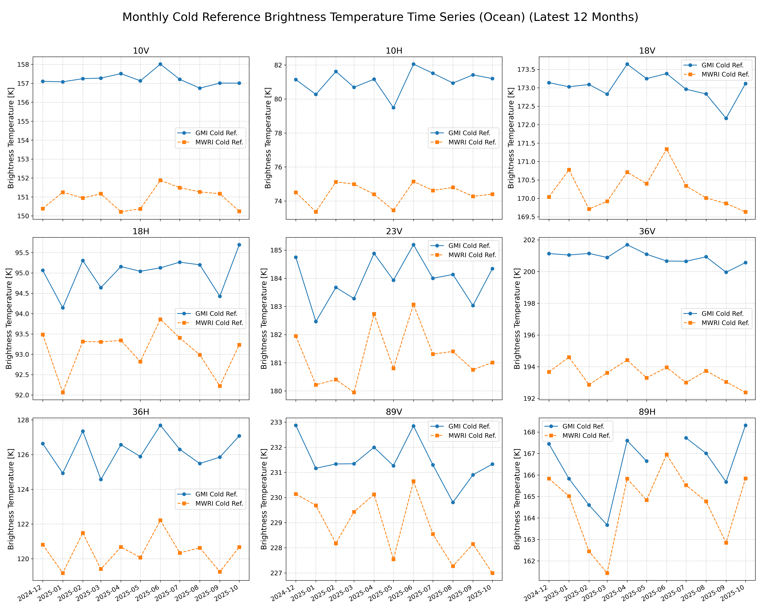
FY-3D exhibits drift in TBs due to blackbody temperature monitoring issues.
GMI data are relatively stable, and nonlinear coefficient correction using one-year-long data can be applied to inter-calibrate FY-3D to the GMI standard and applied to operational applications.

Slide 3
A systematic four-phase framework for dynamic bias elimination
Phase1
Phase2
Phase3
Phase4
Data Preprocessing and Matching up
Radiation Reference Alignment
Dynamic Error Compensation
Bias
Elimination
Action:
Spatial/temporal geometry matching
Action: Double Difference via
ERA5/MWSTRM4.
Action:
Isolating nonlinearity & calculating nonlinear coefficient.
Action:
Residual PDF shifts & dataset generation.
Metric:
Space < 0.03°
Time < 10 mins.
Metric:
Sea/Rainforest target isolation.
Metric:
Zero-centered residuals.
Metric: Extracting µ_{cold} intensity.

Slide 4
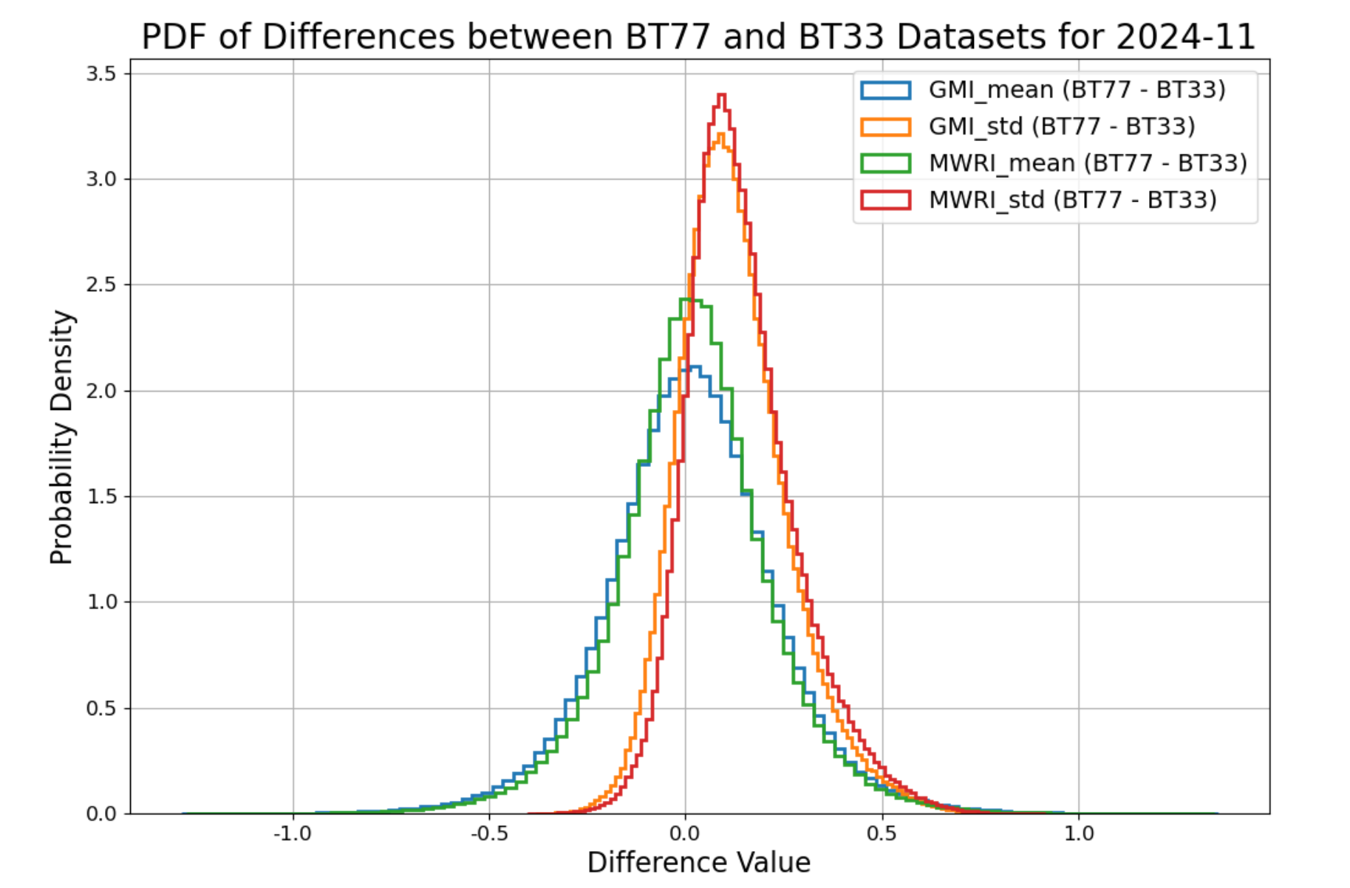
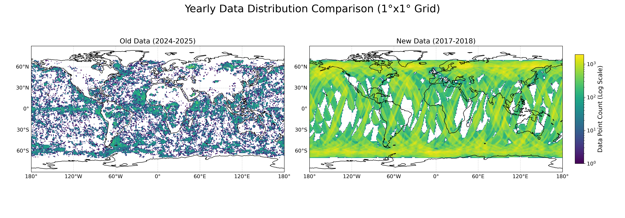
Rigorous SNO matching guarantees statistically uniform global datasets
Homogeneity Screening
Global Distribution
SNO selection criteria: time difference less than 10 minutes, spatial difference less than 0.03 degrees, and the difference between the 3×3 and 7×7 luminance temperature STD of each channel less than 1.
The data throughout the year is evenly distributed globally, which meets the calibration requirements.

Slide 5
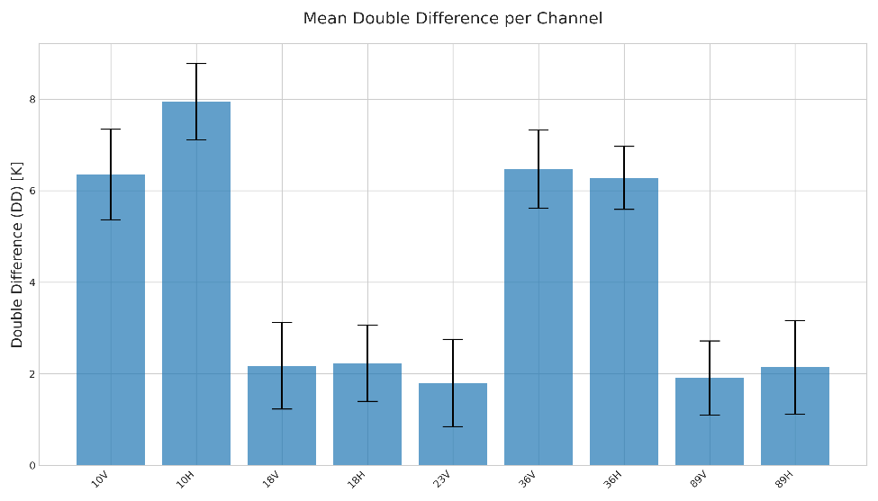
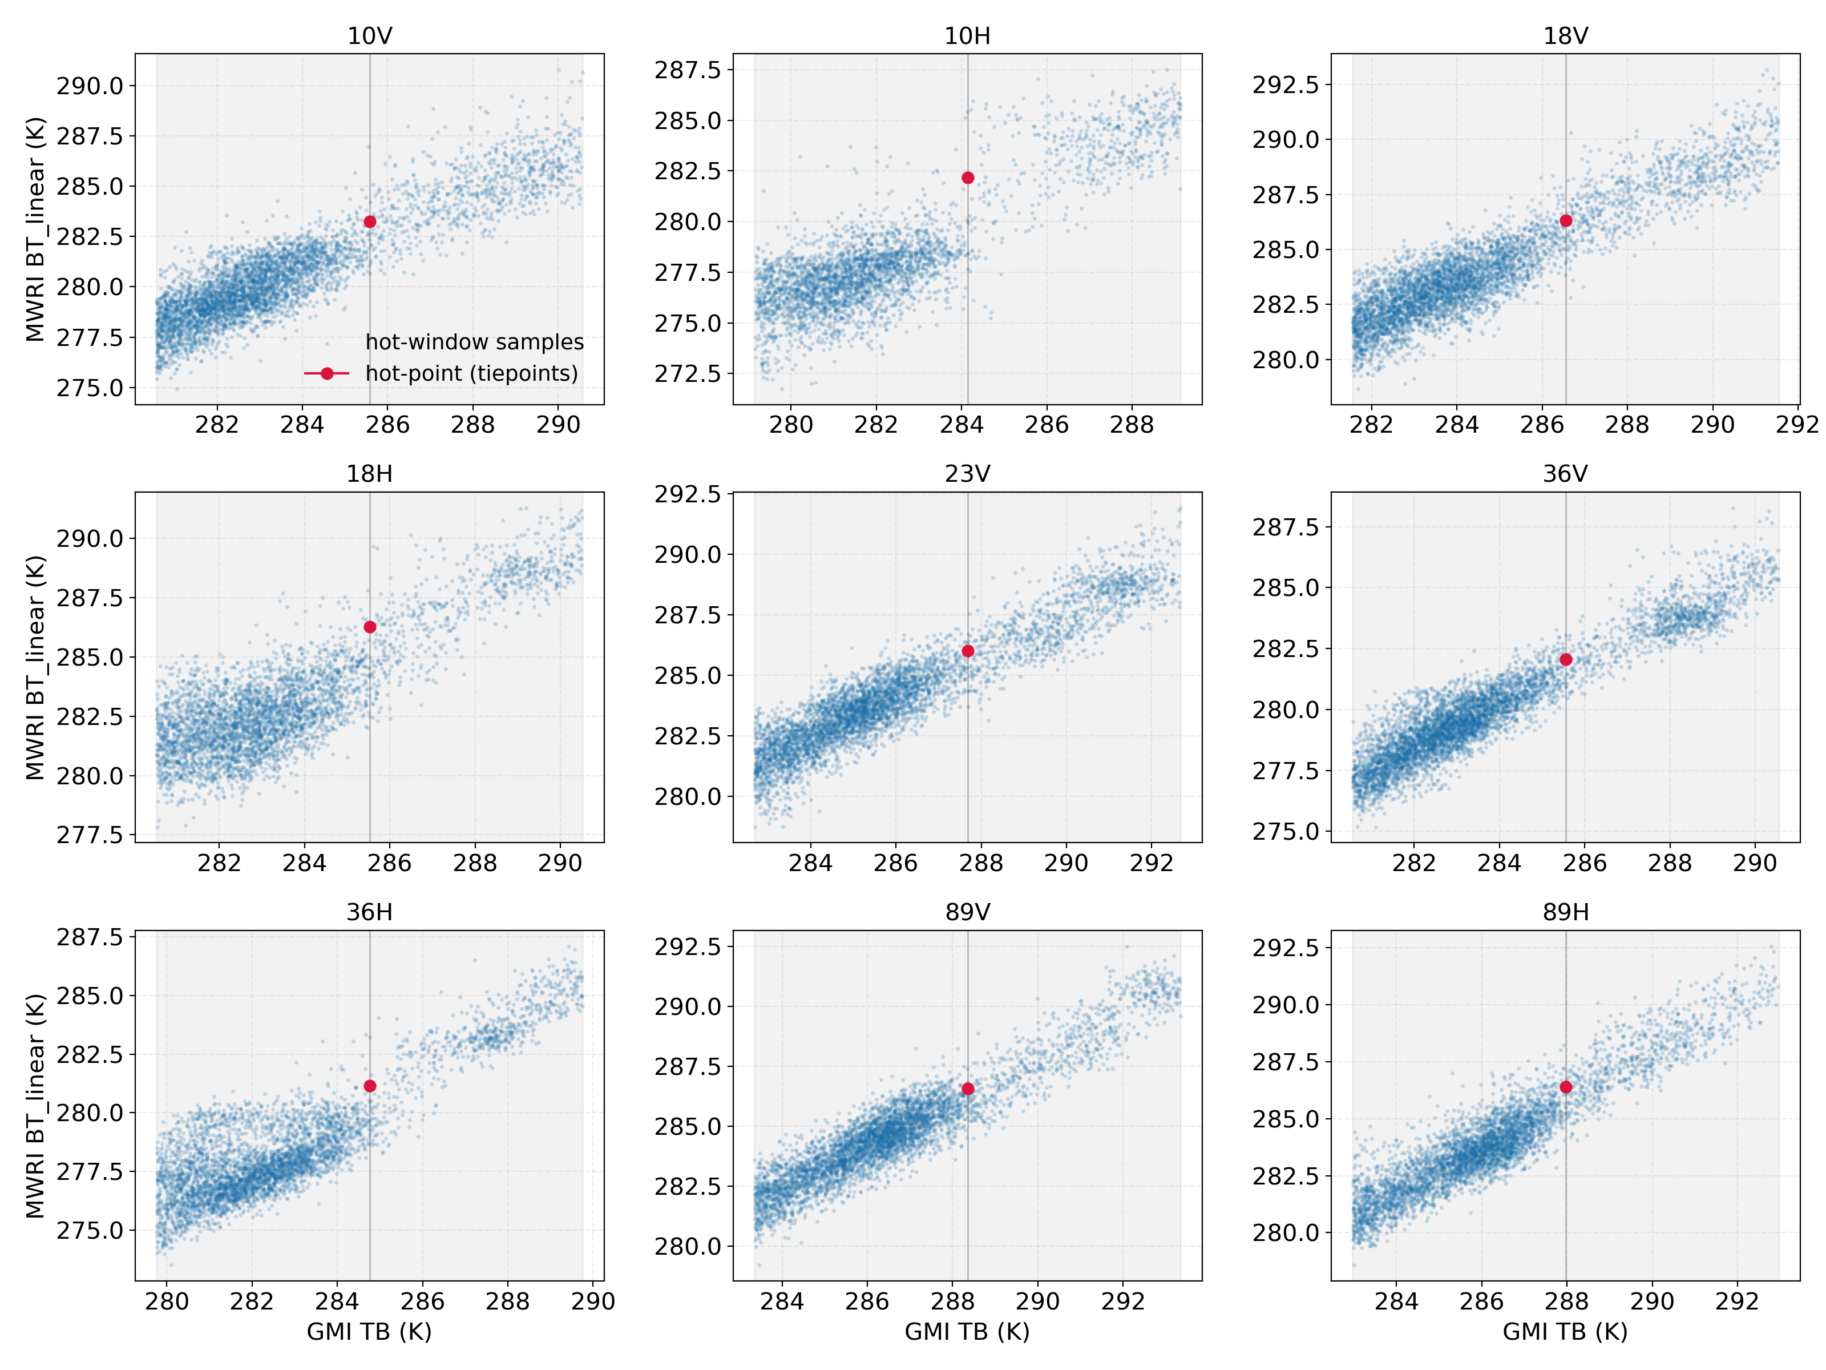
Radiation Reference Alignment via Double Difference (DD)
$$DD=\left(T_{GMI−O}−T_{MWRI−O}\right)−\left(T_{GMI−B}−T_{MWRI−B}\right)$$
Observed differences
Background simulations
(ERA5 + MWSTRM4 RT model).
The sea-brightness temperature is derived from the DD of clear-sky and moisture-free ocean conditions.
The hot-brightness temperature is derived from the DD of Tropical rainforests without polarization.
Notes:
热点附近的窗口散点只用于“检查一致性/合理性以及温度分布”，不是用来拟合热点值。

Slide 6
The determined sea and Rainforest scene deviation values by the Double Difference
$$TB_{calibrated−hotload}= TB_{original}+ {Deviation}_{ rainforest}$$
 | Sea-Scene |  |  | Rainforest-Scene
Channel | Mean Calibration differences (K) | STD of Calibration differences (K) | Mean GMI TB (K) | Mean Calibration differences(K) | STD of Calibration differences(K) | Mean GMI TB (K)
10V | 5.9355 | 1.0916 | 167.4522 | 2.3293 | 1.0918 | 285.5751
10H | 7.7473 | 1.2228 | 90.1329 | 1.9578 | 1.3980 | 284.1416
18V | 1.7896 | 1.0313 | 190.8271 | 0.2240 | 0.9896 | 286.5534
18H | 1.9594 | 1.0252 | 122.8313 | -0.7433 | 1.1005 | 285.5253
23V | 1.5038 | 1.0070 | 218.0963 | 1.6656 | 0.8534 | 287.6833
36V | 6.0545 | 0.9052 | 213.6787 | 3.4869 | 0.6691 | 285.5545
36H | 6.2381 | 0.8484 | 151.1619 | 3.5990 | 0.9224 | 284.7570
89V | 1.8359 | 0.9000 | 258.3129 | 1.7922 | 0.7618 | 288.3535
89H | 1.5266 | 1.0643 | 222.8525 | 1.5648 | 0.8362 | 287.9724

Slide 7
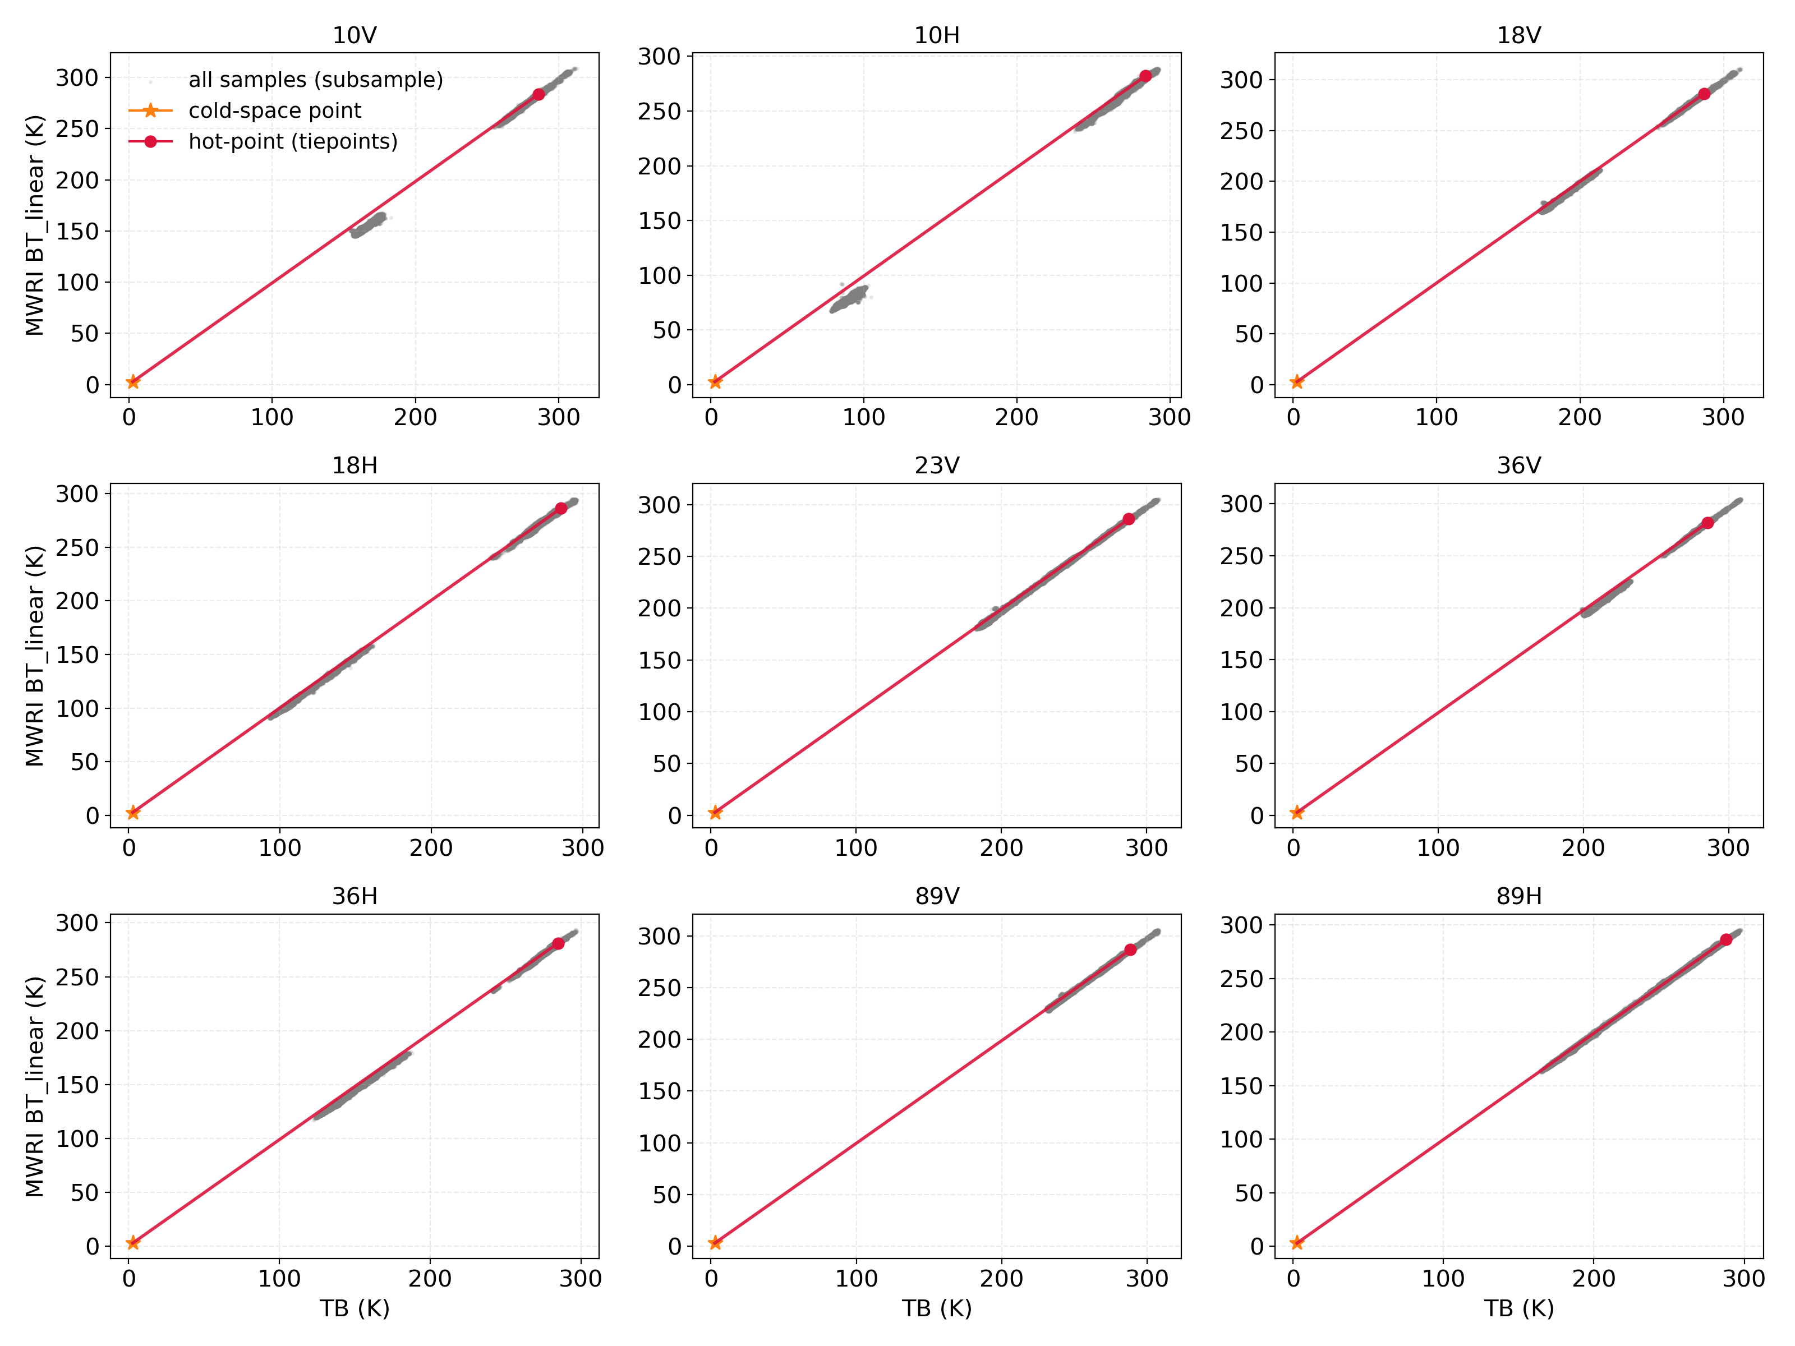
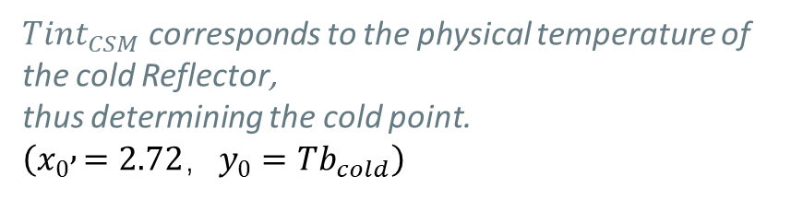
Obtain Deep Space Observations and Determine the two-point linear calibrations
Deep space observations can be calculated using the following formula:
$$Tb_{cold​}=2.72+\left(1−aH​\right)⋅\left(Tint_{CSM​}+13.86031\right)$$
which
𝑎𝐻 𝑐𝑜𝑟𝑟𝑒𝑠𝑝𝑜𝑛𝑑𝑠 𝑡𝑜 𝑡ℎ𝑒 𝑒𝑚𝑖𝑠𝑠𝑖𝑣𝑖𝑡𝑦 𝑜𝑓 𝑡ℎ𝑒 𝑐𝑜𝑙𝑑
Reflector, 𝑤ℎ𝑖𝑐ℎ 𝑖𝑠 𝑎𝑚𝑜𝑛𝑔 𝑡ℎ𝑒 𝑡𝑒𝑛 𝑐ℎ𝑎𝑛𝑛𝑒𝑙𝑠：
0.9996,0.9996,0.9995,0.9995,0.9995,
0.9995,0.9993,0.9993,0.9990,0.9990
$Tint_{CSM​}$​ corresponds to the physical temperature of the cold Reflector,
thus determining the cold point. $\left(x_{0} , =2.72，y_{0}=Tb_{cold}\right)$
All cold scene and hot scene sample points represent non-linear characteristics on both sides of the straight line between the cold and hot points.

Slide 8
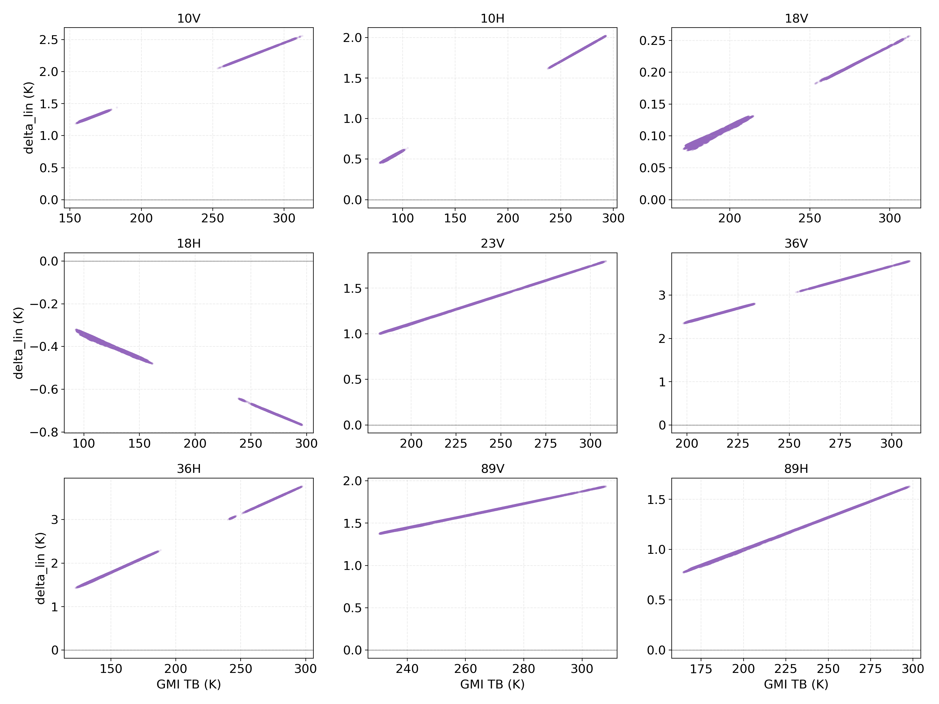
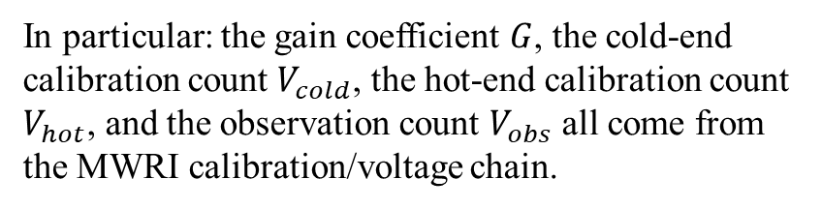
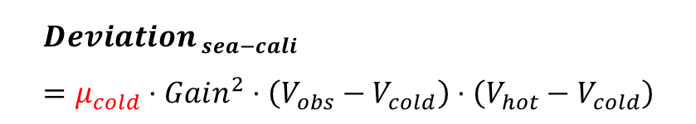
Isolating instrument nonlinearity across the ocean cold scene
$${Deviation}_{ sea−cali}= {Deviation}_{ sea−scene}+{Delta}_{Linear}$$
$${Deviation}_{ sea−cali}=μ_{cold}⋅Gain^{2}⋅\left(V_{obs​}−V_{cold}\right)⋅\left(V_{hot​}−V_{cold​}\right)$$
Localized constant representing channel nonlinear intensity
Counts from the MWRI
calibration linkage.
In particular: the gain coefficient $G$, the cold-end calibration count $V_{cold}$, the hot-end calibration count $V_{hot}$, and the observation count $V_{obs}$ all come from the MWRI calibration/voltage chain.
${Delta}_{Linear}$ as a function of observed brightness temperature

Slide 9
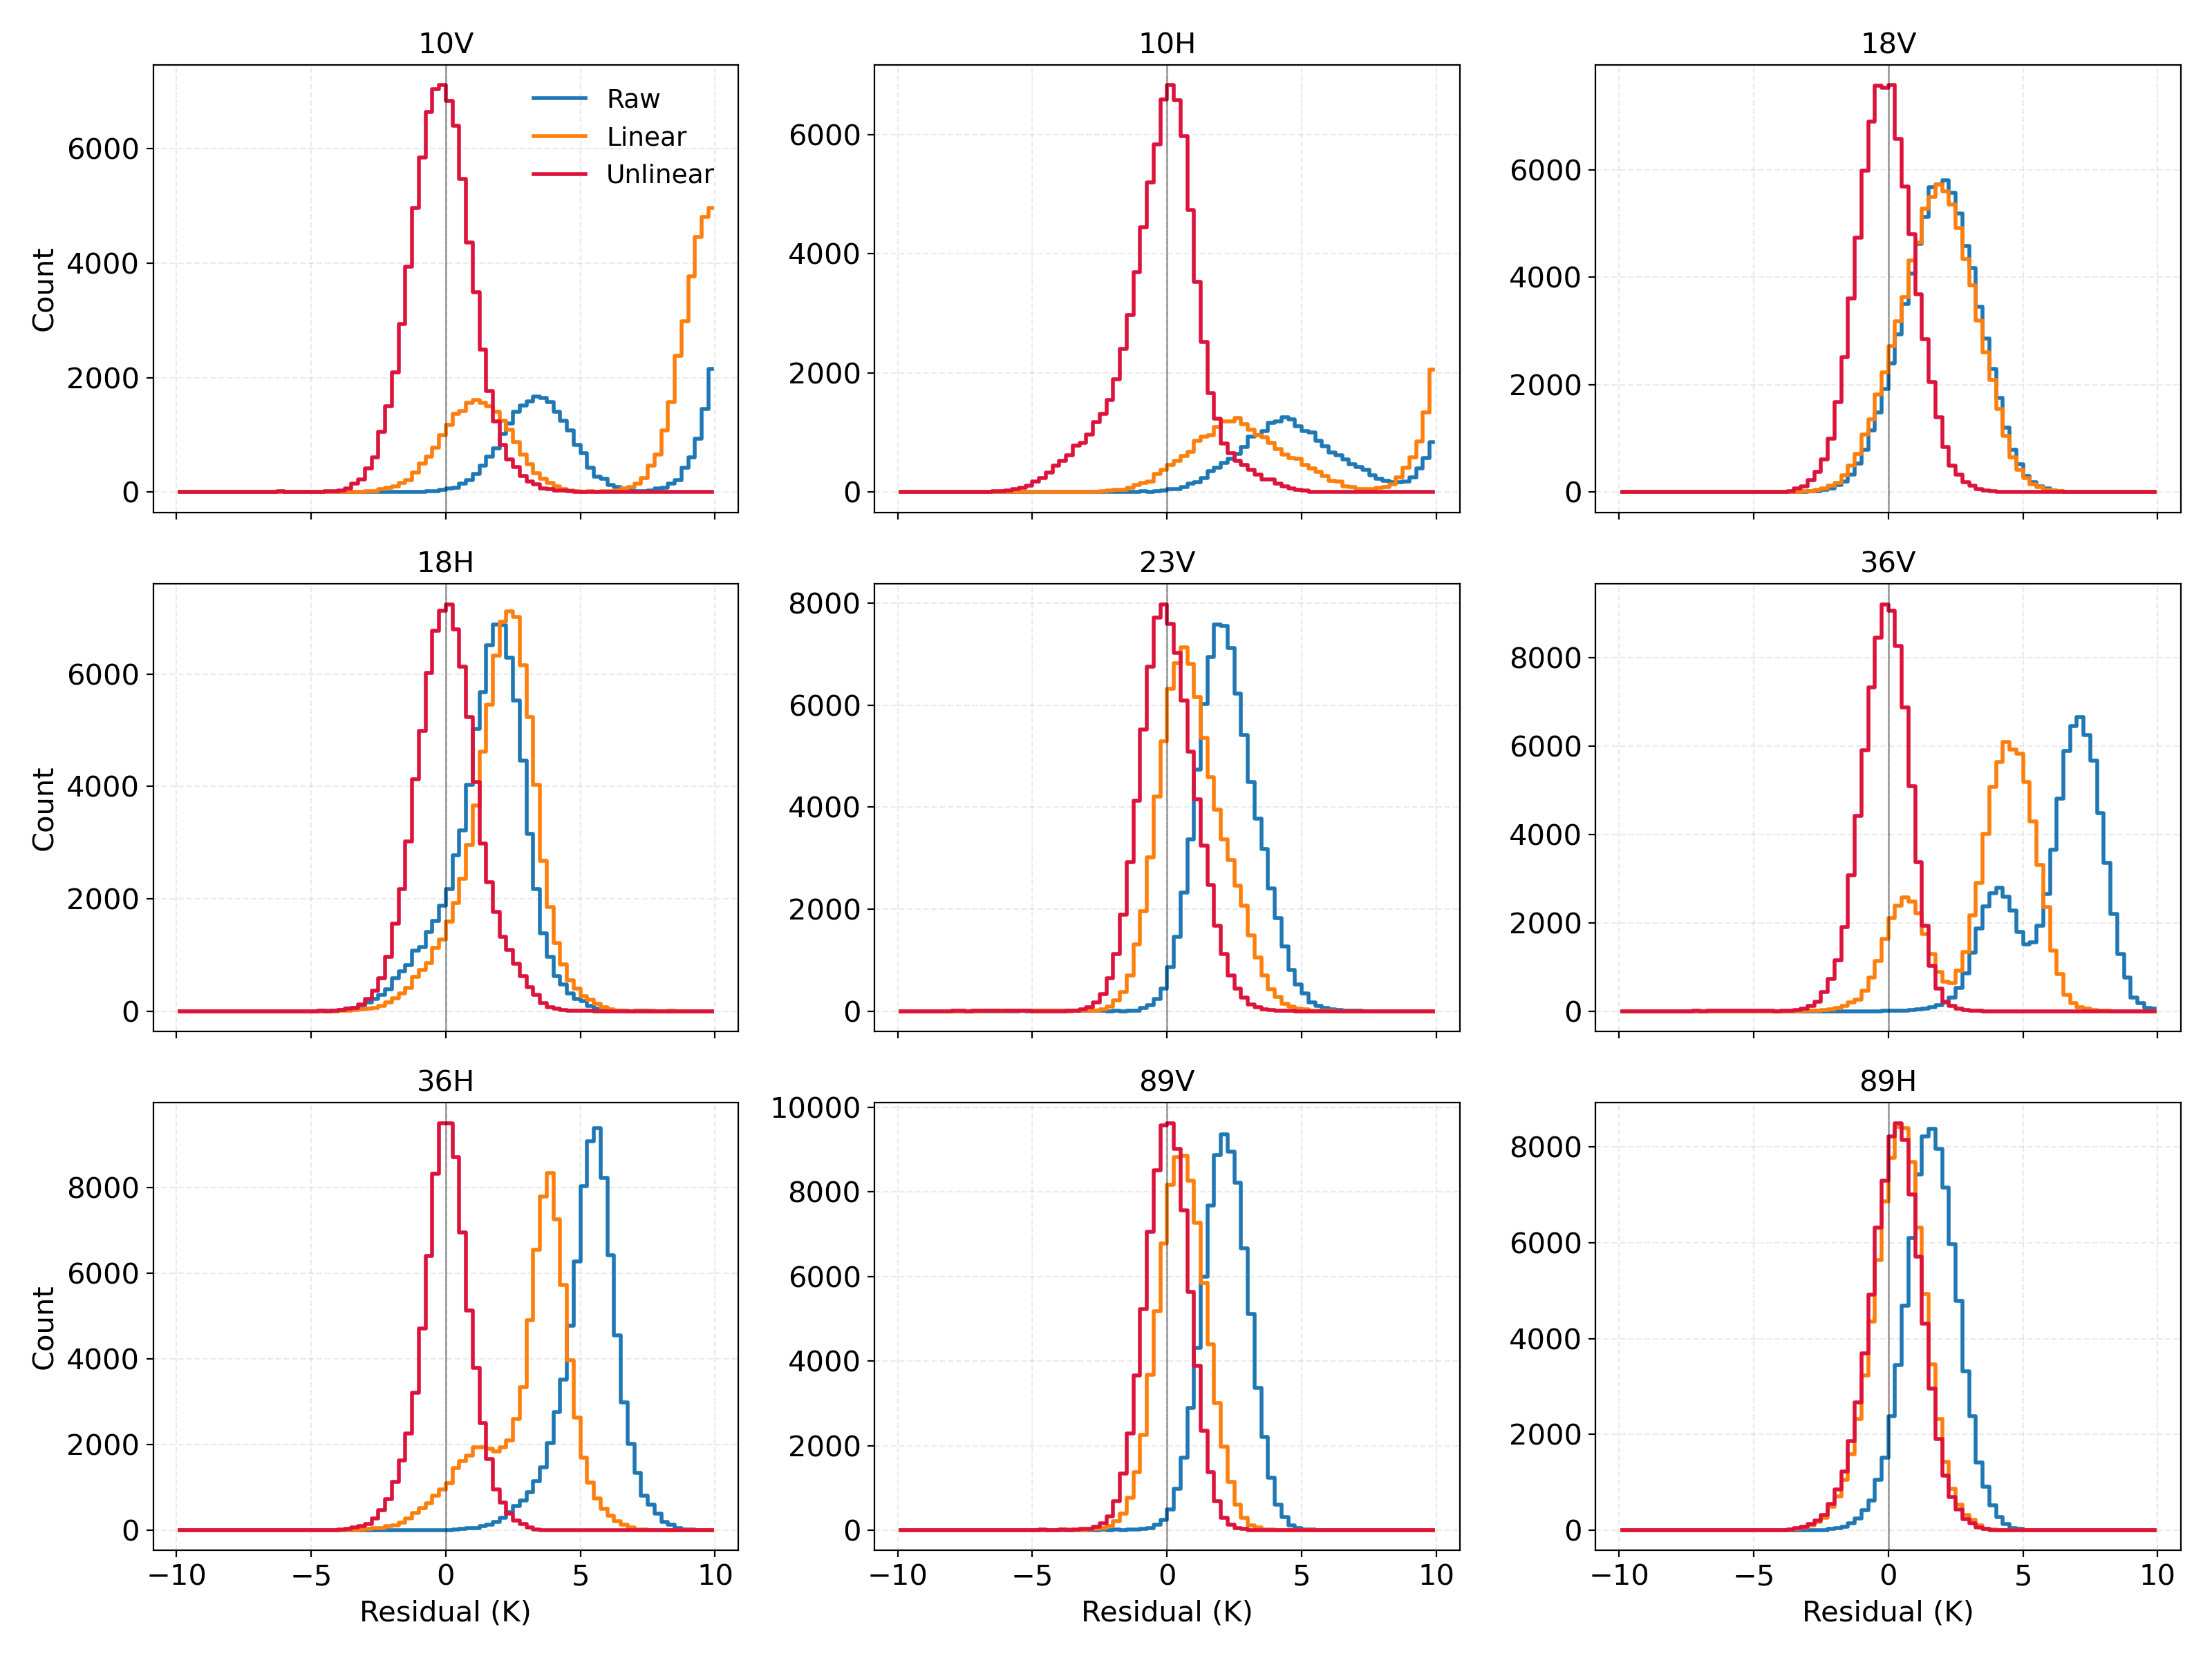
Systematic bias elimination yields normalized,
zero-centered residuals
STATE 1: RAW. Biased, scattered, and structurally skewed prior to calibration.
STATE 2: LINEAR CALIBRATION. Shifted toward zero via Double Difference, but retaining nonlinear coefficients skew.
STATE 3: NONLINEAR CORRECTION. Perfectly zero-centered, normalized Gaussian distribution. Nonlinear artifacts eliminated.
Distribution of residual probability density functions after applying linear correction and subsequent correction to the nonlinear coefficients $μ_{cold}$ on all channel samples.

Slide 10
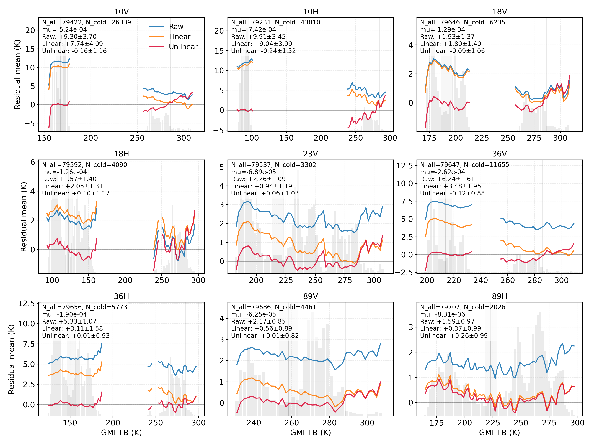
Inter-satellite residuals demonstrate global consistency across all channels
Observation Range：The red line (Nonlinear Corrected) remains tightly bounded near 0 K across the entire 150K to 300K spectrum.
Significance：The dynamic error compensation successfully flattens the response curves, proving that the FY3D-MWRl observations now reliably mirror the GMI reference at all global observation temperatures.
Residuals as a function of observed brightness temperature

Slide 11
FY3D-MWRI dataset is fully calibrated, stable, and ready for operational application
High-quality SNO datasets matched-up and spatially homogenized
Radiation Reference Alignment unified via DD.
Nonlinearity dynamically compensated
Inter-satellite systematic biases calibration
Core Conclusion:
The updated cross-calibration parameters have successfully eliminated systematic nonlinear biases. Currently, FY3D-MWRI remote sensing data has achieved seamless integration with the GMI global reference standard.

Slide 12


THANKS

