Slide 1
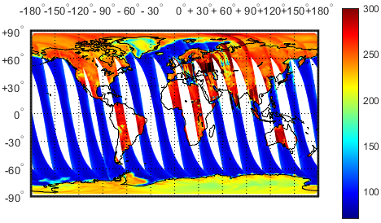
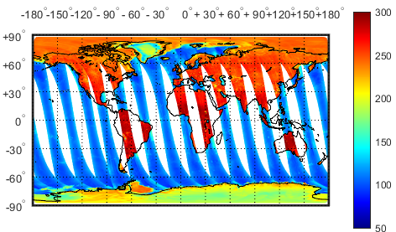
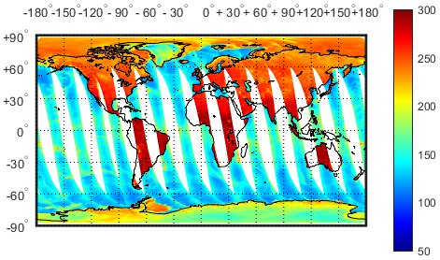
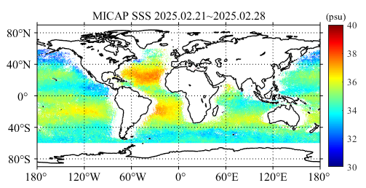
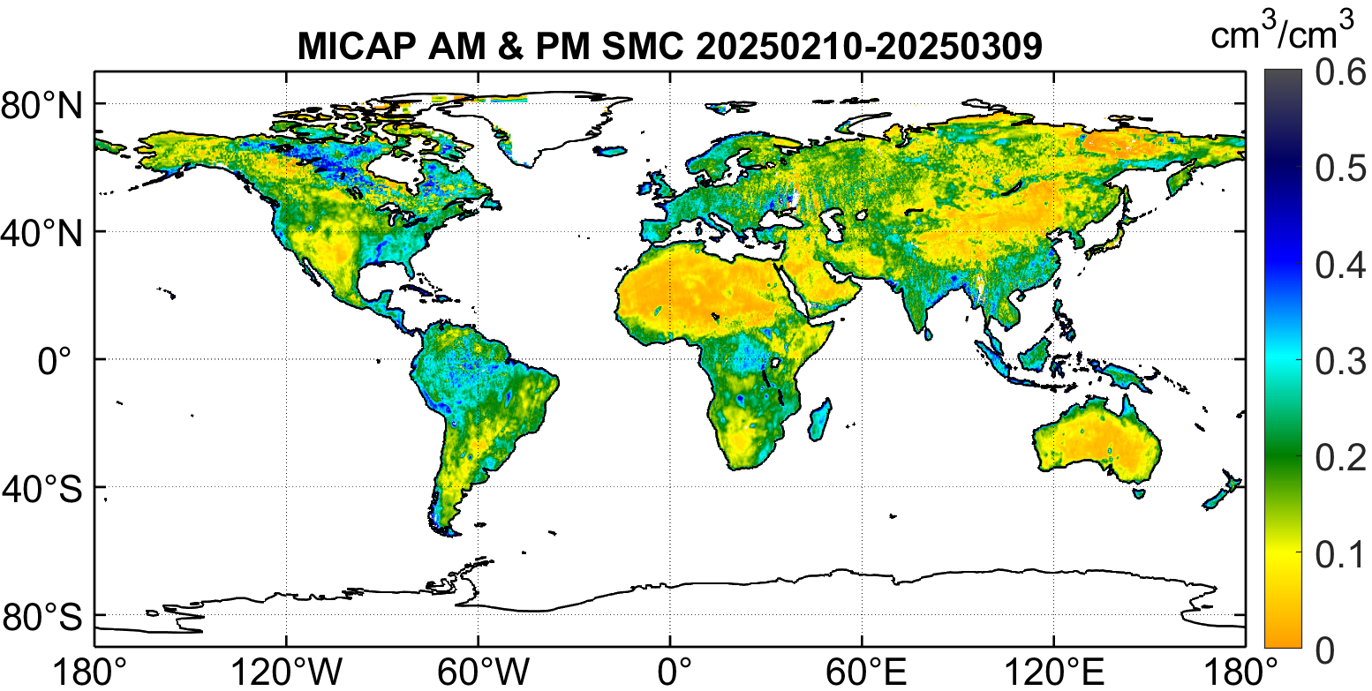
EARLY IN-ORBIT PERFORMANCE OF MICAP L/C/K BAND INTERFEROMETRIC RADIOMETERS:
TOWARD FIRST SPACEBORNE MULTI-FREQUENCY OBSERVATION OF SEA SURFACE SALINITY
Hao LIU^{1，} Jieying HE¹
PAYLOAD TEAM
Donghao HAN¹, Cheng ZHANG¹, Lijie NIU¹, Xing TONG¹, Bingxu LI^{1,2}, Huan MA^{1,2}, Ji WU¹
OCEAN SALINITY TEAM
Wenyu WANG¹, Xiaolin TONG¹, Zhou ZHANG¹, Zhenzhan WANG¹
SOIL MOISURE TEAM
Huizhen CUI¹, Tianjie ZHAO³, Jingyao ZHENG³, Jiashuo GUO^{3,2}
GROUND SEGMENT
Wu ZHOU⁴, Te WANG¹, Ziquan LIU¹

Slide 2
OUTLINE
MICAP Instrument Description
Status During Commissioning Phase
Early In-orbit Performances
Early In-orbit SSS/SST/WS & Soil Moisture
Conclusion

Slide 3
OUTLINE
MICAP Instrument Description
MICAP Instrument Status During Commissioning Phase
MICAP L/C/K Band Radiometers Early In-orbit Performances
MICAP Early In-orbit SSS/SST/WS & Soil Moisture
Conclusion

Slide 4
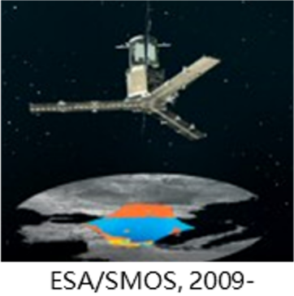
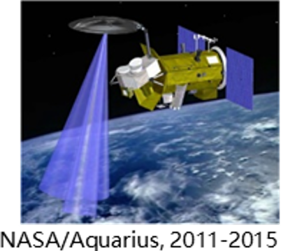
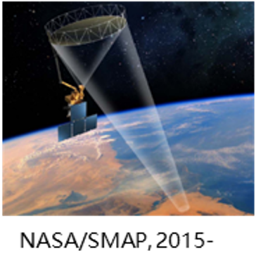
Space-borne Salinity Missions in Last Decades
2D Interferometer
3-beam pushbroom
Conical scan

Slide 5
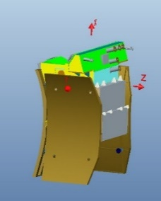
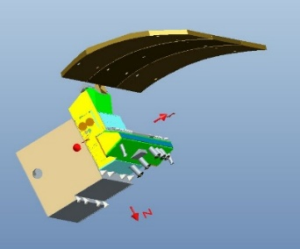
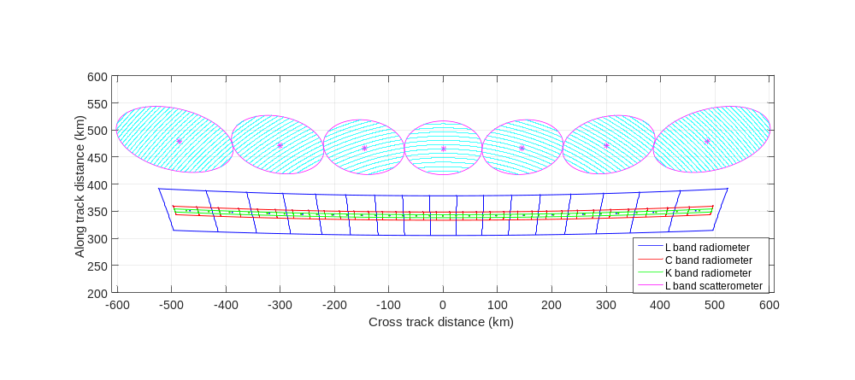
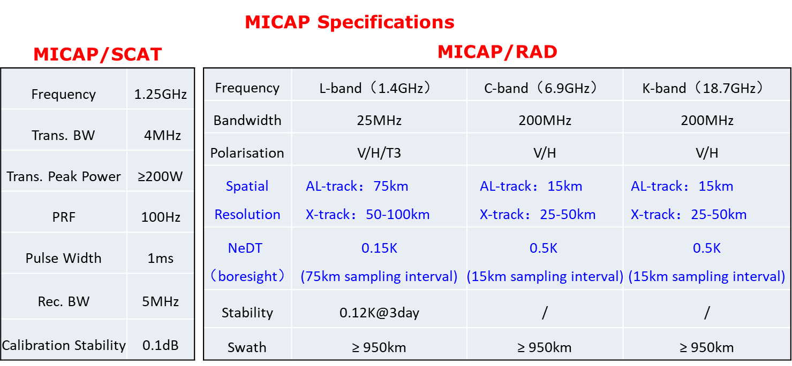
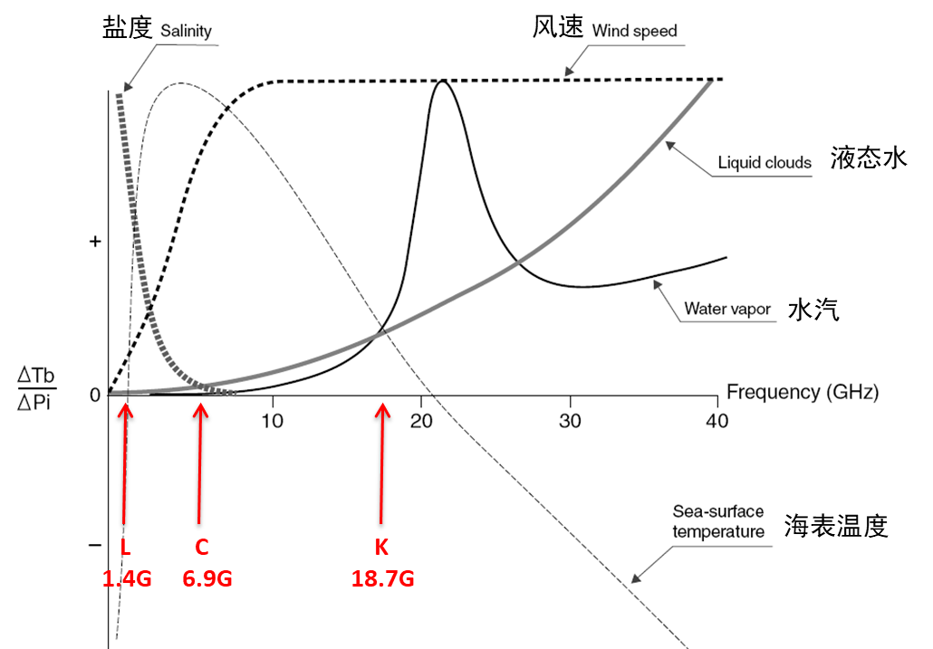
MICAP INSTRUMENT OVERVIEW
Instrument Type: a suit of active/passive instrument package
  Passive part: L/C/K band one-dimensional MIR (microwave interferometric radiometer)
  Active Part: L-band DBF (digital beamforming) scatterometer
  Antenna: parabolic cylinder reflector antenna (~5.5*3m) with linear array feeds.
Motivation of the design
  1D MIR: balanced system complexity & performance
  Parabolic cylinder reflector & linear feed array: to include L-band DBF Scat for roughness correction, & C/K band MIRs for SST correction
  First Spaceborne…
  1D Synthetic Aperture Radiometer
  Multi-frequency Synthetic Aperture Radiometer
  DBF Scatterometer
  On-board RFI Detection & Mitigation for Synthetic Aperture Radiometer

Slide 6
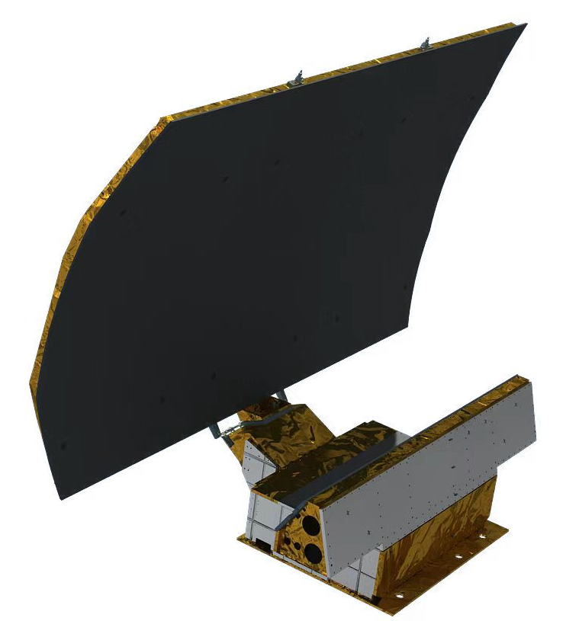
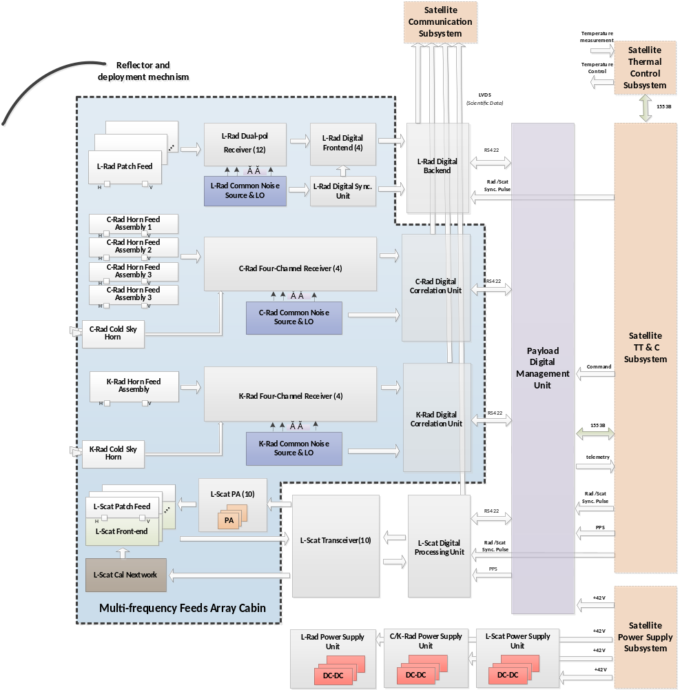
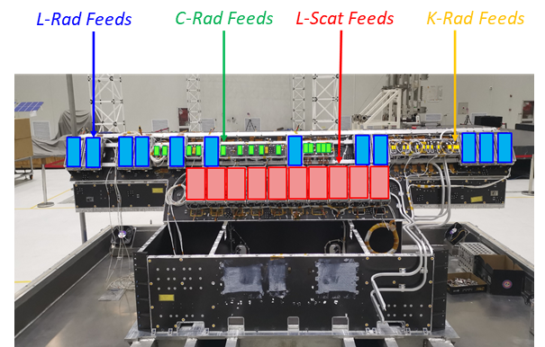
Satellite Platform Subsystems
1.4GHz L-Rad
6.9GHz C-Rad
18.7GHz K-Rad
1.25GHz L-Scat
MICAP Instrument Architecture

Slide 7
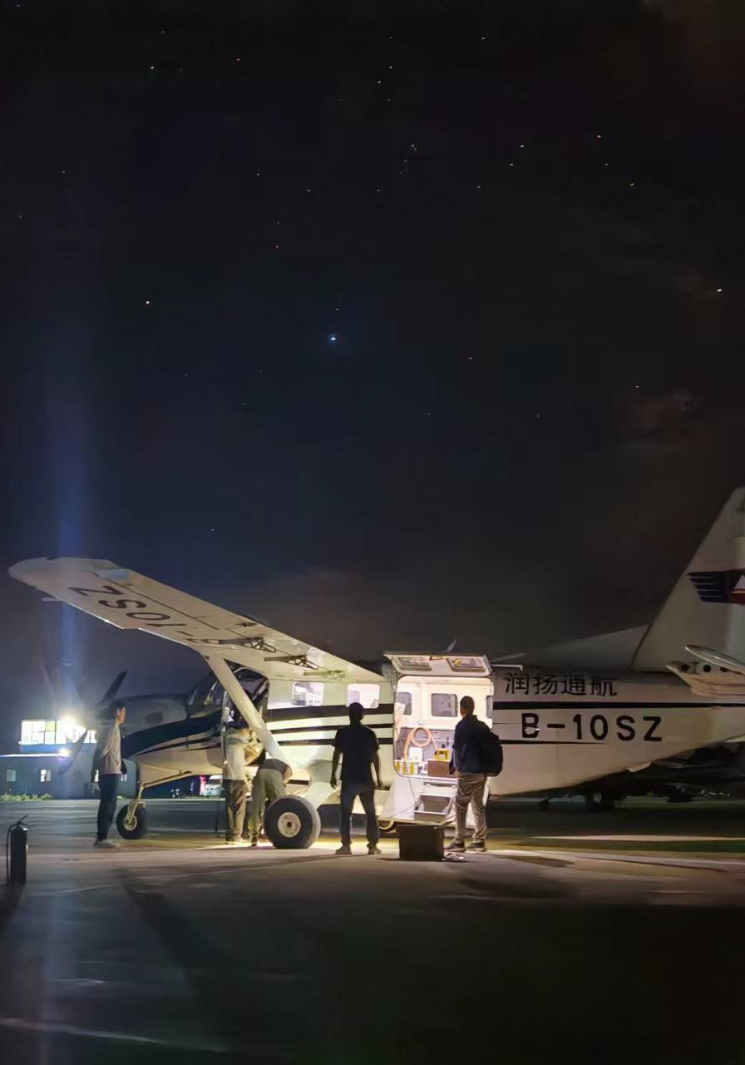
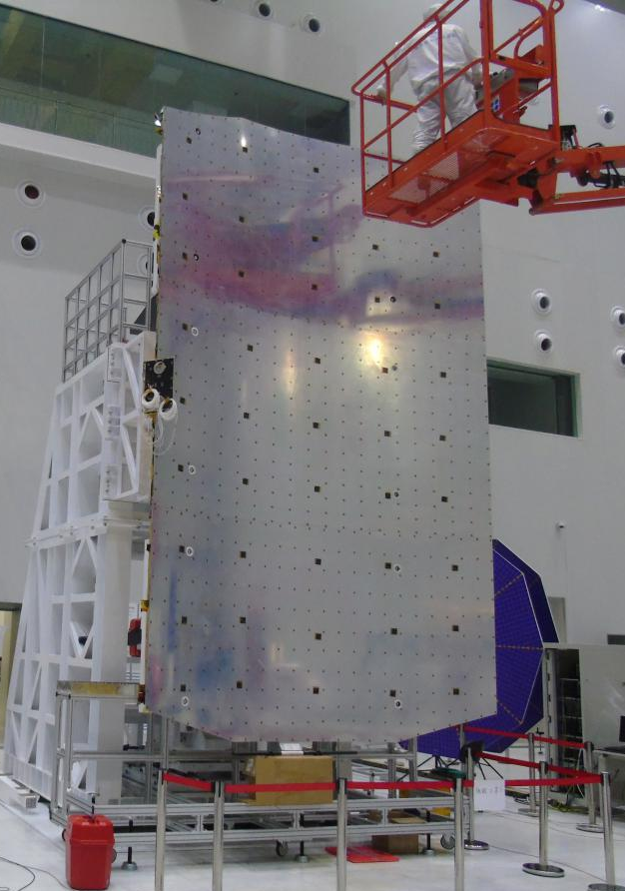
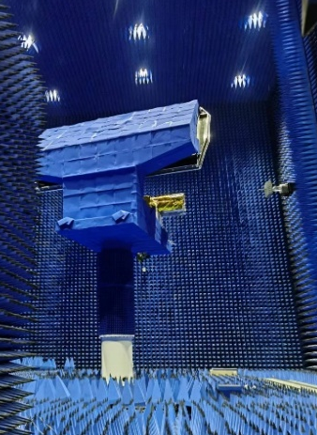
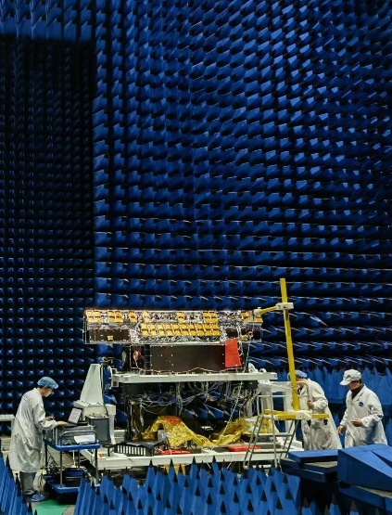
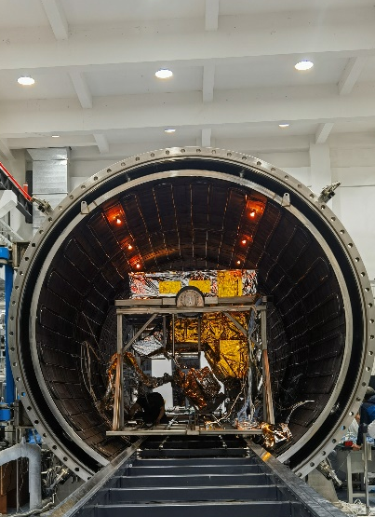
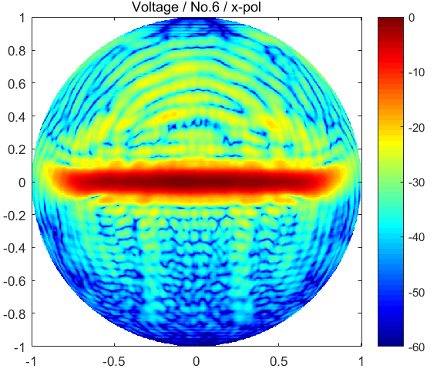
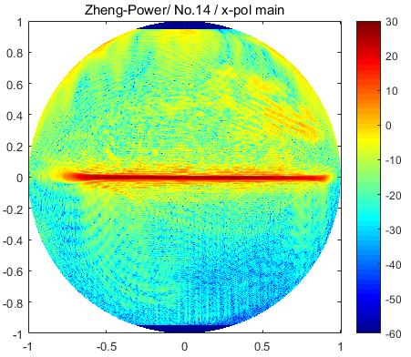
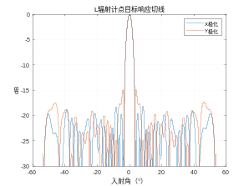
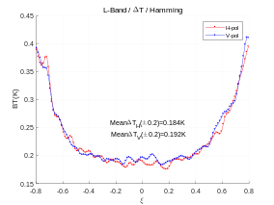
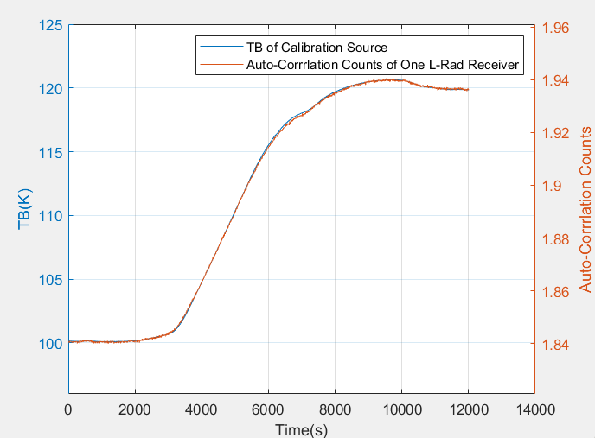
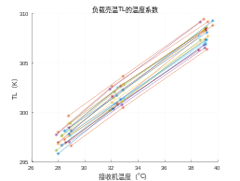
MICAP Pre-launch Activities
  Airborne Campaign
  Reflector Assembly & Surface Accuracy Measurement
  Antenna Pattern Measurement in Cylindrical Near-Field
  Anechoic Chamber Test
  TVAC Calibration
  On-board RFI Detection & Mitigation OFF/ON
  L-Band
  C-Band
  Point Response
  NeDT
  Vraw vs. Tcal
  TL vs. Tph
RMS ≤ 0.2mm

Slide 8
OUTLINE
MICAP Instrument Description
MICAP Instrument Status During Commissioning Phase
MICAP Early In-orbit Performances
MICAP Early In-orbit SSS/SST/WS & Soil Moisture
Conclusion

Slide 9
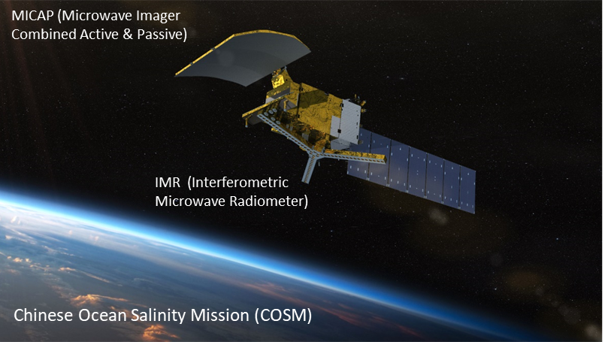
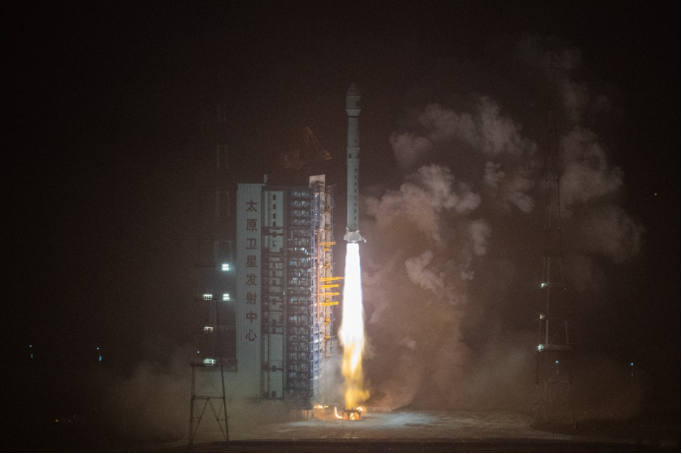
Orbit type: sun-synchronous
Orbit altitude: 654km
Ascending/descending local times: 6:00 pm/am
Successful Launch of Chinese Ocean Salinity Satellite at Nov.14, 2024 !

Slide 10
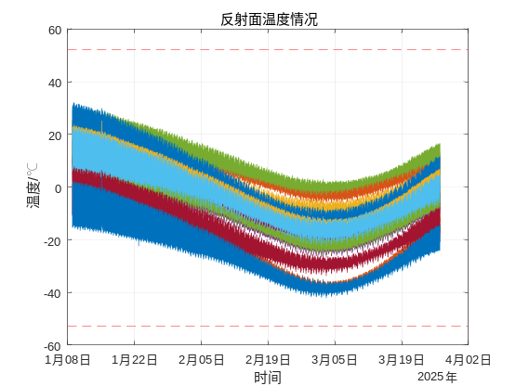
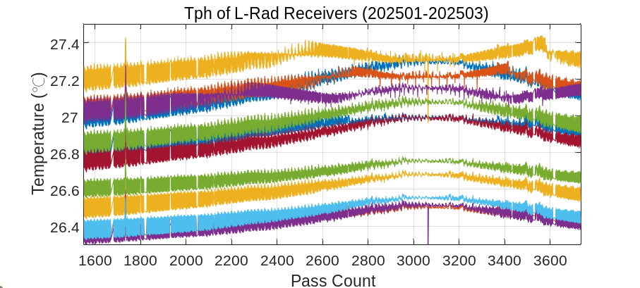
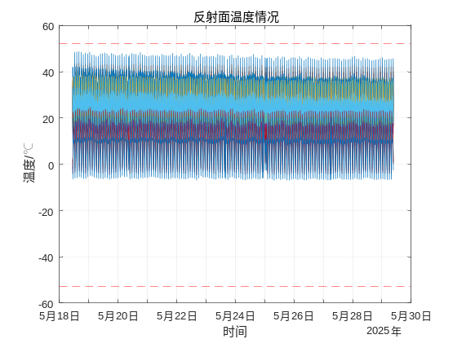
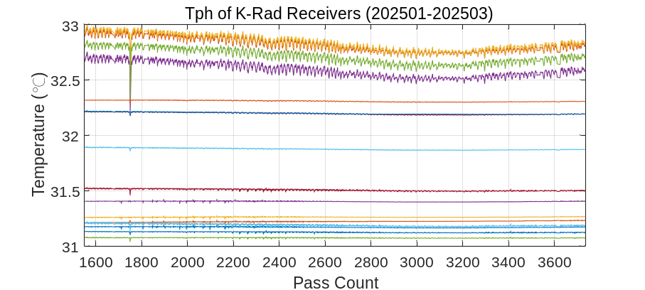
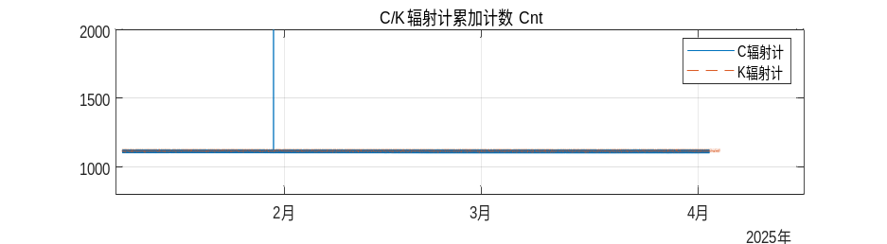
MICAP In-Orbit Health Monitoring
  Reflector Temperature
  Receiver Temperature
  SEU
Low Temperature Condition
TA Counts after correction
TA Counts before correction
High Temperature Condition
SEU Event
The sensor-measured reflector surface temperature points are well within the pre-launch analysis range.
The thermal control stability of L/C/K-Rad Receivers is well within ±0.1℃
SEU Mitigation: Dynamic Reconfiguration/Scrubbing

Slide 11
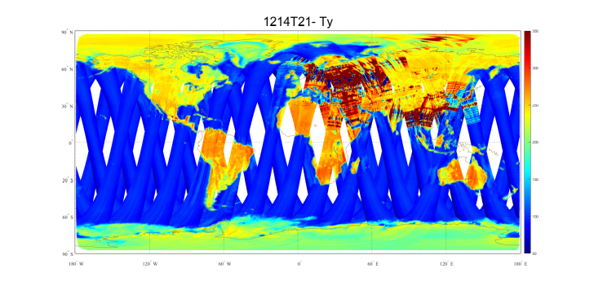
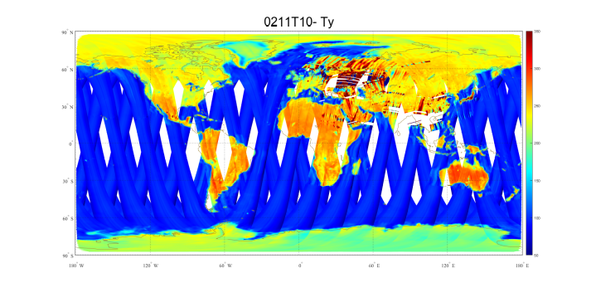
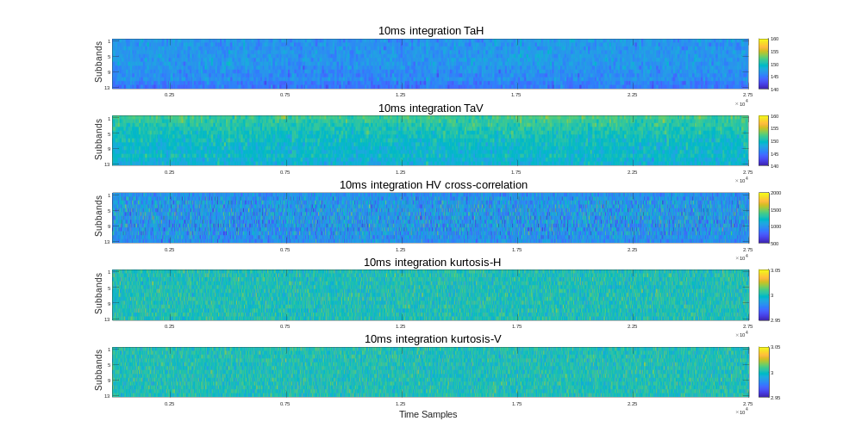
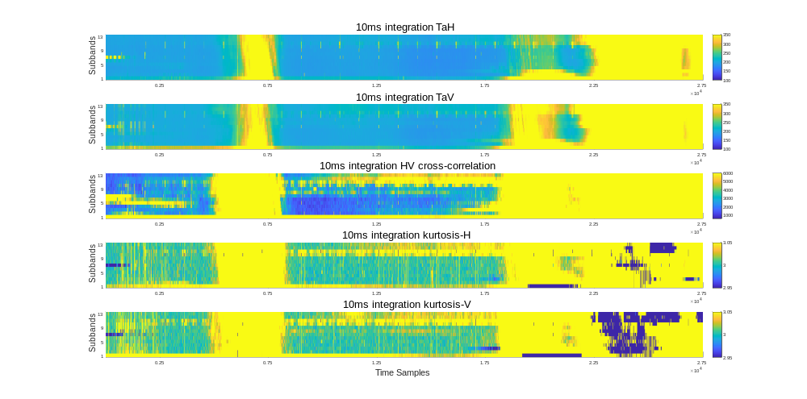
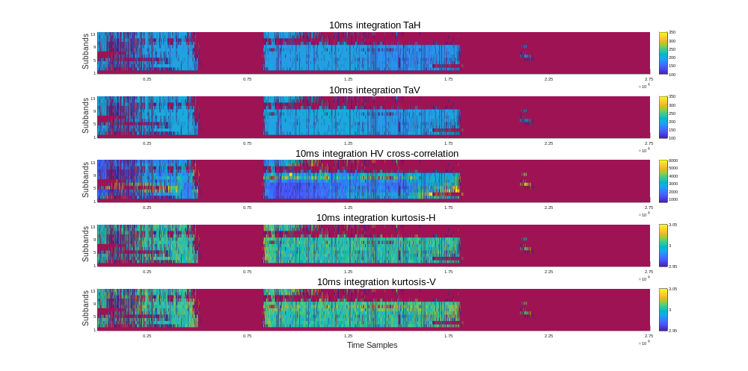
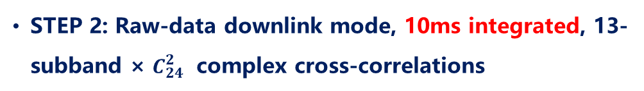
MICAP L-Rad On-board RFI Thresh-hold Parameter Optimization
THP2.PE.6, TH4.P10.1
  STEP 1: On-board RFI Detection & Mitigation OFF
  STEP 2: Raw-data downlink mode, 10ms integrated, 13-subband × $C_{24}^{2}$ complex cross-correlations
  STEP 3: On-board RFI Detection Thresh-hold Optimization
  STEP 4: Nominal Operational Mode (downlinking 1s-integrated, 13-subband data)
  On-board Calibrated 10-ms, 13-Subband X-POL TA
  On-board Calibrated 10-ms, 13-Subband Y-POL TA
  On-board Calculated 10-ms, 13-Subband XY Cross-correlation Counts
  On-board Calculated 10-ms, 13-Subband X-POL Kurtosis
  On-board Calculated 10-ms, 13-Subband Y-POL Kurtosis

Slide 12
OUTLINE
MICAP Instrument Description
MICAP Instrument Status During Commissioning Phase
MICAP L/C/K Radiometers Early In-orbit Performances
MICAP Early In-orbit SSS/SST/WS & Soil Moisture
Conclusion

Slide 13
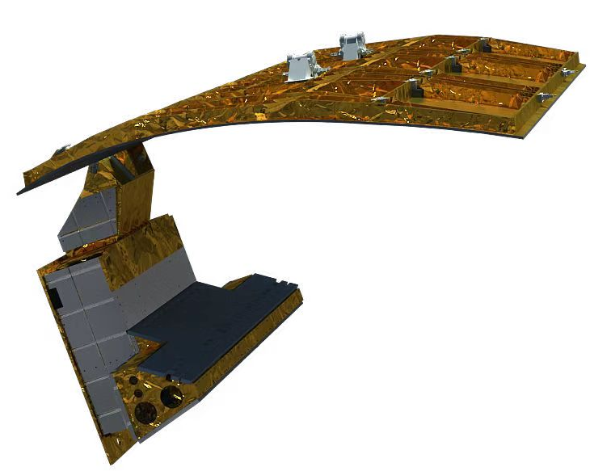
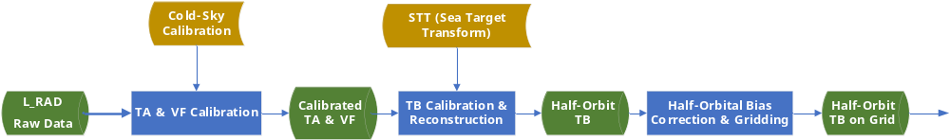
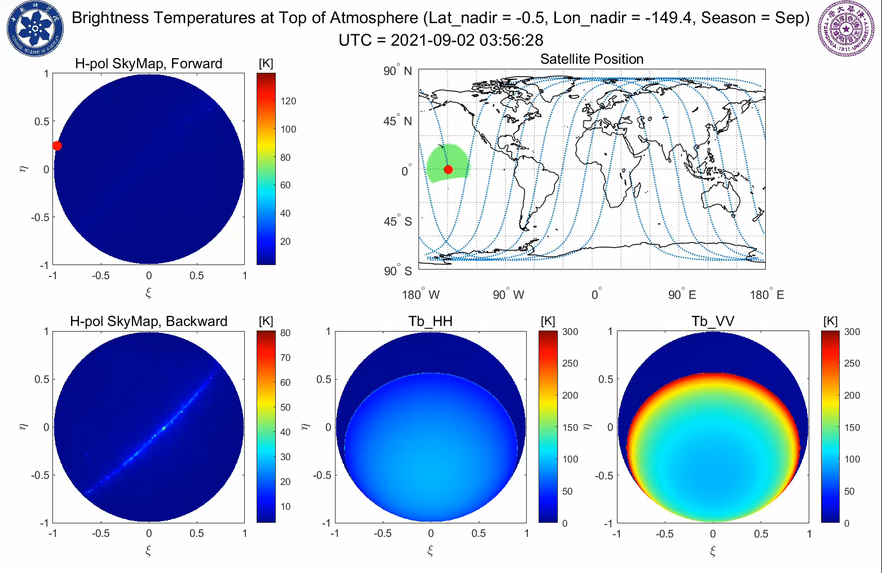
TA/TB Calibration & TB Reconstruction
First Multi-Frequency & One-dimensional Synthetic Aperture Radiometer In-Orbit
MICAP SIMULATOR

Slide 14
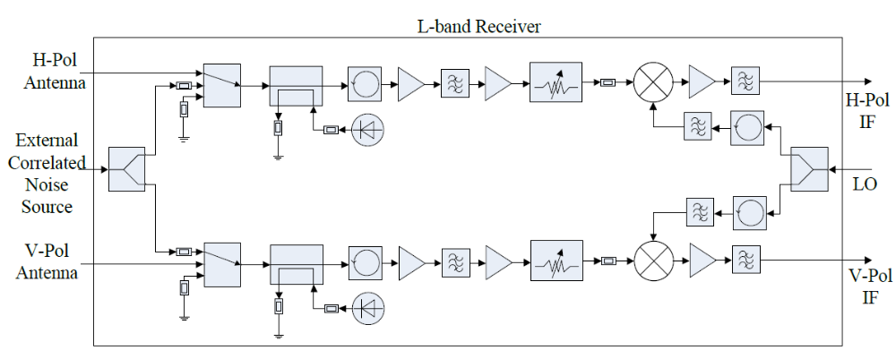
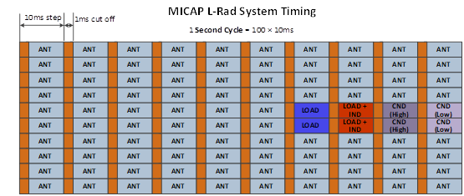
TA Calibration (1): Internal Calibration
Periodical Internal Calibration
  Total Power Calibration: Internal Noise Source injection & Match Load
  Inter-channel Phase Calibration: Correlated Noise Source Injection
System Timing
  1 Second Cycle includes ten 100ms sub-cycles, one sub-cycle includes ten 10ms steps
  Cutting-off the first 1ms of each 10ms step to protect the receiver from scatterometer transmission
  Thanks to the excellent thermal control performance, 96 out of 100 steps are used for observation, only 4 steps for internal calibration
  Running average technics are used to reduce the calibration noise
External Calibration is needed to mitigate the uncertainties of internal noise sources, including in-orbit drifts.

Slide 15
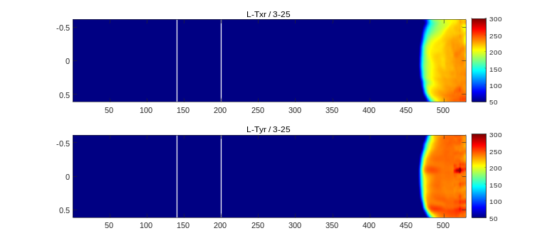
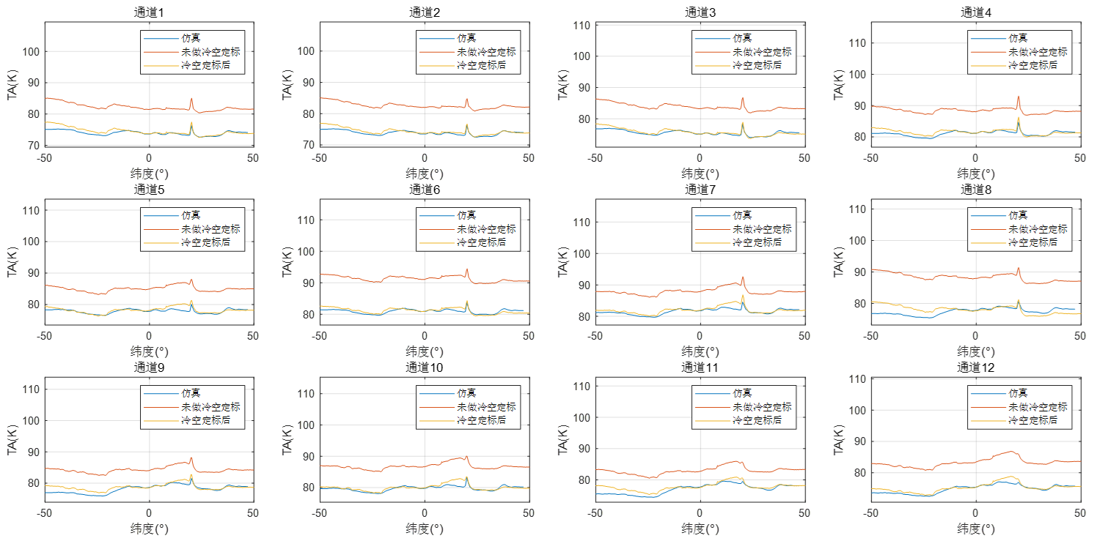
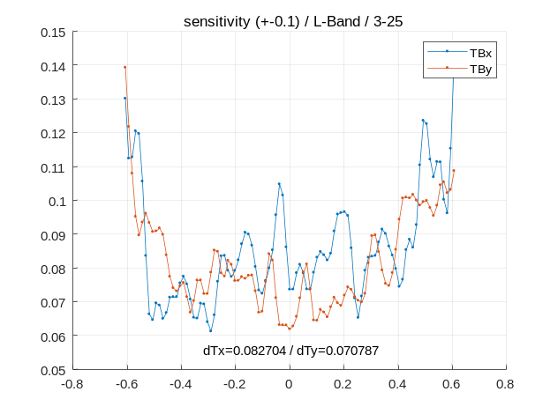
TA Calibration (2): Cold Sky Calibration
Satellite Cold Sky Maneuver
  Continuous maneuver, continuous observation
  Using Observations at which positions both antenna’s forward main beam and (majority of) backward beam are pointing to cold sky
Cold Sky Calibration
  Using Cold Sky Observations to calibration the 12×2 internal noise diodes, whose noise temperature may differ from TVAC measurement on ground and exhibit drifting in early in-orbit stage
X-pol TA(ch1-ch12) Before and After Cold Sky Calibration, comparing with Simulation
TB NeDT Evaluation Using Cold Sky Views
(＜0.1K)

Slide 16

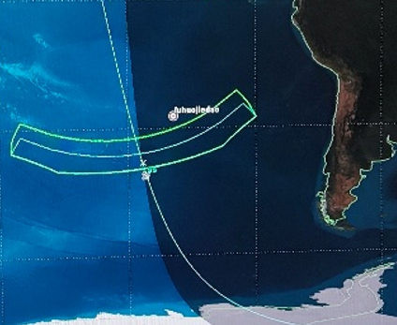
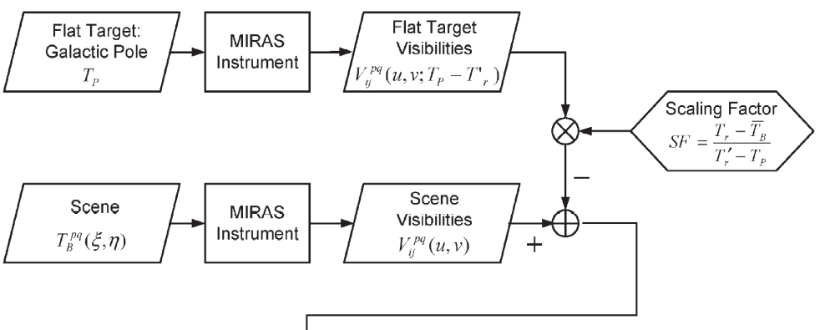
TB Calibration & Reconstruction
Differential TB Reconstruction for Interferometric Radiometers
  Reduce the contribution of receiver backward noises (Tr term)
  Minimize the uncertainty & non-consistency of element antenna patterns
MICAP: Sea Target Transform (STT) Approach
  Using dedicated ocean surface as reference target, the selection of which is strictly constrained with localization and ocean/atmosphere conditions
  Better scene similarity & scaling not needed
  Possible to implemented for 1D FOV
SMOS: Flat Target Transform (FTT) Approach
  Using Cold sky as reference target
Manuel Martín-Neira, The Flat Target Transformation,
IEEE TGAS 2008

Slide 17







BT Recon. Without STT
BT Recon. With STT
Ocean Calibration
Orbital Brightness Temperature
O-B
(Observation - Simulation)
RMSE:1.48K
RMSE: 0.46K

Slide 18





20250329 Tropical Cyclone Courtney
L-band
C-band
K-band
MICAP Observation
MICAP Simulation

Slide 19









MICAP TB Map Comparing with SMAP & AMSR-2
MICAP L-Band X-pol
MICAP C-Band X-pol
MICAP K-Band X-pol
20250220-20250222 Asc INC:33~40 EASE_GRID（15km）
20250220-20250222 Asc INC:33至40 EASE_GRID（15km）
20250220至20250222 Asc INC:33-40 EASE_GRID（15km）
SMAP L-Band H-pol
AMSR-2 C-Band H-pol
AMSR-2 K-Band H-pol
20250220 Asc
20250220 Asc
20250220 Asc

Slide 20






MICAP L-Band Y-pol
MICAP C-Band Y-pol
MICAP K-Band Y-pol
SMAP L-Band V-pol
AMSR-2 C-Band V-pol
AMSR-2 K-Band V-pol

Slide 21
OUTLINE
MICAP Instrument Description
MICAP Instrument Status During Commissioning Phase
MICAP L/C/K Radiometers Early In-orbit Performances
MICAP Early In-orbit SSS/SST/WS & Soil Moisture
Conclusion

Slide 22



MICAP NRT Joint Retrieval of SSS/SST/WS
SSS: NMEFC Forecasts
Others: ECMWF Forecasts
Mode 1 (L-Rad Only)
Cost function
SST and WS are constrained strictly to the background field
Mode 2 (L/C/K CAP)
Cost function
priori errors of SST and WS are taken as 2 K and 2 m/s

Slide 23

MICAP Joint Retrieval of SSS/SST/WS
Single Pass Joint Retrieval (One day Coverage)
Validation approach
SSS: Compare with ARGO array and HYCOM ESPC-D-V02:
SST: NOAA In situ SST Quality Monitor (iQuam) and CMC Group for High Resolution Sea Surface Temperature (GHRSST)；
WS: NDBC Tropical Atmosphere/Ocean (TAO) array and RSS Cross-Calibrated Multi-Platform (CCMP)

Slide 24






MICAP Single-Pass SSS/SST/WS
SSS
Observations from 2025.02.13 to 2025.03.13
SST
WS

Slide 25


MICAP 8-day Average SSS/SST/WS
Wenyu WANG, Zhenzhan WANG, etc

Slide 26
MICAP Monthly Averaged Global Soil Moisture
Multi-channel Collaborative Algorithm, MCCA
（Shi et al., 2008; Zhao et al., 2021）
Huizhen CUI, Tianjie ZHAO, etc

Slide 27
OUTLINE
MICAP Instrument Description
MICAP Instrument Status During Commissioning Phase
MICAP L/C/K Radiometers Early In-orbit Performances
MICAP Early In-orbit SSS/SST/WS & Soil Moisture
Conclusion

Slide 28
Conclusion
New Instrument
New Data
New Sciences…

