Slide 1
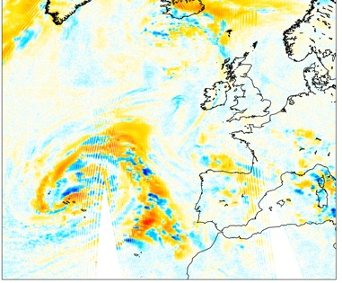
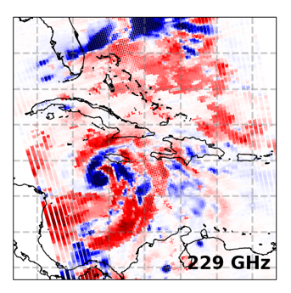
Rapid performance assessment of AWS and MWS with all-sky NWP monitoring at ECMWF
David I. Duncan, Niels Bormann
Thanks to EUMETSAT: Sabatino, Christophe, Tim, Paolo, others
GSICS meeting, March 2026
325±6.6 GHz

Slide 2
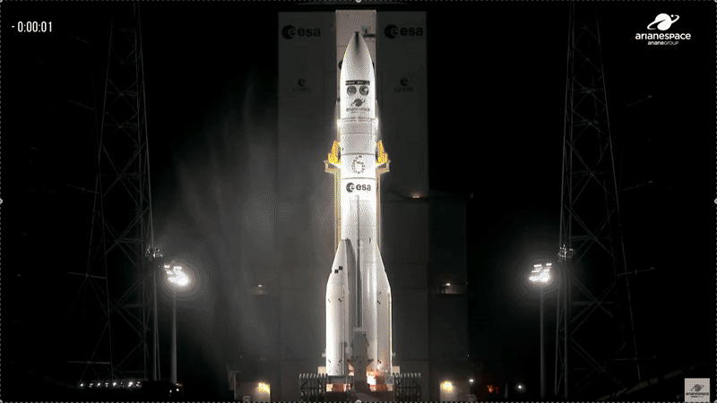
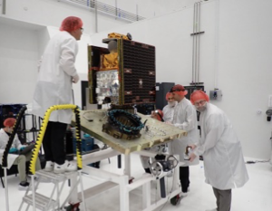
AWS and MWS
Two cross-track MW sounders with very different characteristics!
→ A mixture of familiar and unfamiliar frequencies for NWP use
 | AWS (MWR) | MWS
Satellite name | AWS PFM | Metop-SG-A1 / Metop-D
Satellite size | ~1m³ (125kg) | 6.5x3x3.5 m (4040kg)
Channels | 19 | 24
Spectral range | 50 – 325 GHz | 23 – 229 GHz
Spots per scan | 145 | 95
Scan width (deg) | 109 | 99.66
Integration time (ms) | 2.5 | 13.74
Co-located feedhorns | No | Yes
Scan spacing (km) | 9 | 17

Slide 3
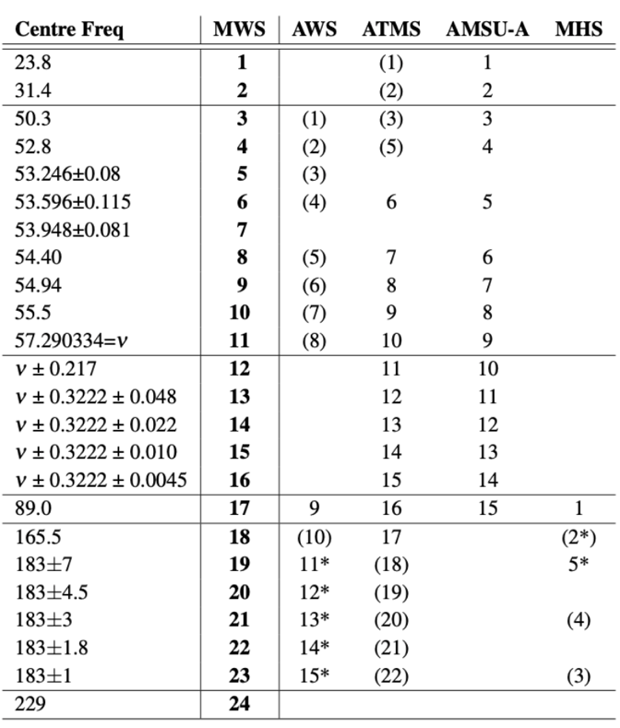
AWS and MWS
21 of 24 MWS channels match closely with ATMS
12 of 19 AWS channels match closely with ATMS
15 of 19 AWS channels match with MWS (AWS sub-mm channels don’t have equivalent elsewhere)
We can leverage heritage instruments with known characteristics as vicarious calibration references
Note that many channel matches are imperfect: QV vs. QH polarization, single- vs. double- side bands, etc.
Here we propose using the NWP model as a transfer standard to permit rapid comparison of new instruments with heritage ones
→ This is particularly helpful when a limited sample of data are available

Slide 4
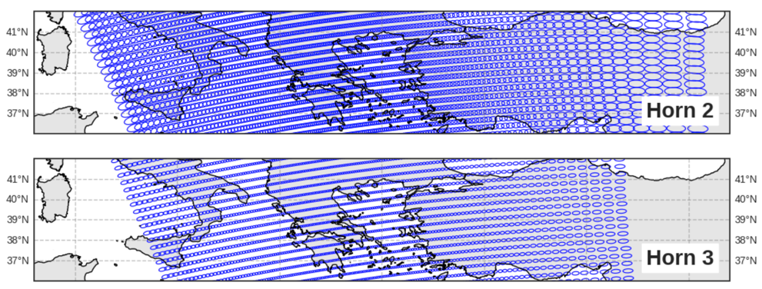
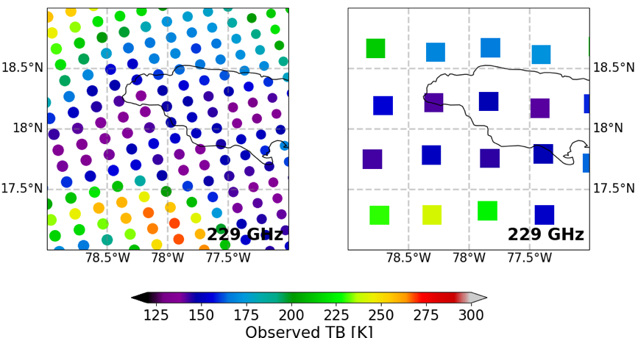
MW sounder pre-processing
Apply spatial averaging (superobbing) to sounder radiances
Treat MWS, AWS, MHS, etc. the same – 50 km superobs
Noise reduction is key for temperature sounding channels (~1/sqrt(N))
Grid-based superobbing allows better use of swath edges
AWS pre-processing is more complex due to non-co-located feedhorns
AWS feedhorns 2 & 3
MWS obs
MWS superobs

Slide 5
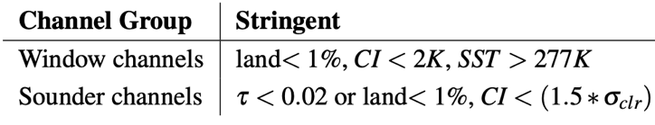
Method for all-sky cal/val sampling
Philosophy:
Balanced sampling by including all-sky RT effects
Maximise size of sample across regions, surfaces, etc.
Two types of data selection:
Channel-based: maximise sample size on per-channel basis
Unified: same population across all 19 channels
Both use ‘cloud impact’ (CI) metric to set threshold of TB influence from clouds that can enter the cal/val sample:
For window channels, CI < 2K is sufficient
For sounder channels, a variable CI threshold is needed due to channel sensitivity
→ We use 1.5 times the clear-sky observation error to account for typical ‘background’ errors
RT modelling comes from RTTOV-SCATT v14 for the clear-sky (B_{clr}) and all-sky (B) background in observation space
5

Slide 6
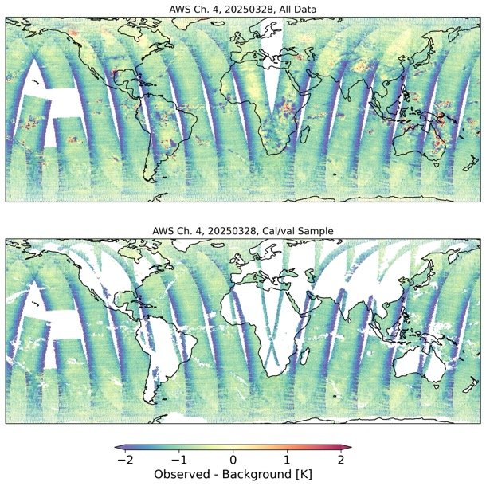
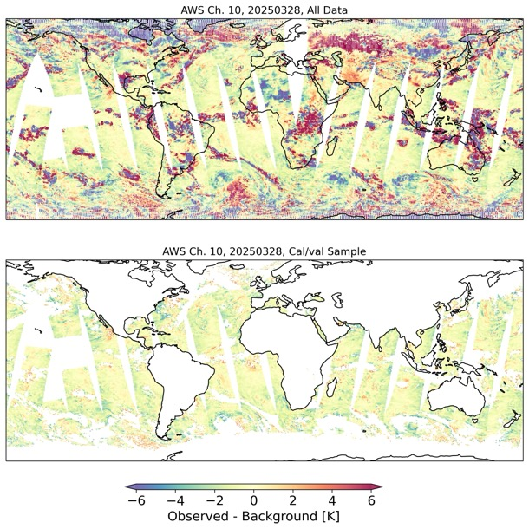
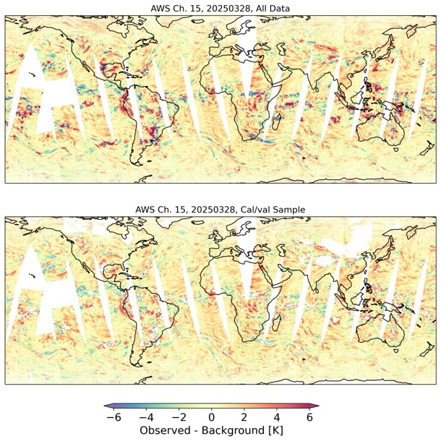
Method for all-sky cal/val sampling
Screening removes largest model biases
Large fractions of data retained (65%, 31%, 85% here)
AWS-4 (53.596 GHz)
AWS-10 (165.5 GHz)
AWS-15 (182.31 GHz)
All Data
Cal/val sample
6

Slide 7
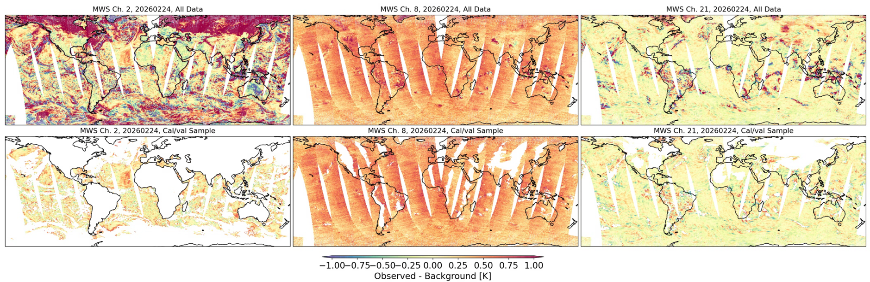
Method for all-sky cal/val sampling
Keep as much data as possible in cal/val sample
MWS-2 (31.4 GHz)
MWS-8 (54.4 GHz)
MWS-21 (183.31±3 GHz)
All Data
Cal/val sample
7

Slide 8
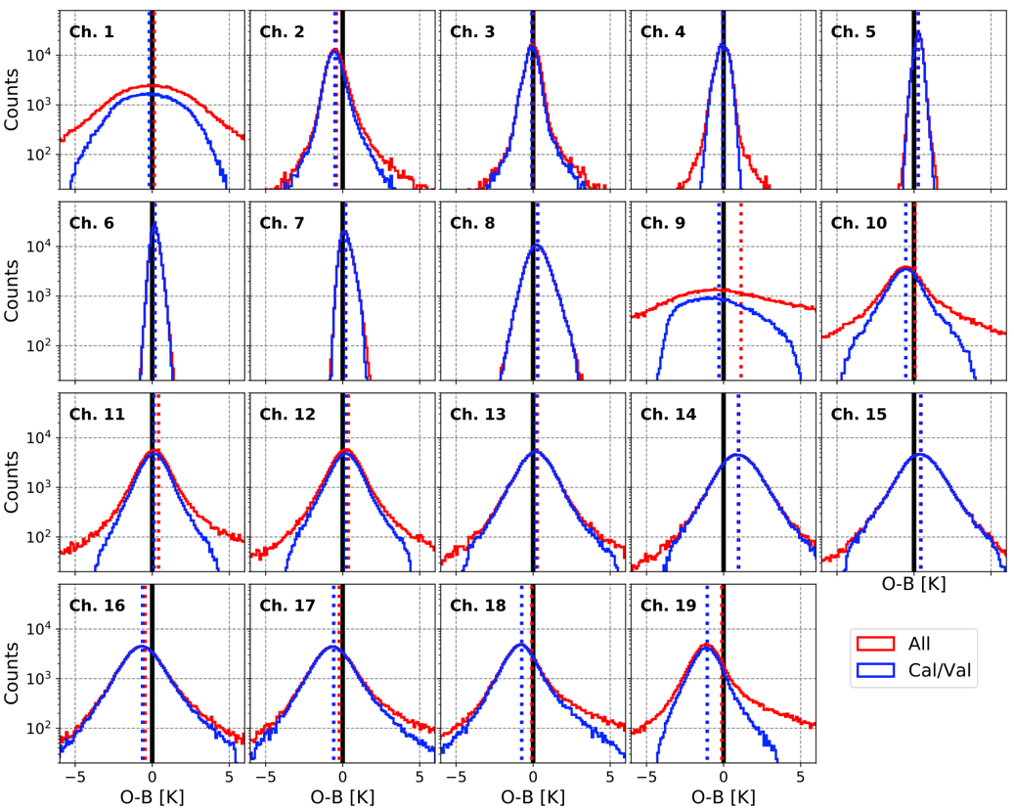
Method for all-sky cal/val sampling
AWS histograms of O-B
A good first look at radiance quality even with limited data
Cal/val sample more Gaussian after removing known cloud biases
8

Slide 9
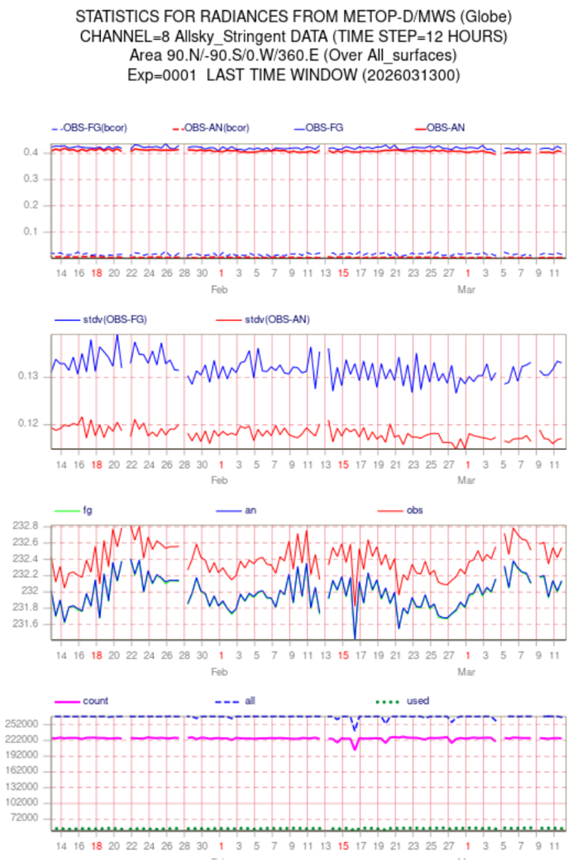
Cal/val monitoring
Near real time monitoring set up using existing infrastructure for operational monitoring of observations
Compare directly to other instruments with same sampling method
Can feed back to space agencies rapidly

Slide 10
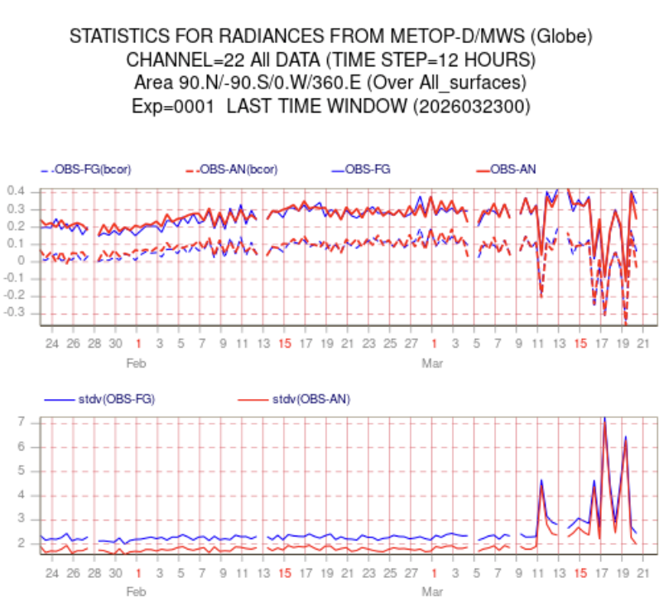
Cal/val monitoring
Near real time monitoring set up using existing infrastructure for operational monitoring of observations
Compare directly to other instruments with same sampling method
Can feed back to space agencies rapidly

Slide 11
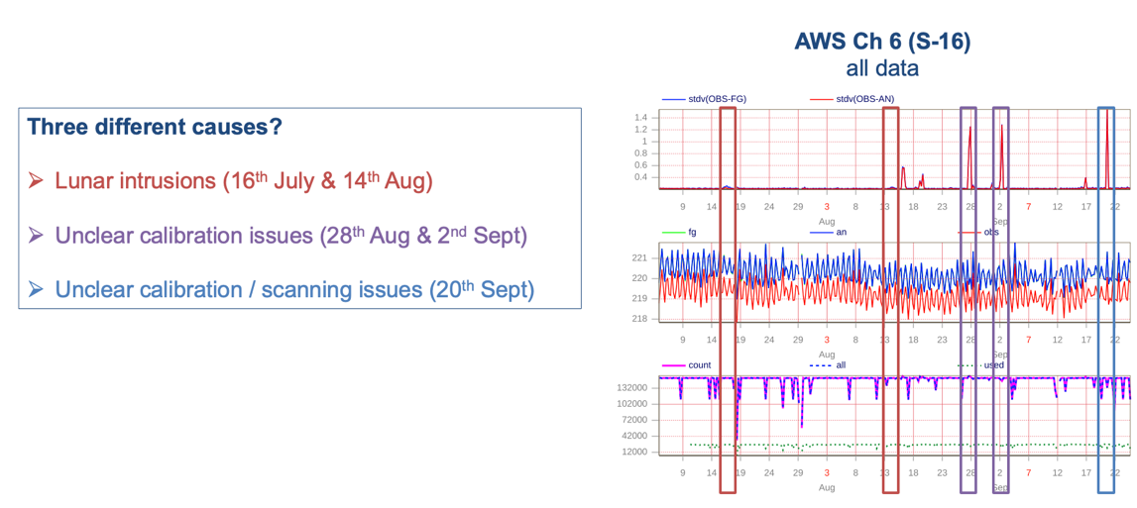
Cal/val monitoring
Near real time monitoring set up using existing infrastructure for operational monitoring of observations
Compare directly to other instruments with same sampling method
Can feed back to space agencies rapidly
Slide shared with ESA last autumn on AWS performance blips

Slide 12
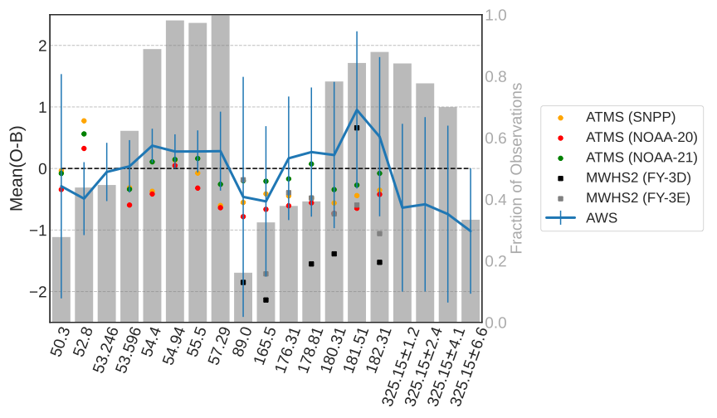
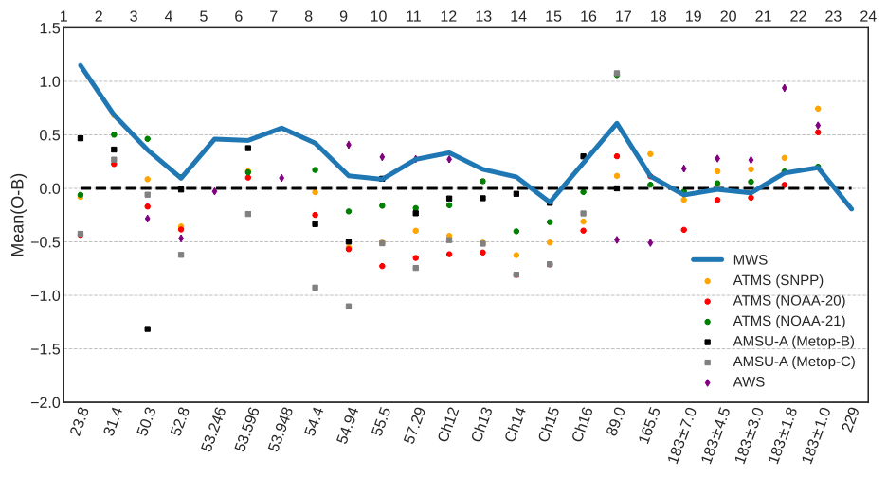
Cal/val results
MWS global biases within ±0.5 K of IFS at all sounder channels
AWS global biases all within 1.0 K of IFS
Data from early 2026
AWS
MWS

Slide 13
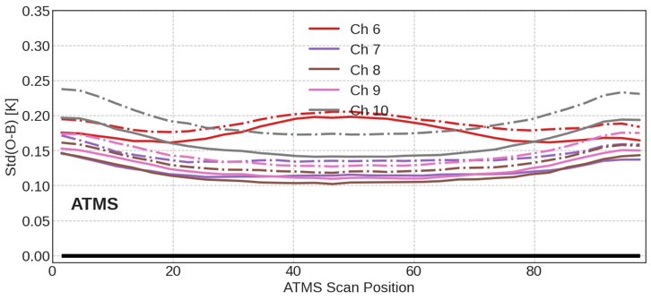
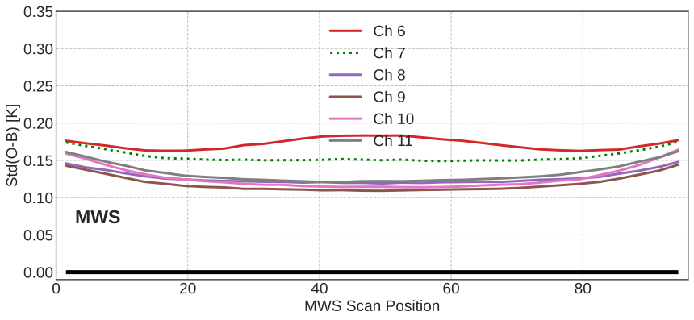
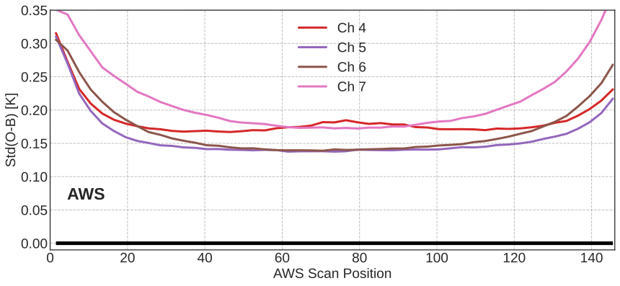
Cal/val results
Std(O-B) a good indicator of instrument noise – NEDT
This analysis shows MWS close to ATMS in NEDT performance
AWS achieves good but not quite ATMS-level noise performance with 50km superobs
Equivalent channels shown
in same colour
Solid = NOAA-20
Dash-dot = SNPP

Slide 14
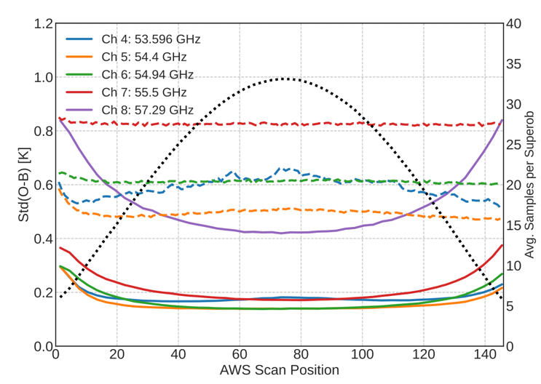
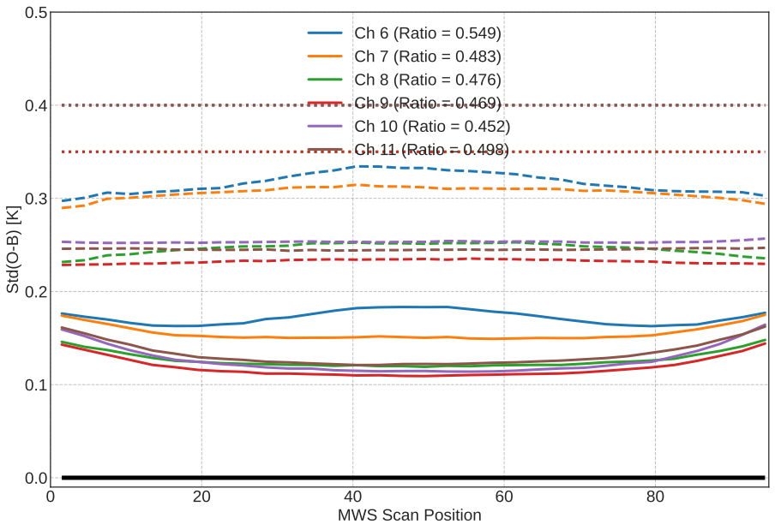
Cal/val results
Compare std of obs vs. superobs to gauge NEDT requirements
AWS T-sounding channels met requirement, except ch 8 (known pre-launch)
MWS T-sounding channels all meet requirements
MWS
AWS
Obs
(dashed)
Superobs
(solid)

Slide 15
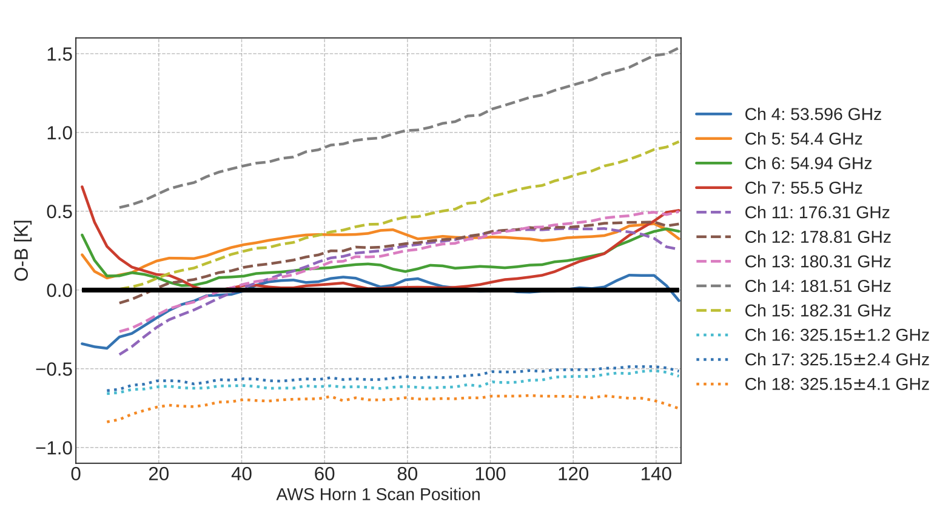
Cal/val results
Evaluate channels with no analogues on heritage platforms – sub-mm!
→ AWS 325 GHz channels very well calibrated from day 1
AWS

Slide 16
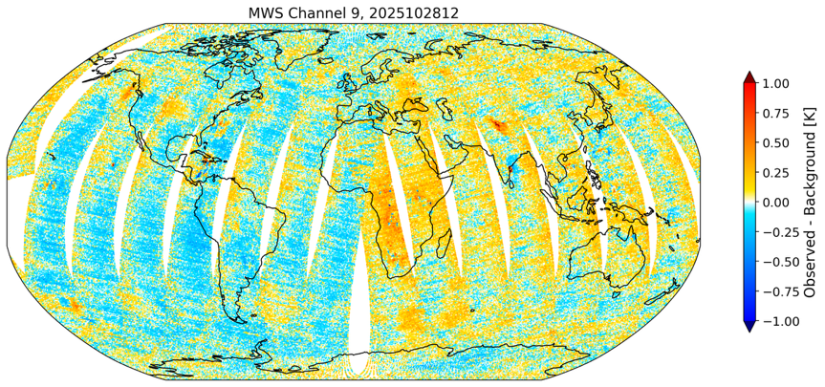
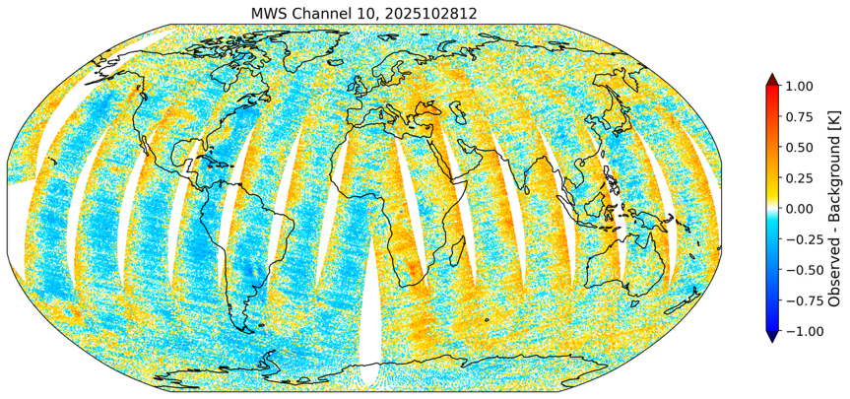
Cal/val results
With bias correction,
50km superobs
MWS
(Metop-D)
O-B after bias correction – remaining biases as a function of orbital position?
Orbital biases of 0.1-0.2 K spotted in 24hrs of preliminary data from EUMETSAT
Confirmed more recently with real-time data stream and comparison with other NWP centres

Slide 17
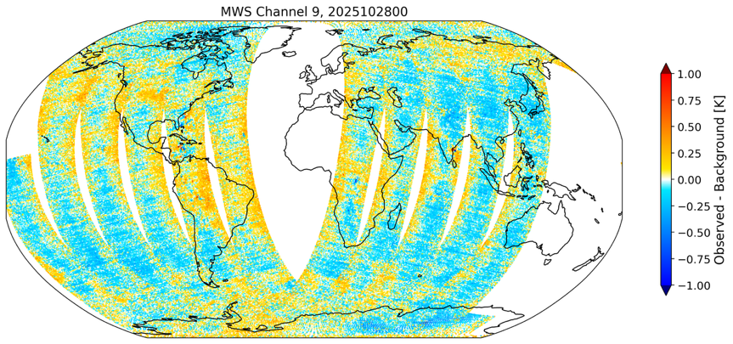
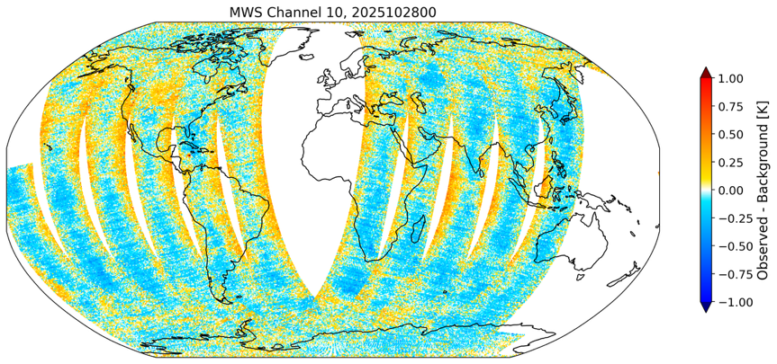
Cal/val results
With bias correction,
50km superobs
MWS
(Metop-D)
O-B after bias correction – remaining biases as a function of orbital position?
Orbital biases of 0.1-0.2 K spotted in 24hrs of preliminary data from EUMETSAT
Confirmed more recently with real-time data stream and comparison with other NWP centres

Slide 18
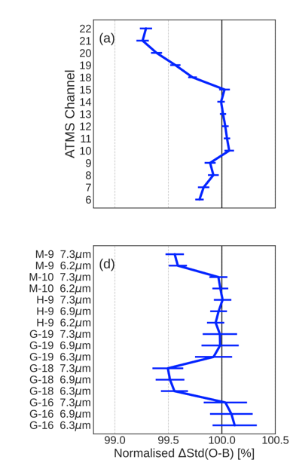
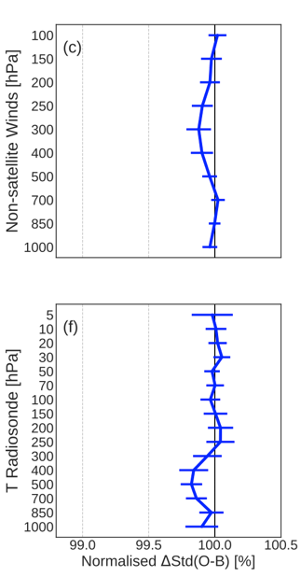
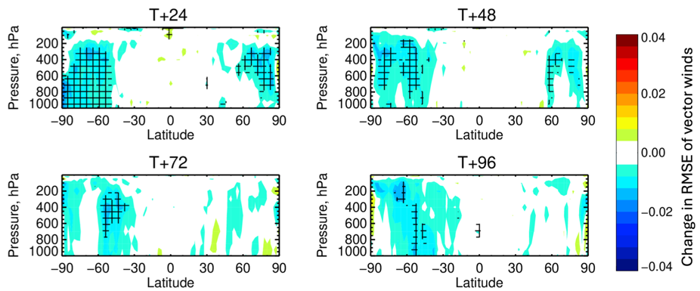
Assimilation of AWS
ATMS
Winds
AWS is assimilated in the all-sky framework
ECMWF uses:
  Channels 4-7 (53-55 GHz)
  Channels 11-15 (183 GHz band)
  Channels 16-18 (325 GHz band)
Positive impact on short-range forecast as measured by fits to independent observations
Medium-range impact up to day 4 in 9 months of assimilation testing
Assimilated operationally since July 2025 – first NWP centre to use AWS!
👍
👍
GEO IR
T sondes
👍
👍

Slide 19
Summary
NWP-based all-sky cal/val is a rapid way to assess the performance of new instruments – even new channels (e.g. 325 GHz)
This method has proven successful for AWS and now MWS, enabling quick feedback to data providers and implementation in the ECMWF DA system
  MWS monitored in NRT since late Dec. 2025
  AWS assimilated in operational system since July 2025
  Looking forward to MWI and ICI later this year!
AWS cal/val & assimilation preprint (AMT): https://egusphere.copernicus.org/preprints/2026/egusphere-2026-712/

