Slide 1
A Forward-looking Framework for High-precision and Traceable transfer of Space-borne Microwave Radiometric Standards
A Roadmap for Climate Change Research and Weather Forecasting
Jieying HE
National Space Science Center, CAS
University of Chinese Academy of Sciences
Notes:
.

Slide 2
CONTENTS
Introduction & Motivation
Current Status of Technology
Proposed Framework & Solutions
Key Technologies implemented
Conclusion & Outlook

Slide 3
01
Introduction & Motivation
Notes:
Introduction and Motivation.

Slide 4
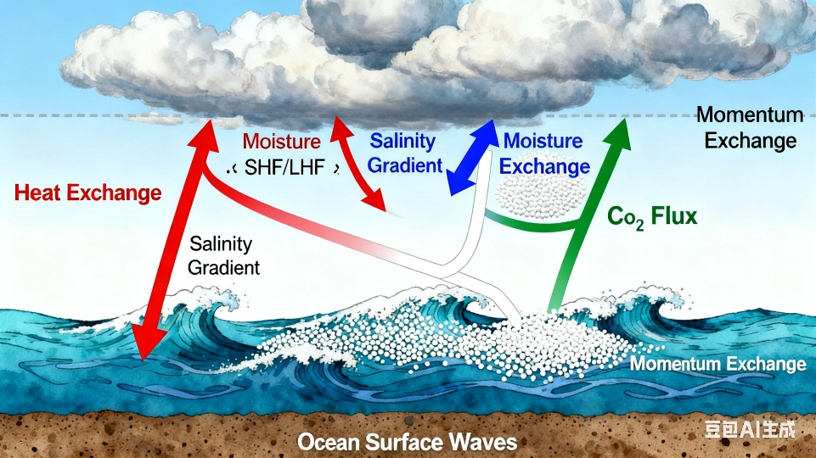
Observation Variables by microwave Remote Sensing
Advantages: all-weather/all-time operation and penetration through clouds/precipitation.
Sea surface temperature (SST): heat
Wind speed, current and waves: momentum
Sea surface salinity (SSS): emission
Vapor
Temperature
Cloud liquid water
Precipitation rate
……
Sea surface
variables
Atmospheric
variables

Slide 5
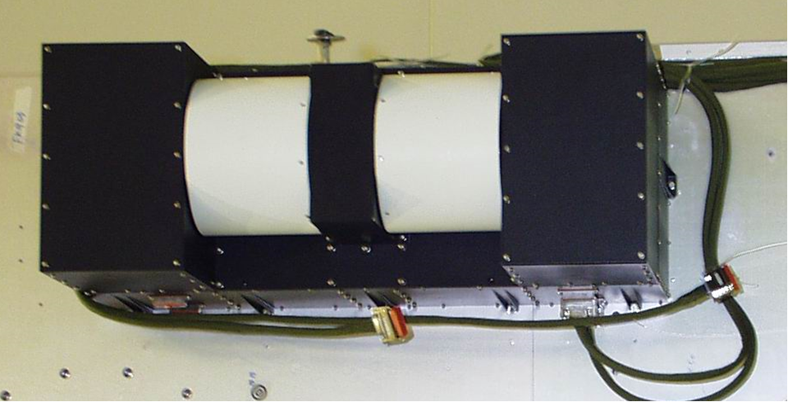
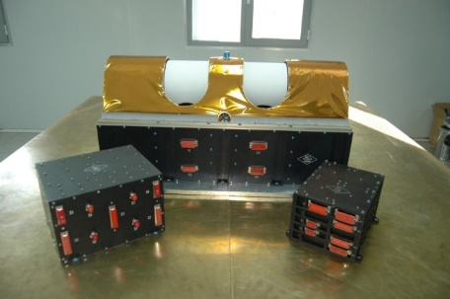
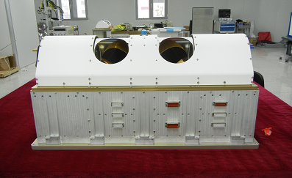
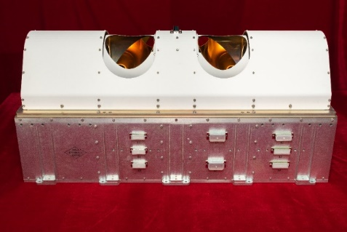
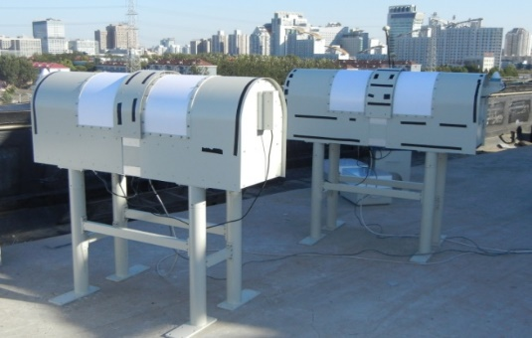
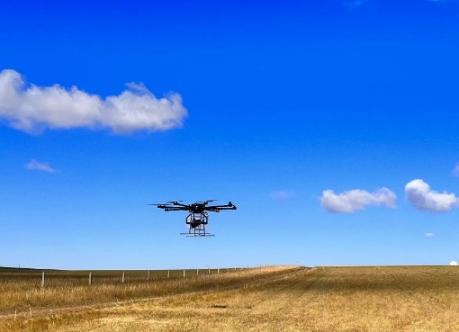
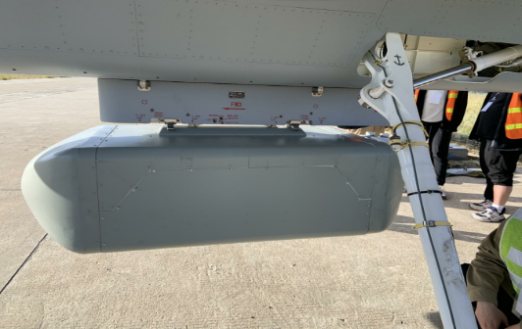
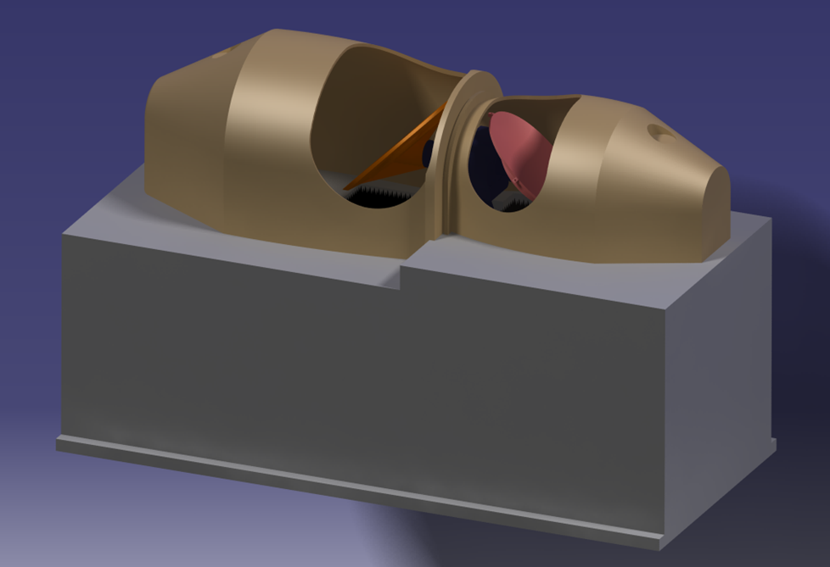
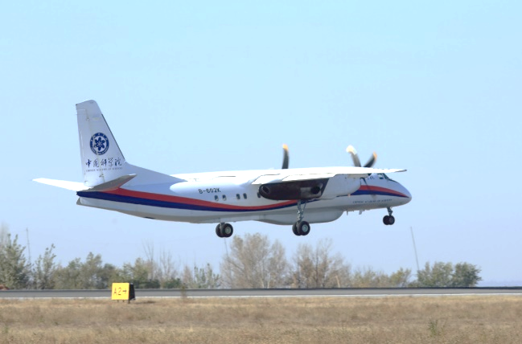
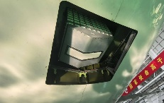
Baseline of our team (Jieying HE, NSSC-CAS)
2000-2008 | 2008-2011 | 2013-2017 | 2021-2025 | 十四五 | 2026~
Ground | UAV | MAV | NG-satellite | 星载 | 星载
 |  |  |  | ·
The last one of FY-3
Filed-campaign
FY-3A/B MWHS-I
FY-3C/D MWHS-II
FY-3E/F/H MWHS-II
Ground-MR
UAV-MR
MAV-MR
Microsat-MR
Hyper-MR

Slide 6
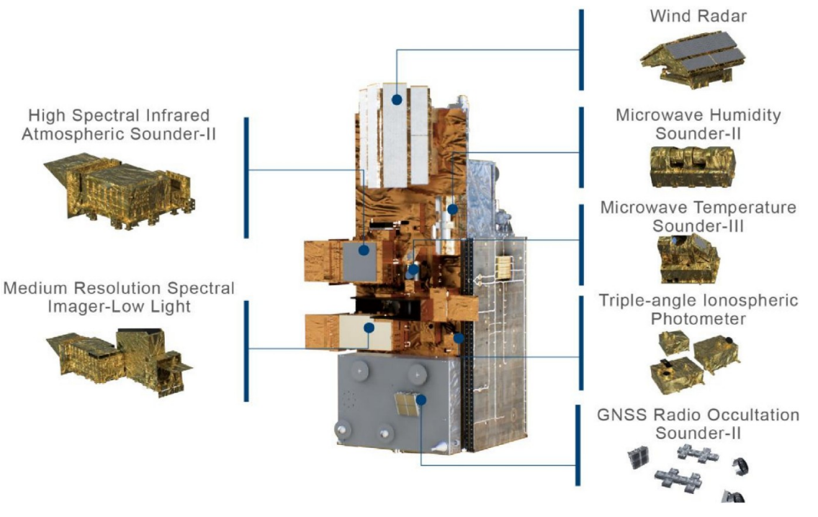
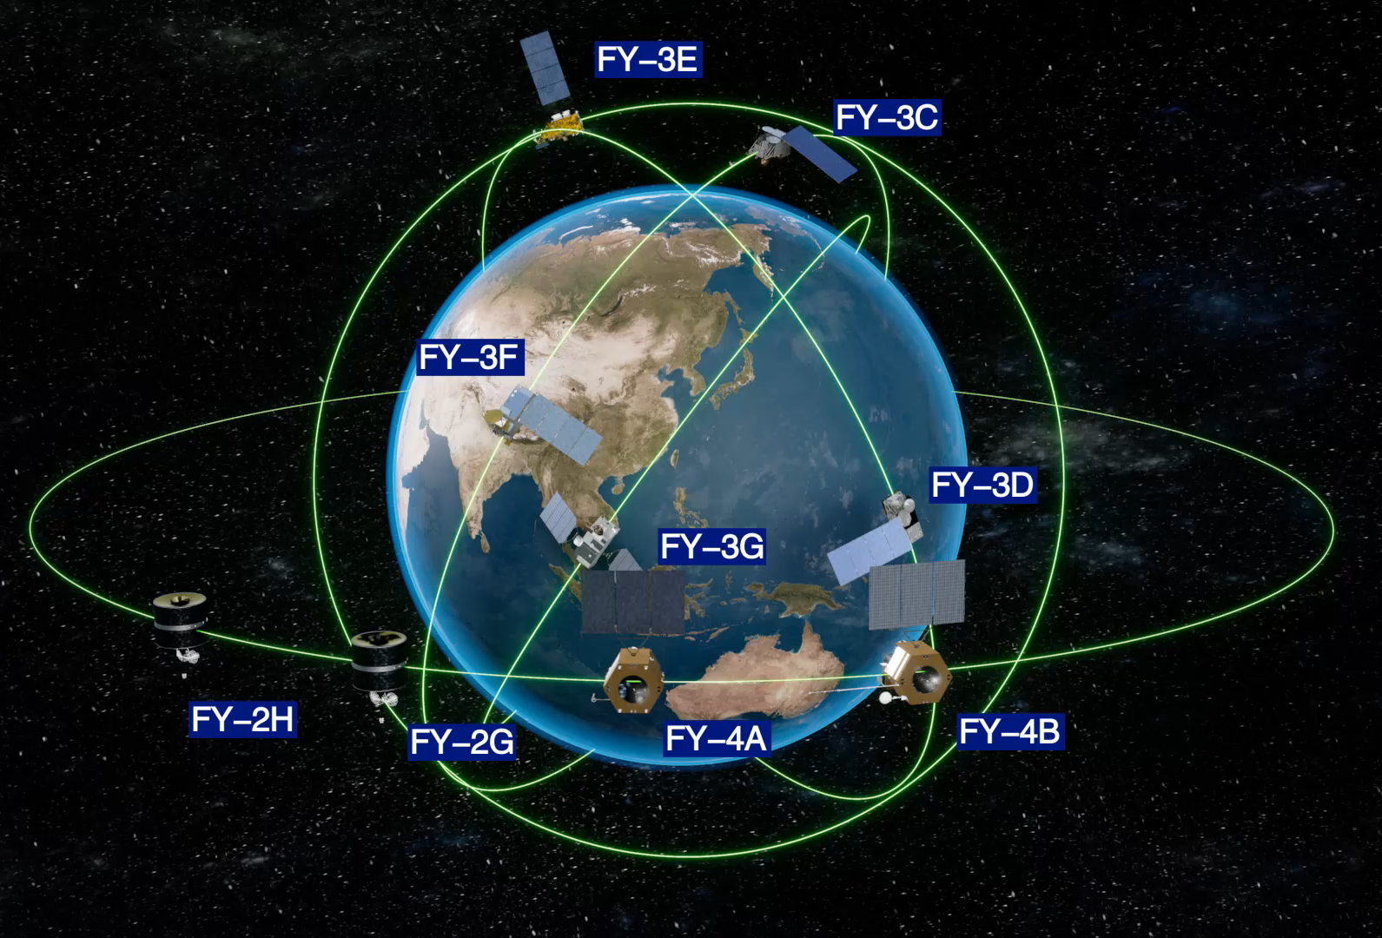
FY-3 meteorological satellite
Long-life, high-performance in-orbit operation
Four payloads are operating in a constellation, achieving full global coverage in 3-4 hours.
Provide timely and accurate atmospheric humidity and temperature initial field information for NWP
Improve early warning capabilities for typhoons, torrential rains, and other severe weather events

Slide 7
Status: Achievements & Limitations
Achievements
Limitations
Successful application of microwave payloads on FengYun series satellites.
Initial realization of multi-satellite networking capabilities.
Historical re-calibration data has been successfully conducted.
Datasets have been used in different fields
Notable discrepancies in calibration accuracy exist among different satellite missions.
Long-term stability and data consistency need further improvement.
Lack of a unified and authoritative space radiation benchmark.
Microwave Remote Sensing: Progress in Mission Deployment vs. Challenges in Standardization

Slide 8

Urgent demands for Climate and Forecasting
Increasing frequency of extreme weather events necessitates higher precision in atmospheric and environmental observations.
The Earth's climate system is warming at a rate of 0.17 K per decade, driving the need for advanced monitoring.
Urgent demand exists for long-term, continuous, and global satellite remote sensing data to study climate change mechanisms.
Advancing high-precision and consistency is critical for addressing the challenges
posed by a changing climate.

Slide 9
02
Current Status of Technology

Slide 10
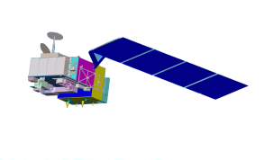




Next-Generation FengYun Satellite
HIGH-PRECISION
Achieve a qualitative leap in observation capabilities for global weather monitoring.
Rigorous performance standards: Accuracy better than 0.4K, consistency better than 0.1 K.
FY-5 series
FY-5A
FY-5B
CONSTELLATION
Morning, Afternoon, dedicated precipitation satellites, plus emergency response constellations.
FY-5X
Real-time 3D stereoscopic sounding
Generation and Re‑application of High‑Timeliness Data Products

Slide 11
Limitations and Challenges
Lack of a Unified Benchmark
No unified reference for space microwave radiation measurements, leading to data inconsistency across platforms.
Complex Transfer Chain
High-precision transfer and consistency traceability are extremely difficult to maintain due to the multi-stage complex chain.
Calibration Accuracy Bottleneck
Traditional techniques have reached limits, unable to meet emerging high-precision requirements (< 0.3K).
Figure: Conceptual Diagram of Complex Network Interactions
These challenges collectively hinder the advancement of microwave remote sensing to the next level.

Slide 12
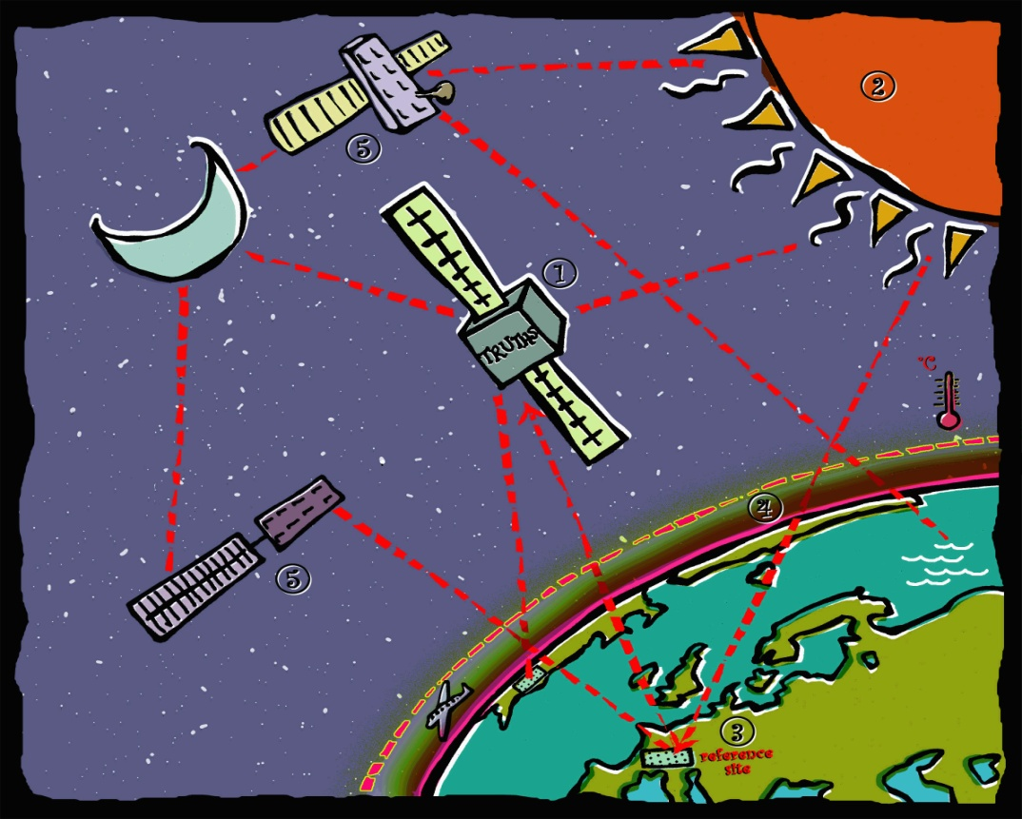
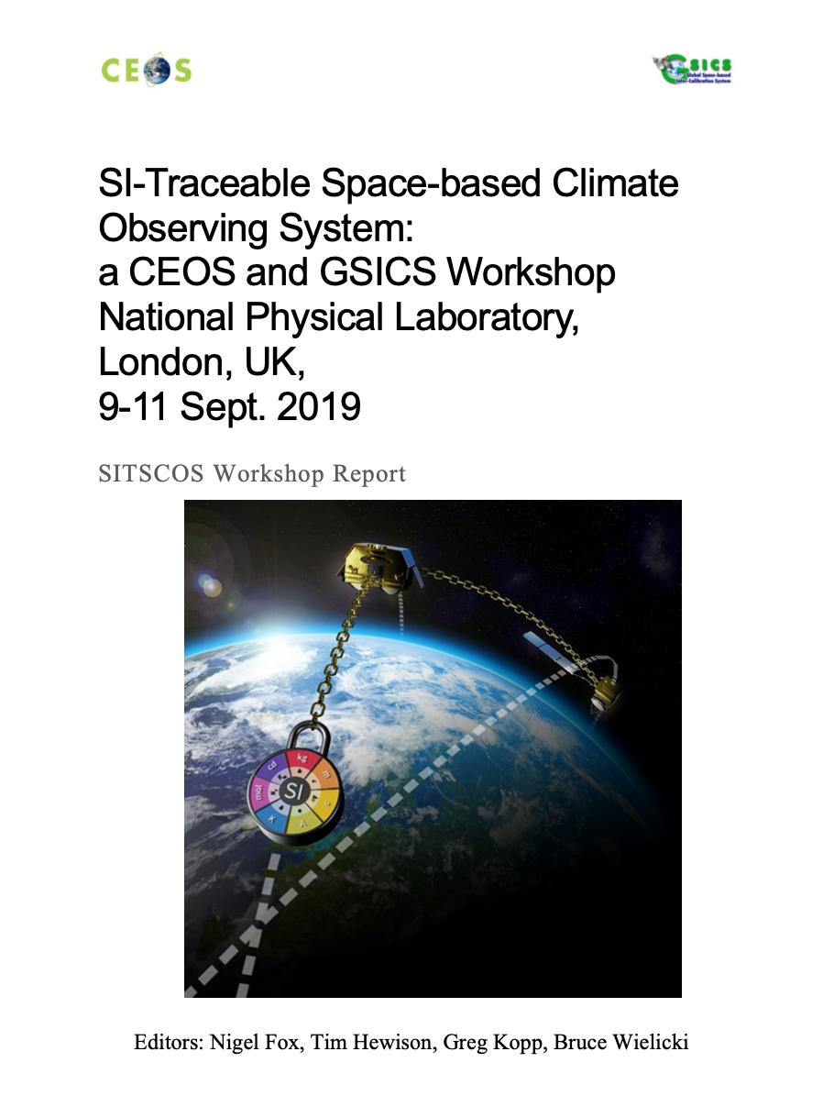
Benchmark Projects: CLARREO & TRUTHS Programs
The US and Europe have proposed programs like CLARREO and TRUTHS to establish high-precision radiation benchmark satellites.
Monitor climate change and calibrate other satellites to improve global remote sensing accuracy.
Current international programs do not cover the critical microwave band for comprehensive sensing.
Address the problem: To fill the global gap in the field of space microwave radiation benchmarks.
FRM: Fiducial Reference Measurements
(proposed by WGCV51, 2019)

Slide 13
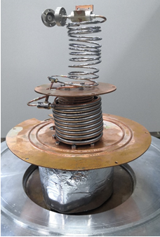
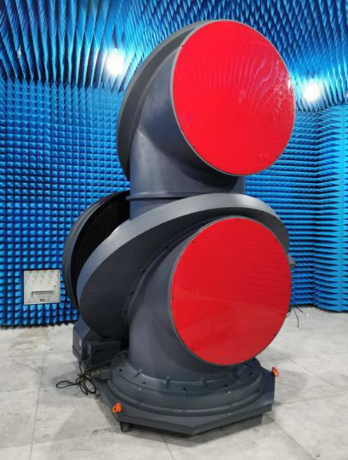
Significant Technical progress
Ground-based Reference Sources
NSCC, CAS has established a large-aperture ground-based reference source platform (6~500 GHz).
Calibration Blackbodies
NIST and NSSC developed high-performance conical cavity blackbodies (18~220 GHz, emissivity > 0.9995).
Standardization
ISO and IEEE are advancing standards for microwave radiometer calibration (ISO/TC 19195).
Cooling Technology
International trend towards multi-stage pulse tube + Joule-Thomson cooling for 4K space applications.
Calibration targets with high emissivity
Prototype of 4K Cryocooler
High-precision Laboratory Equipment & Network

Slide 14
03
Benchmark Framework & Solutions
(Funded by National Key R&D Program of China)

Slide 15
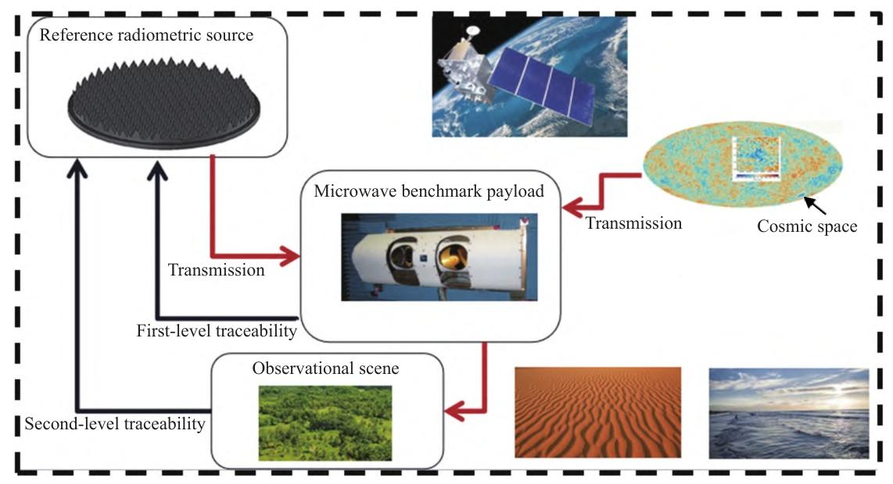
Benchmark Framework and Traceable chain
Top-Level Design
A top-level technical solution for precise and traceable space microwave radiation benchmark transfer.
Key Technologies
Breakthroughs in benchmark payloads, transfer theory, full-link verification, and error simulation.
Final Goal
Provide an unified standardization, enabling highly precise, stable, and traceable space microwave sounding capabilities.
Microwave Radiation Traceability Transfer Process

Slide 16
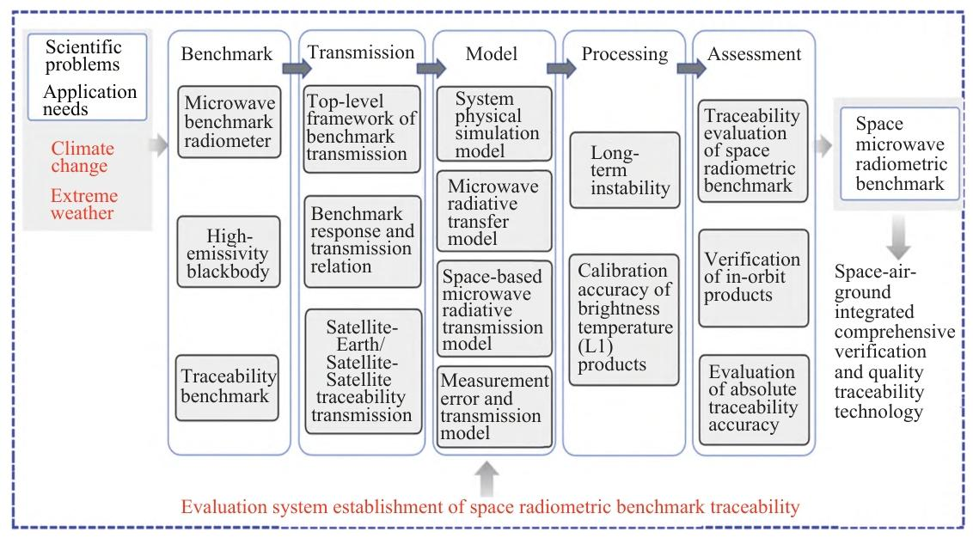
Contents and solutions
Four parts: finding core problems, analyzing scientific needs, building benchmark models, and carrying out system assessment and verification

Slide 17
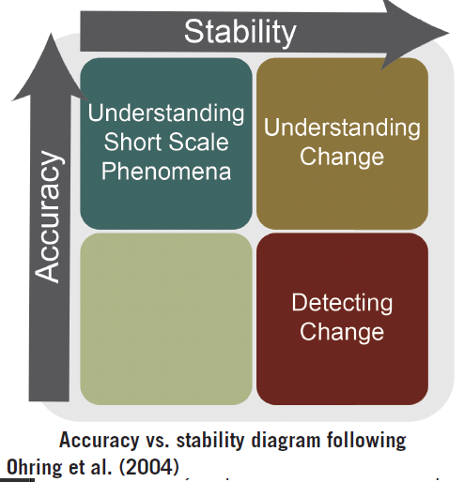
Overall Technical Solution
Establishing the Benchmark
High-precision microwave blackbodies and benchmark radiometers.
Link Modeling
Full-link radiation transfer and error models.
Transfer Verification
Satellite-to-ground/satellite-to-satellite benchmark transfer and evaluation models.
System Establishment
A traceability evaluation system for space radiation benchmarks.
Space Microwave Radiation Benchmark Traceability System

Slide 18
04
Key Technologies Implemented

Slide 19
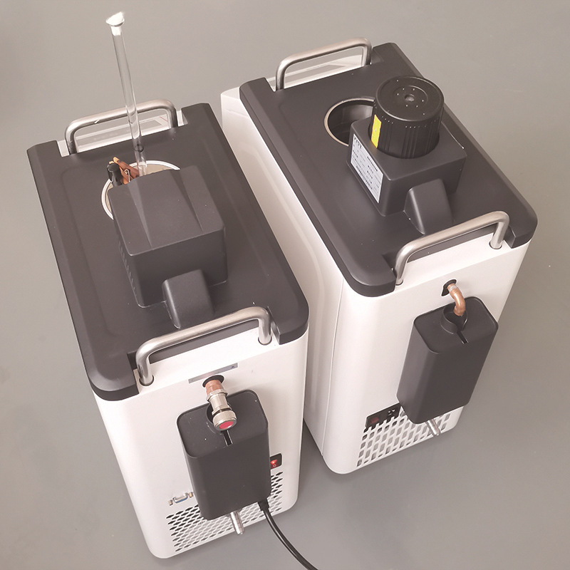
Key Technologies focus on microwave payloads
High-Precision Microwave Payloads
Development of highly sensitive and accurate on-board microwave benchmark radiometers for precise measurements.
Deep-Cryogenic Cooling Technology
Mastering long-life 4K cooling technology independently to ensure stable operation of space-borne instruments.
High-Emissivity Calibration Blackbodies
Development of high-performance, wide-band space calibration blackbodies for accurate radiometric calibration.
Figure: Deep-Cryogenic Cooling System Prototype

Slide 20
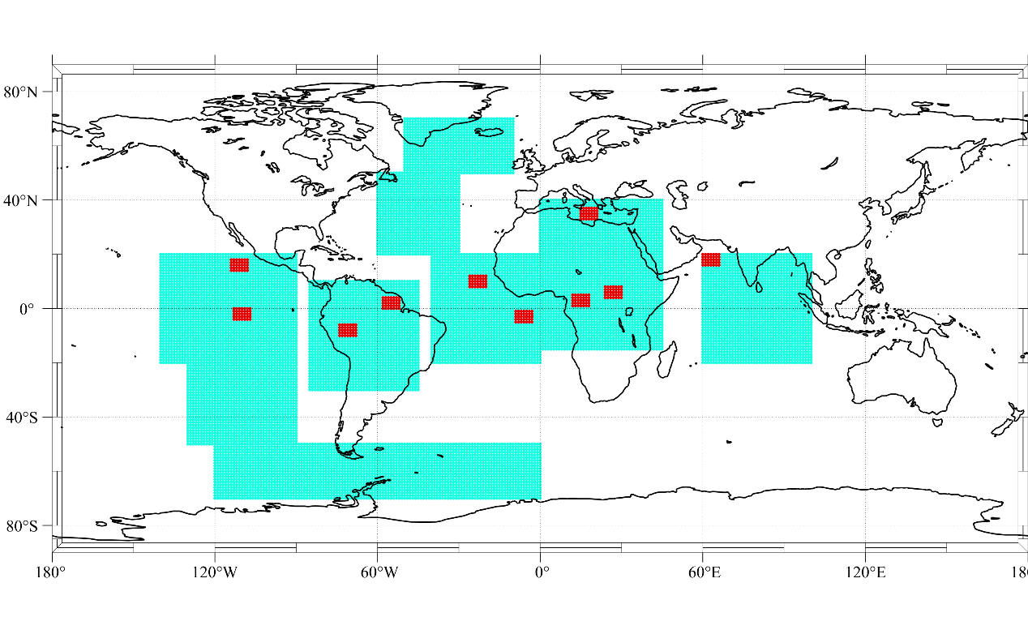
Key Technologies focus on model and verification
Full-Link Radiation Transfer Models
Establishing models for radiation transfer from calibration sources to antennas, ensuring accurate signal propagation tracking.
Integrated Verification Technology
Integrated verification of the full-link microwave radiation benchmark traceability transfer for system validation.
Error Simulation and Evaluation
Physical-level benchmark transfer and error simulation for the entire microwave system to quantify uncertainty.
typical benchmark transfer scenarios selected for traceability tests

Slide 21
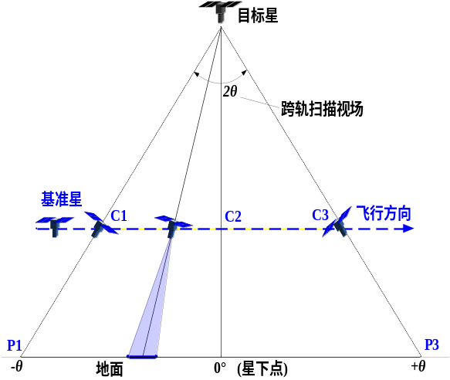
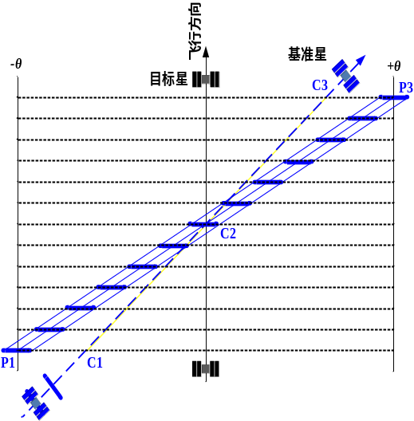
Multi-scenario Benchmark Transfer and Error Traceability
Polar Orbit Cross
Matching time lags and viewing angles across orbital planes to observe the same ground region.
GEO Tracking Cross-Calibration
Cross-calibration along the same path with different spatial resolutions.
Scene Diagnosis
Repeated cross-observations over specific target scenes
t
t
F
3
t
F
2
F
3
F
1
F
satellite to be calibrated
F
2
1
2
?
sun
C
1
C
Benchmark satellite
2
C
t
3
C
1
t
C
2
t
C
3
FOV
P
1
M
N
3
1
N
2
P
?
M
3
α
2
N
M
3
1
FOV-b
Cross-cal
Candidate domain

Slide 22
05
Conclusions & Outlook

Slide 23

Conclusions & Outlook
Establishing a space microwave radiation benchmark is critical for improving observation accuracy and stability.
The implementation of this benchmark framework will provide a qualified and unified reference for space microwave measurements.
Key phased achievements have been made, yet further technological breakthroughs are still needed.
Future Space Exploration & Observation System
Future plan: Promote the Microwave traceability Satellite Program.

Slide 24
Thank You
Q & A
Jieying HE
hejieying@mirslab.cn

