Slide 1


Triadic ATMS Constellation: A Limb-Adjusted Microwave Reference for Climate Monitoring and Sensor Validation
Mitch Goldberg, CCNY/CESSRST
D.Li (CCNY research associate) and S. Mejia (CCNY research associate)
Andrew Dixon (CCNY/CESSRST student), Michelle Wagner (CCNY/CESSRST Student)
March 24, 2026
mgoldberg1@ccny.cuny.edu

Slide 2
Good news, and research needs/questions
The proliferation of the smallsat microwave constellation is now.
How well do smallsats compare with JPSS ATMS – which is regarded as a backbone?
  Currently there are 3 ATMS sensors in the same 13:30 orbit
    SNPP, NOAA20, NOAA21
How many smallsats do we need for weather forecasting vs nowcasting?
What noise performance is needed for weather forecasting (NWP)?
For nowcasting applications, we need to limb adjust.
  Limb adjustment facilitates validation of smallsats.
For NWP, we need more impact studies.
Retrieval studies can help diagnose stability and performance ofdifferent sensors.

Slide 3
Topics
Demonstrate the use of limb adjusted observations and the improved temporal coverage via Cubesats.
Show retrieval performance between ATMS and Cubesats
Discuss and demonstrate why we need a backbone system like ATMS.

Slide 4
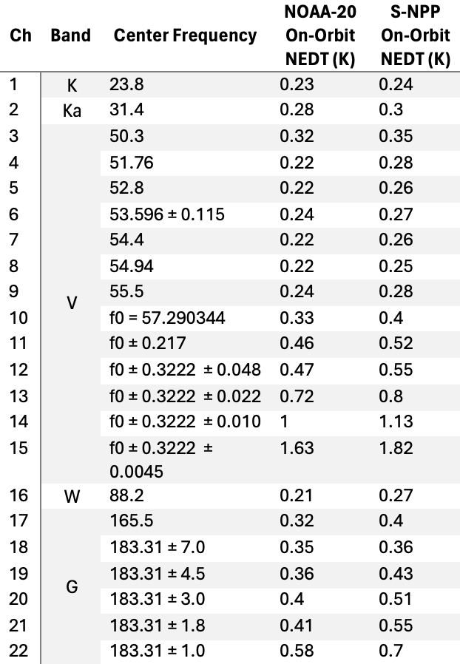
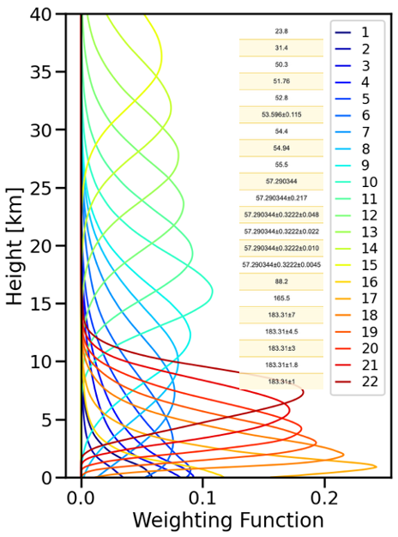
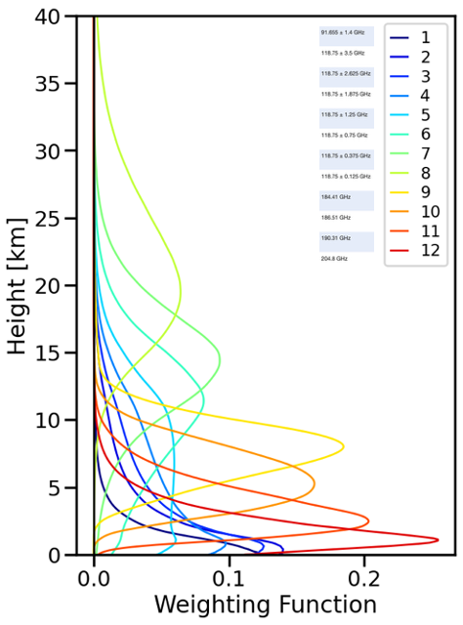
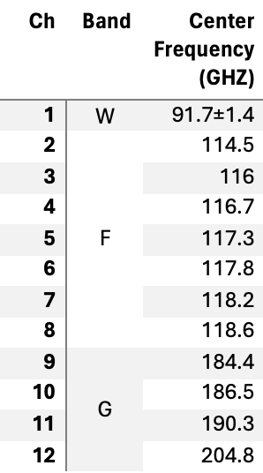
Instrument – Weighting Function
ATMS
TROPICS/TMS
Notes:
The capability of microwave sounder to retrieve temperature and water vapor profiles depends on the sensitivity of the sensor channels with altitude and their noise characteristics. This slide shows the weighting functions of ATMS and TROPICS/TMS. The peak of the Weighting function tells at which altitude the channel is most sensitive.
The blue to green colored lines are the weighting functions of the the temperature channels
The orange to red colored lines are for water vapor channels
We can the see the weighting functions of ATMS are more evenly spaced and go up to 40 km, while the weighting function TROPICS and TMS are mainly peak at altitudes below 15 km, with one channel having a peak near 18km.
So we expect better retrieval accuracy for ATMS.

Slide 5
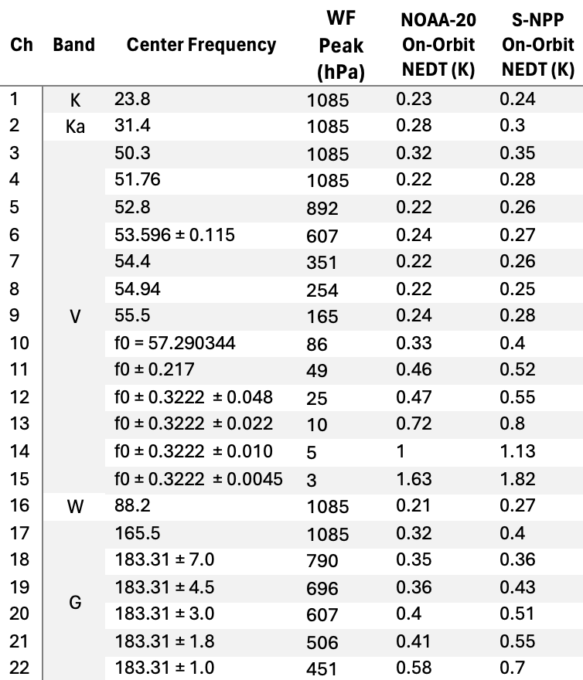
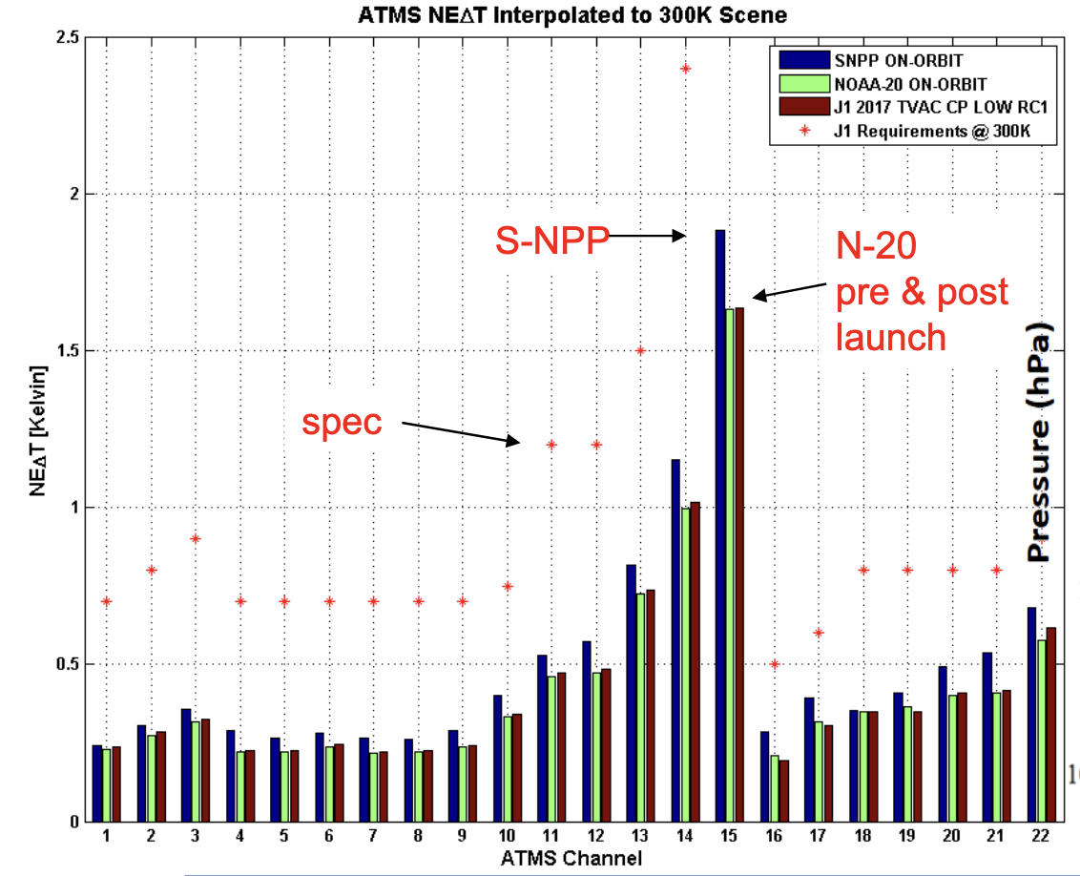
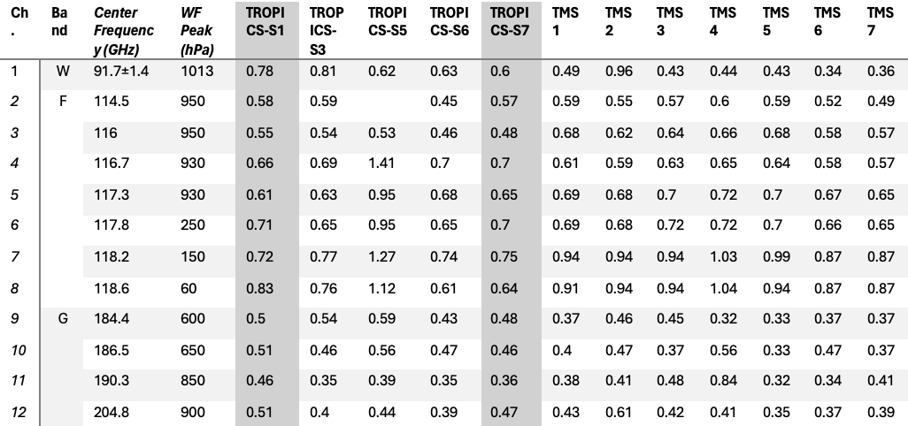
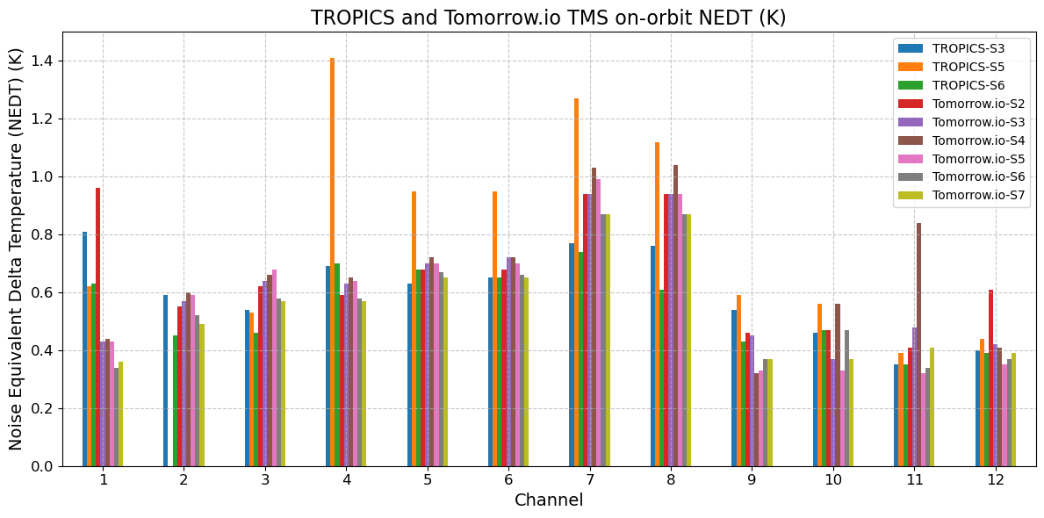
Instrument – Noise Equivalent Delta Temperature (NEdT)
Source: Pieper, M. L., et al. SPIE 2025, Joe Munchak et al. ESS Open Archive, 2025.
Source: Pieper, M. L., et al. SPIE 2025, Joe Munchak et al. ESS Open Archive, 2025.
Source: ATMS SDR TEAM, NOAA-20 ATMS Status March 2019.
Notes:
The Noise Equivalent Delta Temperature (NEDT) of the channels determines the quality of the measurements and retrieval. The left side shows on-orbit NEdT for ATMS on NOAA20 (or JPSS-1) and Suomi-NPP satellite, and the peak of the weighting functions for each channel, the same information for TROPICS and TMS are shown on the right.
The two types of sounders have different channels and are not so easy to directly compare them. The channels highlighted in the red square are temperature channels peak around similar height for ATMS and TMS, you can see the NEdT of ATMS is about the half of TROPICS and TMS
The blue square highlight the water vapor channels, ATMS are slightly lower compared to TROPICS and similar to TMS.
This the bar charts of the two tables, we can see the noise for ATMS is smaller especially for the temperature channels.

Slide 6
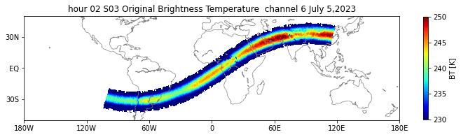
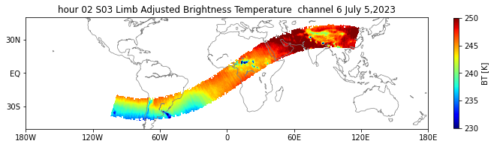
TROPICS S3
TROPICS Limb Adjustment is based on Goldberg, M.D., D.S. Crosby, and L. Zhou, 2001: The limb adjustment of AMSU-A observations: methodology and validation , Journal Appl. Meteor, 40, 70-83.
https://journals.ametsoc.org/view/journals/apme/40/1/1520-0450_2001_040_0070_tlaoaa_2.0.co_2.xml

Slide 7
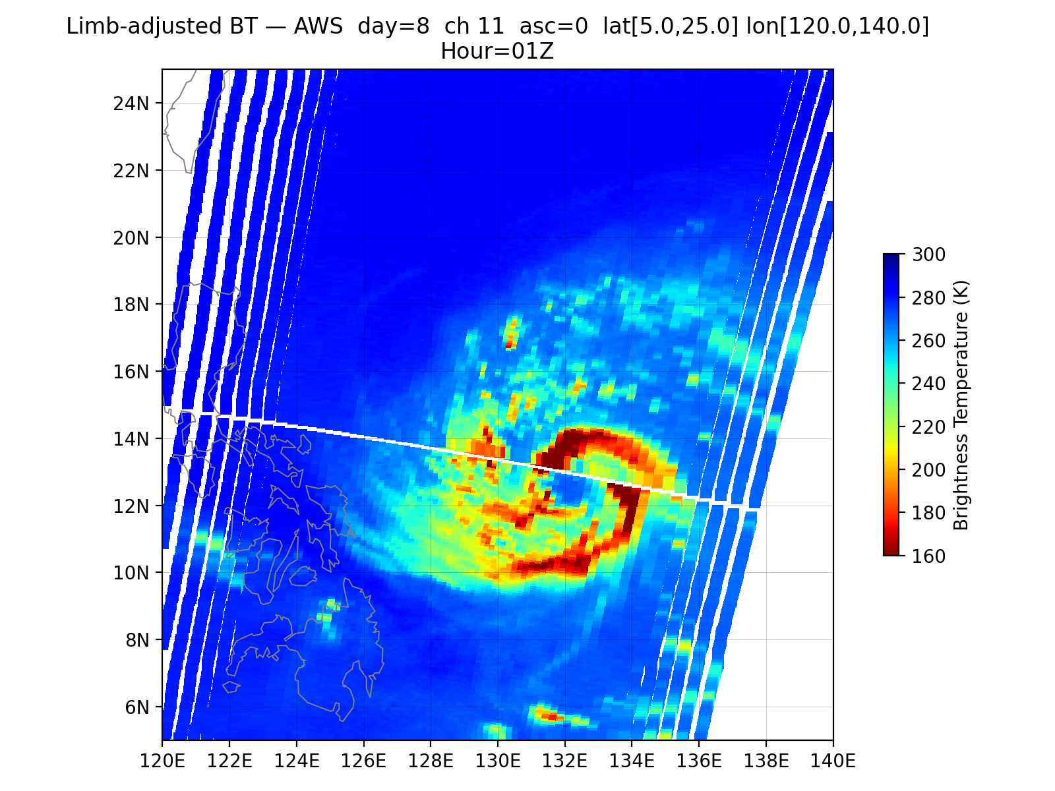
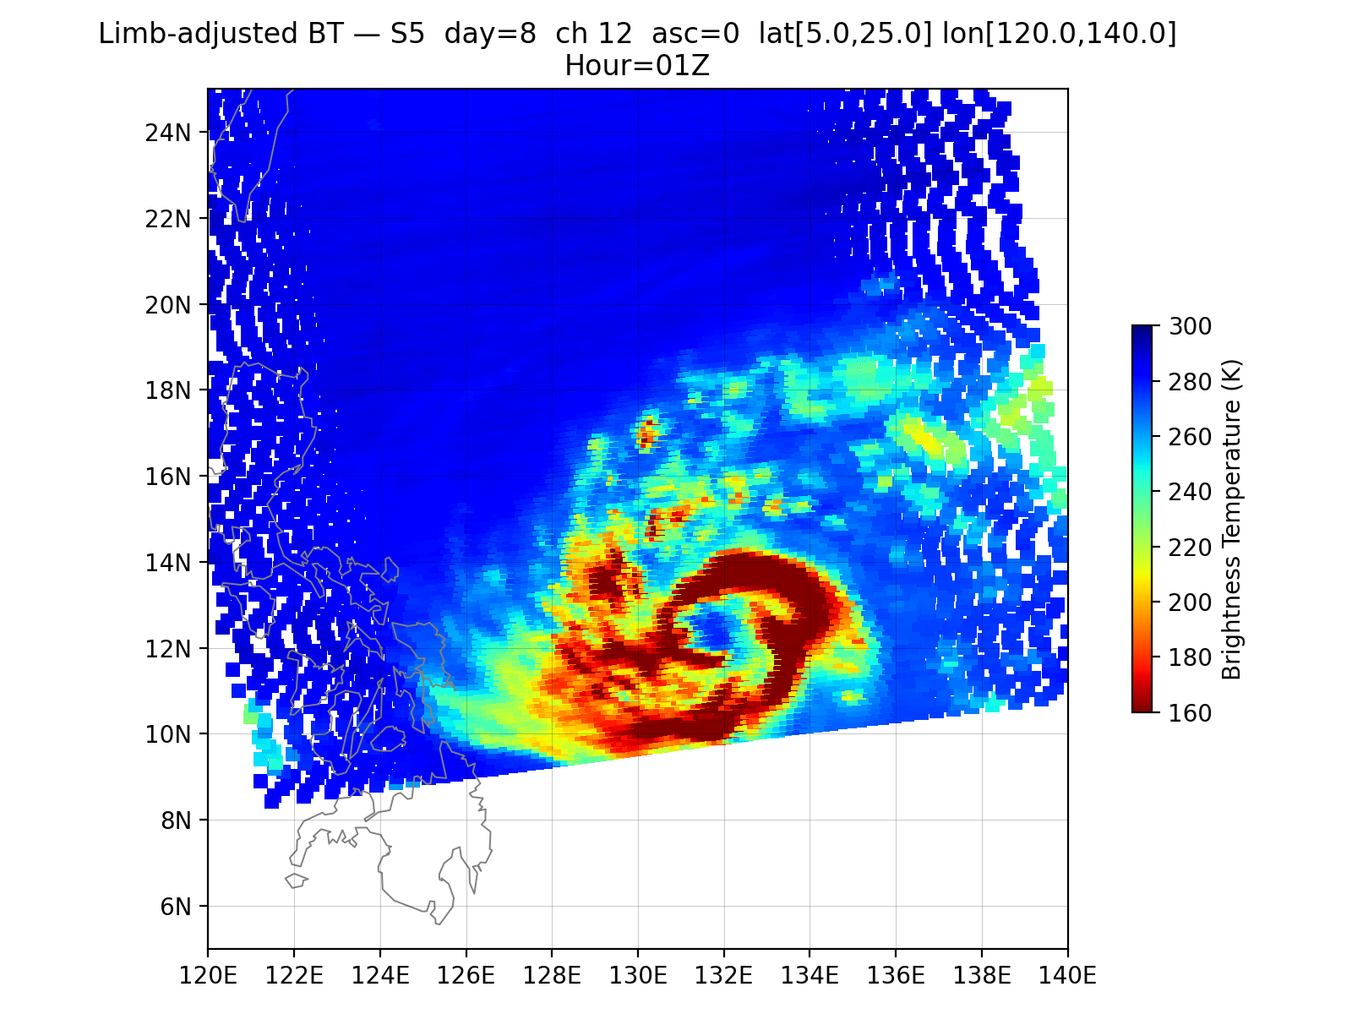
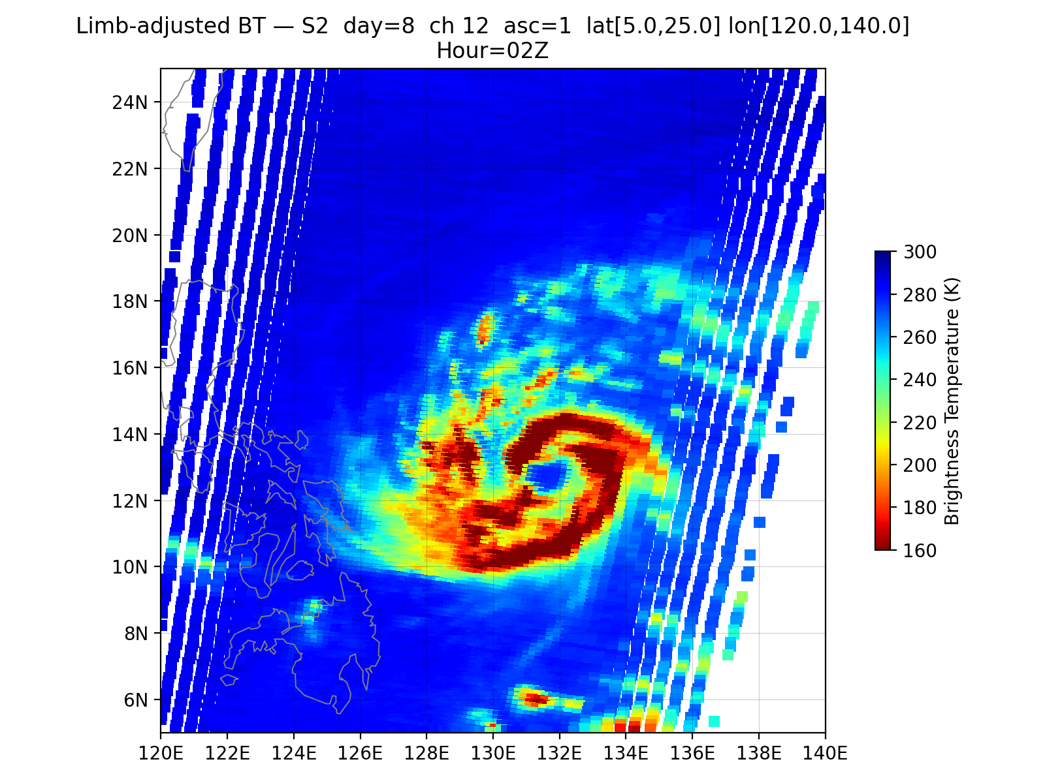
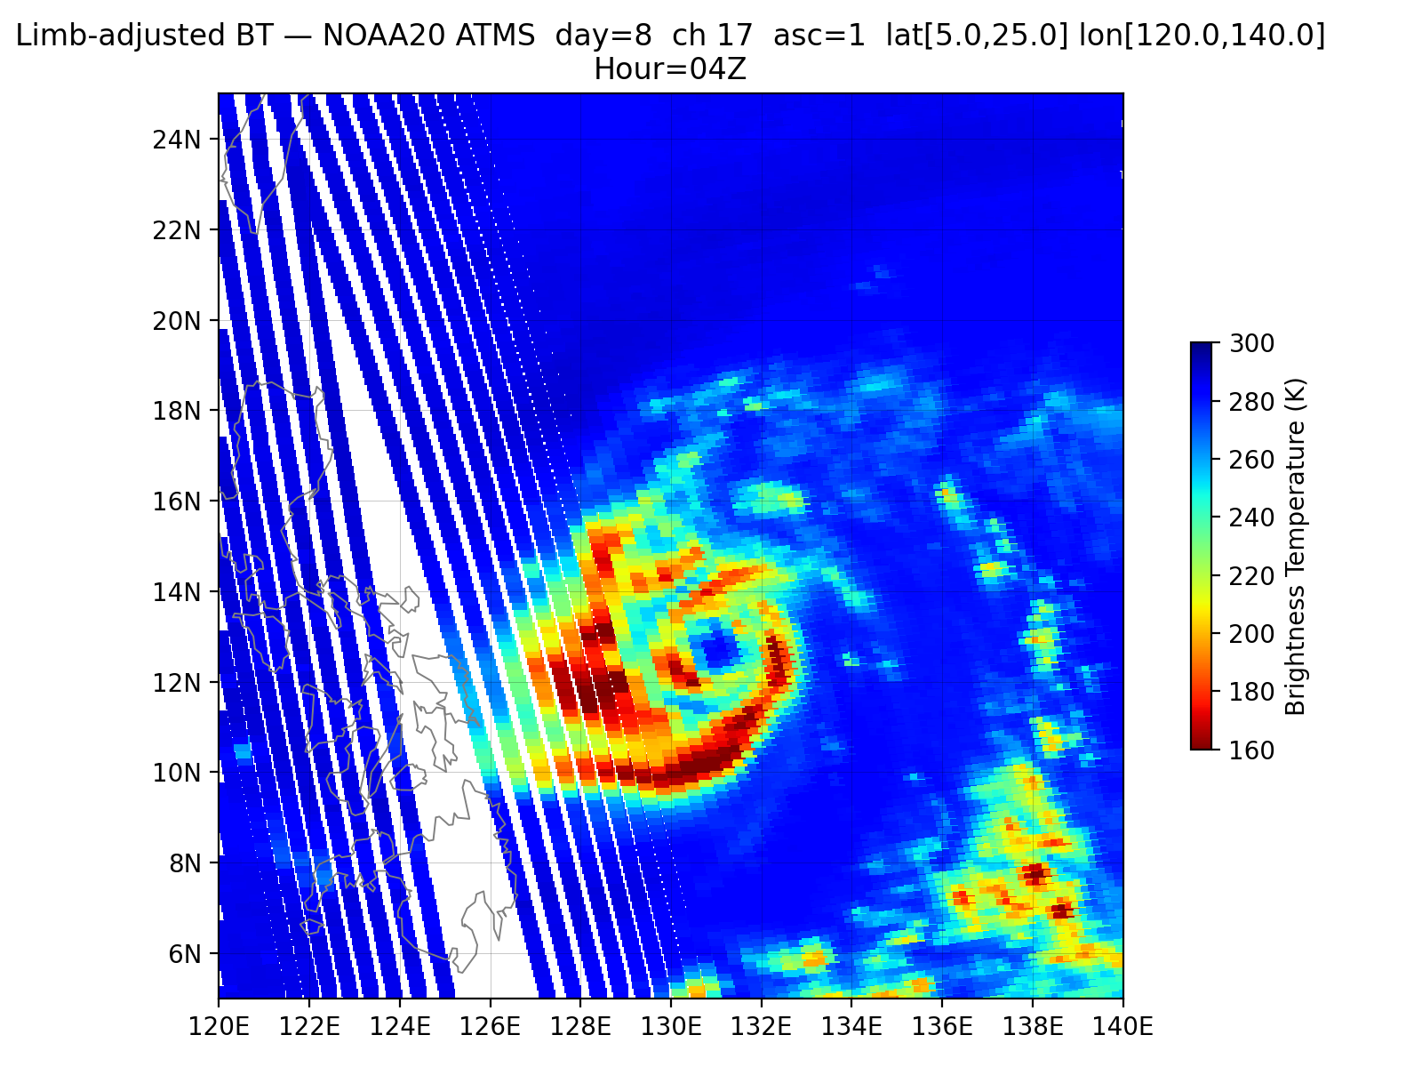
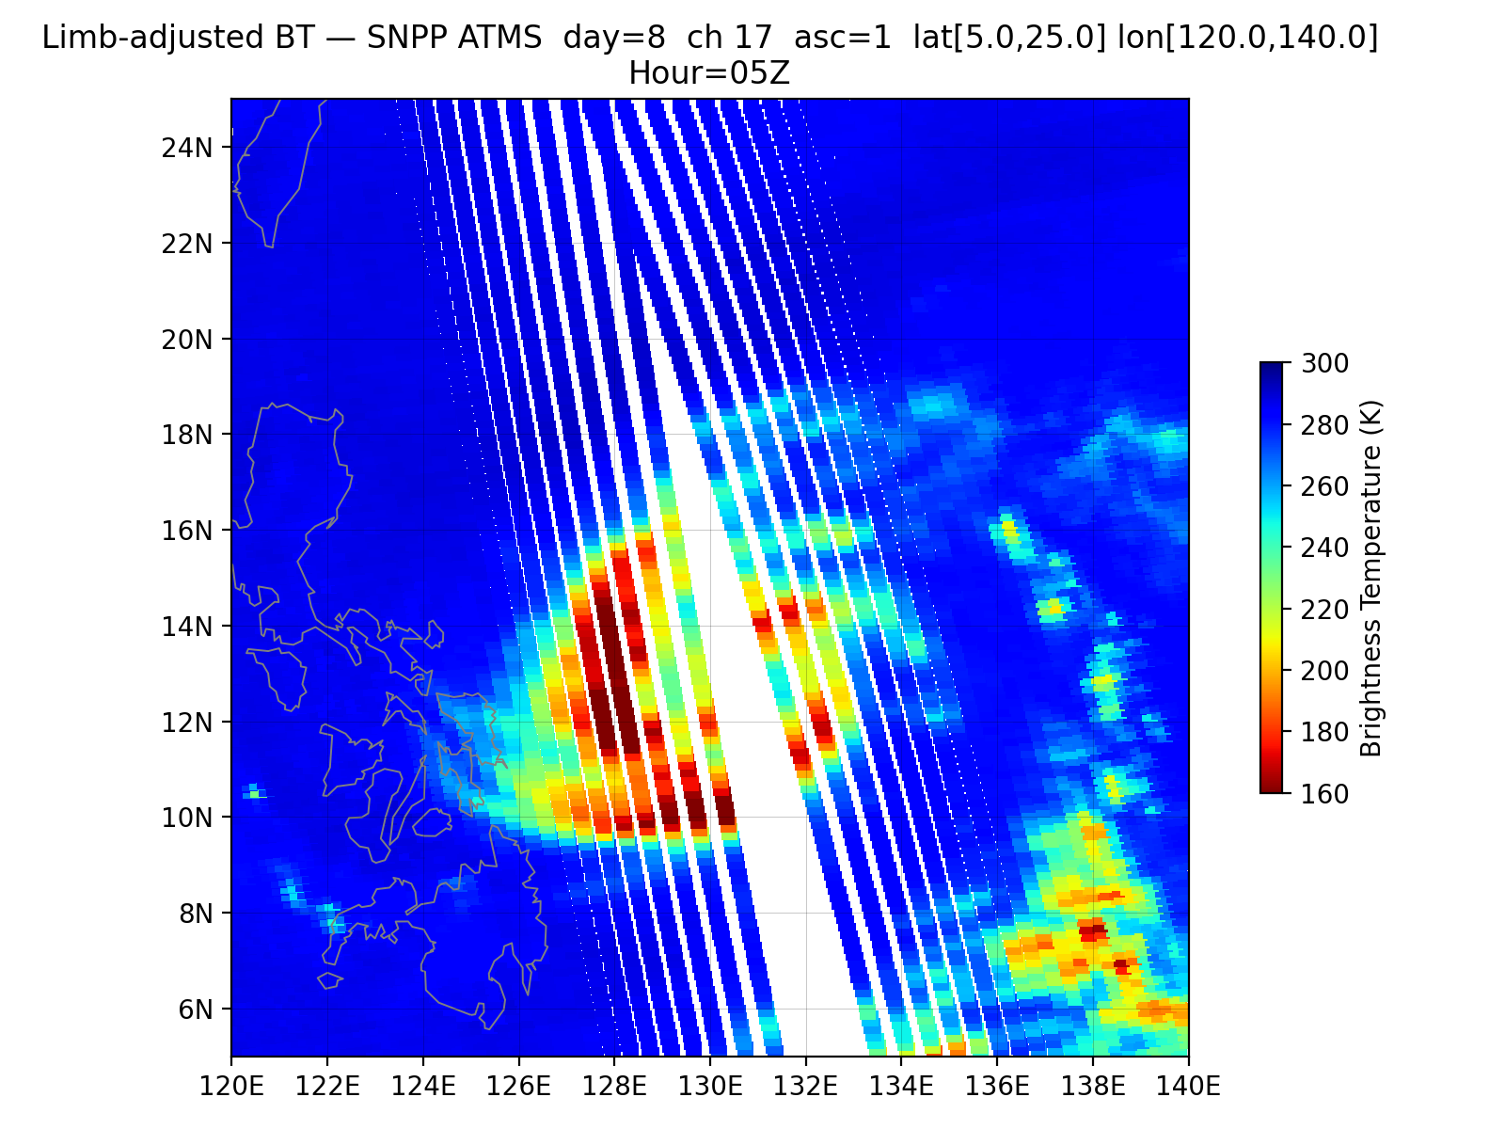
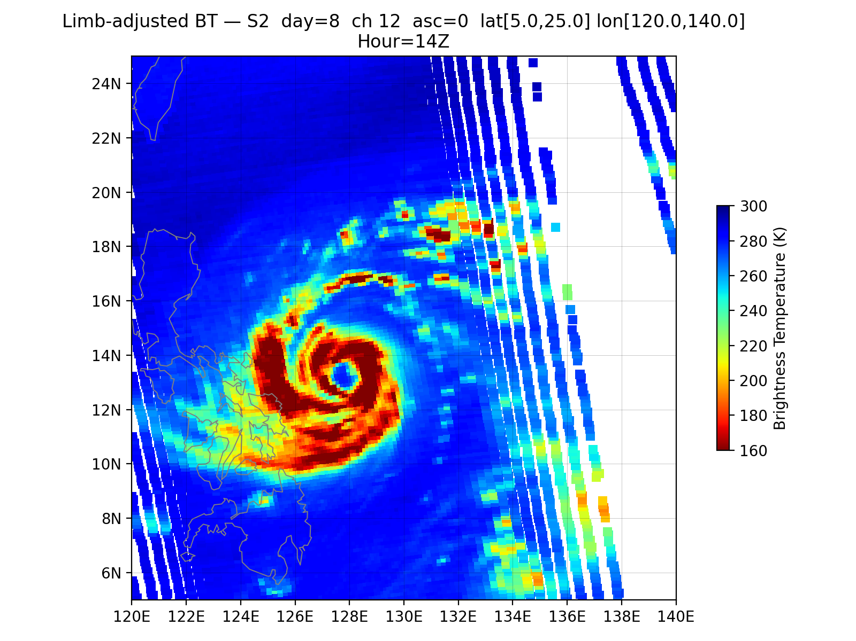
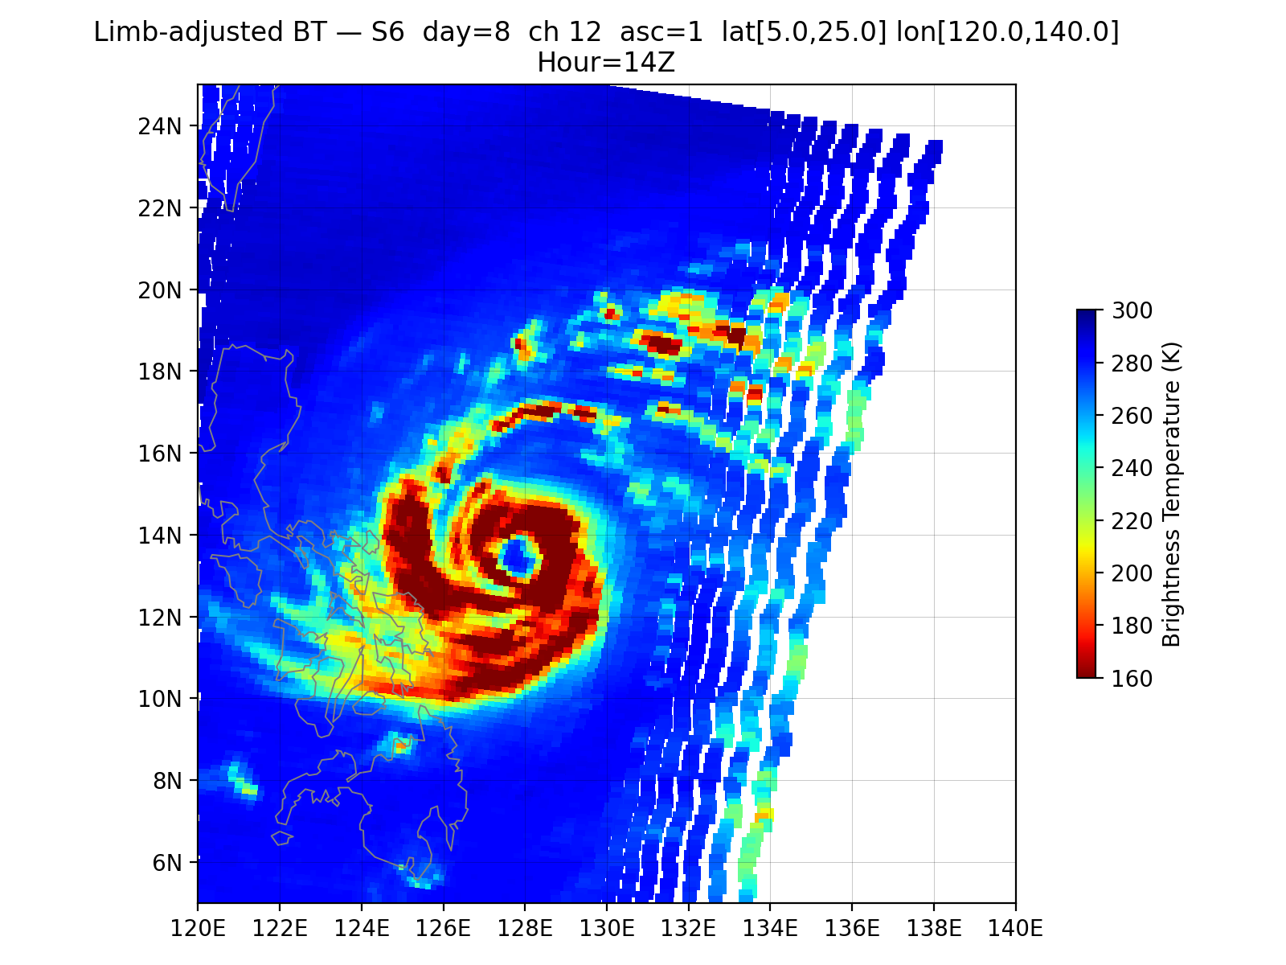
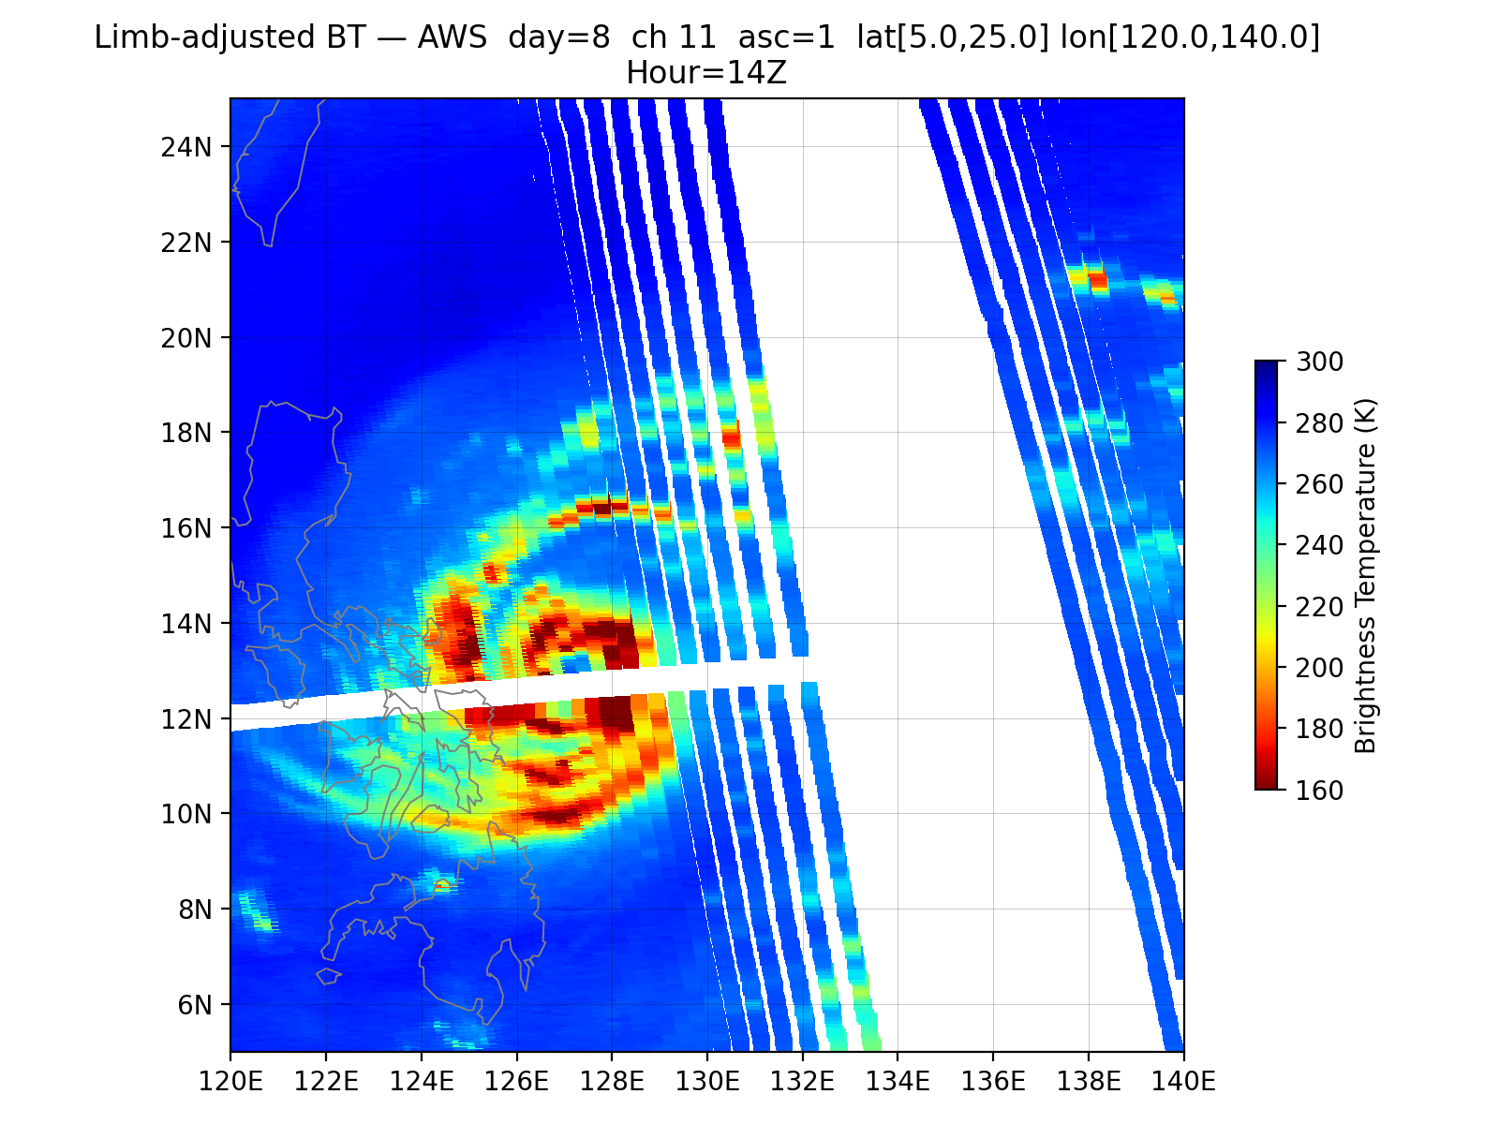
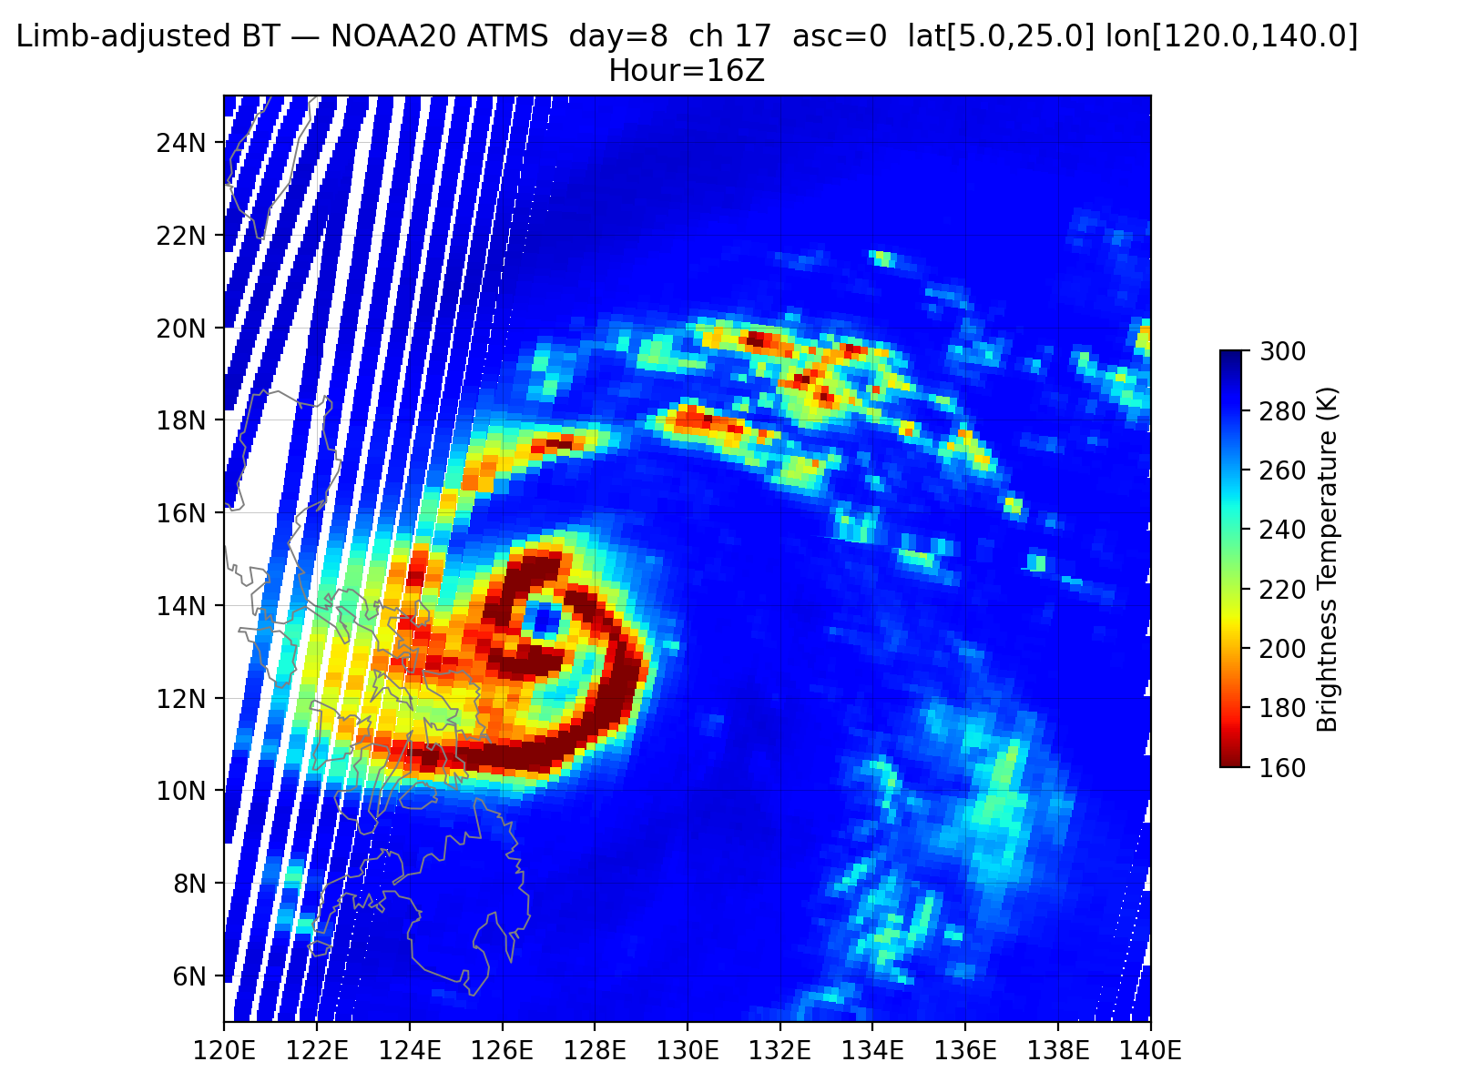
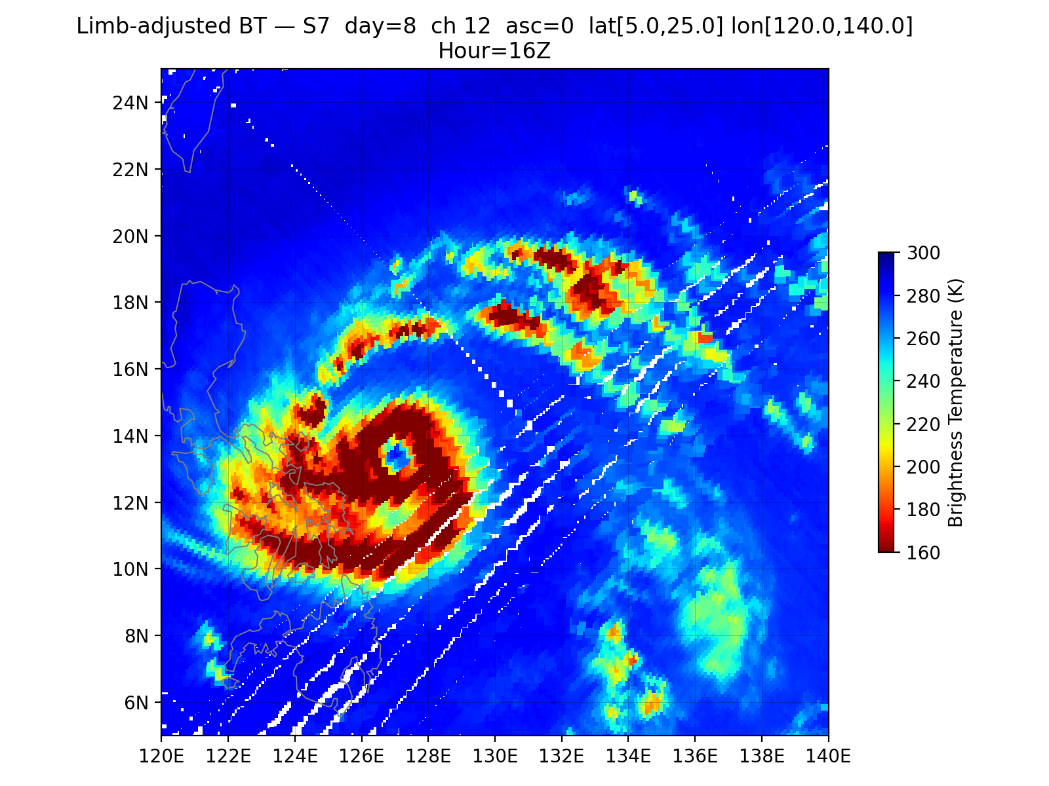
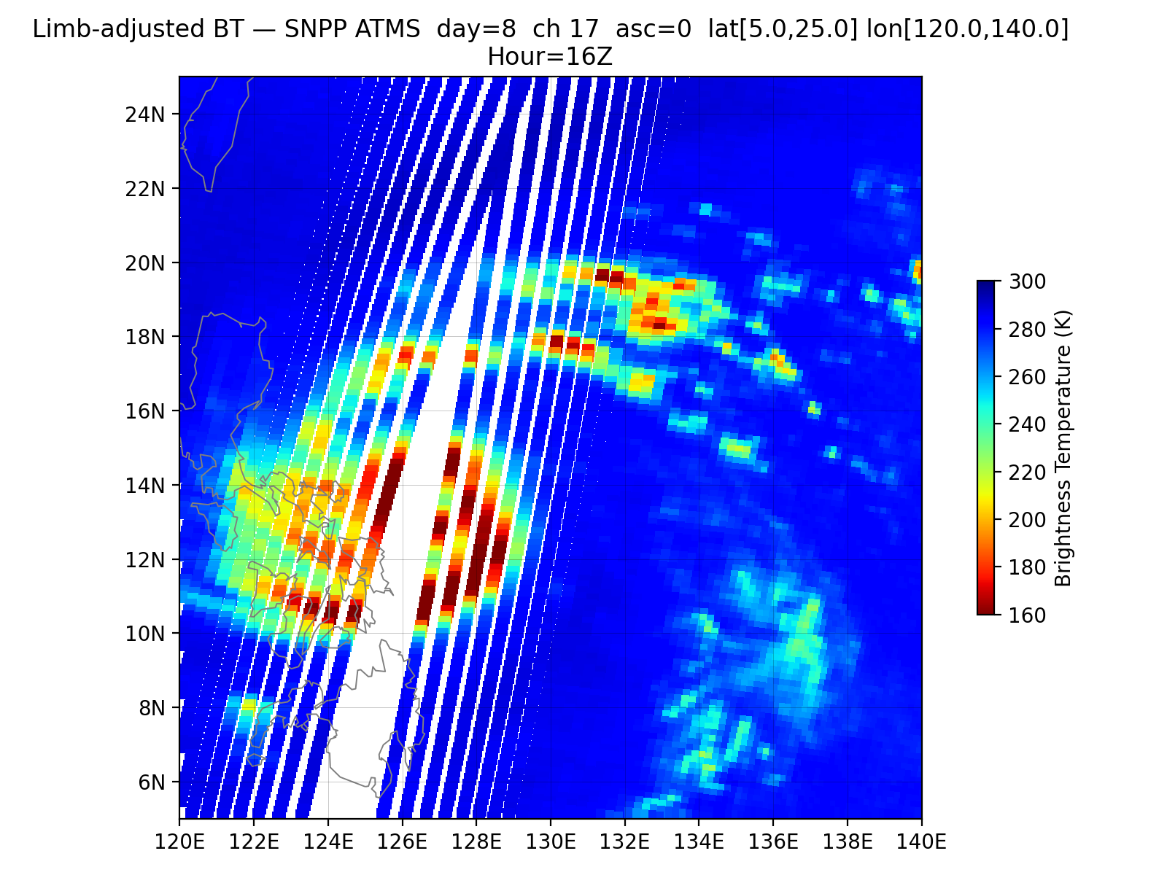
Super Typhoon Uwan / Fung Wong - November 8, 2025
AWS 01 UTC
S5 01 UTC
S2 02 UTC
N20 04 UTC
SNPP 05 UTC
S2 14 UTC
S6 14 UTC
AWS 14 UTC
N20 16 UTC
S7 16 UTC
SNPP 16 UTC
204.8 GHz

Slide 8
Super Typhoon Uwan / Fung Wong - November 8, 2025
AWS 01 UTC
S5 01 UTC
S2 02 UTC
N20 04 UTC
SNPP 05 UTC
S2 14 UTC
S6 1 UTC
AWS 14 UTC
N20 16 UTC
S7 16 UTC
SNPP 16 UTC

Slide 9
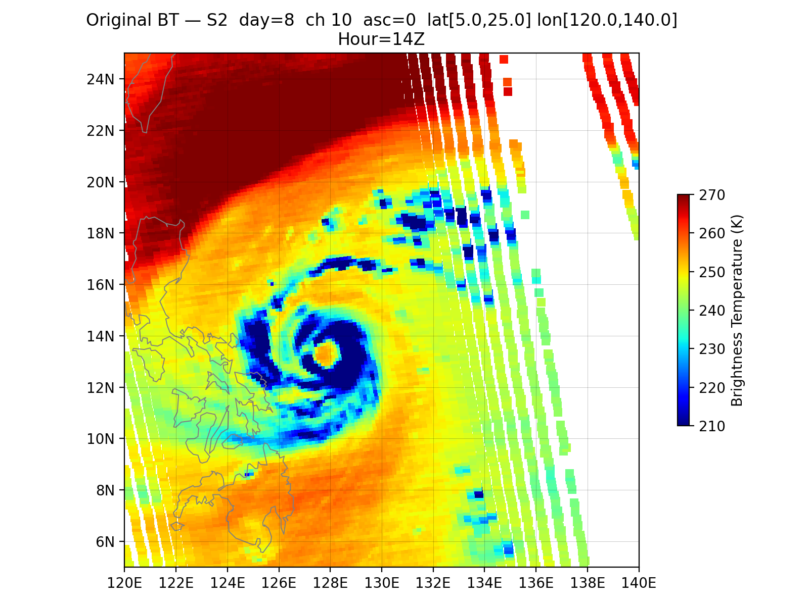
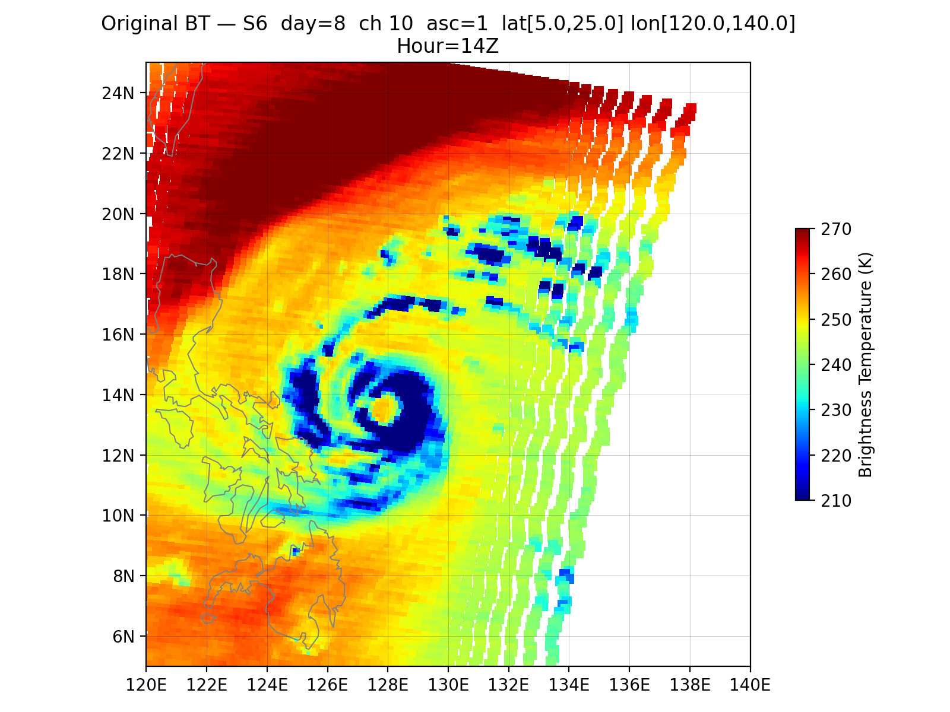
186.5 GHz
186 GHz

Slide 10
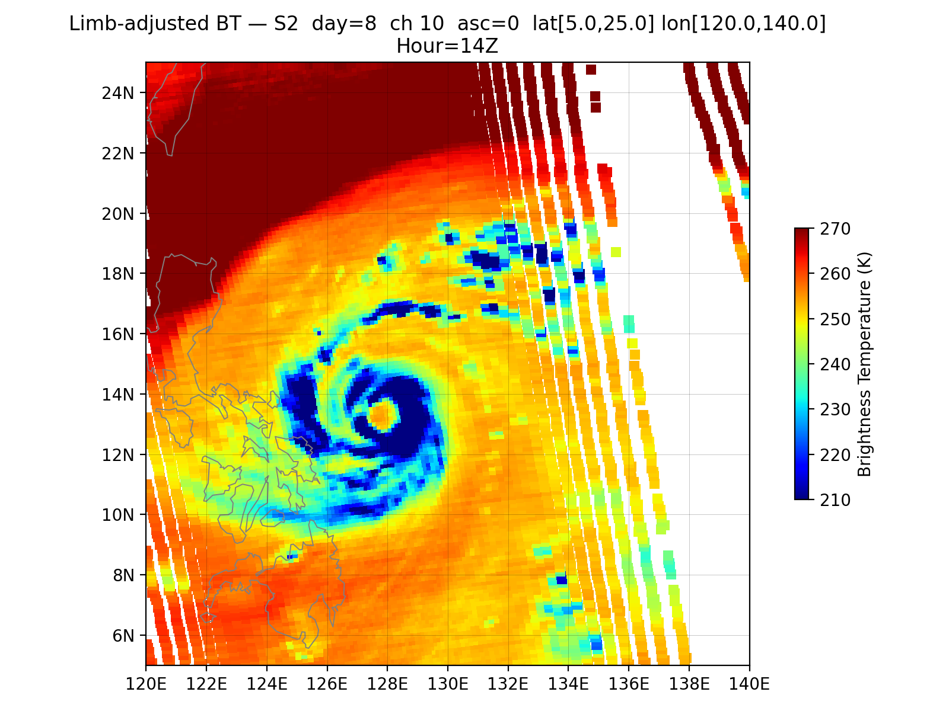
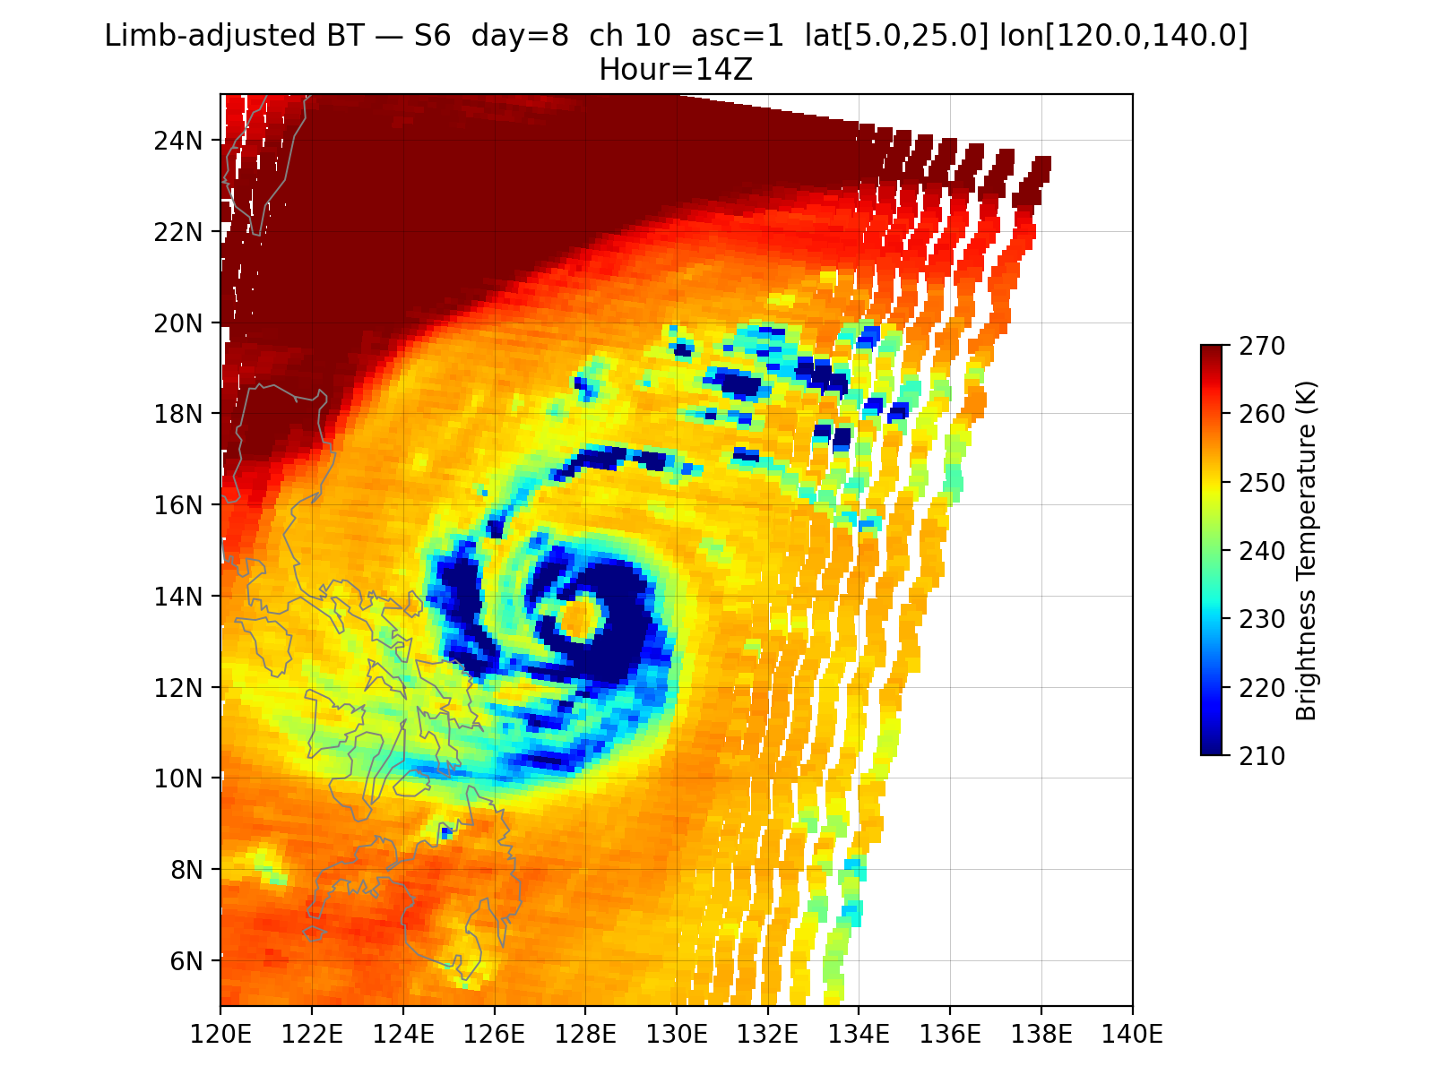

Slide 11
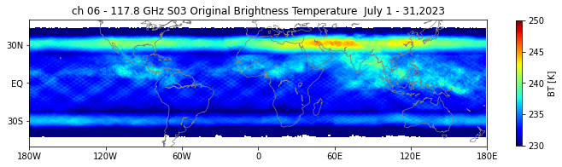
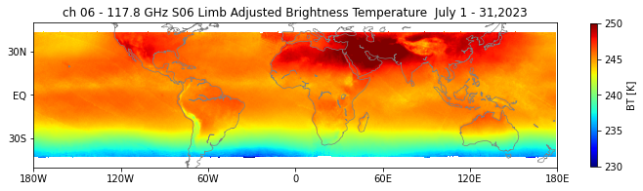
TROPICS S3

Slide 12
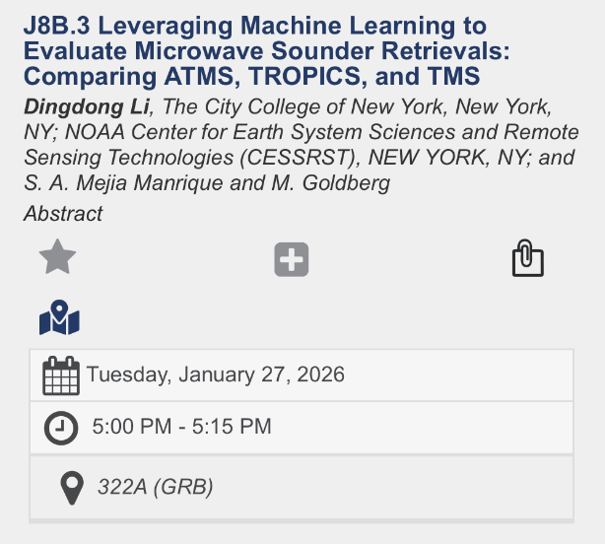
Retrieval Methodology
Multi-Layer Perceptron neural network (MLP)
Input layer
Hidden Layers
Output layer
Input features:
Brightness temperatures (BTs), secant of satellite zenith angle − 1, land/sea mask, and surface pressure.
Architecture:
3 fully connected hidden layers with 64,128,64 neurons, Batch Norm, ReLU activation.
Training:
Optimized using Adam with early stopping and learning rate scheduling; trained separately for temperature and water vapor profiles.
Output:
37 pressure-level temperatures or water vapor mixing ratios.
Loss function:
Mean-squared error (MSE) between predicted and reference profiles from ERA5.
64 nodes with BN and ReLu
128 nodes with BN and ReLu
64 nodes with BN and ReLu
FC
FC
FC
FC

Slide 13
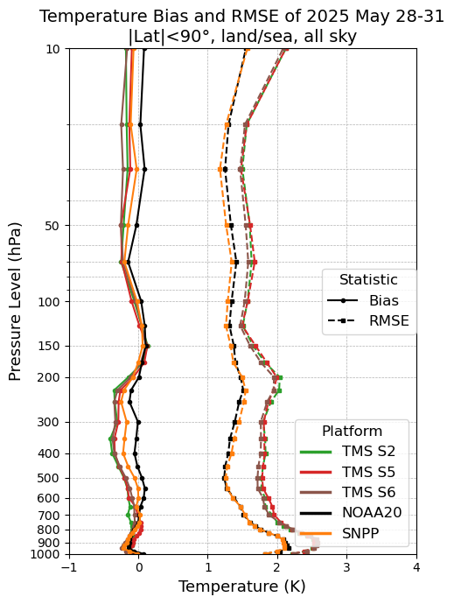
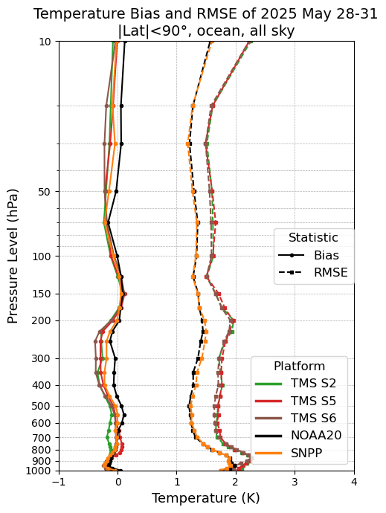
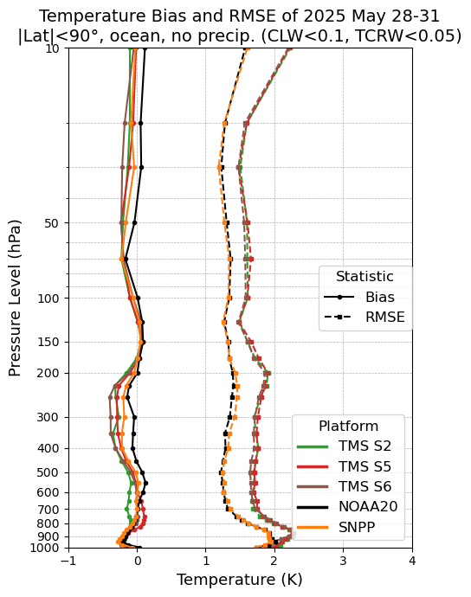
Temperature Retrieval Comparisons of ATMS vs TMS
All weather
Land & ocean, |lat|< 90°
All weather
ocean, |lat|< 90°
no precipitation
ocean, , |lat|< 90°
TMS2 Avg RMSE: 1.97
TMS5 Avg RMSE: 1.98
TMS6 Avg RMSE: 1.95
NOAA20 Avg RMSE: 1.57
SNPP Avg RMSE: 1.56
TMS2 Avg RMSE: 1.84
TMS5 Avg RMSE: 1.85
TMS6 Avg RMSE: 1.81
NOAA20 Avg RMSE: 1.48
SNPP Avg RMSE: 1.48
TMS2 Avg RMSE: 1.83
TMS5 Avg RMSE: 1.84
TMS6 Avg RMSE: 1.80
NOAA20 Avg RMSE: 1.48
SNPP Avg RMSE: 1.49
Notes:
This slide shows the temperature retrieval RMSE and bias with respect to ERA5 for all sun synchronous orbit microwave sounders including the two ATMS on NOAA20 and SNPP and TMS2,5,6
The left panel shows the results for land and ocean under all weather conditions, and middle panel is for ocean only and right for ocean with no precipitation.
All sensors show temperature biases less than 0.5K.
The RMSE of the ATMS on NOAA-20 and SNPP, shown are almost overlapping with each other, which are shown as the the black and orange lines.
The RMSE of TMS2, 5, 6, are also very consistent, with TMS6 being slightly more accurate.

Slide 14
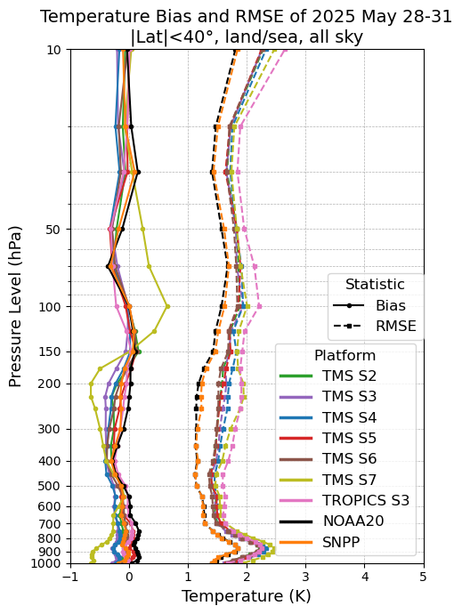
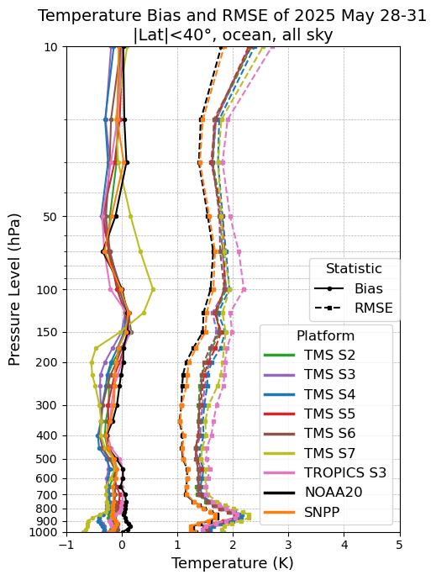
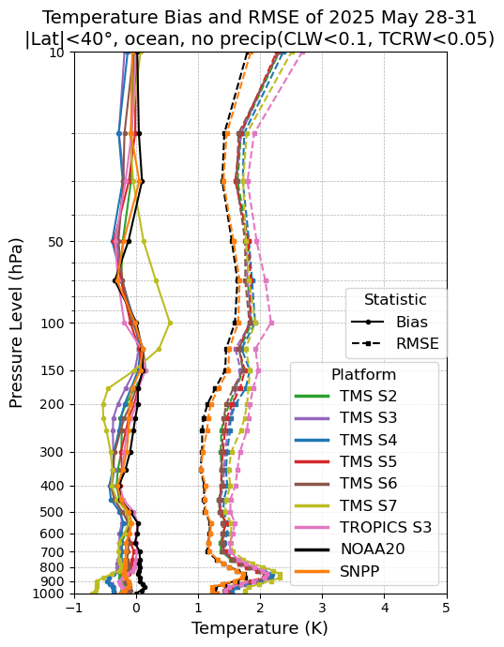
Temperature Retrieval Comparisons of ATMS vs TMS
All weather
Land & ocean, |lat|< 40°
All weather
ocean, |lat|< 40°
no precipitation
ocean, , |lat|< 40°
TMS2 Avg RMSE: 1.72
TMS3 Avg RMSE: 1.73
TMS4 Avg RMSE: 1.79
TMS5 Avg RMSE: 1.73
TMS6 Avg RMSE: 1.70
TMS7 Avg RMSE: 1.90
TROPICS S3 Avg RMSE: 1.89
NOAA20 Avg RMSE: 1.42
SNPP Avg RMSE: 1.43
TMS2 Avg RMSE: 1.61
TMS3 Avg RMSE: 1.63
TMS4 Avg RMSE: 1.69
TMS5 Avg RMSE: 1.61
TMS6 Avg RMSE: 1.60
TMS7 Avg RMSE: 1.79
TROPICS Avg RMSE: 1.77
NOAA20 Avg RMSE: 1.33
SNPP Avg RMSE: 1.34
TMS2 Avg RMSE: 1.61
TMS3 Avg RMSE: 1.63
TMS4 Avg RMSE: 1.69
TMS5 Avg RMSE: 1.61
TMS6 Avg RMSE: 1.59
TMS7 Avg RMSE: 1.78
TROPICS Avg RMSE: 1.77
NOAA20 Avg RMSE: 1.33
SNPP Avg RMSE: 1.35
Notes:
This slide shows temperature retrieval bias and RMSE for all MW sounders within the 40 degree latitude range. Because TROPICS S3 and TMS 3,4,7 are flying on the low-inclination orbits
The bias are mostly within 0.5K for all the MW sounders except TMS7 being slightly larger
The RMSE of two ATMS are very consistent with each other.
The RMSE of TMS and TROPICS S3 are clustering together below 700 hPa, with TMS7, showing as the yellowish green line, being slightly larger. Above 700 hPa, TROPICS S3, shown as the pink line, is larger than TMS7, than the other TMS, than ATMS.

Slide 15
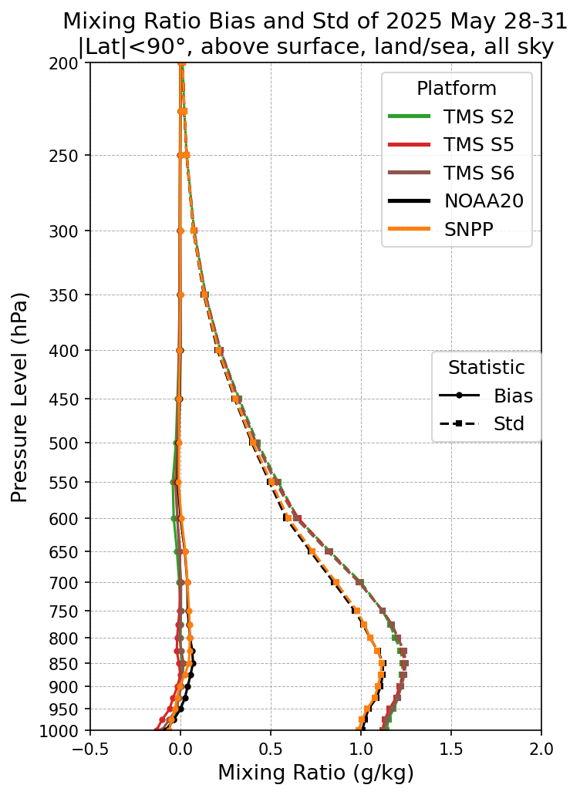
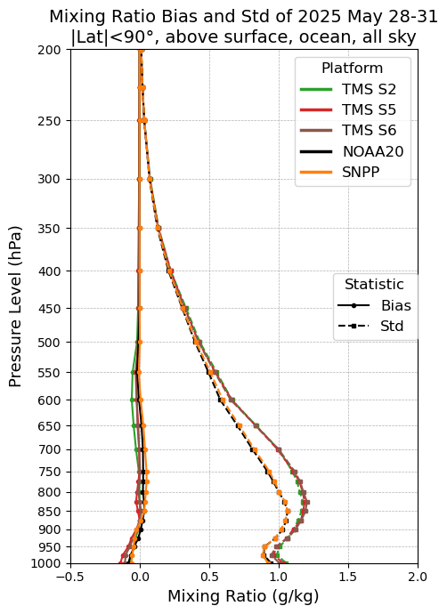
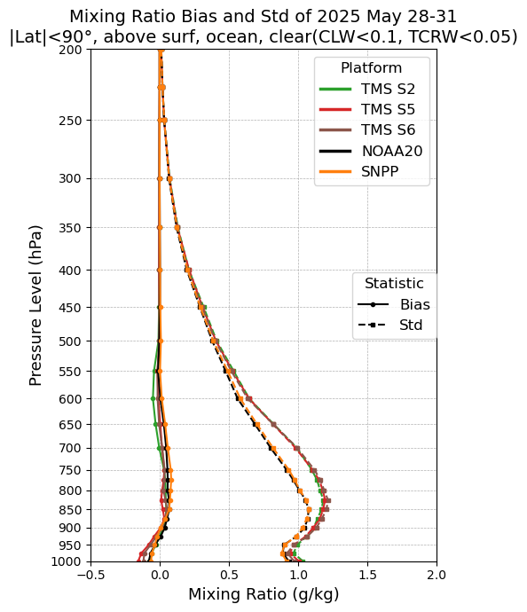
Water Vapor Retrieval Comparisons of ATMS vs TMS
All weather
Land & ocean, |lat|< 90°
All weather
ocean, |lat|< 90°
no precipitation
ocean, , |lat|< 90°
Notes:
This is the RMSE and bias of water vapor mixing ratio profile for ATMS, TMS2,5,6.
Basically, the two ATMS are overlapping with each other and same for TMS2,5,6.
The RMSE difference between ATMS and TMS gets smaller for the ocean only data near the surface.

Slide 16
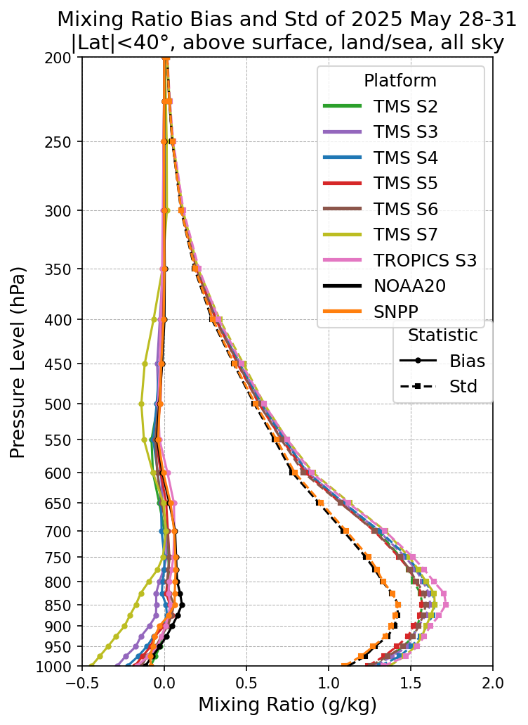
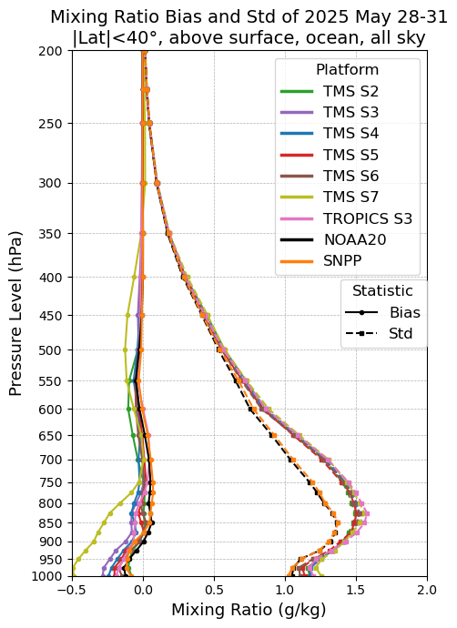
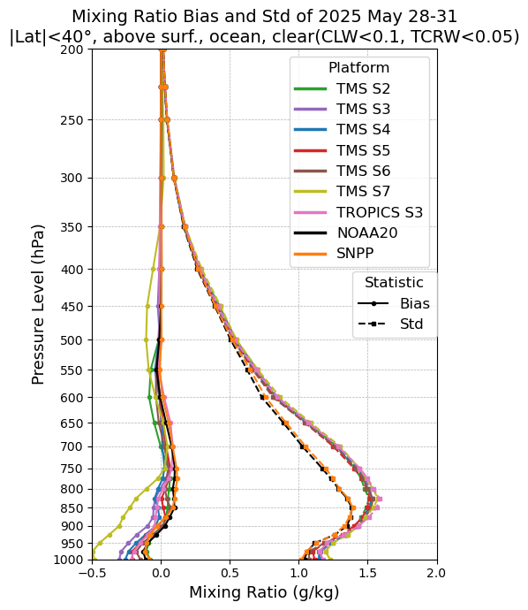
Water Vapor Retrieval Comparisons of ATMS vs TMS
All weather
Land & ocean, |lat|< 40°
All weather
ocean, |lat|< 40°
no precipitation
ocean, , |lat|< 40°
Notes:
This is water vapor RMSE and bias for all MW sounders within 40 degree latitude range.
Similar results to the temperature retrieval and previous slide.
TMS7 shows slightly larger bias
For RMSE, the NOAA-20 and SNPP are still very consistent to one another and all the TMS and TROPICS S3 are closely cluster together, TROPICS S3 has slightly larger RMSE for the all sky condition.

Slide 17
Demonstrate the Importance of the Backbone
Using ATMS as a benchmark – stable orbit – long design life
  SNPP ATMS has a record from 2012 to present, NOAA 20 from 2018 to present.
We collocated 0.25 deg resolution ECMWF ReAnalysis version 5 (ERA5) to every single fov –interpolating in time and space.
We simulate brightness temperatures from the collocated ERA for nadir because we will compare with limb adjusted measured brightness temperatures
First establish ATMS and ERA5 Simulated as benchmarks

Slide 18
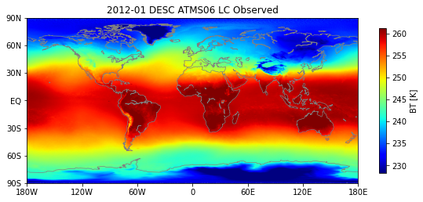
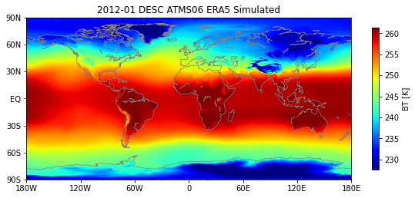
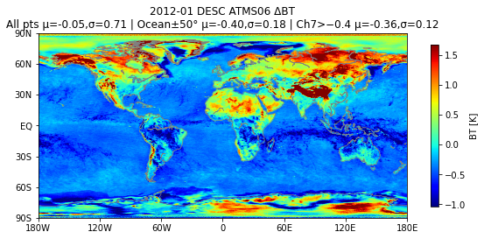
Low – mid tropospheric temperature channel 6. ~ 4km ~ 625 mb

Slide 19
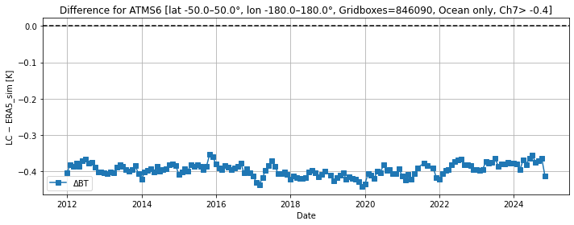
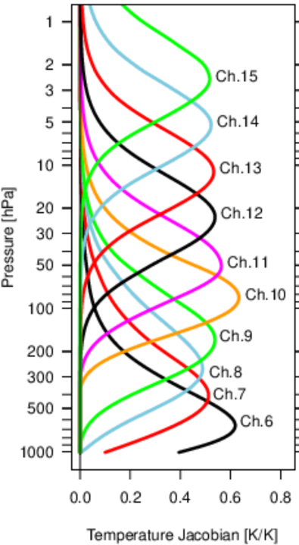
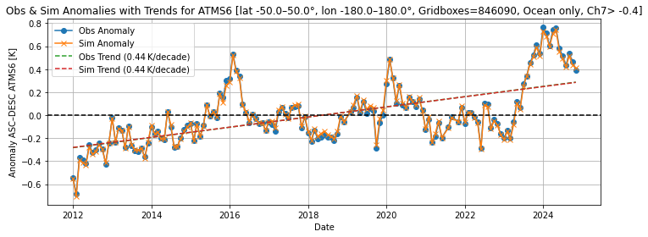
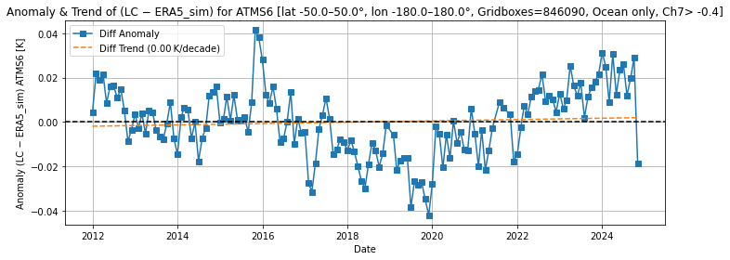

Slide 20
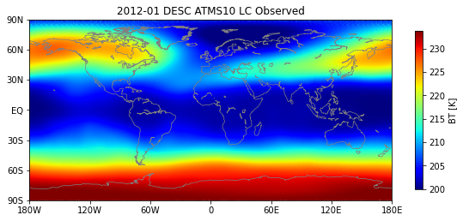
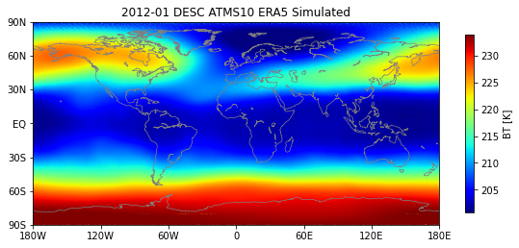
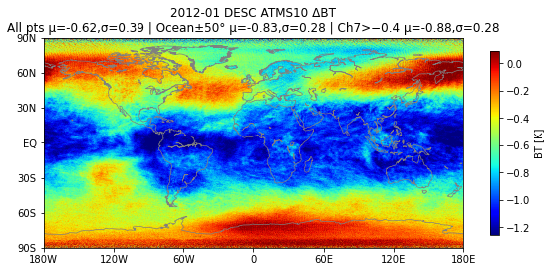
Lower stratospheric temperature channel 10 ~ 17km ~ 80 mb

Slide 21





Slide 22



SNPP, ERA5 SIM
SNPP, NOAA20

Slide 23

Impact of COSMIC-2 2020 onwards ?
Cold bias in ERA5 is corrected by COSMIC-2
Mean (obs-bg) & (obs-an)
O-FG decreases from 2020 -2025.
i.e. FG gets warmer, by 0.1 - 0.2K.
Known model bias tendency in lower stratosphere
is reduced following the introduction of COSMIC-2
Figure from Adrian Simmons

Slide 24



Water Vapor Channel 20. ~ 5 - 6 km. ~ 550 - 475 mb

Slide 25




Water Vapor Channel 20
Is the SNPP ATMS drifting??? Or is it ERA5???

Slide 26


Water Vapor Channel 20

Slide 27

Analysis of TROPICS Data can be impacted by nonuniform sampling
File size in Megabytes as a function of year/month

Slide 28







All data = June 2023 to December 2024
[S3- S3(sim)] - [S6 - S6(sim)]

Slide 29








Slide 30








Slide 31








Slide 32


Robustness of the CCNY MLP Retrieval for ATMS
SNPP using SNPP 2018 training
NOAA 20 using NOAA20 2024 training
NOAA 20 using SNPP 2018 training
All Sky
Standard Deviation

Slide 33



BIAS
SNPP using SNPP 2018 training
NOAA 20 using NOAA20 2024 training
NOAA 20 using SNPP 2018 training

Slide 34
Summary
The Limb Adjustment procedure seems to be accurate
Compares well with ERA5 simulated ATMS brightness temperatures
The overlap of SNPP, NOAA20, NOAA21 in a fixed orbit provides us with an arbitrator to evaluate the smallsat constellation.
We can see a slight drift in ERA5 for some layers (channels), which we need to investigate.
Constellations must include anchor backbone reference instruments.
CCNY AI/ML (MLP) retrieval algorithm is very robust and appears to be performing extremely well.
mgoldberg1@ccny.cuny.edu

