Slide 1



Standard Atmospheric Profile Datasets for
RTM-based Inter-Sensor Microwave Radiometric Calibration? A Demonstration Using ATMS TDR Data
Banghua Yan
SMCD/Sensor and Calibration Branch
NOAA Center for Satellite Applications and Research (STAR)
NOAA
Center for Satellite Applications and Research (STAR)
Coauthors: Ninghai Sun¹, Xianjun Hao¹, Shu-Peng Ho²
Yong Chen², and Yingtao Mo³
2026 GSICS Annual Meeting
^{1.} ERT Inc. ^{2.} STAR/SMCD ^{3.}CIRA

Slide 2
OUTLINE
Introduction
  Advanced Technology Microwave Sounder (ATMS)
  NOAA Community Radiative Transfer Model (CRTM)
Evaluating Inter-sensor Radiometric Consistency of JPSS ATMS TDR Data Quality via CRTM and Two-Source Atmospheric Profiles
  CRTM-based Inter-Sensor Calibration Methodology
  Experiment Design and Atmospheric Profile Datasets
  Results Analysis about O-B (CRTM) and Double Differences (CRTM-DD)
Strategies toward Accurate Radiometric Calibration Error Assessment across Instruments
  Multi-Source Integrated Atmospheric Profile Datasets
  Two Excellent Showcases
    A Reprocessed Global Navigation Satellite System (GNSS) Radio Occultation (RO)-based Temperature and Moisture Profile Dataset from STAR
    A Web-based Integrated Calibration and Validation System (ICVS) Monitoring System from STAR
Acknowledgement and Disclaimer

Slide 3
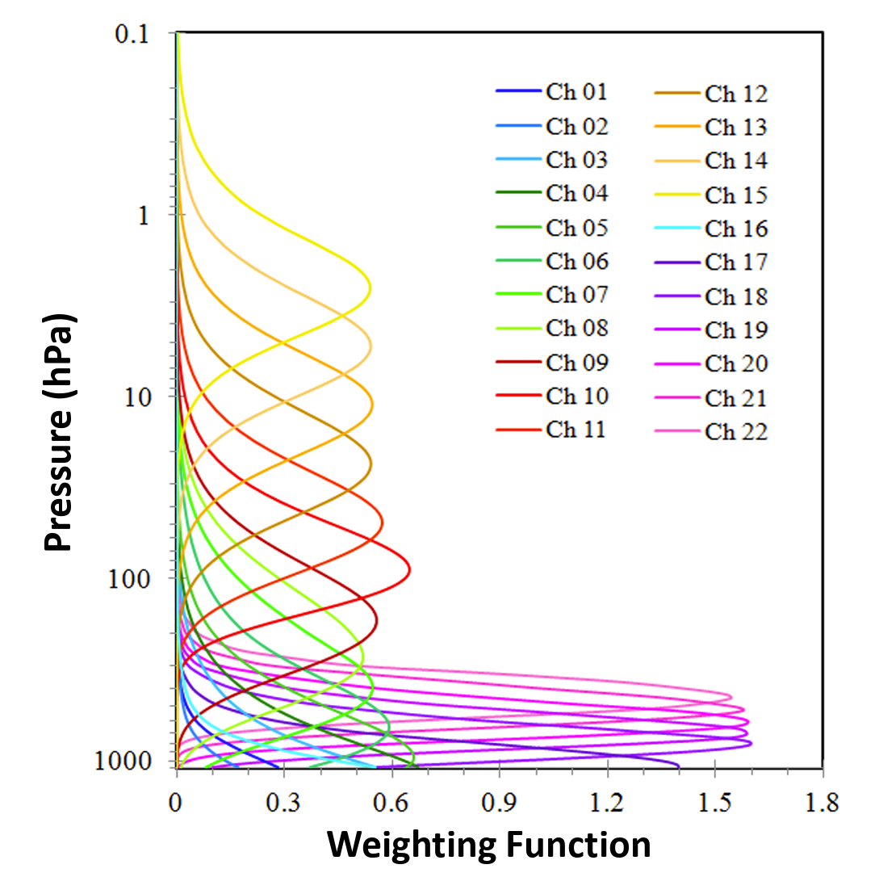
ATMS Instrument Channel Main Characteristics
Advanced Technology Microwave Sounder (ATMS) is a cross-track scanner that is currently carried on the SNPP, NOAA-20 and NOAA-21 satellites. It is a 22-channel microwave sounder providing both temperature soundings between the surface and the upper stratosphere, and humidity soundings between the surface and the upper troposphere.
Table JPSS ATMS channel characteristics [ATMS SDR ATBD, 2022]
Ch. | Center Frequency (MHz) | Bandwidth (MHz) | NEDT (K) (Req.) | Polarization | Beamwidth (°) (Req.) | Accuracy (K) (Req.)
1 | 23800 | <270 | 0.7 | QV | 5.2 | 1.0
2 | 31400 | <180 | 0.8 | QV | 5.2 | 1.0
3 | 50300 | <180 | 0.9 | QH | 2.2 | 0.75
4 | 51760 | <400 | 0.7 | QH | 2.2 | 0.75
5 | 52800 | <400 | 0.7 | QH | 2.2 | 0.75
6 | 53596±115 | 170 | 0.7 | QH | 2.2 | 0.75
7 | 54400 | 400 | 0.7 | QH | 2.2 | 0.75
8 | 54940 | 400 | 0.7 | QH | 2.2 | 0.75
9 | 55500 | 330 | 0.7 | QH | 2.2 | 0.75
10 | 57290.344 [f₀] | 330 | 0.75 | QH | 2.2 | 0.75
11 | f₀±217 | 78 | 1.2 | QH | 2.2 | 0.75
12 | f₀±322.2±48 | 36 | 1.2 | QH | 2.2 | 0.75
13 | f₀±322.2±22 | 16 | 1.5 | QH | 2.2 | 0.75
14 | f₀±322.2±10 | 8 | 2.4 | QH | 2.2 | 0.75
15 | f₀±322.2±4.5 | 3 | 3.6 | QH | 2.2 | 0.75
16 | 88200 | 2000 | 0.5 | QV | 2.2 | 1.0
17 | 165500 | 3000 | 0.6 | QH | 1.1 | 1.0
18 | 183310±7000 | 2000 | 0.8 | QH | 1.1 | 1.0
19 | 183310±4500 | 2000 | 0.8 | QH | 1.1 | 1.0
20 | 183310±3000 | 1000 | 0.8 | QH | 1.1 | 1.0
21 | 183310±1800 | 1000 | 0.8 | QH | 1.1 | 1.0
22 | 183310±1000 | 500 | 0.9 | QH | 1.1 | 1.0
Less sensitive to surface properties
(Citation from ‘ATMS SDR Overview’)

Slide 4
NOAA CRTM – A Fast and Accurate Community Radiative Transfer Model for Satellite Radiance Simulation and Assimilation
CRTM* Functional Chart
Applications:
Satellite radiance assimilation,
Physical retrieval,
Sensor monitoring, Cal/Val (.e..g, cross-sensor bias anal.),
Weather reanalysis
Input:
Pressure, Temperature, Absorber, Hydrometeor, Aerosol,
Surface properties
Scattering
(Cloud, Aerosol, Molecule)
Output:
Forward sensor radiance,
Jacobians/Adjoint/Tangent-linear,
Space radar reflectivity factor,
Aerosol optical depth
Derived surface reflectance and emissivity.
Radiative Transfer Solver
(ADA)
Gas Absorption
(NCCG)
Radar simulator
Surface Emission, Reflection
Aerosol OD calculator
This package is used to develop CRTM Coefficients per satellite instrument
*CRTM is a high-performance 1-D radiative transfer model used to simulate satellite radiances. It serves as a vital tool for both NWP satellite data assimilation and EDR product retrieval.
Notes:
Sensor channel based RT model. Give channel radiance/BT

Slide 5
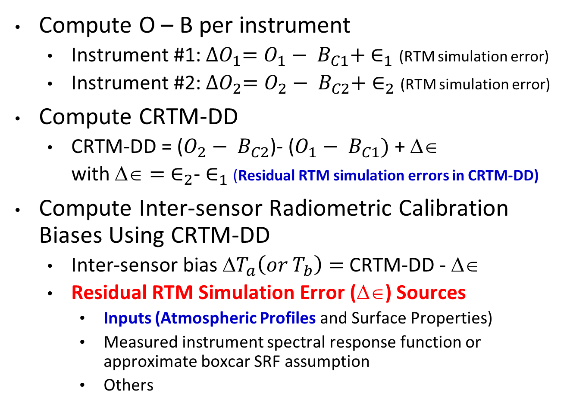
Satellite Inter-Sensor Radiometric Calibration Methodology Using CRTM as a Transfer
Compute O – B per instrument
  Instrument #1: ${∆O}_{1}=O_{1}− B_{C1}+ ∈_{1}$ (RTM simulation error)
  Instrument #2: ${∆O}_{2}=O_{2}− B_{C2}+ ∈_{2}$ (RTM simulation error)
Compute CRTM-DD
  CRTM-DD = ($O_{2}− B_{C2}$)- ($O_{1}− B_{C1})$ + $$
  with $={ ∈}_{2}$- $∈_{1}$ (Residual RTM simulation errors in CRTM-DD)
Compute Inter-sensor Radiometric Calibration Biases Using CRTM-DD
  Inter-sensor bias $T_{a}\left(or T_{b}\right)=$ CRTM-DD - $$
  Residual RTM Simulation Error ($$) Sources
    Inputs (Atmospheric Profiles and Surface Properties)
    Measured instrument spectral response function or approximate boxcar SRF assumption
    Others
Computation Components:
  O: Satellite Observation
      1). This study utilizes ATMS
      TDR data (Ta or antenna
      temperature, without
      antenna pattern correction)
      for the demonstration
  Bc: CRTM radiance simulation without simulation error
  CRTM Input Parameters
  1). ECMWF forecasts:
  atmospheric profiles and
  surface properties
  2). GNSS RO-derived
  temperature and moisture
  profile dataset

Slide 6
Inter-sensor Radiative Calibration Bias Assessment:
Datasets and Experiment Designs
Satellite Radiance Data:
  Data Source: SNPP/NOAA-20/NOAA-21 ATMS TDR data are used for the demonstration
  Dataset Coverage: 2023 ~ Present, where all of SNPP/NOAA-20/NOAA-21 data are available
CRTM Profile and Surface Input Parameters
  Atmospheric Temperature and Moisture Profiles (Two different data sources!)
    ECMWF forecast data
    GNSS RO-derived products (collocation with satellite observations)
      3-hr time window and 50 km distance window (vs. channel peak altitude) (reference: Liu et al., 2019: STAR Software Description and Operations Manual: Tool to Inter-compare ATMS Radiances With CRTM-Simulations Based on COSMIC GPS-RO Soundings)
  Atmospheric Trace Gas Absorber Concentration Profiles (e.g., Oxygen and Ozone)
    ECMWF forecast data
CRTM Simulation Criteria
  Channel Selection: Only applied to the channels from 6 to 15, to reduce simulation errors due to surface emissivity errors
  Environmental Conditions: restricted to clear-sky conditions over oceans
  Geographic Scope: limited to latitudes between ±55° for ECMWF inputs and ±60° for RO-profile inputs
Inter-sensor Radiance Bias Computation
  Monthly mean of CRTM-DD derived inter-sensor biases (in the presence of residual CRTM simulation errors)
  Comparison of CRTM-DD biases using ECMWF and RO-derived atmospheric profiles

Slide 7
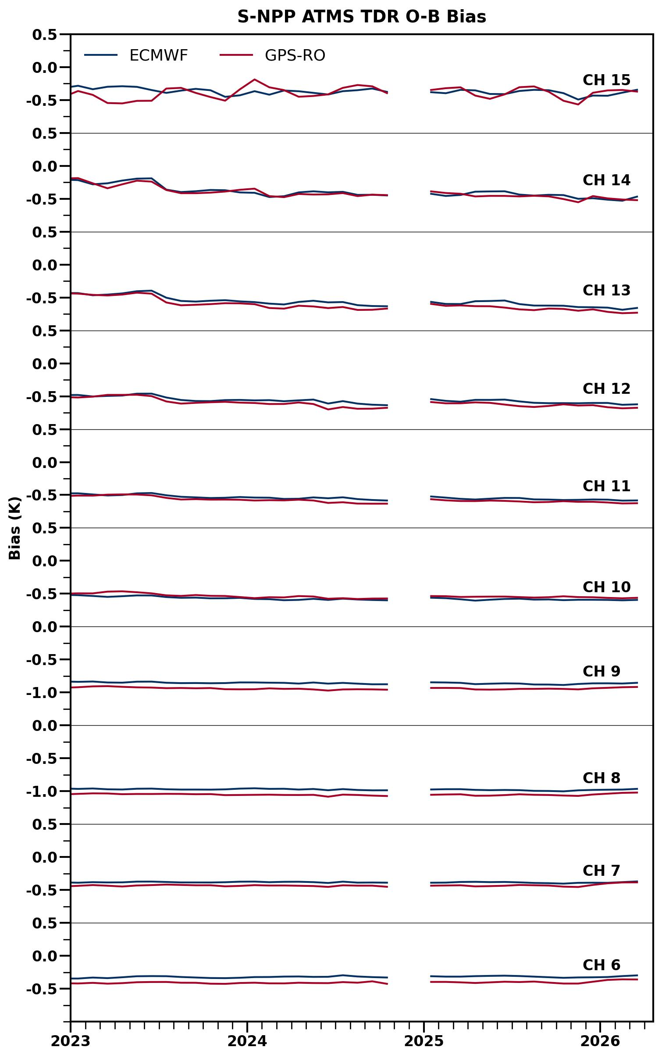
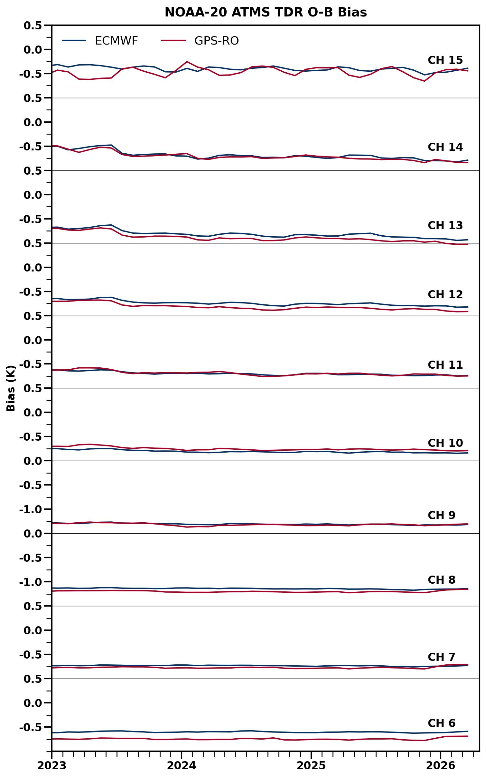
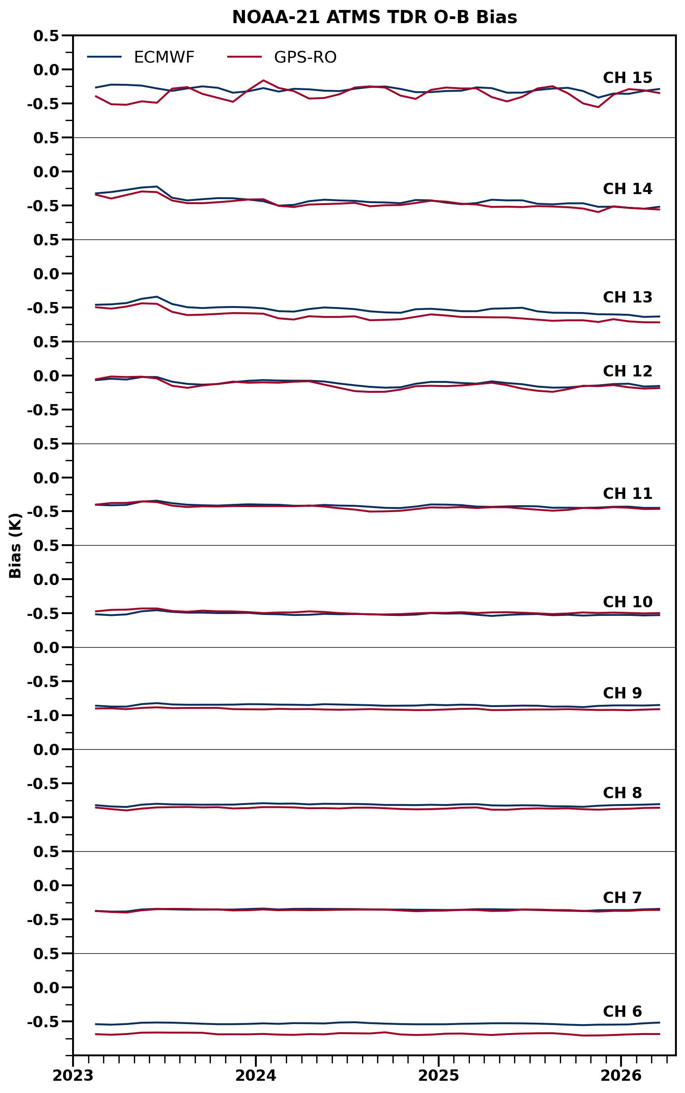
TDR Radiometric Calibration Error across 3 ATMS Instruments:
O – B Using ECMWF and UCAR RO Profile Datasets
Blue lines: ECMWF-Results
Red lines: RO-Results
SNPP
NOAA-20
NOAA-21
TDR Radiometric Error, O – B (K)
TDR Radiometric Error, O – B (K)
TDR Radiometric Error, O – B (K)
Time
Time
Time
Two different sources of atmospheric (temperature and moisture) profiles lead to slightly different instrument radiometric calibration biases across various sounding channels, with the largest deviation of 0.1 K in channels 6 and 13.

Slide 8
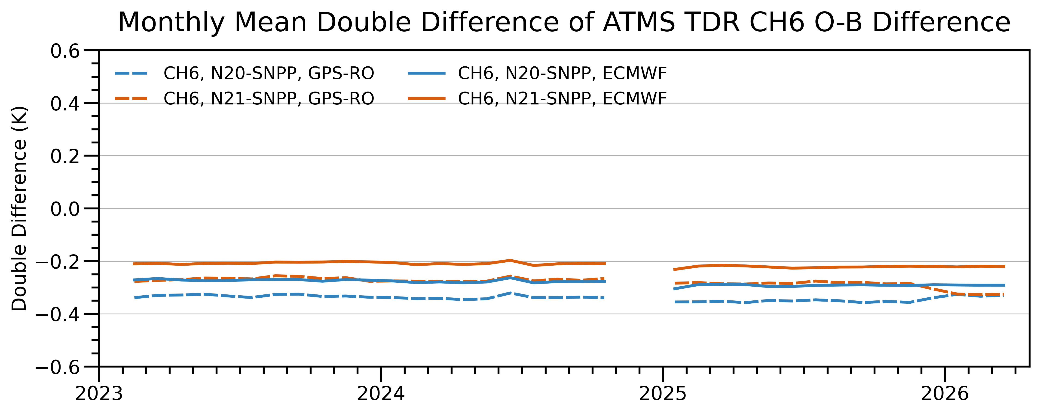
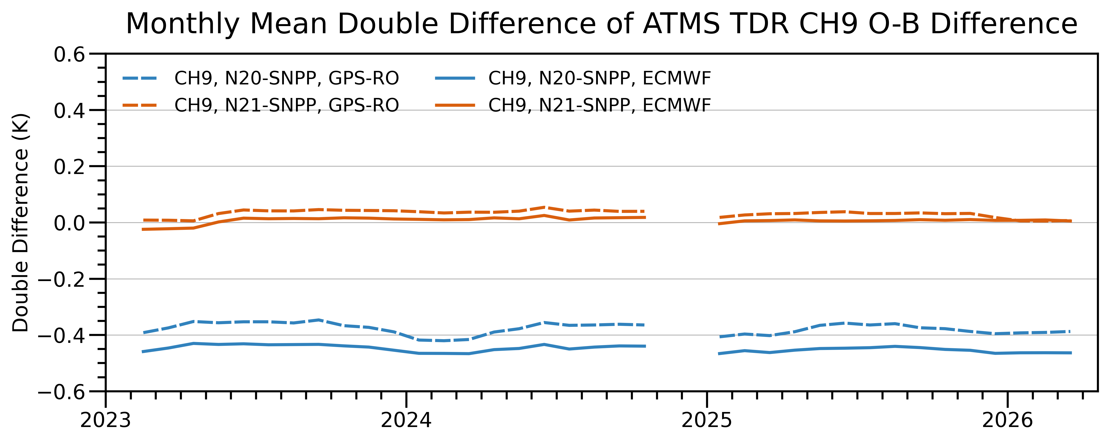
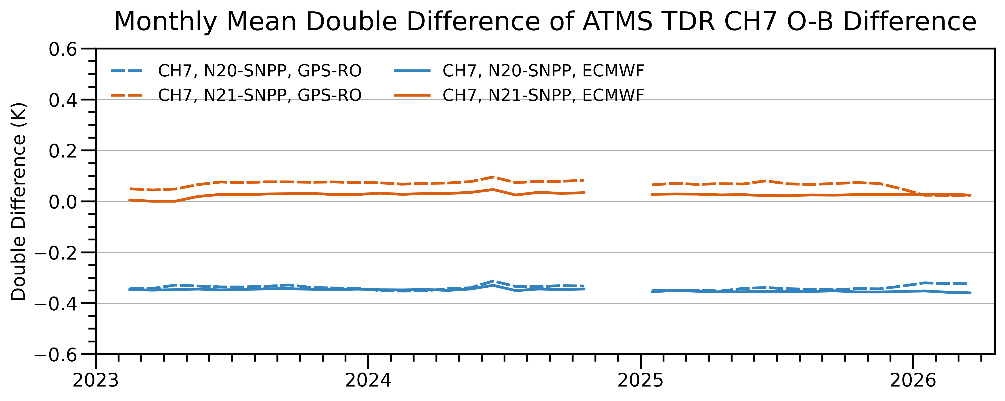
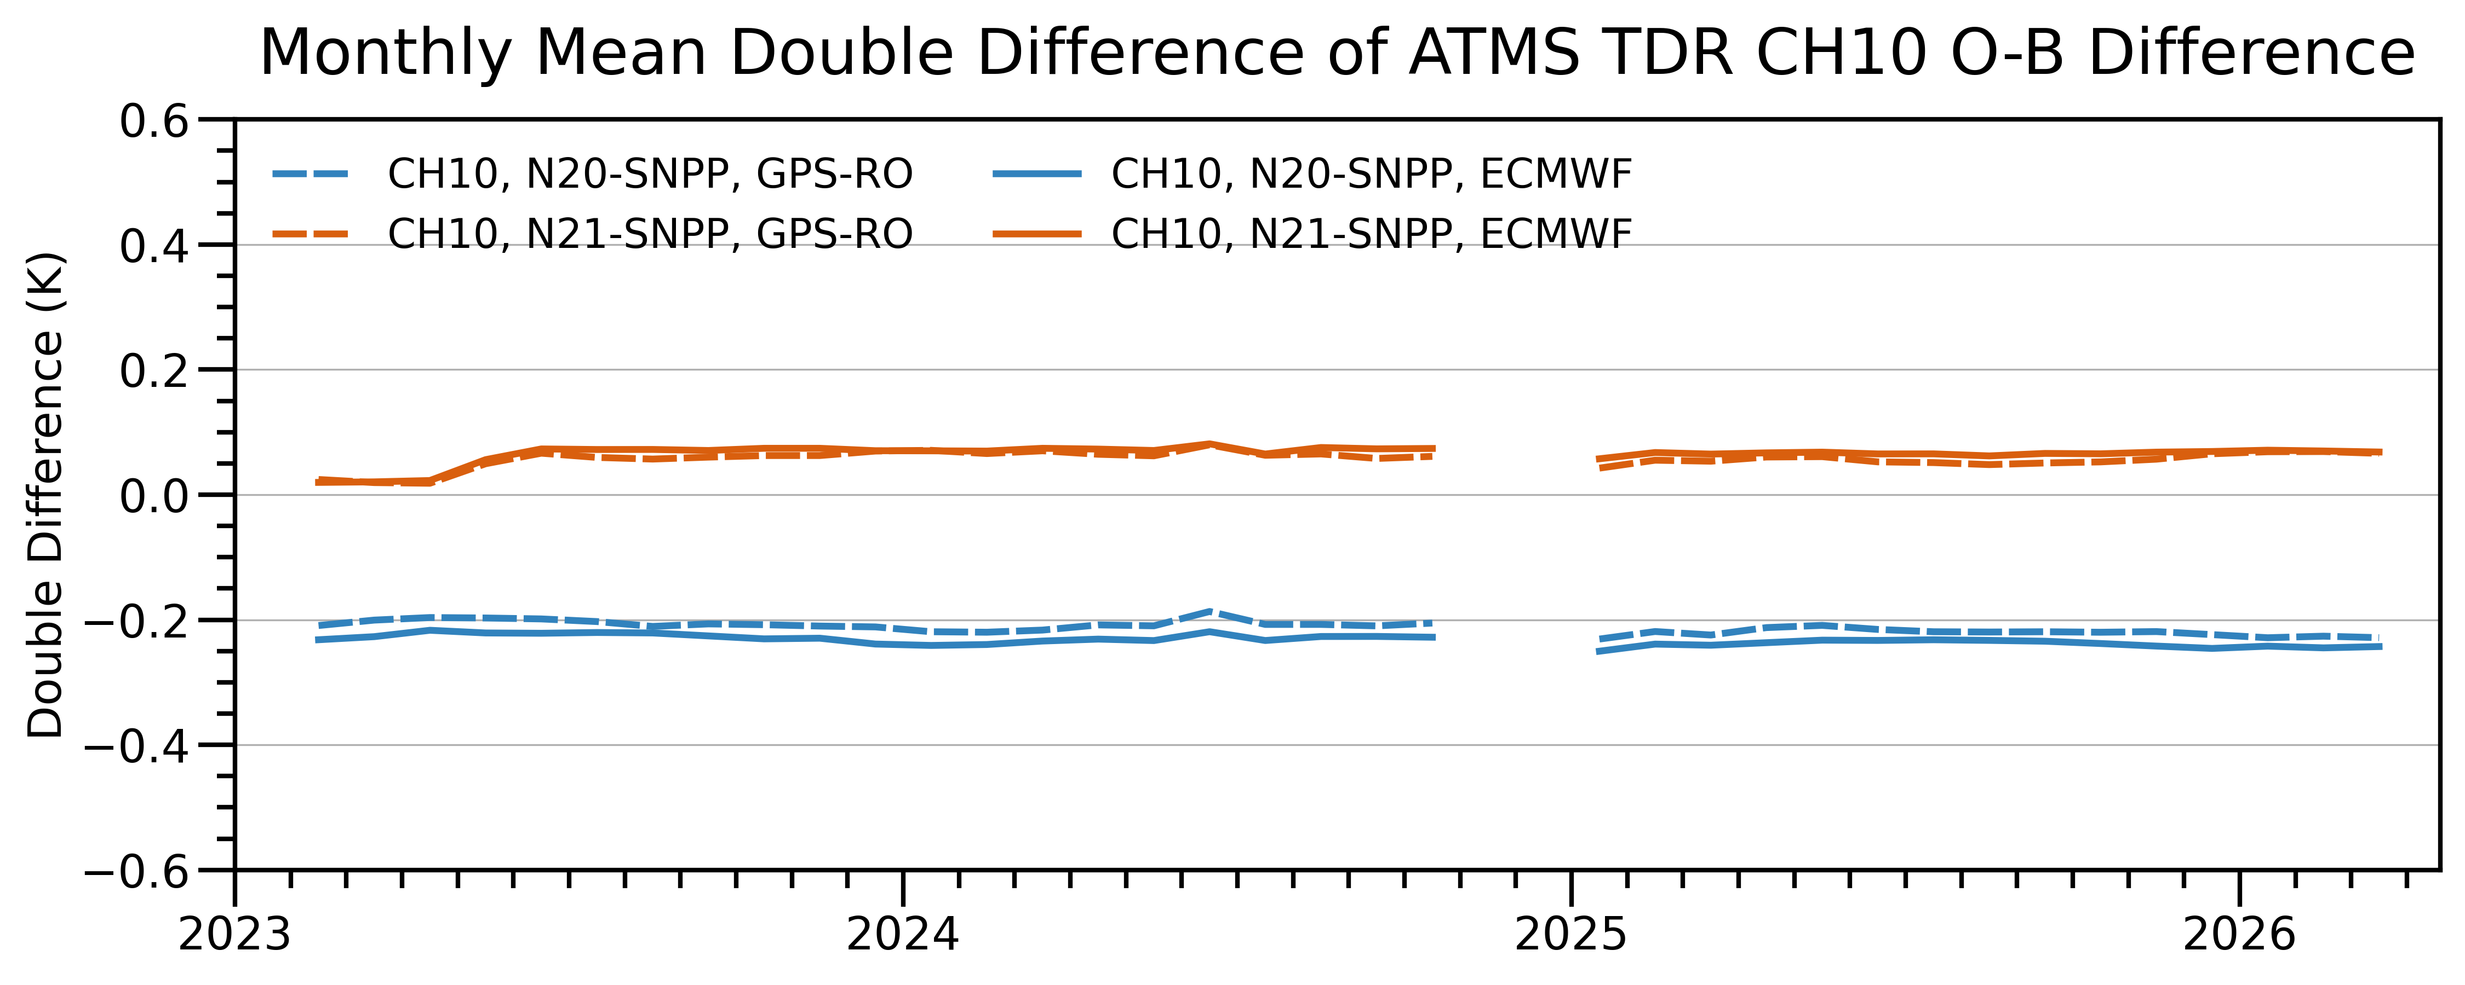
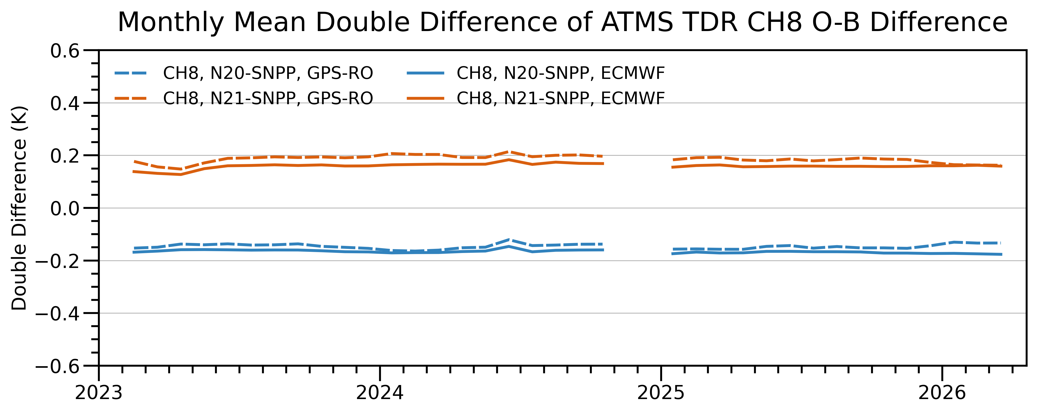
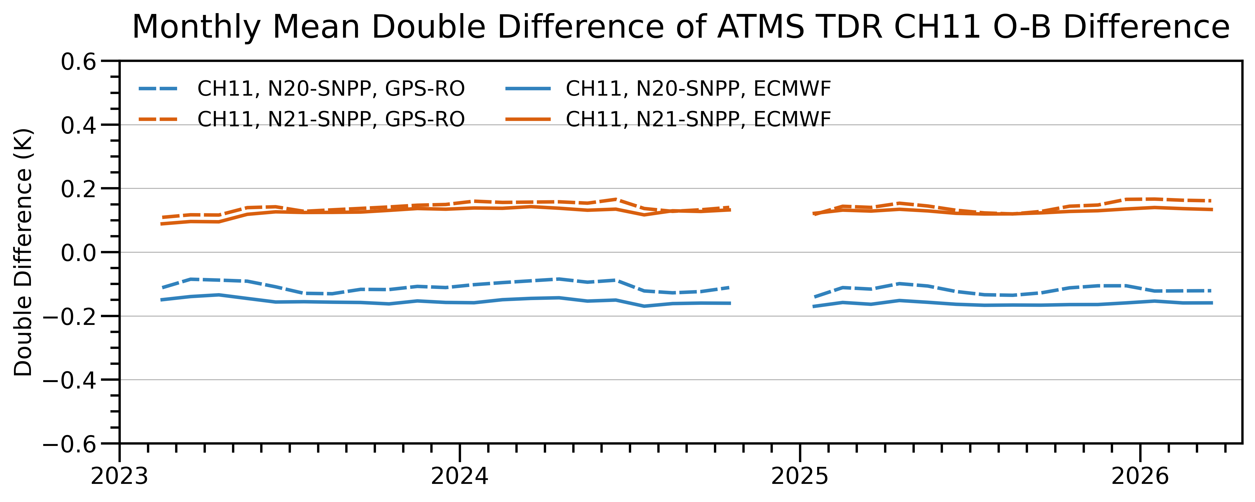
Inter-sensor (TDR) Radiometric Consistency across 3 ATMS Instruments:
Double Difference of (O – B) Using ECMWF and UCAR GNSS RO Profile Datasets (1/2)
CH6
CH9
Time
Time
CH7
CH10
Blue: N20-SNPP
Red: N21- SNPP
Solid lines: ECMWF Input
Dash lines: RO Input
Inter-Sensor Radiometric Calibration Bias, CRTM-DD (K)
Inter-Sensor Radiometric Calibration Bias, CRTM-DD (K)
Time
Time
CH8
CH11
Time
Time
Time

Slide 9
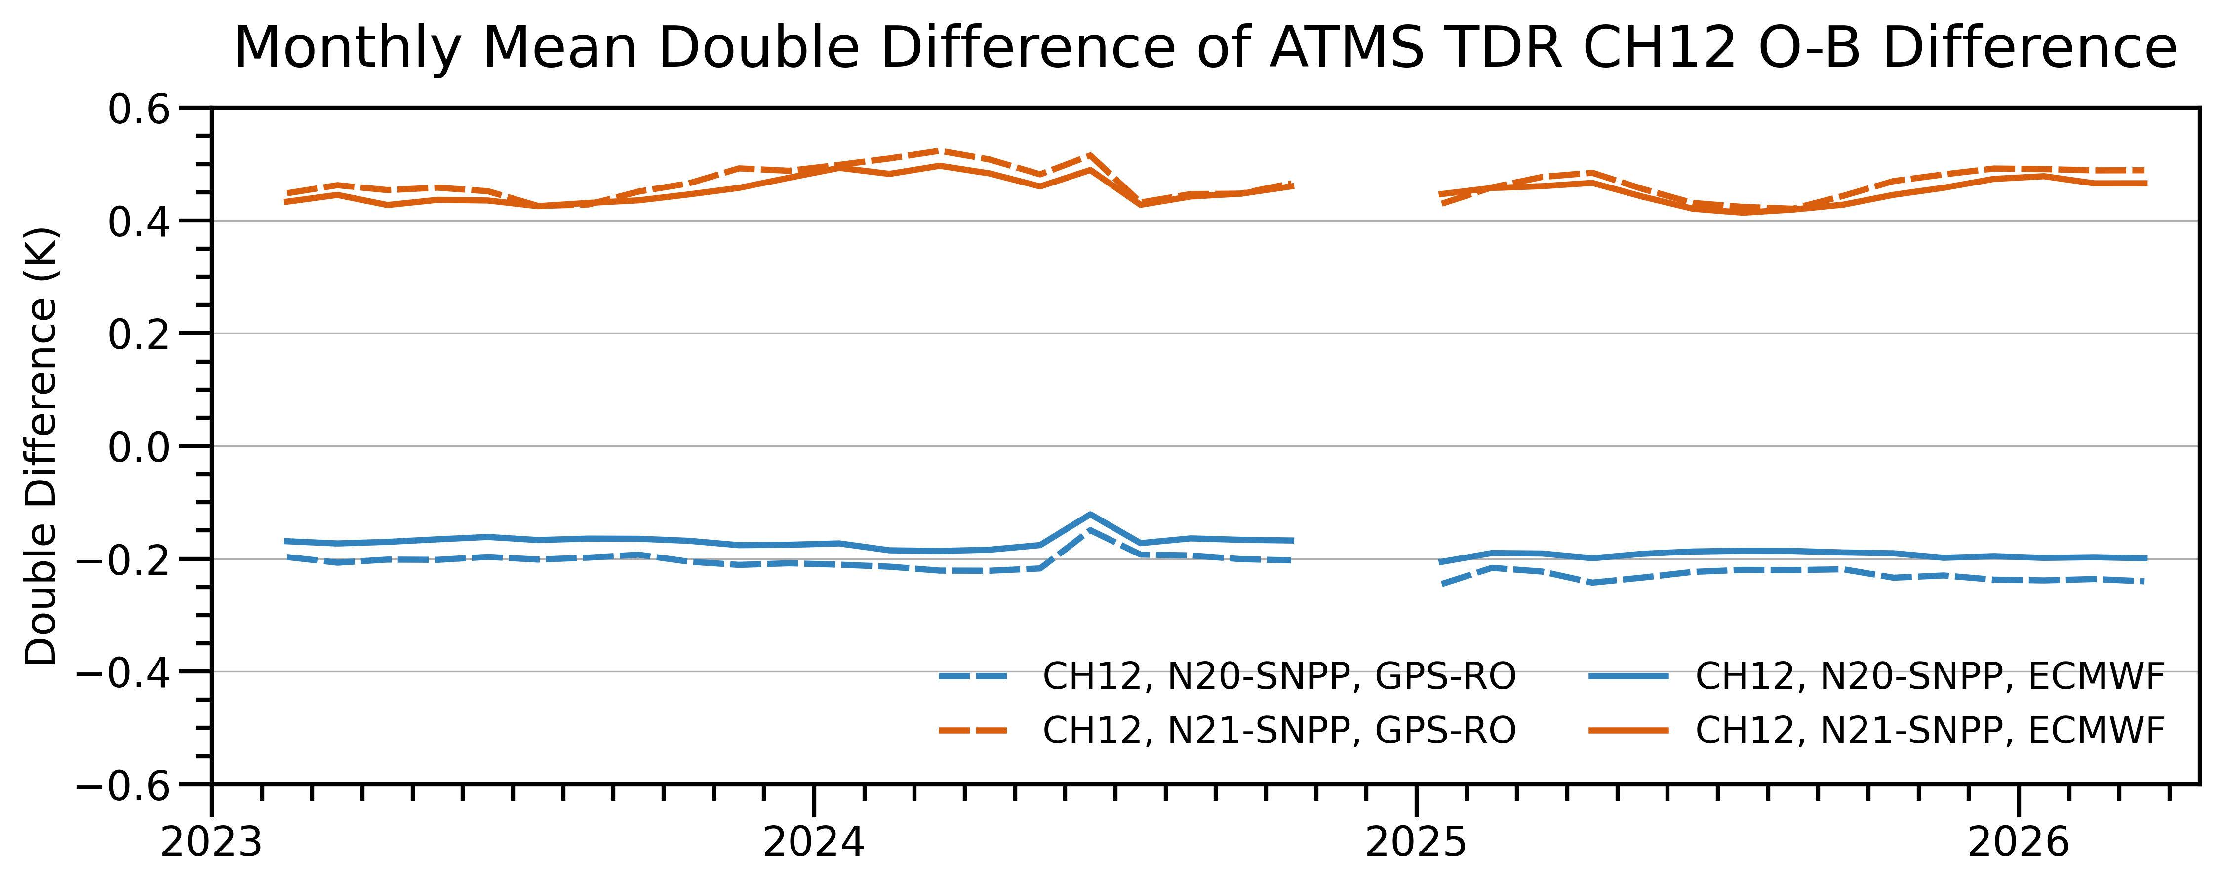
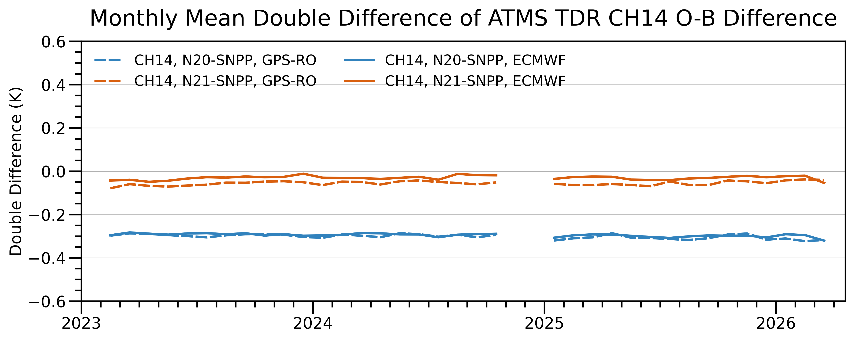
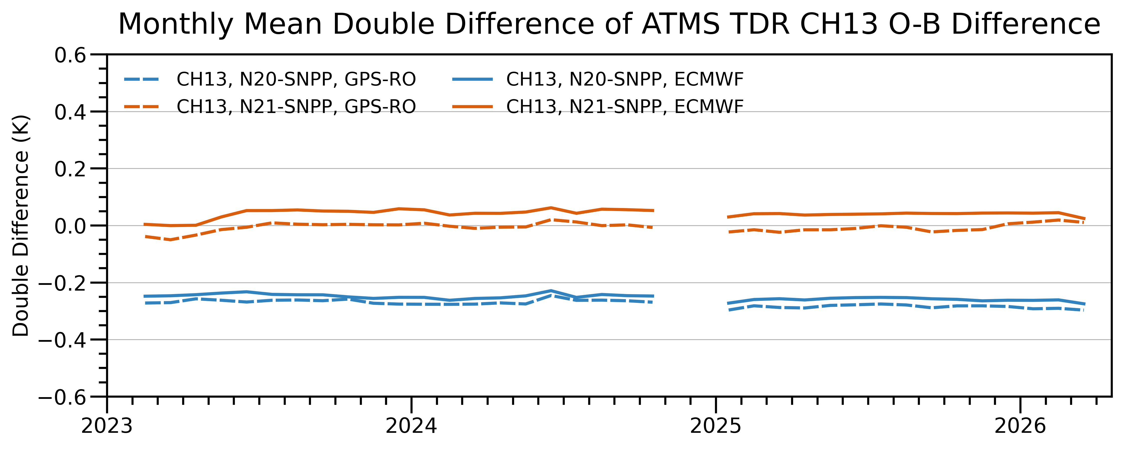
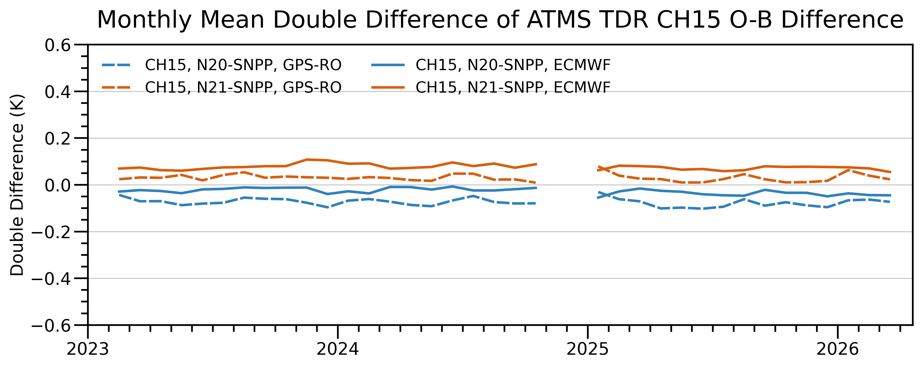
Inter-sensor (TDR) Radiometric Consistency across 3 ATMS Instruments:
Double Difference of (O – B) Using ECMWF and UCAR GNSS RO Profile Datasets (2/2)
CH12
CH14
Time
Time
Inter-Sensor Radiometric Calibration Bias, CRTM-DD (K)
Inter-Sensor Radiometric Calibration Bias, CRTM-DD (K)
Blue: N20-SNPP
Red: N21- SNPP
Solid lines: ECMWF Input
Dash lines: RO Input
CH13
CH15
Time
Time
Two different sources of atmospheric (temperature and moisture) profiles lead to slightly different inter-sensor radiometric calibration biases by deviations up to 0.09 K across 3 ATMS instruments at various sounding channels

Slide 10
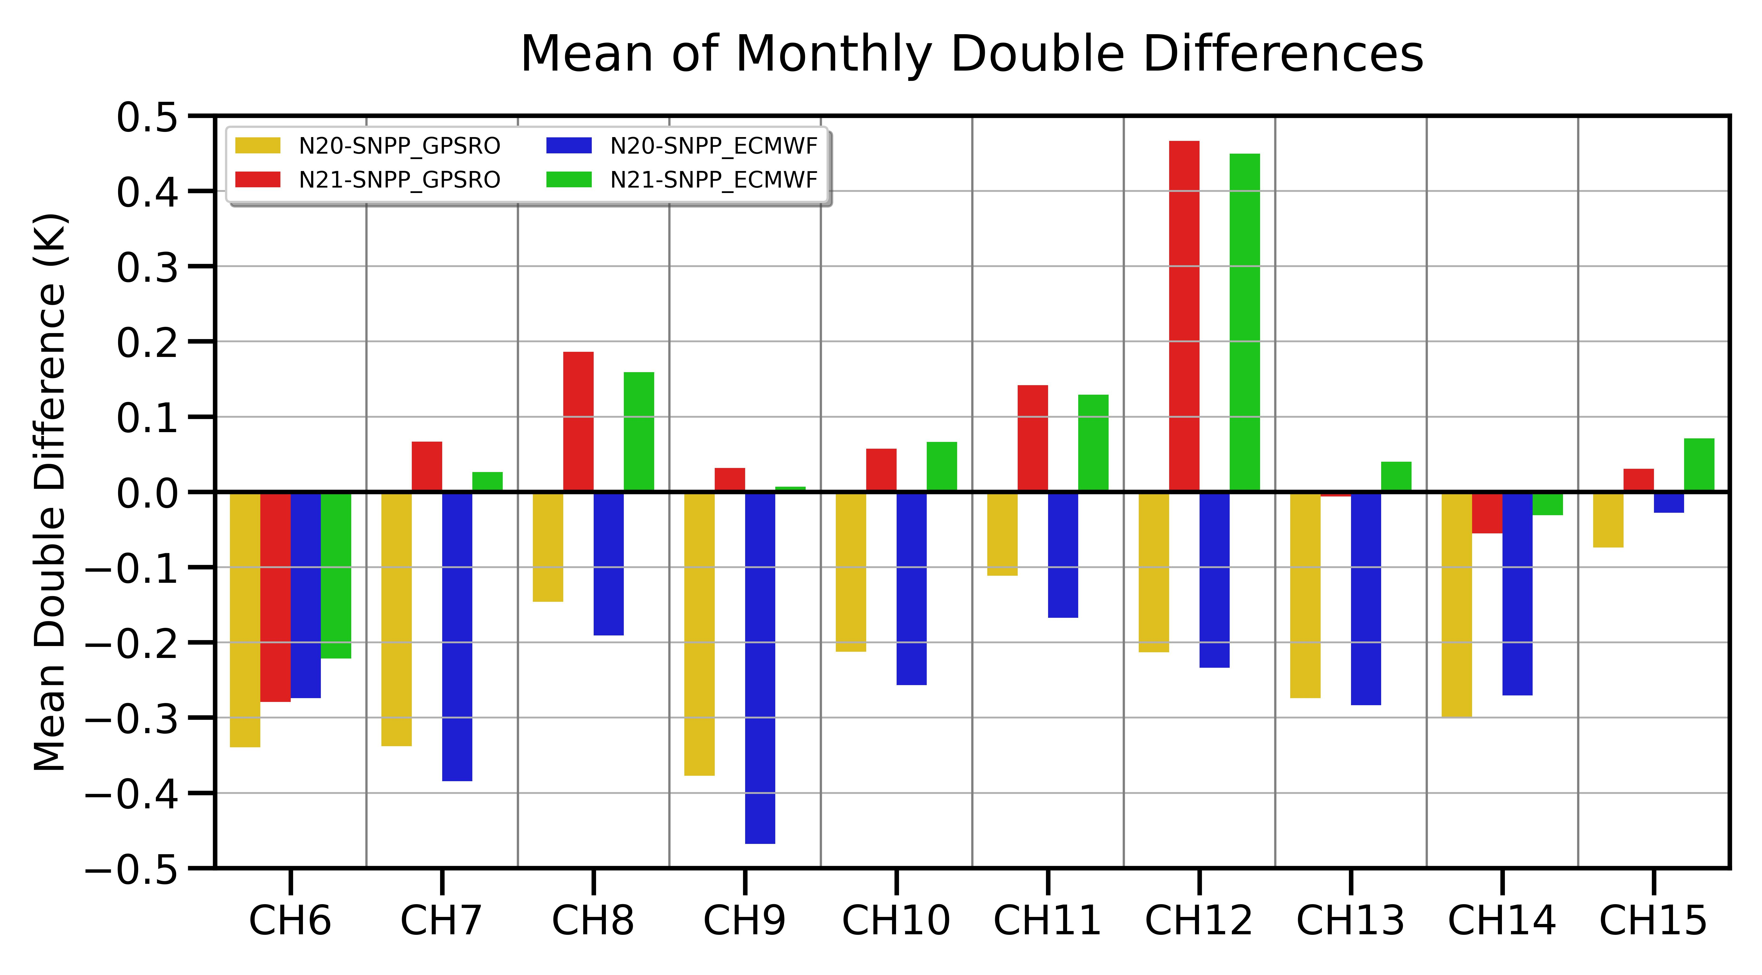
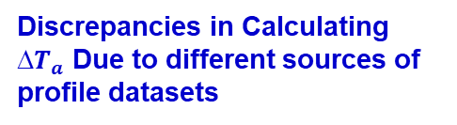
Statistics of Monthly Mean CRTM-DD ($T_{a})$Time Series
Mean DD (K) | N20-SNPP_ECMWF | N21-SNPP_ECMWF | N20-SNPP, GPSRO-ECMWF | N21-SNPP, GPSRO-ECMWF
CH6 | -0.27 | -0.22 | -0.07 | -0.06
CH7 | -0.38 | 0.03 | 0.05 | 0.04
CH8 | -0.19 | 0.16 | 0.04 | 0.03
CH9 | -0.47 | 0.01 | 0.09 | 0.02
CH10 | -0.26 | 0.07 | 0.04 | -0.01
CH11 | -0.17 | 0.13 | 0.06 | 0.01
CH12 | -0.23 | 0.45 | 0.02 | 0.02
CH13 | -0.28 | 0.04 | 0.01 | -0.05
CH14 | -0.27 | -0.03 | -0.03 | -0.02
CH15 | -0.03 | 0.07 | -0.05 | -0.04
Discrepancies in Calculating $T_{a}$ Due to different sources of profile datasets
RO
ECMWF
Mean discrepancy in RTM-based Inter-sensor radiometric calibration accuracy:
≤ 0.1K (sounding channels), which is important for a satellite microwave radiometer

Slide 11
Lessons Learned from the ATMS Demonstration and
Implications for Satellite Microwave Radiometric Calibration
Our analysis indicates that different sources of atmospheric profile datasets can lead to important discrepancies in calibration biases due to residual RTM simulation errors. Specifically, we have noted the following regarding ATMS temperature sounding channels:
  Discrepancies in O – B are up to 0.1 K.
  Discrepancies in inter-sensor calibration biases (CRTM-DD) across satellite instruments are up to 0.1 K.
  It is expected that these discrepancies at window channels would be even larger than at sounding channels. However, a new analysis is needed in future studies.
These impacts are not limited to ATMS but will likely affect the radiometric calibration accuracy assessment for various satellite microwave instruments, such as
  Metop-SG Microwave Sounder and Microwave Imager
  Weather Follow-on Microwave (WSF-M)
  Tomorrow.io Microwave Sounder (TMS)
  Metop-B/C AMSU-A and MHS

Slide 12
ECMWF/NWS-GFS Forecasts vs. RO-Derived Atmospheric Profiles
NWP forecasts from ECMWF or NWS-GFS represent the "state of the art" in global atmospheric modeling, integrating millions of observations into a physically consistent 3D grid.
GNSS RO missions (e.g., COSMIC-1, COSMIC-2, PlanetiQ) provide SI-traceable, absolute measurements of time delay. These are converted into bending angles and refractivity profiles which, unlike traditional satellite radiance, do not require external calibration.
Each data set has its own advantage and disadvantage for RTM-based inter-sensor radiometric calibration (see Table)
Table Advantages and disadvantage of ECMWF and RO Datasets
Key Features | ECMWF Forecasts | RO-Derived Profiles
Forecast Parameters | Almost all necessary RTM inputs: temperature, humidity, ozone, cloud liquid water, ice water, and surface parameters (e.g., skin temperature and wind speed) (More parameters) | Only have temperature and moisture profiles; no information of trace gas profiles
Best Use Case | Large-scale global validation | Precision “anchor” for T- profile (e.g., ATMS CH. 8, 9, 10 RTM simulation)
Vertical Structure | 92 level+ | 8 ~ 30 km with a vertical resolution of 0.1 km
Global Coverage | Global | Sparse (point-based)
Product Vertical Limitation | Surface to a very high level (~0.01 mb) | 8 ~ 30 km
Independence | Low (satellite data is assimilated) | High (Independent)
Model (Algorithm) Bias | Even the best NWP models could have biases or discontinuities due to changes of the model performance, particularly when new satellite data are added to NWP model | The algorithm from "bending angle" to "temperature and moisture"—could introduce certain biases.

Slide 13
A Strategy for Standard Atmospheric Profile Datasets for RTM-based Inter-Sensor Calibration: Multi-Source Integrated Datasets
ECMWF is the most common choice for large-scale, operational inter-sensor comparison
  Spatial and Temporal Continuity: ECMWF provides a "Map without Gaps." It allows you to perform Double-Difference (DD) calculations anywhere on Earth at any time.
  Physical Consistency: Because it is a 4D-Var assimilation product, the temperature, moisture, and pressure fields are physically consistent with one another. This reduces "noise" in the RTM simulations
  Statistical Power: WE CAN Generate millions of "O-B" (Observation minus Background) samples in a single day, thus reducing random noise
  Shortcomings: It has its own model biases.
Quality-Consistency RO Temperature and Humidity Dataset is recommended
  SI-Traceability: RO is based on time-delay measurements traceable to atomic clocks. It is often treated as the "Gold Standard" or anchor for the entire Global Observing System.
  Vertical Resolution: RO has a much higher vertical resolution (~100m) than model levels
  Shortcomings: RO profiles are "points" in space and time. You cannot perform a global comparison as easily as with ECMWF
ERA5 (Reanalysis)
  Long-Term Consistency: This is a reanalysis product, which allows creating a more complete and consistent inter-sensor radiometric calibration biases across instruments.
  Other good features similar to those in ECMWF forecast
A multi-source integrated dataset is recommended to provide a comprehensive assessment for inter-sensor radiometric calibration analysis, when a RTM is utilized as a transfer mechanism

Slide 14
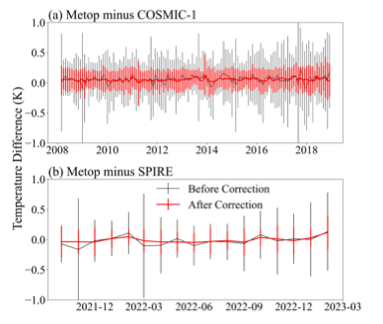
One Showcase: STAR Reprocessed GNSS RO-Derived Atmospheric Temperature and Moisture Profile Dataset
STAR RO team is reprocessing GNSS RO dataset for temperature and humidity profiles (derived from 1D var inversion).
The reprocessed RO-derived profile dataset can be downloaded from https://gpsmet.umd.edu/gnssro/download.php (Ho et al., 2019)
Characteristics of GPS RO Data
  High accuracy (equivalent to <1 K; average accuracy <0.1 K)
  High vertical resolution (0.1 km surface - 1km tropopause)
  All weather-minimally affected by aerosols, clouds or precipitation
  Independent height and pressure
  No instrument drift
  No satellite-to-satellite bias
A comparison with Metop GRAS RO (see figure)
STAR Re-processed GNSS RO vs. Metop- GRAS RO Temperature at 200 mb

Slide 15
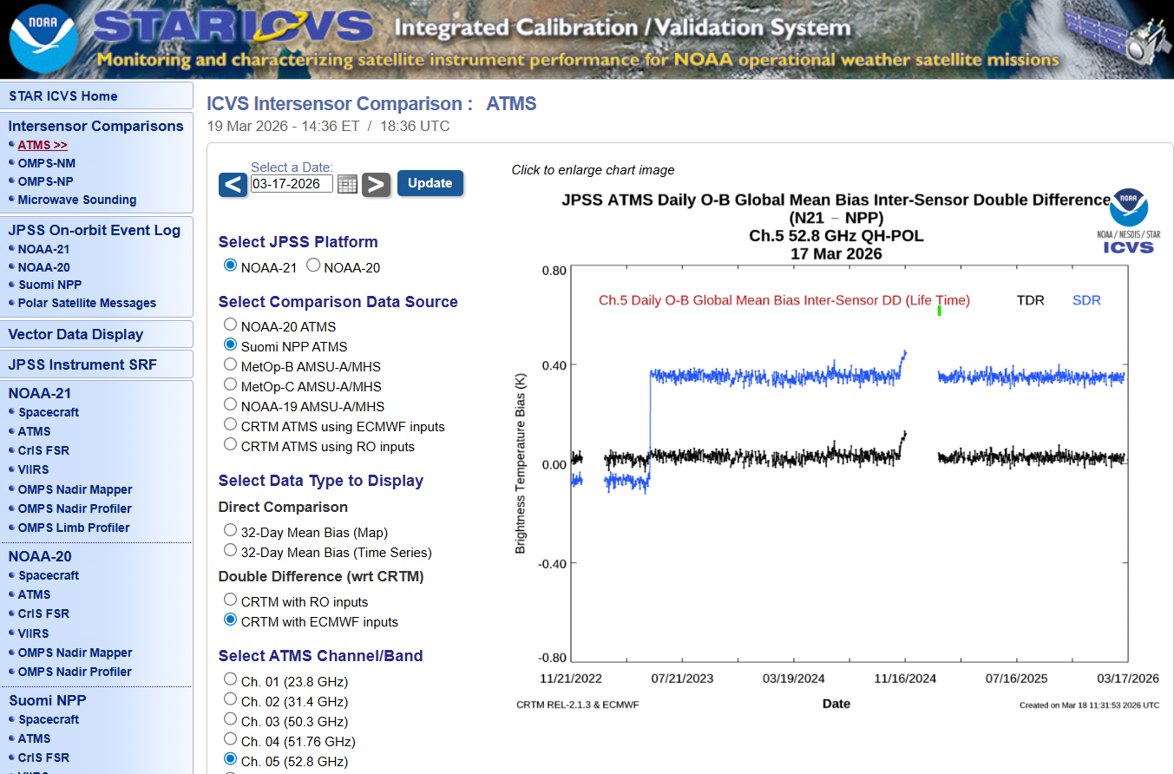
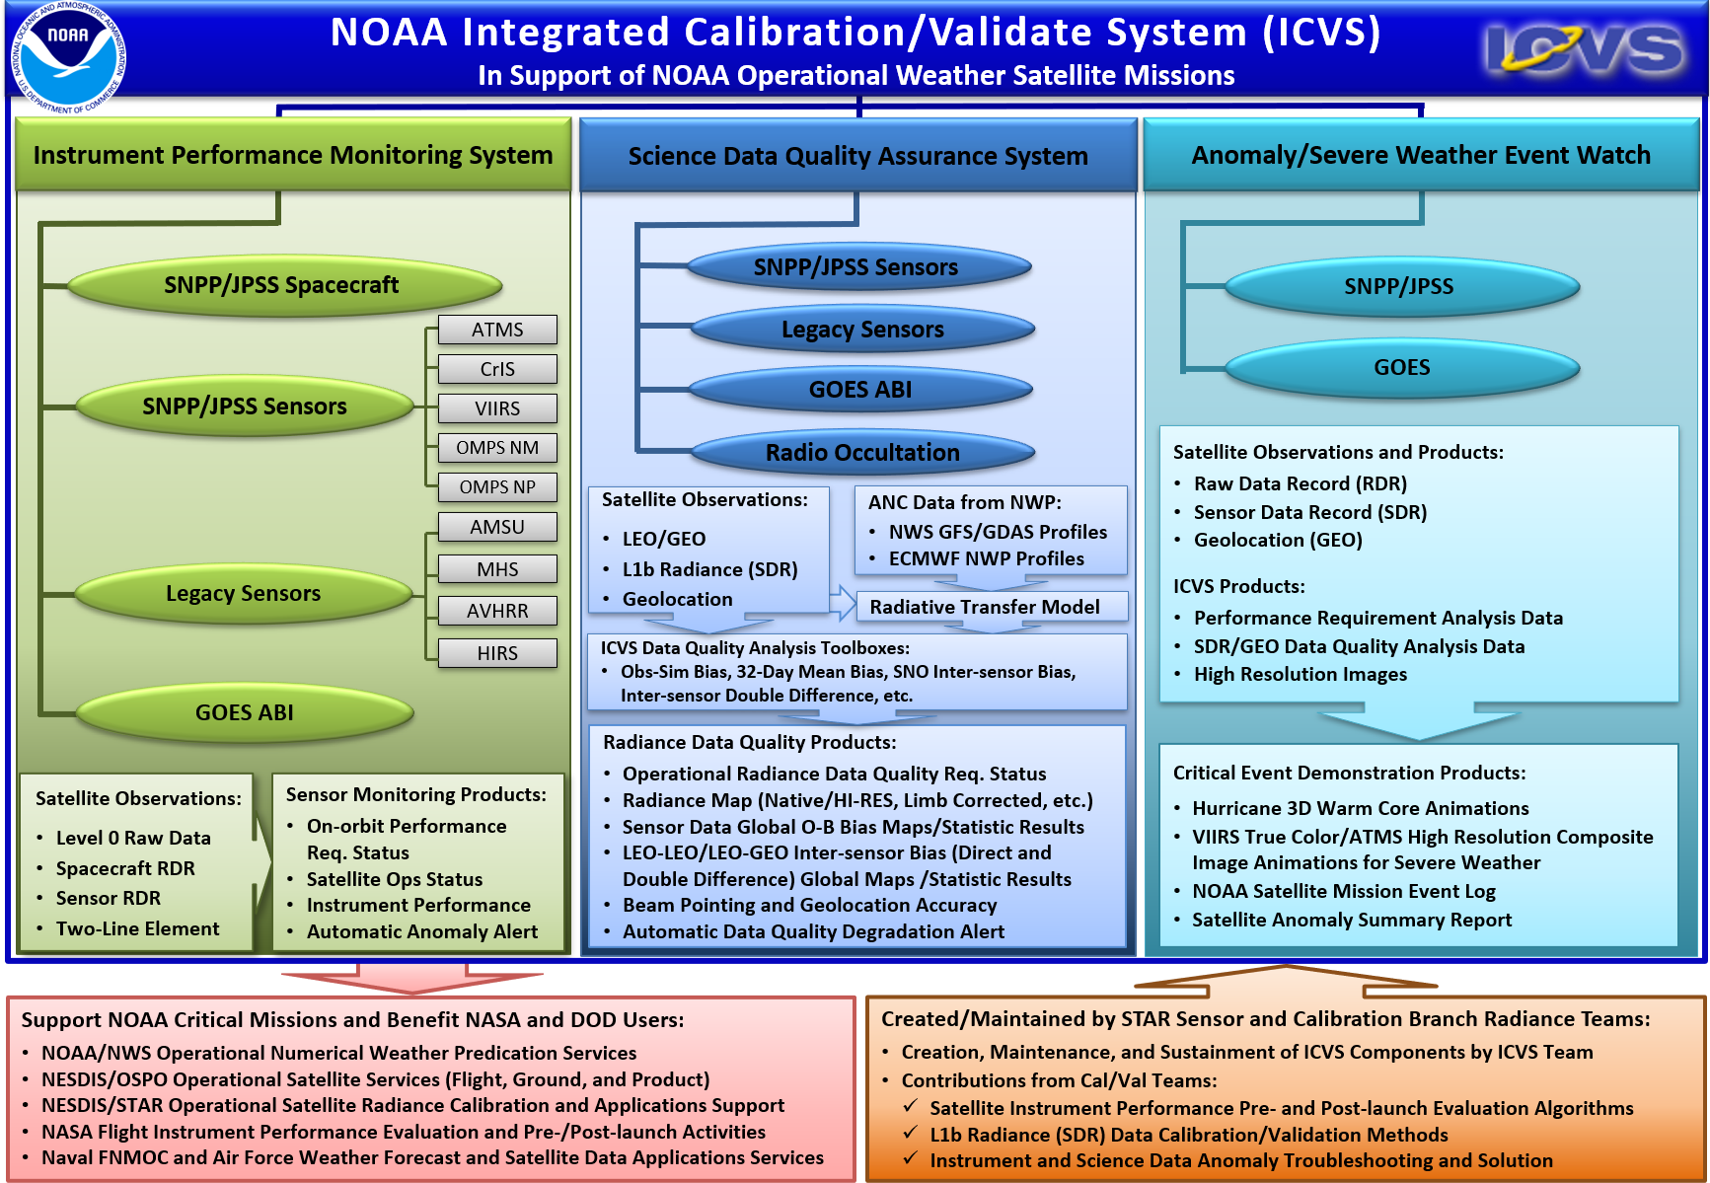
Another Showcase: A Web-based Integrated Calibration and Validation System (ICVS) Monitoring System from STAR
What does ICVS do?
  An integrated calibration and validation system (ICVS) for Satellite Instrument Near-Real Time (NRT) Performance and Data Quality Monitoring to support all NOAA satellite missions
  ICVS is an important tool for level 1b or Sensor Data Records (SDR), and is used by OSPO, NWS, ECMWF, EUMETSAT, NASA, Air Force, NAVO, as well as STAR scientists (especially the radiance or SDR teams)
Key Features
    Currently monitoring 24+ satellite instruments with more than 3000 parameters online, e.g.,
    Inter-satellite calibration of radiances (https://www.star.nesdis.noaa.gov/icvs/comparison_ATMS.php, publicly accessible) using multi-methods and multi-source atmospheric profiles (Yan et. al., 2025)
      Use CRTM (ECMWF forecasts and RO-derived profiles respectively) as a transfer
      Use 3rd sensor as a transfer (SNO based)
      Direct comparison (32-day direct differences)
      Inter-sensor comparison via deep convective cloud targets
    Serves as a web-based dashboard for satellite instrument status
An Example: ICVS Inter-sensor Comparison Website for ATMS
(https://www.star.nesdis.noaa.gov/icvs/comparison_ATMS.php)
ICVS Inter-sensor Comparison Tool

Slide 16
Summary
This study compared CRTM-derived mean radiometric biases at channels from 6 to 15 across 3 JPSS ATMS instruments using ECMWF and RO-derived profiles. The key findings from this study include:
  Discrepancies in O – B are up to 0.1 K due to different sources of atmospheric profile datasets.
  Discrepancies in inter-sensor calibration biases (CRTM-DD) across satellite instruments are up to 0.1 K.
This study further proposes a strategy about standard atmospheric profile datasets for accurate radiometric calibration across instruments by using multi-source integrated atmospheric profile datasets from ECMWF forecasts and GNSS RO-derived profile datasets.
  Specifically, the following two resources from STAR serve as excellent showcases for this approach:
  STAR Reprocessed GNSS RO-Based Temperature and Moisture Profile Dataset
  STAR Web-based ICVS Monitoring System using multi-methods and two-sources of atmospheric profile datasets (ECMWF and RO)

Slide 17
Acknowledgement
Thank Dr. Changyong Cao in STAR and Dr. Siena Iacovazzi in JPSS Office for sharing valuable suggestions and information.

Slide 18
Disclaimer
The scientific results and conclusions, as well as any views or opinions expressed herein, are those of the author(s) and do not necessarily reflect those of NOAA or the Department of Commerce.

