Slide 1
MW Radiometer Technology and Instrument Pre-Launch Testing and Post-Launch Characterization Focus Group
Progress Report
Dazhen Gu, Juyang Hu
March 25, 2026

Slide 2
Outline
Progress and status briefings
Planned Activities

Slide 3
Participants
Dazhen Gu (NIST)
Juyang Hu (CMA)
Tim Hewison (EUMETSAT)
Shengli Wu (CMA)
Fennig Karsten (DWD German Weather Service)
Jon Mittaz (University of Reading)
Hu Yang (NASA)
Raffaele Crapolicchio (ESA)

Slide 4
Focus-group’s Topics
SRF NetCDF convention
Impact of antenna characteristics
Noise Equivalent Power and Noise Equivalent Temperature definitions

Slide 5
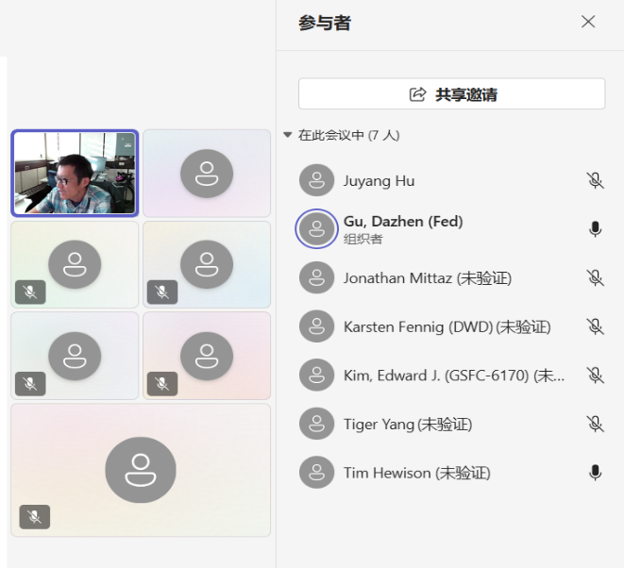
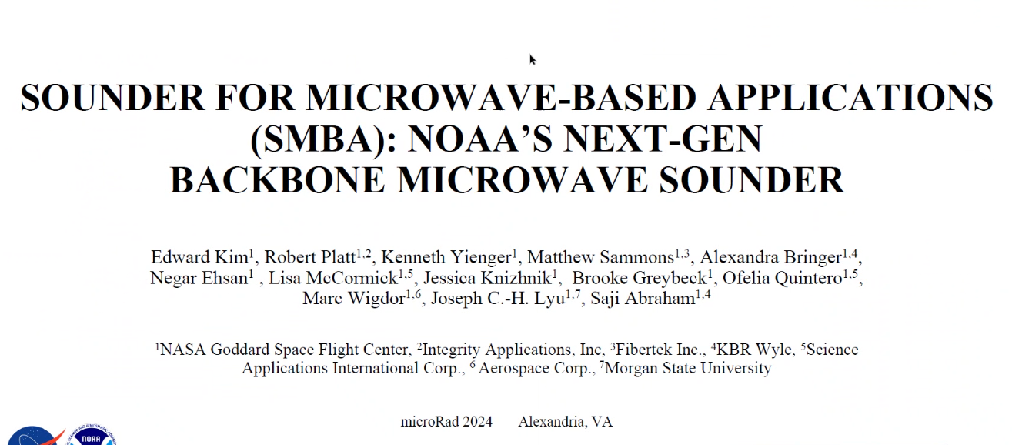
Focus Group Meeting
Date | Agenda
May 9, 2026 | Recap of last meeting Discuss recommendation of SRF netCDF convention Guest presentation by Edward Kim Action items and closing remarks

Slide 6
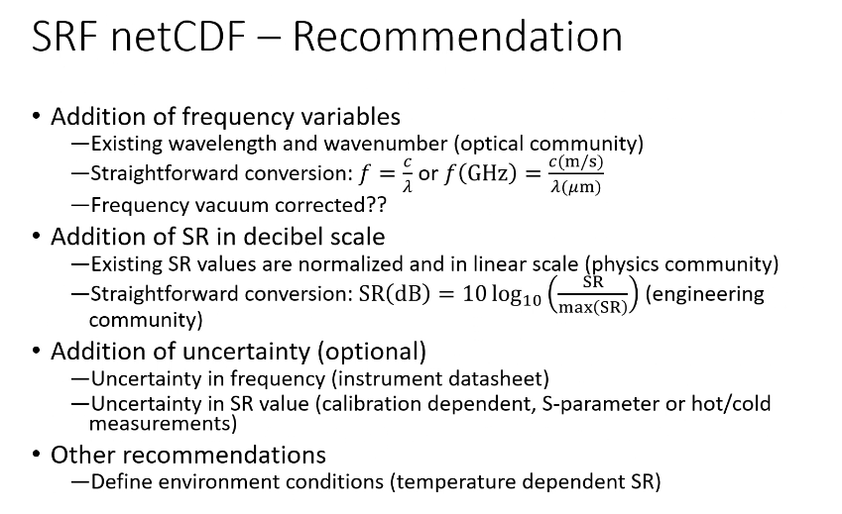
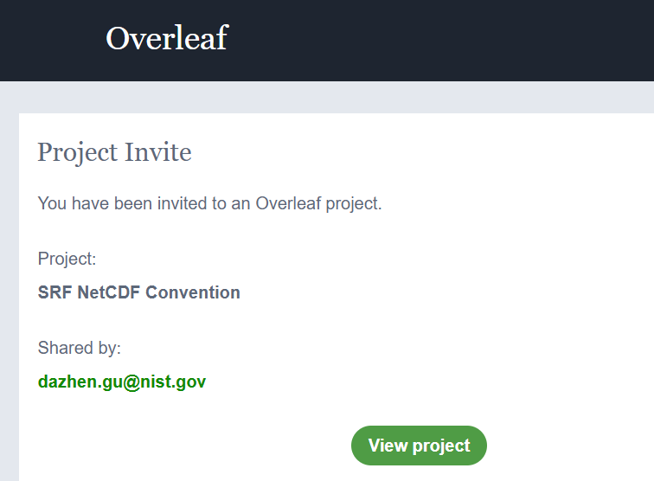
SRF netCDF (Dazhen Gu)
SRF is an aggregated response of the receiver chain, essentially receiver gain
SRF is provided by instrument maker
Obtained by instrument calibration (S-parameter measurement, hot/cold two point calibration)
Prior to 2013, various formats: csv, xml, Microsoft Excel, two-column flat file.
Network Common Data Form unified by Data Management Working Group
Masaya et al developed Python platform built on Google Colab for data extraction and plotting.

Slide 7
SRF netCDF
Feedback received by Tim from the 19th Science Advisory Group (SAG) for our Microwave Imager and Ice Cloud Imager missions:
Ground test: SRFs are characterised over the broadest range possible and archive these data, along with details of how they were acquired, noting out-of-band response is important in analysis of RFI (also for NWP)
Data format: SRFs provided in a common format
EUMETSAT’s NWP SAF (Satellite Application Facility) already provide simplified versions of the SRFs for RTTOV, which we plan to link from Instrument Landing Pages, together with links to access the full SRFs by SFTP (maybe password protected, if access restricted)
Other satellite operators are encouraged to provide SRFs to NWPSAF in specified format
(n.b. this is contrary to my previous proposal to adopt the GSICS netCDF convention for SRFs)

Slide 8
Ground test data available and noise evaluation
SAG recommended received by Tim:
For future missions:
making ground test data available under open data policy along with the operational products -for all missions-, consistently with scientific practices in scientific community missions;
systematically including ground tests with sufficiently long (in a statistical sense) continuous records in a stare (fixed pointing) mode, to enable characterisation and modelling of the noise structure.
expressing specific requirements for correlated noise, including agreed-upon metrics, against which instrument performances can be evaluated during development, commissioning and operations phases.

Slide 9
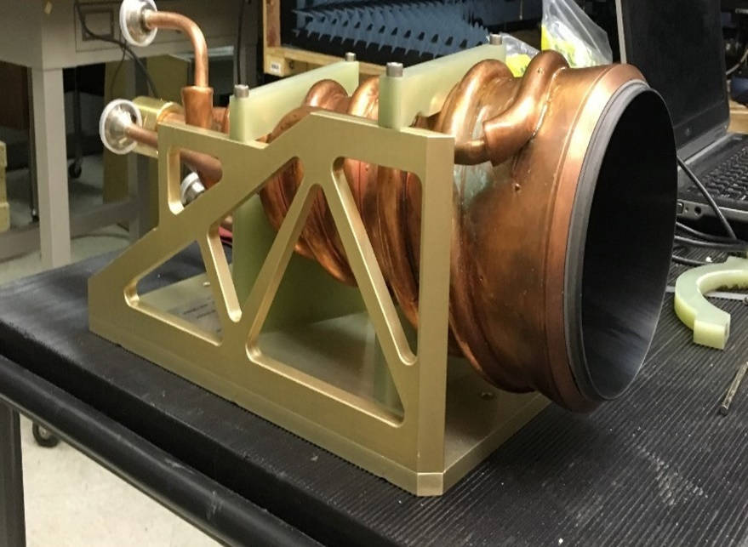
Reference Blackbody
NIST has developed a conical microwave blackbody target to facilitate prelaunch calibration.
electromagnetic properties: across a broad frequency range between 20 GHz and 220 GHz, aligning with ATMS radiometric channels.
Emissivity: a near-ideal 0.9999, was estimated as validated by mono-static reflectivity measurements.
The thermal homogeneity: recently tested in a thermal vacuum chamber at an US aerospace company. The results showed that further refinement of the thermal management component is needed to achieve temperature uniformity to within a fraction of a Kelvin.
NIST blackbody
The coupling by an antenna and surroundings needs to be taken account.
illumination efficiency: characterizes the radiation pattern subtended by the blackbody.
Antenna side and back lobs: can be minimized by choosing a highly directive antenna.
The LO leakage: can be mitigated by including an isolator in the front end.

Slide 10
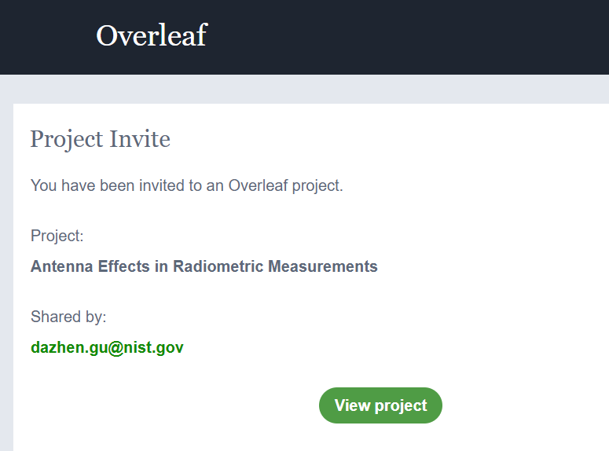
Antenna Effects (Dazhen Gu)
Initiated Overleaf the document about antenna effects in radiometric measurements.

Slide 11
Planned Activities
Continuing next quarterly subgroup meeting.
Continuing SRF netCDF Convention, instrument noise measurement and definition discussion, reference blackbody development following.
Continuing refresh our focus-group topics.

Slide 12
Thanks for your attention !
Welcome suggestions.

