Slide 1
Assessment of Tomorrow.io Microwave Sounder Observations and Performance at NOAA
Flavio Iturbide- Sanchez¹
Pan Liang², Igor Polonsky², Eric Maddy³ and Wayne McCullough³
¹NOAA/NESDIS/Center for Satellite Applications and Research
²AER/Janus Research, Lexington, Massachusetts
³ERT Inc., Greenbelt, Maryland

Slide 2
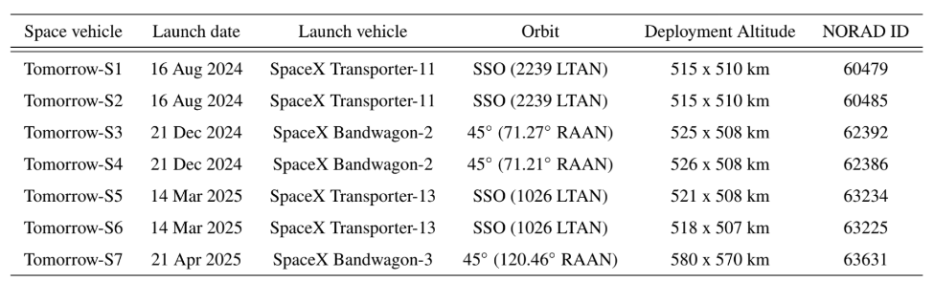
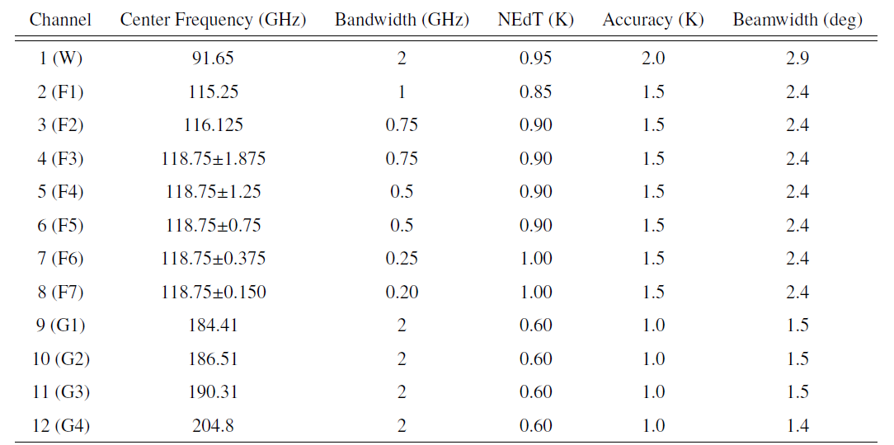
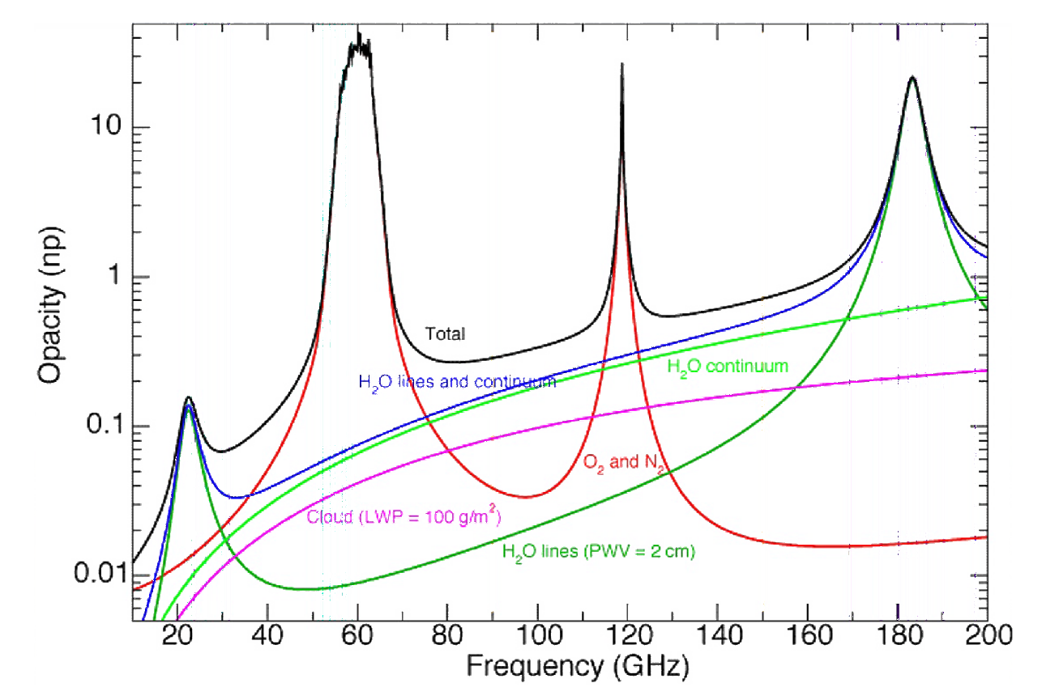
Evaluation of Tomorrow.io Microwave Sounder (TMS) Data
Evaluated Data:
Satellites: TMS-02, -03, -04, -05, -06 and -07
Type and Version: L1B-TB and L1-TBR, v1.0
Data Period: February - November, 2025
Data was available at STAR at the beginning of April 2025.
Launch dates and orbital parameters for the first seven TMS Sounders.
TMS channel performance design specifications
TMS Spectral Bands
W F G
Surface
Temperature
Water Vapor

Slide 3
Radiometric Assessment Approach
TMS L1B Brightness temperature from S02, S03, S04, S05, S06 and S07, both the TB granules and TBR (remapped) granules.
CRTM v3.0 is selected because this version supports TMS’s polarization type. We tested two sets of TMS CRTM coefficients, the Tomorrow.io V4.1 -2025.08.25 release (ODPS) and STAR V4.0-2025.10.06 release (ODPS_WODAS).
6-houly Atm. and Surface GFS data. The files are at 3072x1536 gaussian grids (~13km) and the atmospheric profiles are defined on the 127 Sigma pressure levels. In the collocation process, the GFS parameters are mapped to the TMS FOV’s latitude and longitude using the nearest neighbor method, and then linearly interpolated to the TMS FOV’s acquisition time.
Clear Ocean Mask:
From TMS: Clear fraction(channels)>=Min_threshold(channels),
Land Fraction(channels)<=0.01
From GFS: Total(cloud liquid + ice) < 0.03 mm and Total(rain+snow+graupel) == 0.
Quality check, “combinedQualityFlag” from L1B files are used, which includes RFI, NEDT calibration, ICT-ND consistency, sensor timestamp, altitude, maneuver anomalies, solar and lunar intrusions, we exclude the measurements if any condition is flagged.
Remover outliers: Tb difference Z score > 5. Remove high latitudes: abs(lat)>60°

Slide 4
Processing of TMS Data
L1B files: TBR (remapped), V01.
Platform | Time Period | Days processed | Granules processed | Clear Ocan FOVs collected | Orbit
S02 | 08/23/2025 ~ 11/07/2025 | 76 | 7807 | 2.4M(Ch1) to 43.6M (Ch7) | SSO, 97’4°
S03 | 04/28/2025 ~ 07/10/2025 | 22 | 1722 | 0.7M(Ch1) to 13.9M (Ch8) | Drifting, 45°
S04 | 02/28/2025 ~ 06/10/2025 | 20 | 1779 | 0.7M(Ch1) to 11.9M (Ch7) | Drifting, 45°
S05 | 08/27/2025 ~ 11/07/2025 | 72 | 7122 | 1.9M(Ch1) to 37.7M (Ch8) | SSO, 97’4°
S06 | 08/27/2025 ~ 11/07/2025 (Gap10/13 to 10/20) | 64 | 5932 | 1.6M(Ch1) to 30.7M (Ch7) | SSO, 97’4°
S07 | 09/10/2025 ~ 11/07/2025 | 58 | 5826 | 1.5M(Ch1) to 7.2M (Ch6) | Drifting, 45°
L1B files: TB (not remapped), V01.
S05: 10/01/2025 to 10/05/2025, 5 days, 481 granules
Clear Ocean FOVs: 151K (Ch1) to 2.7M (Ch6)

Slide 5
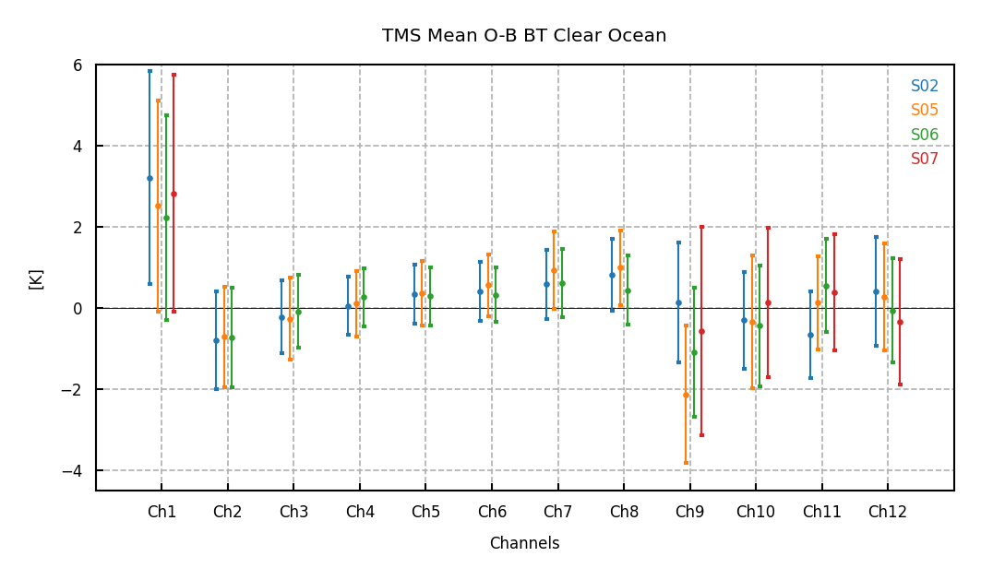
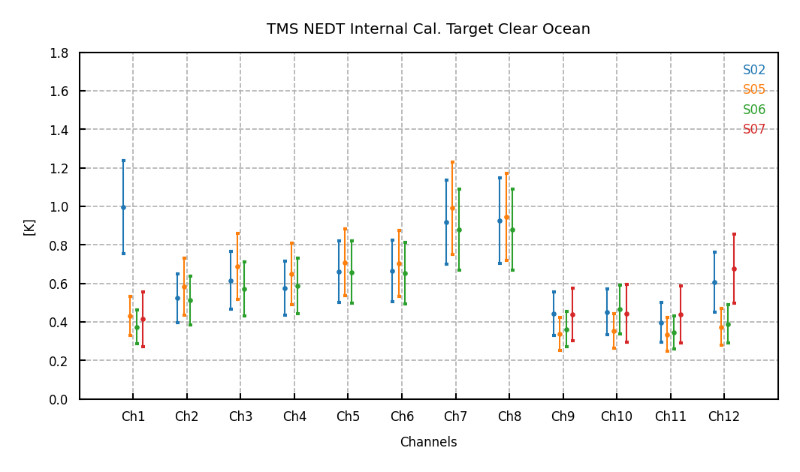
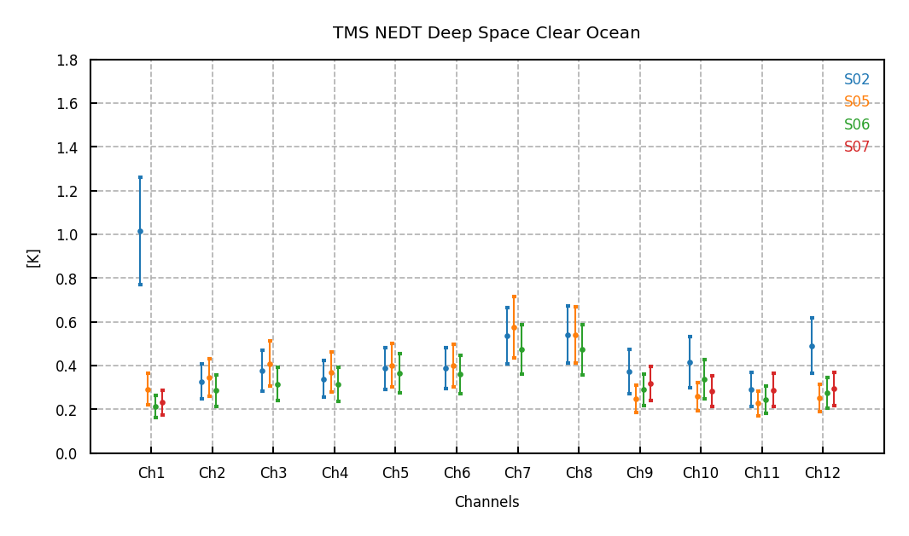
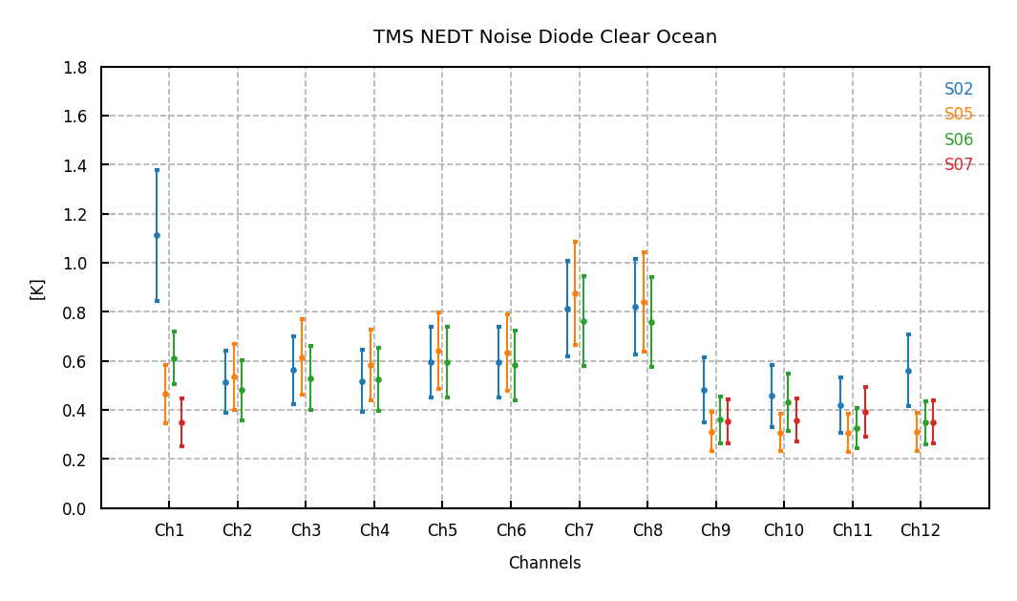
Assessment of TMS TBR Data: O-B Statistics Comparison and NEDT
S02, S05, S06 and S07, (S07 removed Ch 2 to Ch 8)
The O-B stats. are similar cross sensors.
F band channels are stable and show smaller stddev, as designed.
Large biases in the window channels can affected by the surface emissivity, GFS water vapor error, or FWD model biases.
NEDT levels are similar for the sensors, except for S02: Ch 1 and Ch 12.
O-B
NEDT ICT
F band stable and small stddev
NEDT DS
NEDT ND

Slide 6
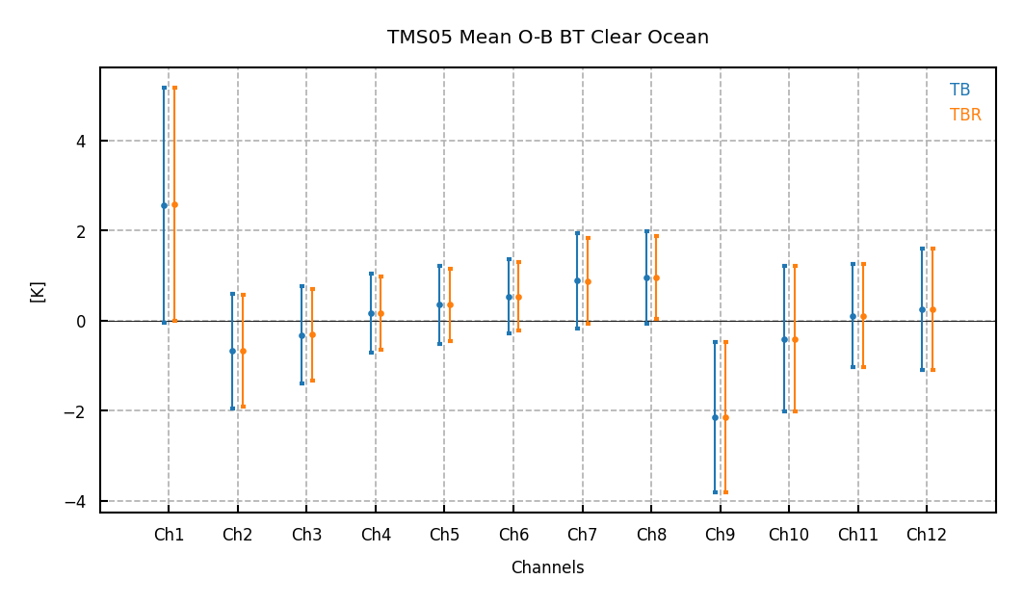
TMS05 TB vs. TBR: O-B Statistics
Compare the data from 10/01/2025 to 10/05/2025.
L1B TB data: we apply the GFS data collocation and CRTM simulation for individual channels.
L1B TBR data: GFS data collocation once for all the channels.
The O-B stats almost the same.
Agreement between TB and TBR comparisons indicates that either dataset is of sufficient quality to perform assessments of radiometric stability and likely also for retrieval and data assimilation studies

Slide 7
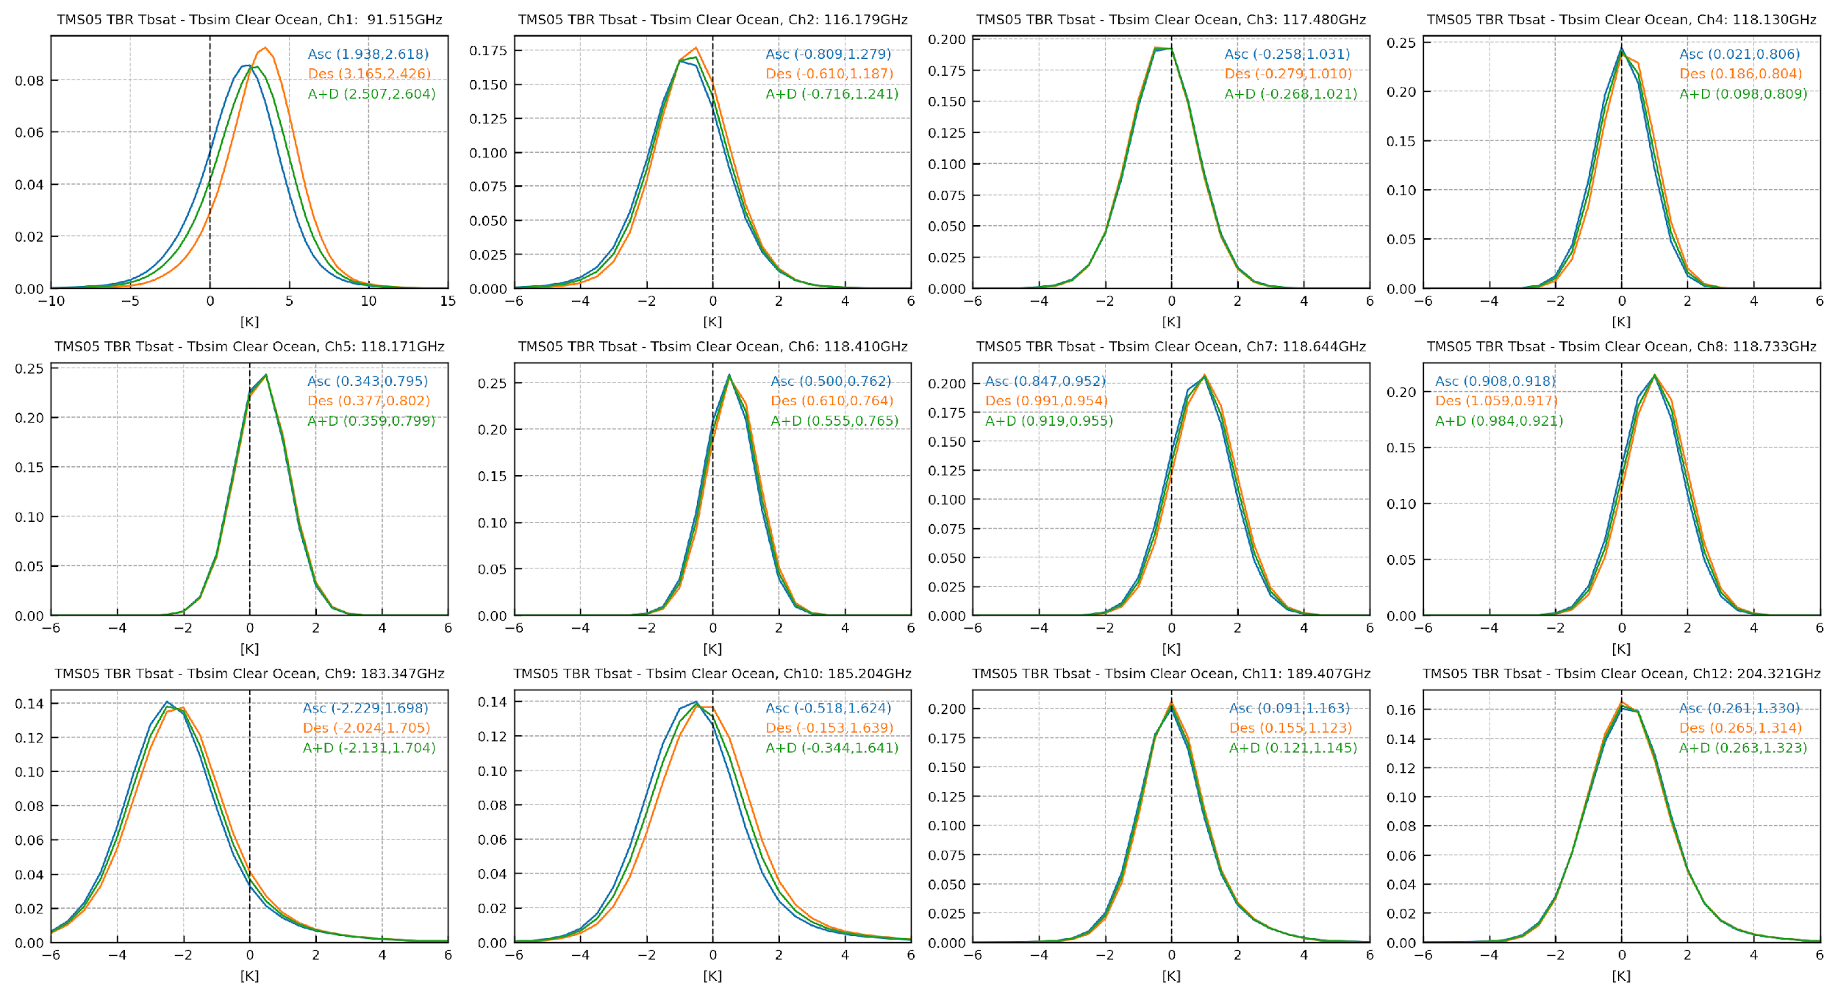
TBR O-B histograms: TMS-05
Ch 1 Asc/Des differences most visible in S05.
Also exist in other sensors.
Tomorrow.io Feedback:
Likely impact of sidelobes on ICT cal. sector (most significant at Ch 1;
G-band also worse than F-band)
S5 nonlinearity may be incorrectly characterized.

Slide 8
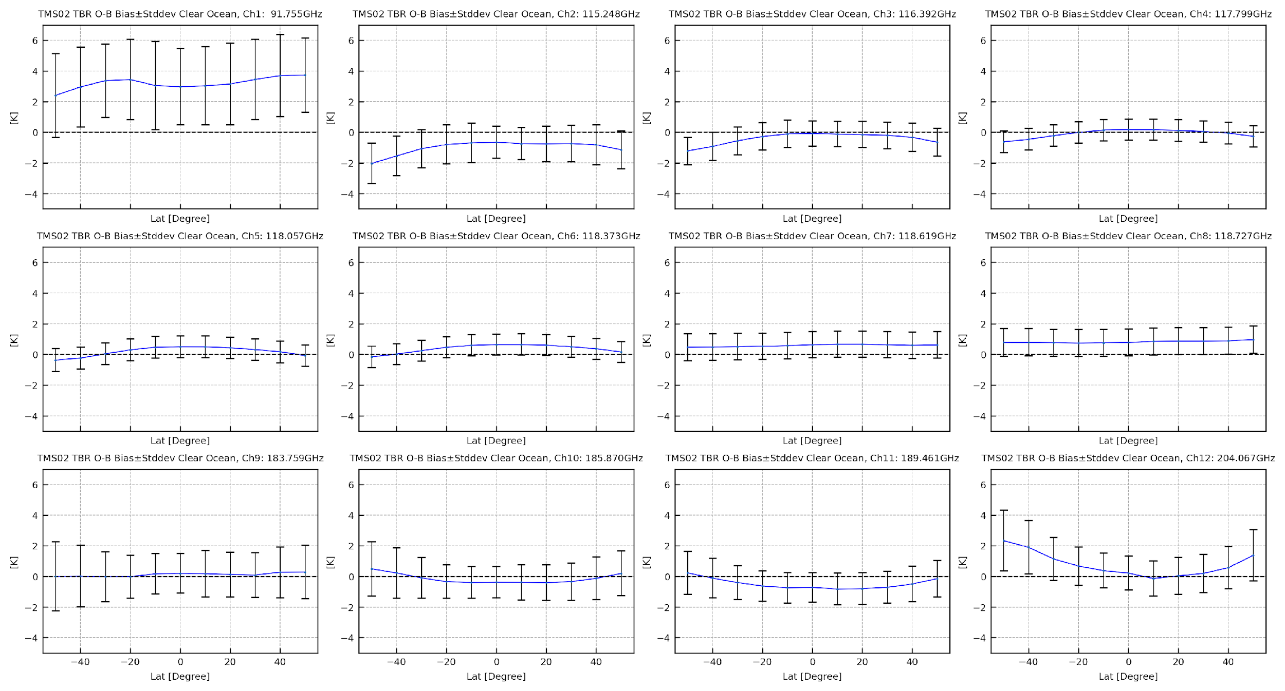
TBR O-B Latitude Dependency: TMS-02
Not as strong as in TMS05

Slide 9
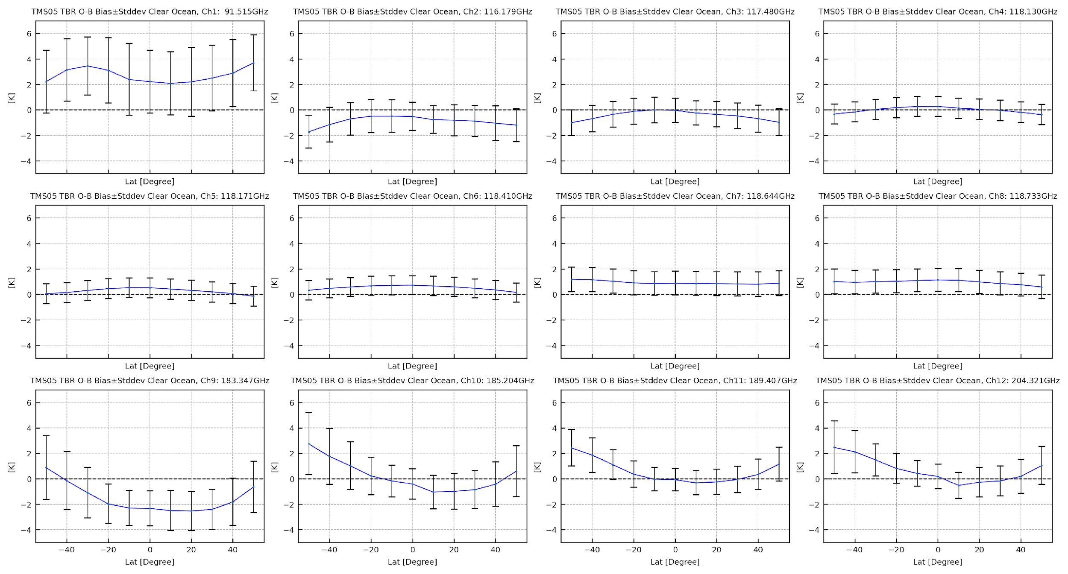
TBR O-B Latitude Dependency: TMS-05
Strong patterns in W and G bands

Slide 10
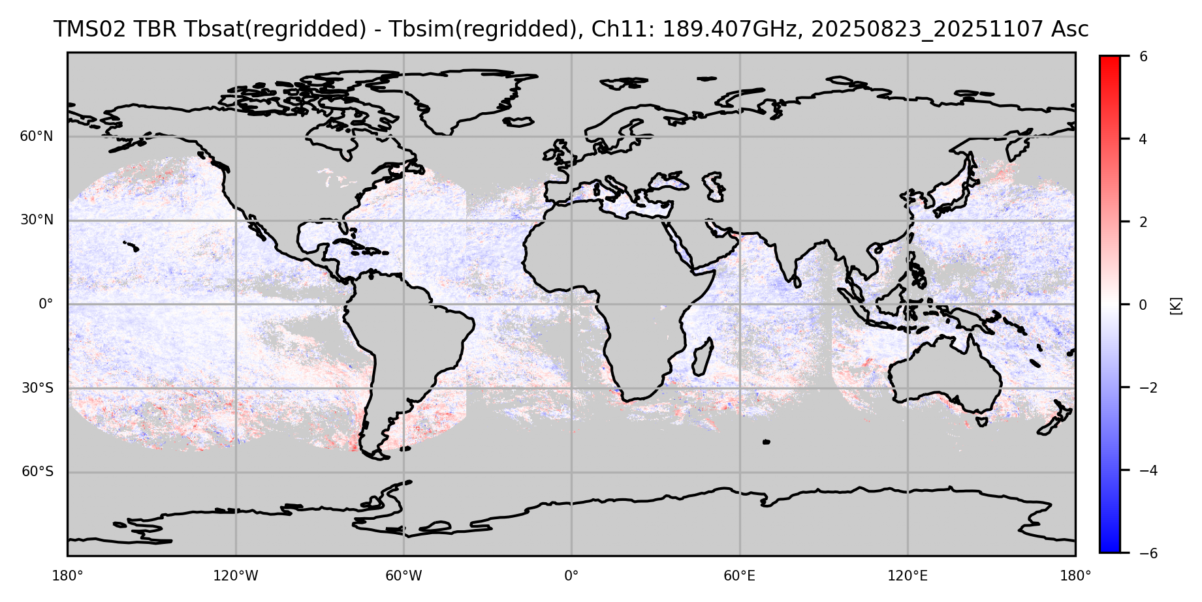
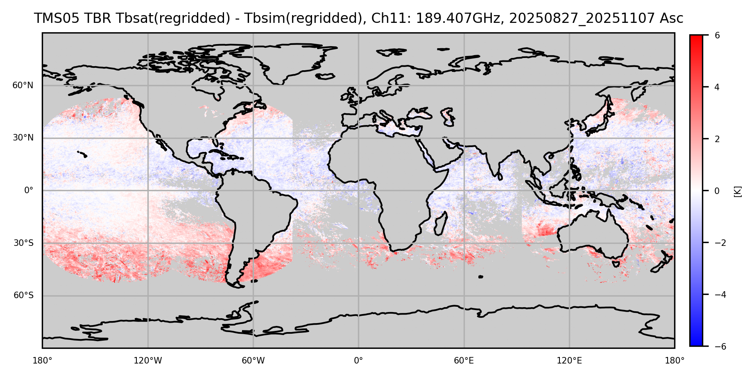
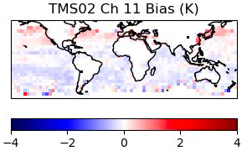
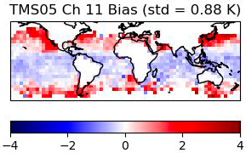
Channel 11 O-B Bias Maps, TMS-02 vs. TMS-05
The top plots are our observations for TMS-02 and TMS-05.
We are investigating possible causes (CRTM, instrument, GFS model) of the latitude dependent biases of TMS-05. Proper treatment of these differences would be required for retrieval and DA studies.
TMS-02 Ascending
TMS-05 Ascending
The bottom plots are Tomorrow.io calculations from ERA5, 04/20/2025 to 05/10/2025, which show the similar pattern.

Slide 11
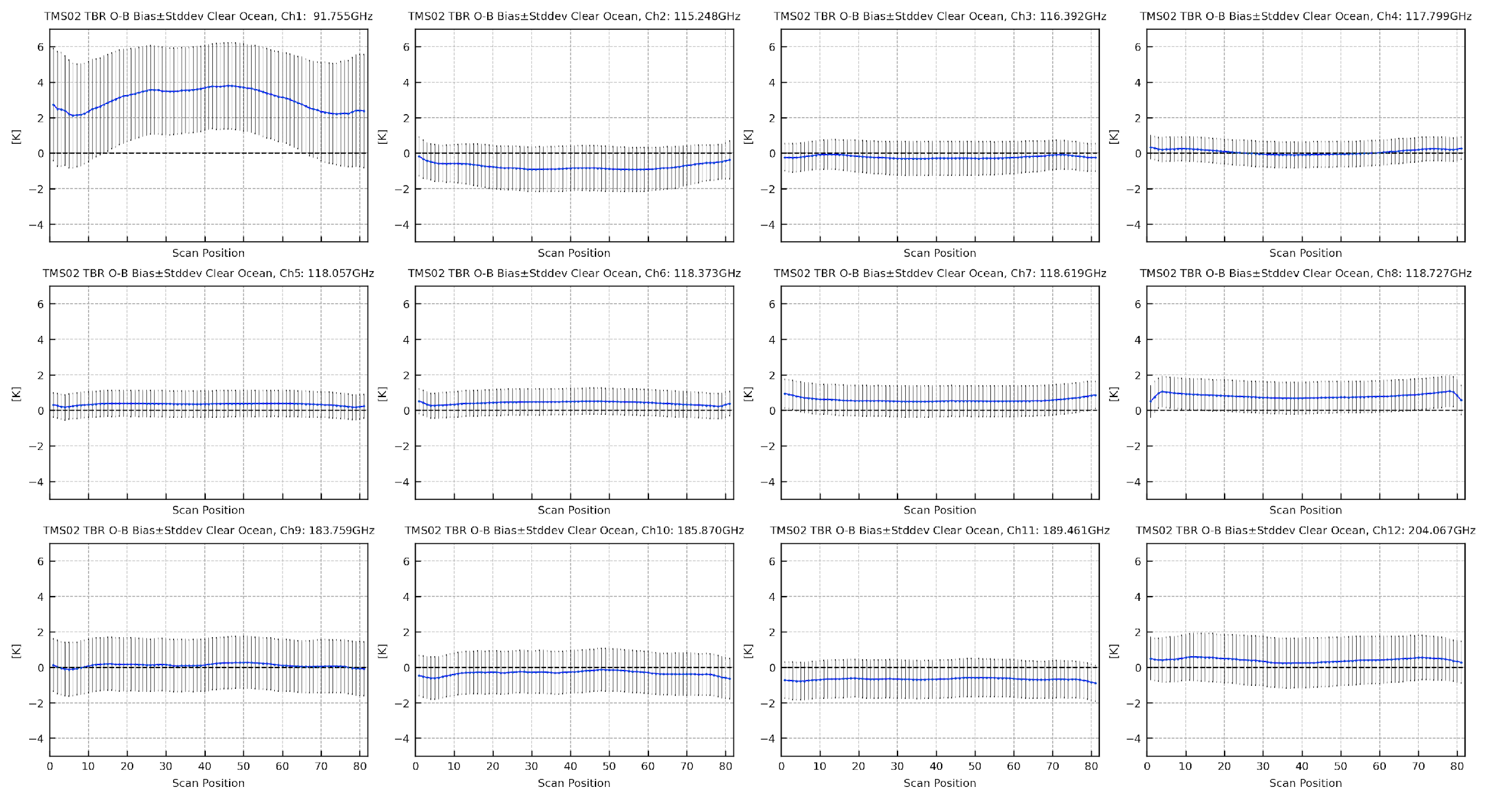
TMS-TBR O-B Scan Angle Dependency: TMS-02
With the exception of some of the more surface sensitive channels, TMS - CRTM scan angle biases are nearly flat which suggests antenna temperature corrections are effective.

Slide 12
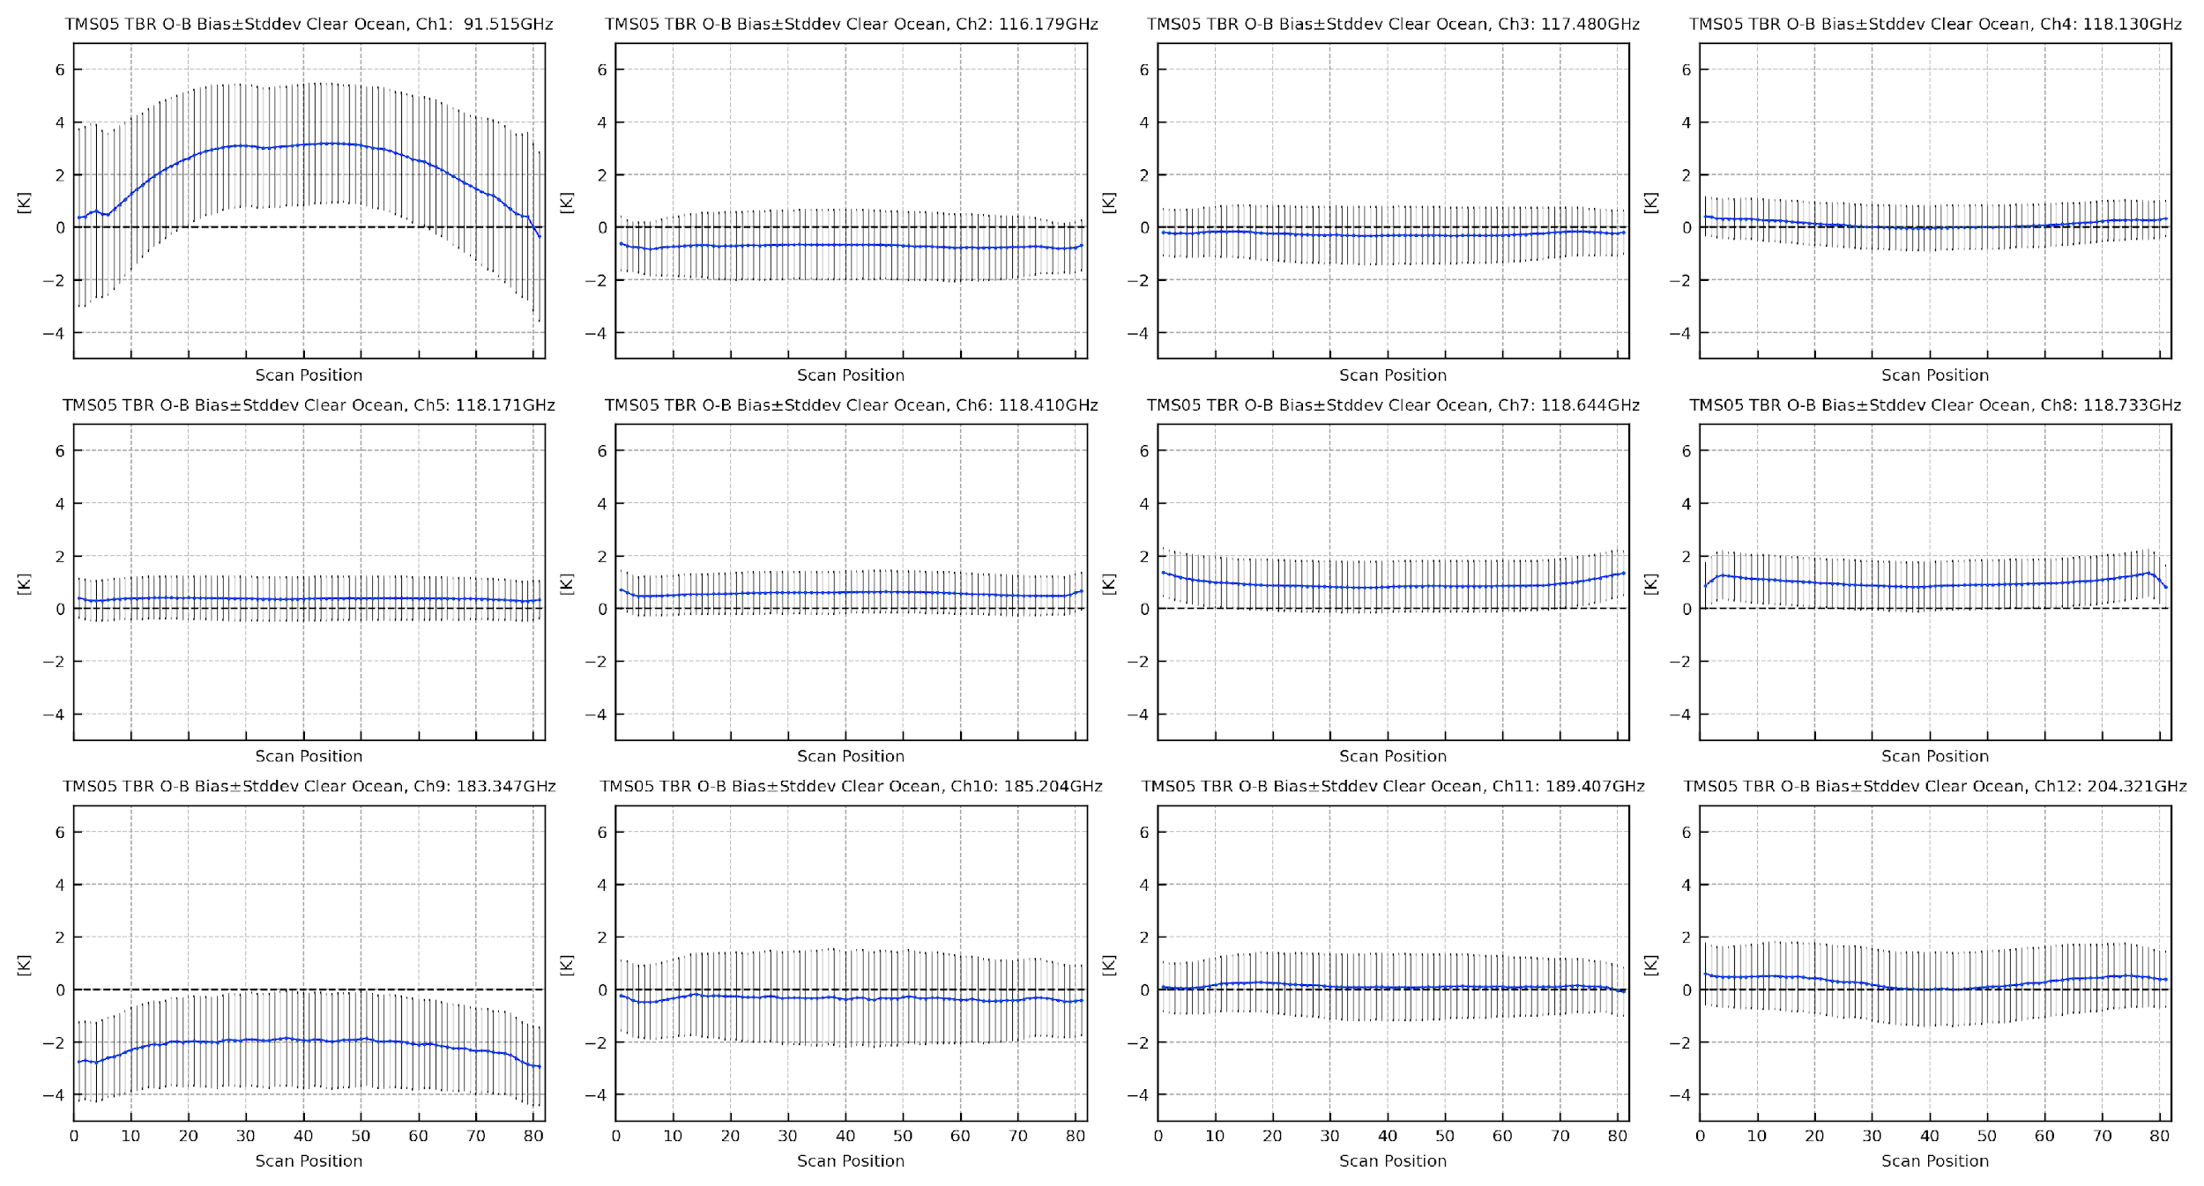
TMS-TBR O-B Scan Angle Dependency: TMS-05
Tomorrow.io Feedback:
TMS has significant
scene-dependent biases with respect to ERA5 simulations in Ch 1 and to a lesser extent, Ch 2.
The residual biases in limb adjustment could be a result of antenna pattern correction error, and errors in the forward model simulations.

Slide 13
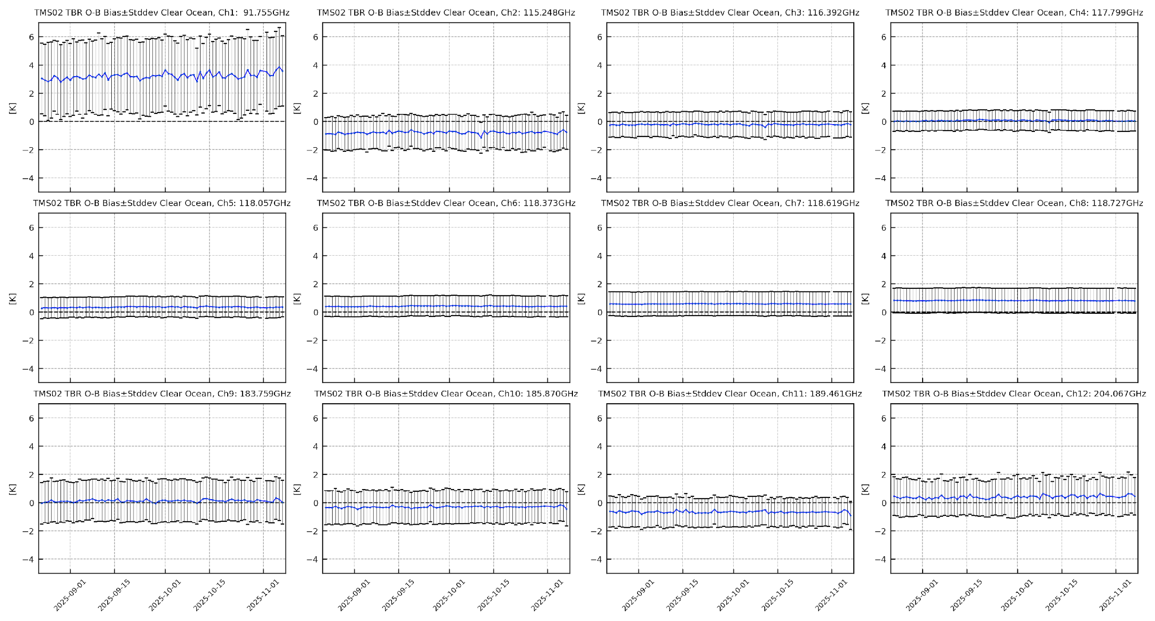
TMS-TBR O-B Temporal Stability: TMS-02
Generally stable.
Ch 1: Small drift in S02 and S05.
1K in ~ 2.5 months
Tomorrow.io Feedback:
ICT thermistors are not fully representative of the ICT radiative temperature, especially during high solar beta
angles when the ICT may be illuminated directly by sunlight.
So the assumption of a static ICT effective emissivity is not always valid

Slide 14
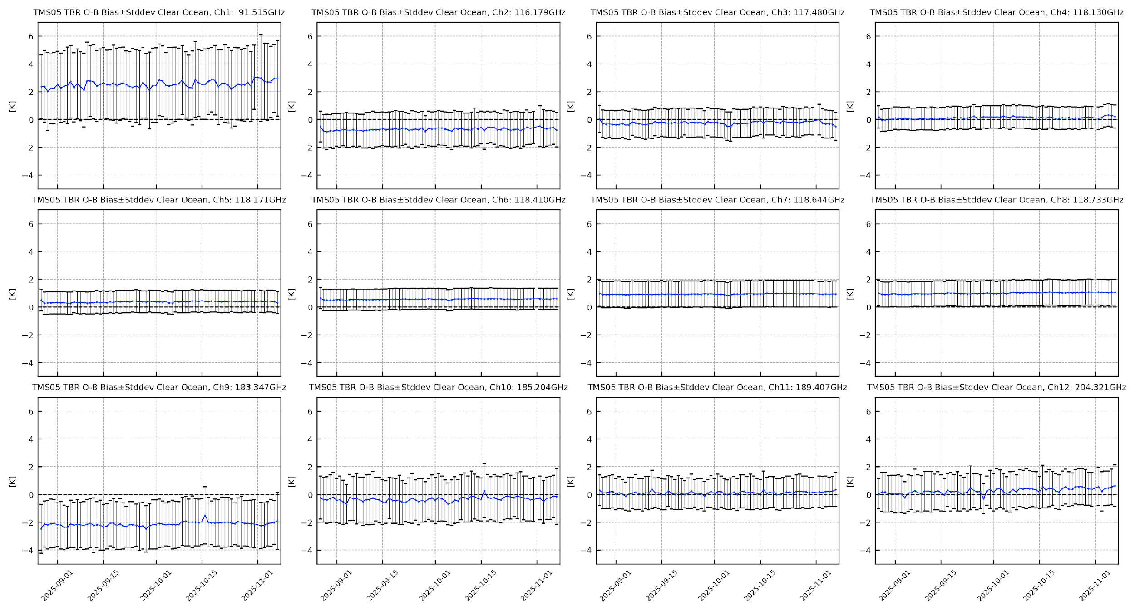
TMS-TBR O-B Temporal Stability: TMS-05

Slide 15
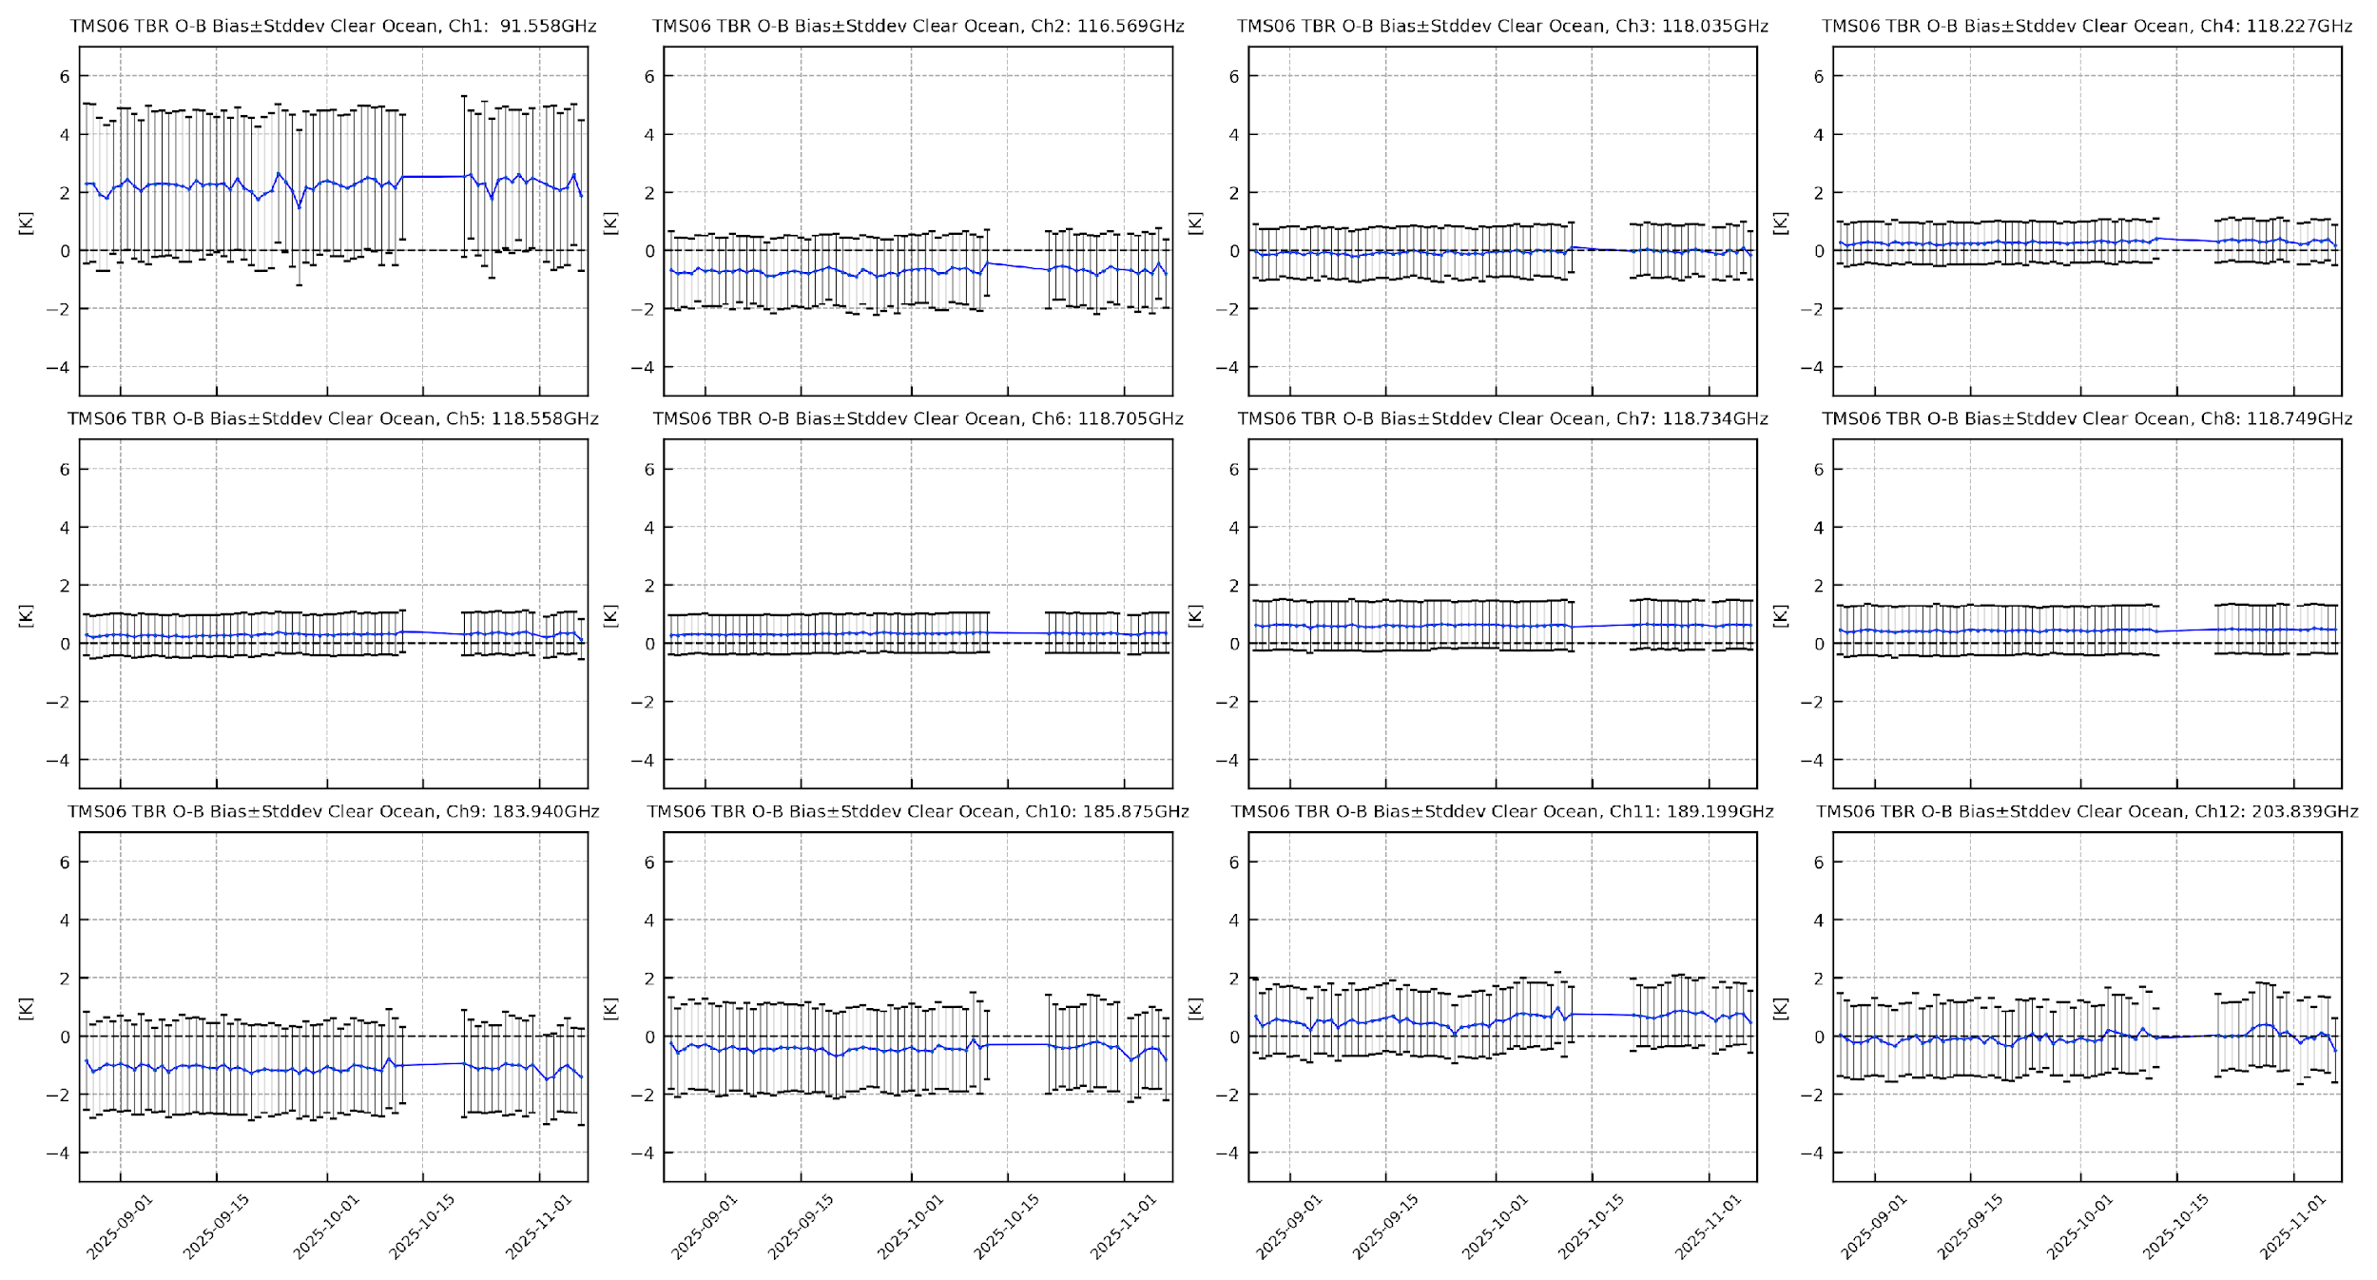
TMS-TBR O-B Temporal Stability: TMS-06
Gap day: 10/13/2025 to 10/20/2025.
S06 in an anomalous state

Slide 16
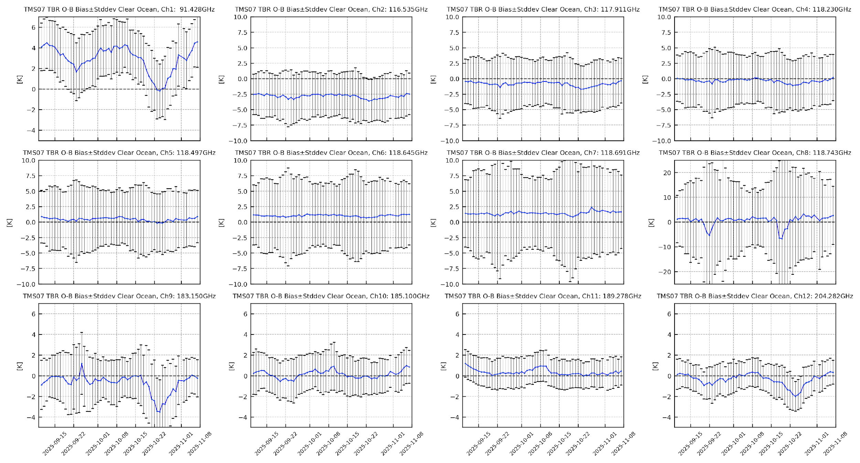
TMS-TBR O-B Temporal Stability: TMS-07
Periodic patterns.
S07 is on the 45° inclination orbit.
Tomorrow.io Feedback:
Bias seems to be a function of solar beta angle and time since spacecraft was in eclipse. Work currently ongoing
to characterize ICT emissivity as a function of spacecraft thermal state.

Slide 17
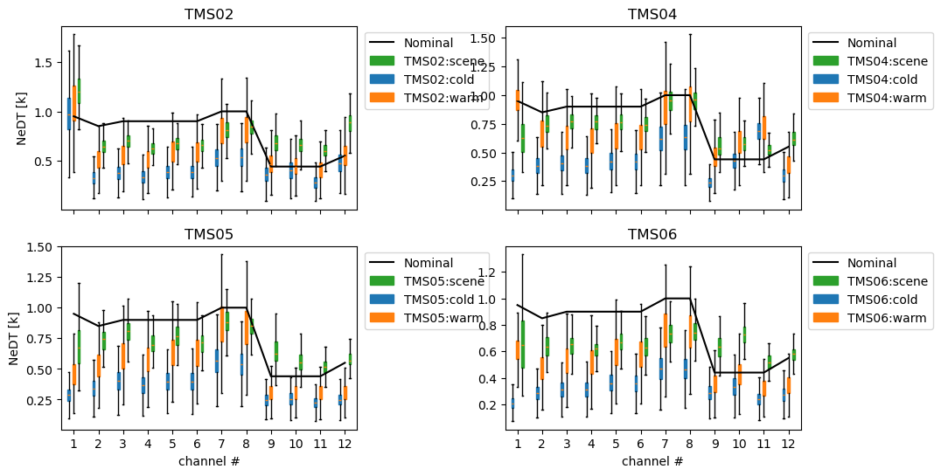
Noise Assessment: TMS-02, -04, -05 and -06

Slide 18
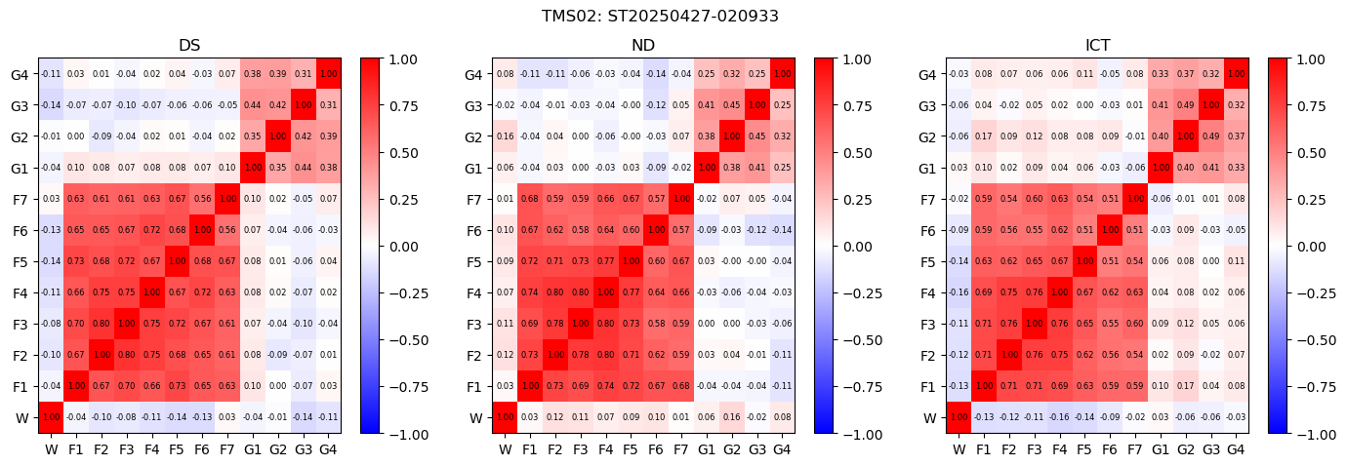
Noise Cross-correlation Matrix: TMS-02

Slide 19
Summary
Radiometric Performance
TMS brightness temperatures show strong agreement with simulated data, indicating robust radiometric calibration.
Large biases in window channels are likely influenced by surface emissivity uncertainties, GFS water vapor errors, and forward model biases.
Cross-sensor consistency observed despite differing orbital configurations, supporting measurement reliability.
Temporal Stability
Stable bias behavior observed for TMS-S02, -S05, and -S06 over the analysis period.
Slow bias drift found in Channel 1, requiring monitoring and potential correction during the calibration process.
Limited data availability for TMS-S03, -S04, and -S07 prevents robust performance assessment
Noise Assessment
Scene-based NEDT assessment shows overall consistent performance, close to or exceeding nominal values.
A high degree of cross-correlation across F-band channels was identified for all sensors.
TMS-07 exhibits near-unity correlation within the F-band channels.
Key Findings for Operations
Systematic dependencies identified:
  Ascending/descending orbit differences
  Latitude-dependent biases
  Scan-angle effects.
These features must be addressed for Calibration refinement, Retrieval algorithm development and Data assimilation readiness
TMS observations demonstrate strong calibration and cross-sensor consistency, with identifiable bias structures and non-random noise characteristics requiring targeted mitigation for operational implementation.

Slide 20
Disclaimer: The scientific results and conclusions, as well as any views or opinions expressed herein, are those of the author(s) and do not necessarily reflect those of NOAA or the Department of Commerce.

