Slide 1
Microwave Sub-Group Discussion on Inter-calibration of small satellites
Tim Hewison
2026 Annual GSICS Meeting

Slide 2
Requirements for Inter-Calibration of Small Satellites
Establish requirements for inter-calibration:​
  Target instruments, channels, dynamic range​
  Inter-calibration uncertainty, traceability​
  Timeliness – lead time and update frequency​
    First: Assess calibration stability!
  Form of inter-calibration product: Algorithm, Coefficient Updates, Corrections, Re-calibration, …​
Identification of suitable reference instrument(s)
  Matching weighting functions? …

Slide 3
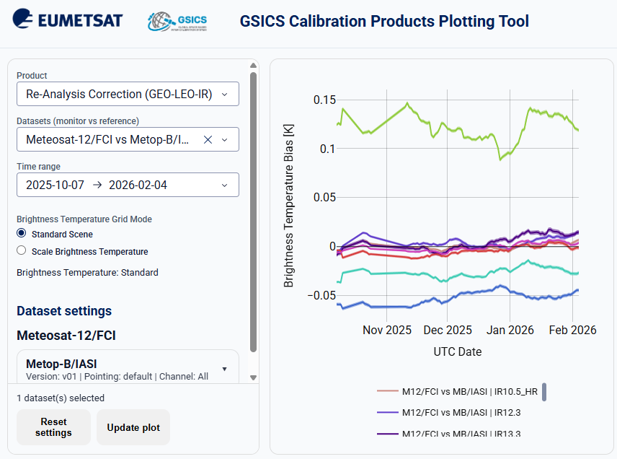
Sub-Group needs for GSICS Website + Plotter
Sub-group needs for:
Website evolutions
GSICS plotter
  (proposed requirements from GDWG meeting)
  EUMETSAT mock-up online to support the discussion.
  Plans for products?

Slide 4
Microwave Sub-Group Discussion on Methods for Inter-calibration of hyperspectral sounders
Tim Hewison
2026 Annual GSICS Meeting

Slide 5
Requirements for Inter-Calibration of Hyperspectral Sounders
Establish requirements for inter-calibration:​
  Target instruments, channels, dynamic range​
  Inter-calibration uncertainty, traceability​
  Timeliness – lead time and update frequency​
    First: Assess calibration stability!
  Form of inter-calibration product: Algorithm, Coefficient Updates, Corrections, Re-calibration, …​
Additional step: Spectral convolution with SRF
  In frequency-space?
  Following IR example
Potential to validate/modify other sensor’s SRF
Identification of suitable reference instrument(s)
  Potential future hyperspectral reference instruments

Slide 6
Thank you!
Questions are welcome.

