Slide 1




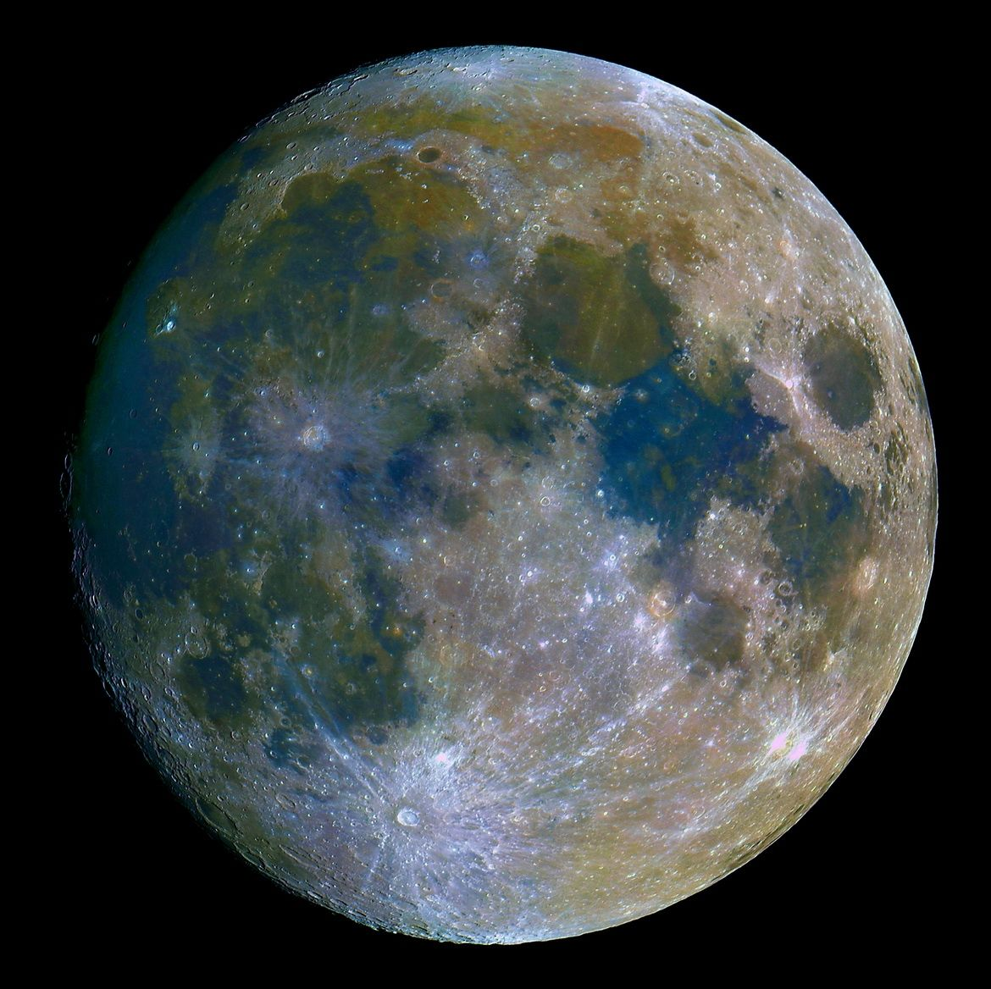
Lunar-Based Cross-Calibration of GF-4 Mid-Infrared Band
Establishing a Radiometric Link from FY-4B/AGRI
Yunkai Xu¹, Yunzhao Wu¹,
Yong Zhang², Ling Sun², and Zhiwei Wang²
1. Purple Mountain Observatory (PMO), CAS
2. National Satellite Meteorological Center (NSMC), CMA
Email address: ykxu@pmo.ac.cn
2026/03/26
GSICS Annual Meeting 2026, Ottawa, Canada | IR Session, 26 March 2026
1

Slide 2
1
Introduction & Motivation
Presentation Outline
2
Lunar Observation Mechanisms & Datasets
3
Radiometric Cross-Calibration
4
Model Comparison & Temperature Analysis
5
Conclusions
2026/03/26
GSICS Annual Meeting 2026, Ottawa, Canada | IR Session, 26 March 2026
2

Slide 3
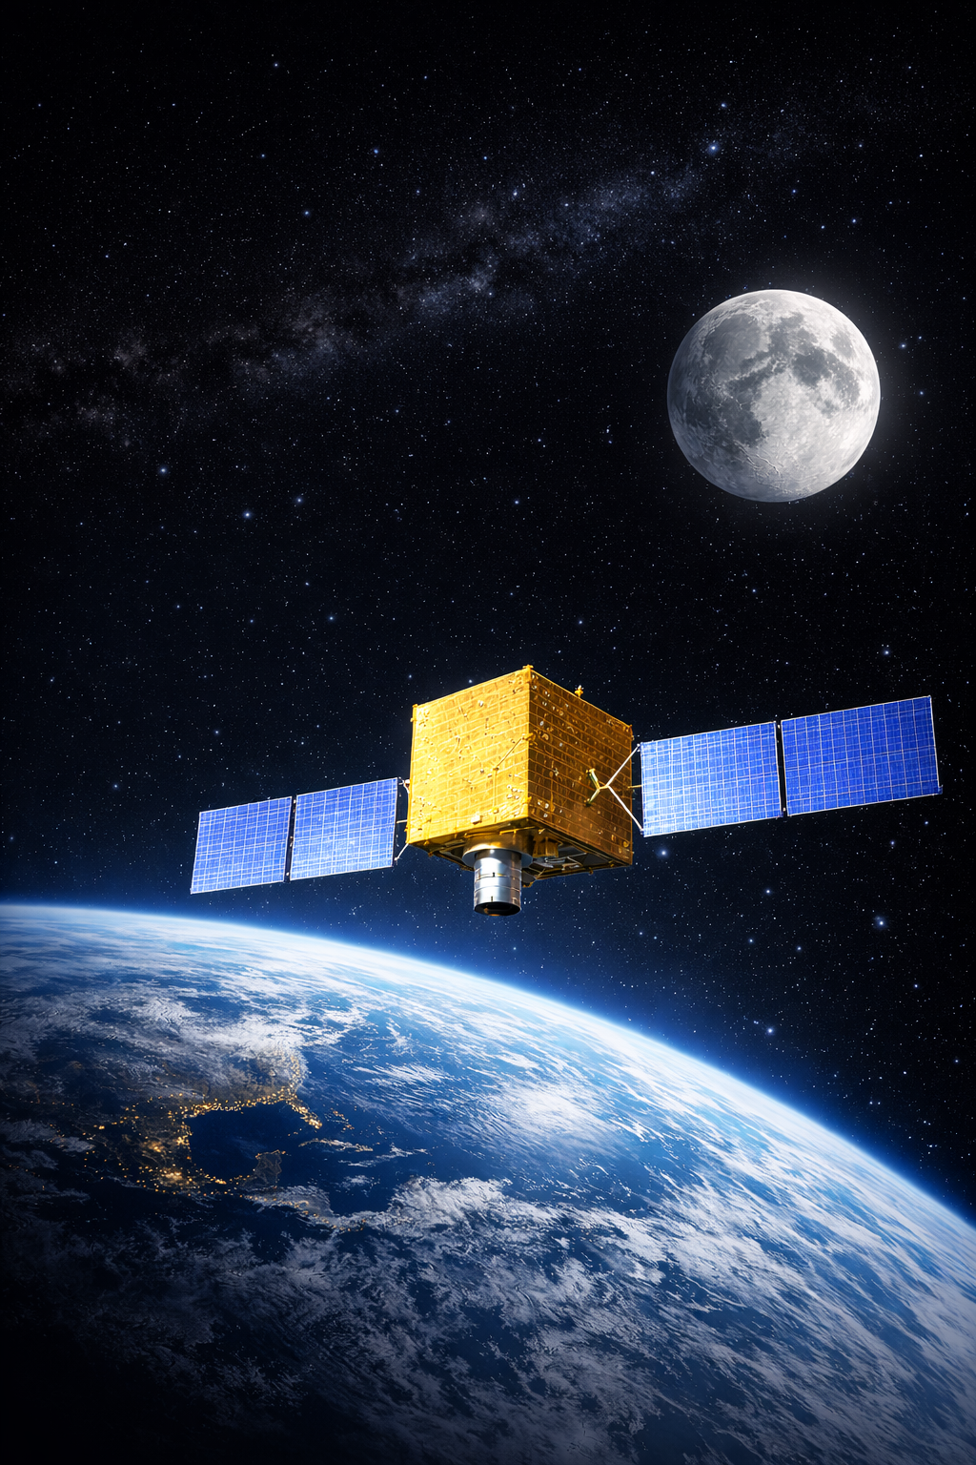
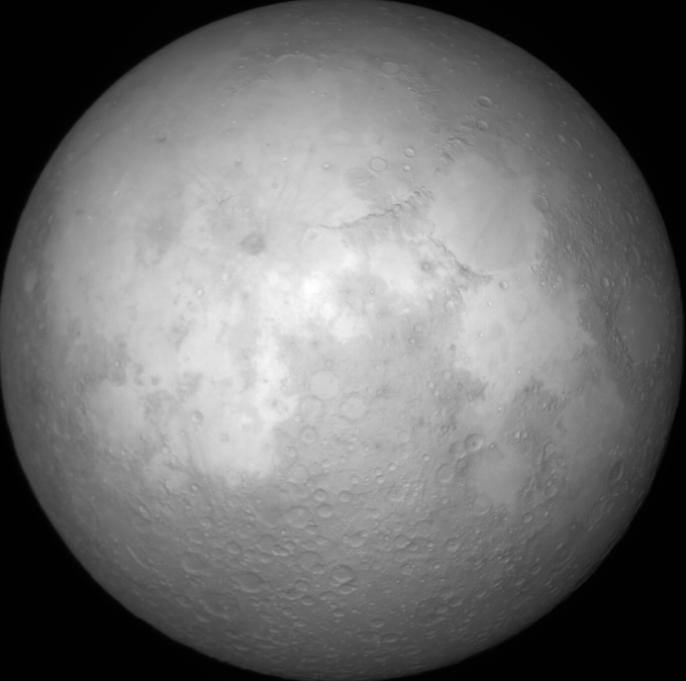
1、Introduction & Motivation
1.1 The Calibration Gap of GF-4
Target Payload: GF-4/IRS (3.5–4.1 μm)
• Critical for high-temperature monitoring (e.g., forest fires).
Hardware Limitation
• No onboard blackbody calibrator.
• Preprocessing coefficients inevitably degrade in orbit.
Current Bottlenecks
• Site-based calibration: Susceptible to atmospheric absorption.
• Dynamic range limits: Natural targets (< 330 K) are too cold for MIR.
The Calibration Gap
• The high-gain, short-exposure (4 ms) mode completely lacks an absolute calibration standard.
GF-4 IRS
2026/03/26
GSICS Annual Meeting 2026, Ottawa, Canada | IR Session, 26 March 2026
3

Slide 4
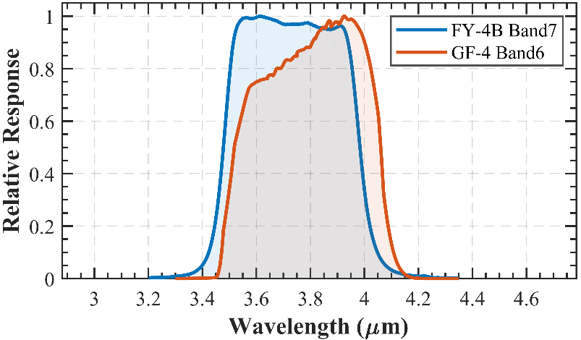
1、Introduction & Motivation
1.2 Why the Moon & Why FY-4B/AGRI?
Why the Moon? (Transfer Benchmark)
• Highly Stable: Atmosphere-free and radiometrically stable over geological timescales.
• Breaks Dynamic Limits: Overcomes the temperature limit of natural Earth targets (< 330 K), crucial for MIR high-temperature calibration.
The "Sub-Pixel" Challenge (e.g., IASI)
• IFOV (14.3 mrad) > Lunar angular diameter (≈ 9 mrad).
• Introduces severe deep-space background noise.
Why FY-4B/AGRI? (Radiometric Reference)
• Onboard Blackbody: Absolute radiometric calibration (Bias < 0.12 K).
• High Resolution: ~21.5 km/pixel, easily capturing the full lunar disk.
• Co-orbital (GEO): Highly consistent viewing geometries with GF-4.
• Perfect Spectral Match: Band 7 (3.75 μm) perfectly overlaps GF-4 MIR & avoids daytime saturation.
Parameter | GF-4 IRS MIR | FY-4B AGRI MIR
Spectral Range (μm) | 3.5-4.1 | 3.4-4.0
Center Wavelength (μm) | 3.80 | 3.75
IFOV (μrad) | 11.249 | 56
Ground Spatial Resolution (m/pixel) | 400 | 2000
Lunar Spatial Resolution (km/pixel) | 4.4 | 21.5
Pixel Array Size | 1024×1024 | 8×1
Detector Type | Staring Area Array | Linear Array Scanning
2026/03/26
GSICS Annual Meeting 2026, Ottawa, Canada | IR Session, 26 March 2026
4

Slide 5

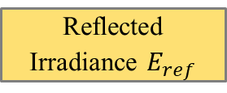
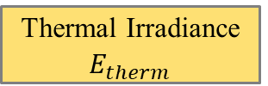

1、Introduction & Motivation
1.3 Cross-calibration framework
Data & Preprocessing
Component Decoupling & Spectral Matching
Calibration & Validation
GF-4/IRS
Raw Images (2018)
SRF Convolution (B6 & MIR)
RELAB
Lunar Soil Spectra
GF-4 Reference Radiance ${ L}_{total}$
Background Subtraction
& Disk Integration
Reflectance Extrapolation Model
(B6 to MIR)
Linear Fit & Calibration Coefficients
Uncalibrated Mean DN
Brightness Temperature Retrieval
M3-corrected ROLO Model
Internal Check
(vs. Reference Benchmark)
External Validation
(vs. TPM)
FY-4B/AGRI
L1 Images (2024)
Thermal Irradiance $E_{therm}$
Reflected Irradiance $E_{ref}$
Geometric Correction & Disk Extraction
Synthesized GF-4 Reference Irradiance${ E}_{total}$
Thermophysical Analysis & Validation
FY-4B Phase Curve Model
2026/03/26
GSICS Annual Meeting 2026, Ottawa, Canada | IR Session, 26 March 2026
5

Slide 6
2、Lunar Observation Mechanisms & Datasets
2.1 Lunar Observing by FY-4B/AGRI and GF-4/IRS
GF-4 / IRS - The Monitored Target
FY-4B / AGRI - The Radiometric Reference
Imaging Mode: Area Array Staring
Spatial Resolution: ~4.4 km/px (High)
Capture: Single Exposure (active attitude maneuver)
Advantage: No image stitching;
avoids geometric/radiometric distortions.
Imaging Mode: Linear Array Scanning
Spatial Resolution: ~21.5 km/px (Moderate)
Capture: Passive Observation (During full-disk Earth scan).
Drawback: Introduces inter-frame staggering; requires geometric registration.
Staring
Scanning
The Mismatch Challenge
Core Dilemma: Observation disparities and a ~5x resolution gap invalidate traditional pixel-level registration.
Methodological Shift: Strictly necessitates a full-disk integrated approach for radiometric transfer.
2026/03/26
GSICS Annual Meeting 2026, Ottawa, Canada | IR Session, 26 March 2026
6

Slide 7
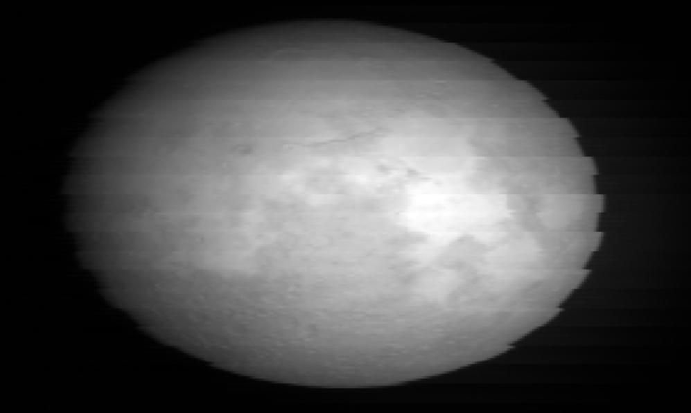
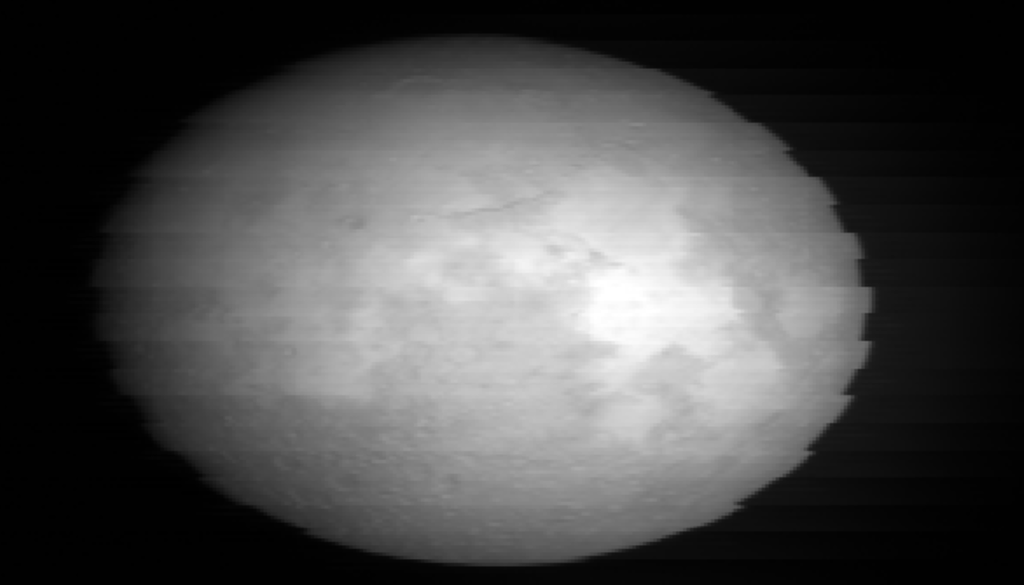
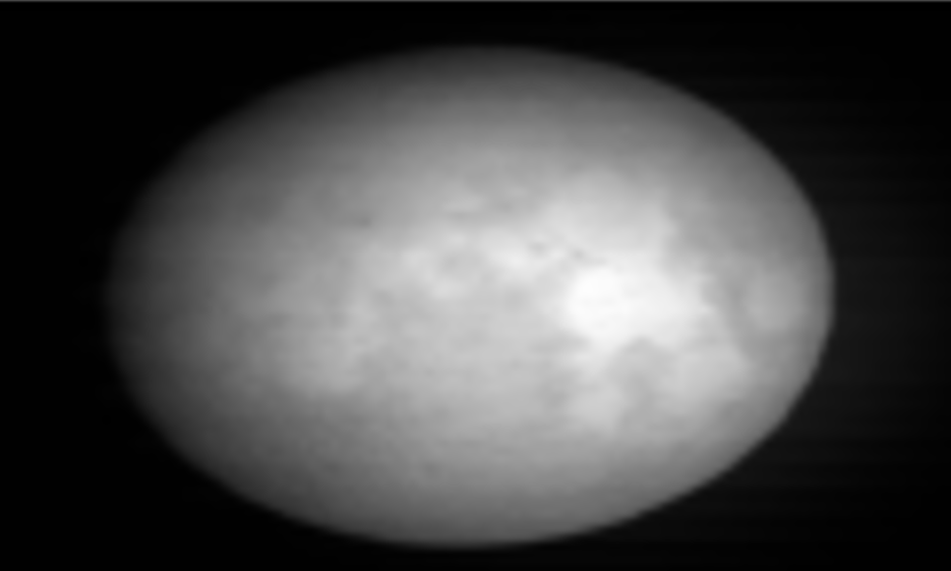
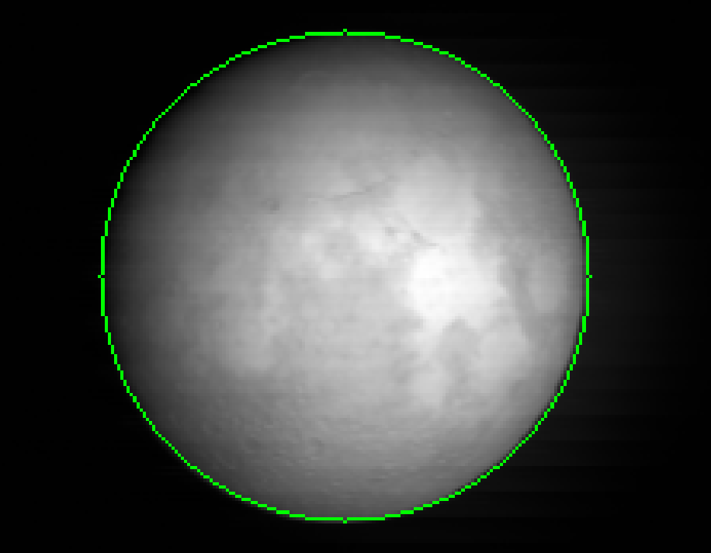
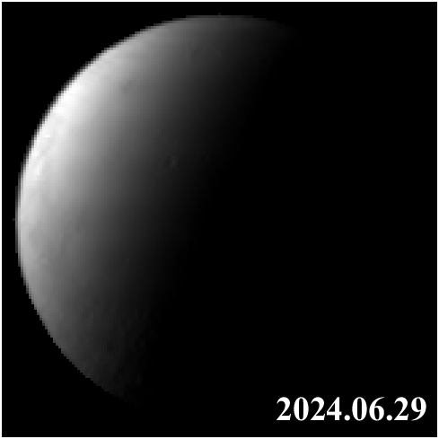
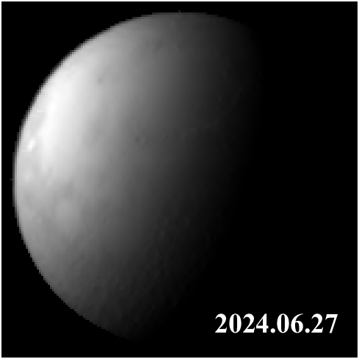
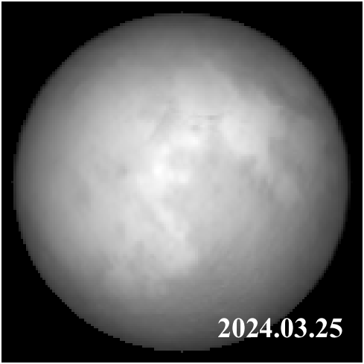
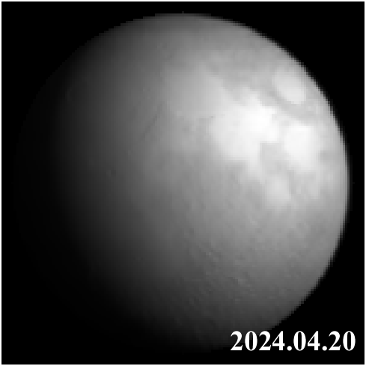
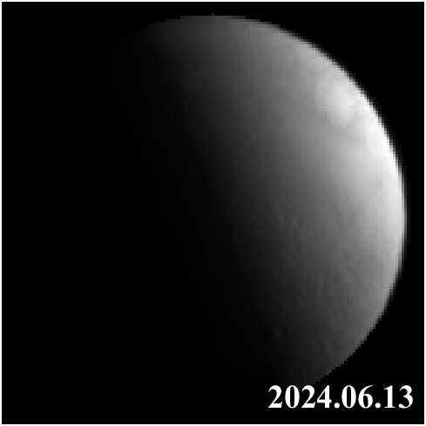
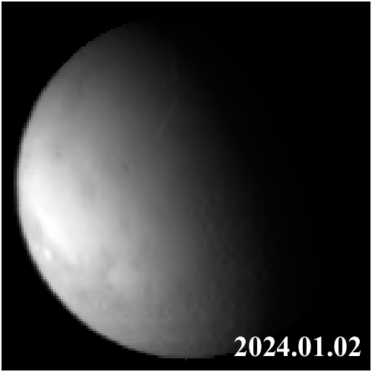
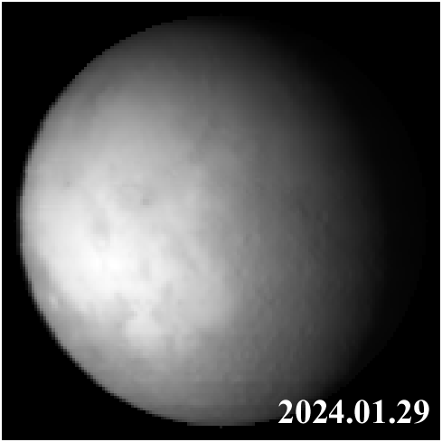
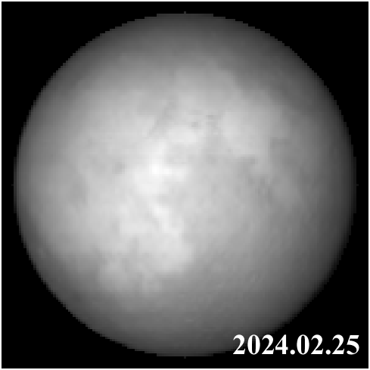
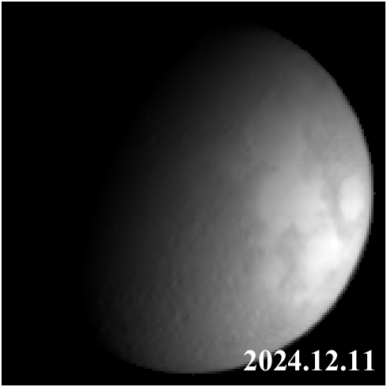
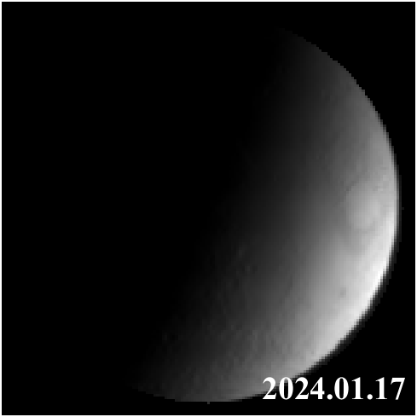
2、Lunar Observation Mechanisms & Datasets
2.2 Datasets and Preprocessing
Jagged Edges
FY-4B/AGRI Raw data (DN)
Calibrated Radiance
Staggering Correction
Oversampling Correction
& Extraction
Strict Data Selection
• Timeframe: 2024 full-disk scanning data.
• Band Choice: B7 selected for wide quantization (avoids high-temp saturation).
• Condition: Strictly unexposed images.
Key Preprocessing Steps
• Absolute Calibration: Via onboard blackbody (15-min intervals).
• Staggering Correction: Sub-pixel translation to eliminate inter-frame jagged edges.
• Oversampling Correction: Anisotropic resampling to correct oversampling (~33% horizontal).
FY-4B AGRI
Diverse lunar phase coverage from the FY-4B/AGRI
2026/03/26
GSICS Annual Meeting 2026, Ottawa, Canada | IR Session, 26 March 2026
7

Slide 8
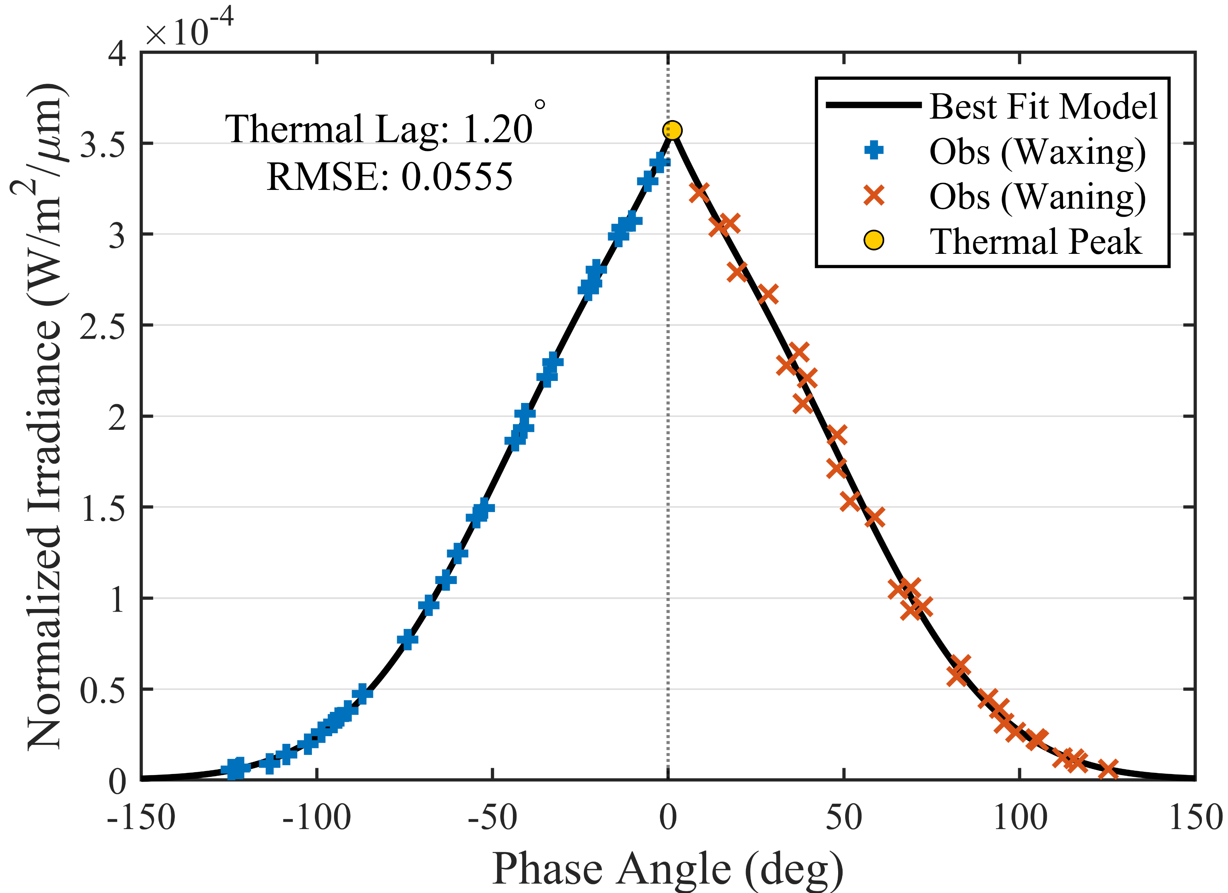
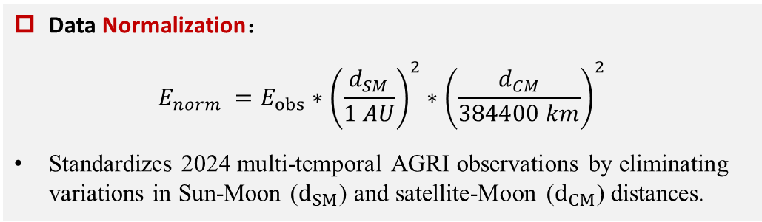
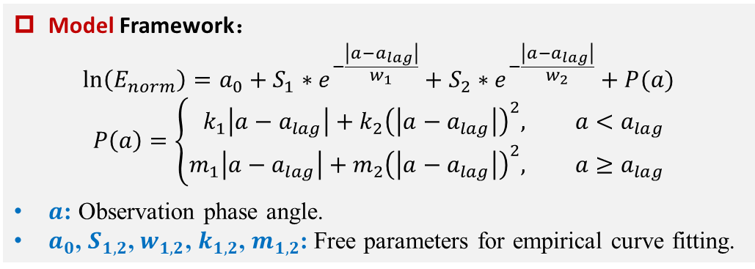
3、Radiometric Cross-Calibration
3.1 Reference Construction & Spatial Matching
Data Normalization：
$$E_{norm} =E_{obs}∗{\left(\frac{d_{SM}}{1 AU}\right)}^{2}∗{\left(\frac{d_{CM}}{384400 km}\right)}^{2}$$
Standardizes 2024 multi-temporal AGRI observations by eliminating variations in Sun-Moon ($d_{SM}$) and satellite-Moon ($d_{CM}\text{)}$ distances.
Lunar phase curve model and fitting results based on normalized FY-4B/AGRI measurements.
Model Framework：
$$\ln\left(E_{norm}\right)=a_{0}+S_{1}∗e^{−\frac{\left|a−a_{lag}\right|}{w_{1}}}+S_{2}∗e^{−\frac{\left|a−a_{lag}\right|}{w_{2}}}+P(a)$$
$$P\left(a\right)=\left\{\begin{aligned}k_{1}\left|a−a_{lag}\right|+k_{2}{\left(\left|a−a_{lag}\right|\right)}^{2}, &a<a_{lag} \\ m_{1}\left|a−a_{lag}\right|+m_{2}{\left(\left|a−a_{lag}\right|\right)}^{2}, &a≥a_{lag}\end{aligned}\right.$$
$a$: Observation phase angle.
$a_{0}$, $S_{1,2}$, $w_{1,2}$, $k_{1,2}$, $m_{1,2}$: Free parameters for empirical curve fitting.
Normalize: Standardizes multi-temporal 2024 AGRI observations to constant distances (1 AU, 384,400 km).
Model: Fits the normalized data to the MIR lunar phase curve model.
Radiometric Transfer (De-normalize): Calculates the FY-4B equivalent irradiance under the exact GF-4 observation geometries.
2026/03/20
2026/03/26
GSICS Annual Meeting 2026, Ottawa, Canada | IR Session, 26 March 2026
8

Slide 9
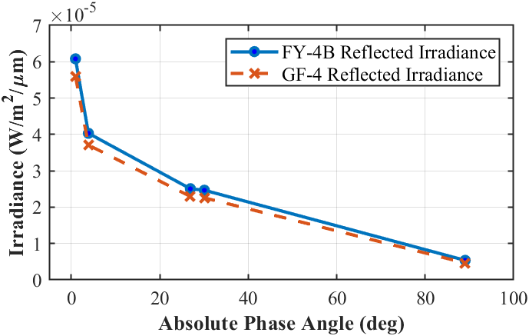
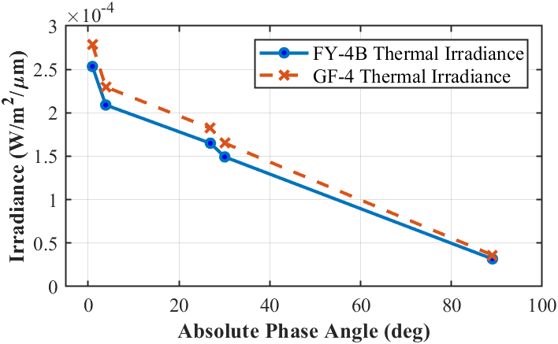
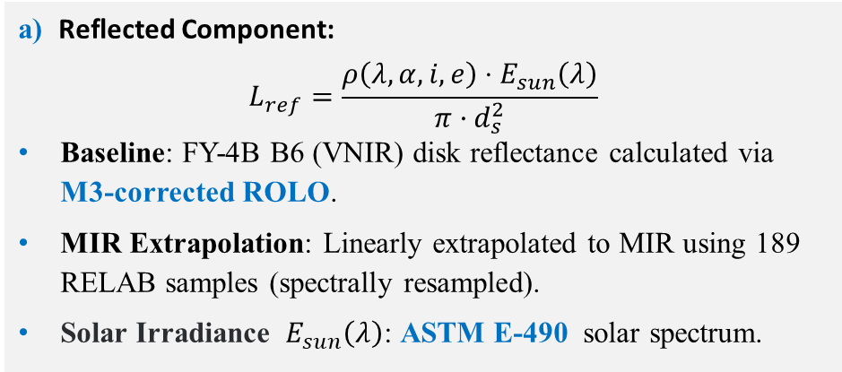
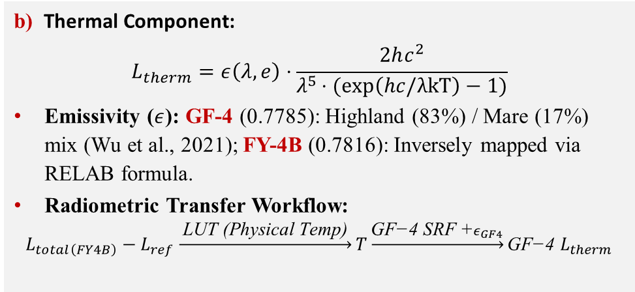
3、Radiometric Cross-Calibration
3.2 Component Decoupling and Spectral Matching
$L_{MIR}\left(α,i,e,λ,T\right)=L_{ref}\left(α,i,e,λ\right)+L_{therm}​\left(e,λ,T\right)$
Reflected Solar Derivation
Thermal Emission Derivation
a) Reflected Component:
$$L_{ref}=\frac{ρ\left(λ,α,i,e\right)⋅E_{sun}\left(λ\right)}{π·d_{s}^{2}}$$
Baseline: FY-4B B6 (VNIR) disk reflectance calculated via M3-corrected ROLO.
MIR Extrapolation: Linearly extrapolated to MIR using 189 RELAB samples (spectrally resampled).
Solar Irradiance $E_{sun}\left(λ\right)$: ASTM E-490 solar spectrum.
b) Thermal Component:
$$L_{therm}​=ε\left(λ,e\right)⋅\frac{2hc^{2}}{λ^{5}⋅(exp\left(hc/λkT\right)−1)}$$
Emissivity ($ε$): GF-4 (0.7785): Highland (83%) / Mare (17%) mix (Wu et al., 2021); FY-4B (0.7816): Inversely mapped via RELAB formula.
Radiometric Transfer Workflow:
$$L_{total\left(FY4B\right)}−L_{ref}\underset{→}{ \text{LUT}\text{ (}\text{Physical} \text{Temp}\text{)} }T\underset{→}{\text{GF}\text{−}\text{4 }\text{SRF} \text{+}ε_{GF4}}\text{GF}\text{−}\text{4 }L_{therm}$$
opposition effect
9

Slide 10
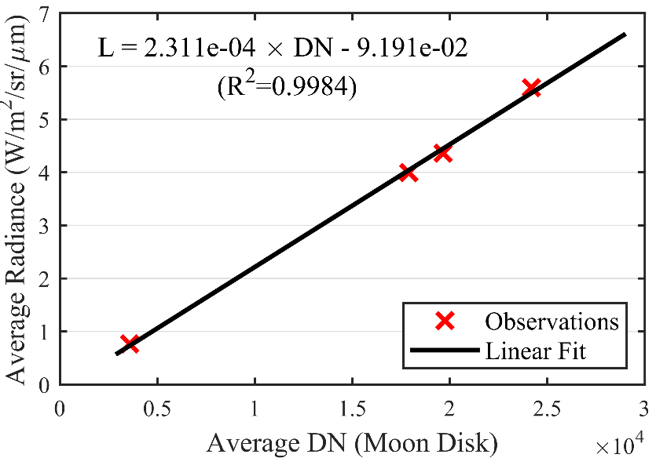
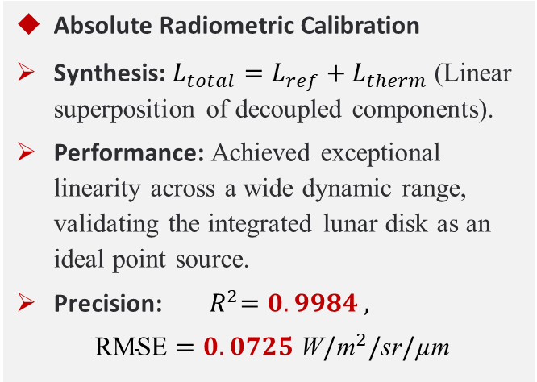
3、Radiometric Cross-Calibration
3.3 Radiometric Component Contributions & Calibration
Date | Phase Angle (deg) | Reflected Irradiance (W/m²/µm) | Thermal Irradiance (W/m²/µm) | Reflected Component (%) | Thermal Component (%)
2018.03.02 | -0.95 | 5.60×10⁻⁵ | 2.78×10⁻⁴ | 16.7 % | 83.3 %
2018.07.25 | -30.09 | 2.26×10⁻⁵ | 1.65×10⁻⁴ | 12.0 % | 88.0 %
2018.07.28 | 3.88 | 3.71×10⁻⁵ | 2.30×10⁻⁴ | 13.9 % | 86.1 %
2018.07.30 | 26.92 | 2.29×10⁻⁵ | 1.82×10⁻⁴ | 11.2 % | 88.8 %
2018.08.04 | 89.04 | 4.64×10⁻⁶ | 3.62×10⁻⁵ | 11.4 % | 88.6 %
Absolute Radiometric Calibration
Synthesis: $L_{total}=L_{ref}+L_{therm}$ (Linear superposition of decoupled components).
Performance: Achieved exceptional linearity across a wide dynamic range, validating the integrated lunar disk as an ideal point source.
Precision: ${ R}^{2}=0.9984 \text{, }$
$$\text{RMSE}=0.0725{ \text{W}/\text{m}}^{2}/\text{sr}/\text{µ}\text{m}$$
MIR Component Contributions
Thermal Dominance: > 83%
Thermal emission dominates the MIR budget, consistently accounting for 83.3–88.8%.
Reflected Fluctuation: 11% - 17%
Reflected component peaks near full moon (16.7%) due to opposition effect and stabilizes at ~11% at large phase angles.
The Necessity of Decoupling (SRF Impact)
Due to SRF differences, GF-4 exhibits systematically ~8% lower reflected irradiance but ~10% higher thermal irradiance than FY-4B.
2026/03/26
GSICS Annual Meeting 2026, Ottawa, Canada | IR Session, 26 March 2026
10

Slide 11
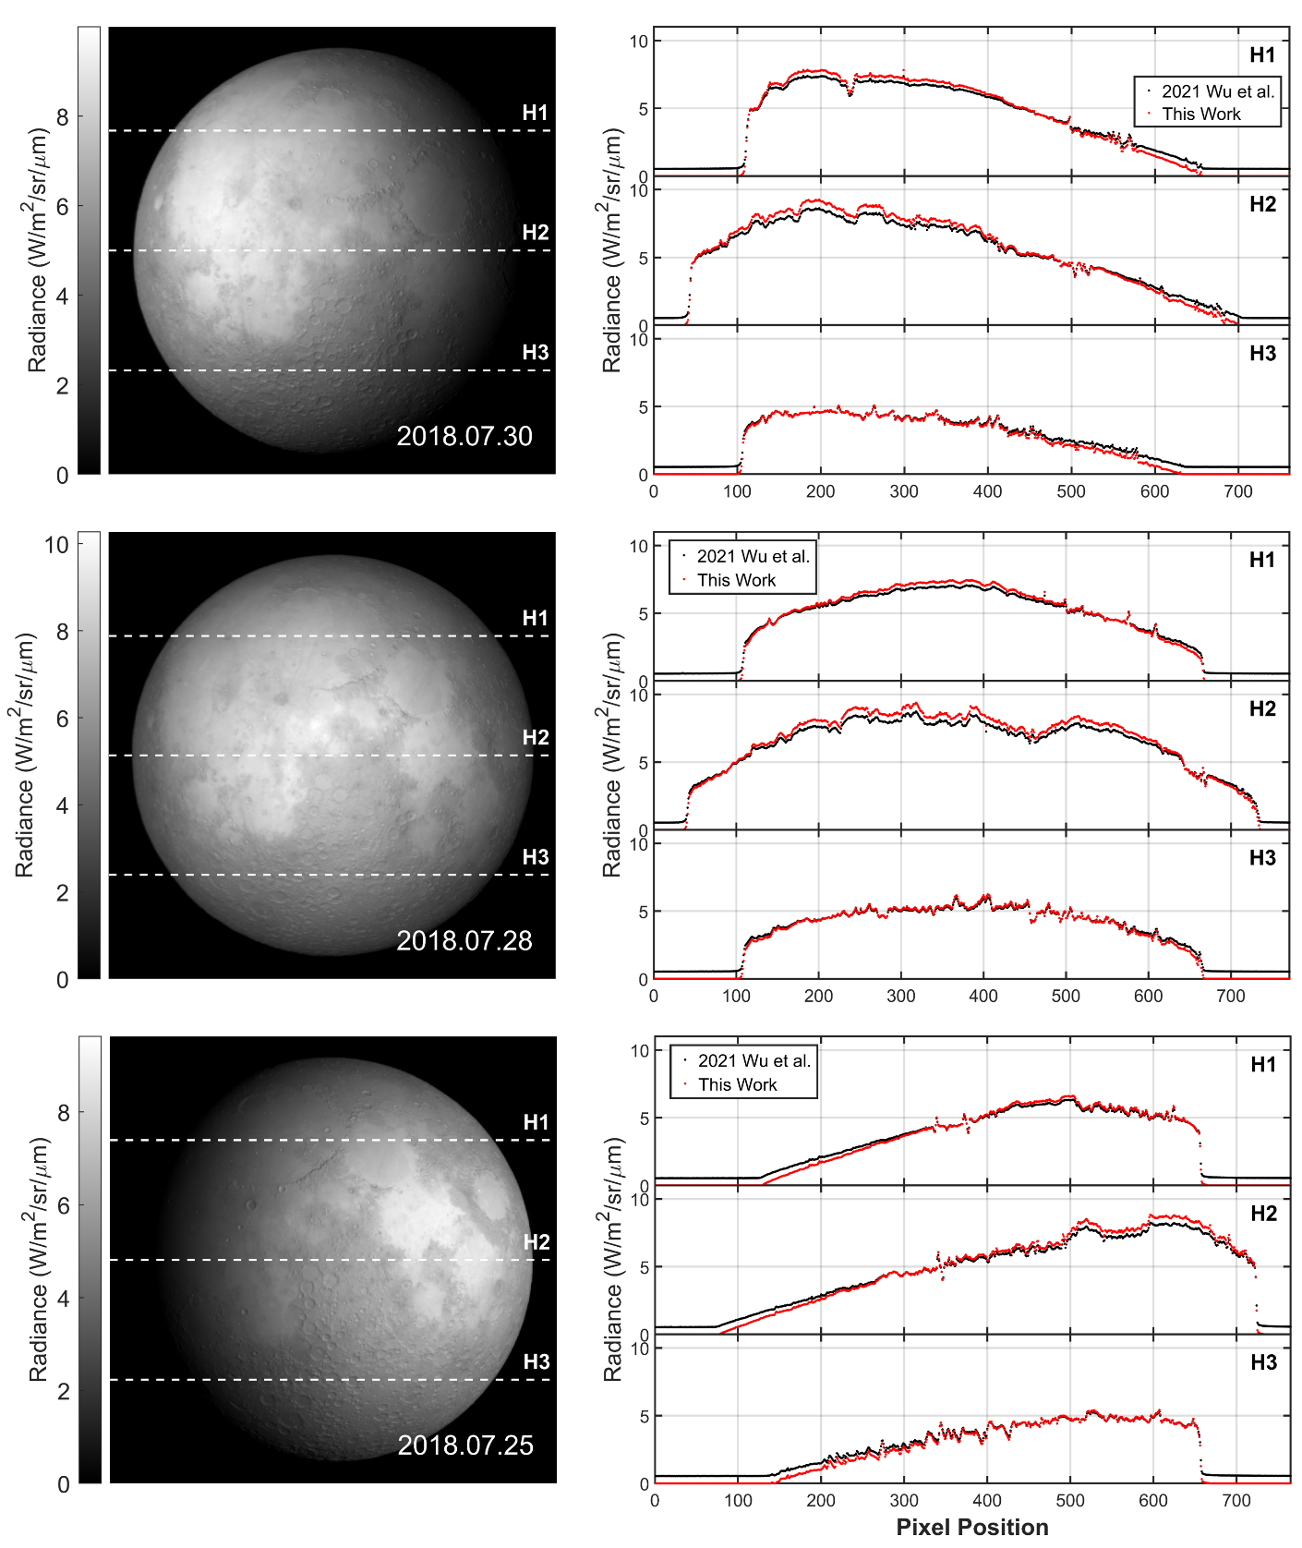
4、Model Comparison & Temperature Analysis
4.1 Comparison with Thermophysical Model Results
1. Baseline: Traditional TPM:
Wu et al. (2021): A 1D heat conduction model assuming a smooth lunar surface.
2. Key Findings from Spatial Profiles
High-Signal Regions (Sub-solar Maria):
  Our radiances (red) are significantly higher in H1/H2.
  Insight: Captures the "Thermal Beaming" effect driven by micro-scale roughness, which smooth TPMs ignore.
Low-Signal Regions (Limb/Terminator):
  Our radiances (red) are systematically lower than TPM.
  Insight: Corrects TPM's unrealistic positive offset at the zero-signal intercept (caused by lacking dark-target constraints).
3. Core Advantage: Superior Dynamic Range
Incorporates a wider range of phase angles (up to 89°).
Provides comprehensive radiometric constraints for both high- and low-temperature targets across the full dynamic range.
11

Slide 12
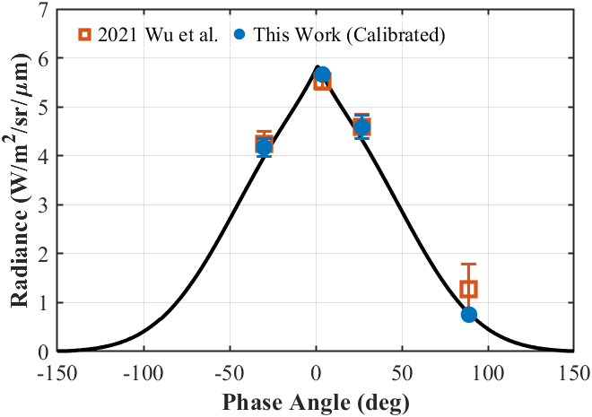
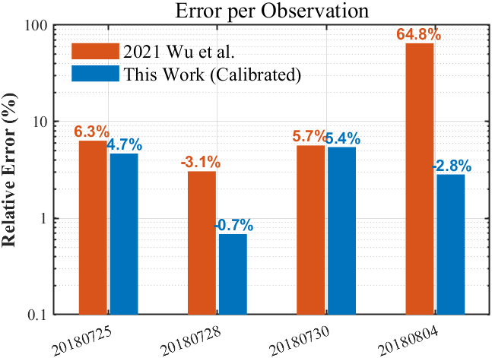
4、Model Comparison & Temperature Analysis
4.1 Comparison with Thermophysical Model Results
(a)
Internal Consistency Check (a):
Aligns perfectly with the FY-4B reference curve across all phase angles.
External Validation (vs. Traditional TPM)
Overall Improvement: Median relative error reduced from 6.0% to 3.8%.
Breakthrough under Extreme Geometries (b):
  At a large phase angle (≈ 89.04°), the TPM produced a severe error of 64.8%.
  Our method corrected this error to -2.8%.
Root Cause of TPM's Failure
Unconstrained Intercept: Lacking low-signal constraints, TPM yields an unrealistic positive offset at zero-signal.
Systematic Bias: This intercept massively inflates the integrated radiance for dark lunar disks (at large phase angles).
(b)
2026/03/26
GSICS Annual Meeting 2026, Ottawa, Canada | IR Session, 26 March 2026
12

Slide 13
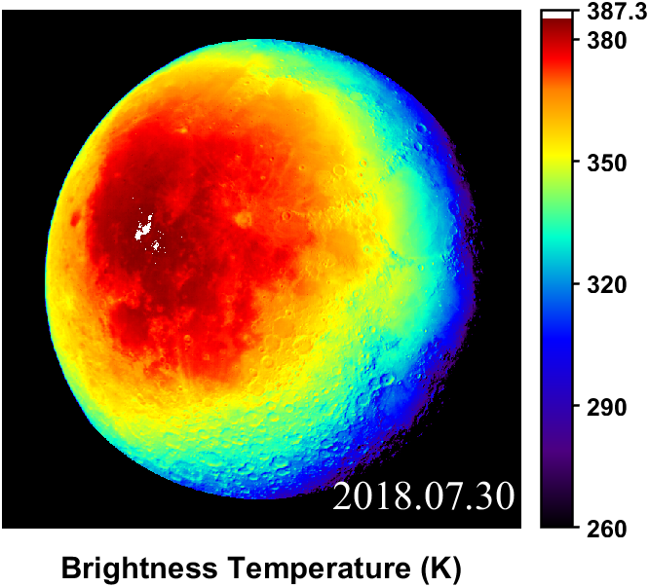
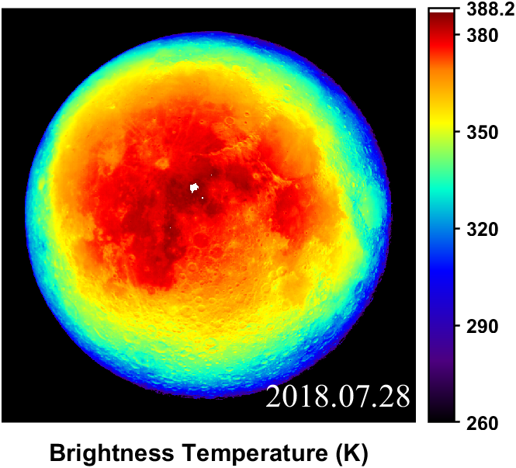
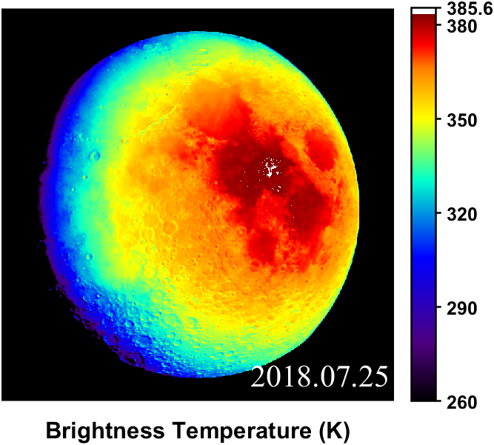
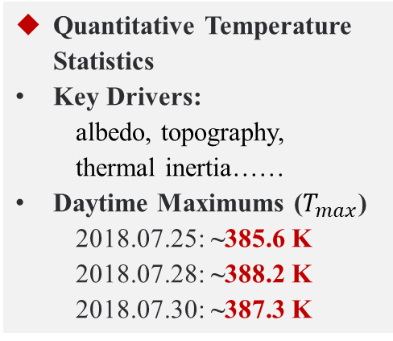
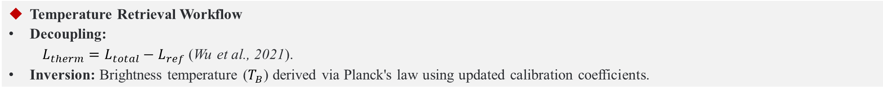
4、Calibration Results & Model Comparison
4.2 Application to Lunar Surface Temperature
Quantitative Temperature Statistics
Key Drivers:
albedo, topography,
thermal inertia……
Daytime Maximums ($T_{max}$)
  2018.07.25: ~385.6 K
  2018.07.28: ~388.2 K
  2018.07.30: ~387.3 K
Temperature Retrieval Workflow
Decoupling:
$L_{therm}=L_{total}−L_{ref}$ (Wu et al., 2021).
Inversion: Brightness temperature ($T_{B}$) derived via Planck's law using updated calibration coefficients.
Spatial Characteristics:
  Albedo Control: Peak temperatures are localized in low-albedo mare regions near the sub-solar point.
  Thermal Inertia: Evening-side temperatures higher than morning-side at equivalent solar incidence.
  Topographic Modulation: Sun-facing slopes of large craters and ridges exhibit significant thermal enhancement.
2026/03/26
GSICS Annual Meeting 2026, Ottawa, Canada | IR Session, 26 March 2026
13

Slide 14
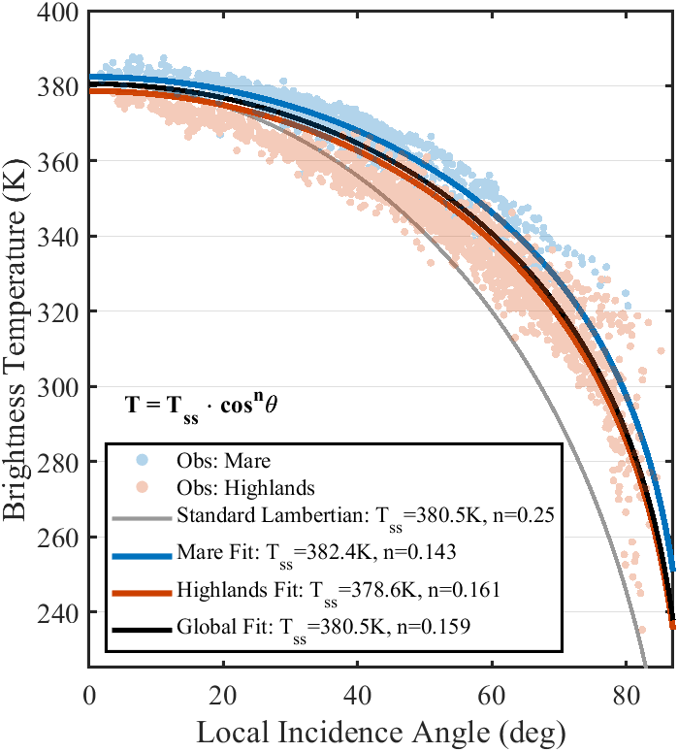
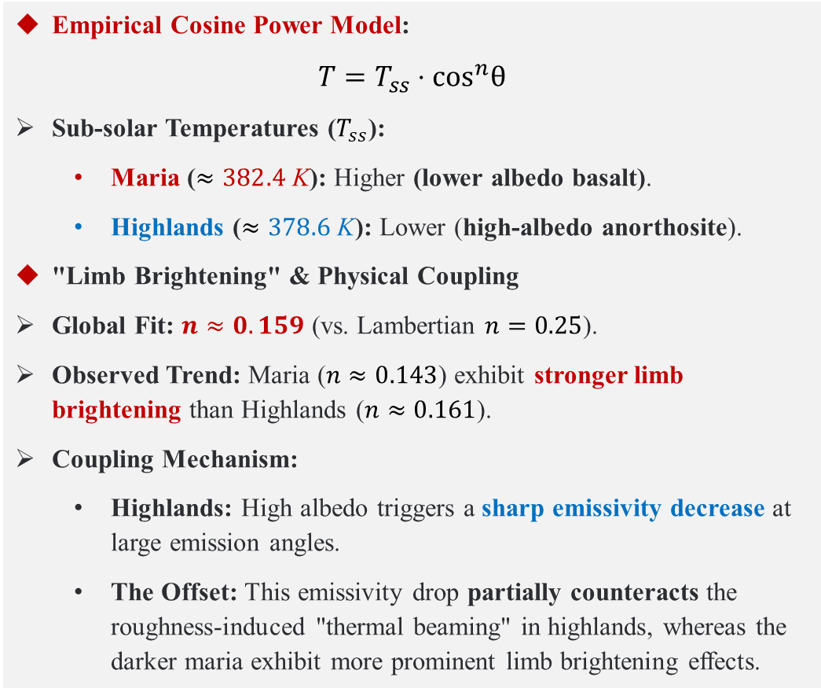
4、Calibration Results & Model Comparison
4.3 Micro-Roughness Effects
Empirical Cosine Power Model:
$$T=T_{ss}⋅\cos^{n}θ$$
Sub-solar Temperatures ($T_{ss}$):
  Maria ($≈382.4 \text{K}$): Higher (lower albedo basalt).
  Highlands ($≈378.6 \text{K}$): Lower (high-albedo anorthosite).
"Limb Brightening" & Physical Coupling
Global Fit: $n≈0.159$ (vs. Lambertian $n=0.25$).
Observed Trend: Maria ($n≈0.143$) exhibit stronger limb brightening than Highlands ($n≈0.161$).
Coupling Mechanism:
  Highlands: High albedo triggers a sharp emissivity decrease at large emission angles.
  The Offset: This emissivity drop partially counteracts the roughness-induced "thermal beaming" in highlands, whereas the darker maria exhibit more prominent limb brightening effects.
2018.07.28
2026/03/26
GSICS Annual Meeting 2026, Ottawa, Canada | IR Session, 26 March 2026
14

Slide 15
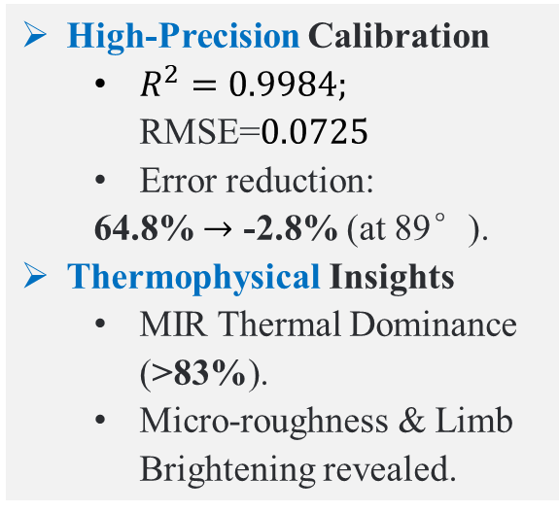
5、Conclusions
1
2
3
Key Achievements
Methodological Advantages
Future Directions
High-Precision Calibration
  $R^{2}=0.9984;$ RMSE=$0.0725$
  Error reduction:
  64.8% $→$ -2.8% (at 89°).
Thermophysical Insights
  MIR Thermal Dominance (>83%).
  Micro-roughness & Limb Brightening revealed.
Robust & Universal: Cross-calibration framework for all GEO MIR sensors.
TPM-Free: Bypasses complex modeling and high-uncertainty parameters (albedo, inertia, RMS slope).
Practical: Low-cost, routine, & ideal for high-temp (fire) detection.
Thermophysical Inversion: Inverting lunar surface properties from full-disk observations.
MIR Characterization: Deep-diving into unique lunar radiation behaviors.
On-orbit Monitoring: Long-term degradation tracking for infrared payloads.
The Moon can be effectively utilized as an ideal, high-stability calibration benchmark for GEO MIR sensors, with our empirical paradigm offering a robust and universal solution.
2026/03/26
GSICS Annual Meeting 2026, Ottawa, Canada | IR Session, 26 March 2026
15

Slide 16
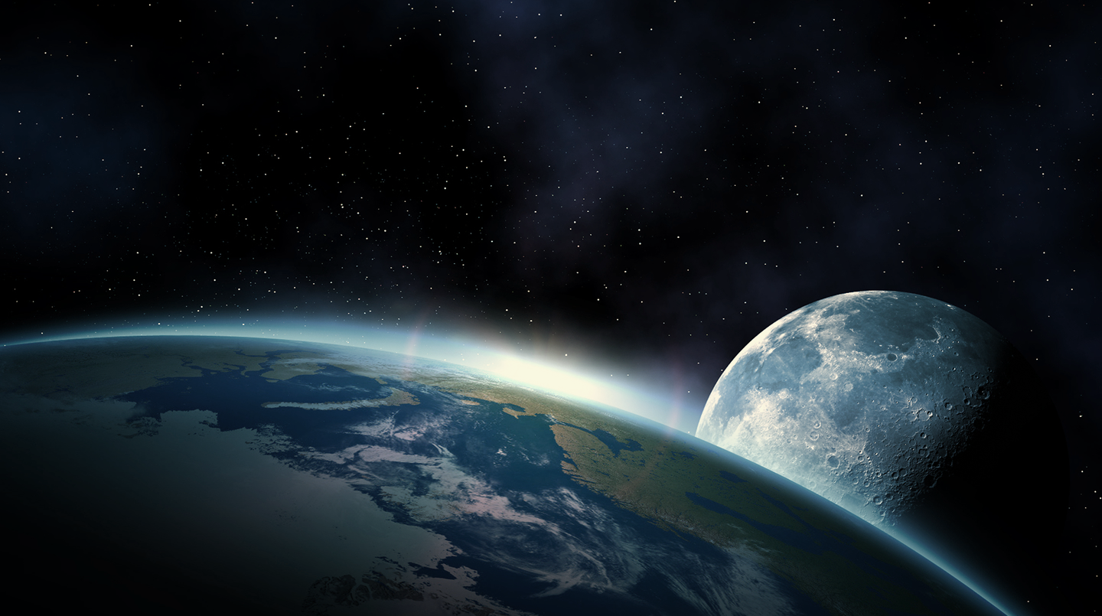
Thank you for your attention
Yunkai Xu¹, Yunzhao Wu¹,
Yong Zhang², Ling Sun², and Zhiwei Wang²
1. Purple Mountain Observatory (PMO), CAS
2. National Satellite Meteorological Center (NSMC), CMA
Email address: ykxu@pmo.ac.cn

