Slide 1
GRWG IR Session of GSICS Annual Meeting
Chengli Qi
NSMC/CMA qicl@cma.gov.cn

Slide 2
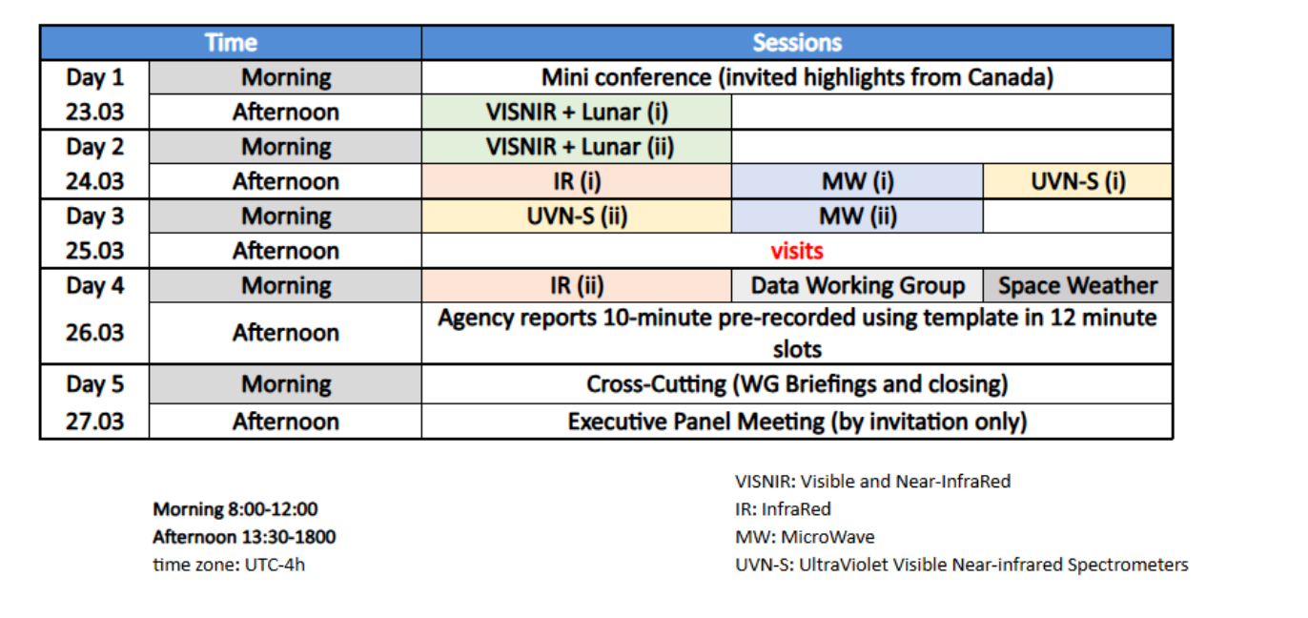

Slide 3
Day 2: 24-Mar-26 IR Breakout Session (i) - AUDITORIUM
Session Chair: Chengli Qi (CMA)
Minute Taker: Likun Wang (UMD)
Meeting Link: | https://teams.microsoft.com/meet/3184732366424?p=5o6Jmo3cI47rzLI1cm
Presentations:
Time (EDT) | Topic | Presenter | Item
14:00 | Session Introduction | Chengli QI (CMA) | 5a | In person
14:10 | FY-3E/HIRAS and FY-4B/GIIRS radiometric and spectral performances analysis using IASI | Dorothee Coppens (EUMETSAT) | 5b | In person
14:40 | On orbit performance assessment of HIRAS-II onboard FY-3H satellite | Junwei Wang (CMA) | 5c | In person
15:00 | Radiometric Calibration Performance of the IR Channels of EUMETSAT Optical Missions | Ali Mousivand (EUMETSAT) | 5d | In person
15:20 | Break
15:30 | <15 mK/decade Radiometric Calibration Stability Demonstrated By Long Term CrIS/VIIRS Comparisons | Dave Tobin (SSEC) | 5e | In person
15:50 | Assessing FOV-to-FOV Differences in NOAA Sensors Using EUMETSAT Algorithms | Likun Wang (UMD) | 5f | In person
16:10 | FY-4C satellite overview and commissioin status | Chengli QI (CMA) | 5g | In person
16:30 | METimage preliminary radiometric validation for IR bands | Francesc Lucas Carbo (EUMETSAT) | 5h | In person
16:50 | Discussion |  | 5i
17:30 | Close
7 talks in first half-day session----- (PM 24 Mar)
15 minutes for talk and 5 minutes for questions

Slide 4
Day 4: 26-Mar-26 IR Breakout Session (ii) - AUDITORIUM
Session Chair: Likun Wang (UMD)
Minute Taker: Chengli Qi (CMA)
Meeting Link: | https://teams.microsoft.com/meet/3184732366424?p=5o6Jmo3cI47rzLI1cm
Presentations:
Time (EDT) | Topic | Presenter | Item
8:00 | Intercomparison of the GSICS Engine and MICMICS for IR GEO–LEO Intercalibration | Ali Mousivand (EUMETSAT) | 5j | In person
8:20 | An overview of the current TircalNet status | Steffen Dransfeld(ESA) | 5k | Virtual
8:40 | Lunar-Based Cross-Calibration of GF-4 Mid-Infrared Band: Establishing a Radiometric Link from FY-4B/AGRI | Wenkai Xu (PMO/CAS) | 5l | Virtual
9:00 | An Operational Monitoring System for HIRAS | Junwei Wang (CMA) | 5m | In person
9:20 | Break
9:40 | MTG/IRS commissioning status | Dorothee Coppens (EUMETSAT) | 5n | In person
10:00 | The Cross-track Infrared Sounder (CrIS) Hybrid Principal Component Analysis / Rapid Event Detection (PCA/RED) Product | Dave Tobin (SSEC) | 5o | In person
10:20 | A Study on the Use of Reconstructed Radiances from Infrared Sounders for Inter-Calibration | Shin koyamstsu (JMA) | 5p | In person
10:40 | Discussion |  | 5q
11:30 | Close
12:00 | Lunch
7 talks in second half-day session----- (AM 26 Mar)

Slide 5
Two Discussion
Discussion 1: The sub-group needs for the website evolutions ( PM 24 Mar)
  See https://gsicsweb.eumetsat.int/ ​
  will be summarized in the cross-cutting (item 10j)
  16:50-17:30
  Hosted by Chengli Qi
Notes:
1）Meeting info and presentation files; 2) Actions and feedback or progress; 2) Publication, related to GSICS, model, method, validation, dataset distribution...

Slide 6
Two Discussion
Discussion 2: The sub-group needs and contribution for the GSICS Dashboard​( AM 26 Mar)
  See mockup on https://gsicsweb.eumetsat.int/gsics-plotter/​
  Discussion on the GDWG session (item 7j) for the implementation and data exchange interface.​
  Will be summarized in the cross-cutting (item 10l)​
  What to report/discuss in the cross-cutting reports​
  10:40-11:30
  Hosted by Likun Wang

Slide 7
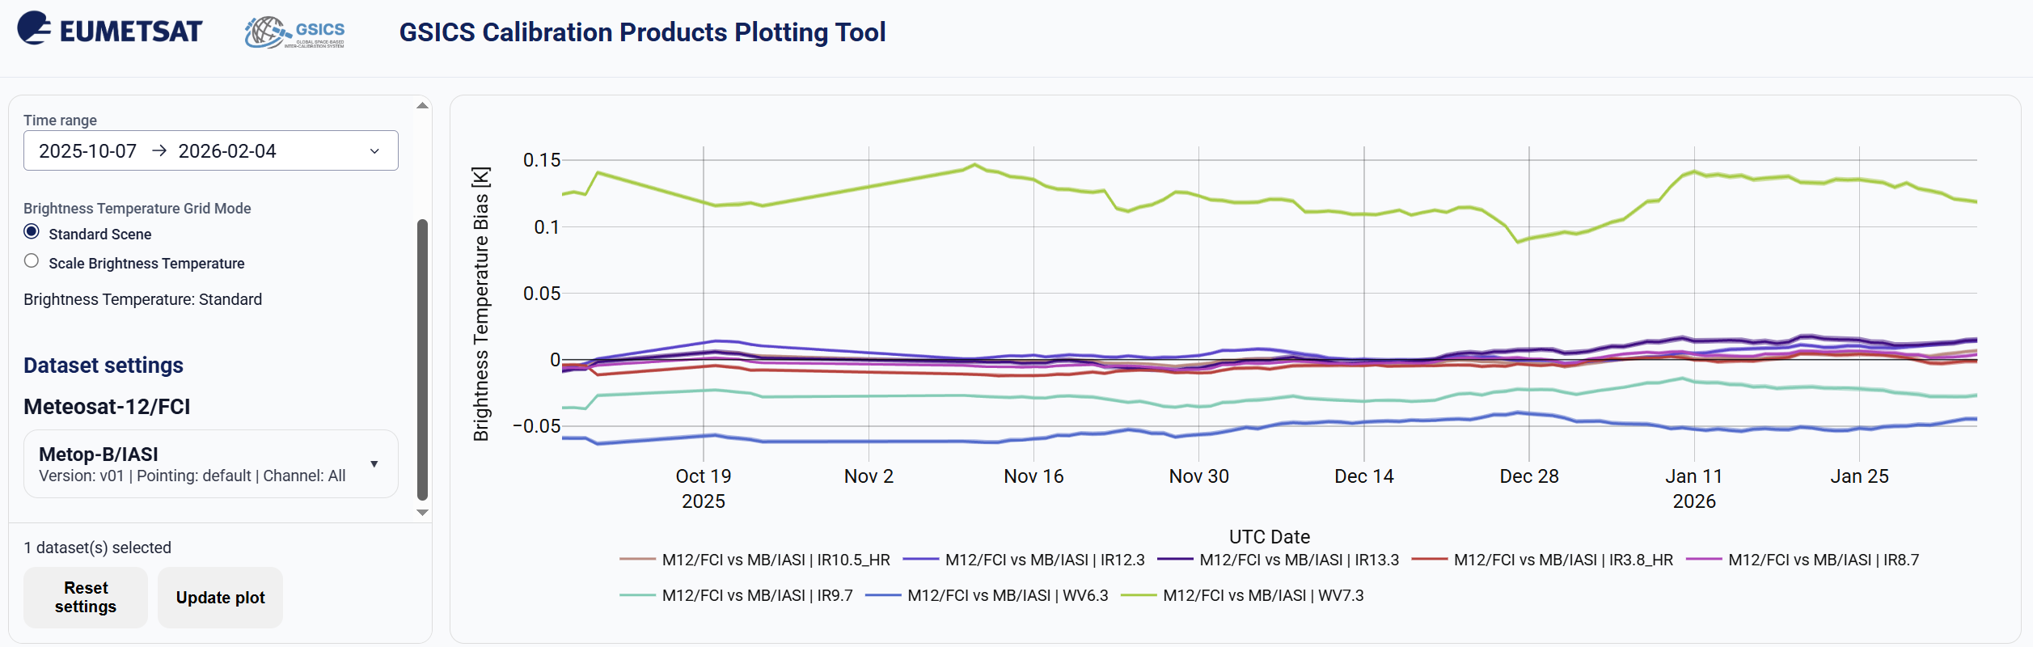
eg.
Notes:
1) not line, but dot line or star line, can look at the sample data. How much samples.

Slide 8
Counterpart of VIS/NIR, Microwave and UV Sub-Groups
  For Detector uniformity correction method
  For Hyperspectral instruments, spectral CAL/VAL
Organize special web meetings on:
data compression, uncertainty models
recalibration, radiometric reference transfer
detector uniformity processing.
Cooperate with instrument calibration groups(pre-launch and on-orbit)
  To communicate relevant information to the users
  To help them understand the root cause of observed biases and develop fixes
Review existing, or develop new inter-calibration
  Algorithms, procedures, corrections, collocation, spectral-gap filling etc.
  Using NWP+RTM, ground-based, near-space measurements, etc.
To define and promote calibration standards, tools and datasets, and best practices
  Including selection of inter-calibration reference
  Threshold values of time/spatial/spectral/angle difference.

