Slide 1
FY-3E/HIRAS and FY-4B/GIIRS radiometric and spectral performances analysis using IASI
Dorothee Coppens, Guillaume Deschamps, Bertrand Theodore, Pierre Dussarrat

Slide 2
Agenda
FY3E-HIRAS
  Radiometric performances
  Spectral performances
  Noise computation
FY4B-GIIRS
  Radiometric performances
  Spectral performances
  Noise computation

Slide 3
Agenda
FY3E-HIRAS
  Radiometric performances
  Spectral performances
  Noise computation
FY4B-GIIRS
  Radiometric performances
  Spectral performances
  Noise computation

Slide 4
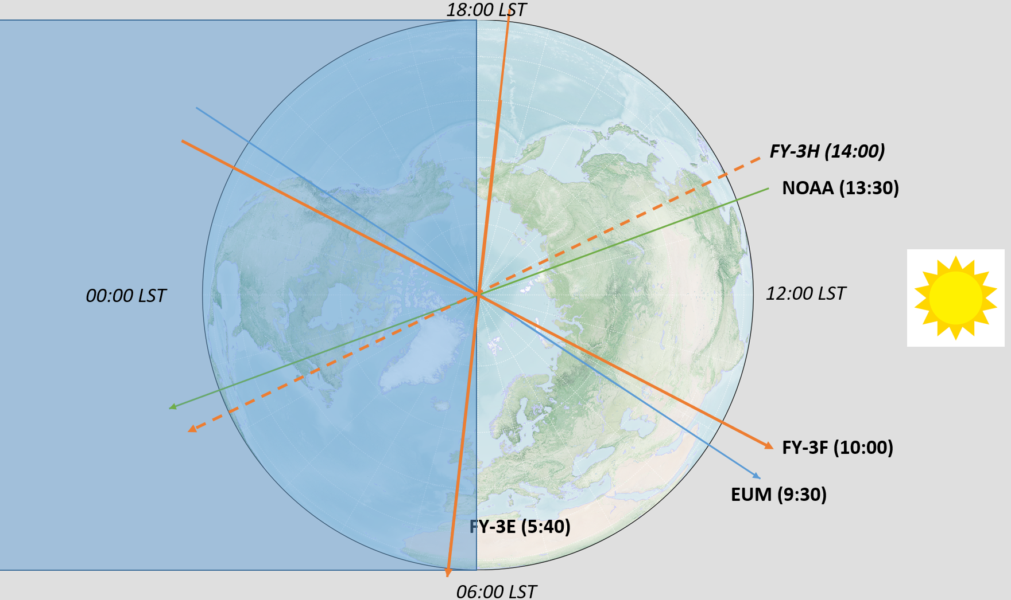
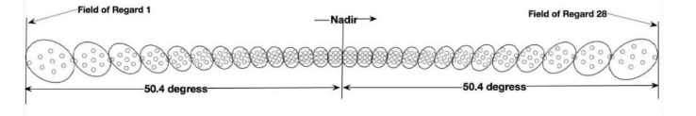
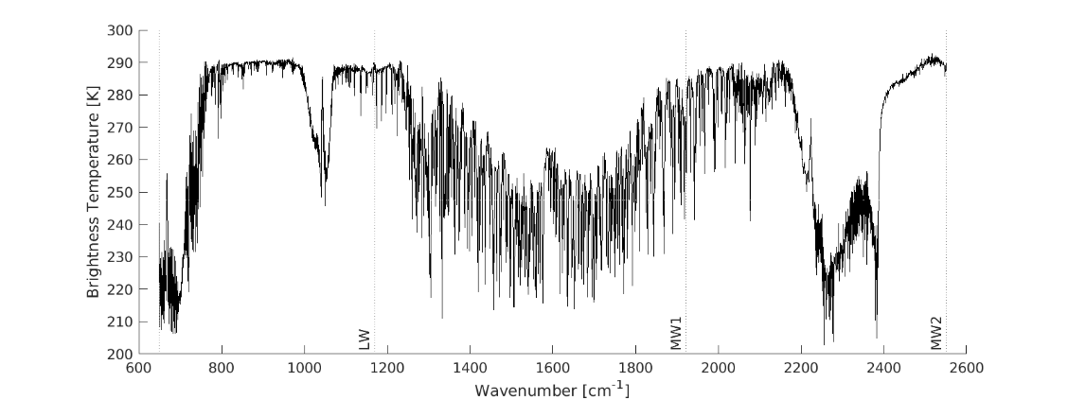
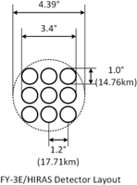
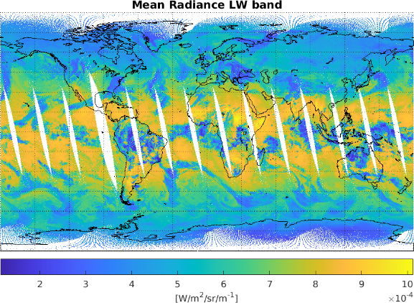
HIRAS-II
HIRAS-II is an evolution of HIRAS, that is flown from FY-3E onward.
The most obvious differences wrt. HIRAS are:
  Continuous spectral coverage from 650 to 2550 cm-1 with a sampling of 0.625 cm-1 in 3 bands (no band merging)
  3x3 pixels in each FOR, 28 FORs making a scan line
It is currently flying on FY-3E (2021) and we receive and re-distribute the L1 on Eumetcast.
HIRAS-II is also flying on FY-3F (2023) and FY-3H (2025) and not distributed to EUMETSAT

Slide 5
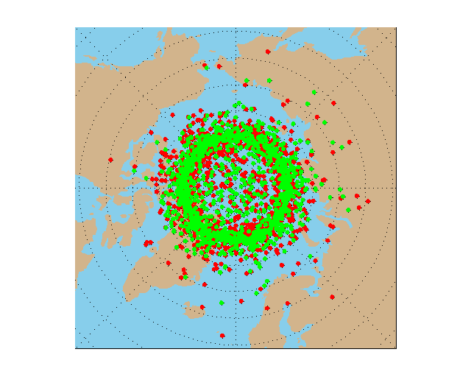
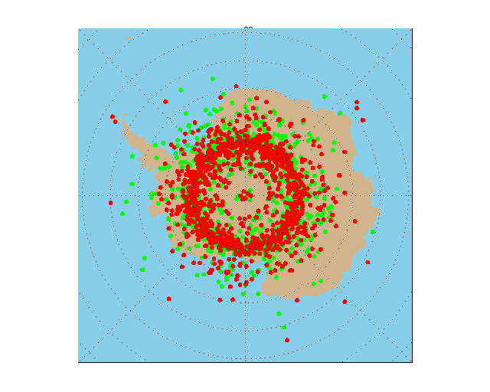
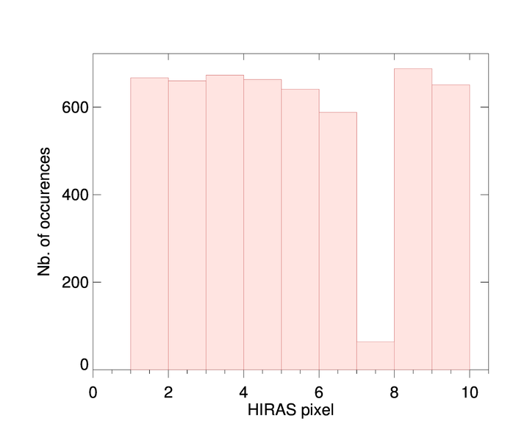
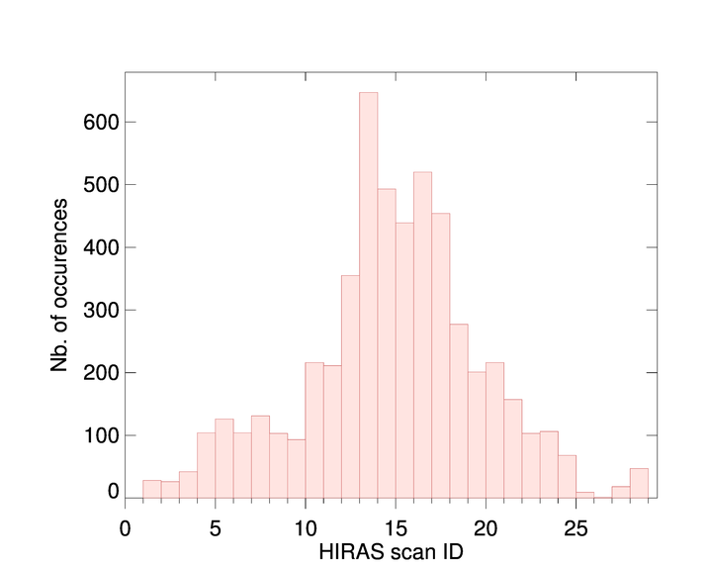
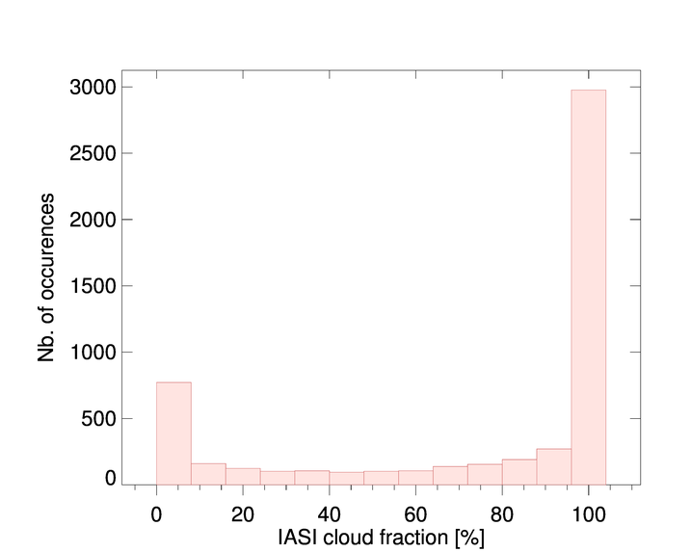
SNOs HIRAS/IASI
Metop and FY-3E are both on a sun-synchronous orbit but with different LTAN → SNOs only over the polar regions
We are storing collocations between HIRAS-II/FY-3E and IASI-B/C since May 2025
The collocations are selected such that:
  Time difference < 15 minutes
  Inter-pixel distance < 0.5 km
  Secant difference < 1%
  These strict criteria have been suggested by Junwei Wang from CMA
This leads to:
  5295 colocations from May 2025 to Feb 2026
  Mostly overcast scenes at nadir
  Under-representation of pixel 7 that is almost always flagged
Red dots: IASI-B, green: IASI-C

Slide 6
Agenda
FY3E-HIRAS
  Radiometric performances
  Spectral performances
  Noise computation
FY4B-GIIRS
  Radiometric performances
  Spectral performances
  Noise computation

Slide 7
Agenda
FY3E-HIRAS
  Radiometric performances
  Spectral performances
  Noise computation
FY4B-GIIRS
  Radiometric performances
  Spectral performances
  Noise computation

Slide 8
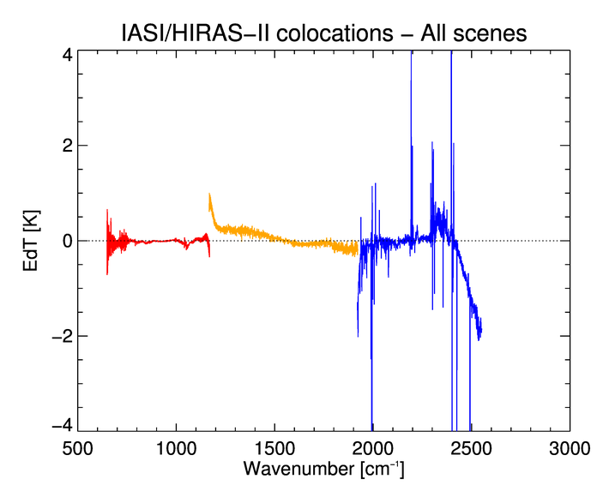
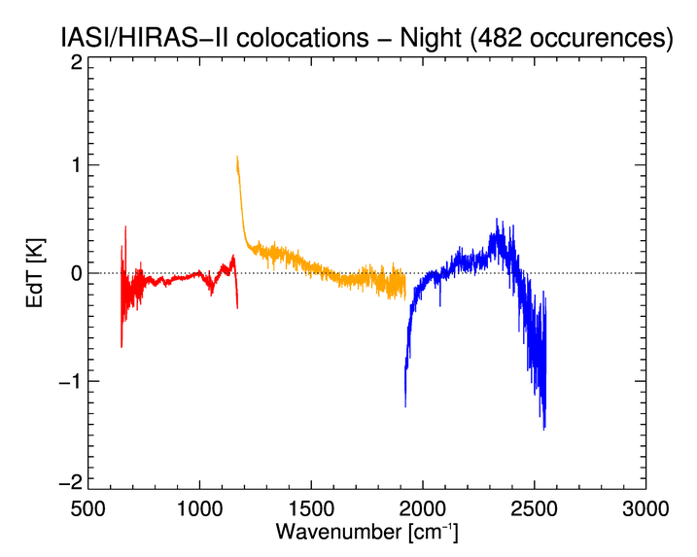
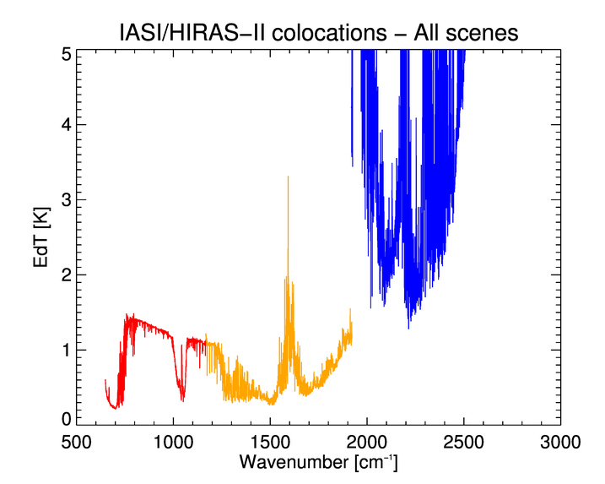
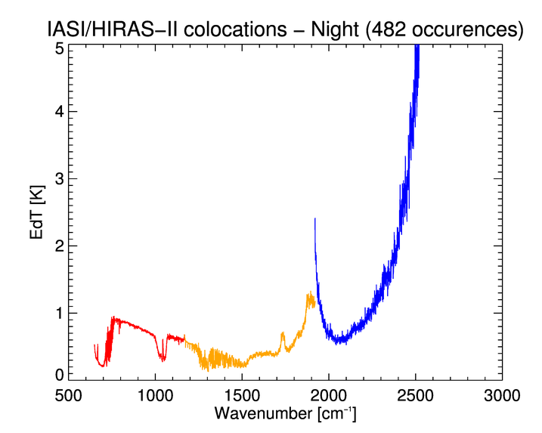
IASI/HIRAS FY-3E : Radiometric offset analysis
Good results in band 1
Relatively good in band 2 despite a dependency with wavenumber
In band 3, we observe an average difference up to 2K. It is better when considering only dark scenes (sun zenith angle > 120 deg) but the pattern is the same
No band merging for HIRAS ➔ Issues at the band edges

Slide 9
Agenda
FY3E-HIRAS
  Radiometric performances
  Spectral performances
  Noise computation
FY4B-GIIRS
  Radiometric performances
  Spectral performances
  Noise computation

Slide 10
Agenda
FY3E-HIRAS
  Radiometric performances
  Spectral performances
  Noise computation
FY4B-GIIRS
  Radiometric performances
  Spectral performances
  Noise computation

Slide 11
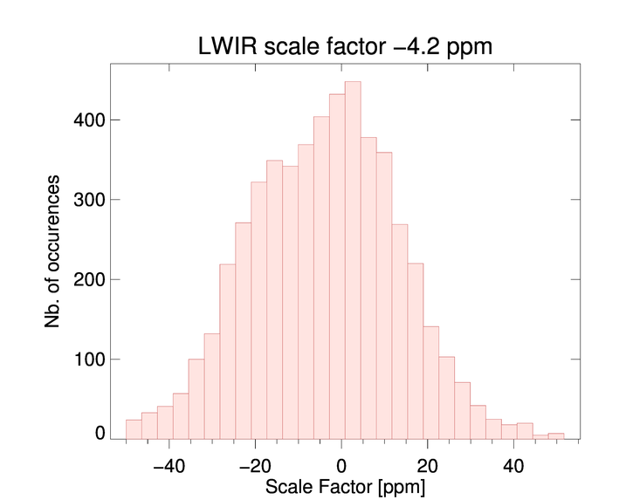
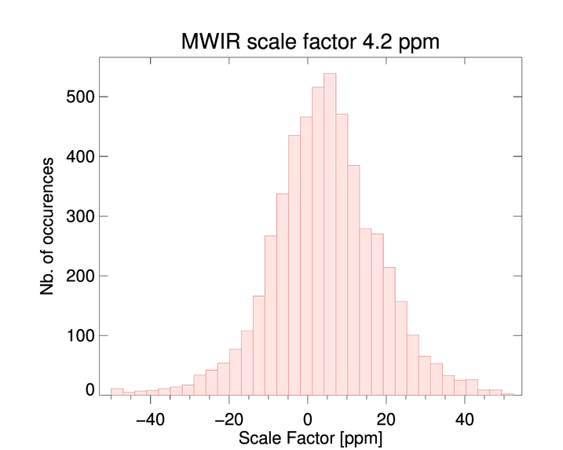
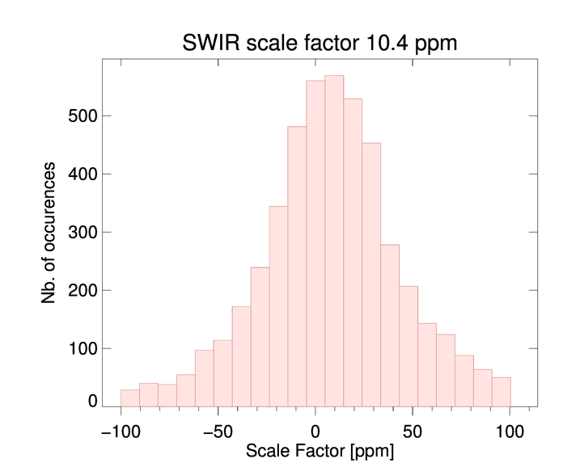
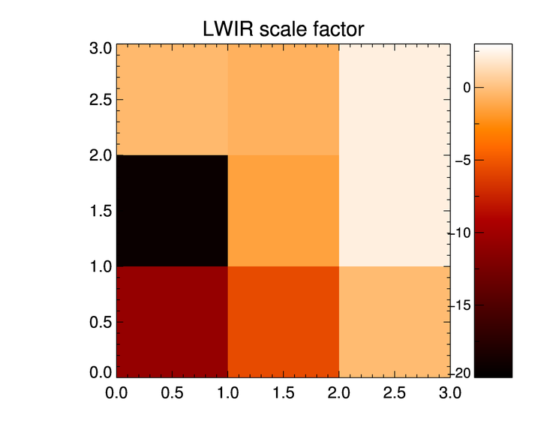
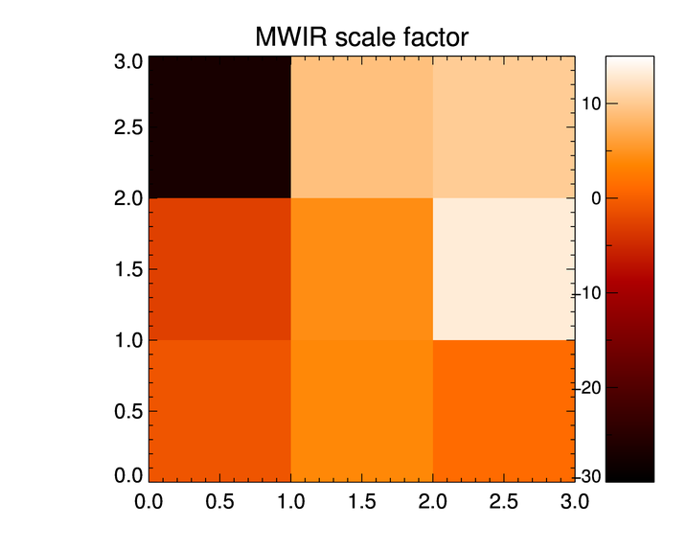
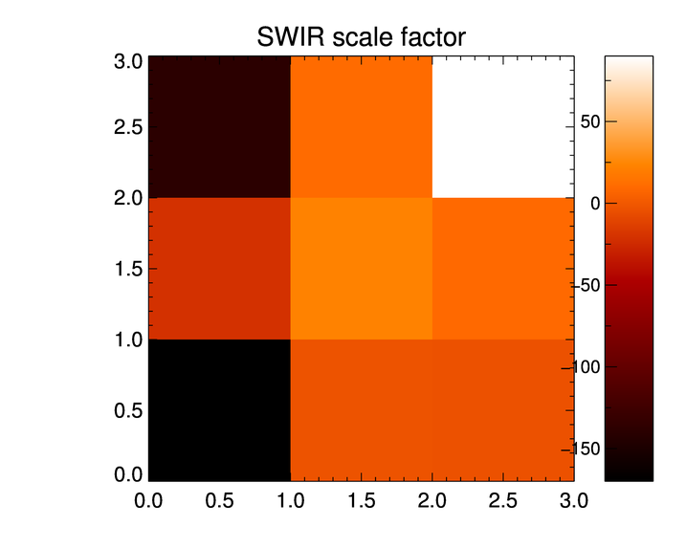
IASI/HIRAS FY-3E : Spectral calibration pixel/scan dependency
It is relatively modest in LWIR and MWIR but with a large dispersion
In SWIR, the values obtained is probably affected by many outliers
Clear dependency per pixel - Maybe a gradient along the diagonal ?

Slide 12
Agenda
FY3E-HIRAS
  Radiometric performances
  Spectral performances
  Noise computation
FY4B-GIIRS
  Radiometric performances
  Spectral performances
  Noise computation

Slide 13
Agenda
FY3E-HIRAS
  Radiometric performances
  Spectral performances
  Noise computation
FY4B-GIIRS
  Radiometric performances
  Spectral performances
  Noise computation

Slide 14
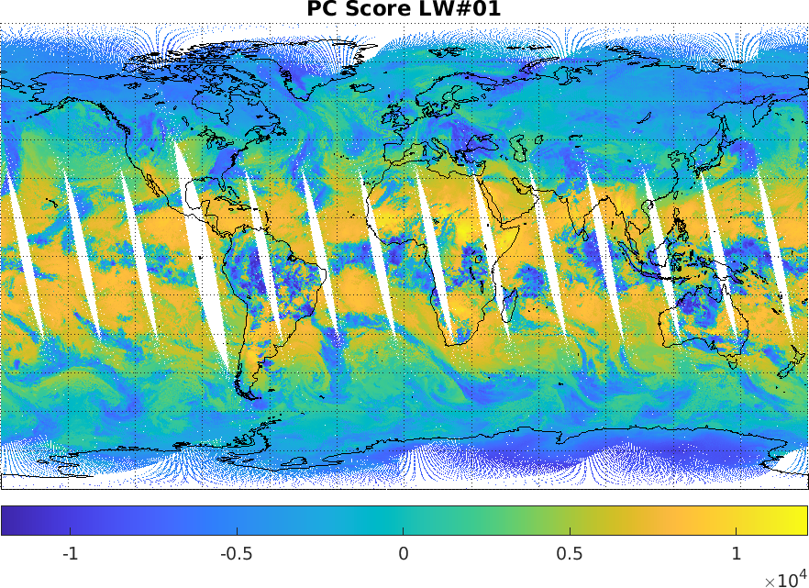
Visual inspection using Principal Component Scores
Example of well-behaving PCS:
  The scores associated to the 1st principal component of the LWIR band represent mainly cloud distributions and surface temperature

Slide 15
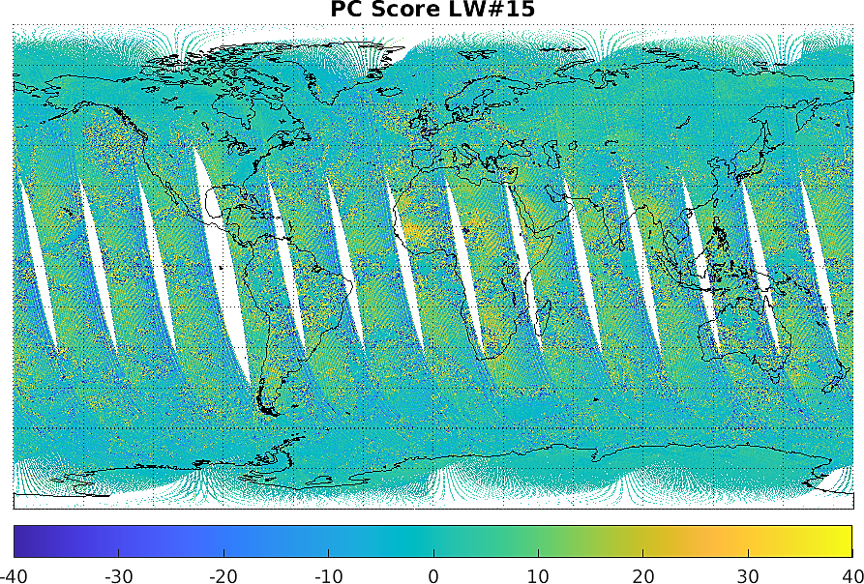
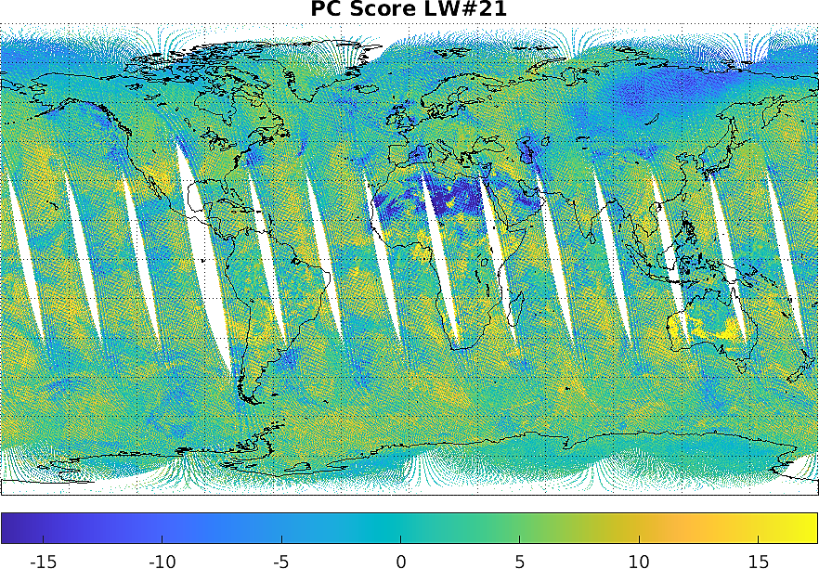
PCs visual inspection
Example of unexpected PCS behaviour:
  The scores associated to the 15th and 21st principal components of the LWIR band exhibit checkerboard patterns (mixed with atmospheric signals)

Slide 16
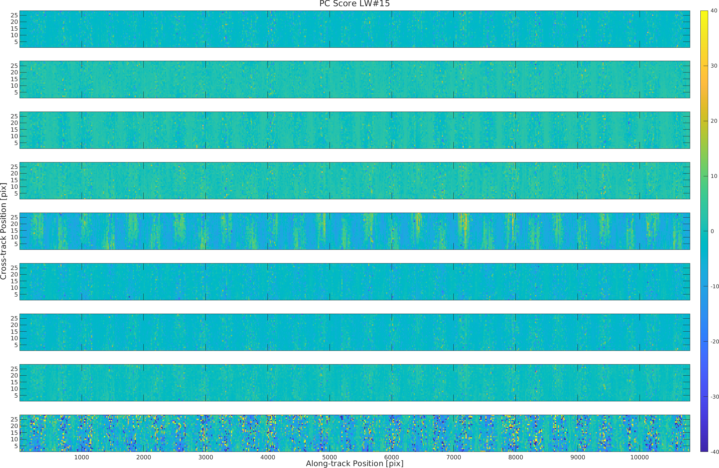
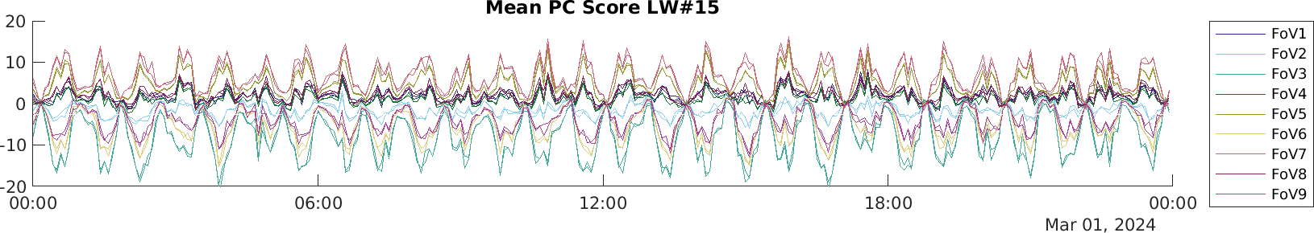
PCs visual inspection
FoV 1
FoV 2
FoV 3
FoV 4
FoV 5
FoV 6
FoV 7
FoV 8
FoV 9
Analysis the 15th PCS over time on a day provide information about the spectral calibration stability
We observe oscillations per half-orbits, with different offsets, amplitudes and signs for the different pixels
Such behaviour is interpreted as thermally driven instrument mis-alignments and defocus that are not compensated.

Slide 17
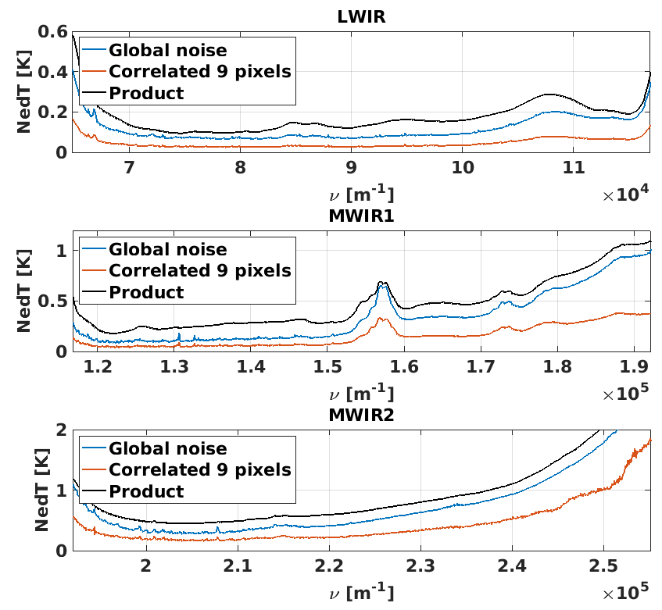
Estimation of the noise using PCA
Using PCA it s possible to retrieve the total noise (blue curve on the plot) that appears to be slightly below the figures provided in the products (in black)
Noise curve shows a significant bump between 1550 and 1600cm⁻¹ : contamination ?
Furthermore, we have developed a formalism to estimate the correlated part of the noise (red curve)
For HIRAS/FY-3E, the correlated noise is more than 50% of the total noise in some spectral regions → root cause ?
(IASI: the correlated noise is ~ 14% of the total noise)

Slide 18
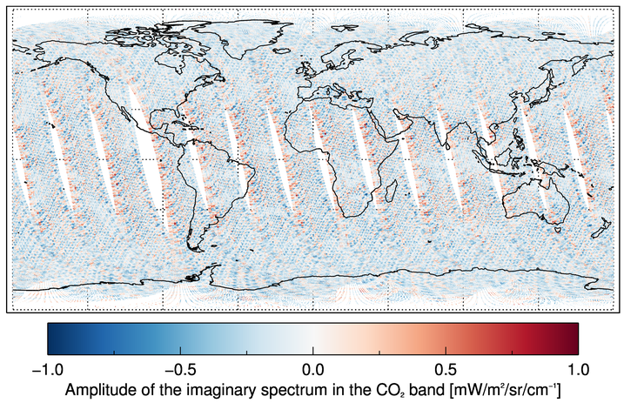
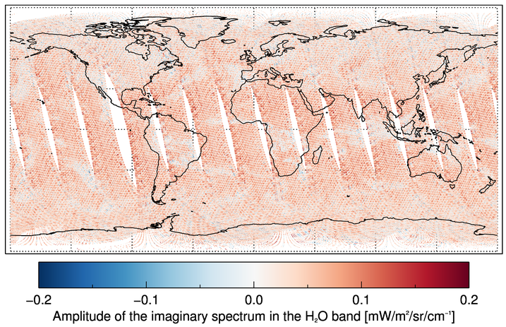
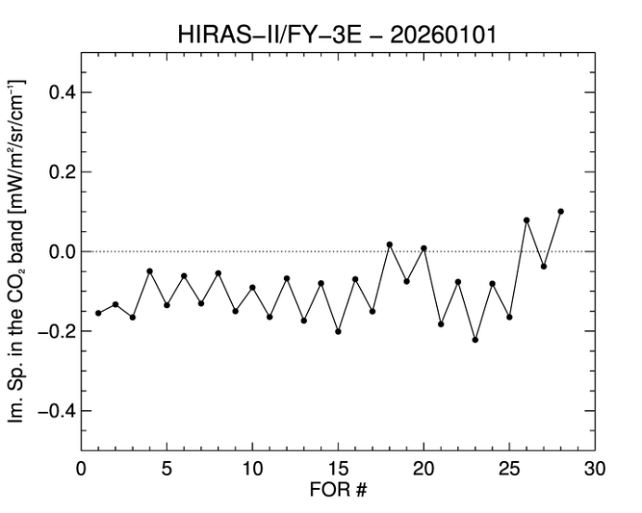
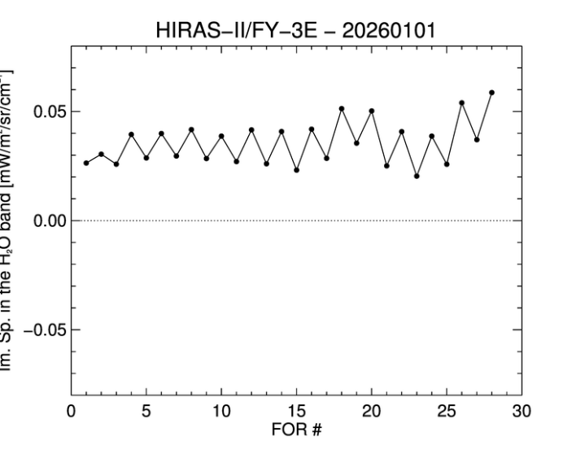
Imaginary part of the spectrum
We observe an asymmetry along the swath (problem with reflectivity of the scan mirror?) and a dependency on the corner cube direction
There is a bias of average value of the imaginary signal ➔ ZPD estimation?

Slide 19
Conclusion
IASI vs. HIRAS-II
  Radiometric differences using IASI show biases in MWIR and especially in SWIR
  Spectral calibration was evaluated showing good average shifts in LWIR and MWIR with a spatial gradient
  The noise evaluated by PCA is lower than in the products but the correlated noise is high
  The imaginary signal is not 0 and exhibits a spatial pattern: it depends on the FOR and on the pixel
FY-3E/HIRAS-II L1 products quality seems to be stable between May 2025 and February 2026

Slide 20
Agenda
FY3E-HIRAS
  Radiometric performances
  Spectral performances
  Noise computation
FY4B-GIIRS
  Radiometric performances
  Spectral performances
  Noise computation

Slide 21
Agenda
FY3E-HIRAS
  Radiometric performances
  Spectral performances
  Noise computation
FY4B-GIIRS
  Radiometric performances
  Spectral performances
  Noise computation

Slide 22
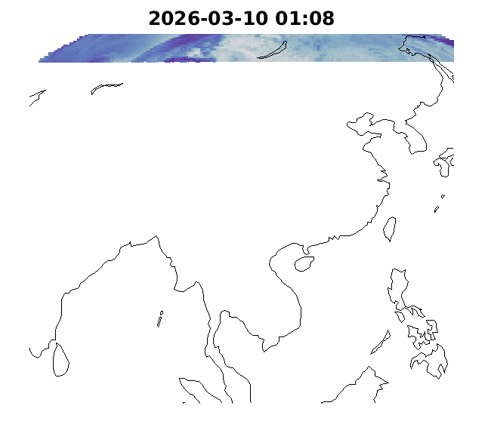
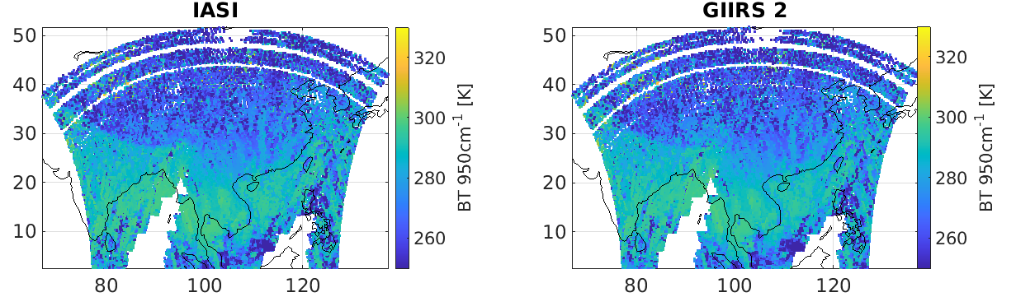
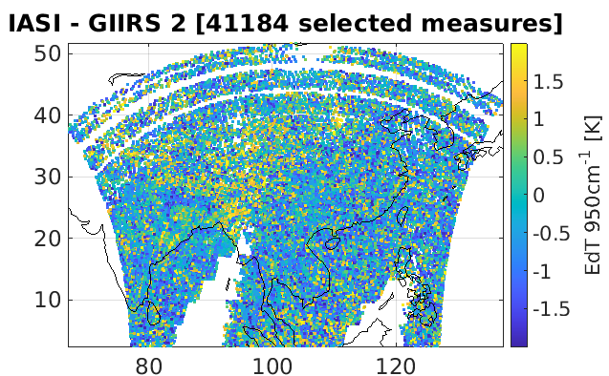
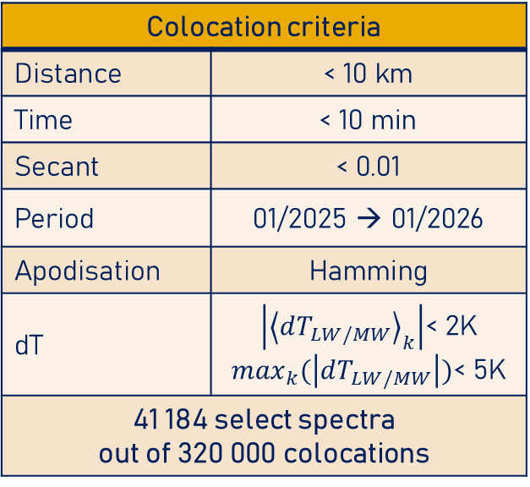
GIIRS-IASI colocations
ACROSS tool:
  Automatic collection of collocated acquisitions between different instruments
  Developed for the monitoring of EUM “hyperspectral” instruments: IASI, IASI-NG and MTG-S IRS
  Collocations between FY4-B GIIRS-2 and the Metop IASI (-B and -C) are also generated everyday and stored in a data base
Colocation criteria
Distance | < 10 km
Time | < 10 min
Secant | < 0.01
Period | 01/2025 → 01/2026
Apodisation | Hamming
dT | $\left|{\left\langle dT_{LW/MW}\right\rangle }_{k}\right|$< 2K $\max_{k}(\left|dT_{LW/MW}\right|)$< 5K
41 184 select spectra out of 320 000 colocations

Slide 23
Agenda
FY3E-HIRAS
  Radiometric performances
  Spectral performances
  Noise computation
FY4B-GIIRS
  Radiometric performances
  Spectral performances
  Noise computation

Slide 24
Agenda
FY3E-HIRAS
  Radiometric performances
  Spectral performances
  Noise computation
FY4B-GIIRS
  Radiometric performances
  Spectral performances
  Noise computation

Slide 25
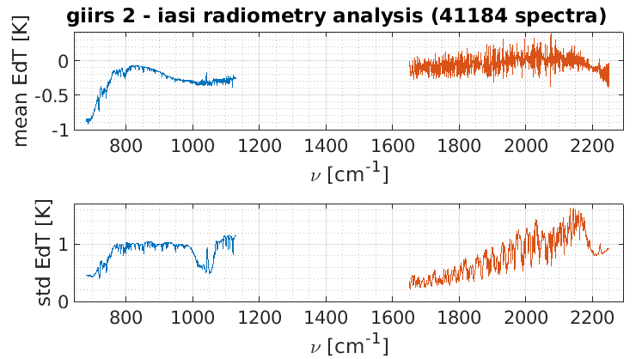
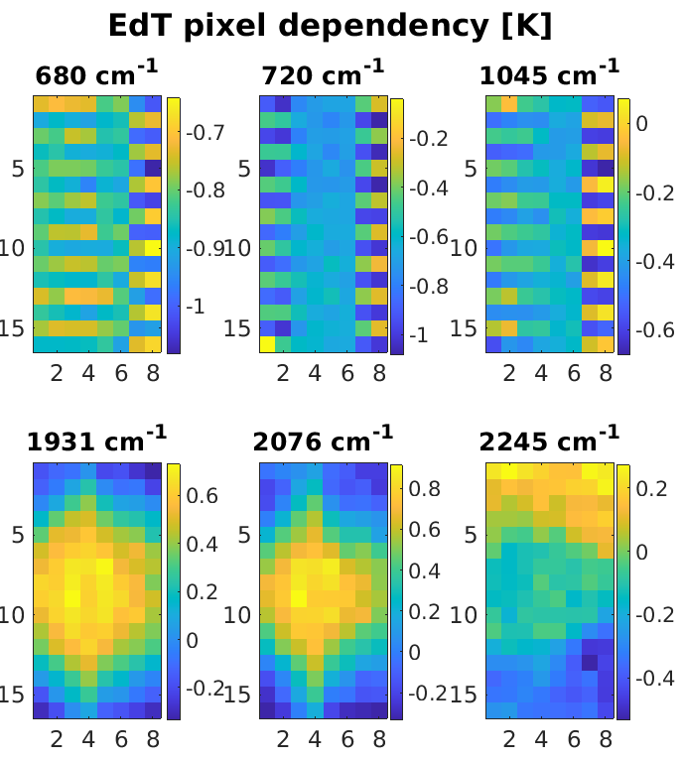
Radiometric performances
Evaluation of the radiometric difference between GIIRS-2 and IASI (B and C)
Converted into a difference in Kelvin at 280K:
Outcomes:
  Significant bias up to 1K at the beginning of the LWIR band – CO2 region
  Spikes in MWIR (associated to SRF distortions)
  Strong pixel dependency : checkerboard pattern in LWIR and “diamond” shape in MWIR

Slide 26
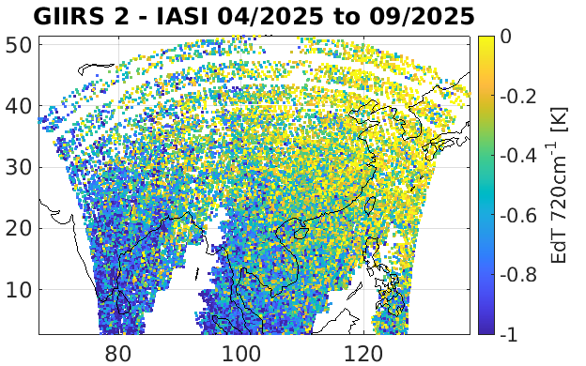
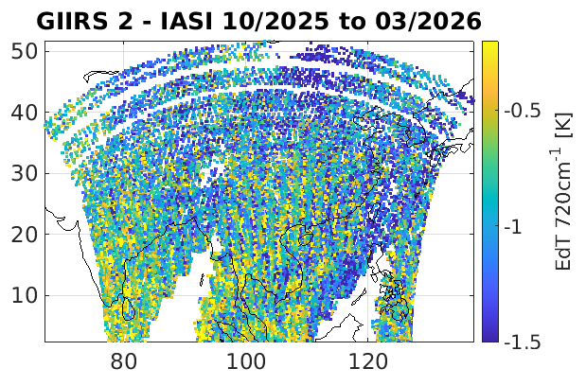
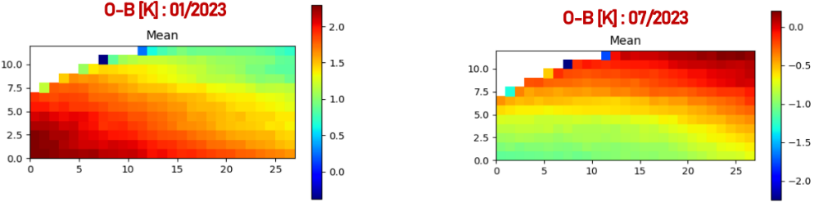
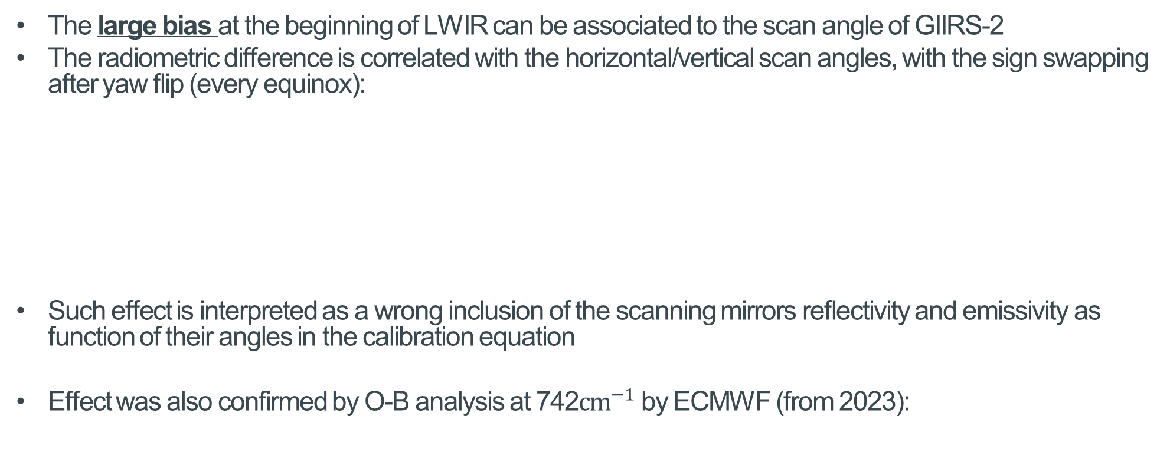
Radiometric calibration vs. scan
The large bias at the beginning of LWIR can be associated to the scan angle of GIIRS-2
The radiometric difference is correlated with the horizontal/vertical scan angles, with the sign swapping after yaw flip (every equinox):
Such effect is interpreted as a wrong inclusion of the scanning mirrors reflectivity and emissivity as function of their angles in the calibration equation
Effect was also confirmed by O-B analysis at 742$cm^{−1}$ by ECMWF (from 2023):
Yaw-flip
Yaw-flip

Slide 27
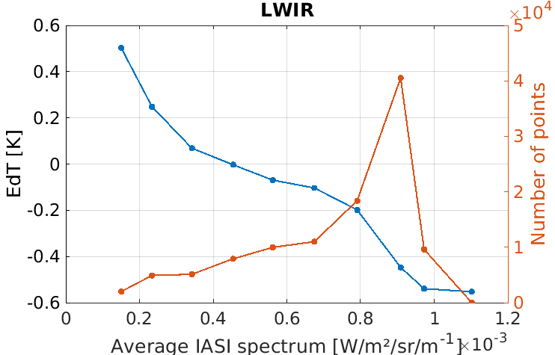
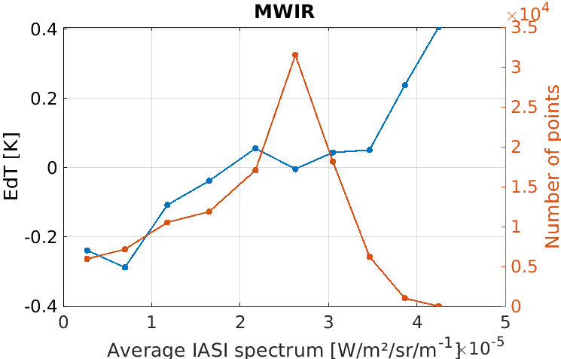
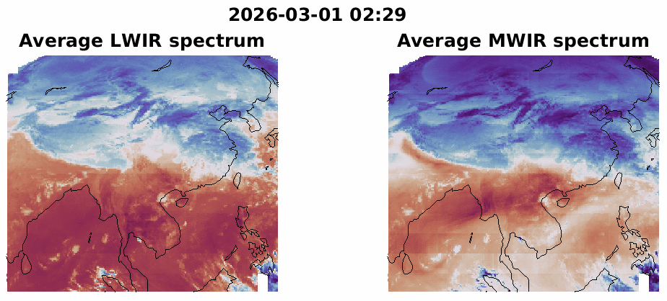
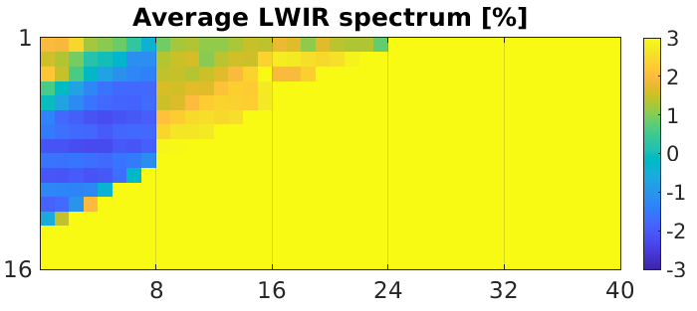
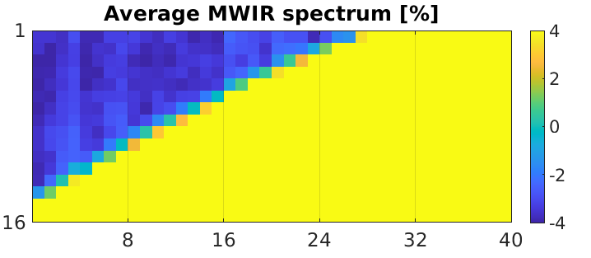
Other radiometric observations
Offset & gain errors clearly visible in both bands:
  Negative slope in most of LWIR channels of a few %
  Positive slope in most of MWIR channels of a few %
Calibration seems very unstable:
  Large bias of K level jumping between lines
  No clear temporal pattern observed
  Related to an issue in the overall instrument calibration coefficient update (offset and gain)
Straylight & space calibration:
  Clear straylight residual in LWIR limb views (few %)
  Strongly negative signal in MWIR space pixels

Slide 28
Agenda
FY3E-HIRAS
  Radiometric performances
  Spectral performances
  Noise computation
FY4B-GIIRS
  Radiometric performances
  Spectral performances
  Noise computation

Slide 29
Agenda
FY3E-HIRAS
  Radiometric performances
  Spectral performances
  Noise computation
FY4B-GIIRS
  Radiometric performances
  Spectral performances
  Noise computation

Slide 30
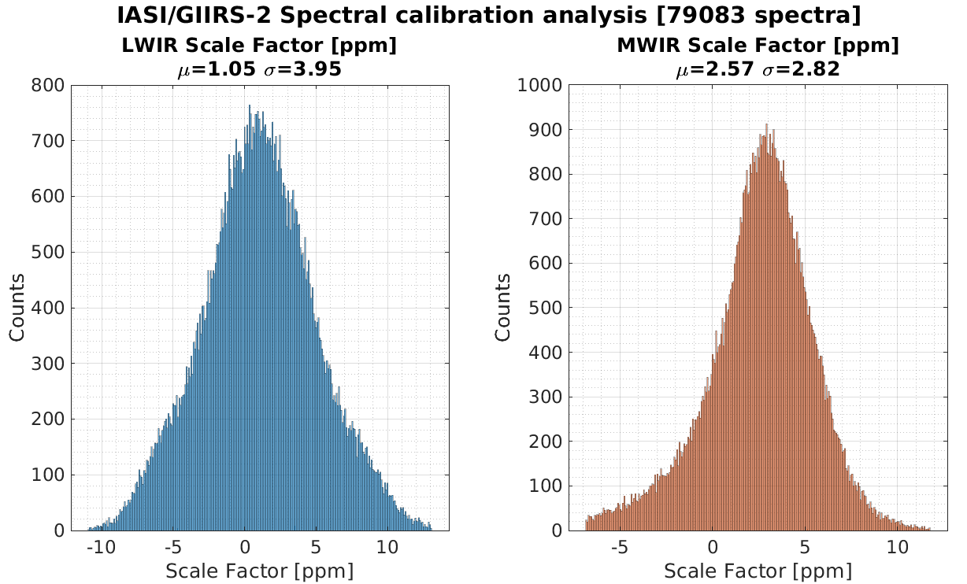
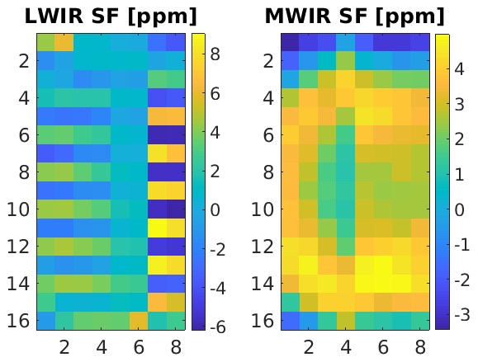
FY4B GIIRS Spectral calibration
Computation of relative spectral “scaling factors” between GIIRS-2 and IASI:
Outcomes:
  Overall small difference in average of 1ppm (LWIR) and 2.5ppm (MWIR)
  Large spatial variability: “checkerboard” (electrical issues confirmed by CMA) and “diamond” pattern (straylight ?)

Slide 31
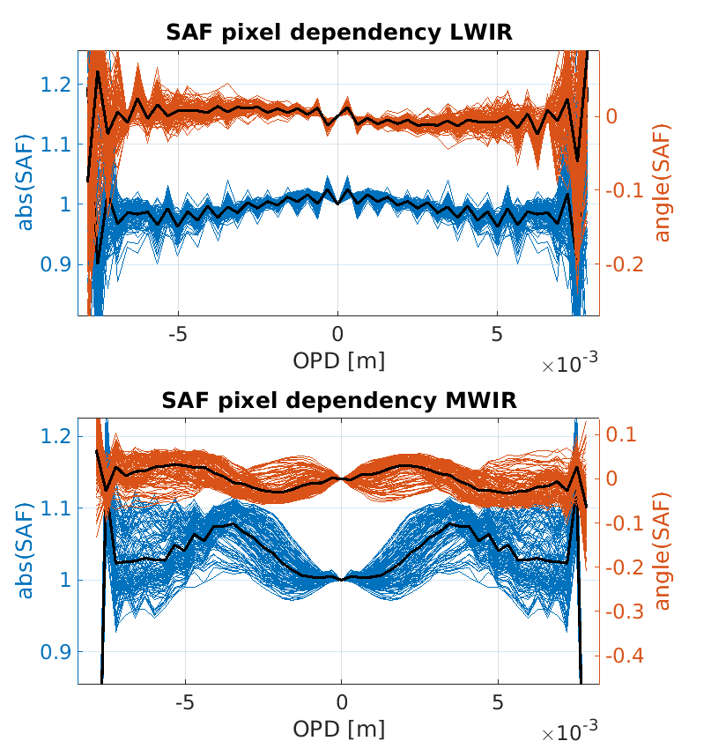
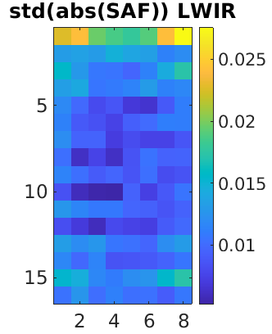
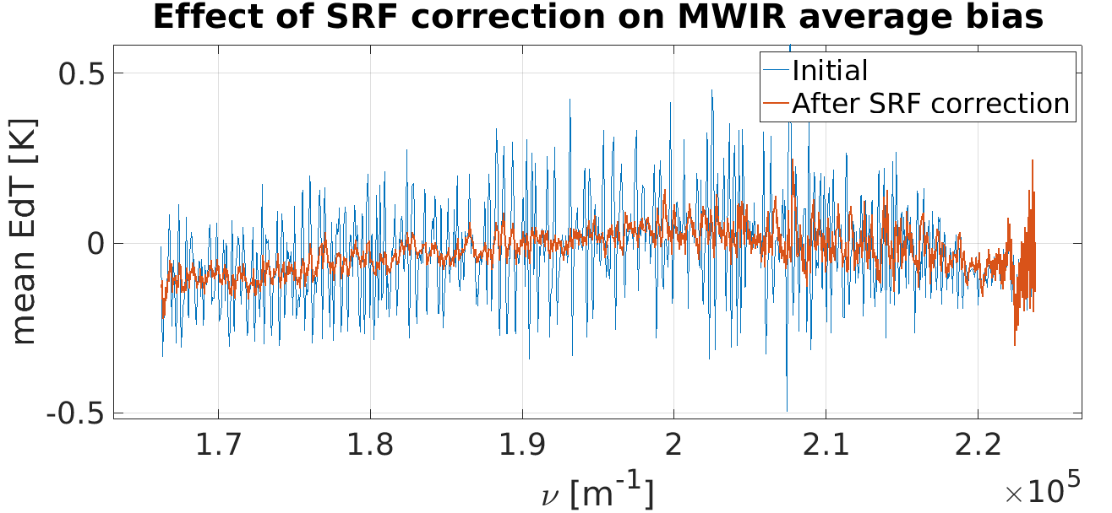

FY4B GIIRS SAF retrieval and correction
Computation of the relative “self-apodisation function” (SAF) of the GIIRS pixels wrt. IASI :
  Dussarrat et al (2024). Spectral Response Function Retrieval of Spaceborne Fourier Transform Spectrometers: Application to Metop-IASI. Remote Sensing
  Dussarrat, P., & Deschamps, G. (2025). Relative Spectral Response Function Retrieval of Hyperspectral Instruments in Atmospheric Spectrometry. arXiv preprint arXiv:2504.19708.
We show that the GIIRS MWIR spectra may be re-processed (by SAF/SRF “uniformization”) to reduce the spikes in the difference with IASI (to be further investigated)
The root cause of these SAF may be related straylight in the MWIR band ? (To be confirmed)

Slide 32
Agenda
FY3E-HIRAS
  Radiometric performances
  Spectral performances
  Noise computation
FY4B-GIIRS
  Radiometric performances
  Spectral performances
  Noise computation

Slide 33
Agenda
FY3E-HIRAS
  Radiometric performances
  Spectral performances
  Noise computation
FY4B-GIIRS
  Radiometric performances
  Spectral performances
  Noise computation

Slide 34


FY4B GIIRS Noise
Evaluation of GIIRS NEdT using PCA technic over a few days of data in March 2026 (removing acquisitions with raised quality flags)
Noise curve show absorptions around 800cm⁻¹ and 1050 - 1100cm⁻¹ : silicon contamination ?
Noise supplied in the products seems to be under-evaluated
~20% of correlated noise common to all pixels in the MWIR band, root cause ?
Good pixel homogeneity in MWIR, a few outliers in LWIR

Slide 35
Conclusion
IASI vs. GIIRS-2
  Radiometric differences show high biases at the beginning of LWIR and spikes in MWIR
  Both bands exhibits calibration slopes “gain” significantly different than 1
  Calibration seems to be jumping in both bands between scan lines and repeat cycles
  Spectral calibration was evaluated showing good average shifts but revealing significant spatial patterns
  Relative SAF were computed and may be used to reduce the spikes in the MWIR bands
  The noise evaluated by PCA is overall satisfactory, but it appears under-evaluated in the products
GIIRS-2 quality has been stable between 2024 and 2026

Slide 36
Thank you!
Questions are welcome.

Slide 37




Anomaly Detection
Pixel discrepancies are visible in the PCS averages per pixel.
* PCS averages are normalized by
$$\overline{PCS}\left(k,p\right)=\frac{mean(PCS\left(k,p\right)−{\left\langle PCS\left(k,p\right)\right\rangle }_{p})}{{\left\langle std\left(PCS\left(k,p\right)\right)\right\rangle }_{p}}$$

Slide 38

PCs visual inspection
Inspection of the PCS can help diagnosing problem with the products
For example, it seems that the 15th PC is related to the spectral calibration of the measurements (~ derivative of the radiance)
By analysing the distribution of the 15th PCS, we study indirectly the spectral calibration of the instrument
NB: in general, the association of a PCS to a given instrument or processing flaw is not straightforward

Slide 39







Principal Component Analysis (PCA)
PCA is foremost a popular dimension reduction methodology
= Principal Component Compression (PCC)
Take advantage of the spectral correlations to define the “directions” of the signal and only keep the most significant ones = the principal components (PC)
PCA transforms every measurements (the radiance $s$) into a limited number of weights called the Principal Component Scores (PCS).
Example: FY-3E HIRAS LWIR band
$$⋮$$
PCS(3) $×$
PCS(2) $×$
PCS(1) $×$

Slide 40

Estimation of the noise using PCA
HIRAS/FY-3E noise has also been estimated per pixel
The noise of the central pixel is low conversely to the surrounding, in particular corner, pixels -> Is the calibration adjusted only on the central pixel ?
In MWIR2, one corner pixel clearly differs from the others with a noise reaching 5 K i.e. 5 times the average noise

