Slide 1
On-orbit performance assessment of HIRAS-II onboard FY-3H satellite
Presenter: Junwei Wang
Contributors: Chengli Qi, Zhichao Guan, Chunyuan Shao, Han Li, Mengzhen Xie, Qian Zhang, Yanfang Lv
NSMC, China Meteorological Administration (CMA)

Slide 2
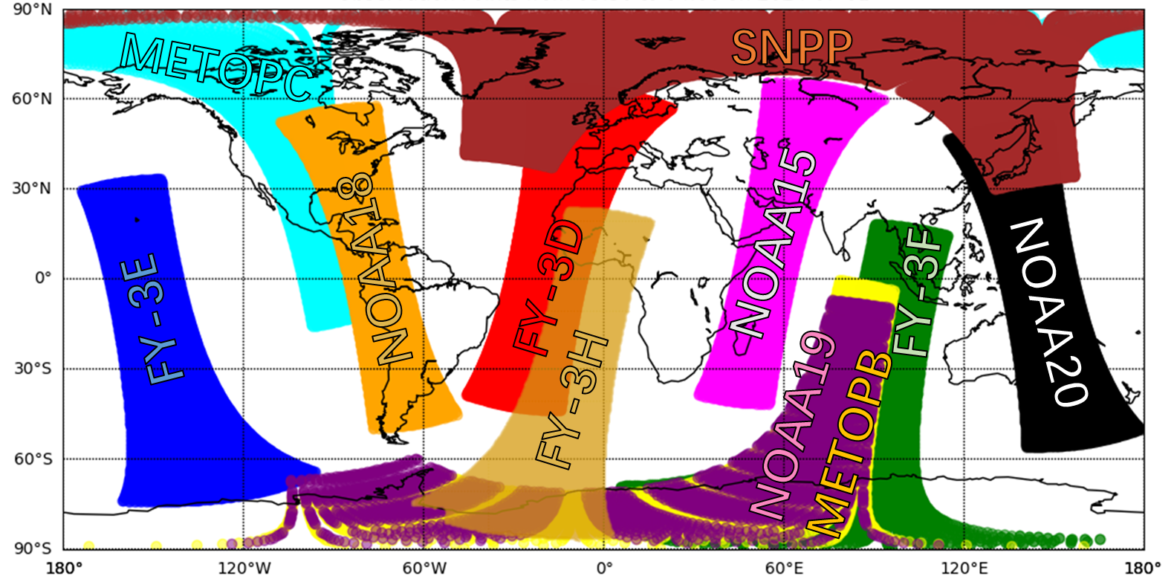
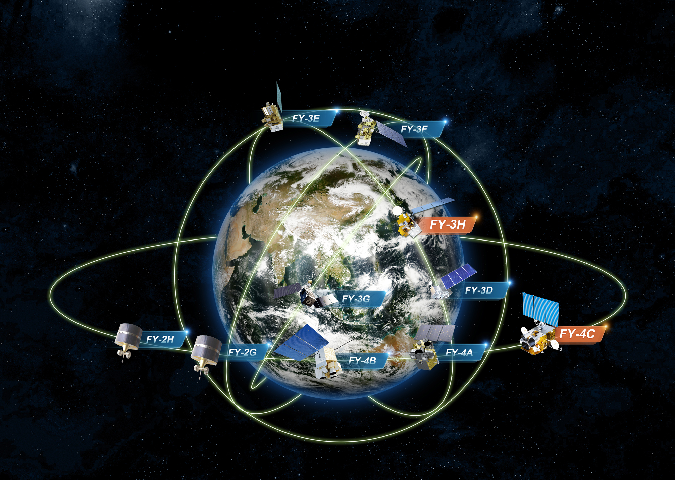
Overview of FY-3H satellite
FY-3H is an afternoon-orbit satellite and the successor to FY-3D, enhancing the capability of high-precision monitoring of global greenhouse gases.
After assimilating FY-3H, the contribution of FY-series satellites in
the CMA-GFS numerical forecasting system has further increased.
Orbit | Sunsynchronous orbit
Altitude | 836 km
ECT | 14:00 asc
Launch | 2025-09-27
Global coverage of polar-orbiting satellites within a 30-minute assimilation time window

Slide 3
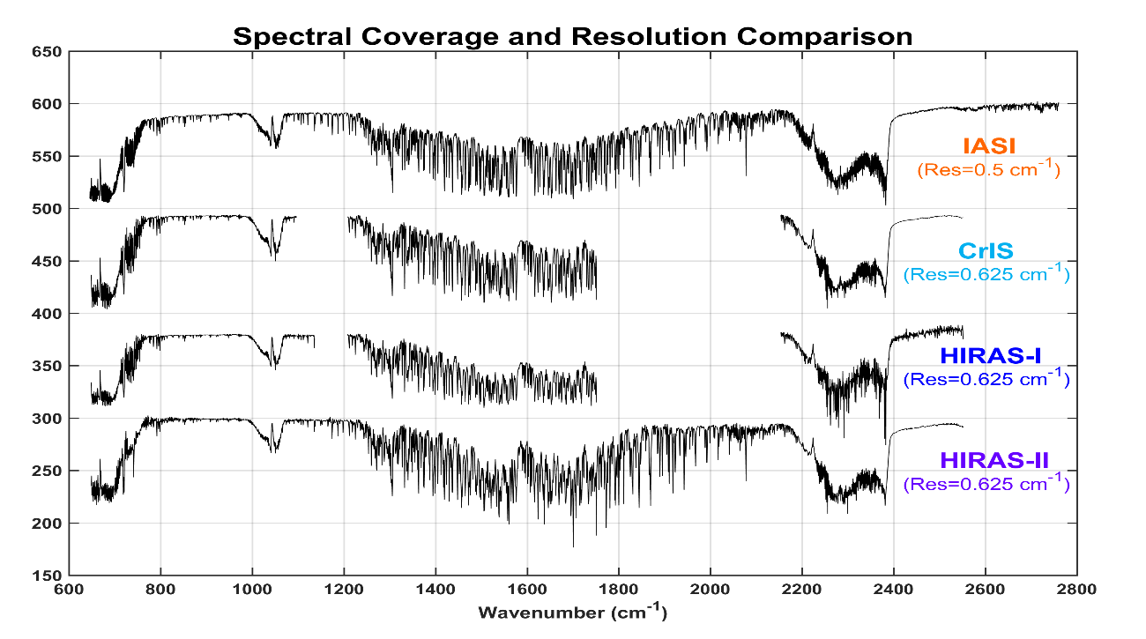
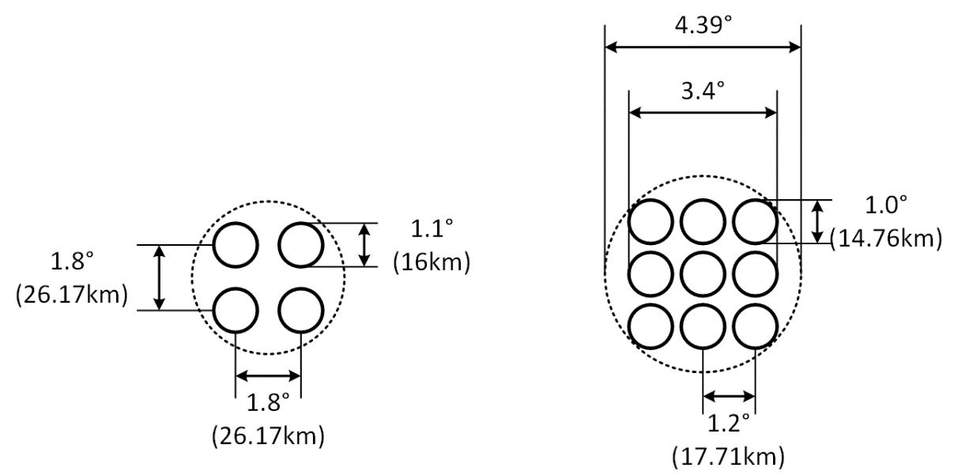
HIRAS onboard the FY-3 satellites
FY-3D FOV layout
FY-3E/F/H FOV layout
Band | Spectral Range (cm⁻¹) | Spectral Resolution (cm⁻¹) | Sensitivity (NEΔT@280K) |  |  | Radiometric Accuracy |  | Spectral Uncertainty
 |  |  | FY-3D | FY-3E/3F/3H |  | FY-3D | FY-3E/3F/3H | FY-3D | FY-3E/3F/3H
LWIR | 650～1168.125 （15.38 μm～8.56 μm） | 0.625 | 0.4 K | 650 ～667 cm⁻¹ | 0.8 K | 0.7 K | 1.0 K | 10 ppm | 7 ppm
 |  |  |  | 667～689 cm⁻¹ | 0.4 K |  | 0.5 K
 |  |  |  | 689～1000 cm⁻¹ | 0.2 K |  | 0.4 K
 |  |  |  | 1000～1136 cm⁻¹ | 0.4 K |  | 0.5 K
MWIR | 1168.75～1920 （8.55 μm～5.21 μm） | 0.625 | 0.7K | 1210～1538 cm⁻¹ | 0.2 K | 0.7 K | 0.4 K
 |  |  |  | 1538～1750 cm⁻¹ | 0.3 K |  | 0.5 K
SWIR | 1920.625～2550 （5.21 μm～3.92 μm） | 0.625 | 1.2 K | 2155～2300 cm⁻¹ | 0.3 K | 0.7 K | 0.5 K
 |  |  |  | 2300～2550 cm⁻¹ | 0.5 K |  | 0.6 K

Slide 4
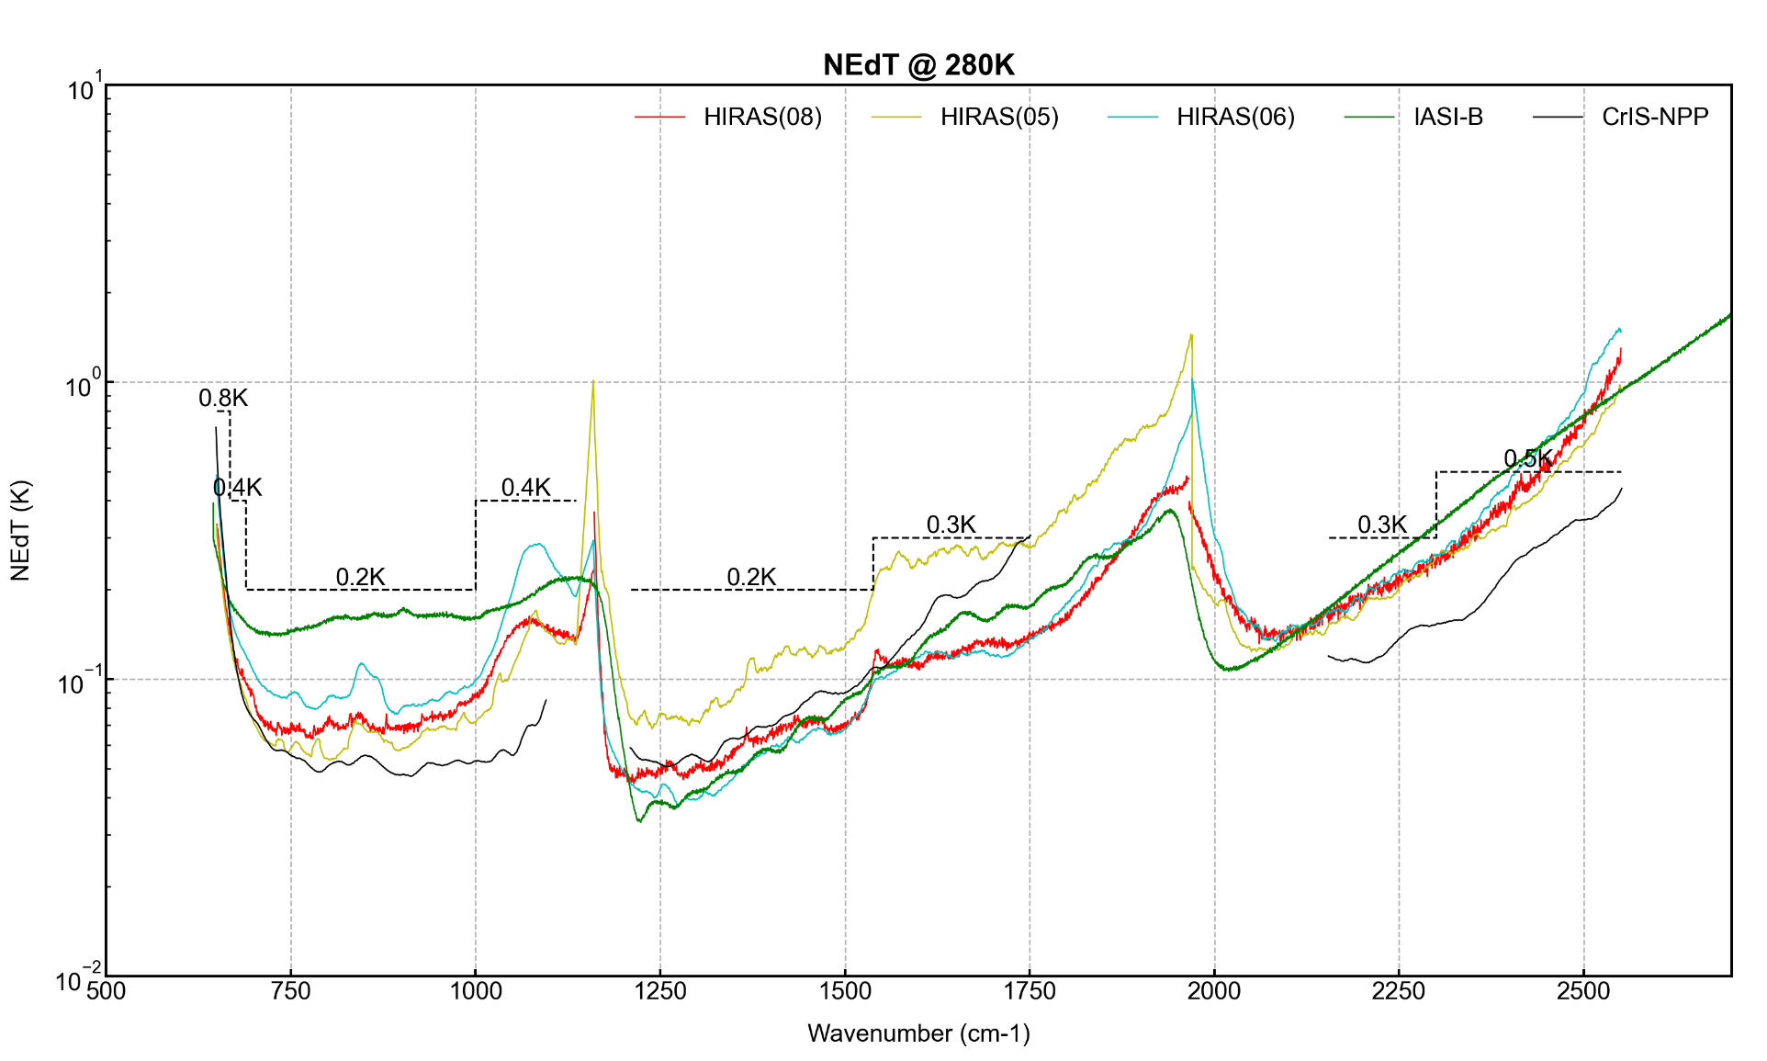
Schedule for FY-3H/HIRAS-II
Schedule
2025.09.27 satellite launch
⋮
bake-out
⋮
2025.12.23 Instrument Powered On
⋮
On-Orbit Cal/Val compaings
⋮
2026.04. pre-release calibration data
2026.07. Public Data Release
NEdT@280K during pre-launch calibration

Slide 5
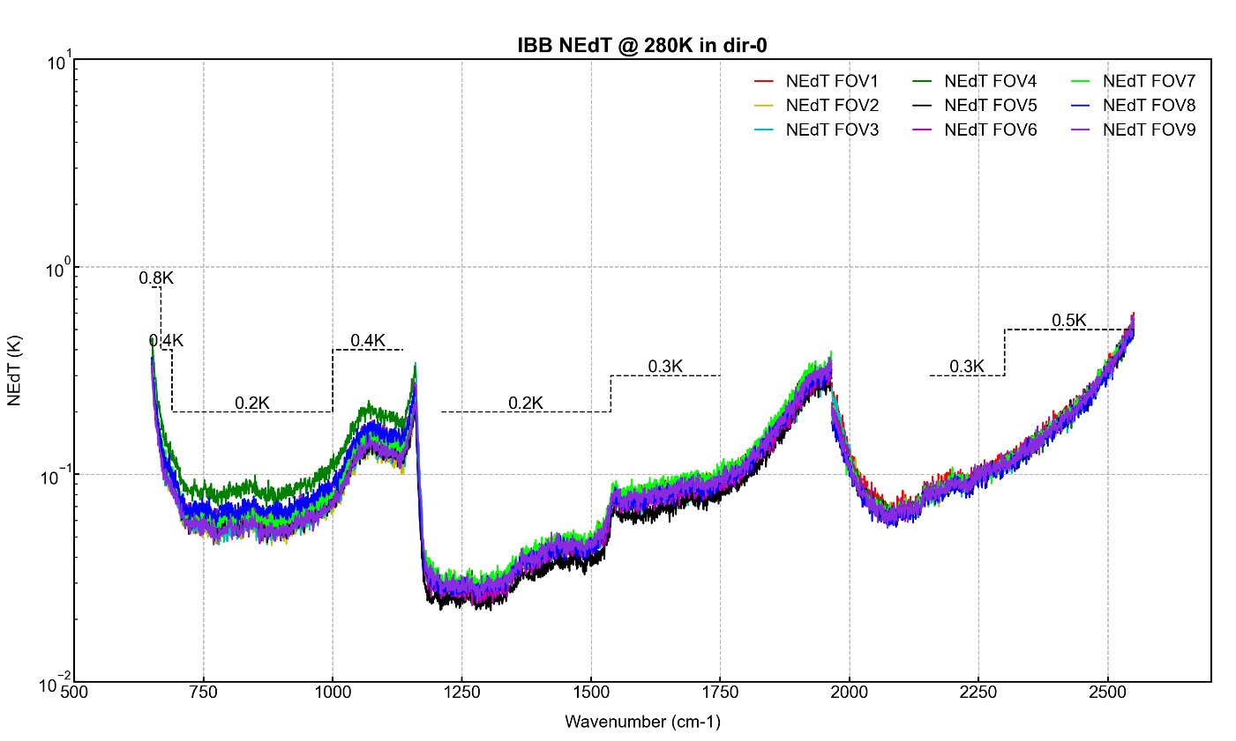
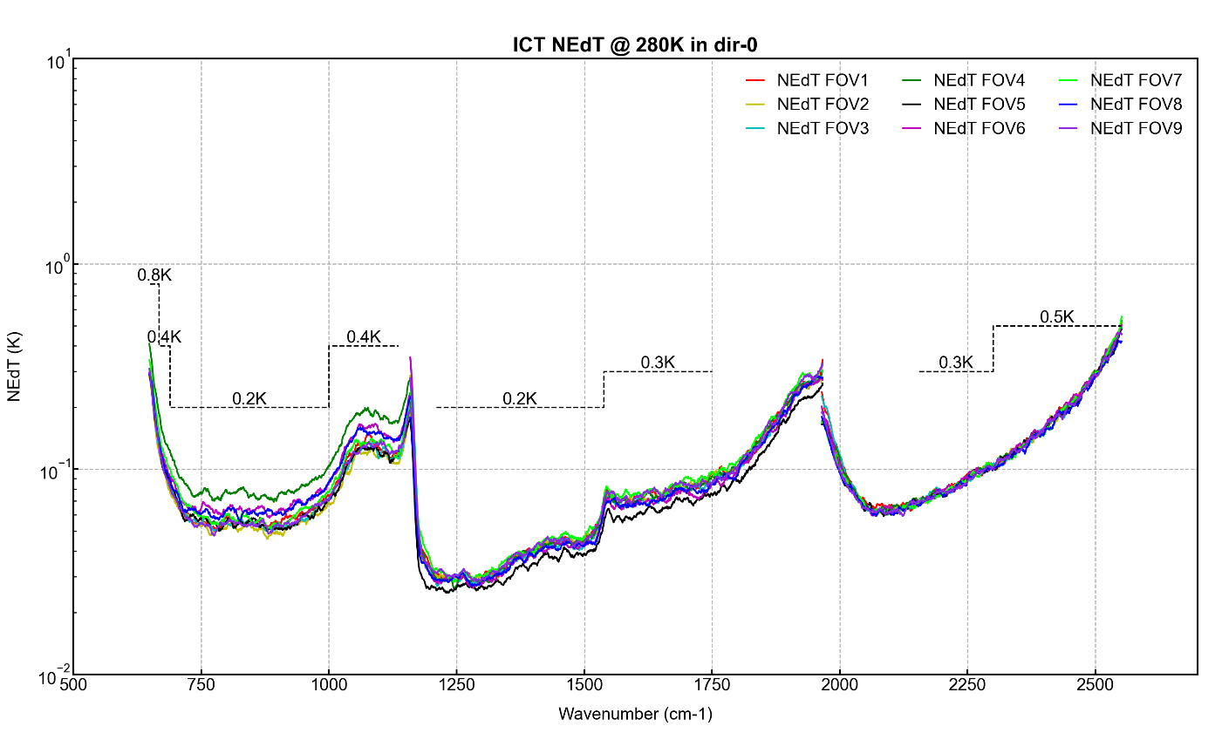
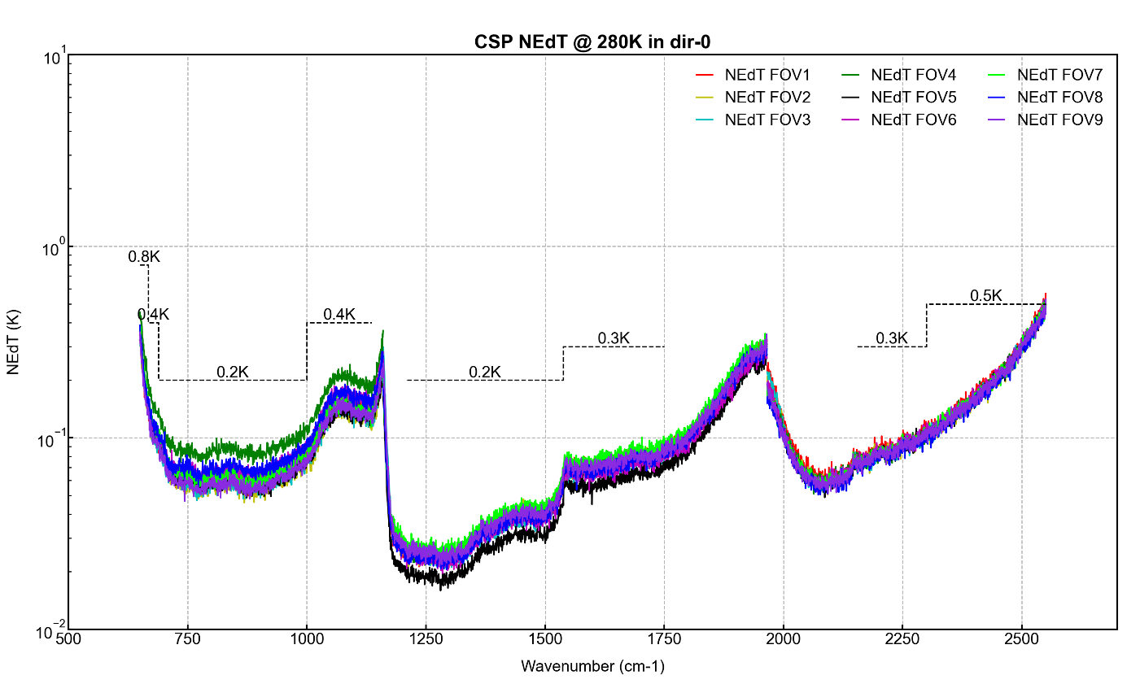
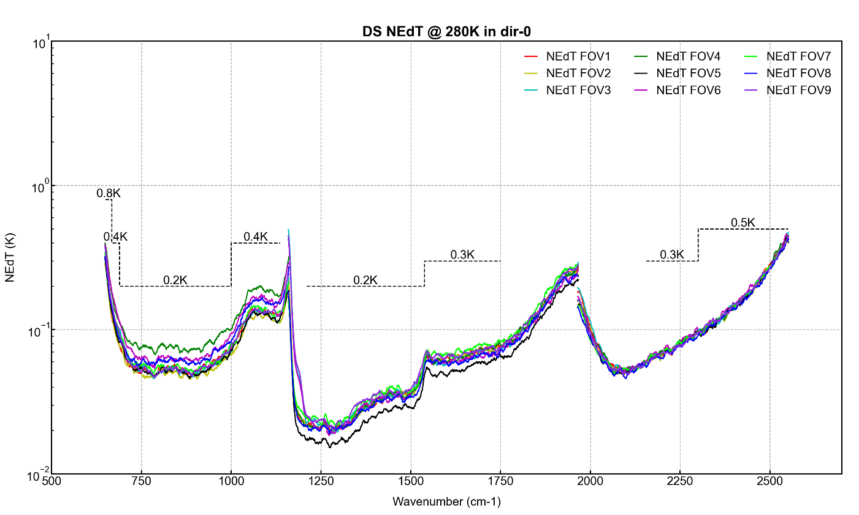
Noise characteristics of FY-3H/HIRAS-II
The pre-launch measured noise is consistent with the in-orbit instrument noise.
The noise levels for the blackbody and dark space are generally consistent; in the MWIR and SWIR bands, the cold-space noise is slightly lower than that of the blackbody.
Prelaunch, blackbody
On-orbit, blackbody
Prelaunch, dark space
On-orbit, dark space

Slide 6
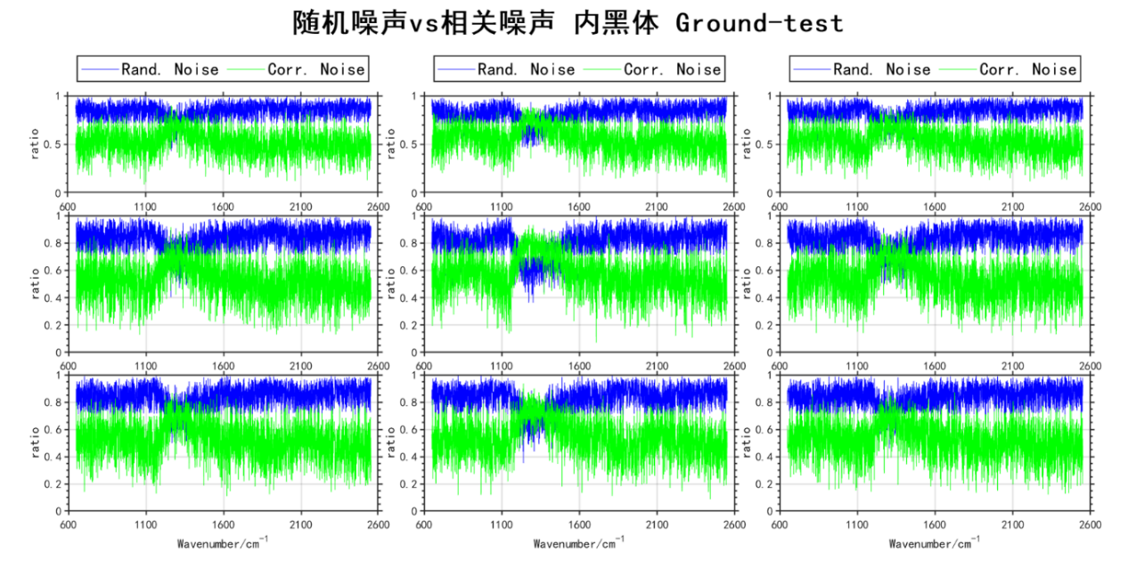
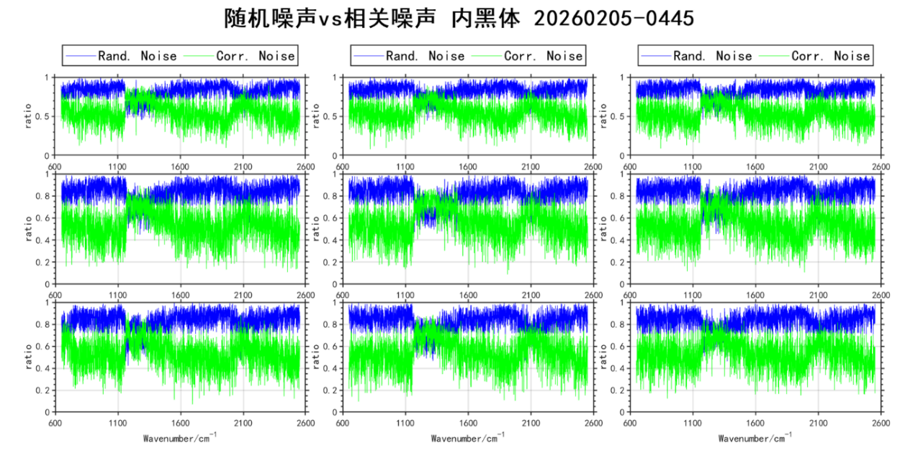
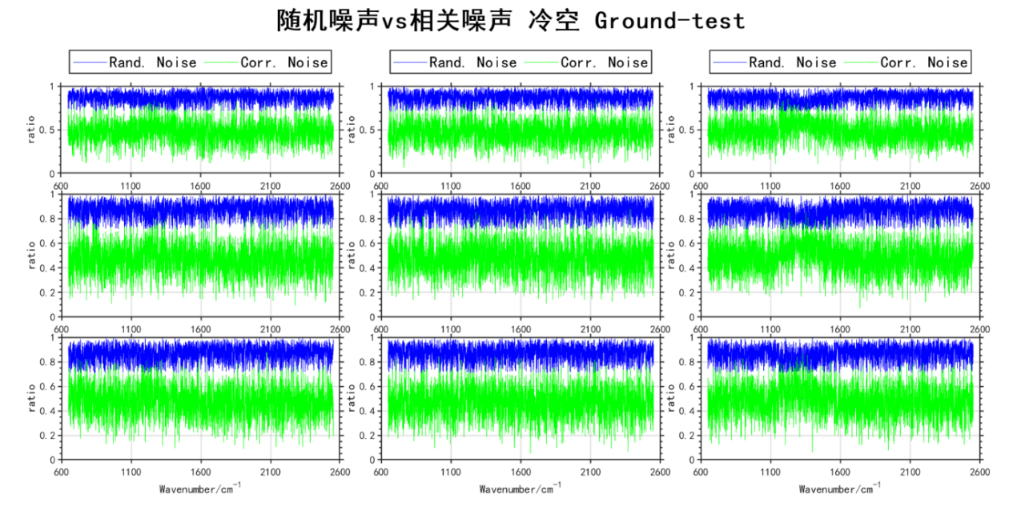
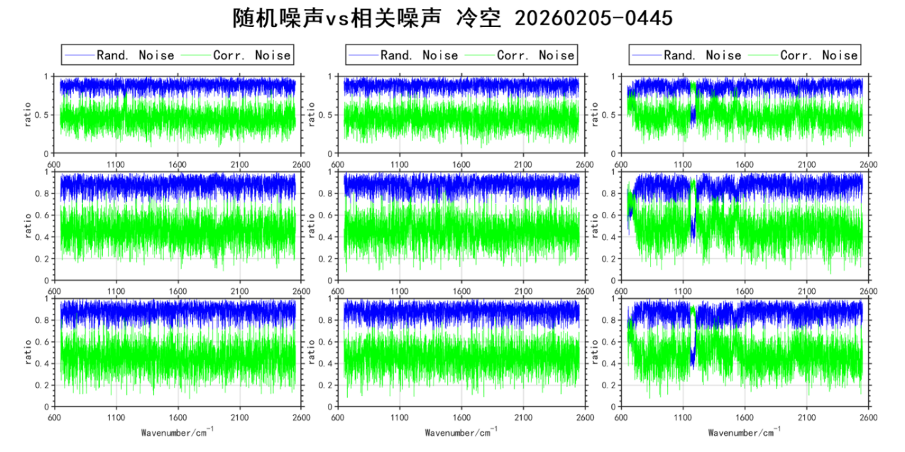
Noise characteristics of FY-3H/HIRAS-II
Random noise vs correlated noise (Prelaunch, blackbody)
Random noise vs correlated noise (on-orbit, blackbody)
Random noise vs correlated noise (Prelaunch, dark space)
Random noise vs correlated noise (on-orbit, dark space)

Slide 7
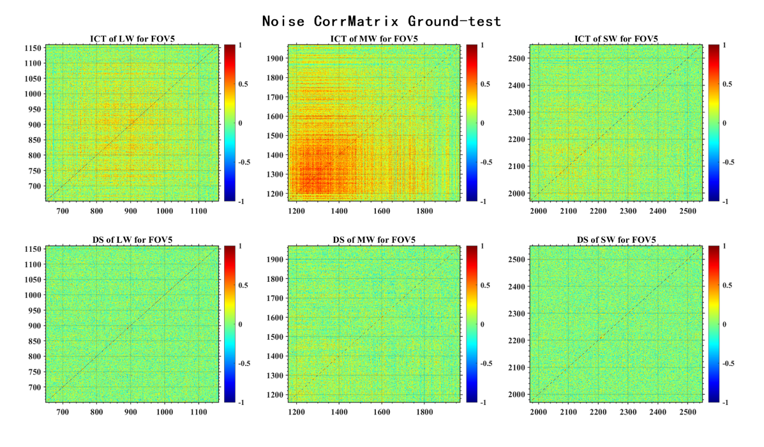
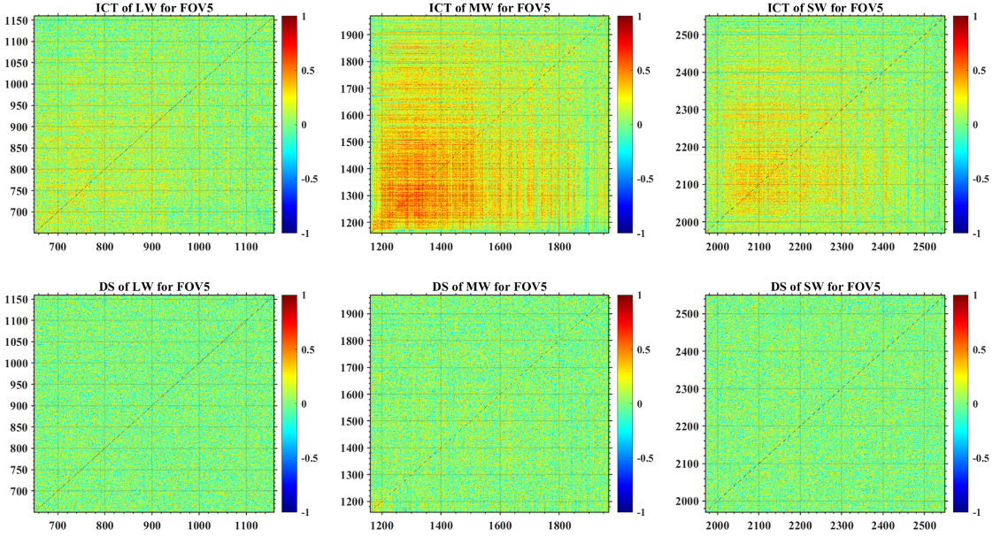
Noise characteristics of FY-3H/HIRAS-II
From the noise correlation matrix of the blackbody, the correlated noise dominates in the MWIR region (1200–1400 cm⁻¹), and the pattern is consistent between pre-launch and on-orbit measurements.
The correlated noise in the MWIR region is relatively high, and the dark space noise is lower than that of the blackbody; the underlying reasons require further analysis.
blackbody
dark space
prelaunch
on-orbit

Slide 8
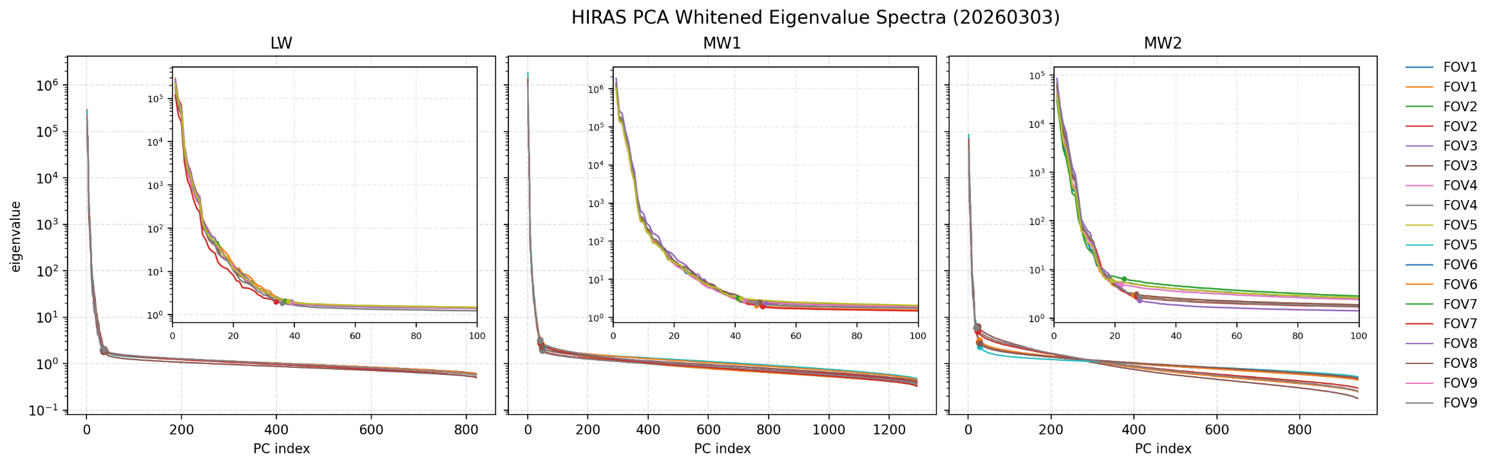
Noise characteristics of FY-3H/HIRAS-II
The instrument noise can also be estimated from Earth observation targets using PCA techniques.
Number of samples after clear-sky ocean pixel filtering
时间x | FOV1 | FOV2 | FOV3 | FOV4 | FOV5 | FOV6 | FOV7 | FOV8 | FOV9
2026-02-25 | 20076 | 21221 | 19613 | 17865 | 19072 | 17934 | 15857 | 18534 | 16756
2026-02-27 | 17574 | 18638 | 17256 | 15748 | 16693 | 15893 | 14249 | 16548 | 14850
2026-02-28 | 19995 | 21134 | 19695 | 17978 | 19098 | 18106 | 16343 | 18657 | 17039
2026-03-01 | 20650 | 21707 | 20220 | 18514 | 19685 | 18558 | 16559 | 19190 | 17426
2026-03-02 | 18406 | 19404 | 17943 | 16229 | 17496 | 16467 | 14531 | 17026 | 15423
2026-03-03 | 16956 | 17948 | 16480 | 14994 | 16070 | 15037 | 13430 | 15690 | 14040
HIRAS L1 spectrum
Clear sky, ocean samples filtering
Construct dataset for PCA
PCA decomposition and reconstruction
Residual statistics and noise estimation

Slide 9
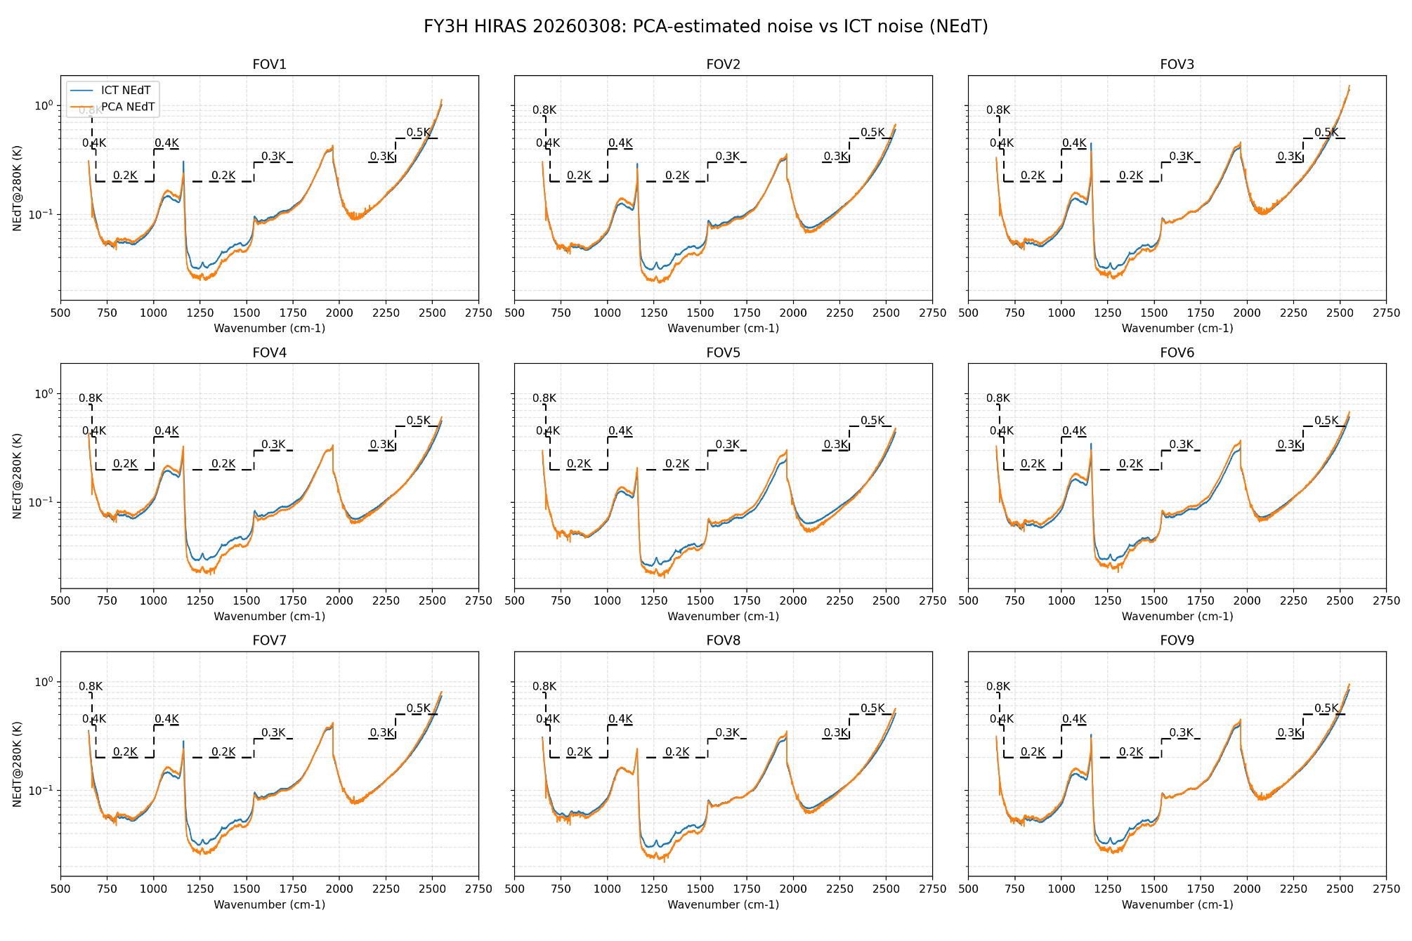
Noise characteristics of FY-3H/HIRAS-II
The NEdT results based on Earth targets are consistent with those obtained from blackbody.
however, since these are results after spectral calibration, off-axis detectors in the shortwave region may exceed the requirements.

Slide 10
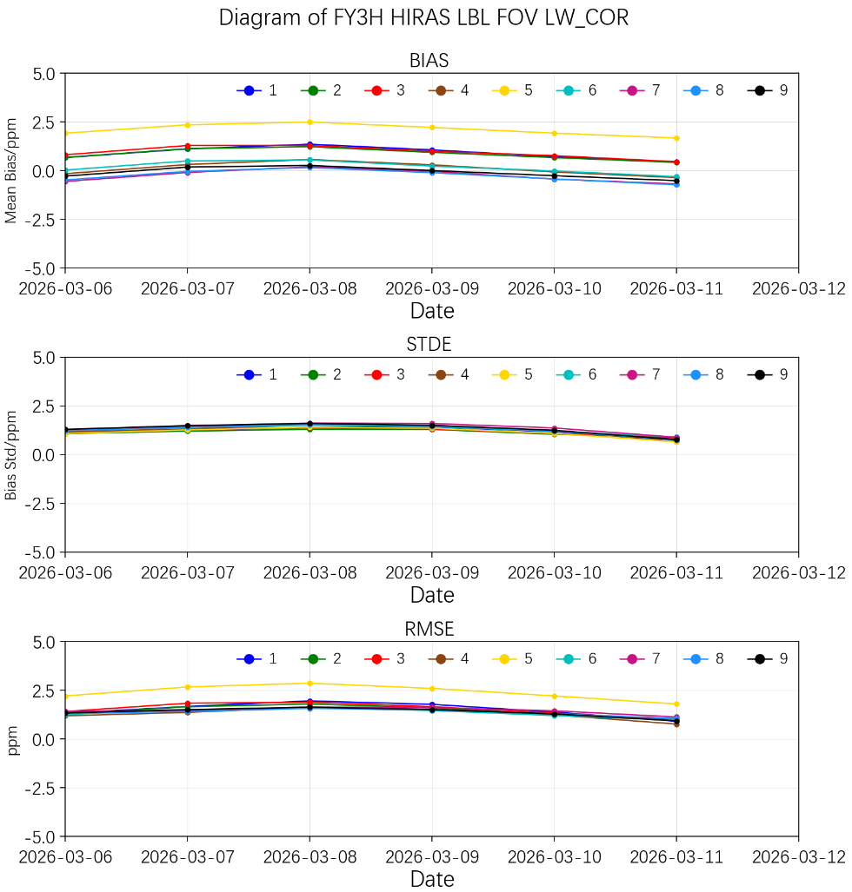
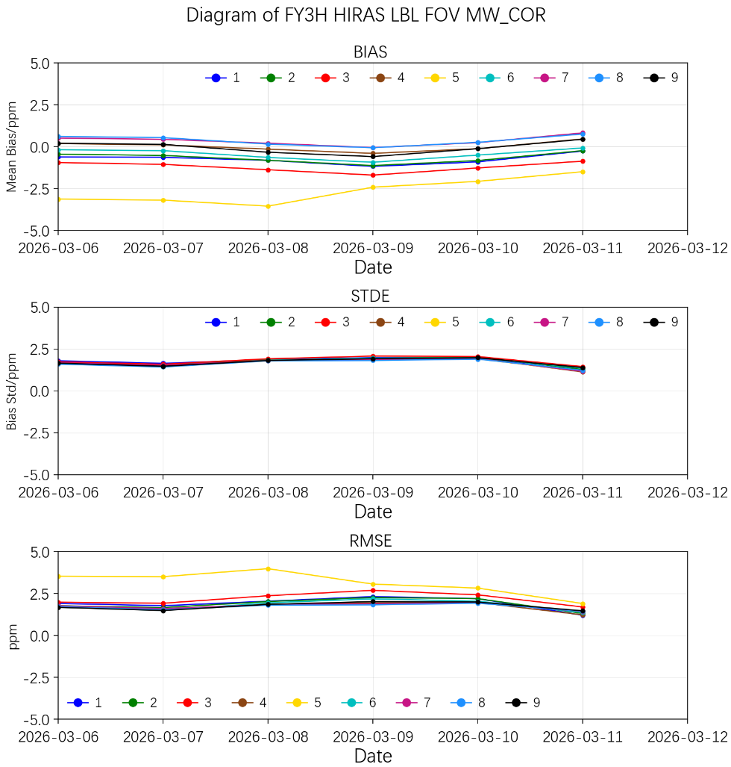
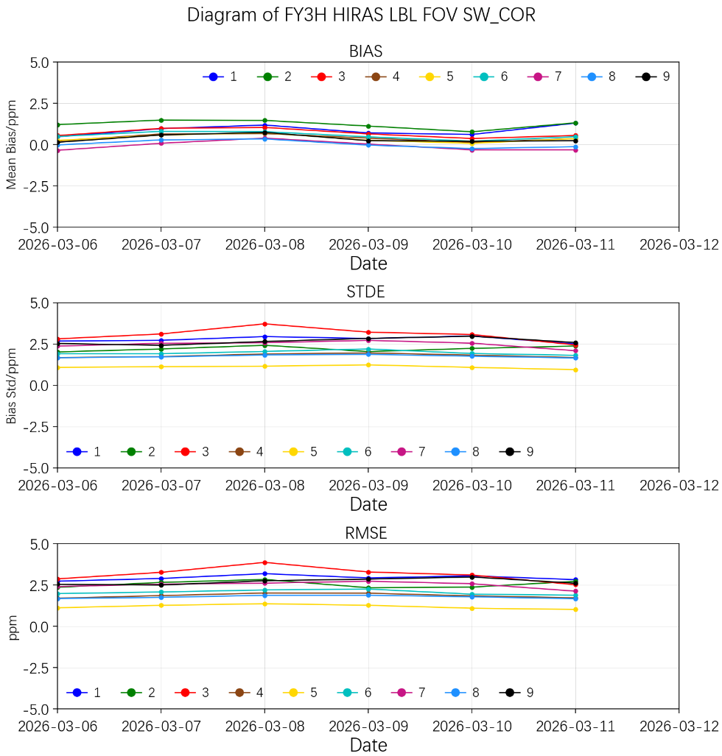
Spectral calibration evaluation of FY-3H/HIRAS-II
bias/ppm | BAND | FOV1 | FOV2 | FOV3 | FOV4 | FOV5 | FOV6 | FOV7 | FOV8 | FOV9
Mean Bias | LW | 1.06 | 0.93 | 0.99 | 0.29 | 2.21 | 0.23 | -0.04 | -0.11 | -0.01
 | MW | -1.18 | -1.13 | -1.7 | -0.4 | -2.42 | -0.93 | -0.06 | -0.07 | -0.6
 | SW | 0.7 | 1.12 | 0.64 | 0.39 | 0.26 | 0.47 | 0.03 | -0.04 | 0.23
RMSE | LW | 1.77 | 1.6 | 1.65 | 1.52 | 2.59 | 1.46 | 1.6 | 1.48 | 1.51
 | MW | 2.32 | 2.26 | 2.69 | 1.94 | 3.06 | 2.18 | 1.88 | 1.82 | 2.02
 | SW | 2.93 | 2.33 | 3.29 | 2.01 | 1.27 | 2.26 | 2.73 | 1.88 | 2.85
The spectral calibration accuracy of HIRAS is evaluated by comparing the measured spectra with the spectra simulated using LBL RTM.
The spectral bias RMSE in all three bands remains below 4 ppm and stable.
LWIR
LWIR
LWIR

Slide 11
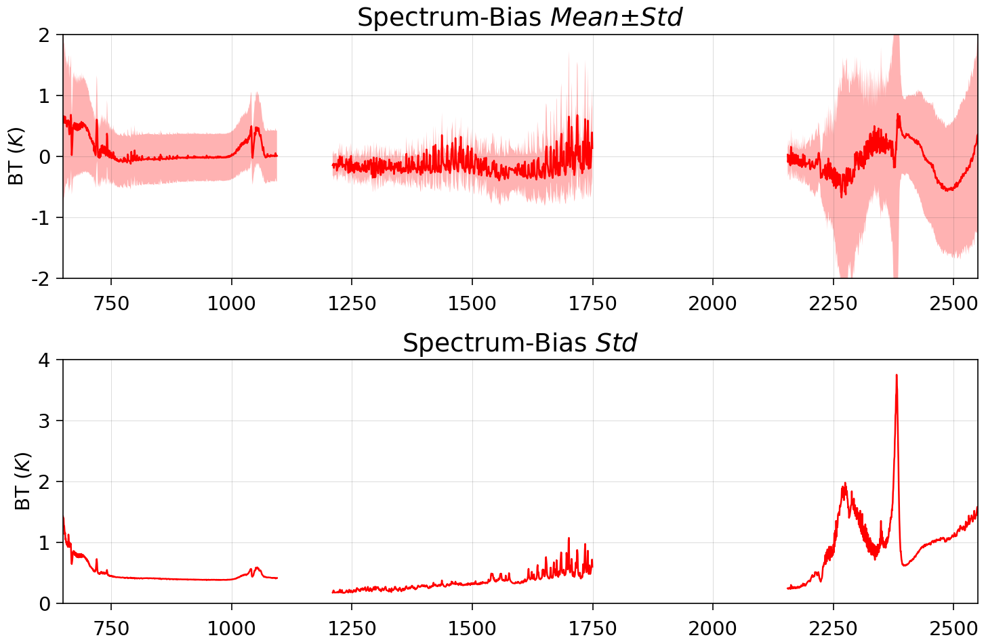
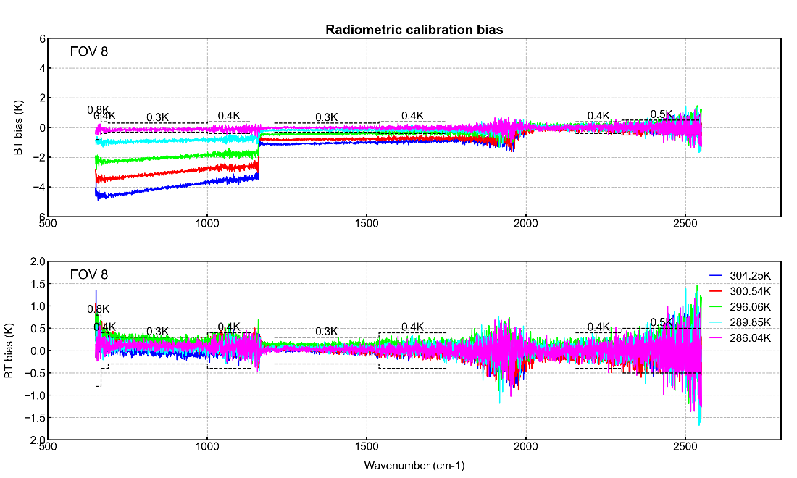
Radiometric calibration evaluation of FY-3H/HIRAS-II
The nonlinearity correction(NLC) coefficients are evaluated by heating and then cooling the on-board blackbody.
Radiometric calibration accuracy is evaluated through inter-comparison with SNO and SNOx data from other instruments. It can be observed that deviations are larger for upper-atmospheric channels, indicating that the nonlinearity coefficients still require fine-tuning.
Before NLC
After NLC
SNO-X with JPSS-1/CrIS
Notes:
After applying the nonlinearity correction, deviations with respect to target temperature are significantly reduced.

Slide 12
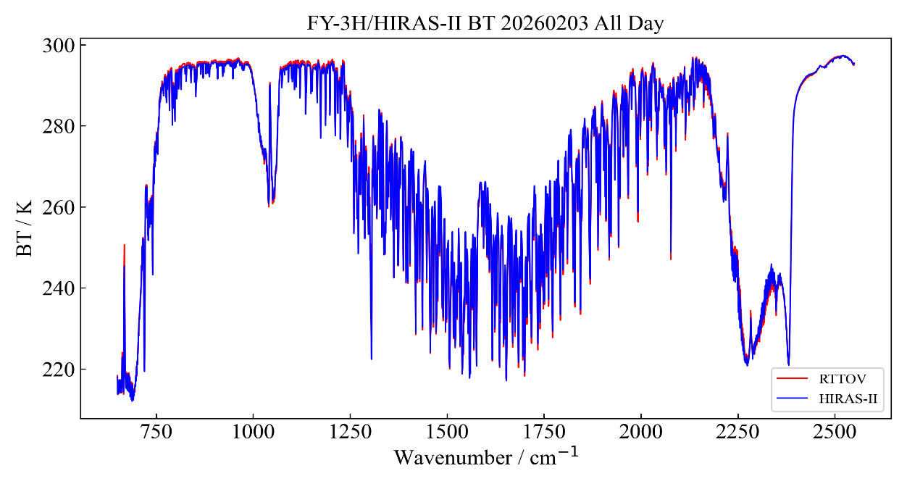
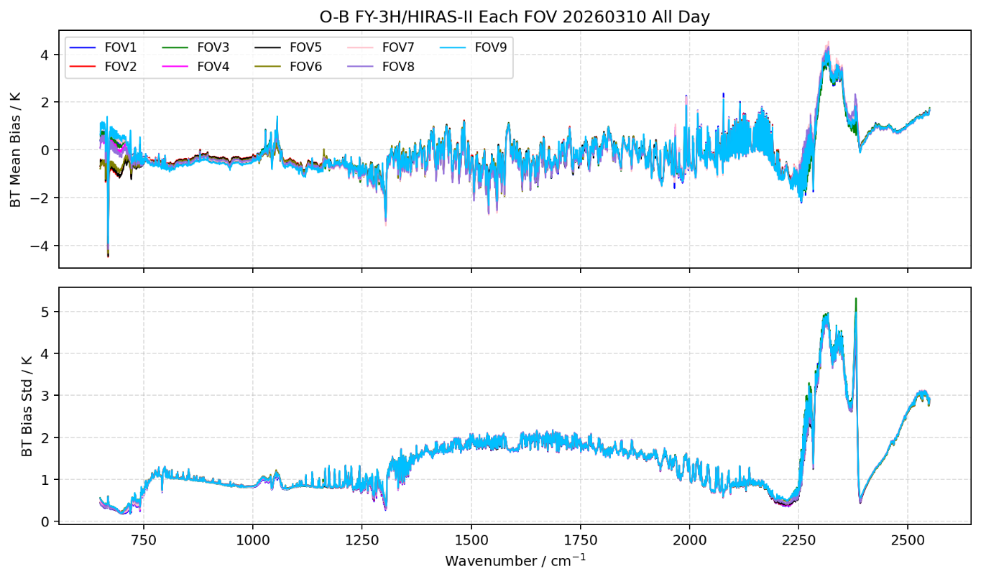
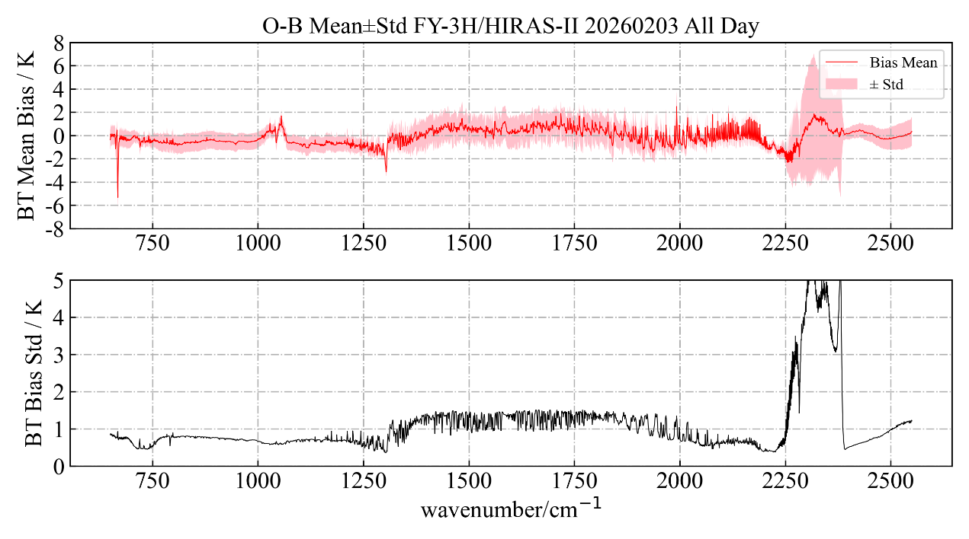
Radiometric calibration evaluation of FY-3H/HIRAS-II
The radiometric calibration can also be evaluated using OMB analysis based on RTTOV radiative simulations.
It can be seen that biases increase significantly for upper-atmospheric channels, indicating that the nonlinearity coefficients still need adjustment for low-temperature targets.

Slide 13
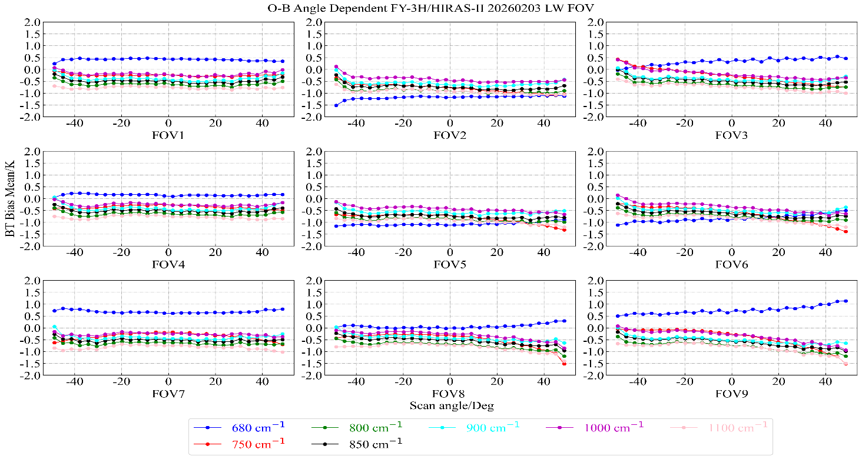
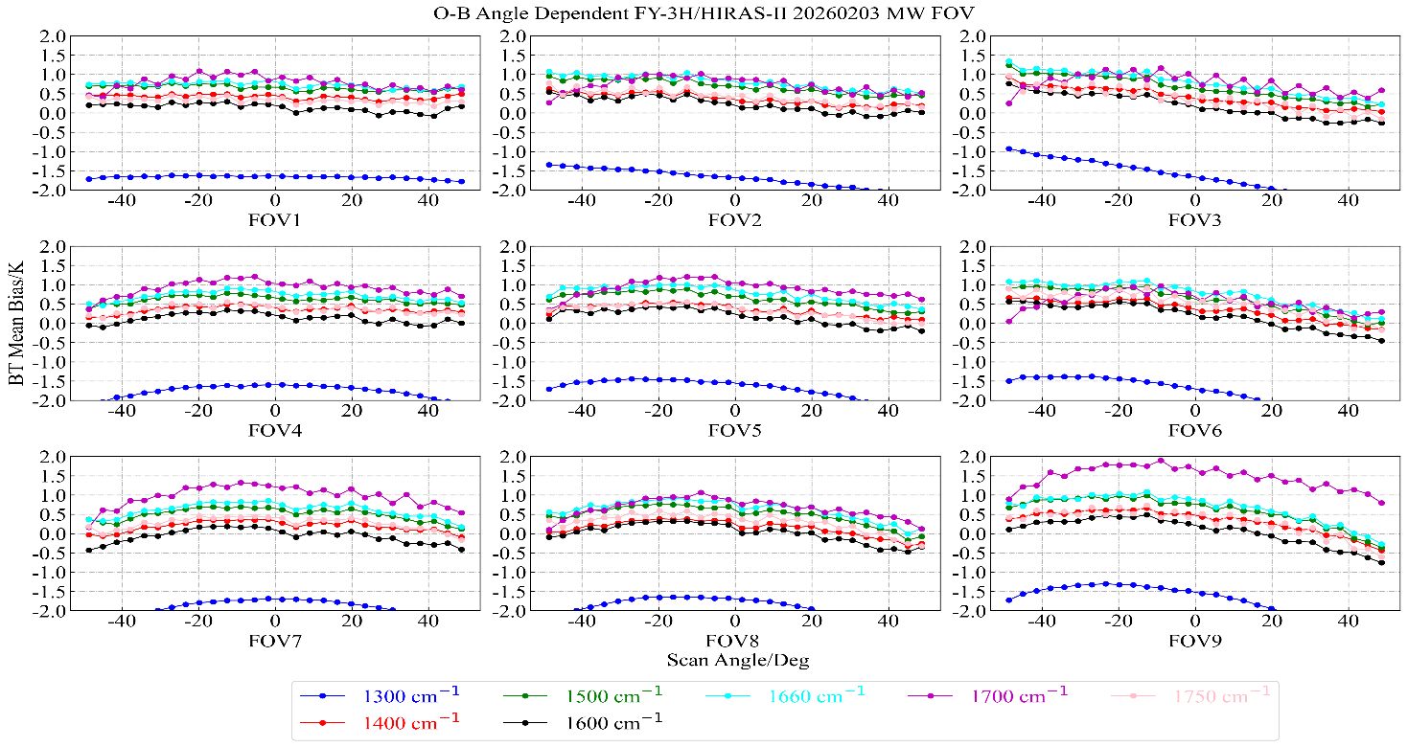
Radiometric calibration evaluation of FY-3H/HIRAS-II
Variation of O–B biases with scan angle based on RTTOV radiative simulations.
Consistent with FY-3E/3F, upper-level channels still exhibit pronounced scan-angle-dependent biases with similar patterns (least evident for FOV 1,4,7, most evident for FOV 3,6,9).
We attribute this to polarization effects and are working on mitigation approaches, including for HIRAS on FY-3E/3F.
LWIR
MWIR
Notes:
After applying the nonlinearity correction, deviations with respect to target temperature are significantly reduced.

Slide 14
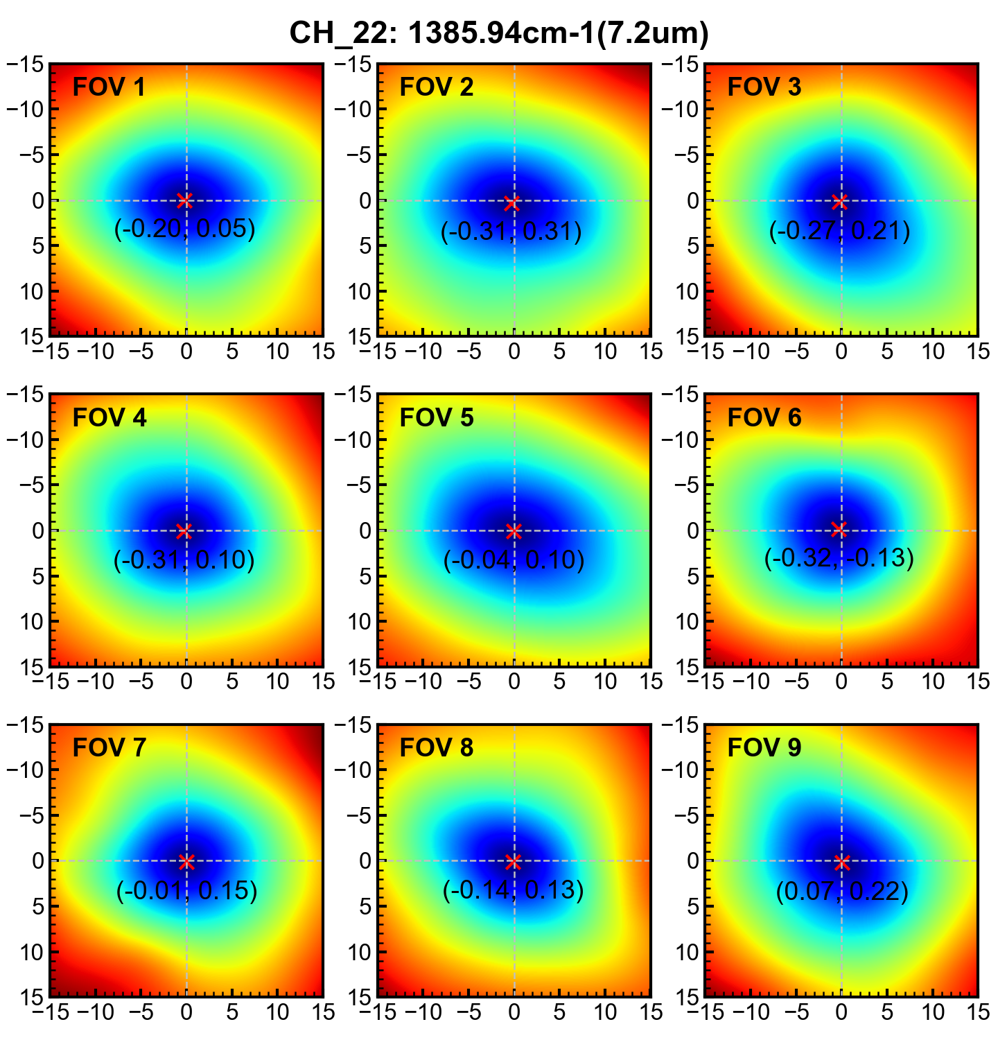
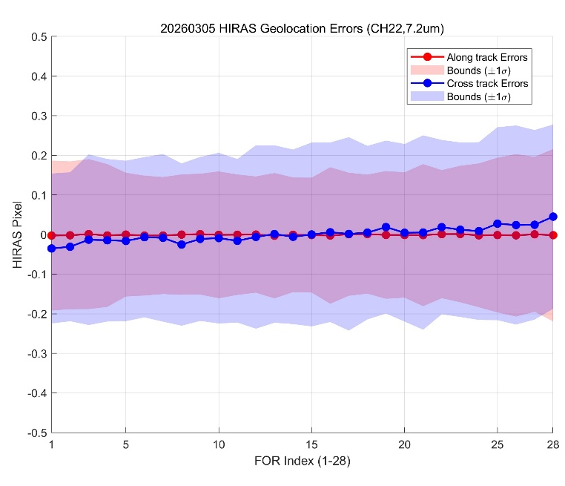
Geolocation evaluation of FY-3H/HIRAS-II
channel | FOR | Along-track BIAS(pixel) | Along-track STD(pixel) | cross-track BIAS(pixel) | cross-track STD(pixel)
HIRAS collocated with MERSI CH22 (7.2μm) | 1 | -0.0027 | 0.1892 | -0.0352 | 0.1893
 | 2 | -0.0020 | 0.1865 | -0.0310 | 0.1880
 | 3 | 0.0011 | 0.1893 | -0.0131 | 0.2154
 | 4 | -0.0025 | 0.1802 | -0.0145 | 0.2052
 | 5 | -0.0002 | 0.1562 | -0.0163 | 0.2025
 | 6 | -0.0028 | 0.1513 | -0.0069 | 0.2023
 | 7 | -0.0027 | 0.1476 | -0.0084 | 0.2117
 | 8 | -0.0002 | 0.1519 | -0.0254 | 0.2048
 | 9 | 0.0009 | 0.1526 | -0.0112 | 0.2070
 | 10 | -0.0009 | 0.1600 | -0.0091 | 0.2155
 | 11 | -0.0005 | 0.1520 | -0.0159 | 0.2064
 | 12 | -0.0001 | 0.1467 | -0.0062 | 0.2315
 | 13 | -0.0030 | 0.1582 | 0.0012 | 0.2238
 | 14 | -0.0007 | 0.1447 | -0.0058 | 0.2203
 | 15 | -0.0015 | 0.1449 | 0.0001 | 0.2321
 | 16 | -0.0025 | 0.1722 | 0.0057 | 0.2266
 | 17 | 0.0006 | 0.1553 | 0.0015 | 0.2441
 | 18 | 0.0009 | 0.1501 | 0.0047 | 0.2190
 | 19 | -0.0010 | 0.1612 | 0.0188 | 0.2183
 | 20 | -0.0013 | 0.1582 | 0.0044 | 0.2241
 | 21 | -0.0016 | 0.1793 | 0.0050 | 0.2453
 | 22 | 0.0009 | 0.1617 | 0.0186 | 0.2201
 | 23 | 0.0012 | 0.1723 | 0.0121 | 0.2202
 | 24 | -0.0021 | 0.1815 | 0.0087 | 0.2244
 | 25 | -0.0014 | 0.1953 | 0.0273 | 0.2435
 | 26 | -0.0021 | 0.2051 | 0.0239 | 0.2513
 | 27 | 0.0005 | 0.1956 | 0.0245 | 0.2392
 | 28 | -0.0017 | 0.2176 | 0.0451 | 0.2326
 | Min | 0.0001 | 0.1447 | 0.0001 | 0.188
 | Max | 0.003 | 0.2176 | 0.0451 | 0.2513
 | Mean | -0.0010 | 0.1685 | 0.0001 | 0.2201
The geolocation accuracy of HIRAS is evaluated by matching with the co-platform MERSI,
The actual footprint location determined by identifying the position with the minimum bias.
All FORs were evaluated, and the geolocation accuracy at nadir is consistent with that at the swath edges.

Slide 15
Summary
All performance metrics of FY-3H meet operational requirements, and its noise performance is overall better than that of FY-3E/3F.
FY-3H still exhibits some degree of nonlinearity, and further fine-tuning is needed to achieve higher radiometric calibration accuracy for low-temperature targets and upper-atmospheric channels.
FY-3H still exhibits scan-angle-dependent biases, which are presumed to be caused by polarization effects. Subsequent work will focus on polarization correction, including for HIRAS on FY-3E/3F.

Slide 16
Thank you !
Email: wangjw@cma.gov.cn

