Slide 1
Radiometric Calibration Performance of the IR Channels of EUMETSAT Optical Missions.
Ali Mousivand¹, Vincent Debaecker², Mounir Lekouara¹
¹EUMETSAT
²Telespazio France
GSICS Annual Meeting, March 23-27 2026, Ottawa

Slide 2
Agenda
GEO missions
MTG-I1 FCI
MSG2-4 SEVIRI
LEO missions
Sentinel-3A&B SLSTR
EPS MetopB&C AVHRR
Conclusions

Slide 3
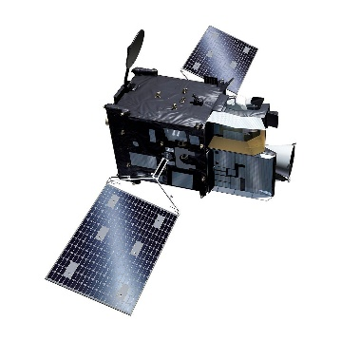
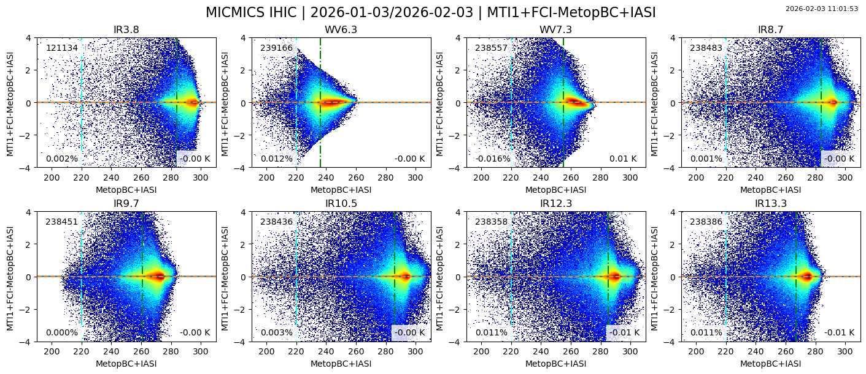
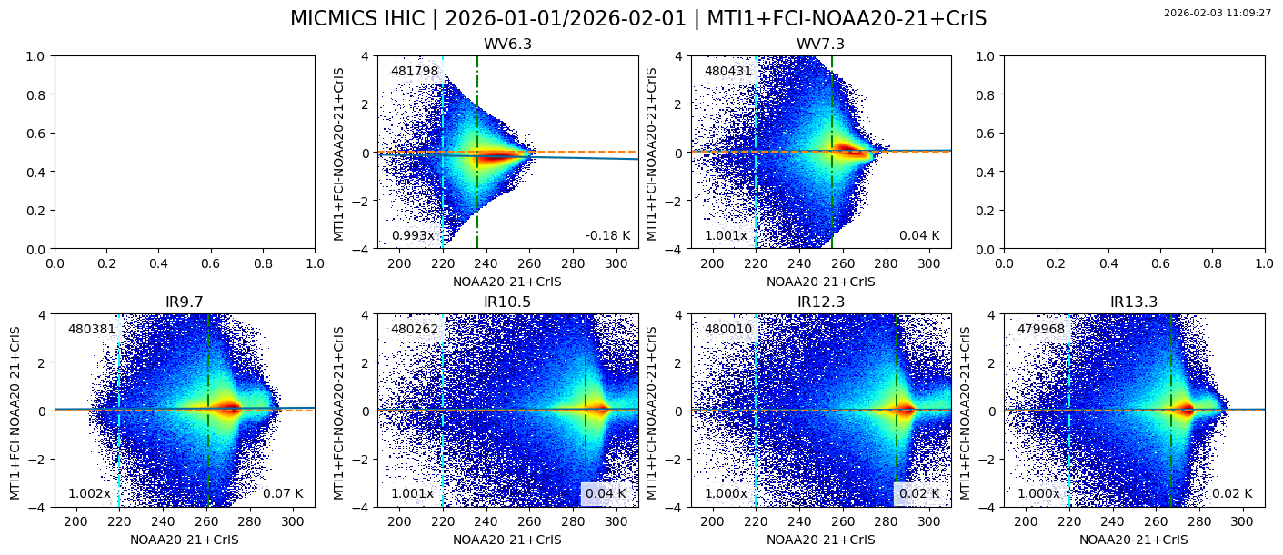
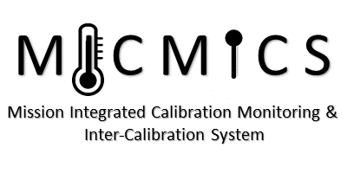
FCI IR channels calibration monitoring
Daily IR gains, generated by MICMICS, are ingested into MTG IDPF-I each day following careful quality checks. Frequency improved to hourly in March 2026;
Monthly FCI Brightness Temperature [K] intercomparison with IASI B&C as reference (top) and with CrIS on NOAA-20 and NOAA-21 (bottom) shows consistent performance across the full dynamic range and for all channels, with the exception of WV7.3, which exhibits some non-linearity in hot scenes;
Radiometric accuracy results demonstrate excellent agreement of approximately <±0.3 K across all channels and instruments, well within the Radiometric Accuracy Requirement of <0.7 K (indicated by the red box in the plots).
Bias [K]
Bias [K]

Slide 4
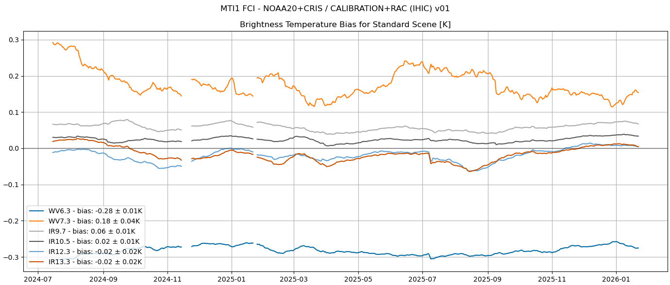
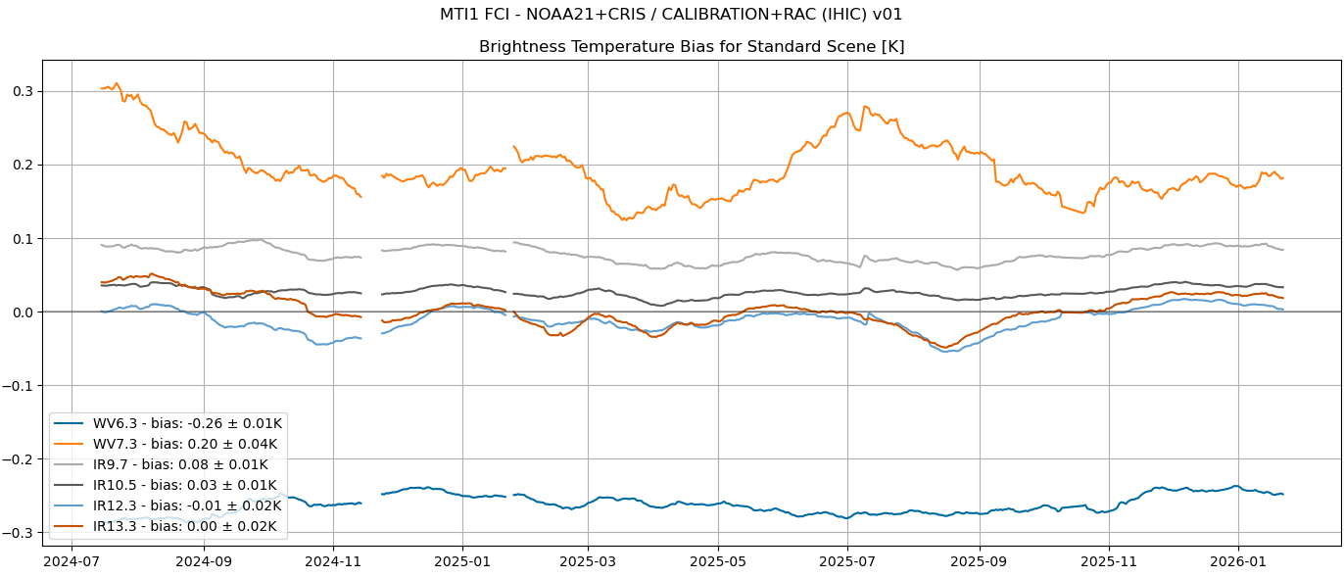
FCI IR channels long-term radiometric stability
FCI Brightness Temperature bias time series for a standard scene (285K for IR12.3 channel) demonstrate strong temporal stability;
Biases within ±0.3 K against CrIS on NOAA-20 (top) and CrIS on NOAA-21 (bottom);
WV6.7 shows a higher bias compared to CrIS on both NOAA satellites, possibly linked to the small gap in the CrIS spectral coverage for this channel, currently under investigation;
WV7.3 also exhibits a slightly larger bias, still remains well within requirements and is consistent with the observed non-linearity-like behaviour;
ECMWF currently assimilates FCI IR channels in its data assimilation system;
Independent assessments of FCI IR channels using NWP-based methods show results consistent with MSG SEVIRI evaluations and indicate overall very good accuracy across all channels, including WV7.3.
Bias [K]
Bias [K]

Slide 5
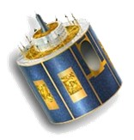
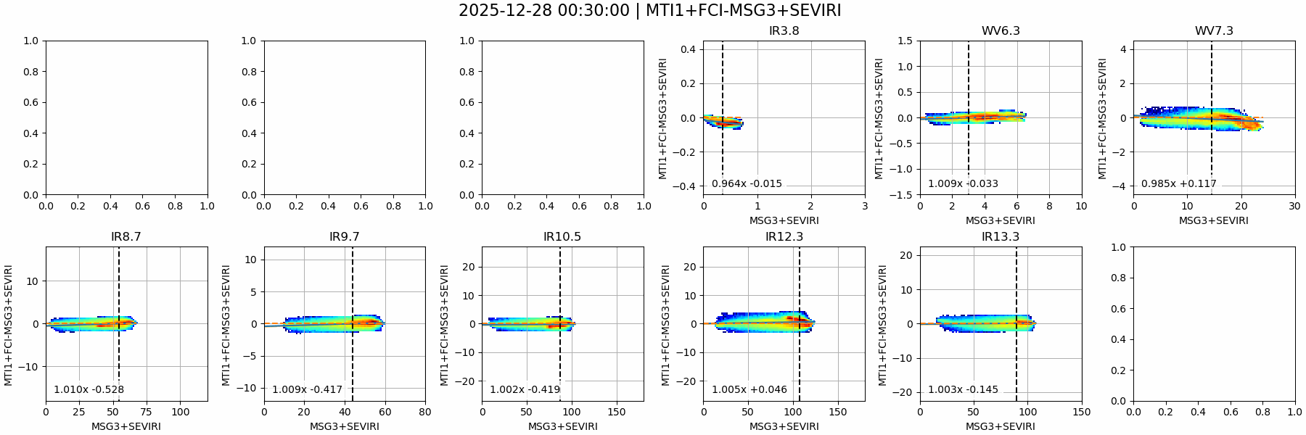
FCI vs MGS3 SEVIRI intercomparison
FCI scatterplots from GEO–GEO collocations with MSG3 SEVIRI (24h dataset);
Most IR channels (and VIS/NIR) show a clear linear relationship with SEVIRI, indicating consistency and stable diurnal calibration;
WV7.3 shows non-linear behaviour relative to SEVIRI, while IR3.8 exhibits larger variability due to daytime observations and sun-glint.
radiance [mW/m2/sr/cm-1] differences

Slide 6
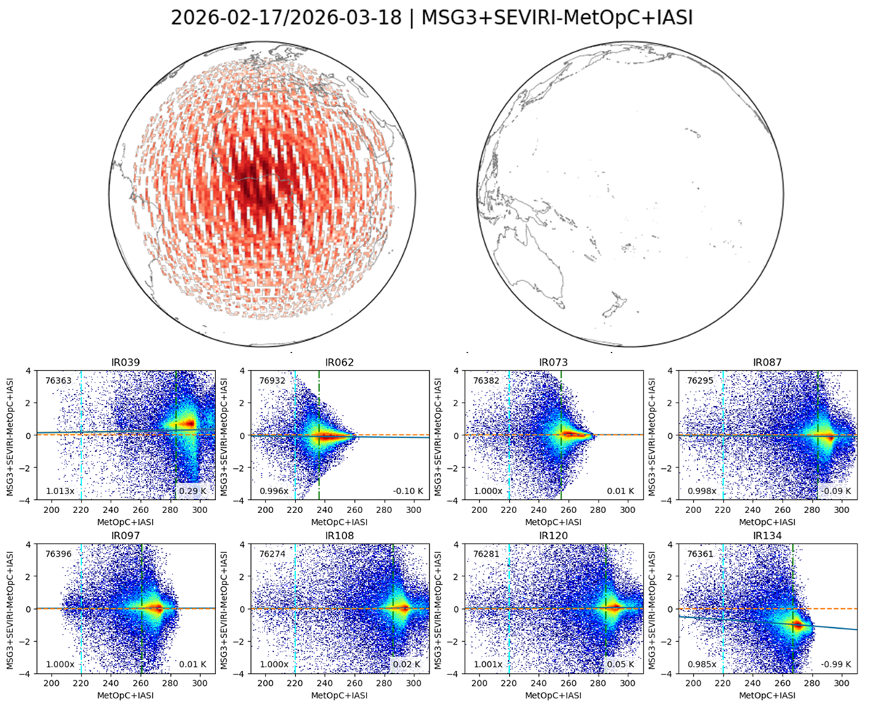
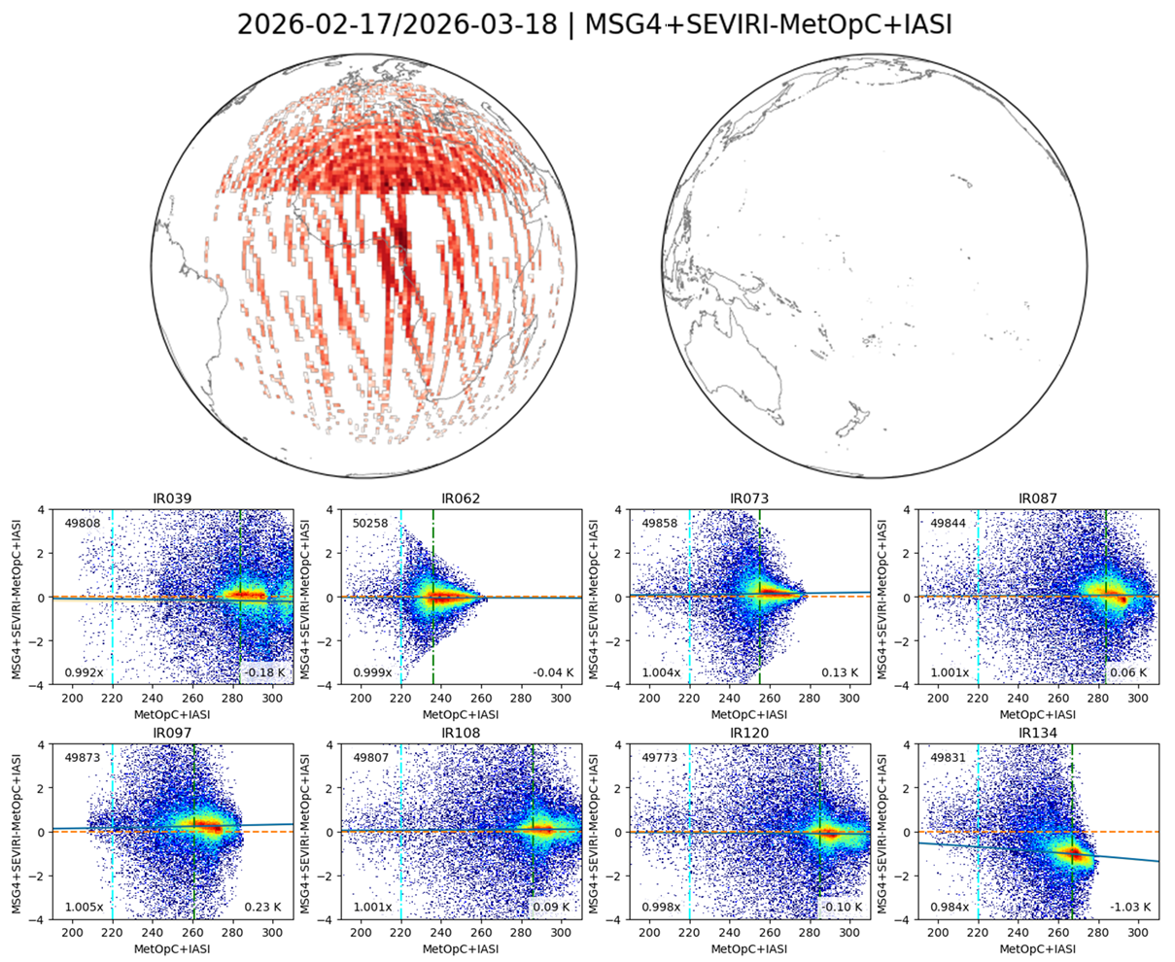
MSG SEVIRI IR channels calibration monitoring
Monthly SEVIRI Brightness Temperature bias [K] intercomparison with IASI B&C as reference (only IASI-C shown) shows consistent performance across the full dynamic range and all channels, except IR3.9 and IR13.4, which exhibit larger bias due to ice contamination;
MSG4 is currently operating in RSS (Rapid Scan Service), whereas MSG3 runs FD (Full Disk) mission. MSG2 is IODC (not shown here!)

Slide 7
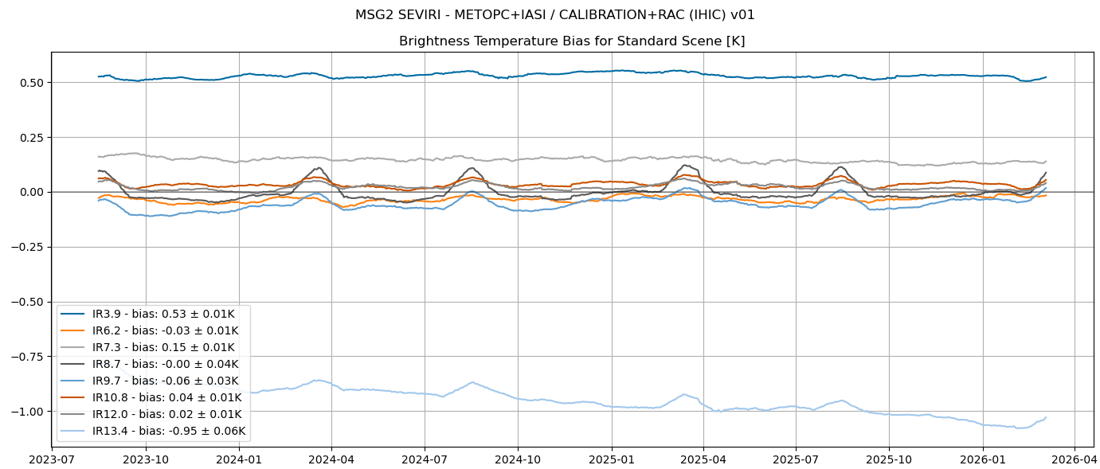
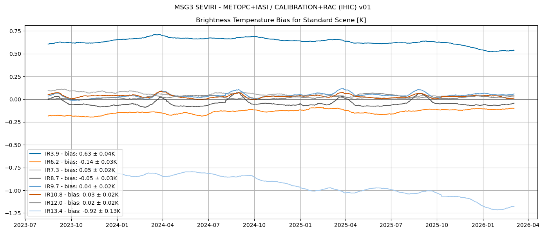
MSG2&3 SEVIRI long-term radiometric stability
MSG2 and MSG3 SEVIRI Brightness Temperature bias [K] time series for a standard scene demonstrate strong temporal stability.
Biases are generally within ±0.2 K against MSG2 (top) and MSG3 (bottom) against IASI-C, except for IR3.9 and IR13.4.
IR3.9 shows a slight bias of about 0.5 K on both Metop satellites, with relatively good temporal stability, further investigation ongoing.
IR13.4 exhibits a larger bias of about 1 K, with a decreasing trend, primarily due to ice contamination.

Slide 8
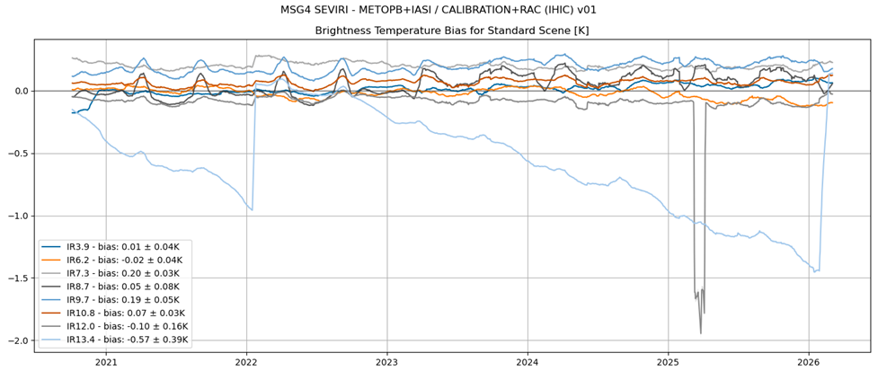
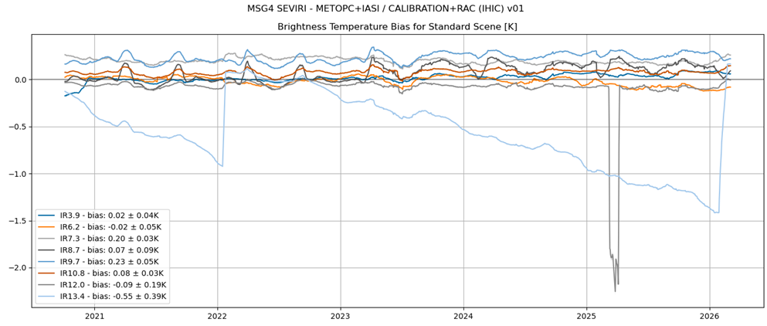
MSG4 SEVIRI long-term radiometric stability
Like MSG2 and MSG3, MSG4 SEVIRI Brightness Temperature bias [K] time series for a standard scene demonstrate strong temporal stability
Biases are generally within ±0.2 K against IASI-B (top) and IASI-C (bottom), with IR13.4 showing decreasing trend before the recent decontamination.

Slide 9
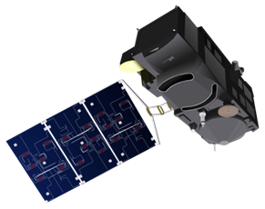
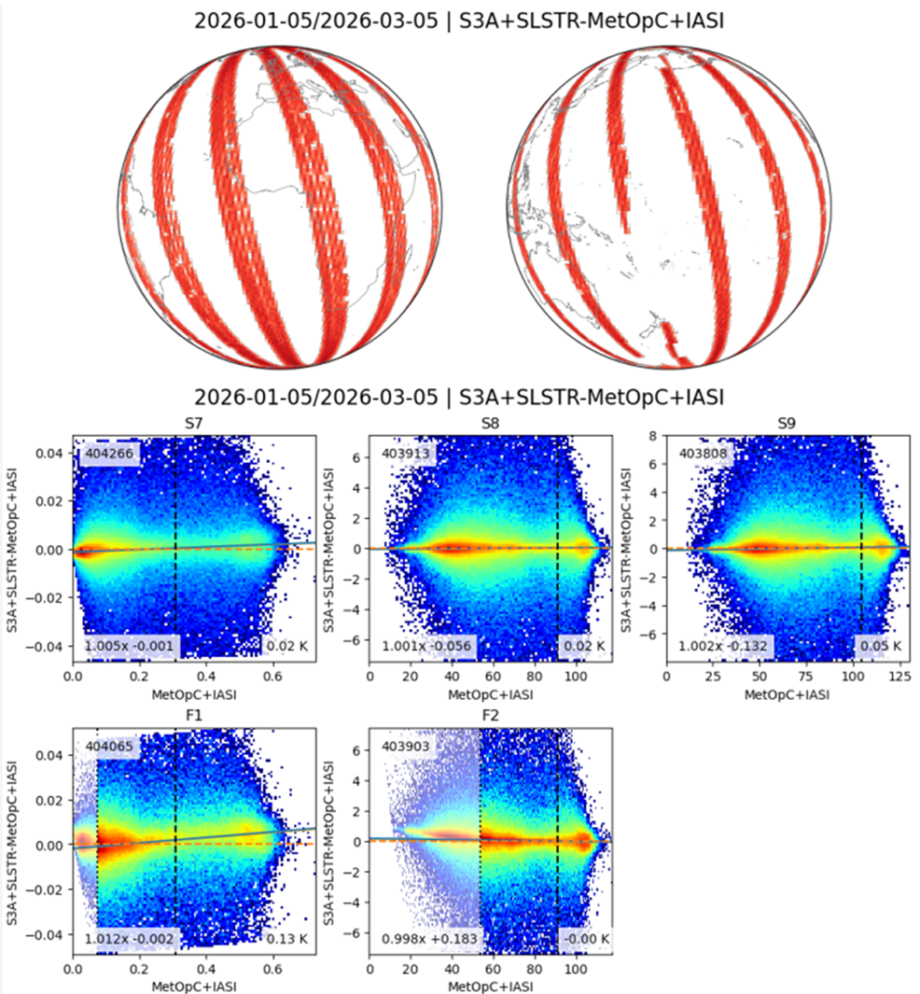
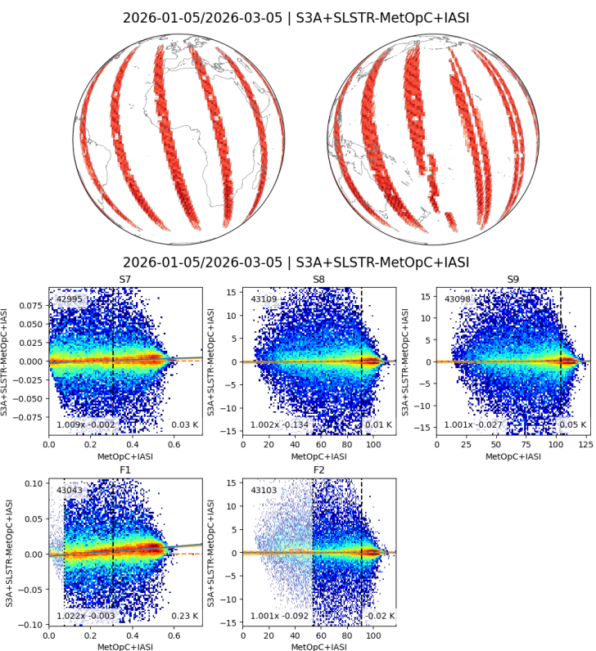
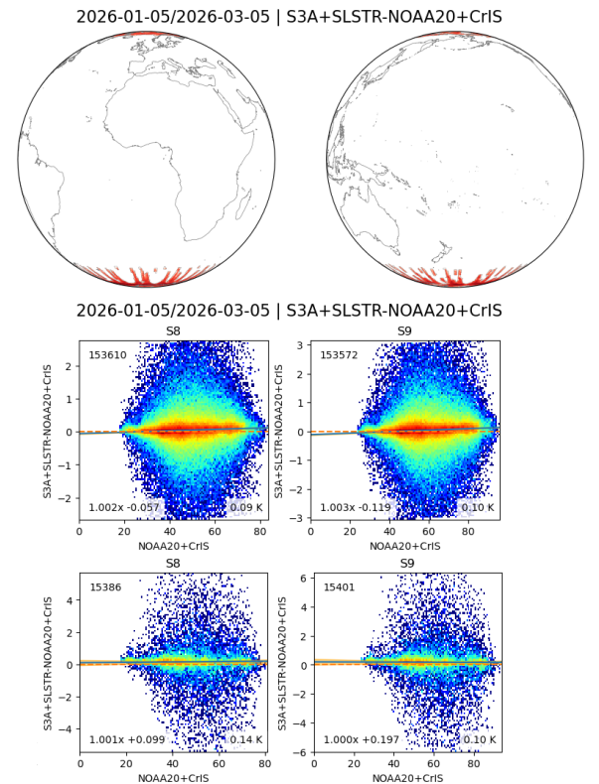
SLSTR IR channels calibration monitoring
Monthly SLSTR Brightness Temperature [K] intercomparison with IASI B&C as reference and with CrIS on NOAA-20 and NOAA-21 shows consistent performance across the full dynamic range for all channels, with the exception of Fire channels, which exhibits some non-linearity-like features;
S3A+SLSTR-MetopC+IASI Nadir S3A+SLSTR-MetopC+IASI Oblique S3A+SLSTR-NOAA20 CrIS Nadir
S3A+SLSTR-NOAA20 CrIS Oblique

Slide 10
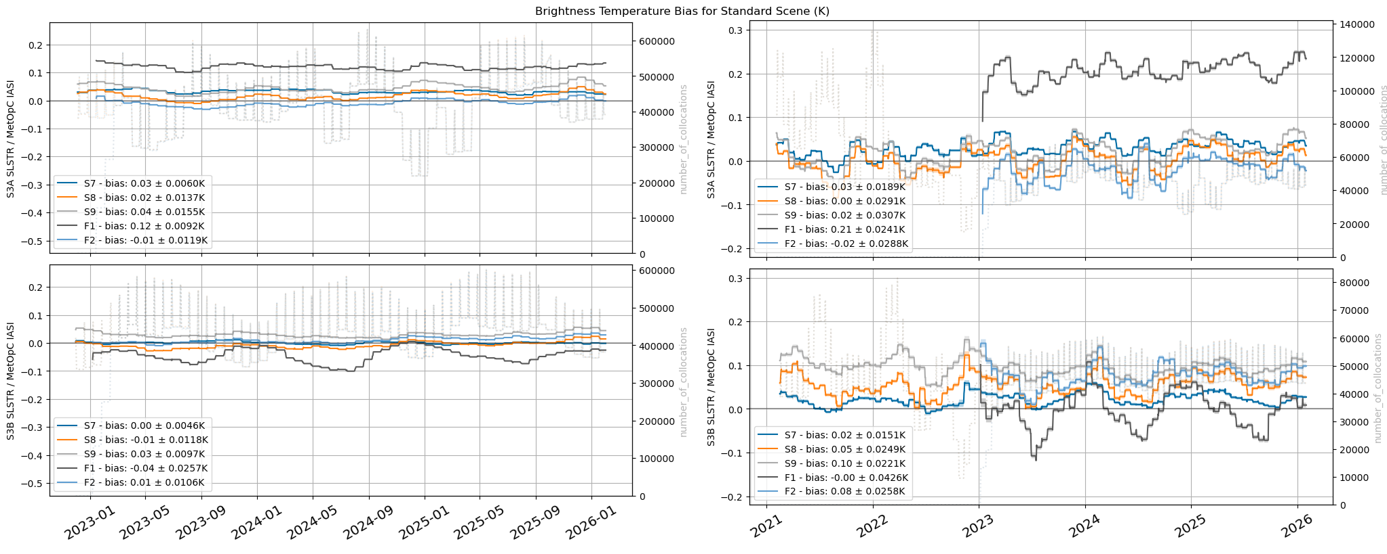
SLSTR long-term radiometric stability vs IASI-C
Bias estimated for standard scenes (~285K) against Metop-C IASI; Metop-B IASI exhibits similar behaviour.
Results indicate biases within ±0.2 K, demonstrating good long-term stability of the IR channels for both S3A and S3B nadir and oblique viewing geometries. However, Metop-B is gradually desynchronising with SLSTR due to orbital drift, leading to fewer collocations, which in turn reduces its influence on the results.
S3A Nadir S3A Oblique
S3B Nadir S3B Oblique
Notes:
Bias for Standard Scenes : S7 [284K]; S8 [286K]; S9 [285K]; F1 [284K]; F2 [286K]

Slide 11
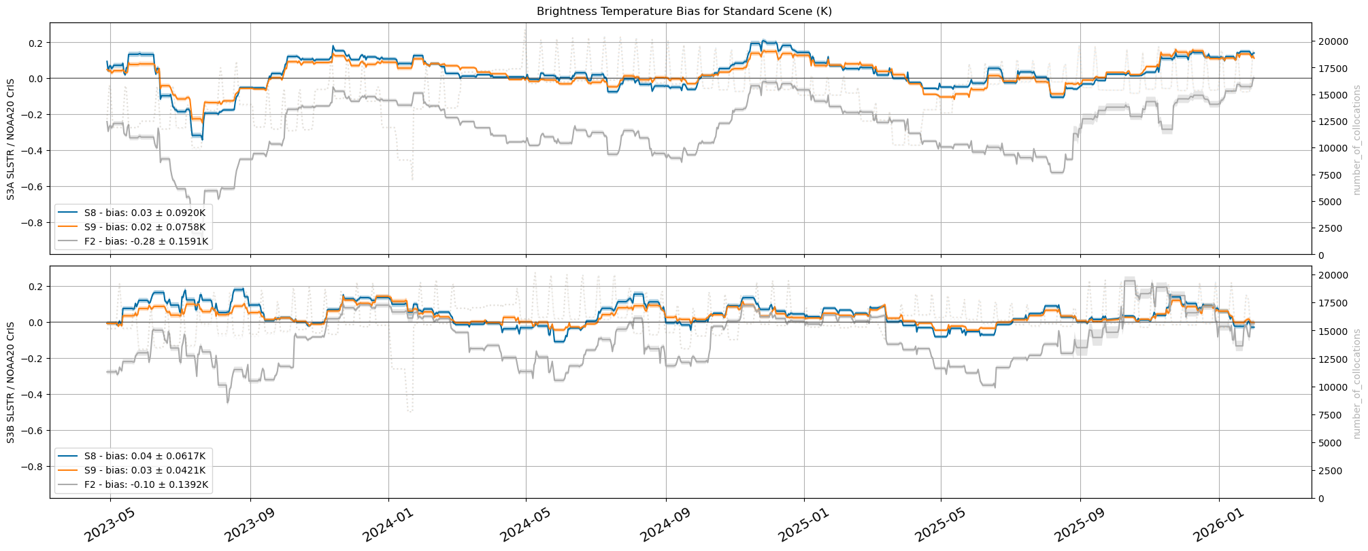
SLSTR long-term radiometric stability vs CrIS NOAA20
Bias estimated for standard scenes for both S3A and S3B nadir view using CrIS-NOAA20 as reference.
Results indicate biases within ±0.2 K for both S3A and S3B in the S8 and S9 channels, although only cold scenes are represented due to collocations occurring near the poles.
No radiance-dependent bias is observed across the available dynamic range.
Comparisons with IASI and CrIS indicate good long-term stability of the IR channels.

Slide 12
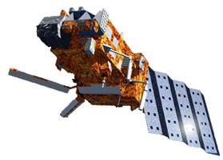
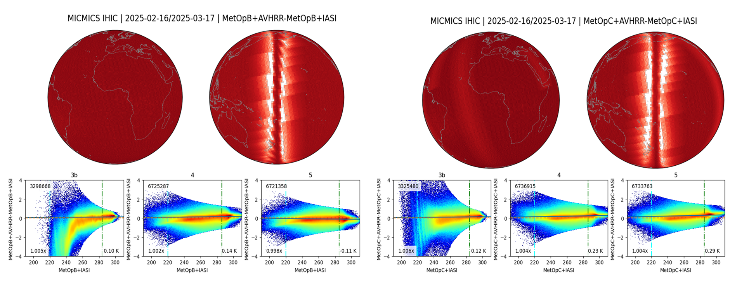
AVHRR IR channels calibration monitoring
Monthly AVHRR Brightness Temperature [K] intercomparison with IASI B&C as reference shows consistent performance across the full dynamic range for channels 4 and 5, while channels 3b exhibits some strong non-linearity-like features towards cold end on MetopB (below 240 K).

Slide 13
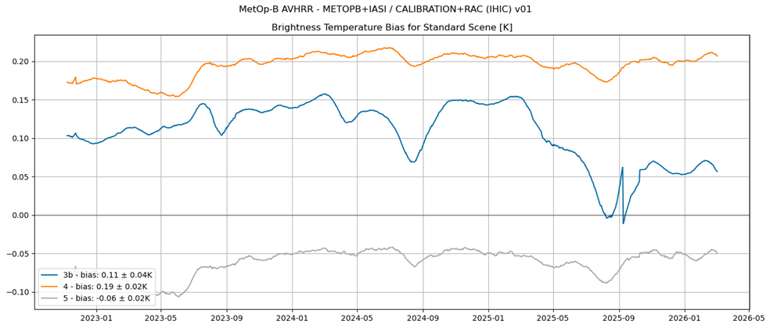
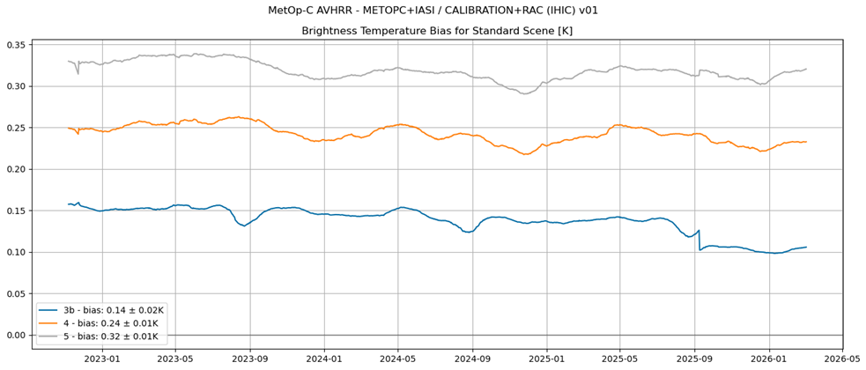
AVHRR long-term radiometric stability
AVHRR Brightness Temperature[K] bias time series for a standard scene shows relatively good temporal stability for channels 4 and 5, while Channel3b shows more variation over time;
Biases are within ±0.35 K against both IASI-B and IASI-C;
A sudden drop in Channel 3b around September 2025 is currently under investigation.

Slide 14
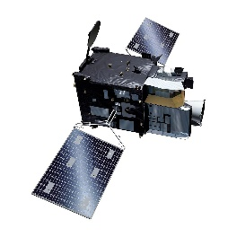
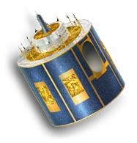
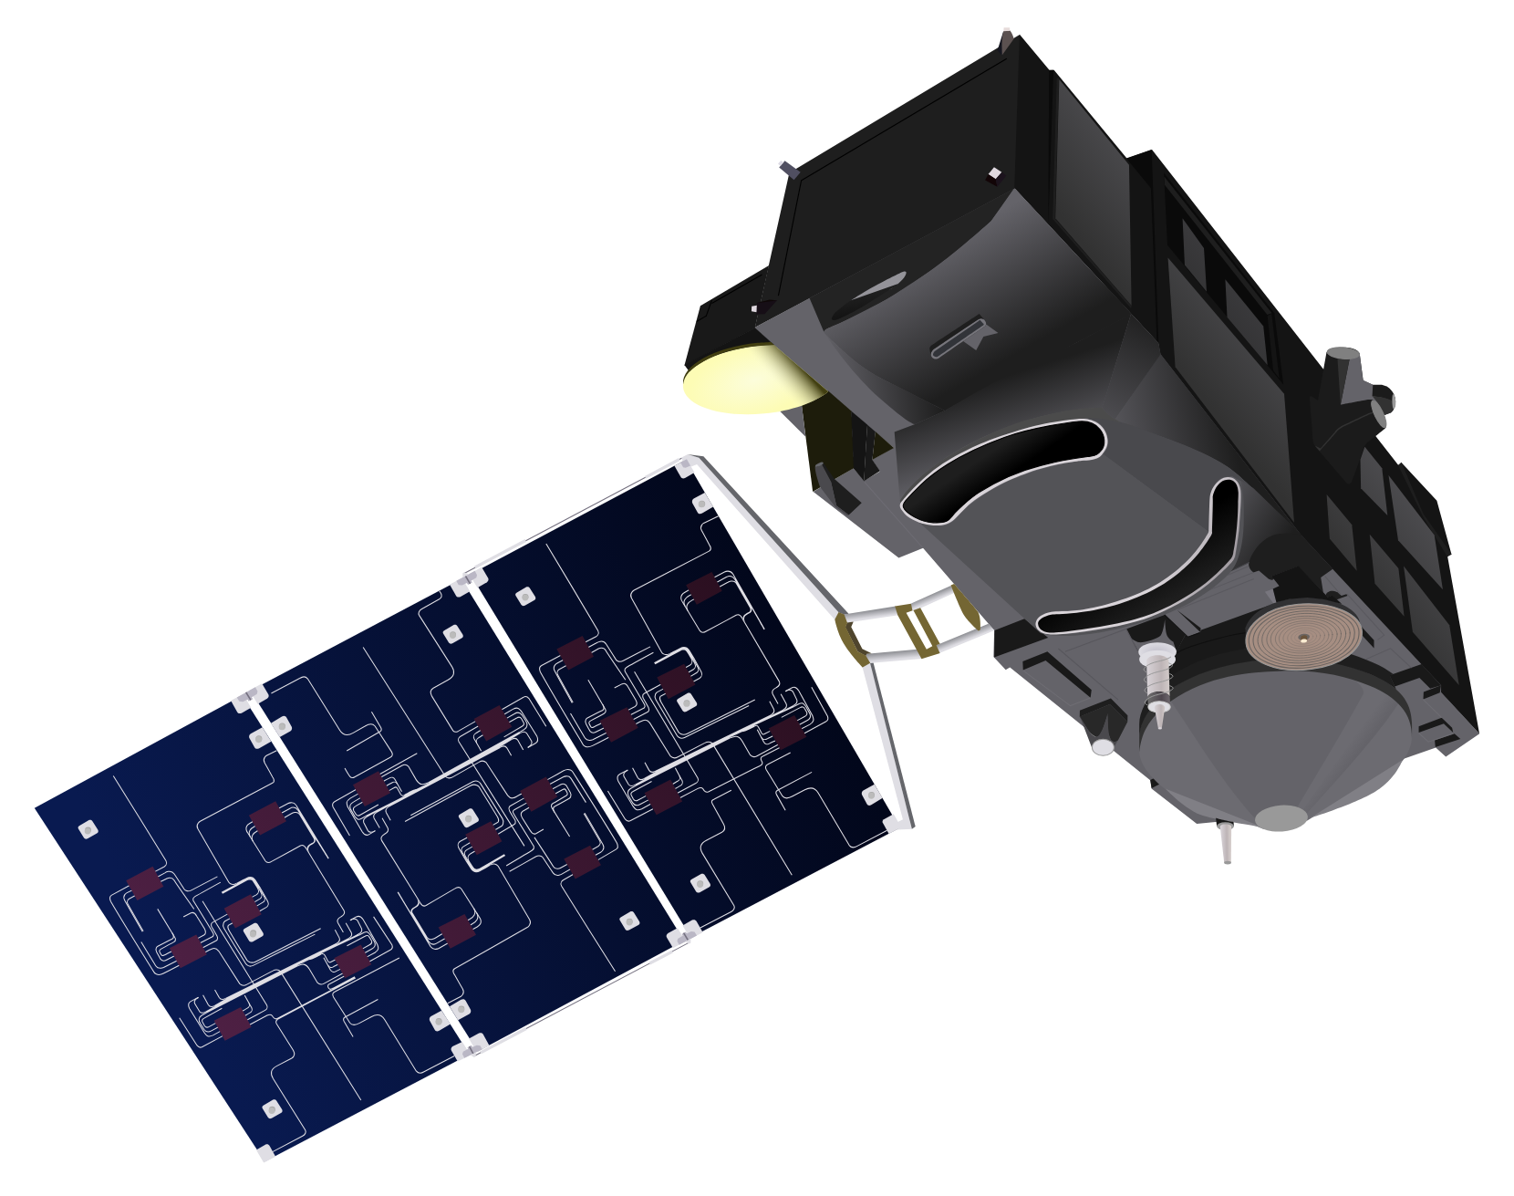

Conclusions
MTG-I1 FCI
  Temporally stable, biases well within requirements, no radiance dependency
  WV7.3 shows slight non-linearity-like feature with no impact on the overall performance of the channels.
SEVIRI
  All channels temporally stable, except IR13.4 which is affected by ice contamination.
  IR3.9 shows a larger bias on MSG2 and MSG3, still within requirements, under investigation.
SLSTR
  Temporally stable, biases well within requirements, no radiance dependency
  Fire channels show slightly higher biases, still well within requirements.
AVHRR
  Channels 4 and 5 are temporally stable, biases within requirements, no radiance dependency
  Channel 3b exhibits some strong non-linearity-like features towards cold end on MetopB, and showing larger temporal variation on both satellites, under investigations.

Slide 15
Thank you!
Questions are welcome.

