Slide 1
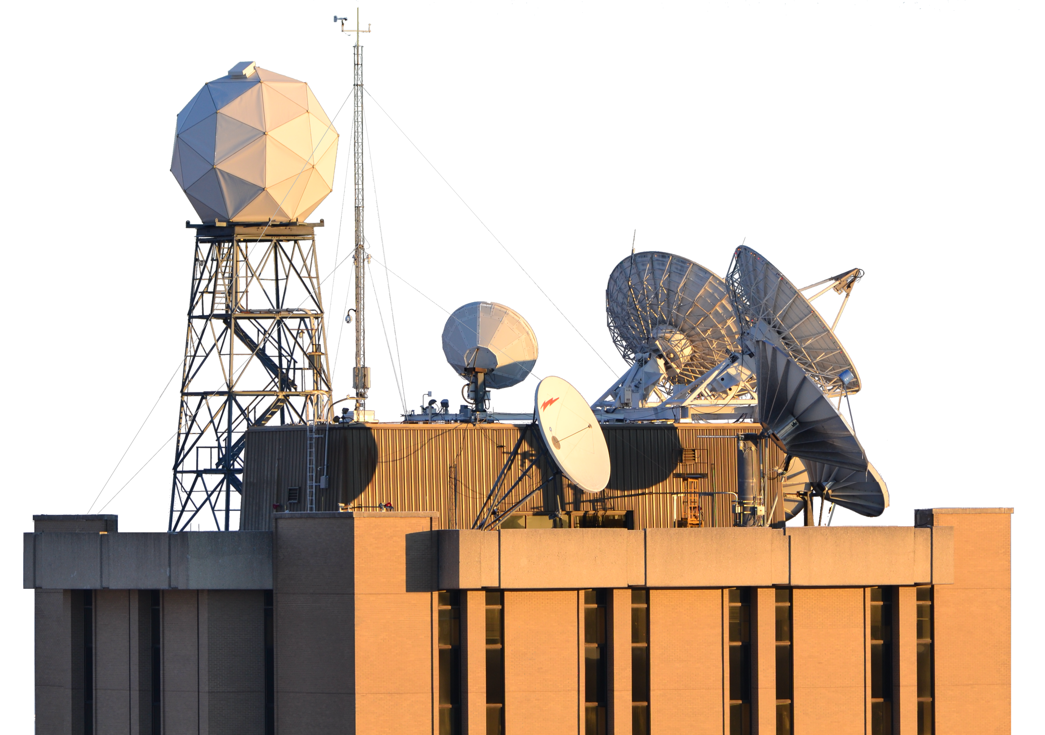



<15 mK/decade Radiometric Calibration Stability
Demonstrated By CrIS/VIIRS Comparisons
David Tobin, Dan DeSlover, Greg Quinn, Michelle Loveless, Joe Taylor
Cooperative Institute for Meteorological Satellite Studies
Space Science and Engineering Center
University of Wisconsin-Madison
GSICS Annual Meeting
Ottawa, Canada
March 2026

Slide 2
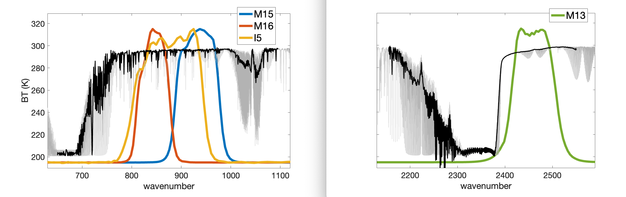
Context/Goal for this particular analysis/presentation:
Creating a multi-decadal record of Hyperspectral IR radiances
example CrIS clear sky spectrum and VIIRS SRFs
Example daily results for SNPP on 1 April 2022 ….

Slide 3
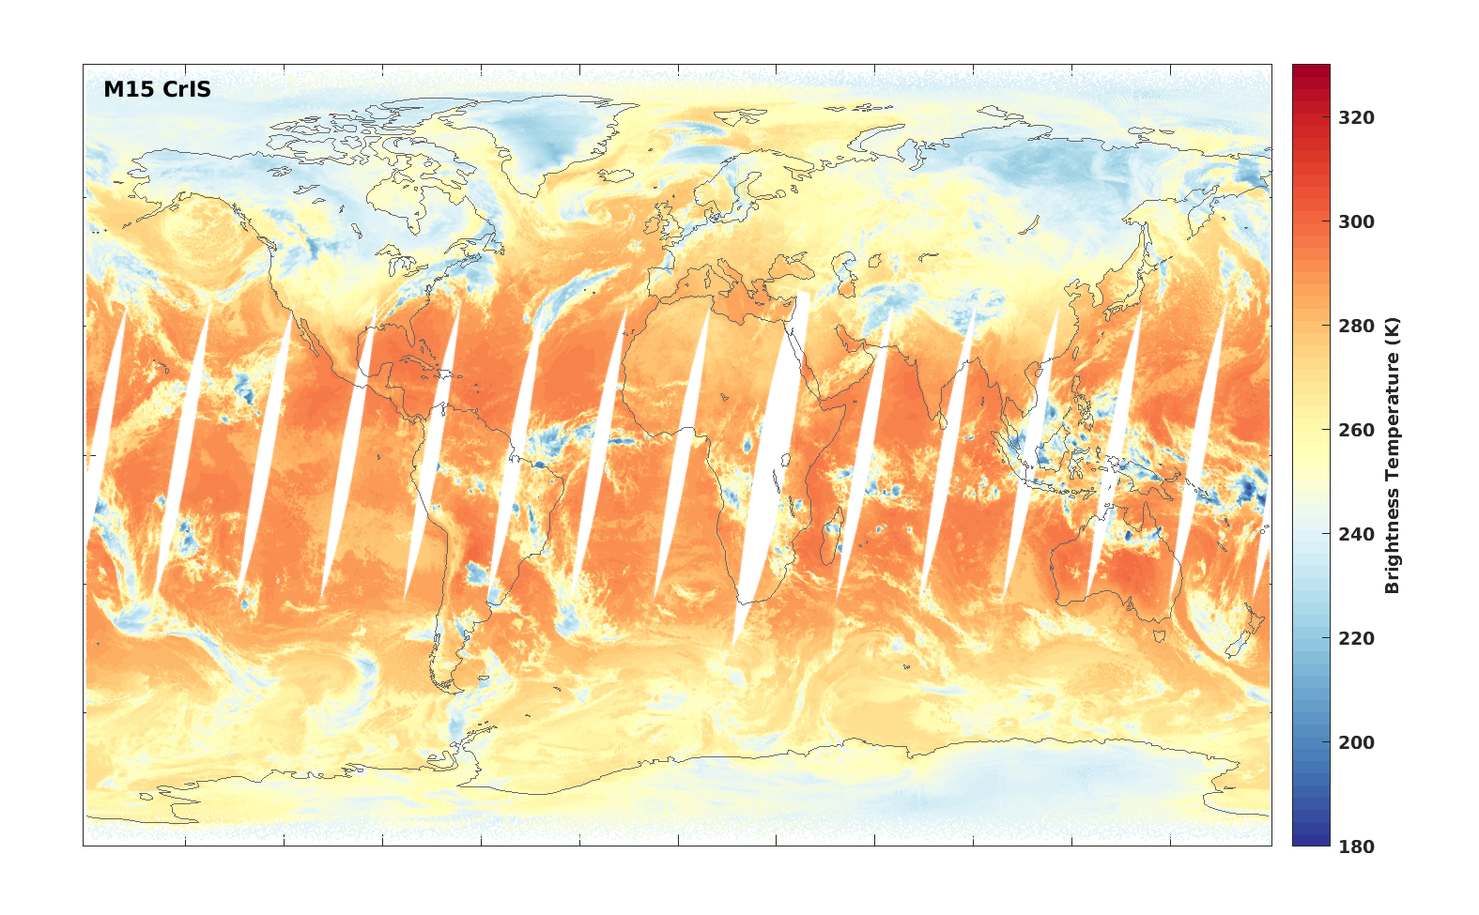
CrIS convolved with VIIRS SRF

Slide 4

VIIRS spatially collocated with CrIS footprints

Slide 5
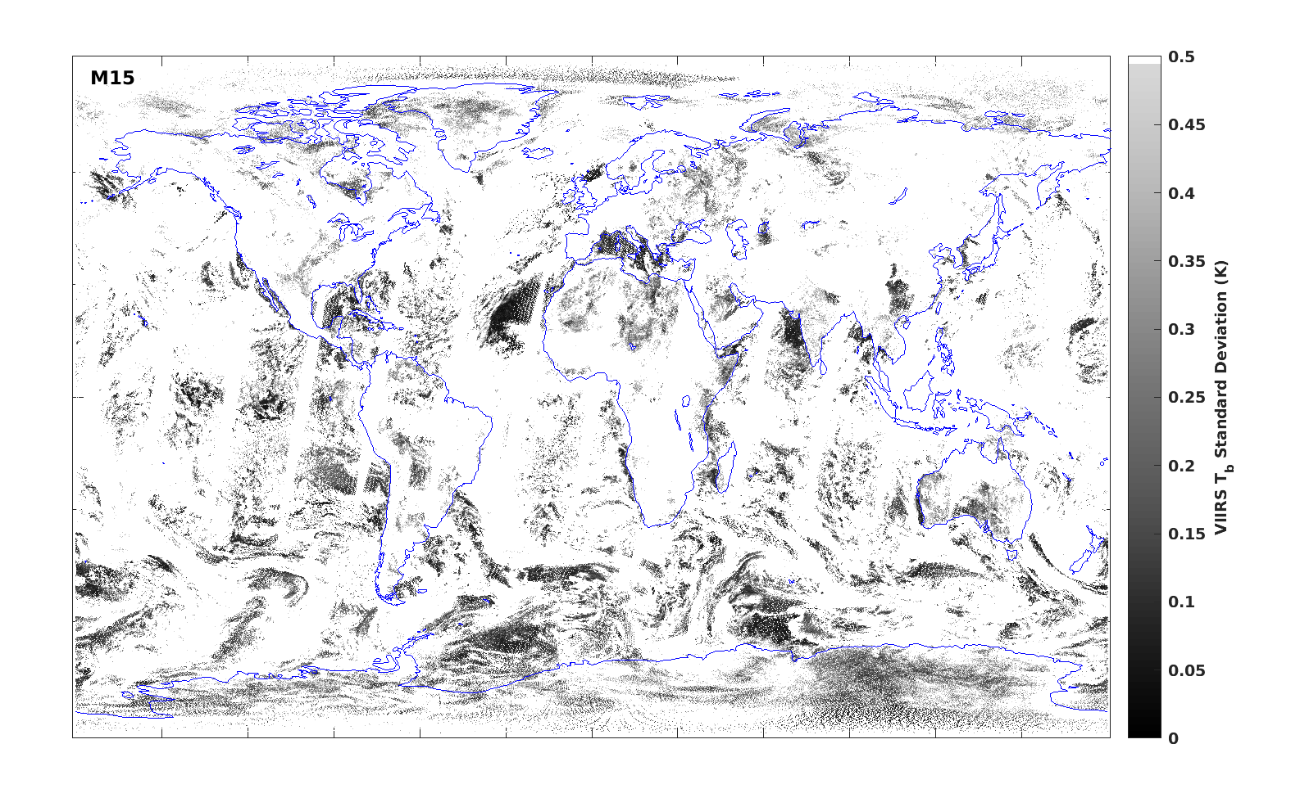
Variability of VIIRS within CrIS footprints

Slide 6
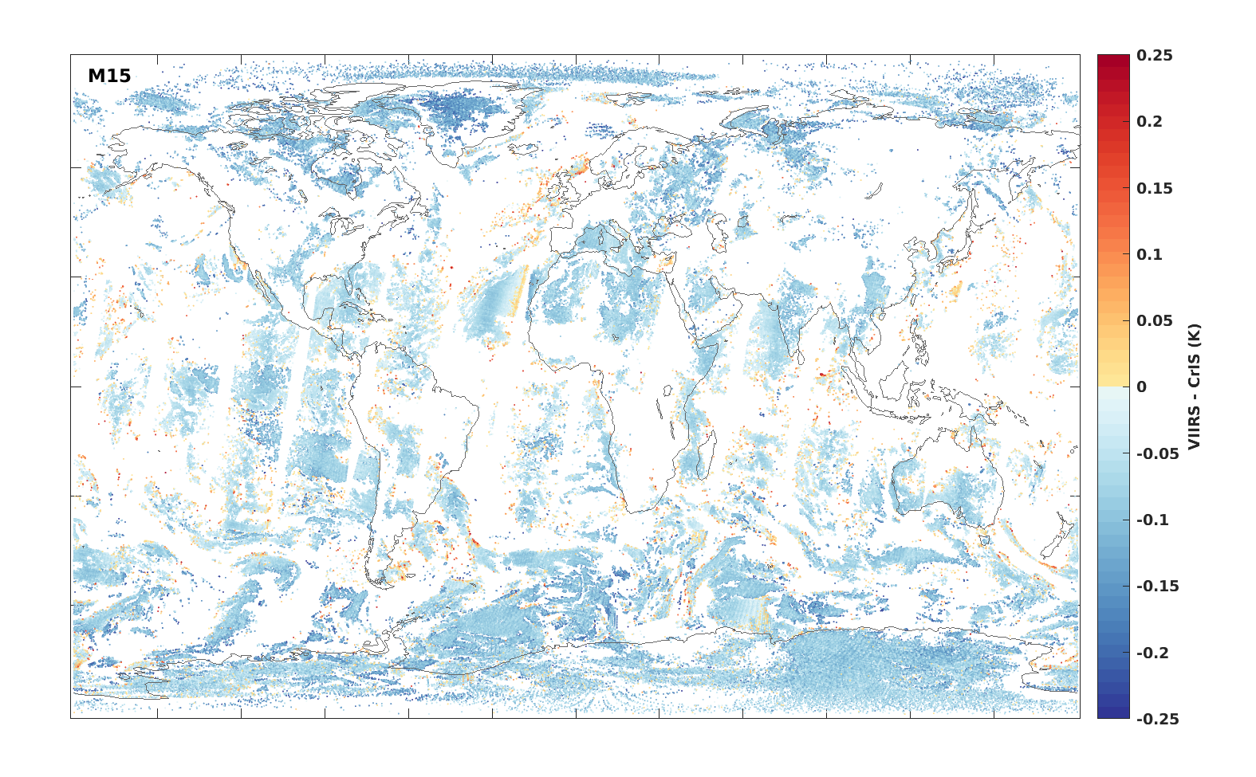
VIIRS minus CrIS

Slide 7
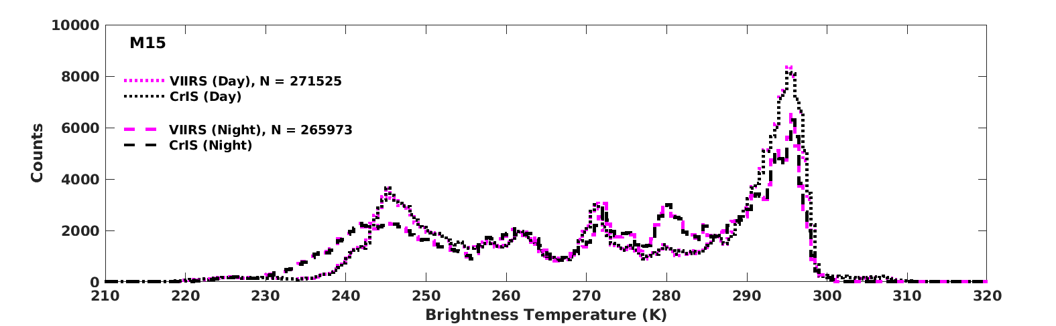
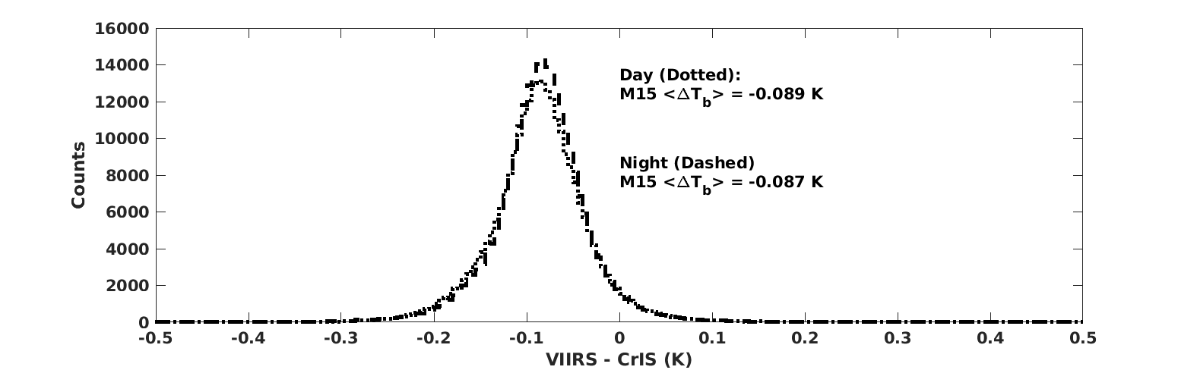
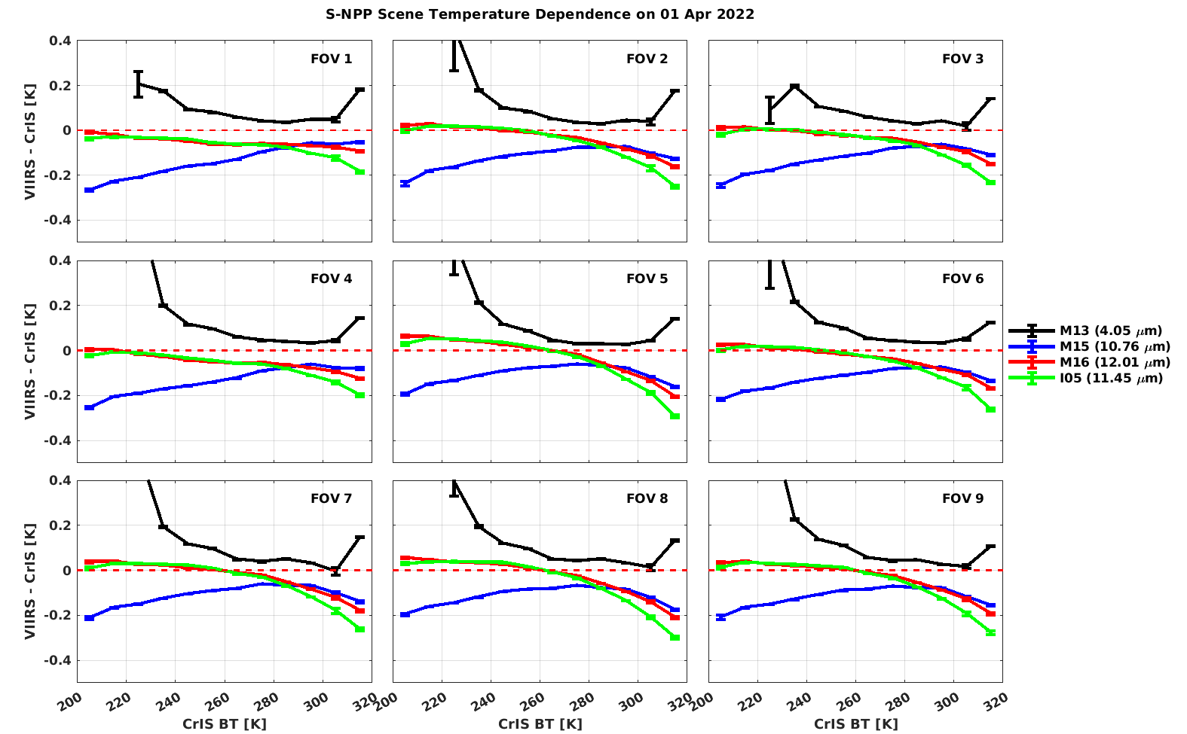
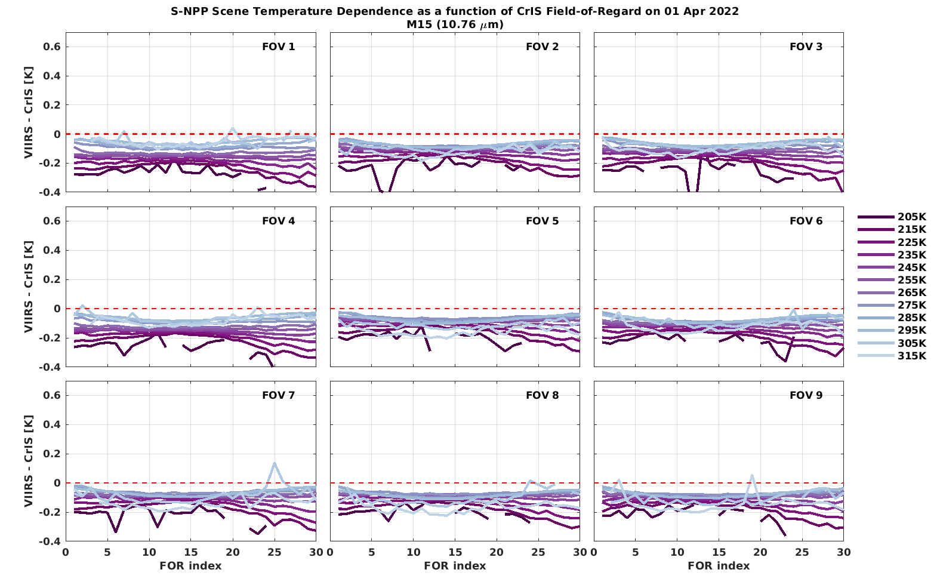
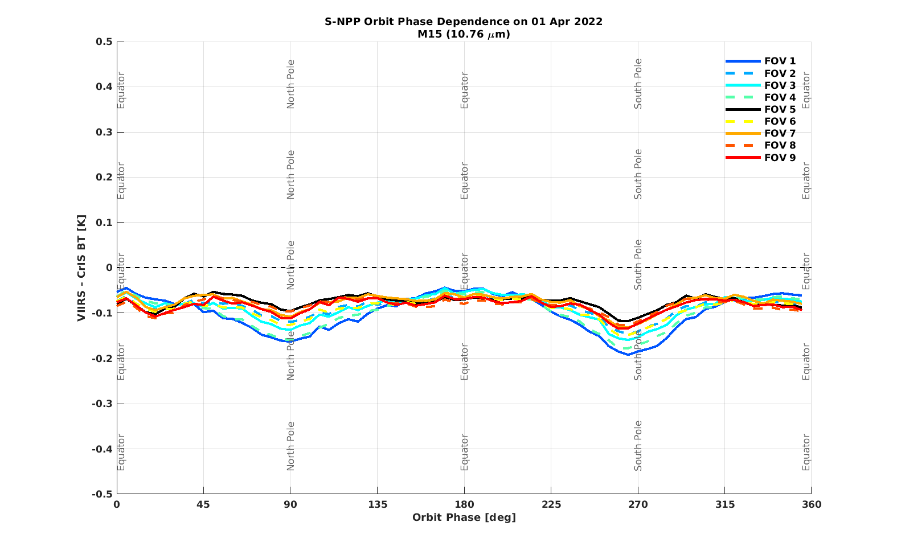
Daily Radiance and BT statistics
BT distributions
BT difference distributions
BT difference vs. scene BT
BT difference vs. view angle
BT difference vs. orbit phase

Slide 8
Aside: FOV dependence of VIIRS-CrIS vs. scene BT

Slide 9
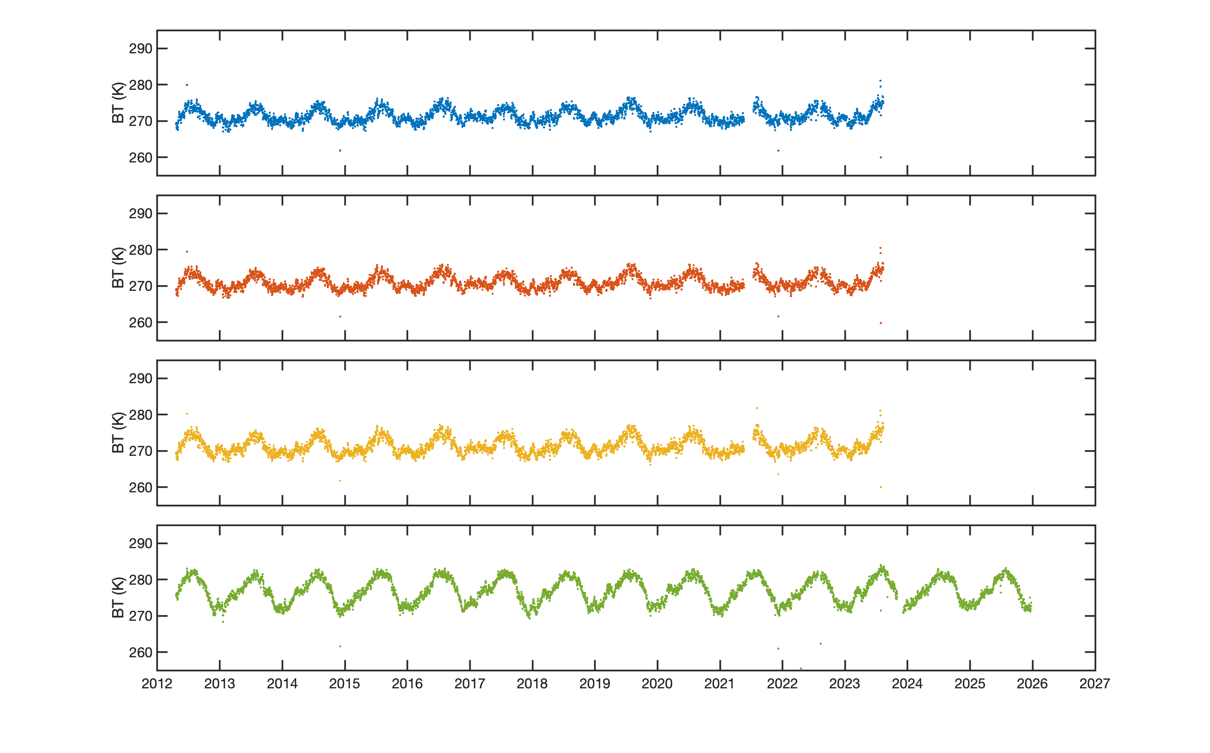
S-NPP Daily Mean BTs vs. Time
M15
M16
I5
M13

Slide 10
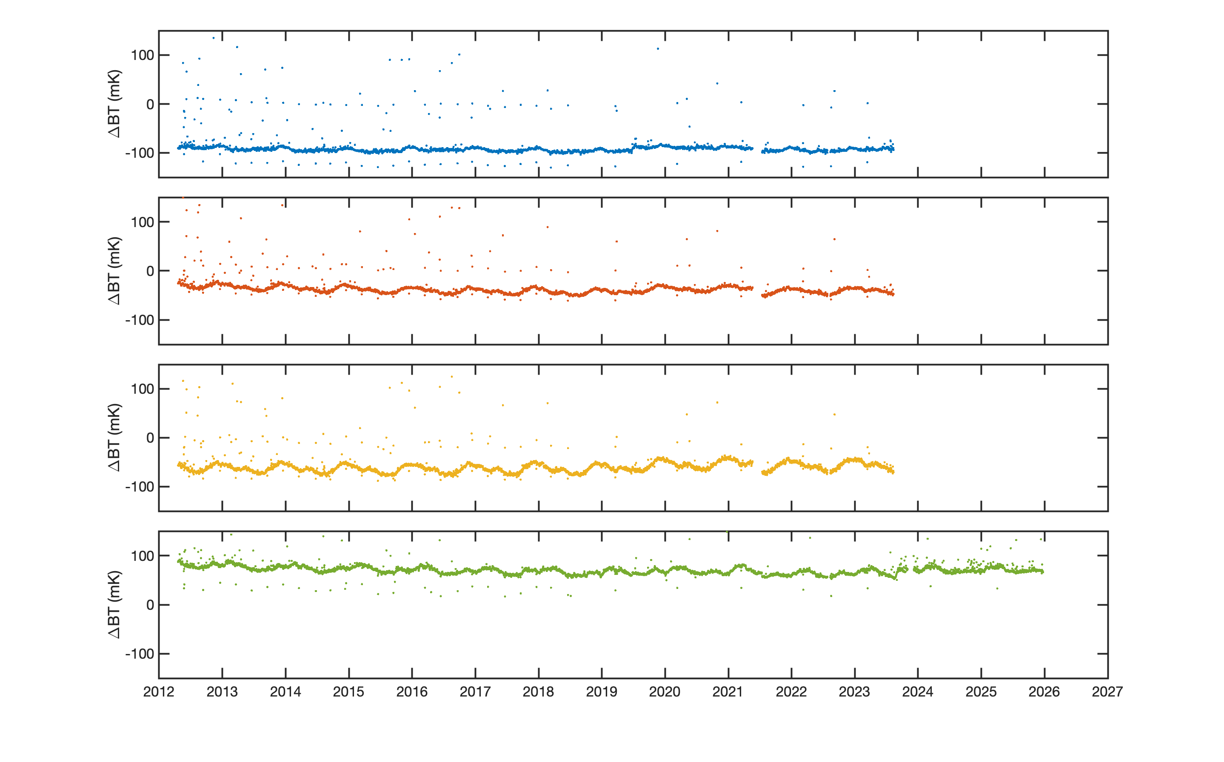
S-NPP Daily Mean BT Difference vs. Time
M15
M16
I5
M13
Notes:
Quarterly WUCD events
CrIS side switches, restarts

Slide 11
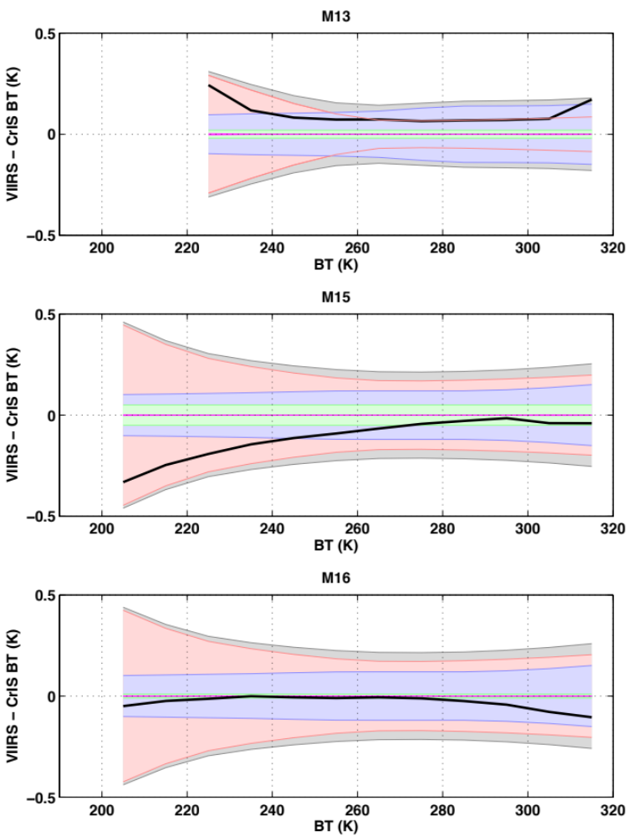
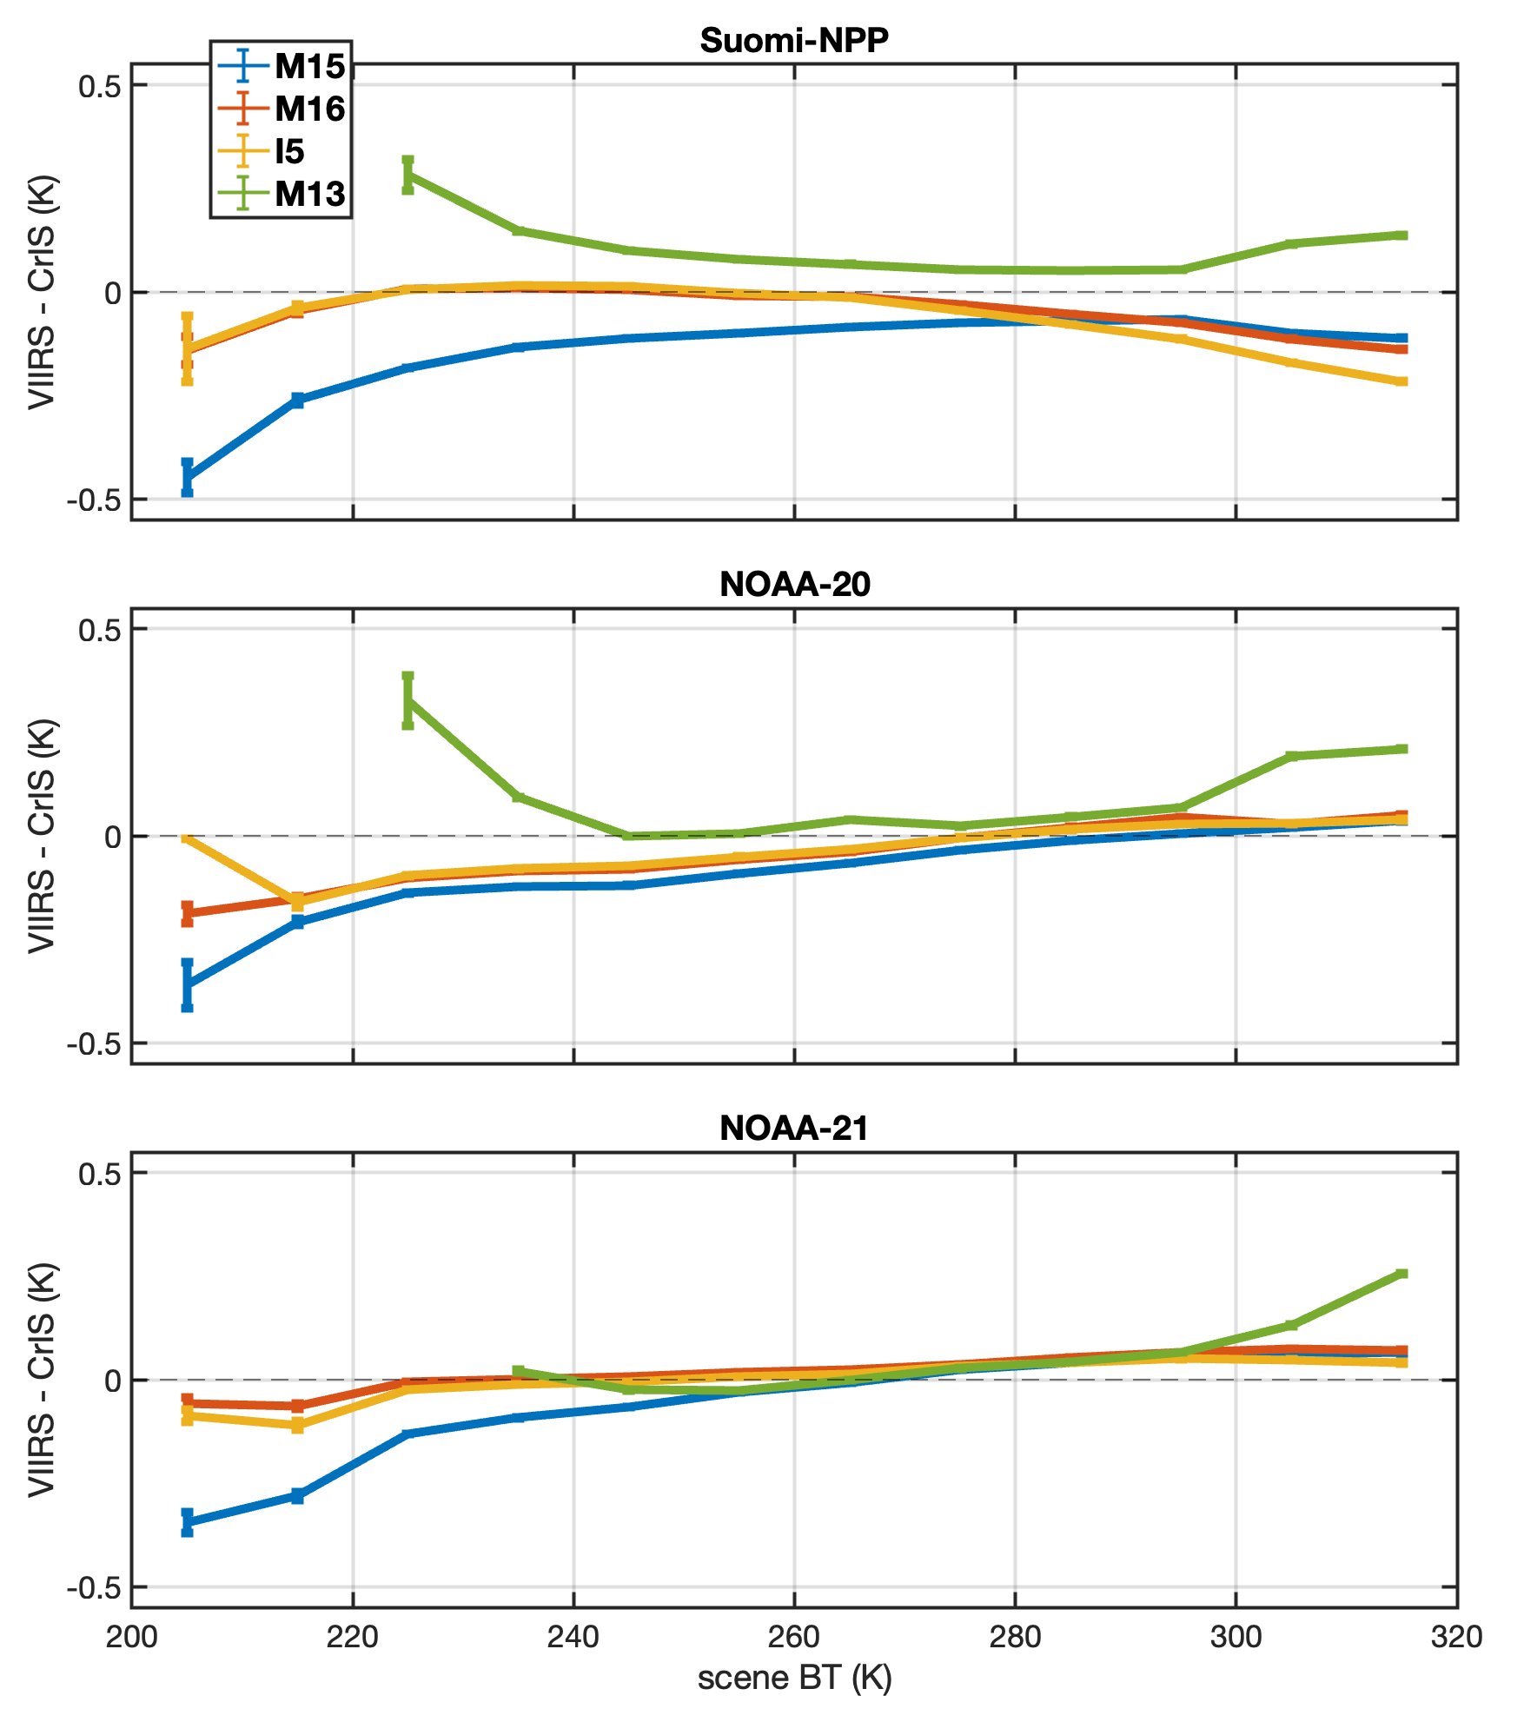
CrIS/VIIRS Differences versus Scene BT
S-NPP analyses including CrIS and VIIRS radiometric uncertainties
Legend
Mean differences
CrIS RU
VIIRS RU
Uncertainty due to Out-of-Band SRF effects
Statistical uncertainty
RSS
McIntire, Efremova, Xiong, “S–NPP VIIRS On-orbit Uncertainty Estimate for Emissive Bands”, CALCON 2013
Tobin, D., et al. (2013), Suomi-NPP CrIS radiometric calibration uncertainty, J. Geophys. Res. Atmos., 118, 10,589–10,600, doi:10.1002/jgrd.50809

Slide 12
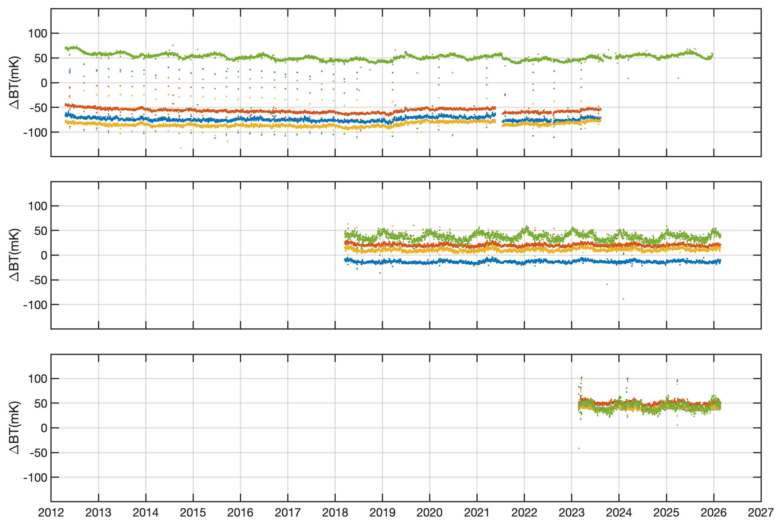
Daily Mean BT Difference for (280K < scene BT < 290K) vs. Time
Linear Trends in [mK/decade]:
Trend SE 95% CI
M15 -0.97 2.07 [ -5.03 3.09]
M16 -4.48 0.99 [ -6.43 -2.54]
I05 4.37 0.40 [ 3.58 5.15]
M13 -4.09 3.20 [-10.36 2.18]
Trend SE 95% CI
M15 0.80 0.82 [ -0.79 2.40]
M16 -1.62 0.01 [ -1.63 -1.61]
I05 2.72 0.46 [ 1.82 3.62]
M13 -1.84 1.60 [ -4.97 1.30]
Trend SE 95% CI
M15 -6.76 0.07 [ -6.90 -6.61]
M16 -8.99 0.07 [ -9.12 -8.85]
I05 -2.40 0.06 [ -2.52 -2.27]
M13 4.87 0.13 [ 4.62 5.12]
S-NPP
(periodic WUCD events)
(side switches in 2019 and 2021)
NOAA20
M1M16
I5
M13
NOAA21
CrIS PRTs and VIIRS thermistors
Notes:
Quarterly WUCD events
CrIS side switches, restarts
CrIS PRTs and VIIRS thermistors

Slide 13
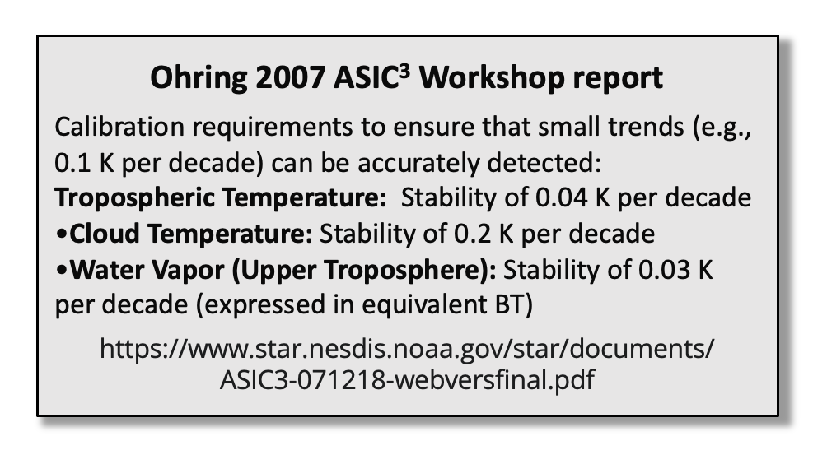
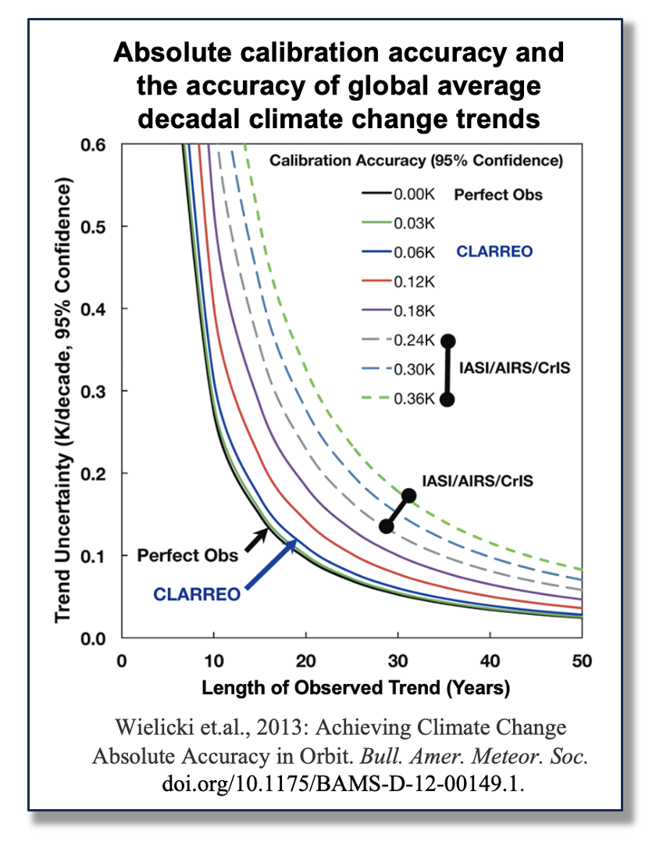
Summary
Intercomparison of CrIS and VIIRS has proven to be a very useful way to assess the calibration of each sensor, including long term stability.
These individual platform/satellite intercomparisons, for SNPP, NOAA-20, and NOAA-21, show agreement with low bias and very good stability … less than 10-15 mK/decade.
  Variants of this CrIS/VIIRS analyses yield similar results.
  SNO analyses of CrISes and IASIes also yield similar trend results.
However: work remains to combine data from consecutive platforms/satellites to create useful multi-decadal data records
  E.g.: Strow et al. 2021: A Climate Hyperspectral Infrared Radiance Product (CHIRP) Combining the AIRS and CrIS Satellite Sounding Record.
  E.g. see next side … SITSATs, e.g. CLARREO, Truths, etc. etc.

Slide 14
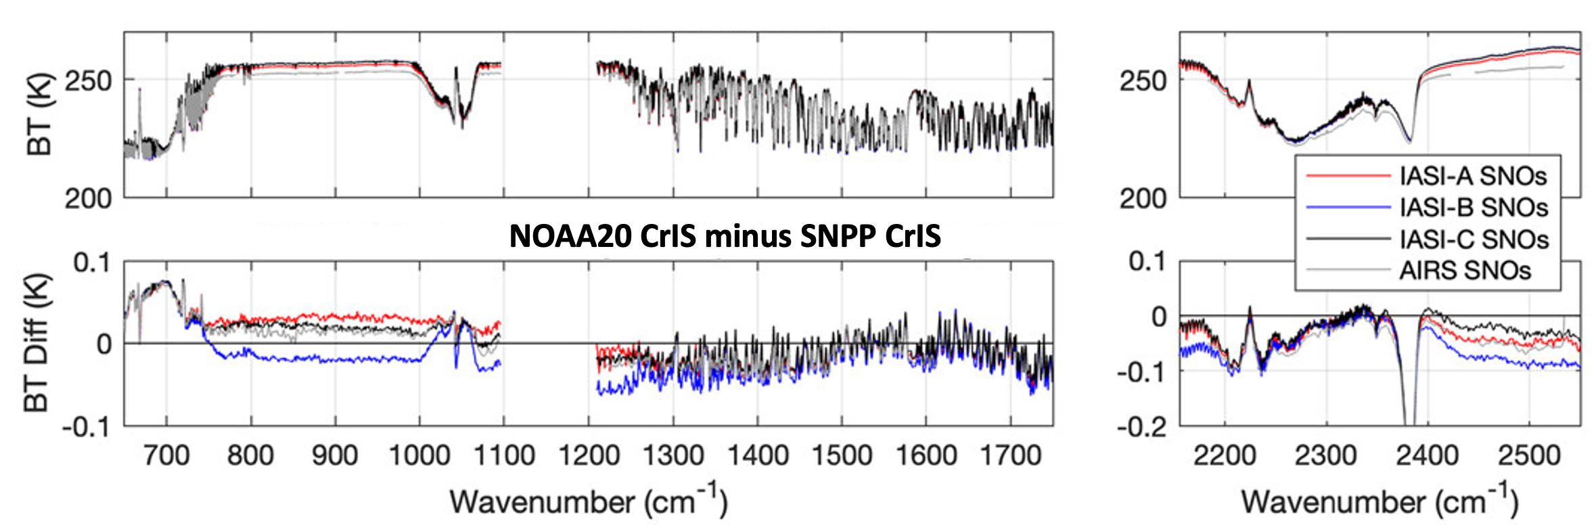

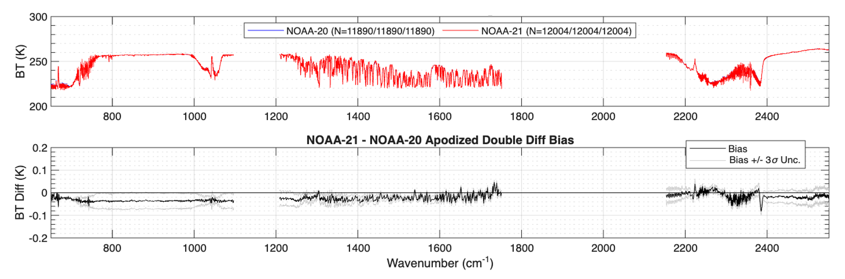
Example differences between CrISes via SNOs
following: Loveless, M. et al., (2023). Comparison of the AIRS, IASI, and CrIS infrared sounders using simultaneous nadir overpasses: Novel methods applied to data from 1 October 2019 to 1 October 2020. Earth and Space Science, 10, e2023EA002878. https://doi.org/10.1029/2023EA002878
NOAA20 CrIS minus SNPP CrIS
NOAA21 CrIS minus NOAA20 CrIS

