Slide 1
Implementation of EUMETSAT Software for Retrieving CrIS FOV SRFs
Likun Wang
Earth System Science Interdisciplinary Center
University of Maryland
wlikun@umd.edu
GSICS 2026 Annual Meeting at Ottawa, Canada; 3/23-3/27 2026

Slide 2
Background
During the 2025 GSICS meeting at Changchun in China, the GSICS IR group was impressed by Pierre's presentation from EUMETSAT on the retrieval of relative spectral response functions. As a result, the following action was agreed upon:
  Action: Group members are encouraged to test the software provided by EUMETSAT to evaluate pixel or field-of-view (FOV) differences. EUMETSAT has kindly agreed to share the software. A web meeting will be scheduled to report on progress.
During the ITSC-25 meeting in Goa, India, I met with Guillaume and Dorothee, who answered many questions and provided valuable support.
I implemented the software and shared the results with Pierre and Dave Tobin, followed by a discussion.
The goal of the presentation is to apply similar practices to CrIS SRFs using the same method.
The theoretical basis of the EUMETSSAT method:
  https://www.mdpi.com/2072-4292/16/23/4449
  https://arxiv.org/abs/2504.19708

Slide 3
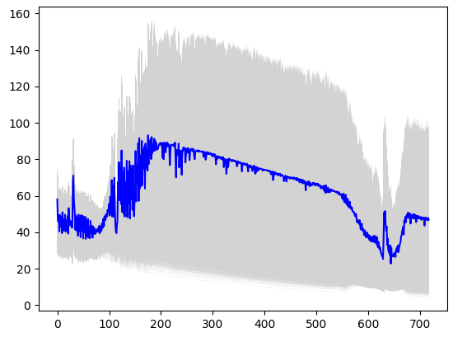
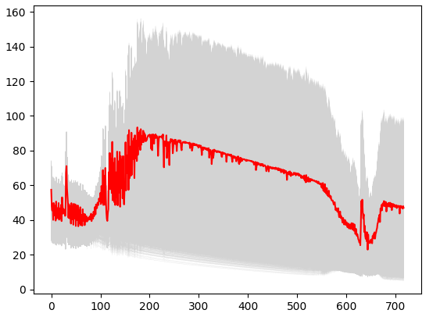
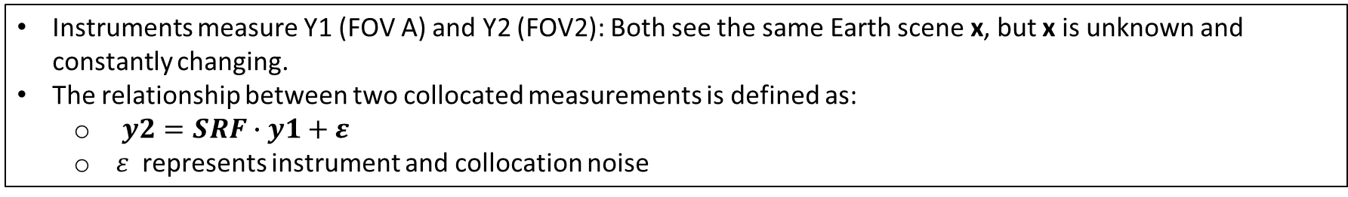
Find the operator SRF that explains why y1≠y2
Instruments measure Y1 (FOV A) and Y2 (FOV2): Both see the same Earth scene x, but x is unknown and constantly changing.
The relationship between two collocated measurements is defined as:
  $y2=SRF∙y1+ε$
  $ε$ represents instrument and collocation noise
FOV A: y1
FOV B: y2
Channel Number
Channel Number
Using 500 files in one day’s 2701 files

Slide 4
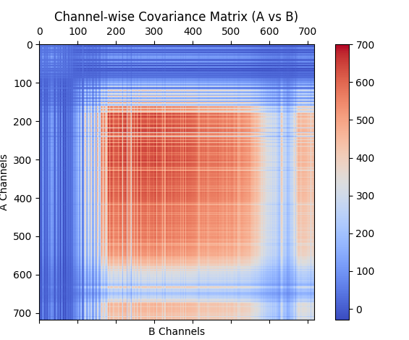

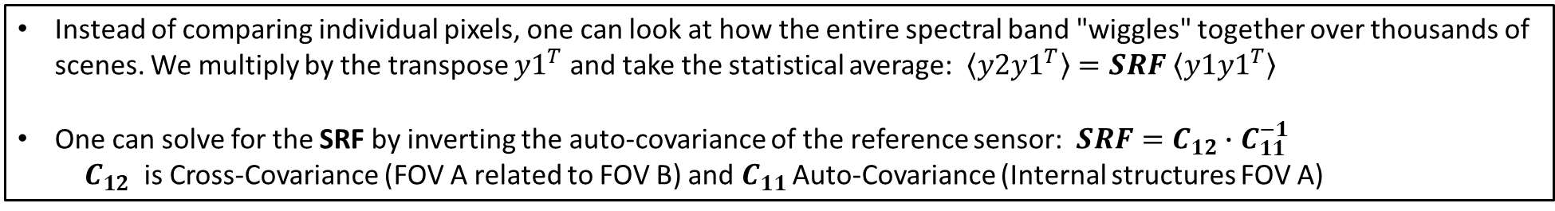
The Statistical "Shortcut" (Covariance Mapping)
Instead of comparing individual pixels, one can look at how the entire spectral band "wiggles" together over thousands of scenes. We multiply by the transpose ${y1}^{T}$and take the statistical average: $\left\langle y2{y1}^{T}\right\rangle =SRF \left\langle y1{y1}^{T}\right\rangle$
One can solve for the SRF by inverting the auto-covariance of the reference sensor: $SRF=C_{12}∙C_{11}^{−1}$
$C_{12}$ is Cross-Covariance (FOV A related to FOV B) and $C_{11 }$Auto-Covariance (Internal structures FOV A)
$C_{11}$
$C_{12}$

Slide 5
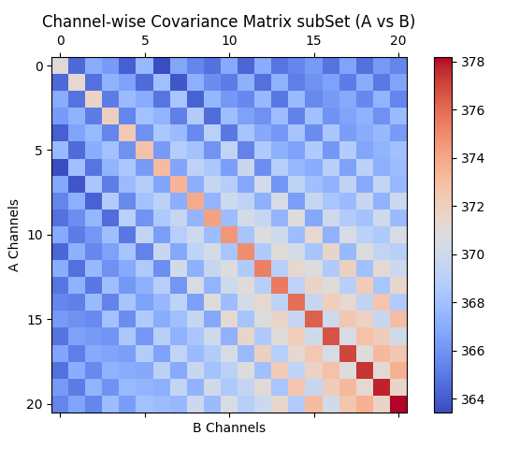
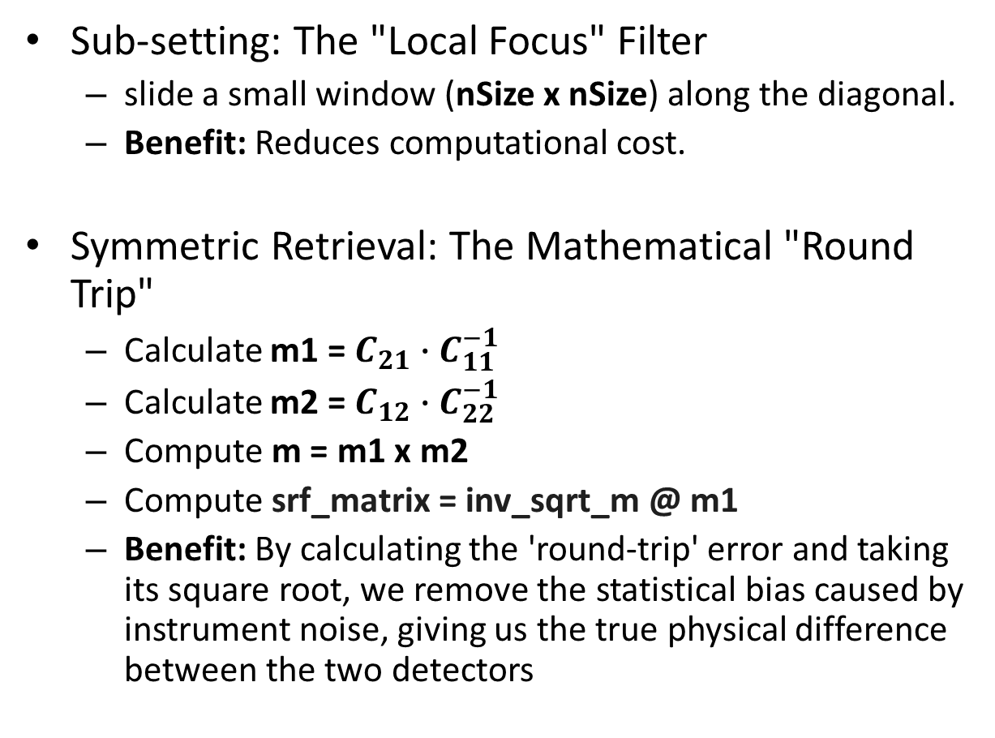
From Raw Covariance to a Clean SRF
Sub-setting: The "Local Focus" Filter
  slide a small window (nSize x nSize) along the diagonal.
  Benefit: Reduces computational cost.
Symmetric Retrieval: The Mathematical "Round Trip"
  Calculate m1 = $C_{21}∙C_{11}^{−1}$
  Calculate m2 = $C_{12}∙C_{22}^{−1}$
  Compute m = m1 x m2
  Compute srf_matrix = inv_sqrt_m @ m1
  Benefit: By calculating the 'round-trip' error and taking its square root, we remove the statistical bias caused by instrument noise, giving us the true physical difference between the two detectors
Original
Sub-setting

Slide 6
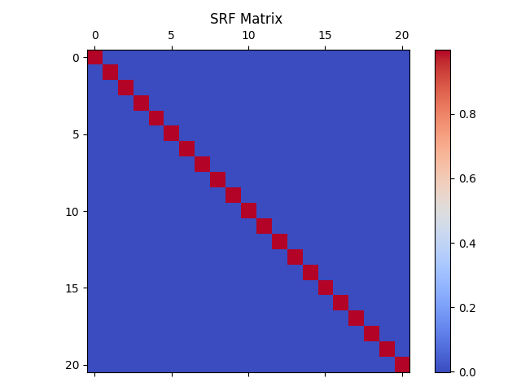
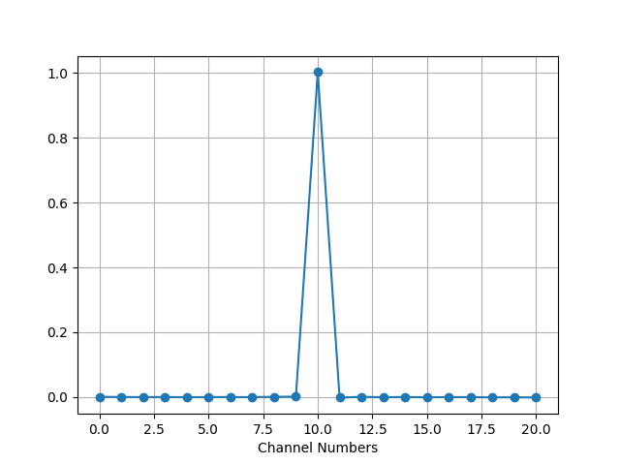
From SRF matrix to SRF

Slide 7
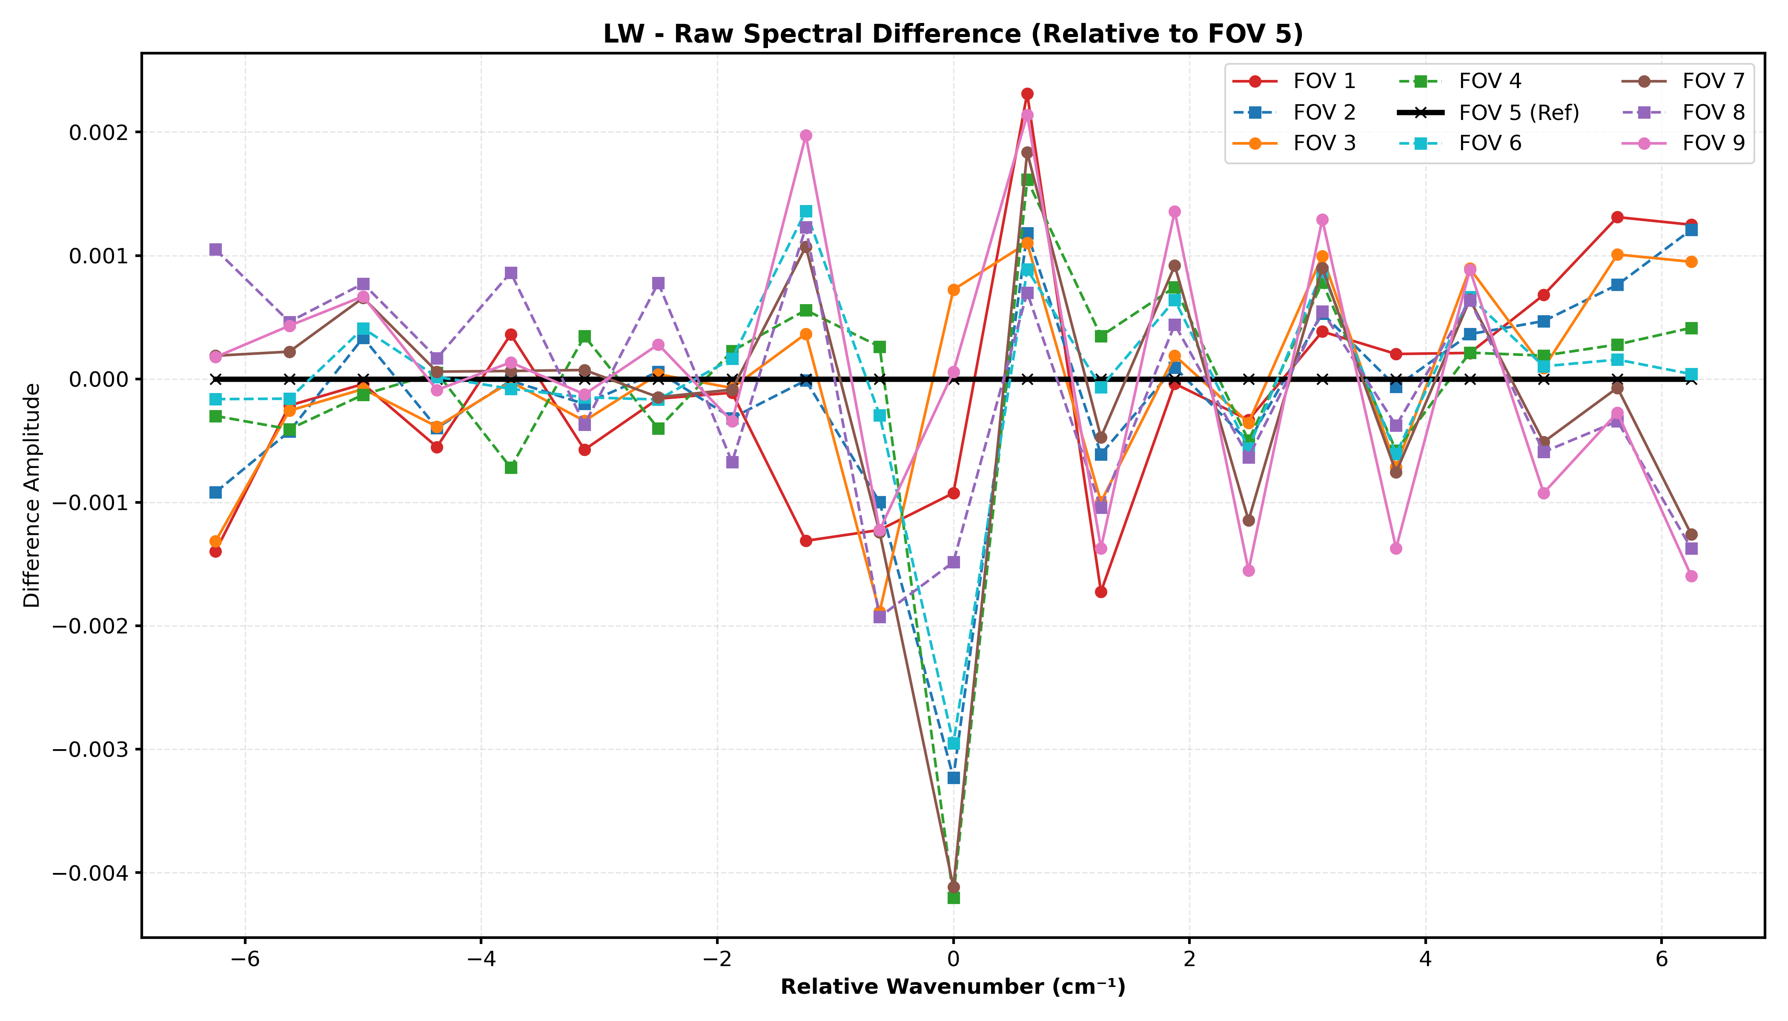
SFRs relative to FOV 5 (central): LW Band

Slide 8
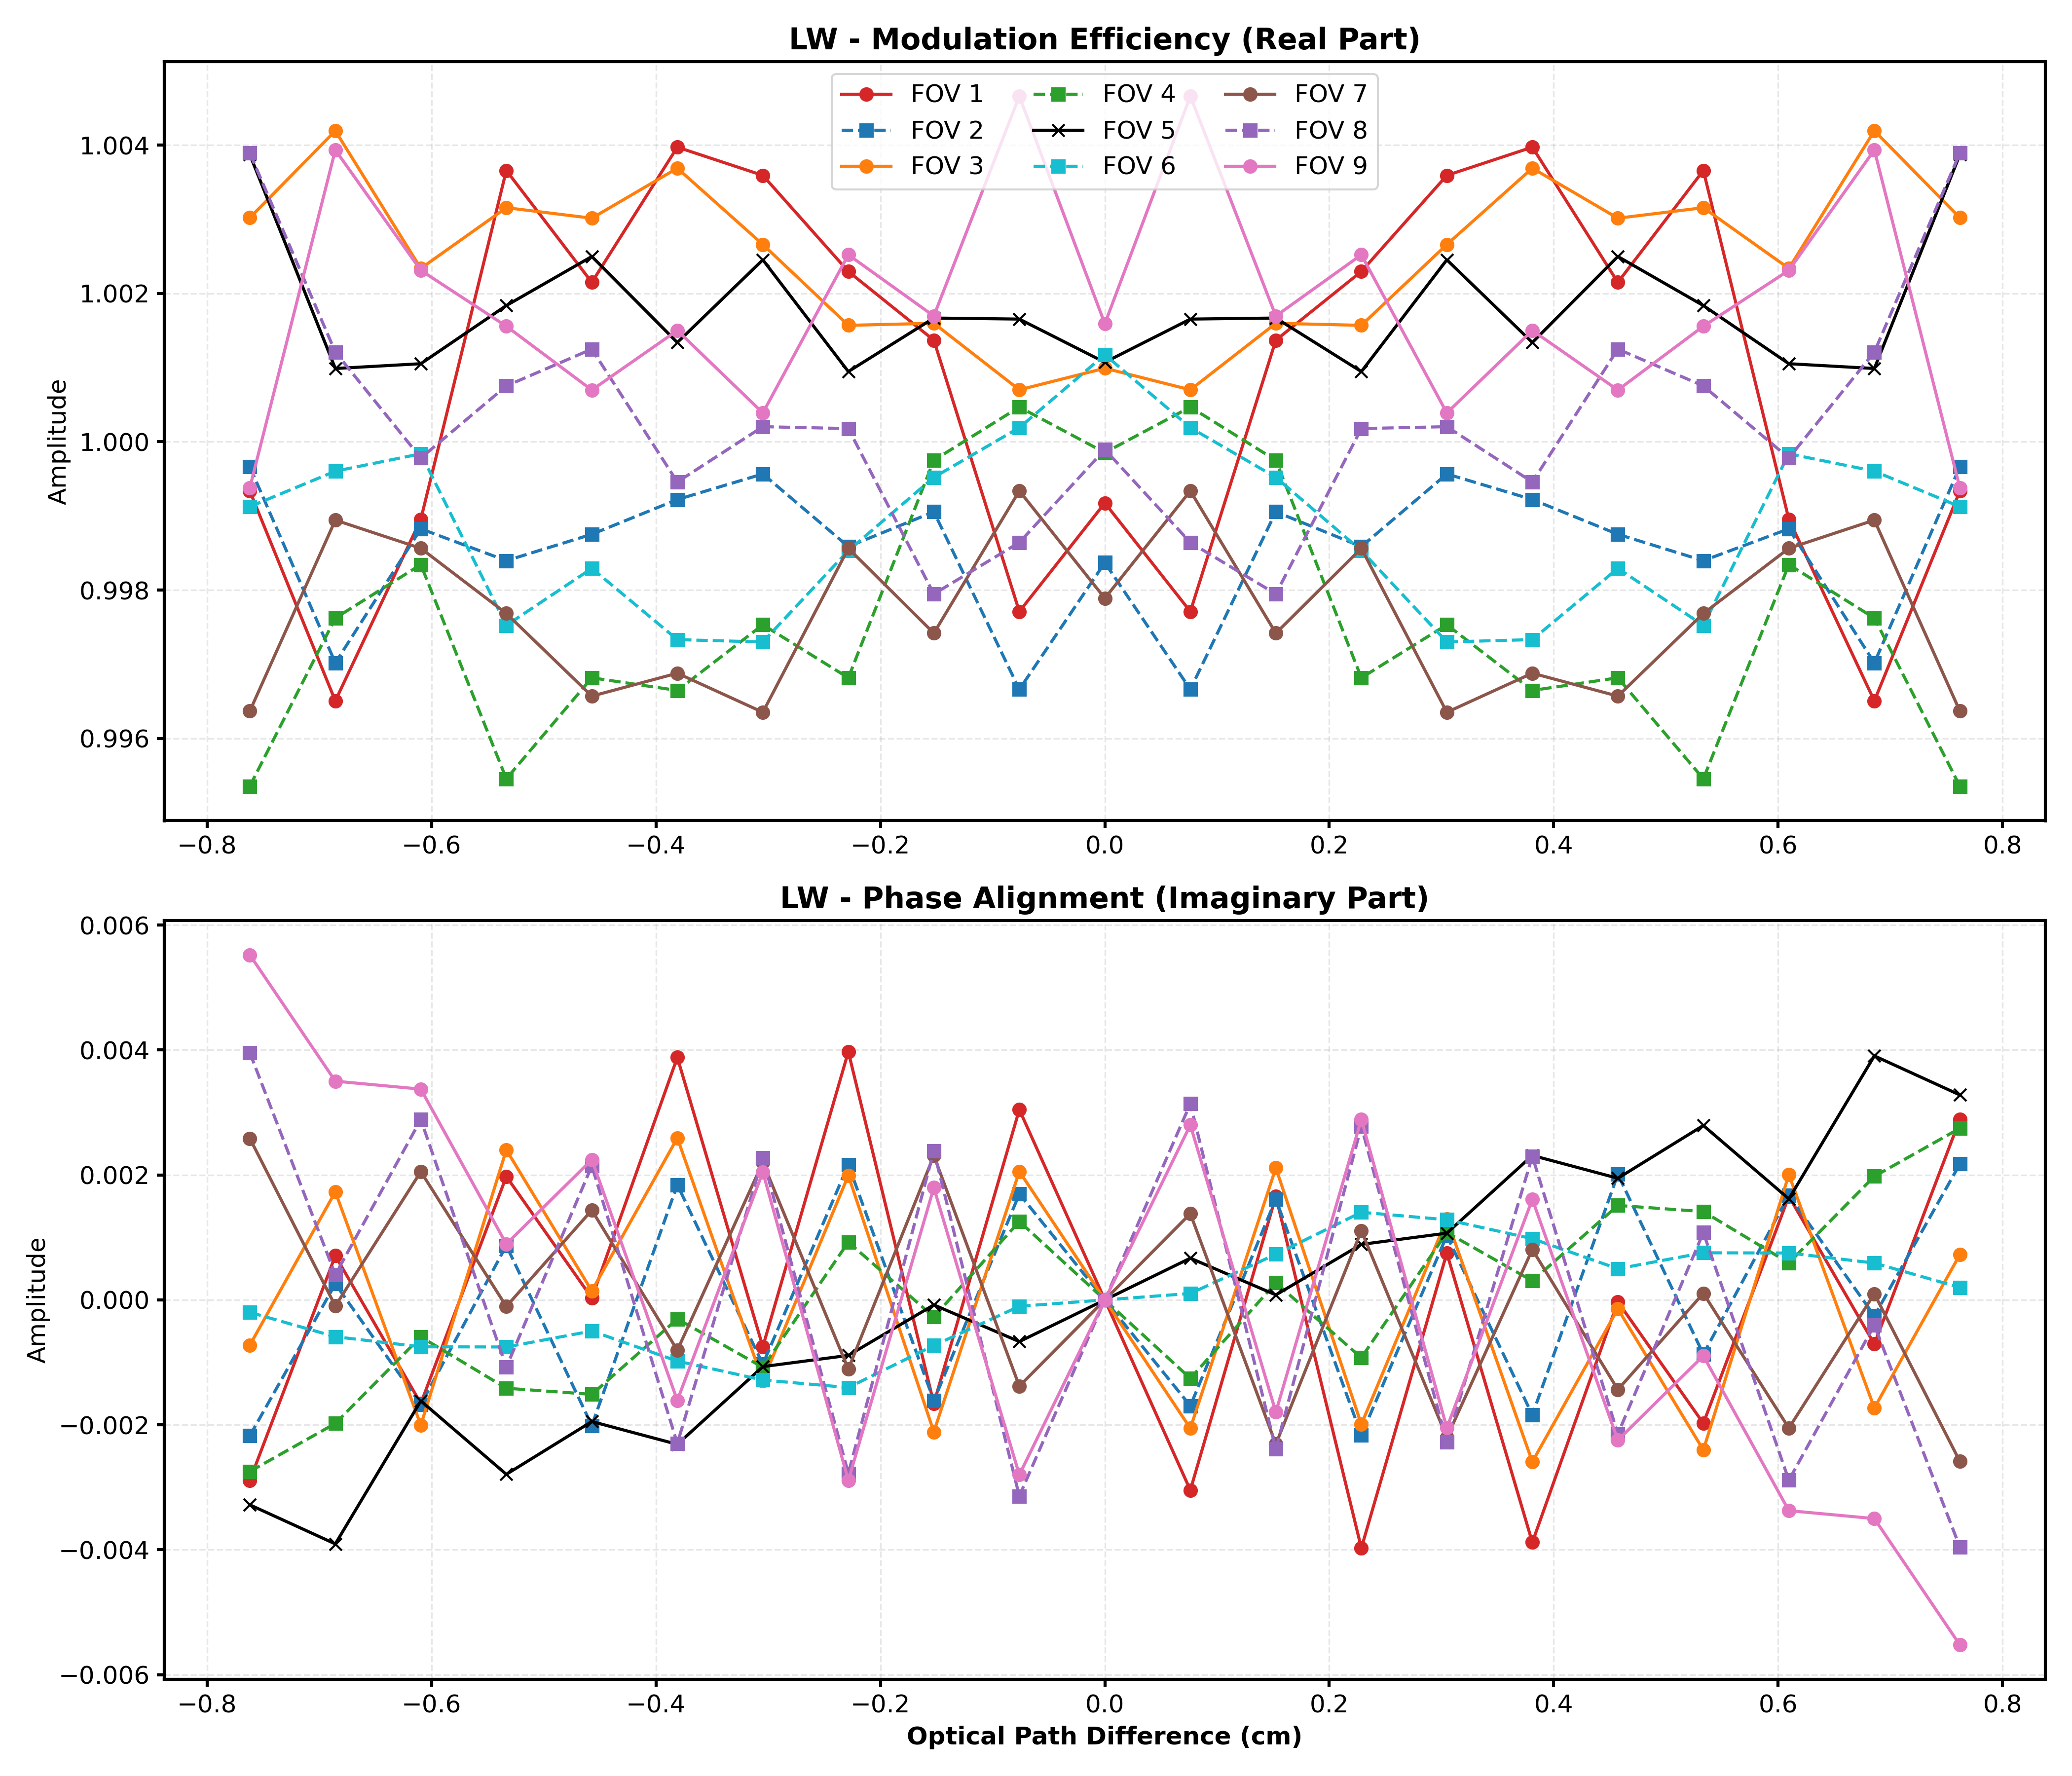
In the Interferogram Domain After FFT: LW Band

Slide 9
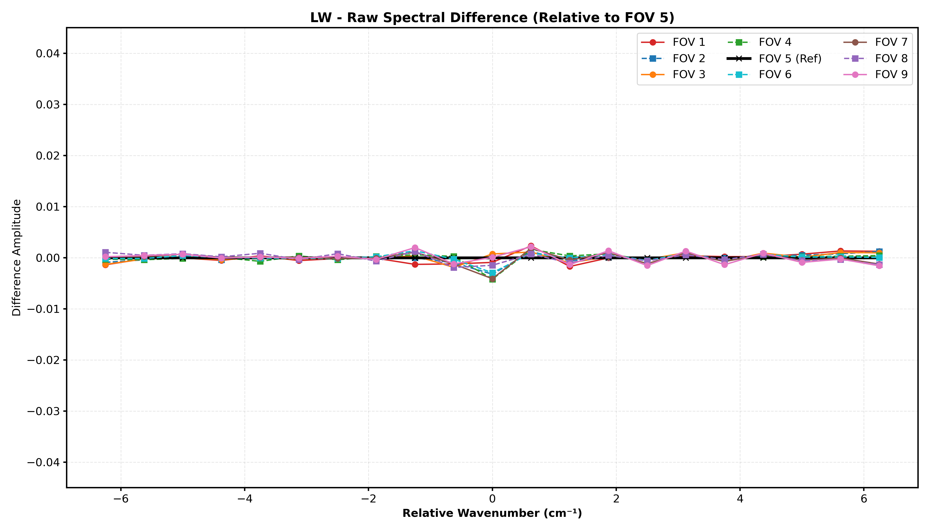
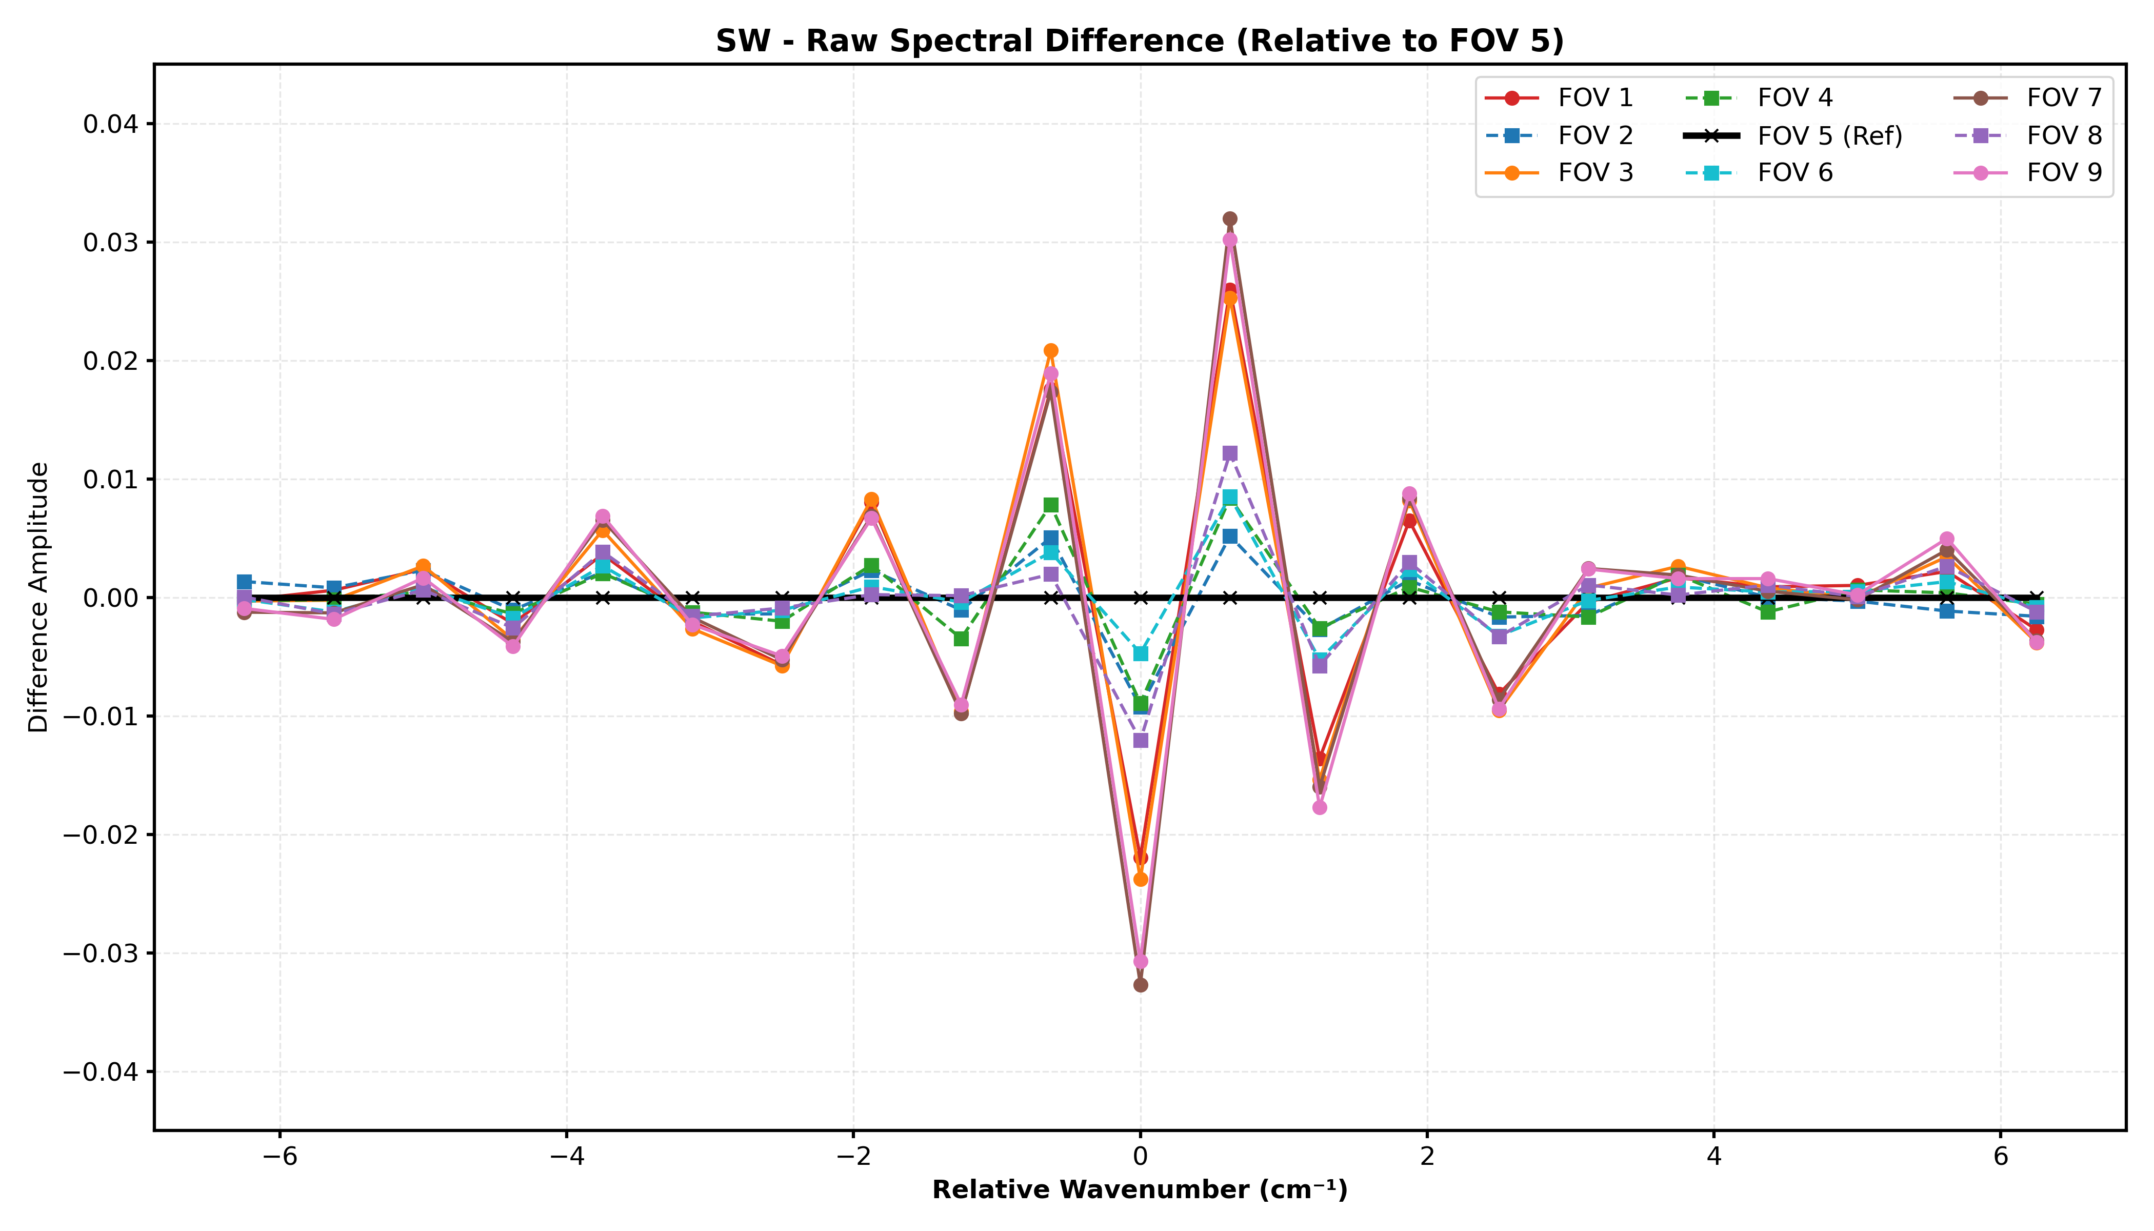
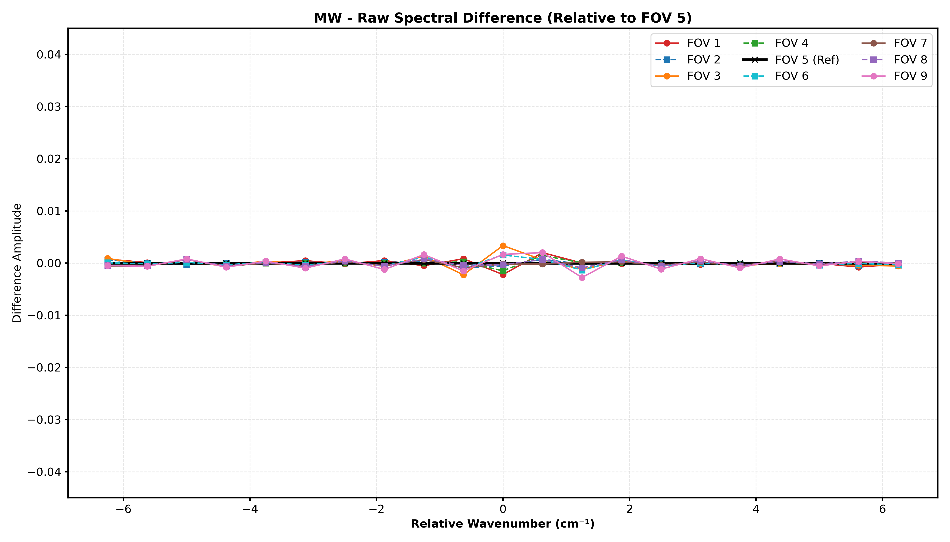
SRF Relative to FOV5
Three Bands Together (Y-Axis on Same Scale)
LW Bands
SW Bands
MW Bands
Spectral differences are minimal in the LW/MW bands but become highly pronounced in the Shortwave (SW) band.
Notes:
"By keeping all three bands on the same Y-axis scale, the physics becomes clear. In the LW and MW, the detectors are almost identical. But in the SW, we see the 'V-shape' self-apodization effect manifest as these sharp spectral residuals. Our mathematical retrieval captures this without any prior knowledge of the instrument's geometry, providing a powerful tool for monitoring sensor health from space."

Slide 10
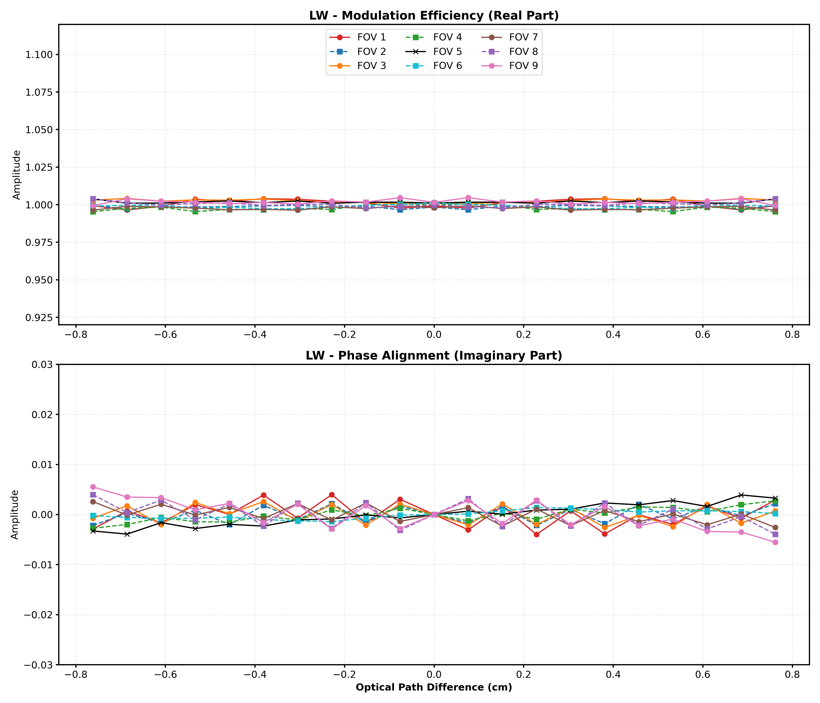
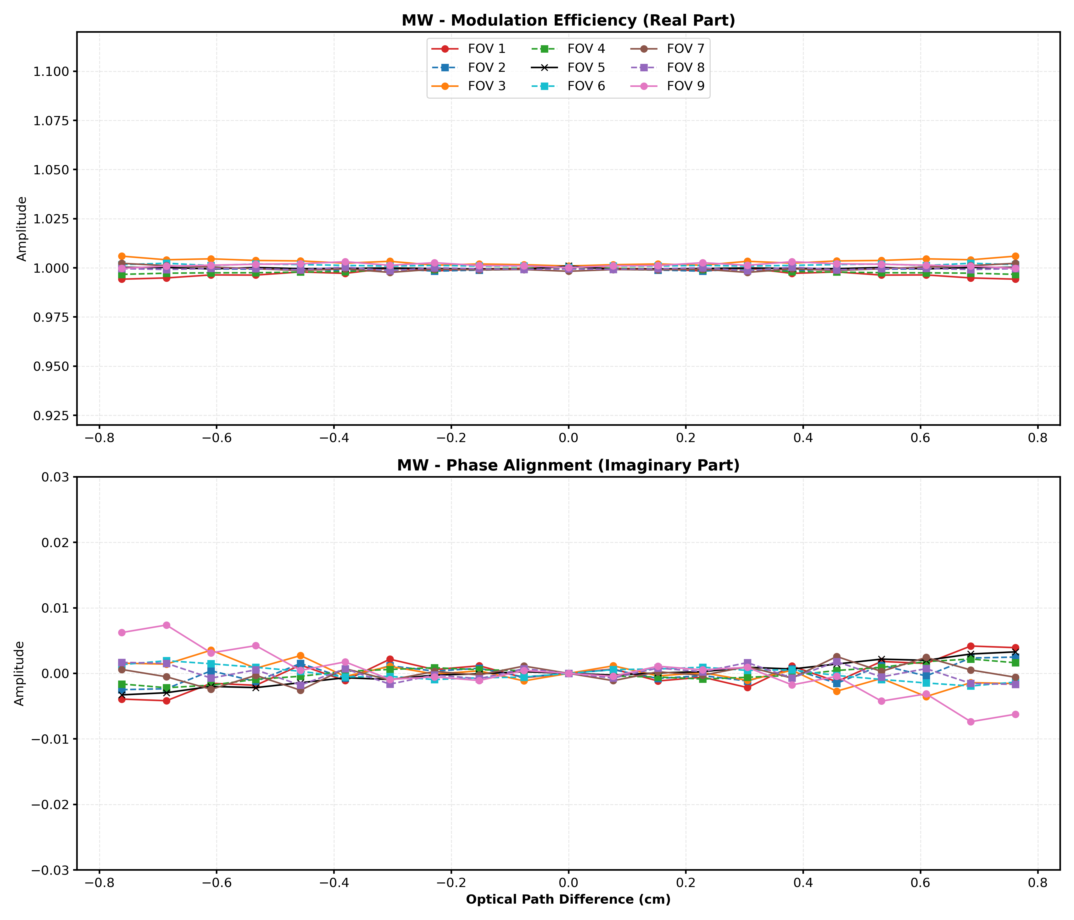
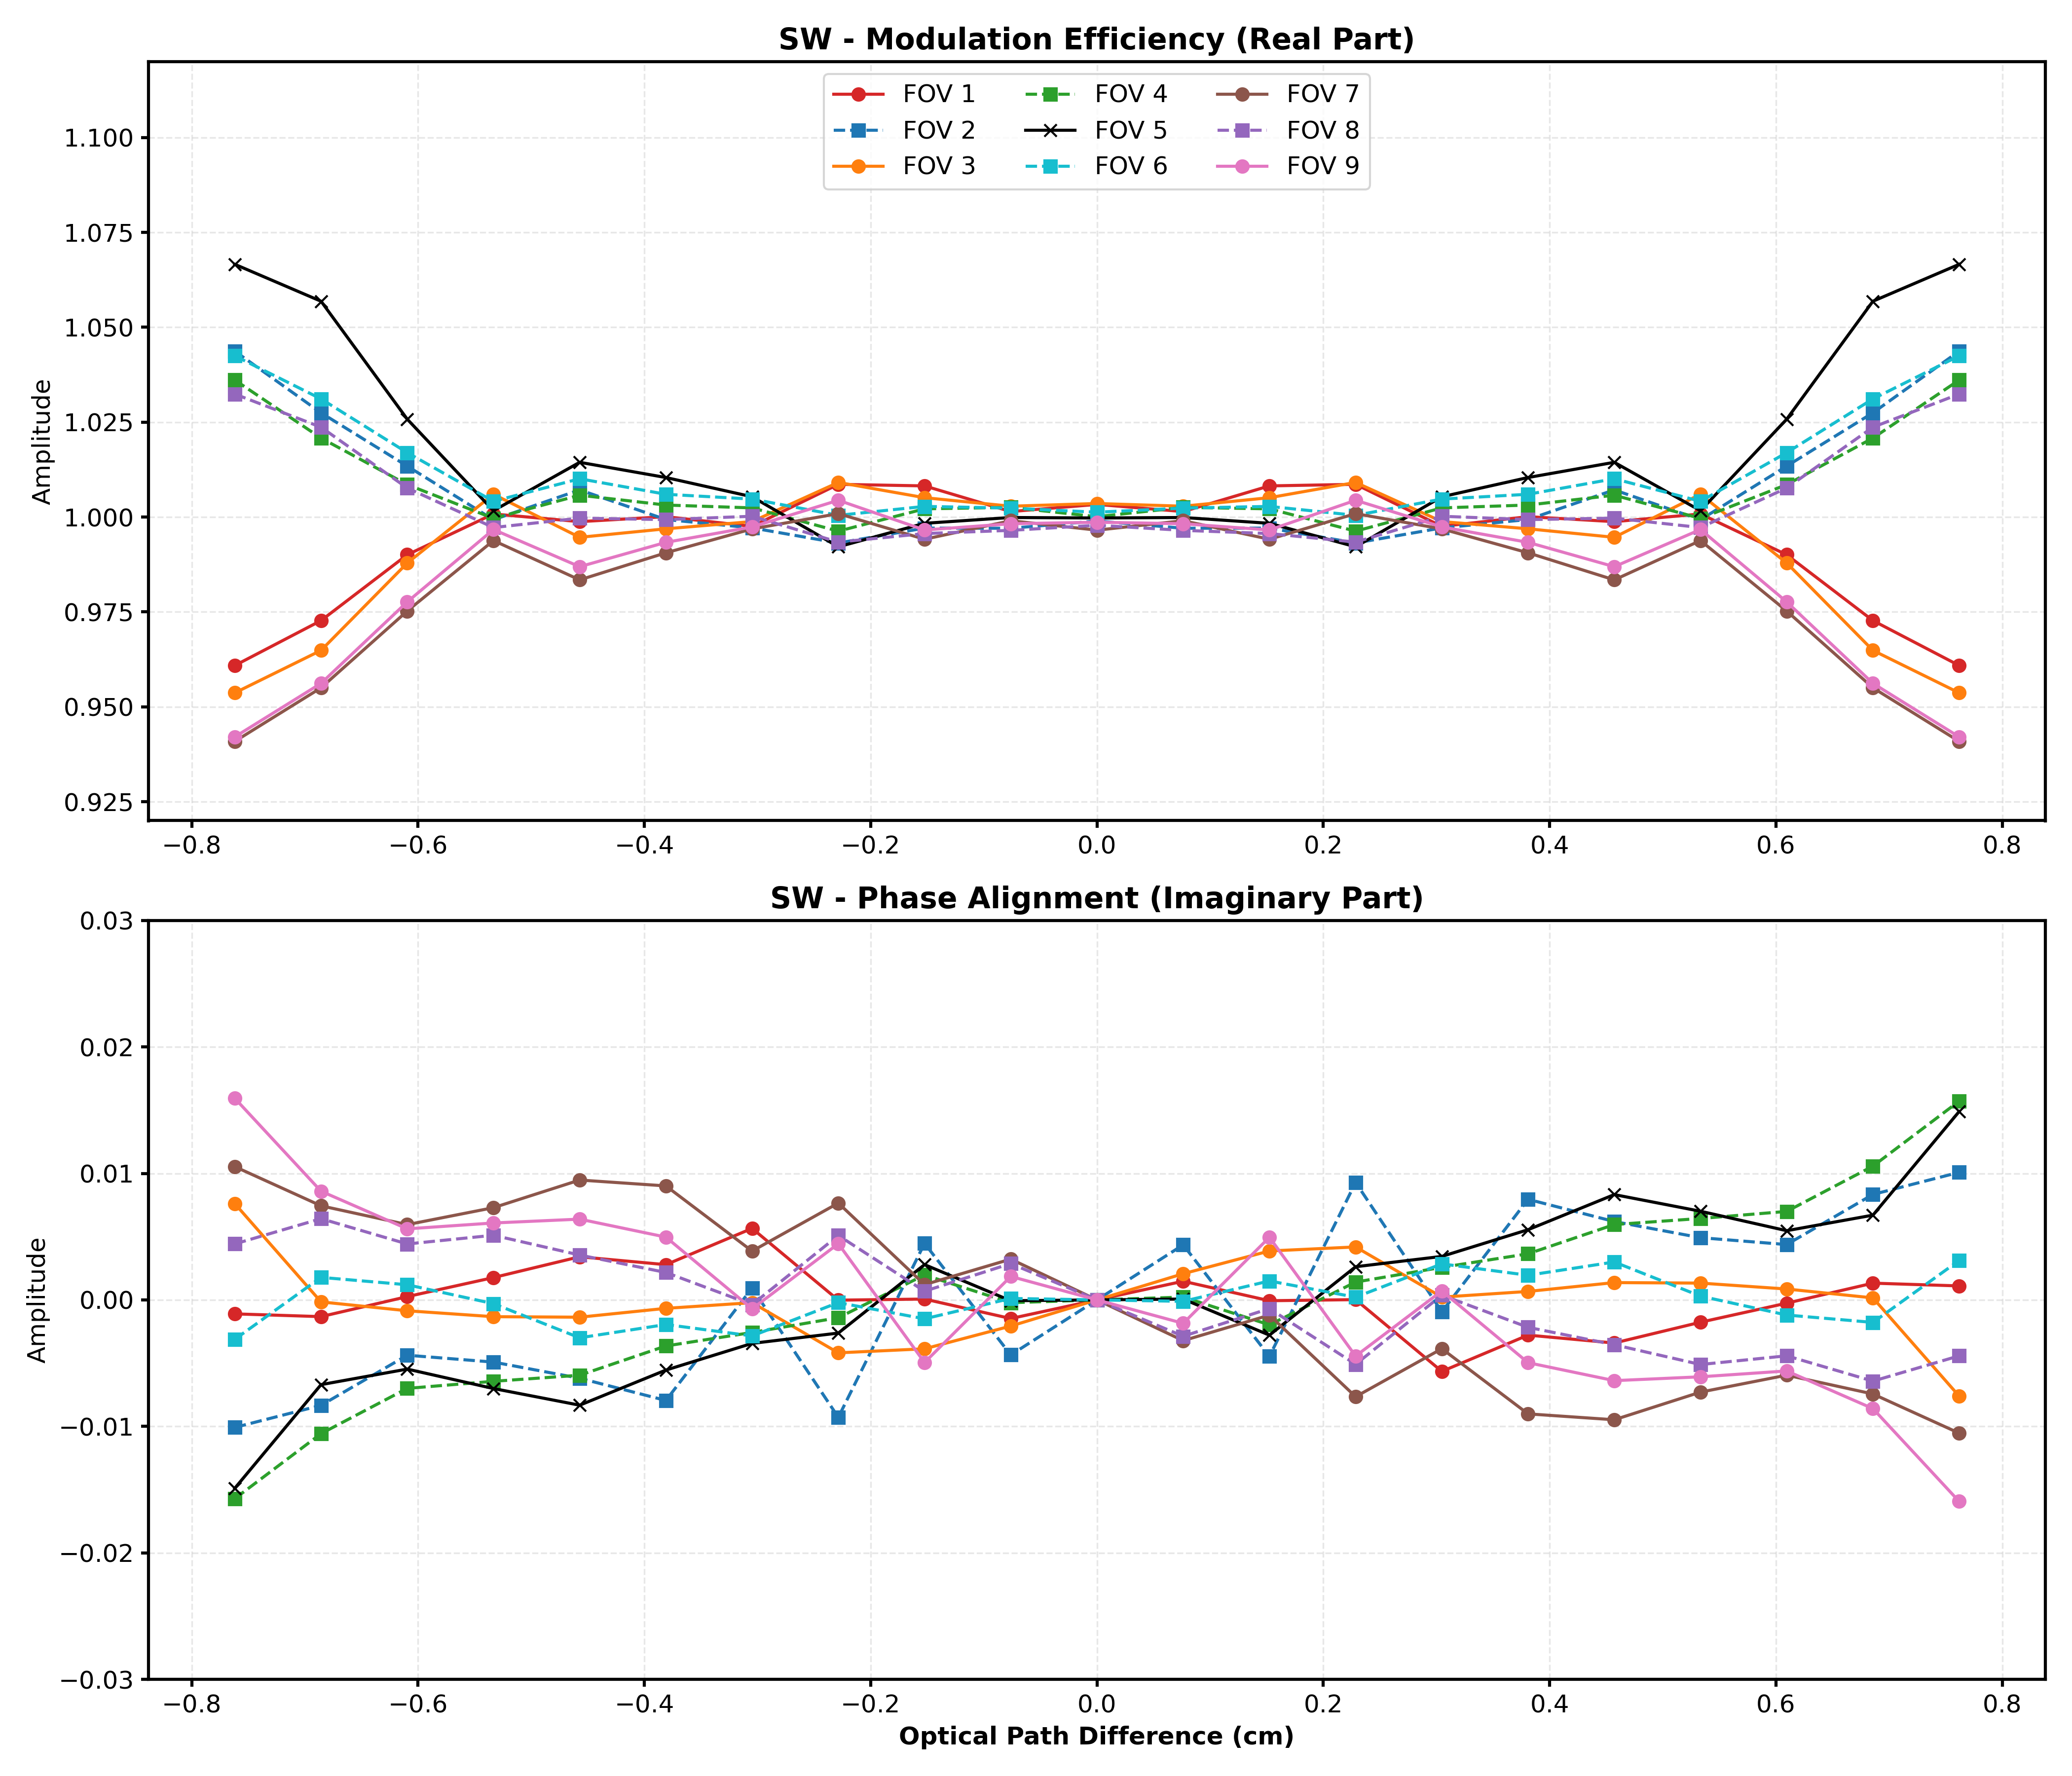
Three Bands together in the Interferogram Domain
(Y in the same scale)
LW Bands
MW Bands
SW Bands
LW and MW (Left and Middle): These look very stable. The Real Part (top) is tight around 1.0, and the Imaginary Part (bottom) is flat and close to zero. This indicates that the Field of Views (FOVs) are very well-aligned and have consistent spectral response functions in these long and mid-wave regions.
SW (Right): The SW band shows the highest divergence between FOVs with three groups . Because SW wavelengths are shorter, the instrument is mathematically more sensitive to tiny physical misalignments in the interferometer.

Slide 11
SW Band: SRF domain relative to FOV5
Corner Group
Side Group
1
2
3
4
5
6
7
8
9
Notes:
"Now, looking at the SRF domain, we see the physical impact of those alignment differences. This plot shows the difference in spectral response for each FOV relative to the center FOV 5. The large oscillations in the middle tell us that the Corner Group detectors—FOVs 1, 3, 7, and 9—see a slightly shifted and broader spectral line than the center. This result is critical because it allows us to quantify exactly how much 'leakage' occurs between adjacent channels for each specific detector in the 3 x3 grids"

Slide 12
SW Band: In the interferogram domain
Center
Side Group
Corner Group
Magnitude: Center > Side > Corner
1
2
3
4
5
6
7
8
9
Notes:
"In this figure, we can see why Band 3 is our most sensitive diagnostic tool. By grouping the FOVs by their physical position on the detector grid, we see a perfect correlation with our mathematical retrieval. The Corner Group, which sits furthest from the center, shows the most signal decay as the interference contrast drops off. Meanwhile, the Center FOV remains the most stable. This pattern proves that our statistical method is correctly capturing the real physical geometry of the instrument while it is orbiting at 7 km/s in space."

Slide 13
Conclusion and Discussion
The EUMETSAT software has been implemented to check CrIS FOV spectral response differences.
It is found that the FOVs in MW and LW bands well agree each other. But the FOVs in the SMIR band form into three different groups.
Discussion
  How can this method or findings help for CrIS SWIR band calibration? Monitoring? Diagnosing?

