Slide 1
FY-4C satellite overview and commission status
Chengli Qi¹⁾，Feng Lu¹⁾, Lu Lee¹⁾, Zhiwei Wang¹⁾,
Xingwei He¹⁾, Lei Yang¹⁾, Shihao Tang¹⁾, Liguo Zhang²⁾, Xiaojie Chen²⁾
¹⁾National Satellite Meteorological Center, CMA
²⁾ China National Space Administration

Slide 2
Outlines
FY-4C overview
Commission test and current status
Prelimitary test results and images
Next work

Slide 3
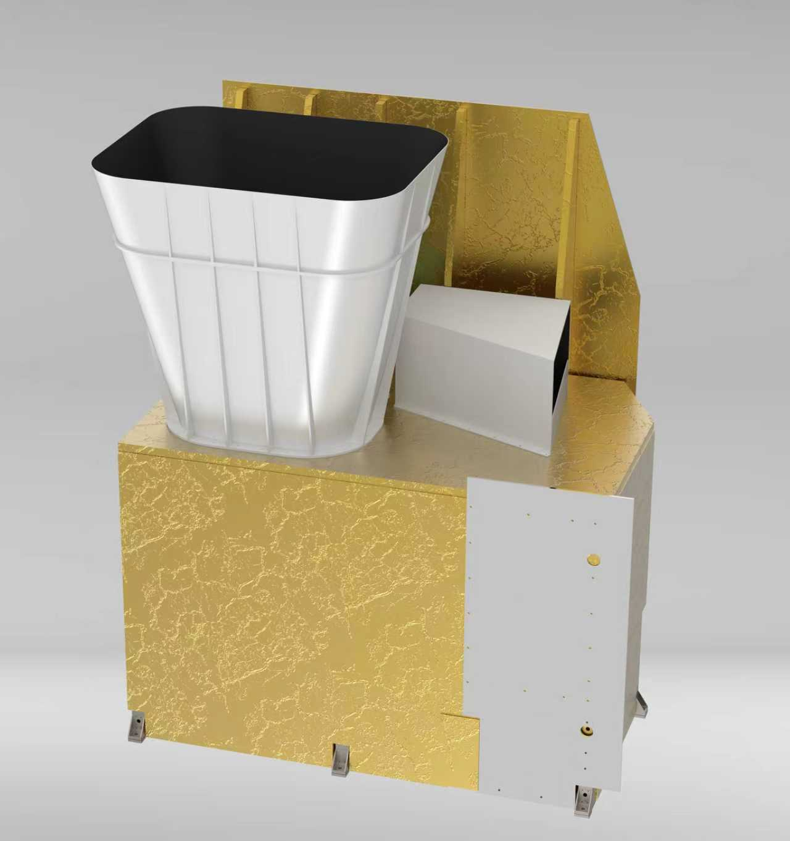
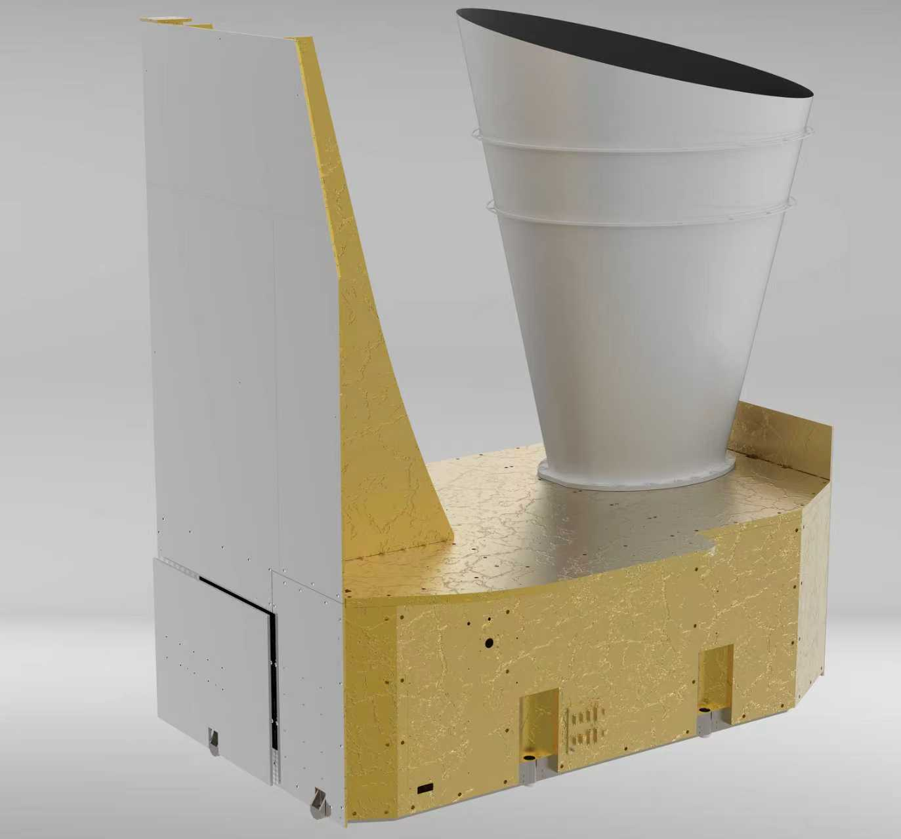
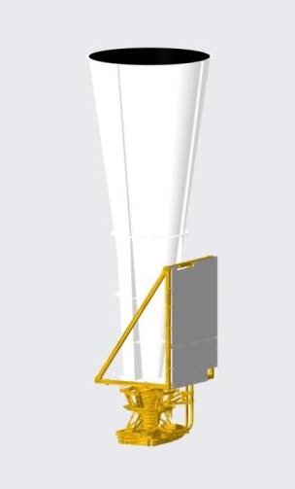
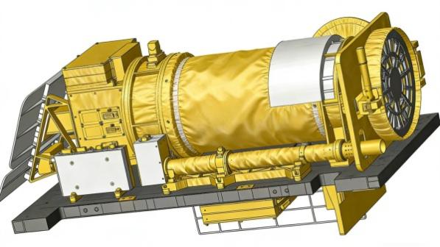
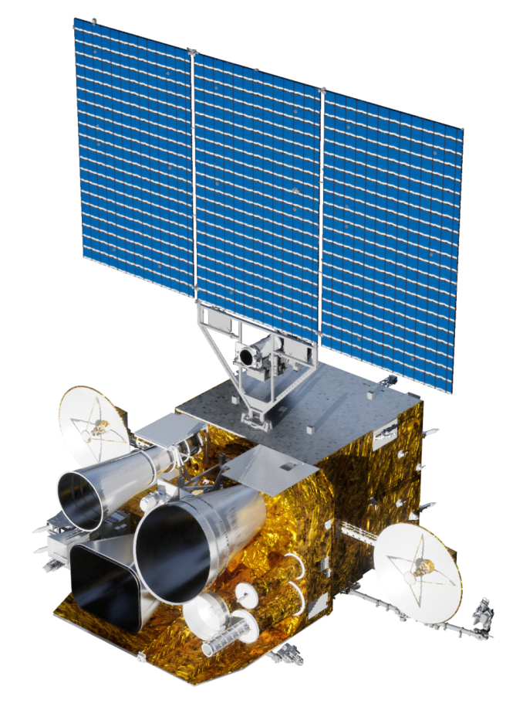
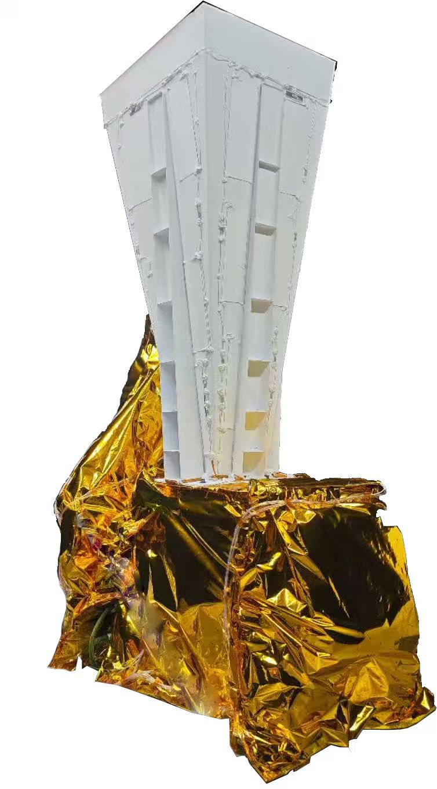
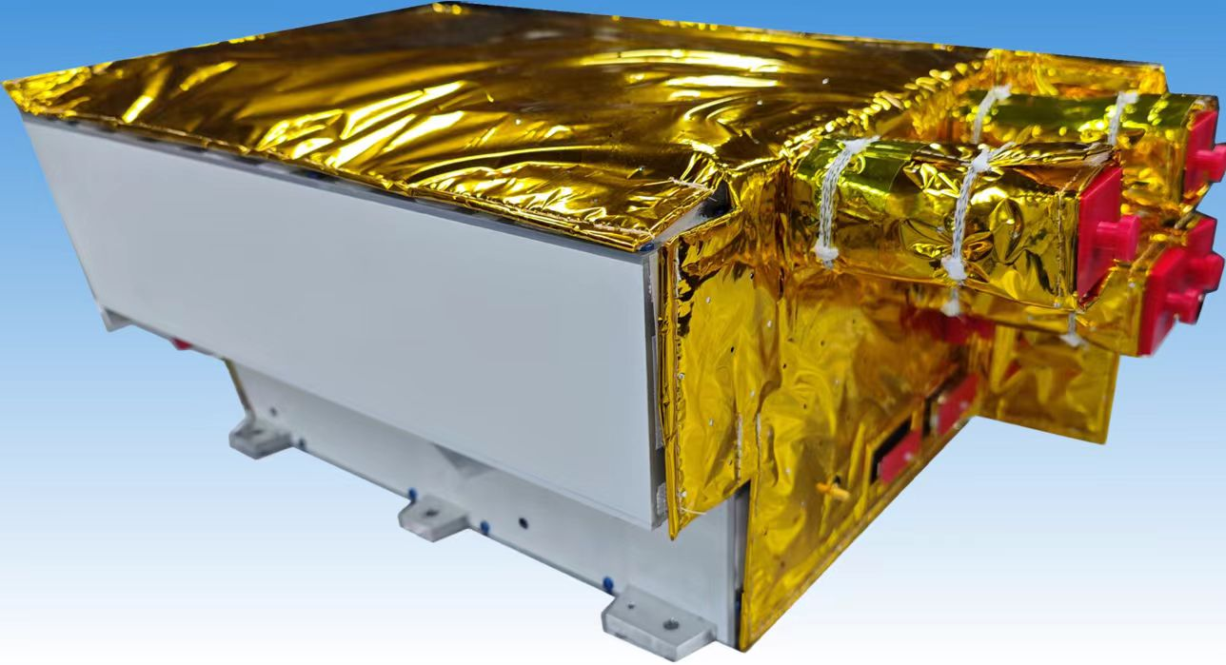
FY-4C overview
AGRI
GIIRS
FY-4C is the second operational satellite in the FY-4 (Batch 02) series. The platform and payloads have been fully upgraded.
It is equipped with a total of 6 payloads, including the Advanced Geostationary Radiation Imager (AGRI), the Geostationary Interferometric Infrared Sounder (GIIRS), the Lightning Mapping Imager (LMI), the Solar Extreme Ultraviolet Imager (SUVI), the Solar X-ray/EUV Monitor (SXUS), and the Multiband Ionospheric Ultraviolet Spectroscopic Imager (MUSI).
It was launched on December 27, 2025.
SUVI
测试目的
LMI
MUSI
SXUS

Slide 4
FY-4C overview
 | FY-4A(EXP) | FY-4B(OP) | FY-4C(OP)
Observation Mode | Imaging +Sounding + Lightning Mapping | Imaging +Sounding | Imaging +Sounding + Lightning Mapping+Solar Imaging
Main Instruments | AGRI :14 channels SSP Resolution：0.5~4Km Fulldisk imaging：15min | AGRI :15 channels SSP Resolution：0.5~4Km Fulldisk imaging：15min | AGRI :19channels SSP Resolution：0.25~2Km 10min：one Fulldisk+10regional
 |  | GHI：7 channels SSP Resolution 0.25-2Km,Regional imaging :1min
 | GIIRS: SSP Resolution:16Km, VIS: 2km Repeat cycle: 2h Spectral Resolution: 0.625cm-1 | GIIRS: SSP Resolution:12Km, VIS: 1km Repeat cycle: 2h Spectral Resolution: 0.625cm-1 | GIIRS: SSP Resolution:8Km, VIS: 0.5km Repeat cycle: 1h Spectral Resolution: 0.625cm-1
 | LMI： SSP Resolution:7.8Km,regional imaging | / | LMI： SSP Resolution: 8Km, Nearly Fulldisk imaging
 | SEP High energy particles | SEP High energy particles,Magnetic field | SUVI Solar-Extreme Ultraviolet imager
 | / | / | SXUS Solar X-EUV Irradiance Sensor
 | / | / | MUSI Multiband Ionospheric Ultra-Violet Spectrum Imager

Slide 5
Commission test and current status
On Jan 2, the Lightning Mapping Imager (LMI) was the first instrument to be activated.
On Jan 3, the Advanced Geostationary Radiation Imager (AGRI) Solar bands and GIIRS VIS band was successfully activated. AGRI operated routine 10-minute observation tasks .
On 26 Feb, AGRI IR detector was powered, 3 space weather instruments of SUVI, SXUS, MUSI powered on 25 & 26 Feb.
On 27 Feb, GIIRS IR interferometer activated . Three days of optical allignment were conducted. Earth observation started on March 1.
Since the activation of all instruments, special tests and experiments have been carried out, alongside in-orbit testing of instrument functions and performance commission test.

Slide 6
Commission test and current status
03
Application System（T0+9，T0+12)
Test the interface and operational workflow for satellite data access into the application system.
Test the application capability of the satellite in multiple operational fields, including weather forecasting, NWP, climatology, real-time monitoring, environmental disasters.
Formulate the FY-4C Application System On-Orbit Test Summary Report.
Test Tasks and Timeline
Timeline
01
02
Satllite Platform（T0，T0+6)
On-Ground System（T0+6，T0+9)
Test the satellite platform, payload functions, performance specifications and stability;
Test and adjust the matching status of the satellite-ground interface;
Formulate the FY-4C Satellite System On-Orbit Test Summary Report.
Test the workflow, timeliness and operational success rate of the ground main operational system;
Test the quality status of L1 and typical L2 products;
Carry out necessary updates of L1 and L2 processing algorithms and parameters;
Formulate the FY-4C Ground System On-Orbit Test Summary Report.
6

Slide 7
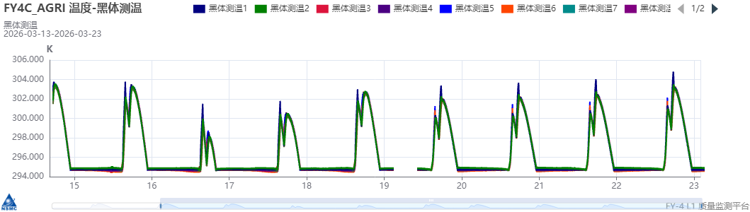
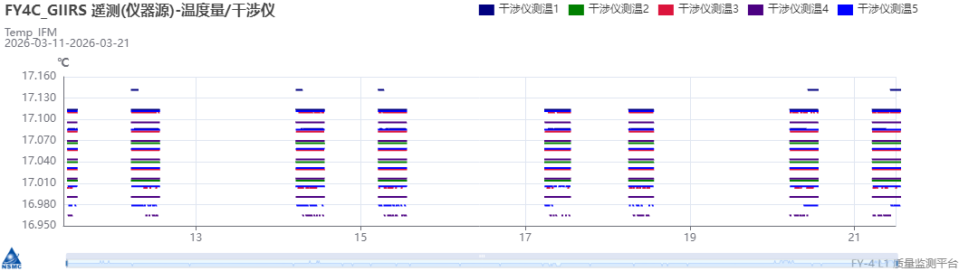
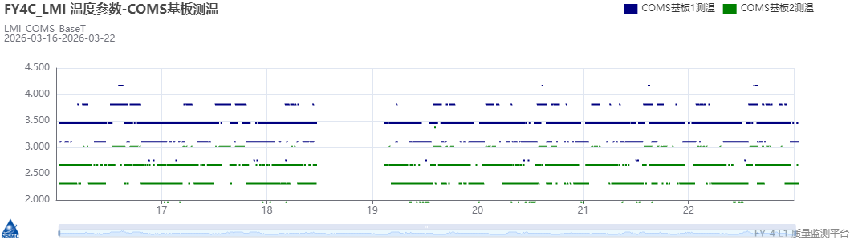
Prelimitary test results and images
Instrument Performance and L1 Product Monitoring System
AGRI Instrument status parameter monitoring（BB temperature diurnal variation）
GIIRS Instrument status parameter monitoring（Interferometer temperature）
LMI Instrument status parameter monitoring（COMS baseplate temperature）
Notes:
Group members are encouraged to test the software provided by EUMETSAT to evaluate pixel or field-of-view (FOV) differences. EUMETSAT has kindly agreed to share the software. A web meeting will be scheduled to report on progress.

Slide 8
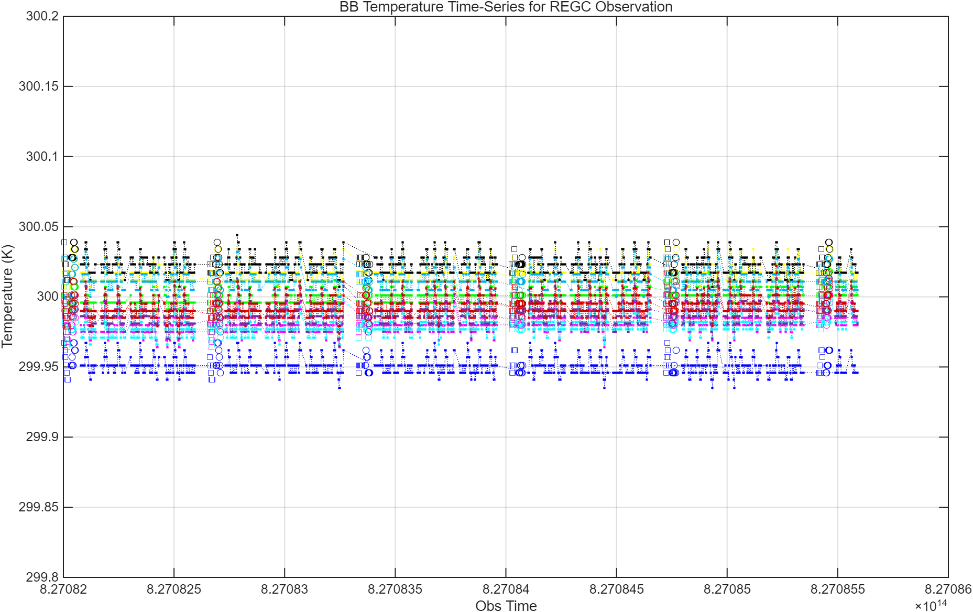
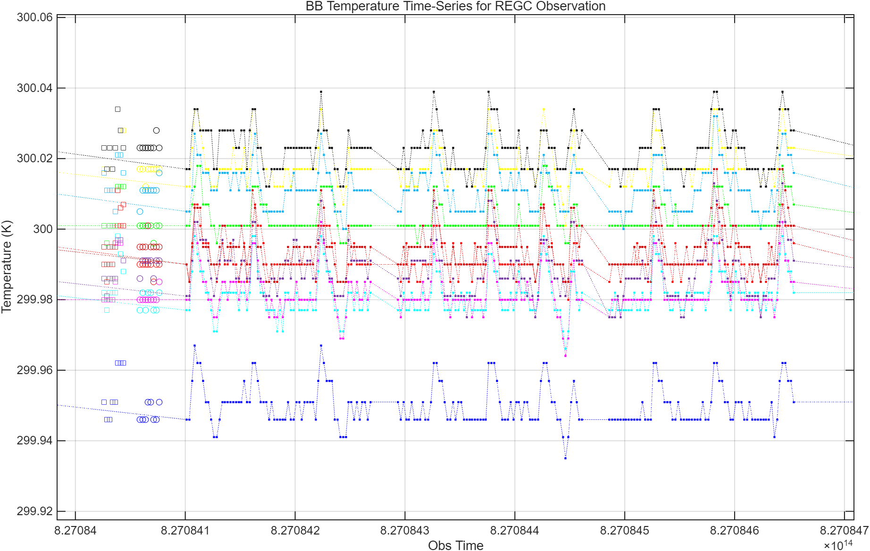
Prelimitary test results and images
挑选几项典型、已完成的功能、性能测试项，给出测试结果（图、表），指标，结论（是否满足）
Time series of blackbody temperature for GIIRS within 1 hour (05:00–06:00 UTC, 18 March 2026):
The peak-to-peak relative deviation of temperatures at the 10 PRTs on the BB does not exceed 0.1 K,
The nighttime uniformity and stability of the BB temperature are to be evaluated.

Slide 9
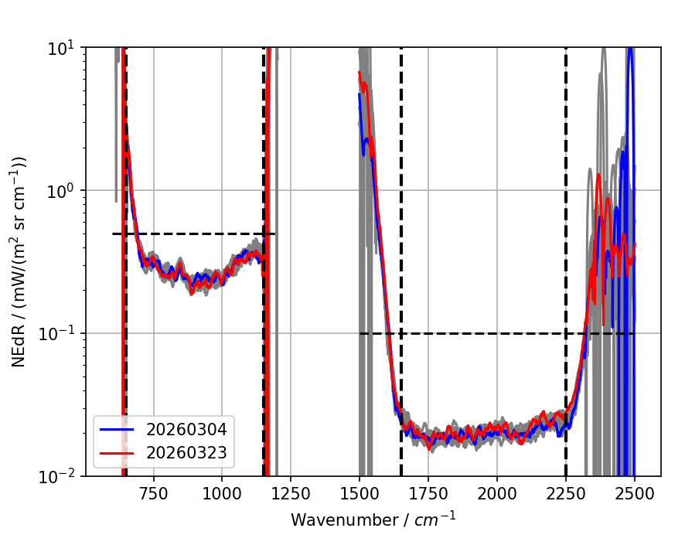
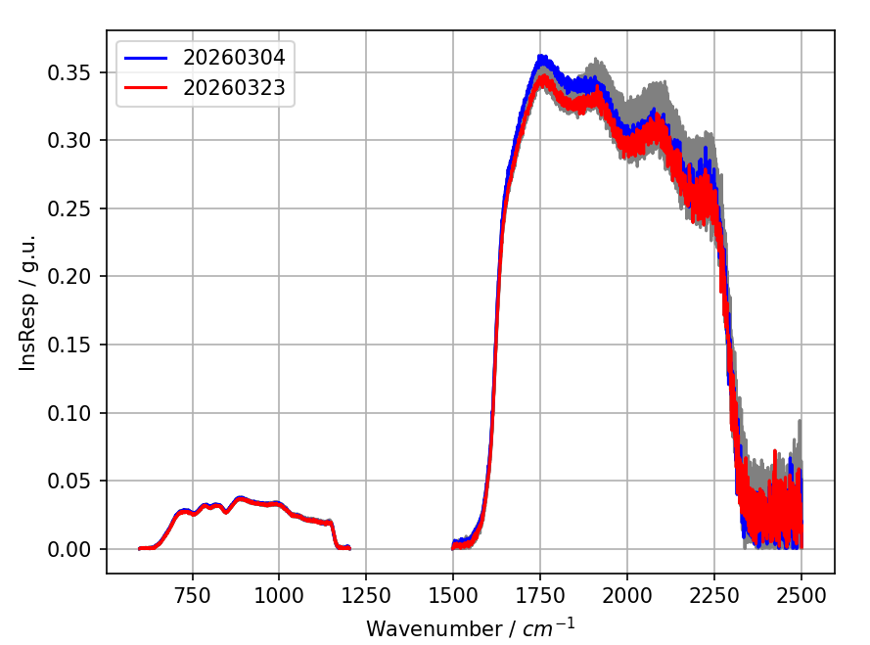
Prelimitary test results and images
Since the activation of the FY-4C/GIIRS infrared detector on 2026-03-04, spectral responsivity and sensitivity spectra have been continuously monitored (represented by the central pixel Pixel [32, 32]).
No obvious absorption attenuation, as observed in FY-4B/GIIRS.
Long-term tracking and monitoring will still be required in the follow-up work.

Slide 10
Prelimitary test results and images
band | NETD(K)@300K
 | Requirement | Pre-launch test mean | On-orbit test |  |  | result
 |  |  | mean | min | max
B10(3.50~4.00μm) | ≤0.2K | 0.11(TDI) | 0.11(TDI) | 0.09(TDI) | 0.20(TDI) | meet
B11(3.972~4.127μm) | ≤0.5K | 0.17(TDI) | 0.17(TDI) | 0.15(TDI) | 0.23(TDI) | meet
B12(5.80~6.70μm) | 0.1K~0.2K | 0.017 | 0.018 | 0.016 | 0.020 | meet
B13(6.75~7.15μm) | 0.1K~0.25K | 0.021 | 0.022 | 0.020 | 0.026 | meet
B14(7.24~7.60μm) | 0.1K~0.25K | 0.031 | 0.033 | 0.030 | 0.036 | meet
B15(8.30~8.80μm) | 0.1K~0.25K | 0.026 | 0.024 | 0.021 | 0.028 | meet
B16(9.42~9.80μm) | 0.1K~0.2K | 0.029 | 0.031 | 0.027 | 0.038 | meet
B17(10.30~11.30μm) | 0.1K~0.2K | 0.040 | 0.032 | 0.007 | 0.058 | meet
B18(11.50~12.50μm) | 0.1K~0.2K | 0.045 | 0.045 | 0.032 | 0.073 | meet
B19(13.00~13.60μm) | 0.3K~0.5K | 0.070 | 0.069 | 0.045 | 0.198 | meet
NETD @300K
band | NETD(K)@240K
 | Requirement | Pre-launch test mean | On-orbit test |  |  | result
 |  |  | mean | min | max
B10(3.50~4.00μm) | ≤2.0K | 0.61(TDI) | 0.67(TDI) | 0.41(TDI) | 0.99(TDI) | meet
B11(3.972~4.127μm) | ≤2.0K(@270K) | 0.37(TDI) | 0.38(TDI) | 0.26(TDI) | 0.50(TDI) | meet
B12(5.80~6.70μm) | 0.4K~0.9K | 0.067 | 0.069 | 0.063 | 0.077 | meet
B13(6.75~7.15μm) | 0.4K~1.2K | 0.065 | 0.068 | 0.062 | 0.078 | meet
B14(7.24~7.60μm) | 0.4K~1.2K | 0.094 | 0.098 | 0.086 | 0.100 | meet
B15(8.30~8.80μm) | 0.4K~1.2K | 0.057 | 0.053 | 0.041 | 0.063 | meet
B16(9.42~9.80μm) | 0.4K~0.9K | 0.059 | 0.063 | 0.056 | 0.079 | meet
B17(10.30~11.30μm) | 0.4K~0.9K | 0.080 | 0.066 | 0.051 | 0.116 | meet
B18(11.50~12.50μm) | 0.4K~0.9K | 0.066 | 0.067 | 0.051 | 0.107 | meet
B19(13.00~13.60μm) | 0.8K~2.0K | 0.107 | 0.109 | 0.070 | 0.311 | meet
NETD @240K/270K

Slide 11
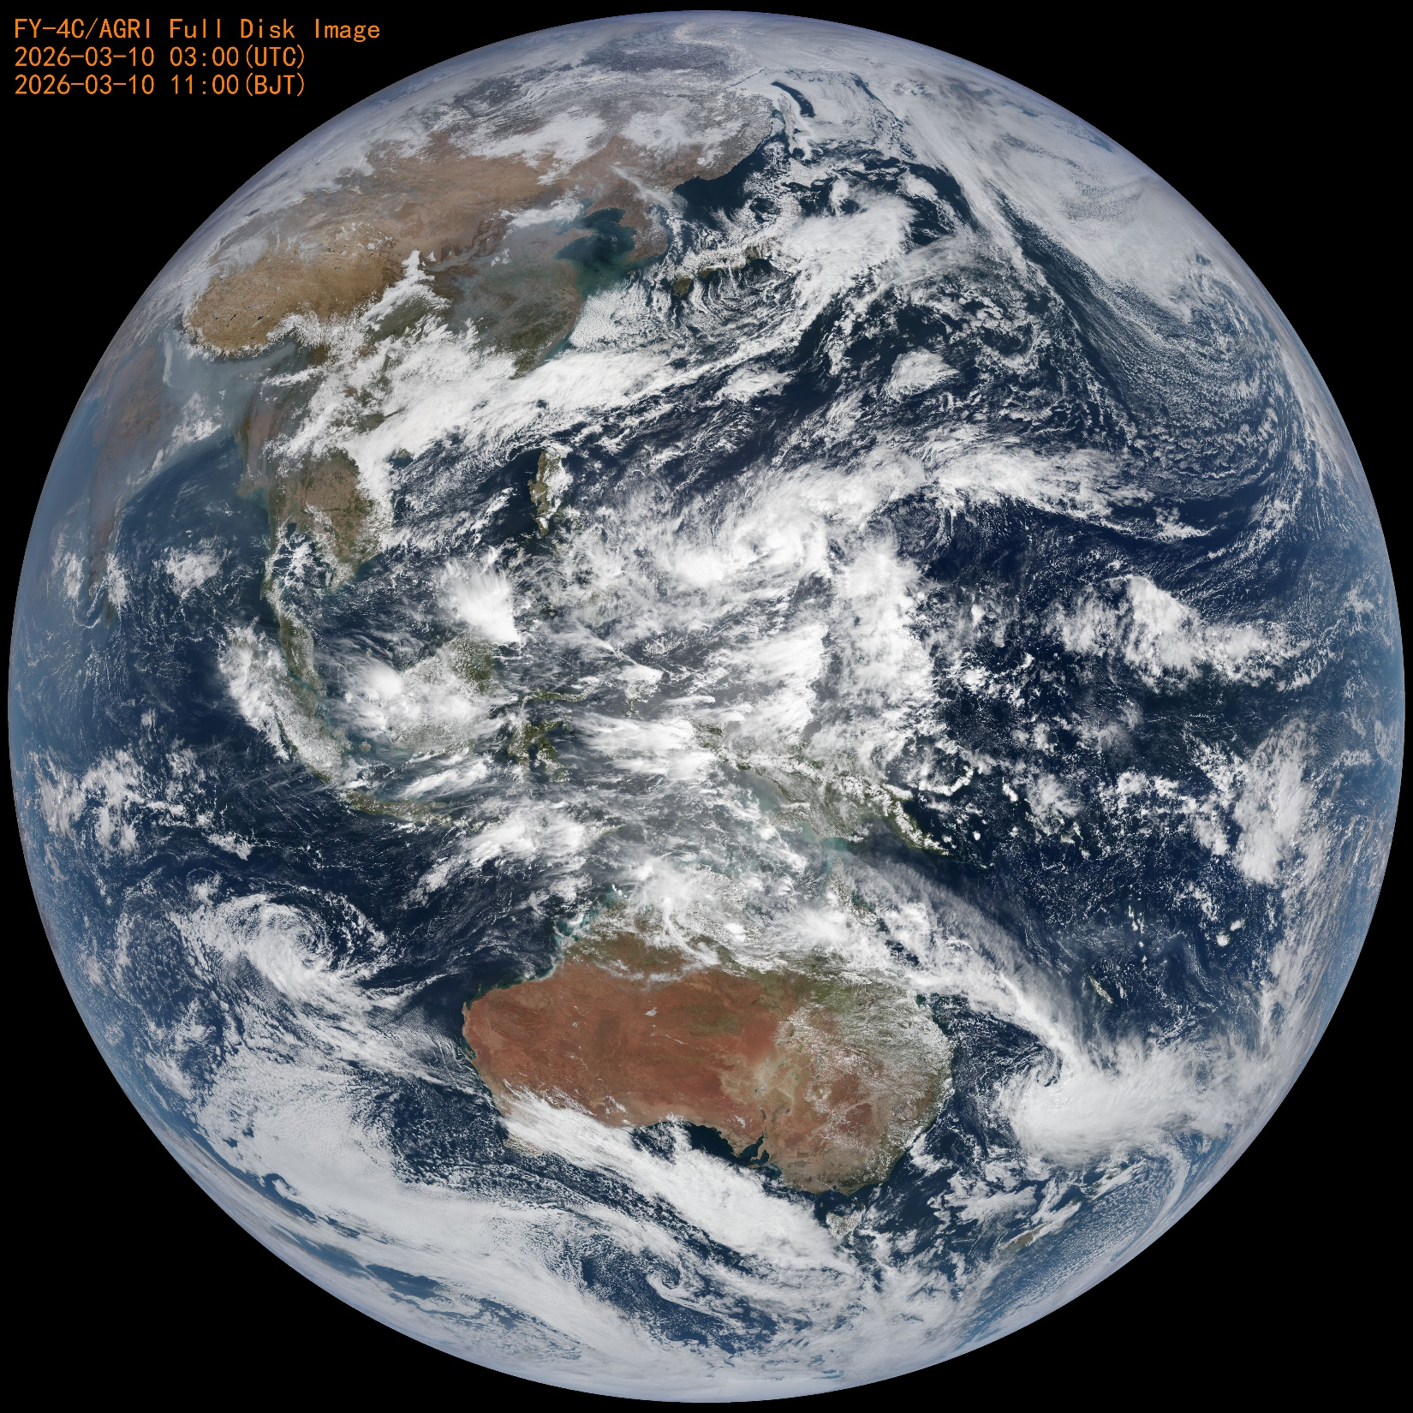
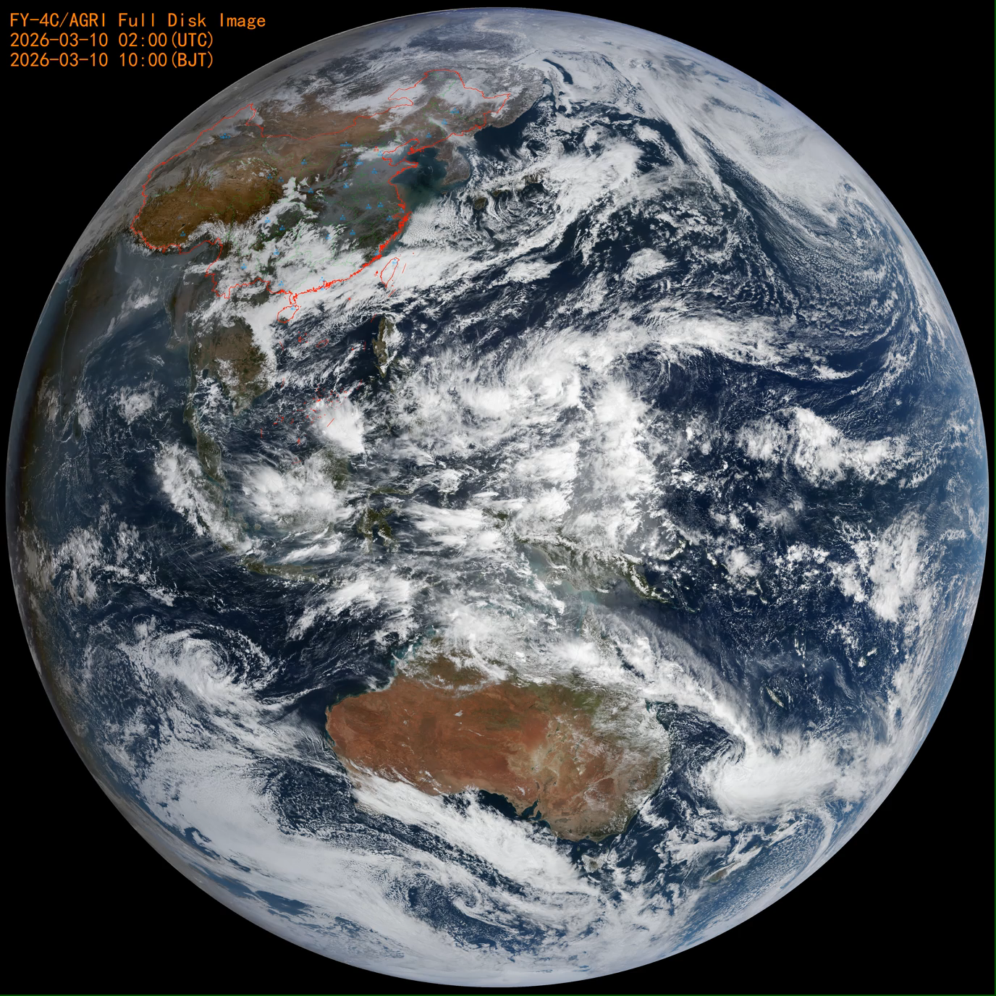
AGRI RGB IMAGE (500m)
Notes:
Group members are encouraged to test the software provided by EUMETSAT to evaluate pixel or field-of-view (FOV) differences. EUMETSAT has kindly agreed to share the software. A web meeting will be scheduled to report on progress.

Slide 12
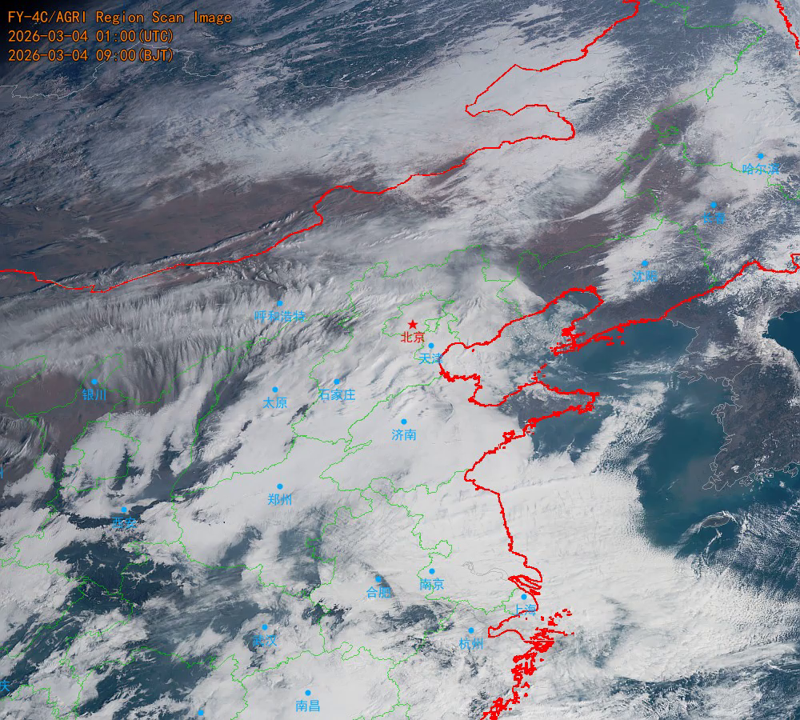
AGRI 1 Minute Regional True-Color Image (RGB)
North China Rain and Snow monitoring image on March 4，2026

Slide 13
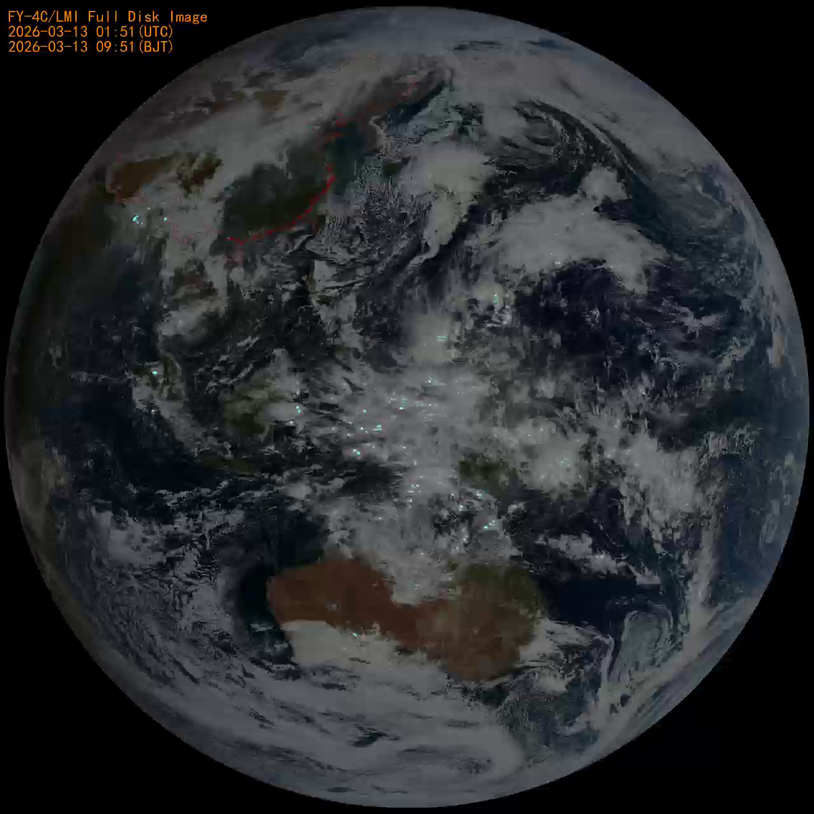
FY-4C Lightning Mapping Imager Observation Image

Slide 14
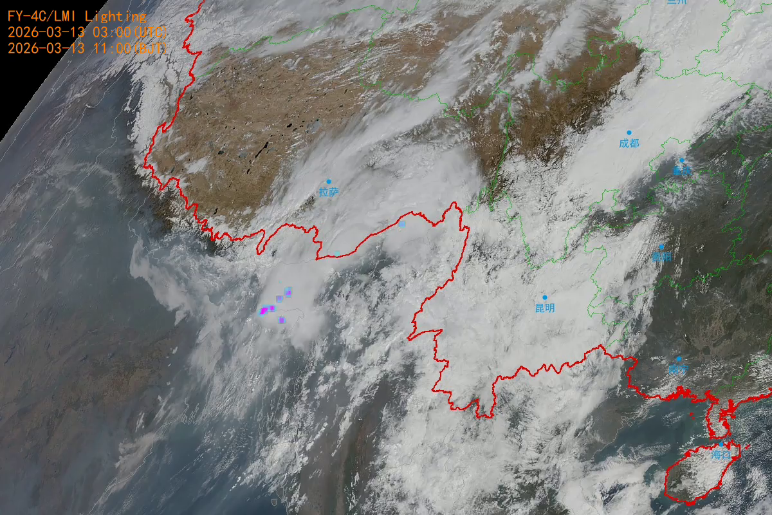
Zoom in on the lightning event map of Bangladesh, South Asia

Slide 15
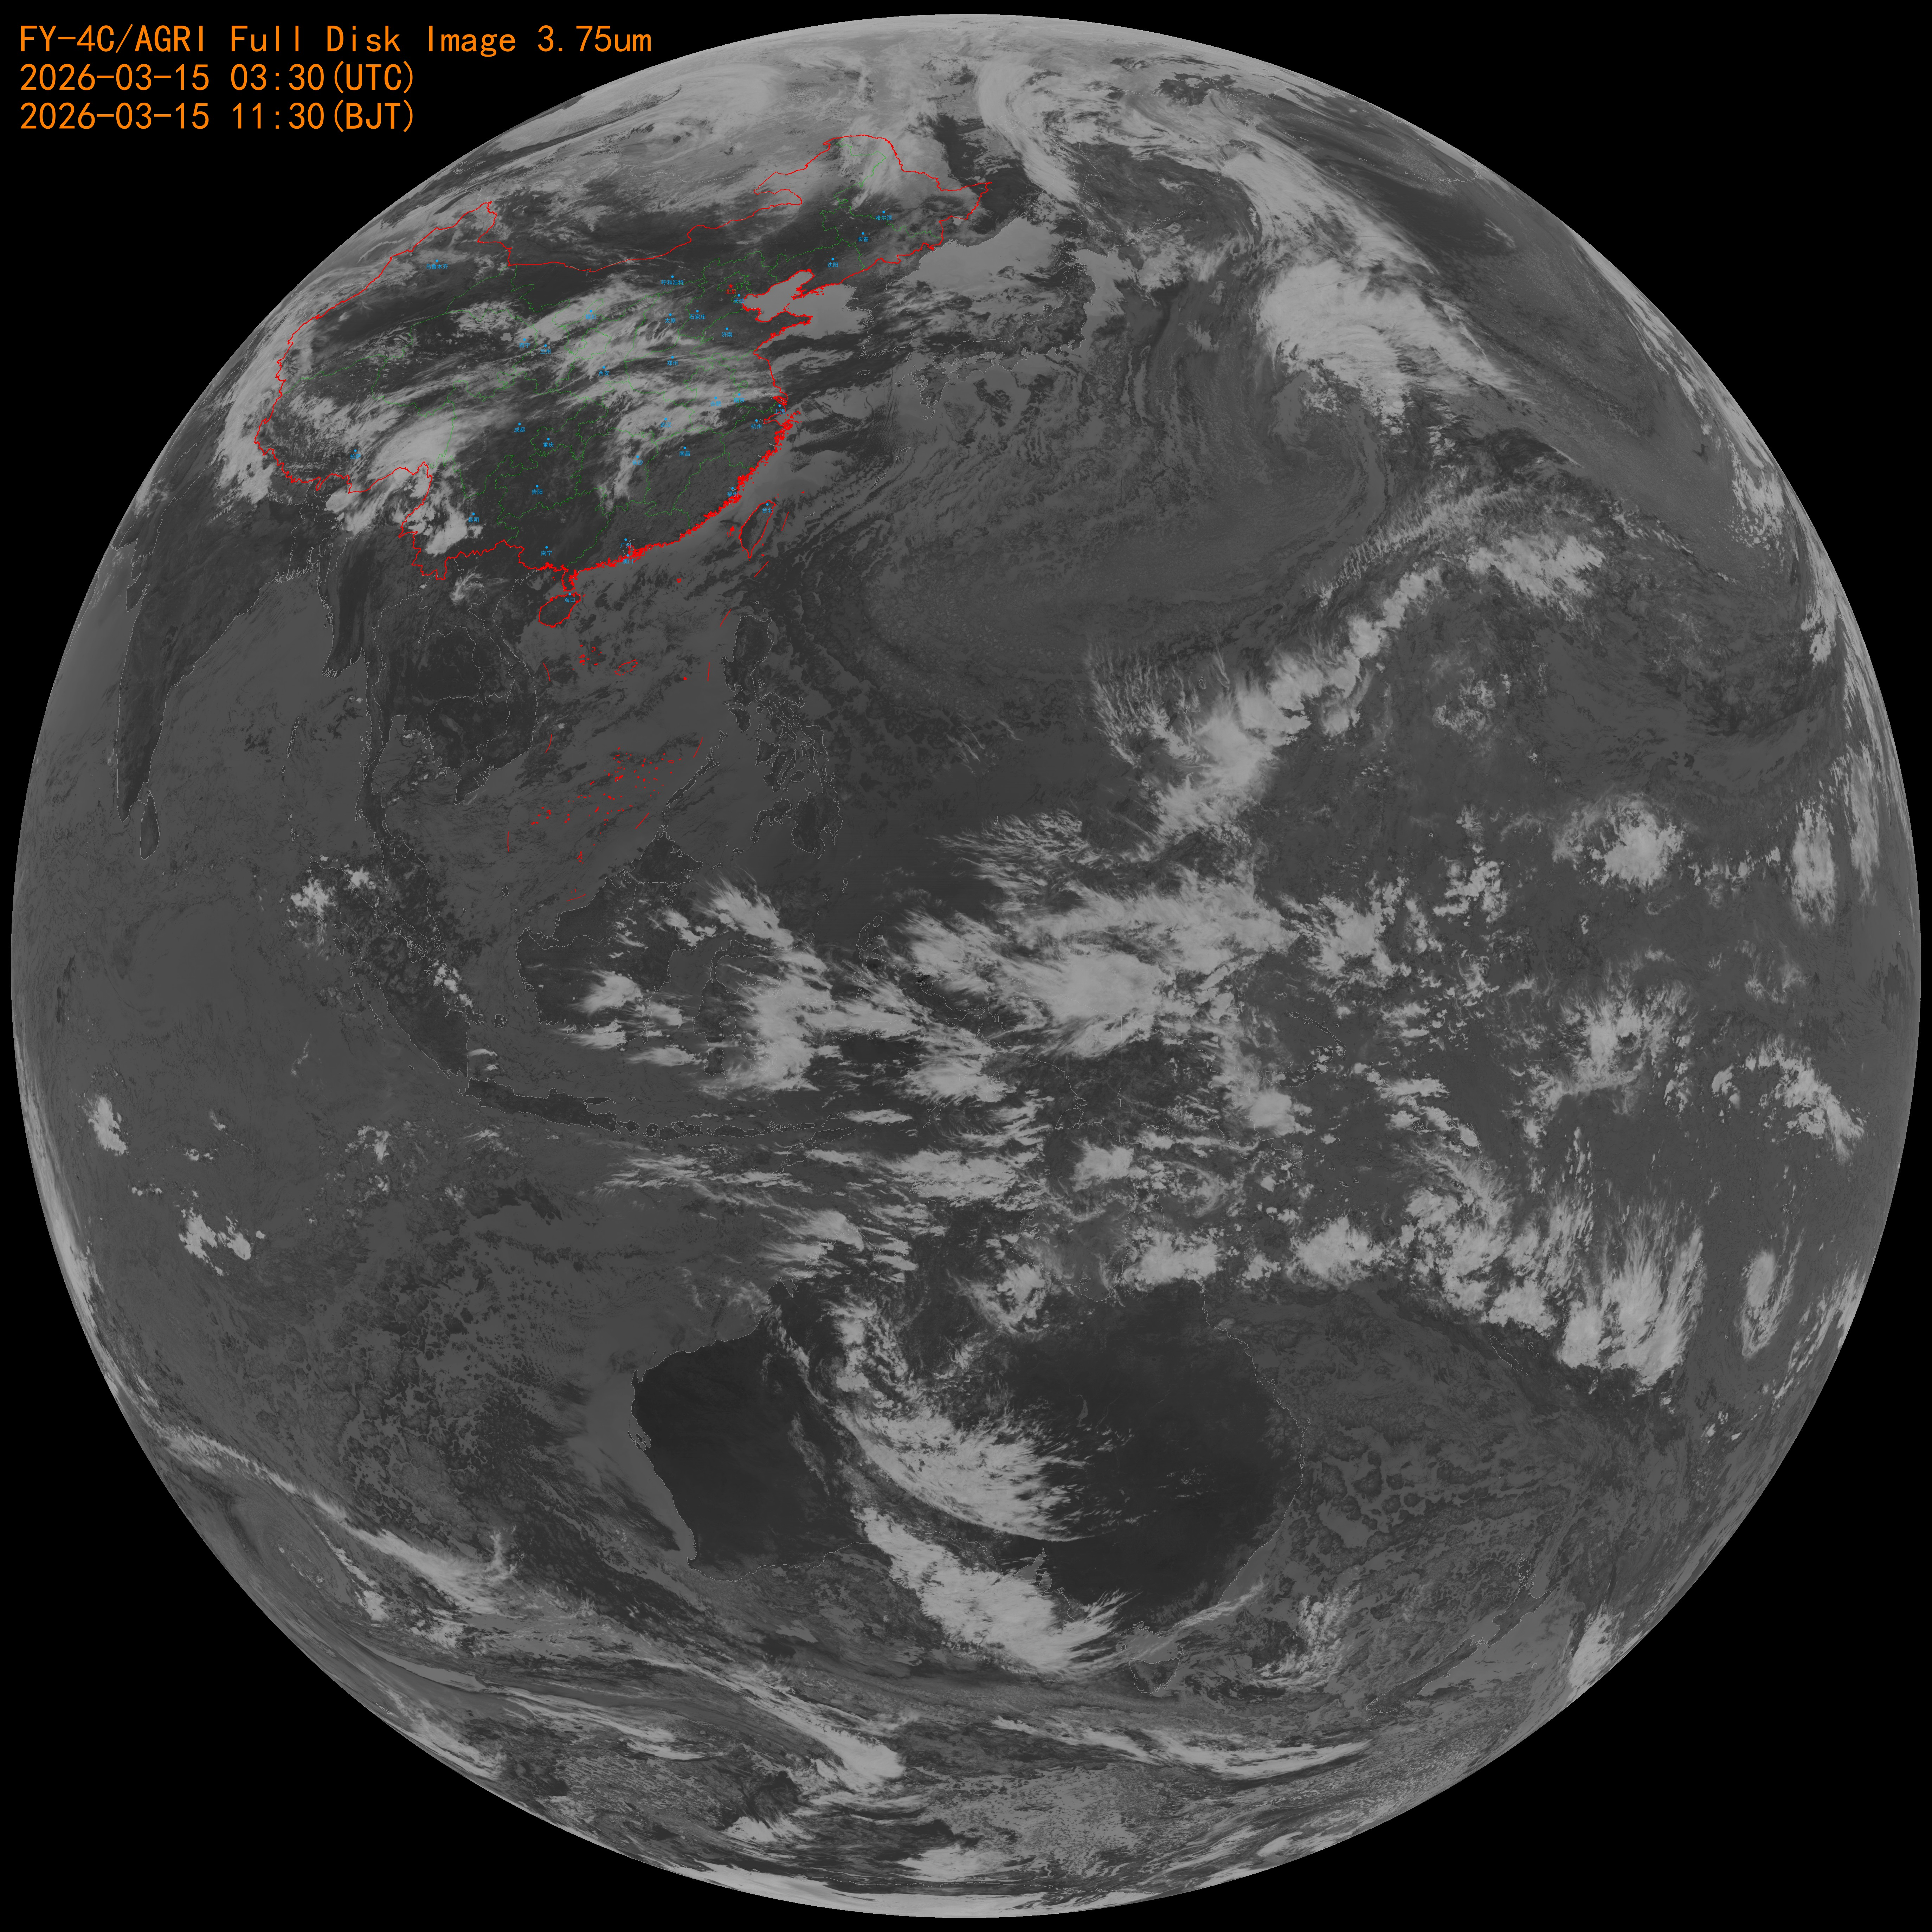
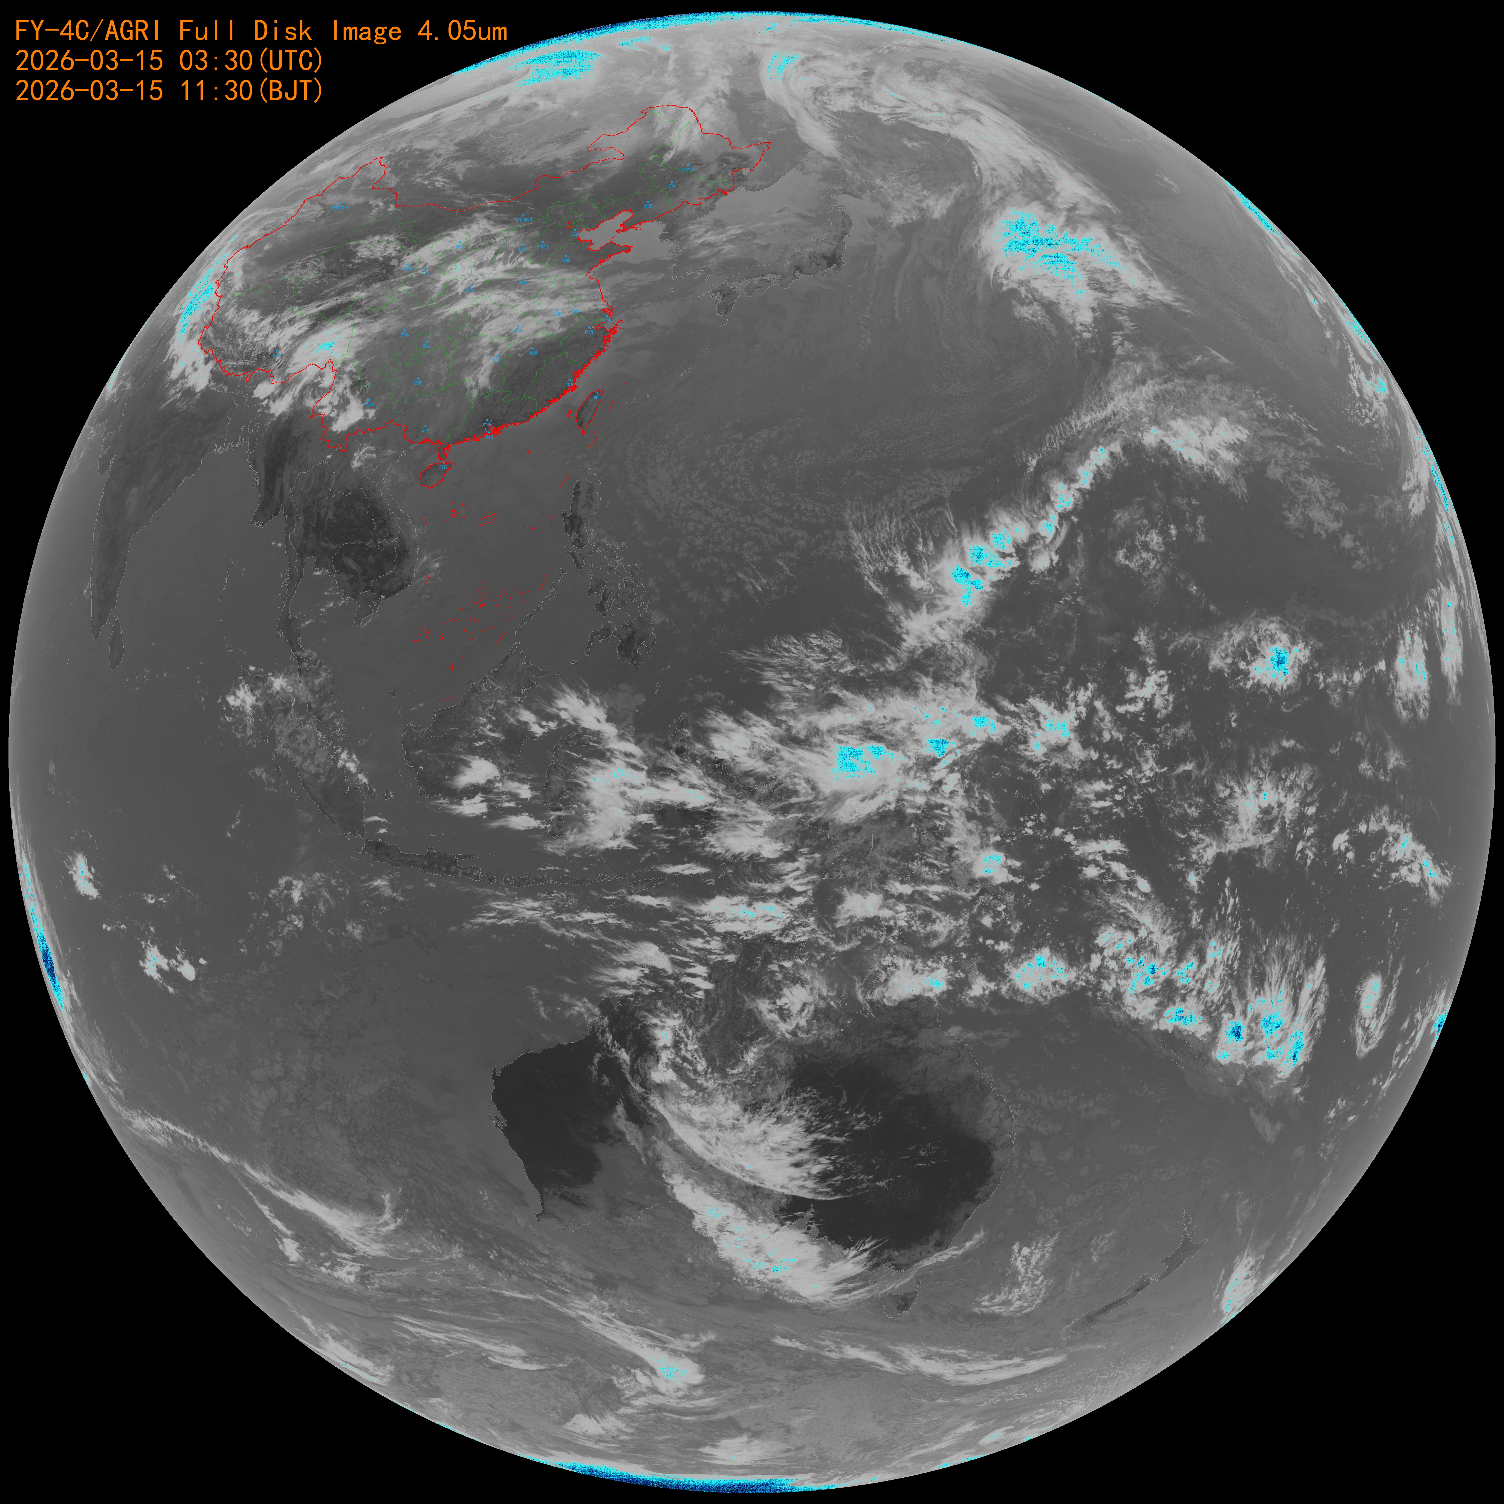
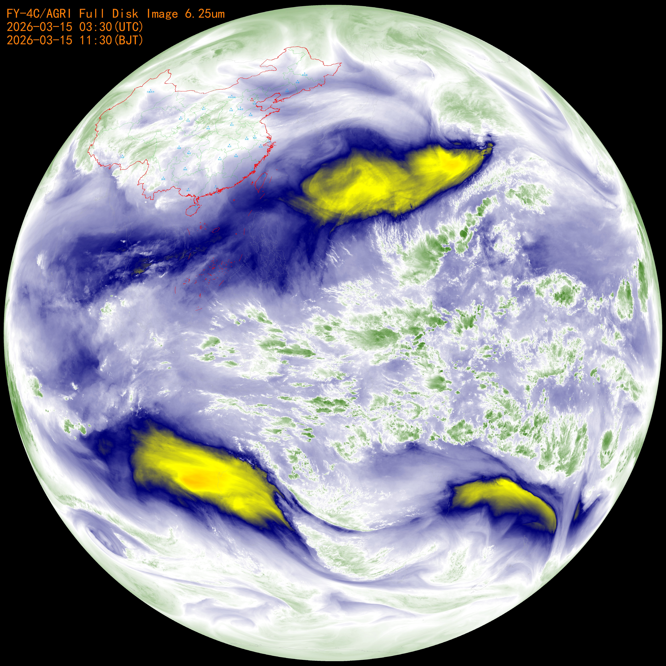
AGRI 10个通道长波红外全圆盘图
CH10 3.75μm
CH11 4.05μm
CH12 6.25μm

Slide 16
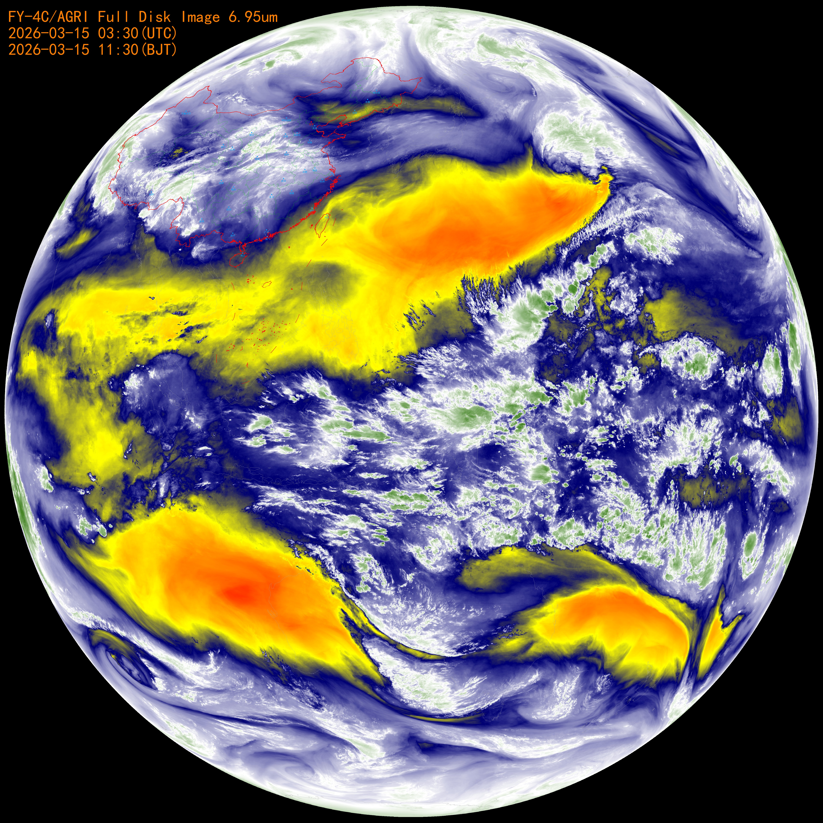
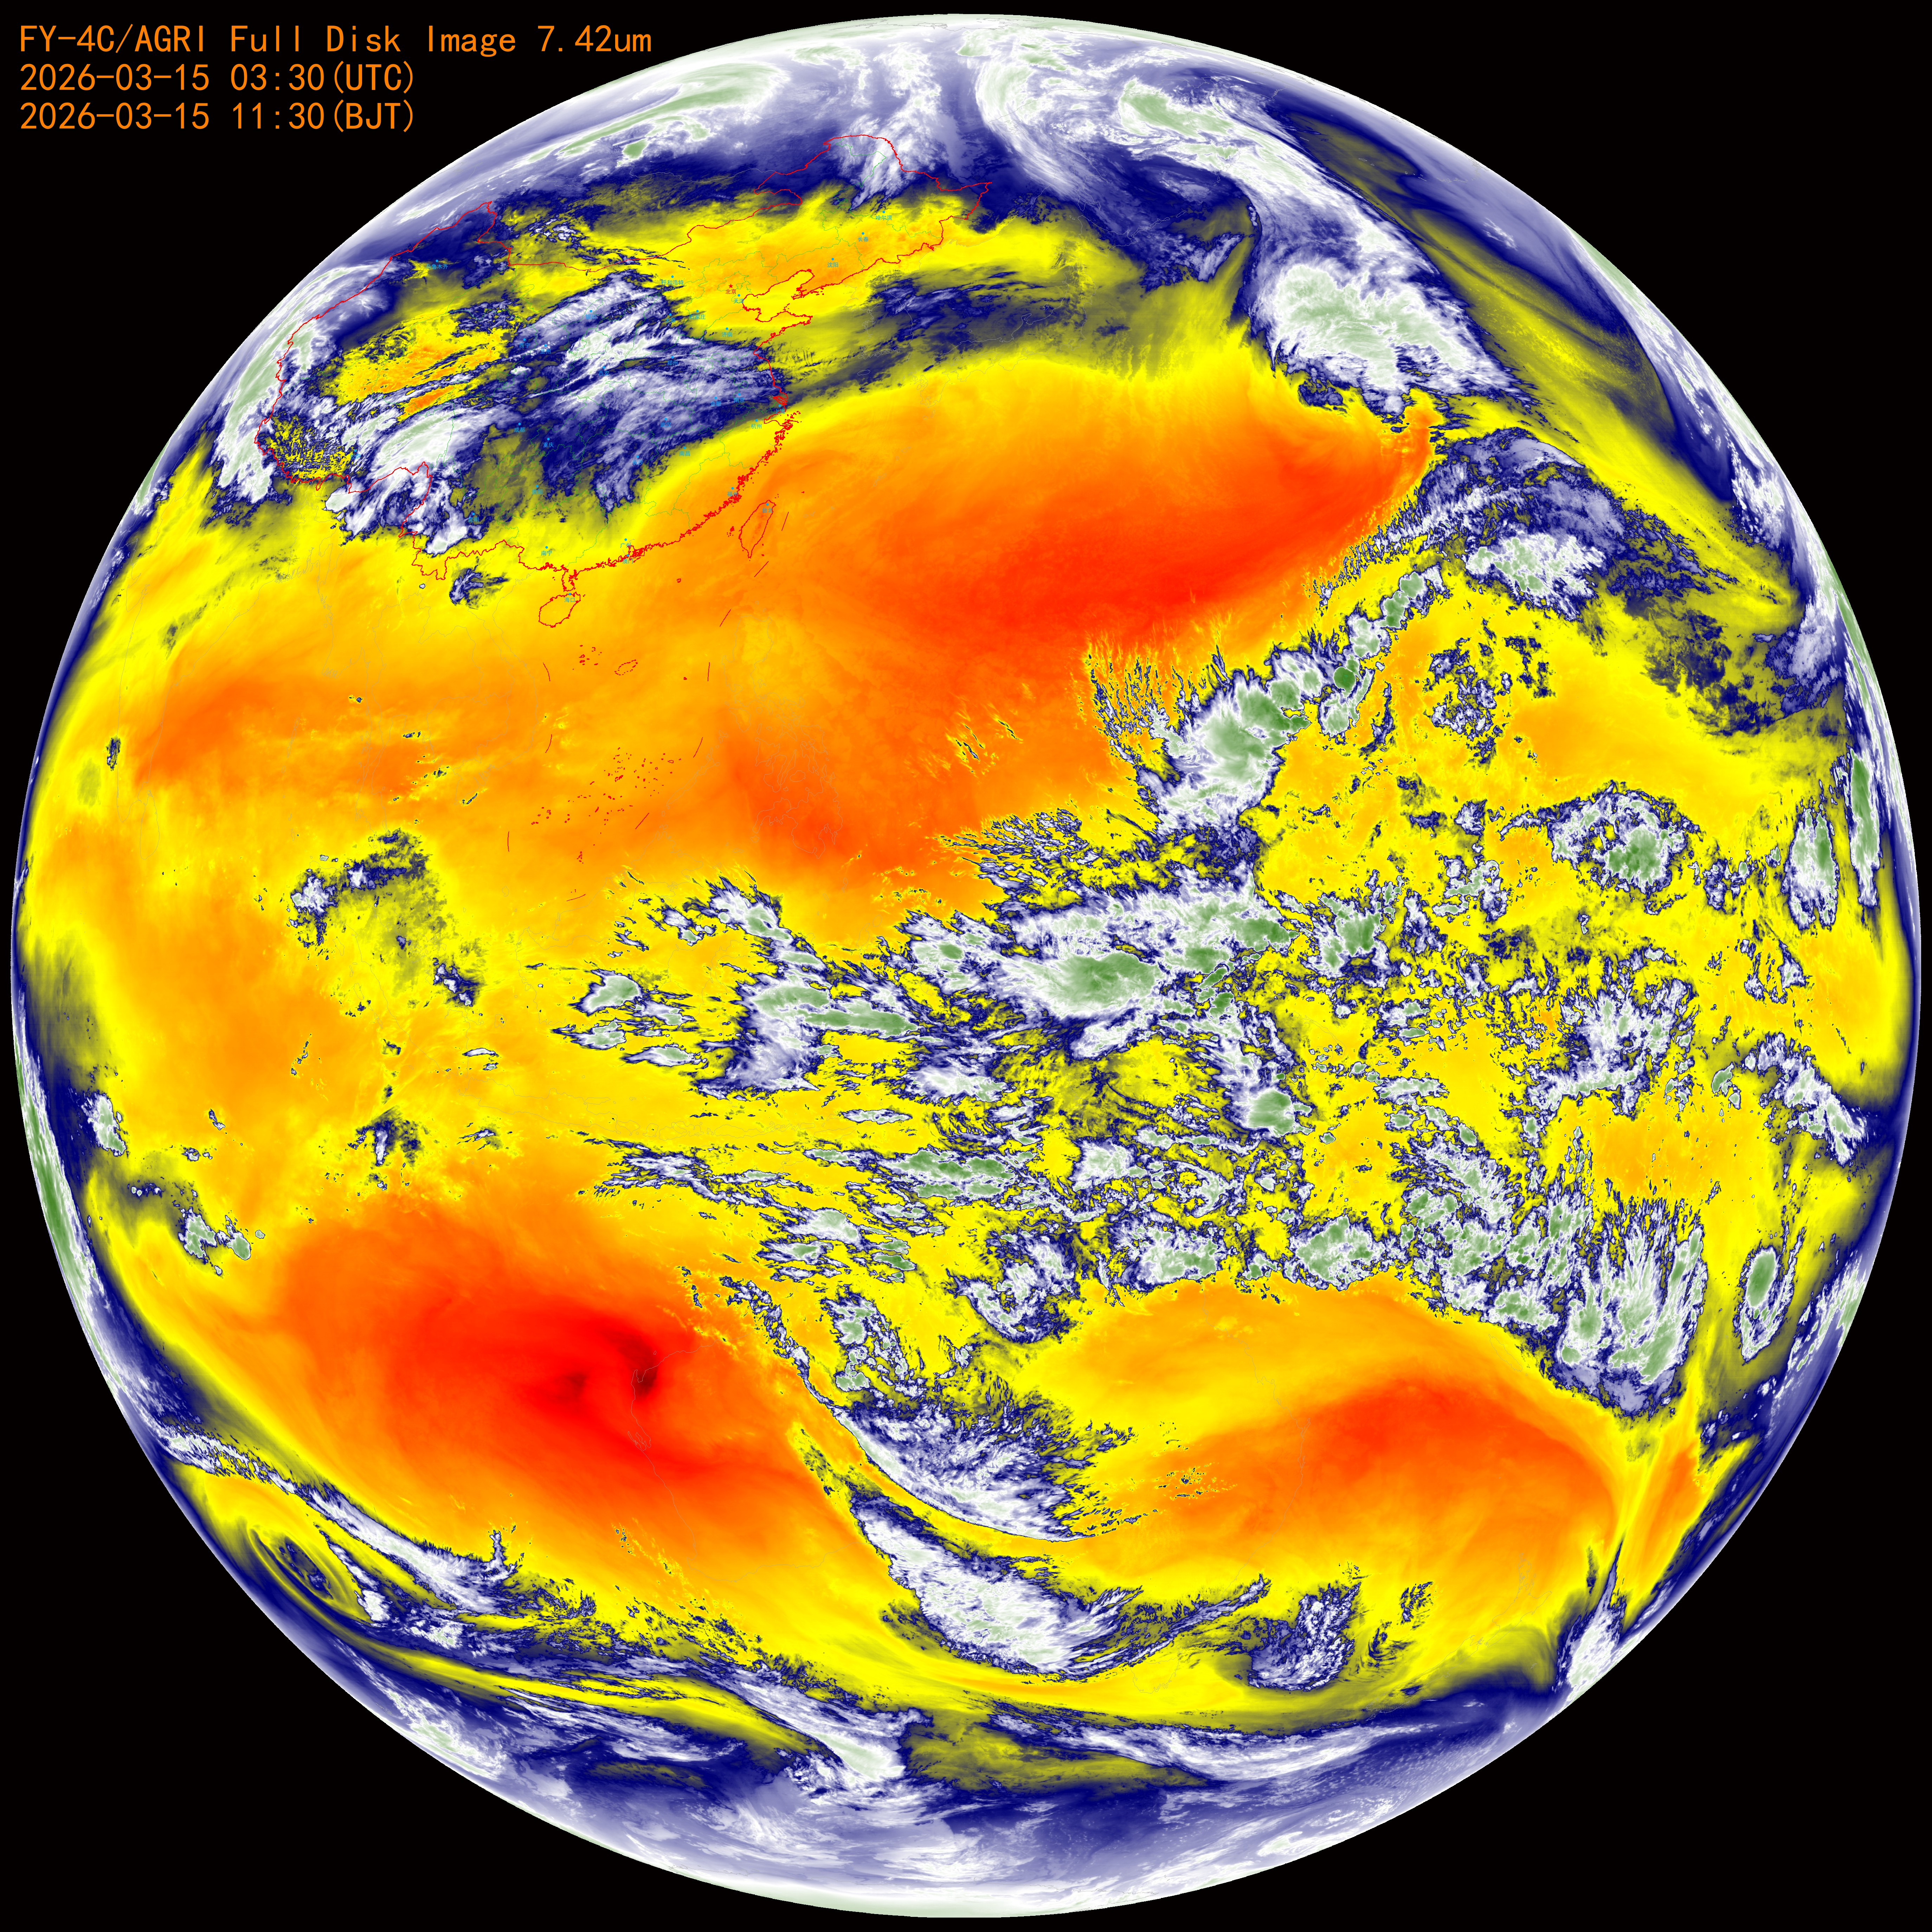
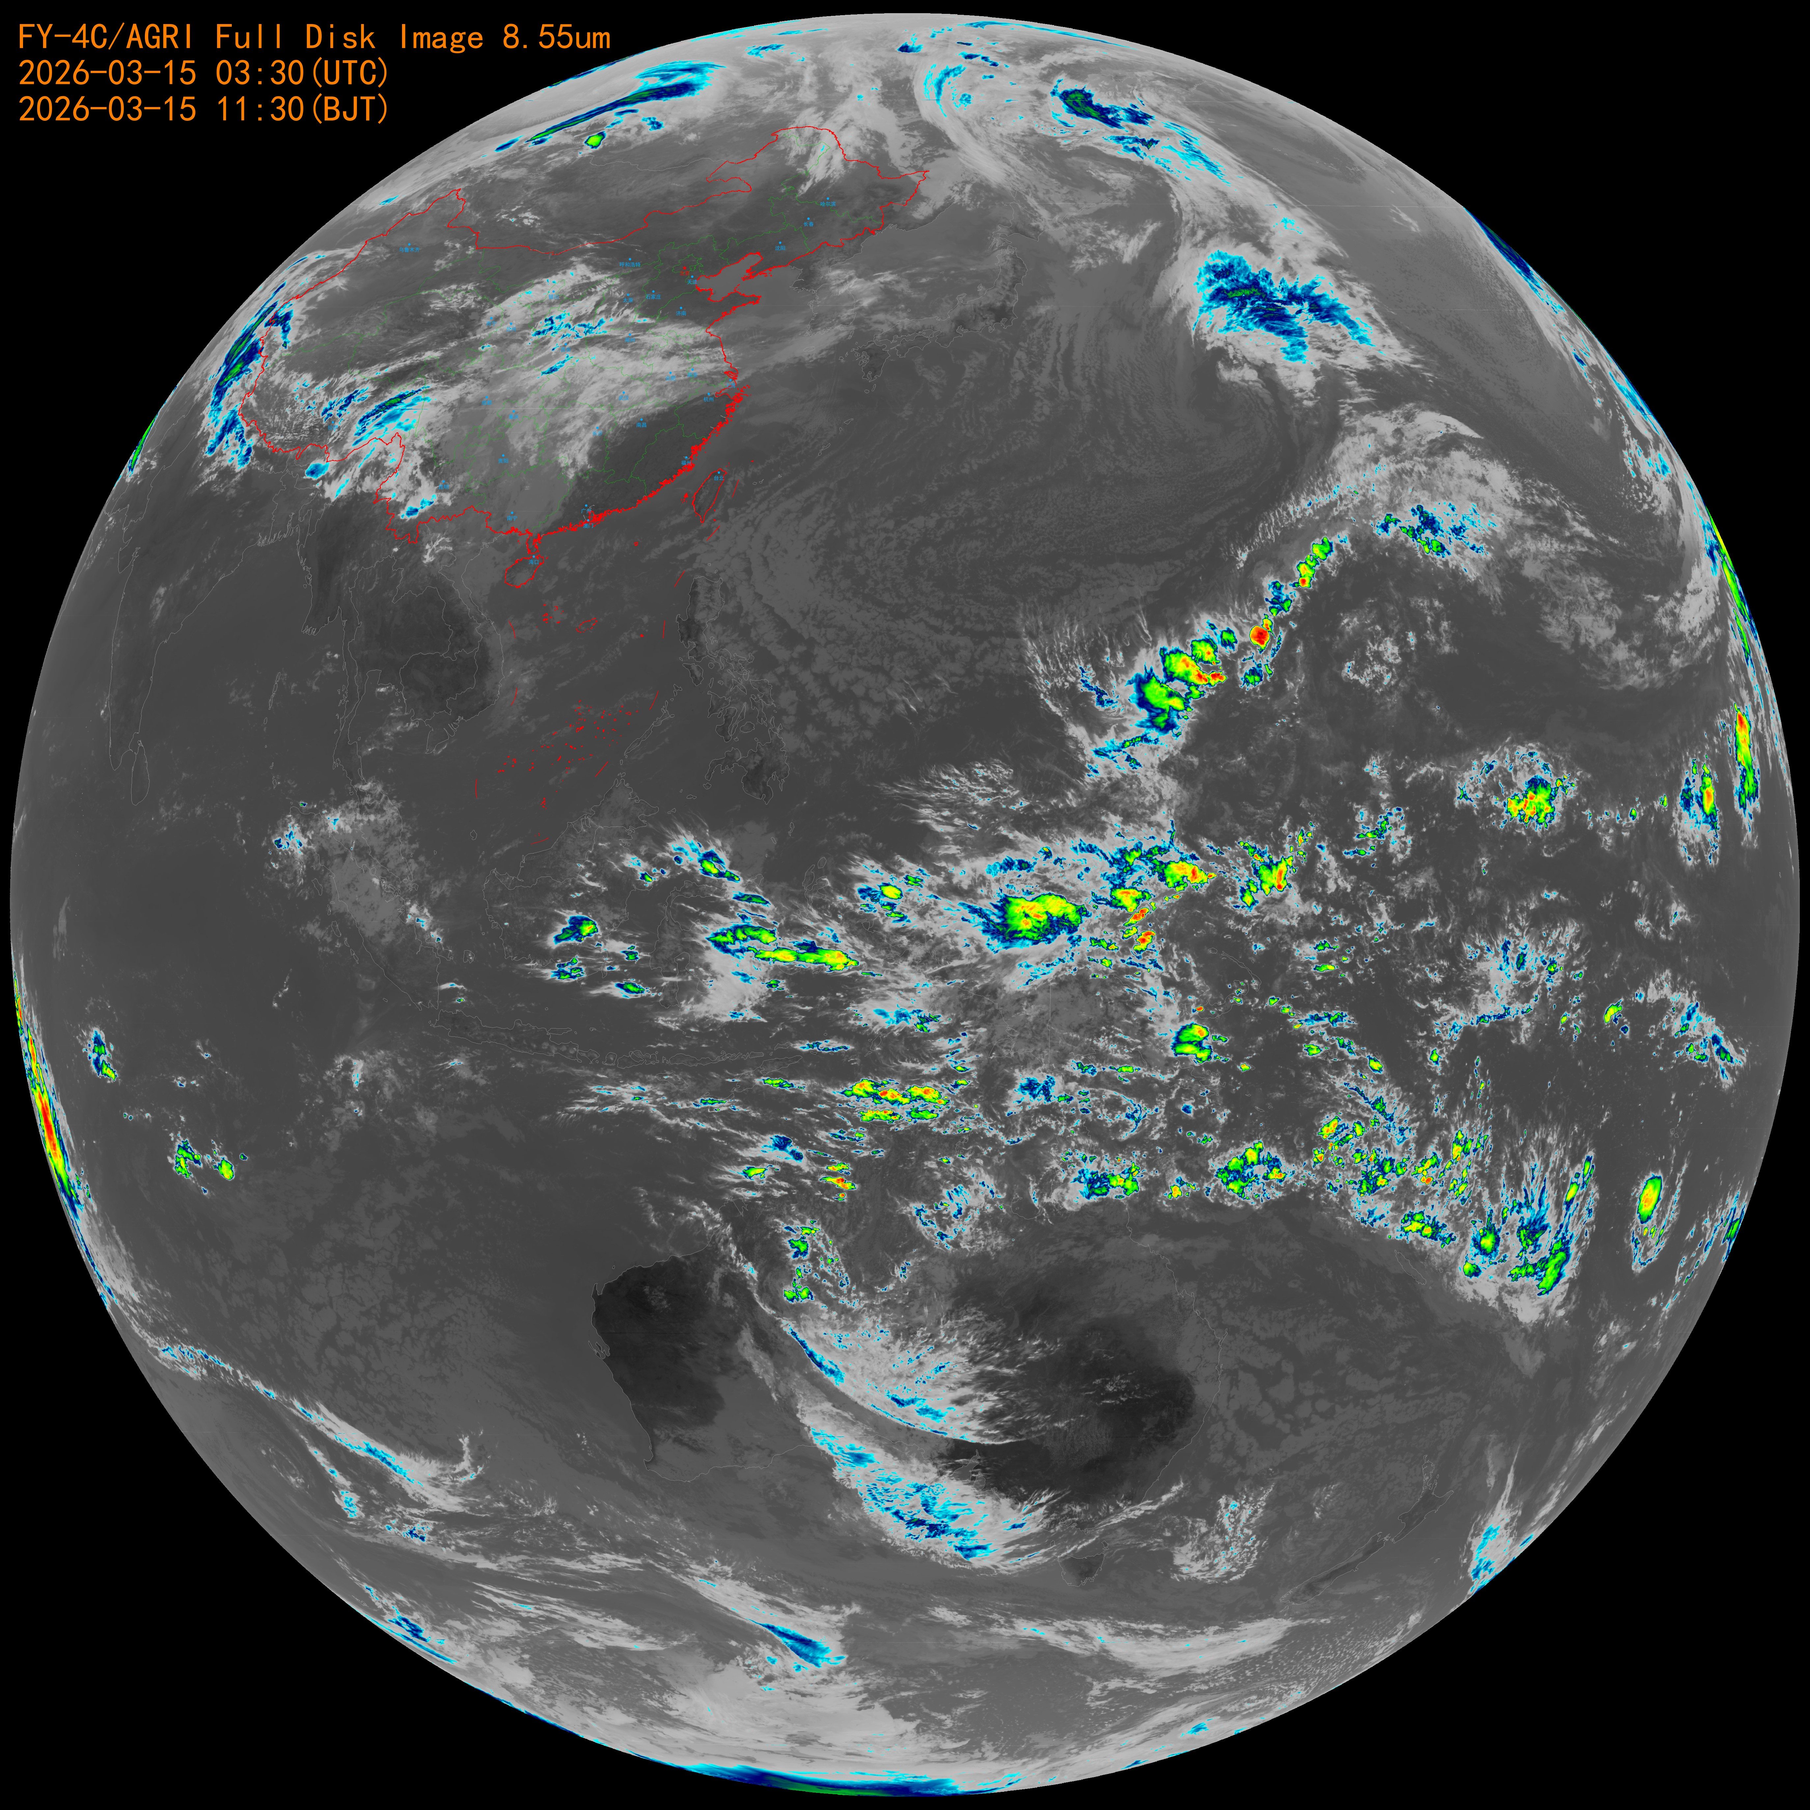
CH13 6.95μm
CH14 7.42μm
CH15 8.55μm

Slide 17
Next step work
Carry out special tests, establish stable instrument status and important parameters related to calibration, navigation registration.
Optimize ground processing algorithms, and fully test all items to ensure the accuracy of subsequent L1 products.
Evaluate the calibration accuracy of reflective and infrared bands, including SNO, OMB, and multi-site cross-calibration.
Notes:
Group members are encouraged to test the software provided by EUMETSAT to evaluate pixel or field-of-view (FOV) differences. EUMETSAT has kindly agreed to share the software. A web meeting will be scheduled to report on progress.

Slide 18
Thanks !

