Slide 1
EPS-SG METimage Thermal Channels Calibration Performance Status for GSICS 03/2026
Francesc Lucas Carbo and Ali Mousivand
Remote Sensing Scientists
23 - 27/03/2026

Slide 2
Agenda
Introduction to METimage Mission
METimage Thermal Channels Calibration Approach
Thermal Channels Calibration Monitoring in MICMICS
METimage Thermal Channels Calibration Performance

Slide 3
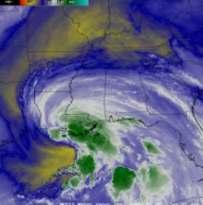
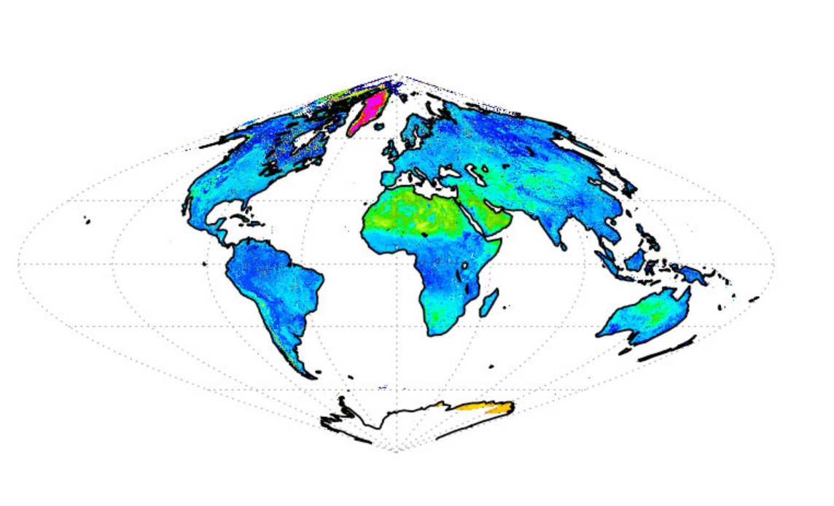
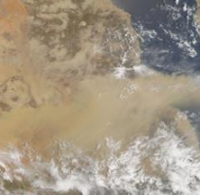
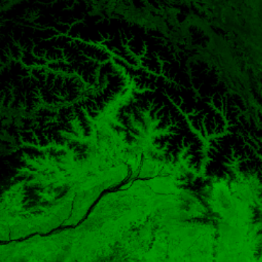
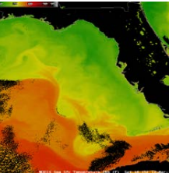
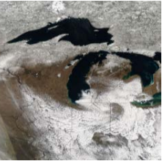
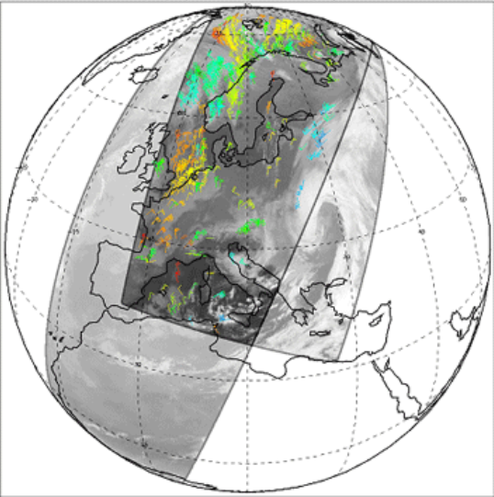
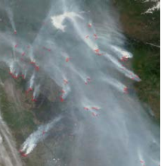
Introduction to METimage Mission
The EPS-SG Visible/Infrared Imager (VII) mission is realized through the METimage scanning optical imaging radiometer, designed to support operational meteorology, climate monitoring, oceanography, and land observation.
  Captures gapless images with a swath width of 2,700 km, enabling 24-hour global coverage
  Provides multi-spectral imagery across 20 channels, covering the VIS, NIR, SWIR, and IR ranges
  Achieves a ground resolution of 500 m at nadir
  Represents a significant advancement over AVHRR and offers performance comparable to VIIRS

Slide 4
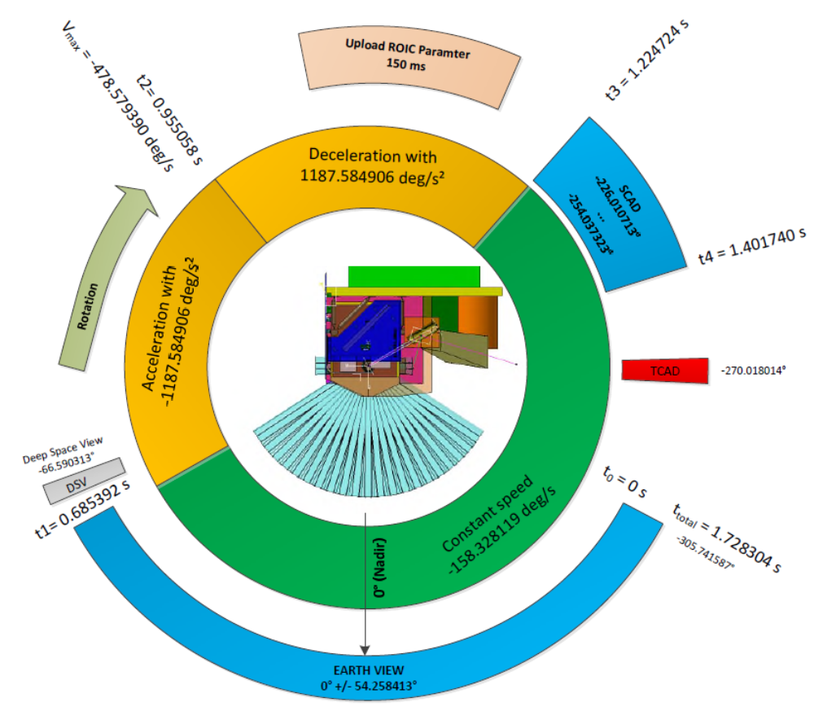
METimage Thermal Channels Calibration Approach
METimage scan mirror continuously rotates within the instrument and projects the scenes onto the telescope and detectors:
  Earth View
  Deep Space
  Thermal Calibration Device (i.e. internal blackbody)
  Solar Calibration Device (i.e. solar diffuser)
Two-point in-orbit radiometric calibration. Each calibration cycle (for every swath) defines:
  an offset point (via Deep Space view) to remove additive signal contributions such as bias and offset terms, dark current fluctuations, instrument thermal self-emission; and
  a gain point to determine the multiplicative response of the instrument, such as optical transmission, photon-to-signal conversion efficiency, etc.
Having frequent calibration views available provides plenty of valuable data for radiometric performance monitoring (e.g. noise, gain/offset stability, PRNU/DSNU, …)

Slide 5
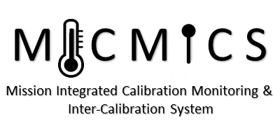
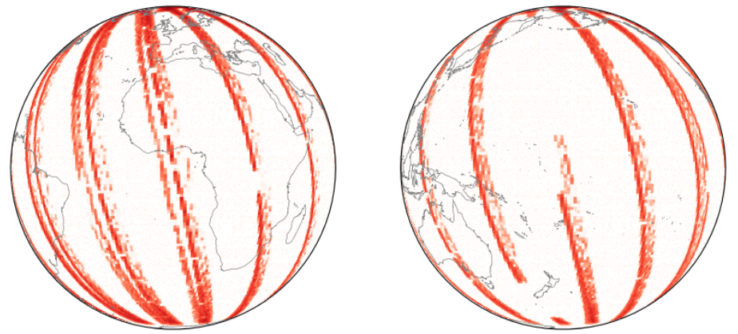
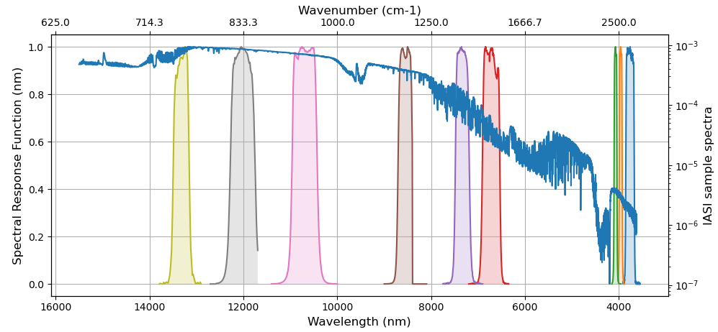
Thermal Channels Calibration Monitoring in MICMICS
Collocate in Space, Time, Angle:
  Collect Simultaneous Nadir Overpasses (SNOs)
  Tie to contemporary reference instrument with very small uncertainty
  Algorithm based on GSICS GEO-LEO IR
  Matching view zenith angle and time
Hyperspectral Reference (IASI):
  Convolve IASI spectrum with Spectral Response Function (SRF) of METimage instrument
  Can diagnose SRF errors
Compare Radiances:
  Apply weighted regression to collocated radiances
  Evaluate uncertainties
Evaluate & Monitor Radiometric Bias:
  Verify Radiometric Accuracy Requirement
  Check long-term stability
  Including decontaminations

Slide 6
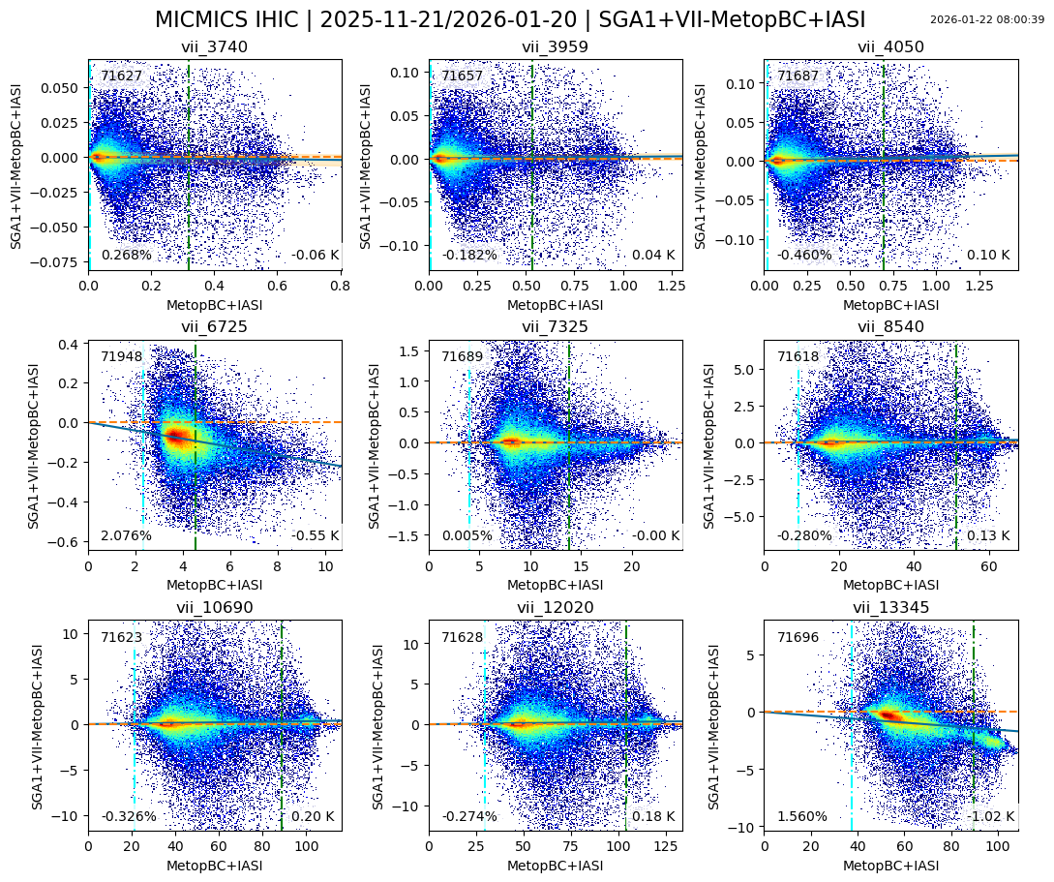
Thermal Channels Calibration Performance
Overall performance is very promising:
  Most thermal channels radiance pairs (METimage − IASI) cluster tightly around zero-difference line
  Regression slopes are near 1 for most bands, indicating consistent scaling between datasets
  Biases are generally small for 3.7 – 4.0 µm, 7.3 –8.5 µm, and 10.7 – 12.0 µm (typically within a few tenths of a kelvin)
Two channels show a noticeable scene-dependent mismatch:
  VII-6725 shows a bias of up to − 0.55 K
  VII-13345 shows a more pronounced scene-dependent mismatch with a bias of up to − 1 K
The discrepancies are strongly band-specific while most other channels behave nominally (slopes ~1, small biases). This pattern is consistent with an SRF-related effect.

Slide 7
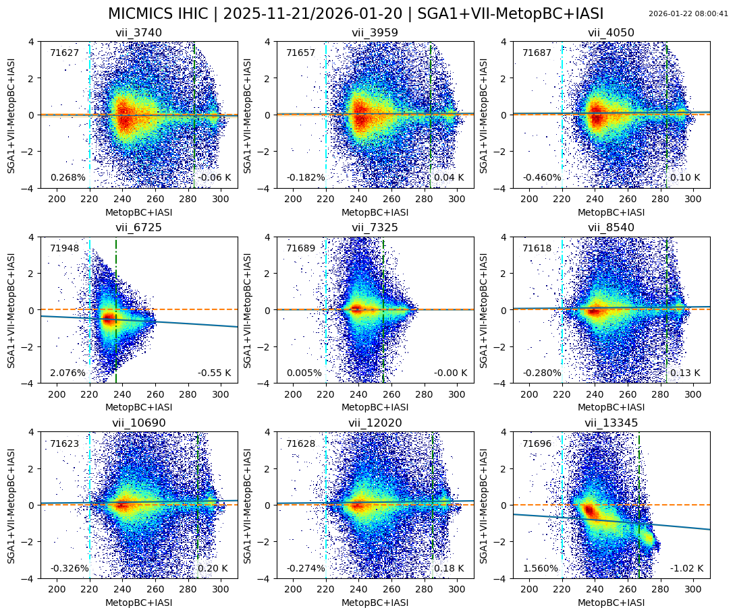
Thermal Channels Calibration Performance
Channel ID | Linear Regression Slope (%) | Number of Collocations (-)
vii_3740 | 0.26793 | 71627
vii_3959 | -0.18201 | 71657
vii_4050 | -0.45983 | 71687
vii_6725 | 2.07620 | 71948
vii_7325 | 0.00454 | 71689
vii_8540 | -0.27987 | 71618
vii_10690 | -0.32625 | 71623
vii_12020 | -0.27417 | 71628
vii_13345 | 1.56013 | 71696

Slide 8
Conclusions
Overall METimage–IASI radiances agreement is good
An issue in the SRF characterization is currently under investigation as the main driver of the slope and bias observed in VII-6725 and VII-13345. Corrective actions are underway.
MICMICS has proven to be a highly effective tool for both routine calibration performance monitoring and the investigation of calibration anomalies

Slide 9
Thank you!
Questions are welcome.

