Slide 1
Intercomparison of the GSICS Engine and MICMICS for IR GEO–LEO Intercalibration
Ali Mousivand¹, Vincent Debaecker², Viju John¹, Tim Hewison¹, Mounir Lekouara¹
¹EUMETSAT
²Telespazio France
GSICS Annual Meeting, March 23-27 2026, Ottawa

Slide 2
Agenda
GEO-LEO IR algorithm
Intercomparisons of different approaches
Conclusions

Slide 3
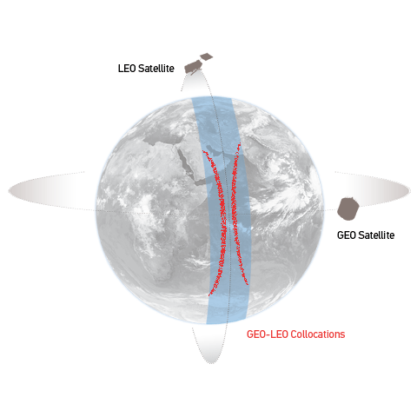
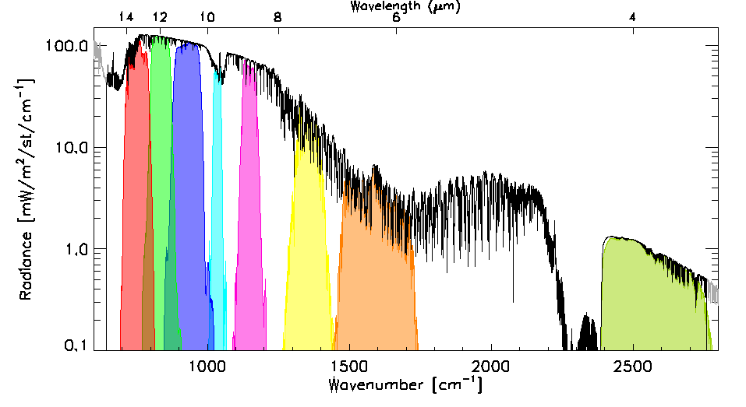
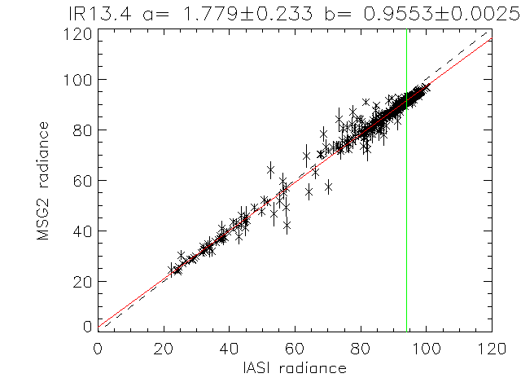
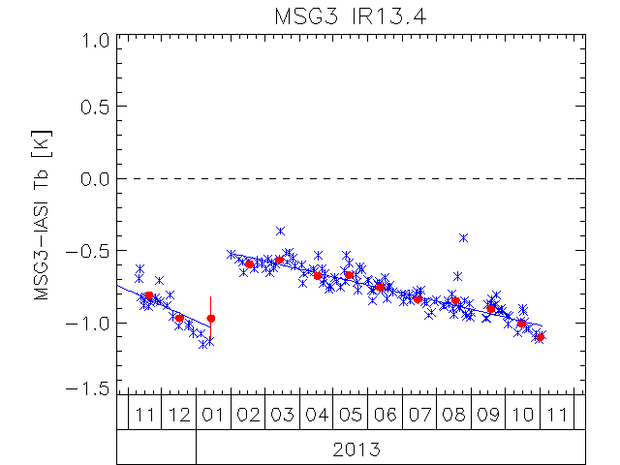

GEO-LEO IR algorithm: SEVIRI-IASI
Collocate in Space, Time, Angle
  Collect Simultaneous Nadir Overpasses (SNOs)
  Maximum difference in |dsec(VZA)|<0.01°
  Pixels’ max time difference |dt|<300s
  Night-time data
  Average all SEVIRI pixels in each IASI FoV (+ var.)
Hyperspectral Reference (e.g., IASI)
  Convolve IASI spectrum with SEVIRI SRFs
  Can investigate SRF errors
Compare
  Apply weighted regression to collocated radiances
  Evaluate uncertainties
Generate GSICS Correction
  Update daily
  Distribute via GSICS Servers
Evaluate & Monitor Bias
  Verify Radiometric Accuracy Requirement
  Check long-term stability
  Including decontaminations
[mW/m2/sr/cm-1]
[mW/m2/sr/cm-1]
Bias at Standard Scene Radiance (~285K)
Bias at Cold Scene (220K)

Slide 4
Intercomparison of different implementations
  All three implementations follow a similar methodology, with minor differences summarised in the table below.
  The main variations is in the USC collocation approach, where both instruments are projected onto a common 2D grid and intersections define collocations and regress the monitoring counts against reference radiance and compute calibration coefficients (not corrections).
Implementation | Geographical domain | Pixels’ max time difference |dt| | Time window | Maximum difference in |dsec(VZA)| | Collocations
GSICS | ±35°N/S (in RSS mode, latitude north limited to 15°N), ±35°E/W | 300s | 30 days | 0.01° (in RSS mode 0.05°) | Night-time
USC | ±35°N/S/E/W | 300s | 5 days | 0.01° | Day and Night (For 3.9 µm only night)
MICMCIS | No limit | 200s | 30 days | 0.01° | Night-time

Slide 5
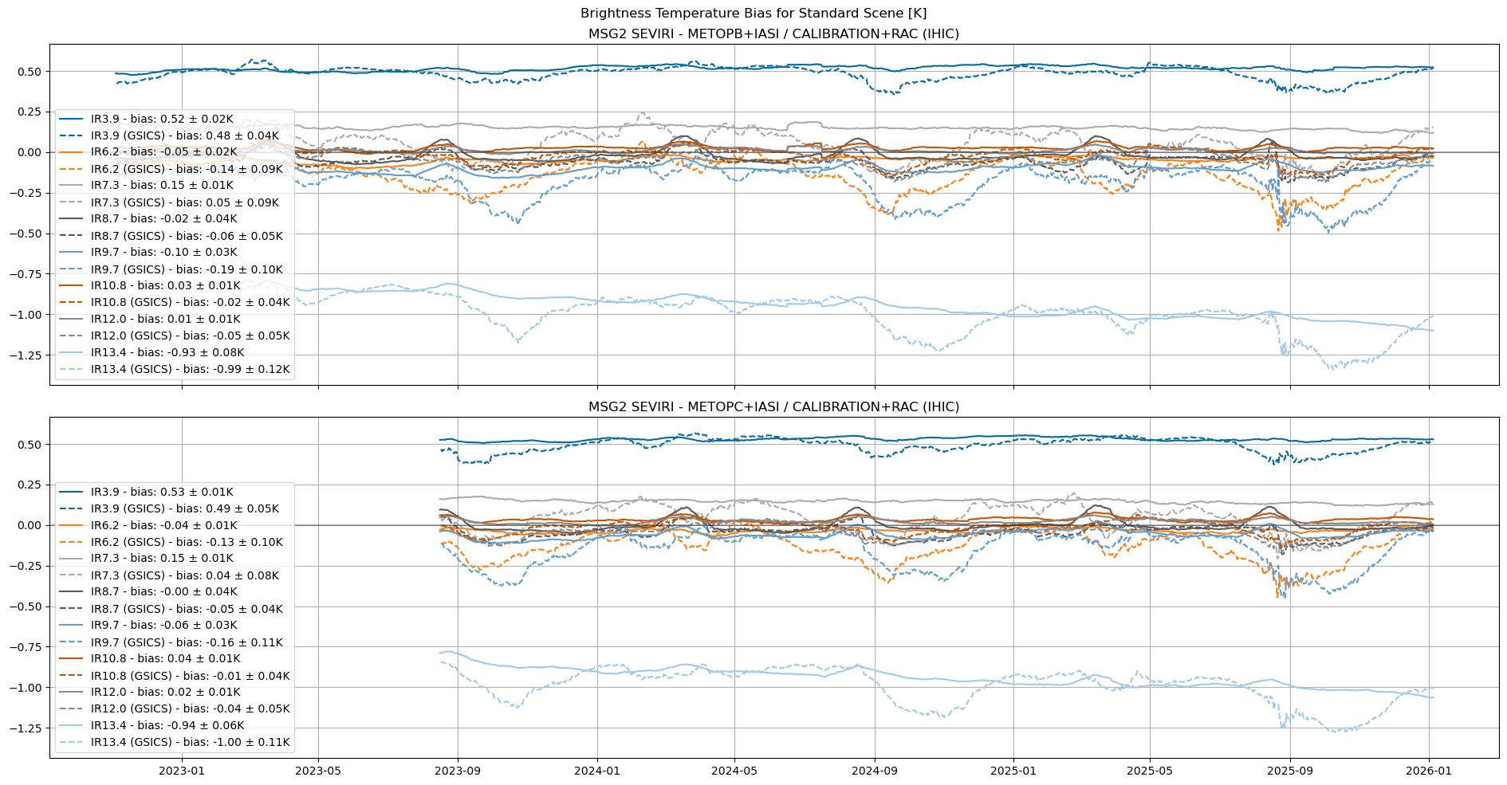
MSG-2 Intercomparison: GSICS Engine vs. MICMICS
Average number of collocations:
GSICS engine: 6000
MICMICS: 28000

Slide 6
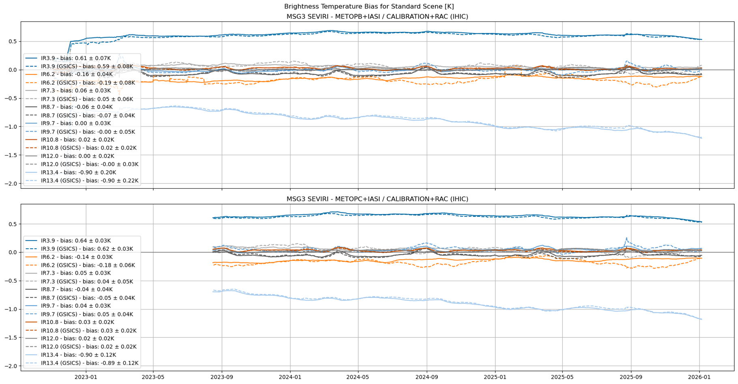
MSG-3 Intercomparison: GSICS Engine vs. MICMICS
Average number of collocations:
GSICS engine: 30000
MICMICS: 28000

Slide 7
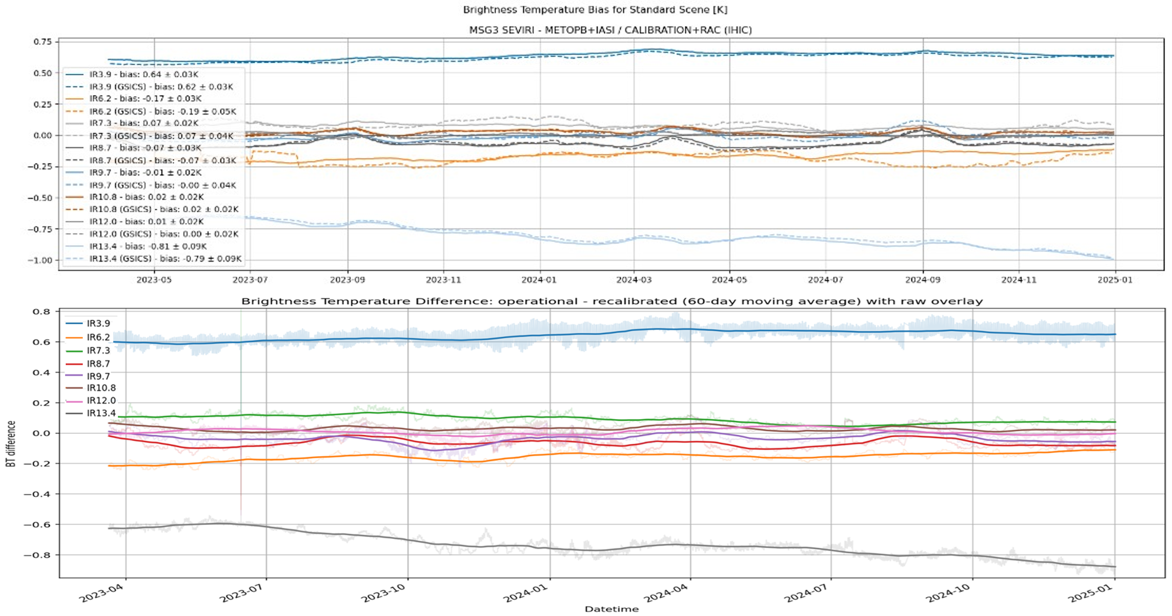
MSG-3 Intercomparison: USC vs. MICMICS

Slide 8
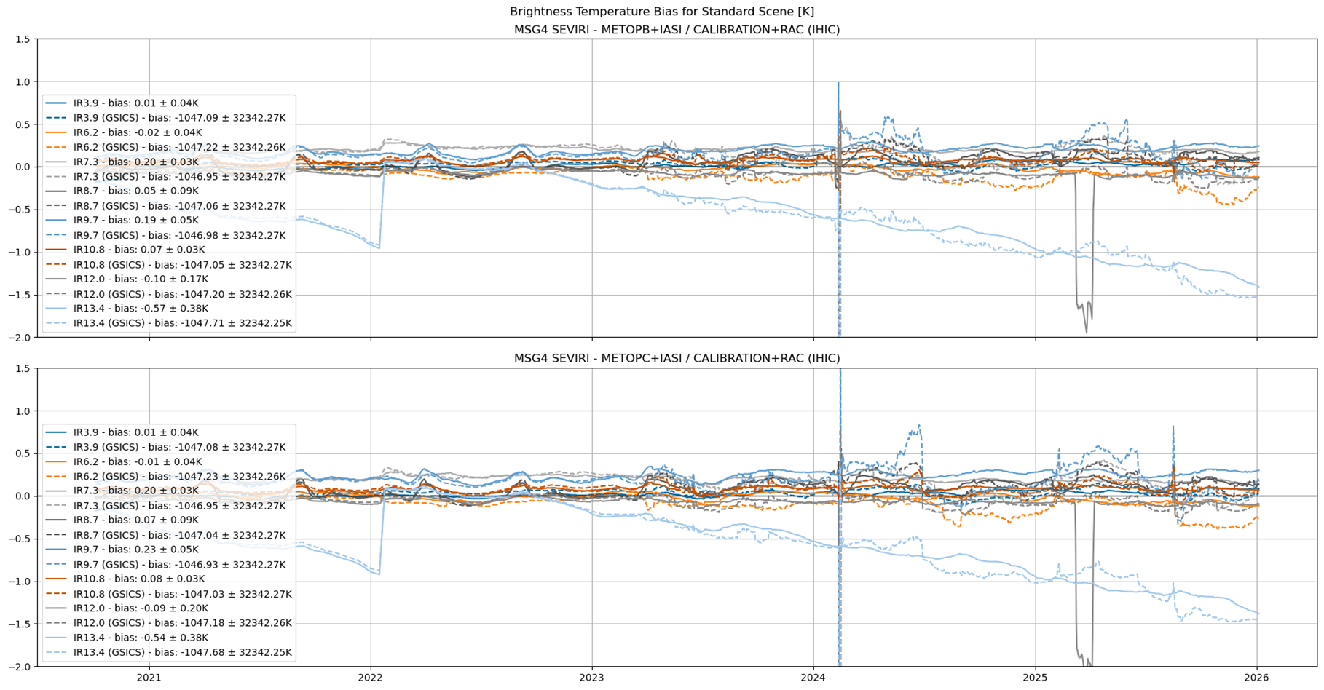
MSG-4 Intercomparison: GSICS Engine vs. MICMICS
Average number of collocations:
GSICS engine: 5000
MICMICS: 16000

Slide 9
Conclusion
  All implementations follow a similar methodology, with only minor differences.
  MICMICS yields more collocations than the GSICS engine and applies more careful outlier removal, resulting in lower uncertainty and reducing the variability seen in the GSICS results.
  Overall, the implementations show good agreement, with MICMICS providing state-of-the-art results.
  The transition from GSICS engine to MICMICS for the generation of the SEVIRI IR GSICS parameters is planned to be completed by the end of the year..

Slide 10
Thank you!
Questions are welcome.

