Slide 1
An Operational Monitoring System for HIRAS
Presenter: Junwei Wang
NSMC, China Meteorological Administration (CMA)

Slide 2
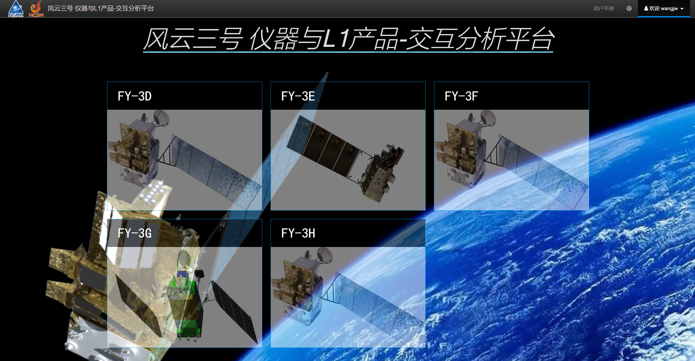
Overview of the monitoring system
CMA has established a monitoring system for FY satellite instrument data to routinely monitor instrument status and the quality of Level-1 data products.
Main functions:
Monitor the status of the satellite platform and its instruments.
Data quality monitoring (routine calibration assessment).
Automatic Diagnosis and Alerts to anomalies during operation.

Slide 3
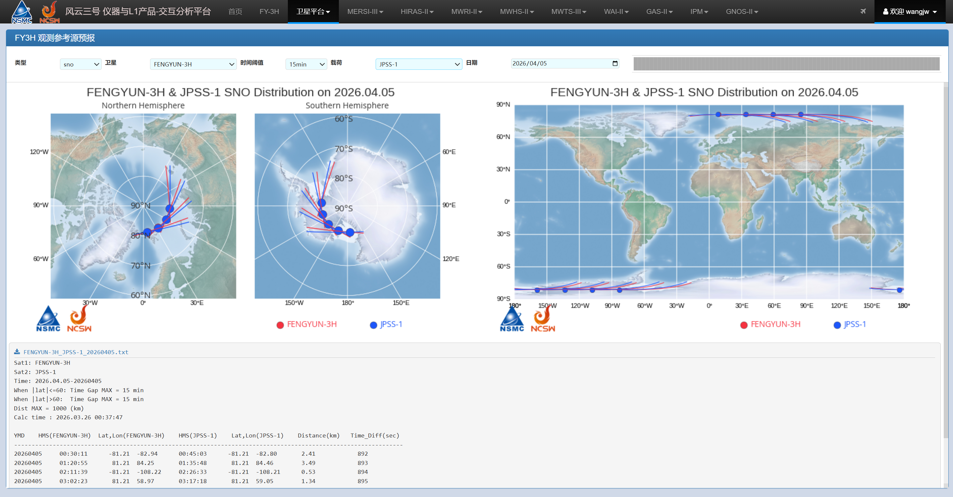
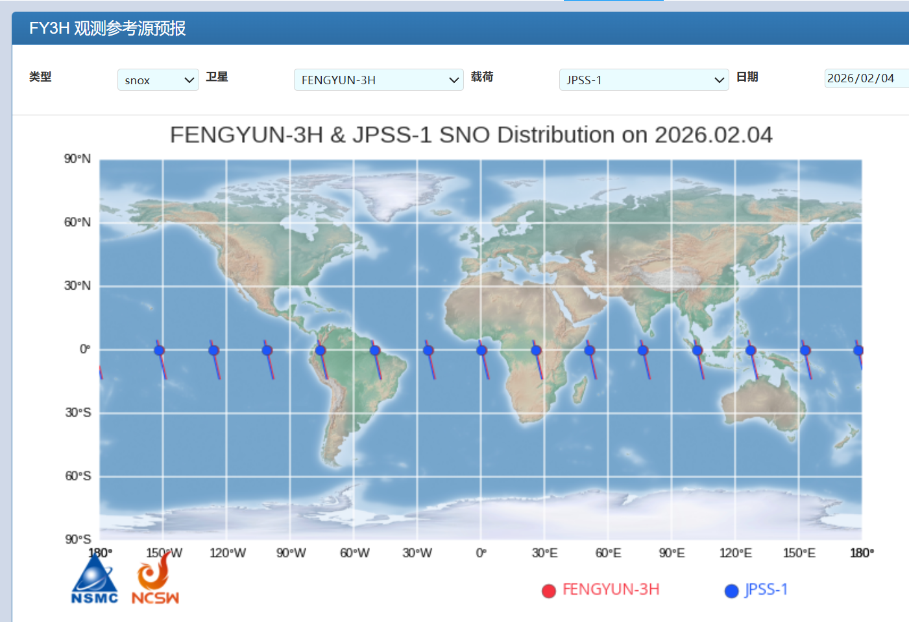
Satellite platform monitoring
The system can directly monitor satellite platform parameters, such as GPS information. It also provides predictions of SNO and SNOx events with other satellites, and can forecast the satellite’s position at a specified time.
FY-3H SNO with JPSS-1
FY-3H SNO-x with JPSS-1

Slide 4
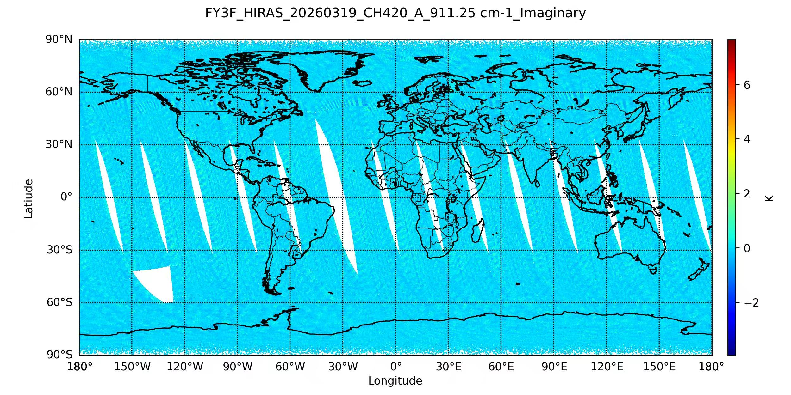
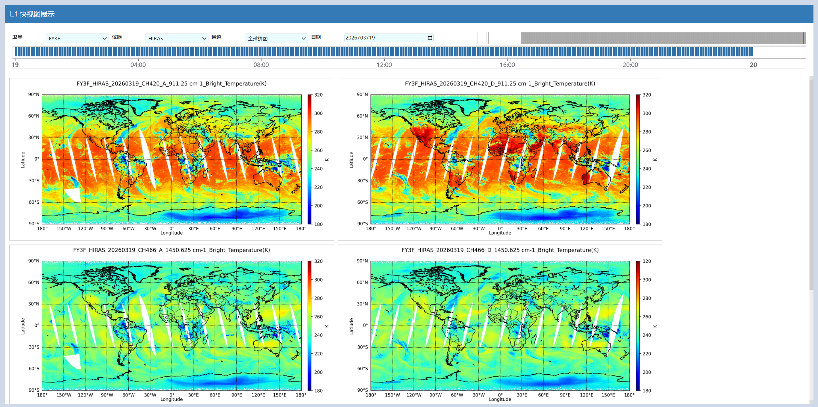
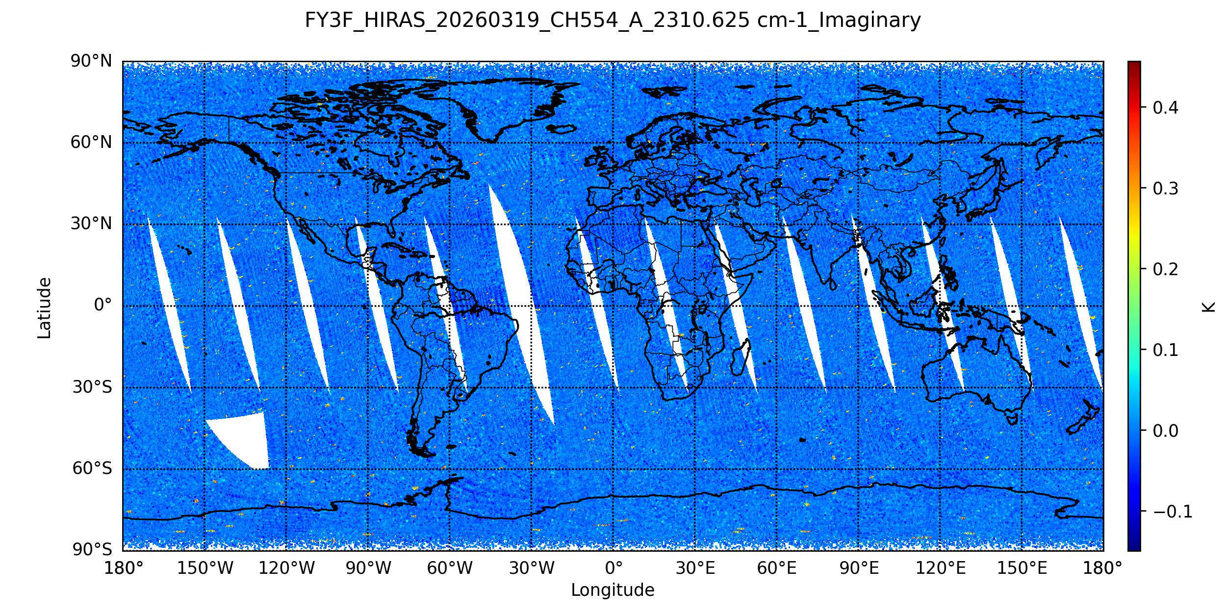
HIRAS L1 data monitoring
Using this system, the daily data completeness of HIRAS can be visualized intuitively, and any anomalies in specific regions can be readily identified.

Slide 5
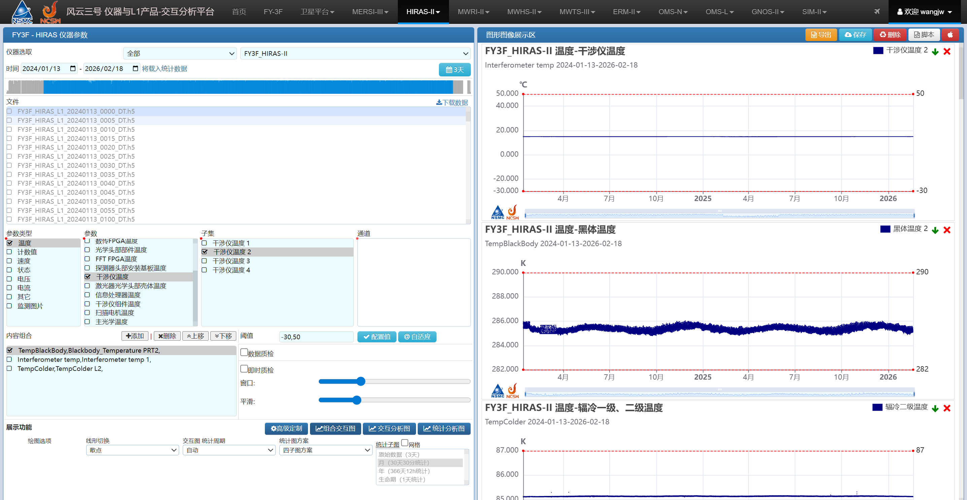
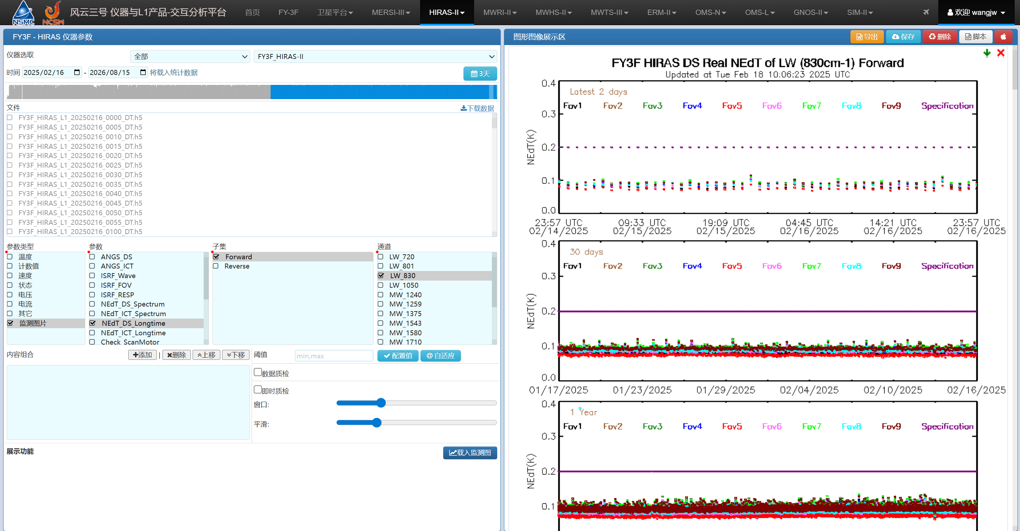
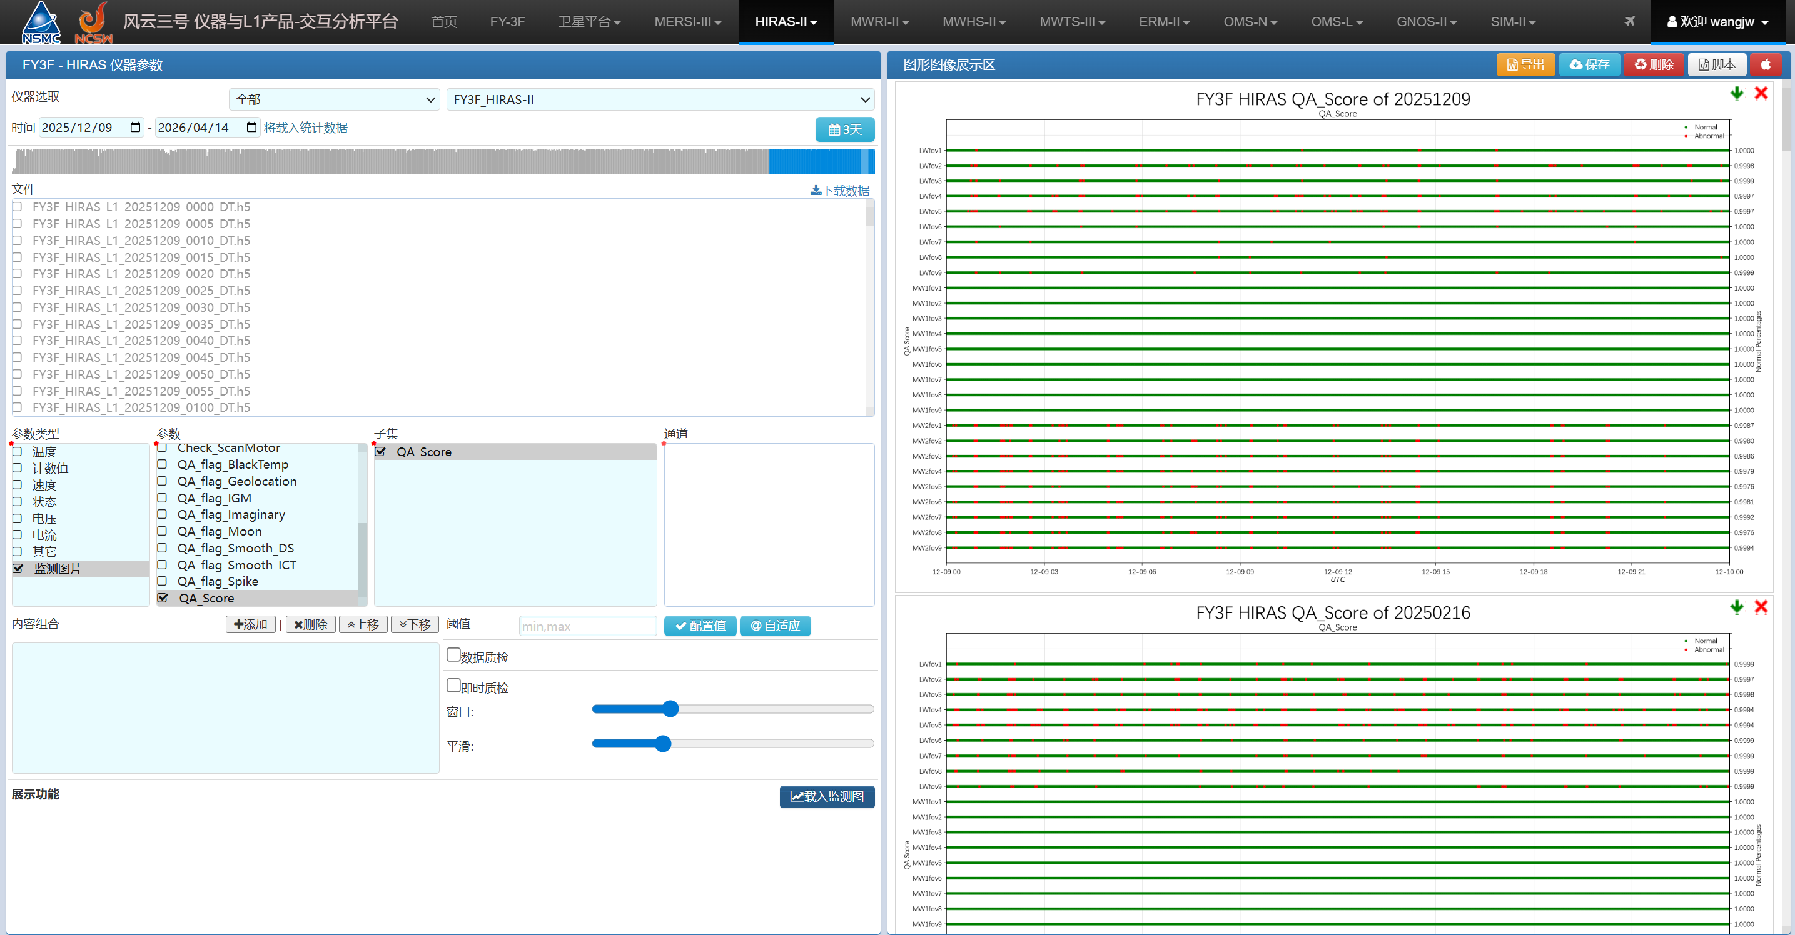
HIRAS parameters monitoring
The system can monitor various HIRAS instrument parameters across different time scales (e.g., one orbit, one year, and the full mission lifetime), including temperature stability, sensitivity, and L1 QA scores.

Slide 6
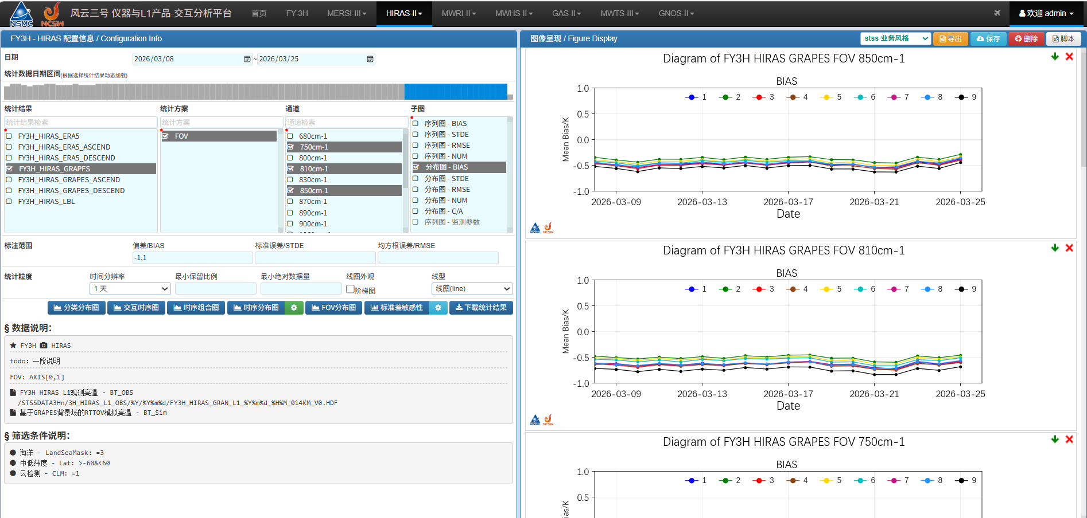
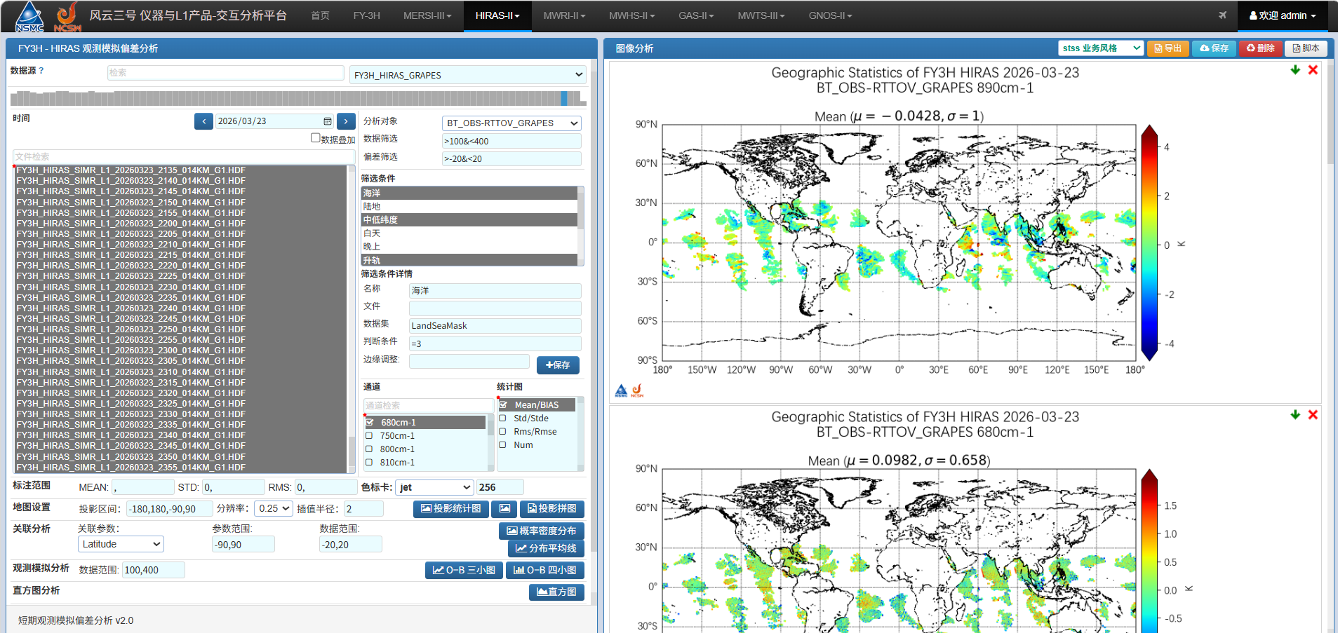
HIRAS Radiometric Calibration Monitoring
The system performs daily OMB analysis, allowing the use of different background data(ERA5 or GRAPES) and filtering criteria to assess the radiometric calibration of HIRAS across different spectral bands.

Slide 7
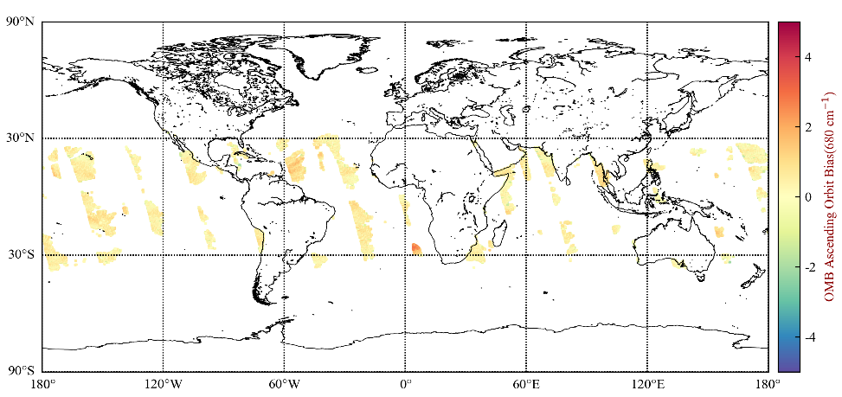

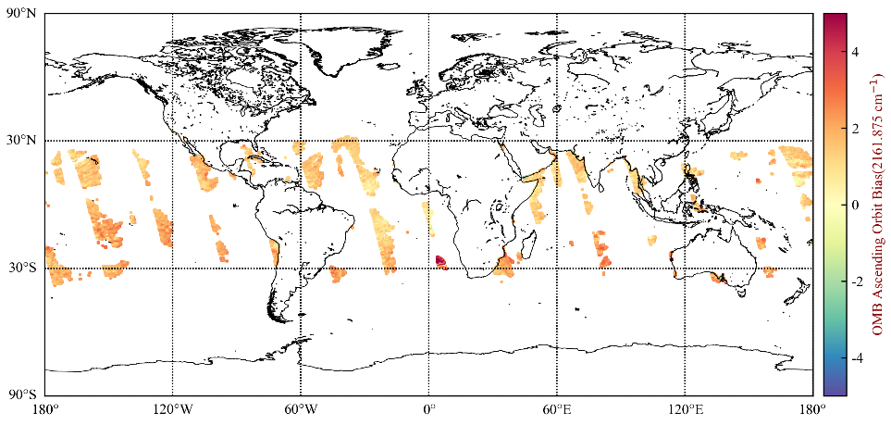
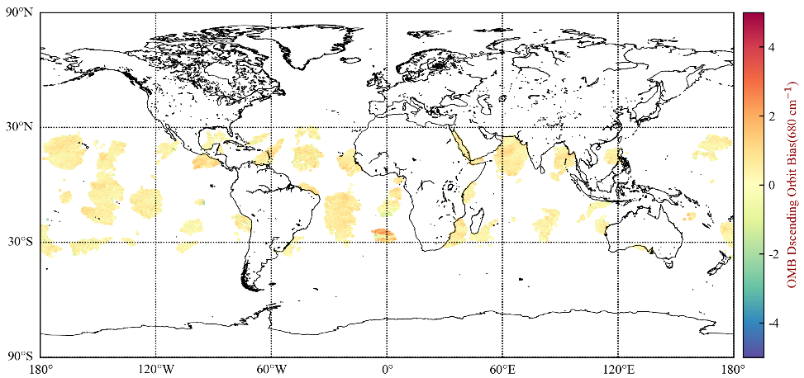
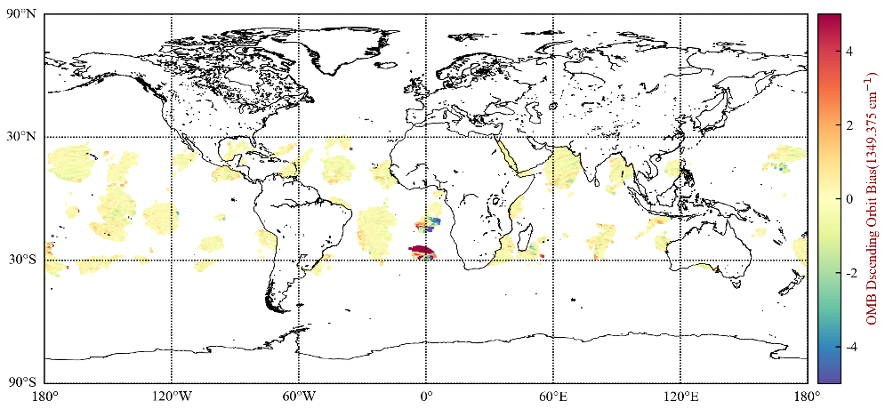
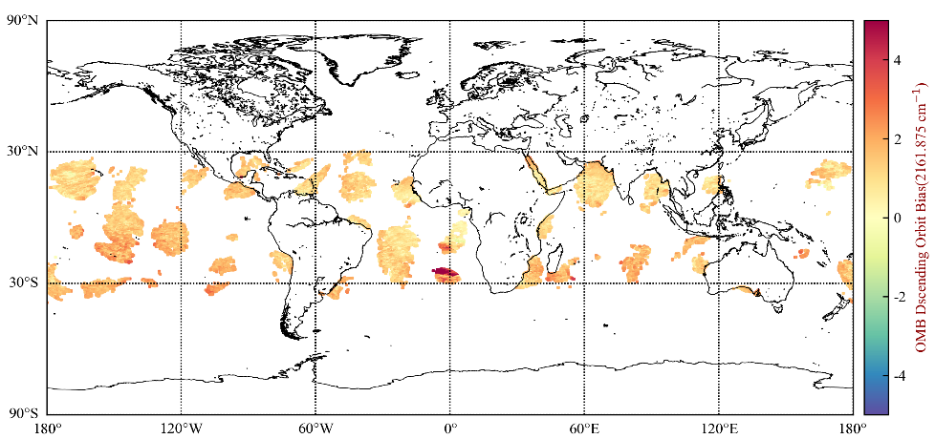
HIRAS Radiometric Calibration Monitoring
This shows the spatial distribution of OMB for three channels.
680cm⁻¹
1349.375cm⁻¹
2161.875cm⁻¹

Slide 8
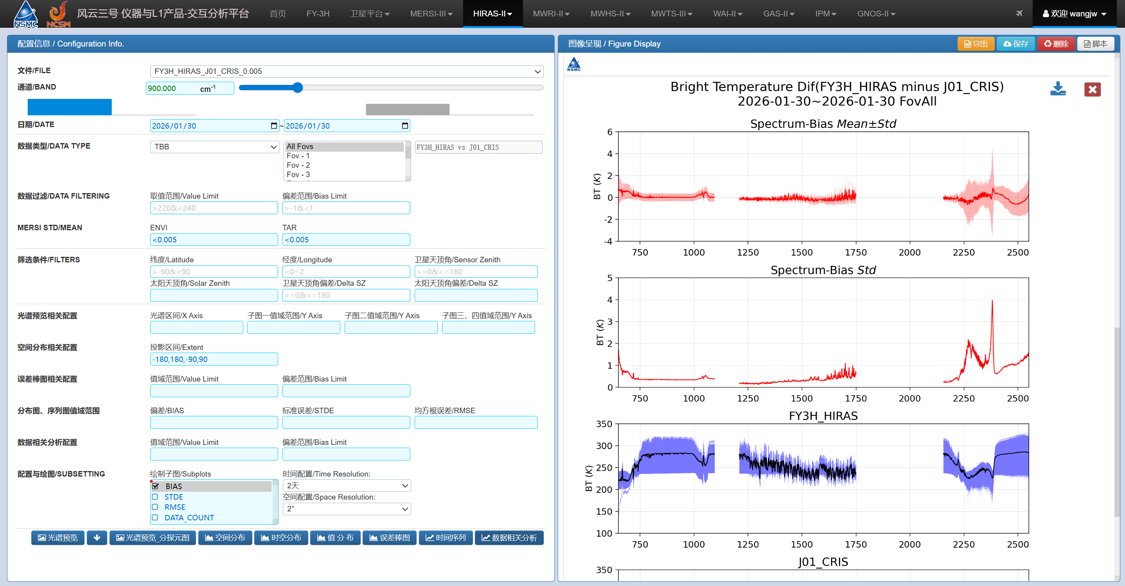
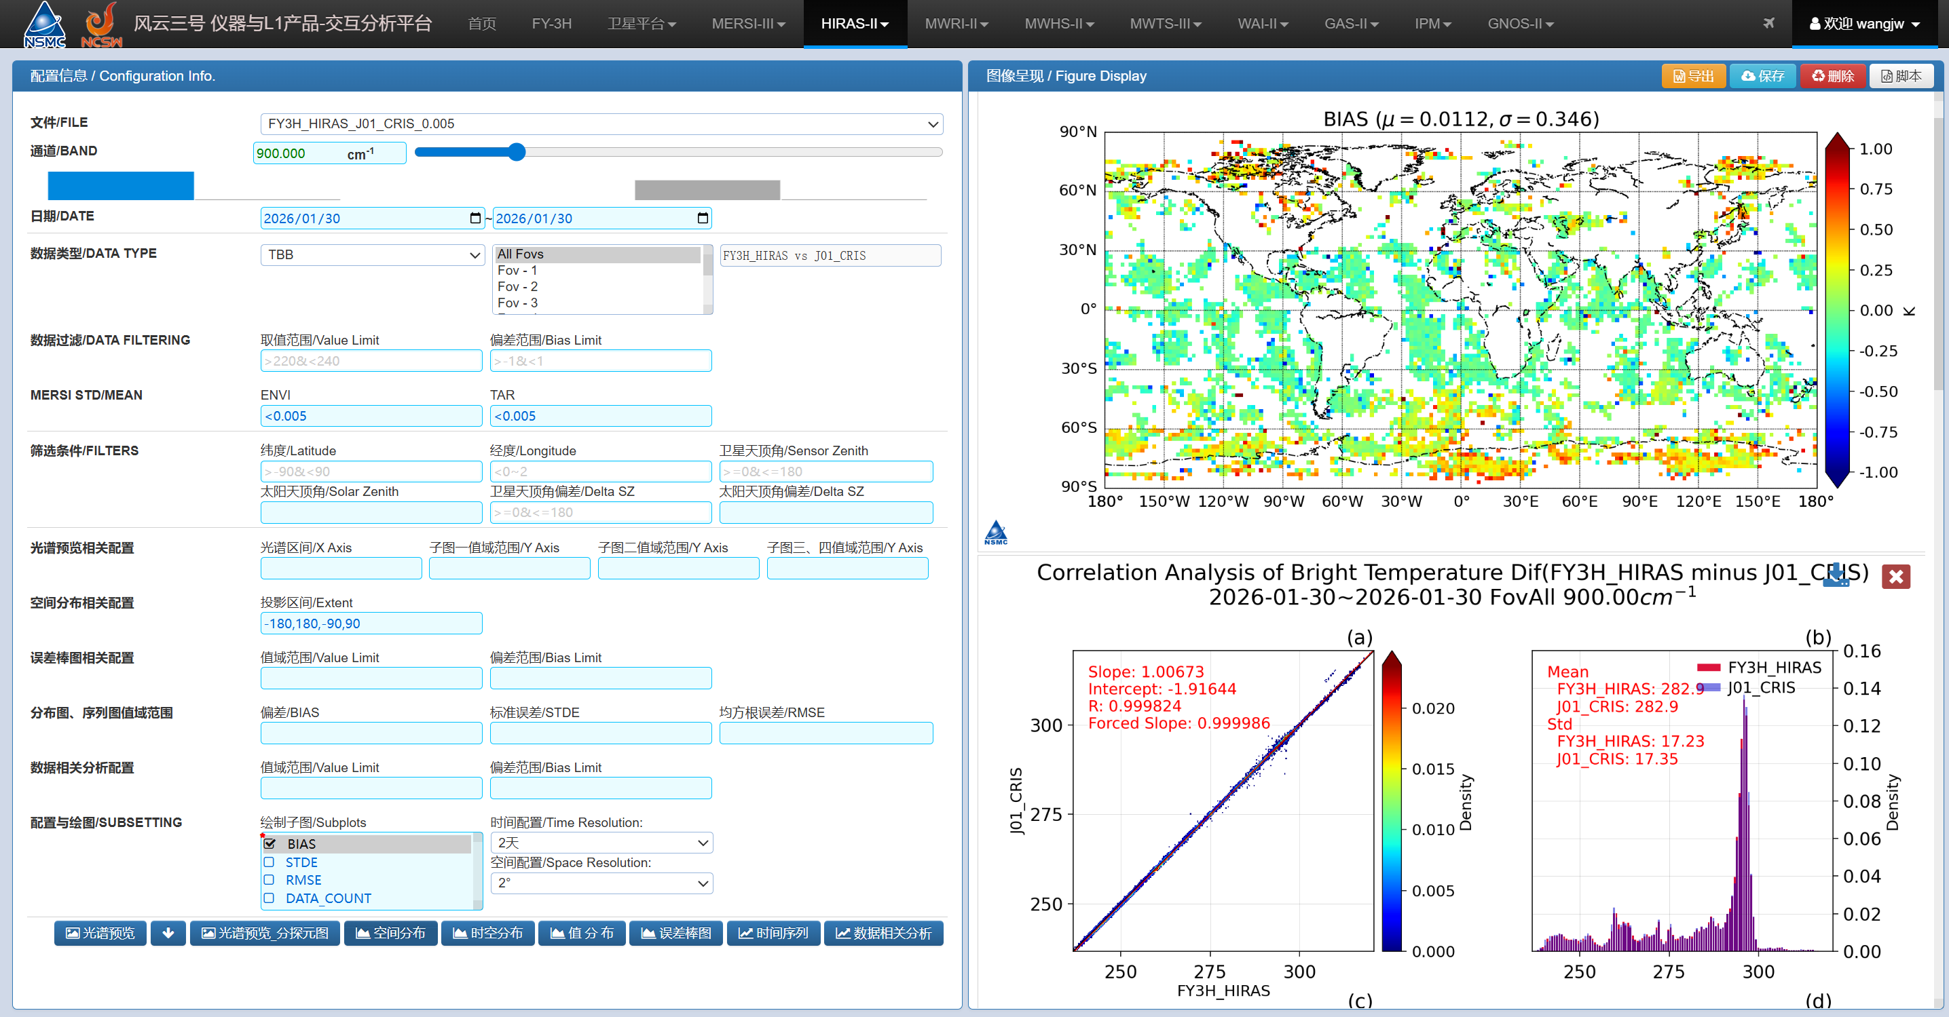
HIRAS Radiometric Calibration Monitoring
The monitoring system routinely tracks cross-comparison results with other instruments and presents them in multiple formats—bias maps, spatial distribution plots, regression plots, and bias histograms—providing a clear and comprehensive view of bias characteristics.

Slide 9
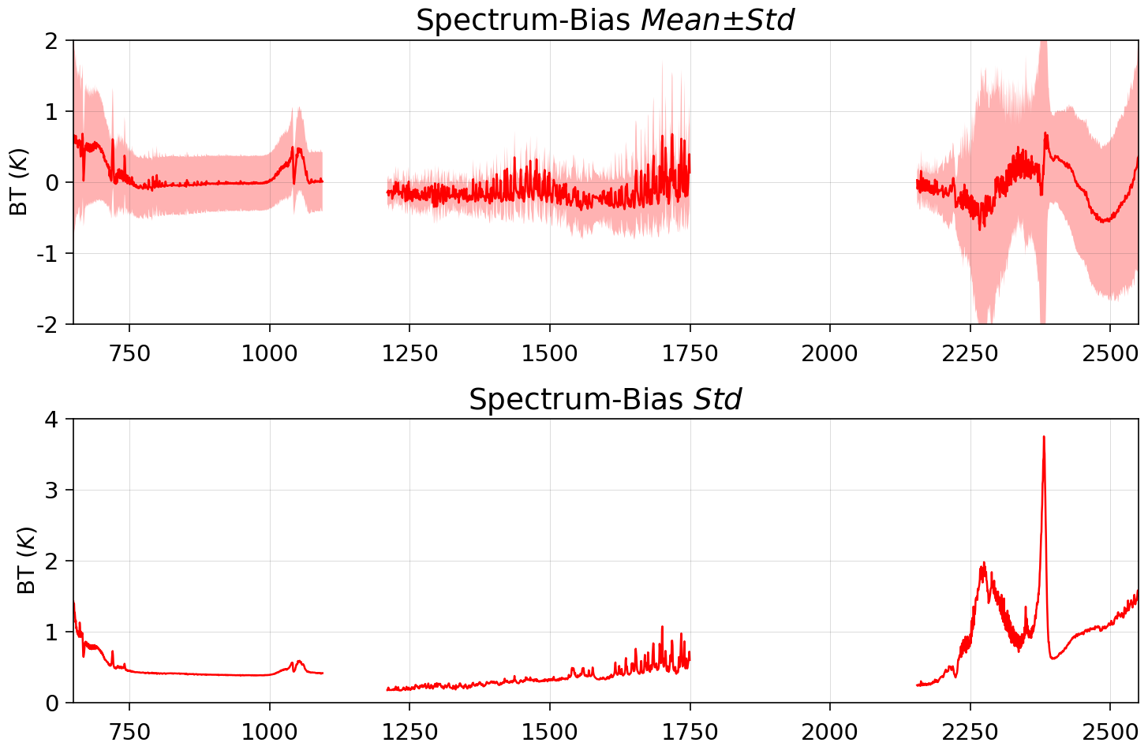
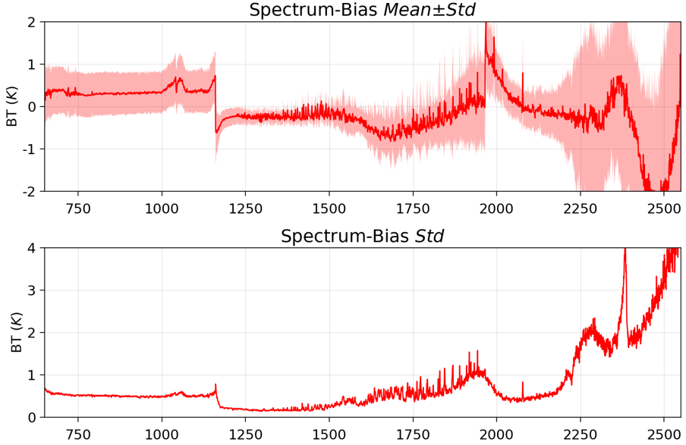
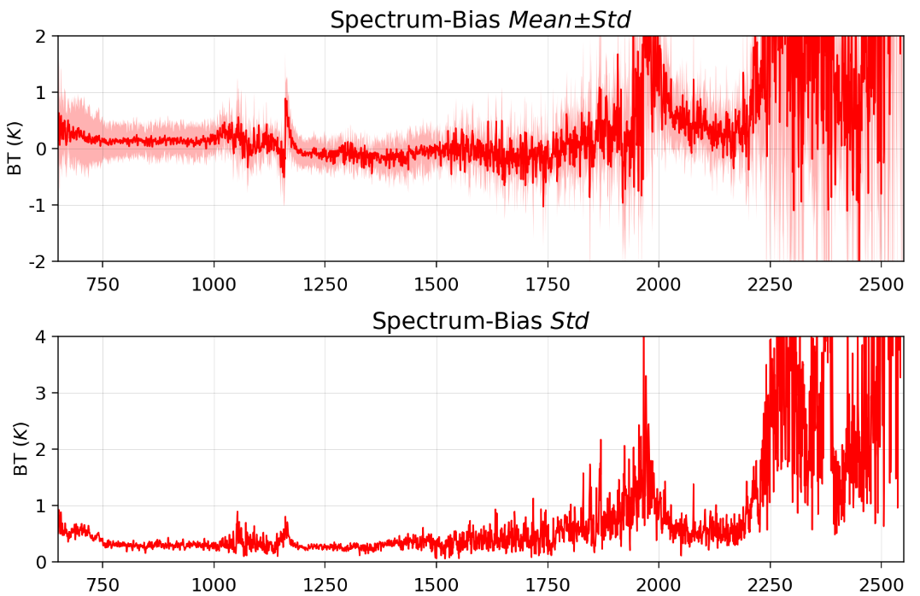
HIRAS Radiometric Calibration Monitoring
FY-3H/HIRAS radiometric calibration accuracy is evaluated through inter-comparison with SNO and SNO-x data from other instruments. It can be observed that deviations are larger for upper-atmospheric channels, indicating that the nonlinearity coefficients still require fine-tuning.
SNO-X with JPSS-1/CrIS
SNO with METOP-C/IASI
SNO with FY-3F/HIRAS

Slide 10
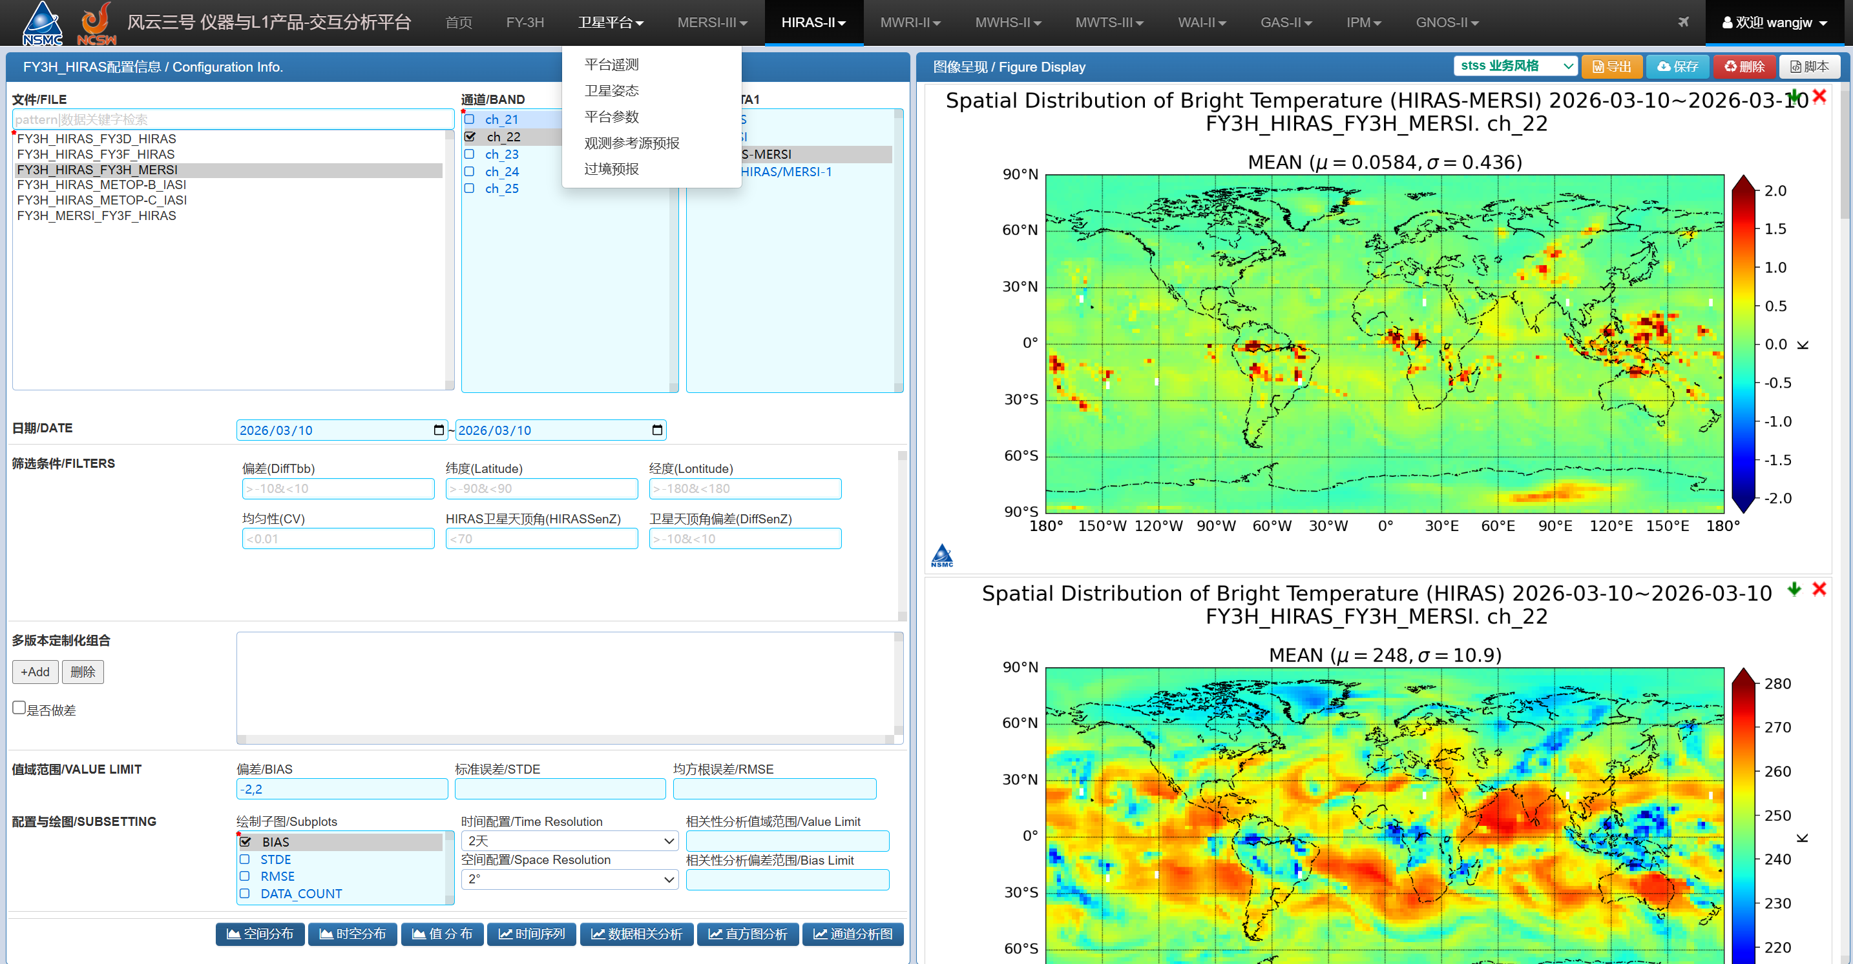
HIRAS Radiometric Calibration Monitoring
monitoring system can also perform daily analysis of HIRAS biases relative to the co-platform MERSI, including spatial distribution and regression statistics.

Slide 11
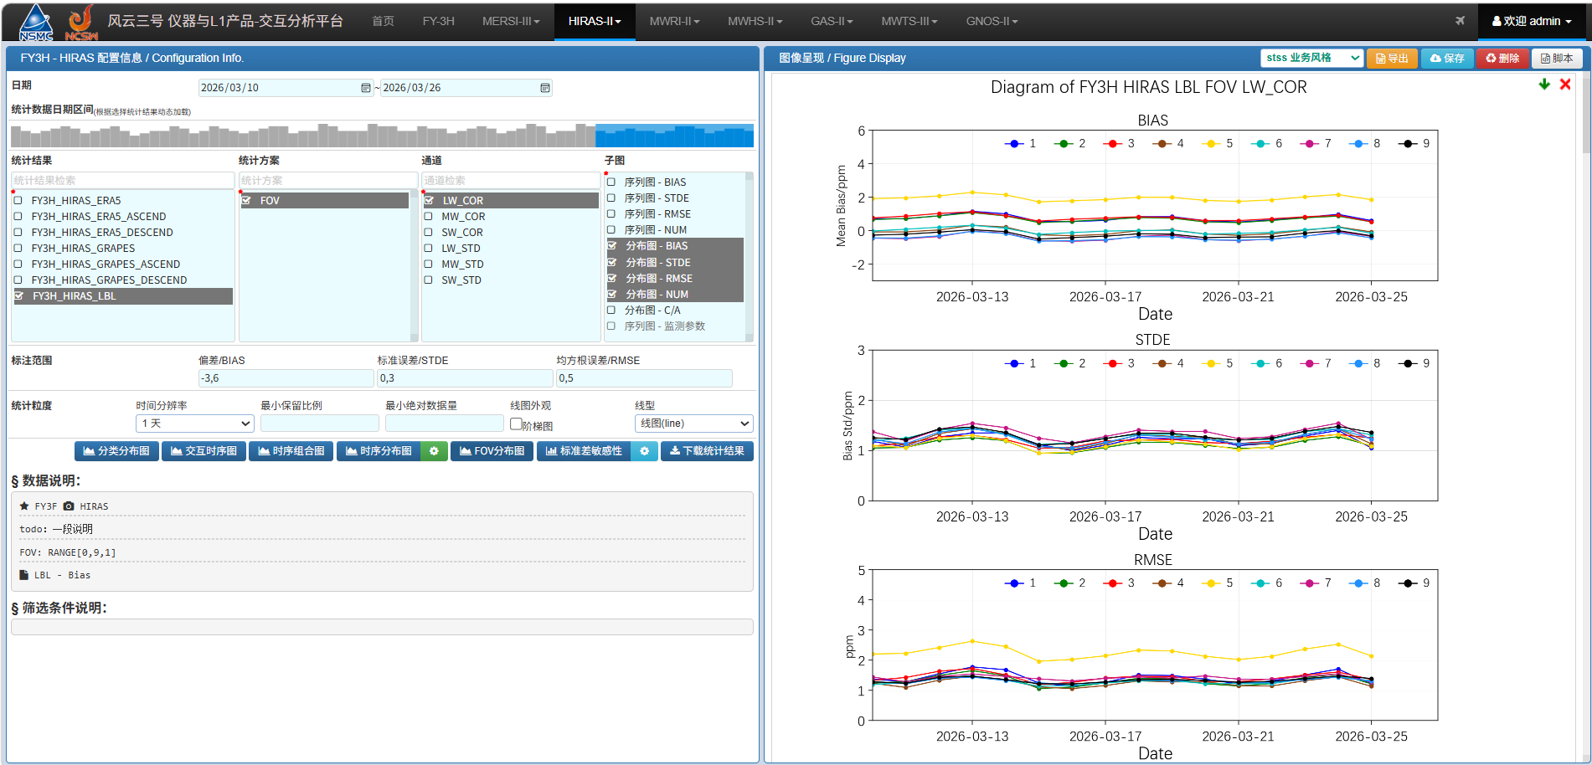
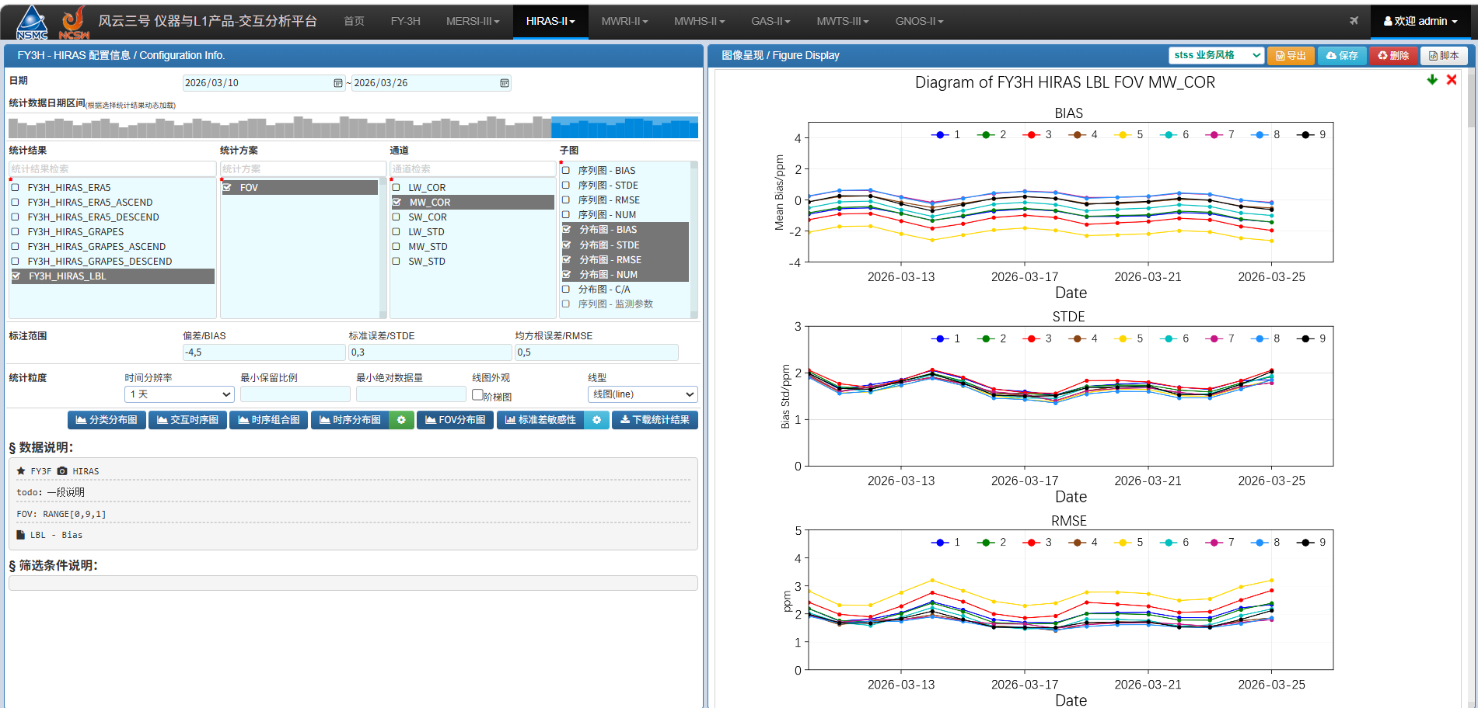
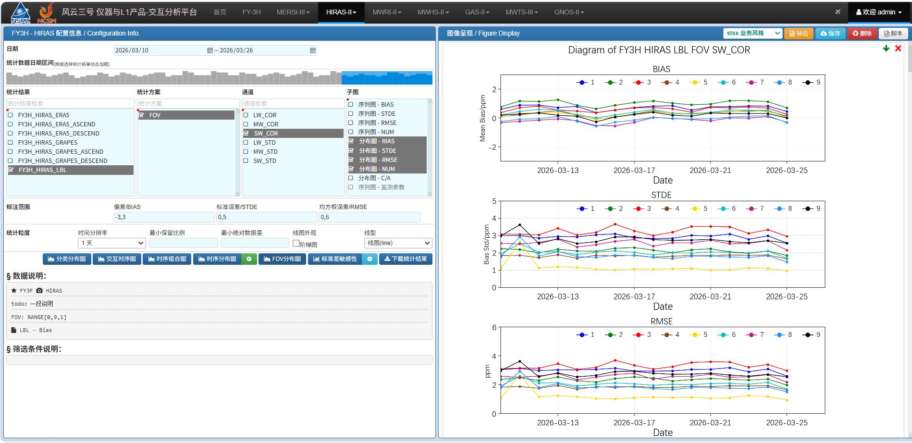
HIRAS spectral calibration monitoring
The spectral calibration accuracy of HIRAS is routinely monitored by comparison with spectra simulated using LBLRTM.

Slide 12
Summary
The monitoring system can automatically perform operational monitoring of the satellite platform, instrument status, and data quality, and is not limited to HIRAS.
The monitoring system features interactive capabilities and can analyze instrument calibration performance using multiple approaches.
Currently, the monitoring system has an automated set of criteria for detecting instrument or data anomalies. In the future, it will integrate an AI-based instrument status diagnosis and alert system for faster response and more accurate assessments.

Slide 13
Thank you !
Email: wangjw@cma.gov.cn

