Slide 1
MTG-S IRS Status
Dorothee Coppens, Pierre Dussarrat, Guillaume Deschamps
GSICS Annual meeting – Ottawa – 23-27 March 2026

Slide 2
Agenda
IRS mission in short
IRS commissioning activities and some results

Slide 3
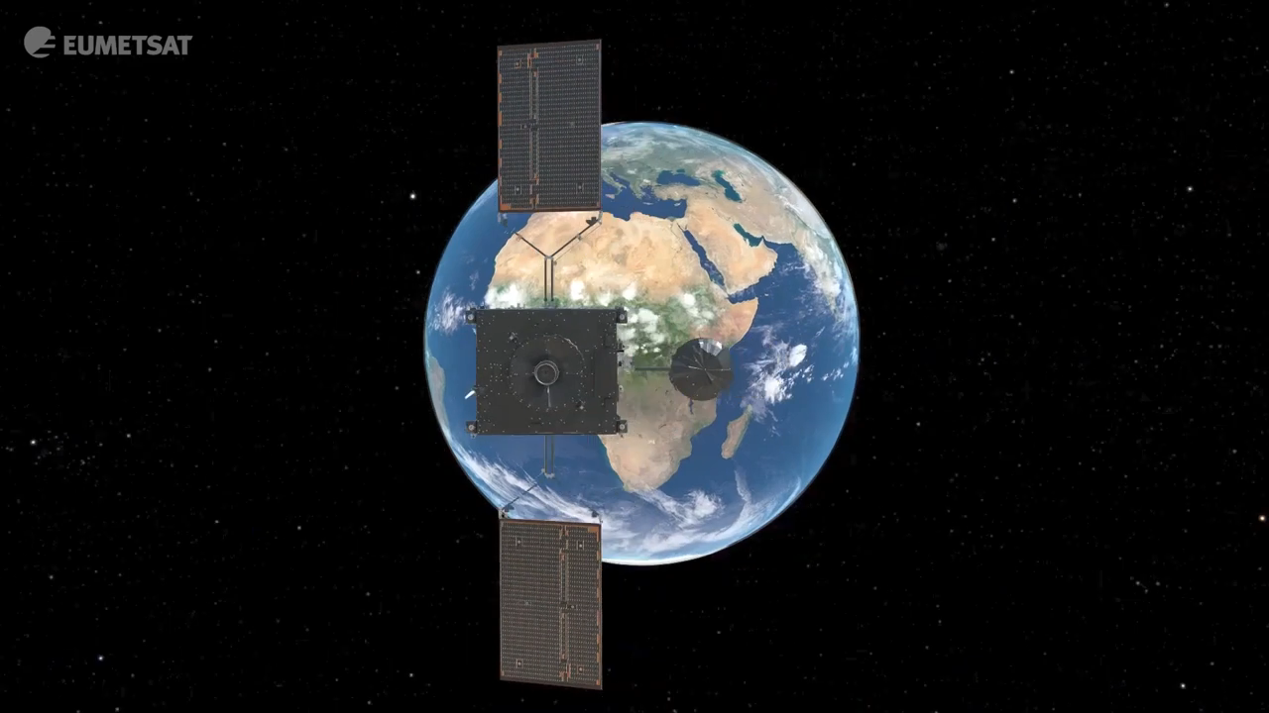

Slide 4
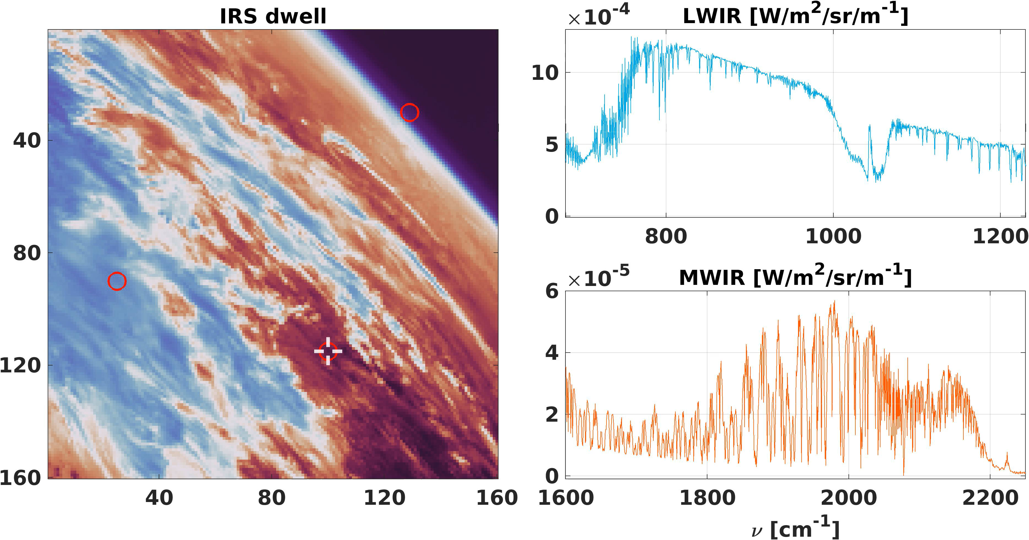
IRS mission
InfraRed Sounder (IRS)
  Imaging capabilities: 160 x 160 = 25,600 soundings per dwells (10s)
  4 km (at nadir) resolution and revisit every 30 min over Europe
  2 spectral bands (1953 channels):
    LWIR 680 – 1210 cm-1
    MWIR 1600 – 2250 cm-1
  Spectral sampling: ~0.605 cm⁻¹
  Total of ~170M soundings per day (IASI: ~1.3M)
  ➔ Unprecedented density of acquisitions

Slide 5
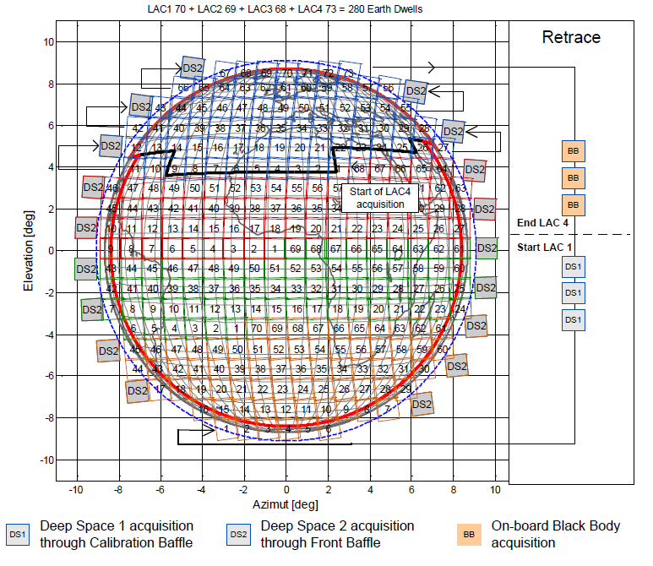
IRS calibration
Radiometric calibration:
  Deep Space 2 (DS2) measurements are used to evaluate the instrument offset (~3min)
  On-board reference Black Body (BB) and Deep space 1 (DS1) measurements are used to evaluate the instrument gain (~15min)
  Requirement of absolute calibration: <0.5K (Target: 0.1K)
Spectral calibration:
  Evaluation using absorption line fitting of spectra acquired over the North Atlantic (30 min)
  Requirement: 3ppm (LWIR) and 1ppm (MWIR)

Slide 6
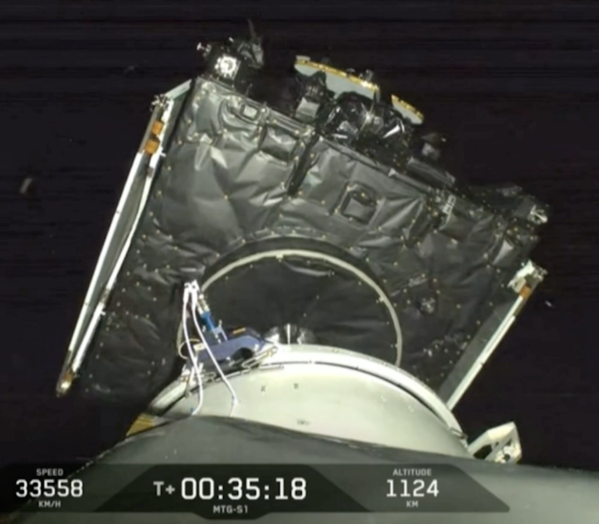
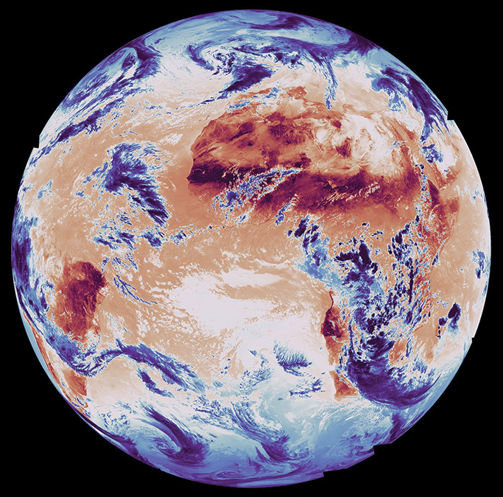
IRS Commissioning activities
July-Sept | LEOP 5 weeks decontamination
September | First IRS acquisition First calibration using the IRS L0/L1 prototype (ISARD) → IRS first light (next slide)
Oct/Nov | On-board detector and processing optimization
December | Reflectivity (front section, scan and flip-in mirrors), non-linearity and sub-pixel deselection characterizations Very early dissemination to MAG members
February | First INR tuning – To be implemented in the IDPF-S
March | Sun straylight characterization (by platform de-pointing) Sun avoidance scanning pattern testing
April | Second INR tuning – To be implemented in the IDPF-S New version of IDPF-S including scene analysis and clouds Demonstration data set (~1 week) release to MAG members
May/June | Final tuning of the parameters, incl. MAG members feedbacks Trial dissemination to Met services
July | Pre-operational dissemination data to all users
2025
2026

Slide 7
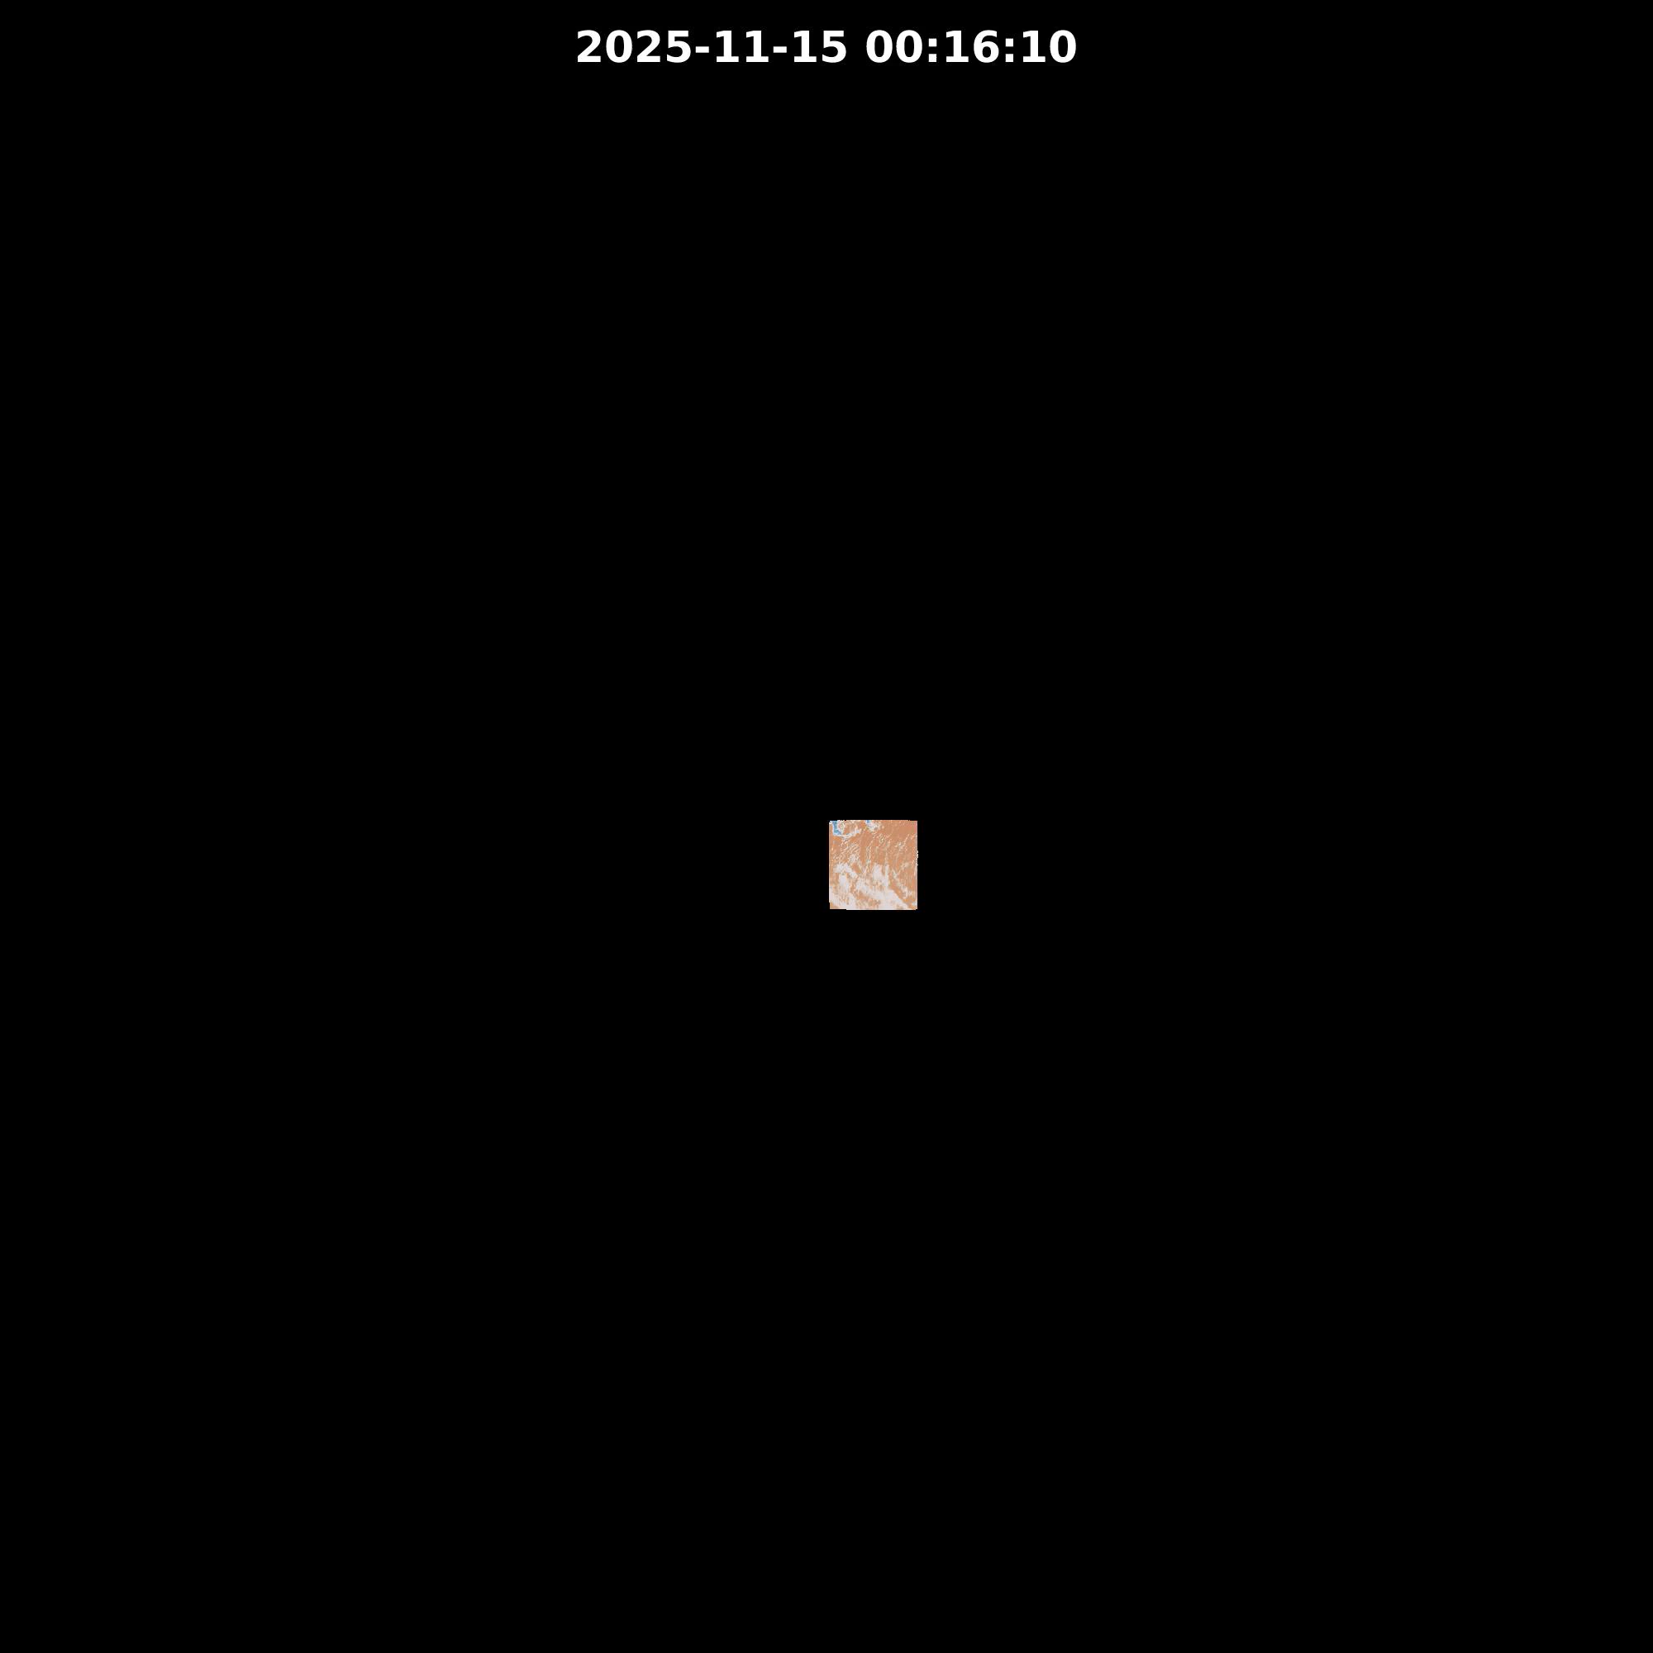
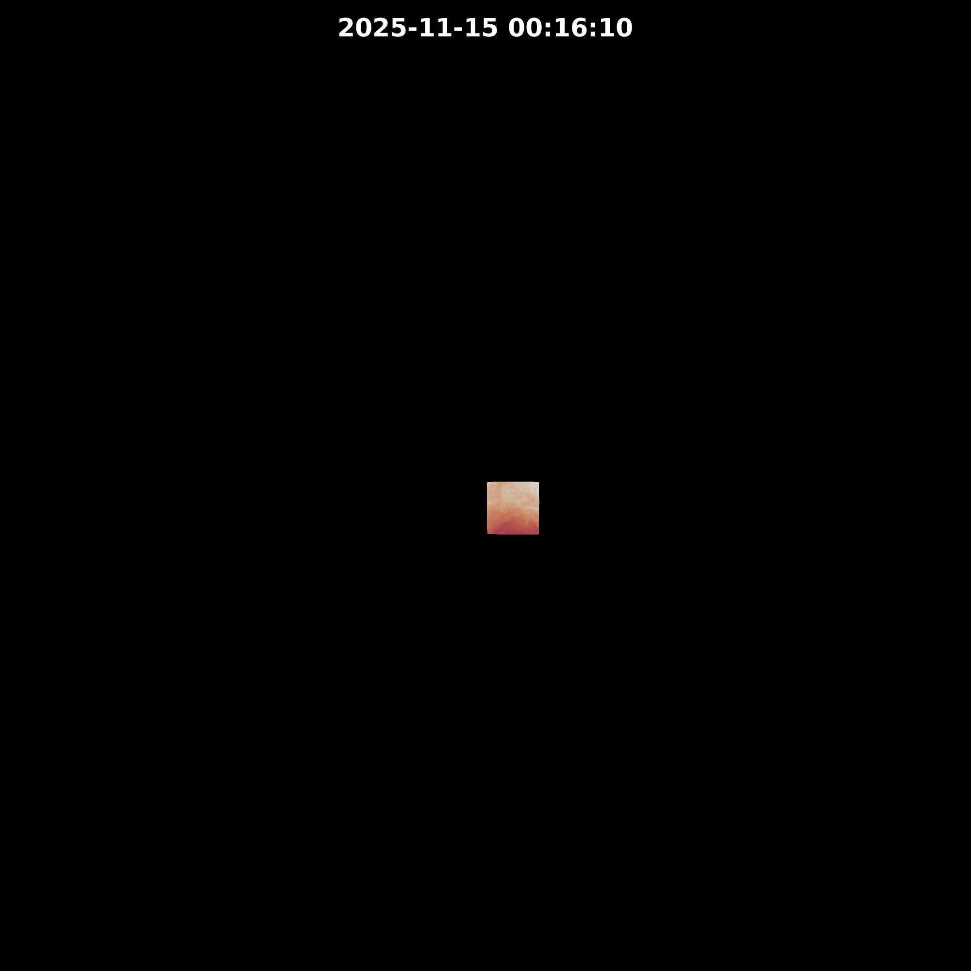
  IRS L1 images – 2 bands
Surface-temperature-sensitive channel – highlighting land and sea surface temperatures as well as cloud-top temperatures and cloud structures
Humidity-sensitive channel – highlighting the atmospheric movement lined to humidity and winds, linked to weather structures

Slide 8
IRS L0/L1 commissioning schedule
Sept 2025 | First IRS acquisition First calibration using the IRS L0/L1 prototype (ISARD) → IRS first light
Oct 2025 | Start of the IRS L1 operational processing (IDPF-S)
Nov 2025 | IDPF-S (without INR i.e. No navigation) is running operationally
Dec 2025 | Very early dissemination to MAG members 12/11/2025 (08:00 UTC) to 17/11/2025 (23:58 UTC): operational data acquired in the scope of the “IQT first tuning” test block using the commissioning scanning sequence 23/11/2025 (00:00 to 23:59 UTC): operational data acquired using the commissioning scanning sequence, including the eruption of the Hayli Gubbi volcano 27/11/2025 (00:01 to 23:59 UTC): operational data acquired with the operational scanning sequence
Feb 2026 | First INR tuning – To be implemented in the IDPF-S
April 2026 | Second INR tuning – To be implemented in the IDPF-S Level 1 demonstration data set (~1 week) release to Cal/Val partners
May 2026 | Level 1 Trial dissemination of pre-operational data (selected users)
July 2026 | Level 1 Dissemination of pre-operational data (all users)
Now!

Slide 9
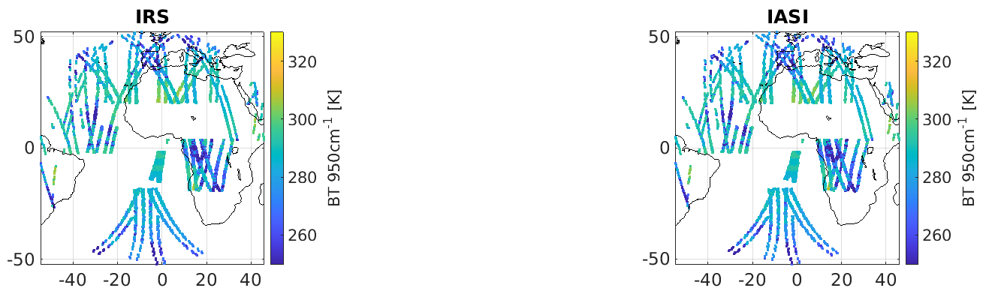
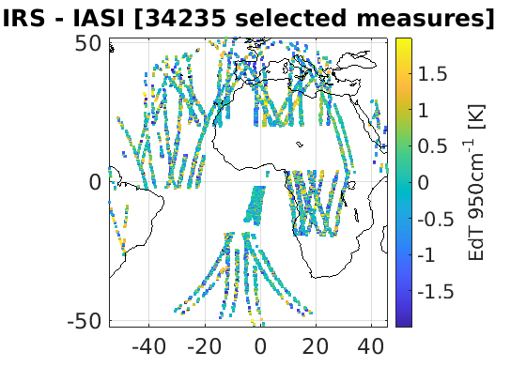
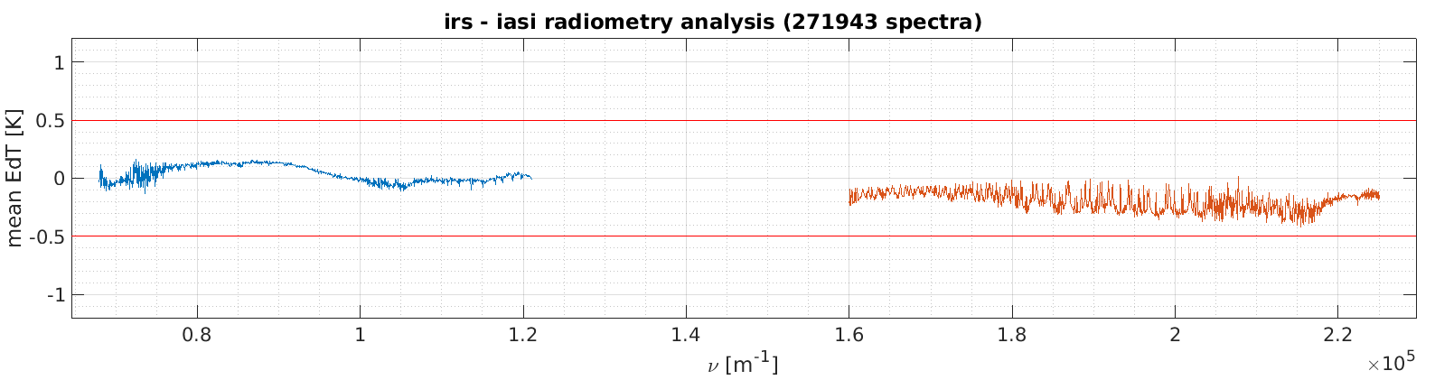
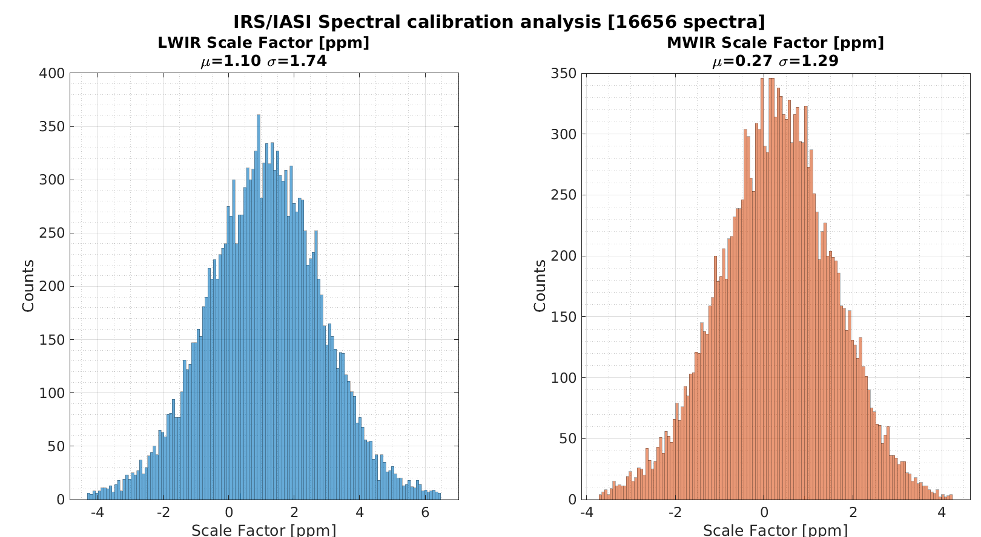
Preliminary performance assessment
ACROSS tool (EUMETSAT): Analysis of collocated acquisitions between IRS and IASI (taken as reference)
Radiometric calibration:
  Within the 0.5K radiometric accuracy requirement
  On-going investigations and characterization should further improve the comparisons, with the aim of reaching <0.1K differences
Spectral calibration:
  Within the 3 (MW) and 1ppm (LW) requirement
  On-going evaluation of chromatism
Complete performance evaluation will be published after the commissioning and release of the IRS L1b pre-operational product in July 2026
1.1 ppm
0.27 ppm

Slide 10
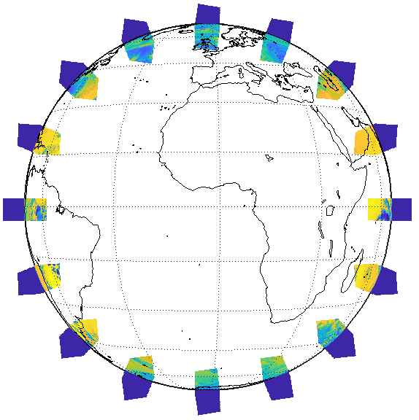



Preliminary in-field straylight correction
Straylight characterization scan law
INCA tool (EUMETSAT) to assess the IRS L0/L1 performances
EUM effort for modelling and mitigating in-field straylight of IRS:
  Creation of a complete straylight model in collaboration of ESA, OHB and TAS
  Design of an innovative post-processing for straylight mitigation (SRF uniformization and deconvolution*)
  Straylight model validation and adjustment in-flight using limb views and a dedicated scan law sweeping the Earth’s limb (space view taken as radiometric reference)
  ~2/3 of straylight is currently removed and further optimization is studied
IRS iPSF model
LWIR
MWIR
Measured
Corrected
Difference
Measured
Corrected
Difference
Dussarrat, P., Deschamps, G., Dehnavi, S., Theodore, B., & Coppens, D. (July 2023). Impact of straylight in Michelson Fourier transform spectrometers. In International Conference on Space Optics—ICSO 2022 (Vol. 12777, pp. 2272-2283). SPIE.

Slide 11
Thank you!
IRS pre-operational dissemination:
  L1b products in July 2026
  L2 products in Q4/2026-Q1/2027

