Slide 1
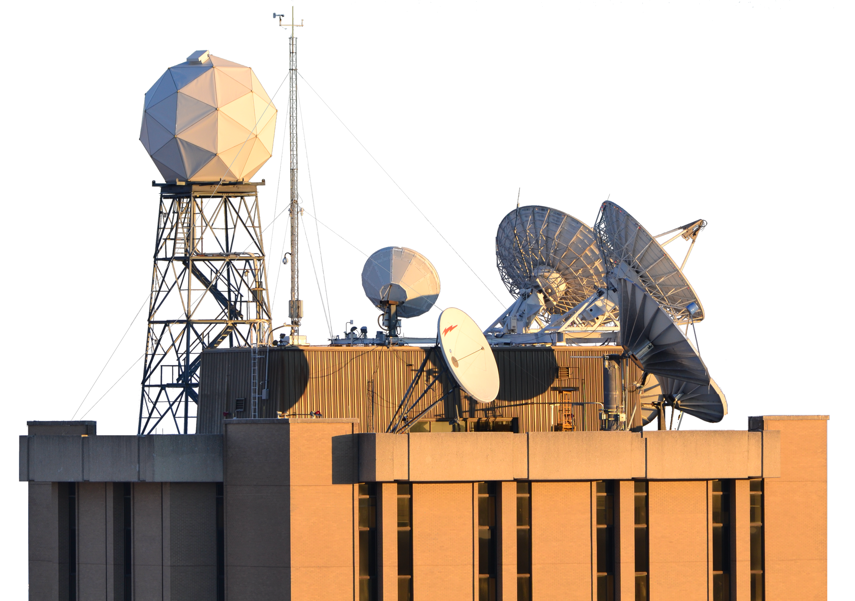



The Cross-track Infrared Sounder (CrIS) Hybrid Principal Component Analysis / Rapid Event Detection (PCA/RED) Product
David Tobin and Joe Taylor
Cooperative Institute for Meteorological Satellite Studies,
Space Science and Engineering Center,
University of Wisconsin-Madison
GSICS Annual Meeting
Ottawa, Canada
March 2026

Slide 2
With acknowledgements to:
Tim Hultberg
Dorothee Coppens
Larrabee Strow
CrIS SDR Cal/Val team
Support from NASA grant 80NSSC22K0713

Slide 3
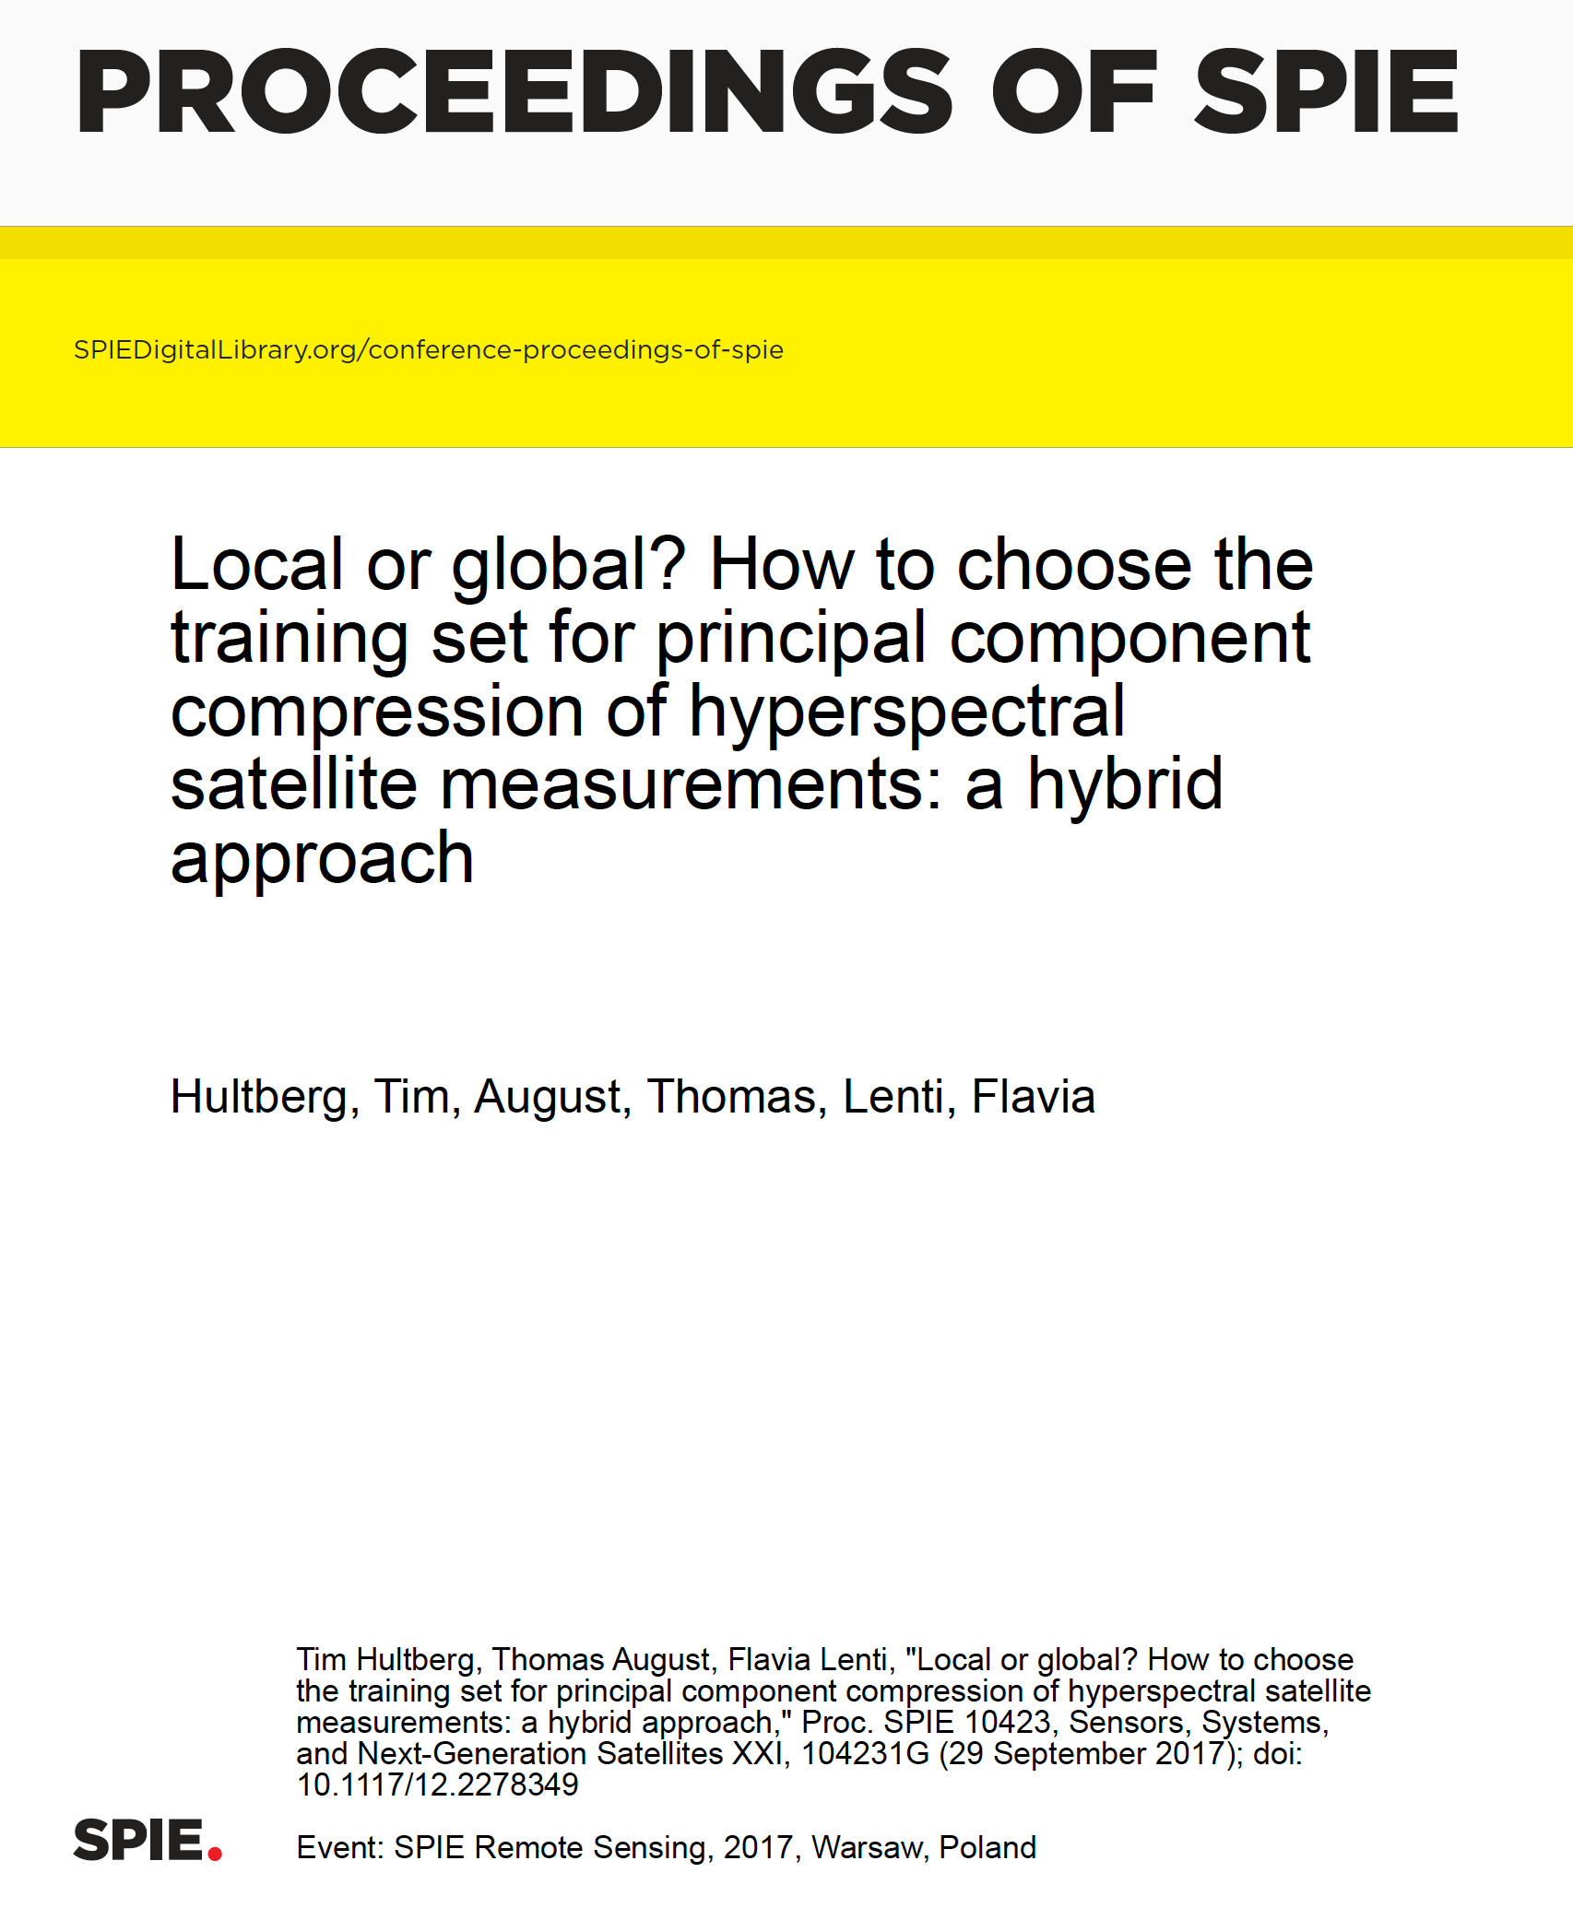
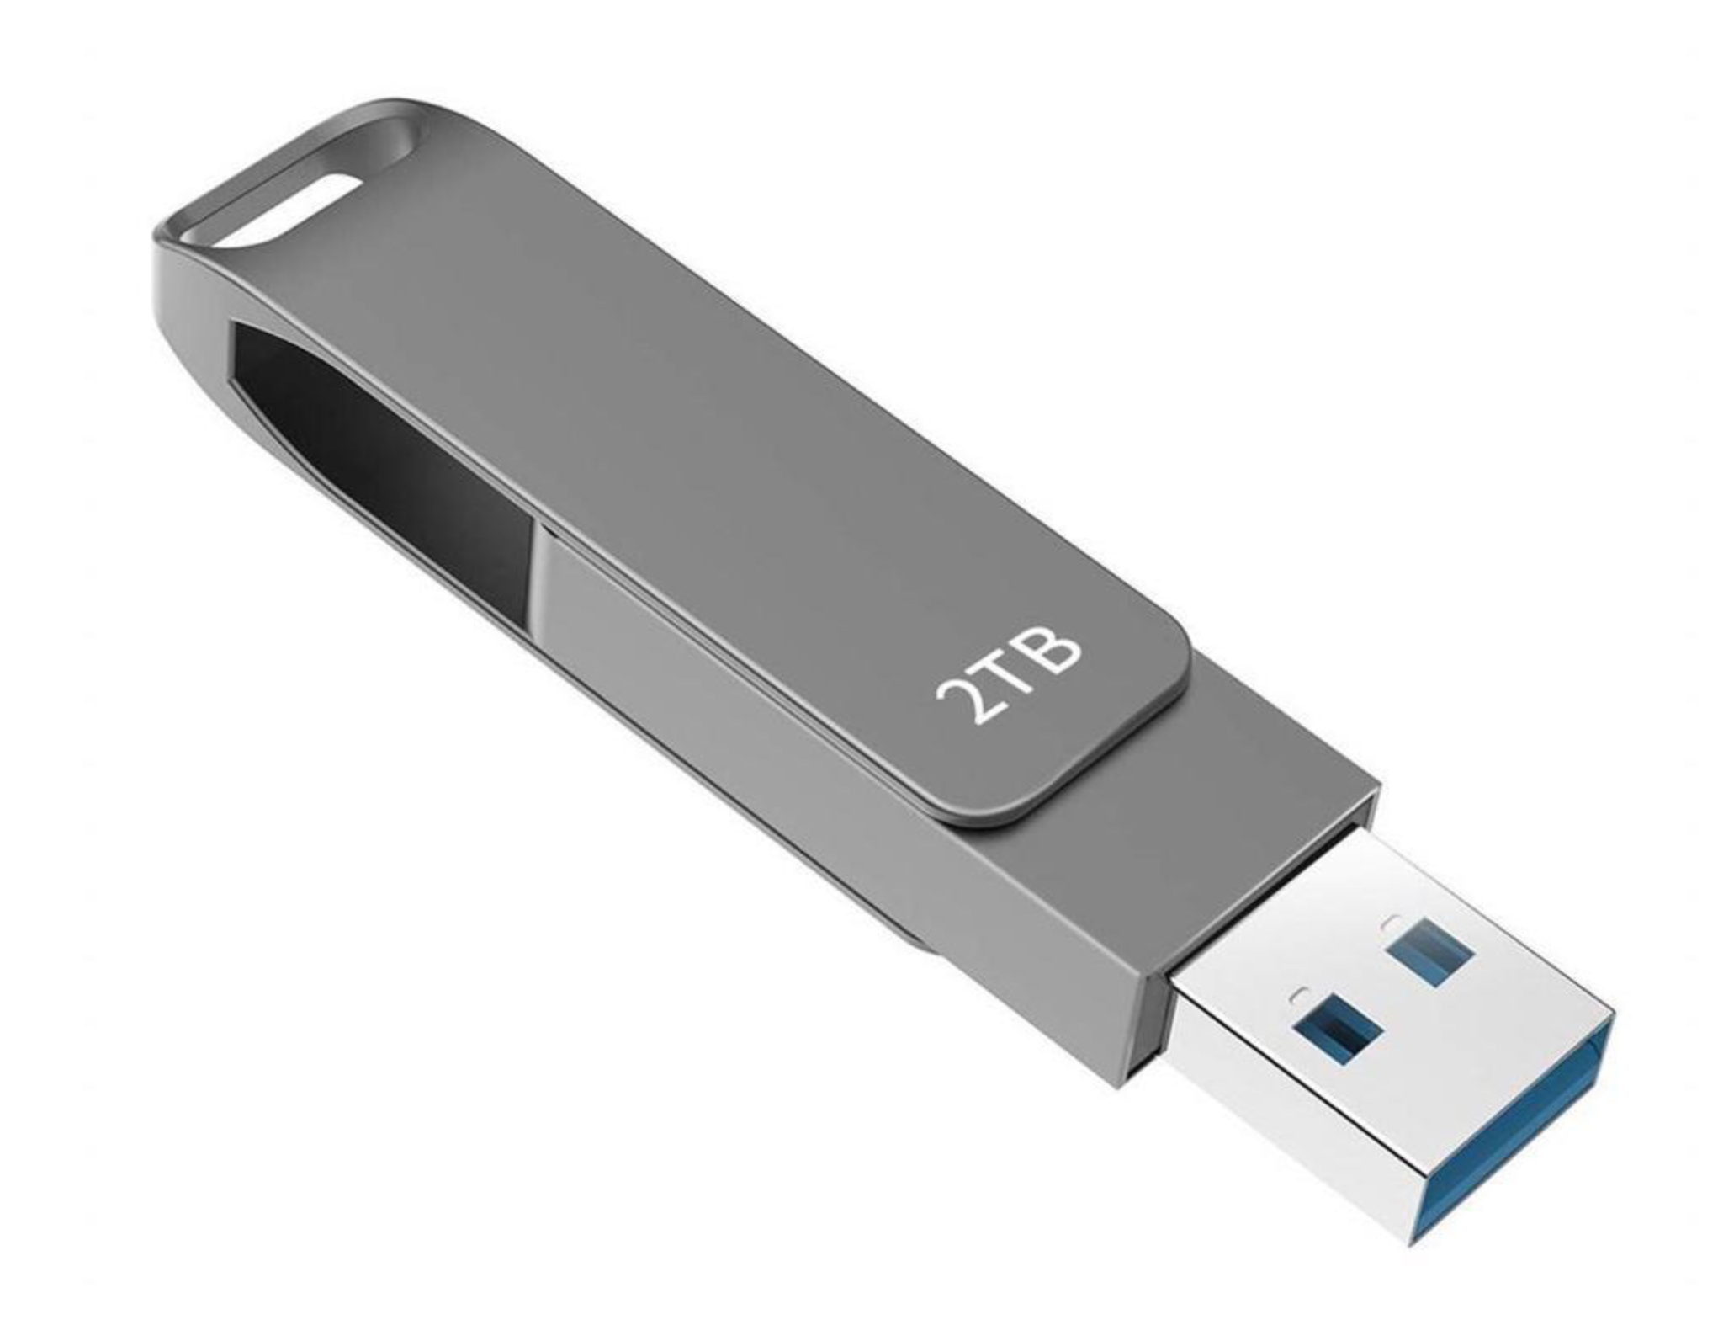
Introduction
The EUMETSAT Hybrid PCA technique
  e.g.: Hultberg et al. 2017
  Available for IASI, IASI-NG and MTG-IRS
Benefits
  Data compression, up to ~50x
    CrIS data accessibility
    Preparing for future sensors
  Random Noise Filtering
  Rare Events Detection (RED)
SNPP mission

Slide 4
References
Huang et al., 2001. Application of Principal Component Analysis to High-Resolution Infrared Measurement Compression and Retrieval. Journal of Applied Meteorology. 40. 365-388. 10.1175/1520-0450(2001)040<0365:AOPCAT>2.0.CO;2.
Antonelli et al., 2004, A principal component noise filter for high spectral resolution infrared measurements. Journal of Geophysical Research. 109. 10.1029/2004JD004862.
Turner et al., 2006. Noise Reduction of Atmospheric Emitted Radiance Interferometer (AERI) Observations Using Principal Component Analysis, Journal of Atmospheric and Oceanic Technology, 23(9), 1223-1238.
Tobin et al., 2007. Hyperspectral data noise characterization using principal component analysis: application to the atmospheric infrared sounder, J. Appl. Rem. Sens. 1(1) 013515 doi: 10.1117/1.2757707
Zavyalov et al., 2011. Preflight assessment of the Cross-track Infrared Sounder (CrIS) performance. Proc. SPIE Eur. Atmos. Remote Sens.. 8176. 10.1117/12.897674.
Serio et al., 2015. Infrared atmospheric sounder interferometer radiometric noise assessment from spectral residuals. Appl Opt. 2015 Jul 1;54(19):5924-36. doi: 10.1364/AO.54.005924. PMID: 26193134.
Hultberg et al., 2017. Local or global? How to choose the training set for principal component compression of hyperspectral satellite measurements: a hybrid approach, Proc. SPIE 10423, Sensors, Systems, and Next-Generation Satellites XXI, 104231G (29 September 2017); doi: 10.1117/12.2278349.
Lee et al., 2019. HIRAS noise performance improvement based on principal component analysis. Appl Opt. 2019 Jul 10;58(20):5506-5515. doi: 10.1364/AO.58.005506. PMID: 31504021.
Serio et al., 2020. Characterization of the Observational Covariance Matrix of Hyper-Spectral Infrared Satellite Sensors Directly from Measured Earth Views. Sensors (Basel). 2020 Mar 9;20(5):1492. doi: 10.3390/s20051492. PMID: 32182769; PMCID: PMC7085552.
Tremblay et al., 2022, "Radiometric Noise Assessment of the Cross-Track Infrared Sounder on the NOAA-20 Satellite," in IEEE Transactions on Geoscience and Remote Sensing, vol. 60, pp. 1-15, 2022, Art no. 5506615, doi: 10.1109/TGRS.2021.3083137.
--
EUMETSAT, 2019. Release of simulated MTG IRS Level 1B data package. https://www.eumetsat.int/simulated-mtg-irs-l1b-dataset
EUMETSAT, 2021. Changes to PC compressed IASI L1C data. https://www.eumetsat.int/changes-pc-compressed-iasi-l1c-data

Slide 5
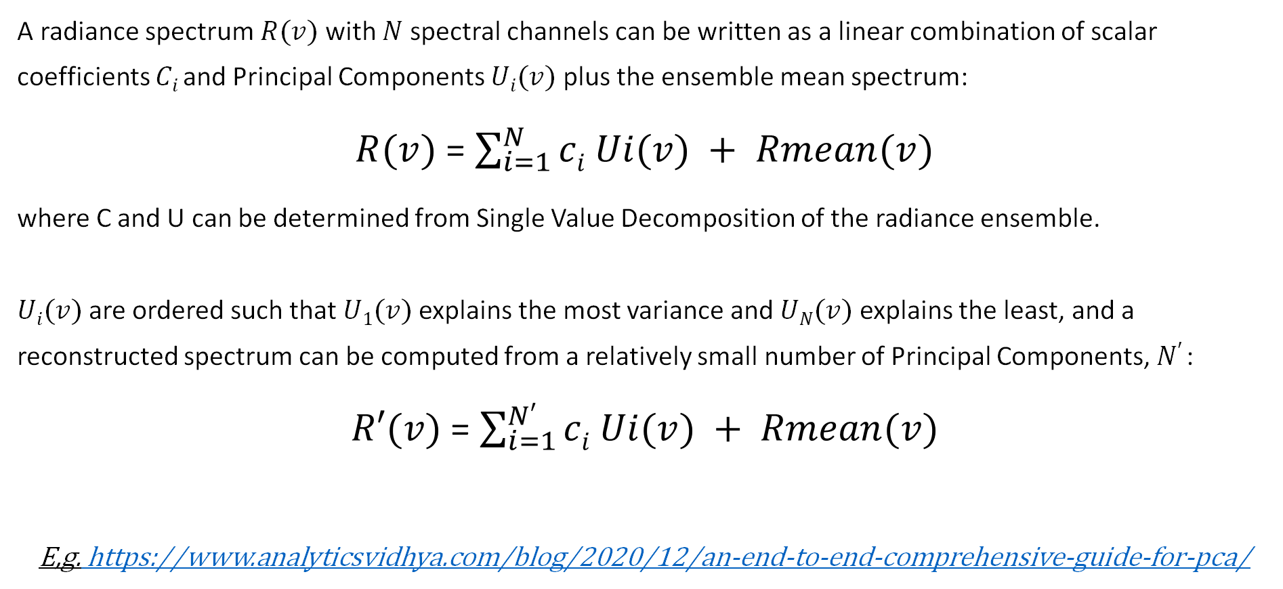
Principal Component Analysis (PCA)
A radiance spectrum $R(v)$ with $N$spectral channels can be written as a linear combination of scalar coefficients $Ci$and Principal Components $Ui(v)$ plus the ensemble mean spectrum:
$R(v)$ = $\sum_{i=1}^{N}{ci Ui(v) + Rmean(v)}$
where C and U can be determined from Single Value Decomposition of the radiance ensemble.
$Ui(v)$are ordered such that $U1(v)$ explains the most variance and $UN(v)$ explains the least, and a reconstructed spectrum can be computed from a relatively small number of Principal Components, $N′$:
$R′(v)$ = $\sum_{i=1}^{N′}{ci Ui(v) + Rmean(v)}$
E,g. https://www.analyticsvidhya.com/blog/2020/12/an-end-to-end-comprehensive-guide-for-pca/

Slide 6
CrIS Hybrid PCA Methodology
Determine a set of global PCs, “PC_{global}”
Based on a large representative set of spectra
The leading nPCs_{global} (150) global PCs are retained
These global PCs are “static” and distributed to users (and the global mean spectrum Rad_{global})
For any given granule of CrIS data
(1) Compute Coefficients for the global PCs, “C_{global}”
(2) Based on the global radiance reconstruction residuals of this granule, compute “Local PCs” (PC_{local}) and the corresponding coeficients “C_{local}” and retain these for the leading nPCs_{local} (10) local PCs (and the local mean residual spectrum Res_{local})
(3) Save C_{global}, PC_{local}, C_{local}, Res_{local} to a file for each granule
Final Reconstructed Radiances:
Rad_{Rec} = ( PC_{global} C_{global} + Rad_{global} ) + ( PC_{local} C_{local} + Res_{local} )
[2223xNrec] [2223x150] [150xNrec] [2223x1] [2223 x 10] [10 x Nrec] [2223 x 1]
Global Local
Notes:
Ma

Slide 7
CrIS Hybrid PCA Methodology (Cont.)
Other considerations:
  All three spectral bands combined
  All nine FOVs combined
  150 global PCs and 10 local PCs
  Sensor dependent global PCs (i.e. different PCs for NOAA-20 vs NOAA-21)
  Noise Normalization (FOV independent)
  Scaled integer representation of PC scores combined with NetCDF integer compression
  PC representation Quality indicators
  Individual Outliers

Slide 8
Global Training
global PCs
Based on a large representative set of spectra
Latitude weighting to not over-weight the poles
0.5 to 1B spectra per sensor
PCs computed from the SVD of covariance of the radiance ensemble
Covariance matrices of subsets (single days) of the ensemble combined into a covariance matrix for the entire ensemble following:
  Pebay, P., 2008, Formulas for Robust, One-Pass Parallel Computation of Covariances and Arbitrary-Order Statistical Moments: Sandia Report

Slide 9
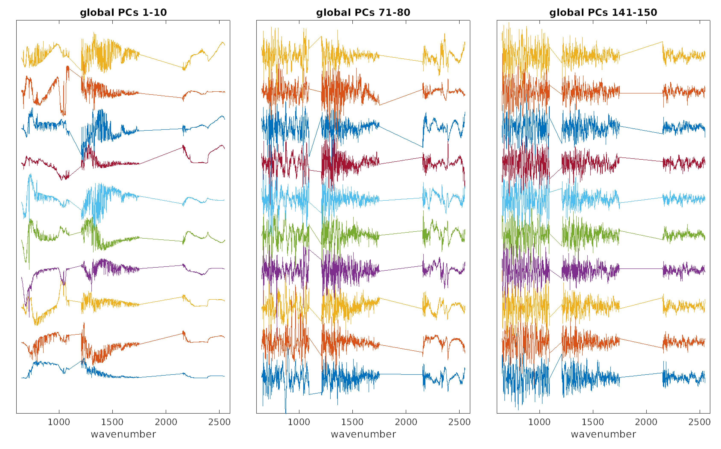
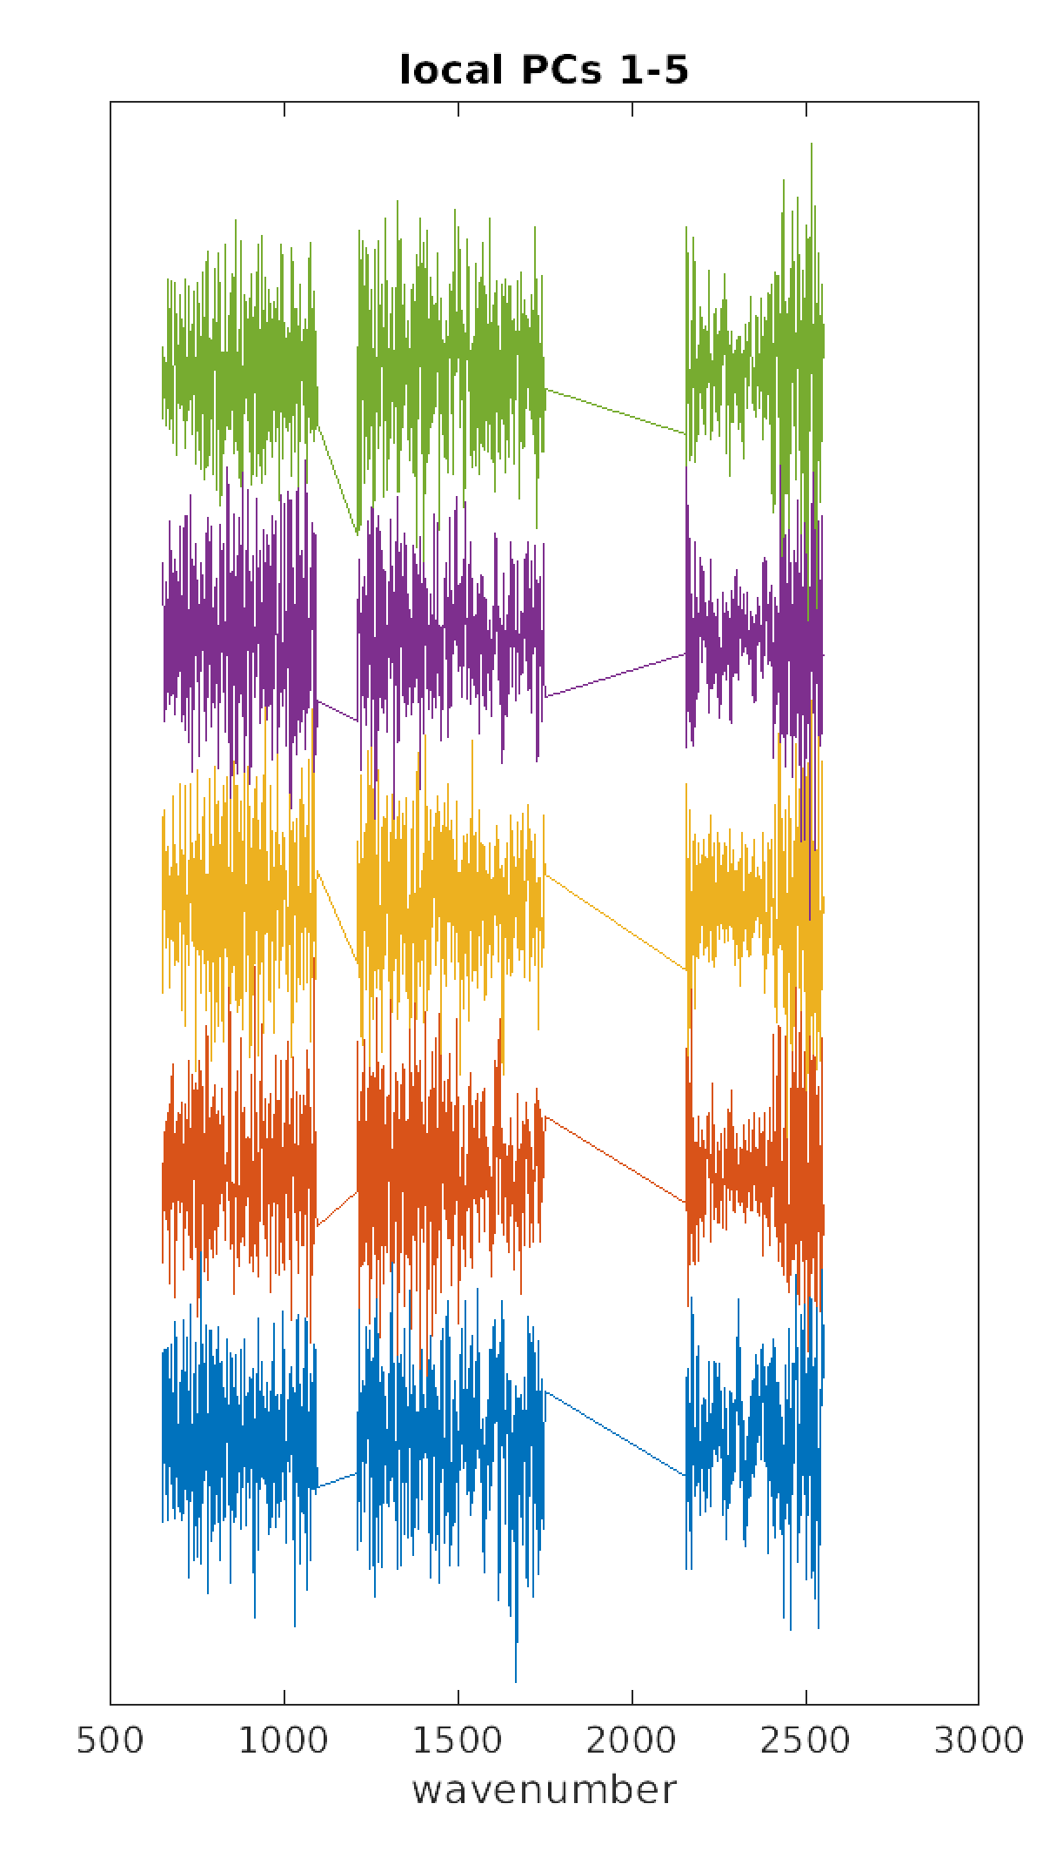
Example PCs
Global PCs
Local PCs
For a randomly selected SCRIF granule
10
80
150
1
71
141

Slide 10
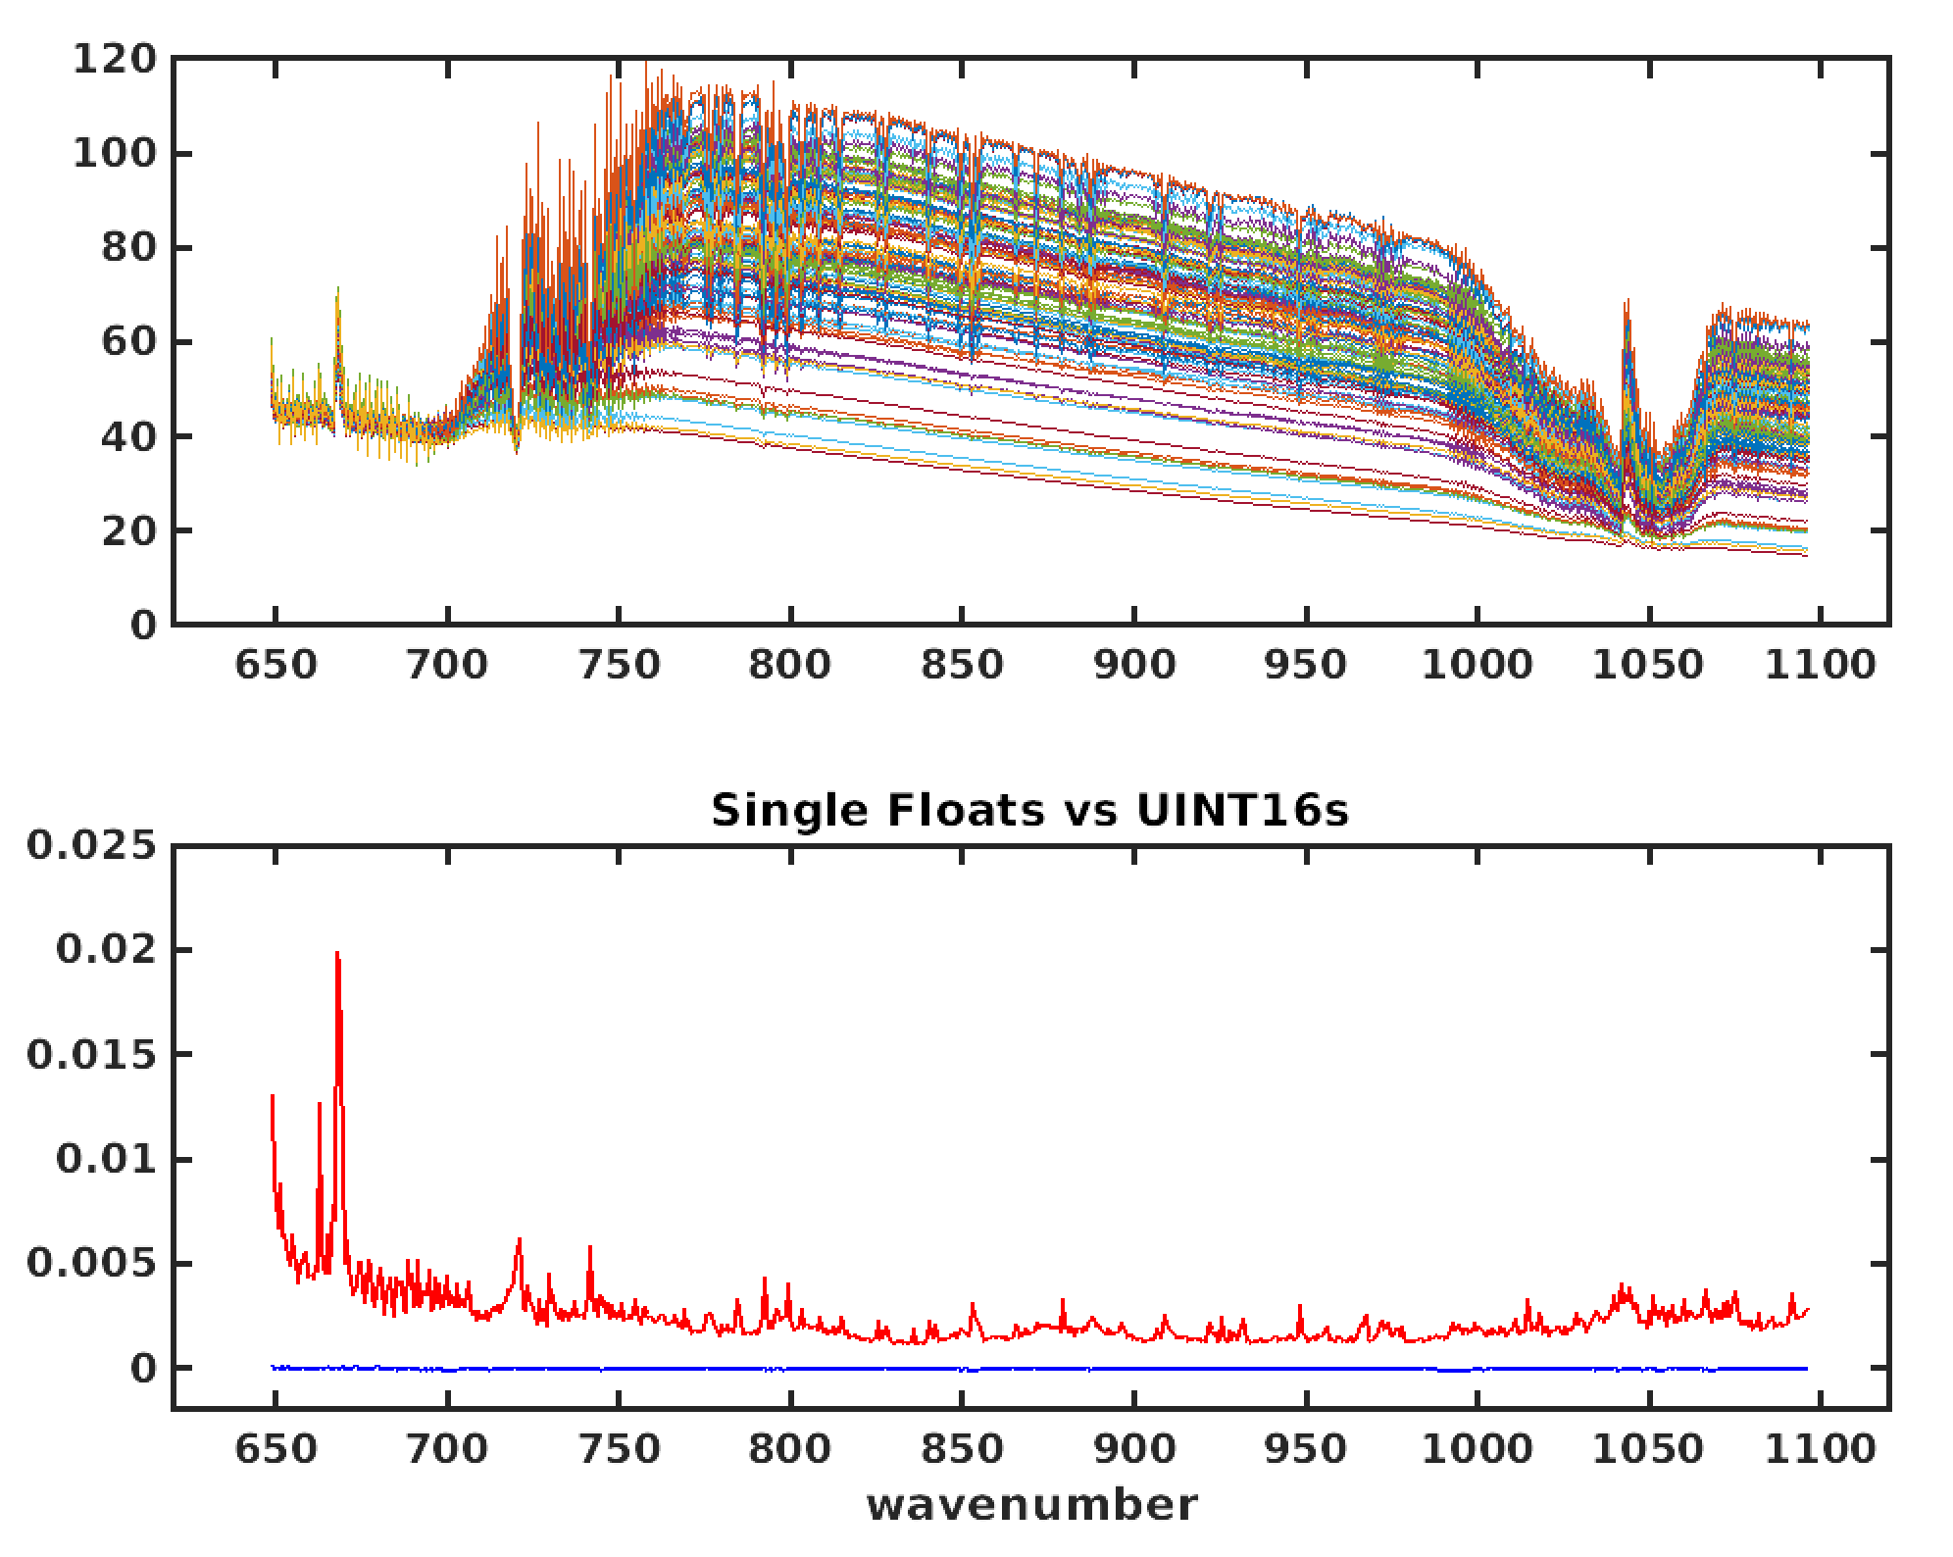
Scaled Integer representation of PC scores
Example reconstructed radiance differences
32 Bit Float vs 16 Bit Unsigned Integers
mW/(m² sr. cm⁻¹)
Mean
STDEV
mW/(m² sr. cm⁻¹)

Slide 11
Compression
Example for radiances from a 4 scan line CrIS granule (1080 spectra): 9,551,520 bytes
Global PCs (150 PCs, 1 time transfer): 2,653,200 bytes
Global Coefs (per granule): 648,000 bytes
Local PCs (10 PCs, per granule): 88,440 bytes
Local Coefs (per granule): 43,200 bytes
Per granule:
Original Radiances = 9,551,520 bytes (also includes imaginary part)
PC representation = 648,000 + 88,440 + 43,200 bytes = 779,640 bytes
PC/Original x100 = 8.2% ... PC data volume is ~8 percent of original radiance data volume
Original/PC = 12.3 … A factor of ~12 reduction in data transfer expense and data storage
And an additional compression of ~4x, from scaled integer representation of the PC scores -
gives total compression of ~50x
This large reduction is due to the lossy noise reduction/compression from the PCA …

Slide 12
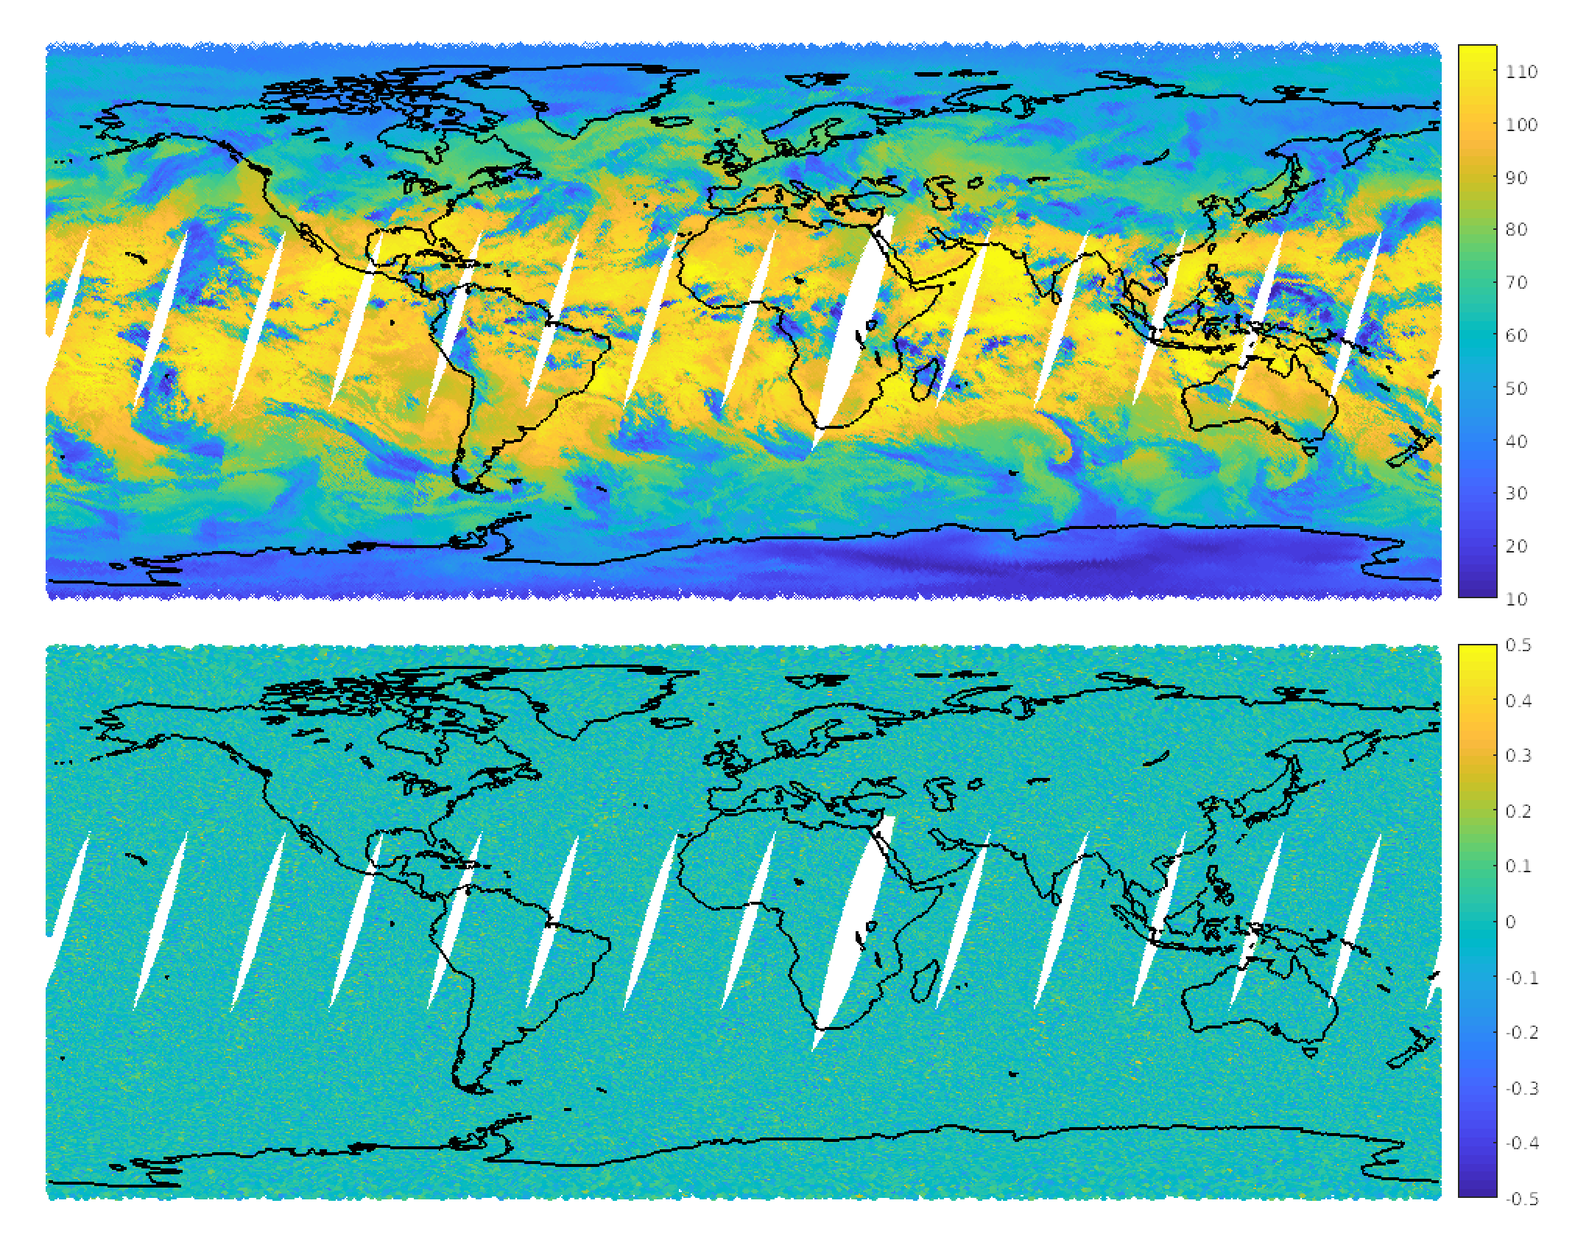
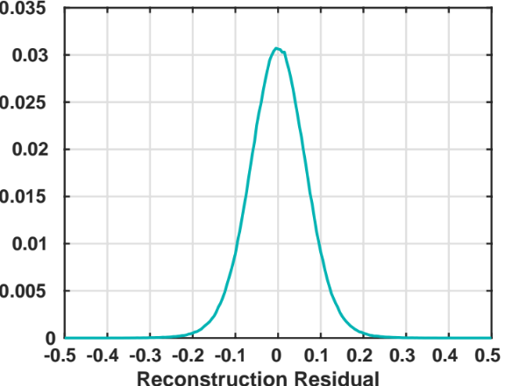
Random Noise Filtering
Example reconstruction residuals
900 cm⁻¹ radiances
20210413 NOAA-20 data
Original Radiance
mW/(m² sr. cm⁻¹)
Original minus Reconstructed Radiance
mW/(m² sr. cm⁻¹)
normalized counts
mW/(m² sr. cm⁻¹)

Slide 13
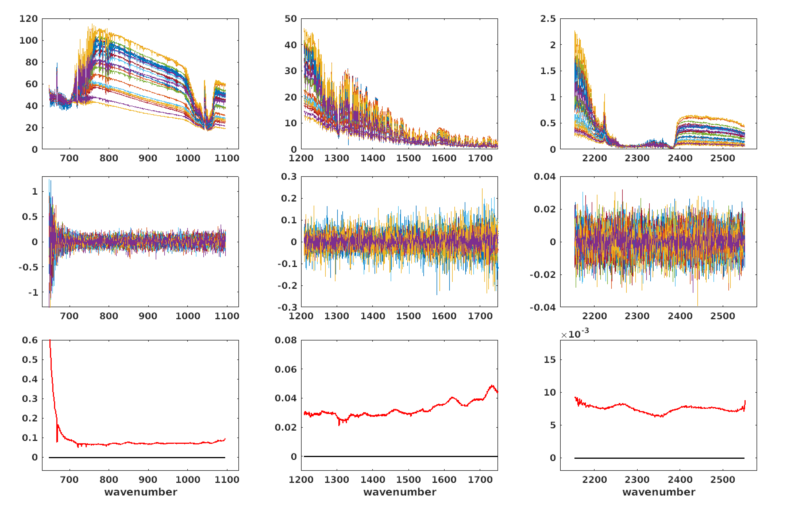
Random Noise Filtering
Example reconstruction residuals
20210413 NOAA20 radiances
~75% random Noise reduction [sqrt(160/2223)] produces data with FOV independent random noise levels
Longwave
Midwave
Shortwave
spectra
mW/(m² sr. cm⁻¹)
residuals
mW/(m² sr. cm⁻¹)
Mean residual
STDEV residual
mW/(m² sr. cm⁻¹)

Slide 14
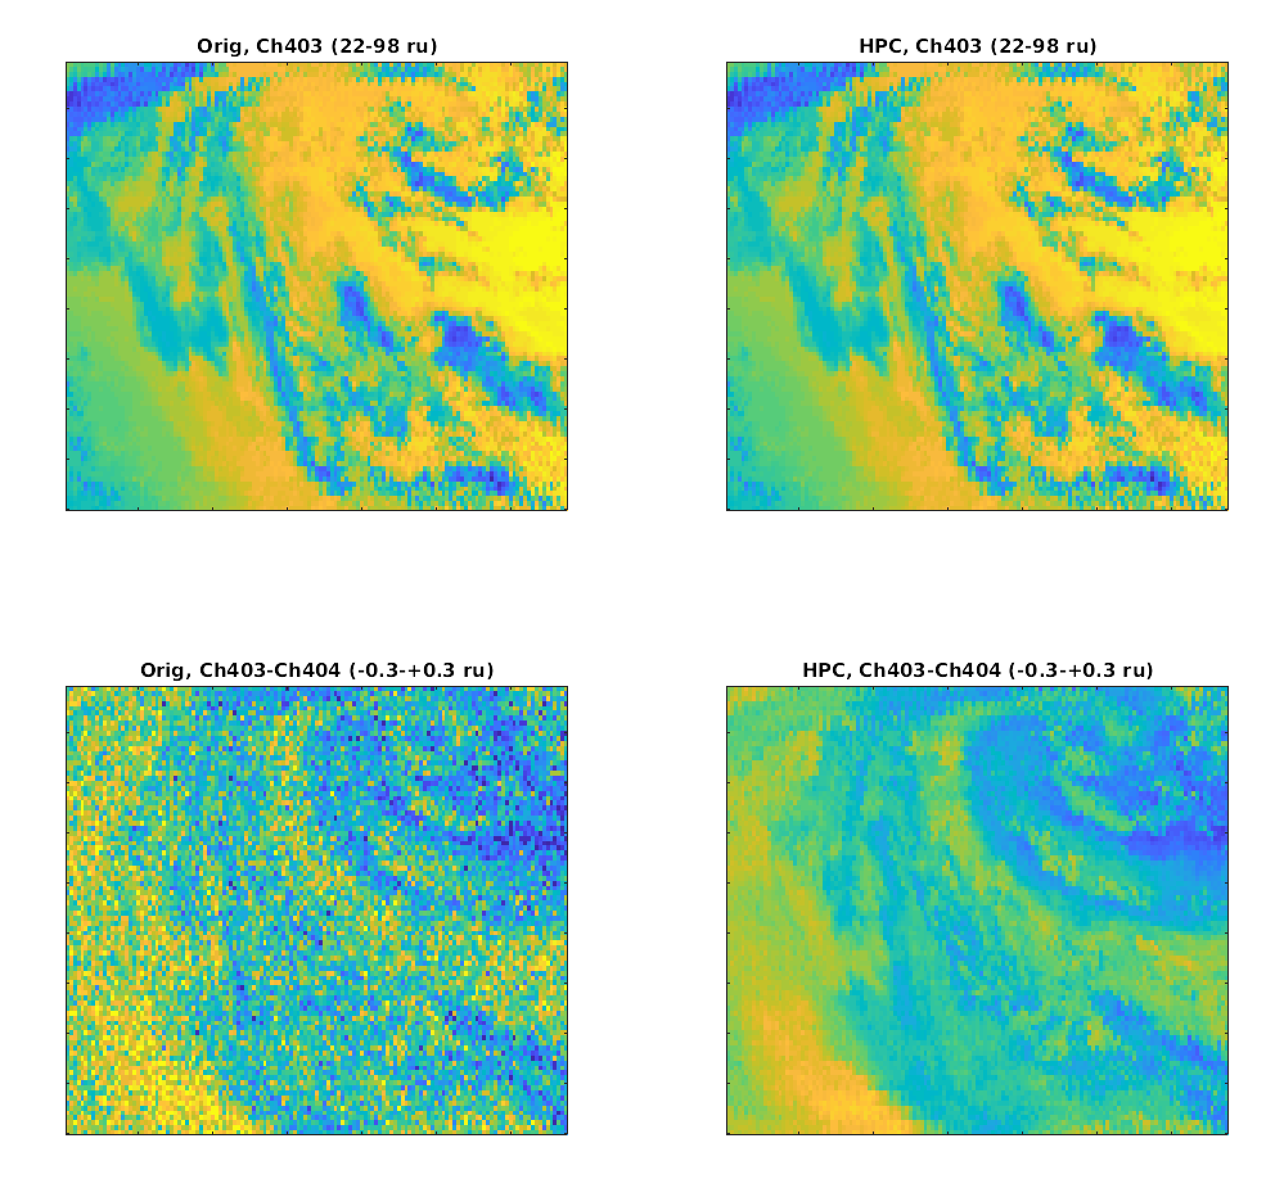
Data Compression and Random Noise Filtering
Original Radiances
PC Representation
  Example 40 scan line file
  Image of 900 cm⁻¹ radiances:
  Color scale is 20 to 100 mW/(m²sr. 1/cm)
~165Mb
~4Mb
  Channel difference image:
  900 cm⁻¹ minus 900.625 cm⁻¹:
  Color scale is -0.3 to 0.3 mW/(m²sr. 1/cm)

Slide 15
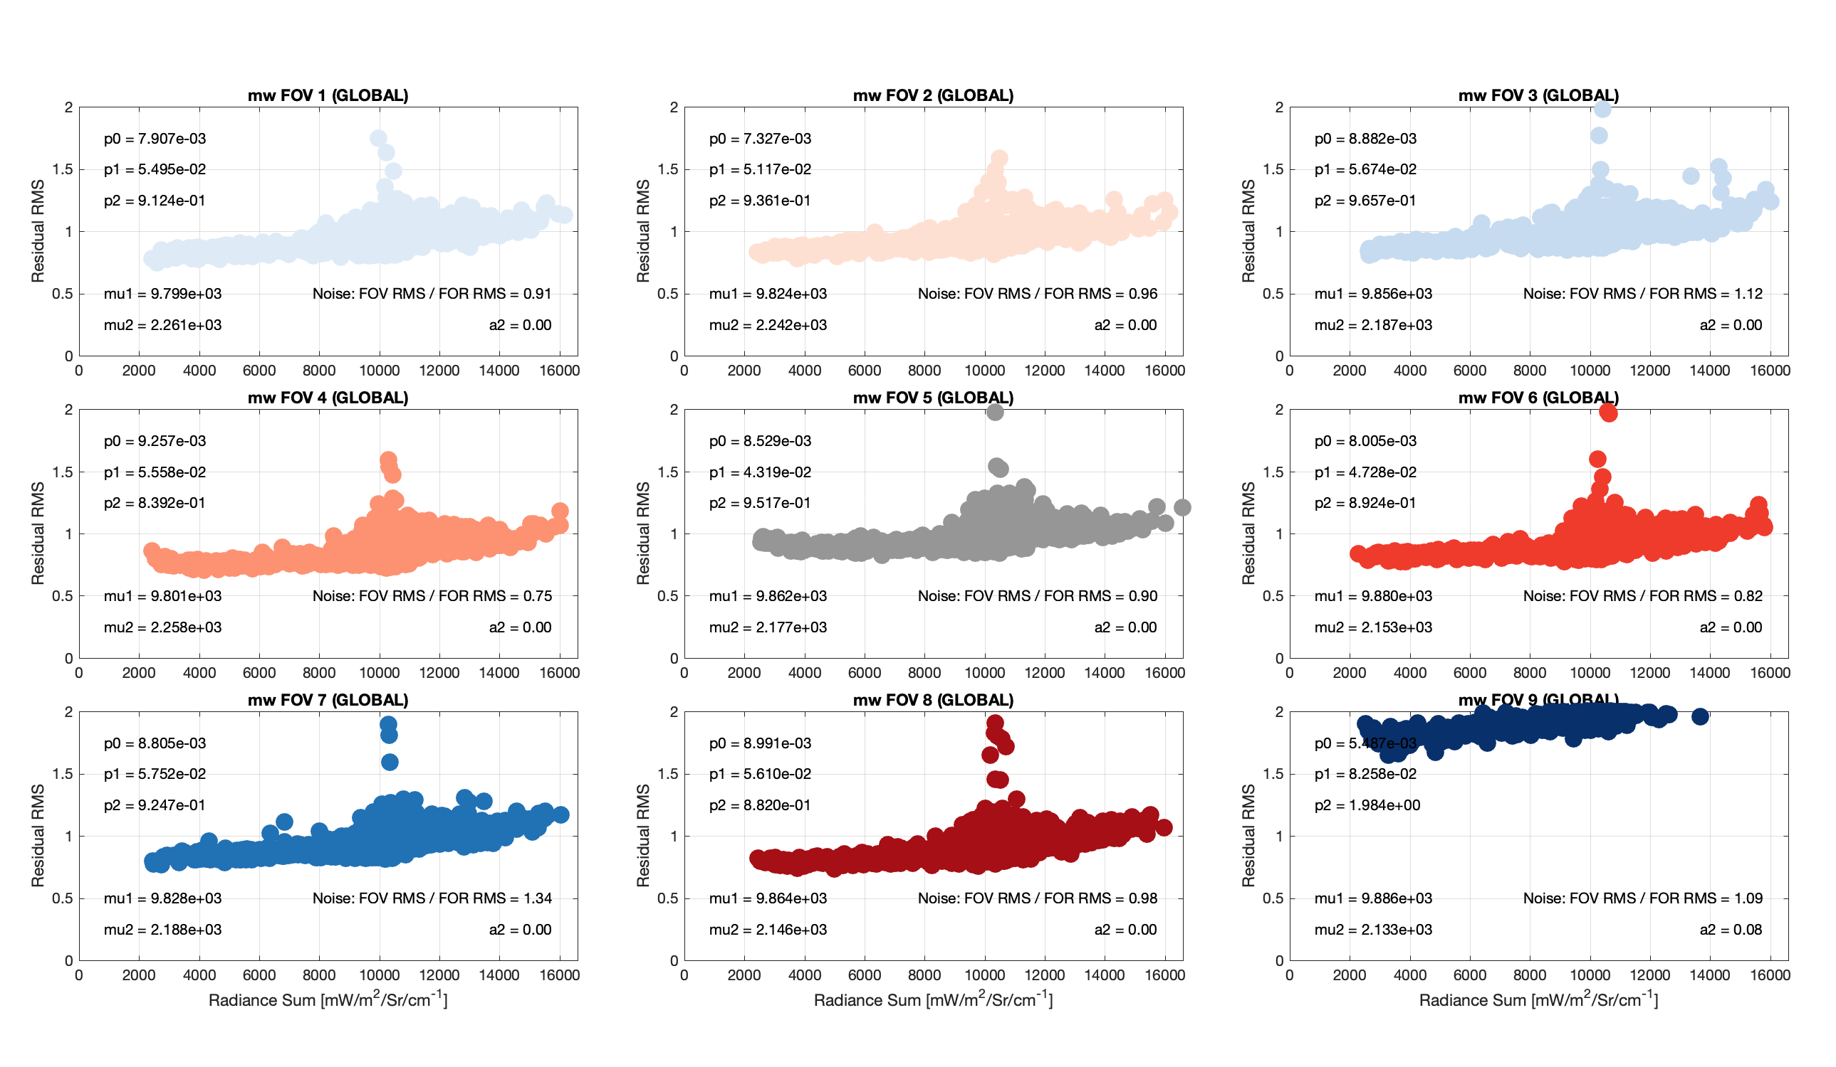
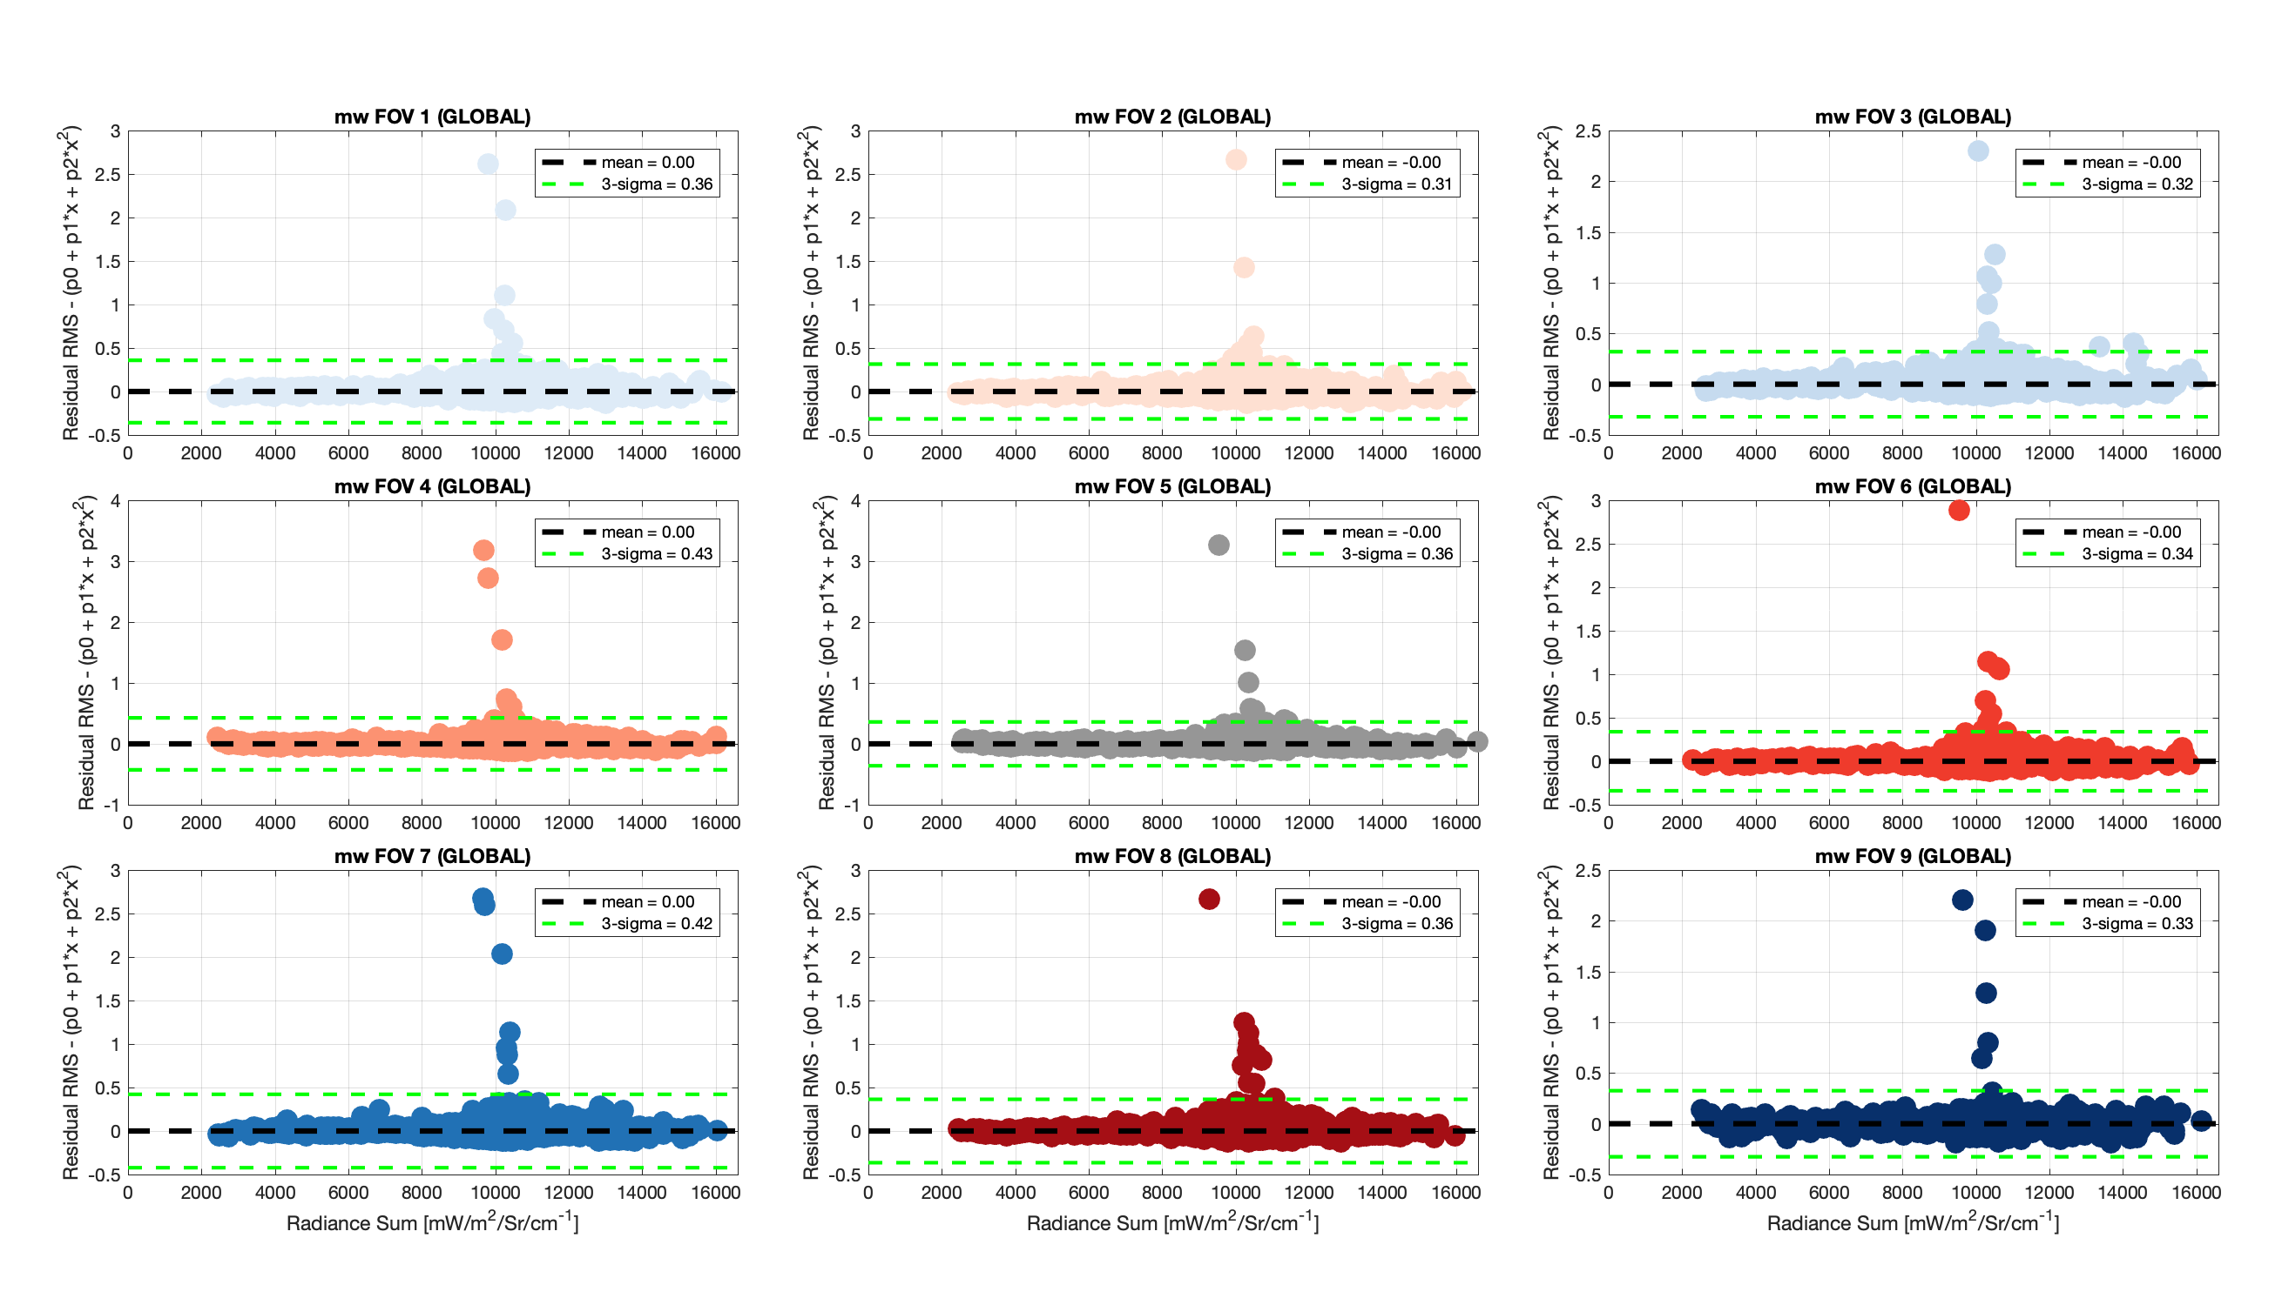
PC reconstruction Quality indicators
“De-trended” reconstruction RMS scores for each footprint and spectral band, for Global-only and Hybrid reconstructions
Corresponding Quality Flags
Original radiances for “Individual outlier” spectra, when identified, included in output PC files
Useful for “rare event” identifications
Example for 20220101 Mt. Etna eruption NOAA20 data (using Global-only PC reconstruction for demonstration)
Radiance RMS versus integrated radiance for MidWave band, by FOV:
Not de-trended
De-trended
*Following Hultberg et al: ‘IASI PC compression – Searching for signal in the residuals’ 13886-iasi-pc-compression-searching-sinal-residuals.pdf
and Hultberg, 2009, ‘IASI Principal Component Compression (IASI PCC) FAQ’ pdf_ipcc_faq.pdf

Slide 16
Rapid Event Detection: PCA RED Score Overview
“De-trended reconstruction scores” are generated for each observation
  “De-trending” removes detector dependence of the reconstruction score
25 Spectral regions:
  CrIS longwave, midwave, and shortwave bands,
  Emission/absorption features (e.g., O₃, CH₄, CO, SO₂, HNO₃, N₂O, NH₃, Isoprene, PAN, Acetylene, Ethylene, Ethane, etc.)
The local-only reconstruction score is used for Rapid Event Detection (RED)
  PCA RED scale: 0 – 127, with scores in the 0 – 10 region indicative of nominal (nonevent) behavior, and 127 defined as the fill value for missing data.
*Adapted from Hultberg et al: ‘IASI PC compression – Searching for signal in the residuals’ 13886-iasi-pc-compression-searching-sinal-residuals.pdf
and Hultberg, 2009, ‘IASI Principal Component Compression (IASI PCC) FAQ’ pdf_ipcc_faq.pdf

Slide 17
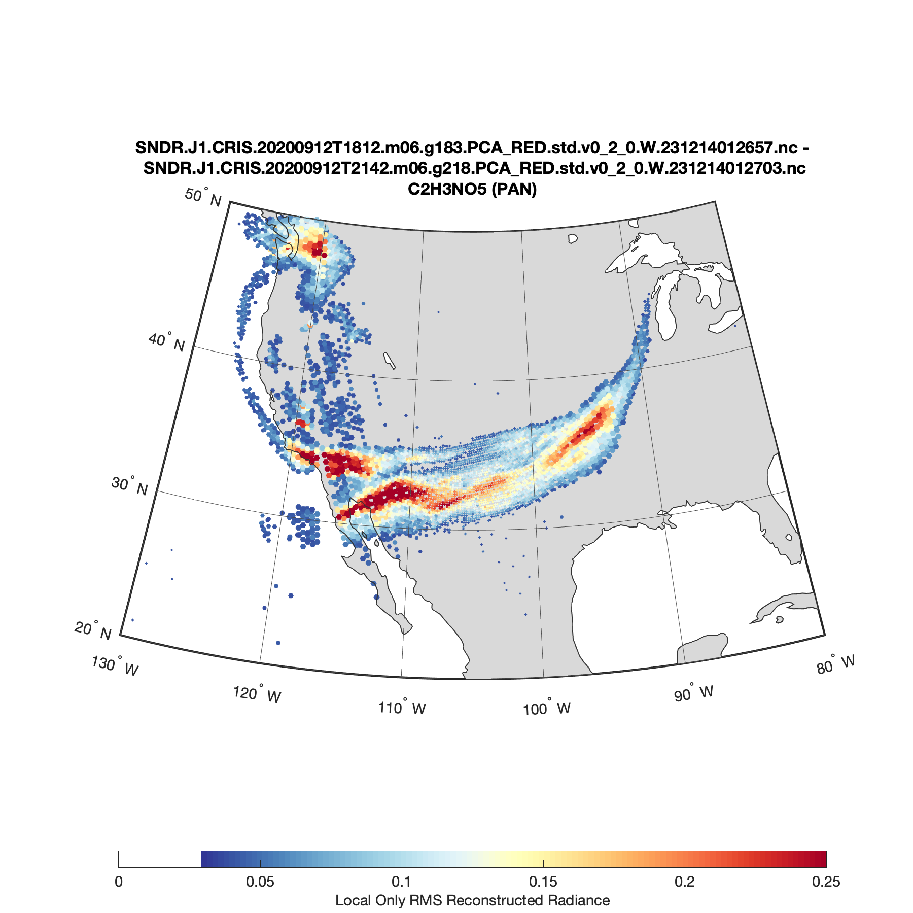
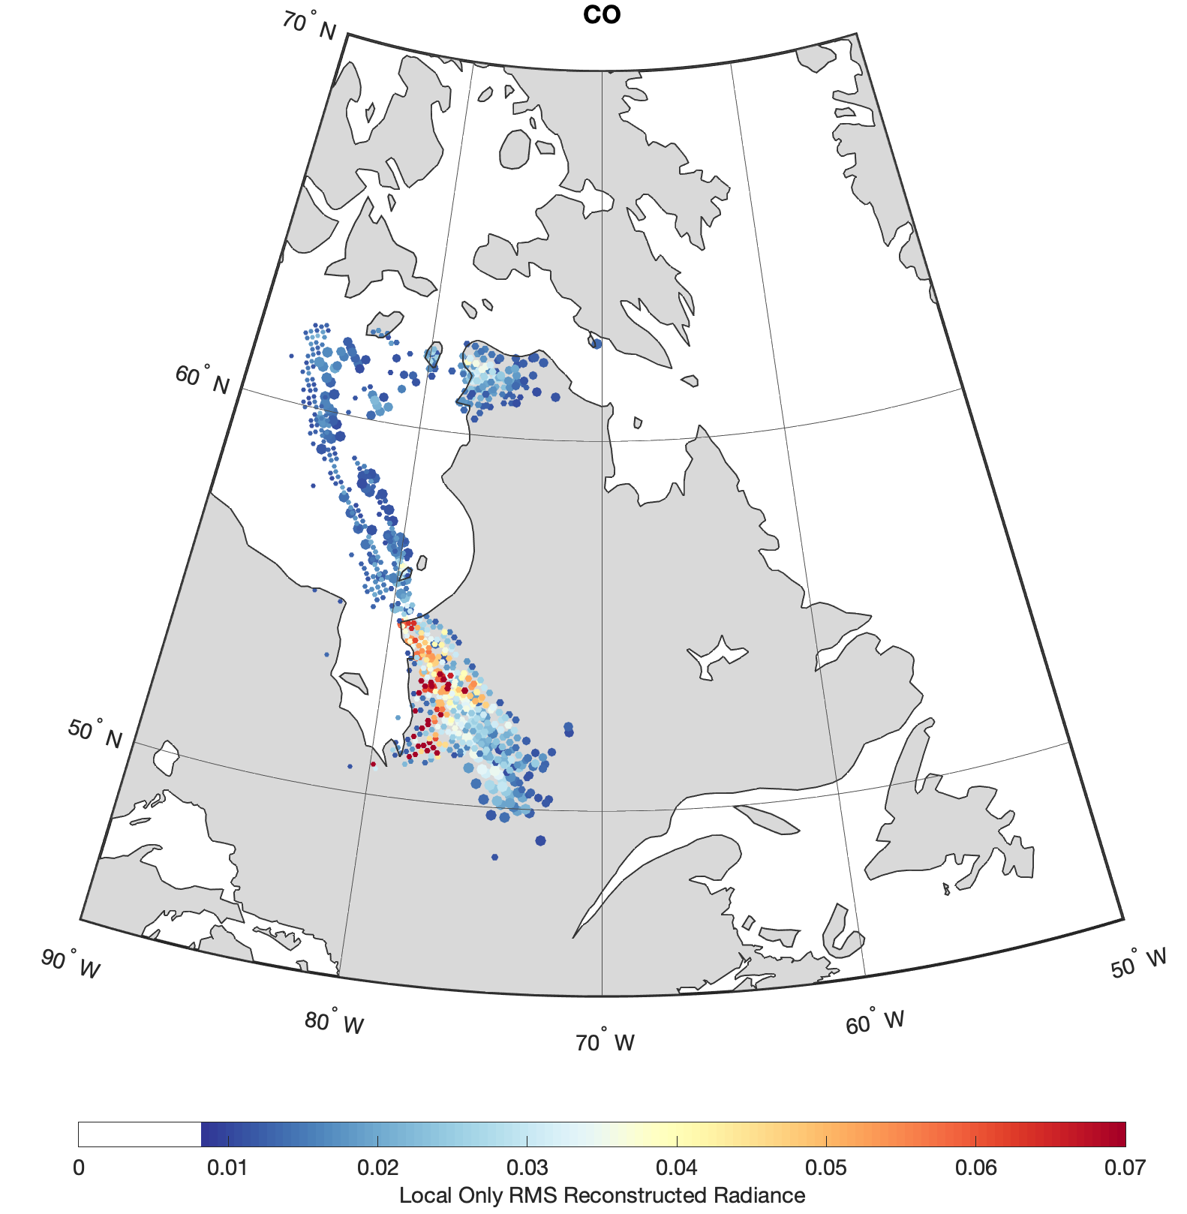
Rapid Event Detection
Examples
2020-09-12
Ascending Overpasses
NOAA-20 CrIS
PAN, Western Canada and California Fires
2023-07-14
Ascending Overpasses
NOAA-20 CrIS
CO, Quebec Fires

Slide 18
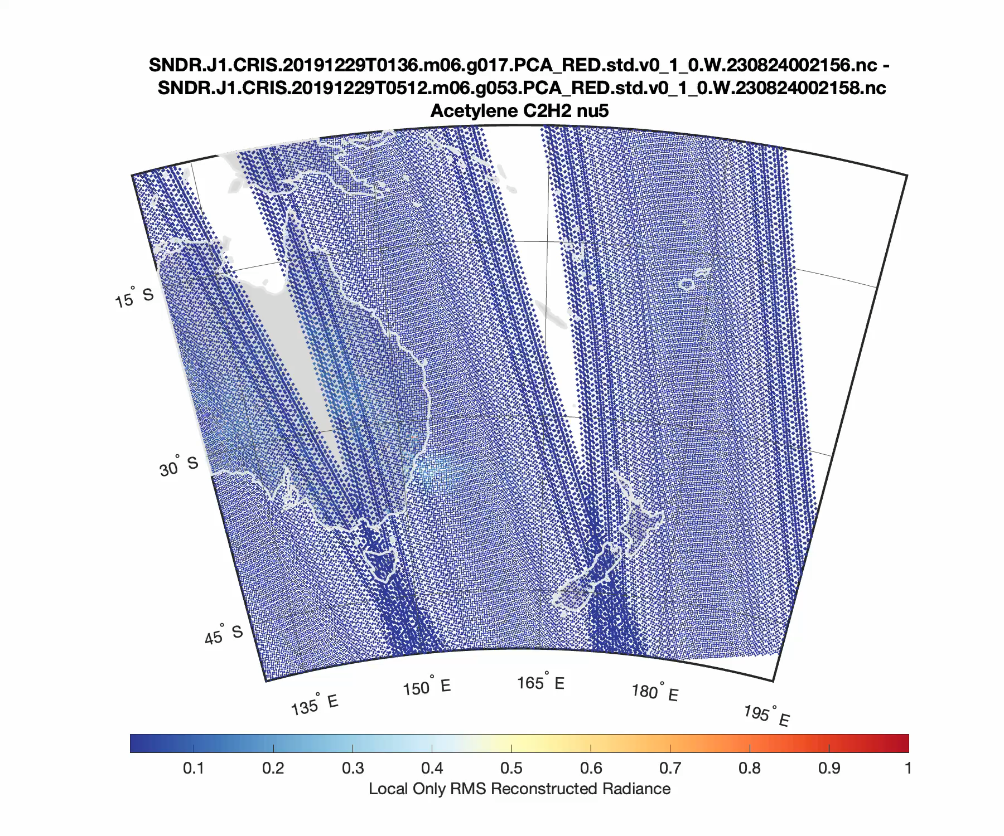
Rapid Event Detection
Example: Australian Wildfires
Dec 26, 2019 – Jan 3, 2020
NOAA-20 CrIS
Ascending and Descending Orbits
Acetylene (C₂H₂)
Local only reconstructed radiances

Slide 19
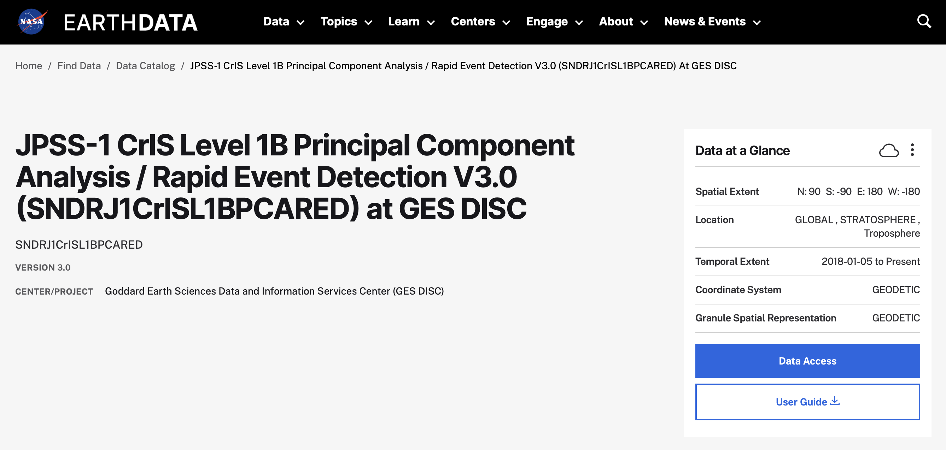
CrIS PCA RED Product Information
Data access and Documentation ….

