Slide 1

A Study on the Use of Reconstructed Radiances from Infrared Sounders
KOYAMATSU Shin
shin.koyamatsu@met.kishou.go.jp
Japan Meteorological Agency / Meteorological Satellite Center
IR Breakout Session (ii) 26 Mar 2026
GSICS Annual Meeting
Ottawa, Canada

Slide 2
Background
The volume of satellite observation data continues to grow as sensor capabilities improve.
Inter-calibration of IR bands relies on hyperspectral IR sounders onboard LEO satellites, requiring large amounts of spectral radiance data.
EUMETSAT developed Principal Component Analysis (PCA)-based compression.
  Metop/IASI Level-1 data is distributed in the form of PC Score (PCS) + Eigenvector (EV) data along with the original radiance data.
  For MTG-S/IRS, Level-1 data will be distributed only in the form of PCA-based compressed products in real time.
  Himawari-10/GHMS is expected to follow the MTG-S/IRS.
Using radiances reconstructed from PCS data for inter-calibration could significantly reduce communication requirements.
However, PCA-based compression is lossy, and reconstructed radiances may not behave identically to original radiances.
We evaluated the impact on intercalibration when replacing original radiances with reconstructed radiances.

Slide 3
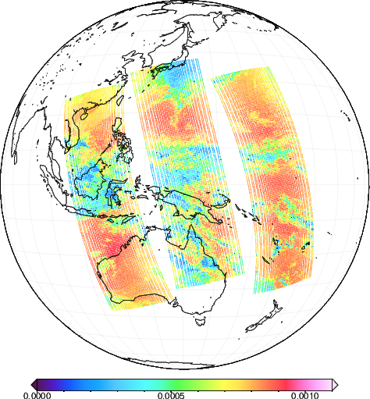

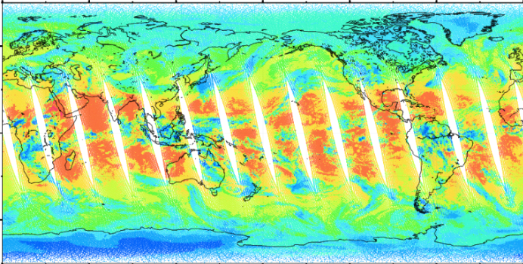

Data Used for Validation
Two types of Metop-B/IASI data observed in Apr. 2025
IASI L1C (EPS Native Format)
  Obtained from NOAA CLASS
  A total of 8,461 channels in 3 bands
  Each file contains ~3 minutes data (22-23 scan lines), ~60 MB
  Same dataset used in JMA operational GSICS processing (coverage limited to regions where Himawari’s SSP ≦ 25°)
IASI PCS (EPS Native Format)
  Obtained from the EUMETSAT Data Store
  PC-based-compressed version of the L1C data
  A total of 300 PCs in 3 bands (local PCs not included in the dataset)
  Each file contains ~100 minutes (one orbit), ~100 MB
1 file
1 file ~ 1 orbit

Slide 4
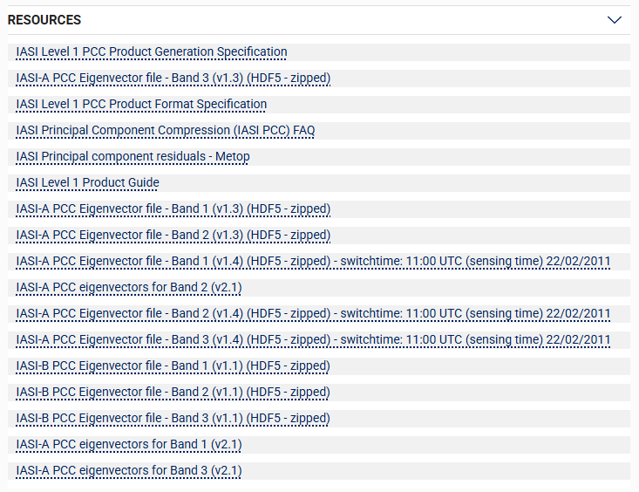
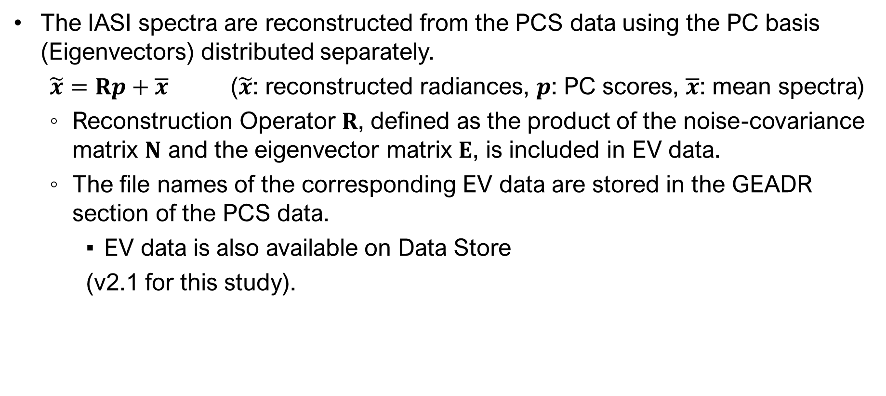
Reconstructing IASI Radiance
The IASI spectra are reconstructed from the PCS data using the PC basis (Eigenvectors) distributed separately.
  $\tilde{x}=Rp+\overline{x}$ ($\tilde{x}$: reconstructed radiances, $p$: PC scores, $\overline{x}$: mean spectra)
  Reconstruction Operator $R$, defined as the product of the noise-covariance matrix $N$ and the eigenvector matrix $E$, is included in EV data.
  The file names of the corresponding EV data are stored in the GEADR section of the PCS data.
    EV data is also available on Data Store
    (v2.1 for this study).

Slide 5
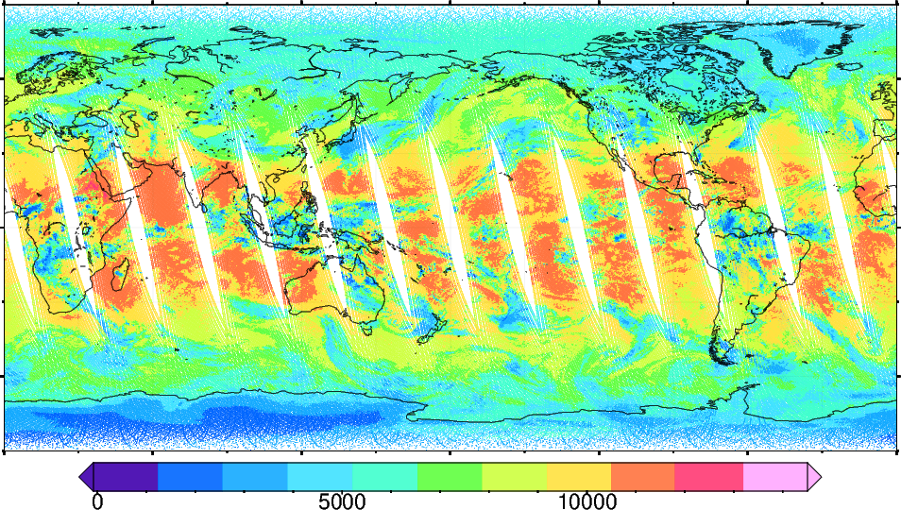
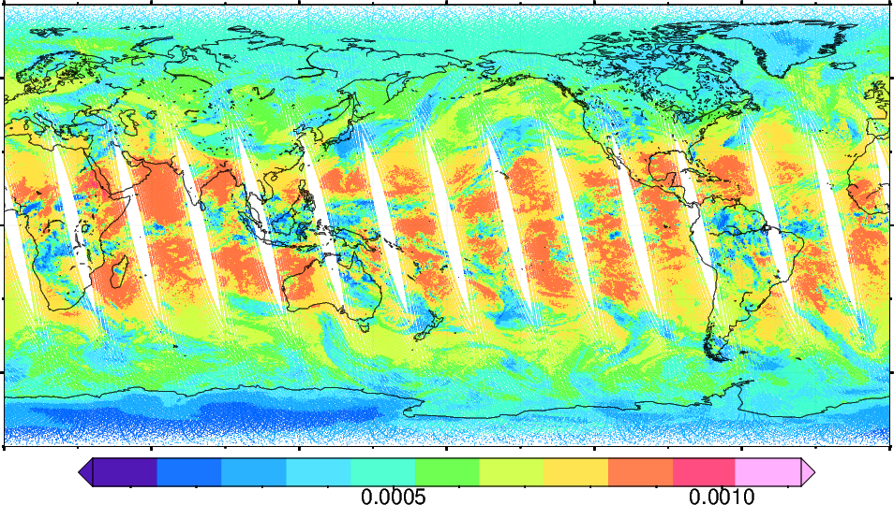
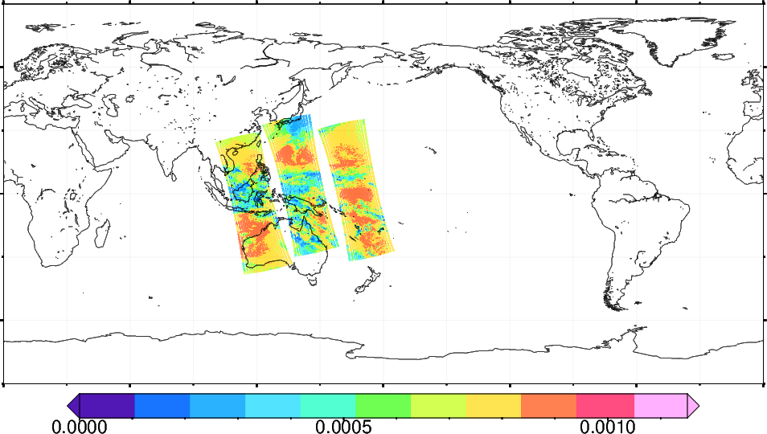
Reconstructed Radiance
IASI PCS
PC Score (Band1, #1)
Reconstructed Radiance (Band1-Mean)
Reconstruction
[W/(m² sr m⁻¹)]
IASI L1C
(used as reference in JMA GSICS operation)
L1C area extraction
[W/(m² sr m⁻¹)]

Slide 6
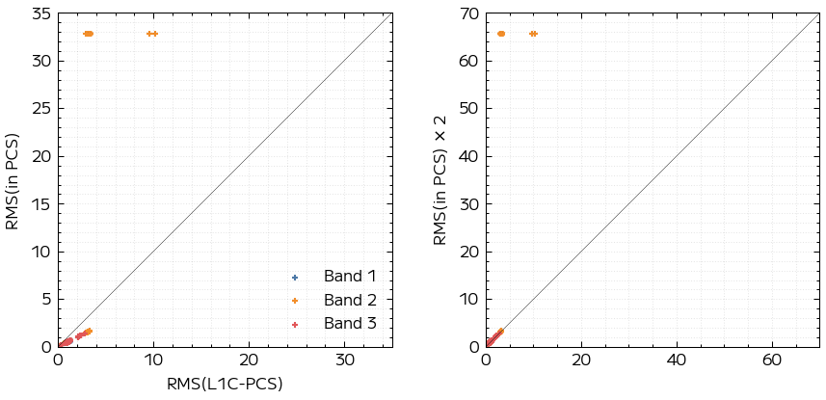
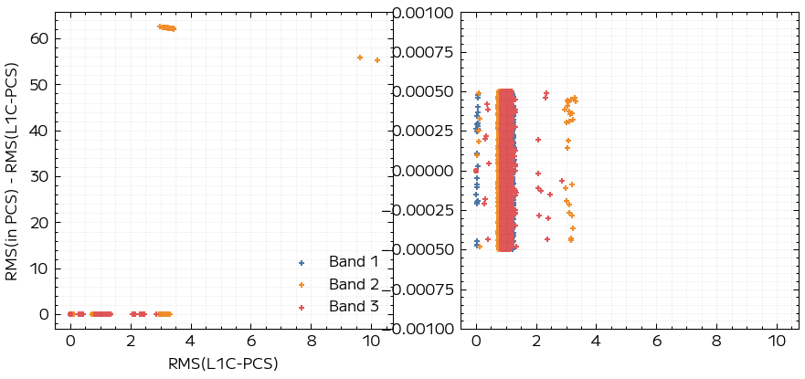
Reconstruction Residual
L1C and PCS observations were paired by matching their observation time.
The RMS of the reconstruction residuals computed from the L1C and reconstructed spectra was compared with the ResidualRMS stored in the PCS data.
  Residuals were normalized by noise covariance matrix (Nedr in EV files).
  ResidualRMS was decoded without applying ResidualQuantisationFactor.
The RMS values computed independently were consistent with the stored values within the expected quantization error, except for a few outliers.
w/ ResidualQuantisationFactor (=0.5)
w/o ResidualQuantisationFactor
Overflown values
(65535 * ScaleFactor)
Difference between computed RMS and stored RMS (residualRMS)
±0.0005

Slide 7
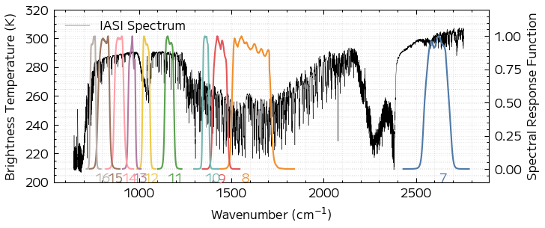
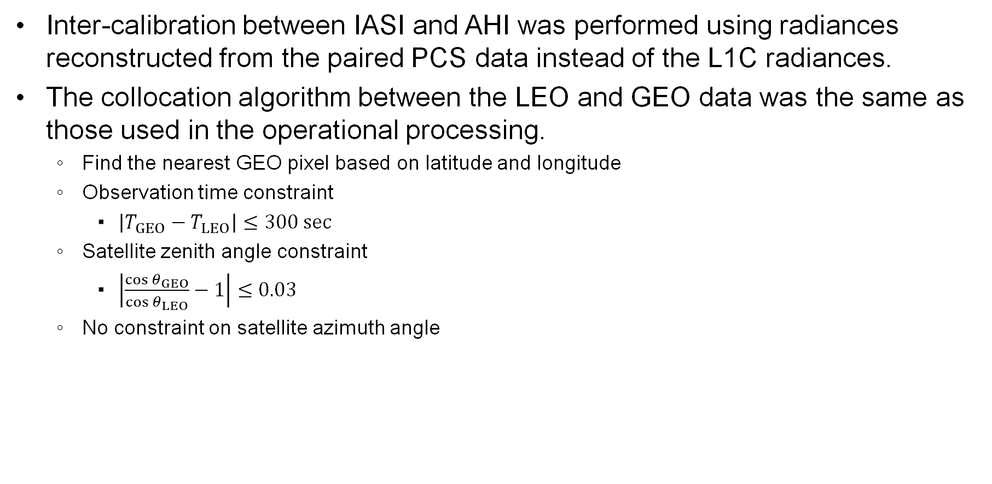
Inter-Calibration using Reconstructed Radiances
Inter-calibration between IASI and AHI was performed using radiances reconstructed from the paired PCS data instead of the L1C radiances.
The collocation algorithm between the LEO and GEO data was the same as those used in the operational processing.
  Find the nearest GEO pixel based on latitude and longitude
  Observation time constraint
    $\left|T_{GEO}−T_{LEO}\right|≤300 sec$
  Satellite zenith angle constraint
    $\left|\frac{\cos{θ_{GEO}}}{\cos{θ_{LEO}}}−1\right|≤0.03$
  No constraint on satellite azimuth angle
Himawari-9/AHI SRFs

Slide 8
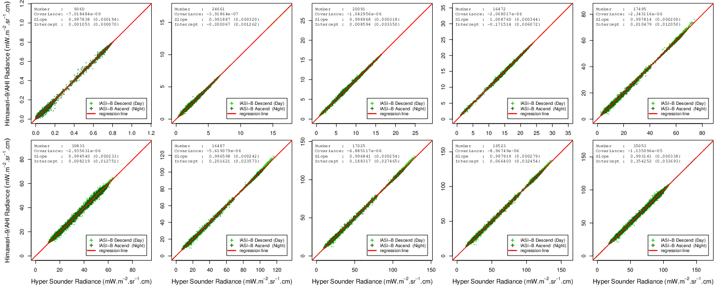
IASI L1C vs. AHI
2025-04-02/2025-04-30 (29 days)
Band 7 (3.9 μm)
Band 8 (6.2 μm)
Band 9 (7.0 μm)
Band 10 (7.3 μm)
Band 11 (8.6 μm)
Band 12 (9.6 μm)
Band 13 (10.4 μm)
Band 14 (11.2 μm)
Band 15 (12.3 μm)
Band 16 (13.3 μm)

Slide 9

IASI PCS vs. AHI
2025-04-02/2025-04-30 (29 days)
Band 7 (3.9 μm)
Band 8 (6.2 μm)
Band 9 (7.0 μm)
Band 10 (7.3 μm)
Band 11 (8.6 μm)
Band 12 (9.6 μm)
Band 13 (10.4 μm)
Band 14 (11.2 μm)
Band 15 (12.3 μm)
Band 16 (13.3 μm)

Slide 10
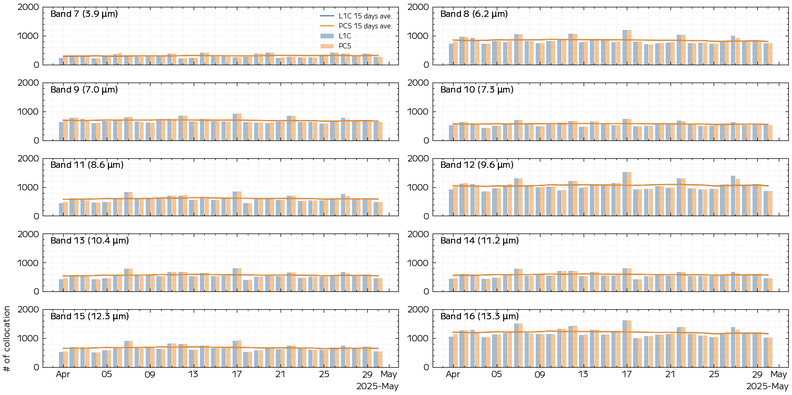
Number of Collocations (L1C vs. PCS)

Slide 11
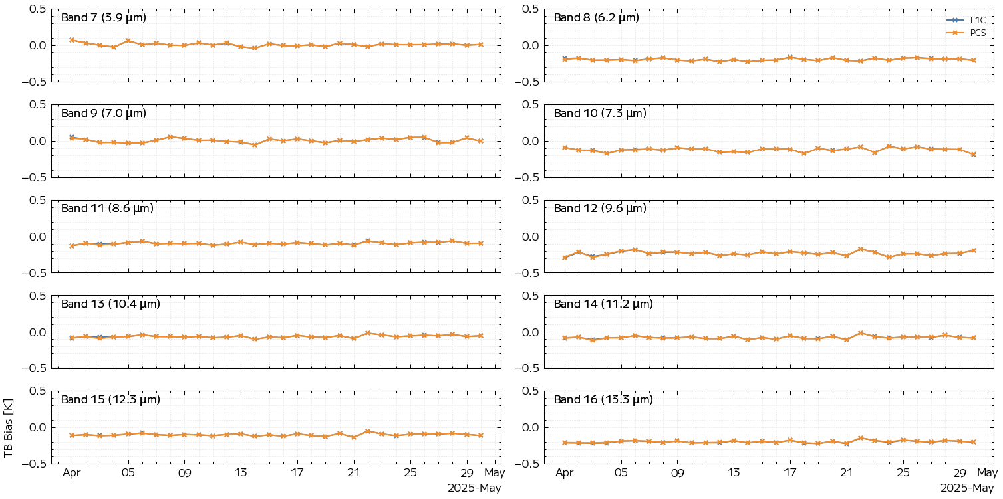
Brightness Temperature Bias (L1C vs. PCS)

Slide 12
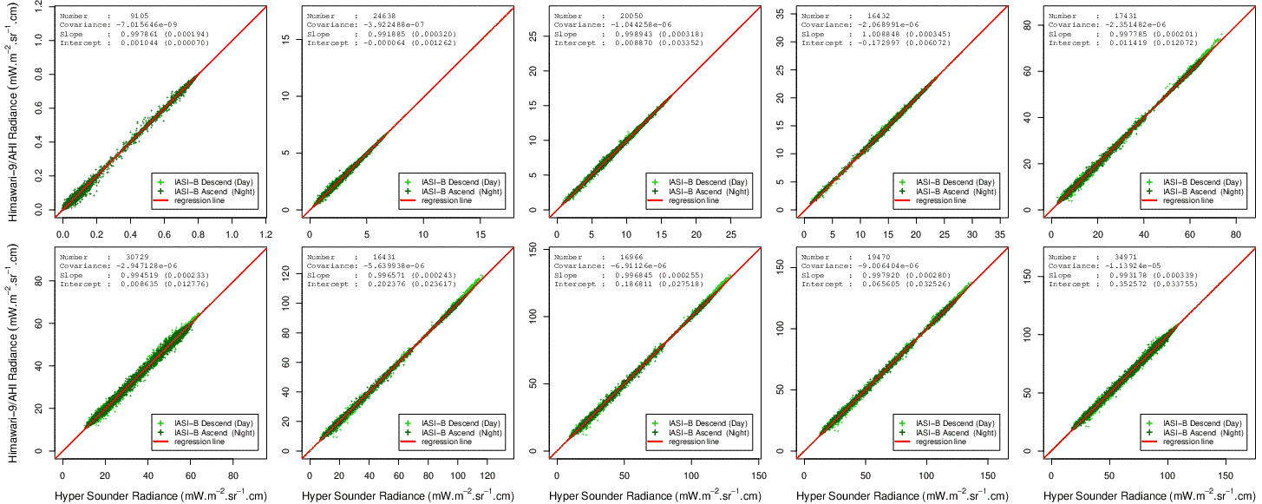
QC with RMS of Residual
2025-04-02/2025-04-30 (29 days)
Band 7 (3.9 μm)
Band 8 (6.2 μm)
Band 9 (7.0 μm)
Band 10 (7.3 μm)
Band 11 (8.6 μm)
Band 12 (9.6 μm)
Band 13 (10.4 μm)
Band 14 (11.2 μm)
Band 15 (12.3 μm)
Band 16 (13.3 μm)
Spectra with residualRMS > 10.0 were rejected.

Slide 13
Summary
PCA allows infrared sounder data to be compressed efficiently while retaining the key spectral information.
In this study, we conducted an experiment in which reconstructed radiances were used for inter-calibration instead of the original full spectral radiances.
The regression results were essentially the same.
Although several outliers were detected, they were successfully removed through screening based on the residual RMS.

