Slide 1
8 years TROPOMI long-term instrument degradation derivation, validation and lessons learned
Erwin Loots ^{1 ,} Edward van Amelrooy ¹, Mirna van Hoek ¹, Emiel van der Plas ¹, Nico Rozemeijer ²
¹KNMI, Royal Netherlands Meteorological Institute, De Bilt, The Netherlands,
²TriOpSys B.V., Utrecht, The Netherlands

Slide 2
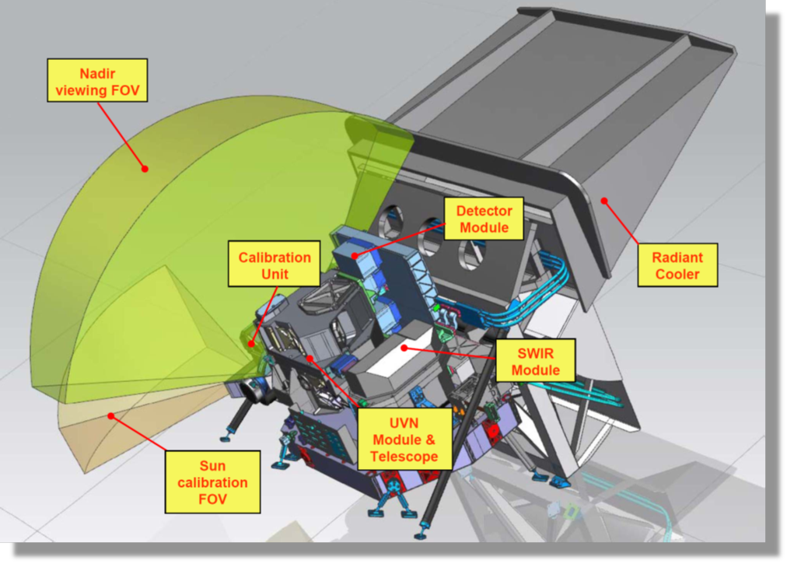
TROPOMI on-board Sentinel-5 Precursor
Single payload
Hyperspectral imager with 4 spectrometers
Sun synchronous orbit (MLTAN 13.30)
Pushbroom with ~ 2600 km swath
High spatial sampling (down to 5.5 km x 3.5 km)
Daily measurements of the Sun via Sun port
Launched 10/2017
Nominal operations since 30/4/2018
TROPOMI spectral bands – based on calibration data
Spectrometer | UV |  | UVIS |  | NIR |  | SWIR
Band ID | 1 | 2 | 3 | 4 | 5 | 6 | 7 | 8
Spectral range [nm] | 267-300 | 300-332 | 305-400 | 400-499 | 661-725 | 725-786 | 2300-2343 | 2343-2389
Spectral resolution [nm] | 0.45 - 0.5 |  | 0.45 - 0.65 |  | 0.34 - 0.35 |  | 0.227 | 0.225
Spectral sampling [nm] | 0.065 |  | 0.195 |  | 0.126 |  | 0.094
Spatial sampling [km²] | 5.5 x 28 | 5.5 x 3.5 | 5.5 x 3.5 |  | 5.5 x 3.5 |  | 5.5 x 7
Detector binning factor | 16 | 2 | 2 | 2 | 2 | 2 | 1 | 1

Slide 3
Tropomi long-term stability
Tropomi long-term stability
Tropomi long-term stability
We want to know the instrument degradation for radiance and irradiance measurements (and hence reflectance degradation)
Goal: acquire Calibration Key Data (CKD) such that long-term instrument drift of both radiance and irradiance are corrected for by the L01b Processor
The only (more or less stable) in-flight measurements we have are:
solar measurements: both daily (QVD1 diffuser) and weekly (QVD2 diffuser)
After the derivation, we can try to validate the L1b products by:
Using ground-based locations suitable for monitoring the long-term stability of the sensor (e.g. PICS)​
Comparative studies using various satellite instruments with similar characteristics covering the same spectral range​
Comparisons with radiative transfer model calculations using reliable input parameters (cloud- and aerosol-free cases only)
What about alternatives… e.g. OMI approach (radiance derived from Antarctic IF-measurements)…...

Slide 4
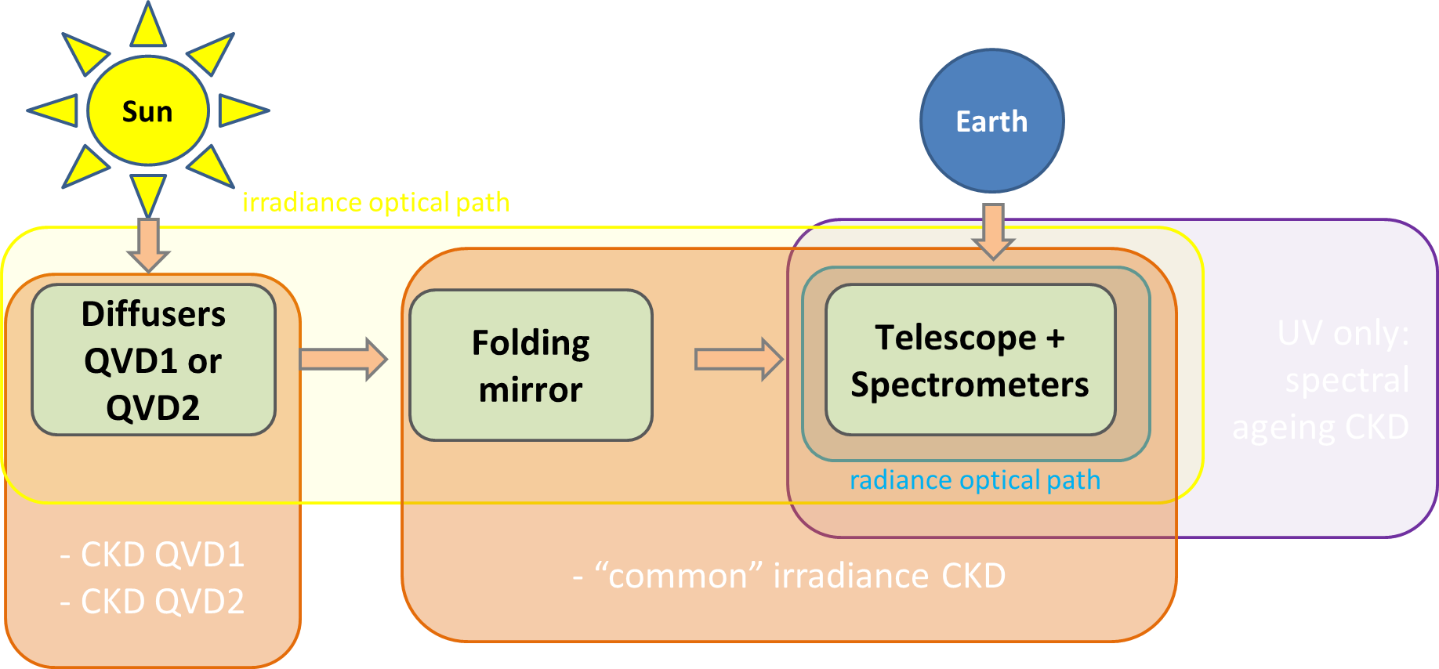
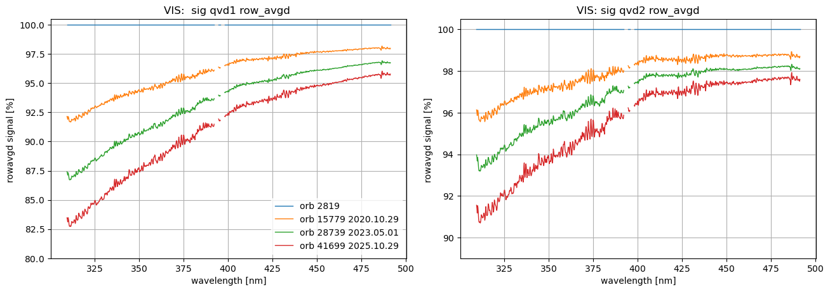
Instrument degradation (1/3)
Goal: Determine (and correct for) the instrument degradation
Diffusers (QVDs) degrade; QVD1 (main, daily) six times faster than QVD2 (backup weekly), proportional to exposure.
The instrument excluding the diffusers (mainly spectrometer) also degrades, proportional to in-orbit time.
→ Separate diffuser-only degradation and common/instrument degradation
Degradation strongest for short wavelengths
Spatial/spectral smoothness not prescribed/modelled, but is emerging from the data

Slide 5
Instrument degradation (2/3)
(Simple) example:
Consider daily and weekly irradiance measurements on 01.05.2023, at 360nm
Use that TROPOMI week is six days, thus QVD1 degrades six times faster than QVD2.
S_qvd1: - 9%; S_qvd2: -4%
Solution: common/instrument degradation: Degr_instr = ?? ;
QVD1-only degradation: Degr_qvd1 = ?? ;
QVD2-only degradation: Degr_qvd2 = ??

Slide 6
Instrument degradation (2/3)
(Simple) example:
Consider daily and weekly irradiance measurements on 01.05.2023, at 360nm
Use that TROPOMI week is six days, thus QVD1 degrades six times faster than QVD2.
S_qvd1: - 9%; S_qvd2: -4%
Solution: common/instrument degradation: Degr_instr = 3% ;
QVD1-only degradation: Degr_qvd1 = 6% ;
QVD2-only degradation: Degr_qvd2 = 1%

Slide 7
Issue 2: Instrument degradation (2/3)
(Simple) example:
Consider daily and weekly irradiance measurements on 01.05.2023, at 360nm
Use that TROPOMI week is six days, thus QVD1 degrades six times faster than QVD2.
S_qvd1: - 9%; S_qvd2: -4%
Solution: common/instrument degradation: Degr_instr = 3% ;
QVD1-only degradation: Degr_qvd1 = 6% ;
QVD2-only degradation: Degr_qvd2 = 1%
→ RAD: -3%;
→ IRR:-9%;
→ REFL: +6%

Slide 8
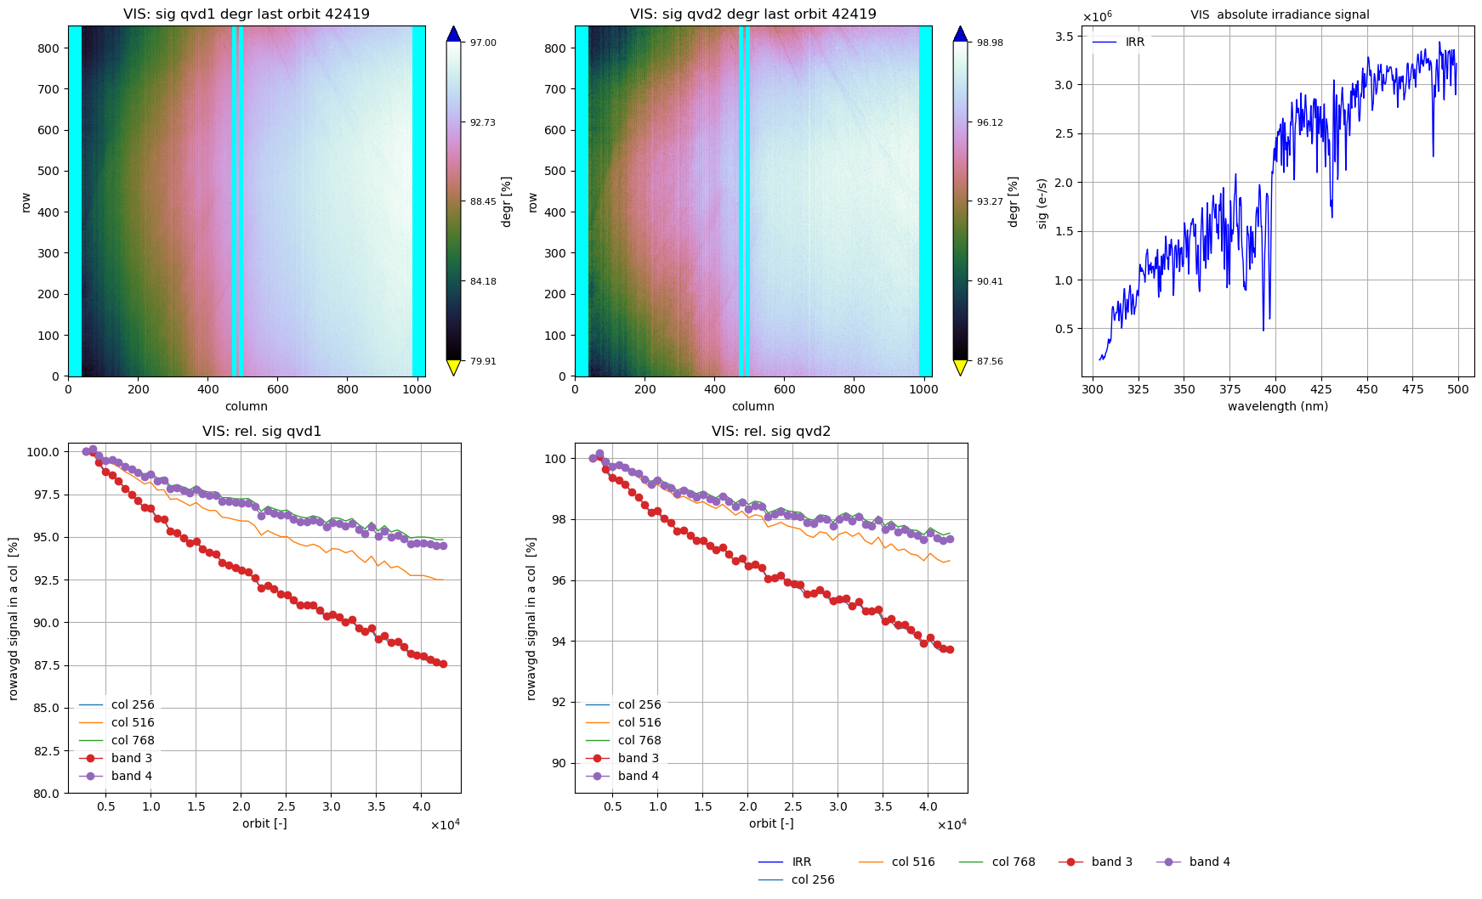
Instrument degradation (3/3)
Formalization: For all irradiance msmts:
Degr S_qvd1 = D_qvd(t_qvd1) * D_instr(t_orb) * H_i
Degr S_qvd2 = D_qvd(t_qvd2) * D_instr(t_orb) * H_i * K_i
(diffuser degr) (instrument degr) (jitter)
We need models for degradation in time,
e.g. D_instr(t) = exp(-at)
Note: engineering data provides cumulative
diffuser usage times t_qvd1, t_qvd2 per orbit
(Degradation in time, as observed from
the measurements, is not smooth -->
→ this is the so-called irradiance jitter)
2018
2025
2018
2025

Slide 9
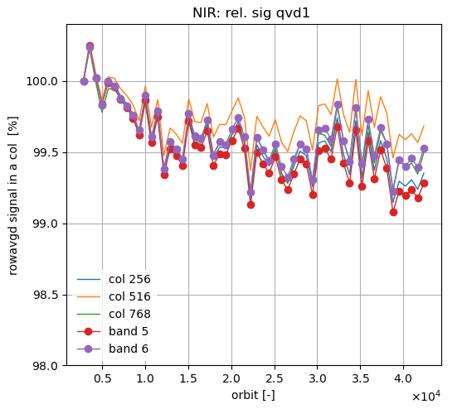
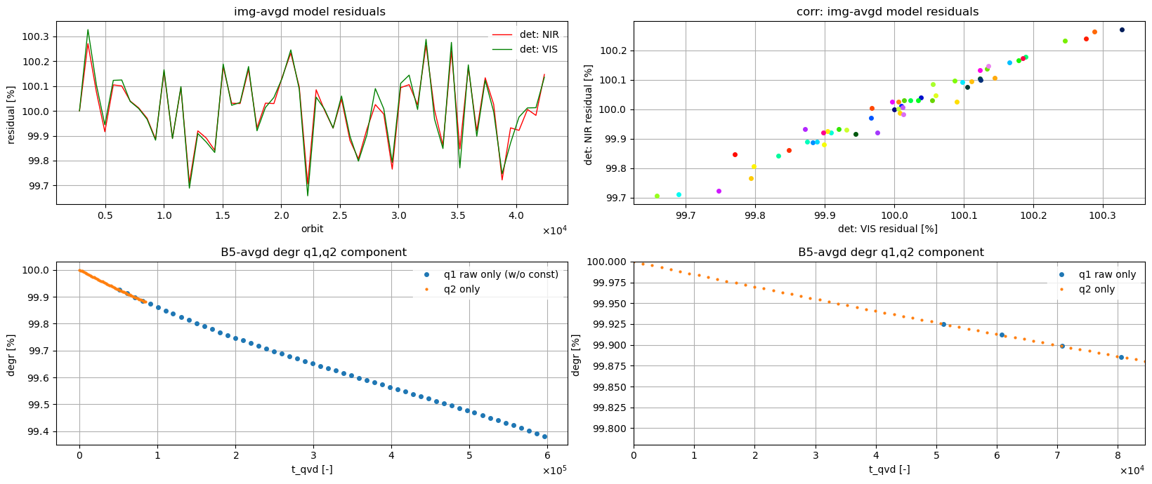
Intermezzo: irradiance jitter
From orbit-to-orbit, small variations (smooth in spectral & spatial direction) are observed. No correction possible (unless, maybe, from hindsight)
This ‘irradiance jitter’ is correlated VIS-NIR and UV-SWIR. Source: diffuser mechanism?
→ Any degradation model cannot be more accurate than these undeterministic variations (giving a lower limit to model residuals)
This disappointing irradiance jitter, once accepted, can help in assessing the quality of our degradation modeling
2018
2025
2018
2025
24 March 2026
GSICS Annual Meeting 2026 - TROPOMI L1b UVN

Slide 10
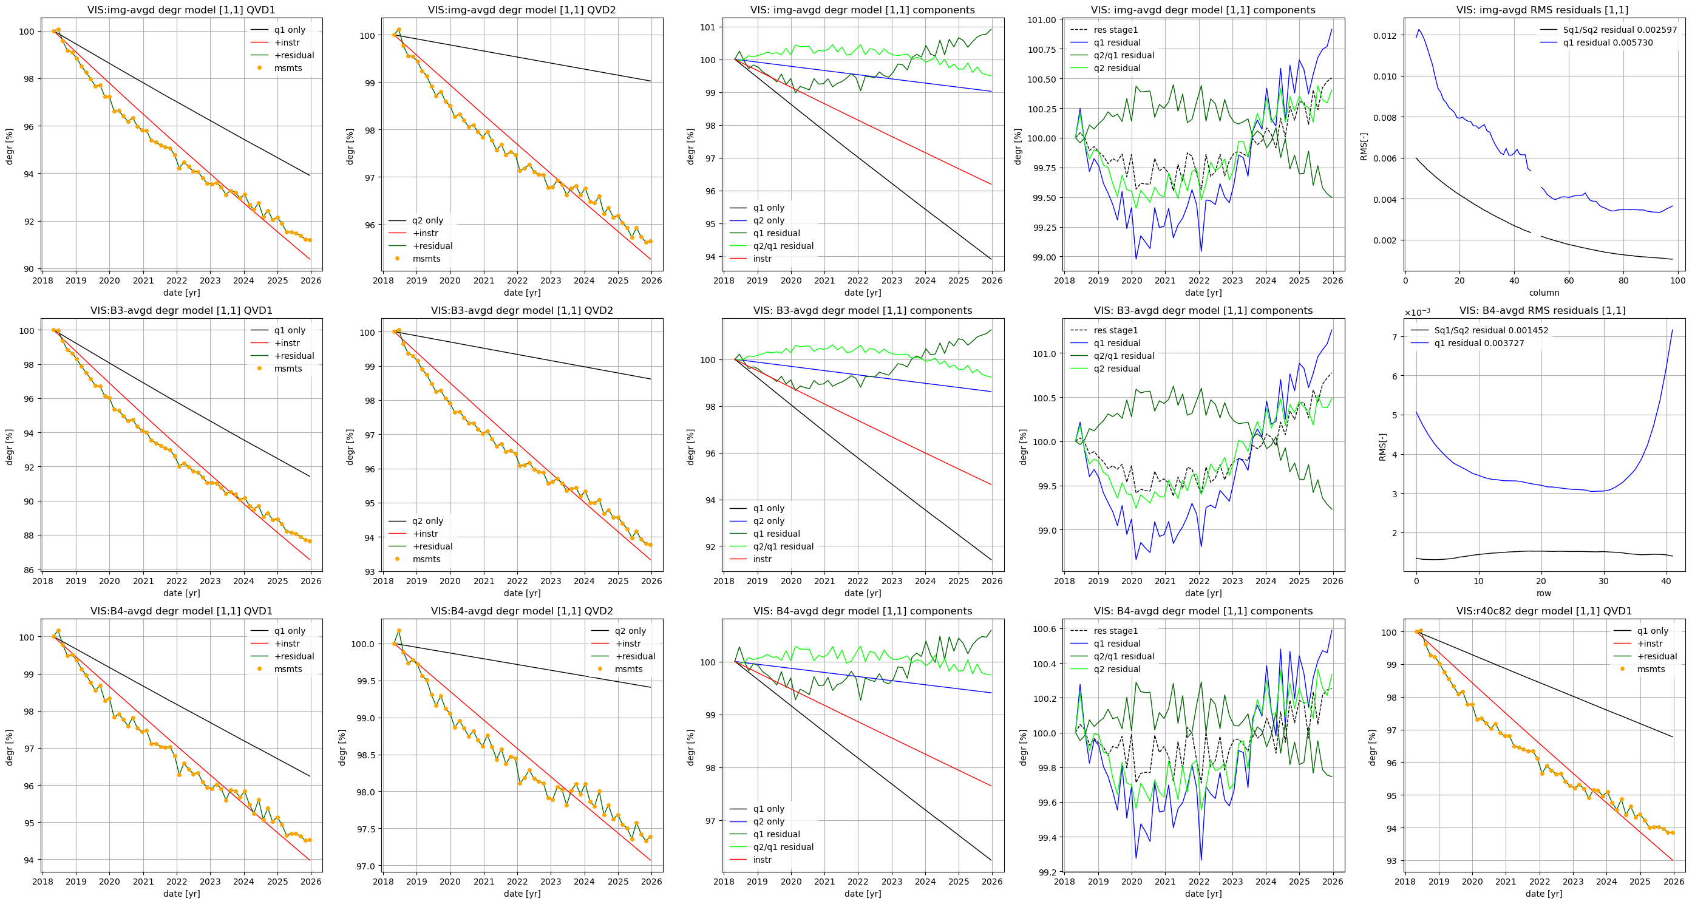
Solving linear systems (1/3)
Formalization: For all irradiance msmts:
(eq1) Degr S_qvd1 = D_qvd(t_qvd1) * D_instr(t_orb) * H_i
(eq2) Degr S_qvd2 = D_qvd(t_qvd2) * D_instr(t_orb) * H_i * K_i
Per week, [S_qvd1, S_qvd2, t_orb, t_qvd1, t_qvd2] available
First model: D_instr(t) = exp(-at), D_qvd(t) = exp(-bt)
Method:
i) eq1/eq2 gives linear system ;
solving gives D_qvd and residual 1/K_i
ii) substitute D_qvd in eq1, gives linear system;
solving gives D_orbit and residual H_i
Clearly, we have lack-of-fit: the
residuals are much larger than the
irradiance jitter.
A less simple model is needed….
24 March 2026
GSICS Annual Meeting 2026 - TROPOMI L1b UVN

Slide 11
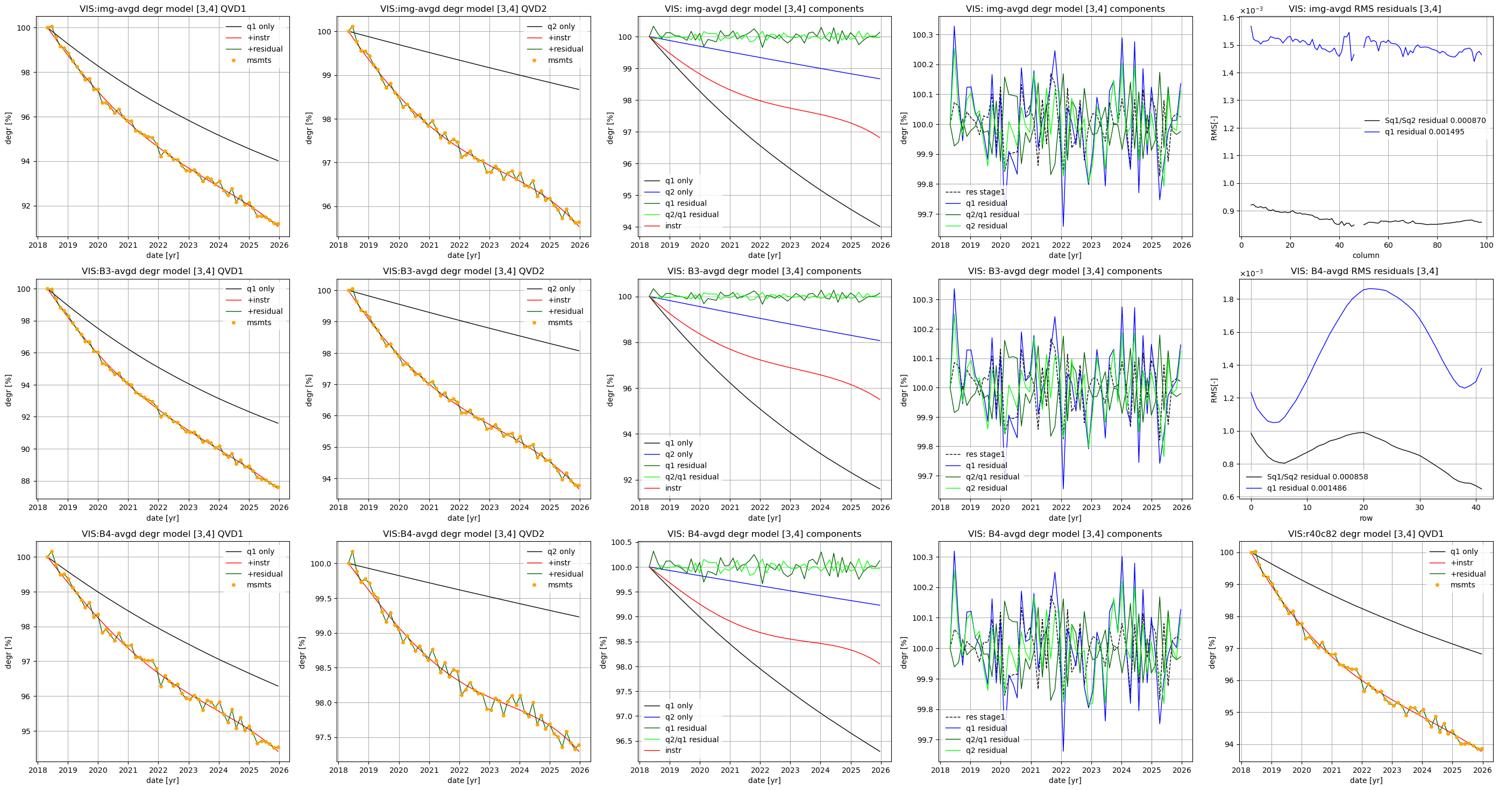
Solving linear systems (2/3)
Formalization: For all irradiance msmts:
(eq1) Degr S_qvd1 = D_qvd(t_qvd1) * D_instr(t_orb) * H_i
(eq2) Degr S_qvd2 = D_qvd(t_qvd2) * D_instr(t_orb) * H_i * K_i
Per week, [S_qvd1, S_qvd2, t_orb, t_qvd1, t_qvd2] available
More extensive model: D_instr(t) = exp(-at – bt^2 – ct^3 -dt^4 ), D_qvd(t) = exp(kt – lt^2 - mt^3)
Method:
i) eq1/eq2 gives linear system ;
solving gives D_qvd and residual 1/K_i
ii) substitute D_qvd in eq1, gives linear system;
solving gives D_orbit and residual H_i
This model ‘looks’ better: no
lack-of-fit, the residuals are
similar as the irradiance jitter
while the jitter itself is not part of
the solution (no overfitting)
24 March 2026
GSICS Annual Meeting 2026 - TROPOMI L1b UVN

Slide 12
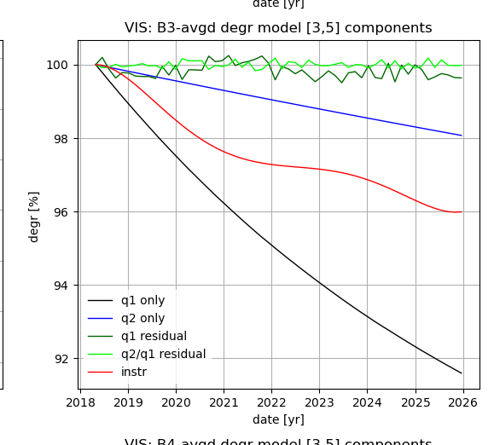
Solving linear systems (3/3)
Lack-of-fit
Structure in residuals...
Formalization: For all irradiance msmts:
(eq1) Degr S_qvd1 = D_qvd(t_qvd1) * D_instr(t_orb) * H_i
(eq2) Degr S_qvd2 = D_qvd(t_qvd2) * D_instr(t_orb) * H_i * K_i
Per week, [S_qvd1, S_qvd2, t_orb, t_qvd1, t_qvd2] available
Thus, we obtain different solutions for D_instr CKD (red line)
and D_qvd CKD (black line), depending on our modeling.
Worse: before even attaining overfitting (by imposing even higher-order polynomials) we encounter numerical stability problems: bad ‘matrix condition numbers’...
Worse: (Matrix condition can partly be improved by tools like orthogonal polynomials.) The t_qvd1 and t_qvd2 times do not overlap much, due to very extensive E1 in-flight calibration of the QVD1 diffuser. This means that the linear system for D_qvd is ill-posed.
However, monitoring the residuals vs jitter helps in assessing the quality of the solution, and hence of the degradation CKDs.
Stable solution
Seems OK….
Structure?
Unstable solution
Ockham’s razor?
24 March 2026
GSICS Annual Meeting 2026 - TROPOMI L1b UVN

Slide 13
Degradation CKDs: on uniqueness
The details of the modeling of diffuser degradation and instrument (common) degradation directly determine the CKDs and therefore the relation between IRR and RAD degradation:
RAD measurements: are corrected with instrument-degradation CKD
IRR measurements: are corrected with instrument-degradation CKD AND QVD1-degradation CKD.
We know the sum of the two (the irradiance msmts themselves), we try to find the the parts.
Assumption: Degr_qvd is smoother than Degr_instr.
No uniqueness guaranteed. Modelling involves fitting smooth curves through daily and weekly msmts
Lack-of-fit/underfitting: residuals too large.
Overfitting: residuals (jitter) become part of CKDs.
Numerical instabilities: The linear systems to be solved have large condition numbers. Check the residuals (jitter): they should be spectrally and spatially smooth.
Irradiance jitter: from disappointment to acceptance to powerful indicator

Slide 14
Why it matters
Question: Why this cumbersome approach of disentangling the instrument-without-diffuser degradation component from solar (irradiance) measurements?
Why not looking directly at at Earth (radiance) measurements?
Answer: Direct derivation could be tried
-using massive sampling of global radiance measurements. Problem: invariants?
-using ground-based locations (Sahara pseudo-invariant calibration sites PICS) or CEOS LANDNET sites, e.g. Railroad Valley
… but let’s first look at validation with these methods:
24 March 2026
GSICS Annual Meeting 2026 - TROPOMI L1b UVN

Slide 15
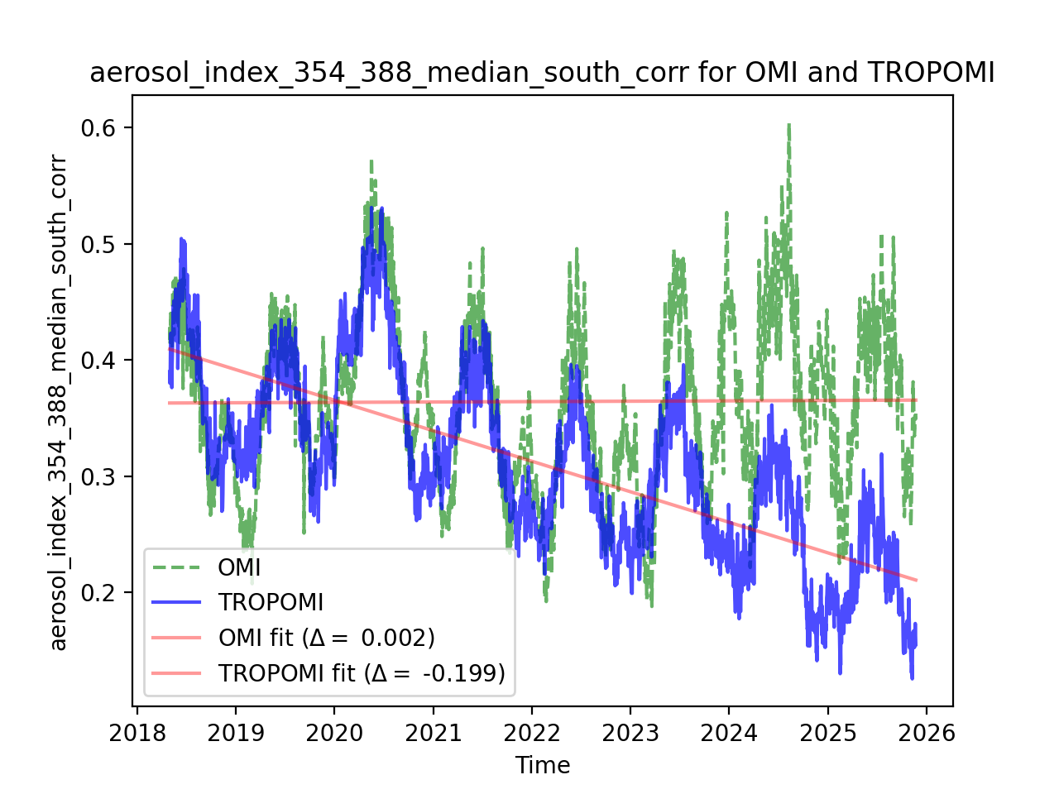
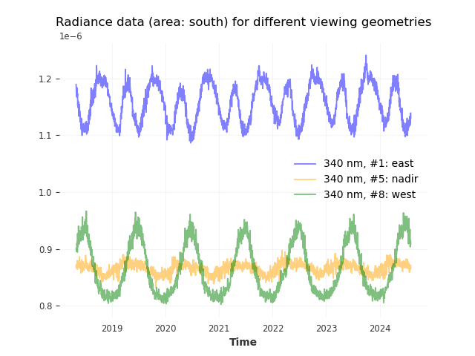
Validation (1/3): massive sampling of Earth radiance
Idea: to derive trends from massive amounts of measurements, either directly (radiance in southern hemisphere/Pacific) or indirectly (AAI from specific wavelength ratios)
Problems: trends through seasonal variations, large sensitivities, AND: on Earth, which quantity (if any) is invariant?
24 March 2026
GSICS Annual Meeting 2026 - TROPOMI L1b UVN

Slide 16
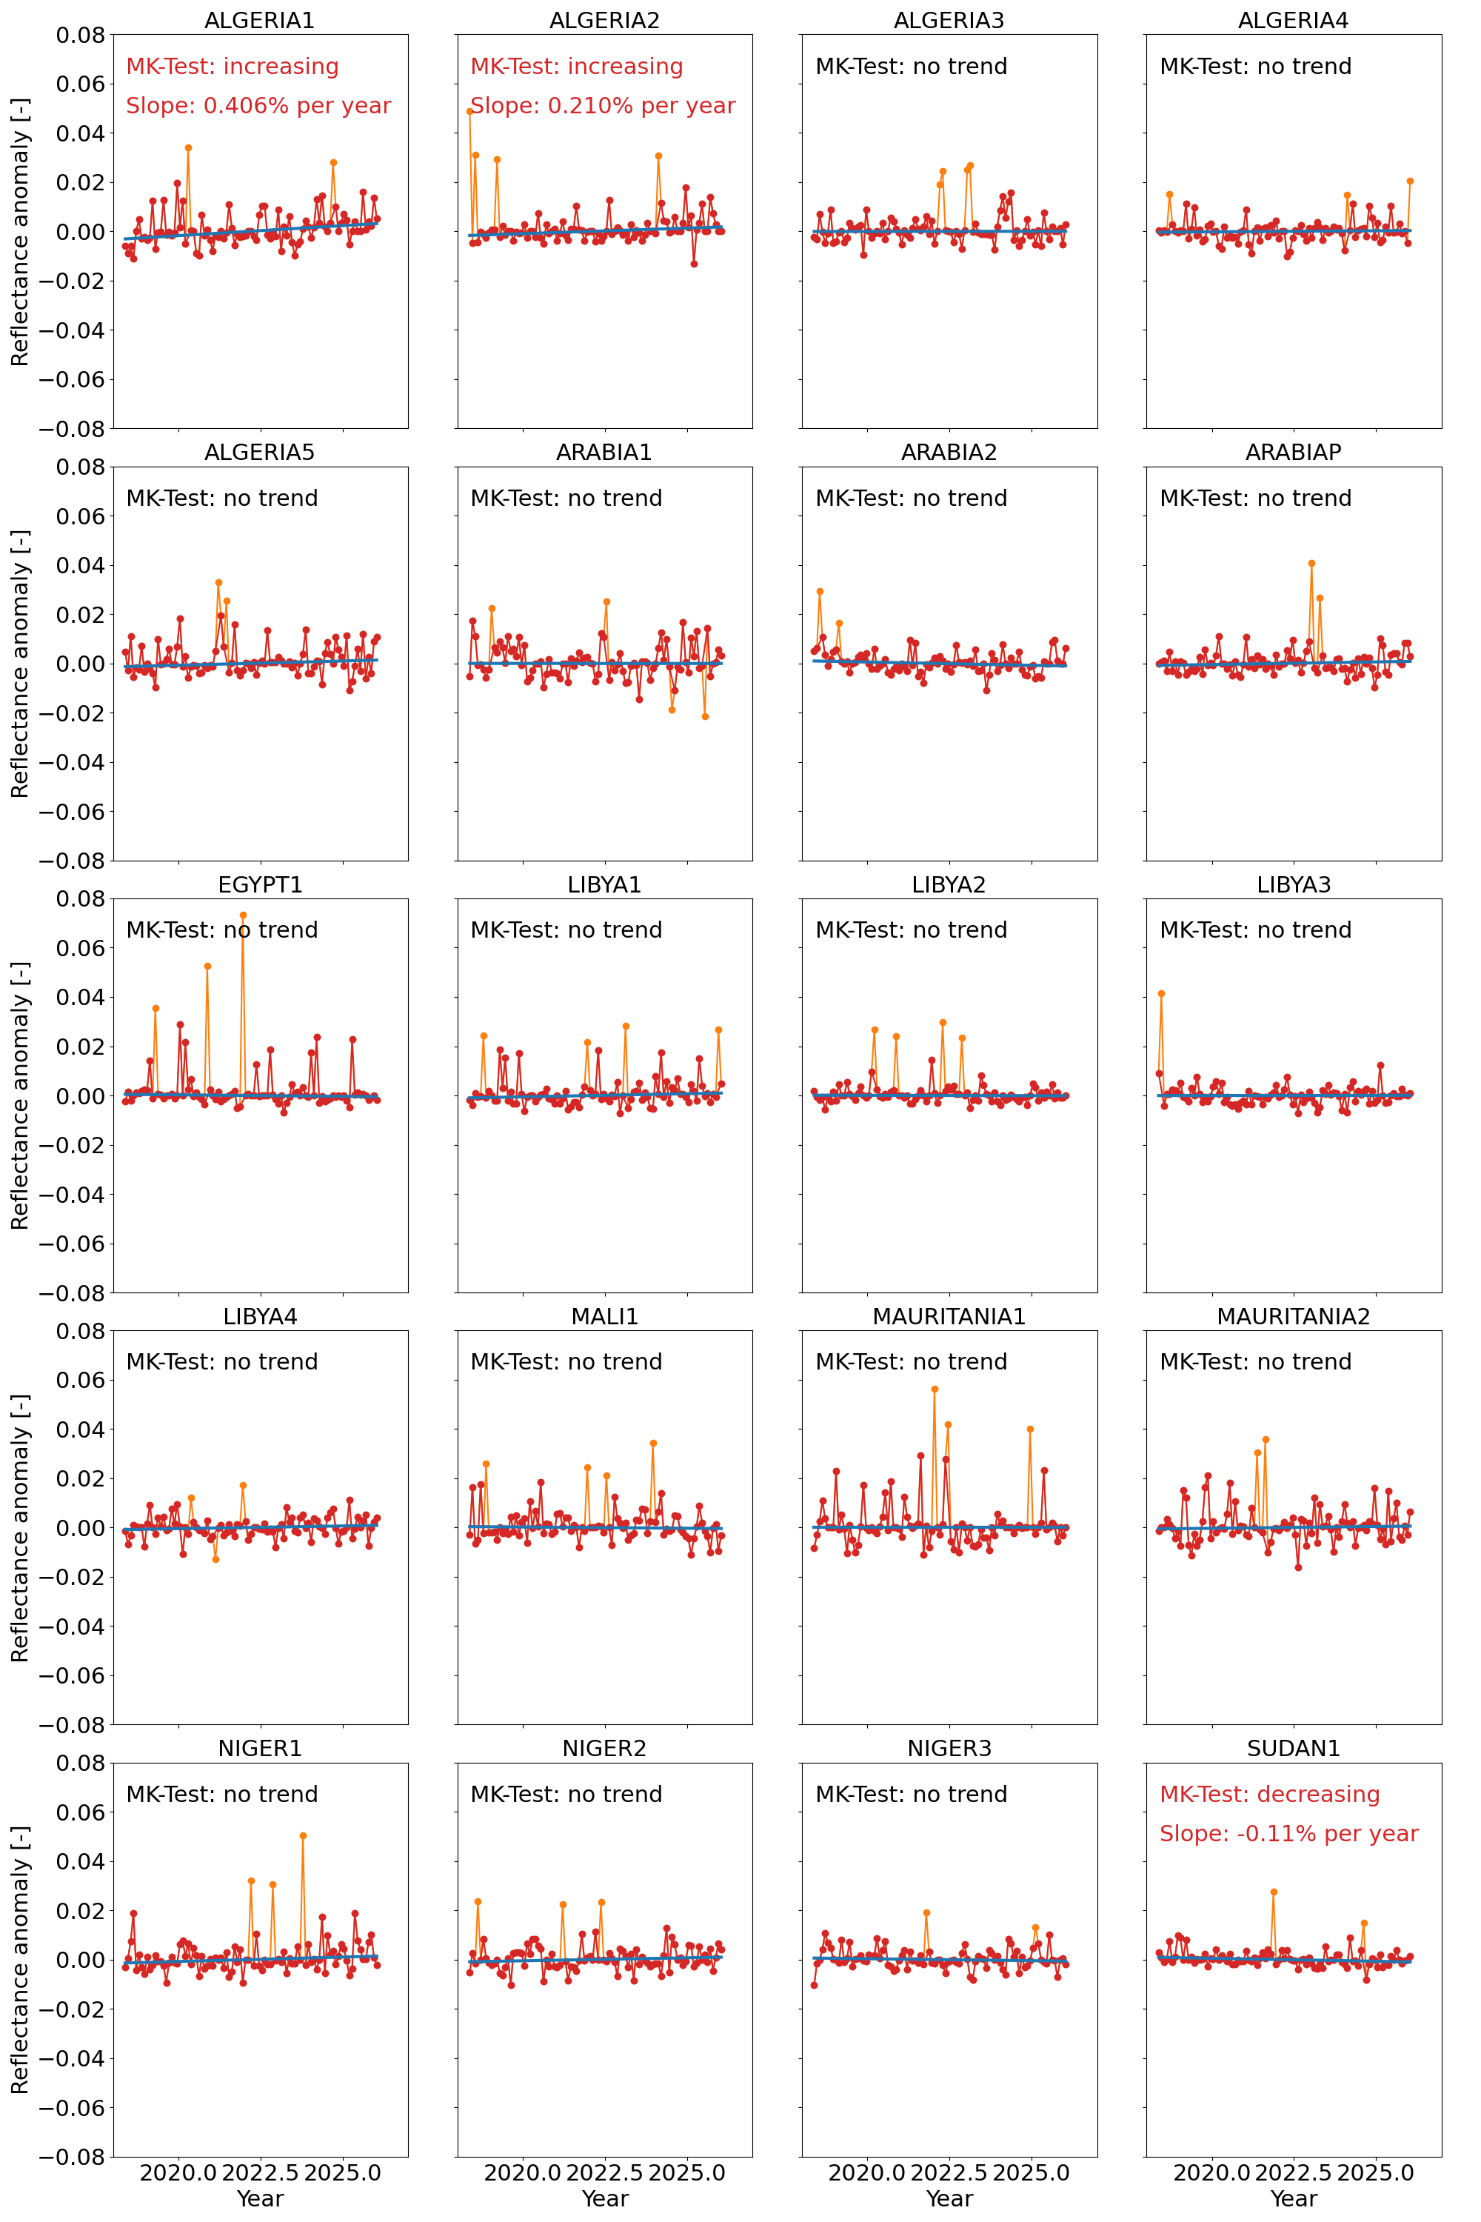
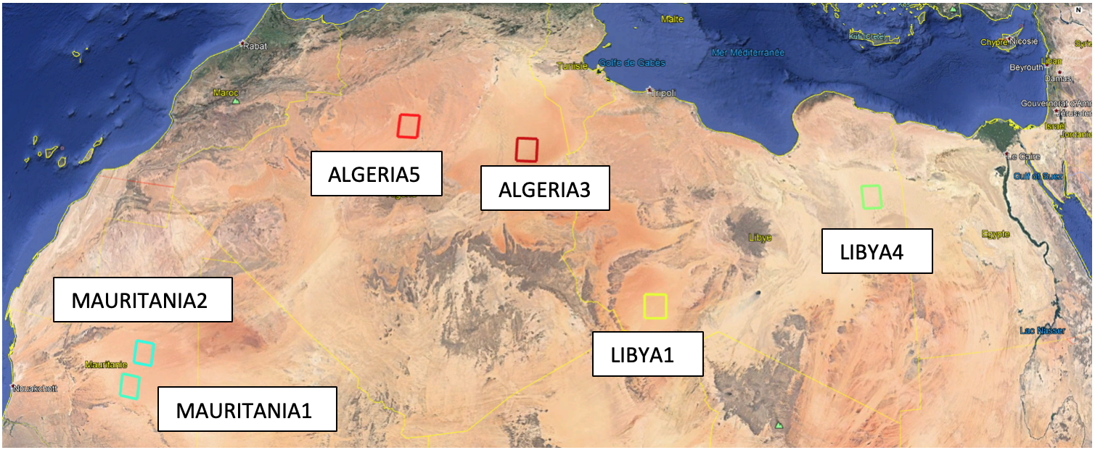
Validation (2/3): PICS
From: https://mpc-vdaf.tropomi.eu
Stability of reflectance (B3,4,6) has been obtained from near cloud-free, near nadir measurements over 20 Pseudo-Invariant Calibration Sites located in the Saharan Desert and the Arabian Peninsula from May 2018 through January 2026. For all bands, the long-term drift is statistically not significant for the bulk of the sites.
24 March 2026
GSICS Annual Meeting 2026 - TROPOMI L1b UVN

Slide 17
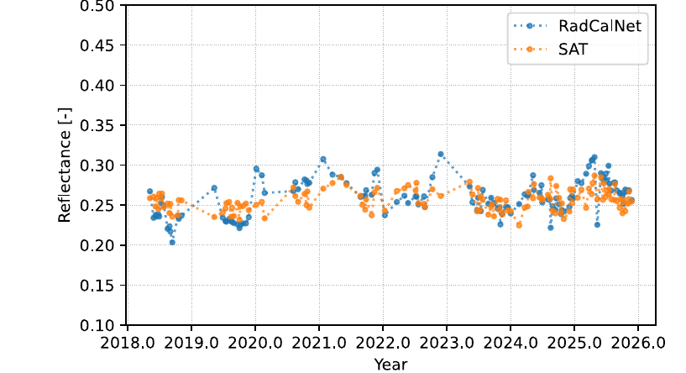
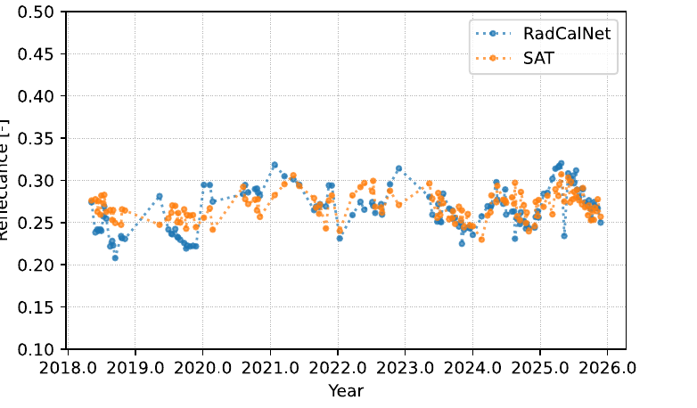
Validation (3/3): Railroad Valley
400nm
VZA < 10deg
CF < 0.2
440nm
VZA < 10deg
CF<0.2
Tropomi:
-TOA reflectance from SCLNLER product, 1nm resolution ) regridded on 0.125 deg ^2 resolution
-330-790nm, with SZA/VZA and cloud fraction information
-Selections on near nadir and low cloud fractions
RRV: (RRV Playa):
-TOA reflectances from RadCalNet archive
- 400-2500nm (10nm resolution)
Number of useful data points is very low. The statistics is heavily influenced by the choice of allowed ground pixels/data filtering.
Nevertheless, this is considered a successful comparison
24 March 2026
GSICS Annual Meeting 2026 - TROPOMI L1b UVN

Slide 18
Resume: Long-term degradation of Tropomi
Using solar measurements with two diffusers, CKDs are derived for the long-term degradation of both radiance and irradiance
Based on a few assumptions, an extensive model leads to a linear system, to be solved with some mathematical and instrumental caveats.
By doing this, many lessons learned: on instrument behaviour, and unexpected findings (straylight, residuals, solar line index timeseries...)
Validation is done using ground-based measurements (Sahara PICS, RRV). No clear remaining trends (which is good), but low spatial/spectral resolution and limited accuracy (less good).
Large-scale sampling comparisons remain inconclusive
Therefore: for Tropomi, calibration using the Sun remains the best option
On numbers: Total (irradiance) degradation (Band 1) is < 22% after eight years, and slowing. No problems concerning extension of mission lifetime.

Slide 19
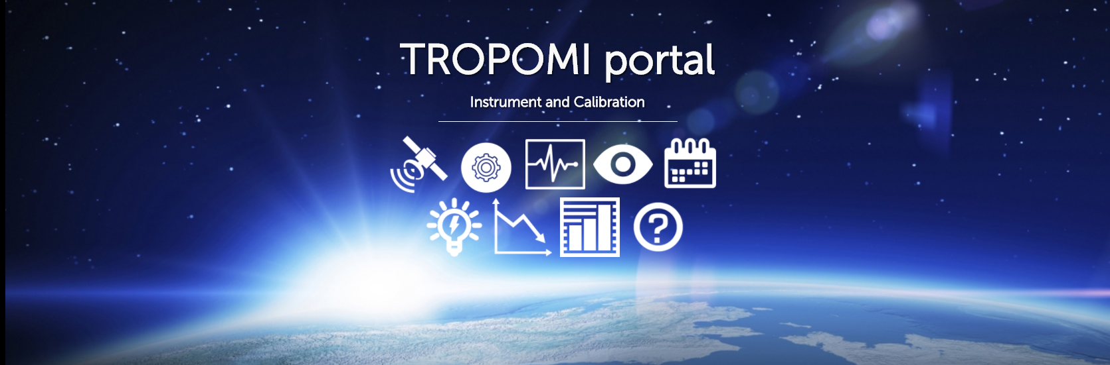

Thank you!
general information: http://www.tropomi.eu/
more on TROPOMI calibration: Kleipool et al. 2018 https://doi.org/10.5194/amt-11-6439-2018
Ludewig et al. 2020 https://doi.org/10.5194/amt-2019-488
Acknowledgement: Sentinel-5 Precursor is a European Space Agency (ESA) mission on behalf of the European Commission (EC). The TROPOMI payload is a joint development by ESA and the Netherlands Space Office (NSO). The Sentinel-5 Precursor ground-segment development has been funded by ESA and with national contributions from The Netherlands, Germany, and Belgium.
GSICS Annual Meeting 2025 - TROPOMI L1b UVN

