Slide 1
GOME-2 in-orbit performance
Pieter Valks, Gabriele Poli, Rasmus Lindstrot
GSICS UVN-S Breakout Session 24 March 2026

Slide 2
Content of the presentation
Metop-B mission EOL extended to 2030
Impact on GOME-2 Solar Visibility
Solar Model performance with impact on GOME-2 L2 products (ozone and NO₂)
GOME-2 instrument throughput and degradation correction
ESA FDR4ATMOS project

Slide 3
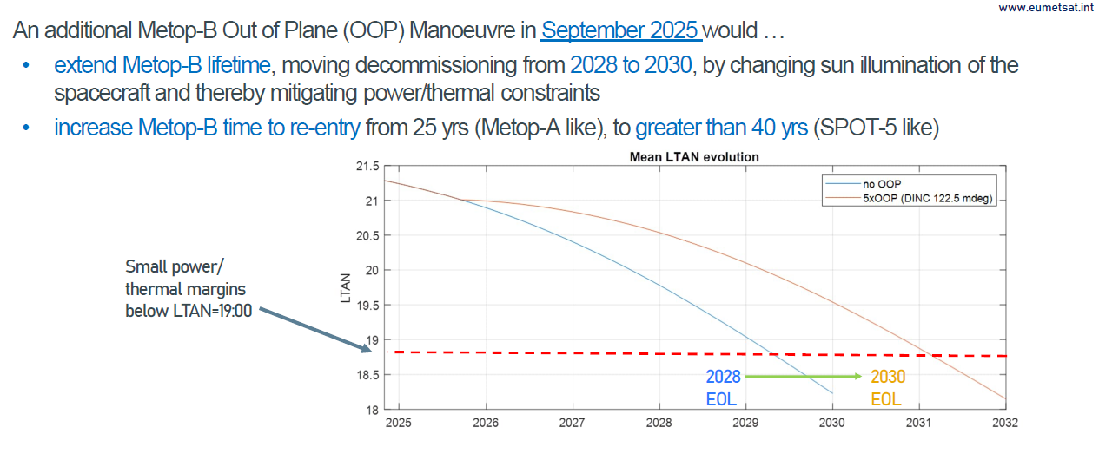
Metop-B OOP Manoeuvre (Sep. 2025) to extend lifetime to 2030

Slide 4

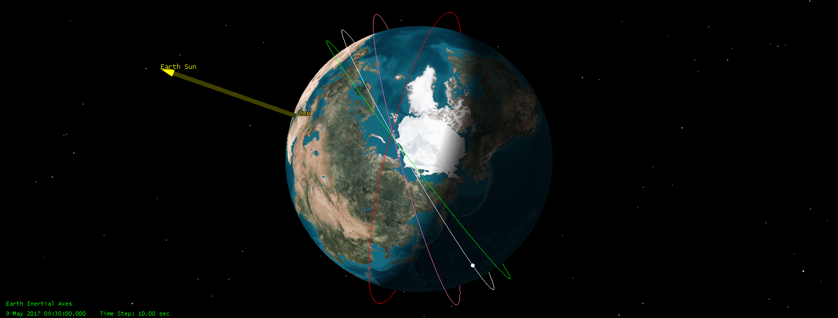
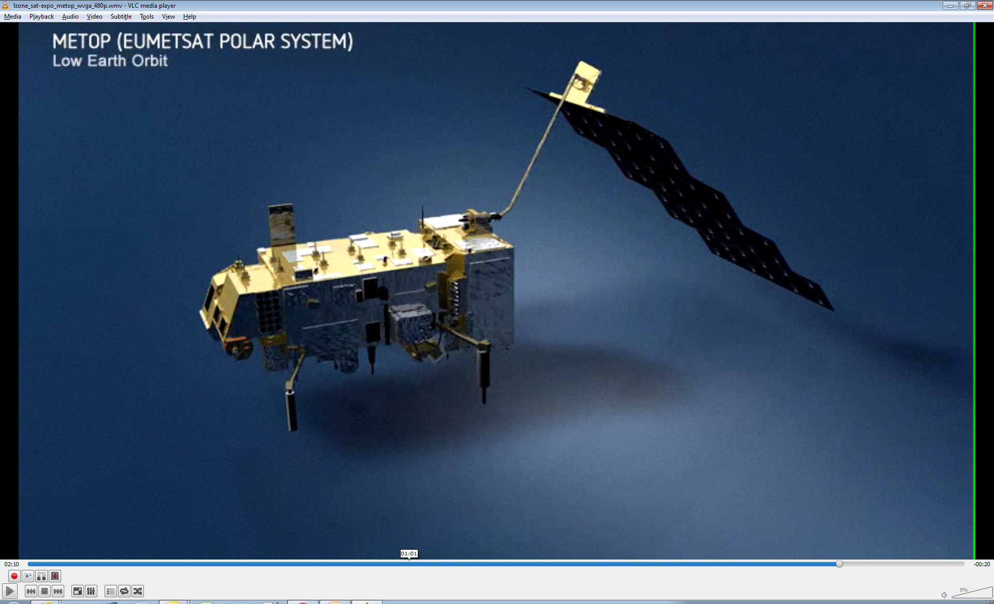
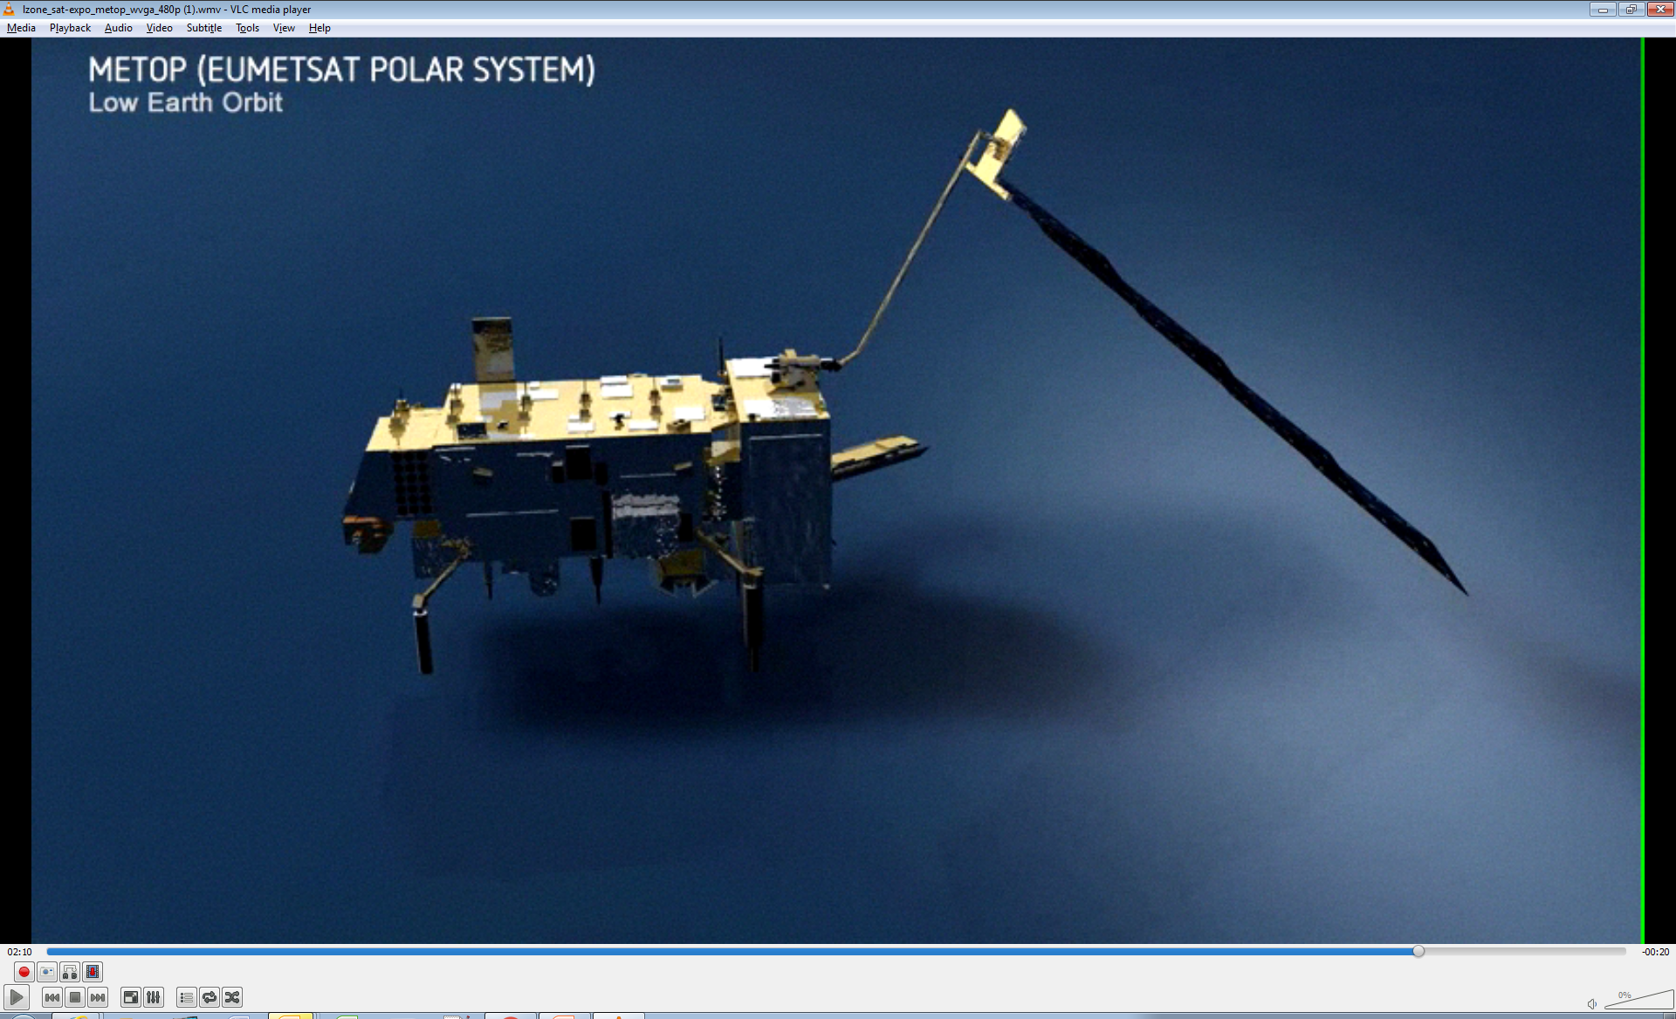
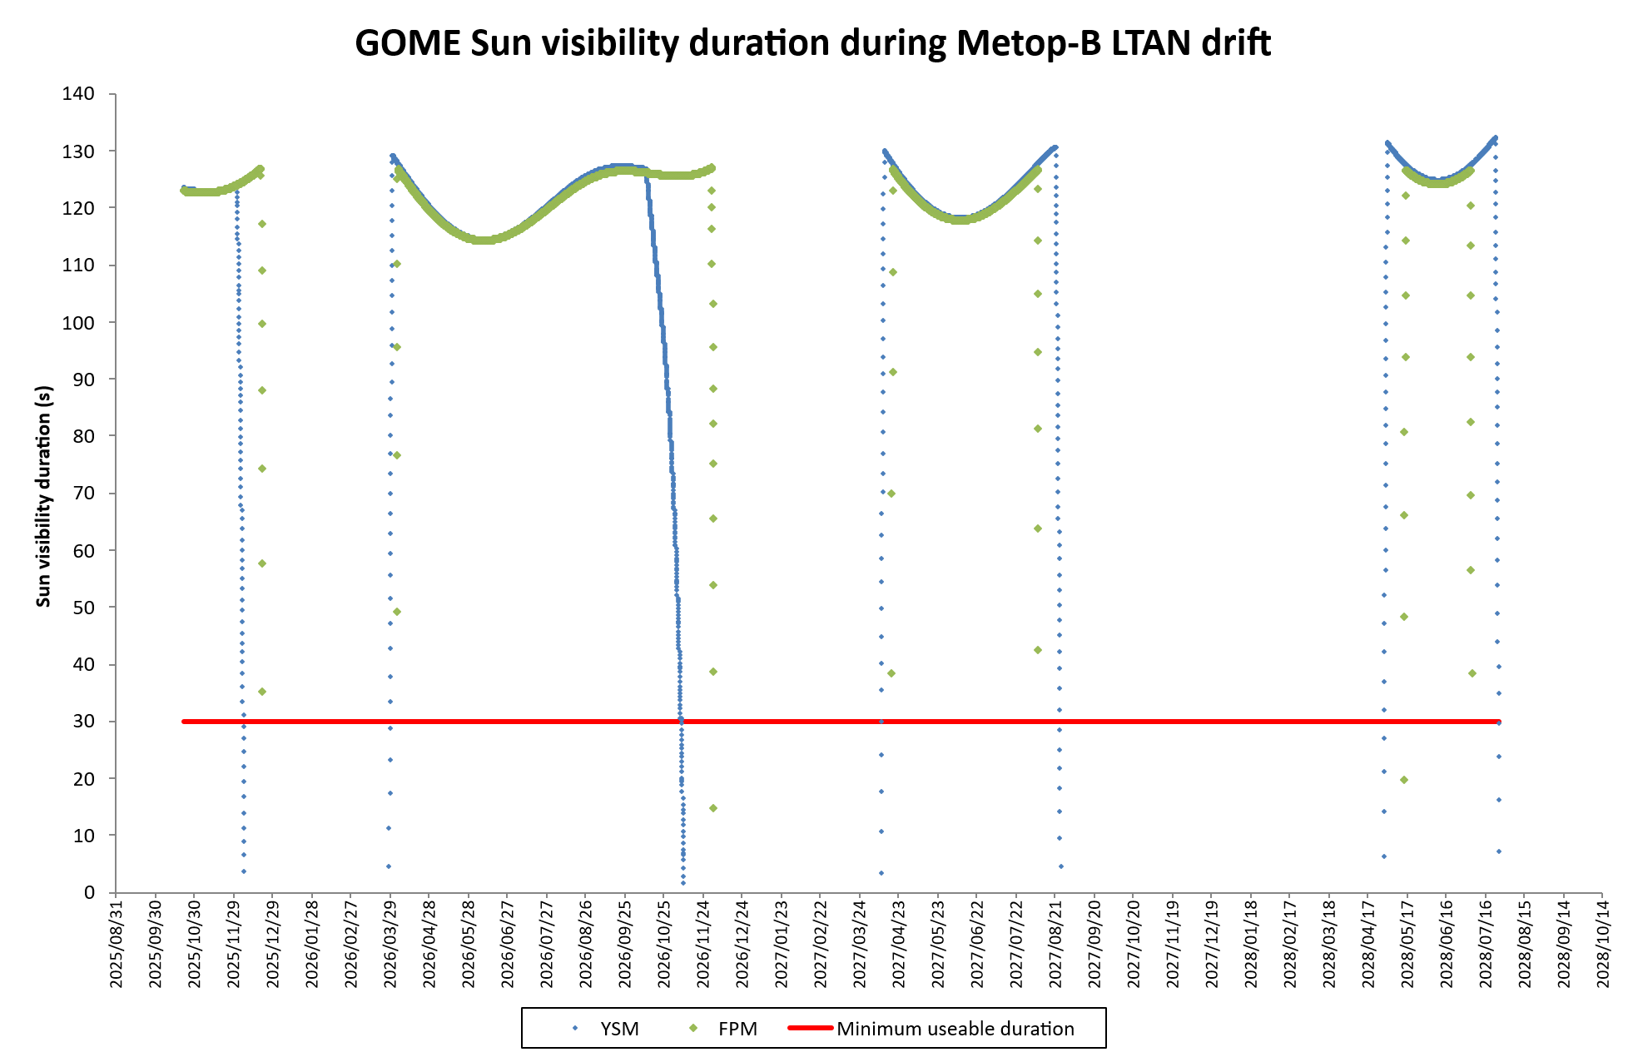
Metop-B GOME-2 Loss of Sun Visibility
Metop Orbit decaying Local Time of Descending Node
(LTDN)
Orbit with nominal LTDN
Orbit with decayed LTDN
Green LTDN 09:30 UTC
Grey LTDN 09:00 UTC
Pink LTDN 08:00 UTC
Red LTDN 06:00 UTC
Satellite Flight Direction
To Sun
Satellite Flight Direction
To Sun
  Sun enters FOV of Sun Port for Solar calibrations
  Eclipses allow other calibrations without stray-light pollution
  No Sun in FOV of Sun Port
  No eclipses so other calibrations suffer stray-light pollution.
Solar Gap GOME-2 / Metop-B
 | Start | Stop
2nd | 28.12.2024 | 19.03.2025
3rd | 25.11.2025 | 28.03.2026
4th | 07.11.2026 | 09.04.2027
5th | 24.08.2027 | 29.04.2028
 | 25.07.2028 | End of mission

Slide 5
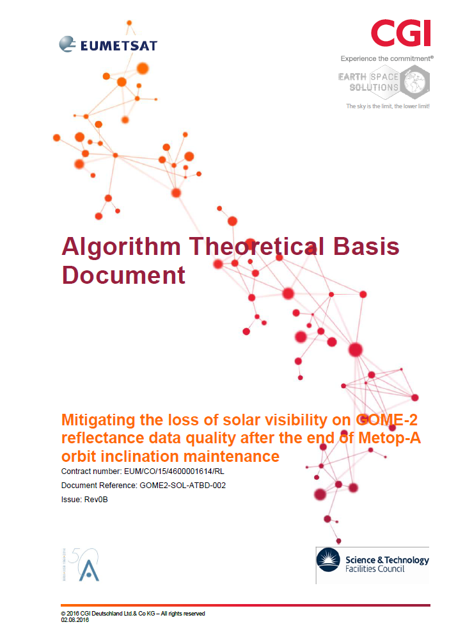
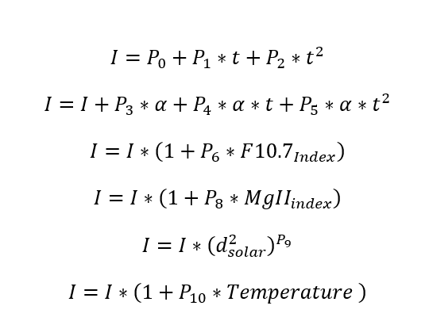
Empirical Solar Model for GOME-2
Aux data
Derived from GOME-2C
GOME-2B OBM
Coefficients P₁ to P₁₀ together with the external parameters are fully describing the information content and evolution of the GOME-2 solar main channel measurement

Slide 6
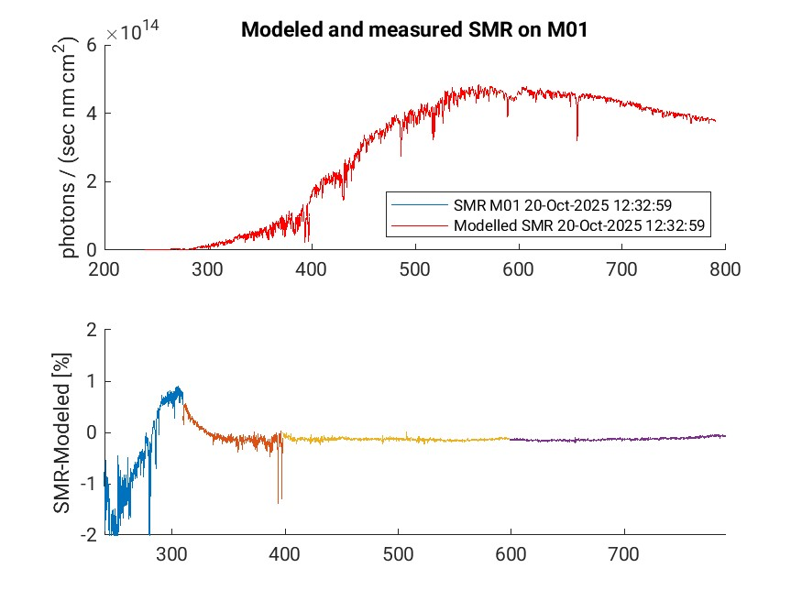
GOME-2 Solar Model performance
Analysis for current solar gap – Model vs GOME-2B SMR (before start of gap)

Slide 7
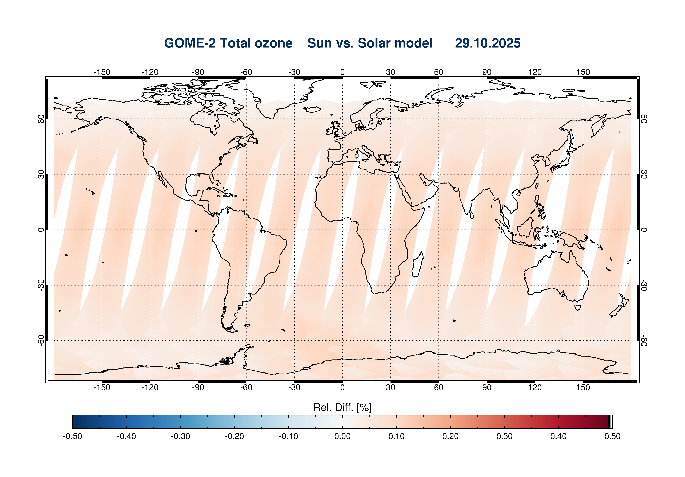
GOME-2 Solar Model performance
Ozone slant column difference (meas. SMR vs solar model)

Slide 8
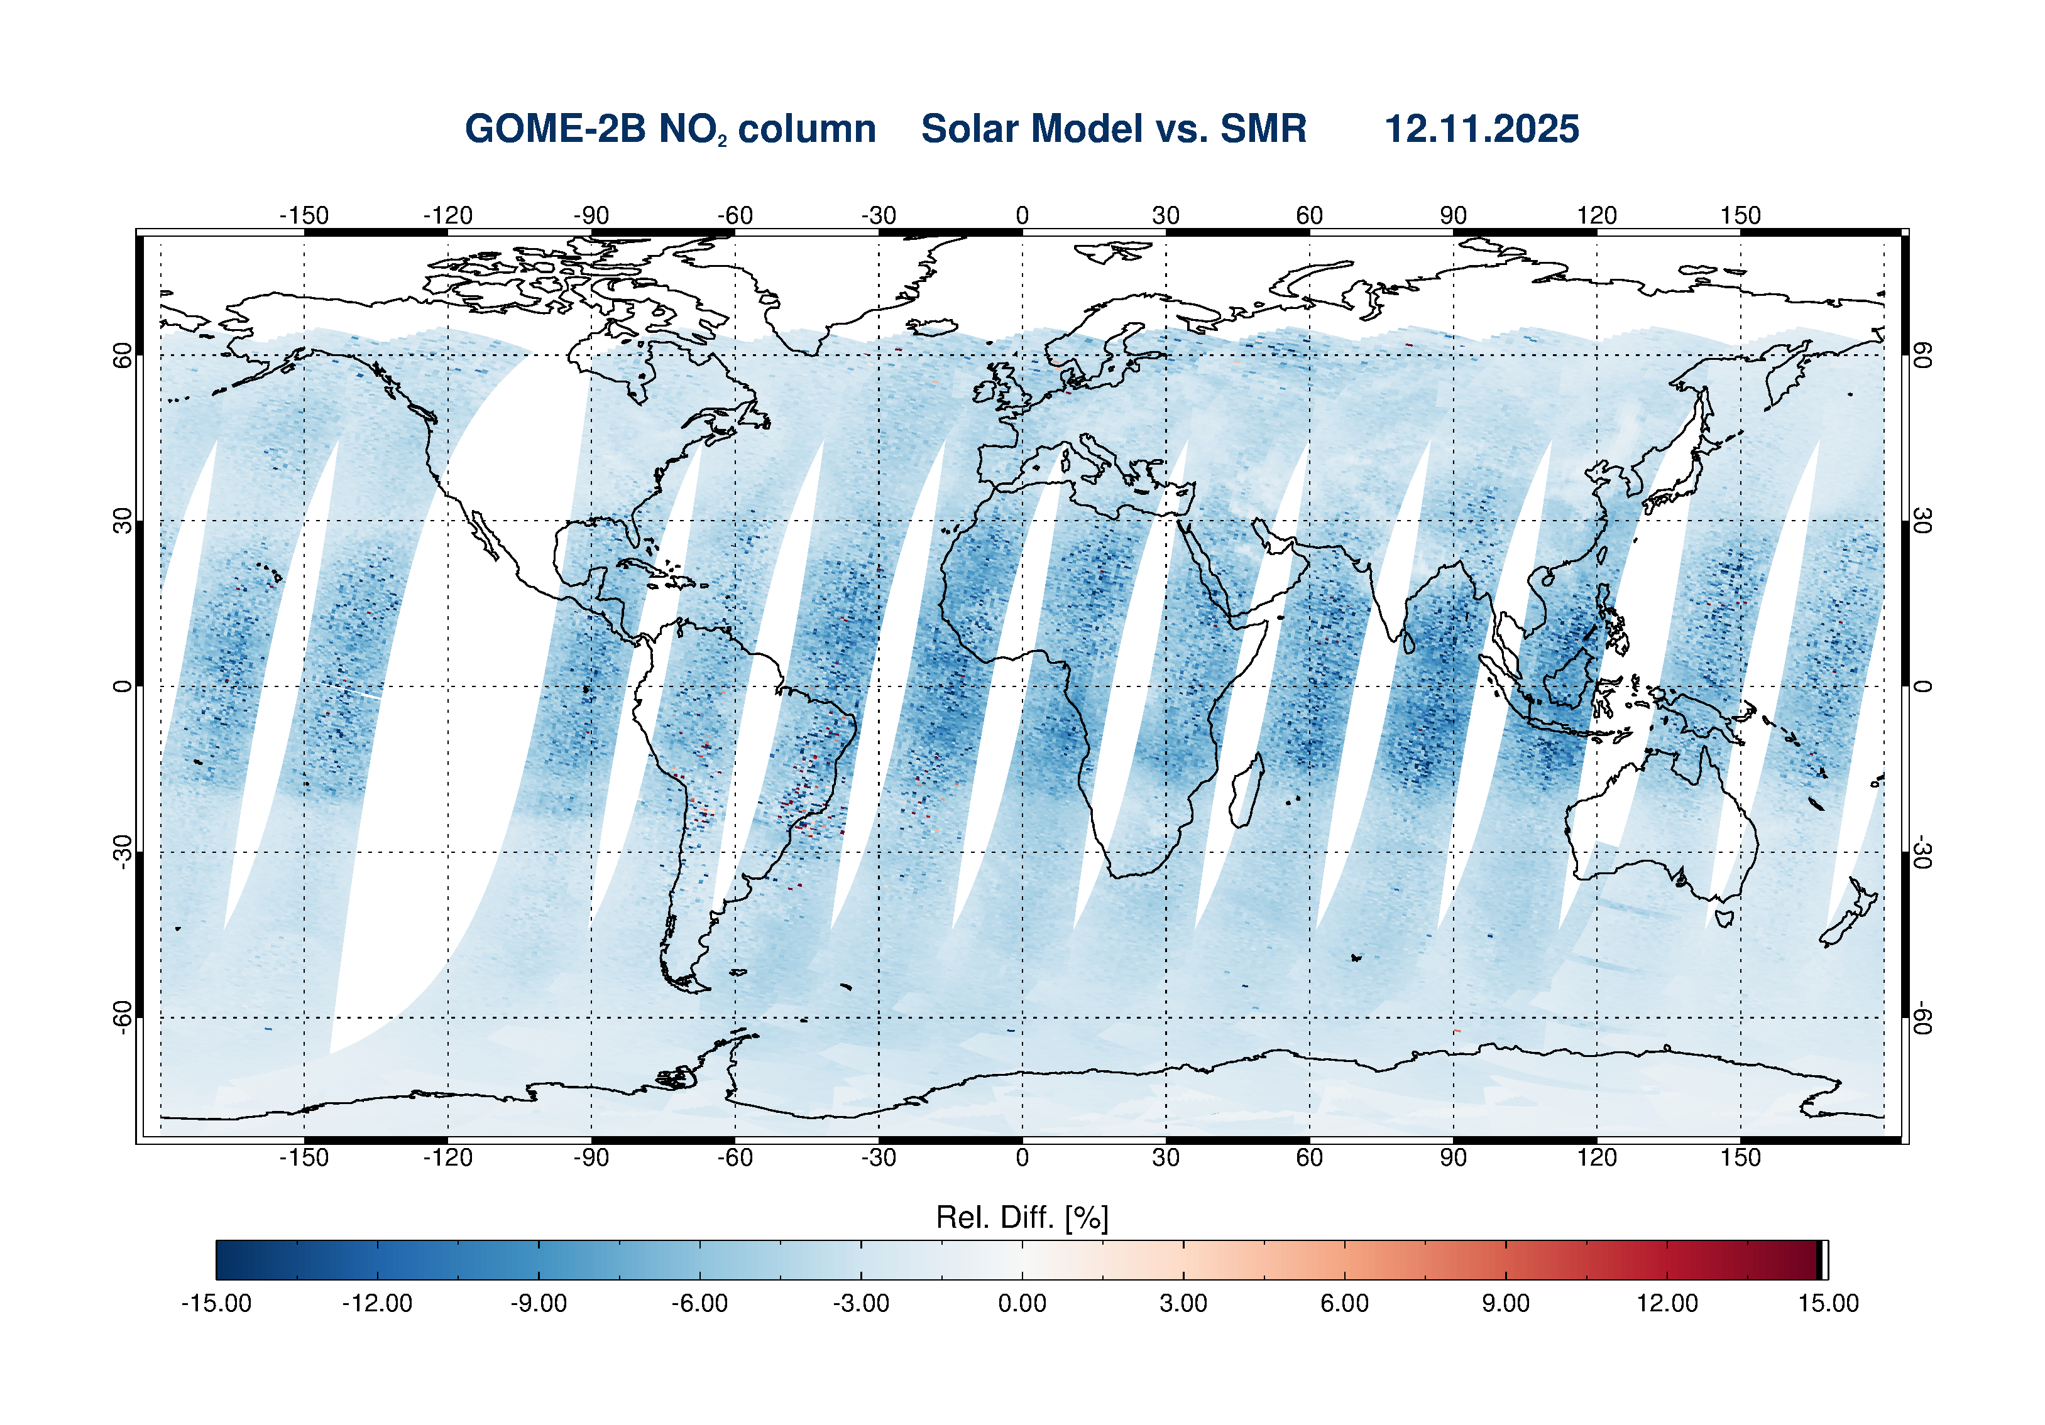
GOME-2 Solar Model performance
NO₂ slant column difference (meas. SMR vs solar model)

Slide 9
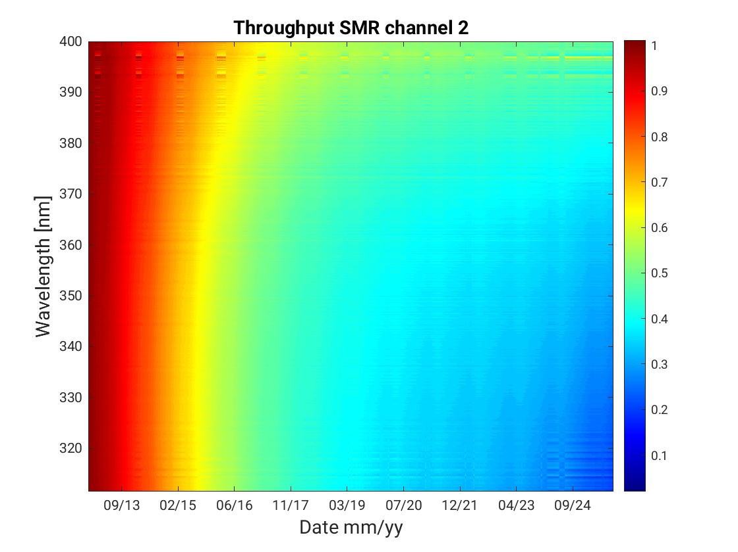
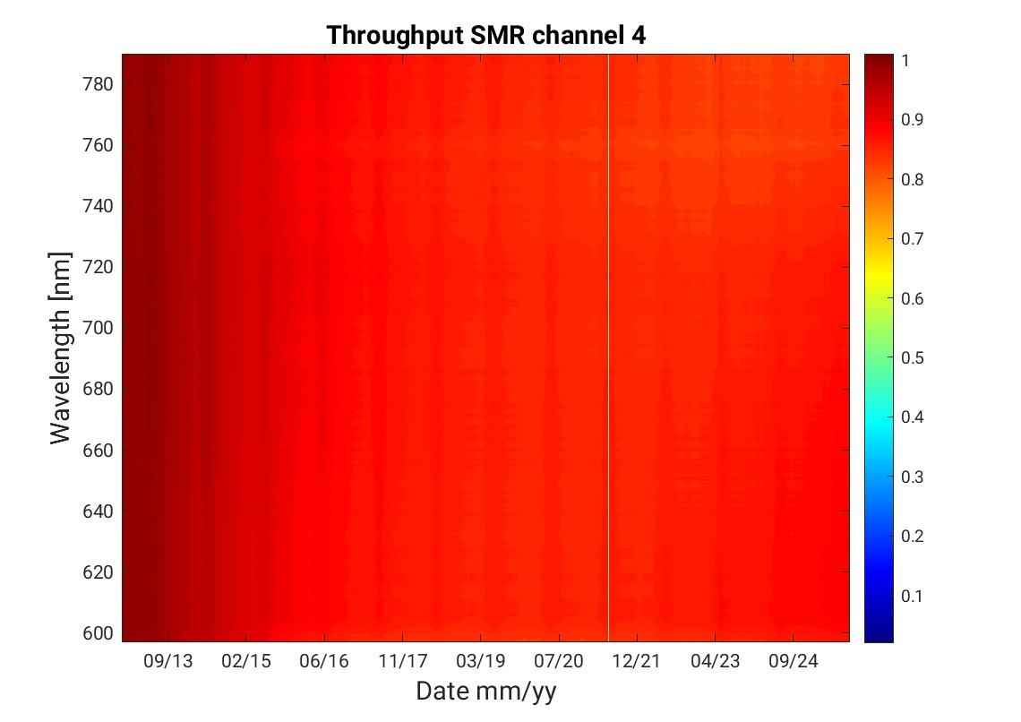
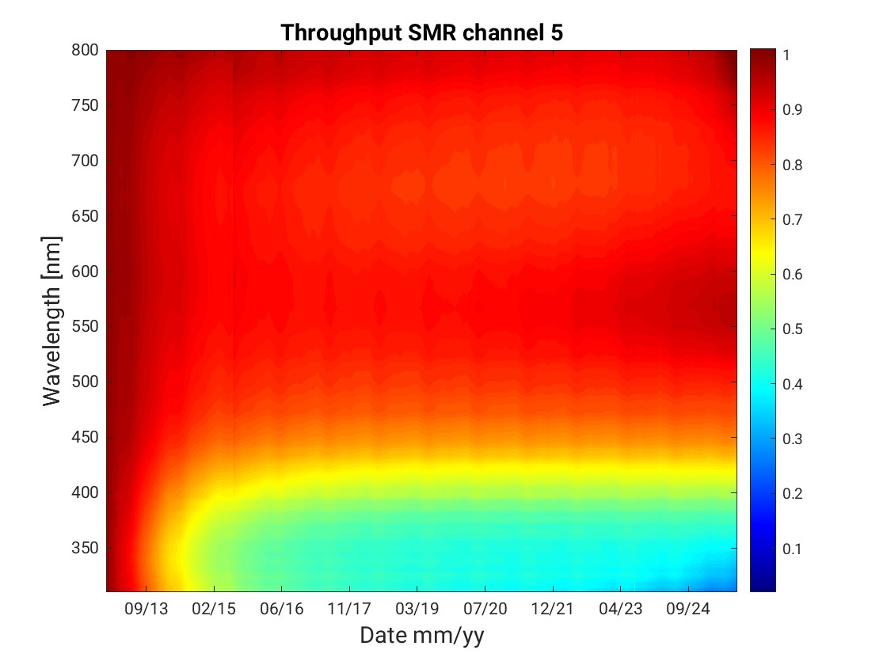
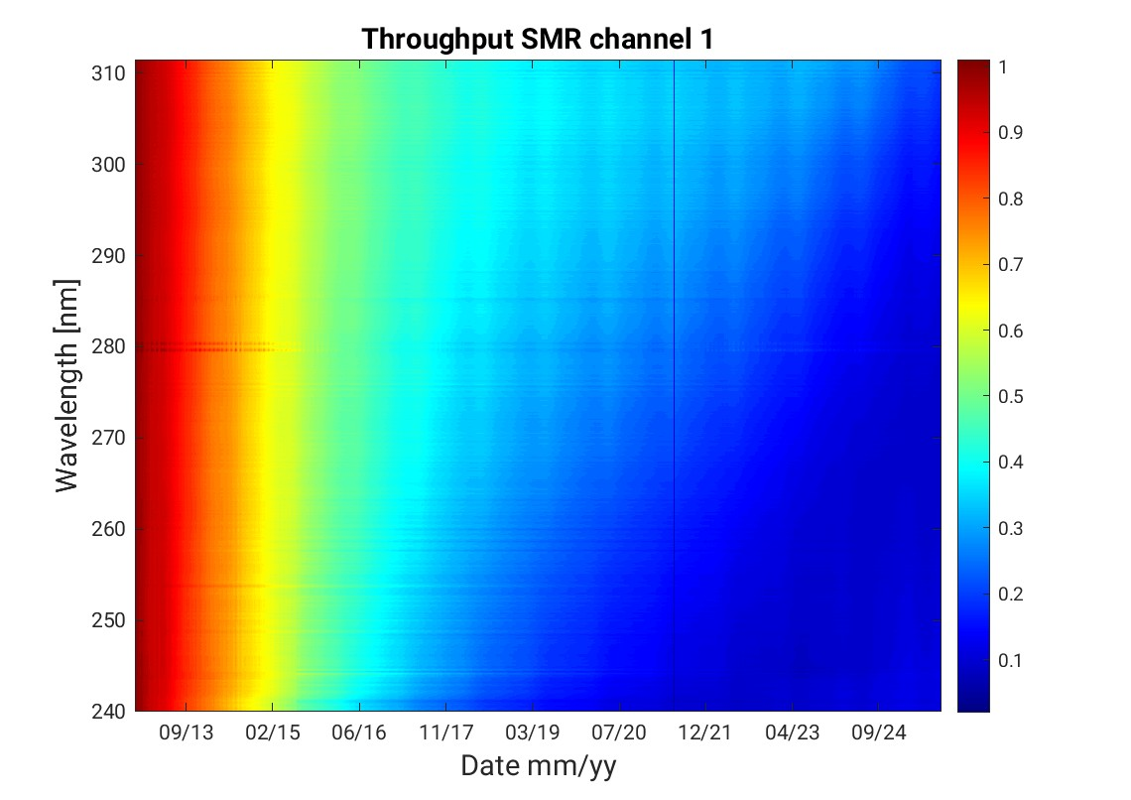
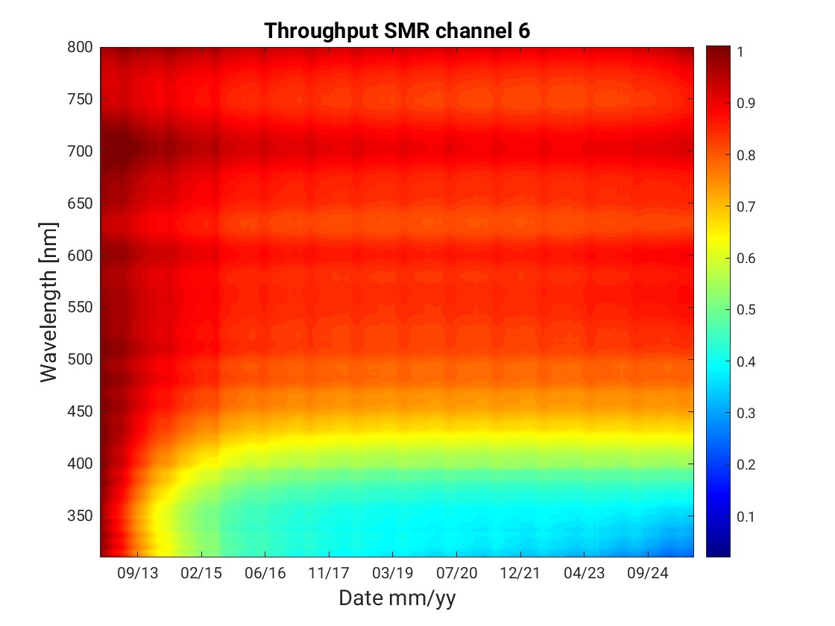
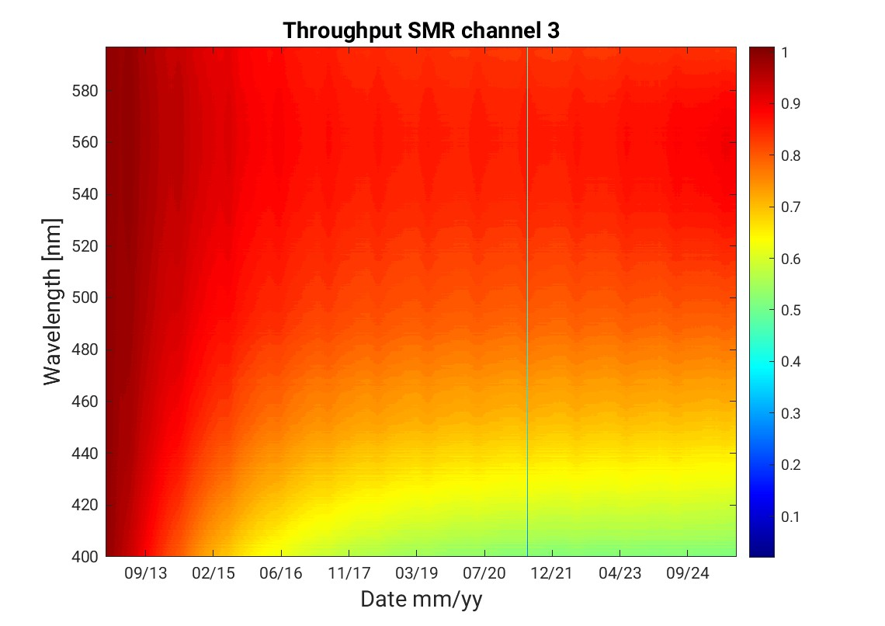
GOME-2B SMR Throughput (normalised)
400 nm
780 nm
PMD-P
320 nm
600 nm
310 nm
580 nm
PMD-S
240 nm
400 nm

Slide 10

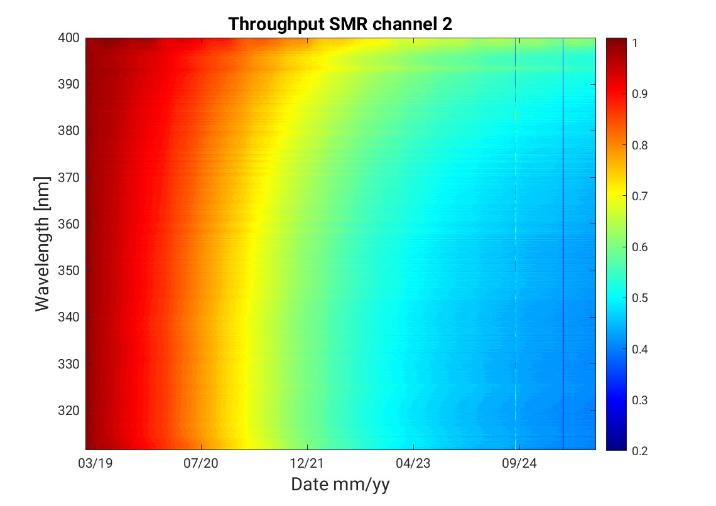
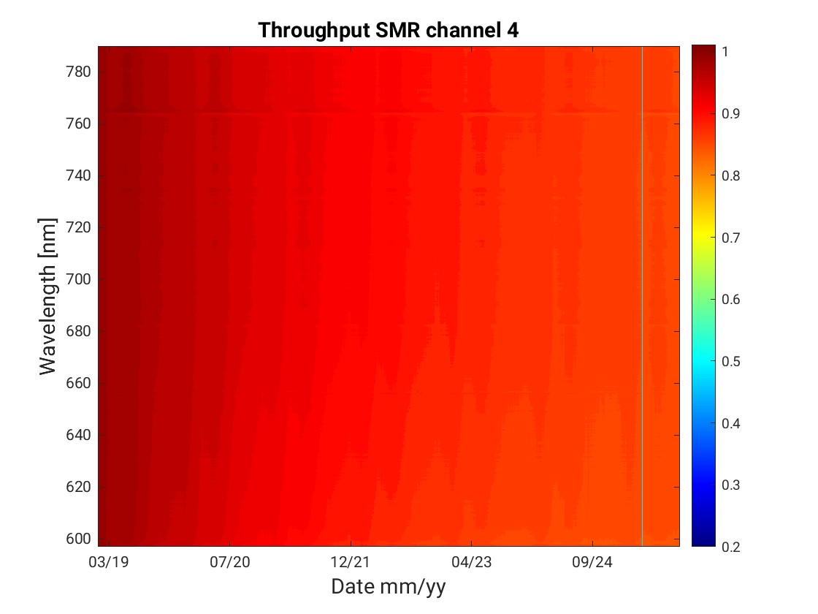
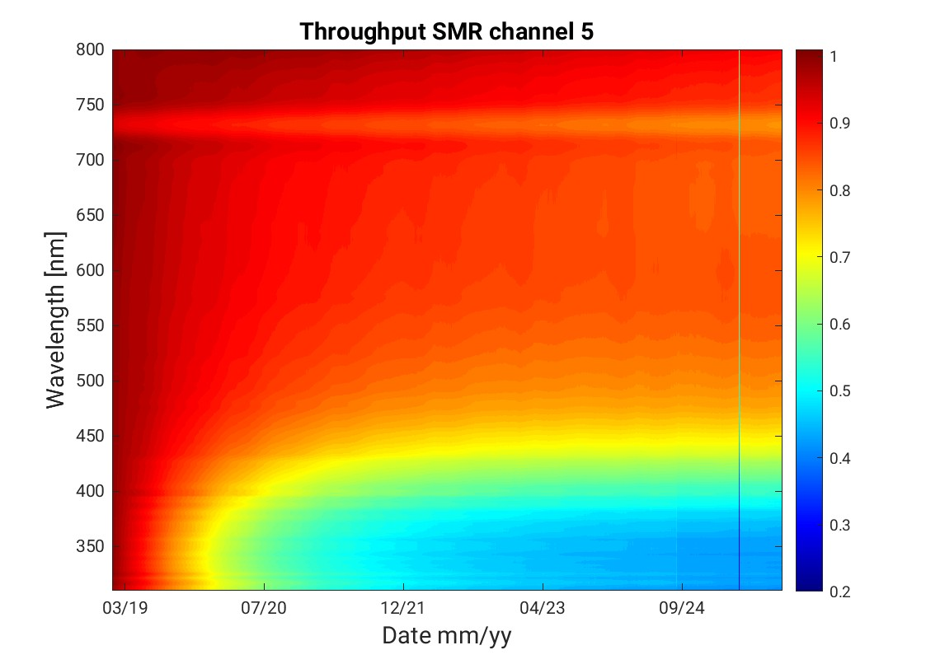
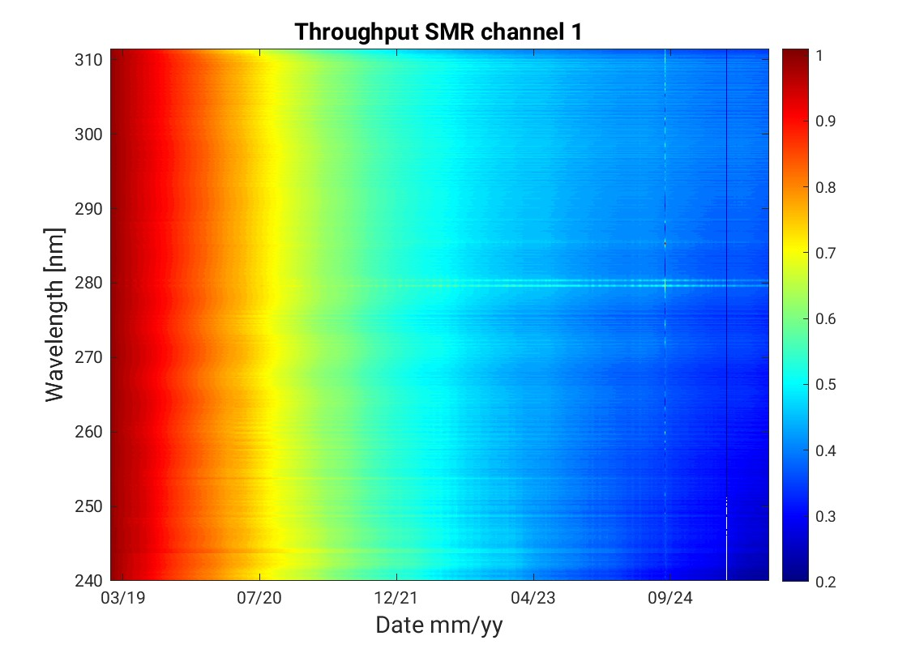
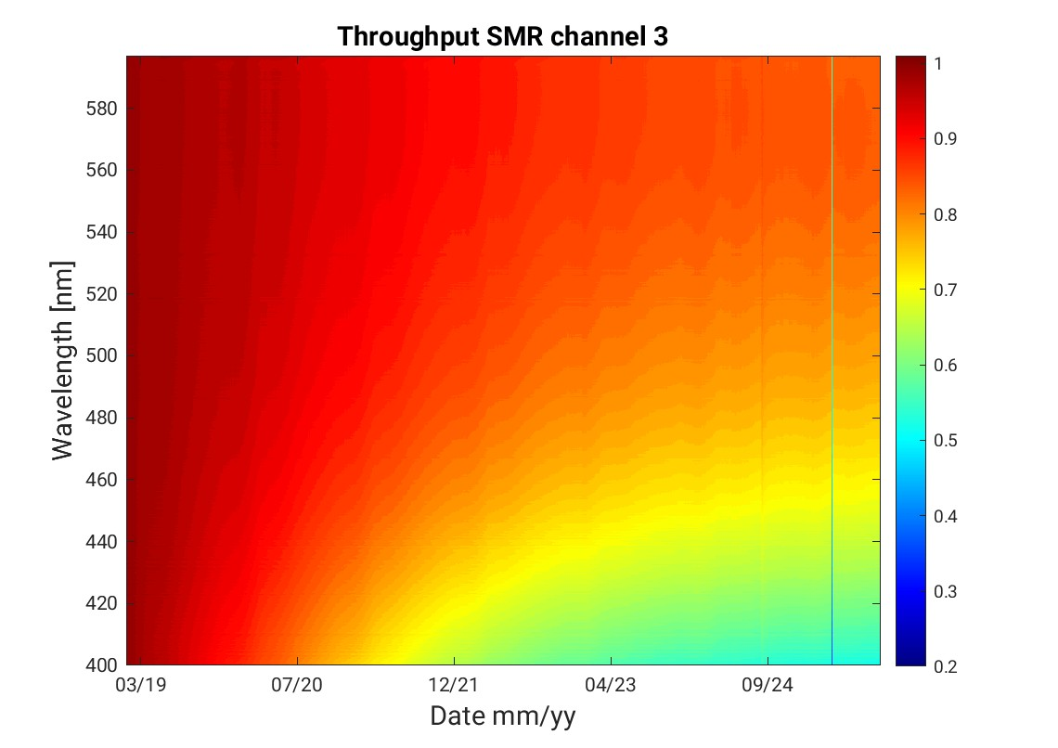
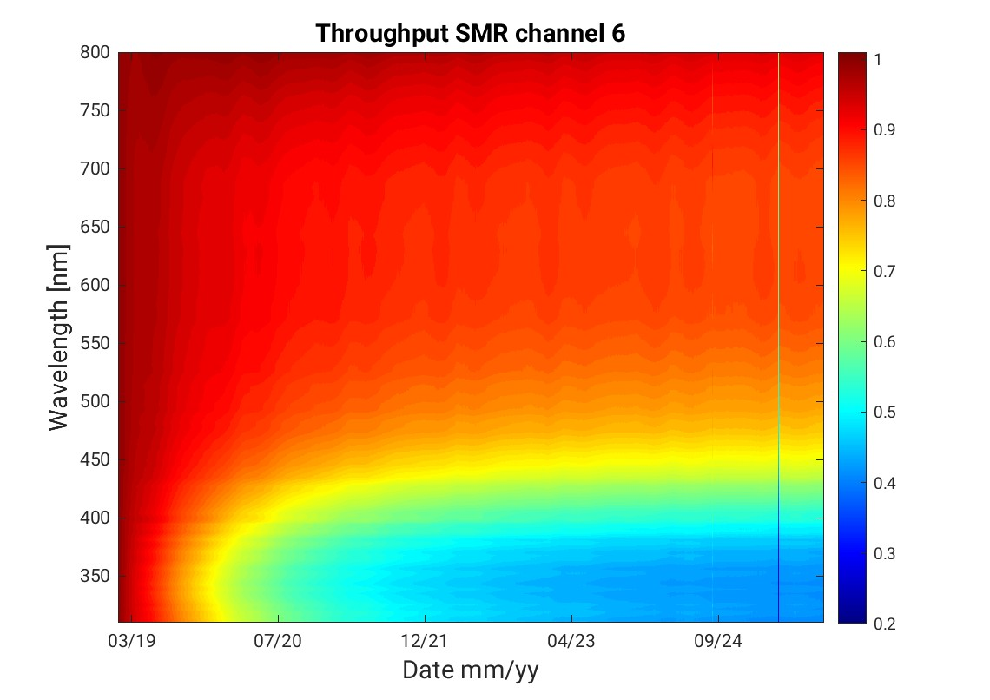
GOME-2C SMR Throughput (normalised)
400 nm
780 nm
PMD-P
320 nm
600 nm
310 nm
580 nm
PMD-S
240 nm
400 nm

Slide 11
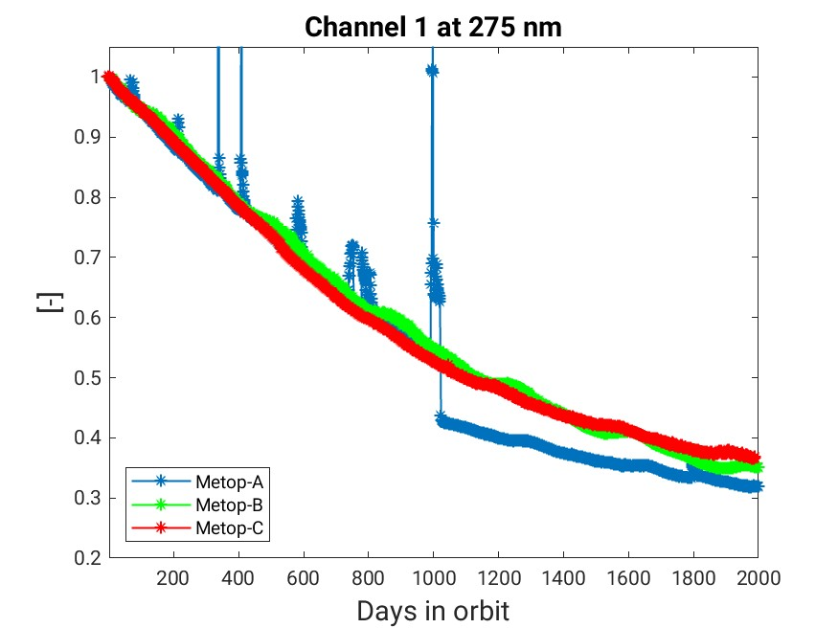
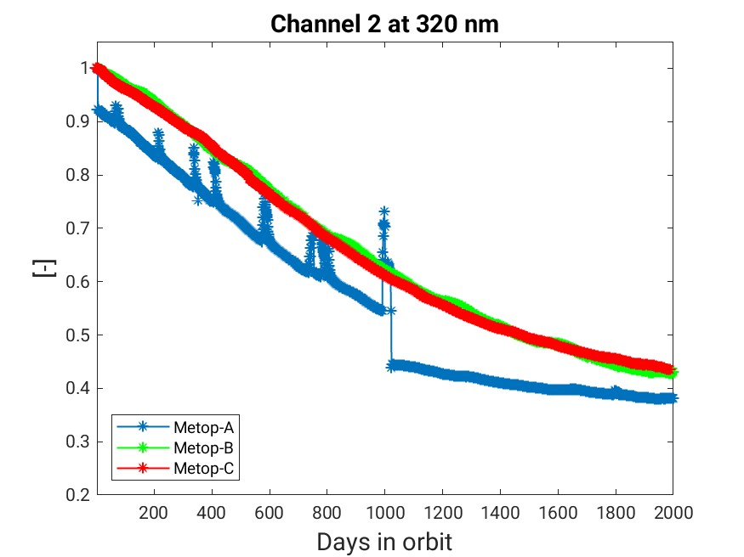
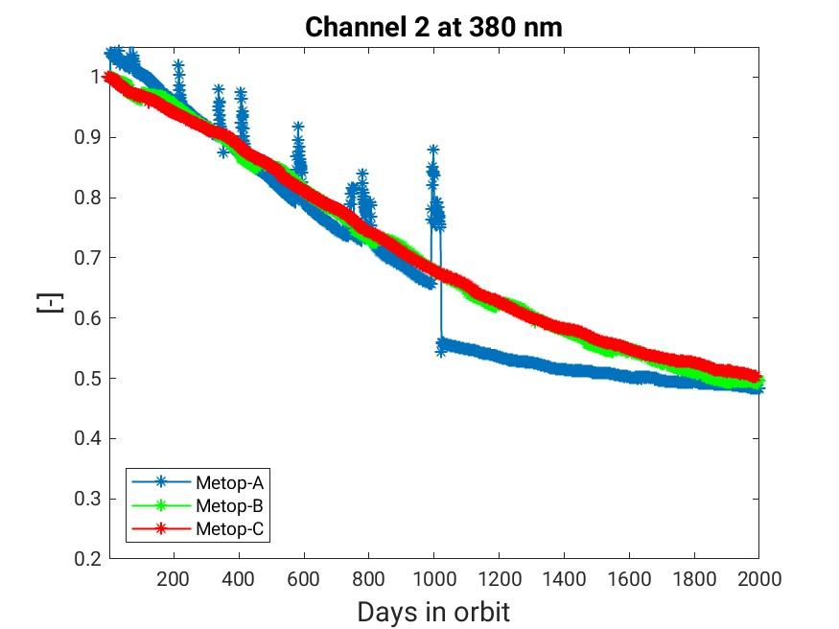
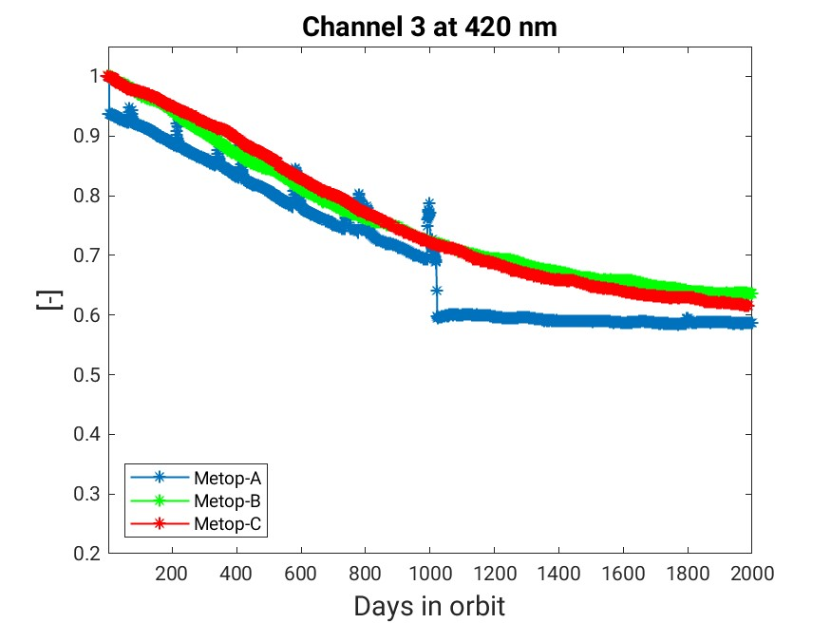
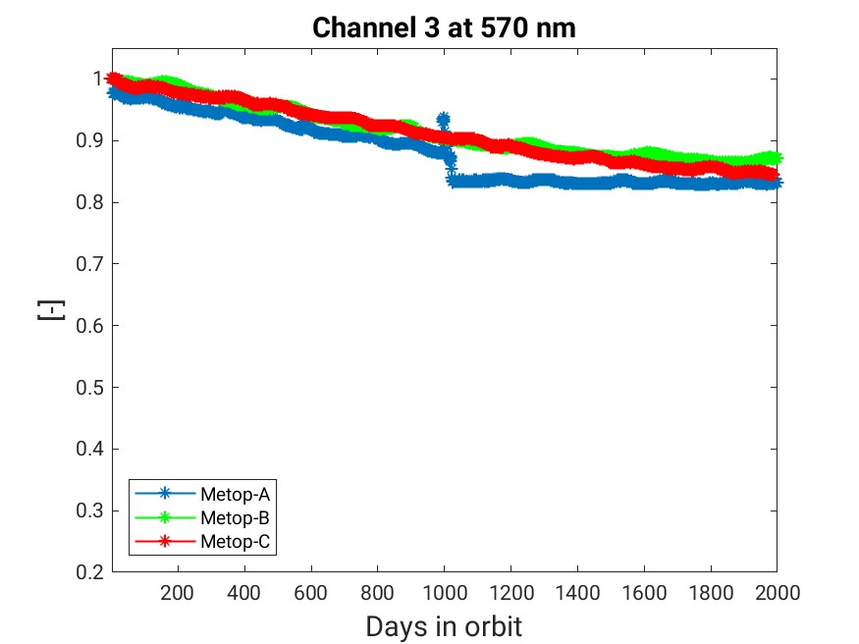
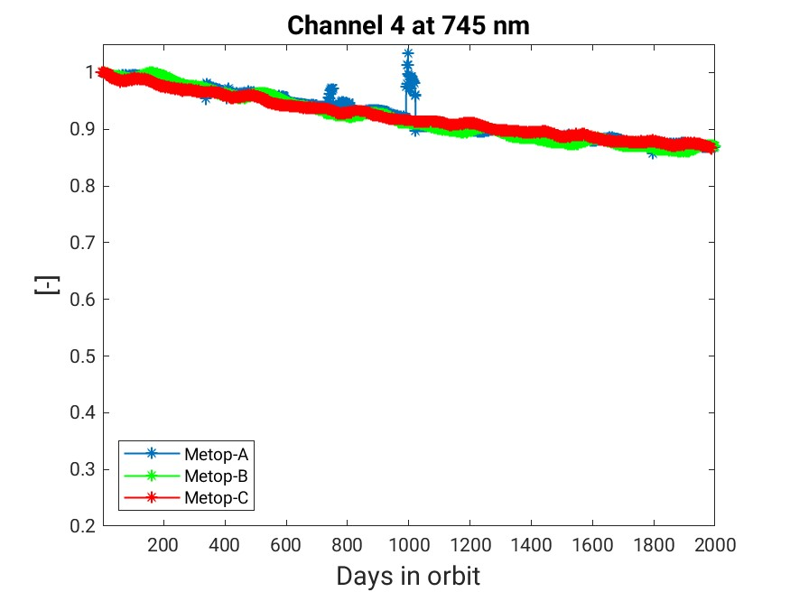
GOME-2 SMR Throughput comparison (same time in orbit)

Slide 12
GOME-2 L1B degradation correction
    Degradation model using measurements over Sahara (20-30°N, 0-30°E)
      Cloud free measurements (cloud fraction < 0.05)
    SMR and Earthshine degradation coefficients for each viewing angle
      set of coefficients (ASCII-files) to correct main science channels (FPA) and PMD L1B data
      include one year forecast (for NRT applications)
    Long-term change in reflectivity (differential degradation) with strong viewing angle dependence
      polarisation dependent scan mirror degradation/contamination effects

Slide 13
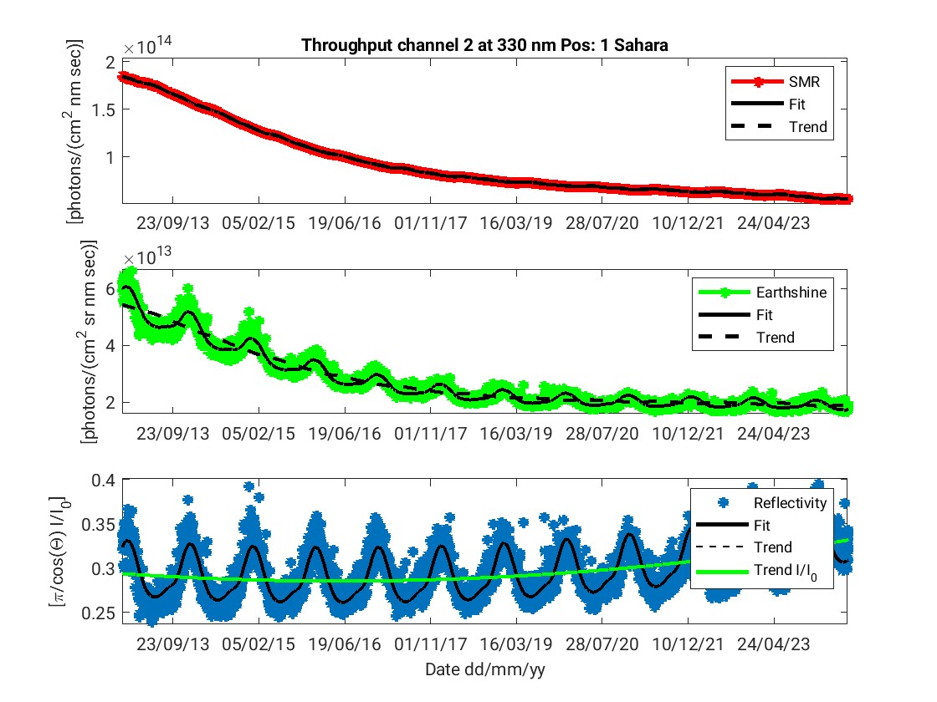

GOME-2 L1B - Throughput 330 nm (Ch. 2) scan pos 1 (east)
SMR
Earthshine (Sahara)
Reflectivity (Sahara)

Slide 14
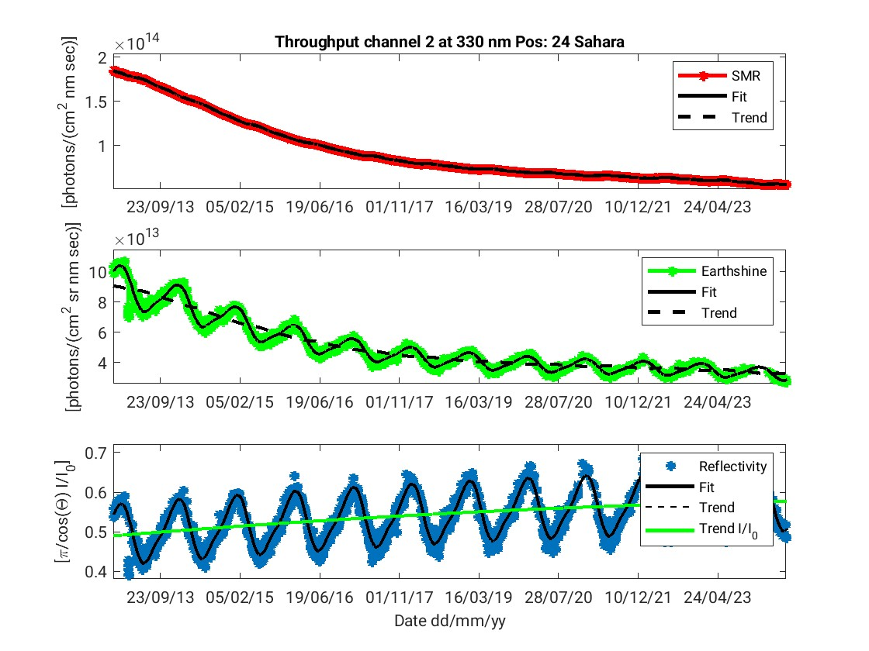
GOME-2 L1B - Throughput 330 nm (Ch. 2) scan pos 24 (west)
SMR
Earthshine (Sahara)
Reflectivity (Sahara)

Slide 15
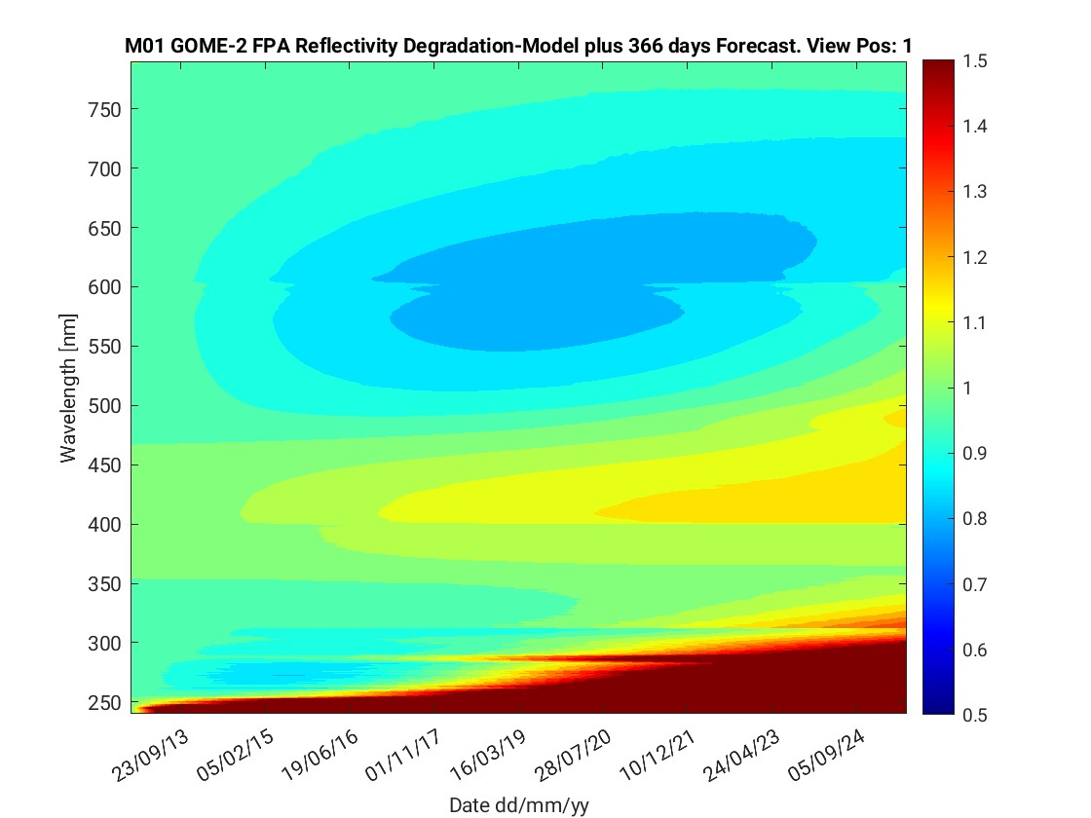
GOME-2 L1B - Refl. Degr. Model scan pos 1 (east)

Slide 16
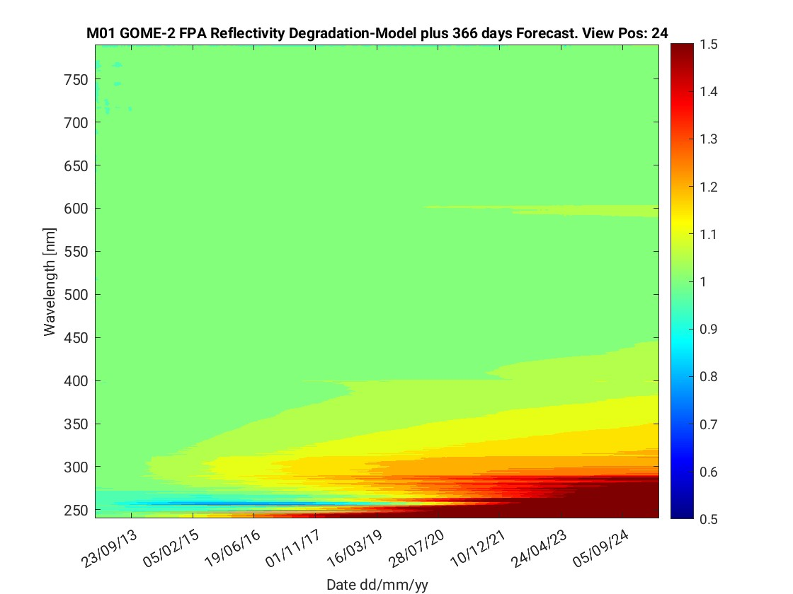
GOME-2 L1B - Refl. Degr. Model scan pos 24 (west)

Slide 17
GOME-2 L1B degradation correction
Degradation coefficients available for GOME-2 on Metop-A, -B and -C
Solar spectrum (SMR) for FPA, PMD-p, and PMD-S: c_{SMR} (λ,t)
Earthshine spectrum for 24 fixed angles and for FPA, PMD-p, and PMD-S: c_{Earth} (λ,φ,t)
Degradation coefficients available for users (via EUMETSAT FTP-site)
Earth_{corr} = Earth / c_{Earth} (λ,φ,t)
SMR_{corr} = SMR / c_{SMR} (λ,t)

Slide 18
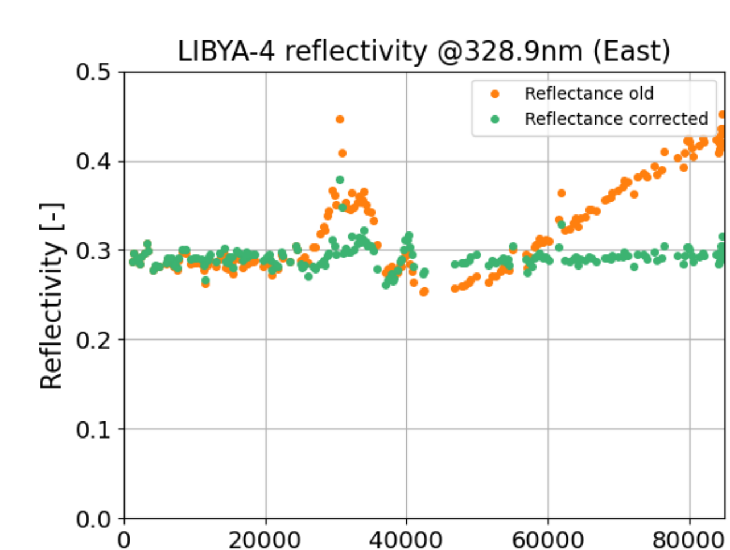
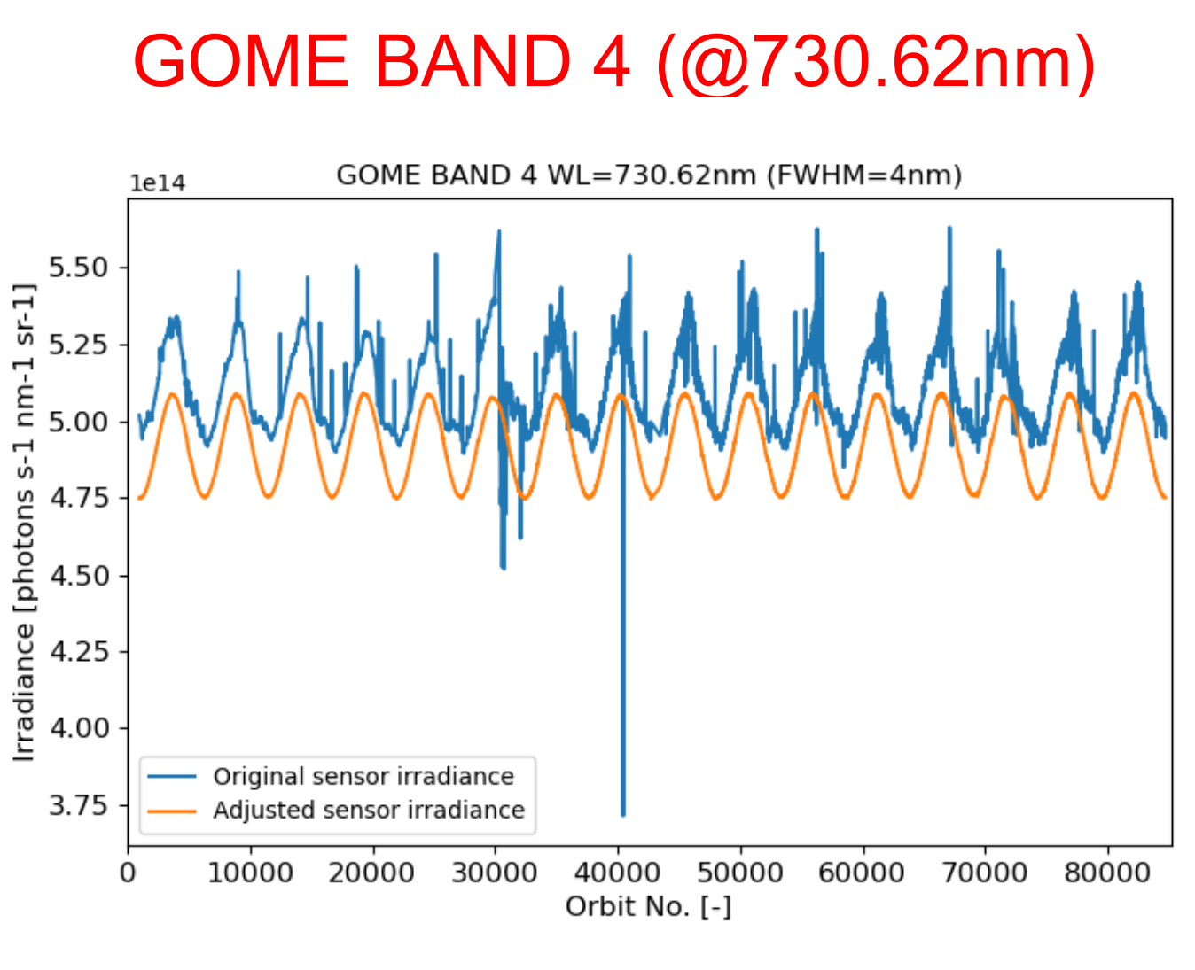
FDR4ATMOS project
Slide provided by Günter Lichtenberg, DLR
The FDR4ATMOS project delivers FDRs on Level 1 Basis
It is funded by ESA LTDP program
The FDR provides harmonised reflectances and solar irradiances
Version 1 included the full GOME and SCIAMACHY missions providing harmonised data from 1995 – 2012
Currently the project is in phase 3. In it
  GOME-2 data will be added in cooperation with EUMETSAT→ FDR from 1995-2024+
  GOME-1 reflectances are degradation corrected (top right)
  V2 solar irradiances are harmonised to the TSIS-HSRS spectrum, not SCIAMACHY (example bottom right)
  Review and add Level 1 uncertainties
  Provide lunar products
Current Status
  Harmonisation of solar irradiances is finished
  First harmonisation curves for GOME-2 are calculated
  Quality checking and Level 2 tests are on-going
  Planned Data Delivery: Begin 2027

Slide 19
Thank you!
Questions are welcome.

