Slide 1
Copernicus Sentinel-4 & -5 - status
Rasmus Lindstrot
CAM – Atmospheric Chemistry
On behalf of the EUM S4 &S5 teams!
TSS Briefing 24 March 2026

Slide 2
Agenda
Sentinel-4 & Sentinel-5
  Mission status
  Early data impressions & investigations

Slide 3
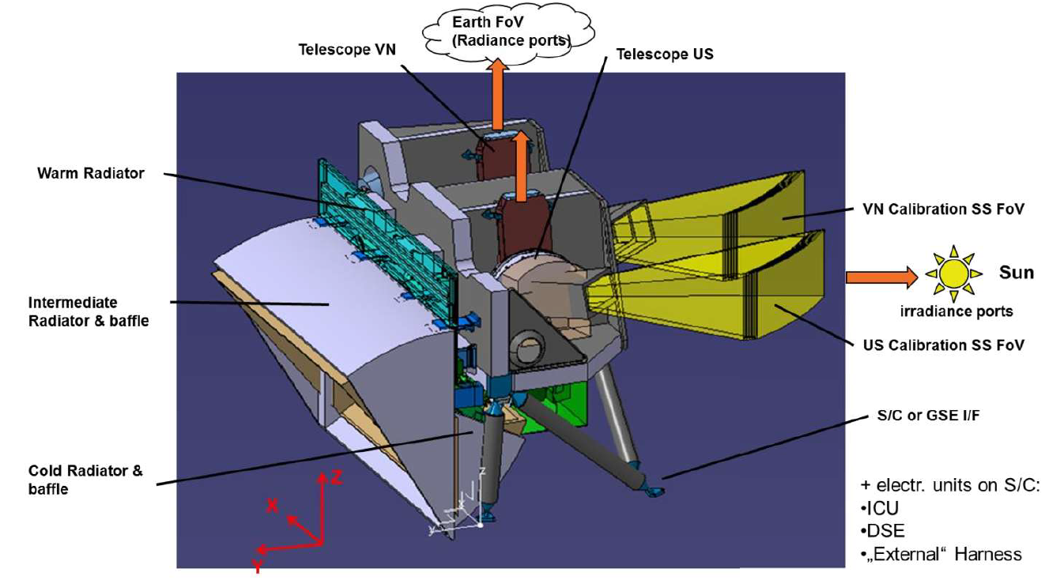
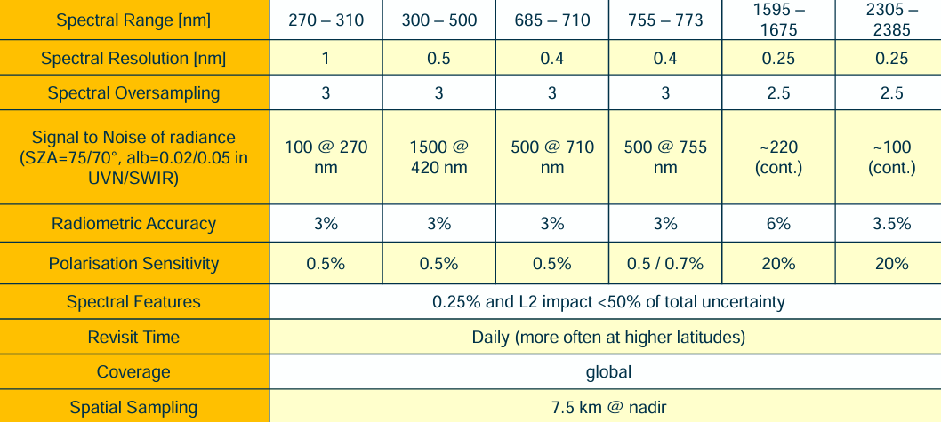
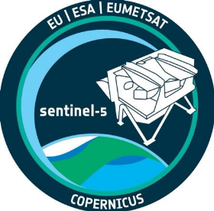

Copernicus Sentinel-5/UVNS
Passive grating imaging spectrometer in push broom configuration with a nominal swath of 2670 km width, and spatial sampling in Nadir of < 50 x 50 km² below 300 nm and 7.5 x 7.5 km² for all other wavelengths (1.4 x 7.5 km² in NIR2).
Launched August 2025
Calibration opportunities
  Daily sun
  On-board WLS, LED, SLS
  Pseudo-Invariant Calibration Targets
  Sat-to-Sat cross comparisons
    METimage (same platform)
    SNOs

Slide 4
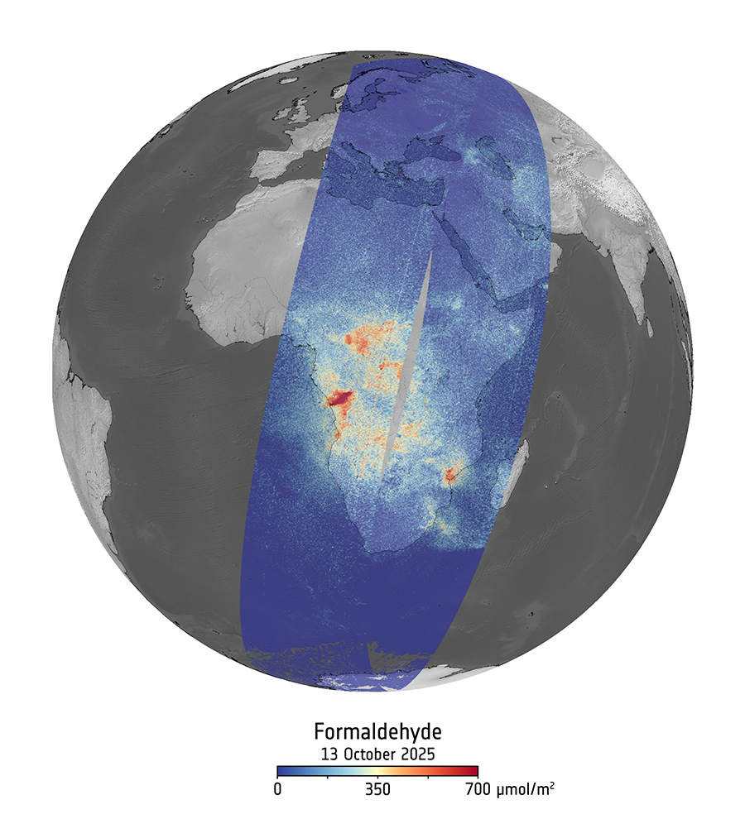
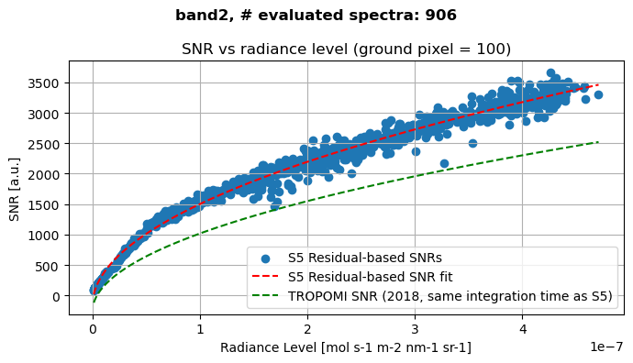
Sentinel-5/UVNS: Some early impressions
Sentinel-5 UV-VIS signal-to-noise is improved with respect to the precursor mission (Sentinel-5P), thanks to, e.g., avoiding pseudo-noise from inhomogeneous illumination (→ S5 slit homogenizer).
Small abundances of weak absorbers like Formaldehyde are clearly detectable from single overpasses - no temporal averaging required.

Slide 5
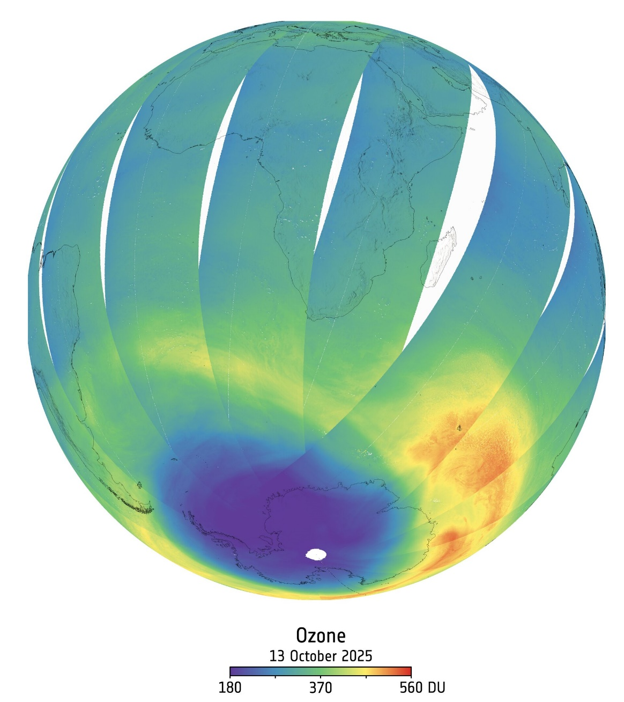
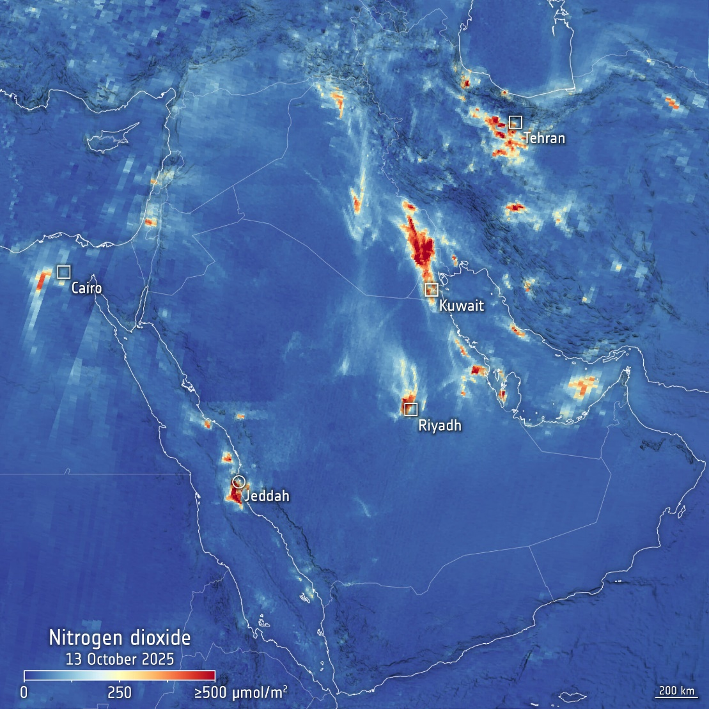
Sentinel-5/UVNS: some early impressions

Slide 6
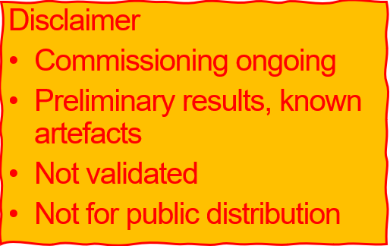
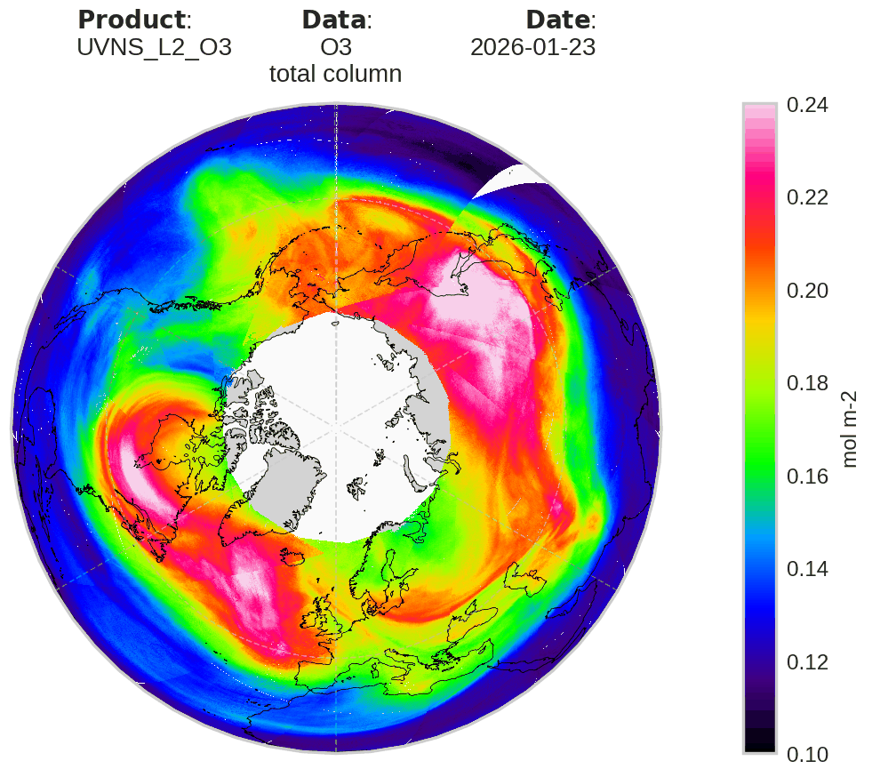
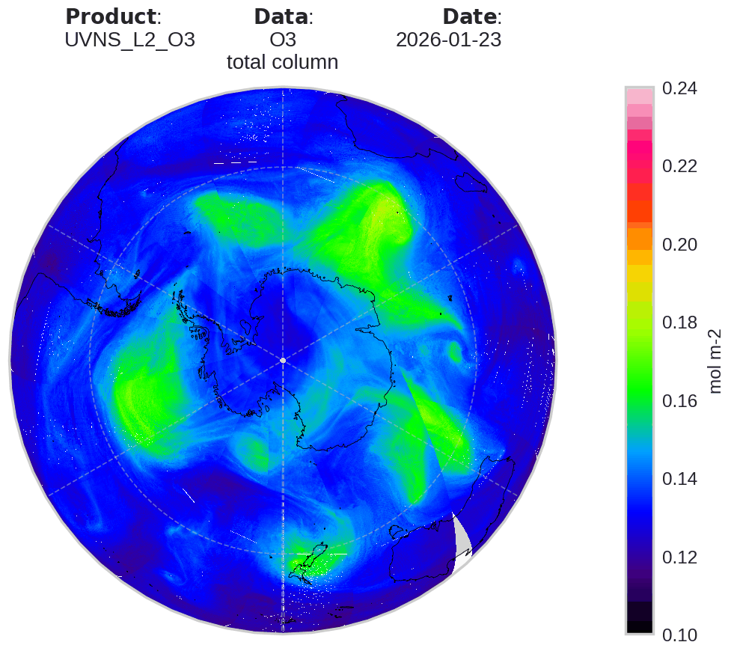
Sentinel-5/UVNS: some early impressions

Slide 7
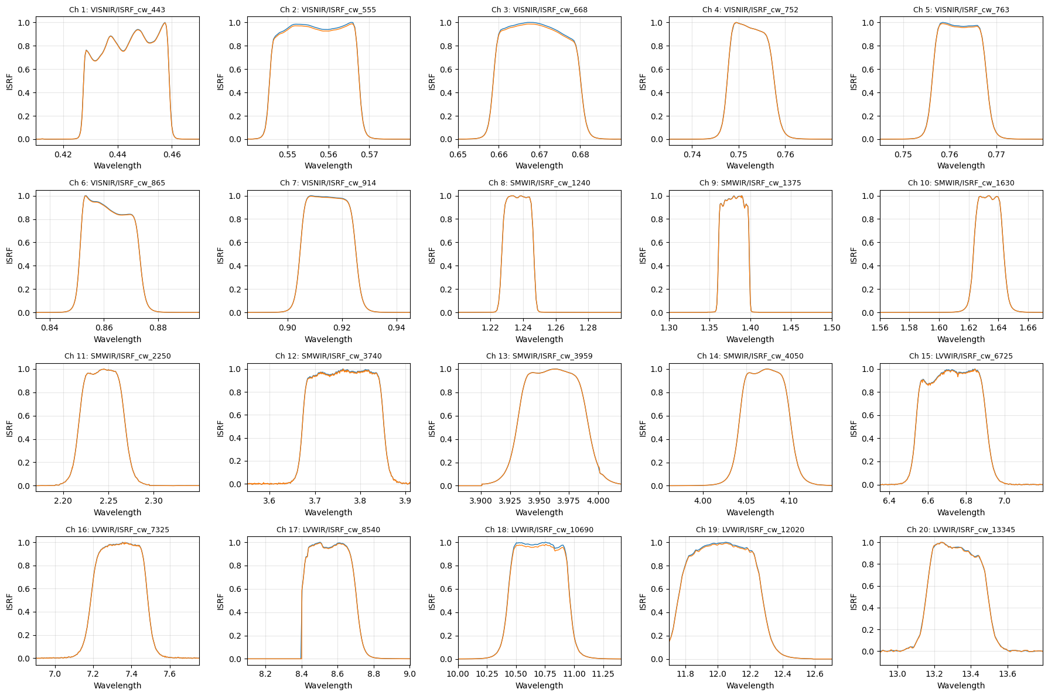
Sentinel-5/UVNS vs METimage radiances
EPS‑SG provides an excellent platform for consistent cross‑comparison of radiances across multiple sensors.
METimage: multispectral imaging radiometer, capturing 20 visible to thermal‑infrared spectral bands at 500 m spatial resolution.
443nm, 752nm, (763nm), 1630nm bands good candidates for cross-comparison with S5.
Comparison via
  spatial averaging of METimage radiances inside S5 7km x 7km footprints
  Spectral convolution of S5 radiances with METimage ISRF.

Slide 8
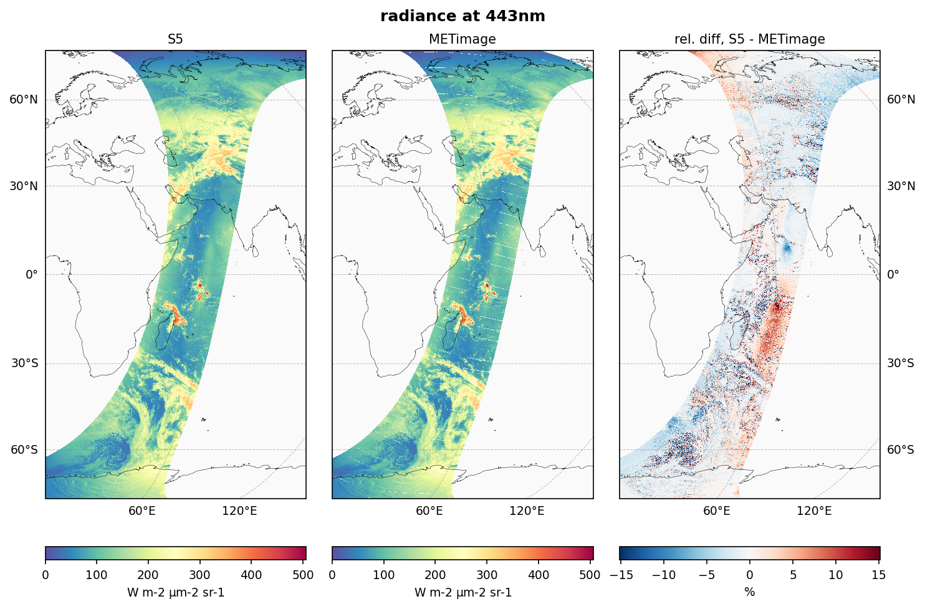
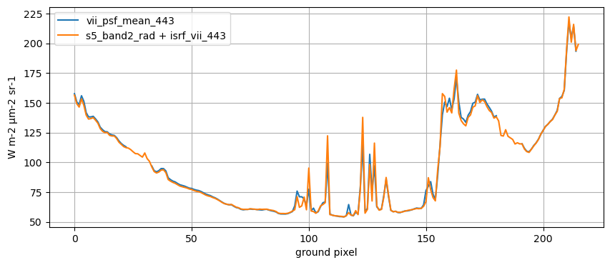
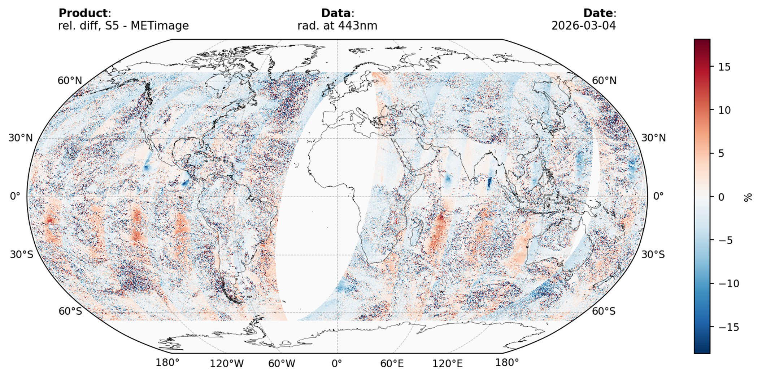
Sentinel-5/UVNS vs METimage radiances
Both missions in commissioning!
S5 and METimage radiances in close agreement over homogeneous surfaces.
Larger deviations observed over cloudy scenes and in regions affected by sun glint.
Some viewing angle dependent deviations found, flipping sign at the equator.
Pattern persistently found in all orbits

Slide 9
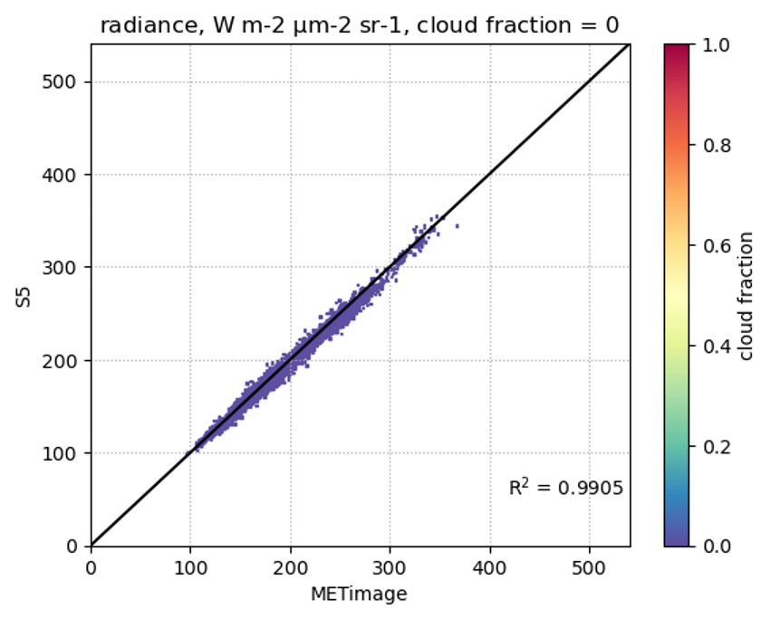
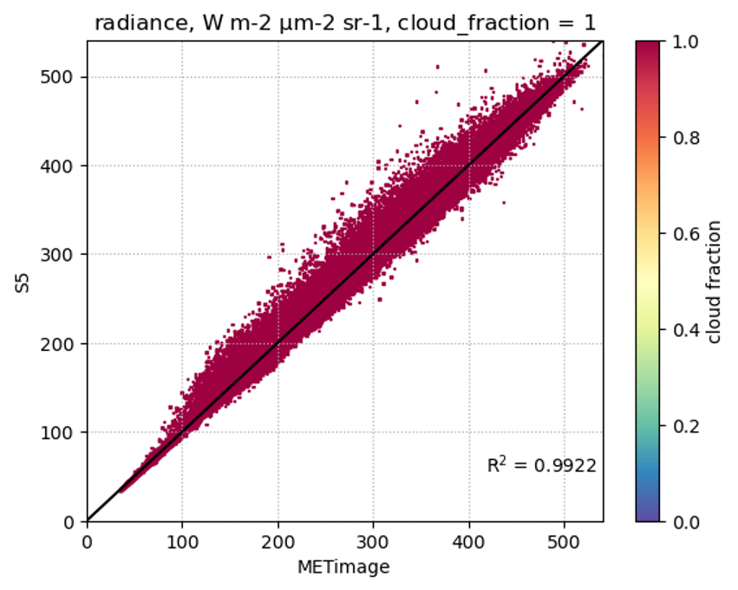
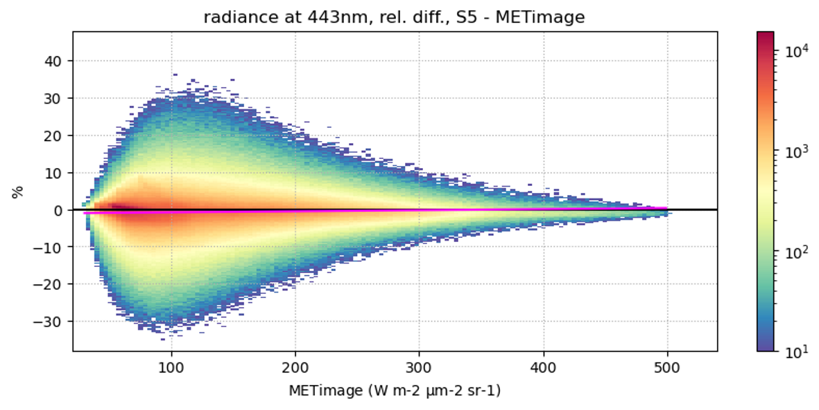
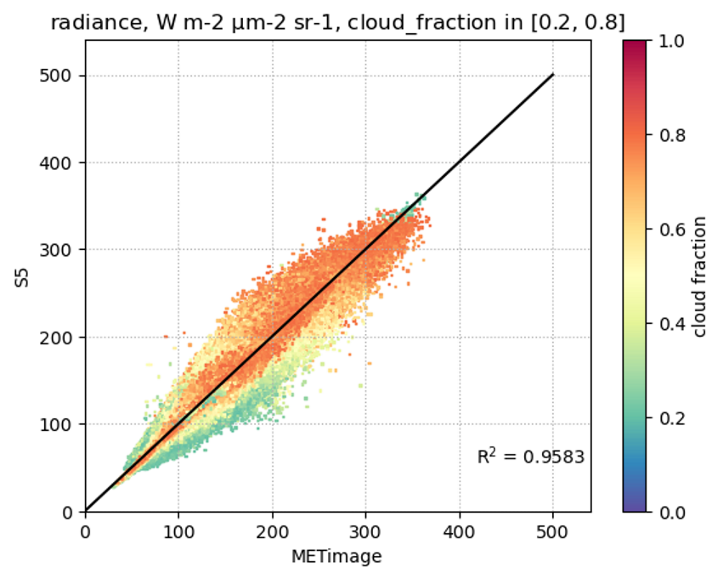
Sentinel-5/UVNS vs METimage radiances
High correlation for fully cloudy and fully clear scenes.
Good agreement across radiance level range

Slide 10

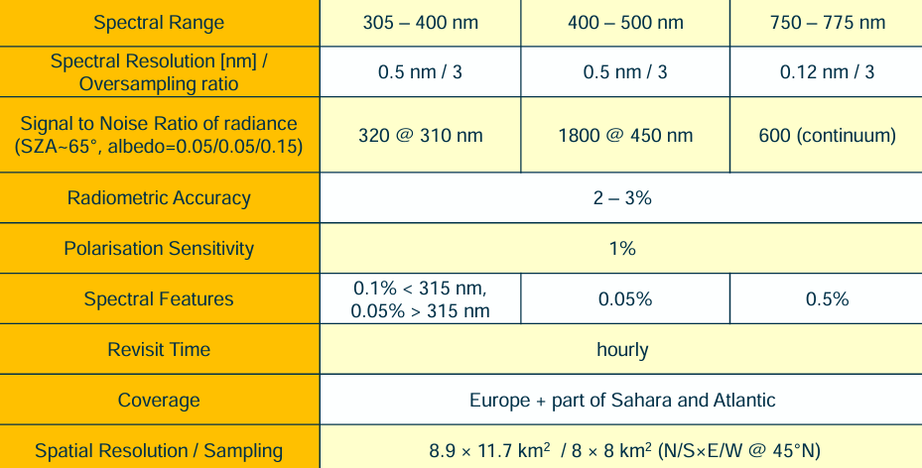
Copernicus Sentinel-4/UVN
Imaging UVN (UV-VIS-NIR) spectrometer, composed of two dispersive spectrometers covering 305–500nm and 750–775nm and a common telescope which projects an image of the Earth onto the two slits.
The spatial coverage over Europe and adjacent regions will be achieved by continuous East/West scanning of the image by a push-broom mirror mechanism, which will cover a field-of-regard of about 11 degrees, while the North/South Instantaneous Field-of-View (IFoV) will be equal to about 4 degrees.
Calibration opportunities
  Daily sun
  Moon
  Star
  On-board WLS, LED
  Pseudo-Invariant Calibration Targets in Northern Africa
  Sat-to-Sat cross comparisons (FCI, OLCI, …)
Launched July 2025

Slide 11
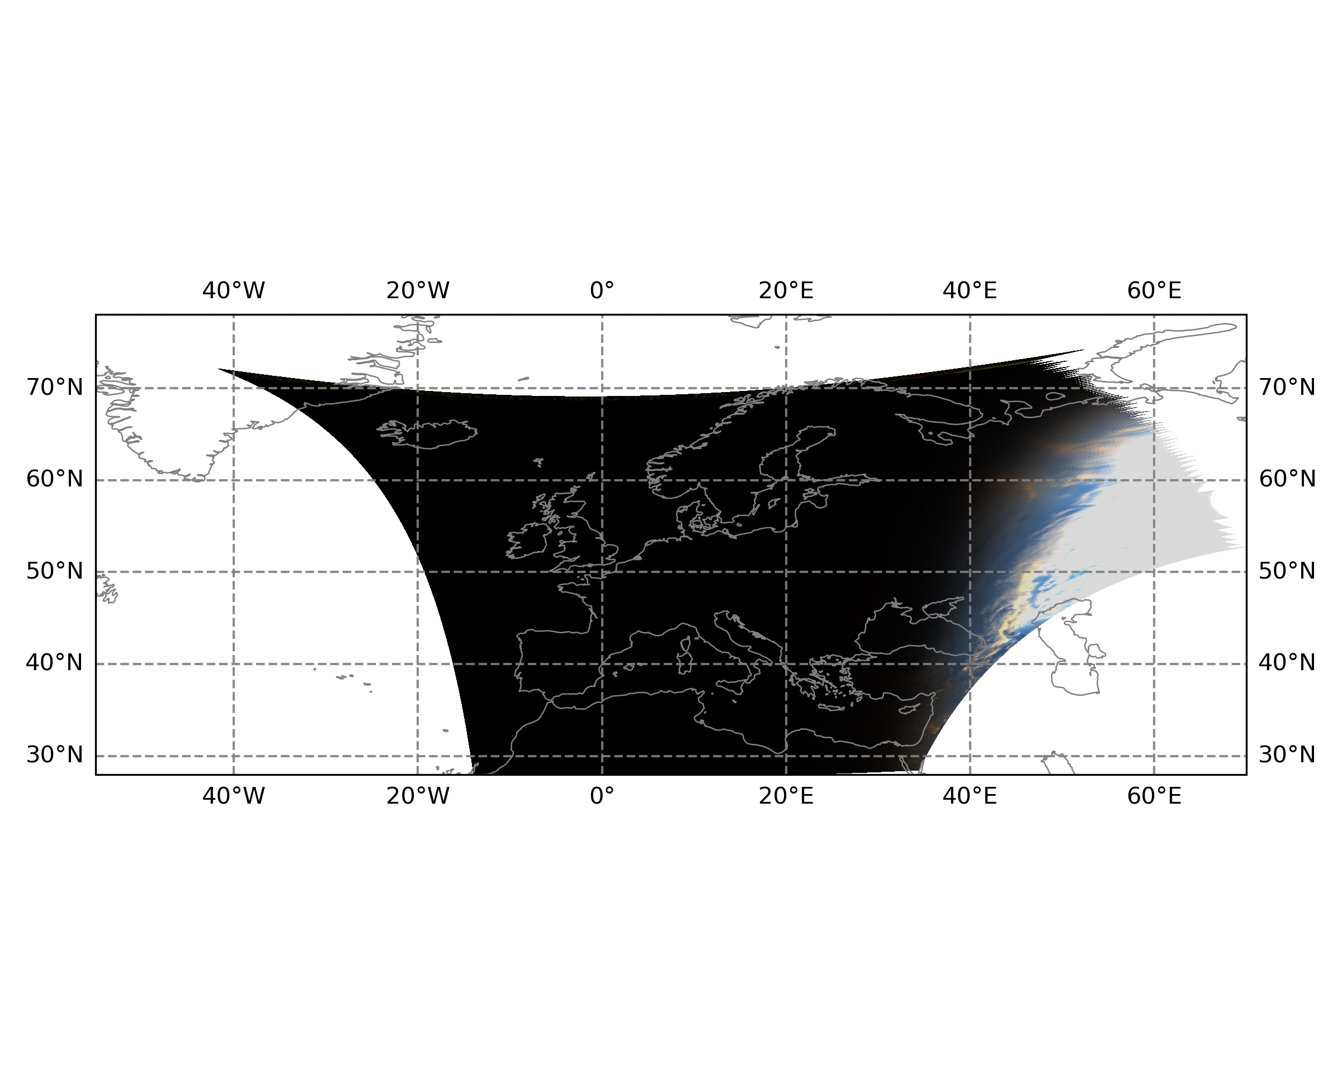
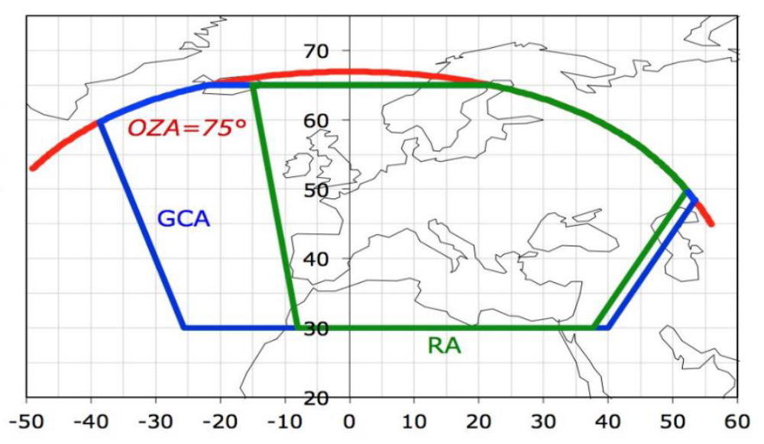
Sentinel-4/UVN scan pattern
Overall daily Earth observation pattern consists of a series of 1 hour-long East-to-West scans (“repeat cycles”) with a fast West-to-East retrace in-between.
Blue: total area to be covered every day.
Green: Size of a 1-hour repeat cycle (shifting throughout the day).
Depending on the seasonally varying duration of Earth illumination by the Sun, the daily Earth observation scan series consists of 16 (winter) to 20 (summer) 1h-scans.

Slide 12
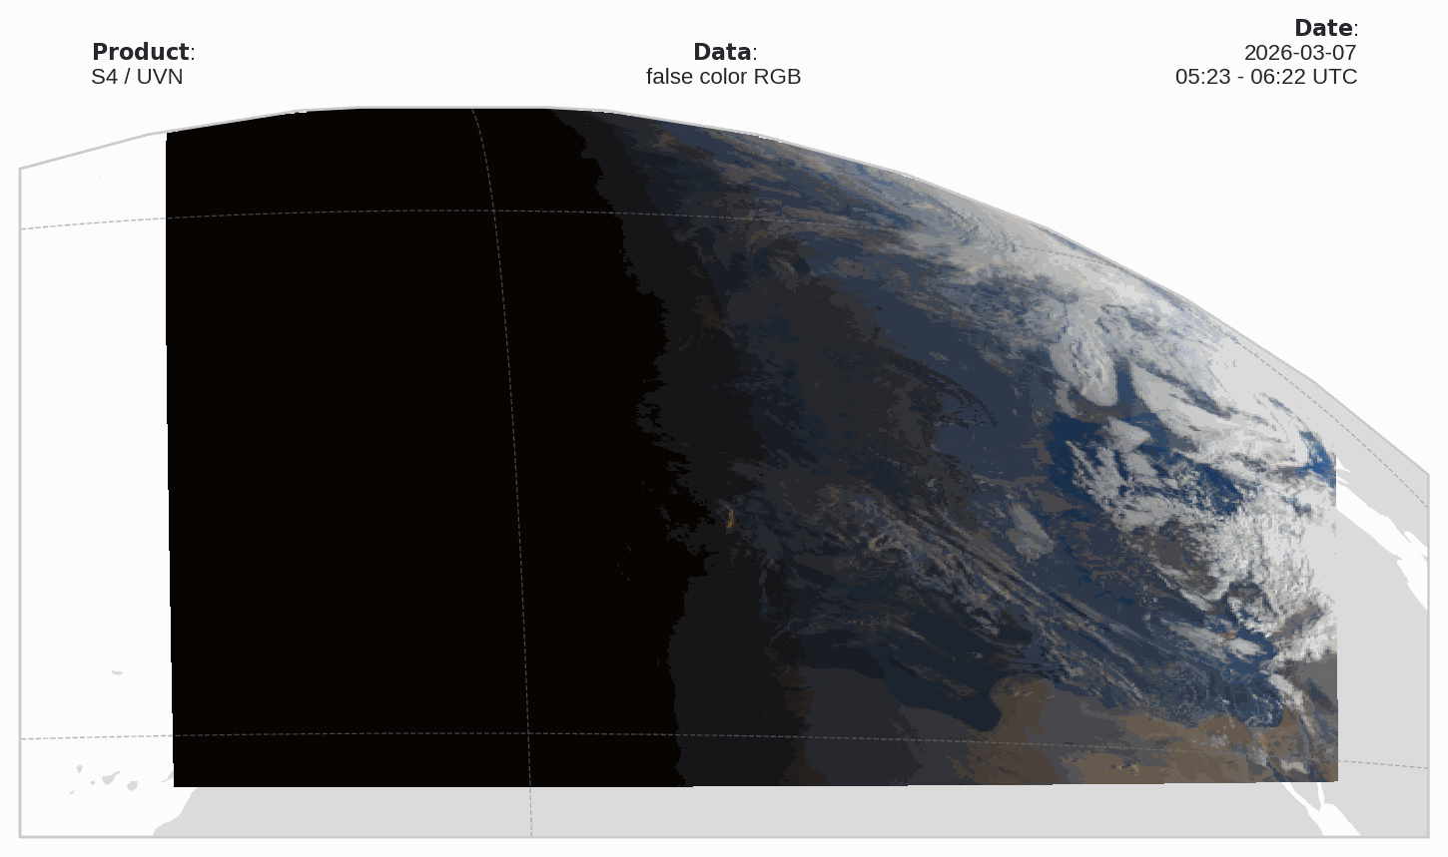
Sentinel-4/UVN: Some early impressions

Slide 13
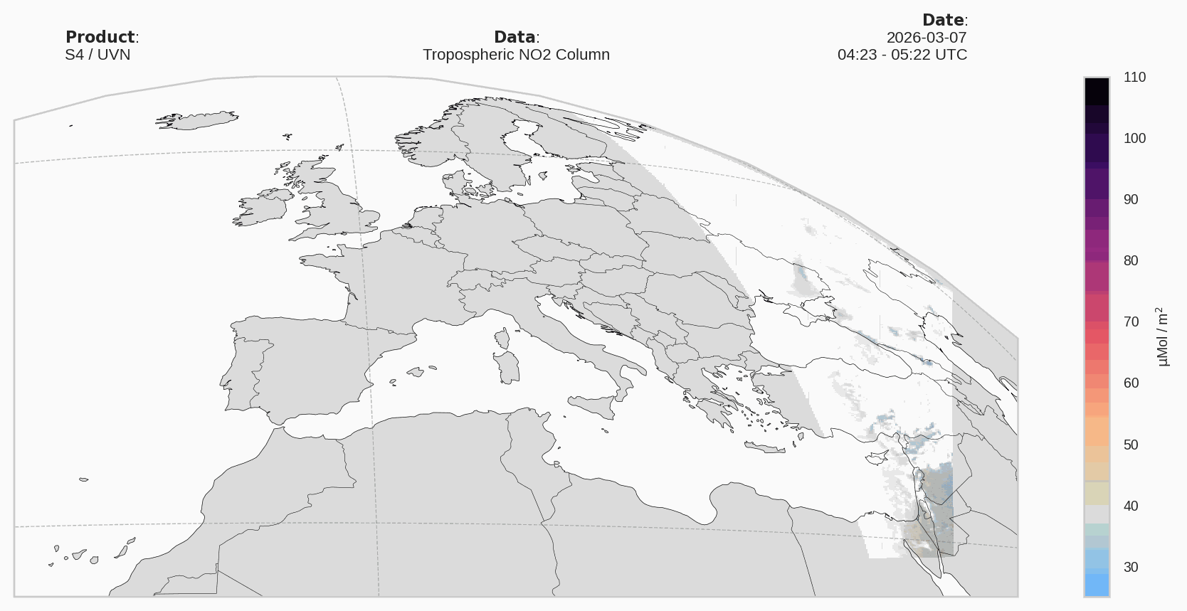
Sentinel-4/UVN: Some early impressions

Slide 14
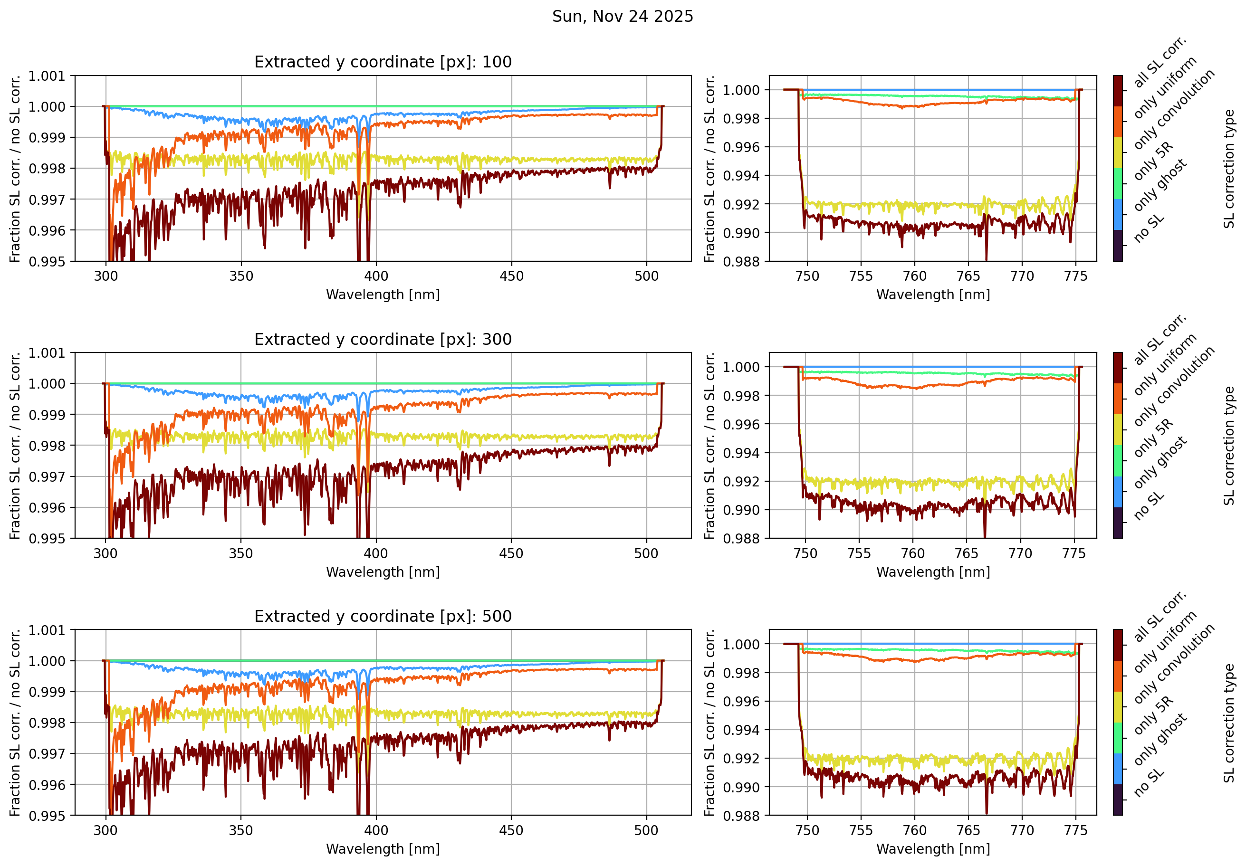
Sentinel-4/UVN: some challenges
Consolidation of instrument operation strategy (adaptation of detector temperatures to avoid deposition of contaminants).
Continuous work on deriving new and improved Calibration Key Data (CKD) from PFM on-ground calibration campaign and in-orbit data.
  Ongoing improvement of straylight correction by updating and completing ghost key data.
  “closed loop” performance testing
UVVIS
NIR

Slide 15
Conclusions
Europe’s new operational backbone missions for monitoring of Atmospheric Chemistry are up in space. Early impressions are promising!
The commissioning of the processors up to level-2 is ongoing on ESA side. EUMETSAT is closely following and amending/complementing these activities.
Kick-off of Cal/Val phases is pending the solution of a number of calibration and processing issues.
ESA will hand over the mission responsibility to EUMETSAT one year after the launches → July/August 2026.
GSICS-type of comparisons is an important part of Cal/Val and routine operational phase (Sun, Moon, SNOs, PICTs, ...)

Slide 16
Thank you!
Questions are welcome.

