Slide 1
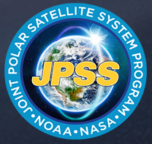

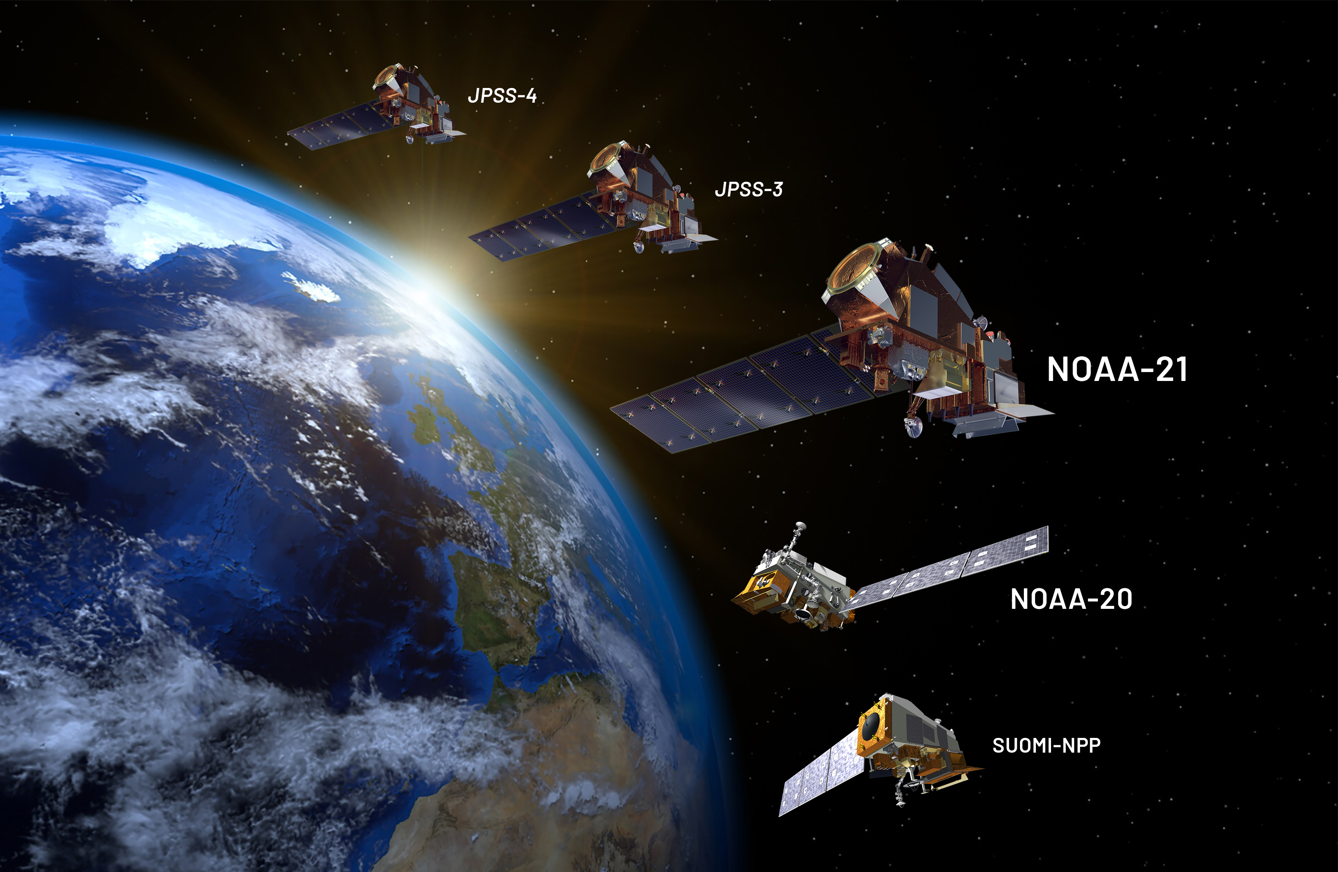
Calibration of the NOAA-20 OMPS Instrument for NASA Products
Brad Fisher, Glen Jaross, Sri Madhavan, M. K. Rama Varma Raja, Jeremy Warner, Mike Linda & OMPS L1B Team

Slide 2
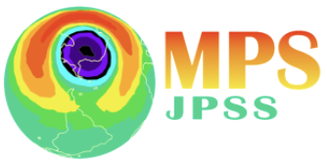
NOAA –N20 Launched on November 18, 2017
Sensor | Nadir Profiler (NP) | Nadir Mapper (NM)
Spectrometer Type | Double-grating spectrometer | Grating Spectrometer
Spectral range (nm) | 248-312 | 300-423
spectral sampling interval (nm) | 1.1 | 1.1
Band Pass (nm) | 0.42 | 0.42
Pixel Spatial Resolution (km²) | 50 x 50 | 17 x 13
Cross Track Ground Pixels | 1 | 140
LEVEL 1 PRODUCTS
Level 1A
Uncorrected, unprocessed signals
Time-ordered counts (uncalibrated)
Conversion of Housekeeping Data
Level 1B
Radiance (calibrated)
Irradiance (calibrated)
Geolocation
Spectral

Slide 3
NASA Level 1 Processing
Flowchart illustrating the Earth View (EV) Level 1B generation process
DATASET | DATASET DEFINITION
CBC | Band Center Wavelengths of each CCD pixel
SRG | Elevation angles at the center of each CCD pixel
FOV | Elevation slit function for each CCD pixel
RAD | Radiometric Coefficients for each CCD pixel
STB | Sample Table
On Board Calibration (non-linearity, pixel gain correction, and
binning)
L1A
Convert housekeeping details to physical variables (P, V, I, etc.)
Subtract Bias, Dark, Smear Signals
Cal. Table Input
Wavelength Assignment
Geolocation
Stray Light Correction
Corrected Counts
L1B
Data Flagging (QC)
Convert EV Signals to RAD
Notes:
RADIANCE COEFFICIENTS (CALCONST)
IRRADIANCE COEFFICIENTS (SIRR-CC)
SDR-CC (contains the mounting matrix and various flags)

Slide 4
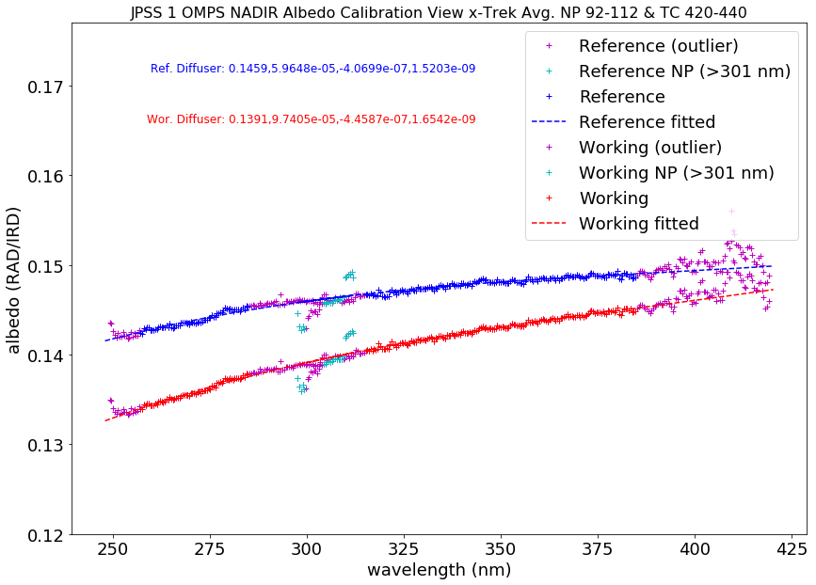
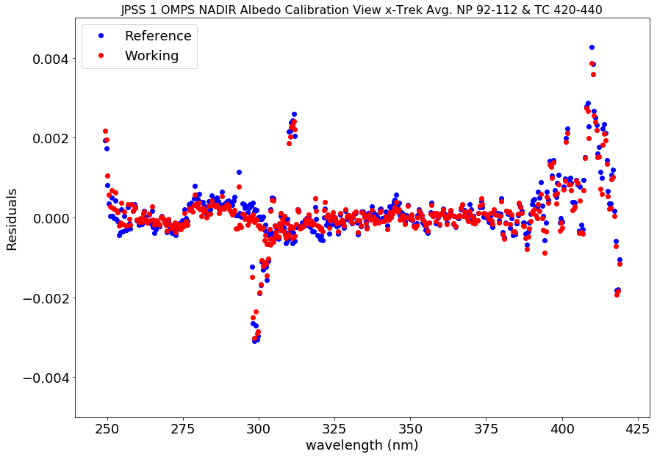
NOAA-20 Day One Radiometric Calibration
January 28, 2018, is defined as Day One, when the first solar measurements using the reference diffuser are made
All subsequent radiance calibration adjustments are applied relative to this date
Day One EV BCW wavelength registration and intra-orbital wavelength variations are characterized
BSDF adjustments are based on Antarctic ice radiances at 354 nm – provides radiometric consistency with other instruments (OMPS and OMI)
Pre-Launch Calibration
Fitting to a low order polynomial reduces test artifacts and fine spectral structure

Slide 5
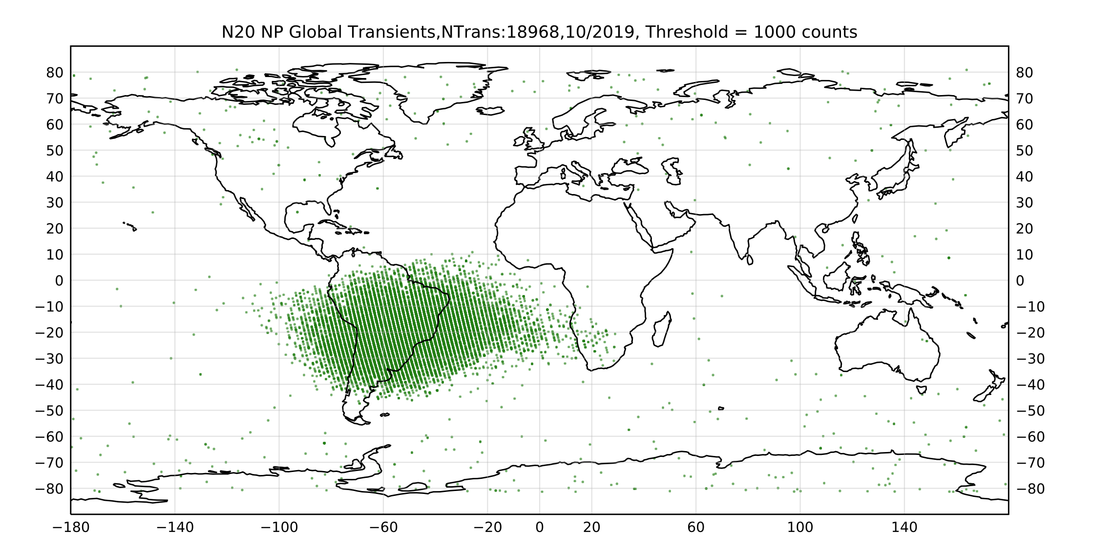
Quality Flags (Transients)
Global map of NP transient monthly detections
Level 1B pixel quality flagging: pixel affected by transients due to high energy particle hits
Principal Component Analysis is used to identify transients in the EV image data (on corrected counts)
Use set number of PCs to define the background counts
2) Reconstruct the background counts
3) Compute difference between observed and reconstructed counts and apply a count threshold.

Slide 6
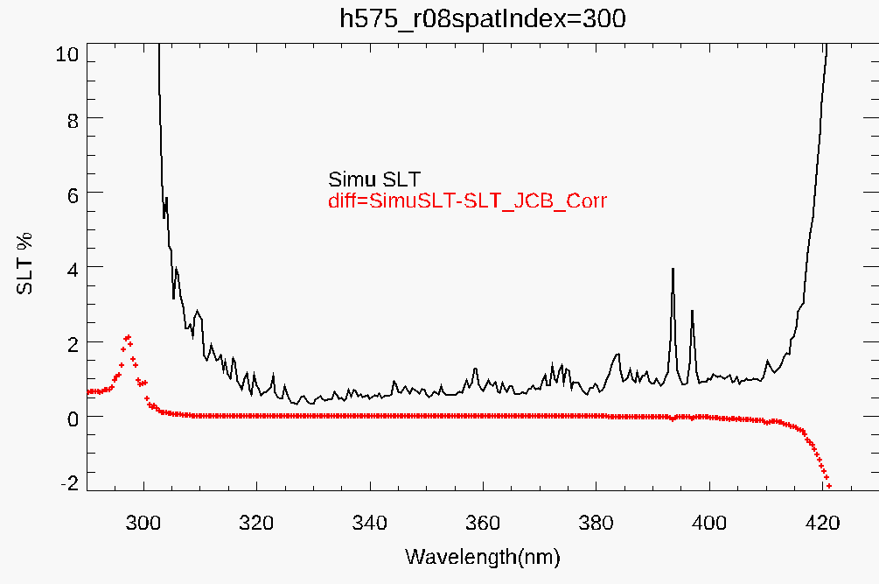
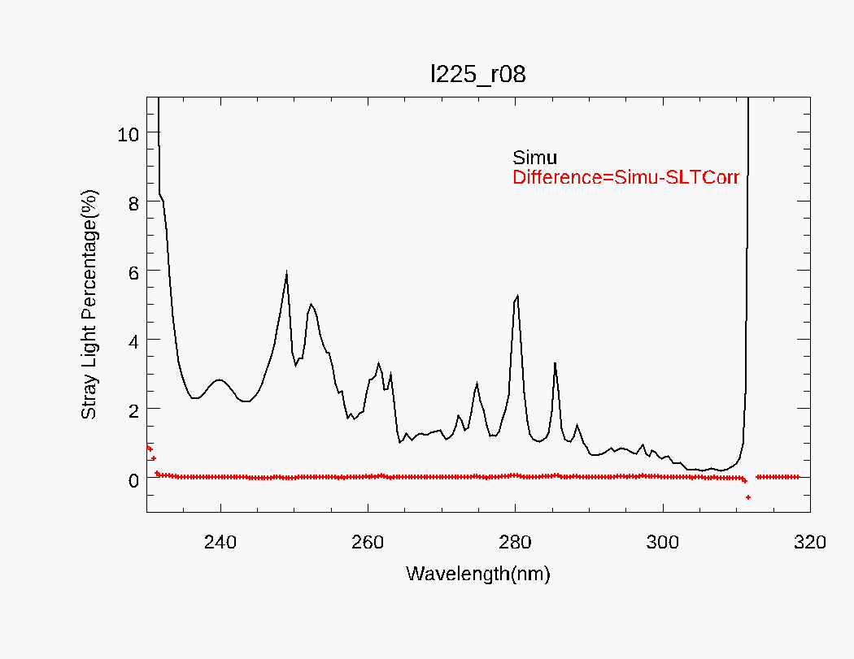
Stray Light Correction
  Stray Light (SLT)
    An SL model is derived from a pre-launch characterization of stray light with updates from inflight validations and applied via a 4-D correction Jacobian.
    Stray light is calculated and removed event-by-event
NM
NP
NM Calculated Stray Light % and Residual % for a single event
NP Calculated Stray Light % and Residual % for a single event

Slide 7
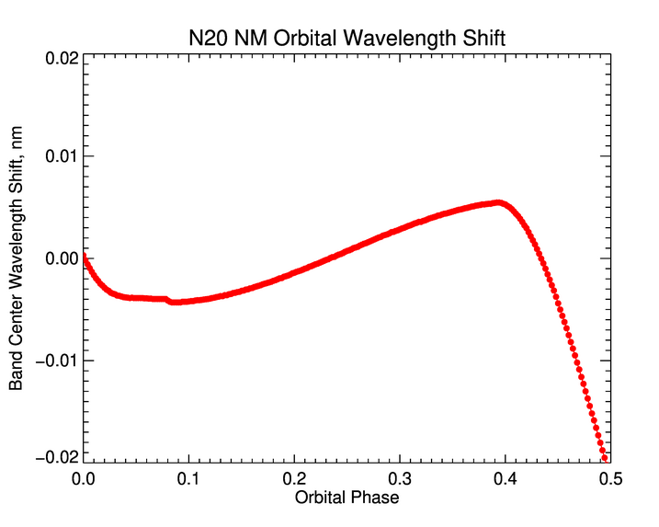
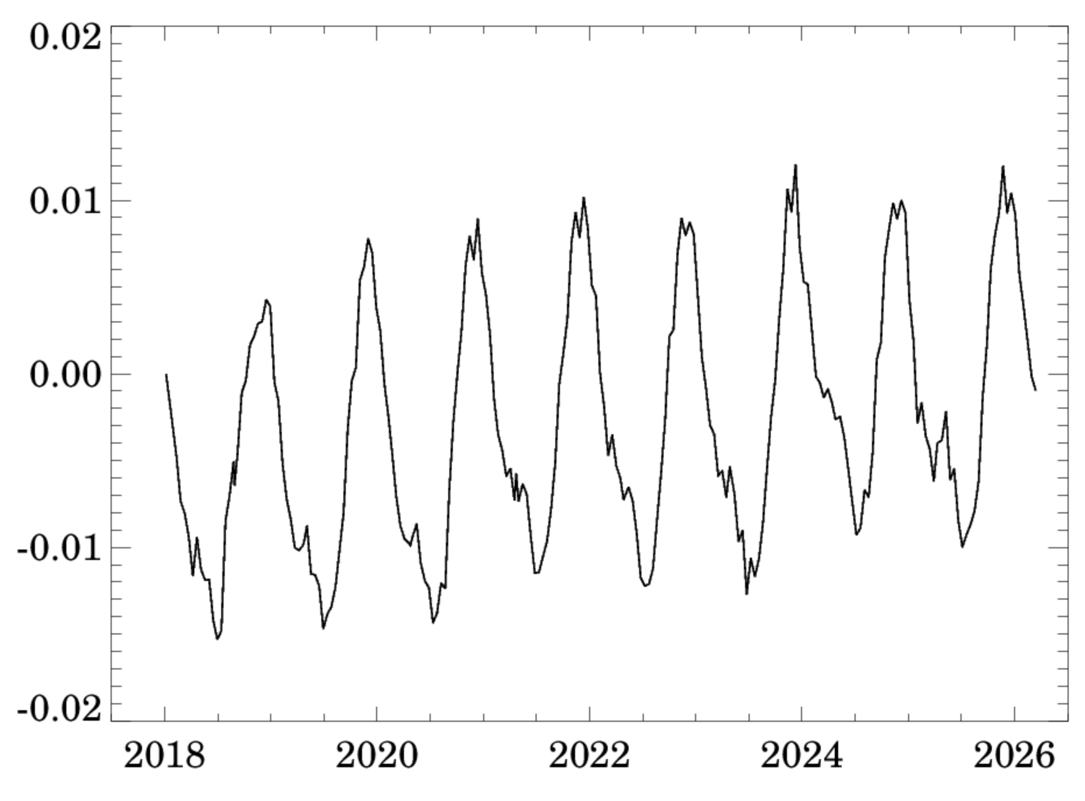
Wavelength Assignment
OMPS N20 NM Intra-orbital spectral shift
OMPS N20 NP Long-Term Spectral Shift
~0.01 nm shift over 6 years
NP
NM
Long-term Shift ~0.012 nm
Spectral Shift [nm]
Intra-Orbital Wavelength Assignment
Wavelength calibration is performed with the solar flux measurements by making use of the spectral structure of the solar Fraunhofer lines compared to a Day One reference spectrum
Wavelength assignment accounts for the seasonal and long-term wavelength shifts, and for NM wavelength assignment also accounts for intra-orbital shifts

Slide 8
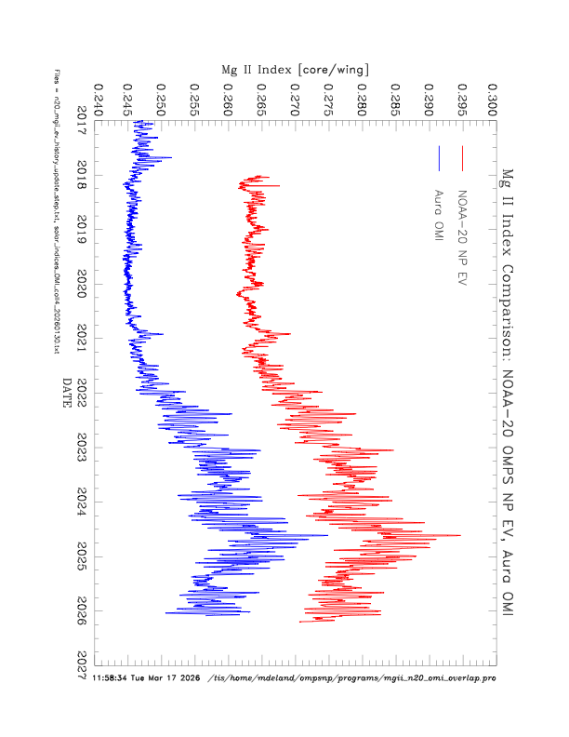
Solar Activity Correction Mg II Index
Mg II Index Comparison: NOAA-20 OMPS NP EV and Aura OMI
NOAA-20 NP EV
Aura OMI
Mg II Index [core/wing]
SA Corrections only applied to NP
Day One
The Mg II Index is computed every day from EV observations and used to correct for changes in solar activity during the mission relative to Day One

Slide 9
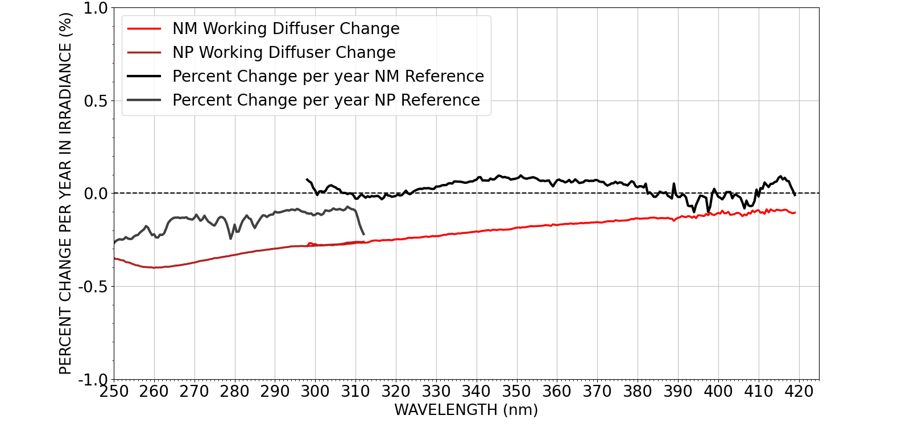
NOAA-20 NP and NM Percent Change per Year in Irradiance (%)
Working diffuser degradation
Change in reference irradiance (instrument change)
NP and NM working diffuser degradation range ~ -0.1 to -0.4% per year
NP instrument changes ranges between -0.3 and -0.1 per year
NM instrument changes is about 0.1% per year

Slide 10
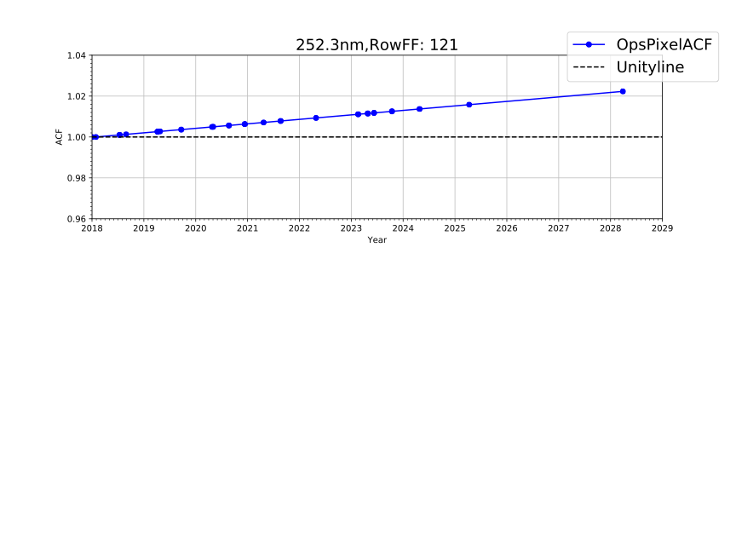
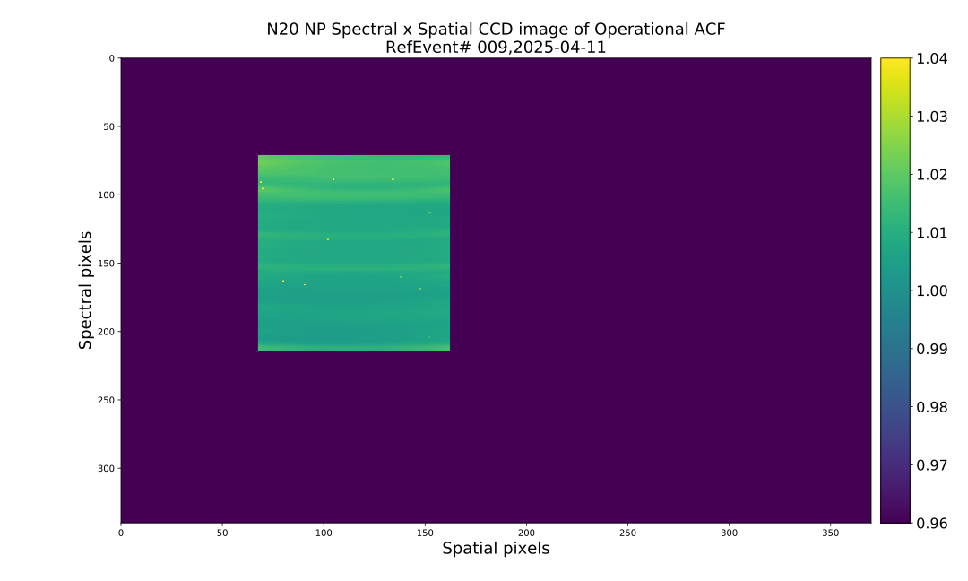
Derivation of Time-Dependent Calibration (CF) of NP
N20 NP CCD image of Operational ACF (CF)
Reference Events 2025-04-11
Increasing Wavelength
Spectral Pixels
The calibration factor (CF) accounts for sensitivity changes in each CCD pixel over time
Spatial Pixels
The lowest wavelength in the image region is 248 nm and the highest is 312 nm
The NP instrument change is about 2%

Slide 11
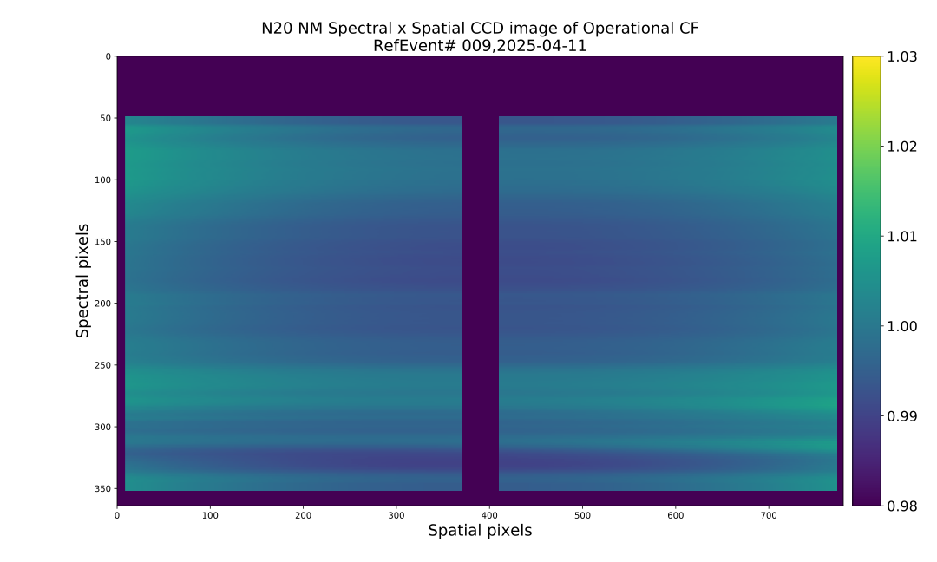
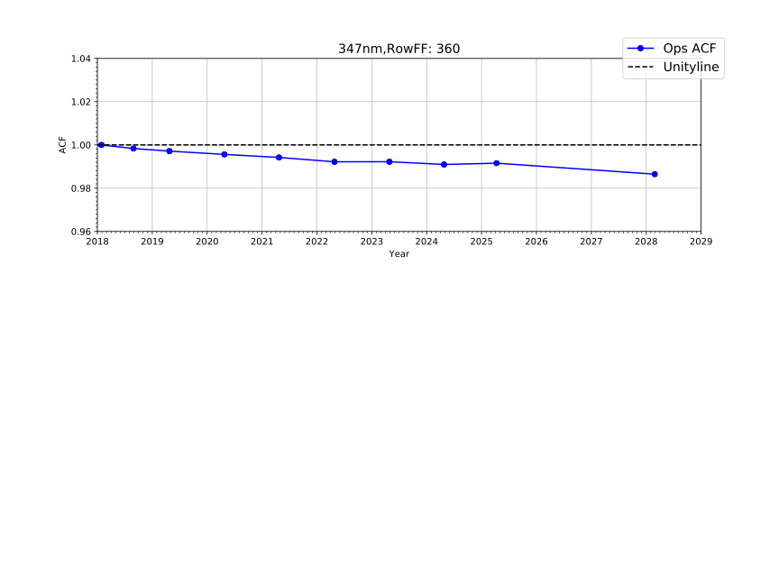
Derivation of Time-Dependent Calibration (CF) of NM
N20 NM CCD image of Operational ACF (CF)
Reference Events 2025-04-11
Increasing Wavelength
predicted
Spectral Pixels
Example of a NM CCD pixel at 347 nm shows sensitivity change over the mission
Spatial Pixels
The lowest wavelength for NM valid image region is around 300 nm and the highest is around 423 nm.
The NM instrument change is about 1%

Slide 12
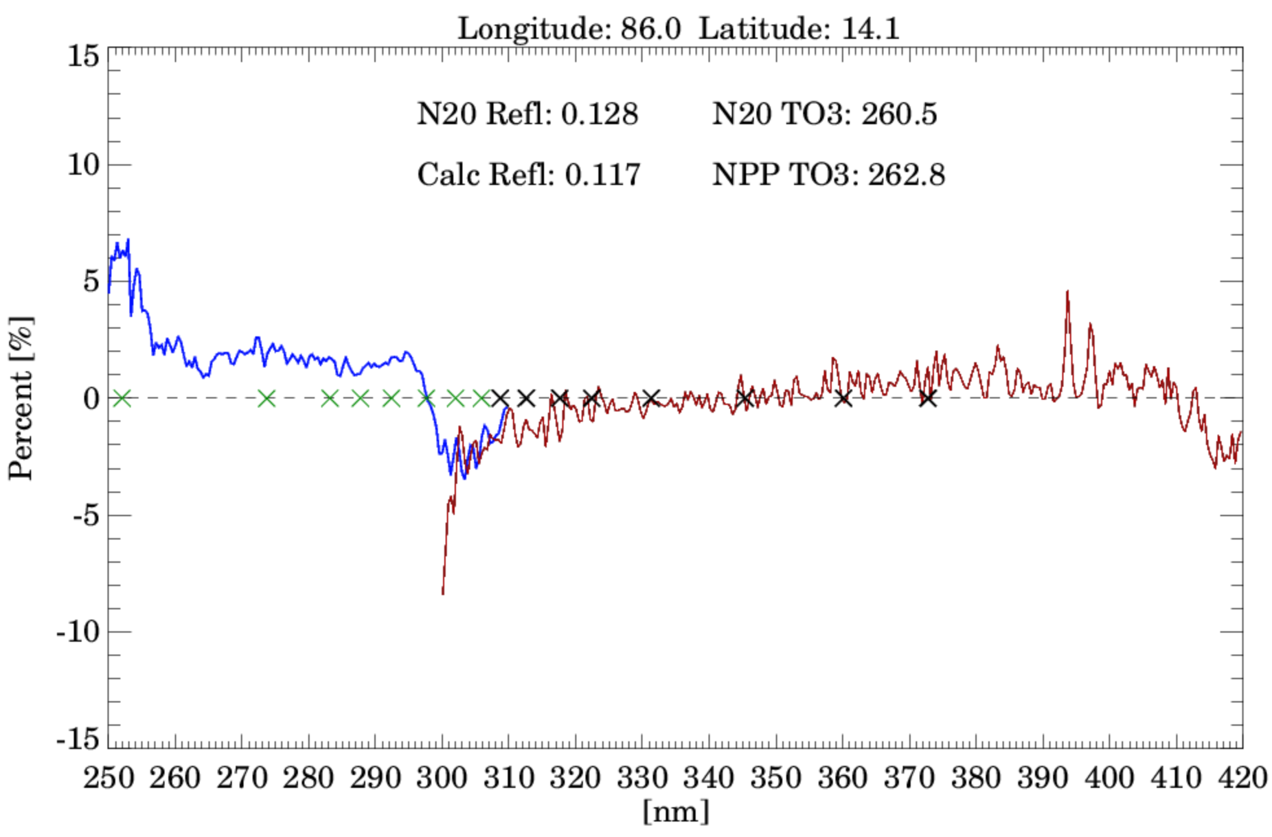
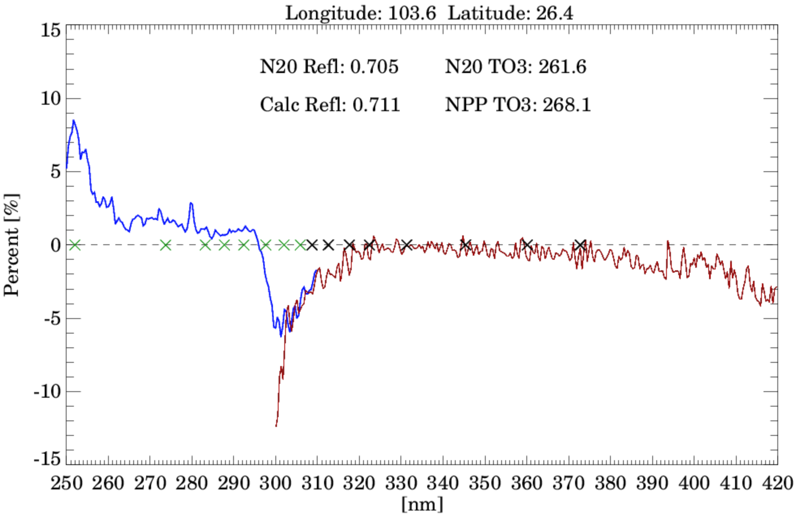
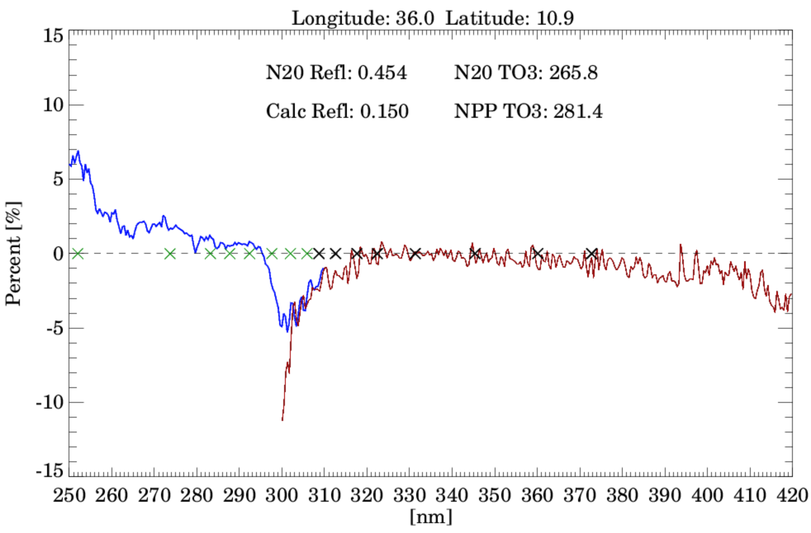
RTM Assessment of OMPS NOAA-20 Performance
for Clear and Cloudy Conditions using OMPS-NPP Ozone
Clear Sky Case (REF < 0.15)
DC Case (ECF >=0.8)
PC Case (0.3 < ECF < 0.5)
N20 Residuals [% change]
N20 Residuals [% change]
N20 Residuals [% change]
Apply MLER Cloud Model
BCW wavelengths for L2 retrievals
X = NM
X = NP
BCW wavelengths for L2 retrievals
X = NM
X = NP
BCW wavelengths for L2 retrievals
X = NM
X = NP
NPP and NOAA-20 fly in parallel orbits at the same latitude separated by 12º longitude
A Radiative Transfer Model is used to assess performance based on OMPS-NPP Ozone profile and OMPS-N20 viewing conditions (geometry, surface, and cloud conditions)
For Clear and DC cases: The RTM is run and then the NOAA-20 reflectivity is recalculated before computing normalized radiances for Clear and Deep Convections (DC) cases.
For partly cloudy (PC) skies: Apply MLER cloud model and then run RTM twice for clear (REF = 0.15) and cloudy (REF = 0.8). Use the 331 residual to adjust the whole NP and NM wavelength spectrum

Slide 13
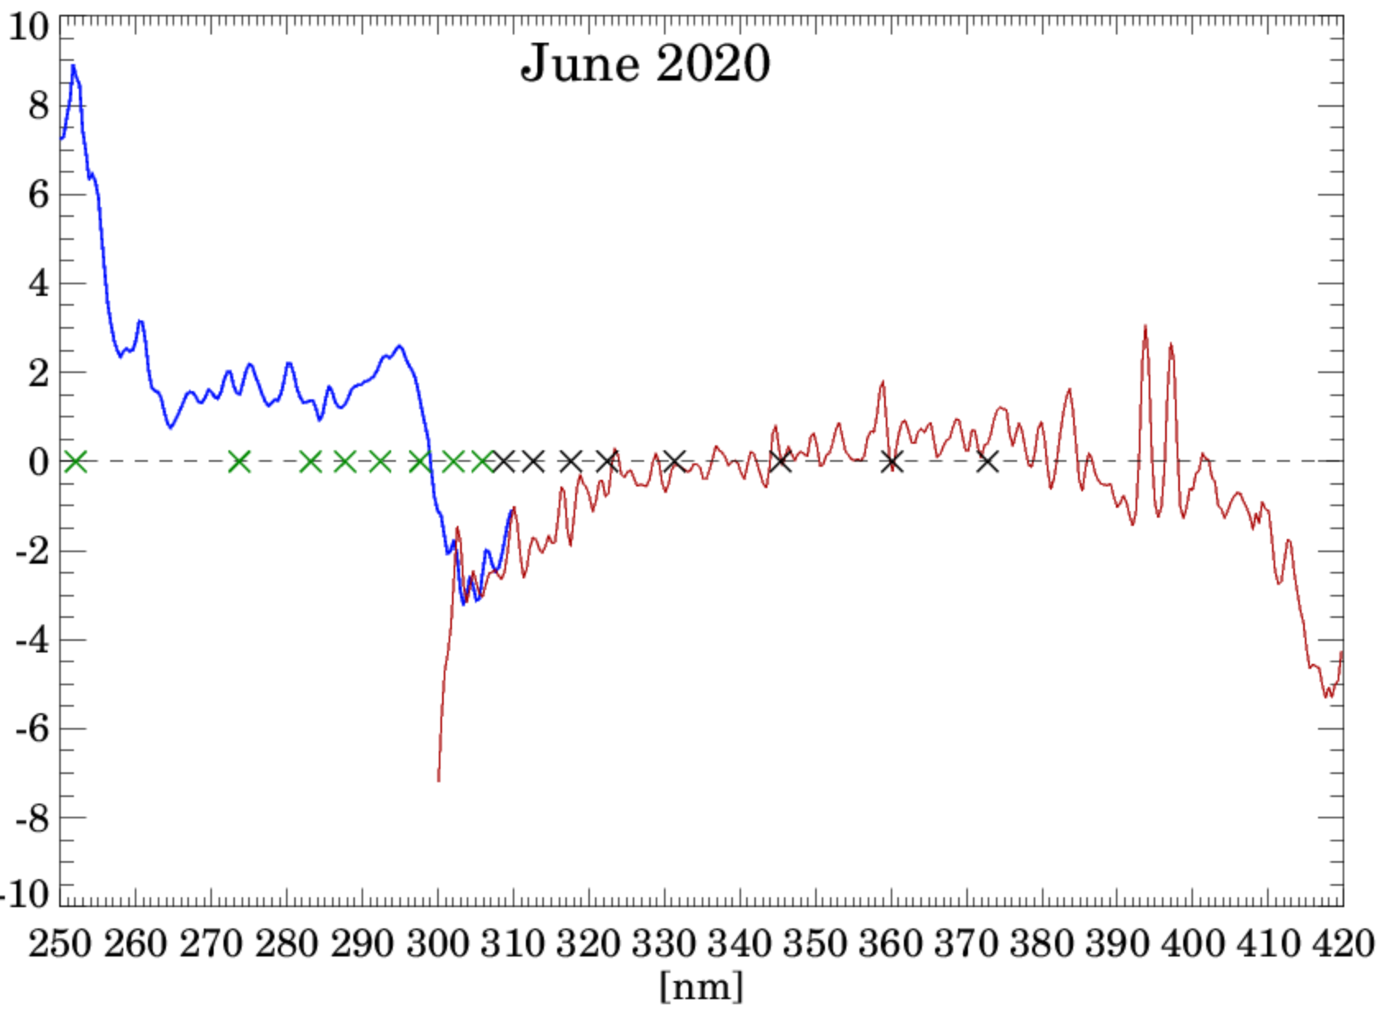
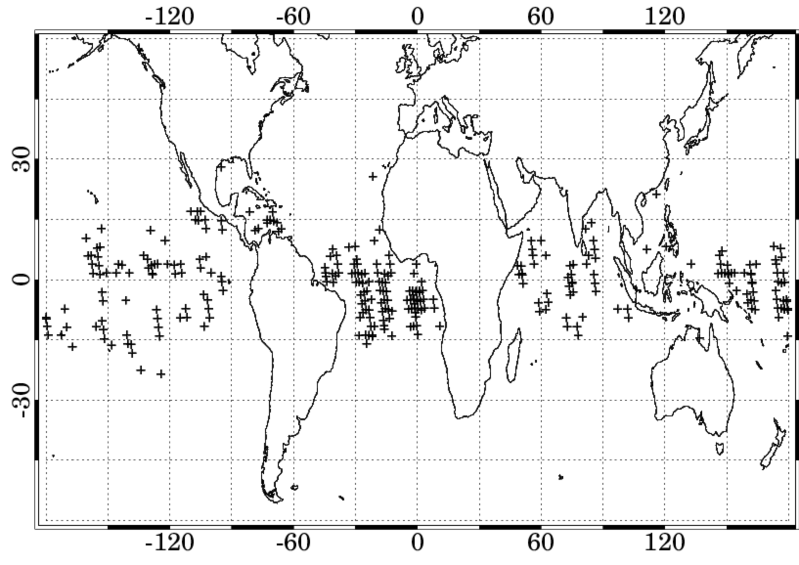
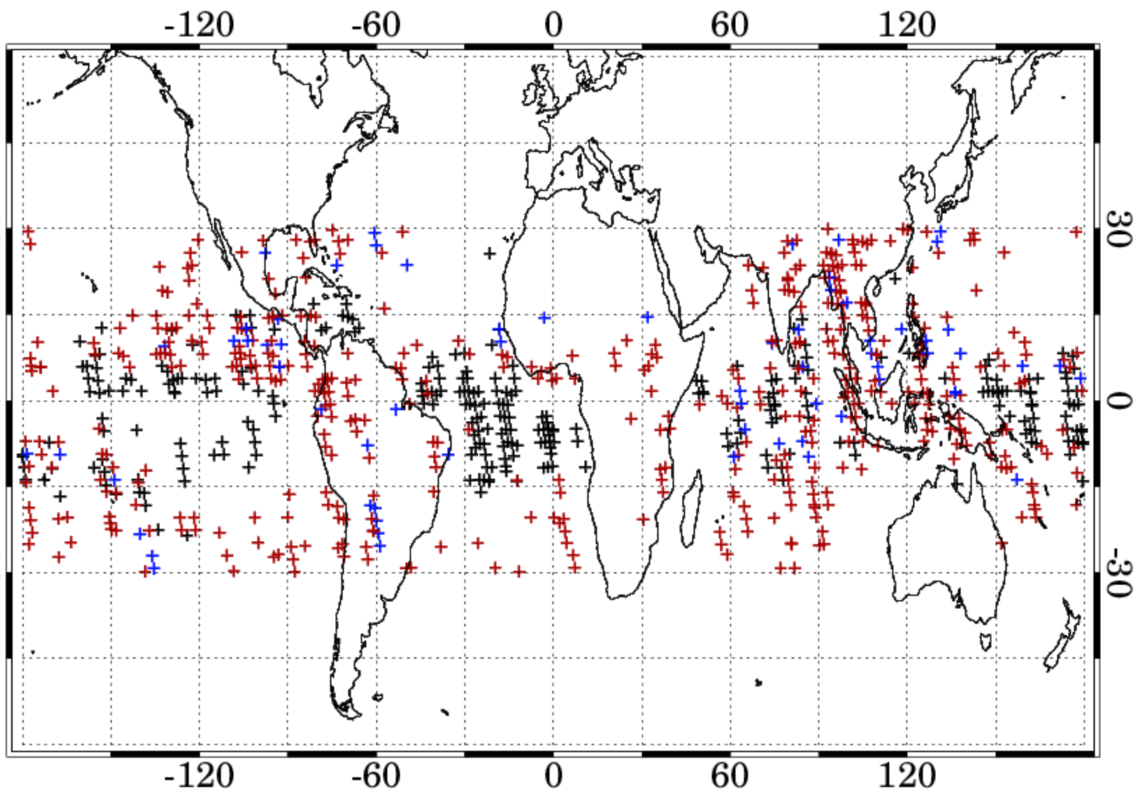
Monthly Zonal Means of Residuals
MZM Clear Sky Case
Sampling (clear)
Sampling (clear, DC, PC)
RTM does not account for Raman Scattering
Clear DC PC
The pixel sampling is constrained to a geographical region between 30S and 30N
Clear sky cases are uniformly distributed but mostly over the tropical oceans
Extending the analysis to cloudy cases (DC and PC) would increase the sampling while also providing some sampling over land
This analysis shows consistency between two OMP instruments and can be used to identify calibration issues and for applying soft calibration to the Level 2 ozone products

Slide 14
Summary
Key Improvements to the NOAA-20 Calibration
Improvement to prelaunch tables (BPS, CBC, IRD, RAD, etc.)
Time-dependent wavelength assignment with intra-orbital adjustments
Time-dependent calibration factor to account for sensor throughput change
Extended NM range from 380 to 423 nm
Geolocation error fixed
Improved stray-light and spectral-ghost correction
BSDF adjustments based on Antarctic ice radiances
New Quality flags for edge-pixels, transients, RTS behavior
RTM residual analysis produced good results for clear and cloudy conditions
We plan to use the RTM residual analysis to apply a static calibration adjustment in our L2 ozone product generation.
Expected Official Release version 2 of N20 L1B Data to GES DISC: Summer 2026

