Slide 1
Monitoring of Measurements for S-NPP, NOAA-20 & -21 OMPS and Metop-C GOME-2 for 2023 to 2025 by using V8TOZ and Global Statistics
L. Flynn (NOAA), E. Beach (STC), Ding Liang (ERT), Z. Zhang (STC), and B. Yan (NOAA)

Slide 2
Disclaimer
"The contents of this presentation are those of the authors and do not necessarily reflect any position of the US Government or the National Oceanic & Atmospheric Administration.“
https://apps-st.fisheries.noaa.gov/rpts/

Slide 3
Short Abstract
This presentations looks at monitoring the calibration of UV spectrometers designed to provide estimates of total column ozone. The first method uses global statistics over 32-day moving averages to compare the three operational NOAA Ozone Mapping and Profiler Suite (OMPS) Nadir Mapper and Nadir Profiler Sensor Data Records (Radiances). The second method monitors statistics from the retrieved parameters (total column ozone, effective reflectivity and an aerosol index) from the NOAA operational Version 8 Ozone Profile (V8Pro) and Total Column Ozone (V8TOz) retrieval algorithms to check for possible calibration drift and cross-track calibration consistency. The V8TOz is also applied to Level 1 measurements from the Metop GOME-2 series of instruments.

Slide 4
Outline
Global Radiance Comparisons summary and approach
32-day Moving Averages for Global OMPS
Pros and Cons for Global Radiance Comparisons
V8TOz Products summary and approach (quick refresher)
Weekly Results for the last three years
Pros and Cons for V8TOz Comparisons
Possible Paths Forward

Slide 5
Global Monitoring Approach
Collect all the radiances over the full globe for SZA < 85° for OMPS Nadir instruments (Nadir Mapper and Nadir Profiler).
Compute 32-day moving averages. (Note: JPSS satellites have a 16-day repeat cycle.)
Compute the relative differences between the three instruments as a function of wavelength.
Add a daily data point to the monitoring figures at:
  https://www.star.nesdis.noaa.gov/icvs/comparison_OMPS_NM.php
  https://www.star.nesdis.noaa.gov/icvs/comparison_OMPS_NP.php
Reference: Long-Term Assessment of Inter-Sensor Radiometric Biases Among SNPP, NOAA-20, NOAA-21 OMPS Nadir and CrIS Instruments Using the NOAA ICVS Framework Banghua Yan , Ding Liang , Xin Jin & Ninghai Sun, Posted Date: 19 September 2025, doi: 10.20944/preprints202509.1548.v1
Notes:
https://www.star.nesdis.noaa.gov/icvs/comparison_OMPS_NM.php
Thank you for your interest in these figures. The trending figures in this site: https://www.star.nesdis.noaa.gov/icvs/comparison_OMPS_NM.php using the 32-day average mean from SDRs with SZA < 85 degrees. Please let me know if you have any questions.

Slide 6
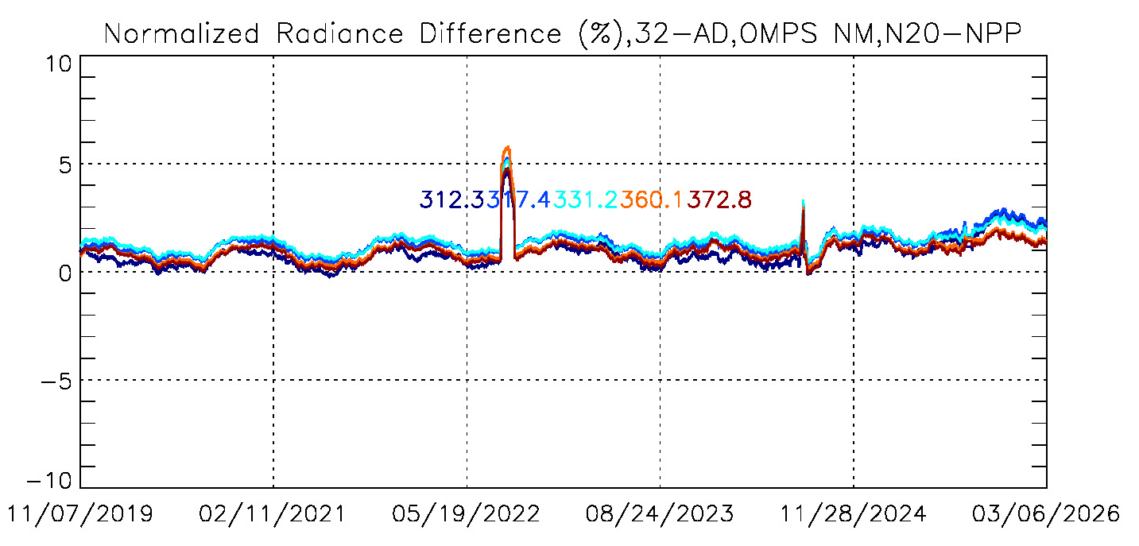
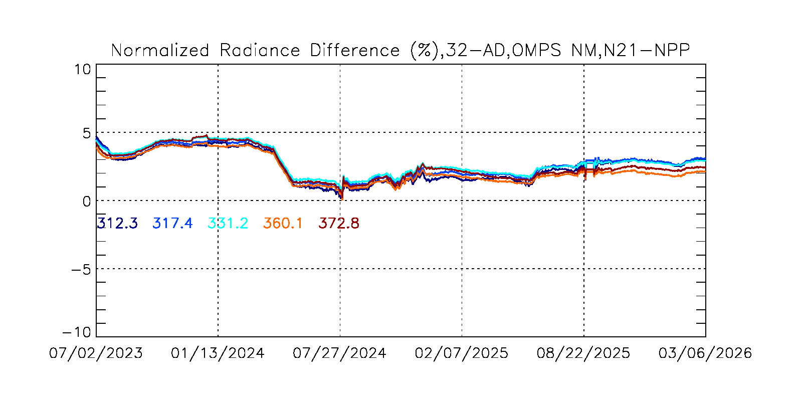
Radiance Differences, %
2%
Time, Date
Operational Monitoring at
https://www.star.nesdis.noaa.gov/icvs/comparison_OMPS_NM.php
See citation for Yan et al. 2025 in the note pages.
Notes:
Long-Term Assessment of Inter-Sensor Radiometric Biases Among SNPP, NOAA-20, NOAA-21 OMPS Nadir and CrIS Instruments Using the NOAA ICVS Framework Banghua Yan , Ding Liang , Xin Jin , Posted Date: 19 September 2025 Ninghai Sun , doi: 10.20944/preprints202509.1548.v1

Slide 7
2%
Radiance Differences, %
Time, Date
Operational Monitoring at
https://www.star.nesdis.noaa.gov/icvs/comparison_OMPS_NP.php
Notes:
Notes from Ding: I have updated the figures on the ICVS website. I noticed a calculation issue with albedo that caused two dramatic changes in the albedo difference trending figures. These issues relate to missing scans starting from 2024/06/30 for NOAA20 and missing scans on 2025/05/28 for NOAA21.
Fortunately, the reflectance calculation has no issue. You can find the reflectance trending plots here:
/data/www/data/smcd1/icvs_metrics/status/Intersensor/OMPS/DirectComparison/2026/03/20260312_j01_j02_nm_ref_relative_diff_trending.jpg
/data/www/data/smcd1/icvs_metrics/status/Intersensor/OMPS/DirectComparison/2026/03/20260312_j01_j02_nm_ref_relative_diff_trending_5chs.jpg

Slide 8
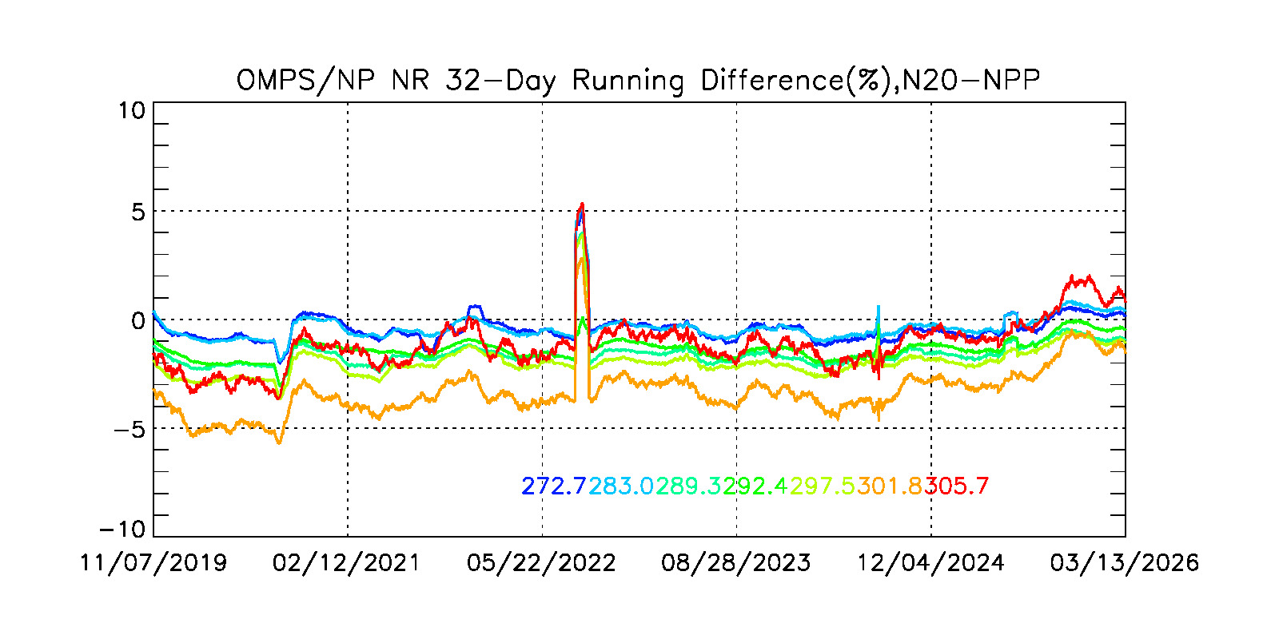
2%
Radiance Differences, %
Time, Date

Slide 9
Pros and Cons for Global Radiance Monitoring
Pros
  Large collection of measurements provides good statistical sampling.
  32-Day Moving average reduces influence of small, short-lived events.
Cons
  Requires stable orbits with similar repeat cycles and controlled identical Equator Crossing Times.
  32-Day Moving average reduces influence of small short-lived events.
  Some influence from different wavelength scales and spectral resolution. E.g. sensitivity of shorter channels to seasonal ozone variations.
  Some influence from different horizontal resolution.
  Major events influence 32 days of data.

Slide 10
Equatorial Pacific Monitoring Approach
The V8TOz uses three channels together with a radiative transfer instrument table (created by using a specific instruments spectral response functions.) to estimate total column ozone, effective reflectivity and an aerosol index. The V8Pro uses 12 channels to retrieval ozone profiles.
Collect all the V8TOz data for weekly or longer time intervals over a Latitude/Longitude box over the Equatorial Pacific.
  Compute averages for ozone, reflectivity, aerosol index and measurement residuals. Compute 1- or 2-percentile for reflectivity.
  Check statistics for parameters sorted by cross-track viewing position.
  Compare time dependence of statistics with other instruments and compare trends with solar diffuser results.
Collect all the V8Pro data for days or months over a Latitude/Longitude box over the Equatorial Pacific.
  Compute daily Initial Residuals for V8Pro profile channels.
  Compute monthly Mean differences for Retrieved / A Priori Ozone Profiles.
Notes:
Wang, W.; Flynn, L.; Zhang, X.; Wang, Y.; Wang, Y.; Jiang, F.; Zhang, Y.; Huang, F.; Li, X.; Liu, R.; Zheng, Z.; Yu, W.; Liu, G.; , "Cross-Calibration of the Total Ozone Unit (TOU) With the Ozone Monitoring Instrument (OMI) and SBUV/2 for Environmental Applications," Geoscience and Remote Sensing, IEEE Transactions on , vol.PP, no.99, pp.1-13, doi: 10.1109/TGRS.2012.2210902.

Slide 11
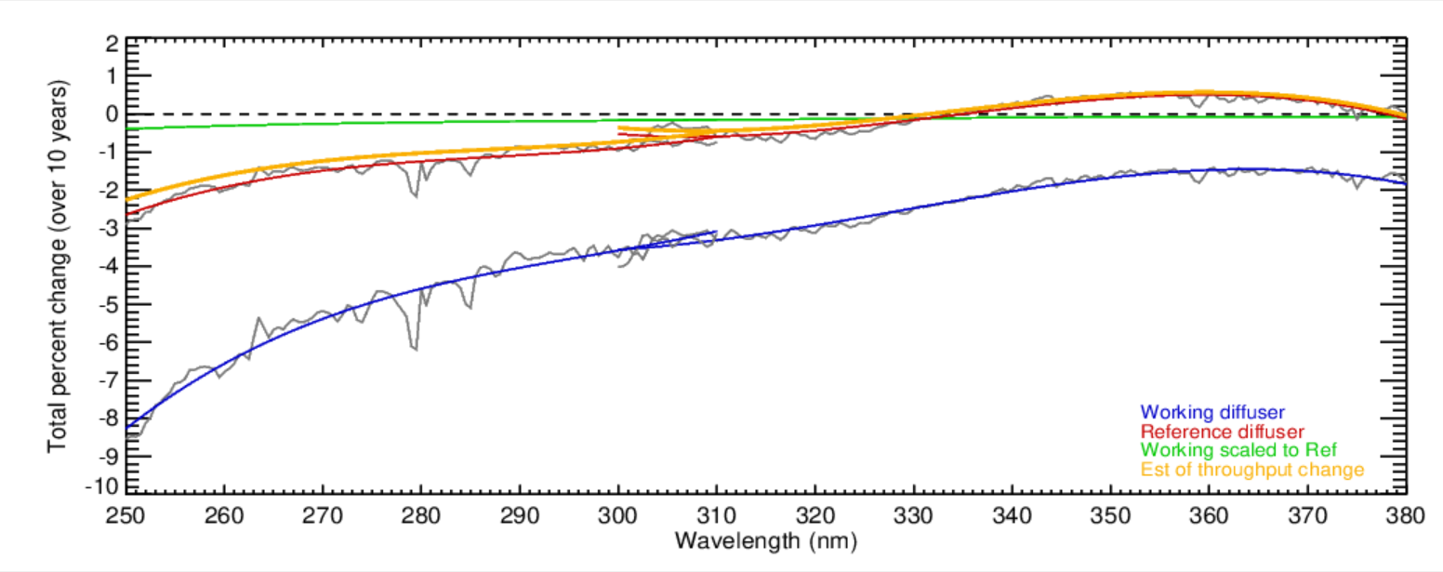
318 nm
331 nm
360 nm
310 nm
Relative
trend over
11 years
for 360 nm
versus
331 nm.
2%
Monitoring of the OMPS Nadir Mapper
Changes by using on-board dual
Solar diffusers works well
Estimates of the total wavelength-dependent throughput changes for the S-NPP OMPS over ten years (2012 to 2022). The blue curve is from linear fits of the changes of the bi-weekly solar measurements from the working diffuser. The red curve is from linear fits of the changes of the annual solar measurements from the reference diffuser. The green curve is a scaling of the blue curve accounting for the difference in exposure frequency for the reference versus the working diffusers. The orange curve is the red curve minus the green curve. It gives an estimate of the throughput degradation for the shared optical path for the radiance measurements. Notice that the instrument throughput changes for the OMPS NM (300 nm to 380 nm) are well within the +-1% level. (This figure was created and provided by Colin Seftor of SSAI for the NASA GSFC Ozone Team.)

Slide 12
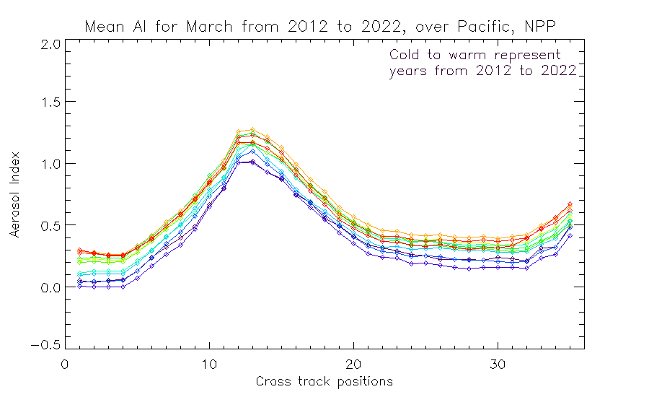
Calibration of UV/Vis Spectrometers for Aerosol Products
[http://gsics.atmos.umd.edu/pub/Development/AnnualMeeting2024/7j_Flynn_GSICS_Aerosols.pptx ]
UV Aerosol Index (331 / 360 nm Pair) from the V8TOz algorithm using TOMRAD.
Trend over
11 years.
Sun Glint Geometry
Colors are time-sorted Cold to Warm
2012 2013 2014 2015 2016 2017 2018 2019 2020 2021 2022 2023
Cross-Track Viewing Position # (#18 is Nadir)
Cross-track dependence over the Equatorial Pacific of the Aerosol Index for S-NPP for March for 11 years Cold to Warm.
The cross-track pattern for the Aerosol Index is also very stable year-after-year and the absolute values are stable at the 0.4 level. The figure on the slide before does show (two ⃝‘s) a trend in the instrument throughput for the 360 nm channel relative to 331 nm which has not been adjusted in any calibration, so some time dependence in this figure is not unexpected.
Notes:
From Zhihua: All the data and files that make the AI plot were put in the place of: /data/data732/zzhang/ForLarry/ai_for_larry
You can run “n20_npp_xtrack_cmp.pro“ to get the attached plot.
To run the IDL file “n20_npp_mean_foraverage.pro", you will get the "zzyyyy0301_31meannpp_rep_pac.sav" file, which is needed for the plot. I only calculate two months' averages of ozone retrieval in files "zz20190301_31meannpp_rep_pac.sav“ and “zz20220301_31meannpp_rep_pac.sav“. It takes about 30 minutes to run the file, about 15 minutes for run one month average. You can cut half the code to run one month or add more months of other years to do calculations.
The file “tenkiloland.sav“ is for screen out the land pixels, you may don’t need it. You can just comment out it in the search.
I hope that will help your work. Please let me know if you have any questions.

Slide 13
Using V8TOz dN/dR and dN/dO3 and ozone and reflectivity differences to determine soft calibration adjustments
The V8TOz output contains a variety of useful parameters in addition to the total column ozone estimates. In particular, the retrieval sensitivities, dy/dx can be used to give soft calibration estimates of the N-value changes to remove reflectivity and ozone bias. If you want to increase the effective reflectivity, R, and the total column ozone, Ω, by ΔR and ΔΩ then you should increase the N-values by
ΔN318 = ΔR dN318/dR + ΔΩ dN318/dΩ = ΔR A1 + ΔΩ B1
ΔN331 = ΔR dN331/dR + ΔΩ dN331/dΩ = ΔR A2 + ΔΩ B2
where dNw/dR is the rate of change of the N-value, Nw, for wavelength, w, with respect to changes in the effective reflectivity, R, and dNw/dΩ is the rate of change of the N-value, Nw, for wavelength, w, with respect to changes in the total column ozone, Ω.
Conversely, if you increase the N values by C1=ΔN318 and C2=ΔN331, then the retrieved R and Ω increase by
ΔR = [C1 * dN331/dΩ – C2 * dN318/dΩ] / D
ΔΩ = -[C1 * dN331/dR,– C2 * dN318/dR] / D
D = [dN318/dR * dN331/dΩ – dN331/dR * dN318/dΩ]
Ω is total ozone in DU, R is effective reflectivity, and
N is -100*log10(Radiance/Irradiance)

Slide 14
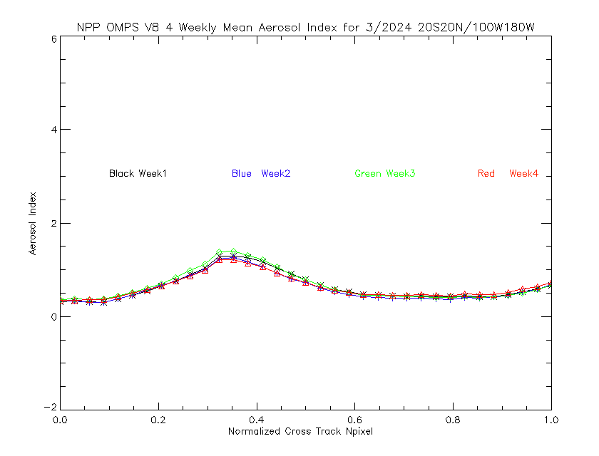
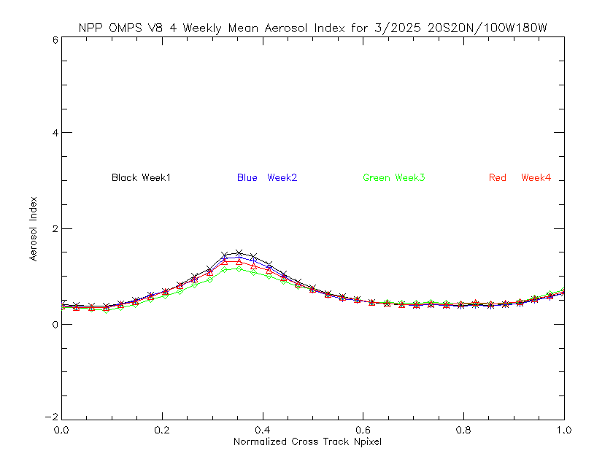
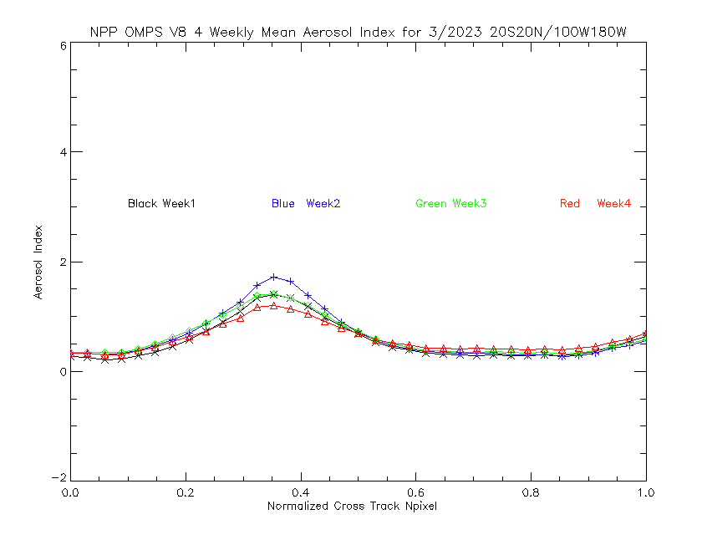
March weekly cross-track for Aerosol Index (NPP)

Slide 15
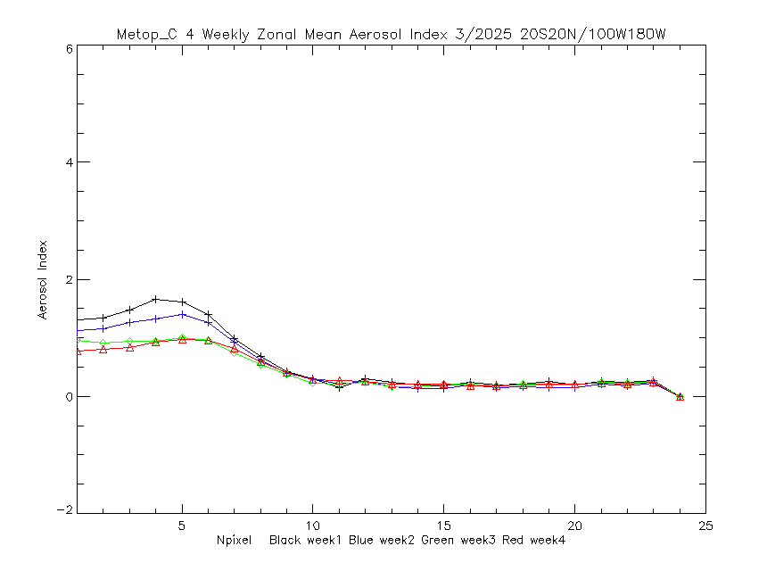
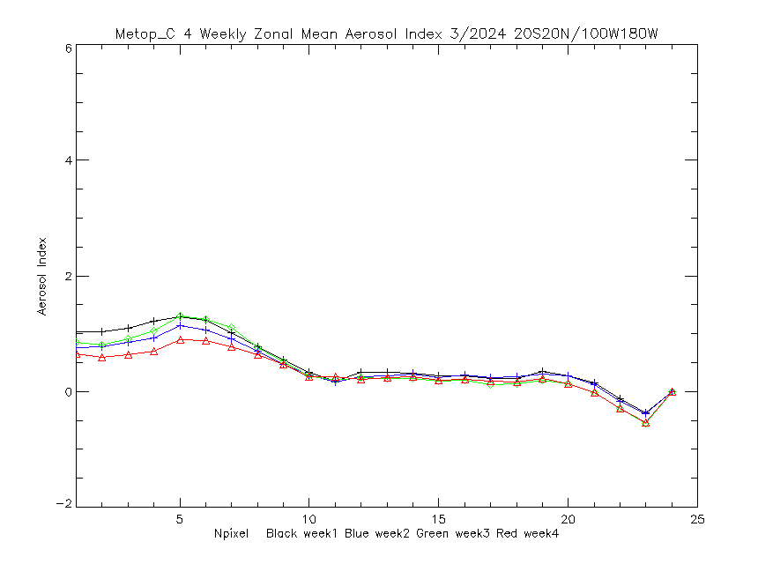
March weekly cross-track for Aerosol Index (Metop-C)
Shift for 9:30 EQT
Versus 13:30 EQT.

Slide 16

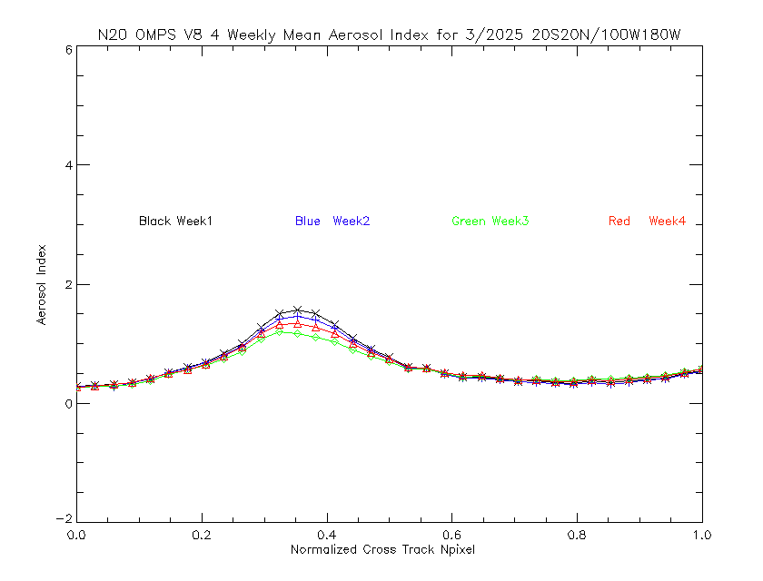
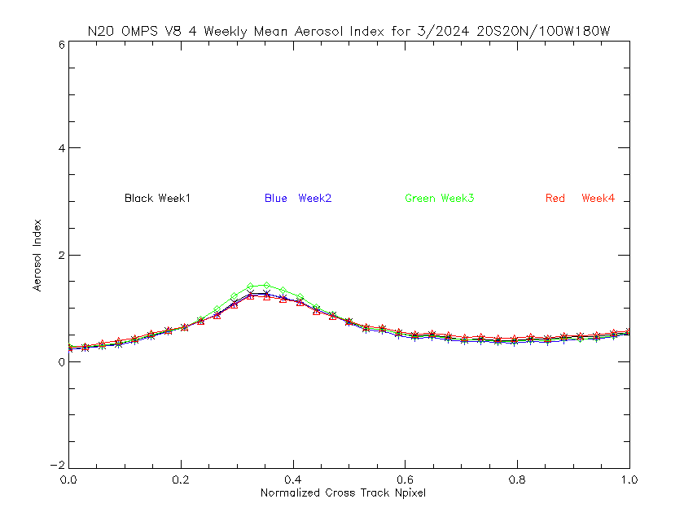
March weekly cross-track for Aerosol Index (N20)

Slide 17
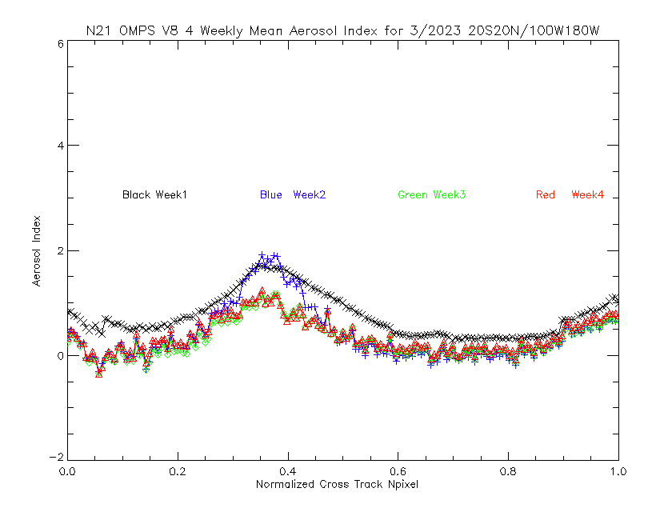
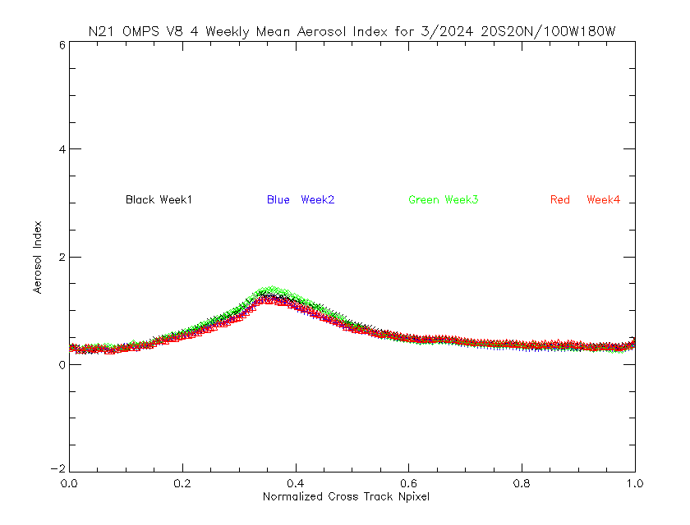
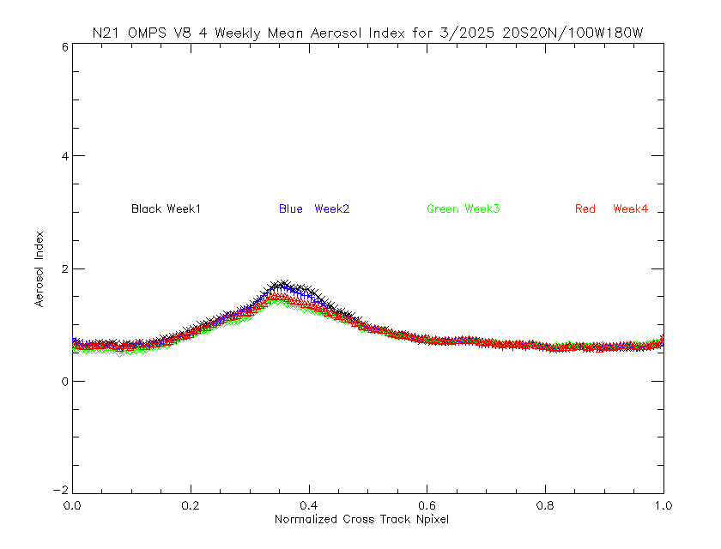
March weekly cross-track for Aerosol Index (N21)

Slide 18
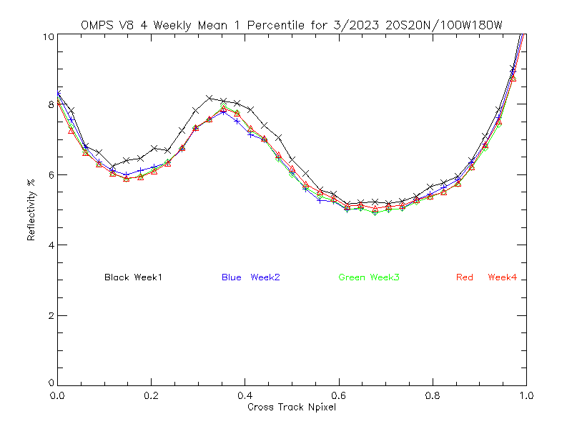
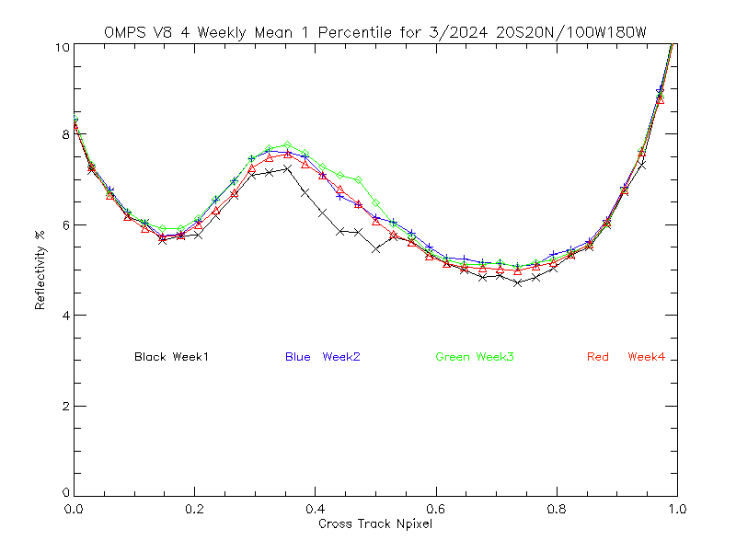
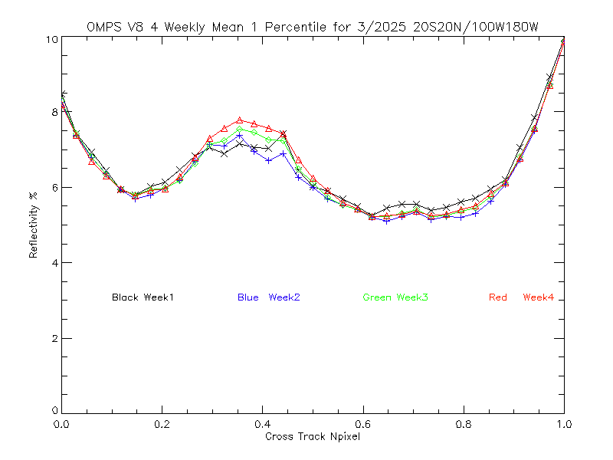
March weekly cross-track for 1-percentile reflectivity (NPP)
2%

Slide 19
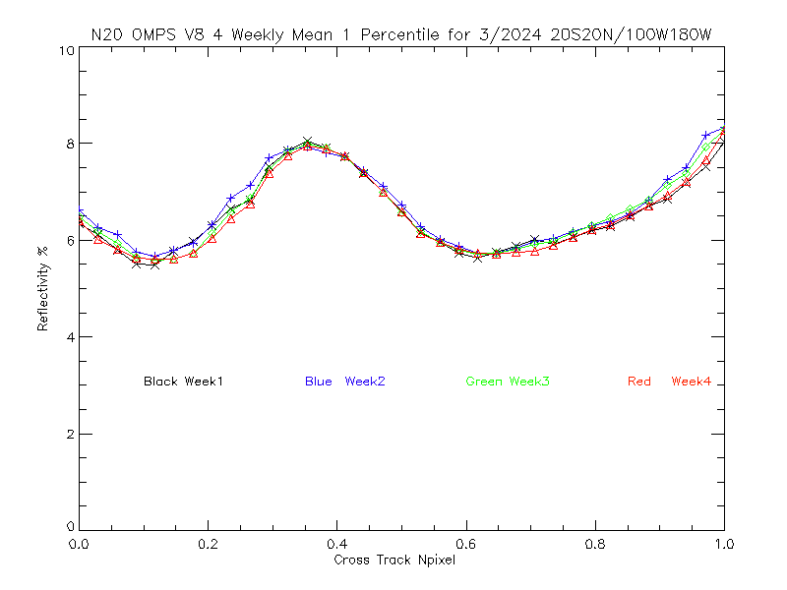
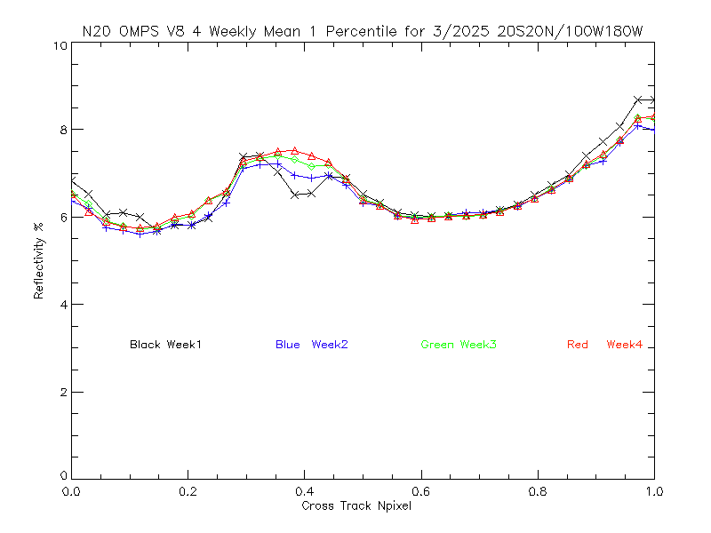
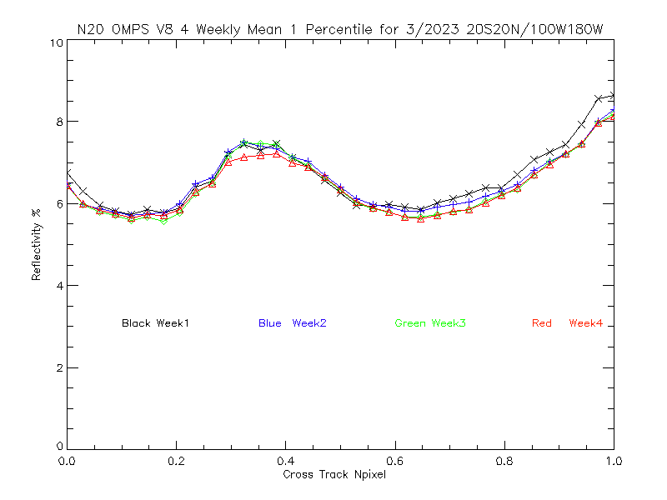
March weekly cross-track for 1-percentile reflectivity (N20)
2%

Slide 20
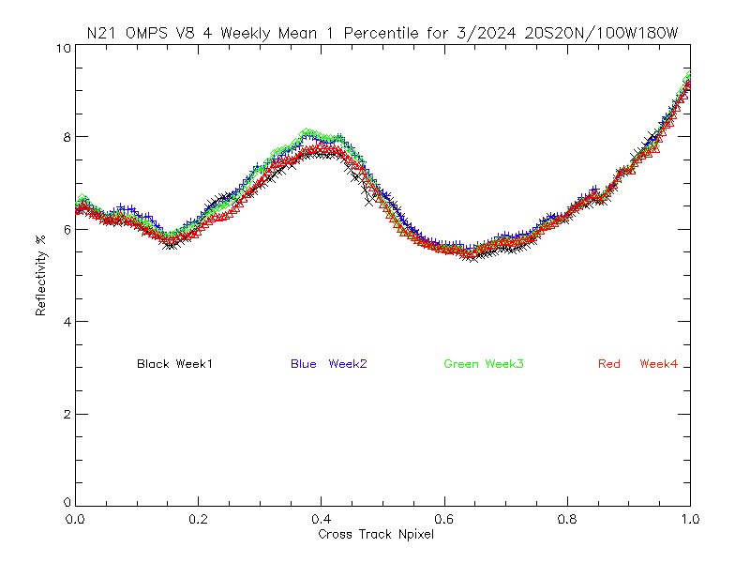
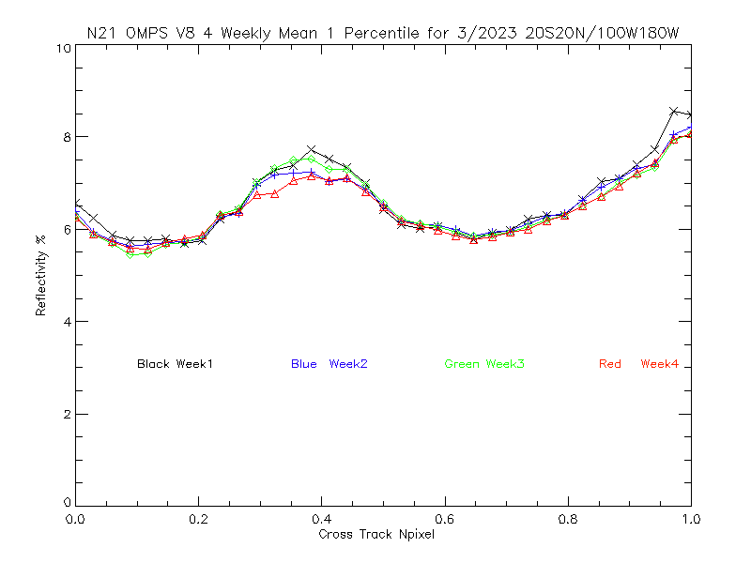
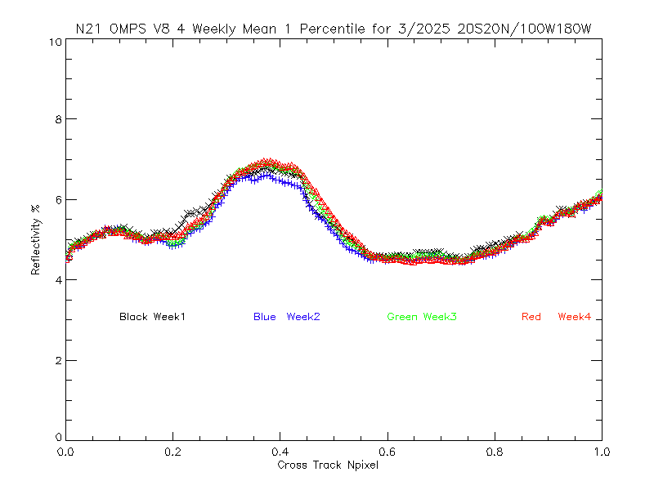
March weekly cross-track for 1-percentile reflectivity (N21)
2%

Slide 21
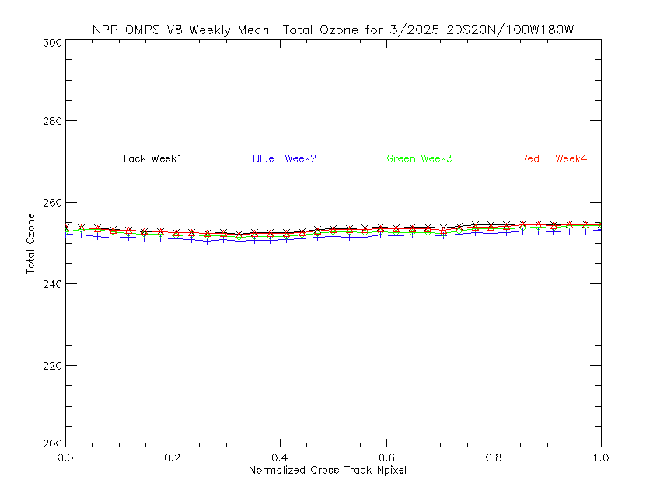
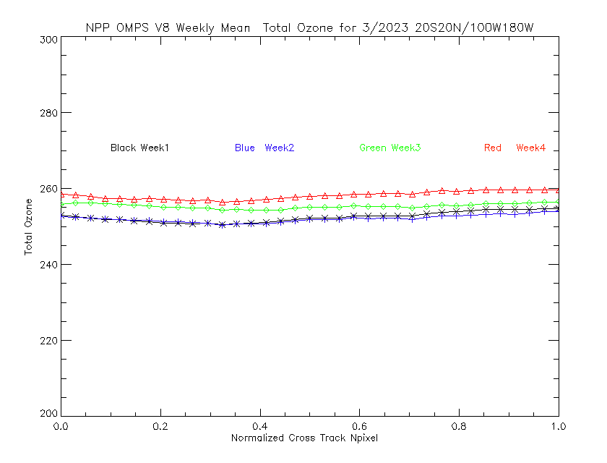
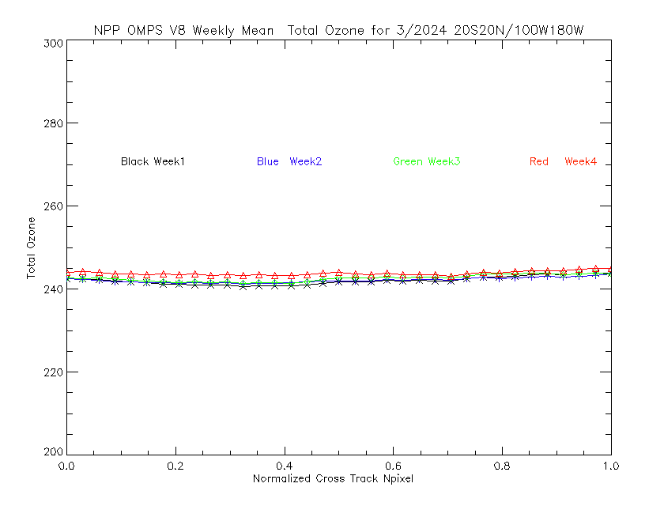
March weekly cross-track for total Ozone for (NPP)
2%

Slide 22
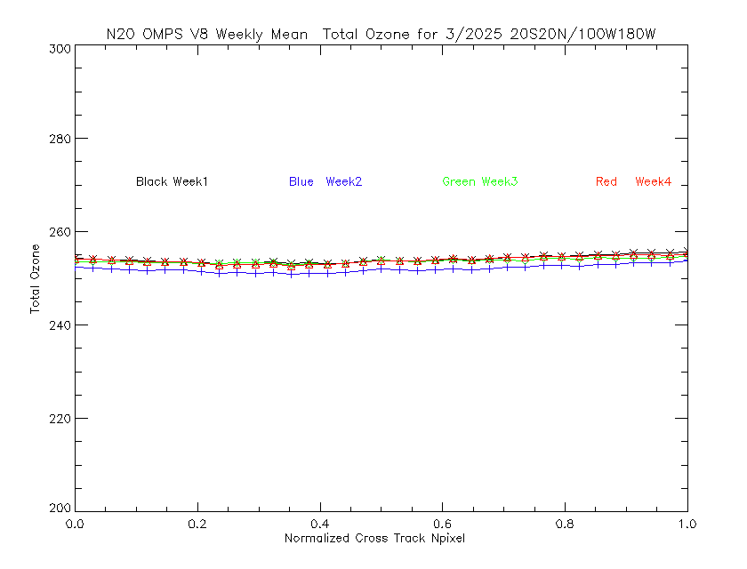
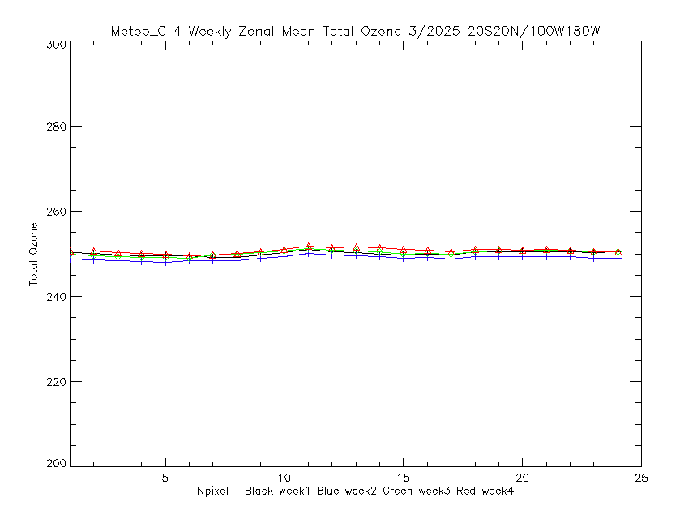
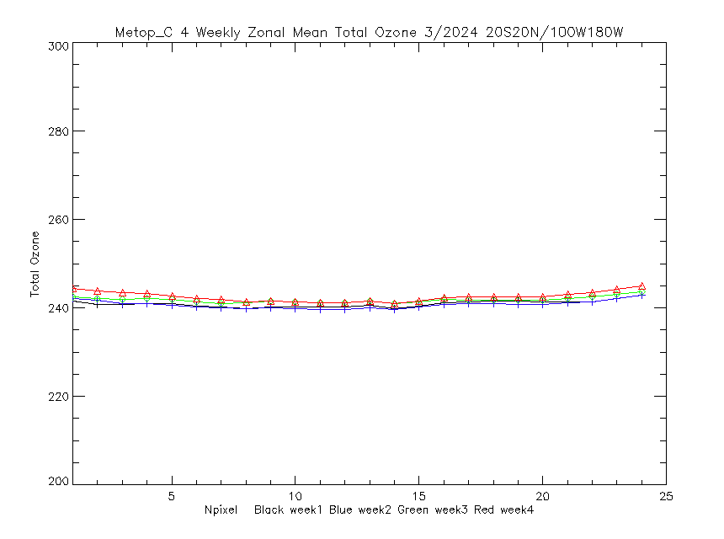
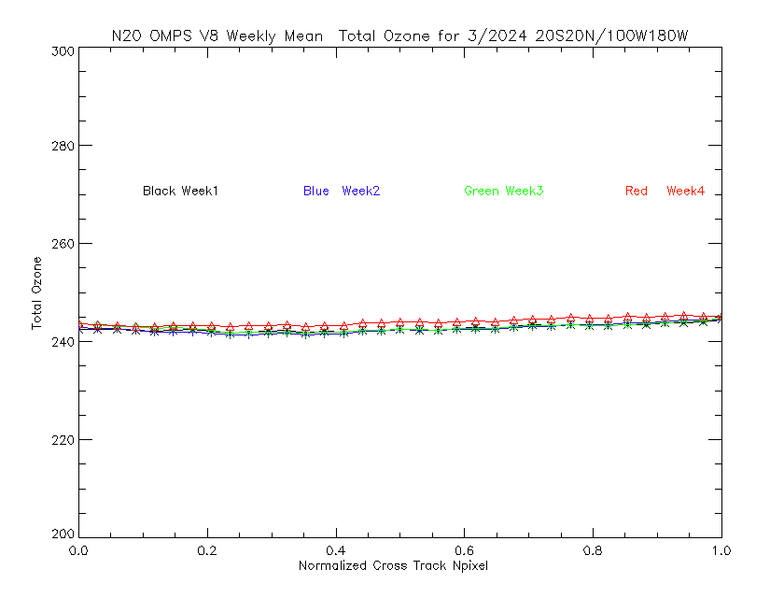
March weekly cross-track total ozone for Metop-C GOME-2
2%
Shift for 9:30 EQT
Versus 13:30 EQT.

Slide 23
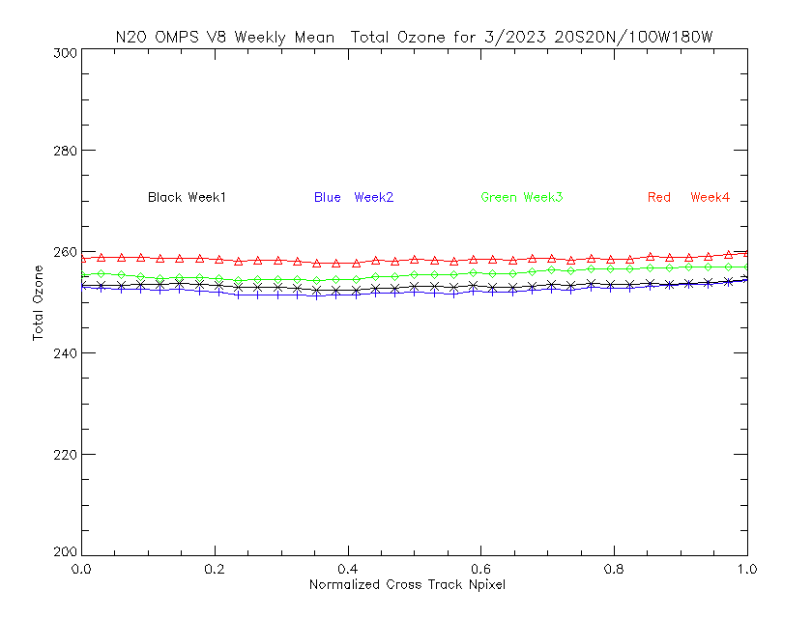
March weekly cross-track for total Ozone for (N20)
2%

Slide 24
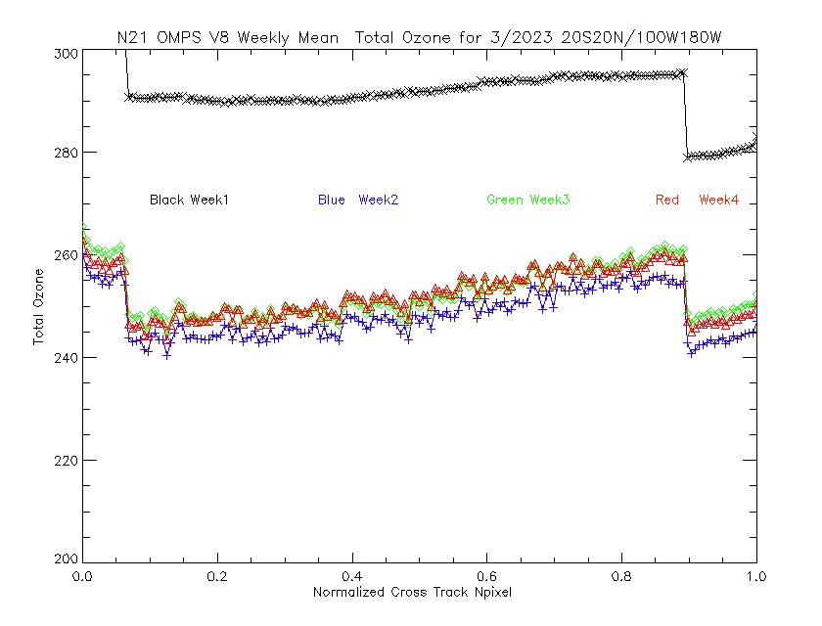
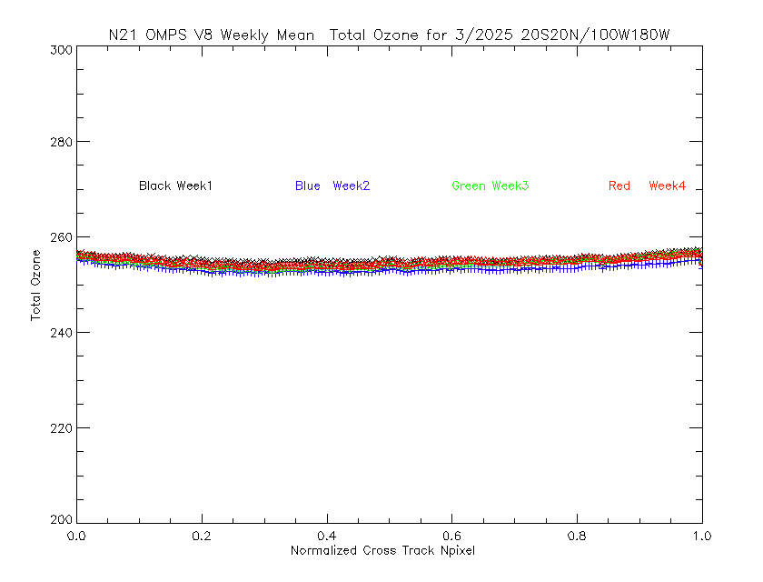
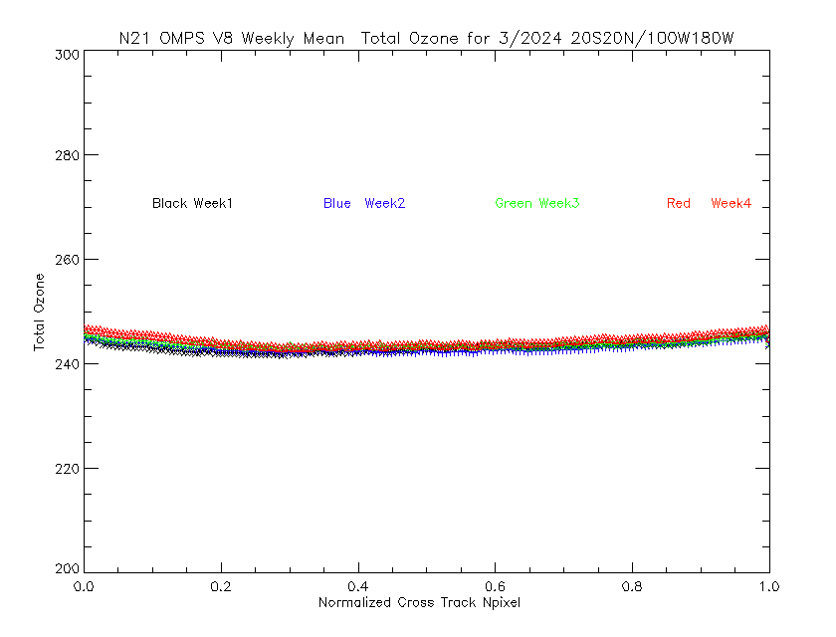
March weekly cross-track for total Ozone for (N21)
2%

Slide 25
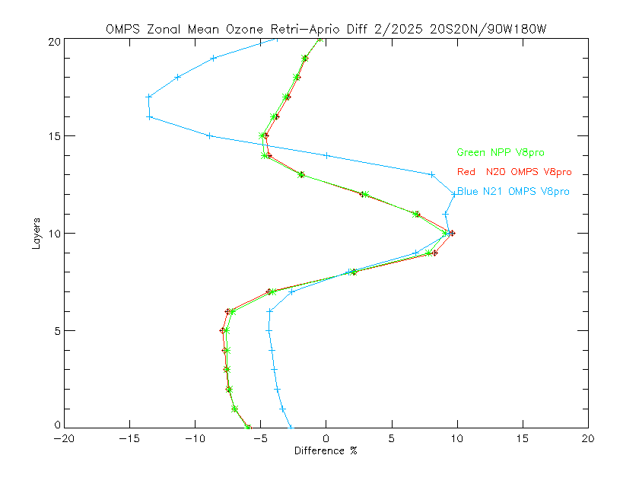
Monthly Mean Difference for V8Pro
Retrieval versus A Priori for 2/2025
NOAA-21 V8Pro before soft calibration to force agreement with S-NPP V8Pro.
Green NPP
Red N20
Blue N21

Slide 26
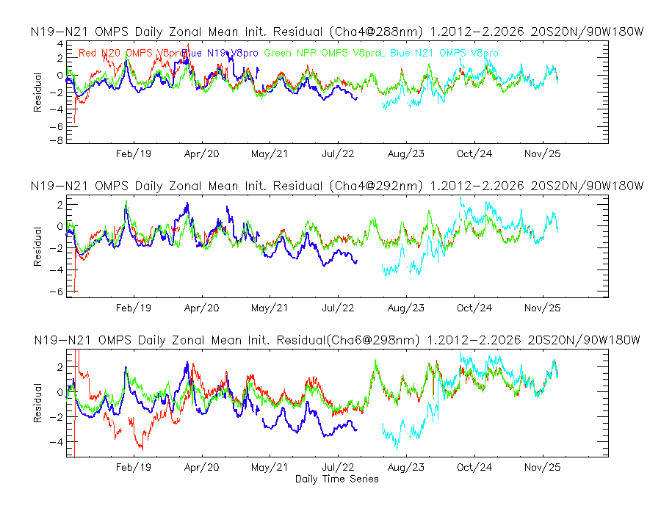

Slide 27
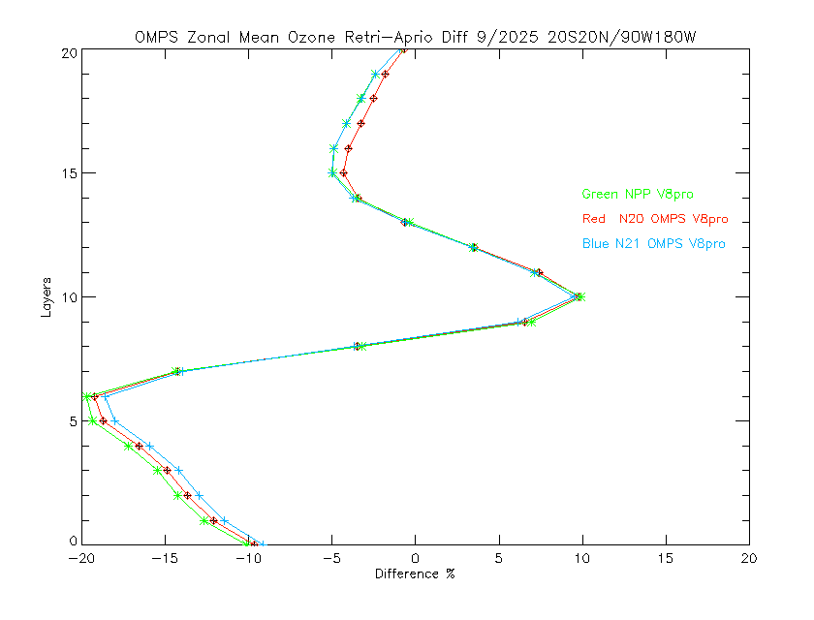
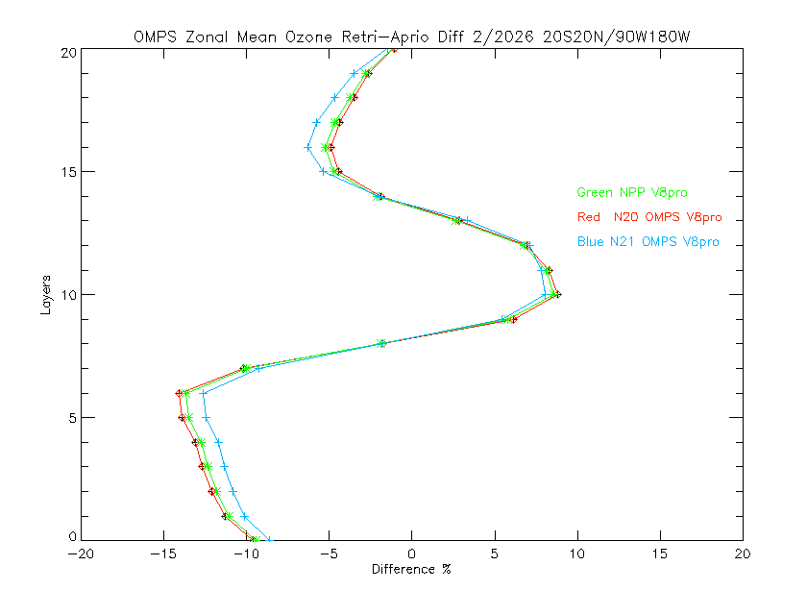
Monthly Mean Difference for V8Pro
Retrieval versus A Priori for 9/2025 and 2/2026
Green NPP
Red N20
Blue N21
Retrieval Layers, #
5%
5%
Layer Difference, %

Slide 28
Pros and Cons for Equatorial Pacific Monitoring
Pros
  Stable open ocean reflectivity and aerosol index.
  Total ozone can be estimated from both V8TOz and DOAS with different sensitivities to calibration errors.
  Provides relative cross-track calibration check.
  Allows intercomparison of all polar orbiting total ozone instruments.
Cons
  Some dependence on surface pressure and ozone column.
  Possible time dependence of aerosols from Asian outflow.
  Possible diurnal variations in clouds.
  Requires controlled Equator Crossing times year-after-year.

Slide 29
Paths Forward
Add monitoring of Metop-C GOME-2 and Metop-SG A1 UVNS.
  29-day orbital repeat for GOME-2. What is the cycle for UVNS?
  Investigate diurnal variations
Compare V8TOz over longer time periods, more satellites and for reprocessed Level 1 / SDR records.
Compare V8Pro over longer time periods, more satellites and for reprocessed Level 1 / SDR records.
Compare both methods to solar diffuser measurement monitoring.
Establish yellow alert levels for bias deviations.

Slide 31
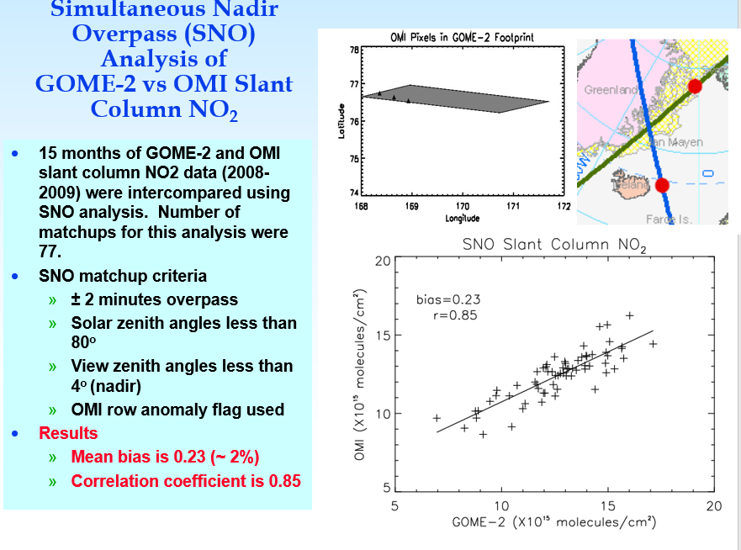
Before doing science applications with the data, we ran the same algorithm on both OMI and GOME-2 and compared the two NO₂ products.
(NOAA S. Kondragunta, J. Niu and C.T. Beck)

Slide 32
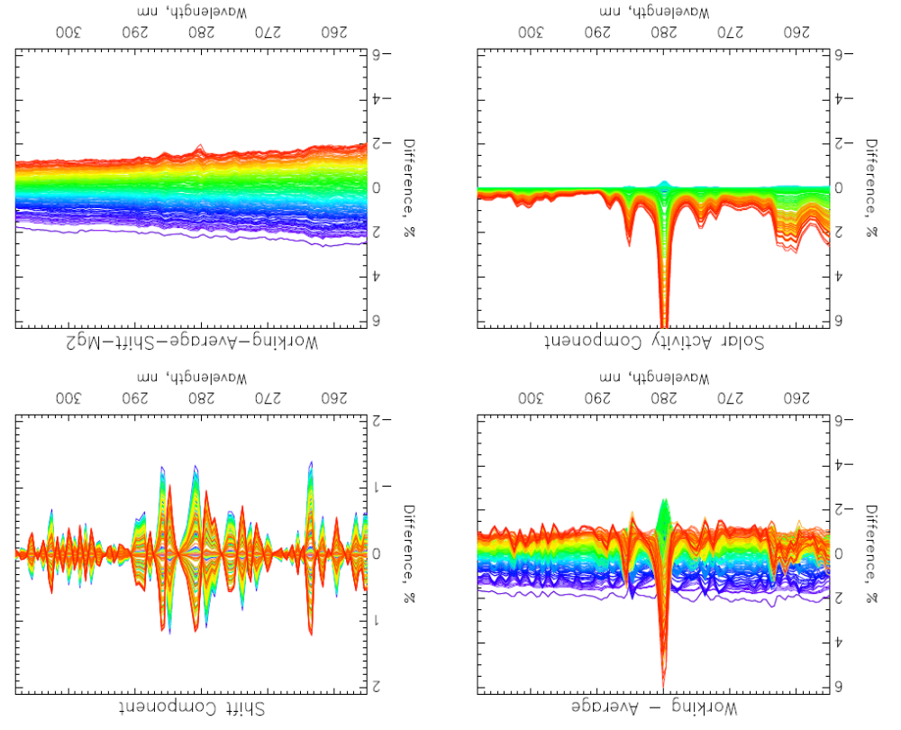

Six years of NOAA-20
OMPS NP bi-weekly Working Diffuser Soar measurements compared to their average.
(b) Wavelength Shift Patterns. Wavelength shifts track optical bench annual thermal variations.
(c) Solar Activity Patterns. Patterns are Mg II scale factors and track Solar activity.
(d) Differences after subtracting the shift and activity patterns. This shows the combined degradation of the reference diffuser and the instrument’s optical throughput.
Note: The working diffuser’s exposure is deployed every two weeks.
(a)
(b)
Newest
(c)
(d)
4%
Oldest

Slide 33
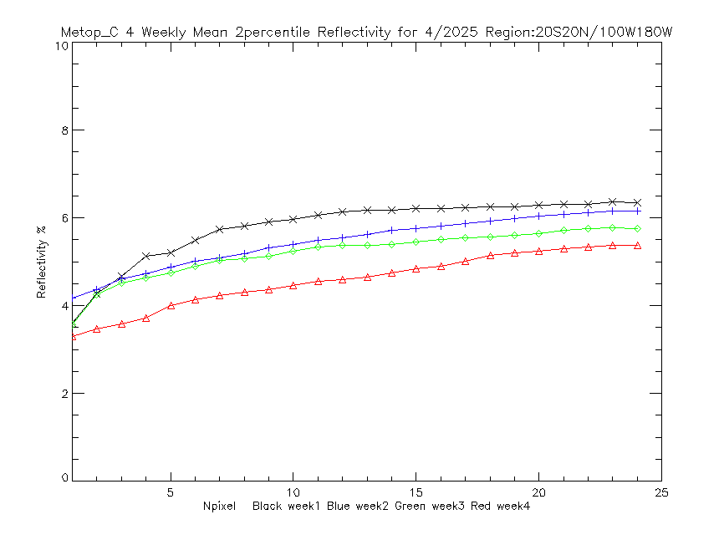
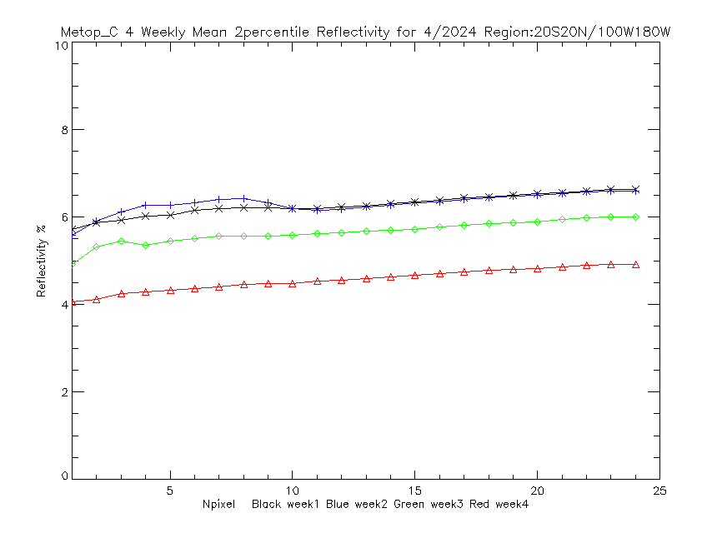

Slide 34
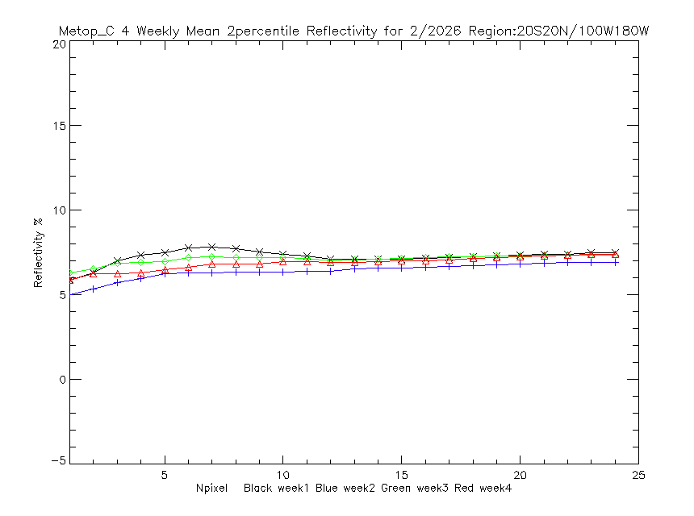
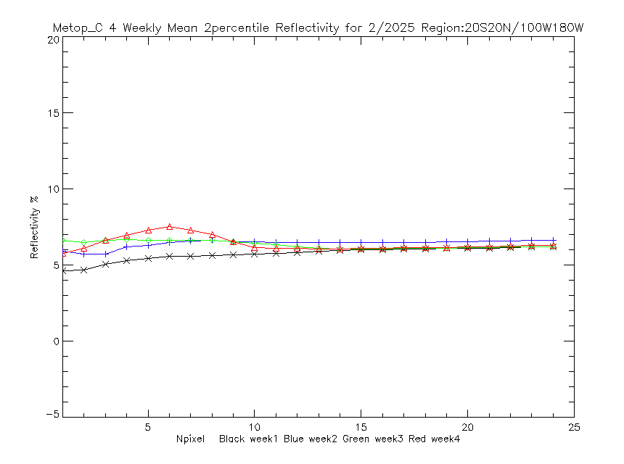
2%

Slide 35
2%

Slide 36
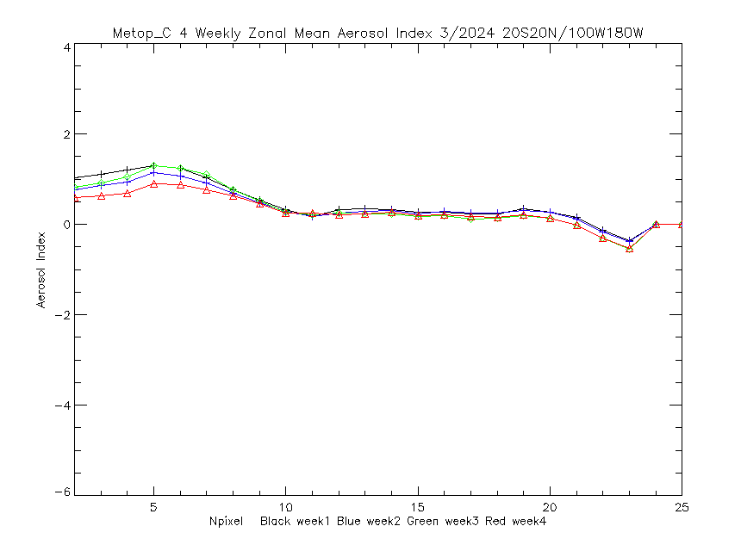
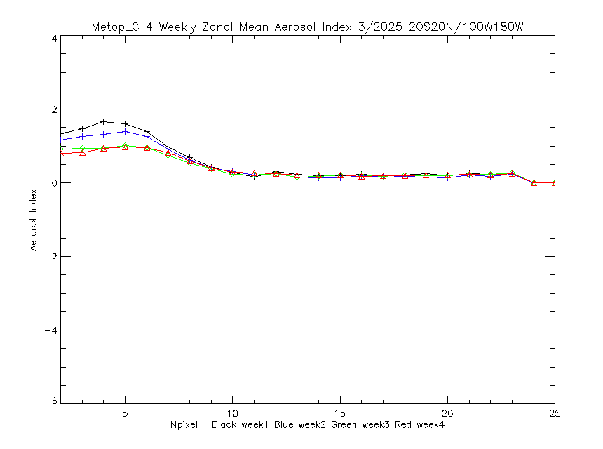

Slide 37
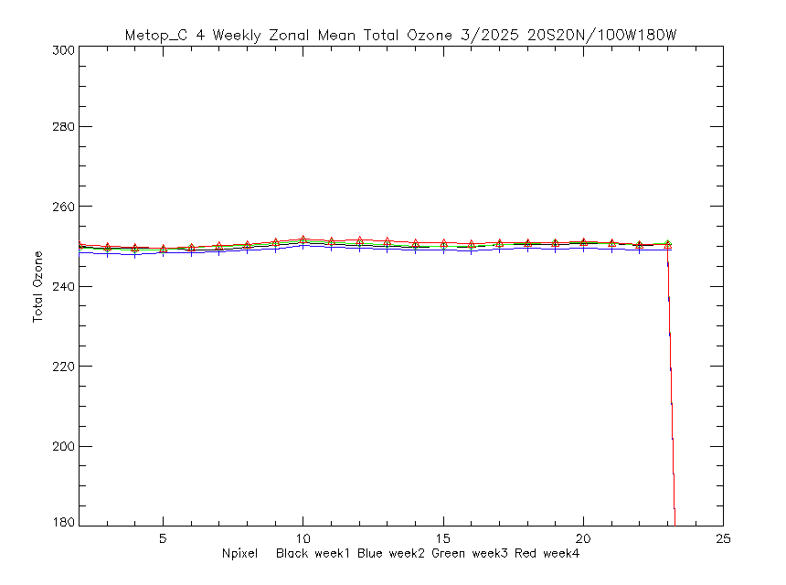
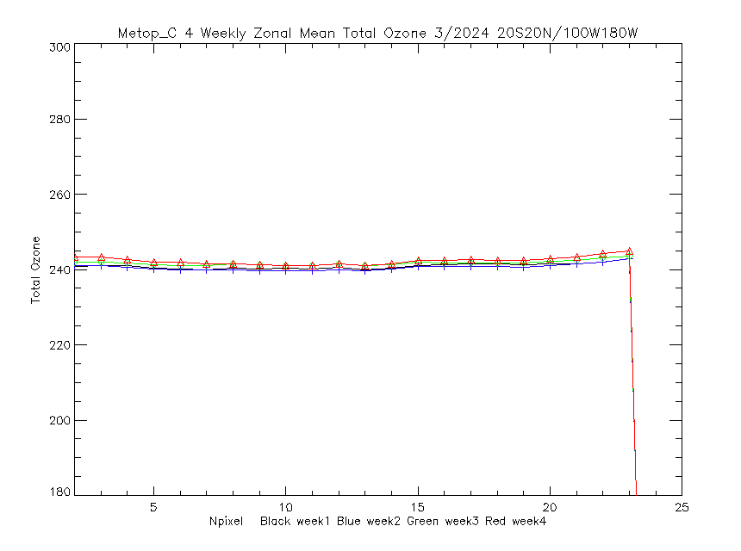

Slide 38
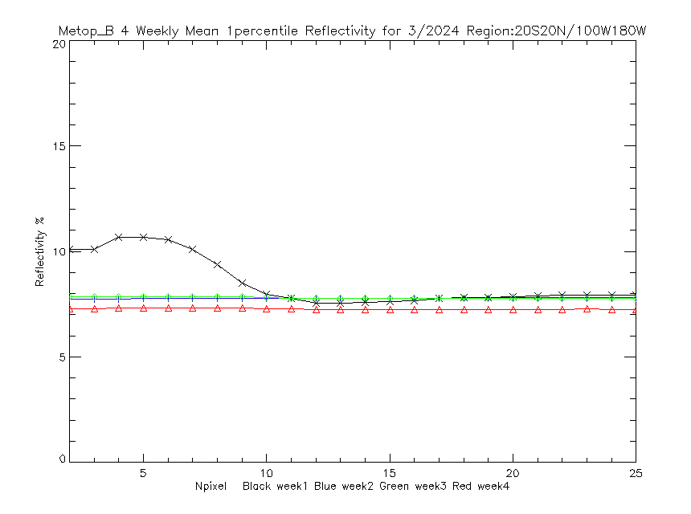



Slide 39




Slide 40
Backup Slides containing last year’s presentation

Slide 41
Outline
NOAA-20 OMPS NP Solar Measurement
  Wavelength Scales, Solar Activity and Degradation
NPP results and Aerosol Index (V8TOz soft calibration)
Soft Calibration for NOAA-21 OMPS
What can be done in orbit?
What can Level 2 bring to Level 1?

Slide 42
Six years of NOAA-20
OMPS NP bi-weekly Working Diffuser Soar measurements compared to their average.
(b) Wavelength Shift Patterns. Wavelength shifts track optical bench annual thermal variations.
(c) Solar Activity Patterns. Patterns are Mg II scale factors and track Solar activity.
(d) Differences after subtracting the shift and activity patterns. This shows the combined degradation of the reference diffuser and the instrument’s optical throughput.
Note: The working diffuser’s exposure is deployed every two weeks.
(a)
(b)
Newest
(c)
(d)
4%
Oldest

Slide 43

Six years of NOAA-20
OMPS NP annual Reference Diffuser Soar measurements compared to their average.
(b) Wavelength Shift Patterns. Wavelength shifts track optical bench annual thermal variations.
(c) Solar Activity Patterns. Patterns are Mg II scale factors and track Solar activity.
(d) Differences after subtracting the shift and activity patterns. This shows the combined degradation of the reference diffuser and the instrument’s optical throughput.
Note: The reference diffuser is used once per year, so the working diffuser’s exposure is 26 times the reference diffuser’s exposure.
(a)
(b)
Newest
(c)
(d)
1%
Oldest

Slide 44

NOAA-20 OMPS NP Wavelength Scales
Estimates of the changes in the wavelength scales from the Mg II solar line feature at 280 nm. The black symbols are from daily analysis of average Earth radiance spectra while the red symbols are from analysis of solar measurements. The bi-weekly solar measurement values are not place into the Level 1b Earth radiance file until five days after the measurements are made and are then used for the next five weeks.
The radiance and irradiance shifts are offset because the ozone absorption gradient across the Mg II feature shifts the location of the minimum core radiances relative to the irradiances.

Slide 45

NOAA-20 OMPS NP Earth Radiance Mg II Index
Estimates of the Mg II Index values. The black symbols are from daily analysis of average Earth radiance spectra while the red symbols are from analysis of solar measurements. The bi-weekly solar measurement values are not yet adjusted for the measured solar activity.
The jump in October 2021 is from a change in the calibration.

Slide 46

A
B
A. Relative changes for a single channel Solar measurements for NOAA-20 OMPS Nadir Profiler.
B. After adjusting for the solar activity using Mg II Scale Factors & Mg II Index.
C. After B and adjusting for the annual cycle in the wavelength scale.
D. After B and C and adjusting for the diffuser degradation.
E. After B, C and D, and adjusting for instrument throughput degradation.
F. Relative differences between working and reference solar measurements versus wavelength.
C
D
E
F

Slide 47

OMPS Nadir Profiler Working Solar Measurements
(a) 12 years of S-NPP OMPS NP bi-weekly Working Diffuser Soar measurements compared to their average
(b) Wavelength Shift Patterns. Wavelength shifts track optical bench annual thermal variations.
(c) Solar Activity Patterns. Patterns are Mg II scale factors and track Solar activity.
(d) Differences after subtracting the shift and activity patterns. This shows the combined degradation of the working diffuser and the instrument’s optical throughput.
Note: The working diffuser’s exposure is 26 times the reference exposure used annually.
Newest
(a)
(b)
(c)
(d)
8%
Degradation Component
Oldest
Notes:
Need to add Dichroic and QE to Wavelength shift pattern.

Slide 48

OMPS Nadir Profiler Reference Solar Measurements
12 years of S-NPP OMPS NP
Annual Reference Diffuser Soar measurements compared to their average.
(b) Wavelength Shift Patterns. Wavelength shifts track optical bench annual thermal variations.
(c) Solar Activity Patterns. Patterns are Mg II scale factors and track Solar activity.
(d) Differences after subtracting the shift and activity patterns. This shows the combined degradation of the reference diffuser and the instrument’s optical throughput.
Note: The working diffuser’s exposure is 26 times the reference exposure for used annually. For the first three years, reference diffuser measurements were made twice a year.
Newest
(a)
(b)
(c)
(d)
2%
Degradation Component
Oldest
Notes:
Need to add Dichroic and QE to Wavelength shift pattern.

Slide 49
318 nm
331 nm
360 nm
310 nm
Relative
trend over
11 years
for 360 nm
versus
331 nm.
Monitoring of the OMPS Nadir Mapper
Changes by using on-board dual
Solar diffusers works well
Estimates of the total wavelength-dependent throughput changes for the S-NPP OMPS over ten years (2012 to 2022). The blue curve is from linear fits of the changes of the bi-weekly solar measurements from the working diffuser. The red curve is from linear fits of the changes of the annual solar measurements from the reference diffuser. The green curve is a scaling of the blue curve accounting for the difference in exposure frequency for the reference versus the working diffusers. The orange curve is the red curve minus the green curve. It gives an estimate of the throughput degradation for the shared optical path for the radiance measurements. Notice that the instrument throughput changes for the OMPS NM (300 nm to 380 nm) are well within the +-1% level. (This figure was created and provided by Colin Seftor of SSAI for the NASA GSFC Ozone Team.)

Slide 50
Calibration of UV/Vis Spectrometers for Aerosol Products
[http://gsics.atmos.umd.edu/pub/Development/AnnualMeeting2024/7j_Flynn_GSICS_Aerosols.pptx ]
UV Aerosol Index (331 / 360 nm Pair) from the V8TOz algorithm using TOMRAD.
Trend over
11 years.
Sun Glint Geometry
Colors are time-sorted Cold to Warm
2012 2013 2014 2015 2016 2017 2018 2019 2020 2021 2022 2023
Cross-Track Viewing Position # (#18 is Nadir)
Cross-track dependence over the Equatorial Pacific of the Aerosol Index for S-NPP for March for 11 years Cold to Warm.
The cross-track pattern for the Aerosol Index is also very stable year-after-year and the absolute values are stable at the 0.4 level. The figure on the slide before does show (two ⃝‘s) a trend in the instrument throughput for the 360 nm channel relative to 331 nm which has not been adjusted in any calibration, so some time dependence in this figure is not unexpected.

Slide 51

Sun Glint Geometry
Cross-track 1-percentile Effective Reflectivity for S-NPP, NOAA-20 & -21 OMPS V8TOz taken over a Latitude/Longitude box in the Equatorial Pacific (20S-20N, 100W-180W). Values are computed independently for each of the 35 or 177 cross-track FOVs.

Slide 52



Total Ozone, DU
Aerosol Index
Cross-Track Viewing Position # (#88 is Nadir)
Cross-track dependence of Ozone, Aerosol Index and 1-percentile Reflectivity over the Equatorial Pacific before and after soft calibration compared to S-NPP and NOAA-20.
Effective Reflectivity, %
Cross-Track Viewing Position # (#88 is Nadir)

Slide 53
March weekly cross-track for Aerosol Index (N21)

Slide 54
Using V8TOz dN/dR and dN/dO3 and ozone and reflectivity differences to determine soft calibration adjustments
The V8TOz output contains a variety of useful parameters in addition to the total column ozone estimates. In particular, the retrieval sensitivities, dy/dx can be used to give soft calibration estimates of the N-value changes to remove reflectivity and ozone bias. If you want to increase the effective reflectivity, R, and the total column ozone, Ω, by ΔR and ΔΩ then you should increase the N-values by
ΔN318 = ΔR dN318/dR + ΔΩ dN318/dΩ = ΔR A1 + ΔΩ B1
ΔN331 = ΔR dN331/dR + ΔΩ dN331/dΩ = ΔR A2 + ΔΩ B2
where dNw/dR is the rate of change of the N-value, Nw, for wavelength, w, with respect to changes in the effective reflectivity, R, and dNw/dΩ is the rate of change of the N-value, Nw, for wavelength, w, with respect to changes in the total column ozone, Ω.
Conversely, if you increase the N values by C1=ΔN318 and C2=ΔN331, then the retrieved R and Ω increase by
ΔR = [C1 * dN331/dΩ – C2 * dN318/dΩ] / D
ΔΩ = -[C1 * dN331/dR,– C2 * dN318/dR] / D
D = [dN318/dR * dN331/dΩ – dN331/dR * dN318/dΩ]
Ω is total ozone in DU, R is effective reflectivity, and
N is -100*log10(Radiance/Irradiance)

Slide 55

Adjustments shifted down due to Level 1 Solar recalibration.
Solar Stitching Discontinuity
March 2024 Results
Cross-Track Viewing Position # (#88 is Nadir)

Slide 56

Adjustments to force agreement with S-NPP V8TOz Total Ozone
Cross-Track Viewing Position # (#18 is Nadir)

Slide 57

Adjustments to force agreement with NOAA-19 SBUV/2 Total Ozone
Cross-Track Viewing Position # (#18 is Nadir)

Slide 58
Proposed Improvement for Solar Activity
Biweekly adjustments implemented five days after the measurements are made do not track the 27-day solar rotation cycle well.
Daily values from the Earth-view measurements or from Metop-C GOME-2 Solar-view measurements could be used but would require daily table updates.
The average Mg II index for the last two bi-weekly solar measurements can be used as a representative value for the 27-day average solar activity.
Proposal: Use this average Mg II Index value and the Mg II Scale factors to adjust the solar irradiance for this contribution relative to the “Day 1” solar. This will at least track the 11-year cycle variations.

Slide 59
Options for Instrument Degradation
Estimate the instrument throughput degradation rates as a function of wavelength from the working and reference measurements
Option 1. Update Earth Calibration Coefficient Tables to correct for this degradation. (Called Calibration Factors Earth for SBUV/2 instruments.)
Option 2. Apply the wavelength degradation estimate to the biweekly solar irradiance measurements to match the degradation effects present in the Earth radiance measurements.

Slide 60


Metop-A GOME-2 Version 8 331-nm Reflectivity for a box in the Equatorial Pacific.
The unadjusted values in the top plot reach a minimum of 8% (higher than expected for the open ocean) for the Nadir scan position.
A single calibration adjustment to the 331-nm channel lowers this value to 4% and also flattens out the scan dependence for West-viewing positions. The East-viewing results are not flat but this is expected as there is sun glint contamination for those angles.
Equatorial Pacific Box
|Lat|<5, Lon<-100
EAST
cross-track WEST
Notes:
Close up of minimum values.
Note Narrow swath data confirms that this is scan angle dependent, not scan timing dependence, that is the narrow swath has 8% minimums for all scan positions.

Slide 61
Summary
Analysis of biweekly working and annual reference solar measurements for NOAA-20 and S-NPP OMPS NP allow accurate characterization of the instrument throughput changes at the 0.1% level.
Soft calibration adjustments to force agreement for all OMPS can be calculated by using the V8Pro and V8TOz ozone, reflectivity and aerosol index estimates and their sensitivity to radiance / irradiance ratio changes.
The stable orbits of the JPSS polar satellites allows the creation of accurate long-term records.

Slide 62
GeoXO Atmospheric Composition Instrument (ACX)
https://www.eoportal.org/satellite-missions/geoxo#spacecraft
GeoXO (Geostationary Extended Observations) is a planned constellation of three geostationary meteorological satellites, developed by NOAA (National Oceanic and Atmospheric Administration) in collaboration with NASA, that aims to advance environmental monitoring across the Western Hemisphere. Designed to provide continuity for the GOES-R series, GeoXO will provide enhanced weather, air quality, and ocean monitoring to address threats from extreme weather and climate change, benefiting public safety and environmental protection.

Slide 63


Slide 64
NOAA GeoXO Atmospheric Composition Instrument (ACX)
Attribute | Value | Purpose
Coverage | CONUS, southern Canada, northern Mexico, Caribbean | Hourly inputs to national air quality, hazard and fire forecasting capabilities and warnings.
Spatial Resolution | 8x3 km² @ nadir | Resolve sources, including cities, highway corridors, airports, oil/gas fields, large point sources like fires and power plants.
Temporal Resolution | 60-Minute Refresh | Capture diurnal variations in pollution emissions, photochemistry, and exposure. Detect episodic events like wildfires and volcanoes. Select for cloud-free conditions. Increase geographic coverage compared with LEO or surface observations.
Spectral Coverage / Resolution | UV: 300-500 nm Vis: 540-740 nm Both @ 0.6-nm | UV: ozone, nitrogen dioxide, formaldehyde, sulfur dioxide, absorption aerosol optical depth. Vis: cloud/aerosol layer height, PBL ozone, vegetation.

Slide 65
Backup slides

Slide 66

Wavelength Shift Patterns: Measured versus Synthetic
S-NPP OMPS NP Wavelength Shift Patterns
The solid line is a quadratic fit of TSIS-1 HSRS Proxy Spectra with ±0.01, ± 0.02 and ± 0.03 nm perturbations.
The dashed line is from the measured solar using a discrete centered difference.
Patterns do not include
pixel-based calibration effects from gradients.

Slide 67


(a) Annual Cycle in Wavelength Shift from Mg II
(b) Annual cycle in 308 nm Solar after removing activity, shift and degradation.
(c) Amplitude of annual cycles versus wavelength.
(a)
(b)
(c)

Slide 68


Slide 69
Estimates of SO2 from OMPS NM.

Slide 70
Complications between wavelength shift and Mg II information from Synthetic Solar
nm nm nm nm nm nm nm
True Shift 0.03 0.02 0.01 0.00 -0.01 -0.02 -0.03
Mg W1 Shift 0.029 0.019 0.009 0.000 -0.010 -0.019 -0.029
Mg C Shift 0.028 0.019 0.009 0.000 -0.009 -0.019 -0.028
Mg W2 Shift 0.029 0.019 0.010 0.000 -0.010 -0.019 -0.029
% % % % % % %
ΔMg II Index -0.12 -0.10 -0.06 0.000 0.07 0.16 0.27

Slide 71
Proposed Improvement for Wavelength Scale Shift and Instrument Gradients
Compute the relative changes in the instrument calibration associated with the pixel-based gradients used to account for the dichroic and the quantum efficiency for a 0.01 nm shift.
Check / confirm the pattern by using solar activity corrected biweekly measurements.
Include this pattern in the adjustments currently applied to the biweekly solar tables for the wavelength scale shifts. This will mean that the solar irradiance has the same calibration error as the Erth radiance.
The alternative is to vary the pixel-based calibration coefficient table to account for the wavelength shifts in the Earth radiances.

Slide 72
Agenda
1. Introduction: Motivation, Background & Goals (L. Flynn, NOAA)
2. Short Summary of TSIS-1 HSRS Resources and Validation (L. Flynn, NOAA)
3. OMI Time Series and Solar Activity (M. Deland, SSAI)
4. Mg II Index Time Series (M. Weber, Universität Bremen)
5. OMPS Working and Reference Diffuser Measurements. (L. Flynn, NOAA)
6. TropoMI Solar Measurements (E. Loots, KNMI)
7. TEMPO Solar Measurements (H. Chong, Harvard)
Information requested from each instrument team to GSICS (Send to Manik.Bali@noaa.gov):
1. Record of solar measurements -- time, spectra, wavelength scale
  1 AU? Degradation corrected? Doppler shift corrected?
2. Bandpass / spectral response information
3. Data readers / Readme
4. Links to documents, presentations and publications.
Thanks to the TropoMI team for leading the way in providing this information.

Slide 73
Motivation, Background and Goals
Most UV/Vis Spectrometers provide Radiance / Irradiance Ratios as their primary measurements.
The key time-dependent calibration analysis is usually to distinguish degradation just affecting solar measurement from instrument throughput changes shared with the Earth radiance measurements.
This topical study is designed to promote discussion and the exchange of ideas and analysis methods for estimating and modelling the sources and magnitudes of changes present in solar measurements.
Another goal is to compare measurements from different instruments with synthetic proxy spectra from references and with each other.
Such comparisons can provide estimates of absolute and relative calibration biases, and can be used to confirm wavelength registration and bandpass resolution.

Slide 74
Introduction to TSIS-1 HSRS Resources
Version 2 of the Total and Spectral Solar Irradiance Sensor-1 (TSIS-1) Hybrid Solar Reference Spectrum (HSRS)
https://lasp.colorado.edu/lisird/data/tsis1_hsrs_p1nm
Odele Coddington et al. 2020: “The TSIS-1 Hybrid Solar Reference Spectrum” https://agupubs.onlinelibrary.wiley.com/doi/abs/10.1029/2020GL091709
Daily values of solar spectral irradiance (SSI) from 1978 to 2021 (inclusive) with 0.1 nm resolution at wavelengths from 115 to 310 nm (on a 0.025 nm grid) and ~0.5 nm resolution at wavelengths from 310 to 500 nm (on a 0.1 nm grid)
https://lasp.colorado.edu/lisird/data/nrl2_ssi_high_res
GSICS 2024, Talk 7.g: Validation of TSIS-1 HSRS in the range 300 nm to 1700 nm using ground-based SI-traceable spectral solar irradiance measurements, by Julian Gröbner, Gregor Hülsen, Saulius Nevas, and Peter Sperfeld. Validation at 1% accuracy. http://gsics.atmos.umd.edu/pub/Development/AnnualMeeting2024/7g-Groebner_mapp_final.pptx
Notes:
Gröbner, J., Kouremeti, N., Hülsen, G., Zuber, R., Ribnitzky, M., Nevas, S., Sperfeld, P., Schwind, K., Schneider, P., Kazadzis, S., Barreto, Á., Gardiner, T., Mottungan, K., Medland, D., and Coleman, M.: Spectral aerosol optical depth from SI-traceable spectral solar irradiance measurements, Atmos. Meas. Tech., 16, 4667–4680, https://doi.org/10.5194/amt-16-4667-2023, 2023.

Slide 75

7g. Validation of TSIS-1 HSRS in the range 300 nm to 1700 nm using ground-based SI-traceable spectral solar irradiance measurements. See references in note pages.
U⁹⁵_{QASUME}=1.6%
Agreement with TSIS-HSRS: 1% outside of strong atmospheric absorption bands
Notes:
GSICS 2024, Talk 7.g: Validation of TSIS-1 HSRS in the range 300 nm to 1700 nm using ground-based SI-traceable spectral solar irradiance measurements, by Julian Gröbner, Gregor Hülsen, Saulius Nevas, and Peter Sperfeld. Validation at 1% accuracy. http://gsics.atmos.umd.edu/pub/Development/AnnualMeeting2024/7g-Groebner_mapp_final.pptx

Slide 76
Mg II Solar Activity and Scale Factor References
There is also a daily reference time series at reasonably good resolution of solar measurements including their estimates for solar activity variations. . https://lasp.colorado.edu/lisird/data/nrl2_ssi_high_res
Mark Weber has time series of solar activity: https://www.iup.uni-bremen.de/UVSAT/data/
MATTHEW T. DELAND AND RICHARD P. CEBULA, JGR, VOL. 98, NO. D7, PAGES 12,809-12,823, JULY 20, 1993, Composite Mg II Solar Activity Index for Solar Cycles 21 and 22 https://agupubs.onlinelibrary.wiley.com/doi/10.1029/93JD00421.
Title: Comparisons of the MG II index products from the NOAA-9 and NOAA-11 SBUV/2 instruments
Authors: Deland, M. T. & Cebula, R. P.
Journal: Solar Physics (ISSN 0038-0938), vol. 152, no. 1, p. 61-68
Bibliographic Code: 1994SoPh..152...61D https://adsabs.harvard.edu/full/1994SoPh..152...61D

Slide 77
Outline
1. Collect working and reference solar measurements at whatever temporal and cross-track / cross-scan sampling is recommended.*
2. Collect wavelength scales and bandpasses / spectral response functions.
3. Construct synthetic spectra from TSIS-1 HSRS Version 2.
4. Construct linear Mg II Scale Factors^ from TSIS-1 Daily activity time series – derived activity spectrum. Compare to up/down/up or down/up/down from measured spectra for high activity.
5. Construct quadratic fit of wavelength shifts from synthetic results and calibration constants.
  Use 0.01 nm steps from -0.03 nm to +0.03 nm, and fit with a quadratic at each wavelength.
  Determine pixel-based throughput (e.g., dichroic) gradient shift pattern as an additional linear term.
  Determine Scale Factor wavelength shift pattern as an additional linear term.
6. Use local quadratic fits of the Mg II features to generate Mg II core-to-wing Index and wavelength shift estimates values for each spectrum. (Should wavelength shifts be smoothed over time?) Check linear relationship with Mg Index time series.
7. Identify average differences between measurements and synthetic proxies, and working and reference measurements.
8. Decompose all spectra with average differences, wavelength shift and solar activity terms. Construct the measurement residuals from these modeled components. (multiple linear regression or EOF analysis)
9. Use an exponential fit of diffuser measurements based on the number of exposures and an assumption that degradation rates per exposure for working and reference are the same to estimate diffuser and instrument degradation rates. Vary functional wavelength dependence of degradation.
10. Compute final model residuals. (Note: there may be outlier spectra that should be removed.)
11. Compute daily estimates of Mg II Index and wavelength shift values from Earth radiances. Compare values to working solar measurements.
* Preferably adjusted with irradiances adjusted to 1 AU and wavelengths adjusted for Doppler shifts.
^ Ca H&K line features can be used in place of Mg II – cores-to-center S-Index for spectra covering 390 nm to 400 nm.
Notes:
Title: Comparisons of the MG II index products from the NOAA-9 and NOAA-11 SBUV/2 instruments
Authors: Deland, M. T. & Cebula, R. P.
Journal: Solar Physics (ISSN 0038-0938), vol. 152, no. 1, p. 61-68
Bibliographic Code: 1994SoPh..152...61D
https://adsabs.harvard.edu/full/1994SoPh..152...61D
JOURNAL OF GEOPHYSICAL RESEARCH, VOL. 98, NO. D7, PAGES 12,809-12,823, JULY 20, 1993
Composite Mg II Solar Activity Index for Solar Cycles 21 and 22
MATTHEW T. DELAND AND RICHARD P. CEBULA
https://agupubs.onlinelibrary.wiley.com/doi/10.1029/93JD00421

Slide 78

Sample difference between a synthetic proxy and a measured spectrum for S-NPP OMPS NP
Measured “Day 1” versus TSIS-1 Proxy.
The agreement is within ~3% above 270 nm. The differences above 308 nm are in a region where the dichroic throughput is rapidly changing. The variations between 250 and 270 nm merit further study.

Slide 79


Degradation of Measured Solar at two Channels
283 nm
308 nm
The solid lines are the Reference Diffuser Solar Measurements and the small + symbols are the Working Diffuser Solar Measurements.

Slide 80
Model and Components for Solar Measurements
Solar Activity Patterns (Scale Factors Relative to Mg II Index)
  From bi-weeky working solar measurements (Up-Down-Up in Mg II Index)
  From TSIS-1 HSRS daily solar pattern convolved with the instrument bandpass.
  From PCA analysis of the solar record try to recognize the solar activity components.
Wavelength Shift Pattern
  From synthetic spectra with a range of shifts using the TSIS-1 HSRS and the bandpass
    The relative shifts can be fit with a quadratic at each wavelength center.
    Synthetic shift patterns do not account for pixel-based calibration gradients.
  From centered differences using the measured spectra.
    Shift(wi) = [[Irrad(w_{i+1})-Irrad(w_{i-1})]/Irrad(w_{i})]/[w_{i+1} - w_{i-1}]
  From PCA analysis.
Degradation
  Diffuser Degradation Linear or exponential in exposure time
  Smooth functions of wavelength
  Instrument throughput degradation
  Assumption: Degradation rates per exposure for working and reference are equal.
Bandpass and Wavelength Complications
Mg II Indices and other information from Earth Radiances. (ICVS Link)

Slide 81

Mg II Feature at OMPS Resolution
The vertices of quadratic fits can be used to make a Mg II core-to-wings index for use with scale factors to estimate solar activity, and to estimate the wavelength shifts relative to other measurements.
The Ca H&K solar features at 393 nm and 395 nm can be used to provide similar information for longer channels.
Wing
Wing
Core

Slide 82

Mg II Scale Factors: Measured versus Synthetic
S-NPP OMPS NP Mg II Scale Factors
The solid line is from the bandpass convolved TSIS-1 HSRS Daily variations.
The dashed line is from the solar measurements using three bi-weekly measurements with a large down/up/down variation in the Mg II Index values.

Slide 83

S-NPP OMPS NP Mg II Index Time Series
Estimates of the Mg II core-to-wings Index. The bi-weekly solar measurements track both the 27-day rotation and 11-year solar cycle activity.
See Monitoring (including daily Earth-view values) at
https://www.star.nesdis.noaa.gov/icvs/status_NPP_OMPS_NP.php

Slide 84

S-NPP OMPS NP Wavelength Shift Time Series
Estimates of the wavelength shifts from the quadratic fits of the Mg II solar feature. The annual cycle tracks the seasonal variations in the instrument temperature gradients.

Slide 85

Principal Component Analysis of combined working and reference diffuser measurements.
(a/b) First pattern and coefficients. This component primarily follows the diffuser and instrument degradation variations. The shorter wavelength have larger degradation.
(c/d) Second pattern and coefficients. This component primarily follows the wavelength shift. Wavelength shifts track the optical bench annual thermal variations.
(e/f) Third pattern and coefficients. This component follows the solar activity some shared power from the annual cycle.
The PCA does not fully distinguish between the three main attributes.
Note: The working diffuser’s exposure is 26 times the reference exposure for used annually.
(a)
(c)
(e)
(b)
(d)
(f)
+ Working
* Reference
Notes:
For the first three years, reference diffuser measurements were made twice a year.

Slide 86
Complications
A wavelength gradient in throughput for dichroic (300-310 nm) and quantum efficiency (below 255 nm) skew the bandpasses.
Pixel-based calibration constants used in Level 1 processing do not properly adjust for gradients when there are wavelength scale shifts.
One can re-center Bandpass for the changes wo/w dichroic as the first moments move.
Time series of Mg II Index and wavelength shifts from Solar can be compared to those in average Earth Radiances (See ICVS.)
An index using the Ca H & K feature can be used in similar fashion.
Stray Light patterns can appear similar to solar activity and bandpass resolution patterns.

Slide 87
Discussion Topics for Solar Studies
Comparisons to TSIS-1 HSRS Version 2
  Absolute to 1%
  Wavelength scale to 0.01 * FWHM (Quadratic shift coefficients)
  Check on Bandpass by feature broadening
Working / Reference Schedule (transmissive versus reflective)
  Repeat reference annually at the same viewing geometry
  Frequency of deployment / Degradation rates
  Solar Activity from Mg II (~280 nm) or Ca H & K (~394 nm)
  Wavelength scale cycles from working
  Careful tracking of goniometric angle parameterization
Choices for solar in the L1B / SDR
  1 AU or Earth/Sun distance adjusted?, Doppler shifted or not?
  Day 1, latest working (what frequency), or degradation corrected (or all three)
    Latest working has wavelength scale and solar activity

Slide 88
Backup and slides from the annual meeting

Slide 89
OMPS Lessons Learned
  Dark current measurements / Corrections
    Science timing pattern at night. Trevor Plot
    Storage versus active
    Arrhenius Law *2 / 5 K
    Temperature dependence (LL TEMPO)
  Wavelength scale (shifts G-to-O, diurnal, Irrad to Rad, Quadratic Coefficients.)
  Dual Diffusers Colin Plot
    Annual Repeat, Track wavelength scale and solar activity, check bandpass
    Consider options for duty cycles
  les and Bandpasses Ca H&K Earth Radiance Plot
    Centering – First Moments
    Modeling SRF functions
  Level 2
    DOAS versus Discrete Channel retrievals
    Back to Pair Justification
  Pixel or wavelength-based calibration
  Broad bandpasses or small scale (DOAS vs V8TOz) Aerosol Plot, NO2 Plot.
  Stray Light and correlations (Ca H&K vs reflectivity)
Experiences and what to look for from TEMPO and GEMS
  Patterns, PCA,
  Diurnal
  Transmissive diffusers (Angles, operations, degradation)

Slide 90
Complications for comparisons
Solar bias N/S
Saturation Recognition? Which channels?
Bias for Aerosol Index and A-Pair used in Step 3 Retrievals
V8TOz standard profiles in the instrument table?
Lessons Learned from OMPS
  EV360 gives accurate dark measurements with correct timing for signal and storage regions.
  NP for 300-305 nm gives OOR stray light correction target. Correlations with longer wavelength.
  Wavelength shift and optical gradients versus pixel based radiometric calibration. (no large gradients.)

Slide 91
Solar More
The instrument should have dual diffusers with options for their use to include changing the duty cycles and switching their roles.
  Accelerated deployment
  Degradation rate estimation
We will want to monitor the transmissive diffuser performance from GEMS and TEMPO.
  How frequent should be working deployment be? Should be reference be twice a year at Equinoxes?
Is there sufficient benefit to be able to deploy both transmissive diffusers to consider this design? (Ref. Don Heath)

Slide 92
Dual transmissive diffusers (additive?)
Signal level, Linearity, Darks aggregation time dependence for LED, Temperature dependence, Control, *2 for 5C.
Workshop on pre-launch Link (What can you characterize in flight? What must be done on the ground?)
SITSats (CLARREO, TRUTHS, LIBRA) Need to get methods for LEO (or Space Station) versus GEO, especially for instruments that do not view the Equator. Role for RT Models.

Slide 93
PCA to get noise...
Bandpass first moments and recentering...
BATC and Solar measurements.
Opportunities for Sign Errors.
Doppler Shift for Solar.

Slide 94
Hi Odele,
I took an action to investigate Sunspot and Mg II Index time series for use with solar models in the UV for GSICS research. We only need these for the satellite age (say 1978 at the earliest).
It appears that the daily files (SN_d_tot_V2.0) at
http://www.sidc.be/silso/datafiles
are the state-of-the-art. Should we recommend the data at this site or do you have another one that you use? Can the Sunspot numbers be used directly or does your model need more specialized information?
The are more options for Mg II Index time series. I found following one (the Bremen Composite) with daily updates:
http://www.iup.uni-bremen.de/UVSAT/Datasets/mgii
Do you use this one or a different one? If you use a different one, do you have renormalization coefficients (slopes and intercepts) to switch between indices from different sources?
One option would be to set this as the intercomparison reference and have different Mg II creators give the linear fit coefficients for their records using it as a transfer standard.
Larry Flynn
Notes:
Facular Brightening • Mg II index: 1978 onward • Ca II K index: 1974 onward • He I Index: 1974 onward • F10.7-cm flux: 1974 onward • Plage index: 1944-1987 • Visible solar images: prior to 1940 • Group Sunspot Number: 1610 onward
Sunspot Darkening • USAF SOON:1982 onward • RGO: 1882-1982. • Group Sunspot Number: 1610 onward

Slide 95
Below is Odele's reply. We are in agreement on the Mg II Index choice -- the Bremen site with Mark Weber's at
http://www.iup.uni-bremen.de/UVSAT/Datasets/mgii
She gives a choice for the Sunspot record but it looks like the USAF SOON network one from
https://services.swpc.noaa.gov/json/sunspot_report.json
will have to do.

Slide 96
Planned Activities
GHG Missions next quarterly meeting: 12-13UTC, Friday, April 26, 2024
Three planned UVN-S Topical Meetings (fifth Thursday of the month)
  Evaluating and modeling solar measurements
    Diffuser degradation
    Instrument throughput degradation
    Solar activity
    Wavelength shifts and Bandpasses
    Stray Light
  Matchup Inter-comparisons for LEO/GEO, LEO/GEO/Lagrange-1, LEO/LEO
    SNO
    Ray tracing
    Using RT Forward models to account for viewing differences (V8TOz examples)
  Use of Targets and Statistical approaches
    Ice Radiances
    Open Ocean
    Land (PICS, etc.)
    Deep Convective Clouds
    Aerosol Indices

Slide 97

7i. Assessment of OMPS Nadir Mapper SDR Reflectance Using Deep Convective Clouds As Calibration Targets
Reflectance changes over ten years with 1-sigma uncertainty vs wavelength:
Mean DCC reflectance is stable with 10-year changes well within 2% requirement;
Positive reflectance changes for wavelength > 330nm;
Reflectance changes increase with wavelength and them decrease with wavelength;
Max reflectance changes is ~0.6%/ 10years.
Figure. 8 S-NPP OMPS-NM DCC mean reflectance changes over ten years with 1-sigma uncertainty vs wavelength when threshold is 210K.

Slide 98
Data Sharing for UV Spectrometers
Where are SRF (slit functions, spectral response functions, bandpasses) available?
Where are Solar irradiance datasets available?
Can we share these SRF and Solar datasets at a site on the GSICS wiki?
http://gsics.atmos.umd.edu/bin/view/Development/ReferenceSolarSpectrum
Where are Level 1 Reprocessed data available?

Slide 99
Instrument Team Information Sheet
Level 1 Format and ATBD (Document location)
Spectral Response Key dataset (Dataset location, can we place a copy on the wiki?)
Instrument event tracking (Website)
Solar Irradiance time series
Irradiance – day 1?, wavelength?, solar activity? Earth/Sun distance or 1 AU?, Degradation corrected? Doppler corrected or adjusted?
Radiance – wavelength?, Earth / Sun distance or 1 AU?, Degradation corrected?
Reprocessed Level 1 records (Access)

Slide 100
Draft OMPS Team Information Sheet
Level 1 Format and ATBD (Document location)
  STAR JPSS - Instruments - Ozone Mapping and Profiler Suite (OMPS) (noaa.gov)
  XML and Data Description?
Maturity Reviews and Validation
  STAR JPSS - Algorithm Maturity Matrix (noaa.gov)
Radiance
  Wavelengths
    OMPS NP has an annual cycle in the wavelength scale. Operational data wavelengths are updated every two weeks. Reprocessed data wavelengths are updated with daily interpolation of biweekly solar results.
    OMPS NM has an orbital cycle in the wavelength scale. Operational data are updated with granule characterization of the wavelength scales for each cross track FOV.
  Radiances are given as measured for the current Earth / Sun distance without degradation corrections.
Spectral Response Function Key dataset (Dataset location)
Instrument event tracking (Website)
Solar Irradiance time series
Irradiance – day 1?, wavelength?, solar activity? Earth/Sun distance or 1 AU?, Degradation corrected?
Reprocessed records
  NOAA's Comprehensive Large Array-data Stewardship System
Data Access
  STAR JPSS - JPSS Data Access (noaa.gov)
  NOAA's Comprehensive Large Array-data Stewardship System
Notes:
Additional information is available in the OMPS V8TOz and V8Pro algorithm theoretical basis documents (ATBDs) and the SDR ATBDs and maturity review briefings, which can be accessed at:
https://www.star.nesdis.noaa.gov/jpss/Docs.php
https://www.star.nesdis.noaa.gov/jpss/OMPS.php
and
https://www.star.nesdis.noaa.gov/jpss/AlgorithmMaturity.php
OMPS SDR near-real-time status and performance monitoring web page are available by using the following password protected websites:
https://www.star.nesdis.noaa.gov/icvs/status_NPP_OMPS_NM.php
https://www.star.nesdis.noaa.gov/icvs/status_NPP_OMPS_NP.php
https://www.star.nesdis.noaa.gov/icvs/status_NPP_OMPS_LP.php
OMPS SDR near-real-time status and performance monitoring web page are available at the open website:
https://www.star.nesdis.noaa.gov/icvs/index.php
OMPS EDR near-real-time status and performance monitoring web pages are available at the following websites:
Archive https://www.class.ncdc.noaa.gov/saa/products/search?datatype_family=JPSS_OZONE
Operations http://www.ospo.noaa.gov/http://www.ospo.noaa.gov/Products/atmosphere/index.html
Long-term https://www.star.nesdis.noaa.gov/smcd/spb/OMPSDemo/proOMPSbeta.php
Daily maps https://www.star.nesdis.noaa.gov/jpss/EDRs/products_ozone.php
Activity https://ozoneaq.gsfc.nasa.gov/omps/npp/activity
Validated Maturity
https://www.star.nesdis.noaa.gov/jpss/AlgorithmMaturity.php

Slide 101

Degradation is small and well-characterized
Degradation trending for 2 channels: 267.8 nm for the S-NPP NP (a) and NOAA-20 NP (c); 299.3 nm for the S-NPP NP (b) and NOAA-20 NP (d). Each subfigure illustrates the response change in the working diffuser (dot), reference diffuser (square), and sensor degradation (solid line), as well as dot-dashed line that fits the diffuser change in a time series. (From paper by C. Pan)
Degradation is not included in bi-weekly updates but is include in reprocessing. (Note: SBUV ACF).

Slide 102


NOAA-20 OMPS NP Daily Earth-view Wavelength Shifts
The SDR Team is considering
how to address the
two-week lag in
SDR Table updates.
These lags are removed in reprocessings.
Wavelength scale and solar activity are
included in operational biweekly updates.
S-NPP OMPS NP Daily Wavelength Shifts
Shift in
S-NPP wavelength
scale in early 2021
0.02 nm

