Slide 1
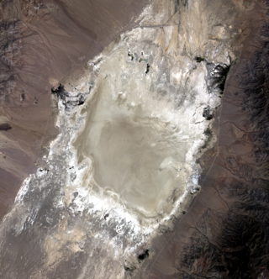

© 2026. California Institute of Technology. Government sponsorship acknowledged.
JPL Vicarious Calibration at the Railroad Valley Playa
Graziela R. Keller*, Carol J. Bruegge, Dejian Fu, Richard Lee, Thomas Pongetti, Rob A. Rosenberg, Edwin Sarkissian, Marcin L. Witek
Jet Propulsion Laboratory, California Institute of Technology, Pasadena, CA
March 2026
*OCO-3 Calibration Team Lead. Also supporting the calibration teams of OCO-2, MAIA, and MISR.
Reviewed and approved for public distribution via the URS. This document has been reviewed and determined not to contain export controlled CUI.

Slide 2




Currently Supporting
Launched in 2014. Three high-resolution NIR spectrometers (0.765, 1.61, 2.06 μm) used to measure XCO2, on a dedicated satellite in a sun-synchronous polar orbit, crossing the equator near 1:30pm. Observes the RRV Playa in target mode.
Launched in 2019. Uses the flight spare spectrometers from OCO-2. Is operated from the ISS, in a non-repeating orbit. Observes the RRV Playa in target mode.
Launched in 1999 on the Terra satellite, operated in a sun-synchronous orbit with crossing time at 10:30am until 2020. Employs 9 push-broom cameras fixed at different angles (nadir, 26.1º, 45.6º, 60.0º, 70.5º), observing in four spectral bands: blue, green, red, and near-infrared at 446, 558, 672, and 867 nm. MISR is performing its last data reprocessing which includes vicarious calibration results.
Launch expected in 2027/2028 on a non-repeating orbit. MAIA’s primary science objective is to study the effects of various compositional makeups of particulate matter air pollution on human health. It focuses on specific set of targets and integrates multi-spectral, multi-angle, and polarimetric data to distinguish between different aerosol types. Unlike MISR, it is equipped with a two-axis gimbal for pointing.

Slide 3
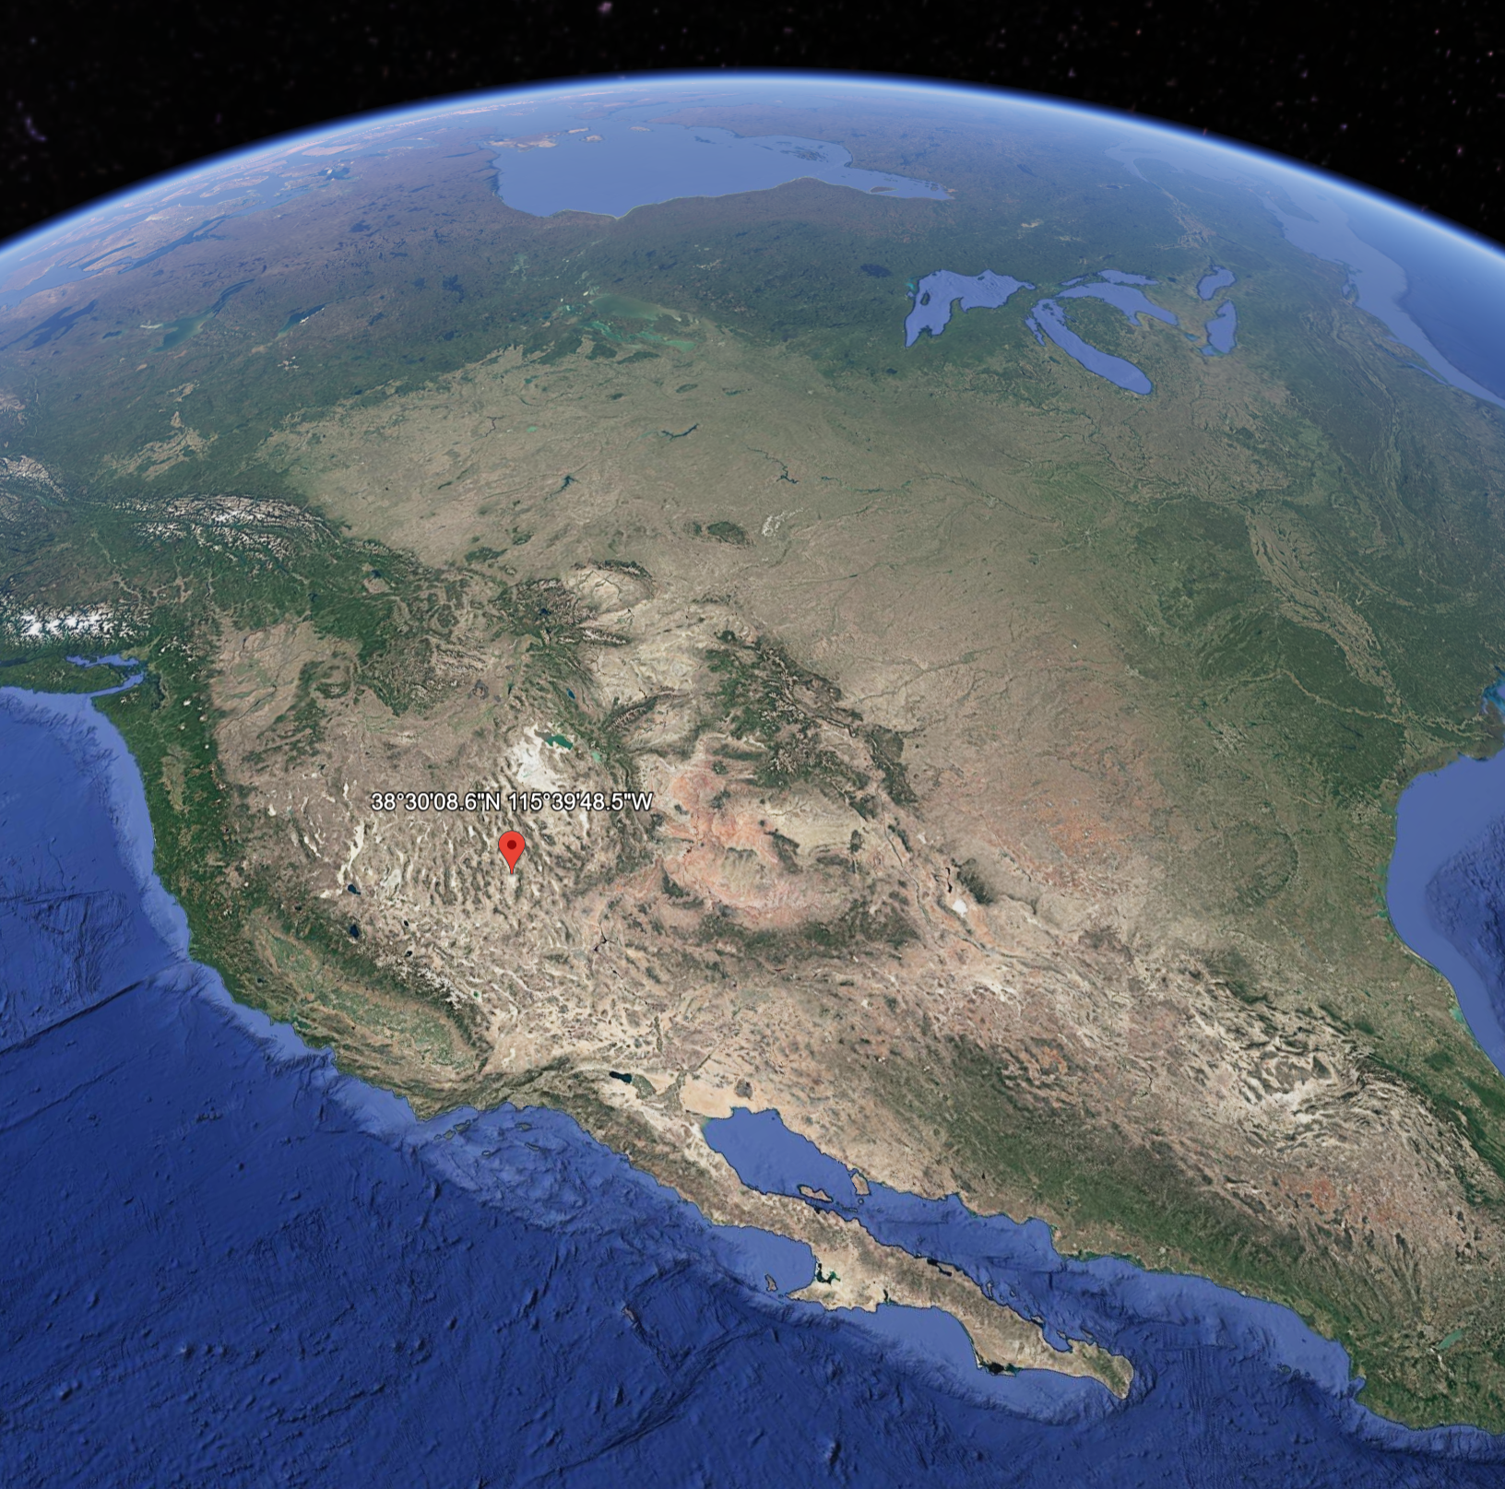
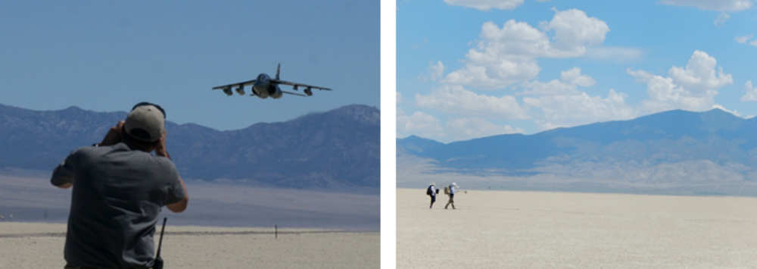
The Railroad Valley Playa
The Railroad Valley (RRV) Playa is a dry lakebed in the desert in Nevada and it is a main vicarious calibration target within the United States.
RRV is uniquely suited for use in the vicarious calibration of remote sensing satellites. The Playa is the only location in the United States with all the required characteristics due to the lakebed being large, flat, free of vegetation, of a consistent surface color, undisturbed, easy to access (8h drive from JPL), and with few clouds.
Currently, the JPL Viccal Team’s measurements of the RRV Playa support absolute calibration efforts for OCO-2, OCO-3, MISR, and MAIA.

Slide 4
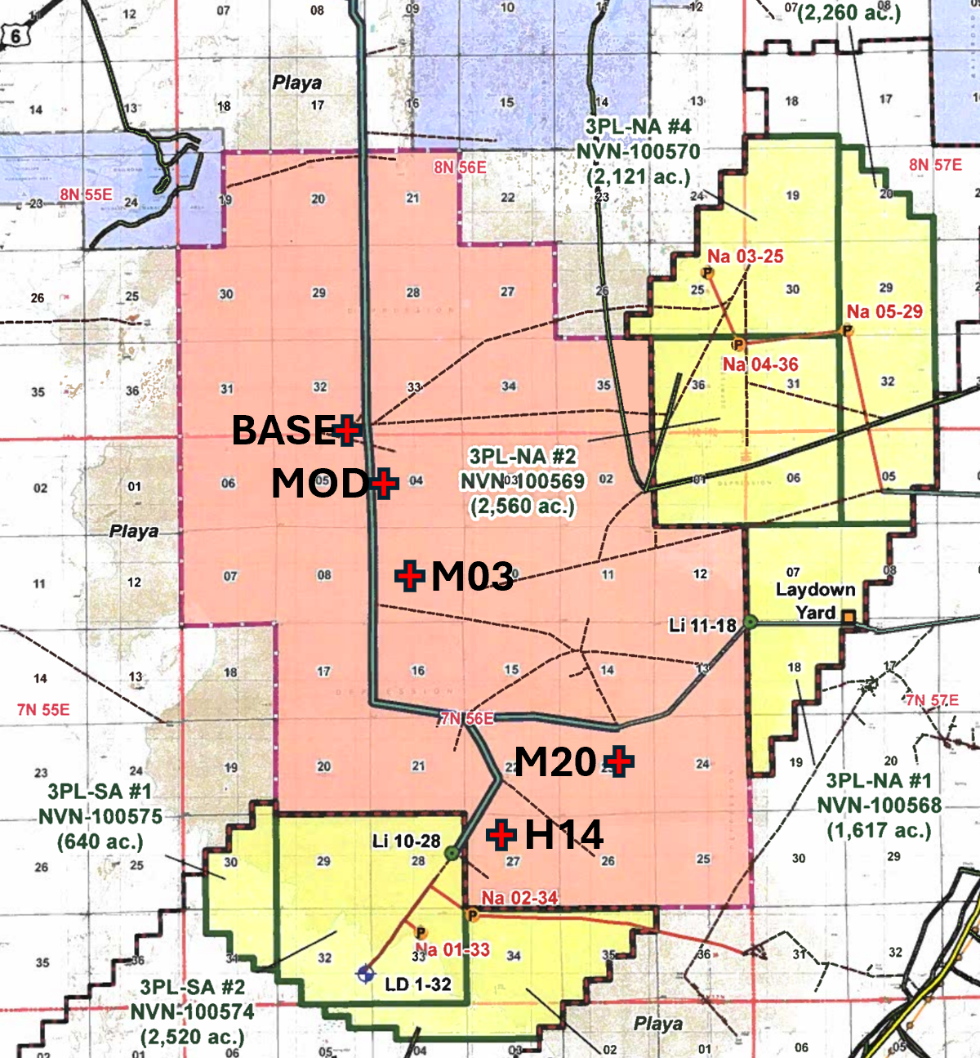
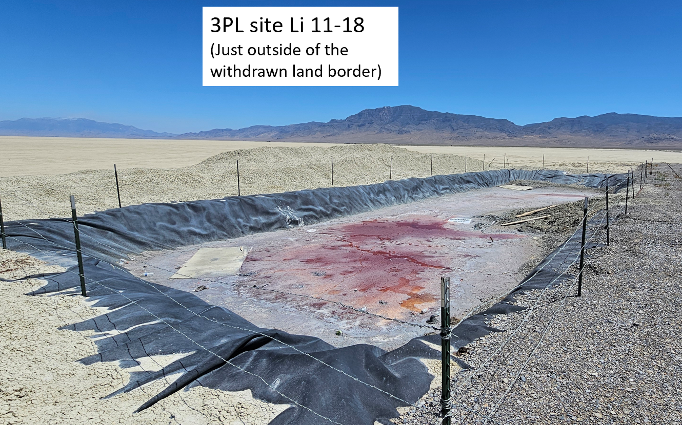
Site Preservation
3PL sump site Li 11-18
(Just outside of the withdrawn land border)
RRV hosts massive lithium brine deposits, which are currently undergoing active exploration by 3 Proton Lithium (yellow).
3PL holds mining claims that overlap with the withdrawal area.
NASA led initiative to preserve the Playa.
As of April of 2023, the RRV Playa has been withdrawn from private use for a 20-year period for the calibration of Earth observing satellites
Pongetti, T.

Slide 5
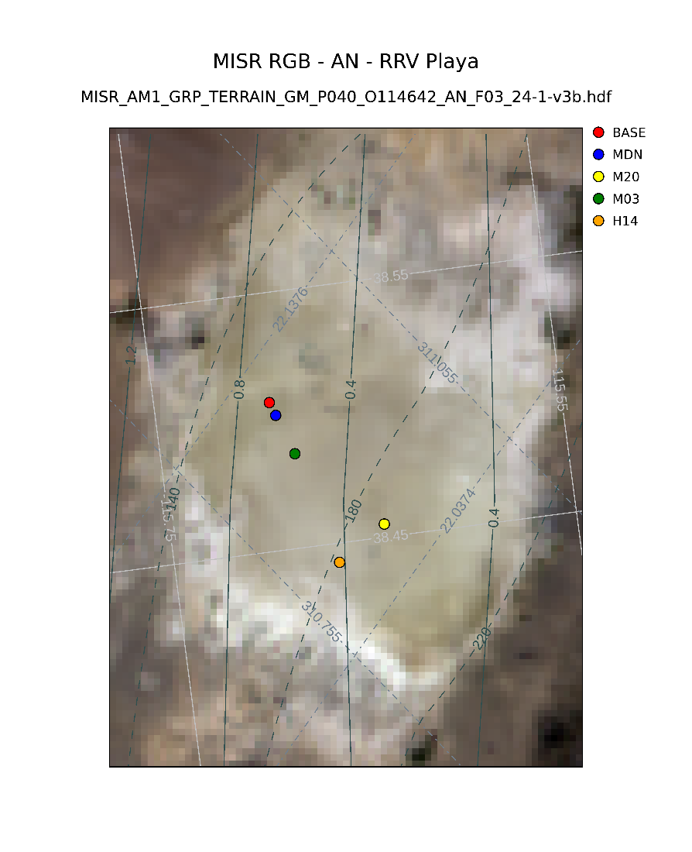
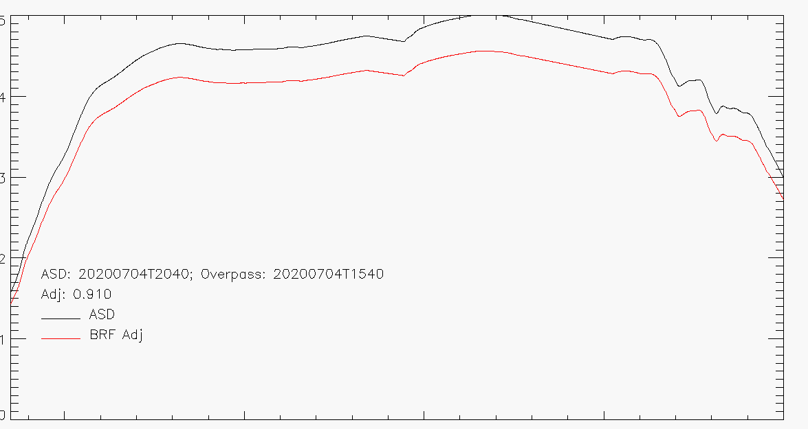
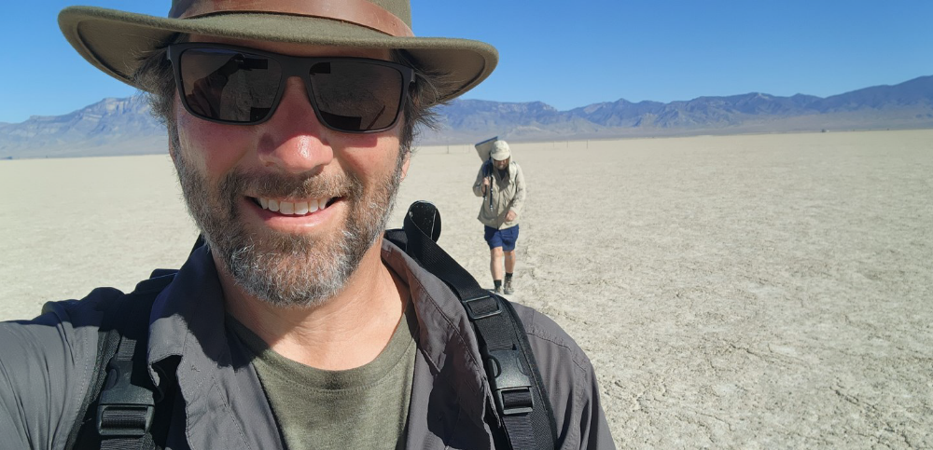
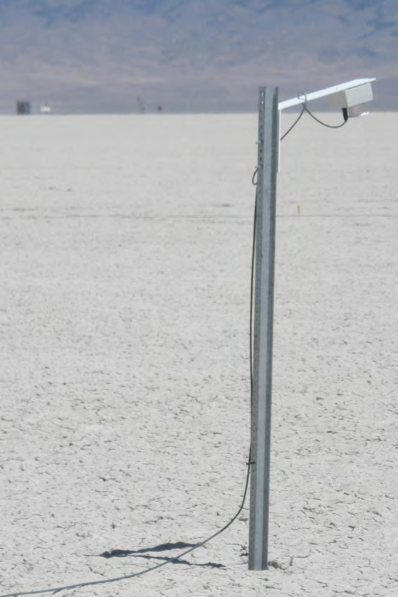
Manned Campaigns and JPL measurements
The Playa, which can be freely accessed, hosts frequent manned campaigns by teams supporting various missions, where mobile field spectrometers are used to take surface reflectance measurements over large areas.
For the past 14 years, NASA’s Jet Propulsion Laboratory has been sending teams to the Railroad Valley Playa each spring, summer, and fall to take in-situ reflectance measurements, supporting vicarious calibration efforts by the OCO-2, OCO-3, and MISR instruments.
The in-situ data is collected with field spectrometers (ASD-FS4) manufactured by Analytical Spectral Devices covering from 350 – 2500 nm at 3/10 nm spectral resolution, at the calibration sites.
0.5
0.4
Reflectance
0.3
Pongetti, T.
0.2
ASD: 20200704T2040
OCO3: 20200704T1540
Black: ASD measurement
Red: Scaled to OCO3 overpass time using LSpec measurements at RRV M03
Scaling: 0.91
0.1
0.0
JPL Viccal team members taking ASD field data at RRV as part of an annual OCO/GOSAT summer campaign.
500
1000
1500
2000
2500
JPL Lspec – Multiple LED automated spectrometers on the various calibration sites used for time of day corrections.
Wavelength (nm)
ASD spectrum with and without Lspec scaling for difference in time of day correction.
Notes:
er

Slide 6
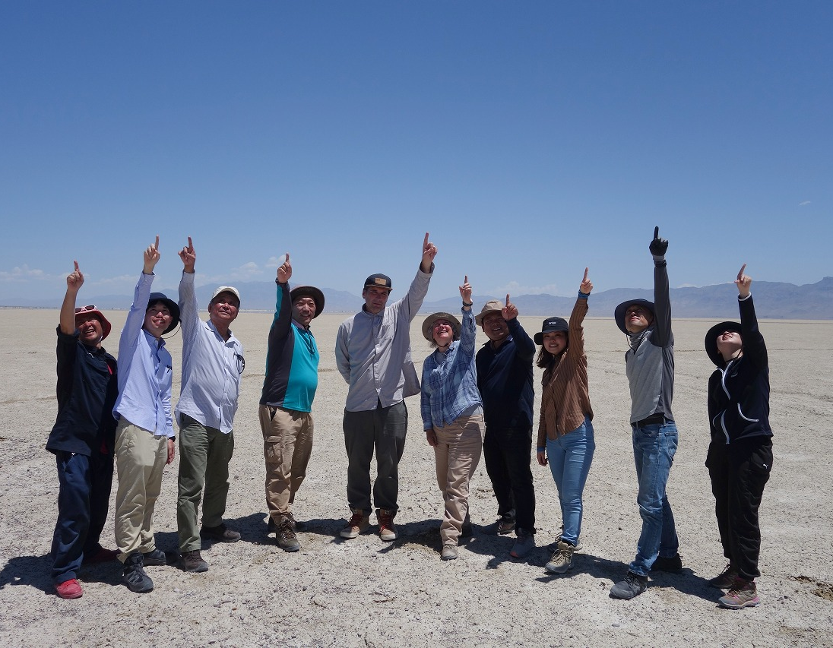
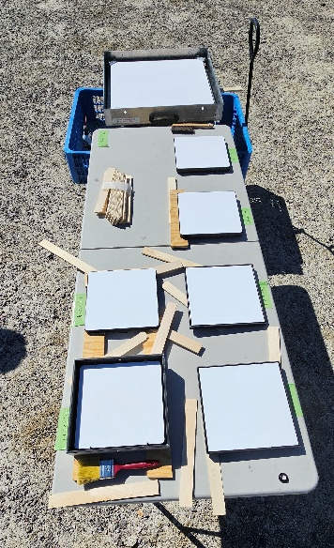
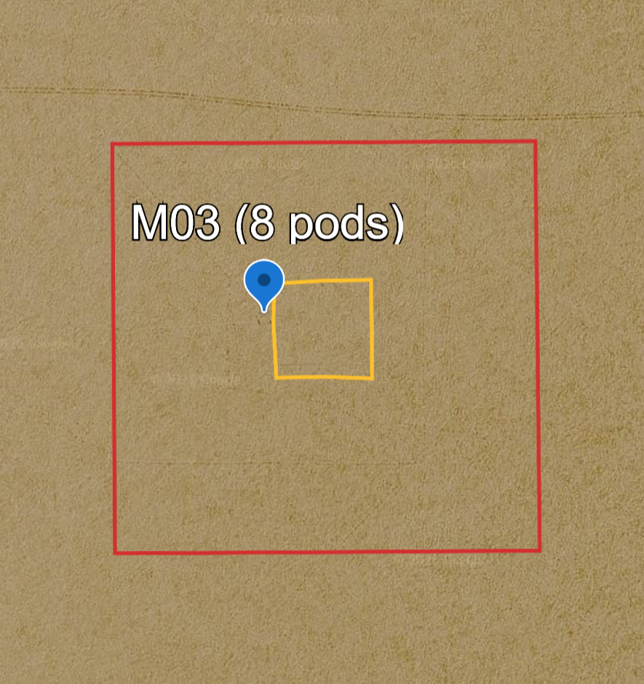
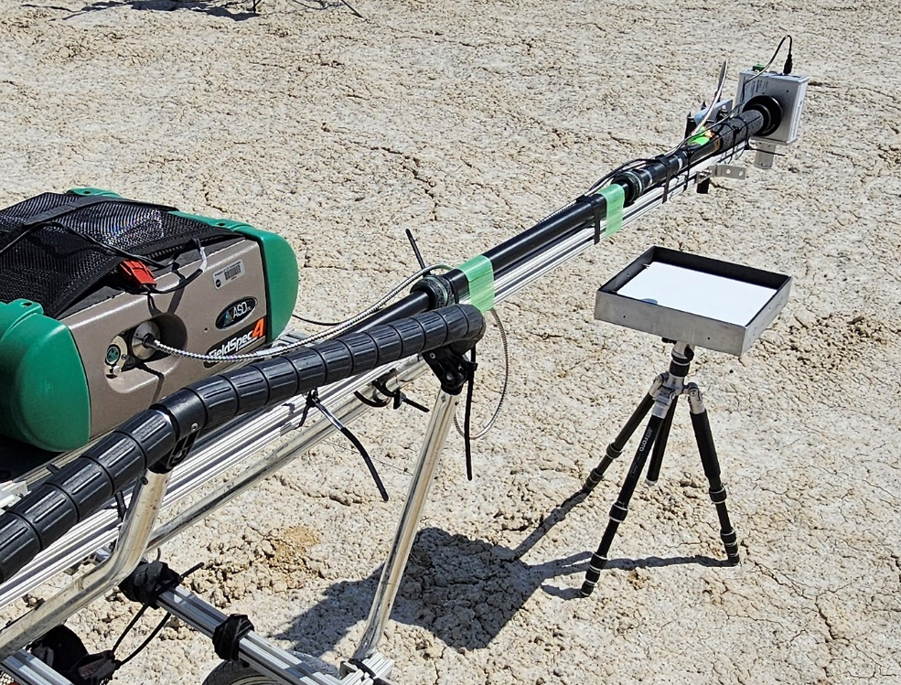
Manned Campaigns and JPL measurements
JPL/JAXA
Summer Campaign
~400 ASD measurements taken while traversing the playa near the LSpec sites, within 30 min window.
Alternate measurement between playa surface and Spectralon reference – Our surface reflectances are independent of solar model and atmospheric models.
Time measurement to center around satellite overpass time to get direct coincidence when possible. Otherwise LSpec can be used to reconcile observations and in-situ measurements.
International partnership: every summer the JPL team is joined by the GOSAT team. Reflectance data available at JAXA’swebsite https://www.eorc.jaxa.jp/GOSAT/GHGs_Vical/index.html
Spectralon panel intercomparison.
Spectralon panel is a portable calibration target.
Outer square is the walking pattern for the ASD measurements on site MO3. Inner square is the LSpec array.
Pongetti, T.
Notes:
er

Slide 7
Summary of Capabilities and Datasets Used
Current framework can be adapted for other sensors, with modifications to match and ingest sensor data and instrument related parameters are required, as well as changing the BRF product used or the radiative transfer software.
Match in-situ measurements with Sensor overpasses
Ingest meteorological data.
Ingest aerosol measurements
Ingest Sensor ToA Radiances
Ingest calibrated in-situ ASD surface reflectances that are independent of solar and atmospheric models, taken at a nadir view geometry
Radiative transfer code: MODTRAN6 *
Viccal ToA Radiances
Results: Sensor to Viccal ratios
Spectral Response Function
Match and ingest BRF Products to correct for view geometry, difference in time of day.
TSIS Solar Model
Keep;
Replace;
May want to replace.
Atmospheric Model
* OCO-2/3 - ACOS full physics retrieval algorithm

Slide 8
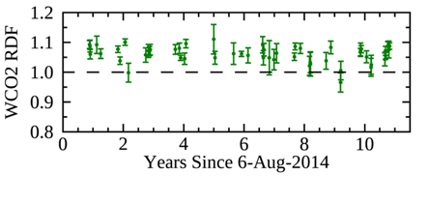
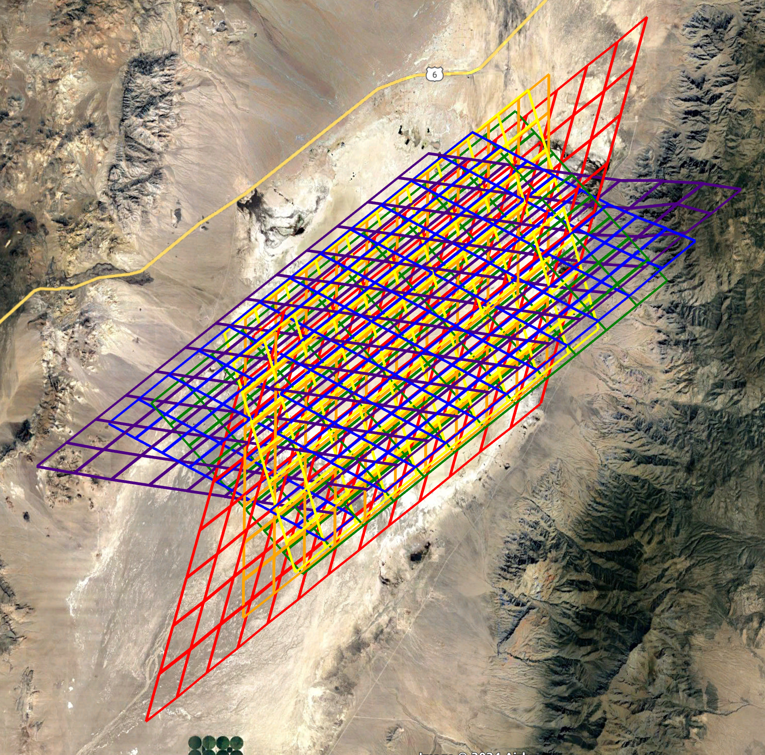
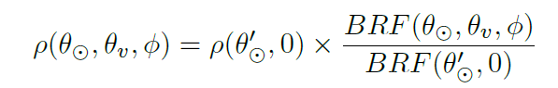
Orbiting Carbon Observatory 2/3
OCO-2 results for WCO2 band (1.61μm): B11 VicCal results indicate ~6% offset in absolute scaling, confirmed through other studies.
OCO-2 and OCO-3 view the Playa in target mode, where the site is covered in segments of different view angles (analysis limited to <30º).
Fu, D., Bruegge, C., Rosenberg, R.
LIMITATIONS
NADIR ASD MEASUREMENTS AND LARGE SATELLITE VIEW ANGLES: View geometry corrections are applied using BRF/BRDF products.
NOT ALWAYS CONCOMITANT for OCO-3:
Time of day corrections can be derived from Lspec data or BRF/BRDF products.
Edwin Sarkissian
Reflectance at overpass geometry
Reflectance at ASD geometry

Slide 9
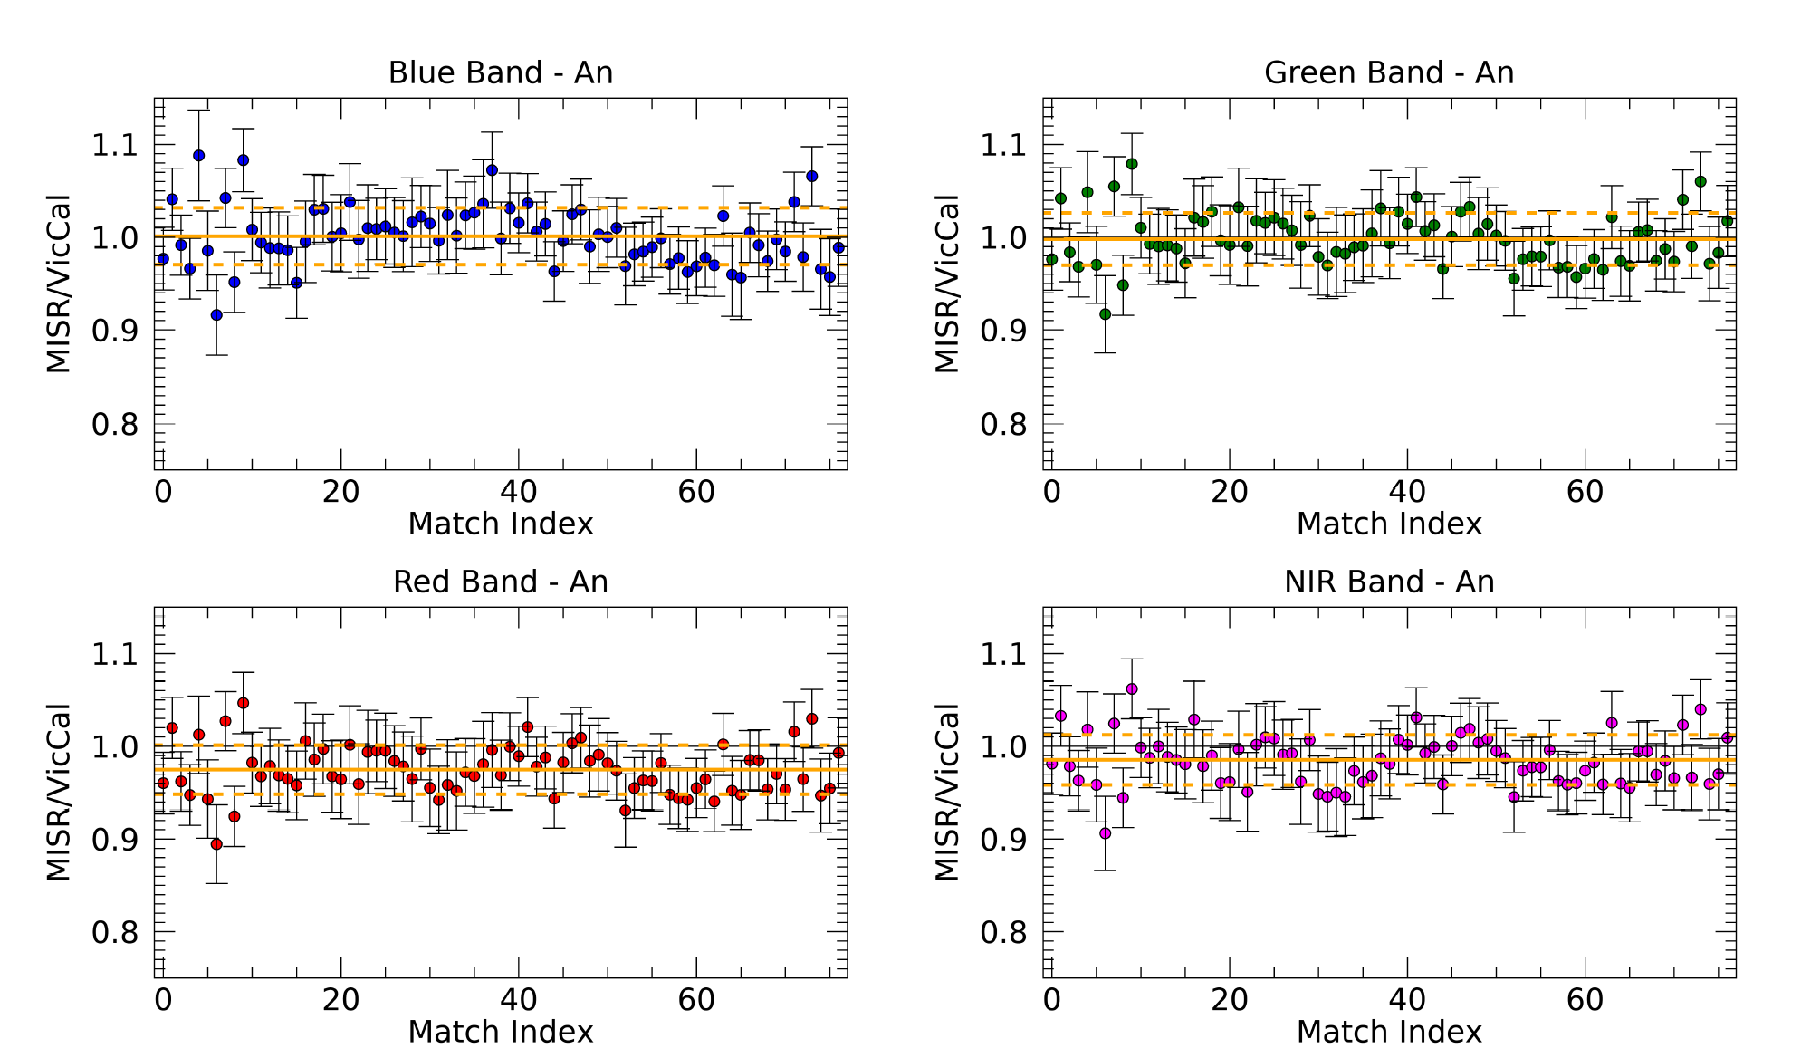
Multi-angle Imaging SpectroRadiometer - MISR
Aboard the Terra satellite
These are results of MISR’s vicarious calibration for its nadir camera (An) using data between 2012 and 2022. Small footprint (250m) and small view angles (< 15 degrees, dependent on path – 39, 40, 41 ). Figures show ratios of ToA radiances.
Scalers for the upcoming reprocessing of MISR Level 1B2 Georectified Radiance Product.
Blue | Green | Red | NIR
1.002 | 0.999 | 0.975 | 0.986
Keller, G. R., Bruegge, C., and Witek, M.

Slide 10
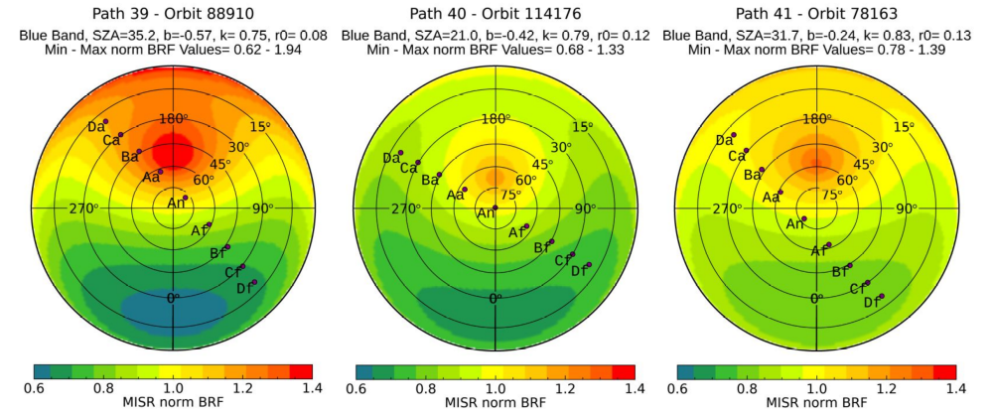
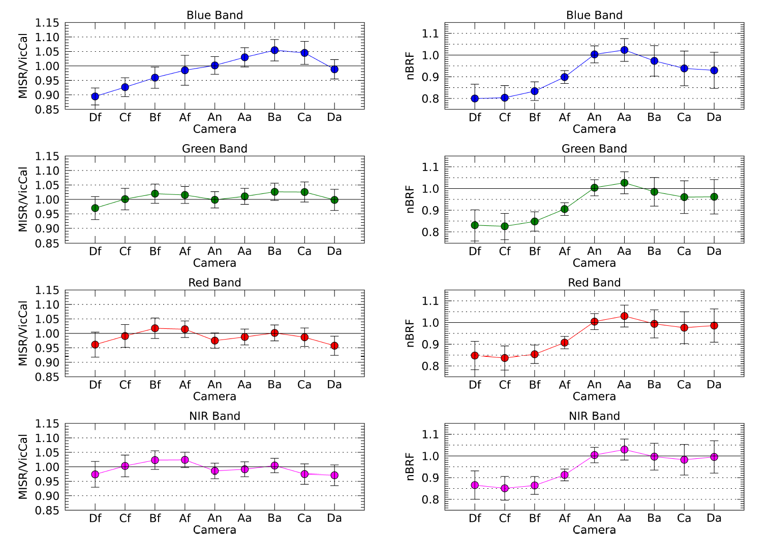
MISR Viccal – Off Nadir
Of MISR’s 36 channels, 34 were found to be within 5% of vicarious radiances, but a large discrepancy was seen in the C (60º) and D (70.5º) fore cameras.
higher view angle ND higher view angle

Slide 11
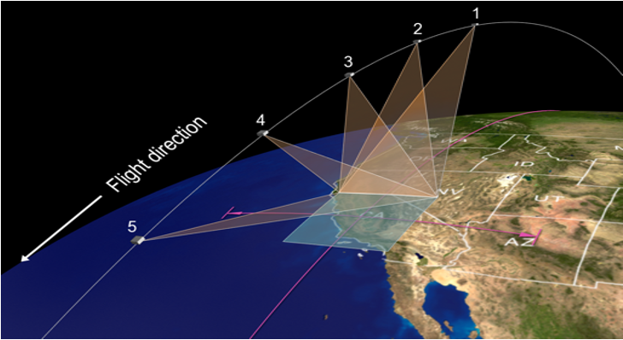
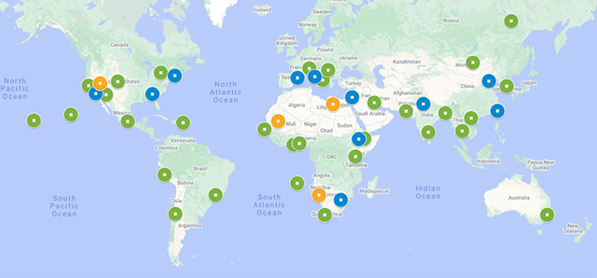
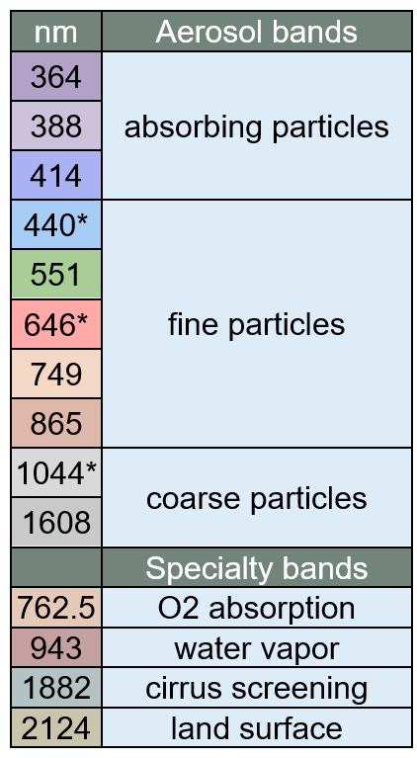
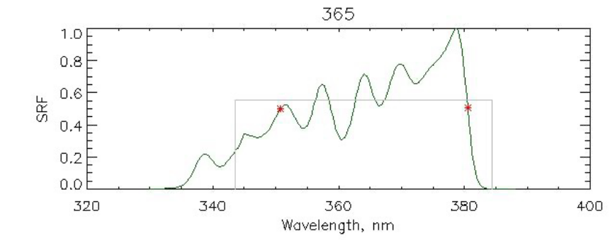
Multi-Angle Imager for Aerosols - MAIA
MAIA is a human health / air quality mission and a partnership between NASA and ASI.
The MAIA instrument is a pushbroom spectropolarimetric camera mounted on a 2-axis gimbal, providing both along-track and cross-track pointing capabilities.
Challenges:
UV:
  The ASD-FS4 field spectrometers only observe down to 350nm and the SRF of MAIA’s shortest wavelength band extends down to 335nm.
  BRF/BRDF products don’t extend to UV.
MODIS and MISR BRDF/BRF products won’t be available for the duration of the MAIA mission.
Data sparsity (5 revisits/13 weeks during the prime science mission) and view angle ~ 12 degrees.
Approach:
Complement in-situ measurements with ultraviolet BTS2048-UV-S Bi-Tec spectroradiometer covering 190 – 430 nm at 0.13 nm/pixel.
Extend in situ measurements to include angle matching ones to forgo and/or validate BRDF corrections which could lead to data at higher angles being used to enhance data availability.
Use VIIRS BRDF products.

Slide 12
Conclusions
The JPL Viccal Team’s measurements of the RRV Playa currently support calibration efforts by various missions: OCO-2, OCO-3, MISR, MAIA.
Our unique calibration approach, in which we take ASD measurements of a Spectralon Panel, provides surface reflectances that are independent of solar and atmospheric models.
Our measurements, framework, and existing software can be adapted for other missions.
We are currently extending our capabilities to include UV in-situ measurements and angle matching measurements.
The JPL Viccal Team would like to find new missions to support with, not only in-situ measurements, but also data analysis, in an effort to expand our activities at the RRV Playa.
JPL Viccal Team: Graziela R. Keller, Carol Bruegge, Thomas Pongetti, Dejian Fu, Rob Rosenberg, Emily Payne, Edwin Sarkissian, Richard Lee.

Slide 13
Capabilities Summary
 | ASD FieldSpec 4 Standard-Res | LSPEC | BTS2048-UV-S Bi-Tec
Number of Sensors | Individual | Several per site | 1
Area Covered | Mobile | Stationary: multiple sites | Mobile
Spectral Resolution | 3 nm @ 700 nm, 10 nm @ 1400/2100 nm | 1550nm(HWHM100nm), 850nm(HWHM40nm), 750nm(HWHM30nm), 660nm(HWHM??nm), 639nm(HWHM20nm), 574nm(HWHM11nm), 515nm(HWHM30nm), 468nm(HWHM25nm) | 0.13 nm/pixel
Spectral Range | 350 – 2500 nm | 468 - 1550 nm | 190 – 430 nm
Temporal Resolution | Few 30 min measurements a day, for a few days, three times a year. | Samples every 10 minutes | Same as ASD
Field of view | 8 degrees | ~20 degrees
Polarization capabilities | No | No | No

