Slide 1
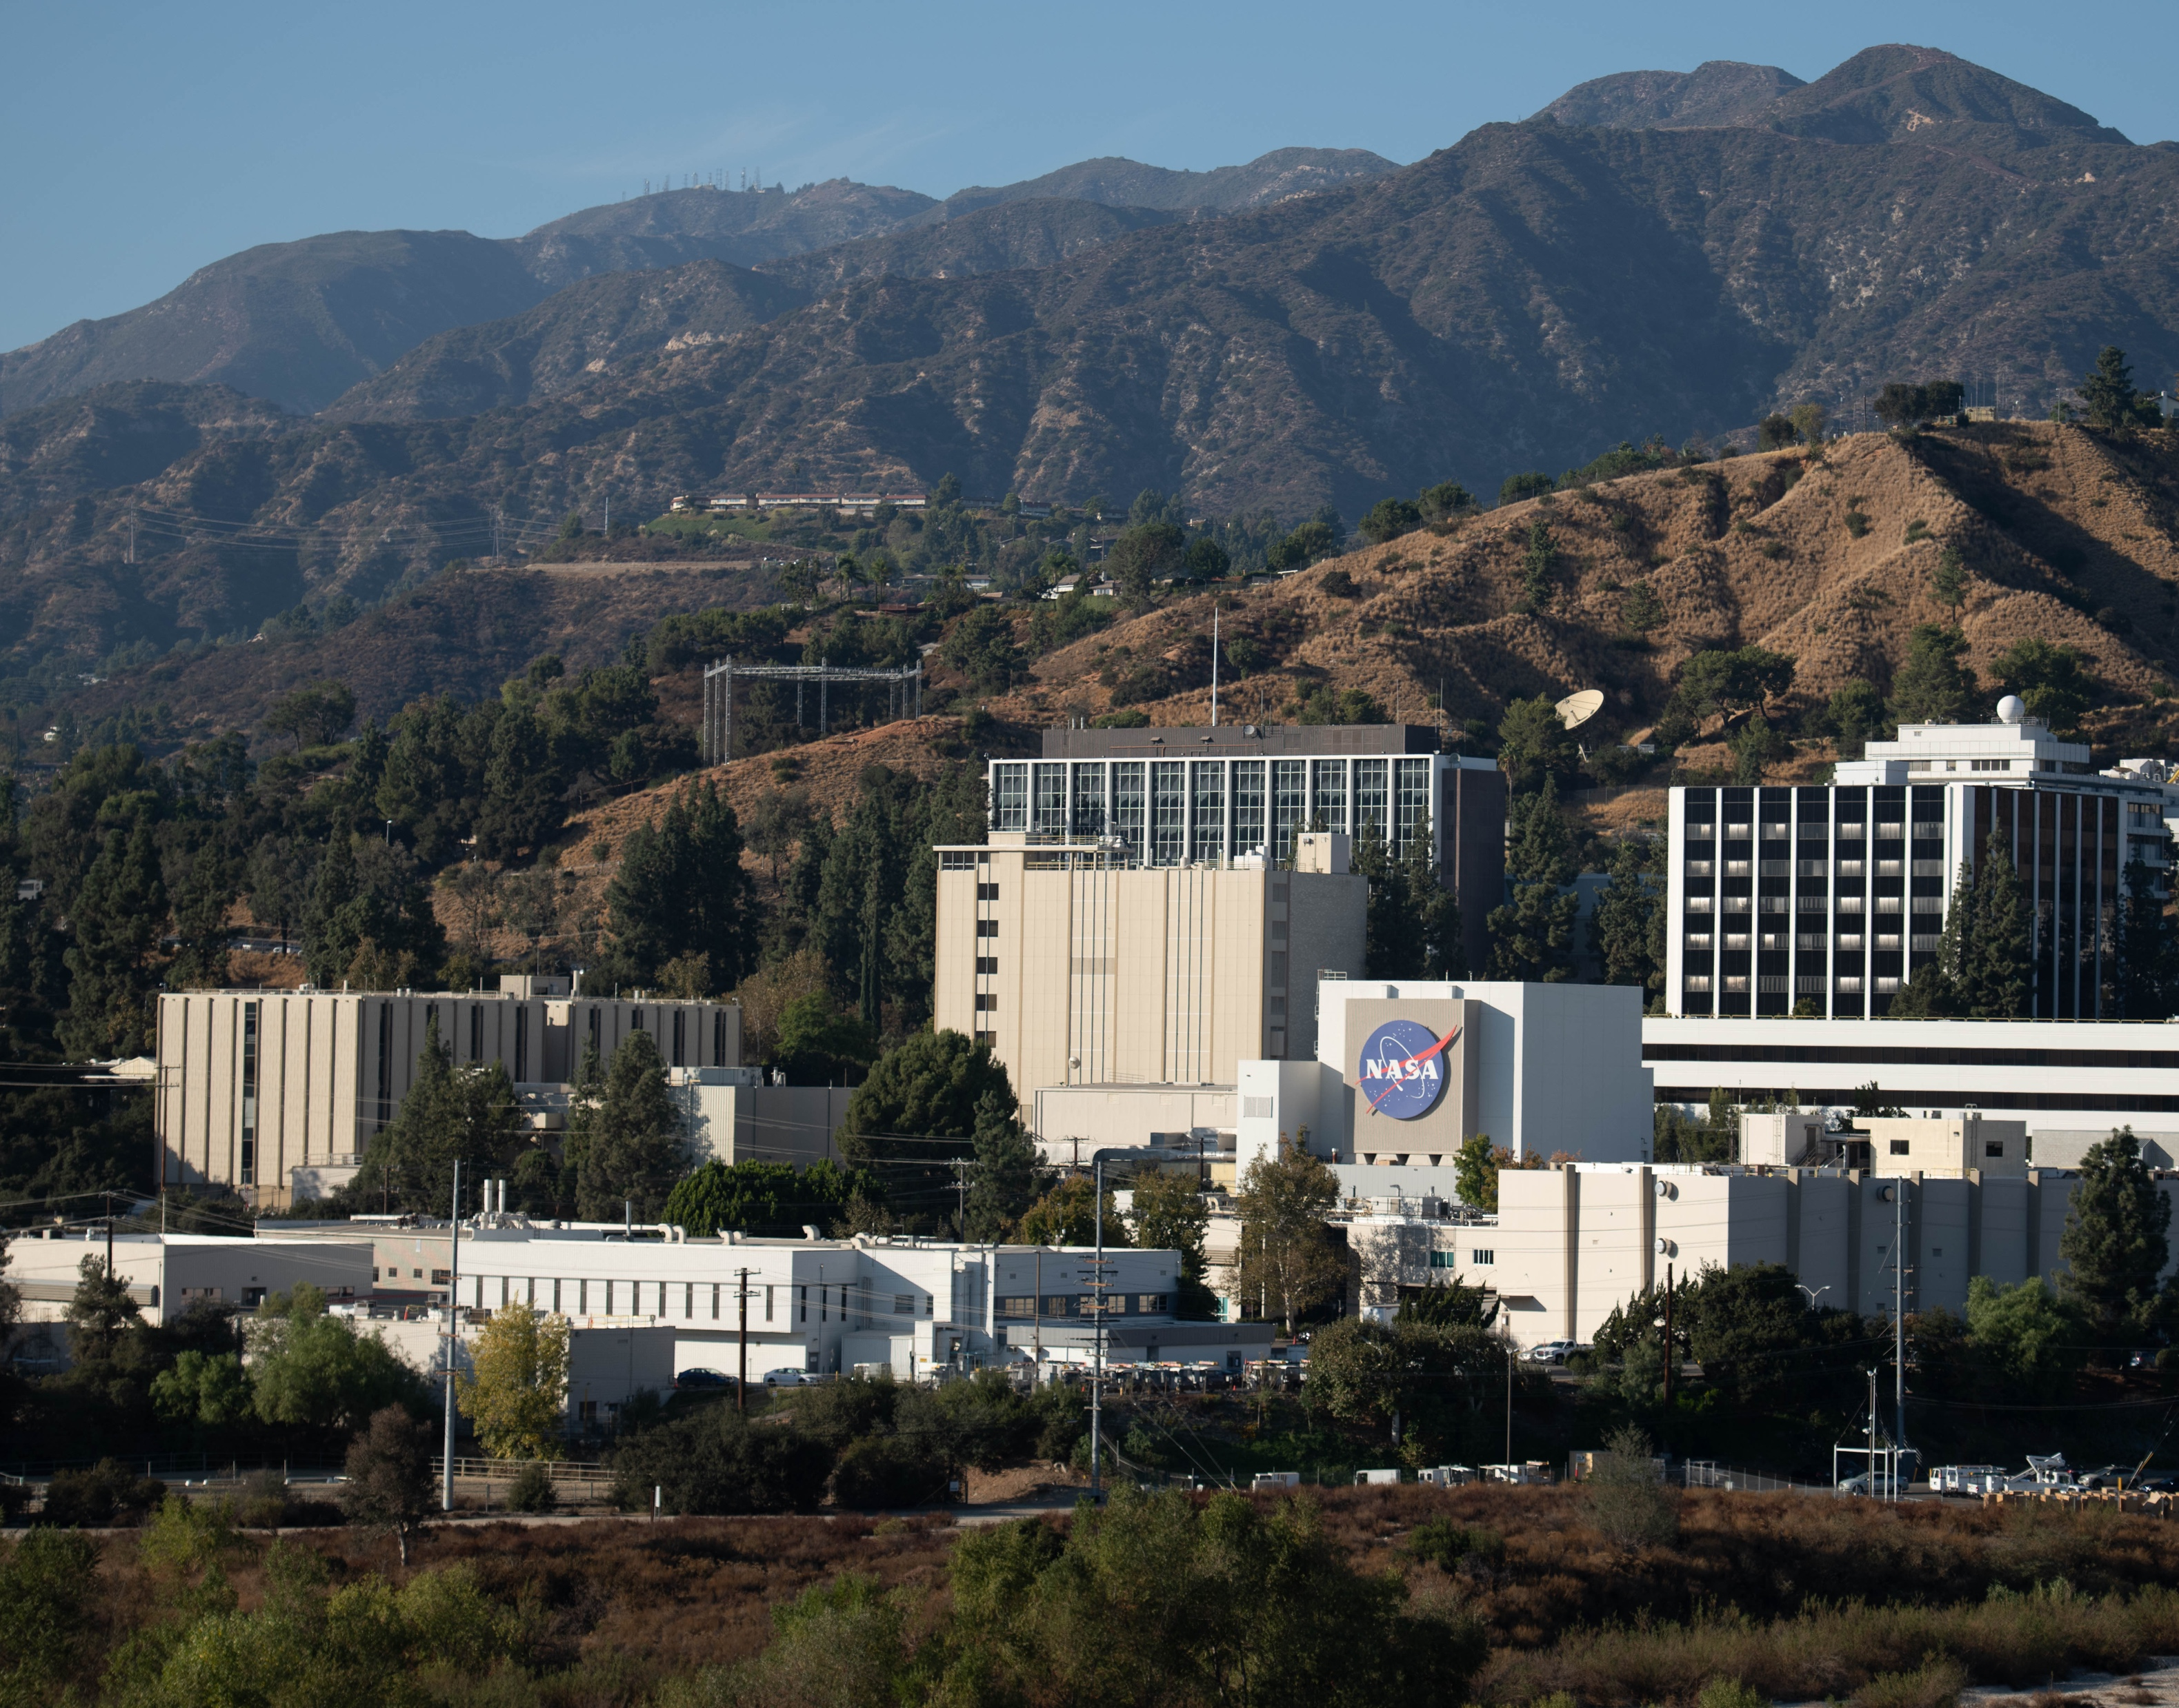
The OCO-2 / 3 Radiometric Puzzle
Robert Rosenberg, Graziela Keller, Thomas Kurosu, Virgil Adumitroaie, Dejian Fu, Richard Lee, Junjie Liu, Vivienne Payne
Jet Propulsion Laboratory, California Institute of Technology
GSICS Annual Meeting
Ottawa, Canada
UVN/S Breakout #6G
Tuesday March 24, 2026
16:20-16:40 EDT
Contact: Rob.Rosenberg@jpl.nasa.gov

Slide 2



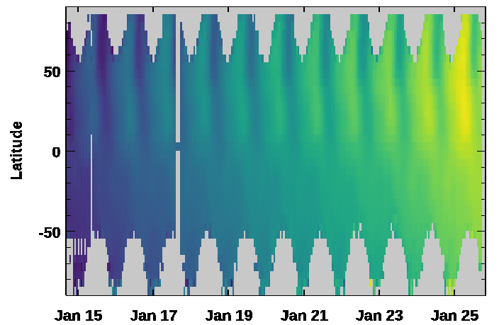
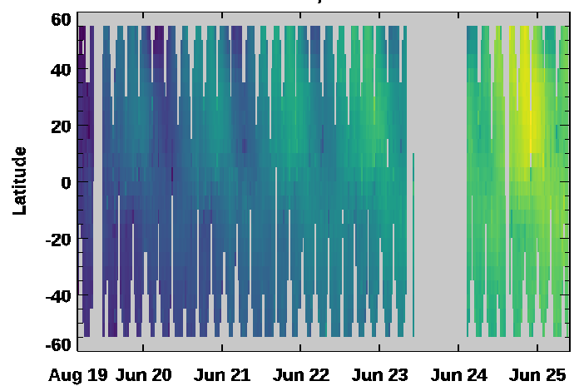
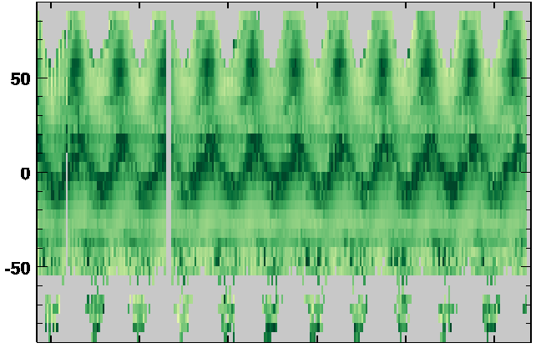
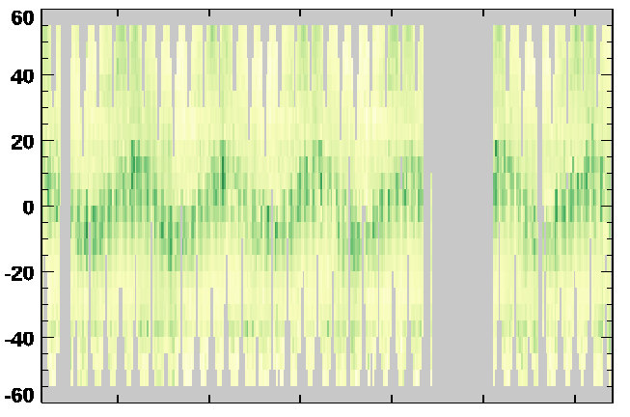
Watching the Earth Breathe & Plants Glow
The OCO-2 / 3 Radiometric Puzzle
XCO2 (ppm)
Fluorescence

Slide 3
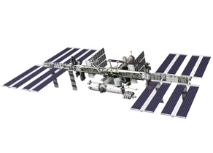

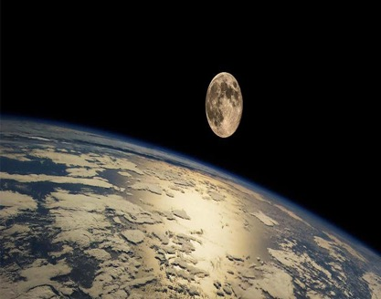
Overview
The OCO-2 / 3 Radiometric Puzzle
Instruments are healthy and missions are active, exploring 2027-2029 scenarios
OCO-2 is a dedicated satellite in the “A-Train” Afternoon Constellation (705 km)
Science on 92% of orbits from Sep 6, 2014, to Jul 30, 2017
Science on 96% of orbits from Sep 19, 2017, to March 19, 2026
OCO-3 is on the Japanese External Module – Exposed Facility of ISS (~410 km)
Science on 85% of orbits from Aug 6, 2019, to Nov 12, 2023
Non-operational storage to accommodate another payload
Science on 87% of orbits from July 15, 2024, to March 19, 2026
Both instruments view on-board calibrators, scan the Moon, target deserts on Earth, and are regularly decontaminated. Many of the details are different. Better knowledge of each has increased the combined team’s collective understanding.

Slide 4
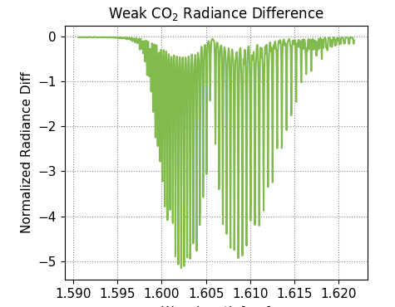
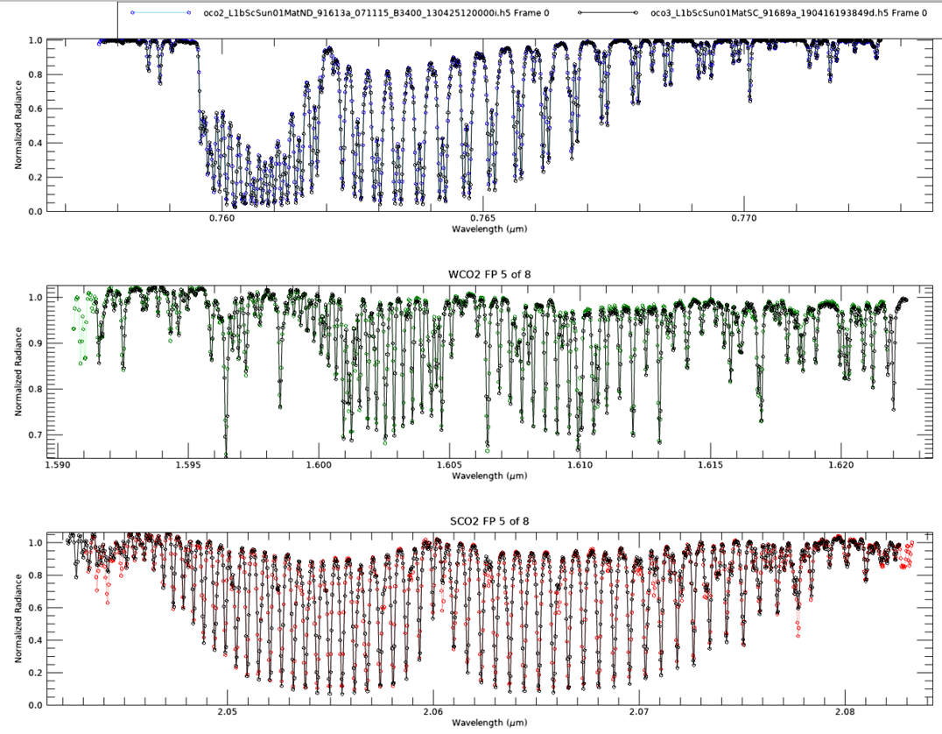
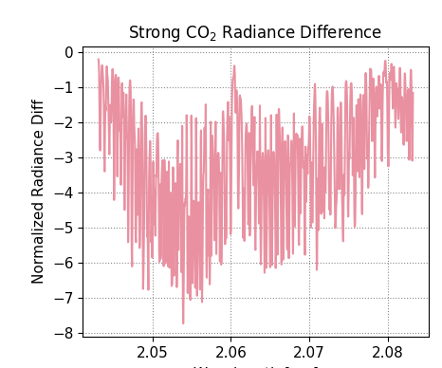
“Squiggly Line” Science: Level 1 to Level 2
The OCO-2 / 3 Radiometric Puzzle
Mission Requirements: 1 ppm (0.23%) Current Performance: 0.85 ppm (0.20%)
Color: OCO-2 test, 20 Apr 2012, 395 ppm
Black: OCO-3 test, 27 Apr 2018, 412 ppm
Difference in modeled radiance for 390 and 400 ppm, normalized by noise stddev

Slide 5
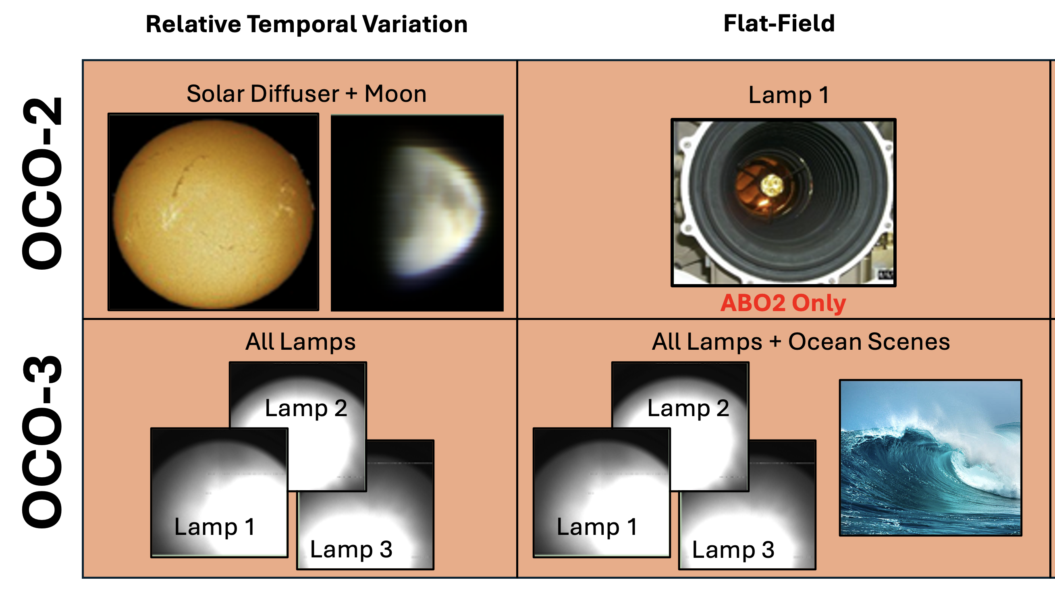
Regular Onboard Calibration
The OCO-2 / 3 Radiometric Puzzle
OCO-2:
Solar, Dark, and Lamp measurements every non-downlink orbit
Decontaminated frequently early in the mission, annually from 2019-2023, still studying impacts of skipping 2024
Large numbers of bad pixels in WCO2 & SCO2 channels limits flat-field efforts
OCO-3:
No solar diffuser in pointing mirror assembly, 3 onboard lamps viewed at varying cadences (1 / 19 / 80 per week)
Strong contamination artifacts between Feb 2020 and Jan 2021, max 5 months between decons since then
Unique coefficients for each detector element

Slide 6
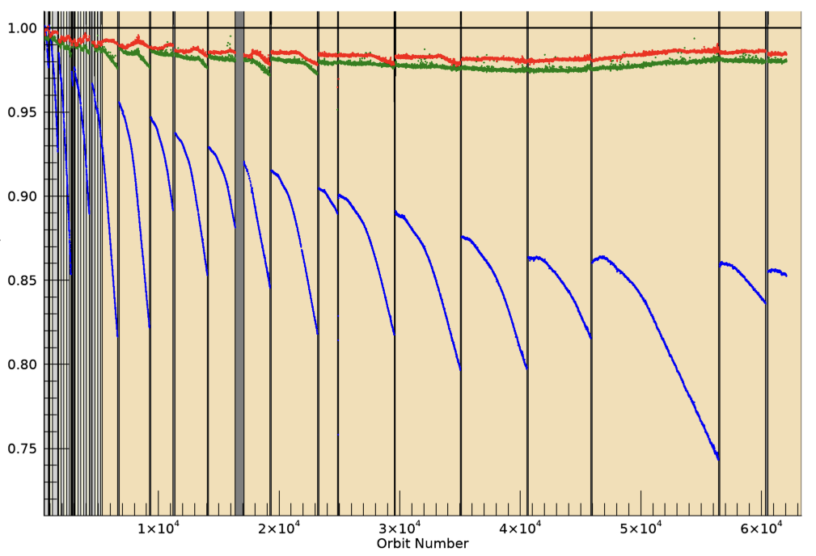
OCO-2 Relative Solar Trends
The OCO-2 / 3 Radiometric Puzzle
ABO2 0.76 μm
WCO2 1.61 μm
SCO2 2.06 μm
Ratio to 2014

Slide 7
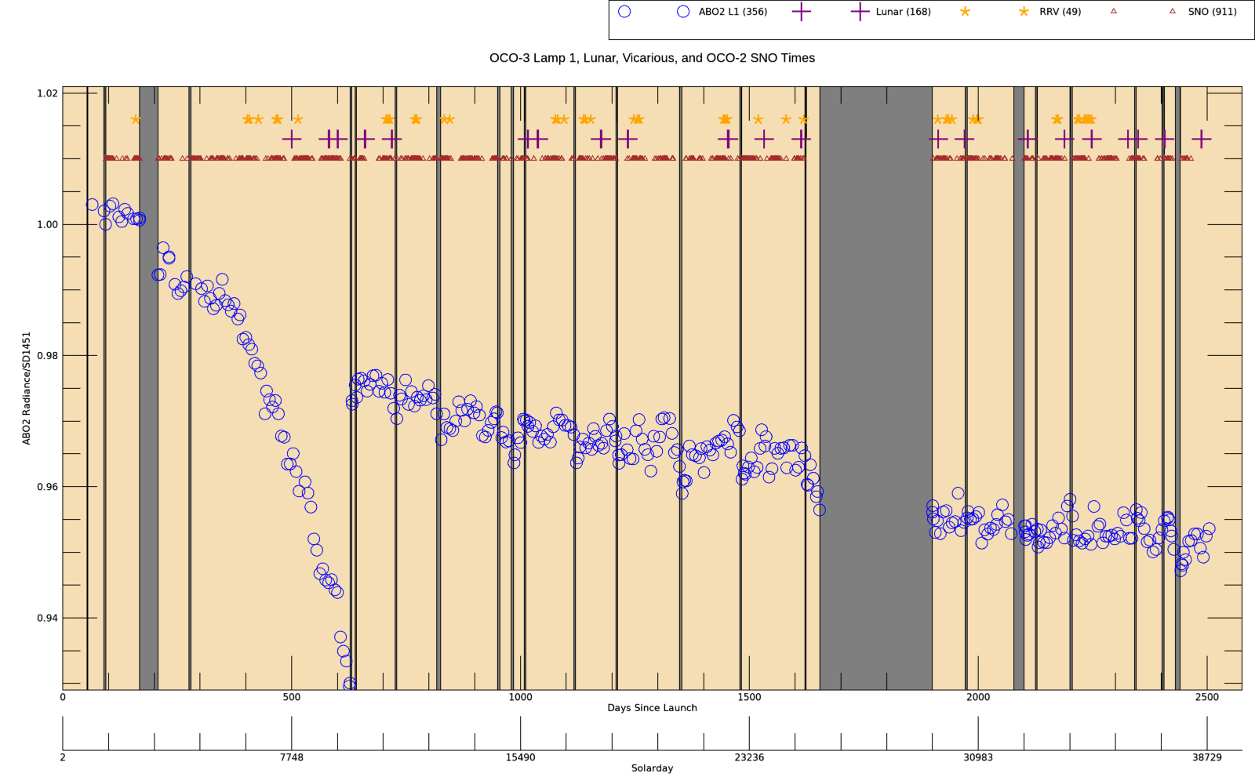
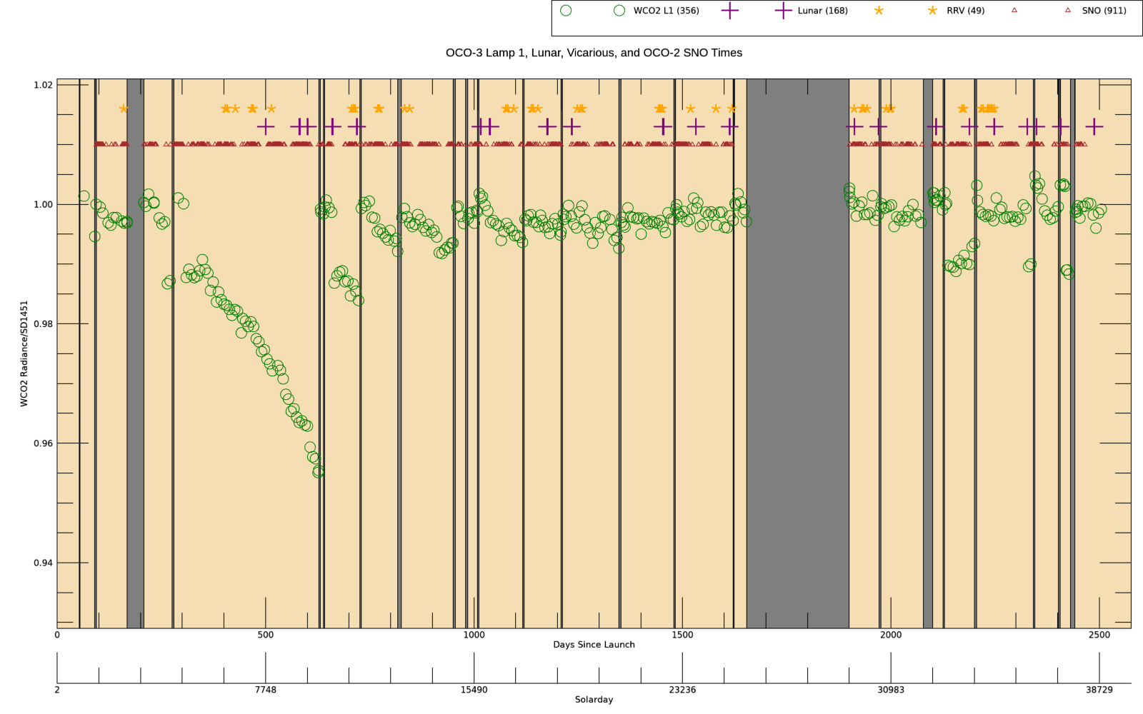
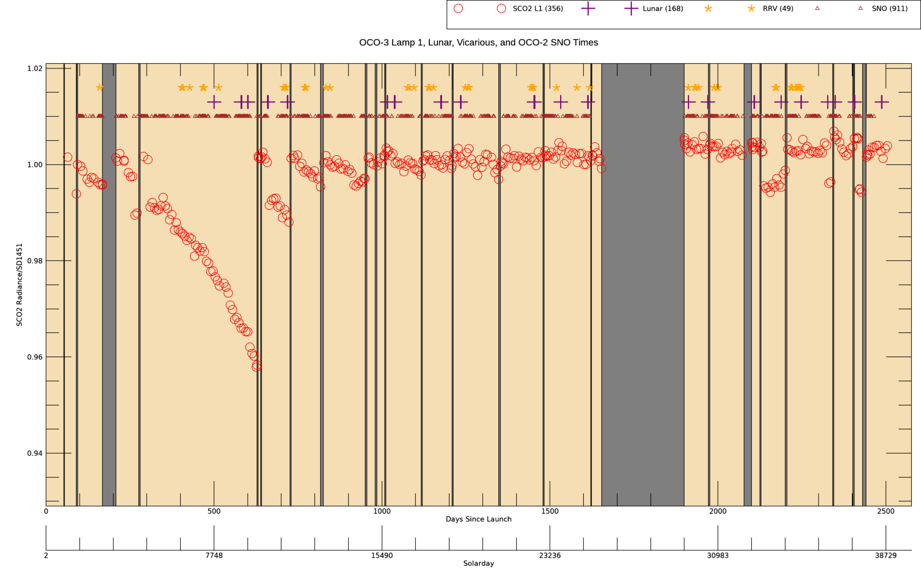
OCO-3 Relative Lamp Trends & Special Cal Times
The OCO-2 / 3 Radiometric Puzzle

Slide 8
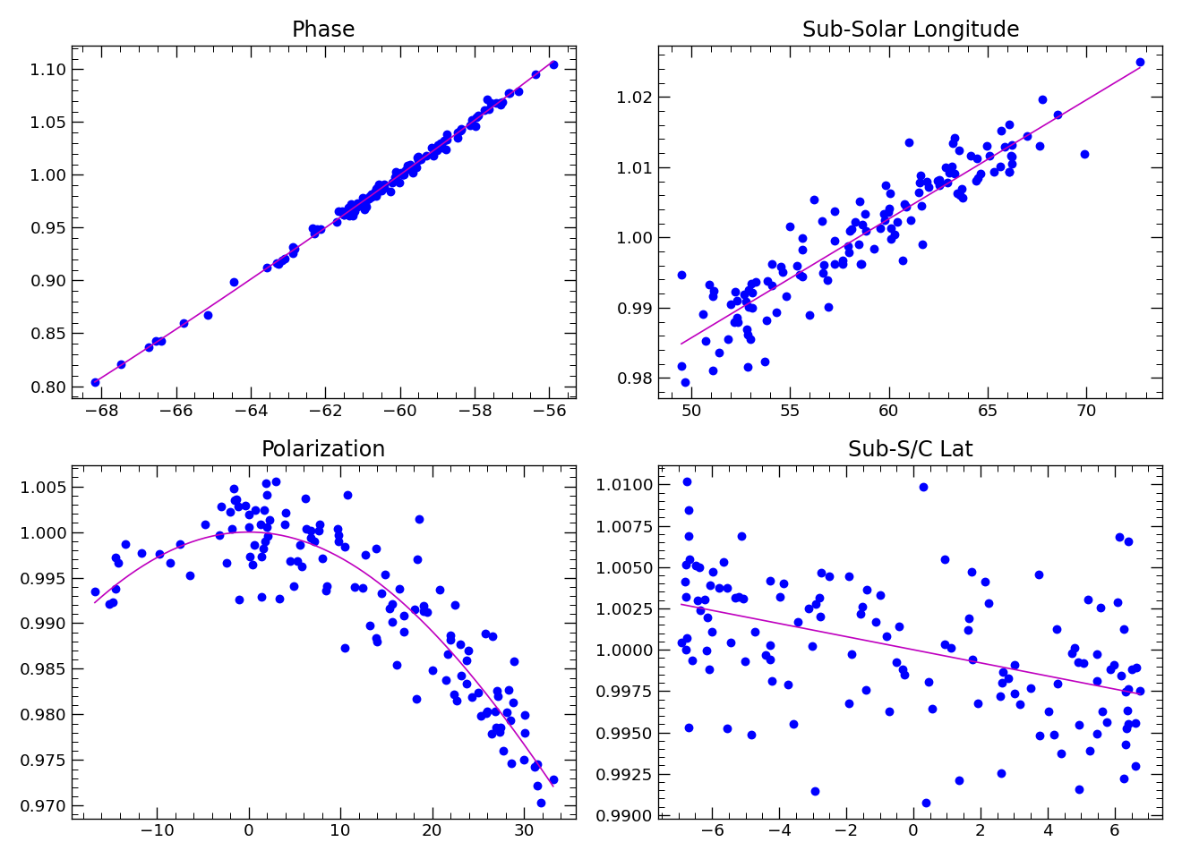
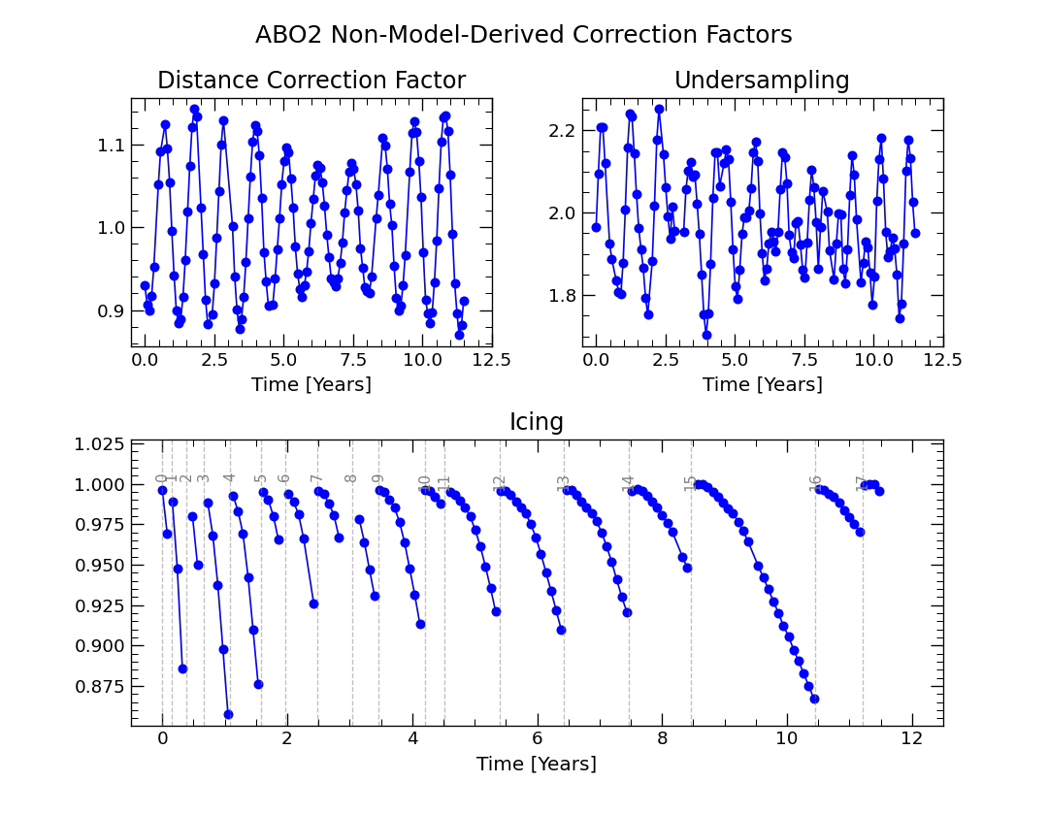
OCO-2 Lunar Irradiance Model
The OCO-2 / 3 Radiometric Puzzle

Slide 9
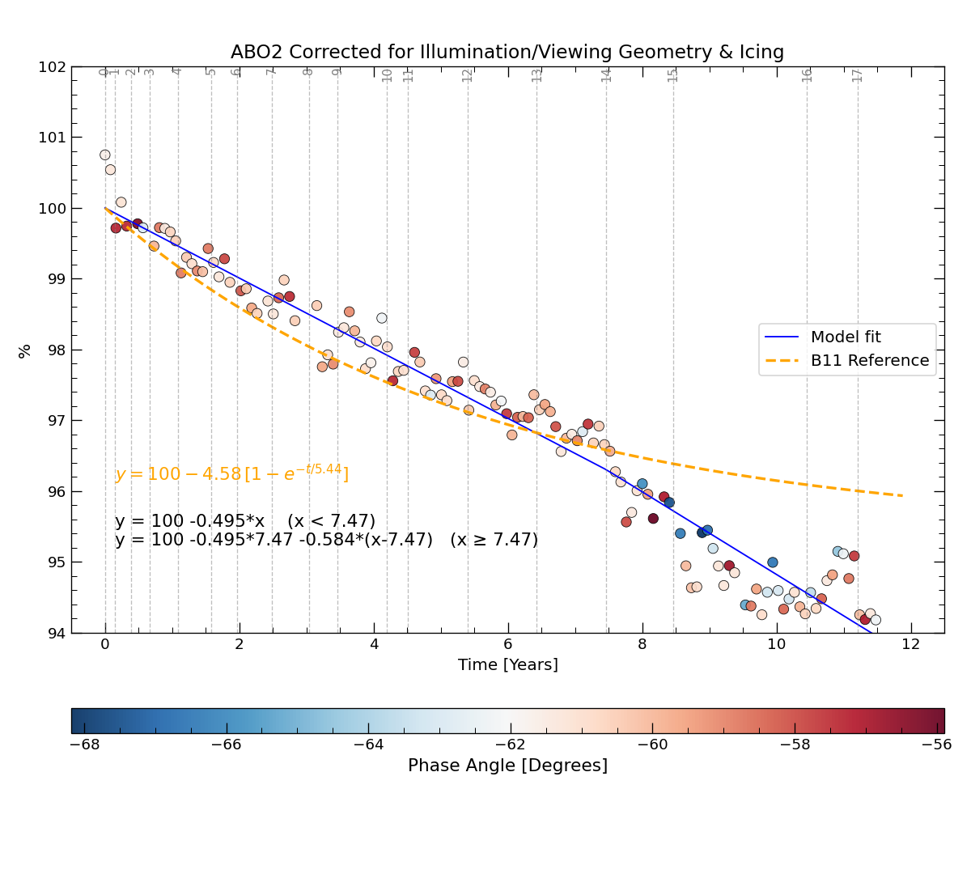
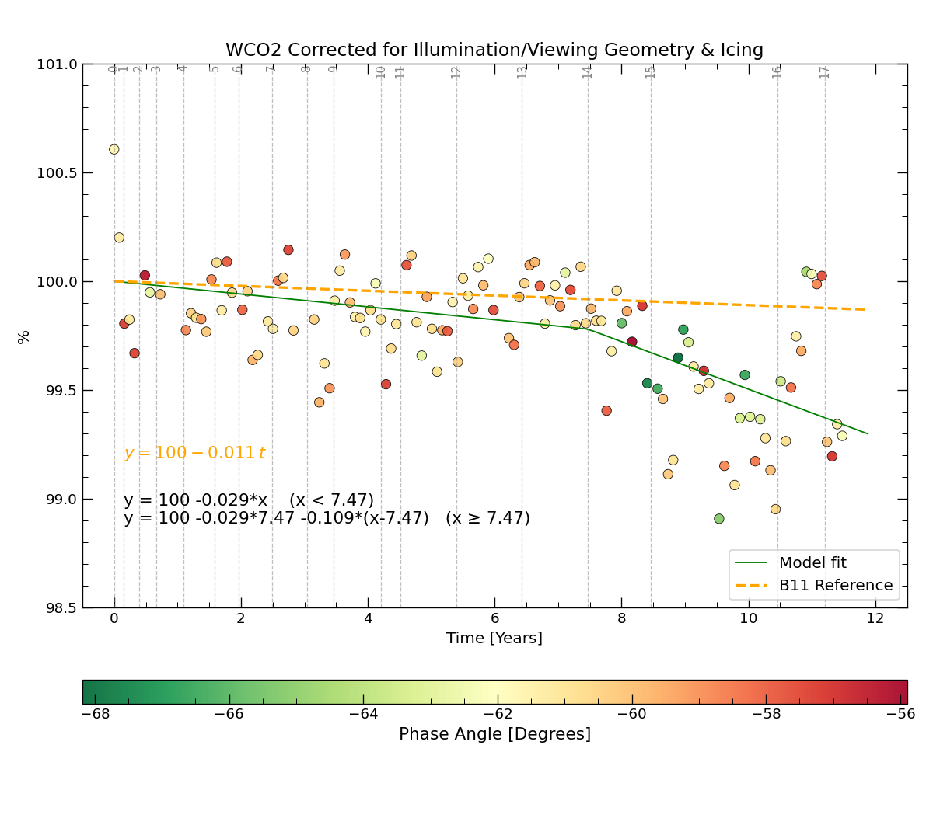
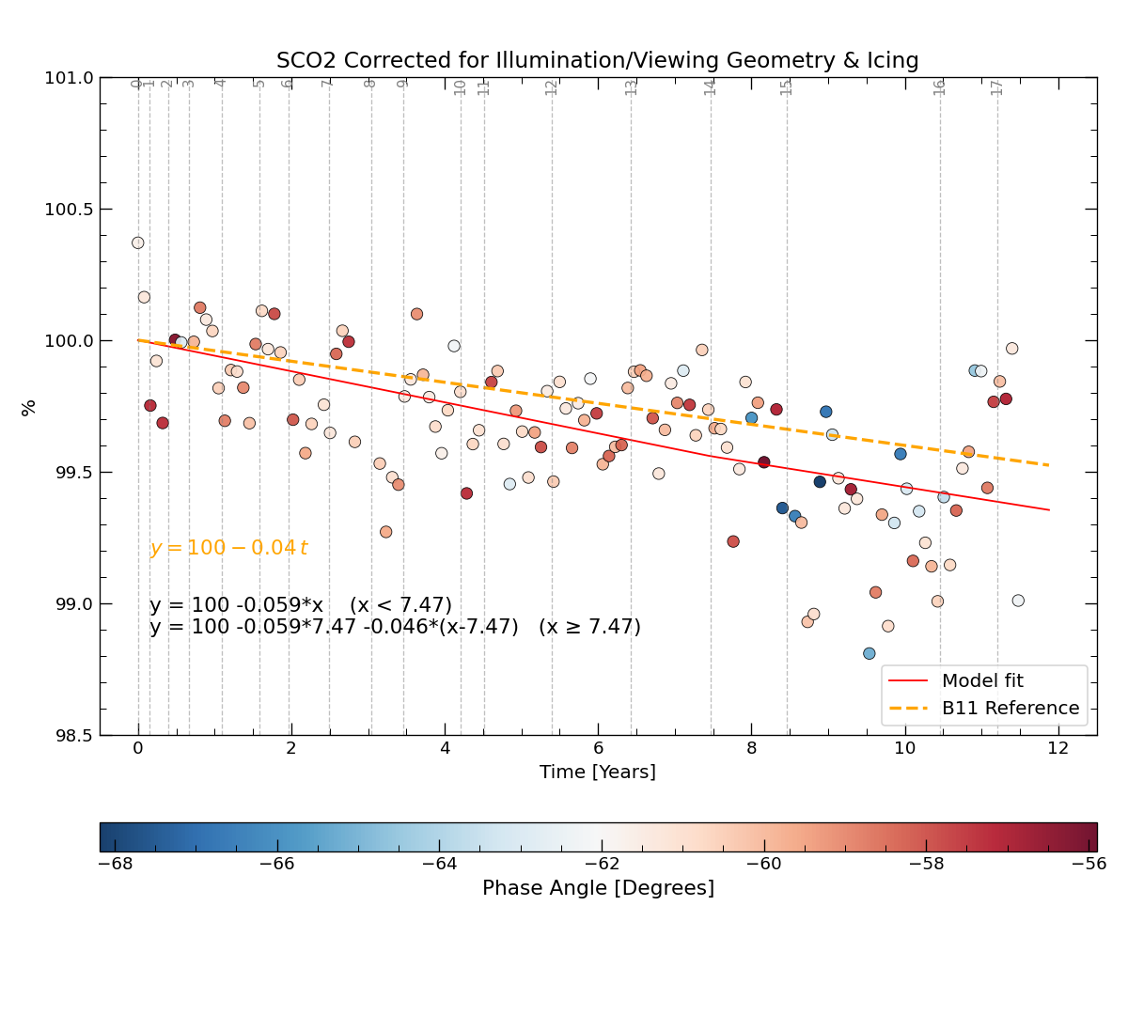
OCO-2 Lunar Irradiance Relative Trends
The OCO-2 / 3 Radiometric Puzzle

Slide 10
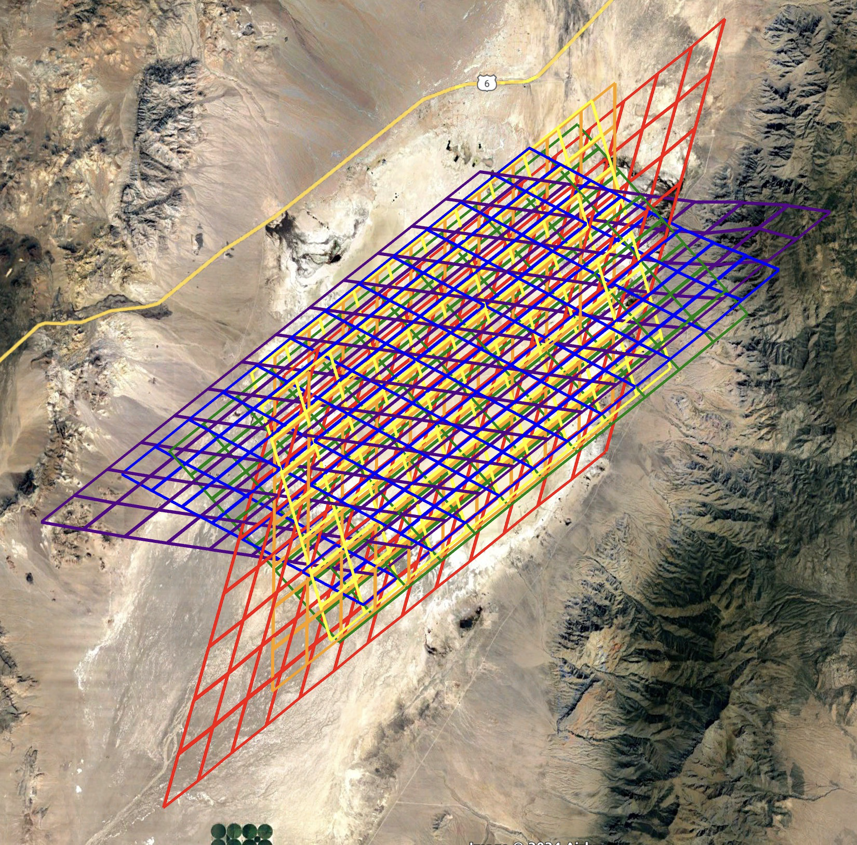
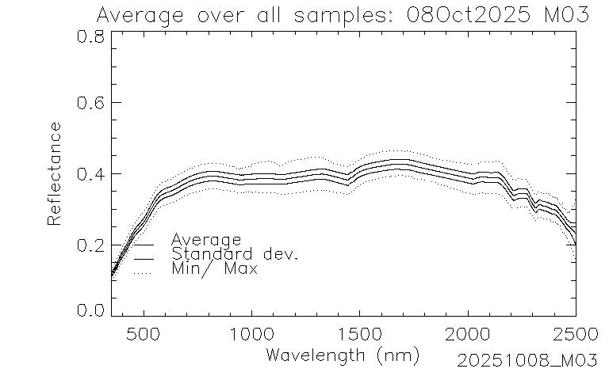
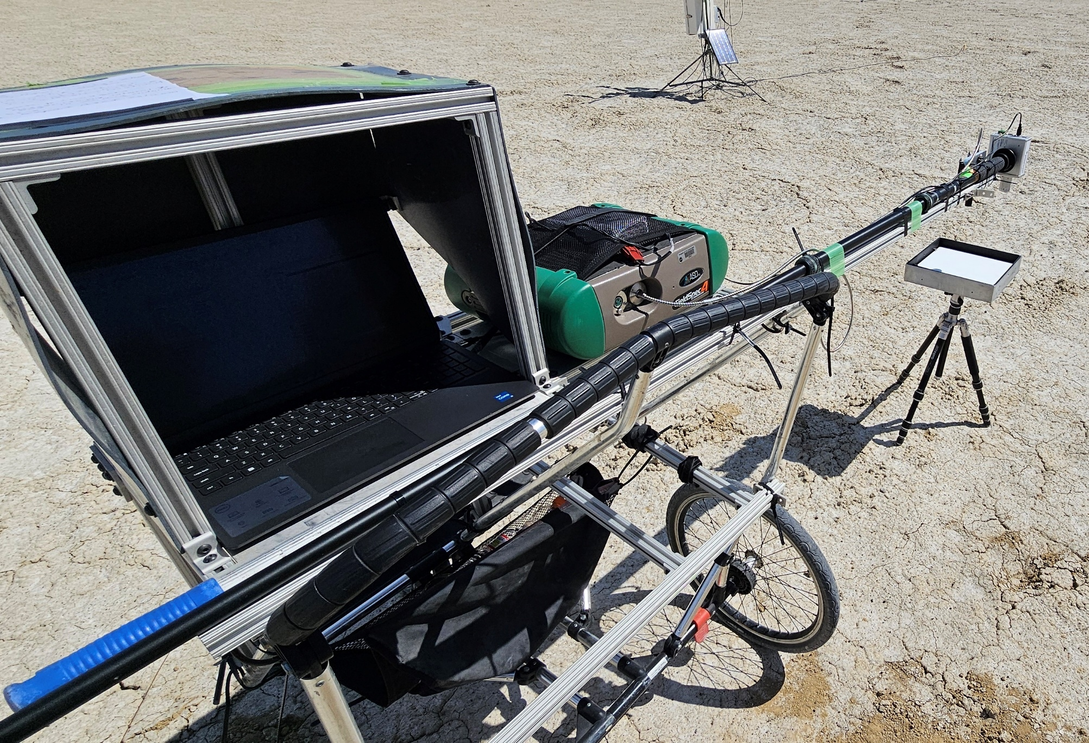
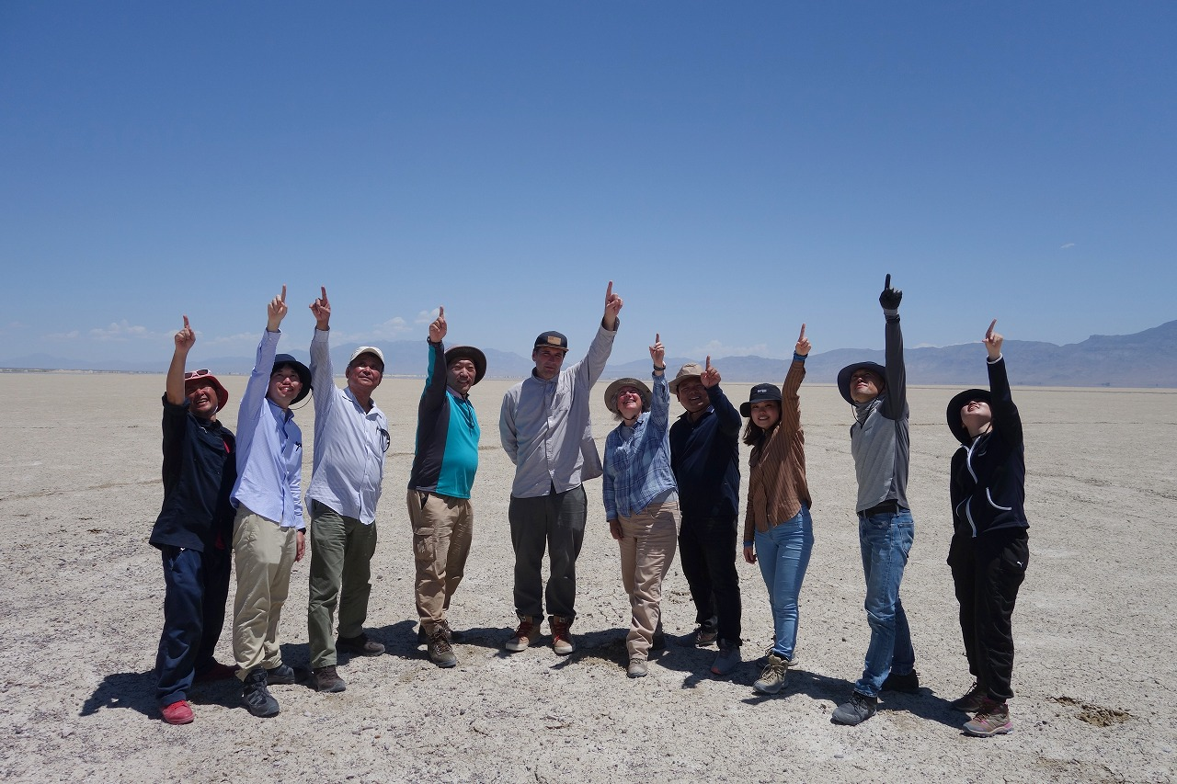
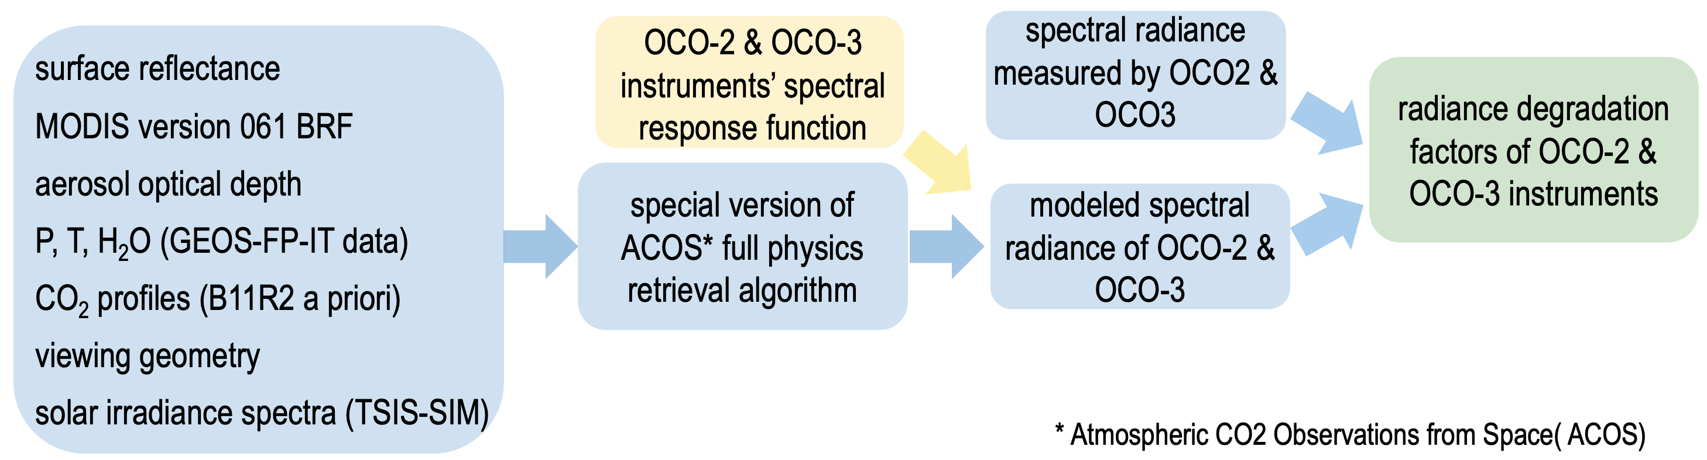
Vicarious Calibration Methodology
The OCO-2 / 3 Radiometric Puzzle
Image Credits: T. Pongetti, E. Sarkissian

Slide 11
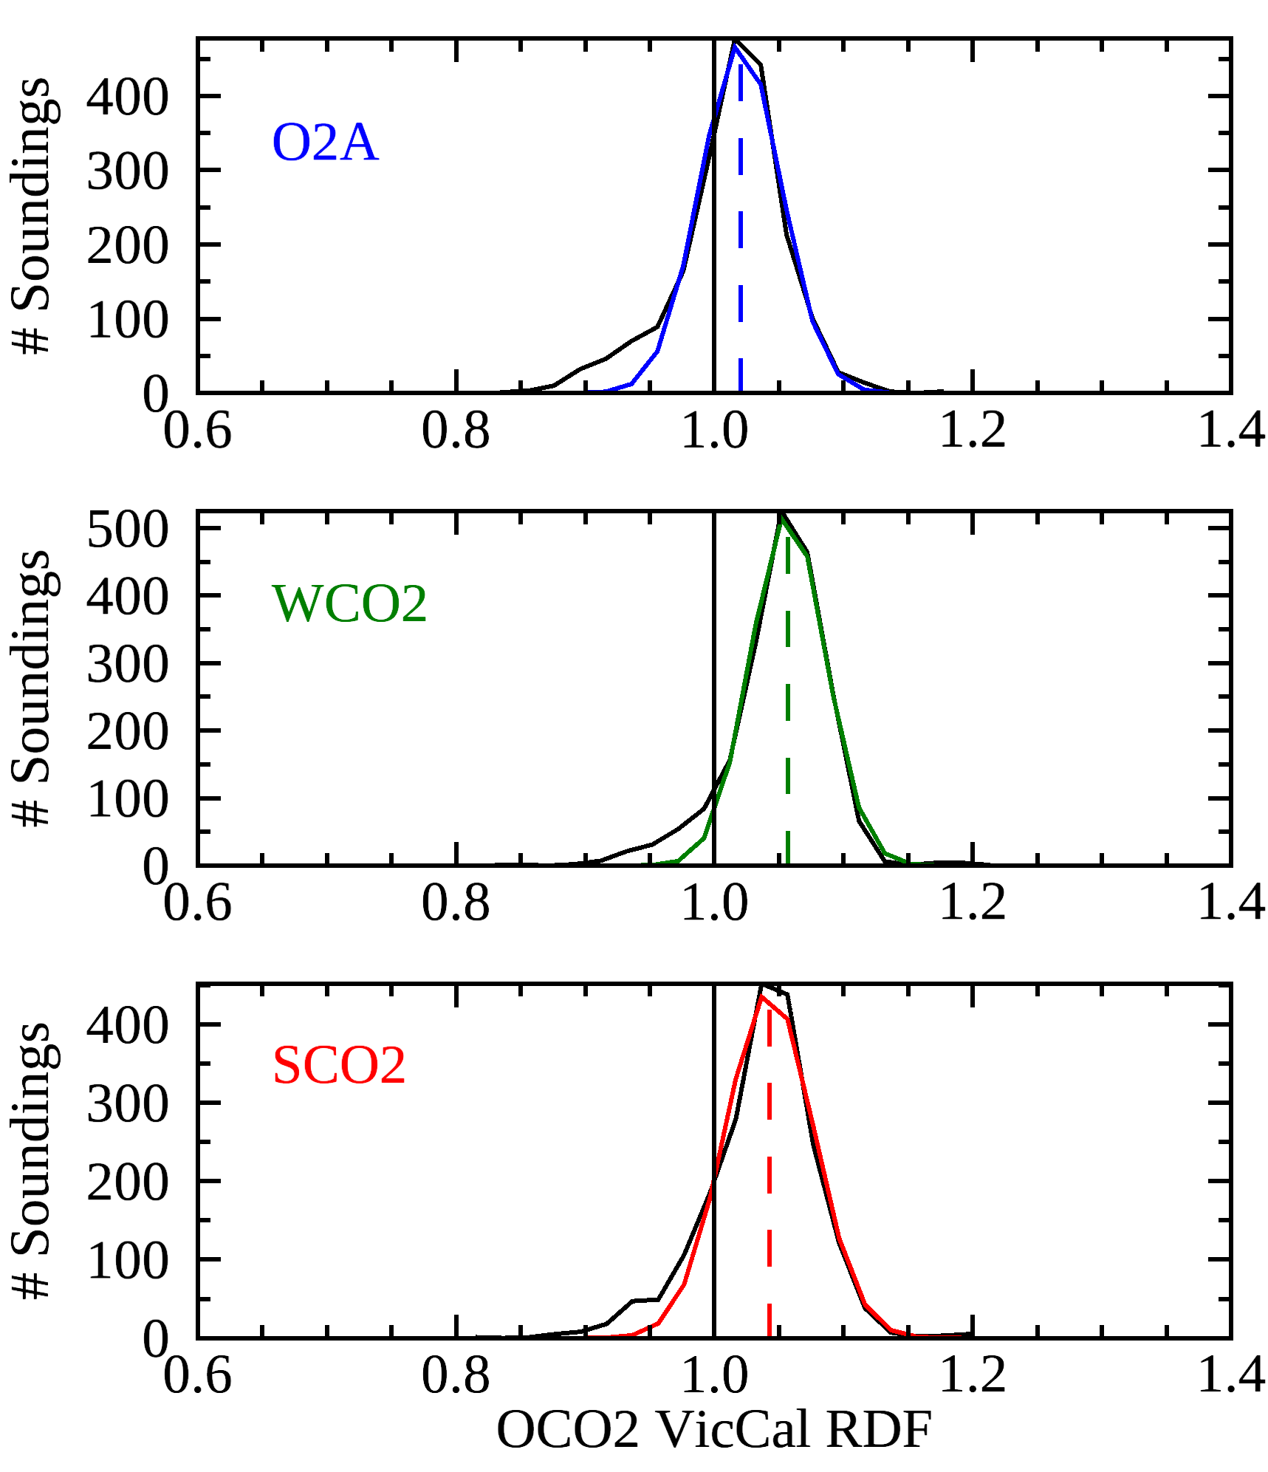
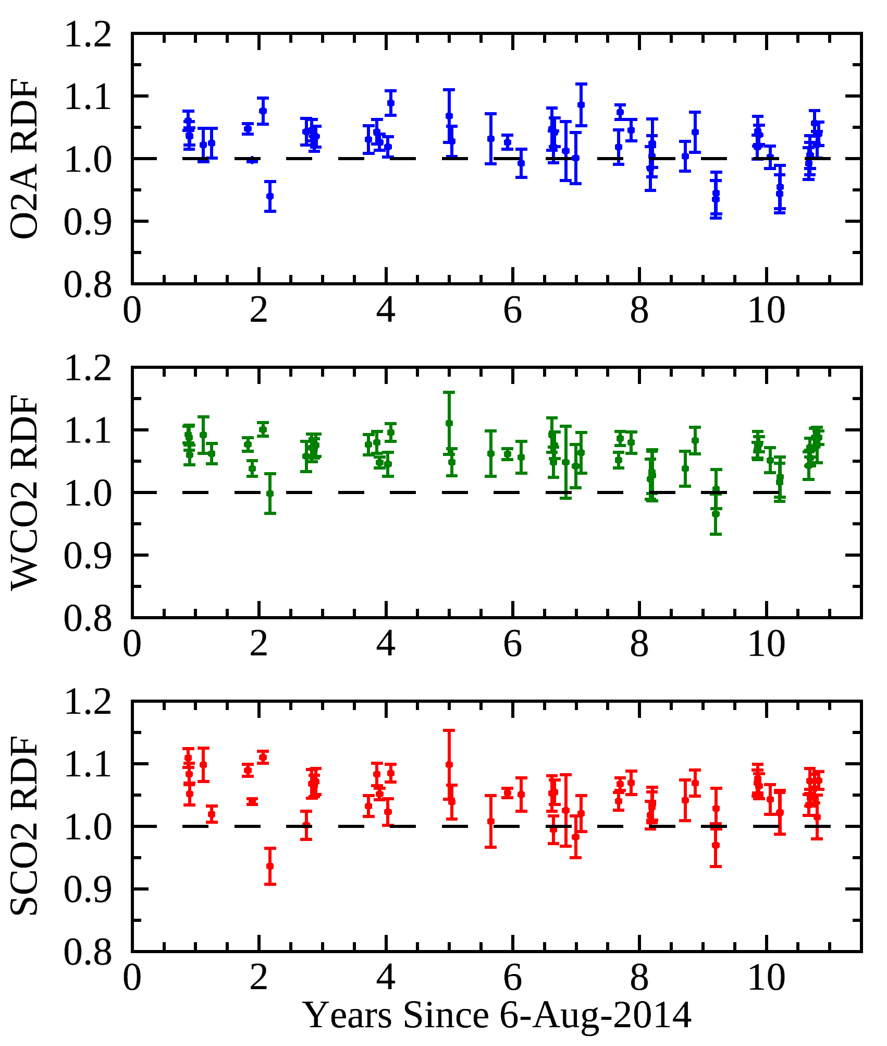
OCO-2 Vicarious Calibration at Railroad Valley
The OCO-2 / 3 Radiometric Puzzle
Total soundings: 2011
O2A RDF = 1.004 + 0.002 * Year
1.004 ± 0.003 0.002 ± 0.001
Gaussian: 1.020 ± 0.037
WCO2 RDF = 1.071 - 0.001 * Year
1.071 ± 0.005 -0.001 ± 0.001
Gaussian: 1.057 ± 0.034
SCO2 RDF = 1.057 - 0.001 * Year
1.057 ± 0.004 -0.001 ± 0.001
Gaussian: 1.043 ± 0.040

Slide 12
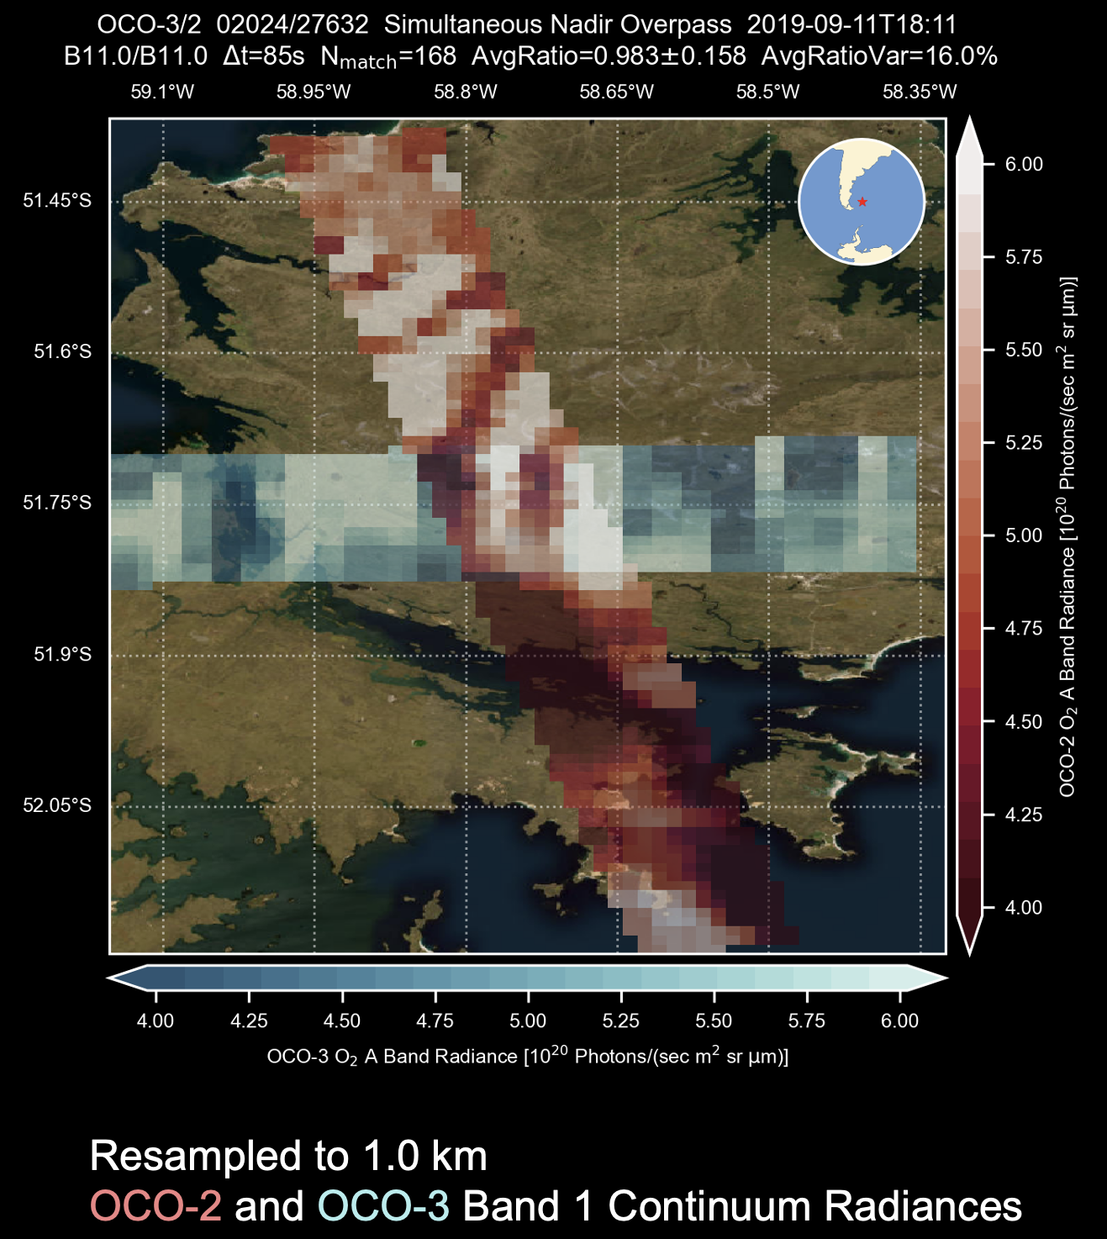
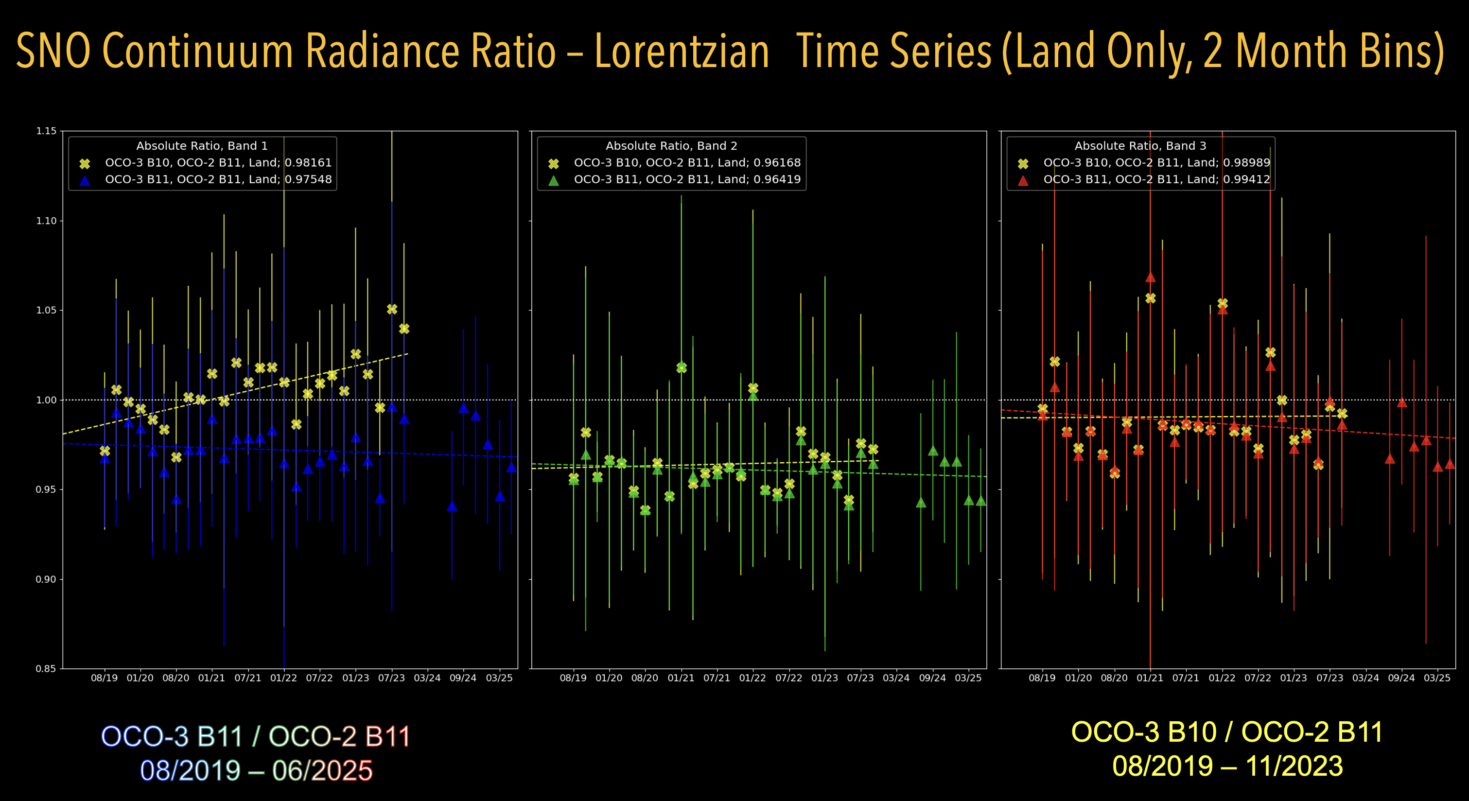
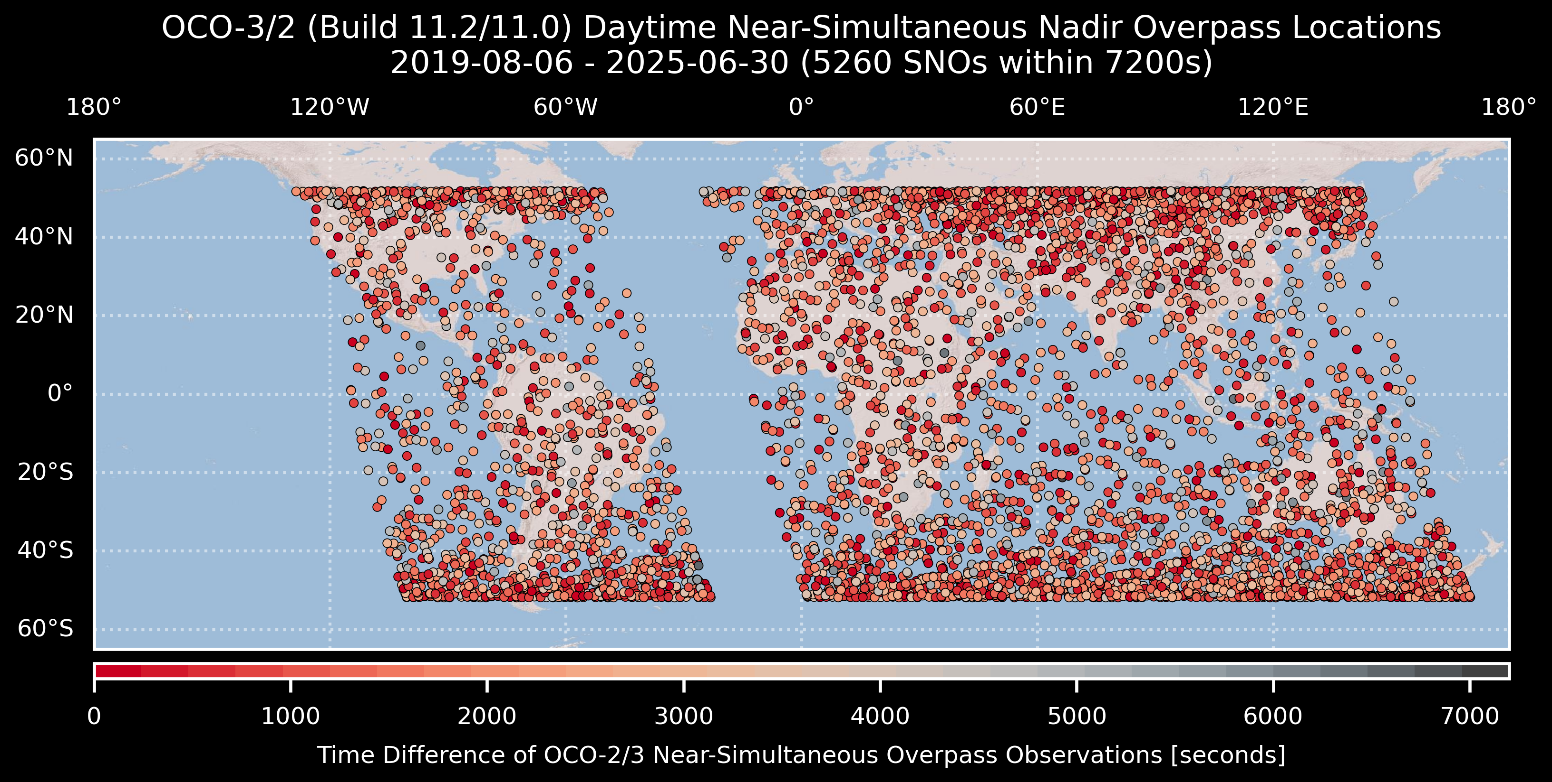
Simultaneous Nadir Overpasses
The OCO-2 / 3 Radiometric Puzzle

Slide 13
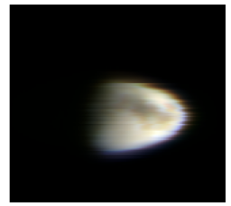
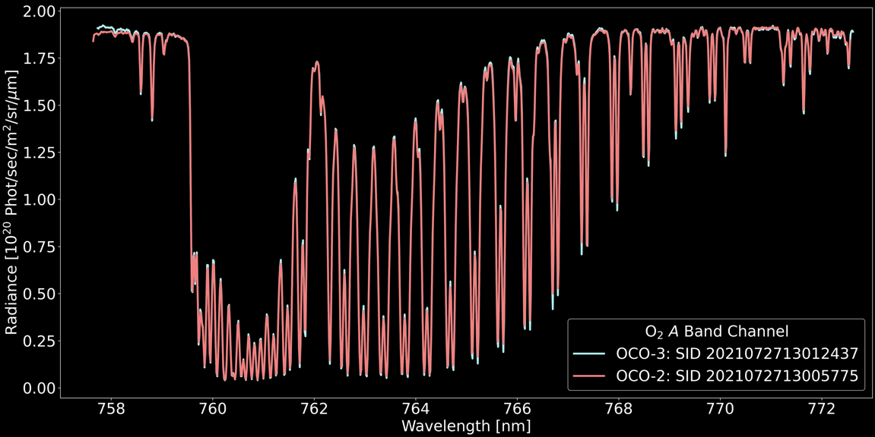
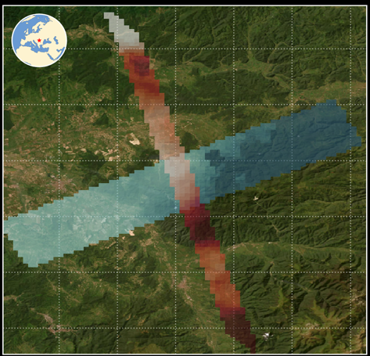
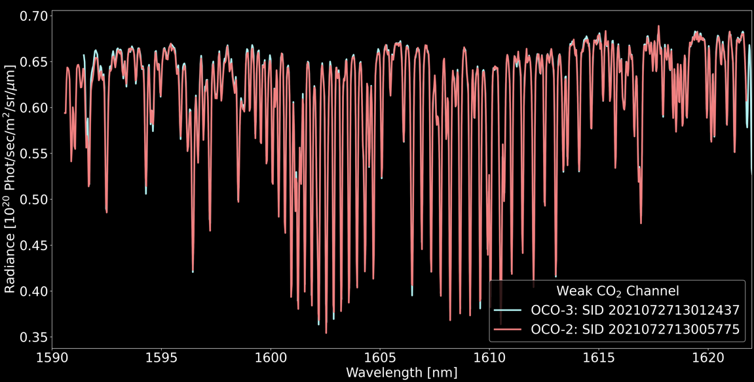
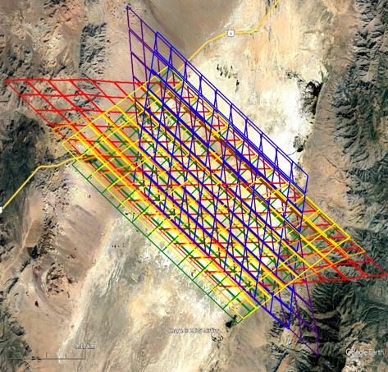
Combining Knowledge
The OCO-2 / 3 Radiometric Puzzle
1. Based on Lunar, estimate a drift in OCO2 from Feb 2022 onward and apply to SNOs
2. SNOs estimate OCO2/OCO3 =
1.033, 1.048, 1.022
(constant in time)
and validate OCO-3 B11 Lamp Aging assumption
Individual OCO-2 and OCO-3 Band 1 & 2 Radiance Spectra
(from a SNO 25 sec apart)
3. RRV estimates match well if OCO3 = 1.0
1.020, 1.057, 1.043
(constant in time)

Slide 14
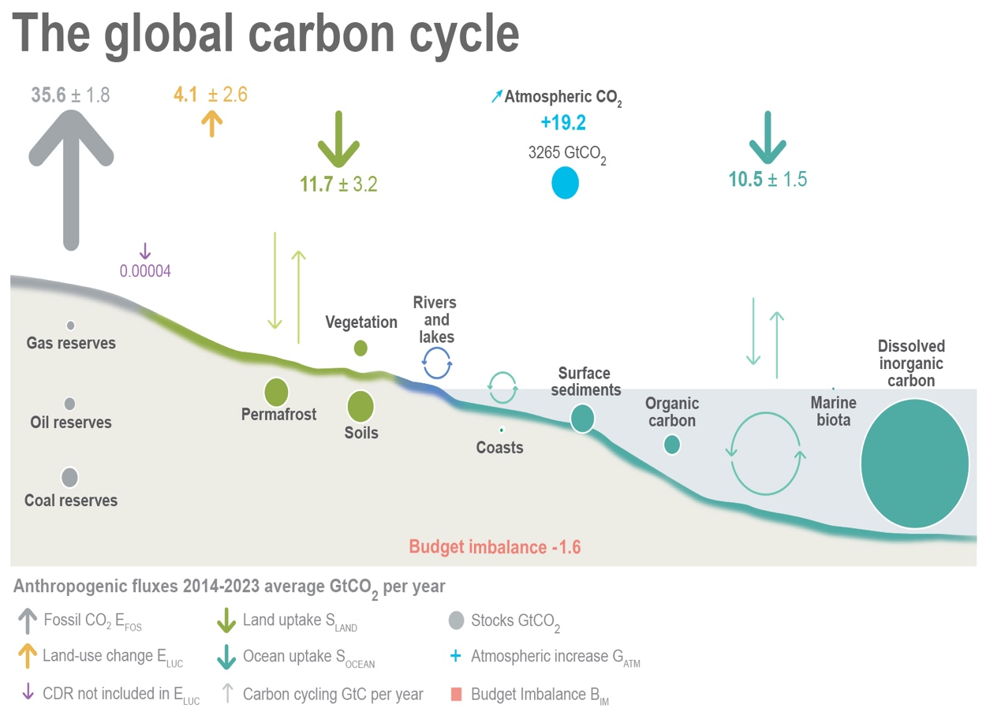
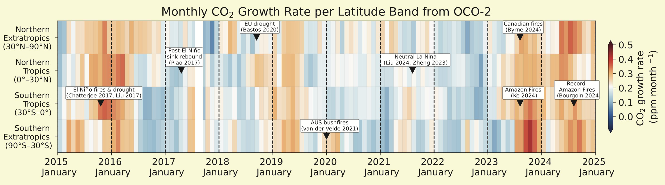
Conclusion
The OCO-2 / 3 Radiometric Puzzle
doi.org/10.5194/essd-2024-519
OCO-2 and OCO-3 use several independent techniques to constrain the degradation of primary onboard calibration sources
Monthly lunar observations (OCO-2)
Vicarious Calibration at Railroad Valley (3 annual campaigns)
Simultaneous Nadir Overpasses
Combining results from the above investigations has strengthened our understanding of errors in the current OCO-2 version (summer 2021) and validated OCO-3’s latest reprocessing (spring 2023)
Calibrated, geolocated spectra OCO2_L1B_Science V11.2 & OCO3_L1B_Science V11 accessible at GESDISC: 100,000+ orbits combined!
https://disc.gsfc.nasa.gov/datacollection/OCO2_L1B_Science_11.2.html
https://disc.gsfc.nasa.gov/datacollection/OCO3_L1B_Science_11.html
Level 1a science & L1a/L1b calibration are also public

