Slide 1
GEMS Status and Calibration Update
GSICS Annual and Executive Panel Meeting 2026
Geostationary Environmental Monitoring Spectrometer
March 25, 2026

Slide 2
1. GEMS Status
2. Analysis of Radiometric correction
3. Analysis of Geometric correction

Slide 3
1. GEMS Status

Slide 4

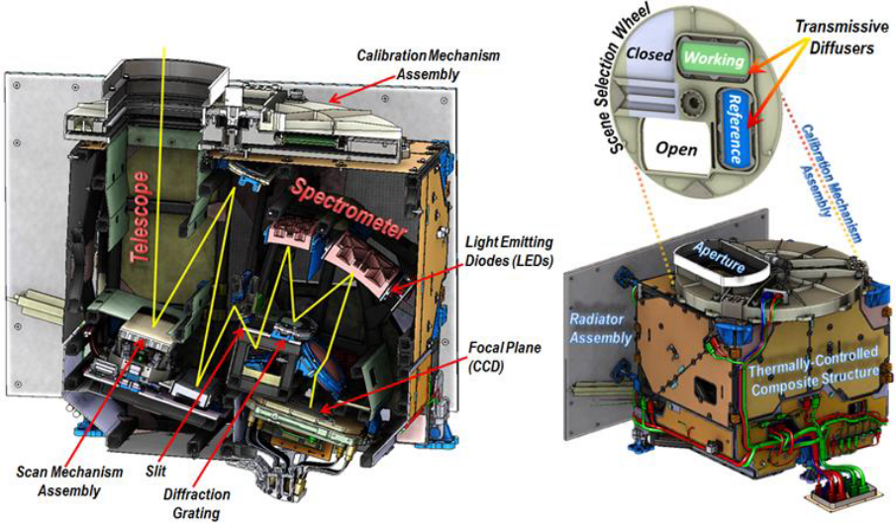
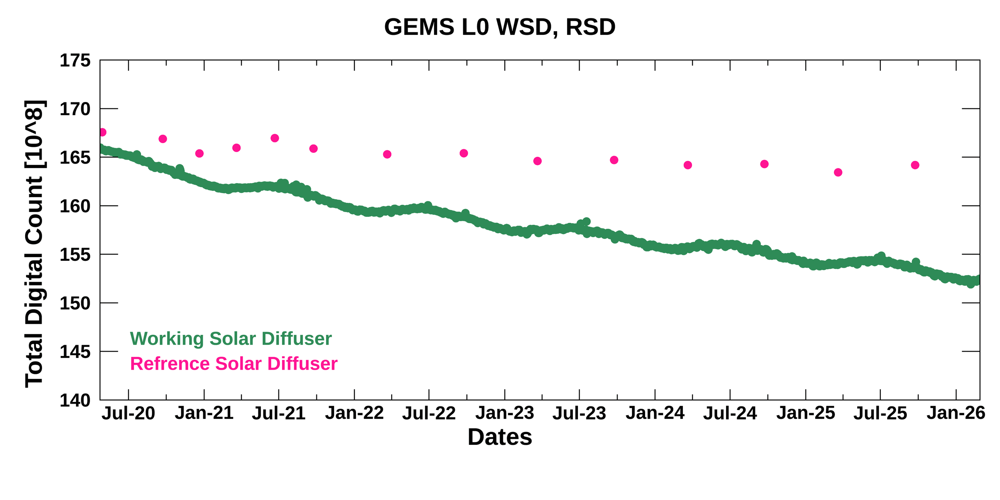
1
GEMS Status
GEMS L0 monitoring
Solar irradiance (WSD) : total 2110 obs.(1/day) -> approx. 8.14% reduce(linear)
Solar irradiance (RSD) : total 14 obs. (2/year) -> approx. 2% reduce
*WSD: Working Solar Diffuser, RSD: Reference Solar Diffuser
RSD: -2.02%
WSD: -8.14%
Optical part
Diffuser +
Optical part

Slide 5
1
GEMS Status
GEMS L0 monitoring
Attenuation prediction for operation until 2033*: RSD 3.4%. WSD 11.5% (Conservative attenuation approx. 15%)
*extended operation considering follow-up GEMS development schedule
Adjustment solar obs. cycle(daily -> weekly) attenuation: attenuation delay from 11.5% to approx. 8.9%
Adjusting the solar obs. Cycle when designing follow-up GEMS missions is expected to extend the sensor’s lifespan
-3.4%
-8.9%
-11.5%

Slide 6
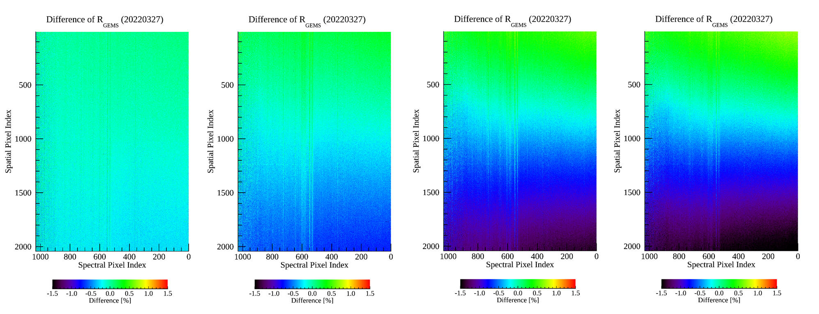
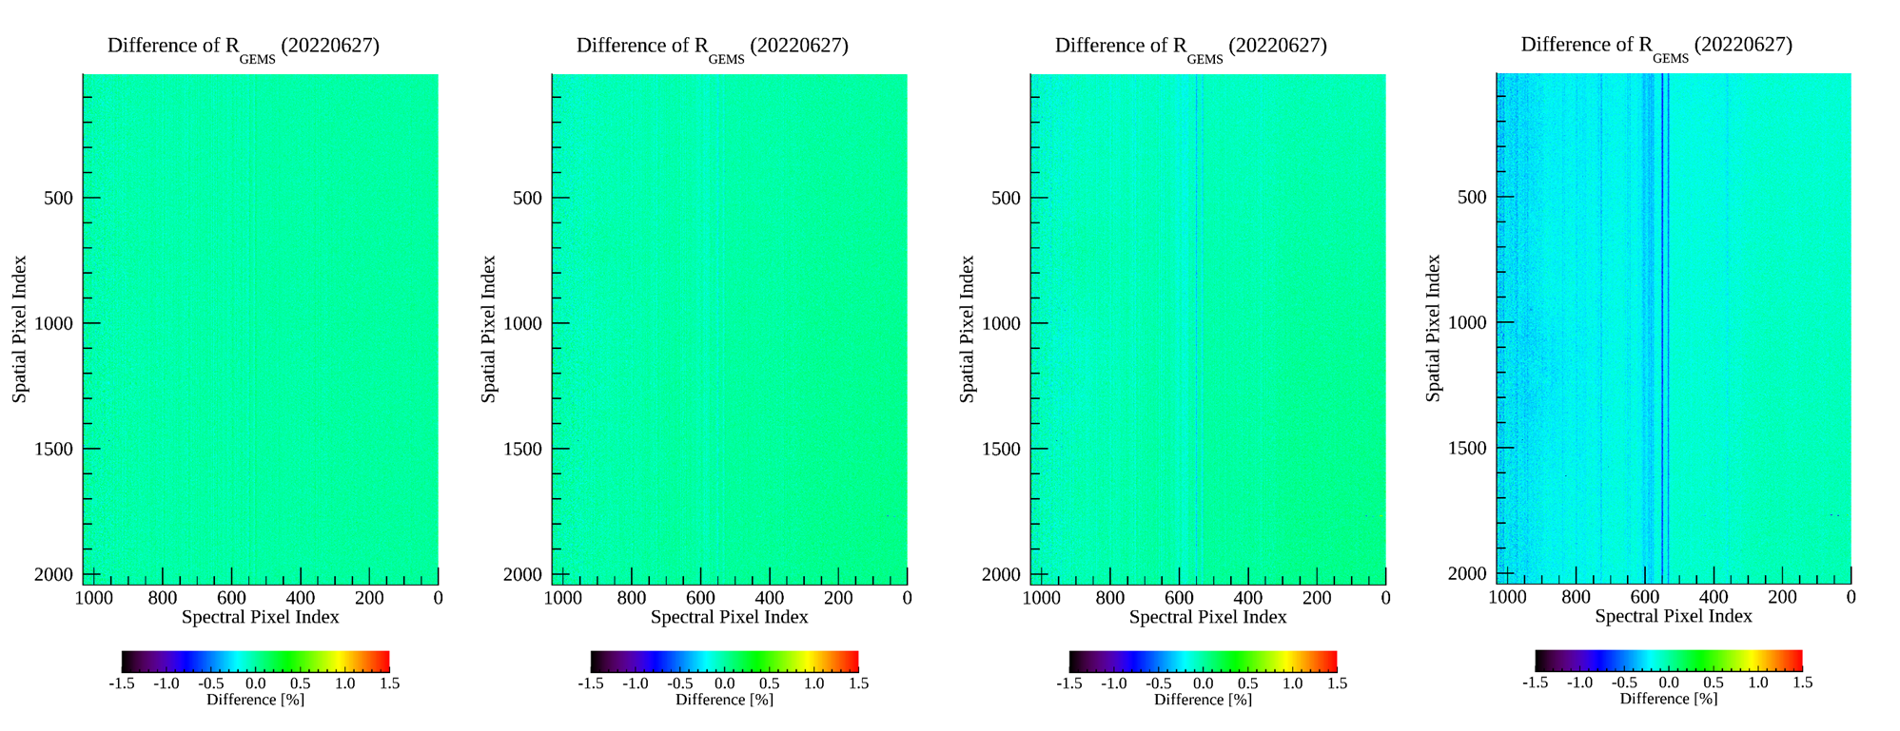
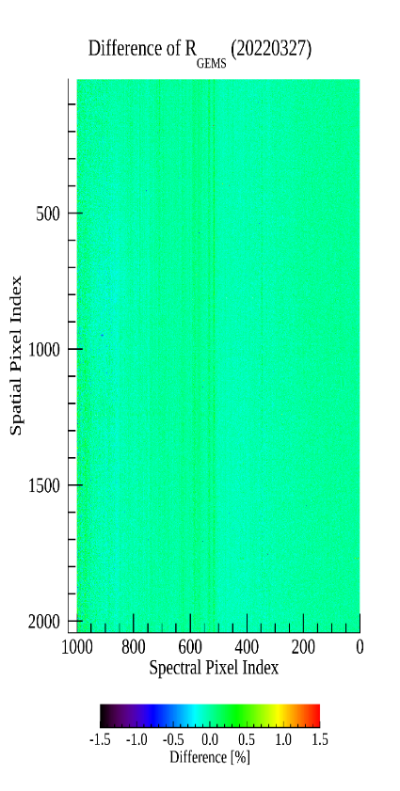
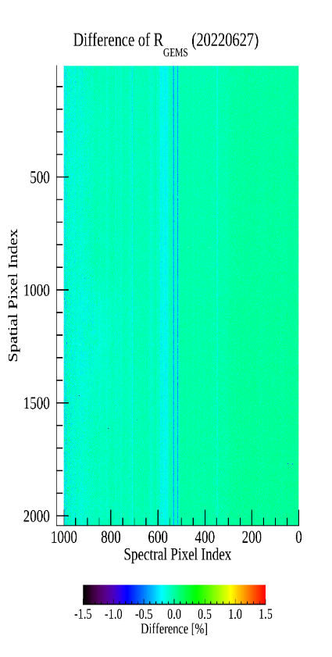
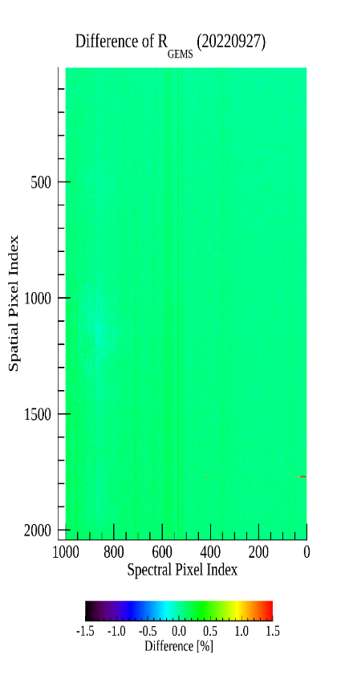
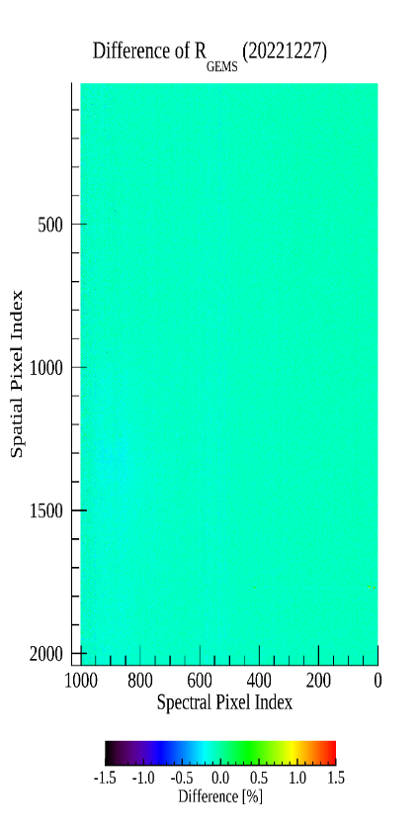
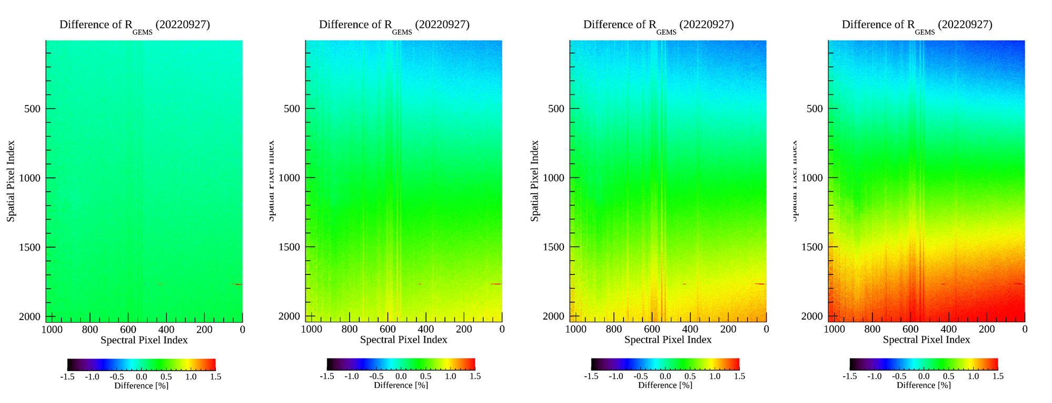
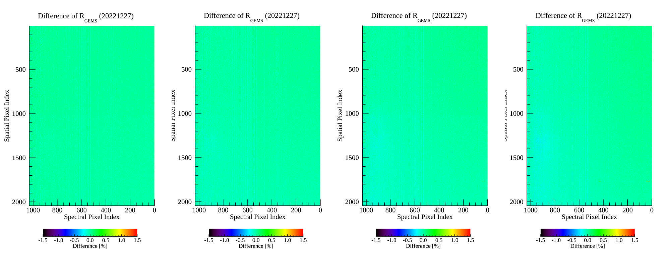
1
GEMS Status
GEMS L0 monitoring
Mar.
+day1
+day3
+day5
+day7
(WSD) Difference analysis by observation data
There are seasonal differences, but the larger the difference
in observation dates, the greater the difference.
As a result of correcting for influence of the obs. Date(SAA, BTDF, etc.),
the difference due to the adj of solar obs. Cycle(daily → weekly) was
reduced, confirming the possibility of using as input data.
Jun.
+day1
+day3
+day5
+day7
Mar.
Jun.
Sep.
Dec.
Day 7 – Day 0
Day 7 – Day 0
Day 7 – Day 0
Day 7 – Day 0
Sep.
+day1
+day3
+day5
+day7
Dec.
+day1
+day3
+day5
+day7

Slide 7
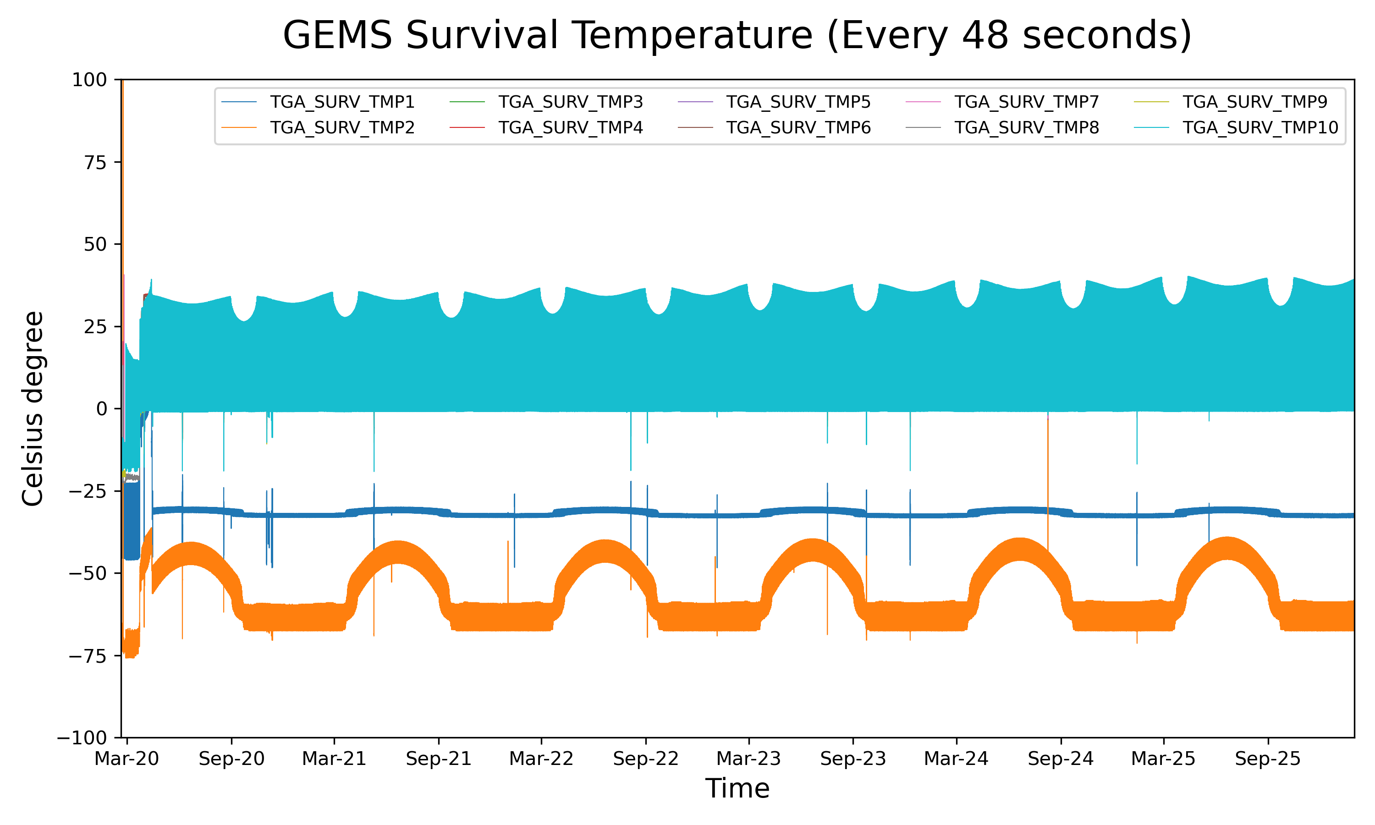
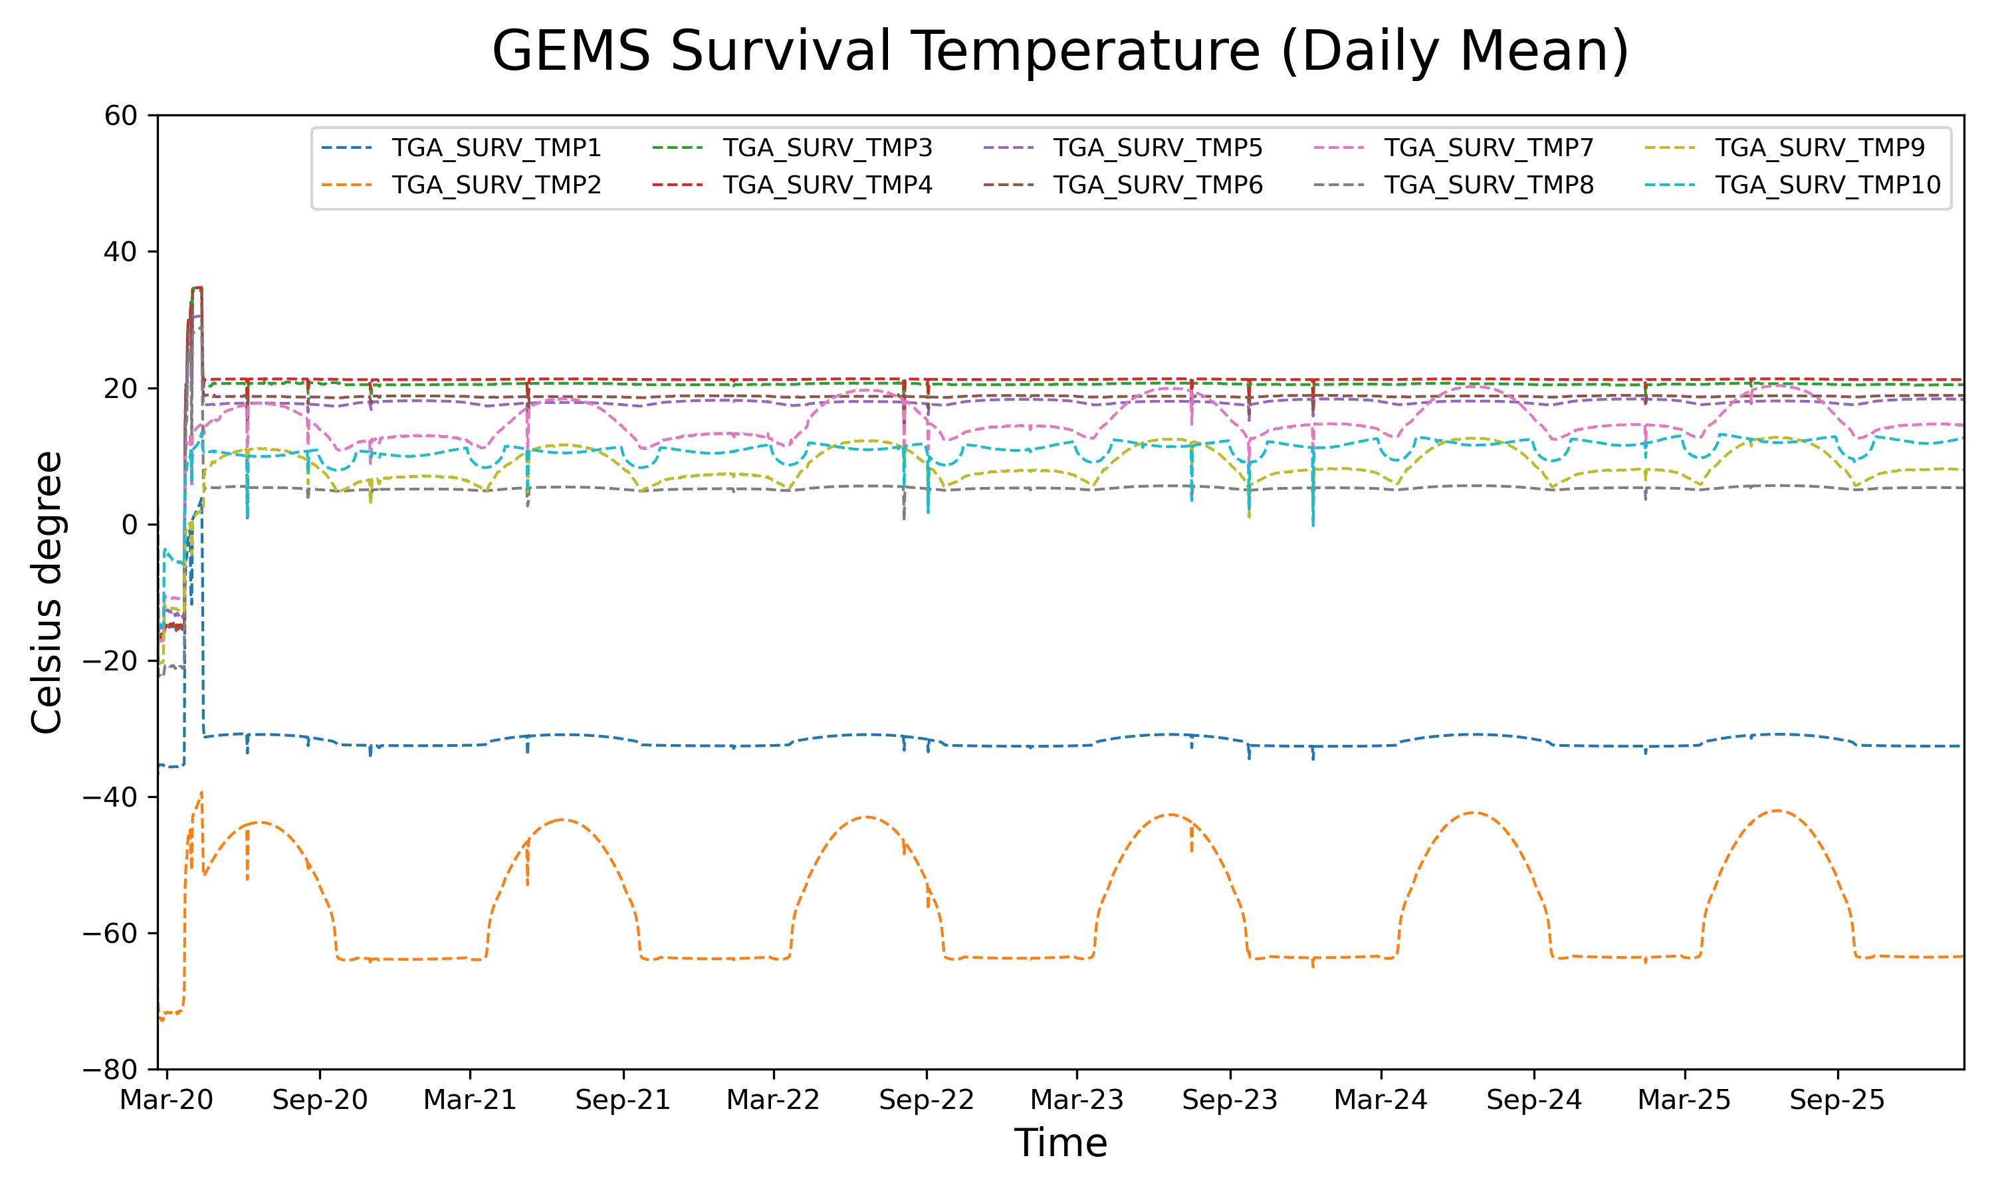
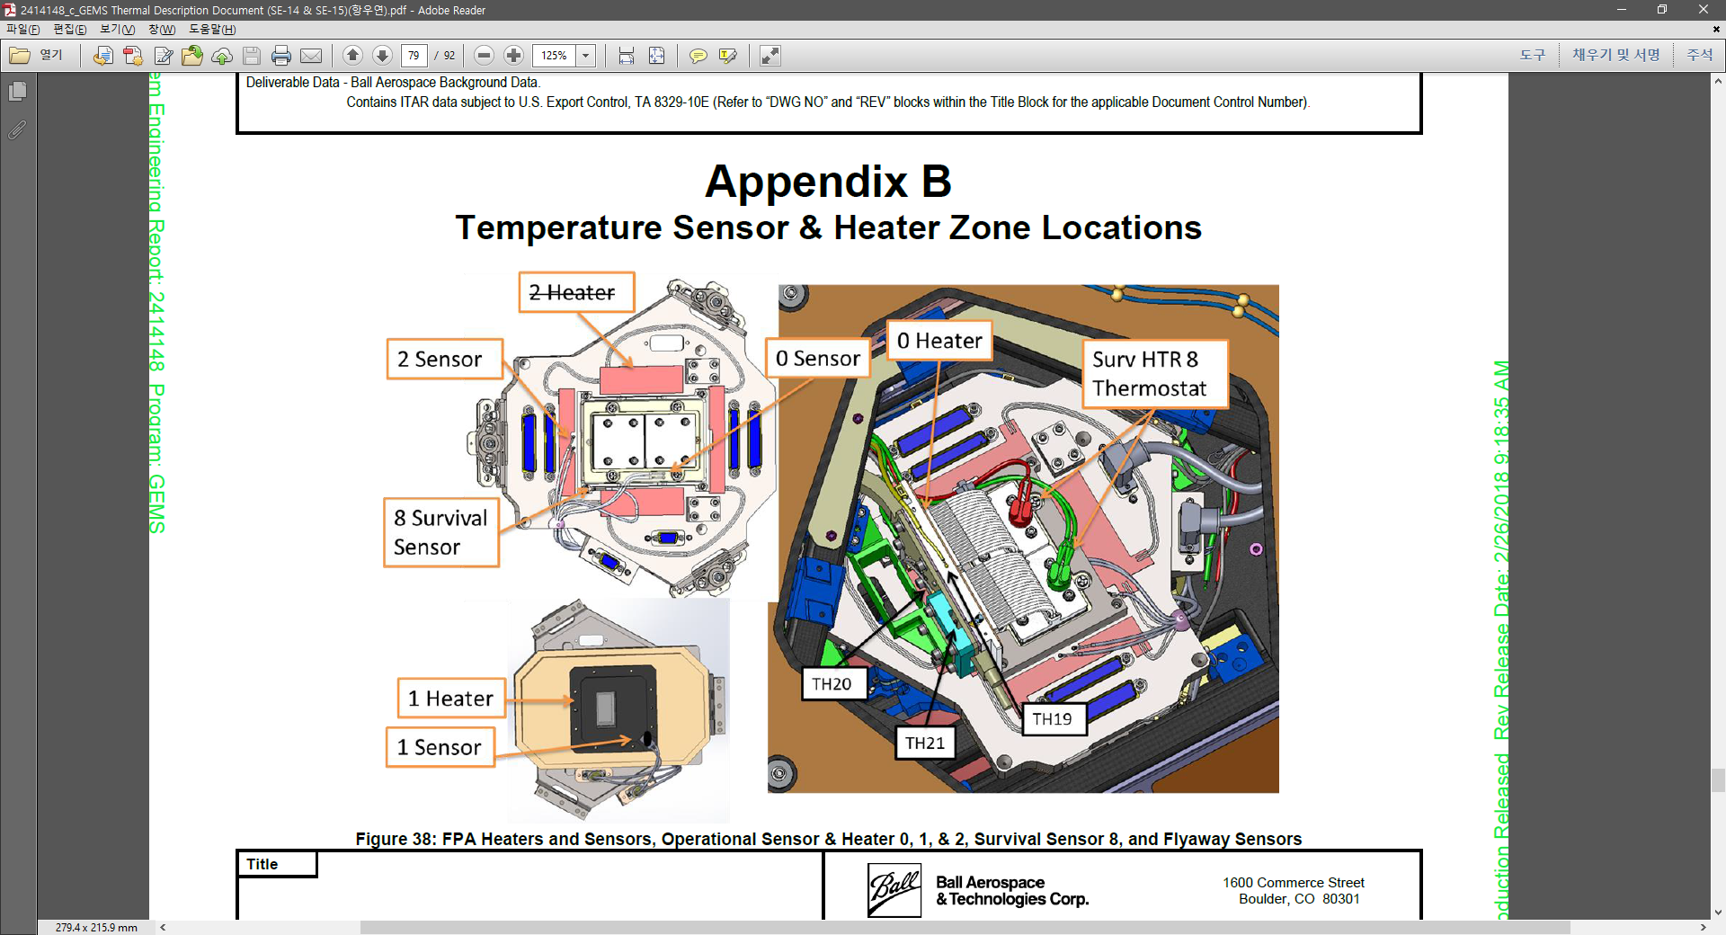
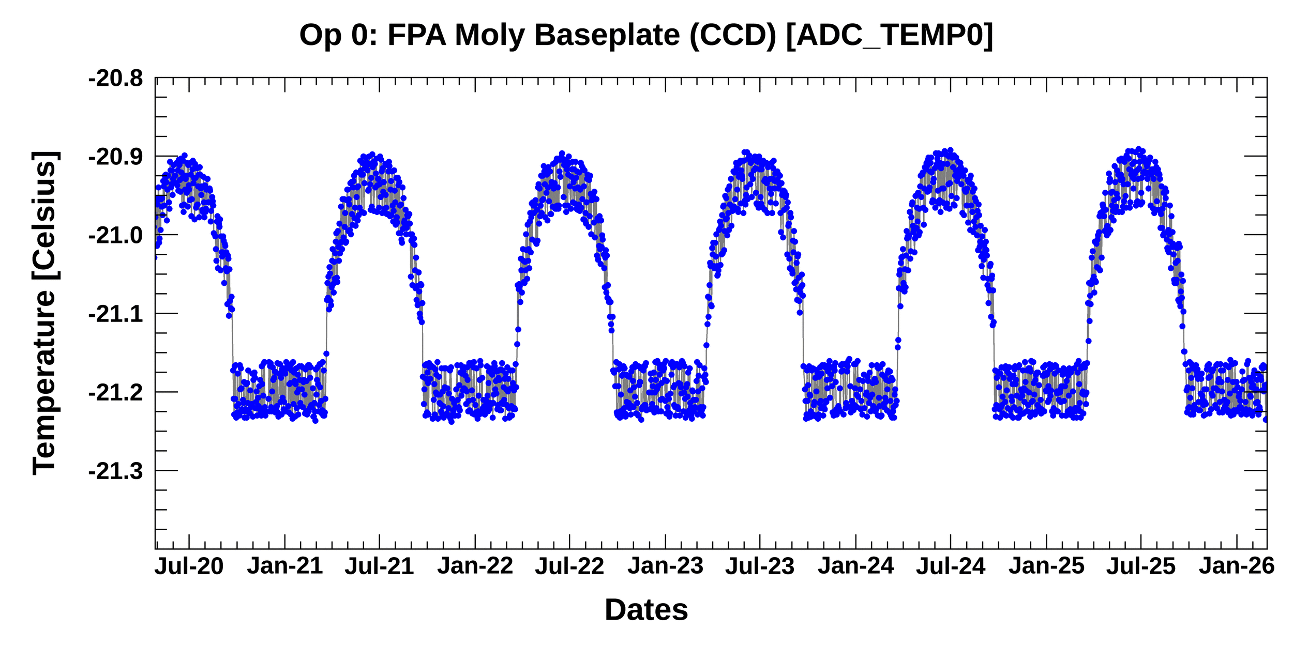
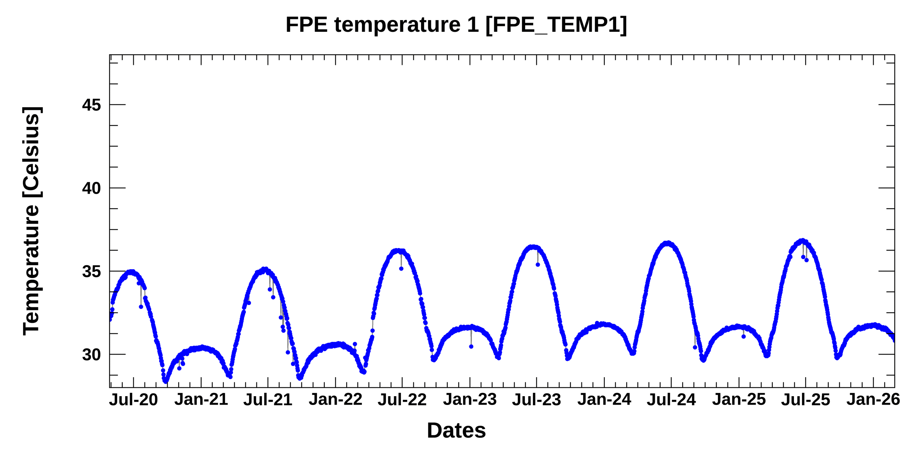
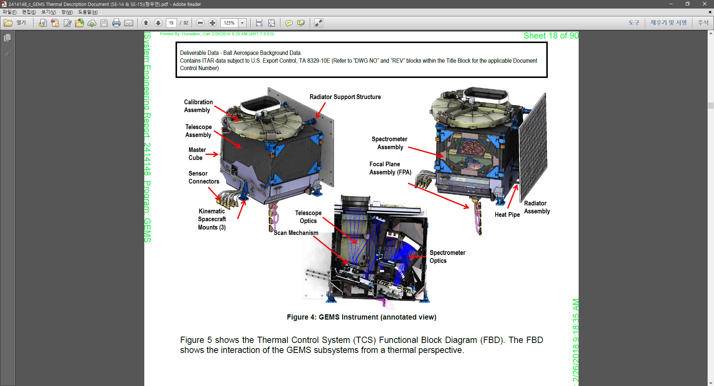
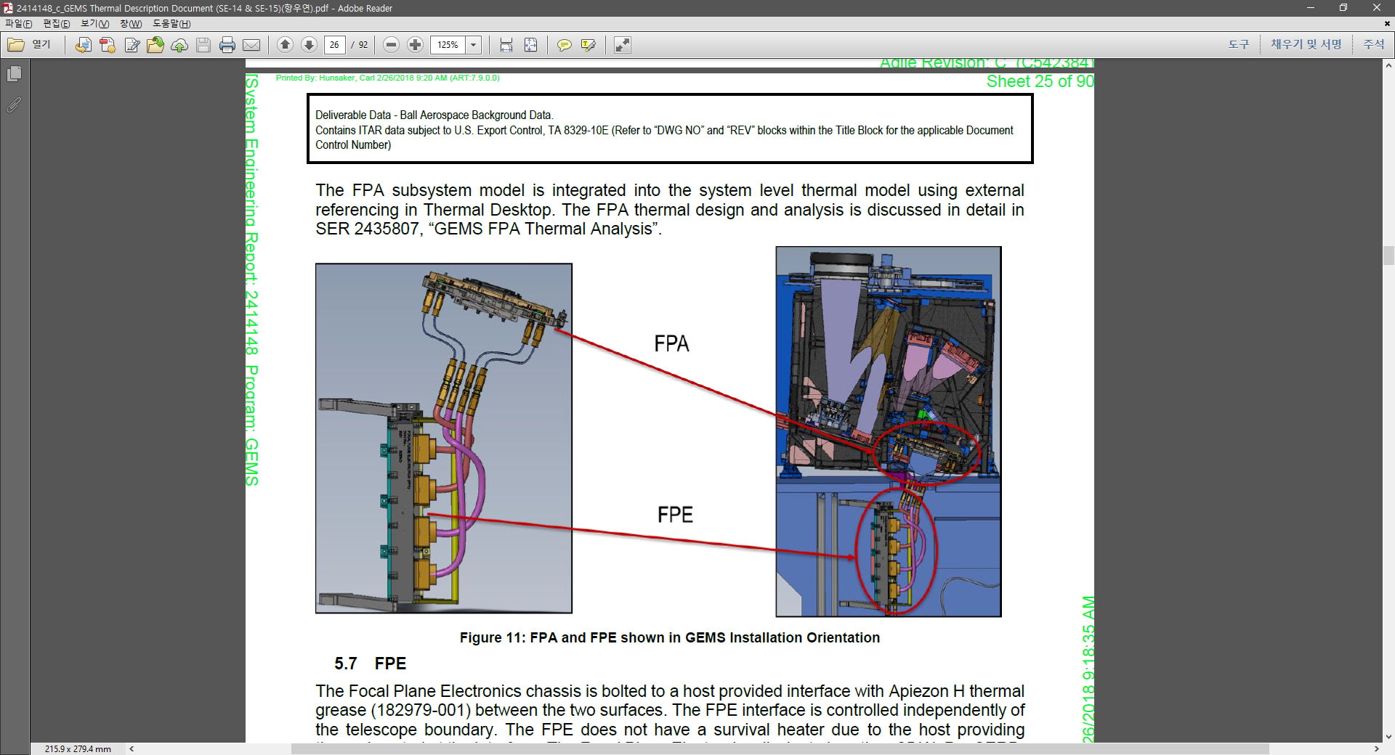
1
GEMS Status
GEMS L0 monitoring
Longterm change analysis of 34 temperature sensors
→ analysis of the entire operation period showed seasonal fluctuations in the appropriate temperature(-36~65℃)*
*provided by the BATC
The order of the light incident path within the GEMS
Location | Temperature Sensor number
Calibration Mechanism Assembly (CMA) | 3,4
Scan Mirror Assembly (SMA) | 5,6,14
Telescope | 10-13,15-22
Spectrometer | 7-8
Focal Plane Array (FPA) | 0-2
Focal Plane Electronics (FPE) | 23
Radiator Support | 9
Location of sensor near CCD
Location of sensor in FPE

Slide 8
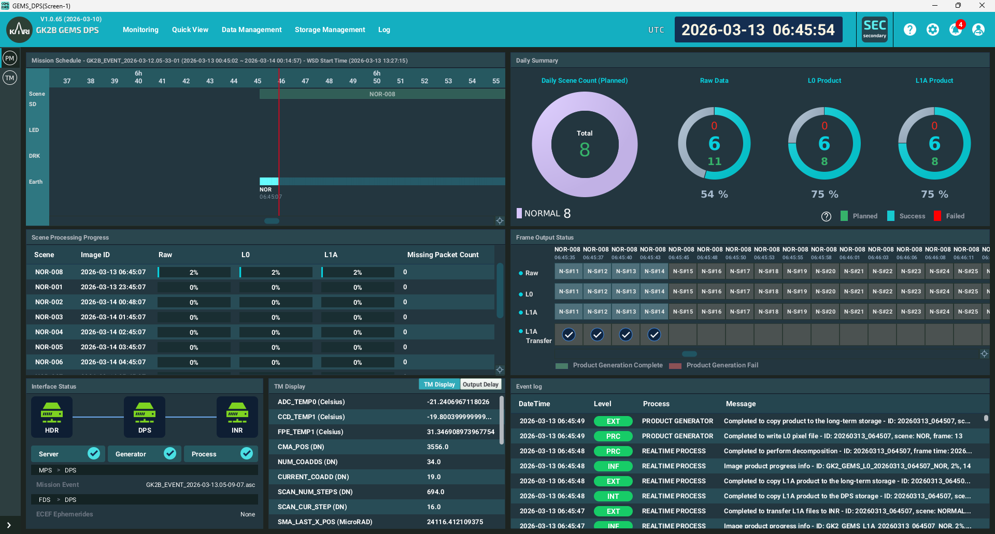
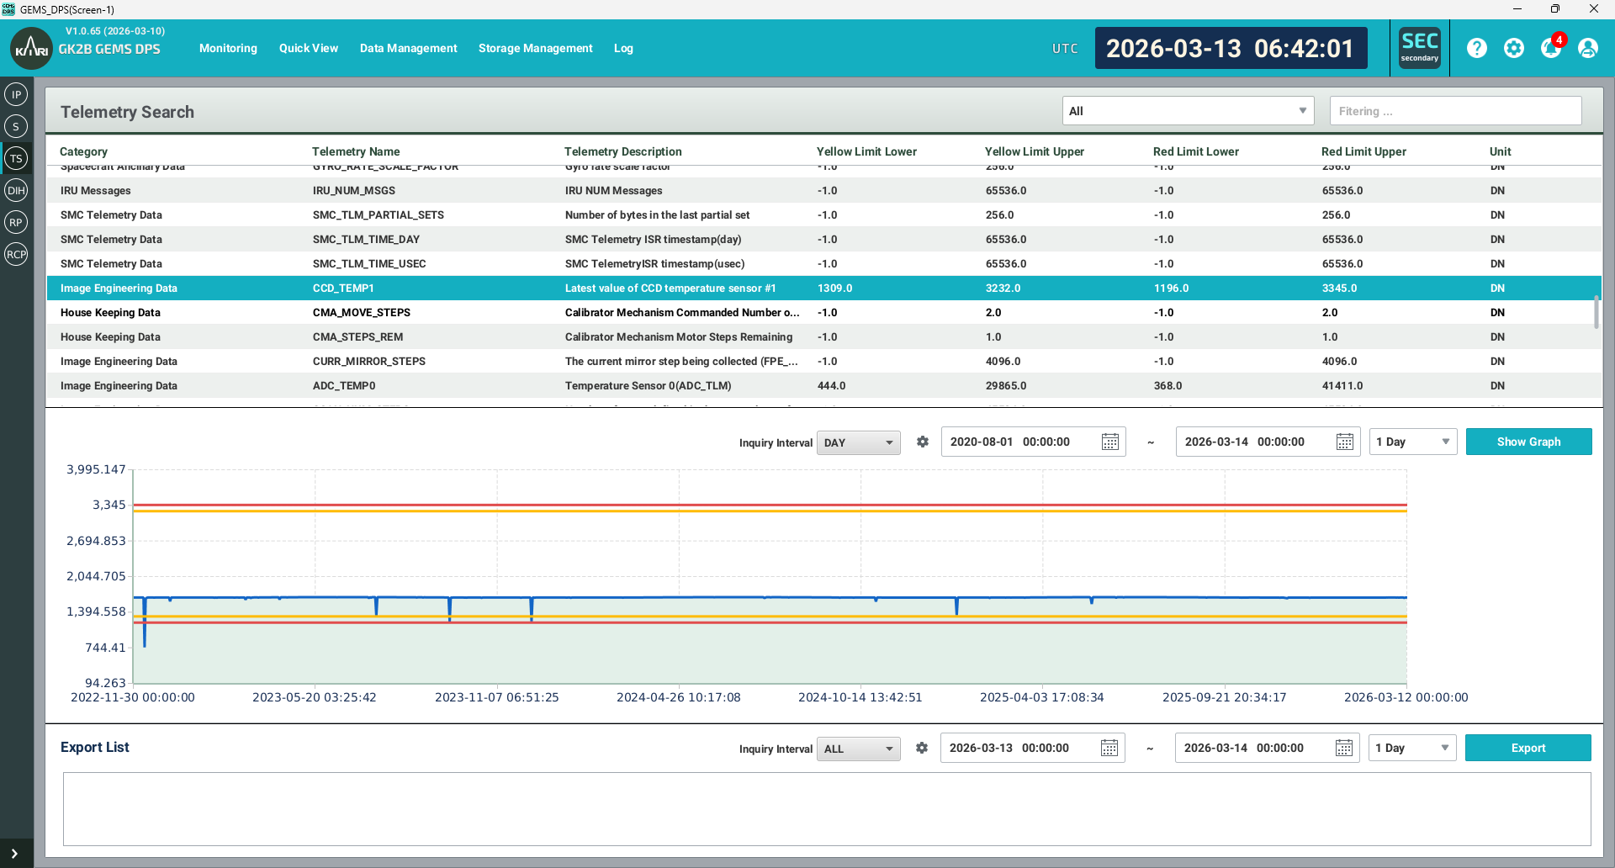
1
GEMS Status
GEMS DPS monitoring

Slide 9
2. Analysis of Radiometric correction

Slide 10
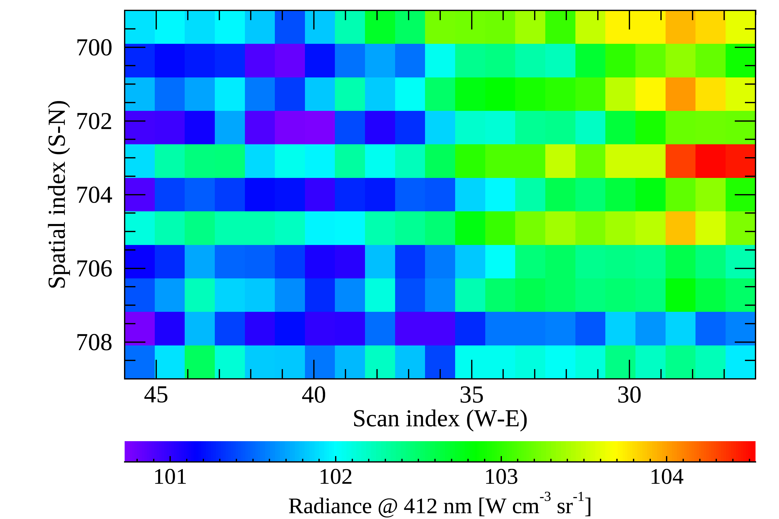
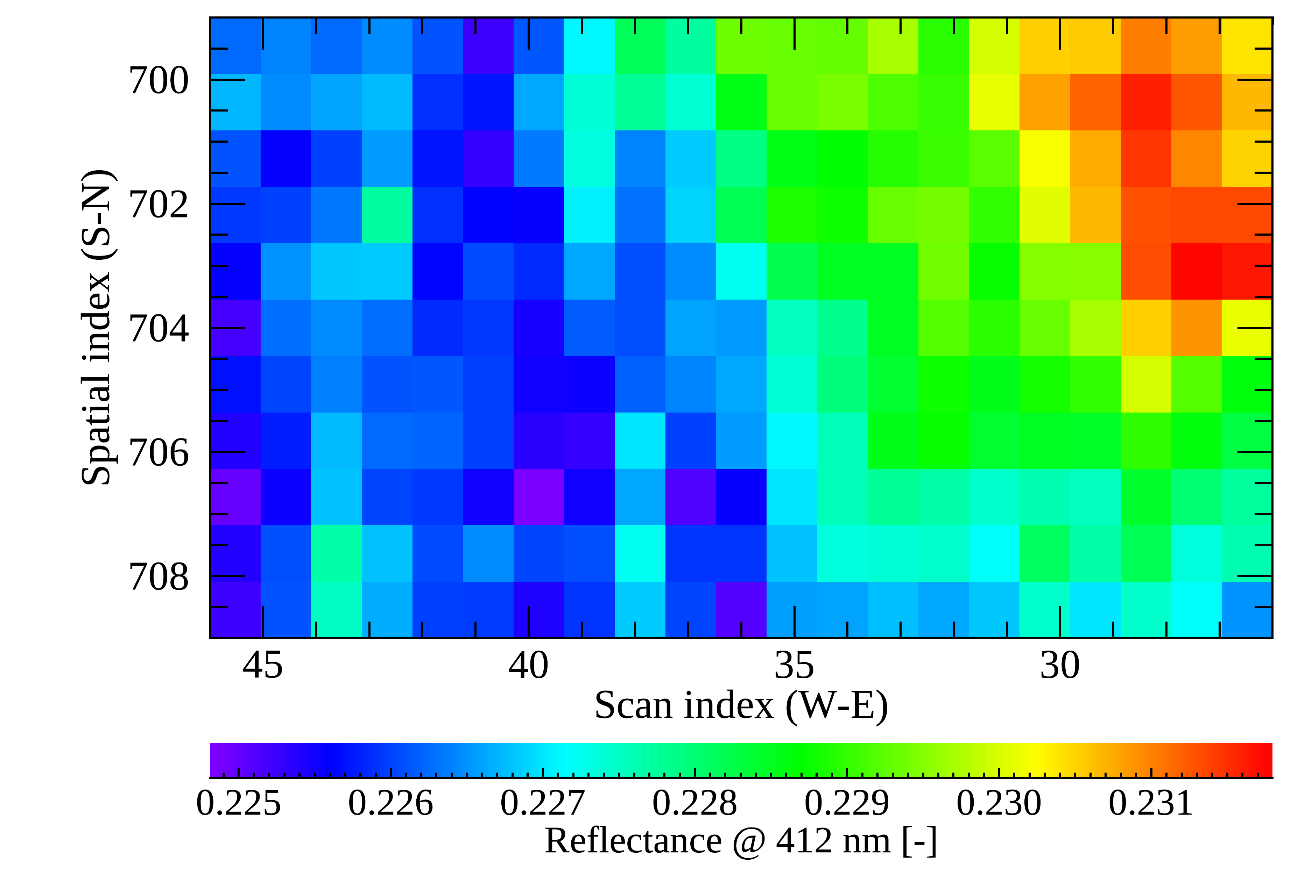

2
Analysis of Radio. correction
Unusual stripe pattern (N-S direction) on CCD
Clearly appear in weak signals about 2% variation (i.e., dark ocean)
- Occurs irregularly when GEMS reboots
Testing the feasibility of applying TEMPO gain correction method to GEMS
Radiance
March 20, 2022
Reflectance = $\frac{Earth Rad}{Solar irrad}$

Slide 11
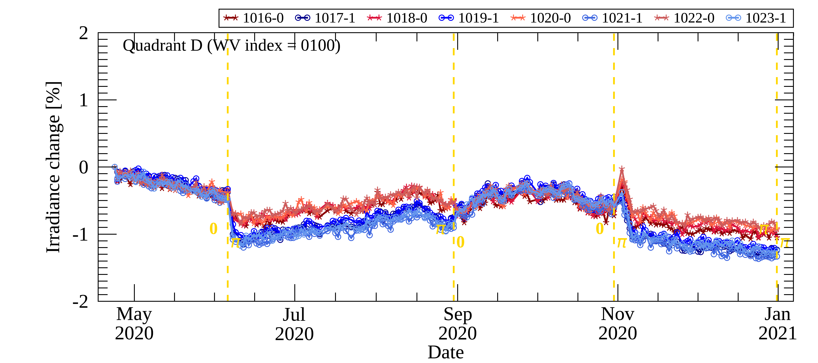
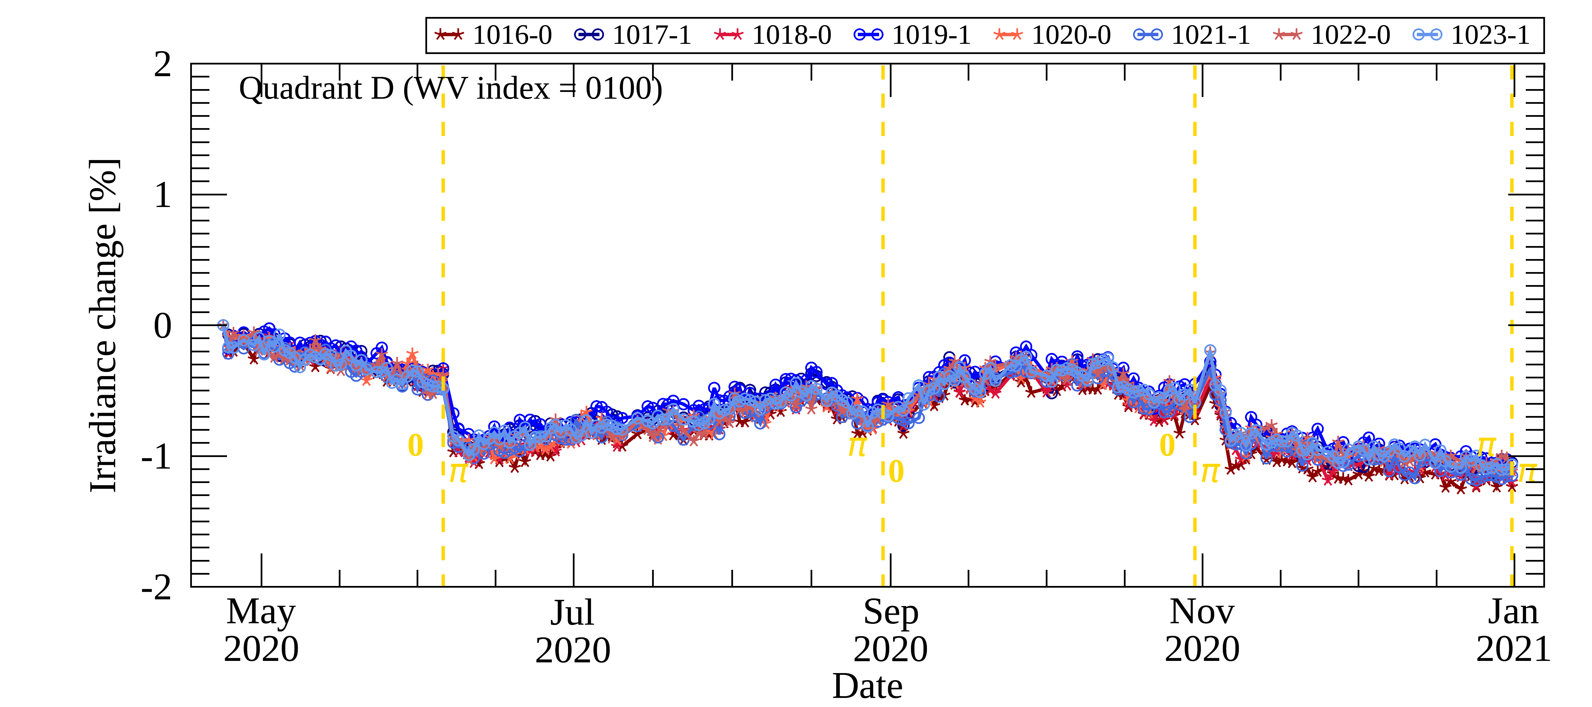
2
Analysis of Radio. correction
Unusual stripe pattern(N-S direction) on CCD
Correction is performed using the error ratio by gain of the radiometric correction
Abnormal differences between adjacent pixels during time series analysis are reduced after correction.
→ Earth and solar observation each need to be applied
Quadrant D (WV index = 100)
before
After Gain & Radiometric calibration coeff.

Slide 12
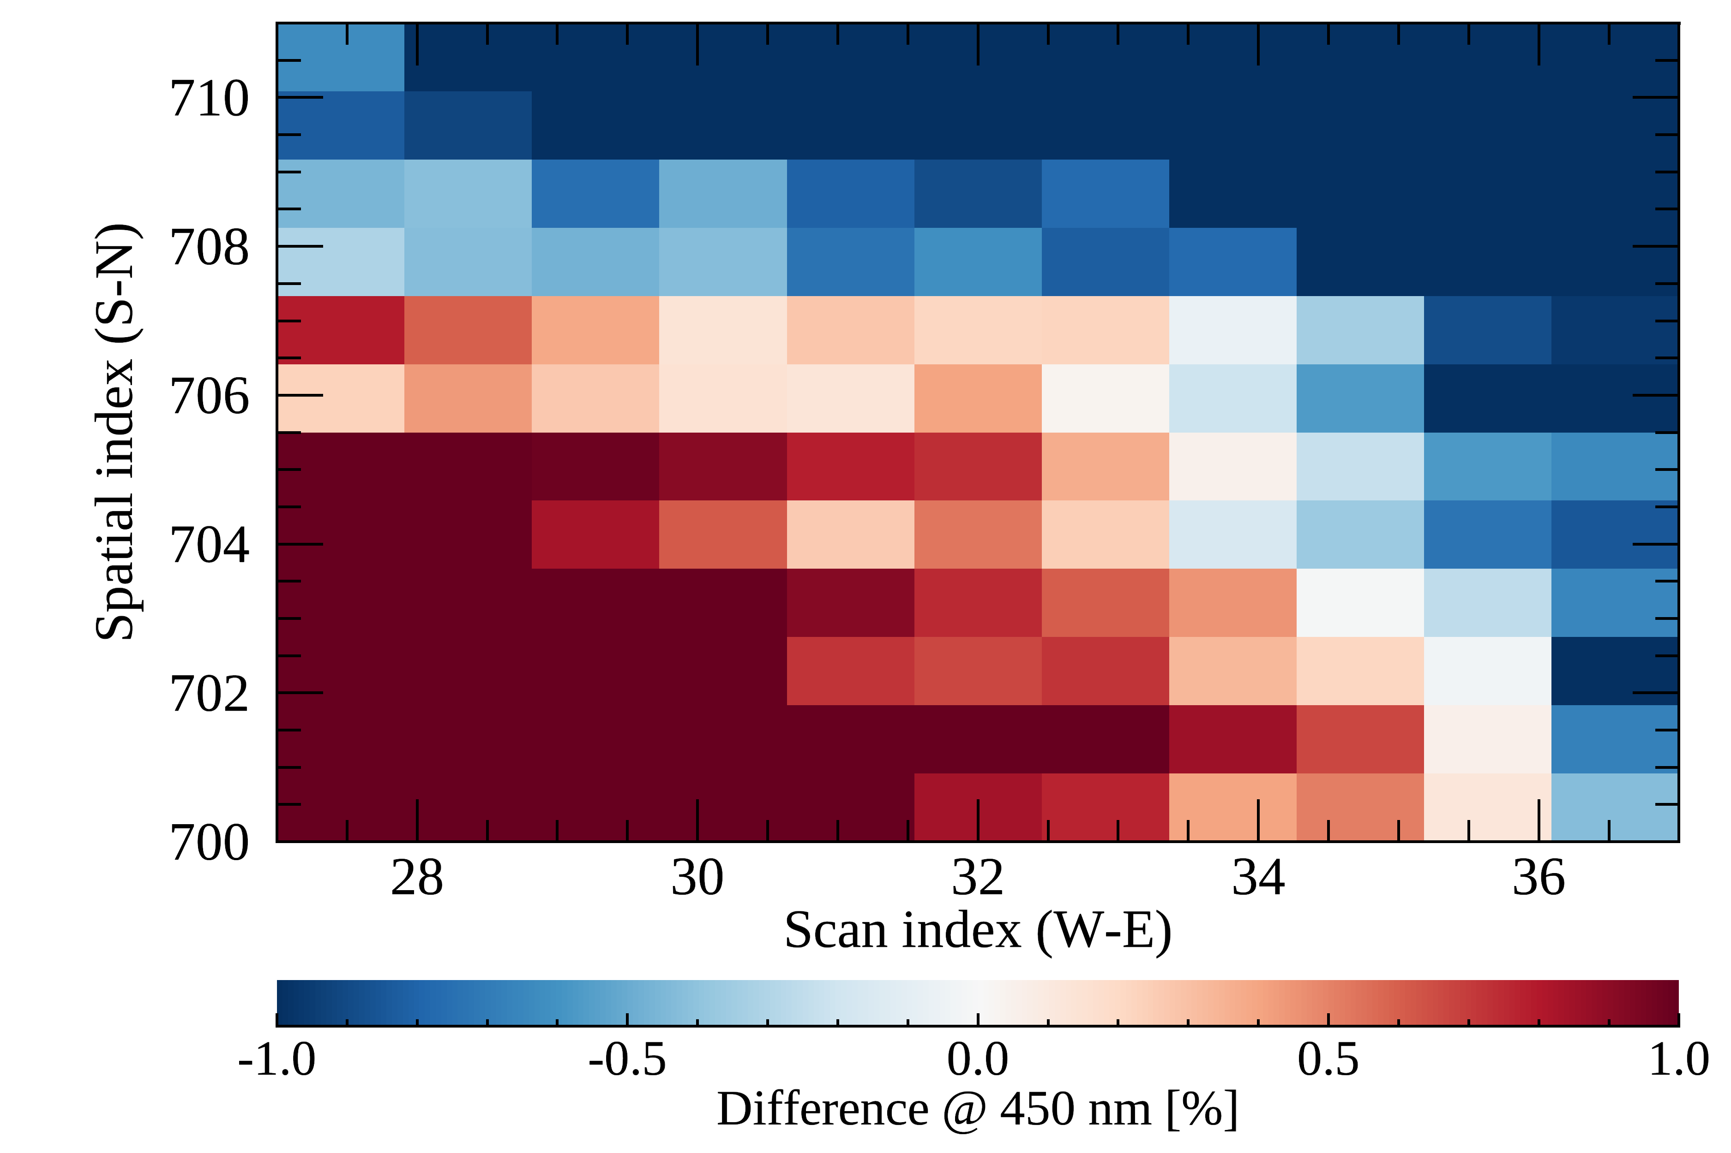
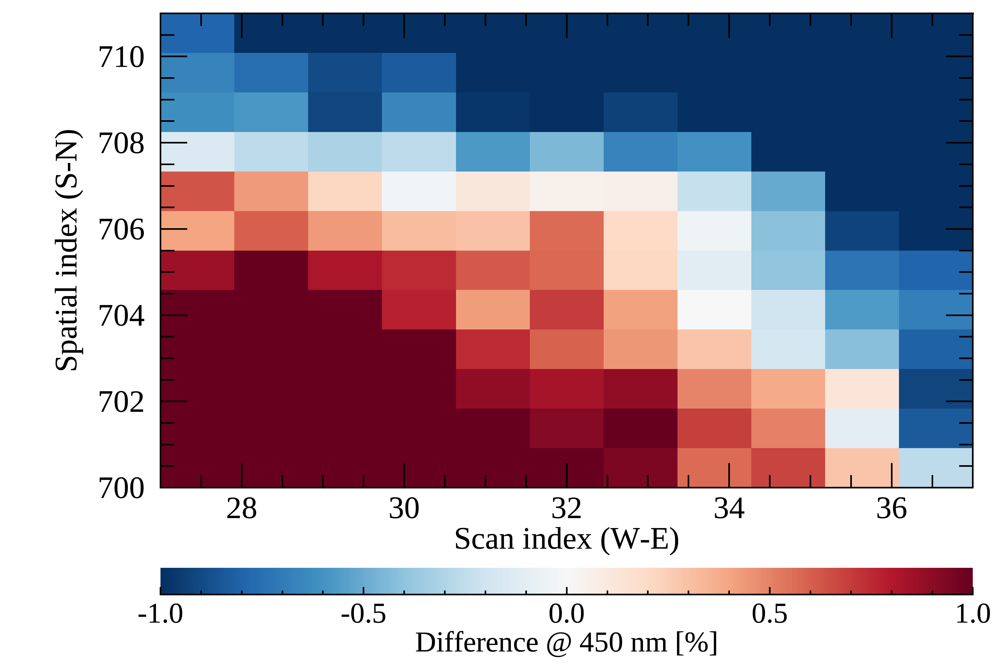
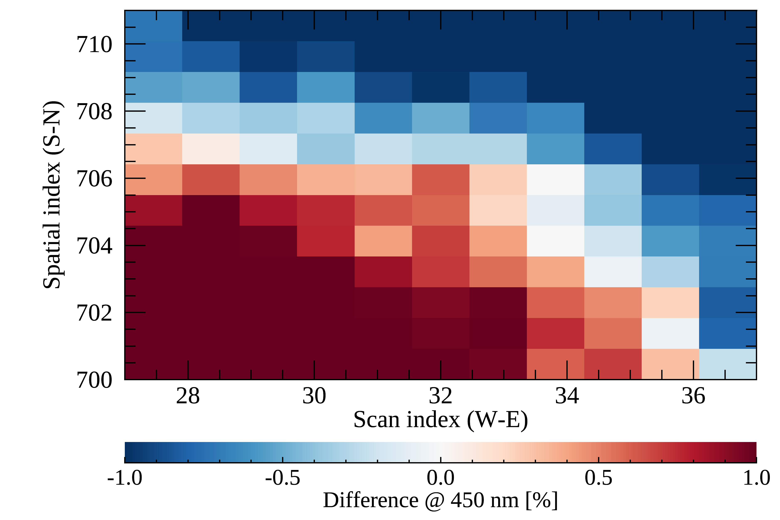
2
Analysis of Radio. correction
Unusual stripe pattern(N-S direction) on CCD
Correction is performed using the error ration by gain of the radiometric correction
Spatial distribution analysis
To verify the correction results, compare with the earth reflectance with the striped pattern offset
After correction irradiance shows a similar spatial distribution with Earth reflectance
Before
After
Earth reflectance

Slide 13
3. Analysis of Geometric correction

Slide 14
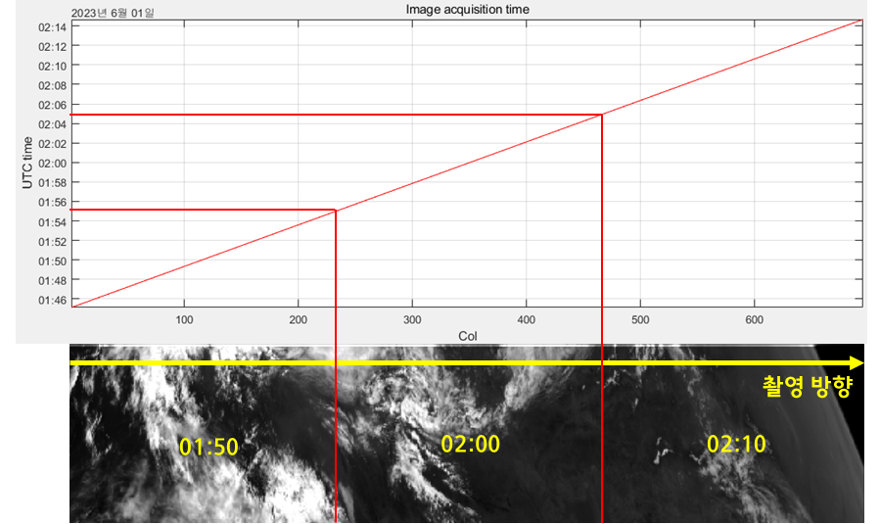
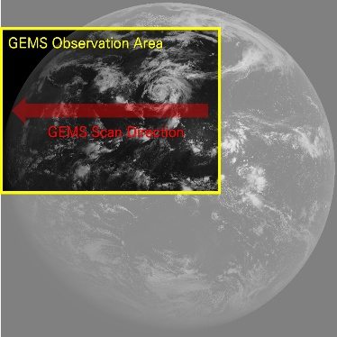
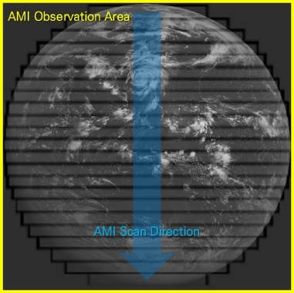
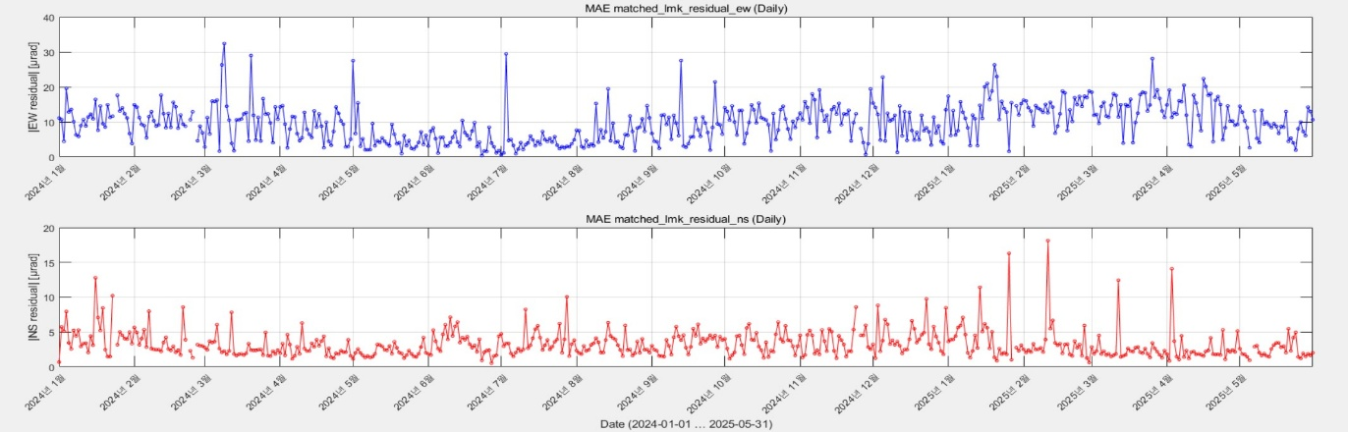
3
Analysis of Geo. correction
Analysis of Geometric accuracy through matching based on GK-2A
Due to observation characteristic of GEMS(spatial/radiometric resolution, wavelength), to difficult for extracting features and acquiring landmarks → using other sat data with guaranteed geometric correction quality(GK-2A/AMI)
- considering scan pattern: GEMS: East Asia E→W during 30min / AMI: full disk N→ S during10min
- spectral coincidence: fitting the GEMS wavelength according to AMI blue band SRF
- spatial matching: average of AMI pixel values contained in GEMS pixel
GEMS vs AMI comparison
GEMS vs AMI matching
AMI
accuracy

Slide 15
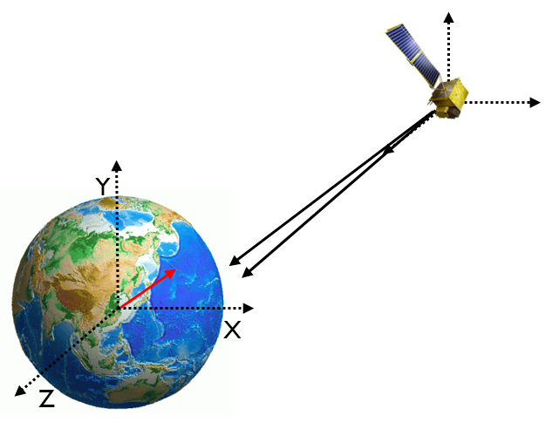
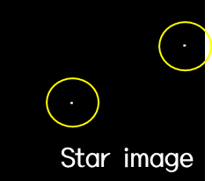
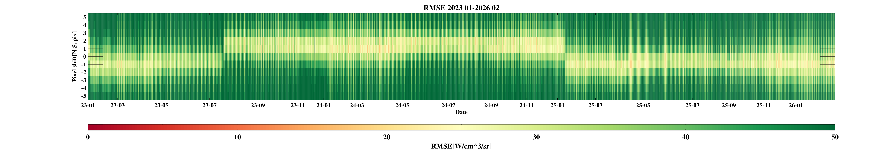
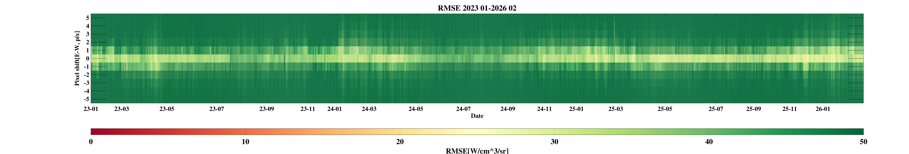
3
Analysis of Geo. correction
Analysis of Geo. accuracy through matching based on GK-2A
Star tracker attitude control
Results of Geo. Correction accuracy analysis (’23.1~’26.2) -> ± 1pixel error in N-S direction
Geo. Correction error due to GEMS reboot
Change to attitude control methods in preparation for extended GEMS operation
Applying attitude
control(’23.4.3~24)
Applying attitude
control(’23.9.24~)
Reboot(‘23.7.17)
Reboot(‘25.1.13)
North-South
East-West

Slide 16
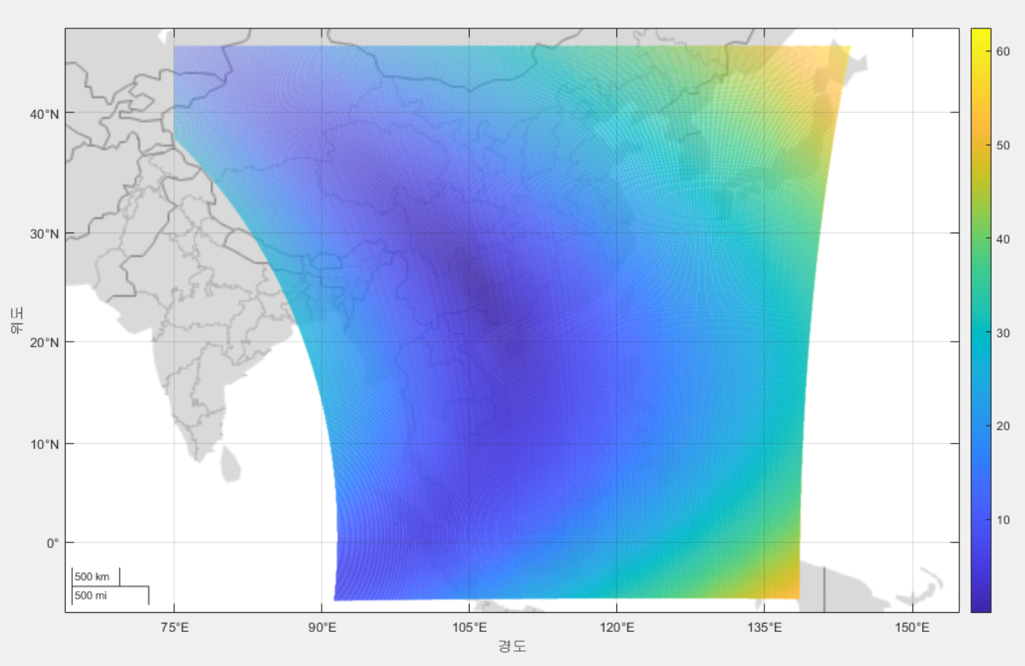
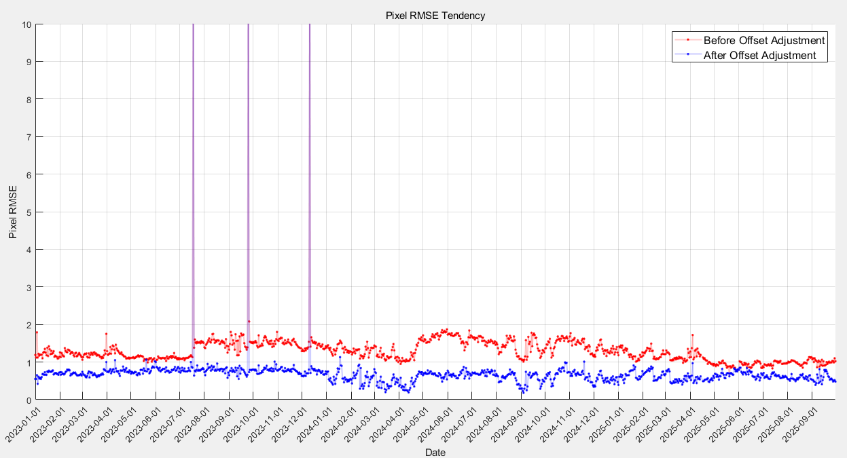

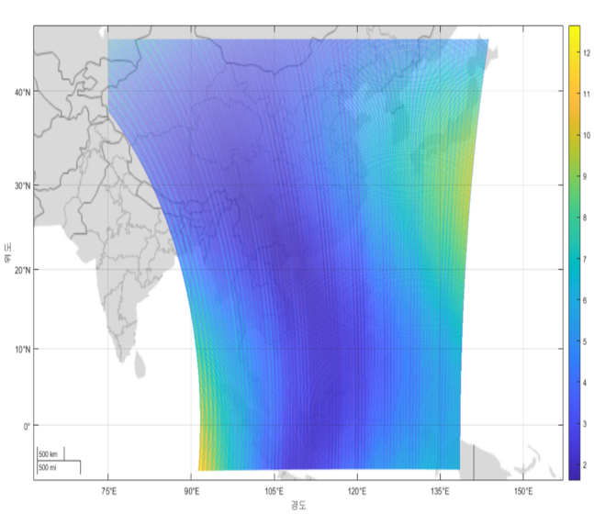
3
Analysis of Geo. correction
Analysis of Geo. accuracy through matching based on GK-2A
Offset adjustment using spatiotemporal matching results
INR bias improved from 1~1.5pixels to within 0.65 pixels

