Slide 1
Research on the Non-Uniformity Correction Method for FY-3F OMS-N
Mao Jinghua¹, Wang Yongmei ¹, Wang Qian² , Hu Xiuqing², Yan Huanhuan²,Wang Yapeng², Xu Jian¹ , Fan Meng³ , Yu Chao³, Wei Fei¹
1 NSSC 2 NSMC 3 AIRCAS
March 25, 2026

Slide 2
Outline
FY-3F OMS-Nadir instrument Review
On-orbit Performance and Analysis
On-orbit Performance
WLS Analysis
Data Processing
Level 2 Product Validation
  AOD and AAI
  NO₂ TVCD
  Cloud Fraction
  Conclusion

Slide 3
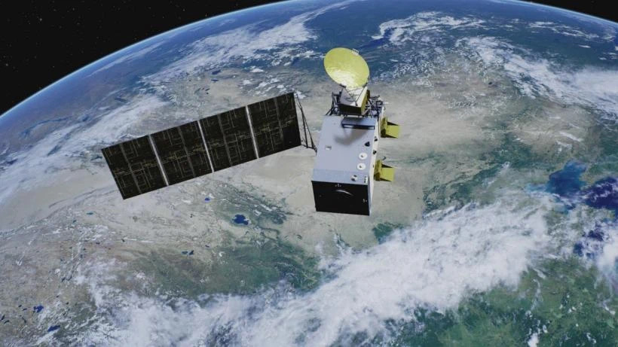
FY-3F OMS-Nadir instrument Review
The launch date for FY-3F is end of 2023 with a 8 year design lifetime
The Earth system's observation capacity has been strengthened, enhancing detection of stratospheric and tropospheric components like ozone and sulfur dioxide.
The Ozone Monitoring Suite - Nadir (OMS-N) is the payload of the FY-3F mission

Slide 4
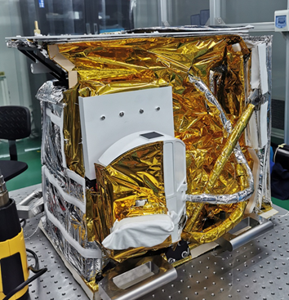
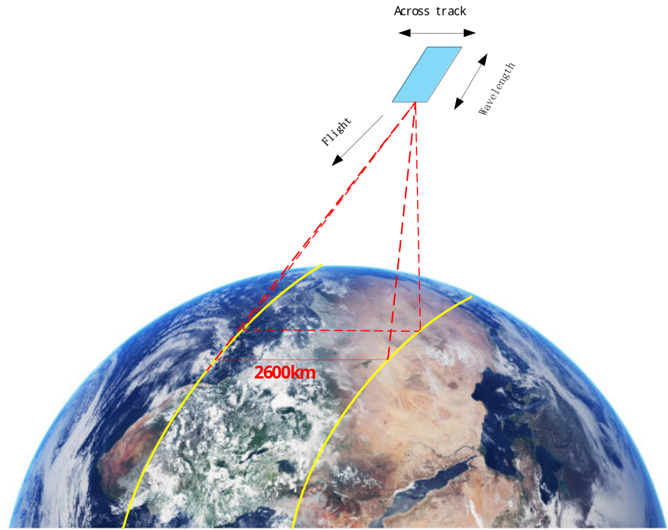
FY-3F OMS-Nadir instrument Review
The OMS-N
UV-VIS nadir viewing pushbroom grating spectrometer
Spectral range : 250-320nm,310-495nm
Spectral resolution :0.5-0.6nm
FOV :112°
Spatial resolution(nadir):7×7km²
The science products
Total column: O₃，NO₂，SO₂ ，HCHO,BrO,OCIO
O₃ profile
Aerosol：optical depth，absorbing index

Slide 5
Outline
FY-3F OMS-Nadir instrument Review
On-orbit Performance Analysis and Data Processing
On-orbit Performance
WLS Analysis
Data Processing
Level 2 Product Validation
  AOD and AAI
  NO₂ TVCD
  Cloud Fraction
  Conclusion

Slide 6
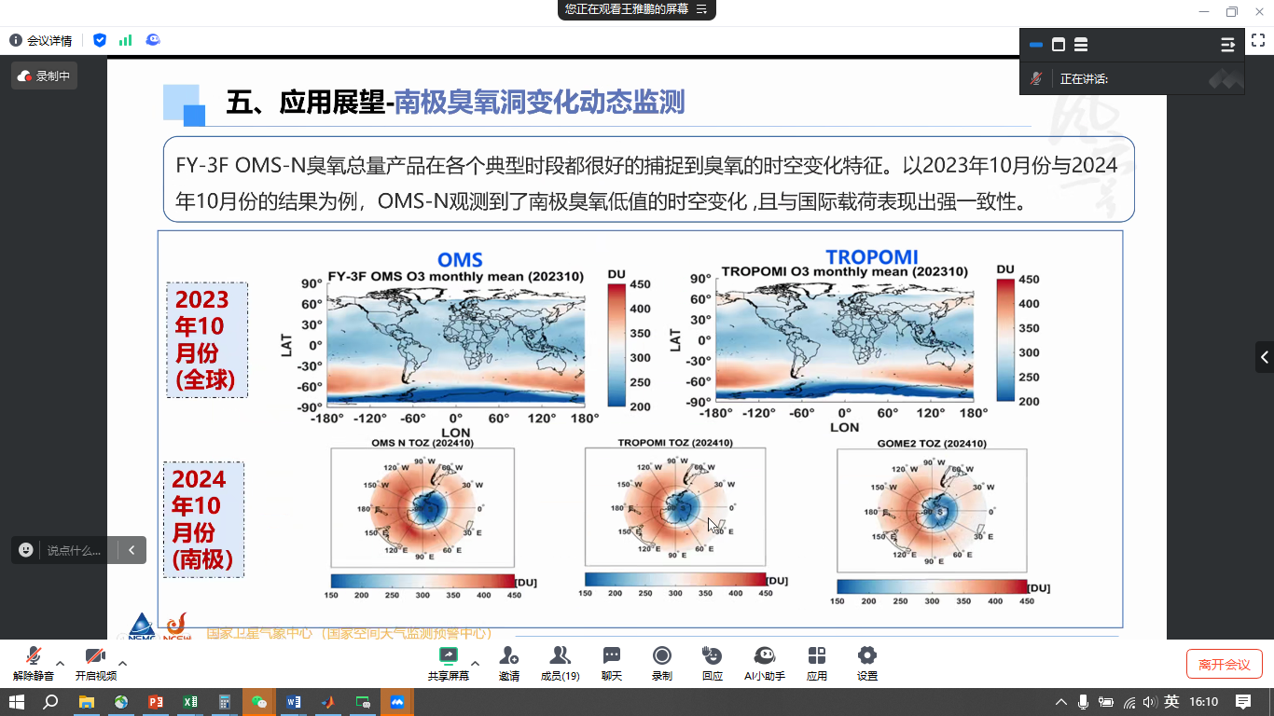
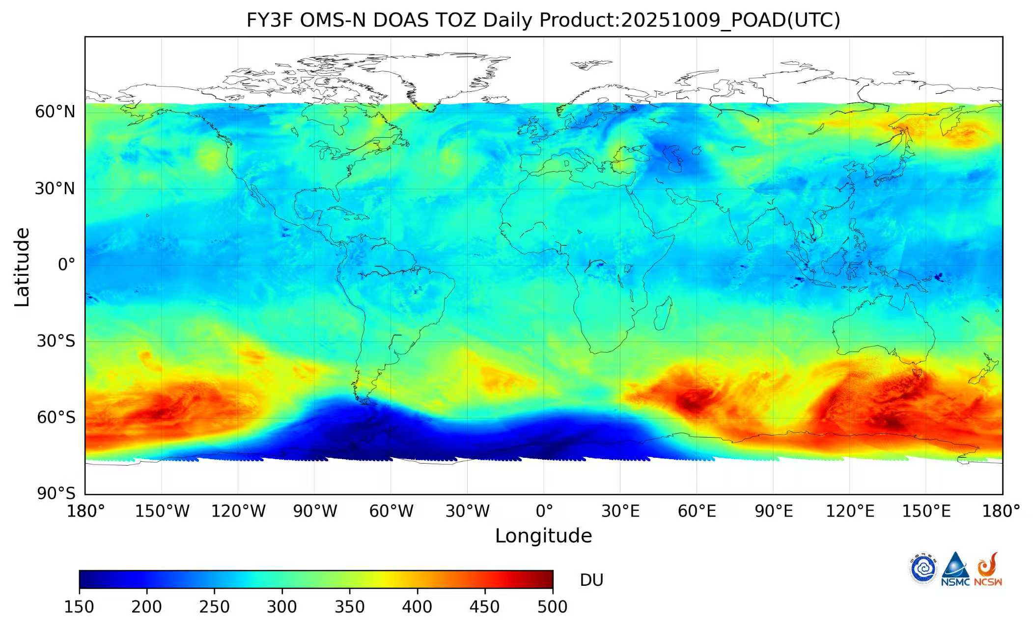
On-orbit Performance
O₃
2025/10/9
目 录
CONTENTS
CONTENTS
（Image source: Xu, Wang, Chen, et al., Science China Earth Sciences）
CMA/NSMC and NSSC/CAS
（Image source ：NSMC）
Since October 2023, OMS-N has been tracking the spatiotemporal changes of the Antarctic ozone hole for two straight years.
Building on the FY-3A, B, C/TOU heritage, the China Meteorological Administration (CMA) has once again secured operational capacity for annual ozone hole monitoring.

Slide 7
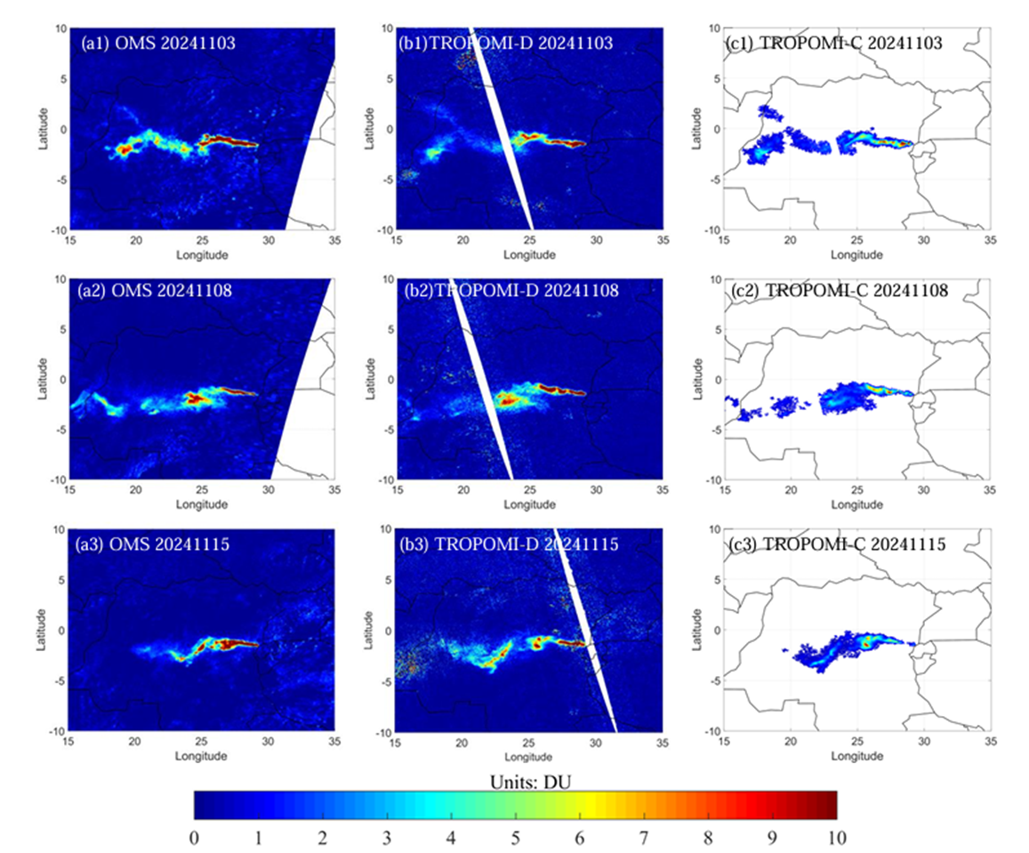
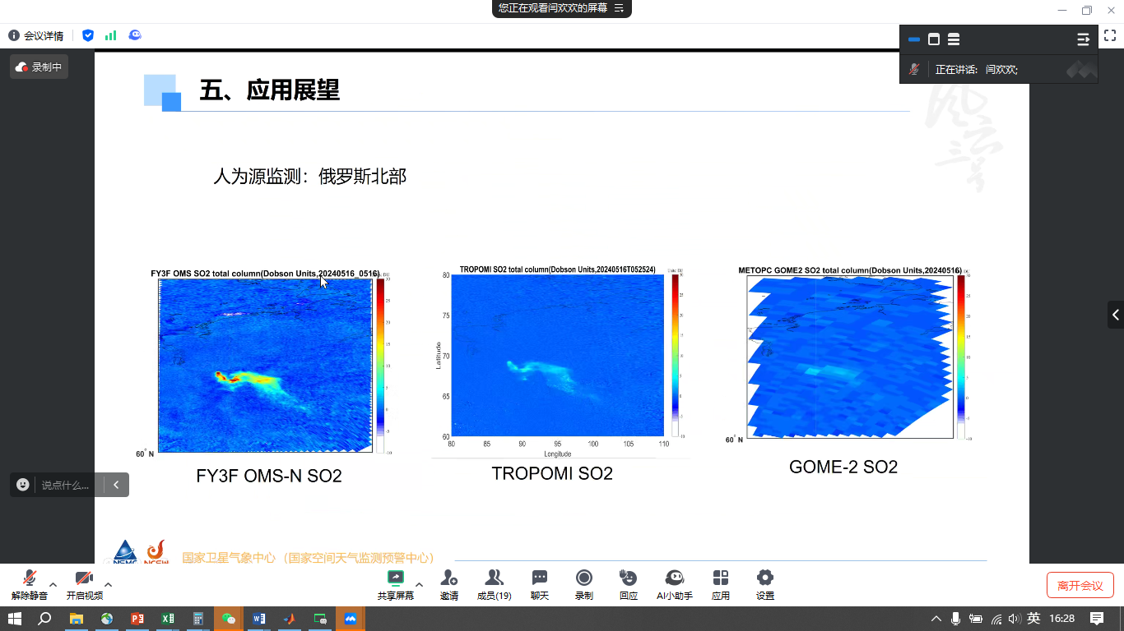
On-orbit Performance
SO₂
SO2 retrievals of OMS and TROPOMI over the Nyamuragira volcano on November 3, 8, and 15, 2024. The missing pixels are the gap between the two orbits, or the Nan values in TROPOMI COBRA data
OMS-N demonstrates high sensitivity in SO₂ monitoring for volcanic eruptions and anthropogenic source pollution.
(Image source:SO2 retrievals of OMS and TROPOMI over the Nyamuragira volcano on November 3, 8, and 15, 2024. The missing pixels are the gap between the two orbits, or the Nan values in TROPOMI COBRA data)

Slide 8
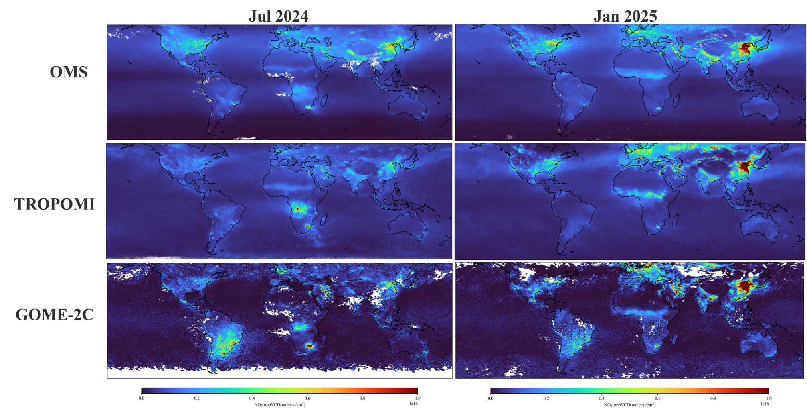
On-orbit Performance
NO₂
（Image source:Yu Chao, et al. Aerospace Information Research Institute, Chinese Academy of Sciences）CMA/NSMC, AIR/CAS, NSSC/CAS
The global distribution results demonstrate that the three NO₂ datasets from OMS, TROPOMI, and GOME-2 exhibit good consistency, particularly over anthropogenic activity regions including East Asia, Western Europe, the Middle East, and central-southern Africa.
Compared with GOME-2, OMS has a higher spatial resolution, showing a significant advantage.

Slide 9
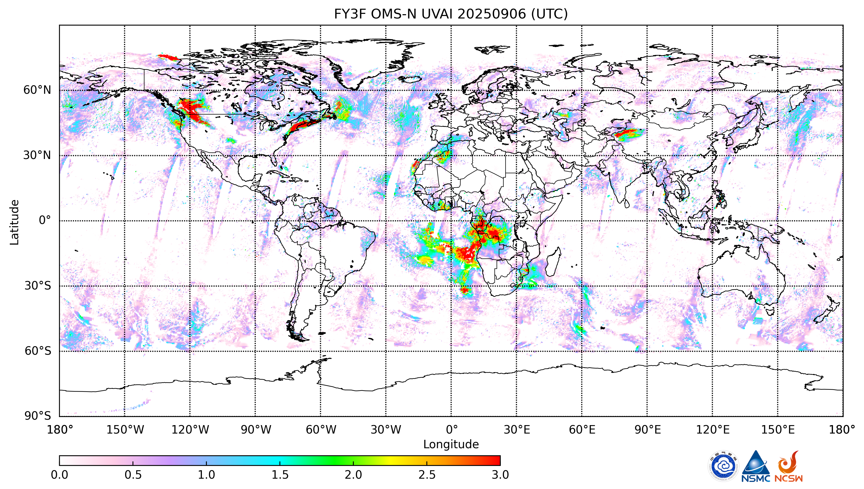
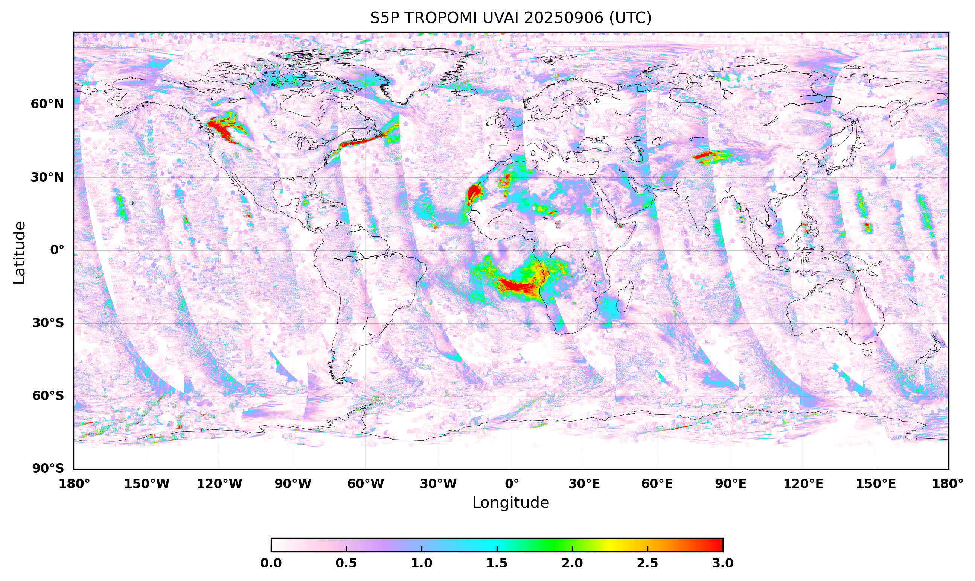
On-orbit Performance
UVAI
OMS-N UVAI
TROPOMI UVAI
African dust plume
African dust plume
North American wildfire emission plume
Asian dust plume
North American wildfire emission plume
Asian dust plume
Large-scale biomass burning emission plume from "slash-and-burn" agriculture in southern Africa
Large-scale biomass burning emission plume from "slash-and-burn" agriculture in southern Africa
（ Image source: Meng Fan , et al. Aerospace Information Research Institute, Chinese Academy of Sciences）CMA/NSMC, AIR/CAS, NSSC/CAS
As Sentinel-5P is an afternoon satellite with a large overpass time gap from FY-3F, plume position drift occurs.
OMS-N and TROPOMI successfully captured the plume conditions of different events.

Slide 10
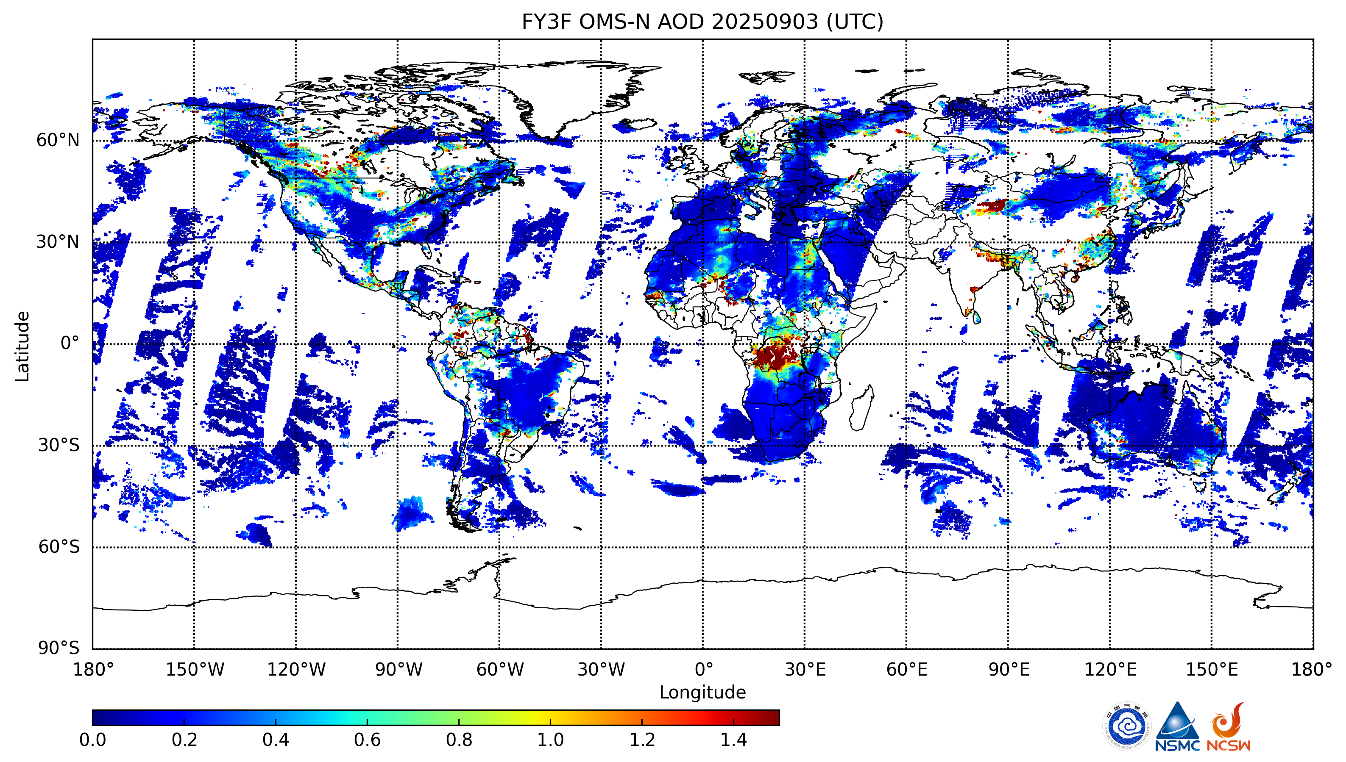
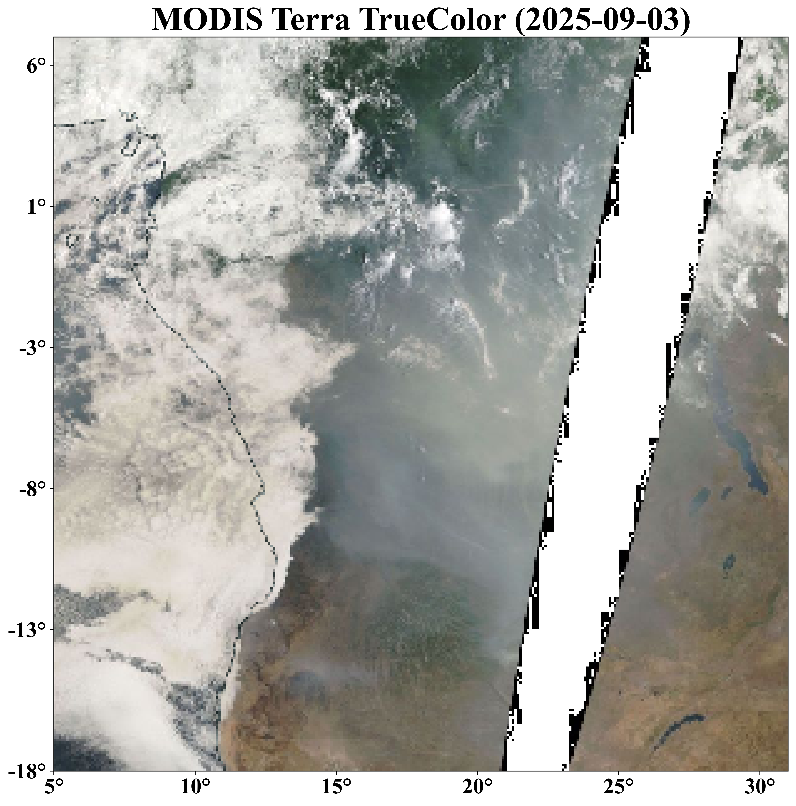
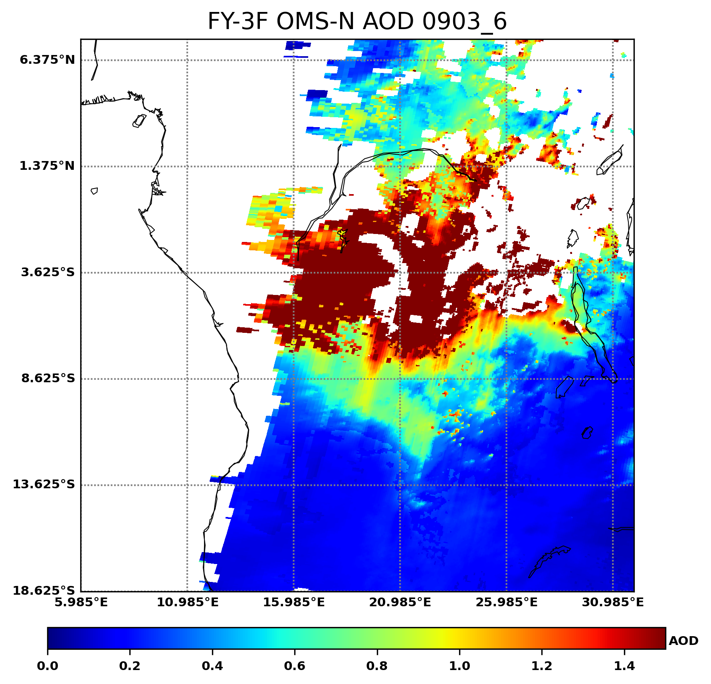
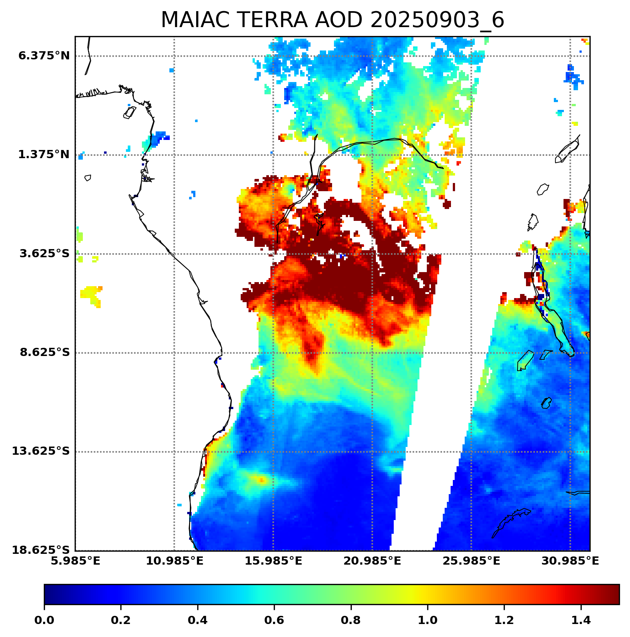
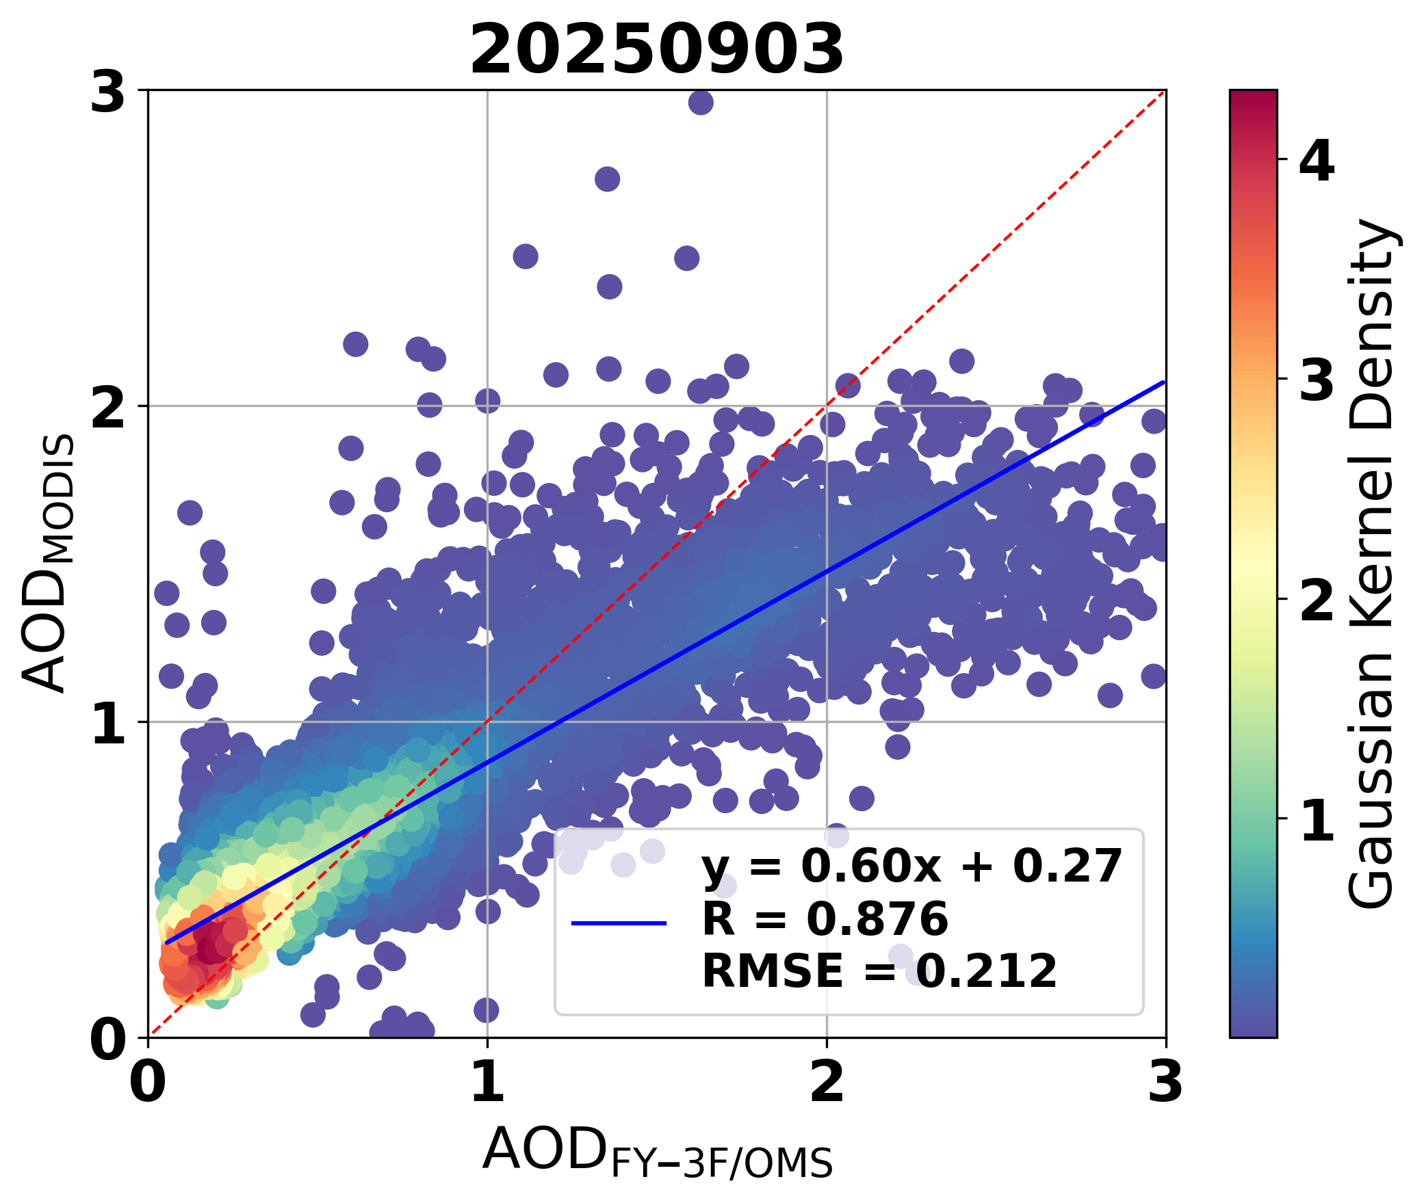
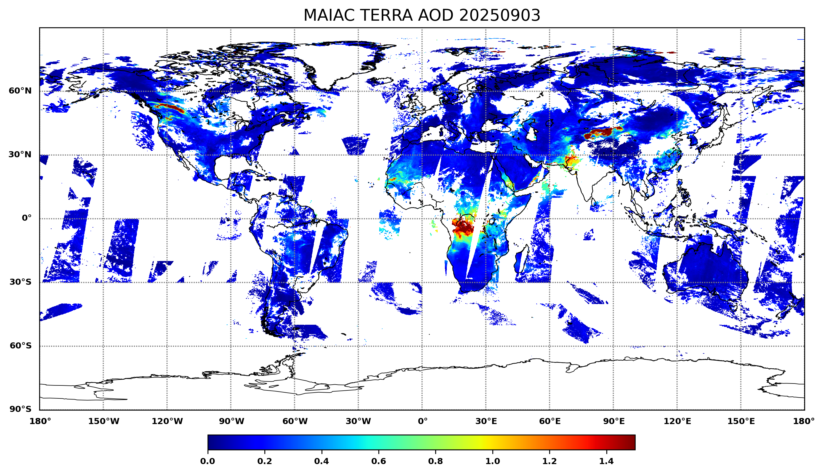
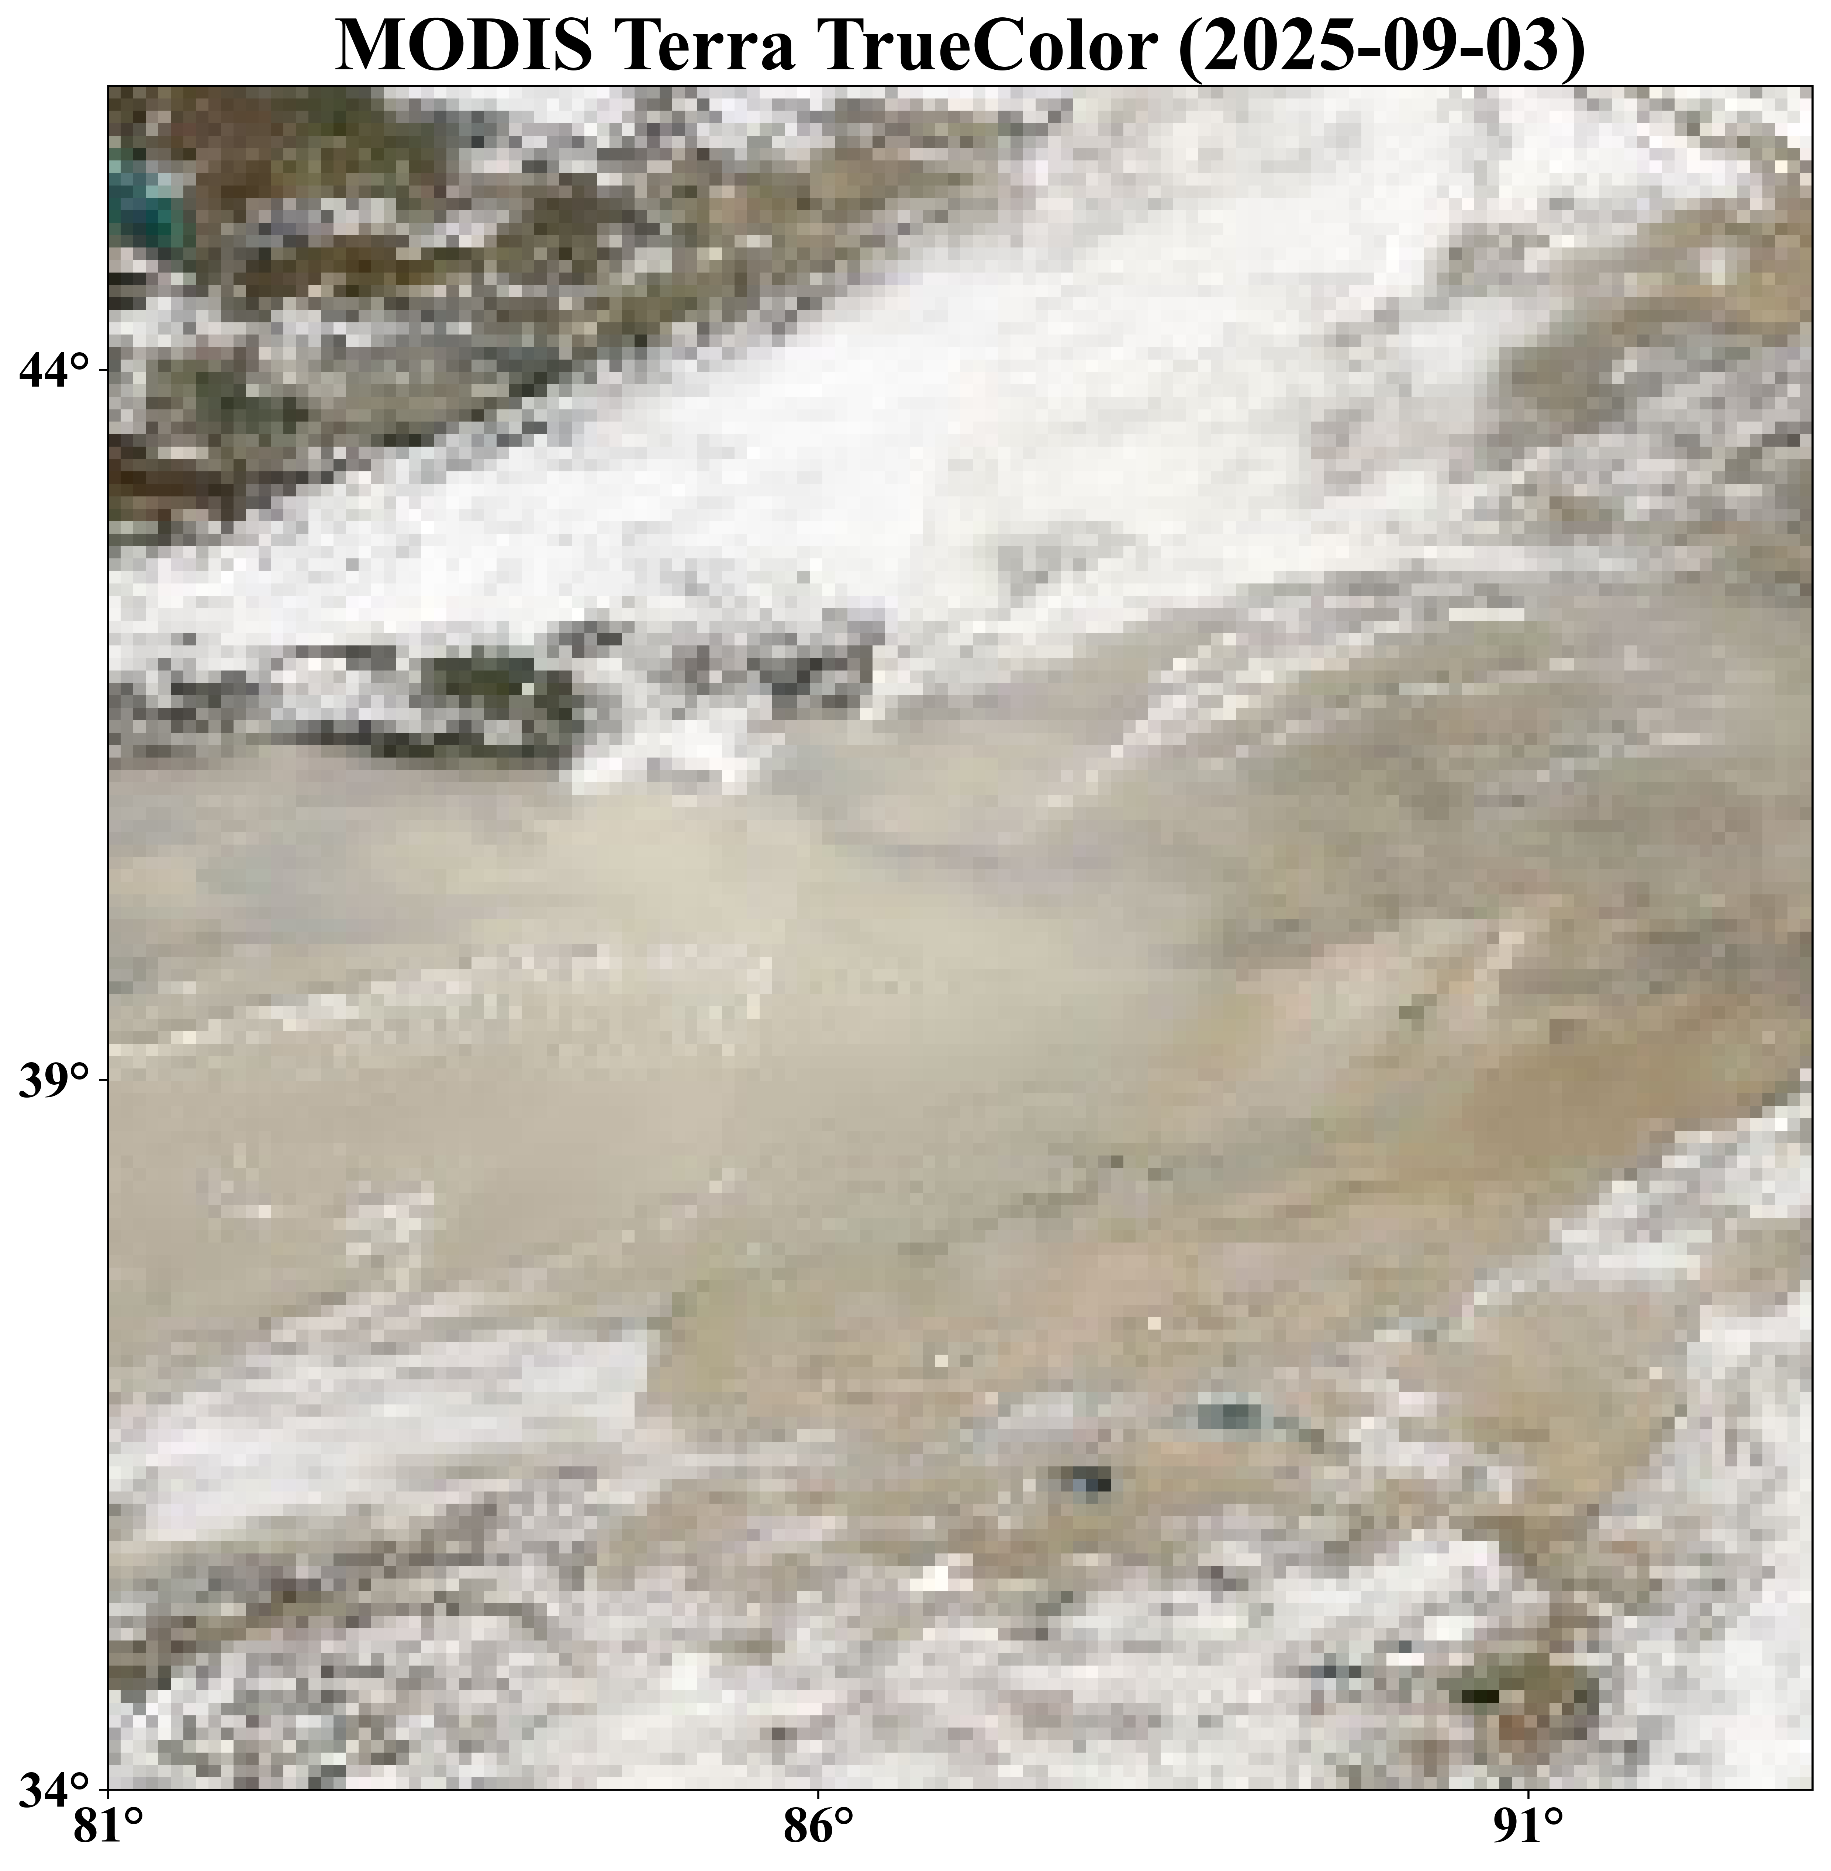
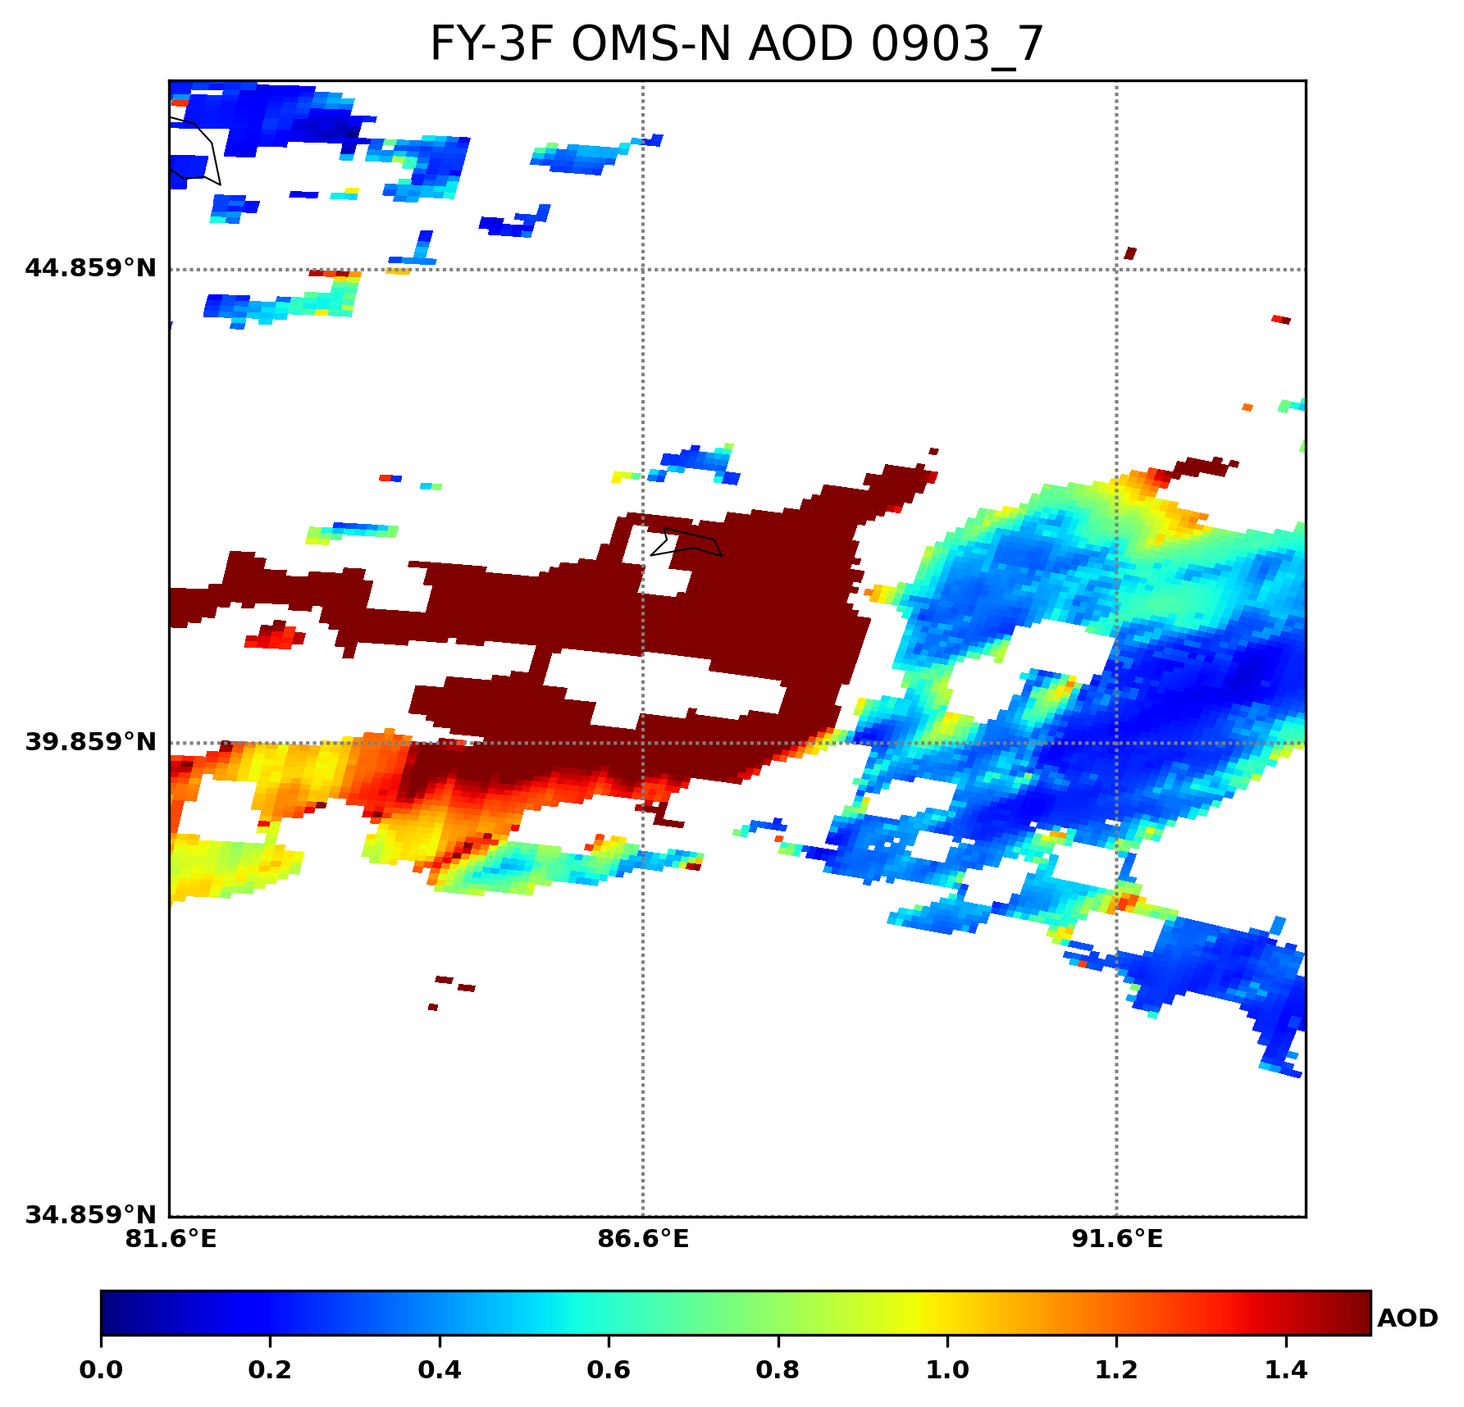
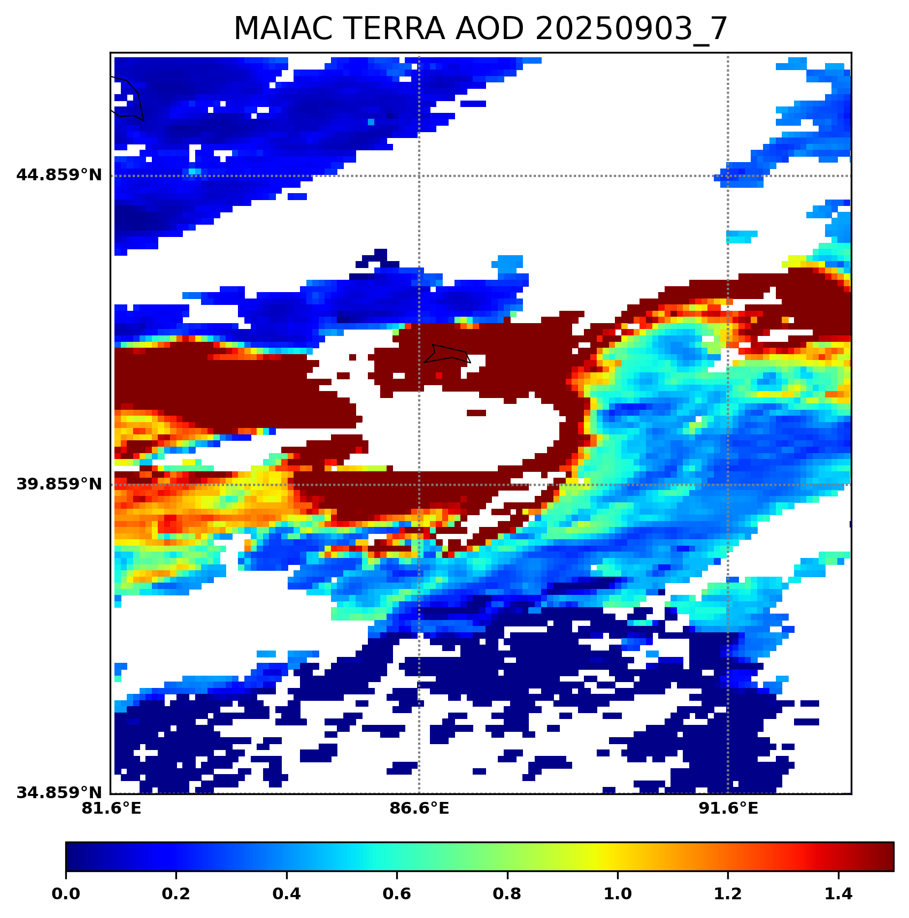
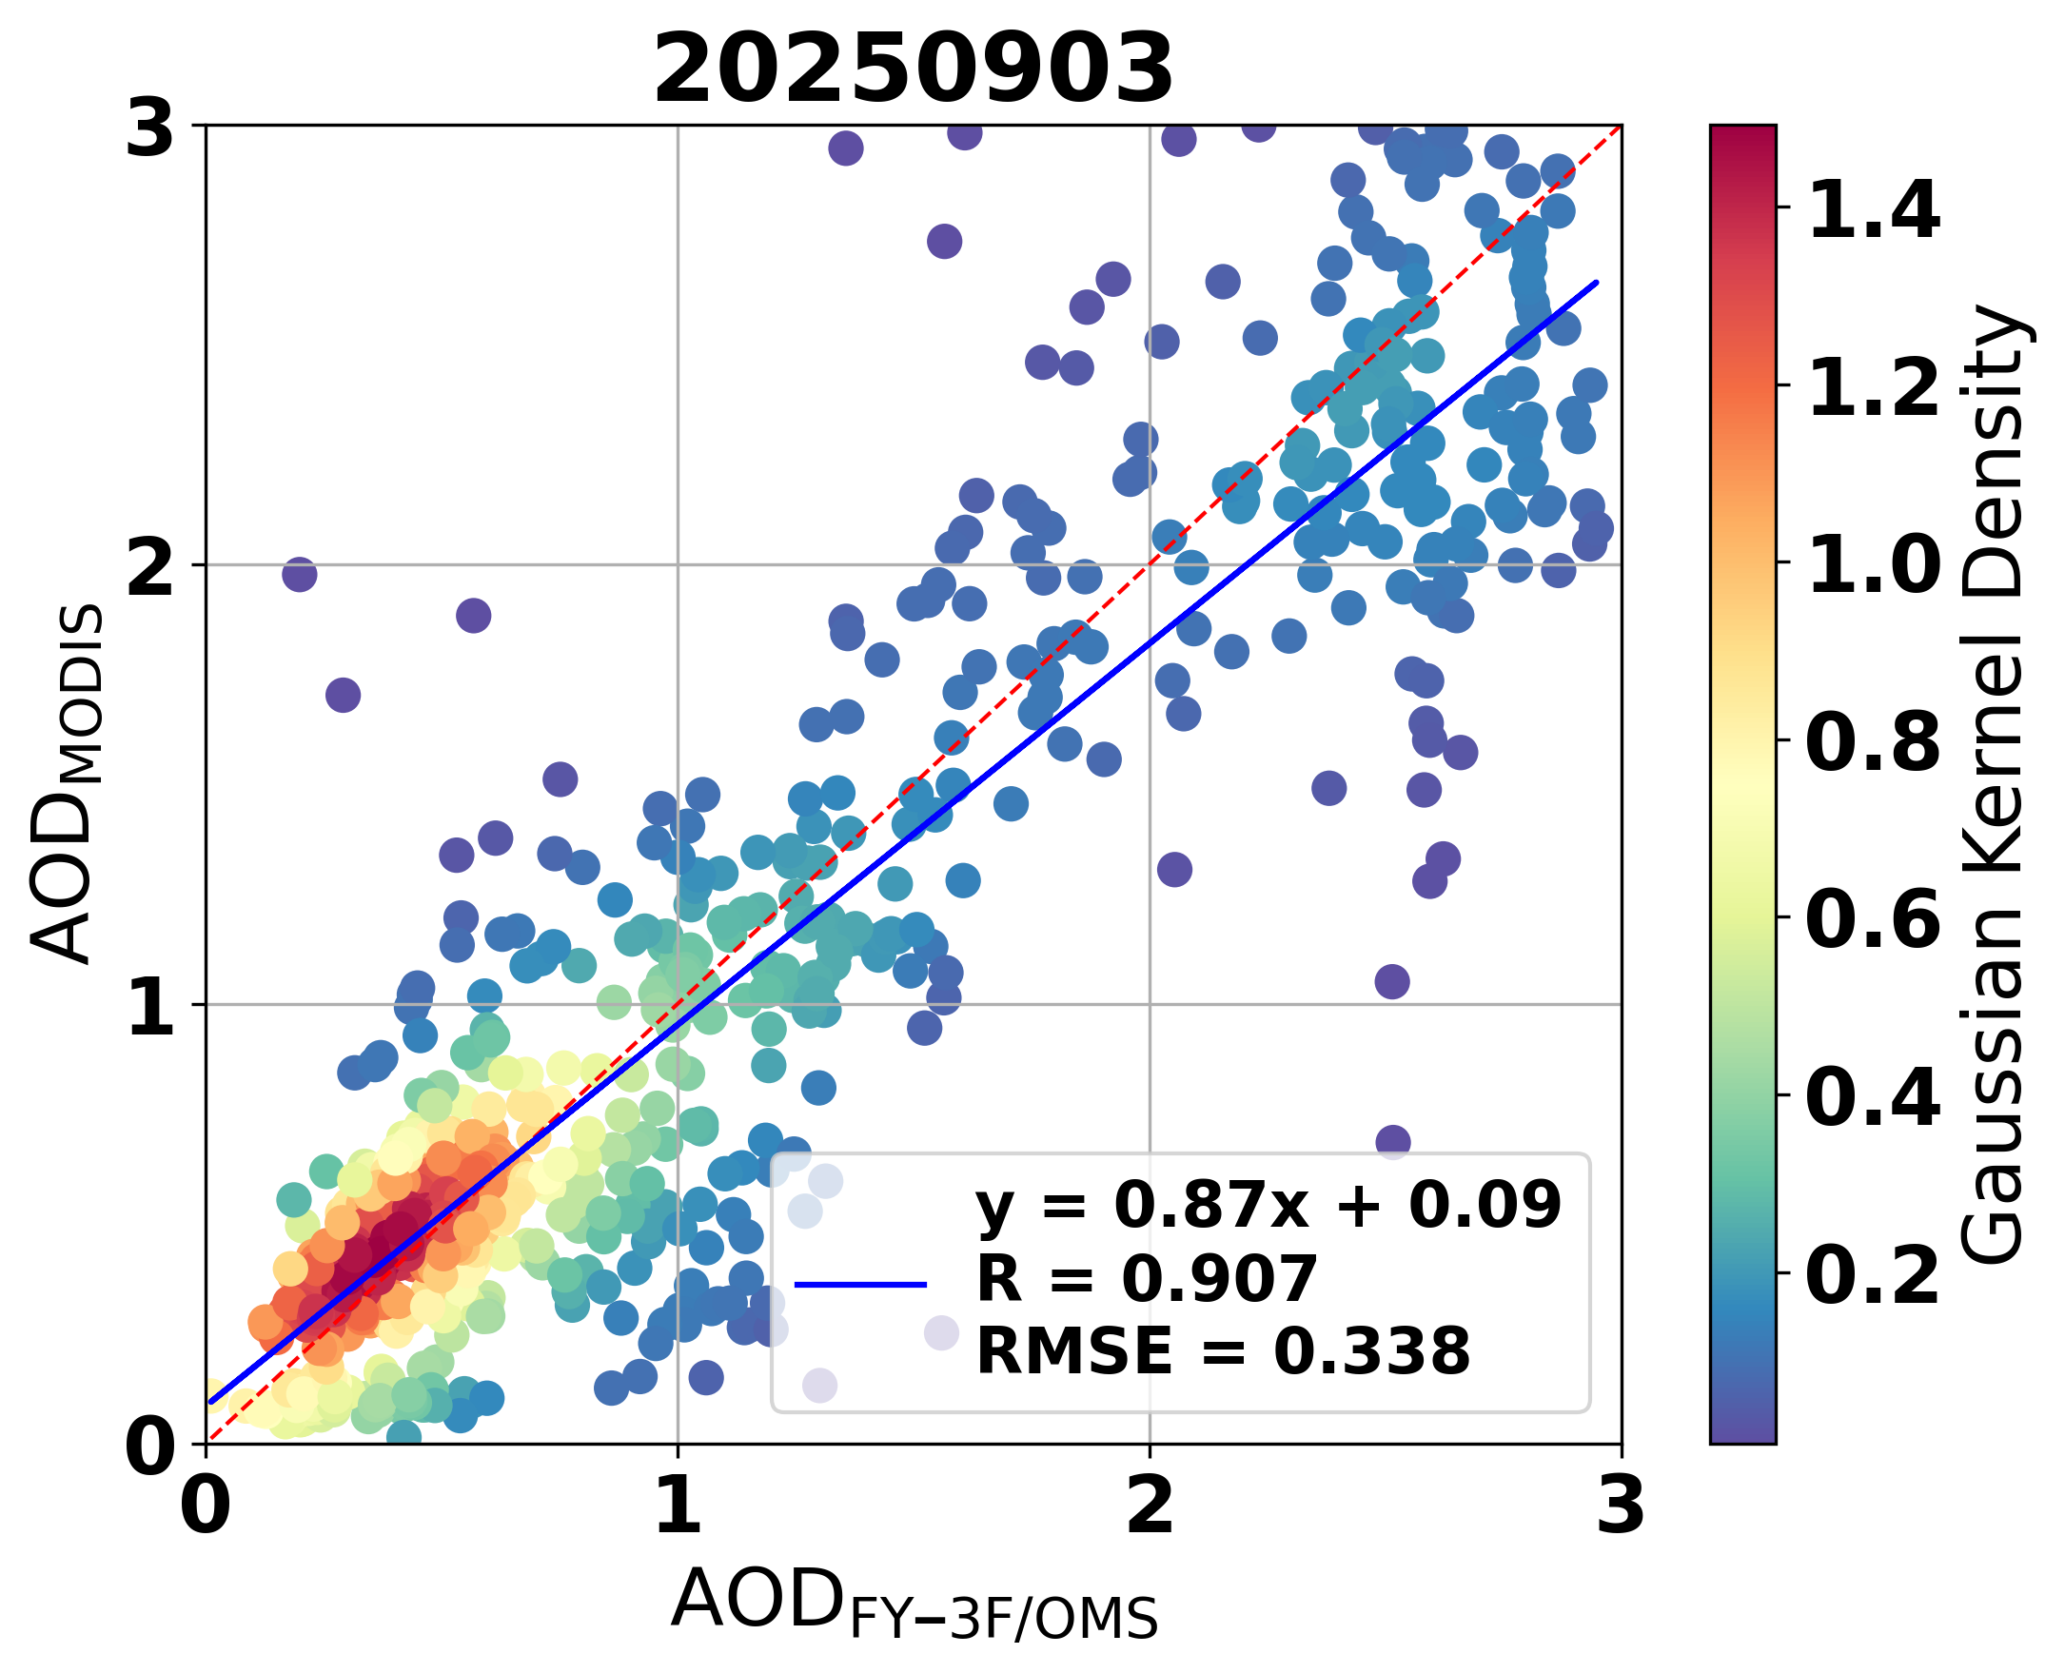
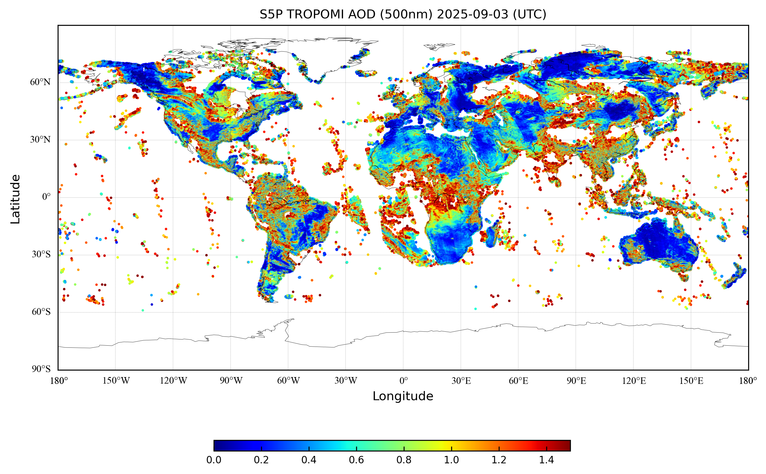
On-orbit Performance
AOD
True Color Image
OMS-N AOD
MODIS AOD
AOD Validation Results
OMS-N
MODIS
TROPOMI
Cross-validation shows OMS-N AOD has better consistency with MODIS AOD (industry benchmark) than TROPOMI AOD.
In highly polluted areas, its spatial distribution agrees well with MODIS.
Correlation coefficient R > 0.85 stably, and > 0.9 in some typical regions.

Slide 11
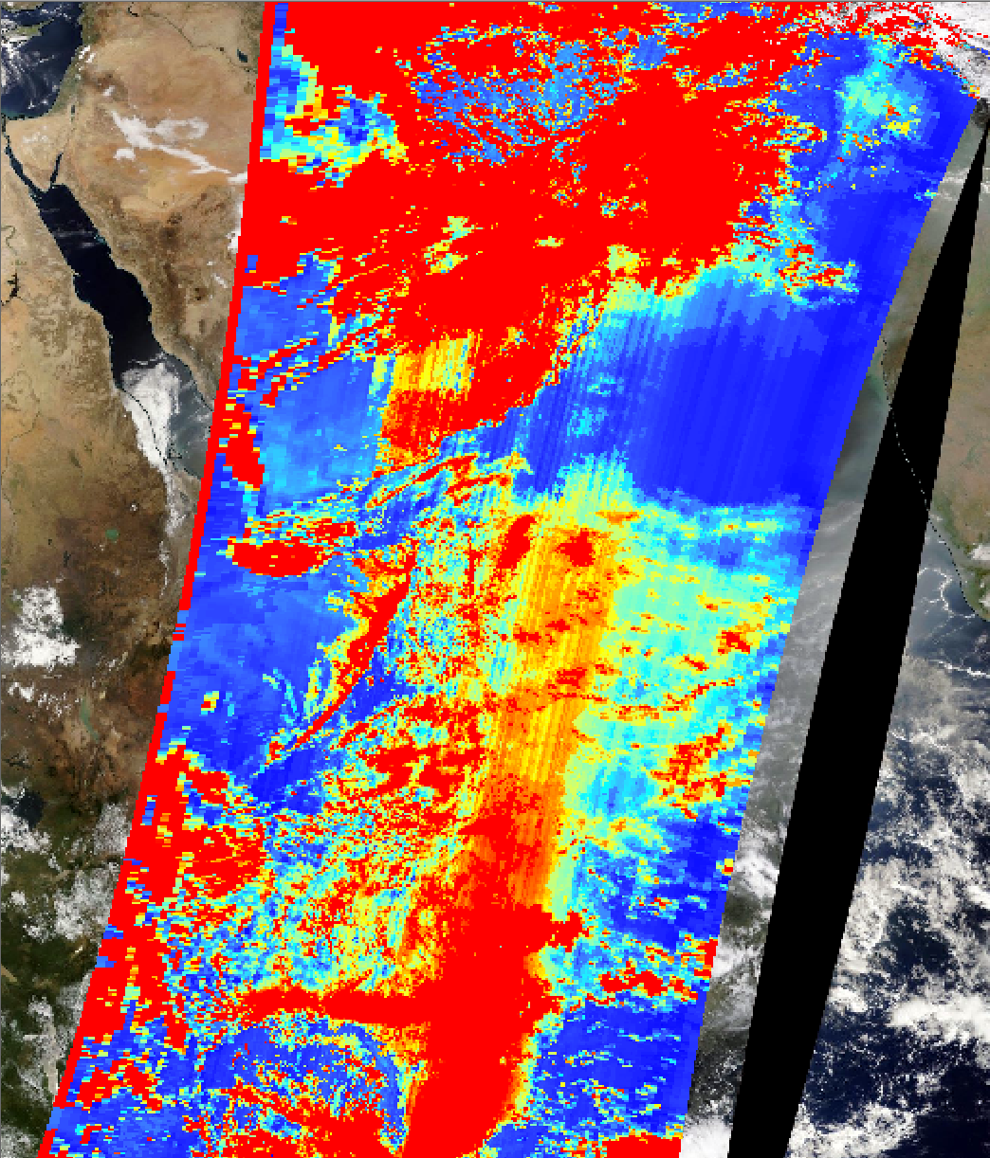
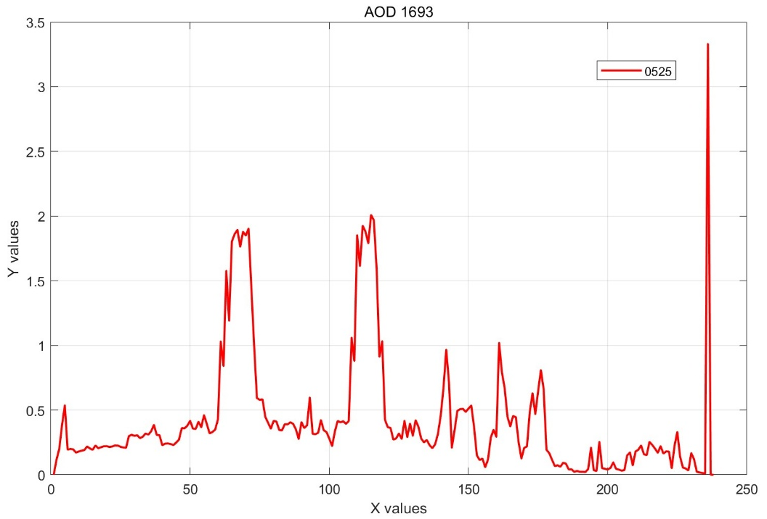
Analysis
We have found that striping artifacts are widespread in the product, leading to degraded data quality, so we conduct stripe analysis during the L1 data preprocessing stage.
0.5
Striping artifacts are widespread in the product, and are more severe in high-value regions.
0

Slide 12
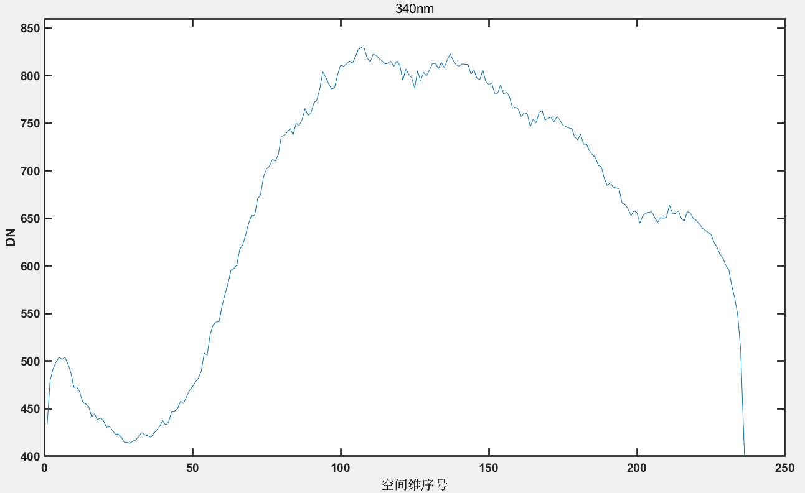
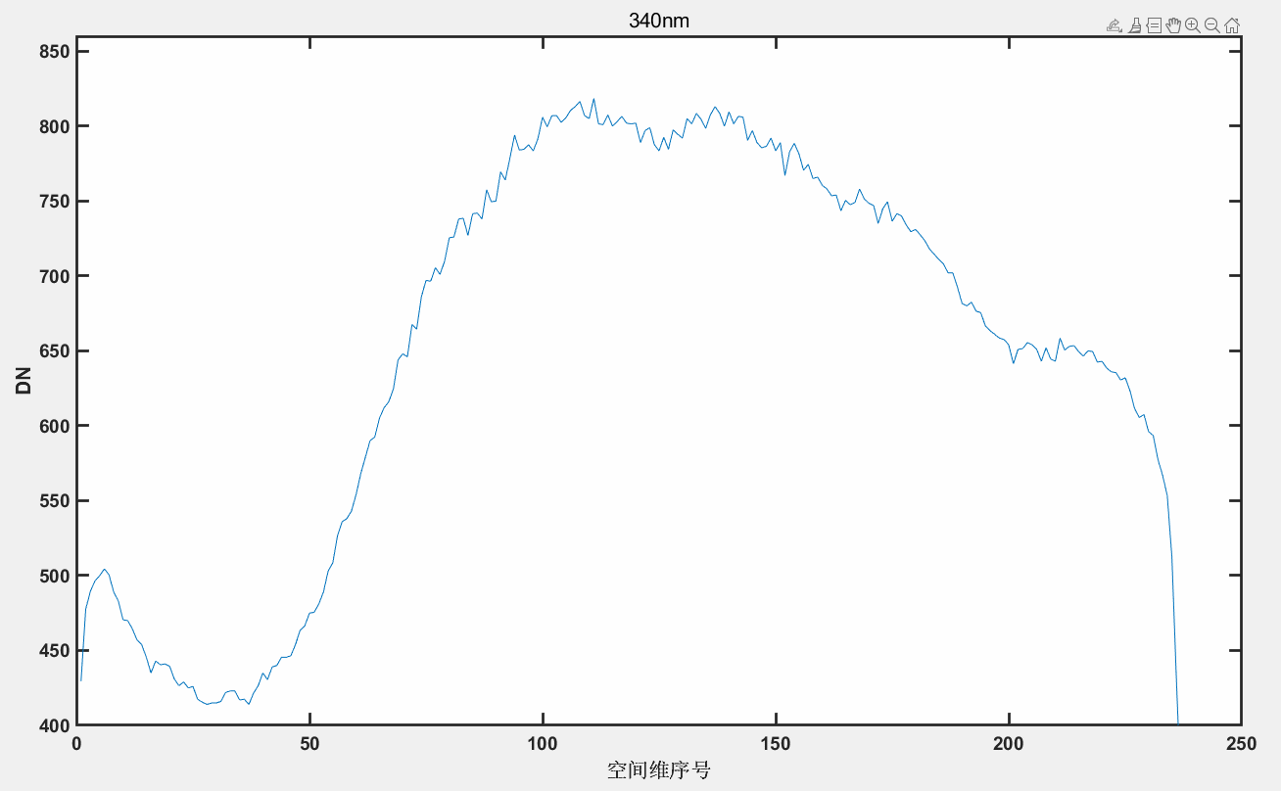
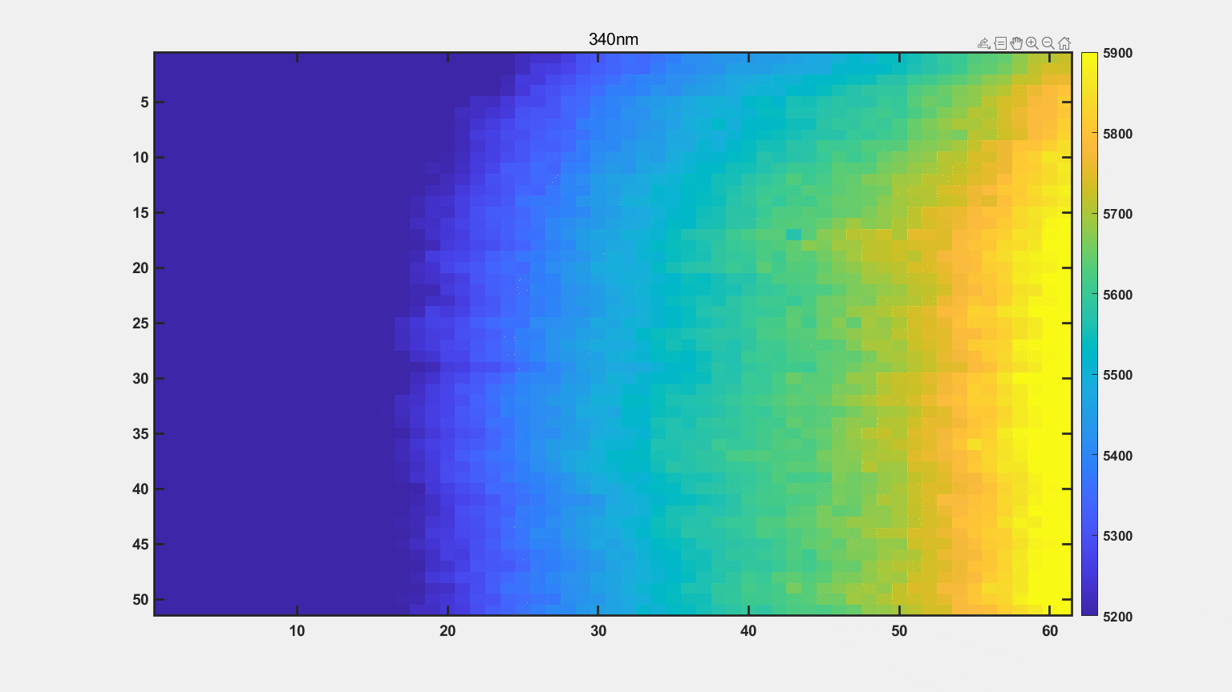
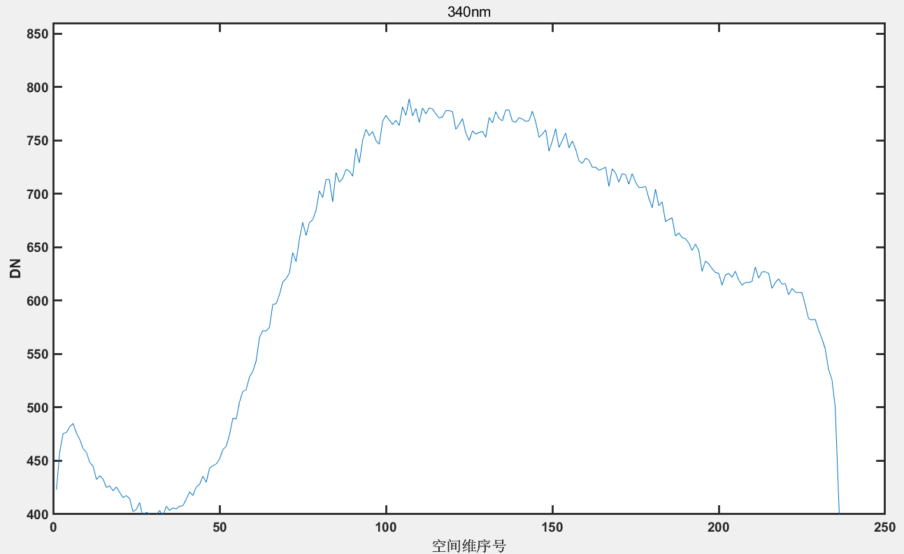
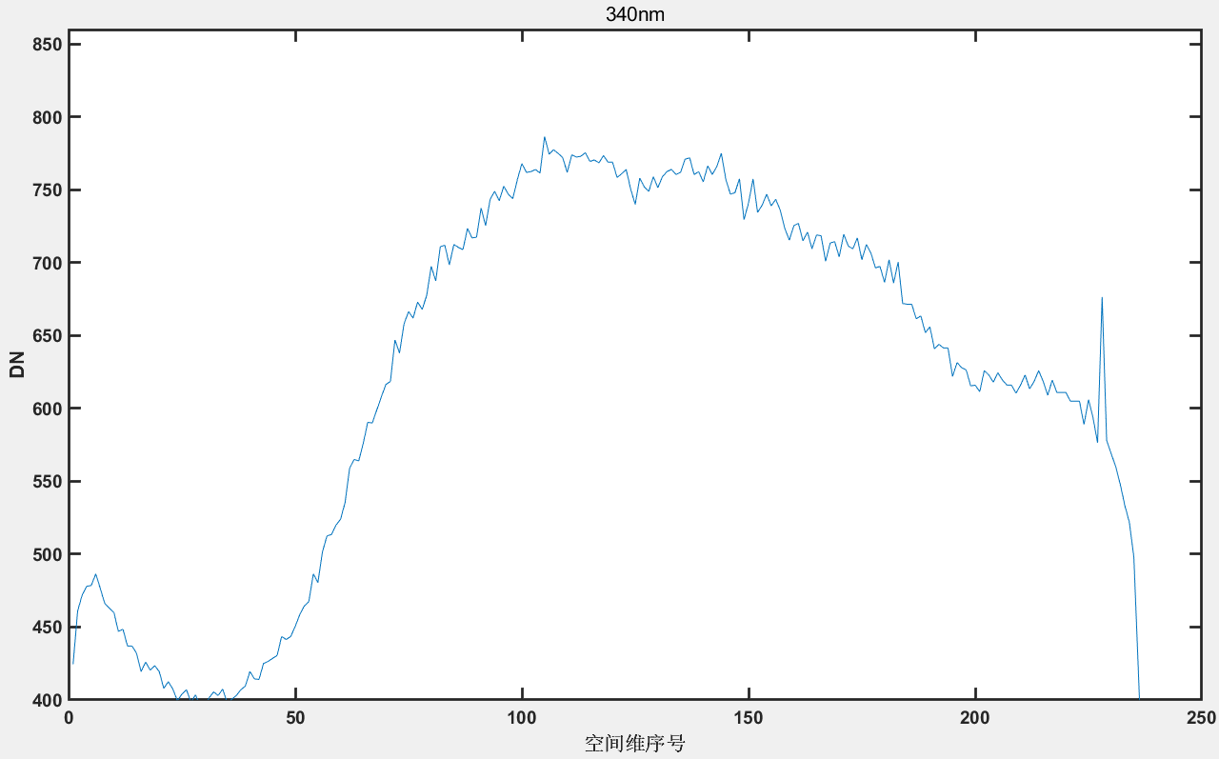
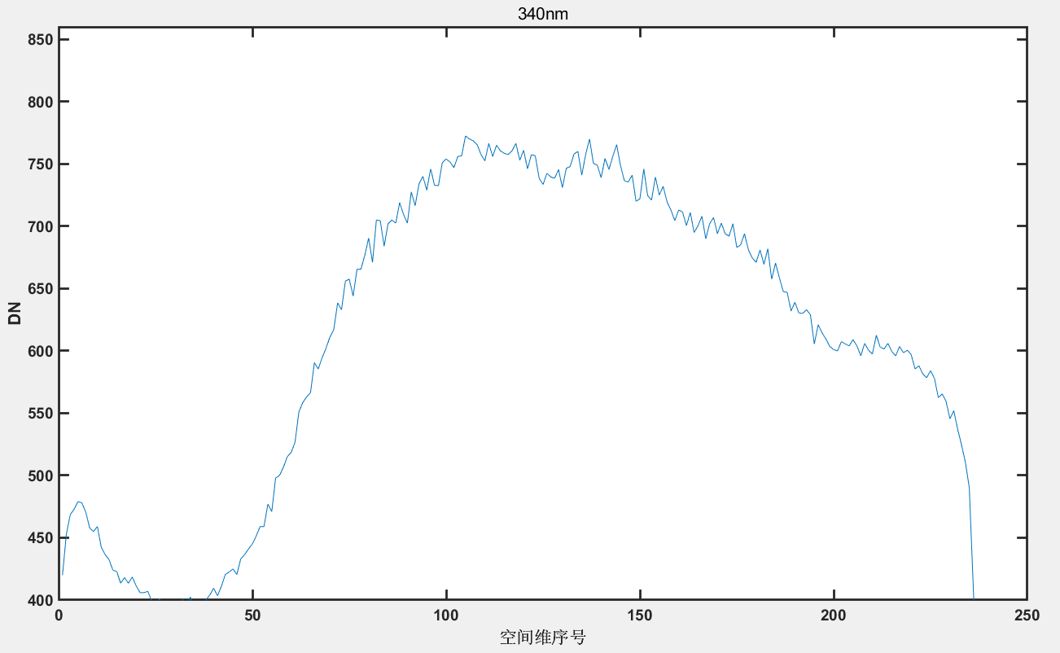
Analysis
DN Analysis – On-orbit White Light Source
Same Lamp Activation – Taking 340 nm as an Example
2023.09.22
2023.10.10
2024.07.22
2024.09.23
20250316
The positions of peaks and valleys vary over time.
The amplitudes of peaks and valleys fluctuate over time.

Slide 13
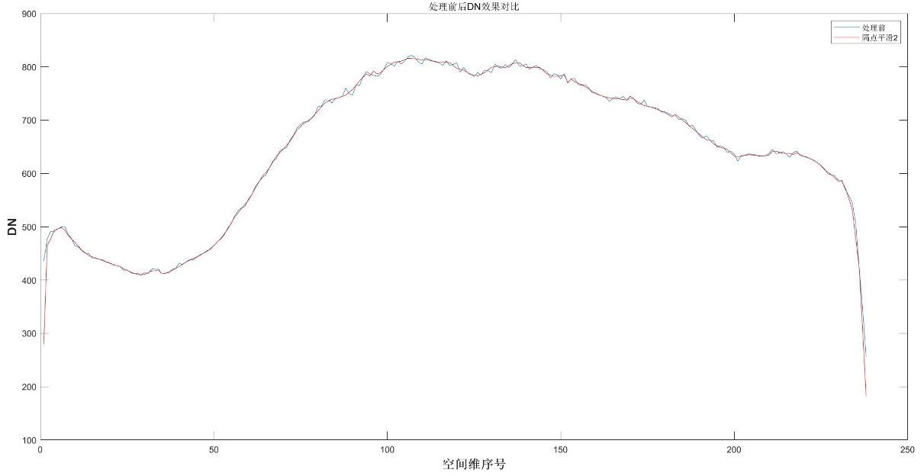
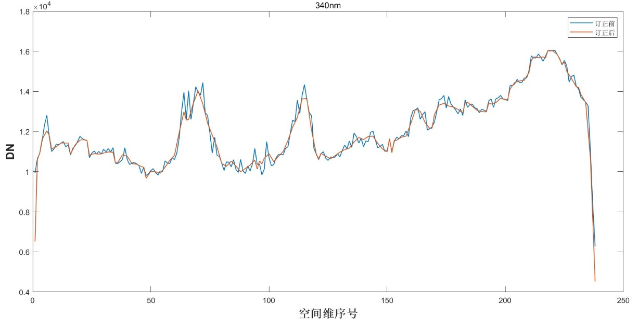
Data Processing
DN Matrix (Spectral × Spatial × Scan Line)
Dark Current Correction
DN Extraction Adapted for SMILE Effect
Comparison Before and After WLS Correction
Spatial-Domain Adaptive Multi-Pass Filtering
Perform Radiometric Coefficient Conversion
Reconstruct 3D Level‑1 Matrix
Comparison Before and After Correction for Earth Observation

Slide 14
Outline
FY-3F OMS-Nadir instrument Review
On-orbit Performance Analysis and Data Processing
On-orbit Performance
WLS Analysis
Data Processing
Level 2 Product Validation
  AOD and AAI
  NO₂ TVCD
  Cloud Fraction
  Conclusion

Slide 15
Level 2 Product Validation
L2 Product Validation
AOD&AAI
NO₂
CLOUD
340 nm & 380 nm wavelength pair algorithm – Most sensitive to striping artifacts
400–460 nm DOAS algorithm
460–490 nm spectral fitting algorithm

Slide 16
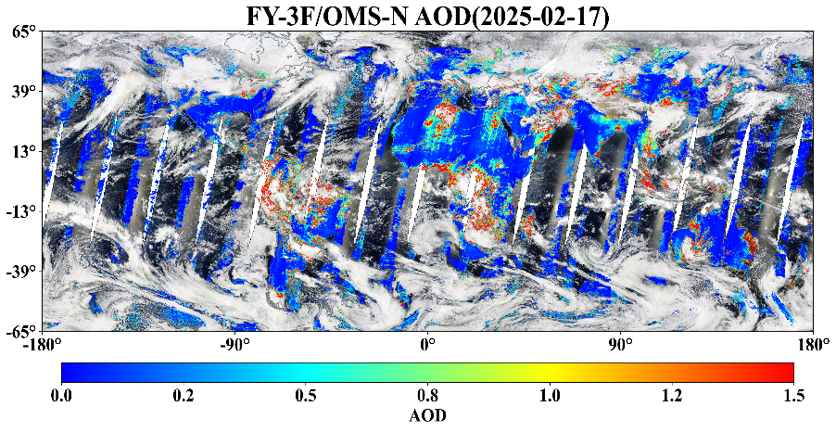
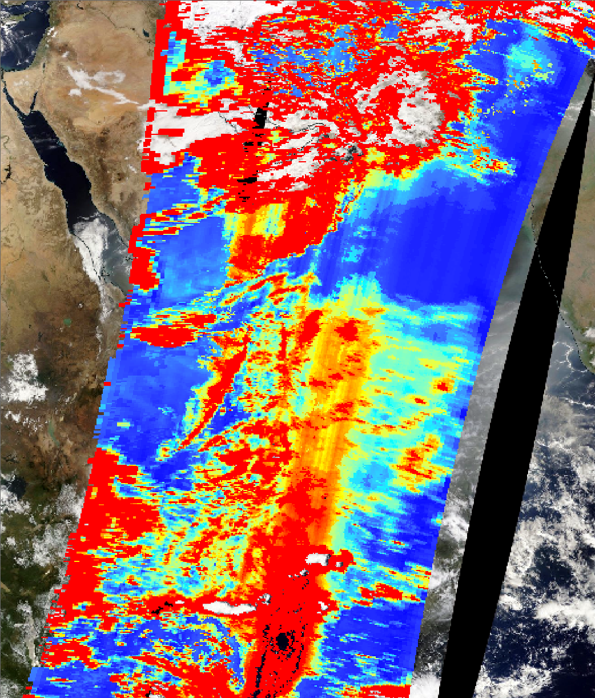
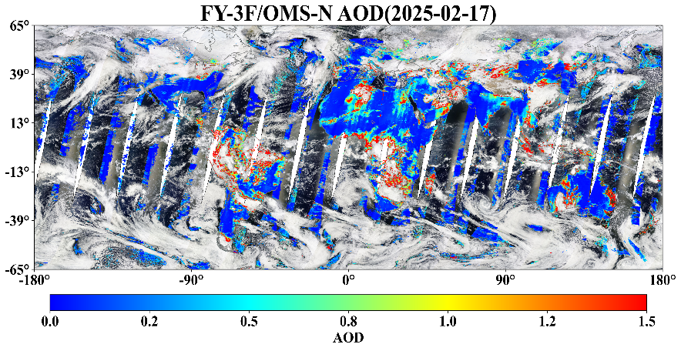
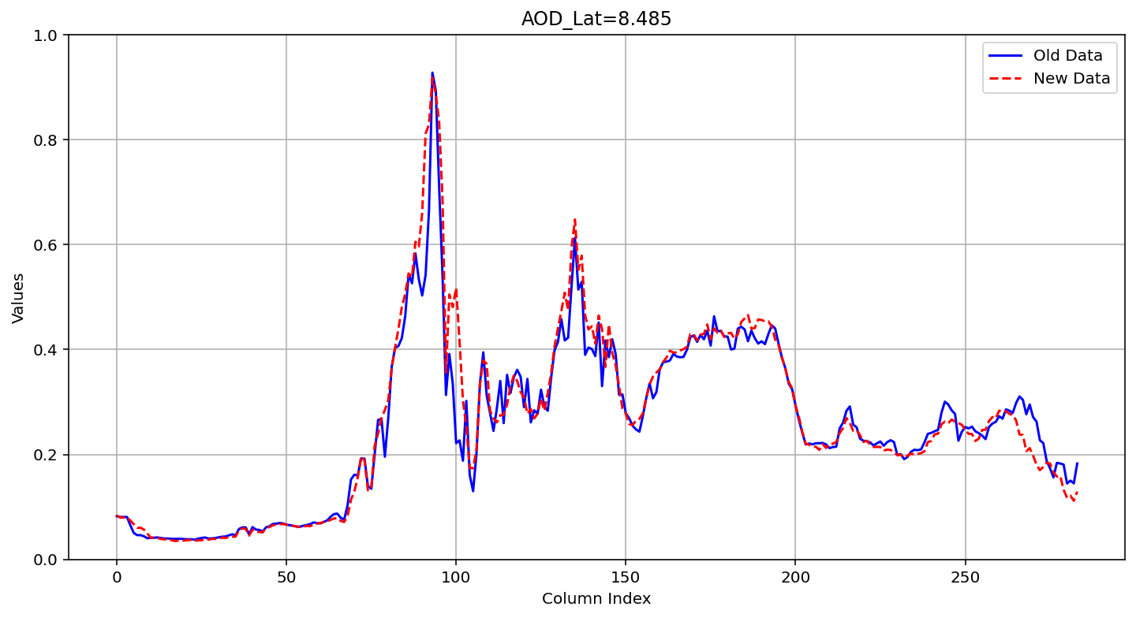
Level 2 Product Validation
AOD
Before Correction
After Correction
0.5
(a)Original L1
0
Fine striping artifacts are significantly improved
(a) L1 after PRNU correction

Slide 17
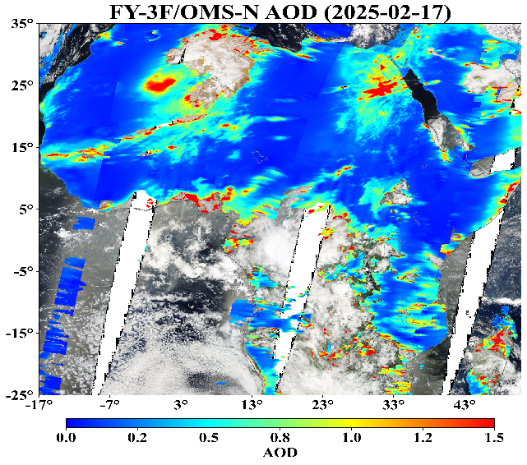
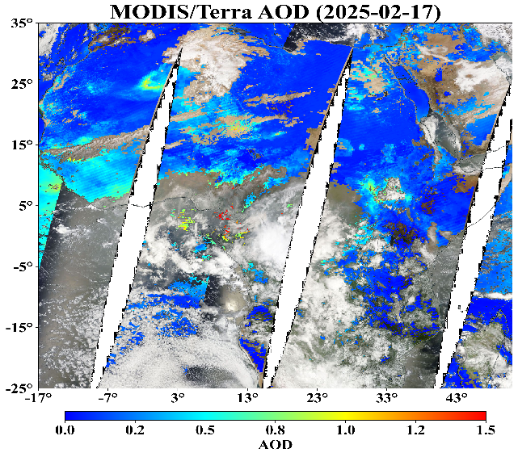
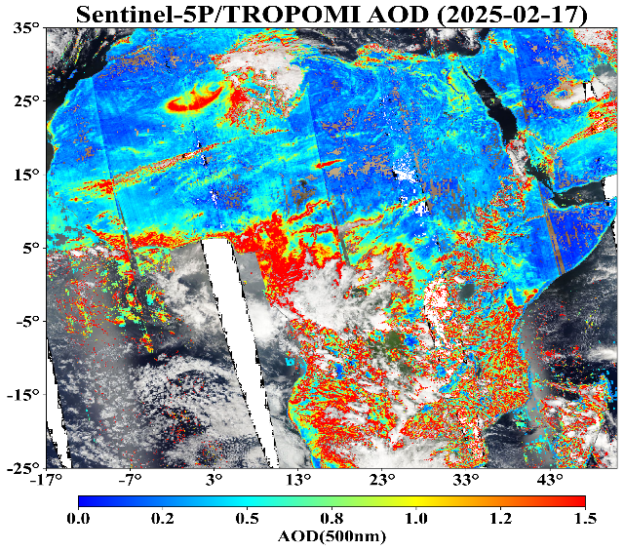
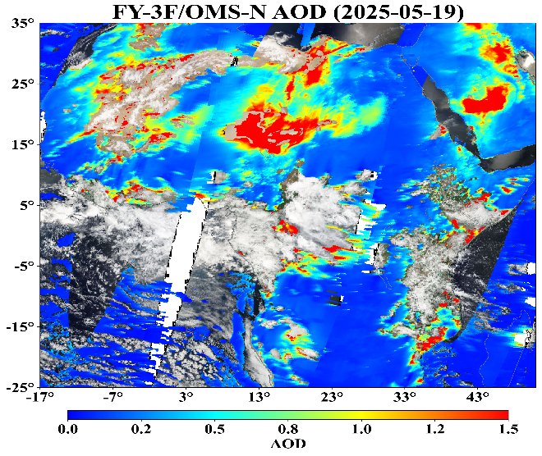
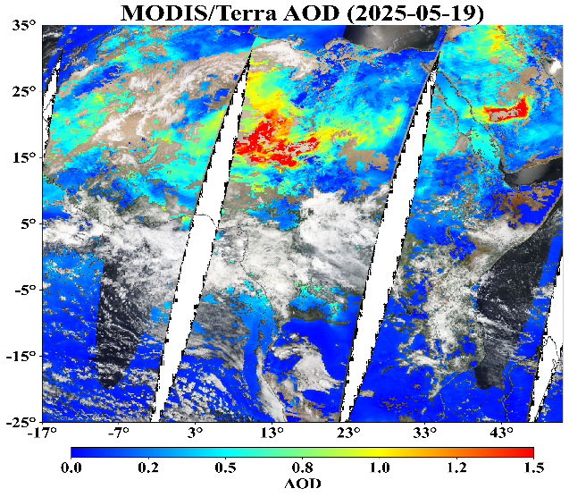
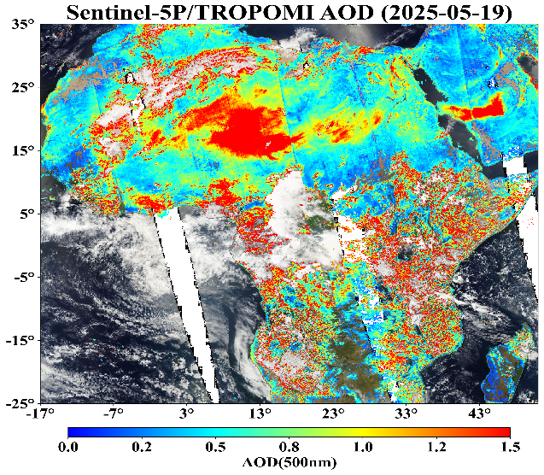
Level 2 Product Validation
AOD
Comparison of FY3F/OMS AOD Retrieval Results with Other Satellite AOD Products (After Correction on 2025-02-17 and 2025-05-19)
(a) Comparison of AOD Retrieved from PRNU-Corrected OMS-N L1 Data, MODIS/Terra AOD, and TROPOMI AOD on 2025-02-17
0
(b) Comparison of AOD Retrieved from PRNU-Corrected OMS-N L1 Data, MODIS/Terra AOD, and TROPOMI AOD on 2025-05-19

Slide 18
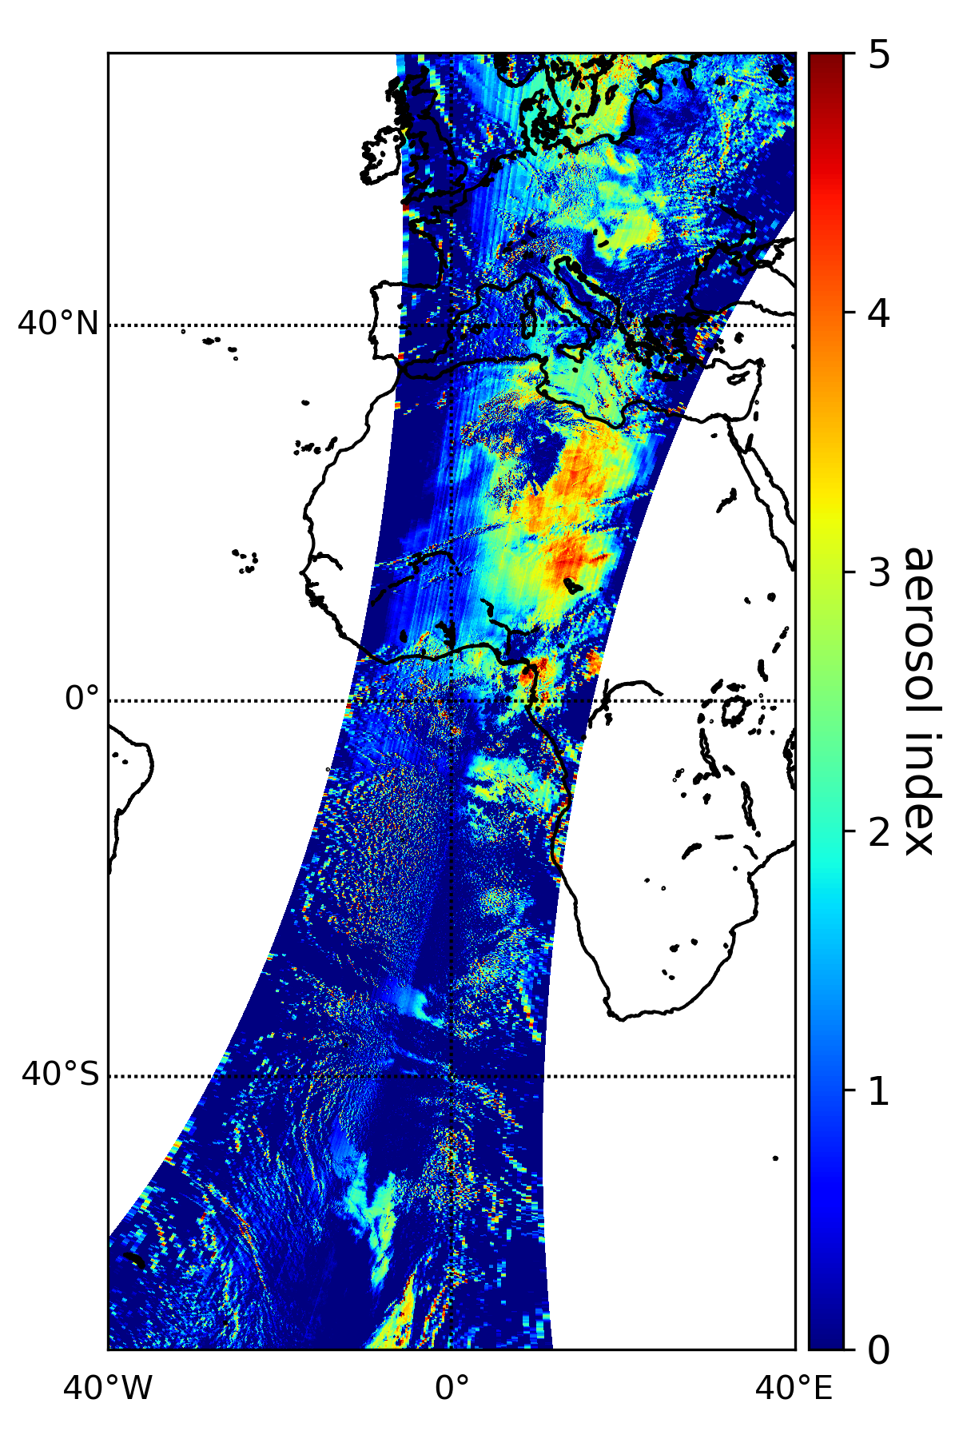

Level 2 Product Validation
AAI
Aerosol Index, OMS (340/380)，Background-Removed
L1_OLD
L1_PRNU1
Optimization of Fine Striping Artifacts
Comparison of Retrieved AAI Before（left） and After（right） PRNU Correction
(a)
(b)
PRNU矫正前后反演的AAI对比图

Slide 19
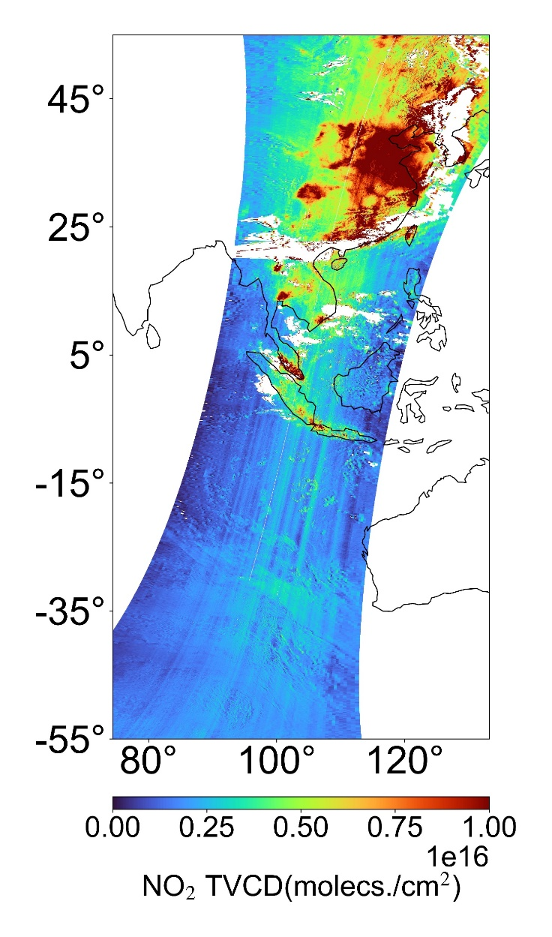
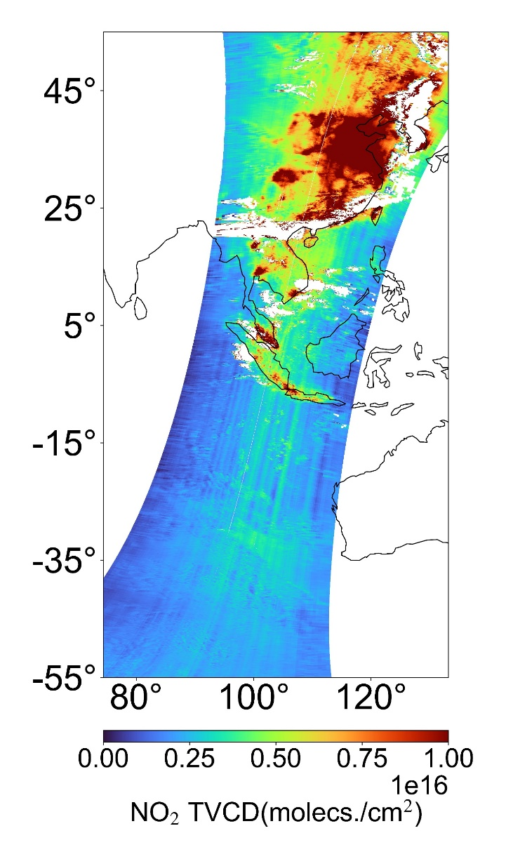
Level 2 Product Validation
NO₂
(a)
(b)
Comparison Map of Retrieved NO₂ Before (a) and After (b) PRNU Correction

Slide 20
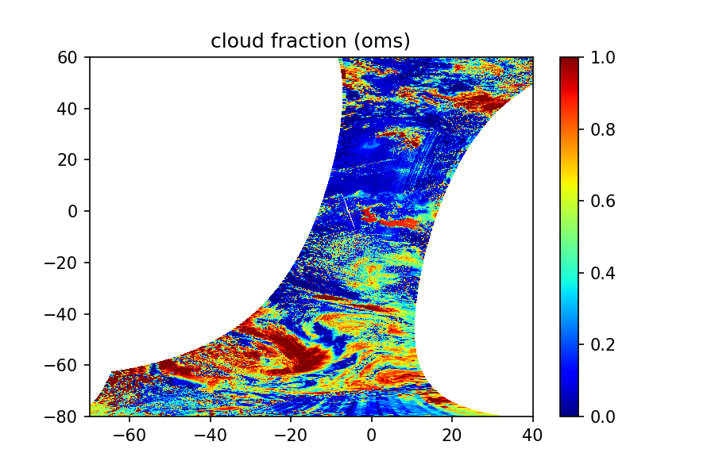
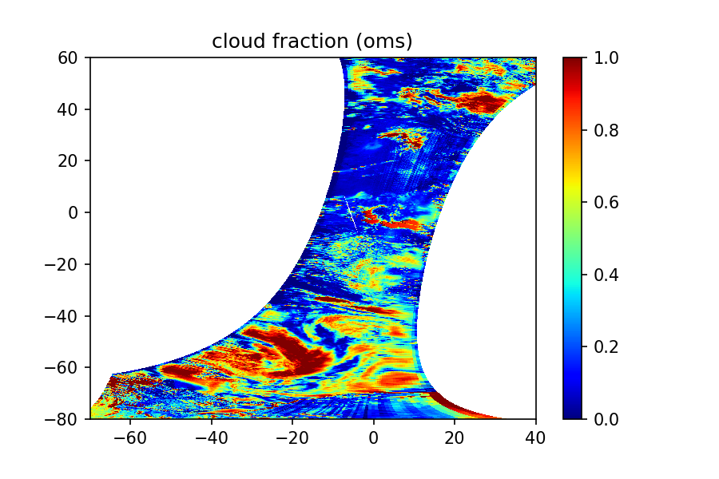
Level 2 Product Validation
CLOUD
L1_OLD
L1_PRNU1
Comparison Map of Retrieved Cloud Parameters Before (a) and After (b) PRNU Correction

Slide 21
Outline
FY-3F OMS-Nadir instrument Review
On-orbit Performance Analysis and Data Processing
On-orbit Performance
WLS Analysis
Data Processing
Level 2 Product Validation
  AOD and AAI
  NO₂ TVCD
  Cloud Fraction
  Conclusion

Slide 22
Conclusion
Summary
The existing PRNU correction algorithm has improved fine random striping, and although it cannot completely eliminate striping problems, it has significantly increased the authenticity and reliability of the observational data.
Future work
Validate the PRNU correction algorithm on a larger dataset to test its broader performance.
Develop on-orbit stray light correction for the ultraviolet (UV) band to enhance the UV data quality
Email:maojinghua@nssc.ac.cn

Slide 23
Conclusion
Thank You

