Slide 1
On-Orbit Performance Algorithm Optimization and Global Calibration Consistency Verification of the OMS-L Instrument
Li Yuan1, Liu Song1, Wang Jiachen1, Li Zhanfeng2, Lin Guanyu2
, Zhang Xiaoyun3 , Jiang Ruonan3
1 NSMC 2 CIOMP 3 ShineTek
2026 GSICS Annual Meeting, Ottawa, Canada, 25 March
Notes:
200字/页

Slide 2
1
Instrument Review
Table of Contents
2
On-Orbit Performance and
Algorithm Optimization
3
Accuracy Verification
4
Summary and Future Work
Notes:
My report will cover four parts: instrument introduction, in-orbit performance, accuracy verification and future plans.

Slide 3
Instrument Review
  OMS-L is an ultraviolet hyperspectral atmospheric limb sounder onboard the FengYun-3F satellite (FY-3F), launched on August 3, 2023, with a detection band of 290-500 nm and a spectral resolution of 0.6 nm.
  On October 18, 2024, we adjusted the instrument's tangent height layers, changing the vertical detection range from the original 15-60 km (15 layers) to 9-84 km (25 layers). Currently, global limb scattered radiance composite observation data have been acquired, enabling the detection of various atmospheric components such as ozone and nitrogen dioxide.
  Observation data from June 9, 2024 onwards can be downloaded from: http://data.nsmc.org.cn/DataPortal/cn/data/dataset.html

Slide 4
1
Instrument Review
Table of Contents
2
On-Orbit Performance and
Algorithm Optimization
3
Accuracy Verification
4
Summary and Future Work
Notes:
My report will cover four parts: instrument introduction, in-orbit performance, accuracy verification and future plans.

Slide 5
Improved On-Orbit Bad Pixel Flagging Algorithm
Band1 Bad Pixel Detection Results
Background
OMS-L is subject to high-energy particle bombardment on orbit, leading to anomalies in bright/dark pixels that interfere with data preprocessing (e.g., the calculation of the mean difference between bright and dark pixels).
Objective
To realize bad pixel flagging and provide robust support for on-orbit data preprocessing.
Method
Integrate the Interquartile Range (IQR) method and Median Absolute Deviation (MAD) method to calculate anomaly thresholds respectively and identify initial anomalies.
Adapt threshold coefficients by different type, and leverage the complementarity of the two methods to enhance anti-interference capability.
Introduce a temporal dimension to verify non-recovered anomalous pixels.
Outcome
The algorithm effectively suppresses the interference of bad pixels on the mean difference between bright and dark pixels, and improves the quality of L1 data.
Detection Type | Number of Bad Pixels | Bad Pixel Ratio (%) | Unrecovered Number | Observation Duration (months) | Unrecovered Ratio (%)
Bright Pixel - IQR | 5171 | 1.29 | 4809 | 20.93 | 93.00
Bright Pixel - MAD | 5293 | 1.32 | 4972 | 20.93 | 93.94
Dark Pixel - IQR | 487 | 1.52 | 410 | 20.93 | 84.19
Dark Pixel - MAD | 535 | 1.67 | 466 | 20.93 | 87.10
Band2 Bad Pixel Detection Results
Detection Type | Number of Bad Pixels | Bad Pixel Ratio (%) | Unrecovered Number | Observation Duration (months) | Unrecovered Ratio (%)
Bright Pixel - IQR | 2541 | 0.64 | 2217 | 20.93 | 87.25
Bright Pixel - MAD | 2748 | 0.69 | 2407 | 20.93 | 87.59
Dark Pixel - IQR | 246 | 0.77 | 187 | 20.93 | 76.02
Dark Pixel - MAD | 308 | 0.96 | 235 | 20.93 | 76.30
Results are as of 11:20 on October 14, 2025

Slide 6
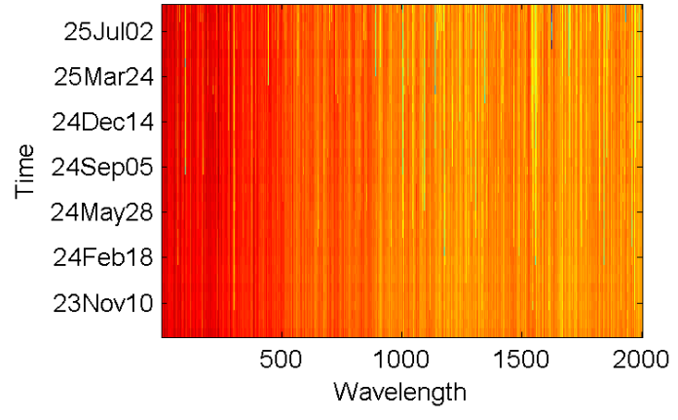
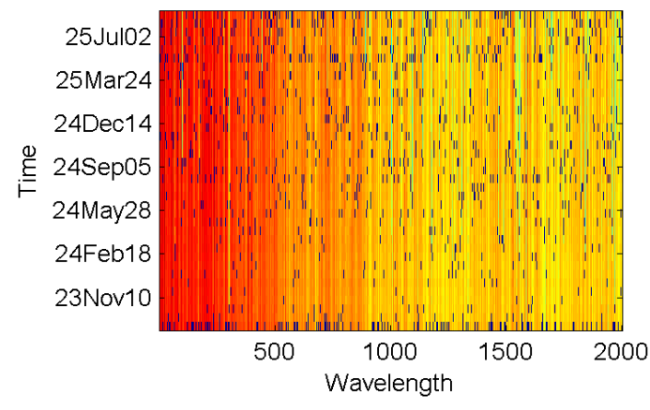
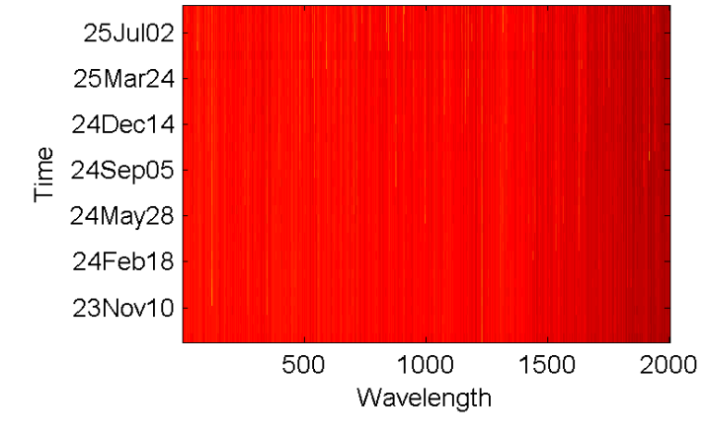
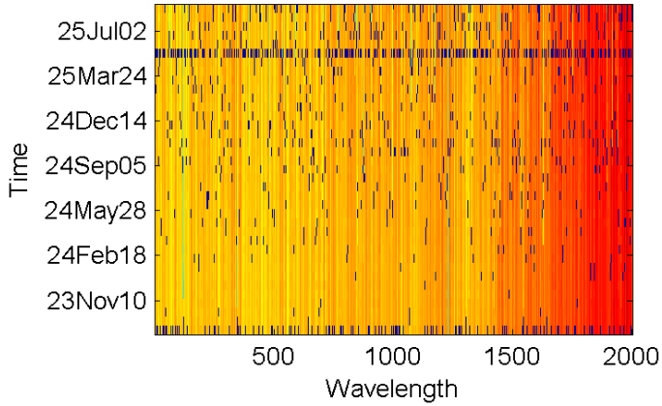
Improved On-Orbit Dark Current Analysis Method
Background
OMS-L dark current analysis suffers from random interference and instantaneous noise bias, which compromises the reliability of radiometric calibration.
Objective
To improve the traditional method and accurately extract the intrinsic characteristics of dark current.
Method
On-orbit layer: Iteratively remove outliers following an approximately normal distribution using the 3σ criterion to mitigate random interference.
Long-term time-series layer: Eliminate temporally varying outliers to avoid instantaneous noise bias.
Introduce the p-value test to quantitatively evaluate the temporal variation pattern, distinguishing genuine trends from accidental fluctuations.
Outcome
The temporal variation of dark current models for Bands 1 and 2 has changed from weak correlation (with p≥0.05 and ∣r∣<0.5) to moderate correlation (with p<0.05 and 0.5≤∣r∣<0.7).
The improved dark current analysis is more accurate and reliable, enhancing the quality of OMS-L on-orbit remote sensing data.
Dark Current Model of Band 1 Before Outlier Removal
Dark Current Model of Band 1 After Outlier Removal
Dark Current Model of Band 2 Before Outlier Removal
Dark Current Model of Band 2 After Outlier Removal

Slide 7
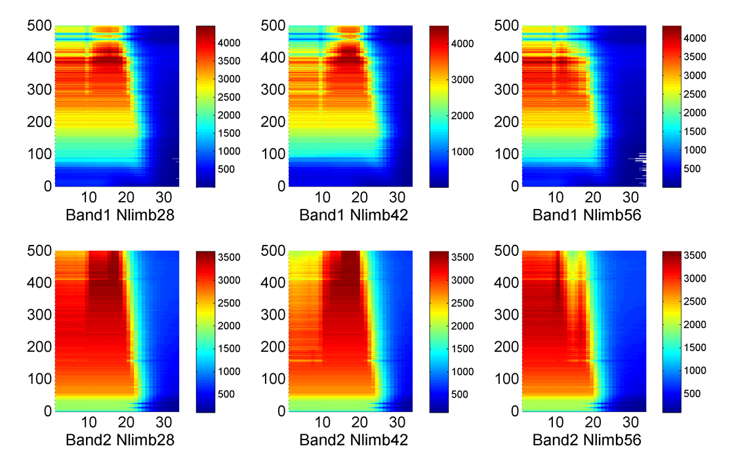
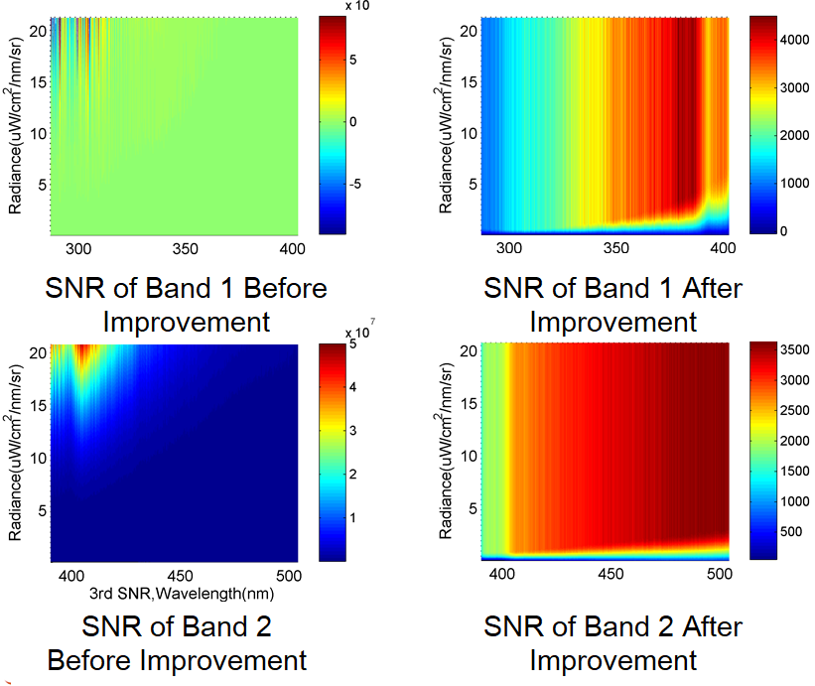
Optimized SNR Fitting Method
The actual limb atmospheric observation radiance differs from the SNR modeled radiance by more than two orders of magnitude. An improved a priori smoothed quadratic fitting method is proposed: the quadratic coefficient is forced to be negative (in line with physical laws); the fourth-order fitting is used to smooth the axis of symmetry and reduce coefficient fluctuations; a radiance saturation threshold is set to avoid SNR anomalies. Ultimately, the on-orbit SNR calculation values are ensured to converge to a reasonable range (0-4000), and the stability and practicability are significantly improved.
Convergent values with reasonable distribution
Abnormal values before improvement
SNR of OMS-Limb at Different Tangent Heights on Orbit (Horizontal axis: tangent height identifier, Vertical axis: spectral number)
Stable spatial distribution after improvement

Slide 8
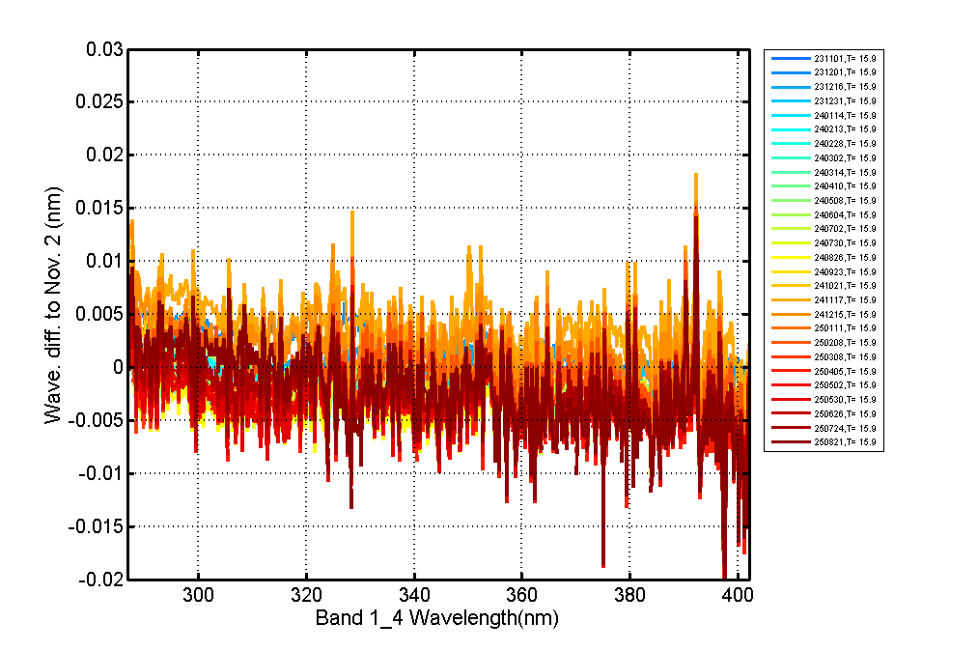
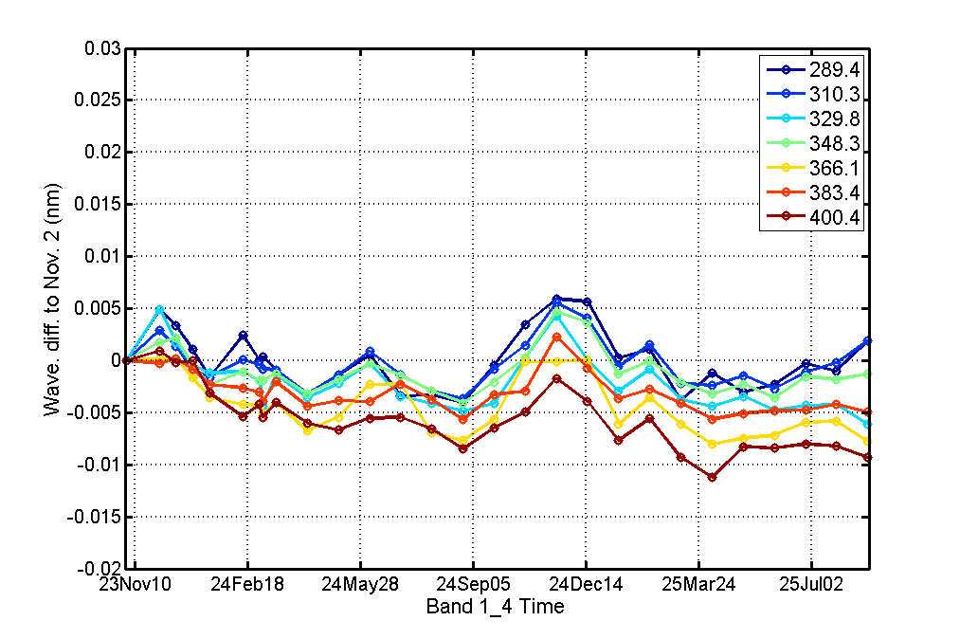
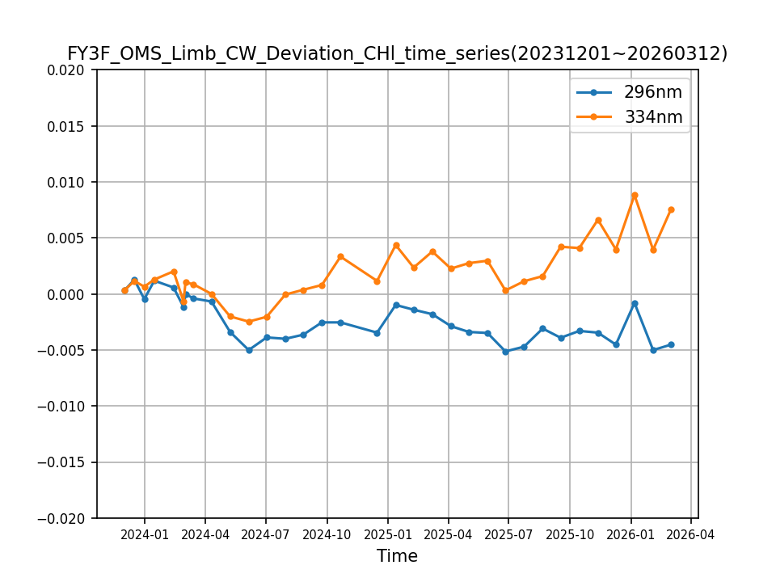
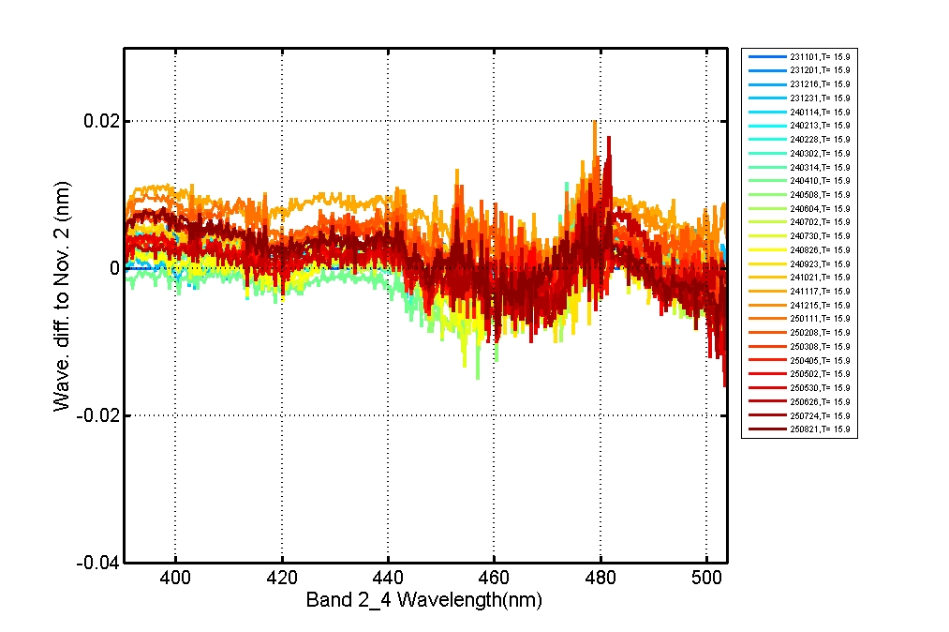
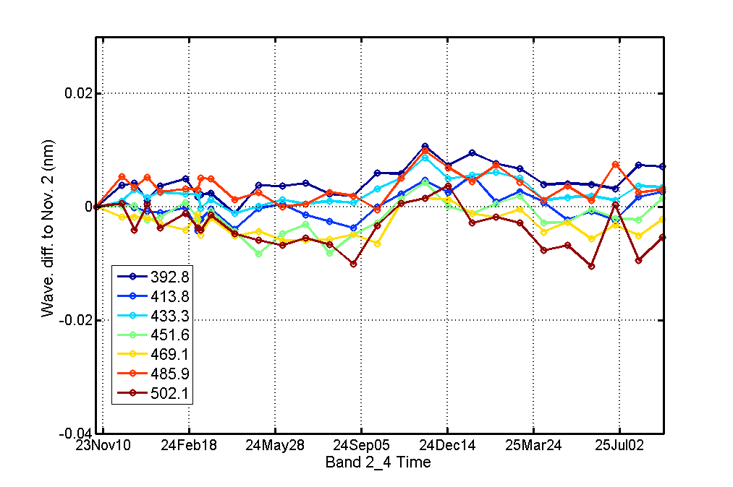
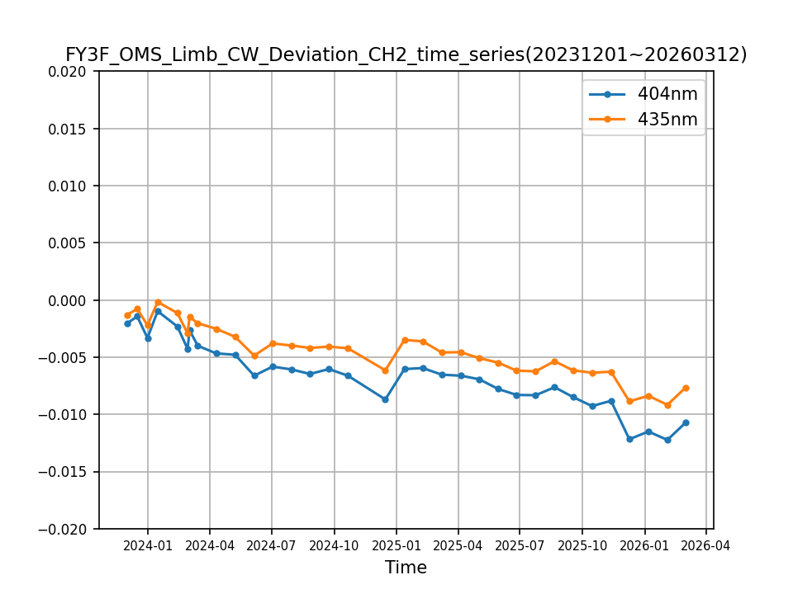
Monitoring Wavelength Shift Stability via On-Board Calibration
OMS-L has exhibited excellent overall wavelength stability during more than two years of on-orbit operation, with the shift amplitude of most channels (including the product-sensitive 320 nm and 355 nm) stably within 0.01 nm for a long time. Since March 2025, some channels of Band 1 and Band 2 have shown an increasing trend of shift exceeding 0.01 nm. In the follow-up, we will improve the understanding of the wavelength shift characteristics of the instrument channels based on more shift data, And realize dynamic correction of wavelength shift.
Wavelength Shift of Band 1 with Spectra at Different Times (Solar Calibration)
Wavelength Shift of Band 1 with Time at Different Spectra (Solar Calibration)
Wavelength Shift of Band 1 with Time at Different Spectra (Mercury Lamp Calibration)
Wavelength Shift of Band 2 with Spectra at Different Times (Solar Calibration)
Wavelength Shift of Band 2 with Time at Different Spectra (Solar Calibration)
Wavelength Shift of Band 2 with Time at Different Spectra (Mercury Lamp Calibration)

Slide 9
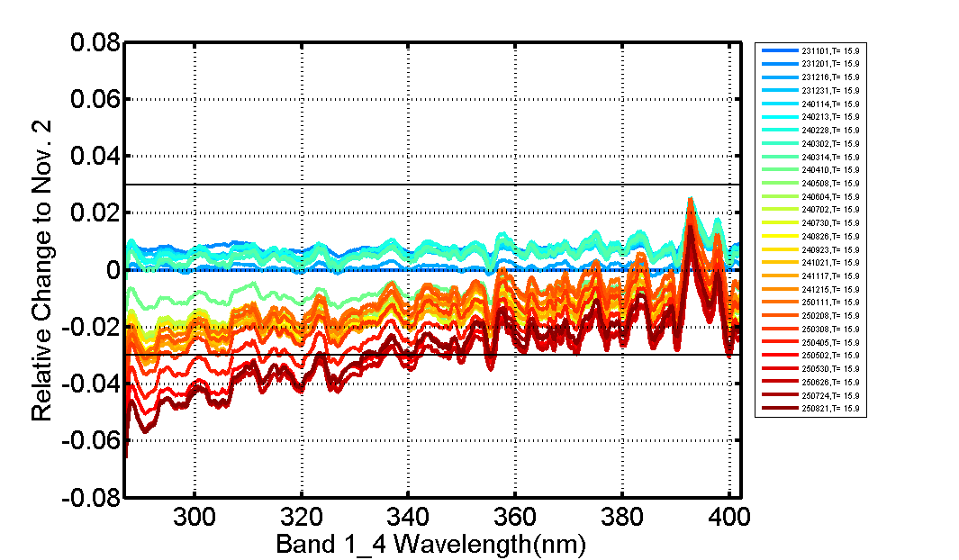
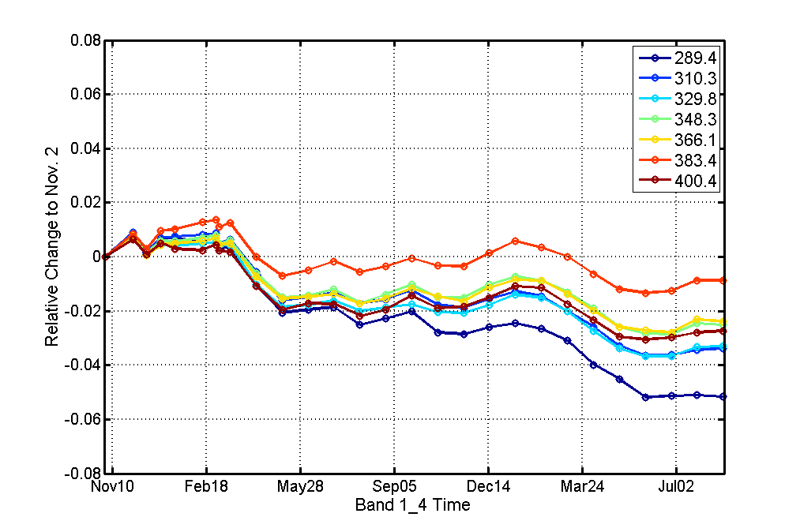
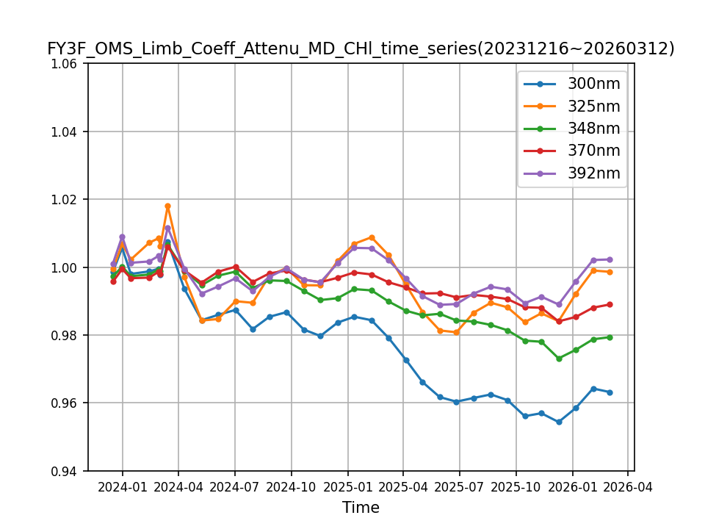
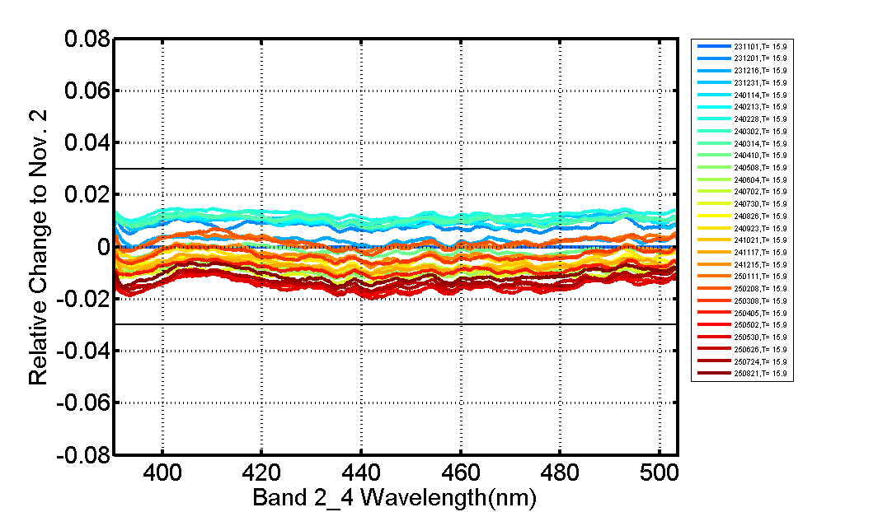
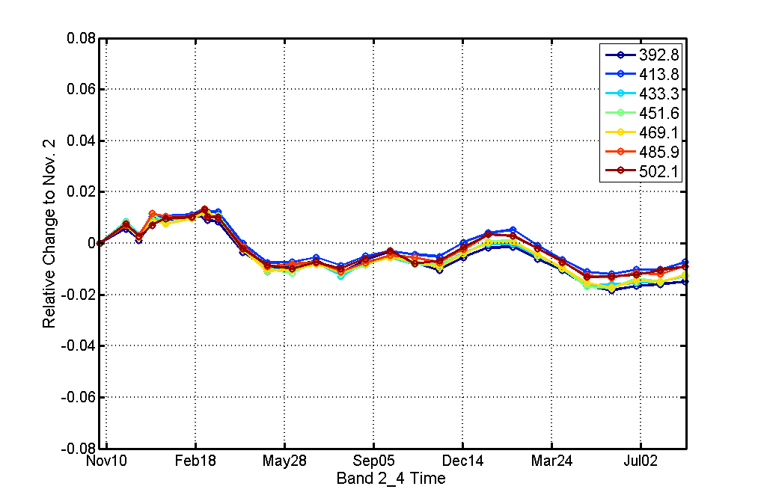
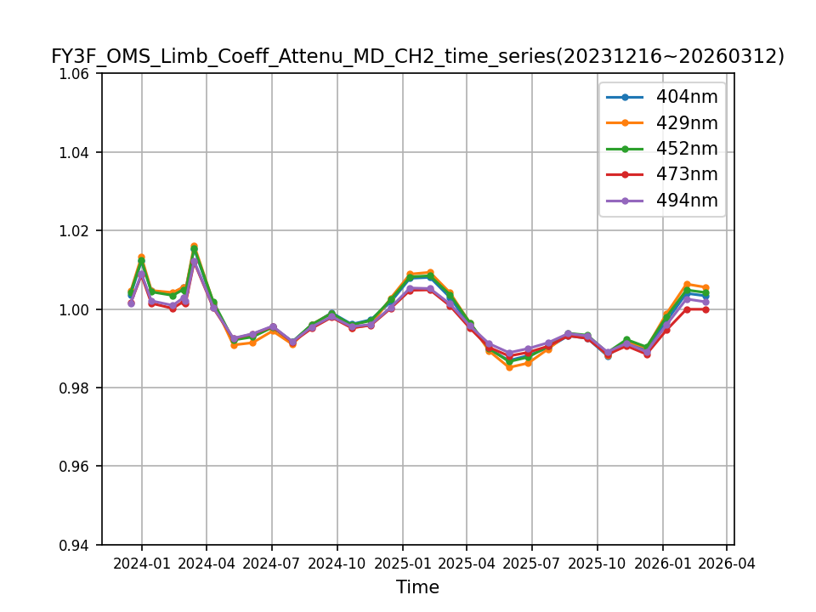
Monitoring Responsivity degradation via On-Board Reference Panels
As of March, 2026, the responsivity of channels above 340 nm in Band 1 and all channels in Band 2 has remained stable within 3% for a long time. Since May 2025, the responsivity degradation of channels below 340 nm in Band 1 has exceeded 3%. The short-wavelength degradation characteristics of OMS-L and its dynamic correction model are currently being investigated and established.
Relative degradation of Band 1 with Spectra
Relative degradation of Band 1 with Time
Relative degradation of Band 1 with Time(Corrected for Backup Reference Panel degradation)
Relative degradation of Band 2 with Spectra
Relative degradation of Band 2 with Time
Relative degradation of Band 2 with Time(Corrected for Backup Reference Panel degradation)

Slide 10
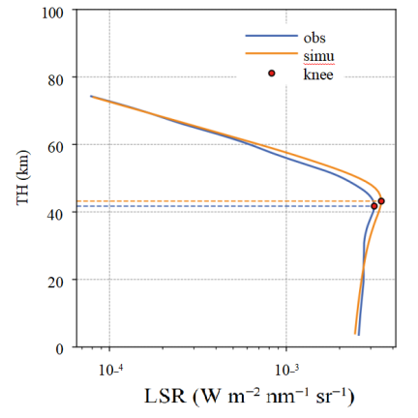
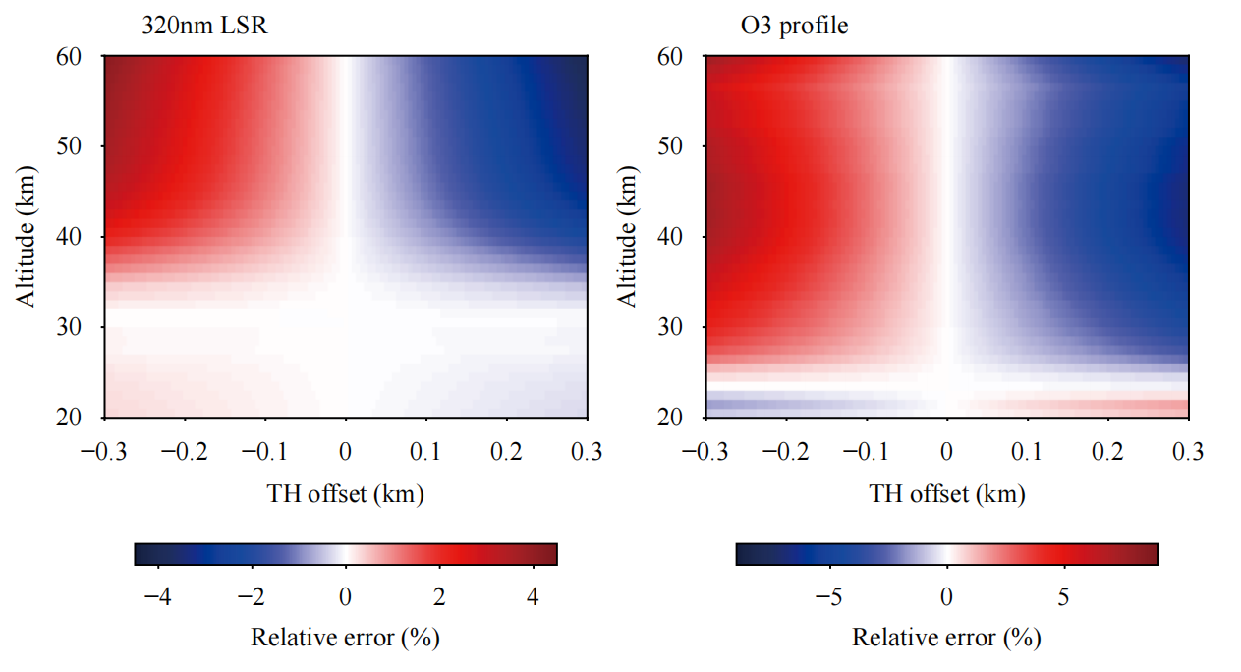
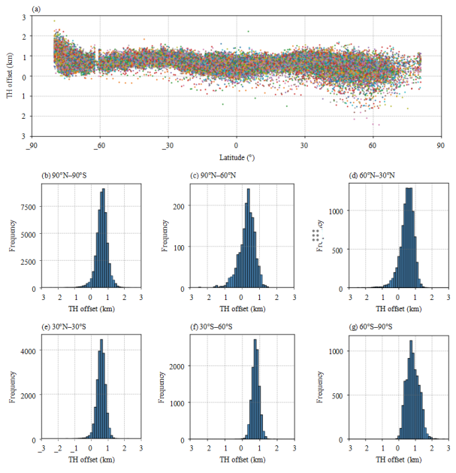
Tangent Height Correction via Knee Point Method (Liu Song)
Aiming at the problem that OMS-L has no star tracker and cannot directly verify the tangent height, an on-orbit tangent height verification and correction algorithm (KB algorithm) based on the knee point of the 305 nm ultraviolet limb scattered radiance (LSR) profile is proposed. After correction by this algorithm, the correlation coefficient between the simulated radiance and the observed spectrum reaches 0.973, which verifies the reliability of the algorithm and provides key support for improving the OMS-L data quality and retrieving ozone products.
Comparison of the 305 nm LSR profile observed by OMS-L with the corresponding simulated profile
Sensitivity analysis shows that the theoretical accuracy of the algorithm is ±300 m, and its error impacts on the 320 nm radiance simulation and ozone profile retrieval are within ±4% and ±8%, respectively.
The results from November 2024 to March 2025 show that the overall tangent height deviation is within ±1 km.
Citation: Liu, S., Y. Li, N. Xu, et al., 2026: Validation and correction of in-orbit tangent height for the ozone monitoring suite-limb onboard . J. Meteor. Res., 40(2), 1-9, doi: https://doi.org/10.1007/s13351-026-5189-3

Slide 11
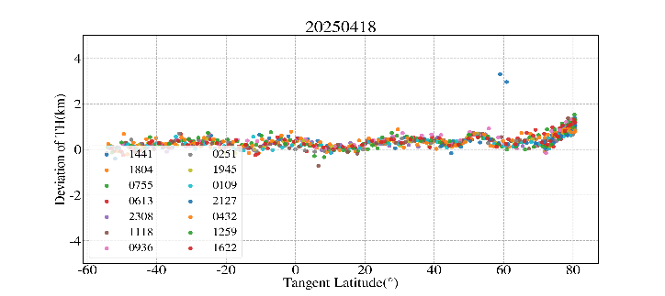
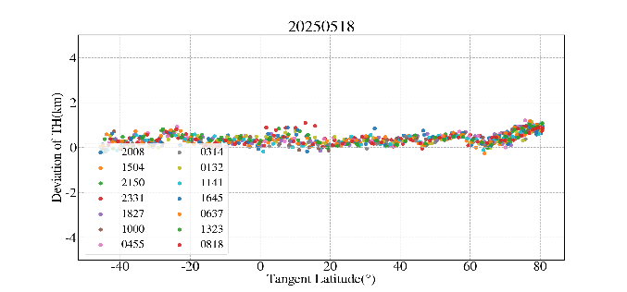
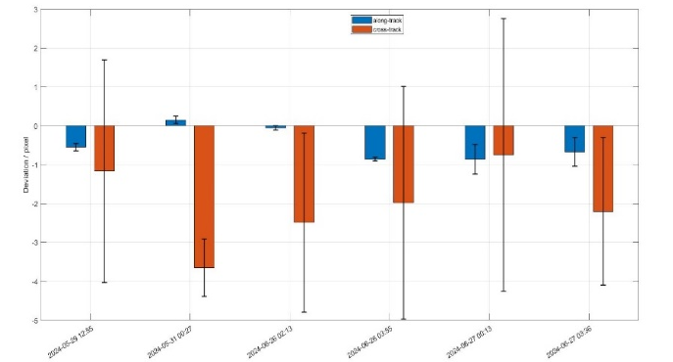
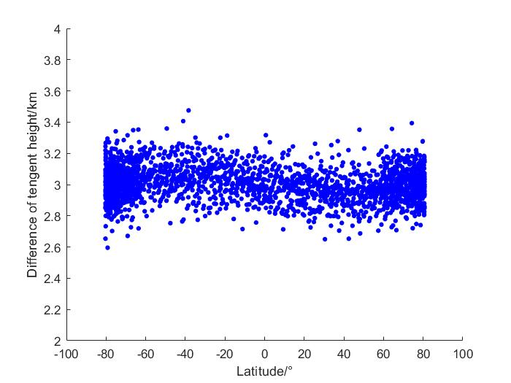
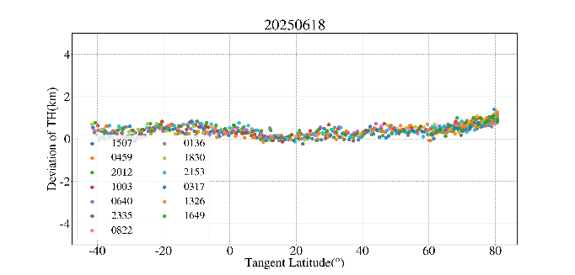
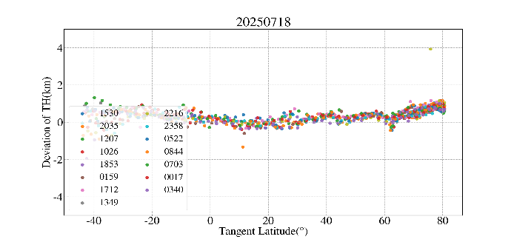
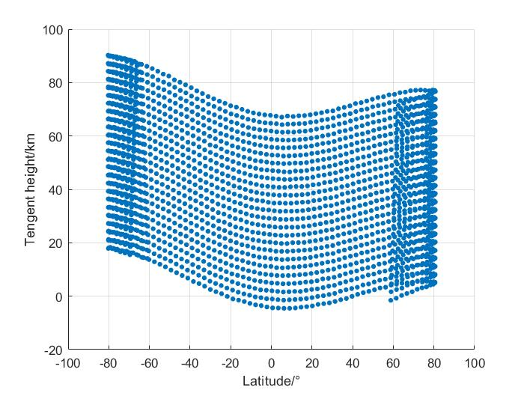
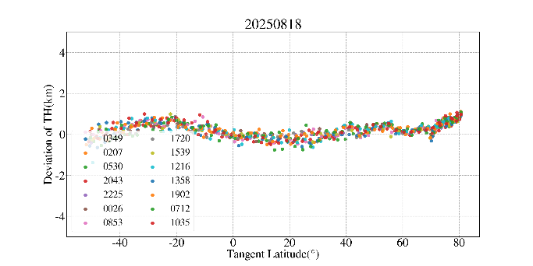
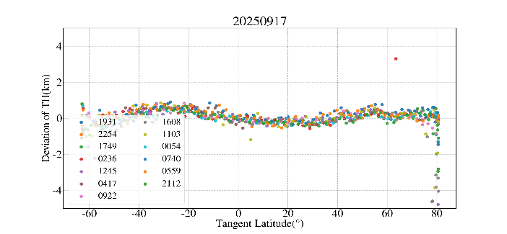
Tangent Point Positioning and Tangent Height Correction
Relative Tangent Height of OMS-L
The relative tangent height of OMS-L between 0-100 km layers was calculated, with the mean value of 3.01 km and the standard deviation being 0.1 km.
Absolute Tangent Height Correction of OMS-L via Knee Point Method
The tangent height correction accuracy better than 400 m and the seasonal variation of tangent height less than 300 m.
Tangent Point Pointing Accuracy of OMS-L
The overlay image matching was conducted between the OMS-L 0 km full-pixel Earth-imaging mode and OMS-N, a co-platform and co-band instrument on FY-3F. Results show that the tangent point positioning accuracy of OMS-L is about 5 km, equivalent to 0.1°.
Wang Jiachen, Shang Jian, Yang Lei, et al. Optics and Precision Engineering, 2026, 34(02):179-190.

Slide 12
1
Instrument Review
Table of Contents
2
On-Orbit Performance and
Algorithm Optimization
3
Accuracy Verification
4
Summary and Future Work
Notes:
My report will cover four parts: instrument introduction, in-orbit performance, accuracy verification and future plans.

Slide 13
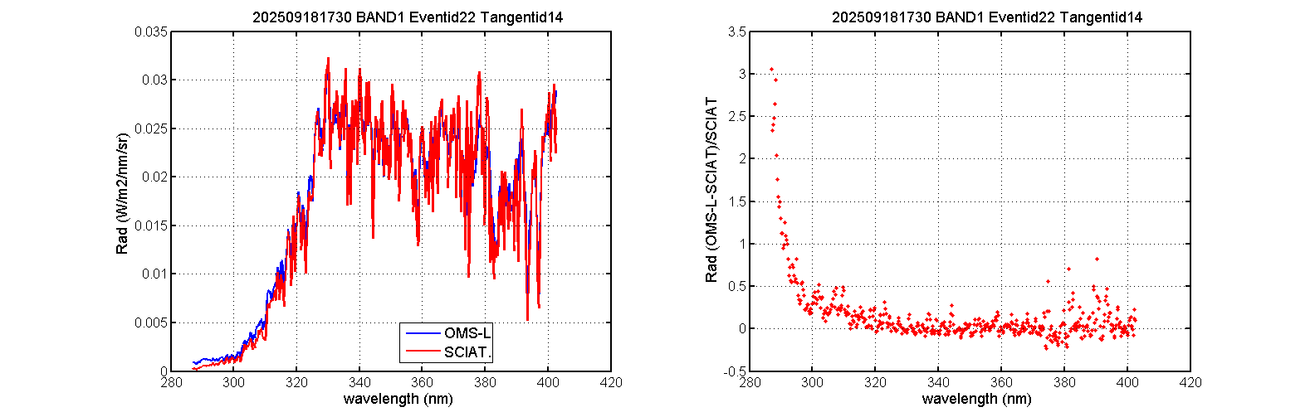
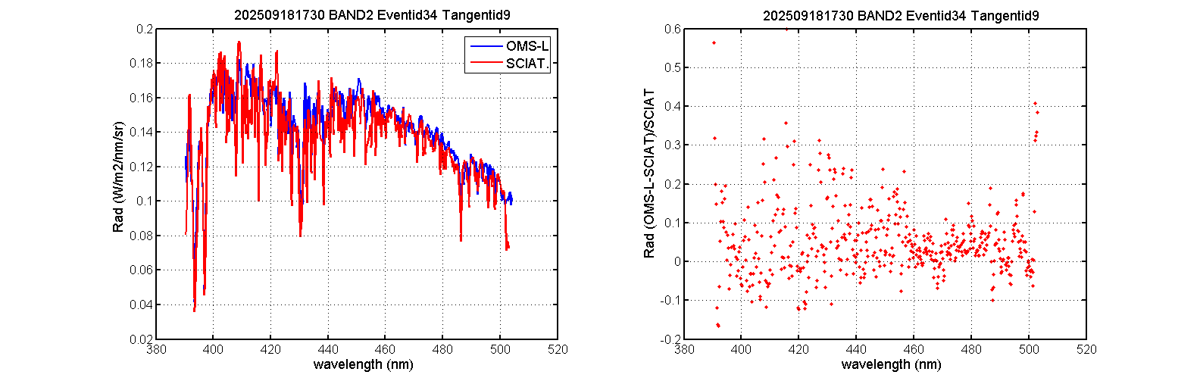
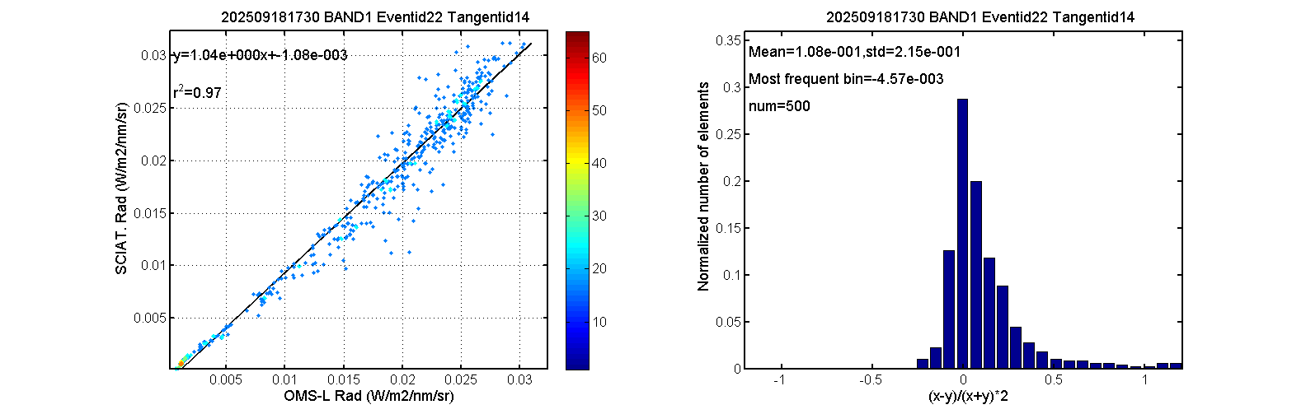
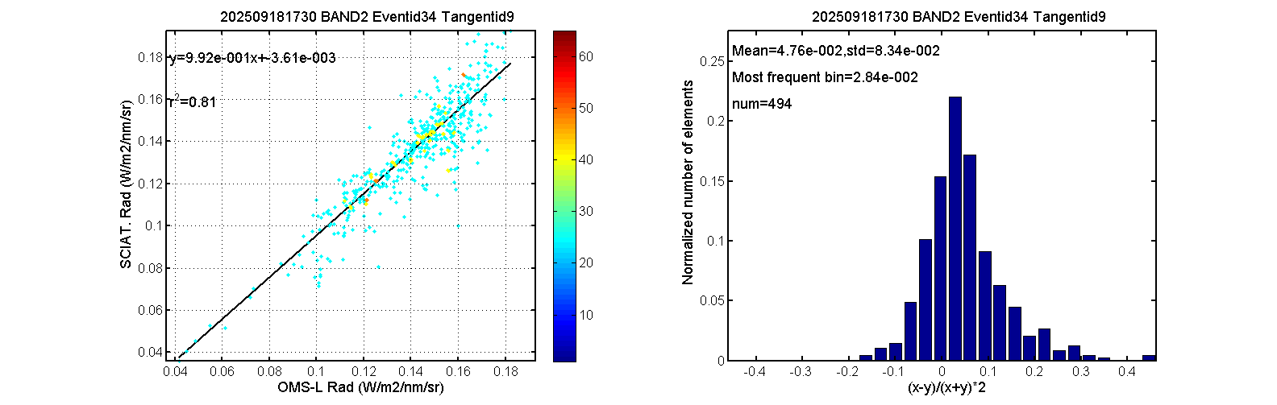
Carrying Out Limb OMB Monitoring
Except for the generally high deviations of channels below 300 nm, it is verified that there are no significant deviations in the spectral distribution and radiometric magnitude of most OMS-L channels compared with the SCIATRAN simulated radiance. For the generally high deviations between the channels below 300 nm and the SCIATRAN simulated radiance, we have further conducted cross-calibration with OMPS LP to investigate the underlying causes.
Spectral Radiance and Relative Deviation of Band 1
Spectral Radiance and Relative Deviation of Band 2
Scatter Plot of Spectral Radiance and Probability Density Distribution of Relative Deviation for Band 1
Scatter Plot of Spectral Radiance and Probability Density Distribution of Relative Deviation for Band 2

Slide 14
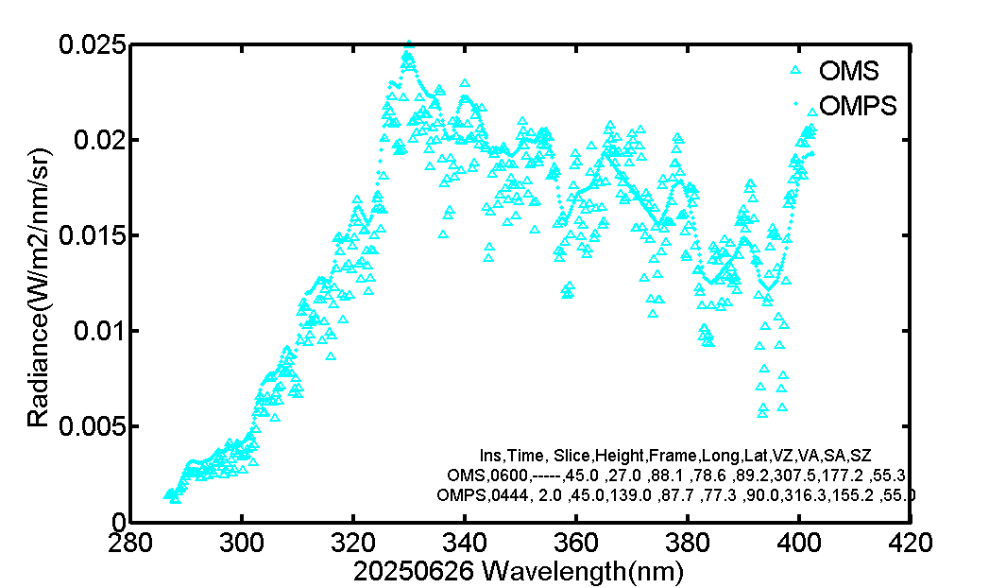
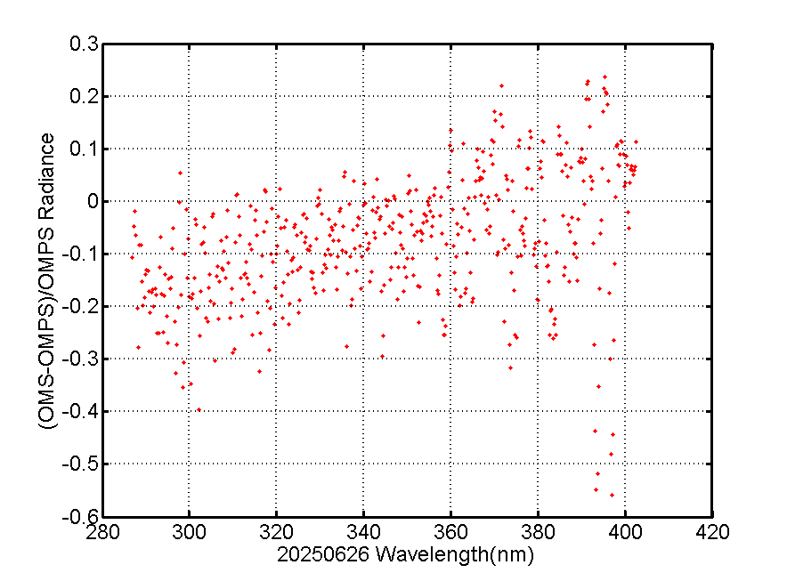
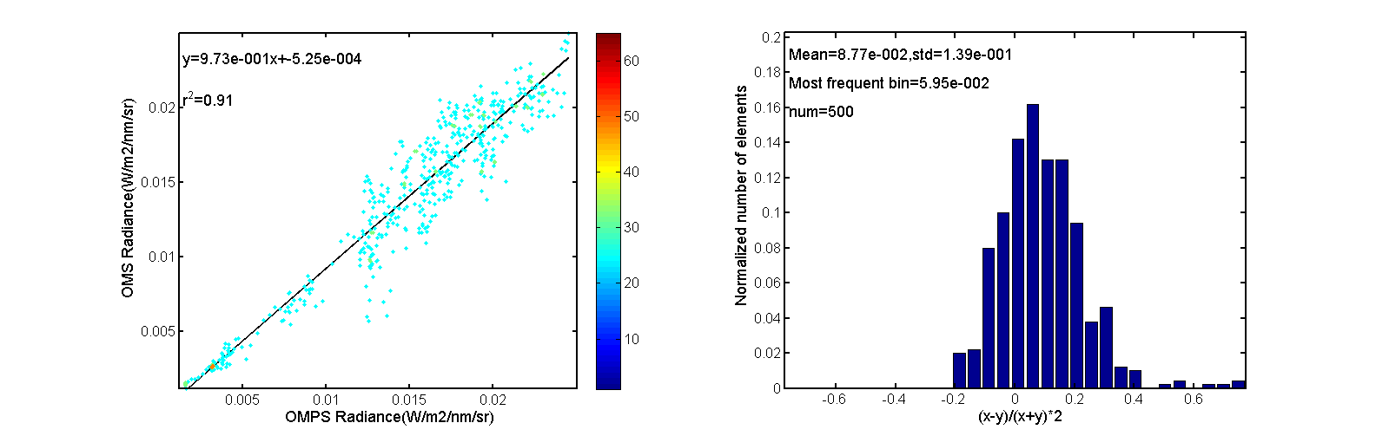
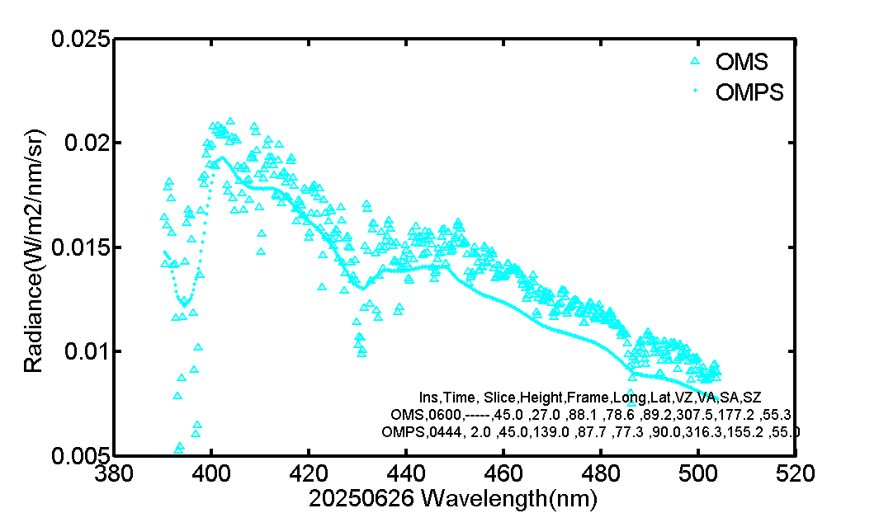
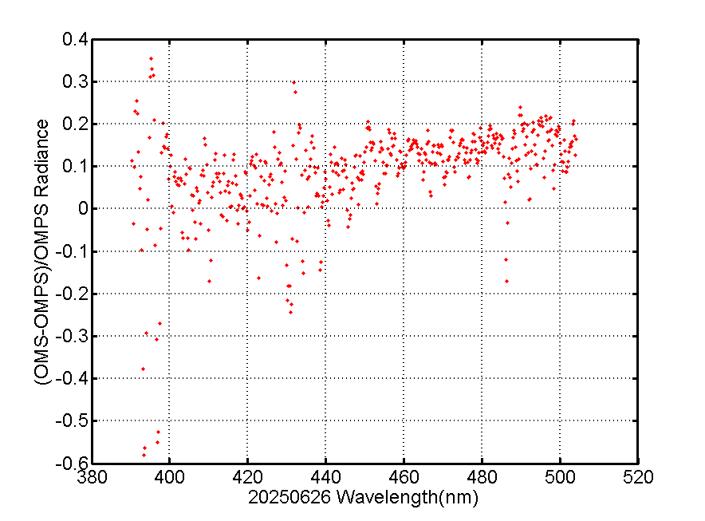
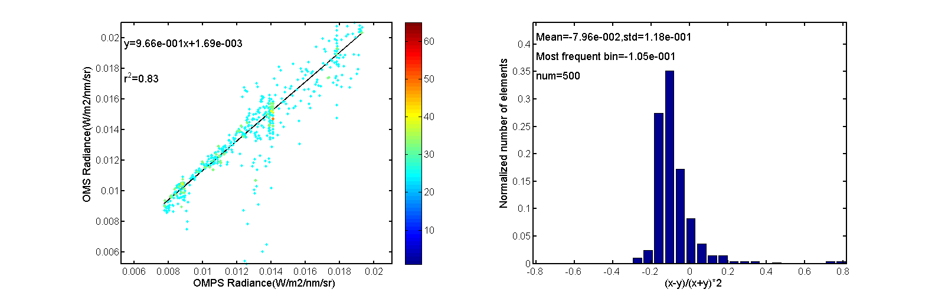
Carrying Out Limb Cross-Calibration
Although the matching points of OMS-Limb and OMPS LP are still very limited and concentrated in the high-latitude regions with large solar zenith angles , the overall results verify that there are no significant deviations in the spectral distribution and radiometric magnitude between OMS-Limb and OMPS LP. We hypothesize that the deviations of OMB in channels below 300 nm stem from inadequate accuracy of the input background field in the atmospheric RTM, which requires further validation and analysis.
Cross-Calibration Spectral Radiance Comparison of Band 1
Cross-Calibration Spectral Radiance Relative Deviation of Band 1
Probability Density Distribution of Spectral Radiance Relative Deviation for Band 1
Cross-Calibration Spectral Radiance Comparison of Band 2
Cross-Calibration Spectral Radiance Relative Deviation of Band 2
Probability Density Distribution of Spectral Radiance Relative Deviation for Band 2

Slide 15
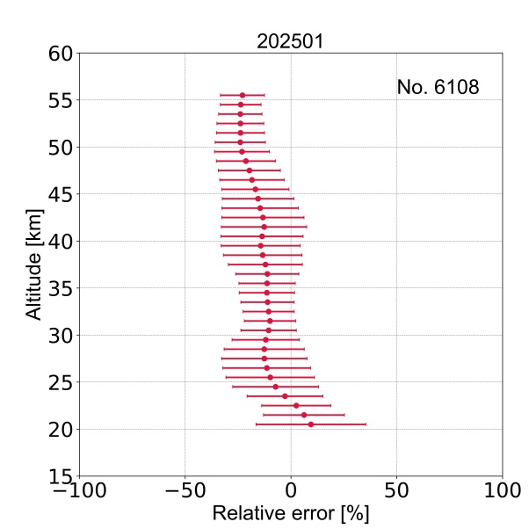
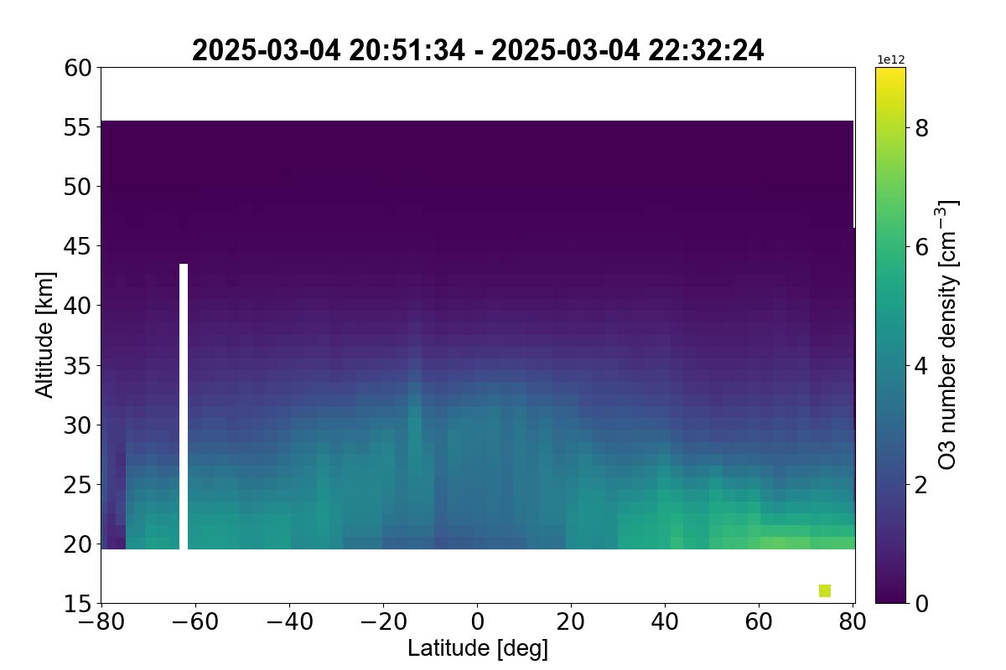
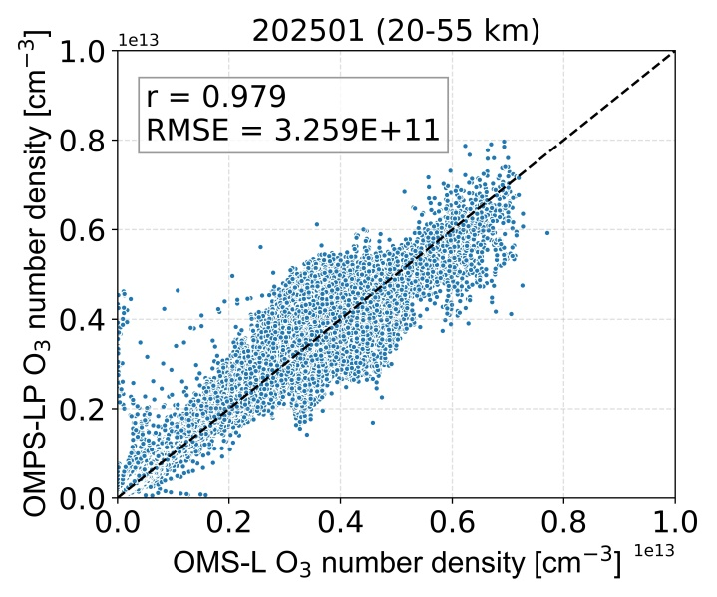
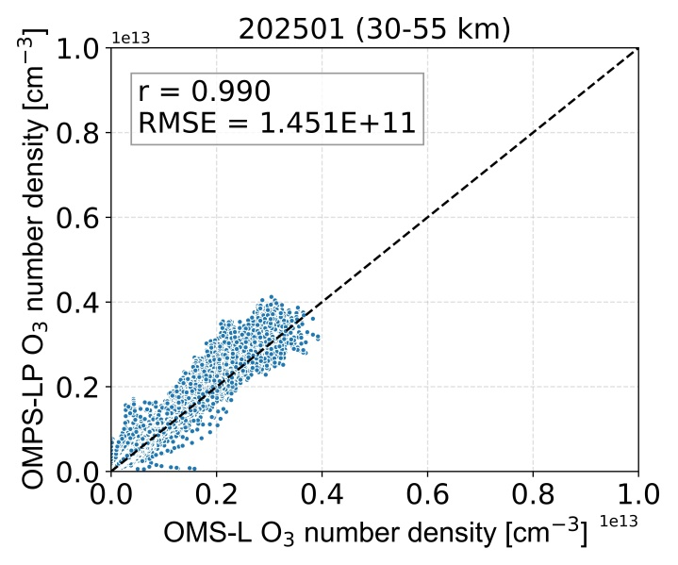
OMS-L Ozone Profile Products (Liu Song)
the preliminary verification results of the FY-3F OMS-L ozone profile products.
The products show good consistency with the OMPS-LP v2.6 ozone profile products, with an average deviation within 20%.
The full-orbit heat map presents the vertical-zonal distribution of ozone number density, clearly showing the typical distribution characteristics of ozone enrichment in low latitudes and relatively sparse ozone in high latitudes. It indicates that OMS-L has the ability to stably generate global ozone profile products and provides reliable data support for atmospheric composition monitoring.
In the 20–55 km height range, the correlation coefficient (r) of ozone number density between the two products is 0.979, with a root mean square error (RMSE) of 3.259×10¹¹ cm⁻³. In the 30–55 km core stratospheric range, the correlation is further improved to r=0.990, and the RMSE is reduced to 1.451×10¹¹ cm⁻³, which verifies the accuracy of the products in the stratosphere.

Slide 16
1
Instrument Review
Table of Contents
2
On-Orbit Performance and
Algorithm Optimization
3
Accuracy Verification
4
Summary and Future Work
Notes:
My report will cover four parts: instrument introduction, in-orbit performance, accuracy verification and future plans.

Slide 17
Summary and Future Work
Summary and Future Work
Summary
  OMS-L has operated stably on orbit. Through the optimization of algorithms such as bad pixel flagging, dark current analysis and SNR fitting, the robustness of data preprocessing and the reliability of radiometric calibration have been significantly improved.
  The tangent height positioning and correction algorithm has achieved a correction accuracy better than 0.4 km, ensuring the observation geometric accuracy.
  The ozone profile products show good consistency with OMPS-LP v2.6, with an average deviation within 20% and a correlation coefficient of 0.990 in the core stratospheric range, indicating that OMS-L has the ability to stably generate global ozone profile products and provides high-quality data support for atmospheric composition monitoring.
Future Plans
  Continuously accumulate wavelength shift and responsivity degradation data, incorporate key influencing factors such as orbital period and ambient temperature to build a multi-parameter coupled dynamic correction model, verify the correction effect with multi-source data, and iteratively optimize the model to improve the correction accuracy.
  Improve the tangent height correction algorithm and optimize the applicability of the KB algorithm in different latitudes and seasons.
  Promote multi-source verification of ozone profile products, carry out long-term comparisons with ground-based observations and other satellite payloads, and improve the credibility and application value of the products.
Notes:
Page 17: Summary and Future Work

Slide 18
THANKS
THANKS
liyuan@cma.gov.cn
2026-3-6

