Slide 1
EMI Stripe Error Correction Method and Results
Zhao minjie, Si fuqi, Zhou haijin, Wu kaili
2026.3.25

Slide 2
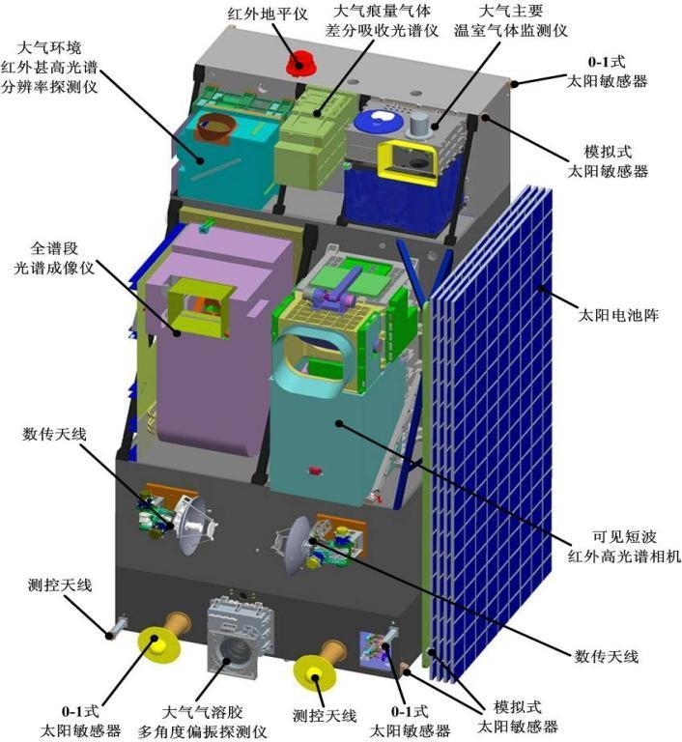
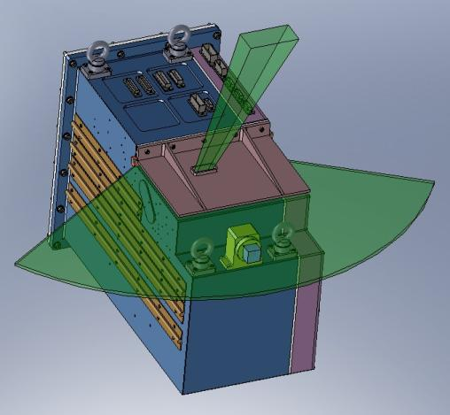
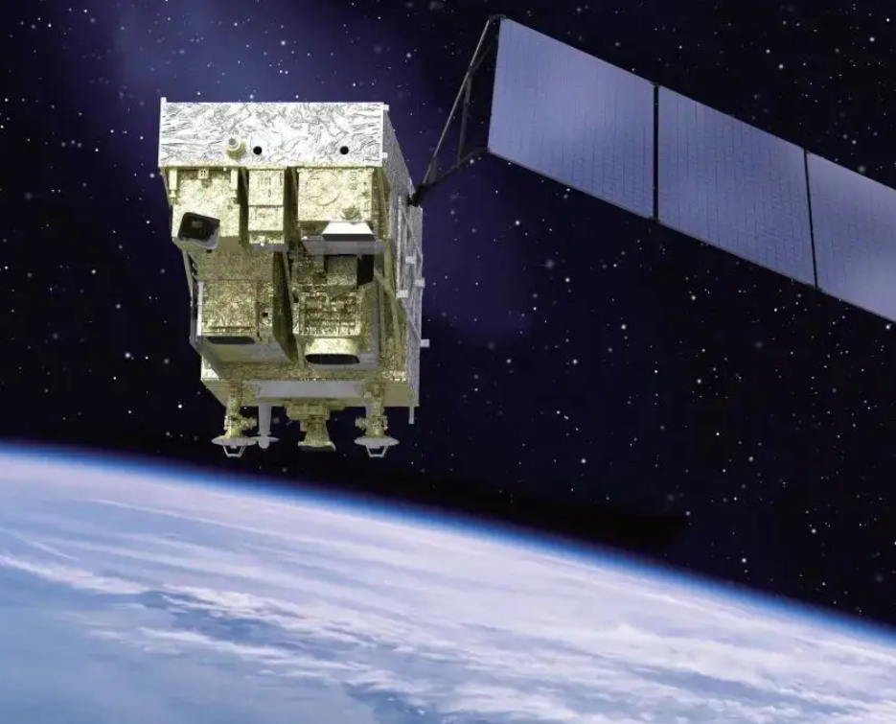
EMI instrument
Monitoring the emissions, distribution, and transmission of global pollutants plays an important role in atmospheric monitoring and research.
EMI
Sun-synchronous
Trace gases:NO2,SO2,O3
One day coverage
Launch in 2021

Slide 3
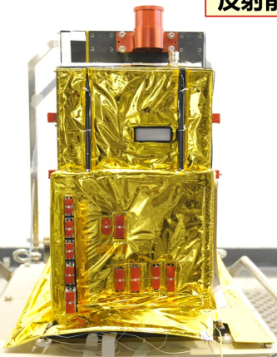
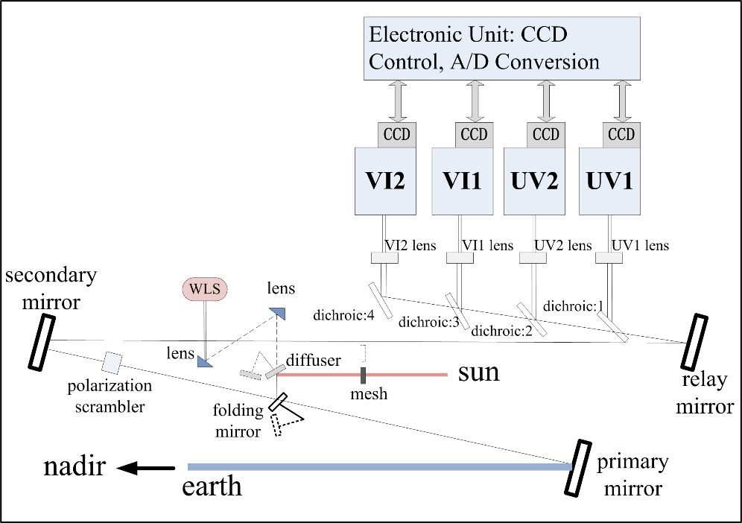
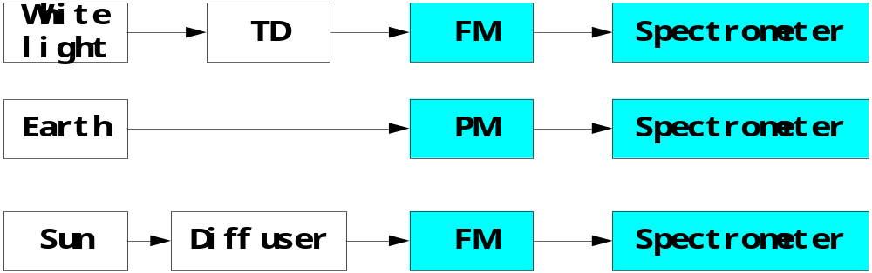
EMI instrument
EMI
Spectral range | UV1:240－315nm、UV2:311－403nm; VIS1:401－550nm、VIS2:545－710nm;
Spectral resolution | 0.3-0.5nm
telescopy swath IFOV | IFOV 114 degrees
CCD detectors | 1024×1024 pixels (UV1/2); 1252×576(spectral ×spatial) pixels (VIS1/2)
ground pixel size | 24km×13km
mass | 95kg
size | 50cm×36cm×65cm
orbit | Polar,sun-synchronous average altitude:705km orbit perriod:98 minutes 53 seconds
Four Offner imaging spectrometers
Three observation modes

Slide 4
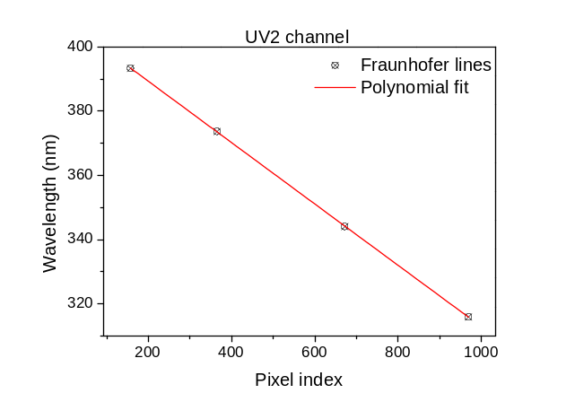
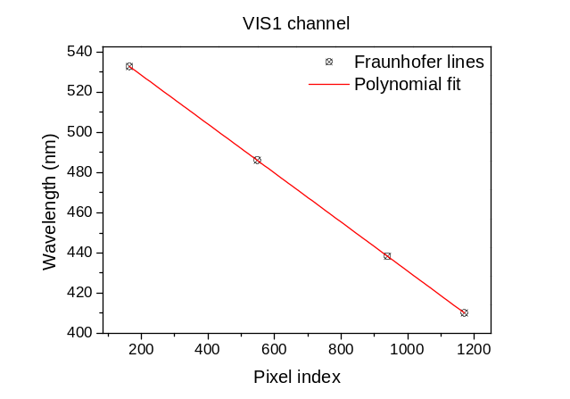
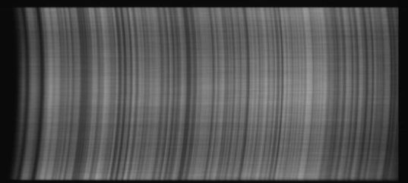
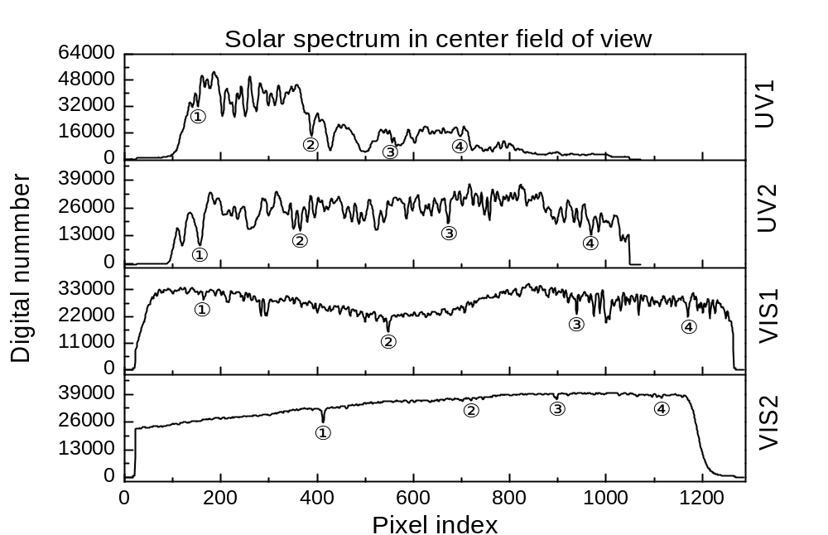
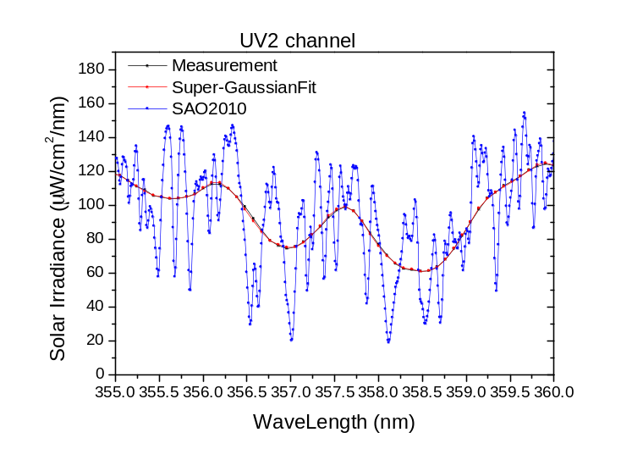
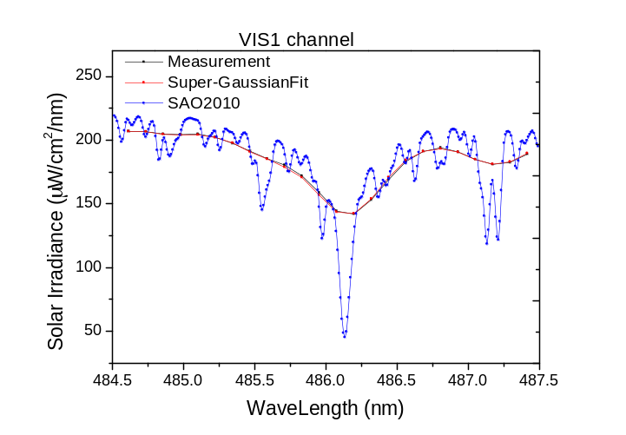
EMI Irradiance
Solar+diffusers
Polynomial fit
spectral
spatial
Solar spectral image
Wavelength accuracy 0.05 nm
0.43 nm
0.40 nm

Slide 5
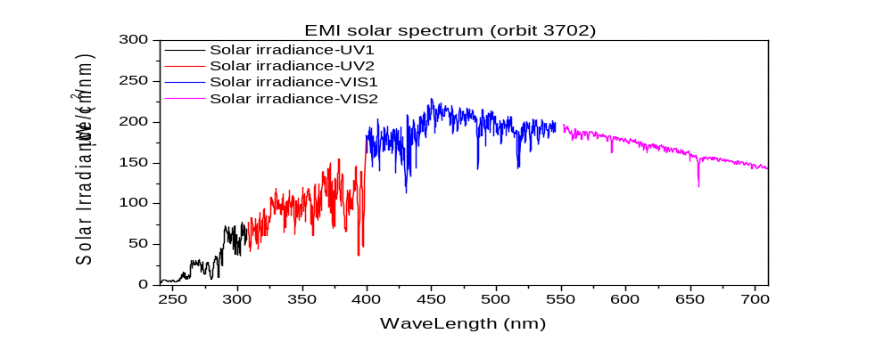
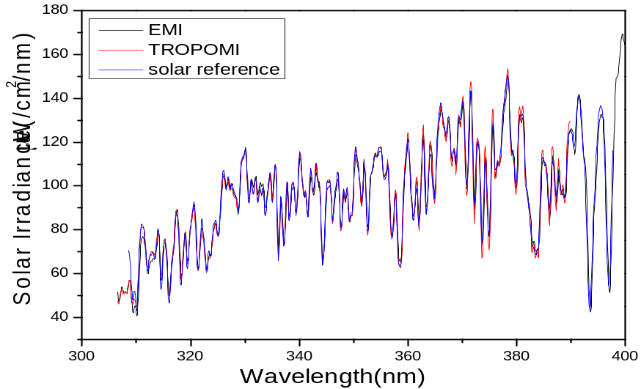
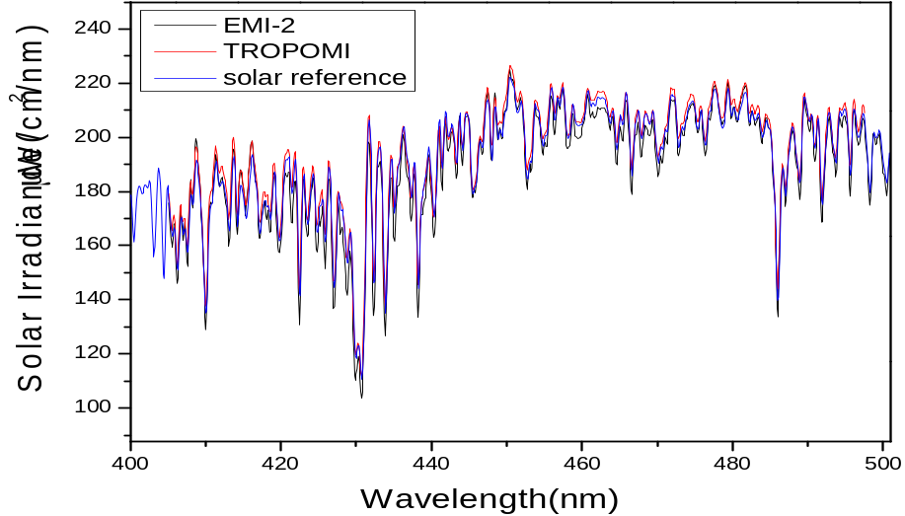
EMI Irradiance
Verification
EMI and TROPOMI
Average deviation is less than 4%

Slide 6
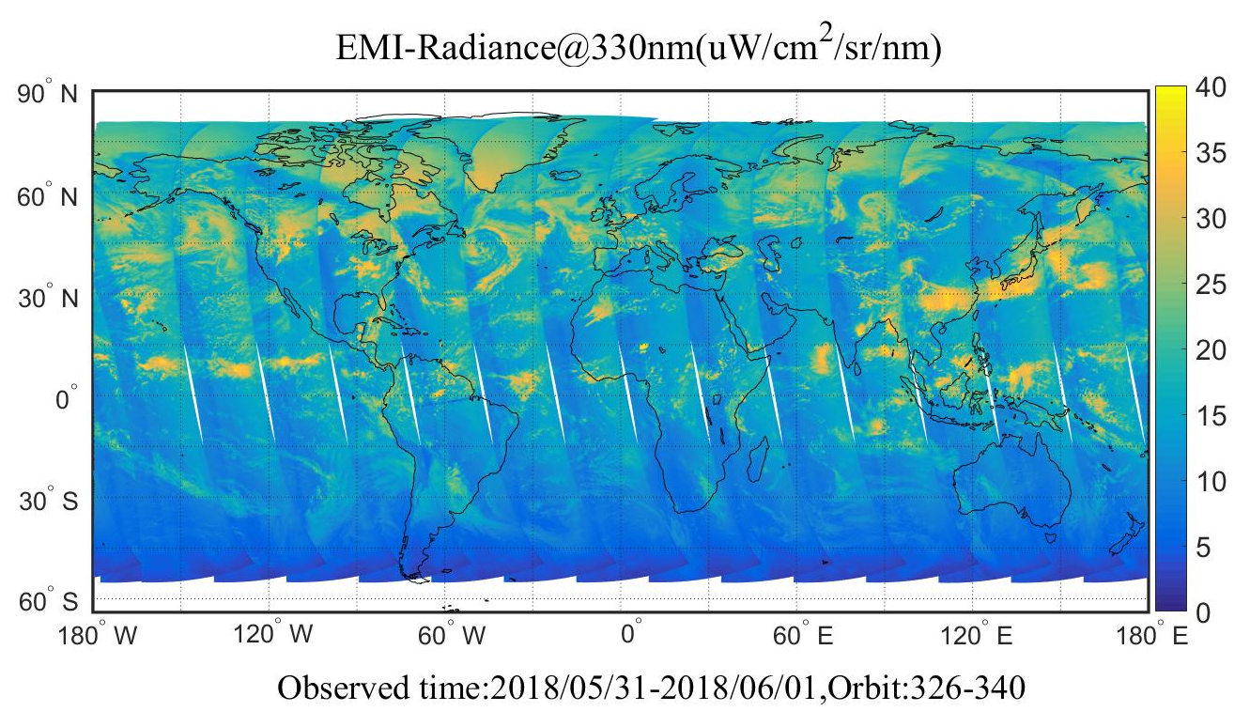
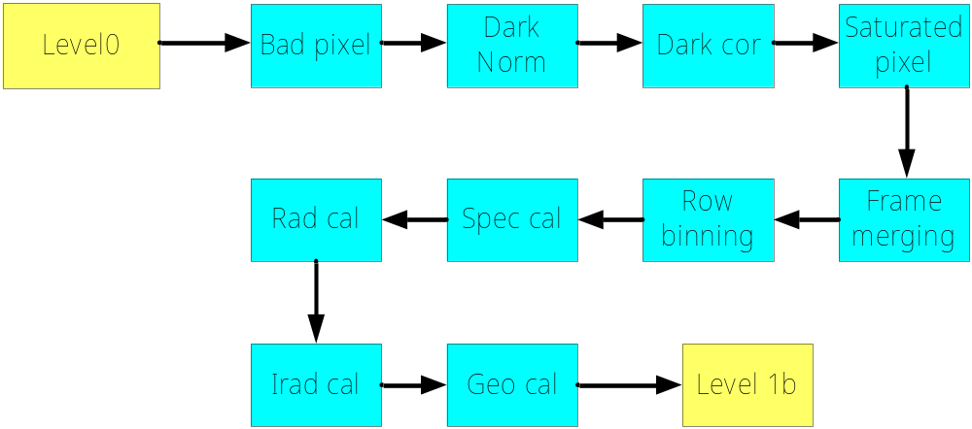
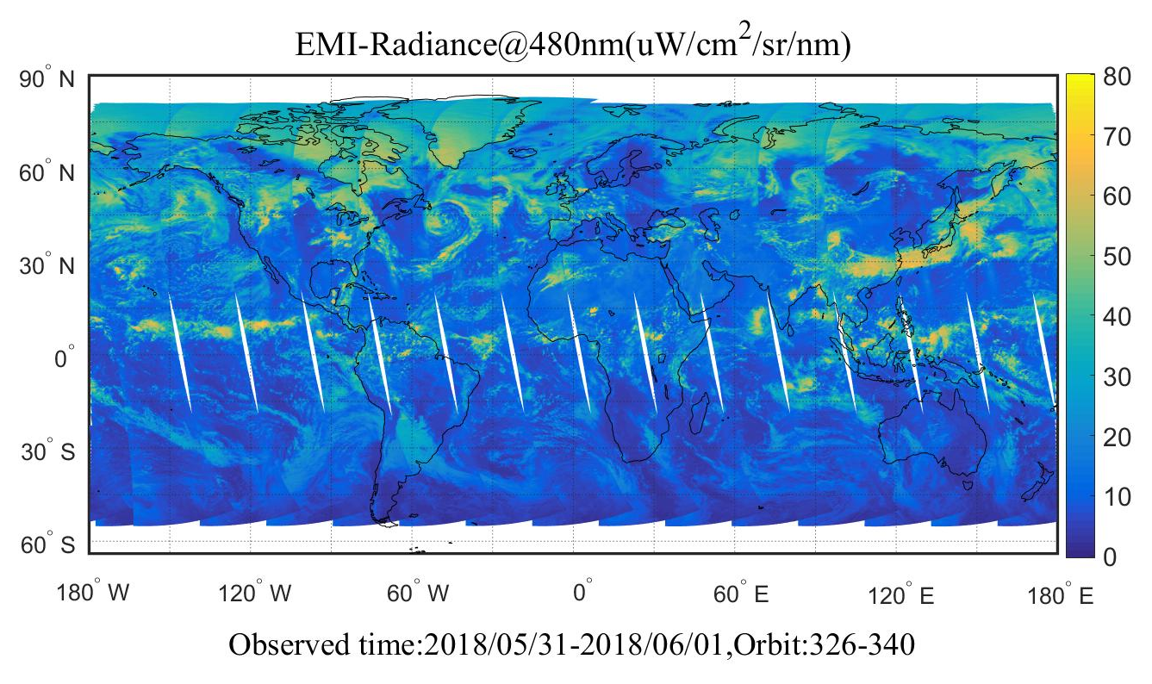
EMI Radiance
EMI L1B data
EMI L1B data processing
Processing time for one orbit is about 20 minutes

Slide 7
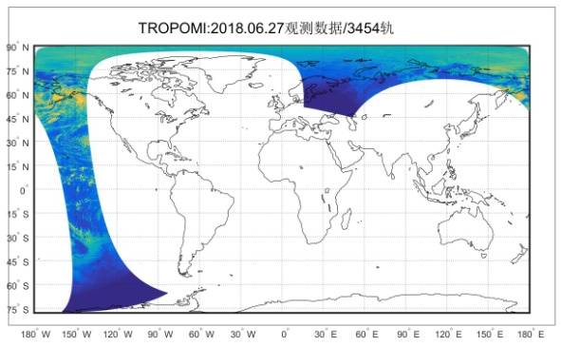
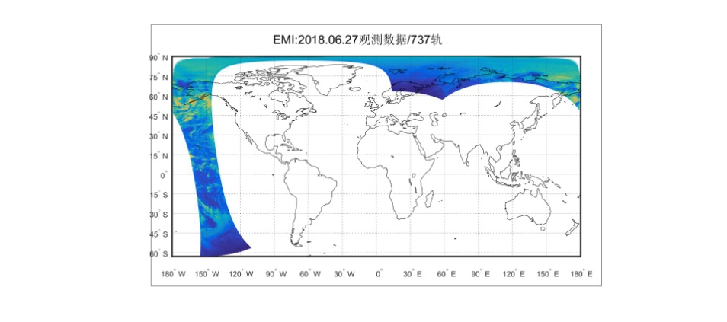
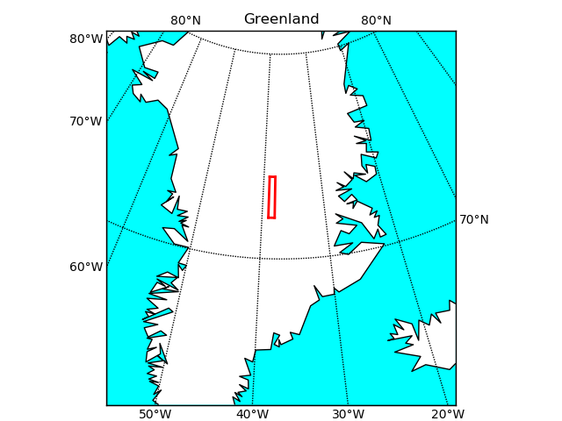
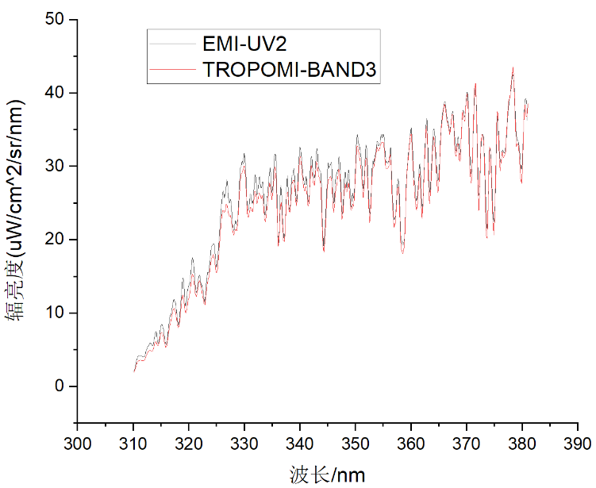
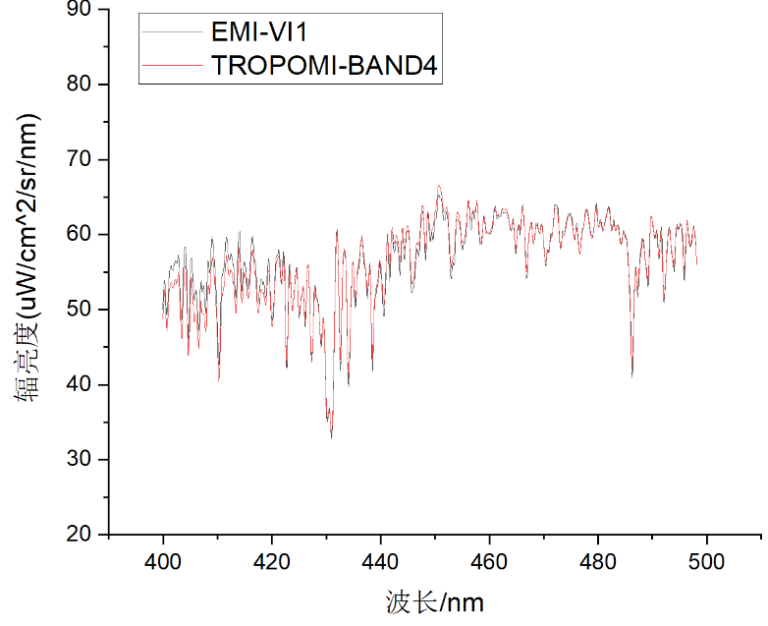
EMI Radiance
Cross comparison
TROPOMI
EMI
 | TROPOMI | EMI
orbit | 820Km（太阳同步） | 705Km（太阳同步）
FOV | 2600Km | 2600Km
ascending time | 13:30 | 13:30
orbit period | T=98.8min | T=98.925min
spectral range | BD1:267-299nm BD2:299-331nm BD3:304-400nm BD4:400-498nm BD5:661-724nm | UV1:240-315nm UV2:311-403nm VIS1:401-550nm VIS2:545-710nm
spectral resolution | 0.5nm | 0.3-0.5nm
Spatial resolution | 7km×7km | 48km×13km
Relative error less than 6%

Slide 8
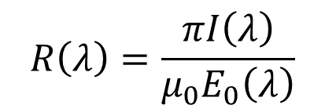
Inversion algorithm
DOAS(Differential Optical Absorption Spectroscopy) method
Atmospheric radiance
$$R\left(λ\right)=\frac{πI\left(λ\right)}{μ_{0}E_{0}\left(λ\right)}$$
Reflectance spectrum
Solar irradiance
Difference between radiance and irradiance
Introduce inversion error

Slide 9
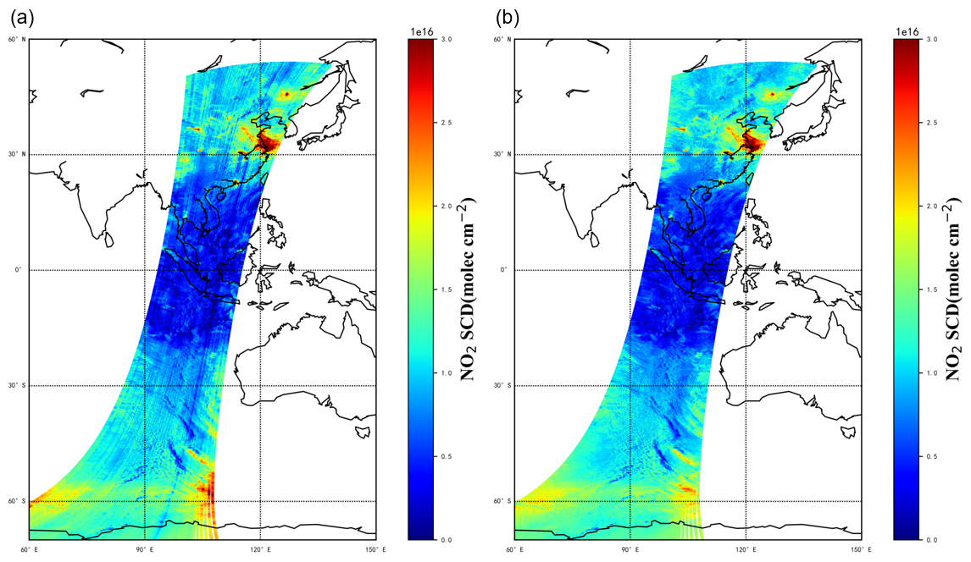
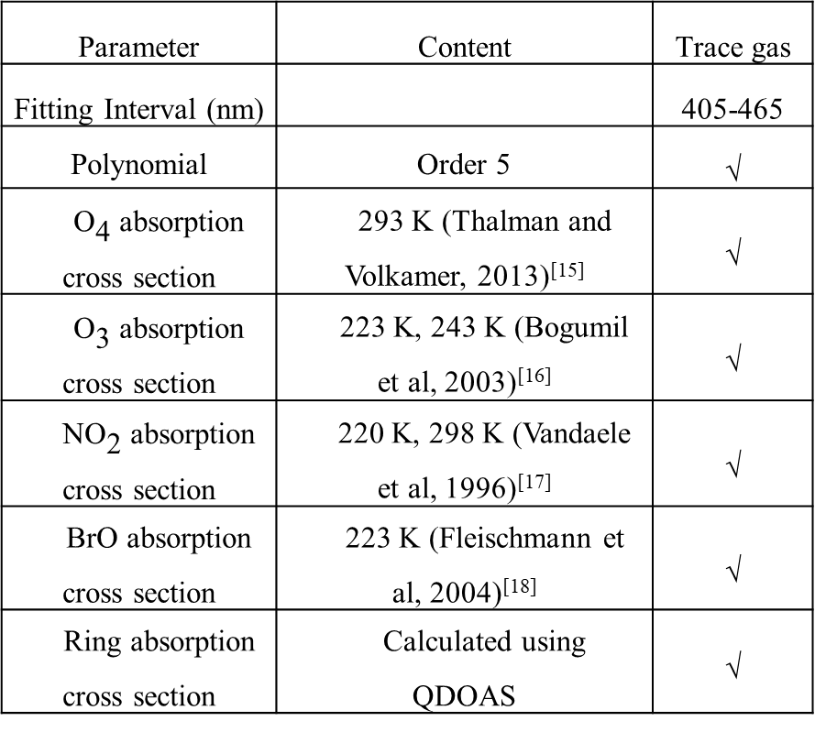
Inversion algorithm
DOAS fitting for retrieving the NO2
Stripes along the orbit
Parameter | Content | Trace gas
Fitting Interval (nm) |  | 405-465
Polynomial | Order 5 | √
${\text{O}}_{\text{4}}$ absorption cross section | 293 K (Thalman and Volkamer, 2013)^{[15]} | √
${\text{O}}_{\text{3}}$ absorption cross section | 223 K, 243 K (Bogumil et al, 2003)^{[16]} | √
${\text{NO}}_{\text{2}}$ absorption cross section | 220 K, 298 K (Vandaele et al, 1996)^{[17]} | √
BrO absorption cross section | 223 K (Fleischmann et al, 2004)^{[18]} | √
Ring absorption cross section | Calculated using QDOAS | √
Systematic overestimation or underestimation

Slide 10
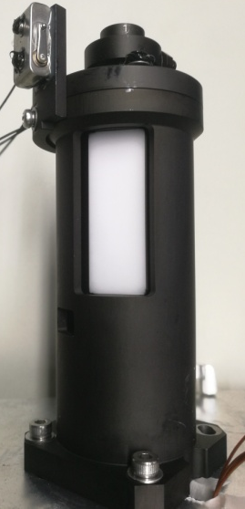
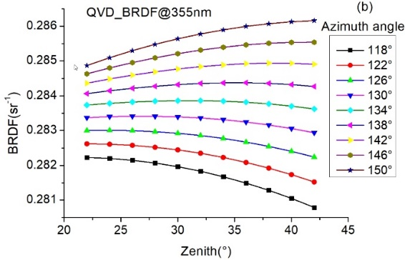
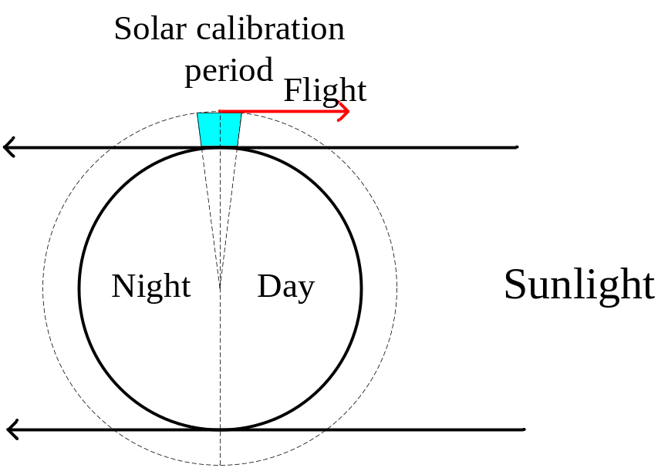
Stripe Error Correction
1. Solar calibration angle is different
Non ideal Lambertian characteristics
Azimuth | 330°—345°
Elevation angle | -6°—+6°
Scattering surface roughness
Quartz Volume Diffuser (QVD)
Calibration angle varies with season and calibration time
Solar spectrum depends on
the incident angle

Slide 11
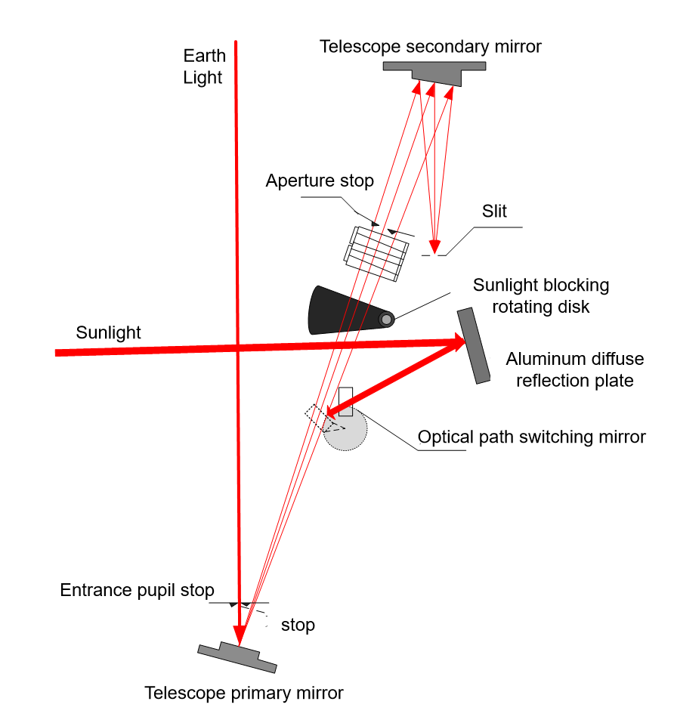

Stripe Error Correction
2. Sunlight path and Earthlight path is different
Radiometric response is different
Spectral response function is different
Spectral differences in irradiance and radiance
Earth light
Primary mirror
secondary
mirror
slit
Solar
diffuser
Folding mirror

Slide 12
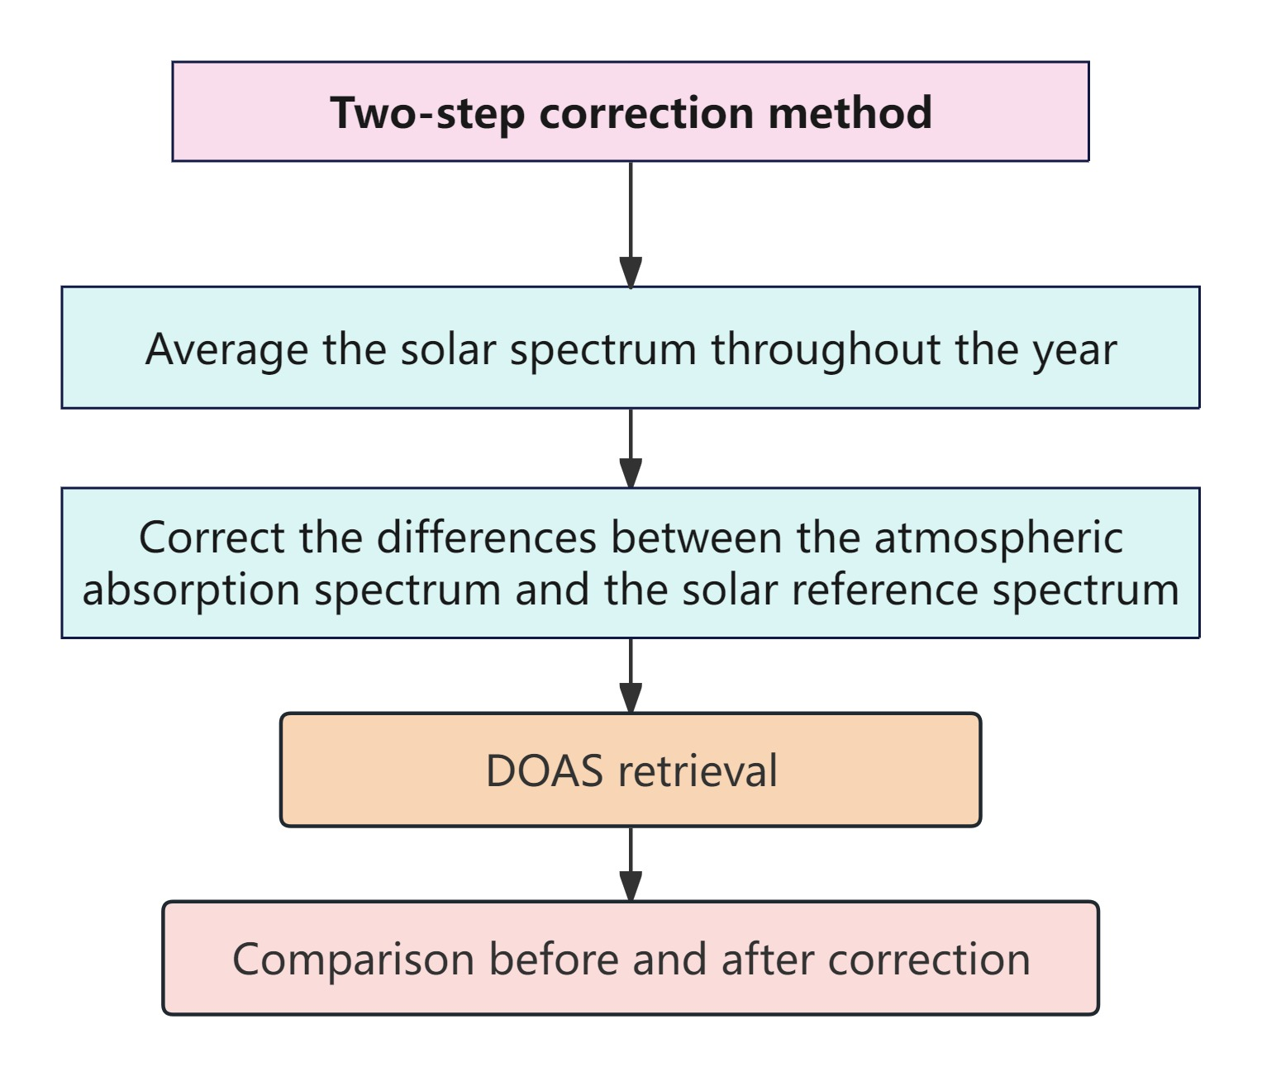
Stripe Error Correction
Stripe Correction method

Slide 13
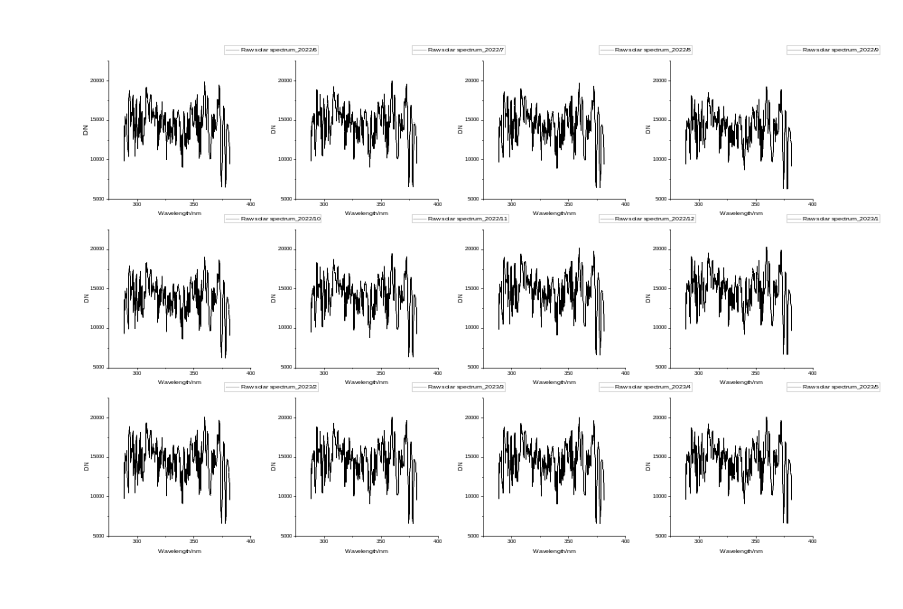
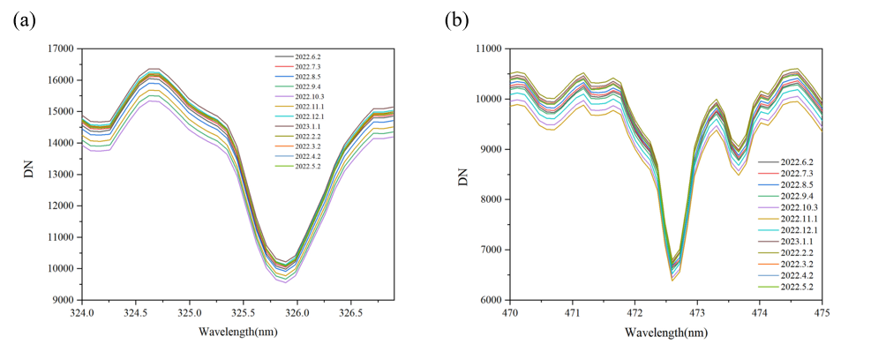
Stripe Error Correction
STEP 1: Average raw solar spectrum throughout one year
2022/6
2022/7
2022/8
2022/9
2022/10
2022/11
2022/12
2023/1
2023/2
2023/3
2023/4
2023/5
Annual raw solar spectrum (measured once a month)
Fraunhofer line throughout one year

Slide 14
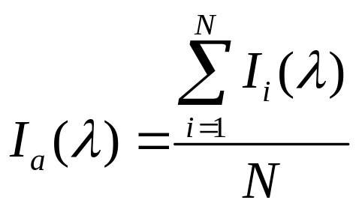
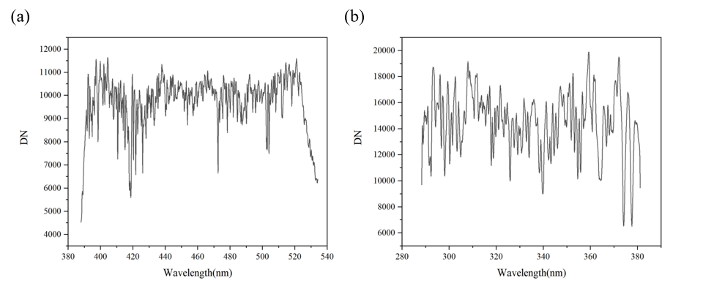
Stripe Error Correction
STEP 1: Average raw solar spectrum throughout one year
Single spectrum
Average spectrum-VIS channel
Average spectrum-UV channel
Average spectrum
Eliminate spectral differences caused by solar incidence angles
Eliminate speckle effects on the rough surface of the diffuser
Reduce the introduced spectral structure
Improve signal-to-noise ratio(SNR)

Slide 15
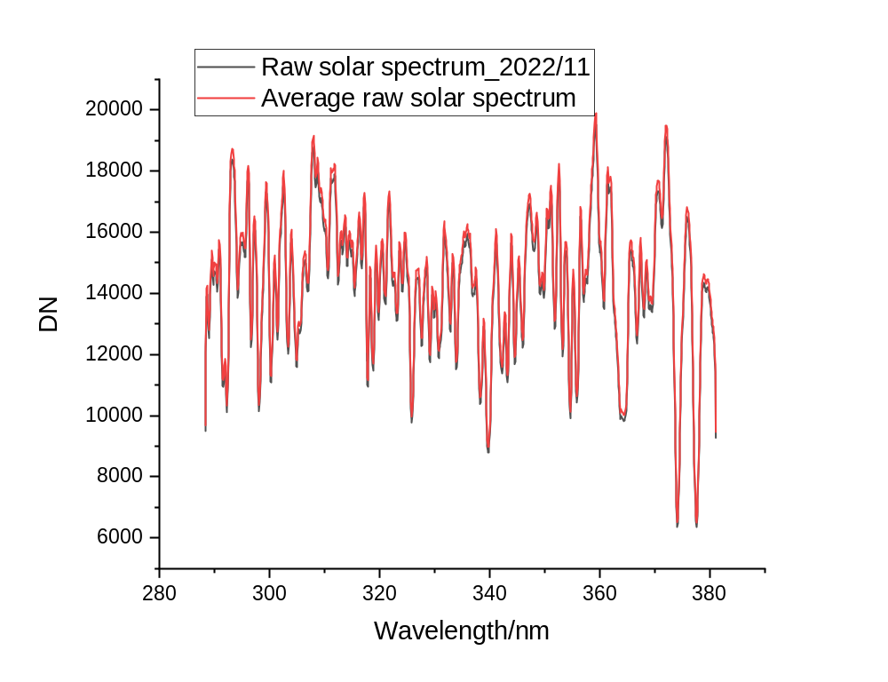
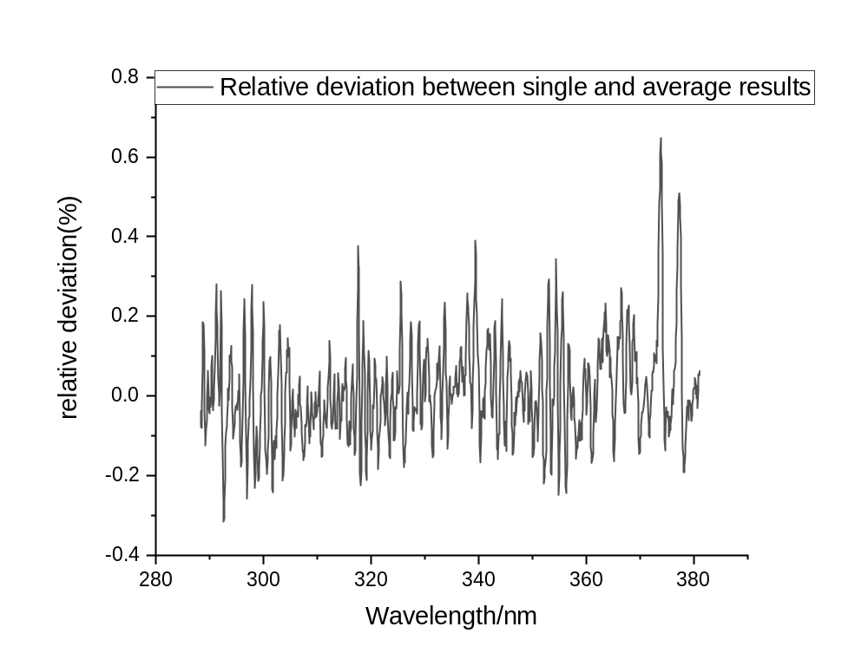
Stripe Error Correction
STEP 1: Average raw solar spectrum throughout one year
Average relative deviation is 0.3%.
Relative deviation varies with wavelength, high-frequency structure may introduce inversion errors

Slide 16
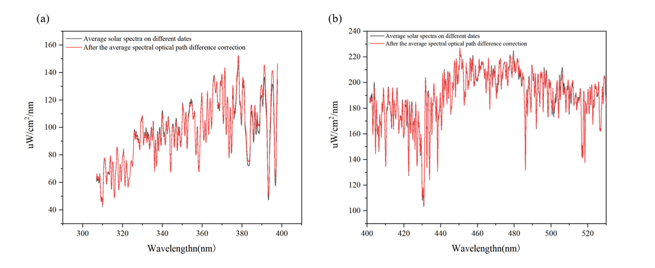
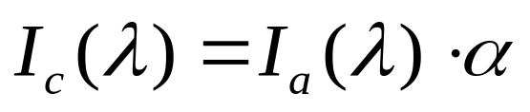
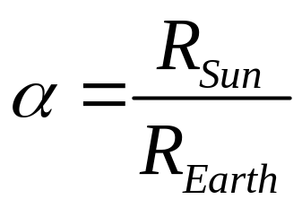
Stripe Error Correction
STEP 2: Correct sunlight and earthlight path
UV channel
Corrected
solar spectrum
Average
solar spectrum
Irradiance response
Radiance response
VIS channel
Difference is about 2.1%

Slide 17
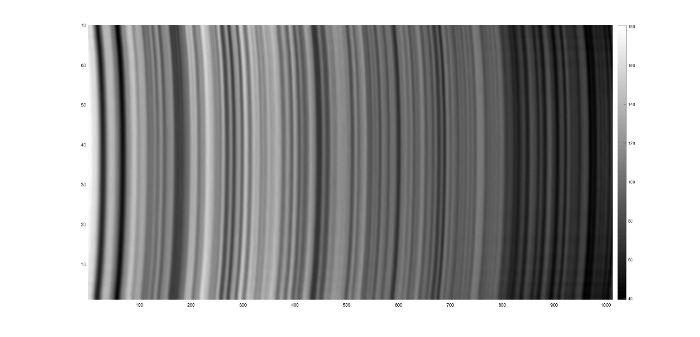
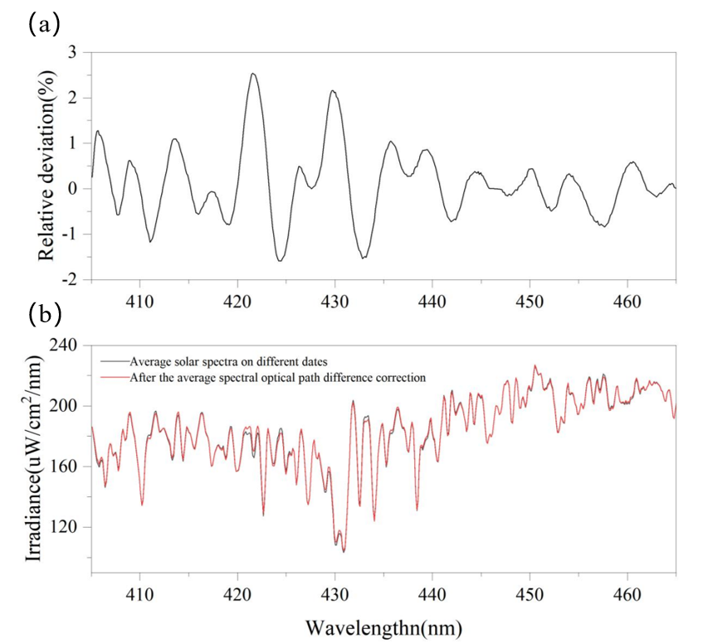
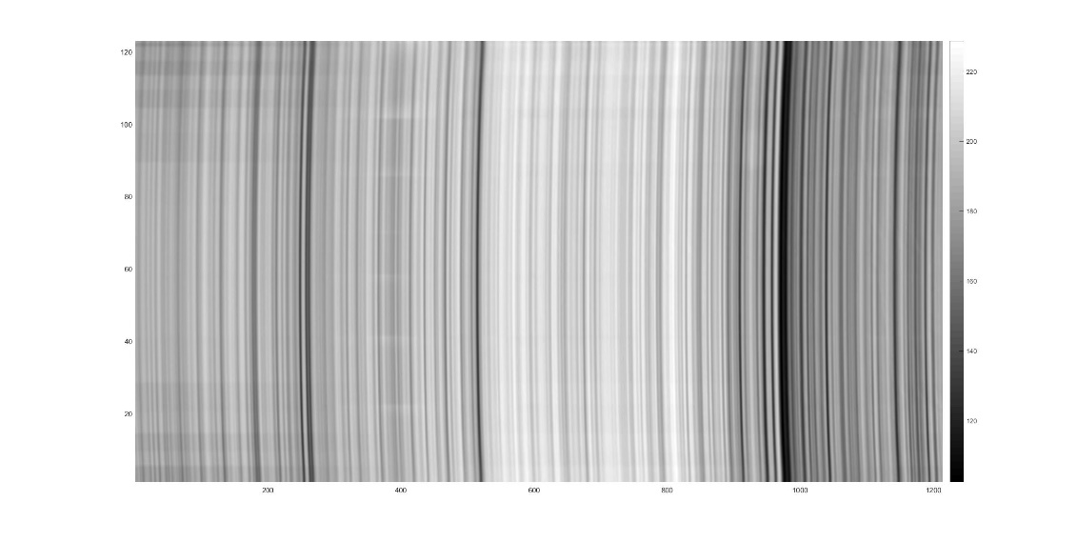
Stripe Error Correction
spectral
STEP 2: Correct sunlight and earthlight path
UV channel
NO2 inversion bands comparison
spatial
VIS channel
Full-Field-of-View Solar Reference Spectrum
Average difference before and after correction is 1.6%

Slide 18
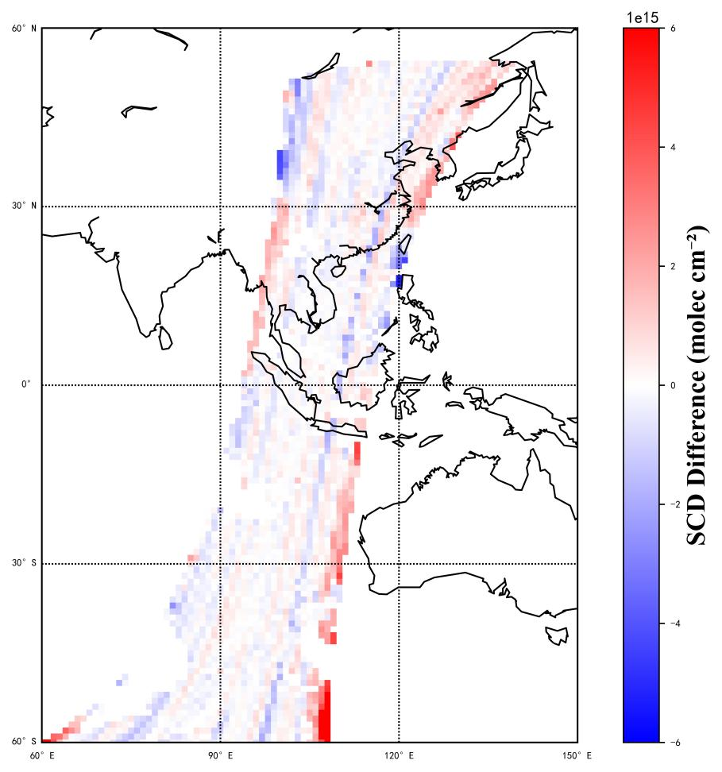
Stripe Error Correction
NO₂ SCD retrieval results
Corrected SCD - Uncorrected SCD
Before stripe correction
After stripe correction
RMS± 6×10¹⁵ molec/cm²
RMS± 0.8×10¹⁵ molec/cm²
± 2×10¹⁵ molec/cm²

Slide 19
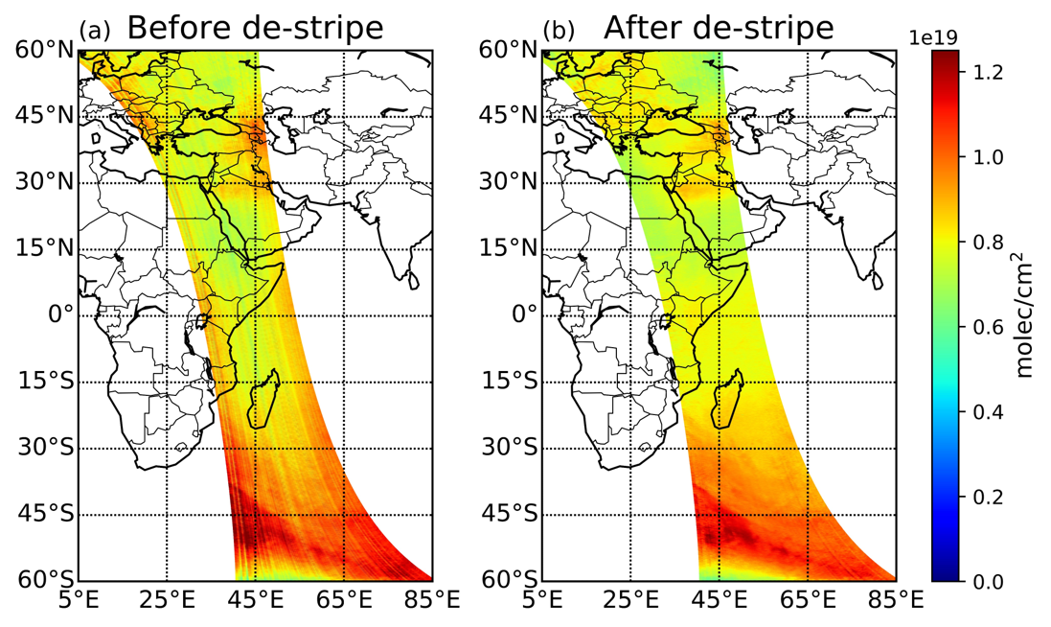
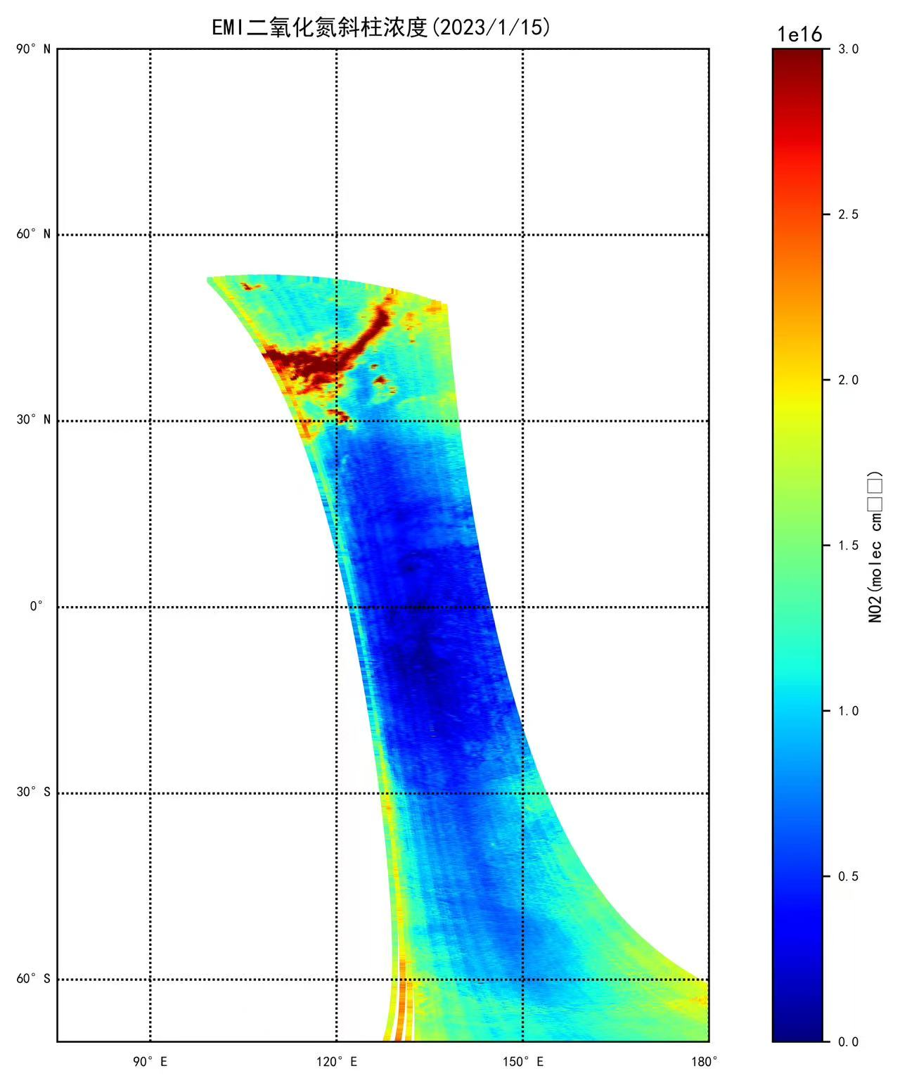
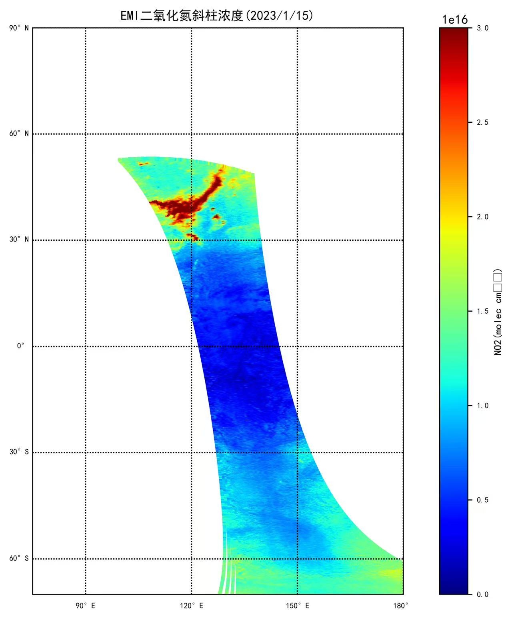
Stripe Error Correction
Before
After
Stripe noise significantly reduced
Better spatial continuity
systematic bias significantly corrected

Slide 20
Thanks for your attention！

