Slide 1




Tropospheric Emissions:
Monitoring of Pollution
TEMPO Level 1 Status
Heesung Chong¹, X. Liu¹, D.E. Flittner², J. Houck¹, J. Carr³,
W. Hou¹, J. Park¹, G. González Abad¹, C.R. Nowlan¹, H. Wang¹,
L. E. Flynn⁴, S. Marchenko⁵, J. Joiner⁵, J. E. Davis¹,
R. M. Suleiman¹, J. Fitzmaurice¹, L. Yatsuhashi¹, K. Chance¹,
B. Baker⁶, C. Seftor⁵, G. Jaross⁵, J. O. Robaidek⁷, X. Wu⁴,
H. Xu⁴, B. Basnet⁴, Y. Bai⁴, C. Cao⁴, D. Doelling²
¹SAO, CfA ²NASA LaRC ³Carr Astro.
⁴NOAA/NESDIS ⁵NASA GSFC ⁶BAE ⁷UW–Madison
March 25, 2026

Slide 2
Contents
Updates in Version 4
Toward Version 5
Major updates
  Absolute calibration
  Stray light correction
  Spectral calibration
Additional updates
  Diffuser goniometry correction
  Etalon fringe correction
  Parity normalization
  Dark current correction
  Smear correction
Major tasks
  Dynamic bad pixel detection
  Degradation correction
  Polarization correction
Additional tasks
  Spectral calibration update
  Stray light correction update
  Absolute calibration update

Slide 3
Updates in Version 4

Slide 4
Absolute calibration
Issue in Version 3: Positive bias in Sun-normalized radiance (on the order of 10%)
(Earth radiance)
(Sun-normalized radiance) =
(Solar irradiance)
(Earth-radiance electric current) * (Calibration coefficient)
=
(Solar-irradiance electric current) * (Calibration coefficient) / (Diffuser transmittance)
Approach: Adjust the solar diffuser transmittance.

Slide 5
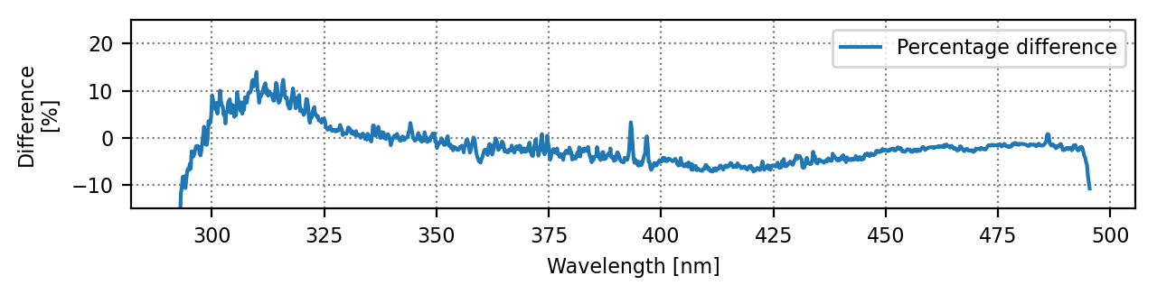
Absolute calibration
(TEMPO Version 3 irradiance) – (TSIS-1 reference irradiance)
2023/08/01 (first-light)
1024th spatial index
Why did the transmittance bias not appear in Version 3? → Biases in calibration coefficients
(Solar irradiance) = (Solar-irradiance electric current) * (Calibration coefficient) / (Diffuser transmittance)
How to verify the hypothesis? → Earth radiance
(Earth radiance) = (Earth-radiance electric current) * (Calibration coefficient)

Slide 6
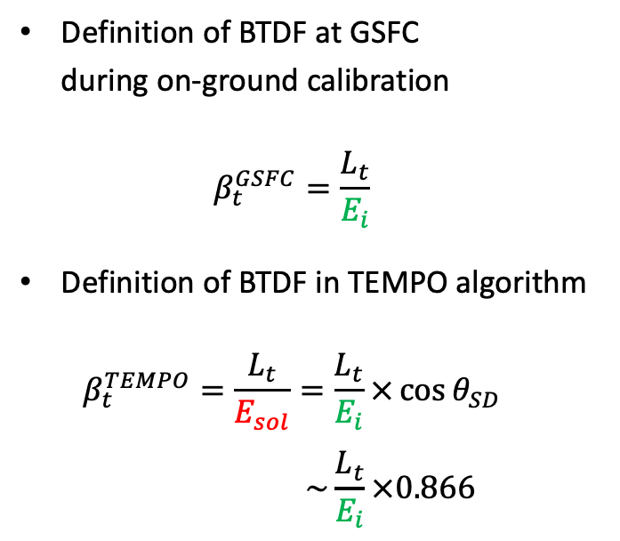




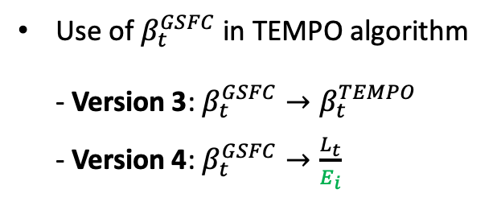
Absolute calibration
Update in BTDF (Bidirectional Transmittance Distribution Function) data interpretation
Definition of BTDF at GSFC
during on-ground calibration
$β_{t}^{GSFC}=\frac{L_{t}}{E_{i}}$
Definition of BTDF in TEMPO algorithm
$β_{t}^{TEMPO}=\frac{L_{t}}{E_{sol}}=\frac{L_{t}}{E_{i}}×\cos{θ_{SD}}$
$\sim \frac{L_{t}}{E_{i}}×0.866$
Use of $β_{t}^{GSFC}$ in TEMPO algorithm
- Version 3: $β_{t}^{GSFC}→β_{t}^{TEMPO}$
- Version 4: $β_{t}^{GSFC}→\frac{L_{t}}{E_{i}}$
$$E_{sol}$$
$$E_{i}=E_{sol}\cos{θ_{SD}}$$
$$θ_{SD}\sim 30°$$
Solar diffuser
$$L_{t}$$
Applying $\cos{θ_{SD}}$ in Version 4 has decreased Sun-normalized radiances by ~13.4%.

Slide 7
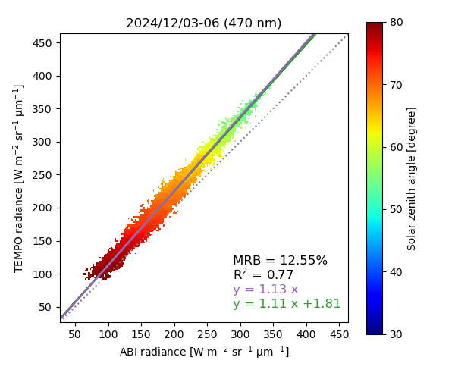
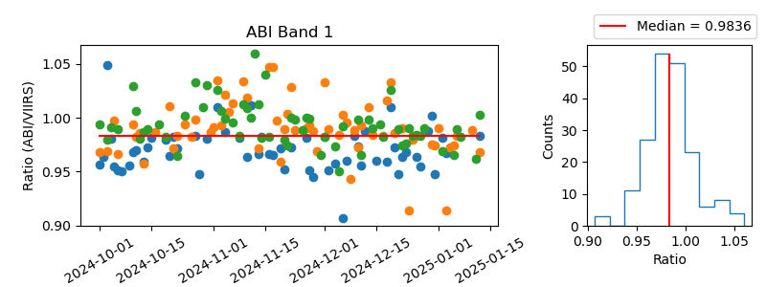

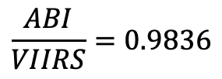
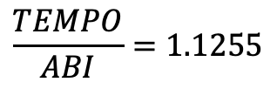
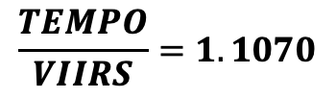

Absolute calibration
Earth radiance intercomparison (TEMPO V03 vs. ABI vs. VIIRS)
Example: 470 nm (UV), GOES-19
$$\frac{TEMPO}{ABI}=1.1255$$
$$×$$
$$\frac{ABI}{VIIRS}=0.9836$$
$$→$$
$$\frac{TEMPO}{VIIRS}=1.1070$$
In Version 4, the UV and visible calibration coefficients have been reduced by 11% and 7%, respectively.

Slide 8
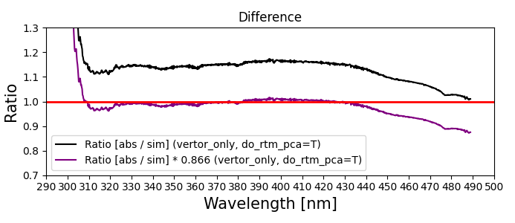
Absolute calibration
Sun-normalized radiance (Version 3 → Version 4)
Ratio: TEMPO / VLIDORT simulation
2023/11/06, scan 009, granule 02
Version 3
Version 4
*Note: Spectral-independent, constant surface albedo (0.074) was used.
[Credit: Junsung Park]
Most significant outcome: Cloud fraction bias have been significantly reduced.

Slide 9
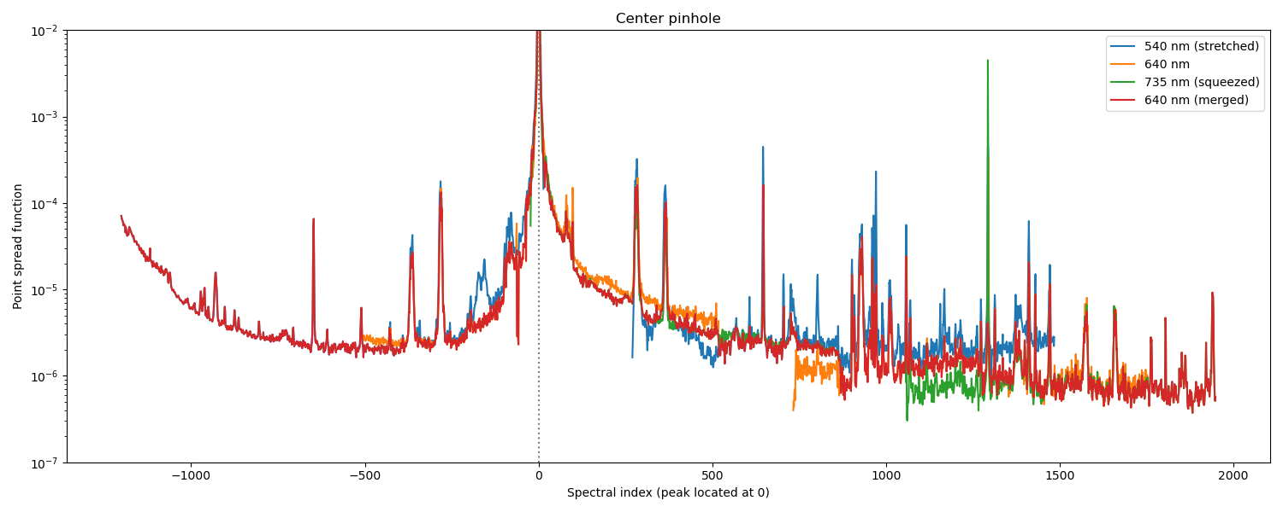
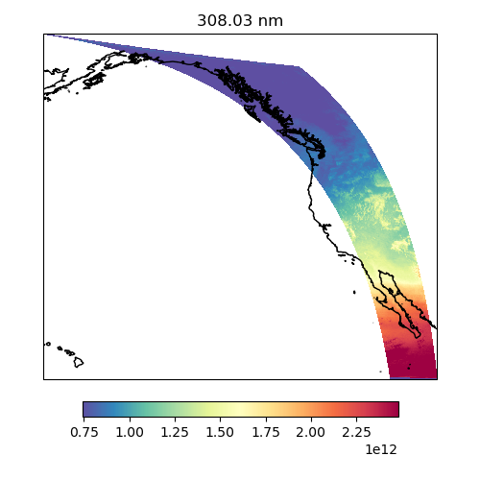

Stray light correction
Issues in Version 3:
Overcorrection at short wavelengths
Background stray light remaining in the UV channel
Undercorrected stray light in cloudy scenes
Improvement 1
Update PSFs (Point Spread Functions).
Improvement 2
Implement a background stray light correction.
VIS PSF
Before
(308.03 nm)
After
(308.03 nm)
Most significant outcome: Ozone profile retrieval has been improved.

Slide 10
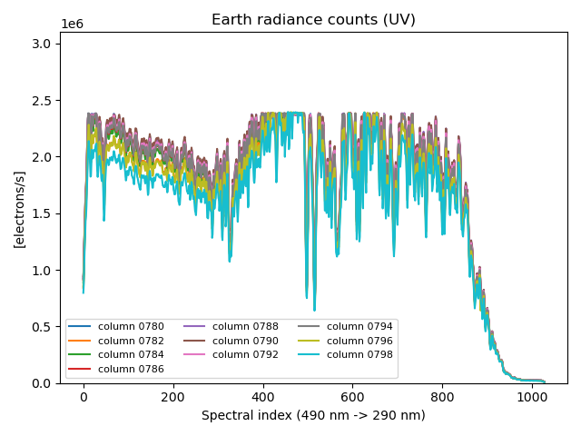
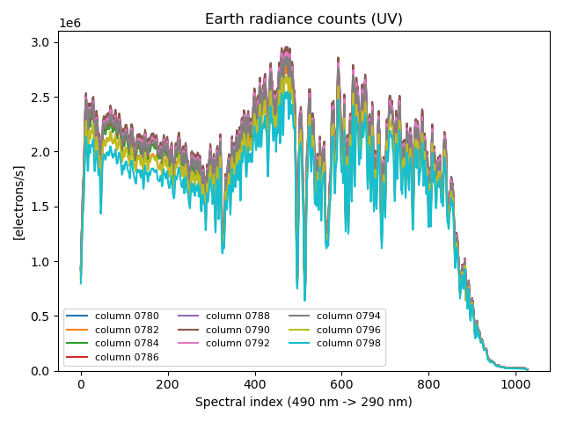
Stray light correction
Improvement 3: Reconstruct radiances for CCD pixels with signal saturation to compute the source for the stray light.
Before reconstruction
After reconstruction
Without reconstructing these flat-tops,
stray light is underestimated.
HCHO
fitting
window
HCHO
fitting
window
Most significant outcome: Positive biases in formaldehyde retrieval over cloudy pixels have been mitigated.
(Reconstructed radiances are only for stray light correction and are not saved in Level-1 files.)

Slide 11
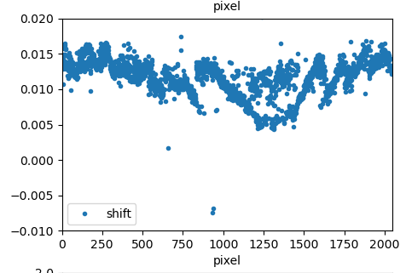
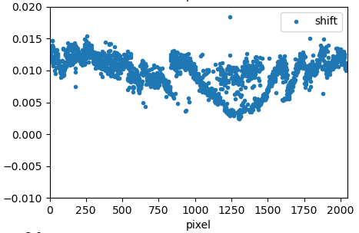
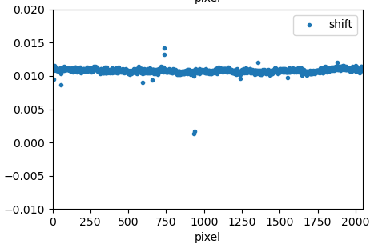
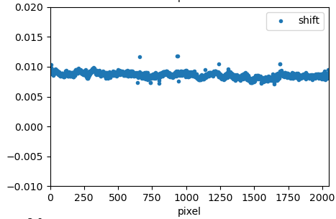
Spectral calibration
Issue in Version 3: Spatial variability (North-South) in wavelength registration
Solution: Remove the slit-function asymmetry factor from the solar fitting to increase stability.
Version 3
Version 4
NO₂ fitting window
HCHO fitting window
NO₂ fitting window
HCHO fitting window
Spectral shift [nm]
Spectral shift [nm]
CCD spatial index (North ➝ South)
CCD spatial index (North ➝ South)
[Image credit: Gonzalo González Abad]
Most significant outcome: The Level 1 calibration capture spectral changes with enhanced accuracy.

Slide 12
Toward Version 5

Slide 13
Dynamic bad pixel detection
Current approach
Static bad pixel map
Level 0-1 processor
Quality flags for saturation, offset, nonlinearity, gain, and smear
Processing for dark current?
Radiance
or
irradiance
No
Yes
Quality flags for hot and cold pixels
Dark current
(50 frames)

Slide 14
Dynamic bad pixel detection
New approach under consideration
Quality flags for transient
Static bad pixel map
Dynamically updated bad pixel map
Level 0-1 processor
Quality flags for saturation, offset, nonlinearity, gain, and smear
Processing for dark current?
No
Radiance
or
irradiance
Yes
Quality flags for hot and cold pixels
Dark current
(50 frames)
if persistent
Most significant outcome: Level 2 retrievals are expected to improve by using only reliable CCD pixels.

Slide 15
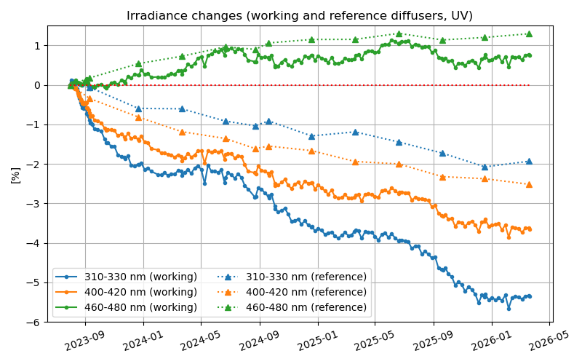
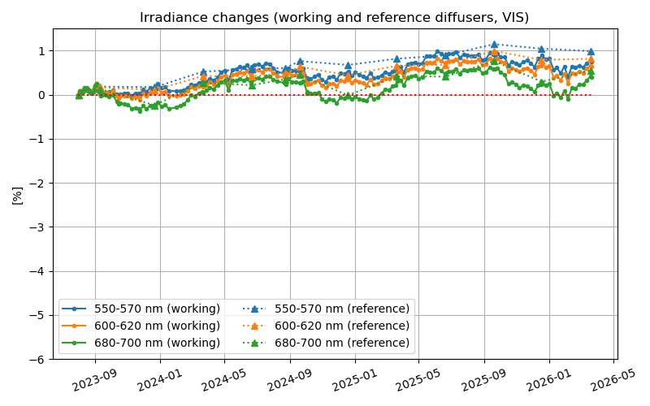
Degradation correction
Solar irradiance trending (2023/08 – 2026/03)
UV (290–490 nm)
VIS (540–740 nm)
Working diffuser (every week)
Reference diffuser (every 3 months)

Slide 16
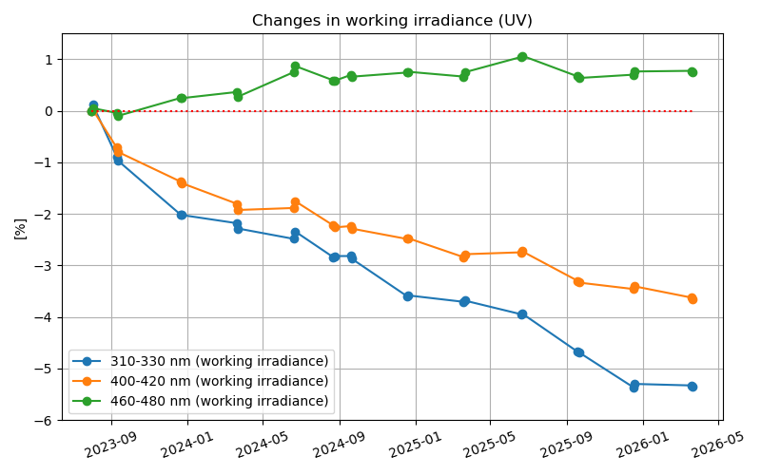
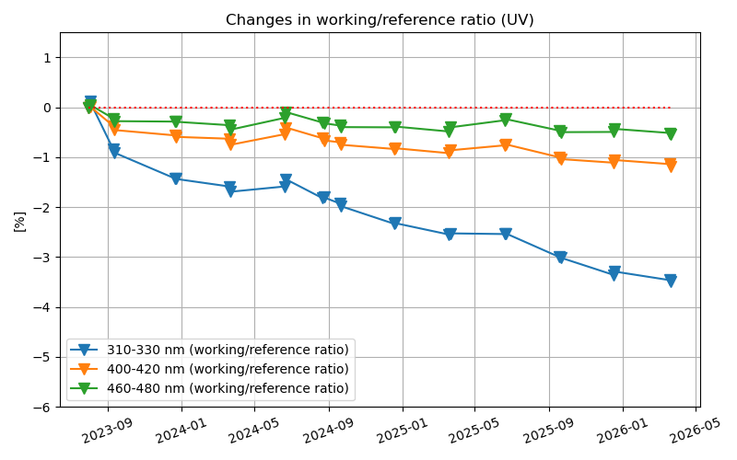
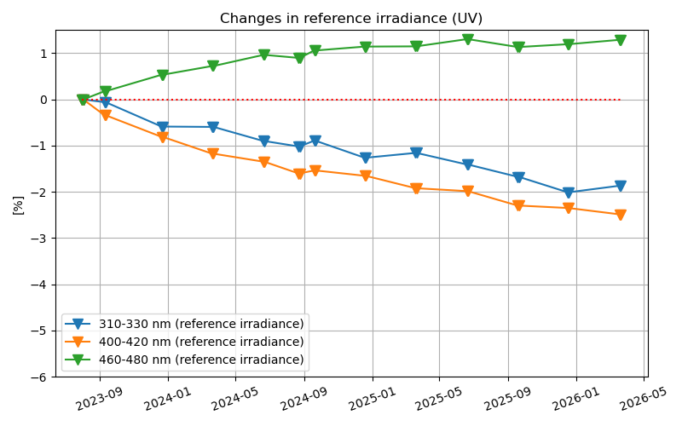
Degradation correction
UV (290–490 nm)
Working irradiance change
Working diffuser change
Optics/detector change
(estimated by working/reference irradiance ratio)
(estimated by reference irradiance)
=
+
To be corrected separately
Correction to be applied to every wavelength in the UV and VIS CCDs.
Most significant outcome: Level-2 retrievals using Sun-normalized radiances will be improved (O₃ & cloud).

Slide 17
Polarization correction
Earth radiance
Source of polarization: Atmosphere & Earth surface
Derive
(1) degree of linear polarization
and
(2) phase angle of polarization
Total ozone column
Level-1
Sun-normalized radiance
Estimate atmospheric and surface parameters
Derive
Stokes parameters
(Q & U)
Polarization-corrected
Level-1 spectrum
if LER:
Scene albedo & Scene pressure
if MLER:
Cloud fraction & Cloud pressure
Most significant outcome: Fitting residuals in Level 2 retrievals are expected to decrease.

Slide 18
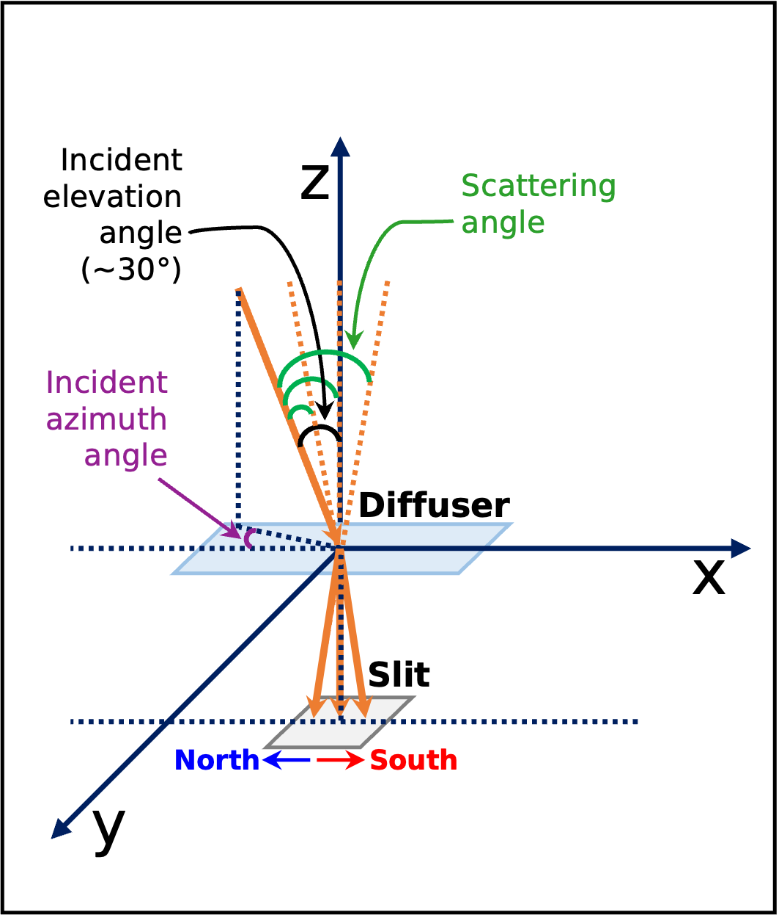
Polarization correction
Solar irradiance
Source of polarization: Solar diffuser
Incident elevation angle
Fresnel Equations
Derive
(1) degree of linear polarization
Polarization-corrected
Level-1 spectrum
Incident azimuth angle
Derive
(2) phase angle of polarization
(two-plate fused silica)
Most significant outcome: Fitting residuals in Level 2 retrievals are expected to decrease.

Slide 19
Summary
In Version 4, we enhanced
  Absolute calibration
  Stray light correction
  Spectral calibration
  Diffuser goniometry correction, etalon fringe correction, parity normalization, dark current correction, and smear correction.
For Version 5, we will enhance
  Bad pixel detection
  Degradation correction
  Polarization correction
  Spectral calibration, stray light correction, and absolute calibration

Slide 20
Thank you for your attention!

