Slide 1
GSICS Data Working Group
GDWG
Breakout Session
Welcome
Paolo Castracane
Starion for ESA/ESRIN

Slide 2
GDWG Overview (from new ToR)
The GSICS Data Management Working Group (GDWG) is an advisory body of the GSICS Executive Panel (EP) for data management and exchange issues. It is composed of Data Management experts designated by GSICS member organizations.
The GDWG shall:
Oversee and coordinate the data management activities of GSICS and advise the EP on questions related to GSICS data management including information delivery services;
Coordinate the specification, maintenance and evolution of data and metadata formats and procedures for data exchange between the satellite agencies, the GSICS Processing and Research Centers (GPRCs), and the GSICS Coordination Center (GCC);
Develop and promote the adoption of open, standardized, machine-readable data formats and metadata schemas to support the discoverability, integration, and reusability aligning with FAIR data principles.
Contribute to the definition and evolution of GSICS Product formats to support long-term sustainability, broader dissemination, and automated data services, including the use of persistent identifiers (e.g., DOIs)
Support the specification of GSICS systems administered by the GCC; GSICS product catalogue, GSICS User Messaging Service, GSICS Wiki, etc.
Support the specification of GSICS systems and tools administered by the GSICS member and observer organizations
Review and validate GSICS deliverables from a data management perspective, including adherence to metadata standards, version control, and long-term accessibility.
Guide the structure, content, and usability of GSICS web platforms (maintained by WMO, GCC, and GPRCs) with an emphasis on modern web presence, user-friendly design, outreach capability, and search engine optimization.
Maintain cooperation with the research and development activities at the GPRCs and assist with their data management activities, as appropriate;
Provide the GSICS Executive Panel with a report on GSICS data management activities including recommendations as appropriate. Submit report three weeks prior to the annual meeting of the GSICS Executive Panel and present it to the Panel.
Build tools to support GSICS Activities. For ex Action Tracker, Alert System, GSICS Data Repository, WIS integration

Slide 3
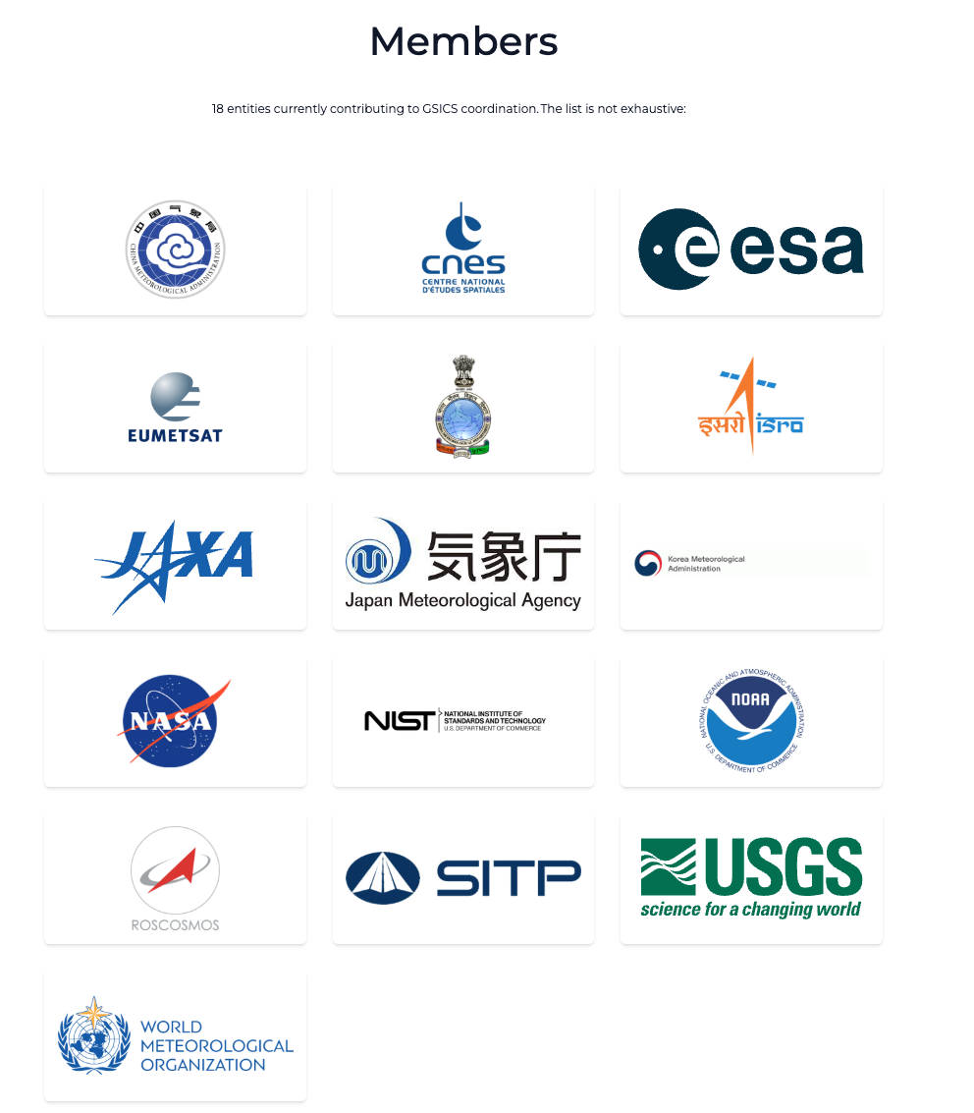
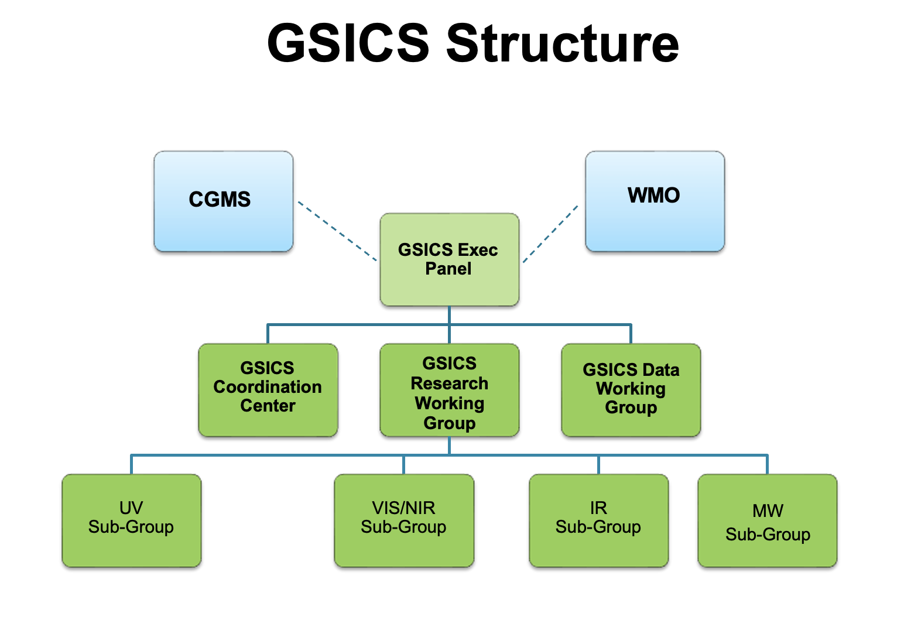

GDWG in the GSICS Framework
GDWG actively supports all aspects of GSICS activities
e.g . systems/metadata/products/wiki/GPPA
Detailed TOR here
Oversee and coordinate the data management activities of GSICS and advise the EP on questions related to GSICS data management including information delivery services

Slide 4
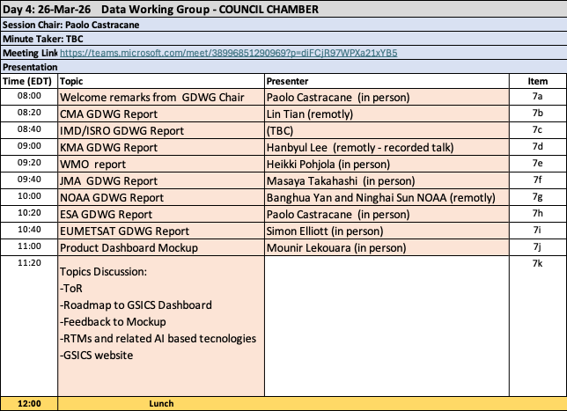
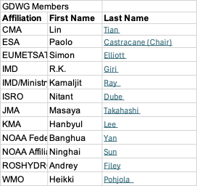
GDWG Membership and GDWG Breakout Session schedule
https://gsics.wmo.int/en/focal-points

Slide 5
Action 2025 status
https://www.star.nesdis.noaa.gov/smcd/GCC/MeetingActions.php
Action ID | Summary | Lead | Due date | Status | Proposed Status (to be updated)
A.GDWG.20240312.4 | Paolo Castracane (ESA) to lead discussion with GCC and WMO on possible enhancement of GSICS websites following WGCV Cal/Val Portal as example. | Paolo Castracane |  | Open | closed
A.GDWG.20240313.1 | CMA to post daily instrument bias on GPRC website in machine readable form. |  |  | Open
A.GDWG.20240313.4 | Paolo to coordinate with Manik on reducing overlap of webpage on solar radiance at ESA, NOAA/wiki and LASP. | Paolo |  | Open | closed
A.GDWG.20240313.5 | Masaya to collect new codes of GSICS deliverable filenaming to be added in Common code table C-13 of WMO Manual on Codes. | Masaya |  | Open
A.GDWG.20240313.6 | Masaya to work on update of GSICS SRF Convention if GRWG requires any updates. | Masaya |  | Open
A.GEP.20240315.1 | GDWG to issue a GSICS standard operating procedure for the generation and the application of GSICS correction for the Level-1 data. |  |  | Open
R.GDWG.20240313.1 | CMA to link quality of reprocessed data related document on reprocessing website | Scott |  | Open
A.GDWG.2025.11k.5: | Agencies and WMO inquire about the data agreement needed for migration to the EUMETSTA data store. |  | 3/1/2026 | Open | closed
A.GDWG.2025.11k.4: | Eumetsat to provide Data policy agreement example and provide examples of relevant documentation e.g. Privacy Notice for data protection, legal information etc. |  | 3/1/2026 | Open | closed
A.GDWG.2025.11k.2 | LG to provide MB with the information to upload the data (e.g. sftp site) |  | 3/1/2026 | Open | closed
A.GDWG.2025.11k.1 | LG to provide slides of his presentation |  | 3/1/2026 | Open | closed
A.GDWG.2025.11k.3 | MB will upload an example of GSICS dataset to test the system | Manik | 3/1/2026 | Open | closed
A.GWG.2025.13a.1 | Mounir Lekouara (EUMETSAT) to coordinate a web meeting of the GRWG and GDWG to review format and content of GSICS products to facilitate their use especially for monitoring and reporting. | Mounir Lekouara | 3/1/2026 | Open
A.GWG.2025.13e.1 | Seb Wagner (EUMETSAT) to coordinate the creation of a database to share additional lunar observations, and work with GDWG to store it. | Sebastien Wagner | 3/1/2026 | Open

Slide 6
Presentations and discussion
Topics for discussion:
-GSICS Terms of Reference: GSICS-RD004_tor-V3.docx
-Document: Roadmap_to_GSICS_Products_Dashboard_V0.0
-Feedback on Dashboard Mockup
-RTMs and related AI based technologies
-GSICS Website
-Vice-chair request

