Slide 1
GSICS 2026 CMA GDWG ANNUAL REPORT
TIAN Lin

Slide 2
Proposed outlines
Agency’s support to GDWG Activites
Recent launches and Instrument Updates (Landing pages for new FY-LEO / FY-GEO instruments)
Calibration Major Updates
GSICS meeting information Updates

Slide 3
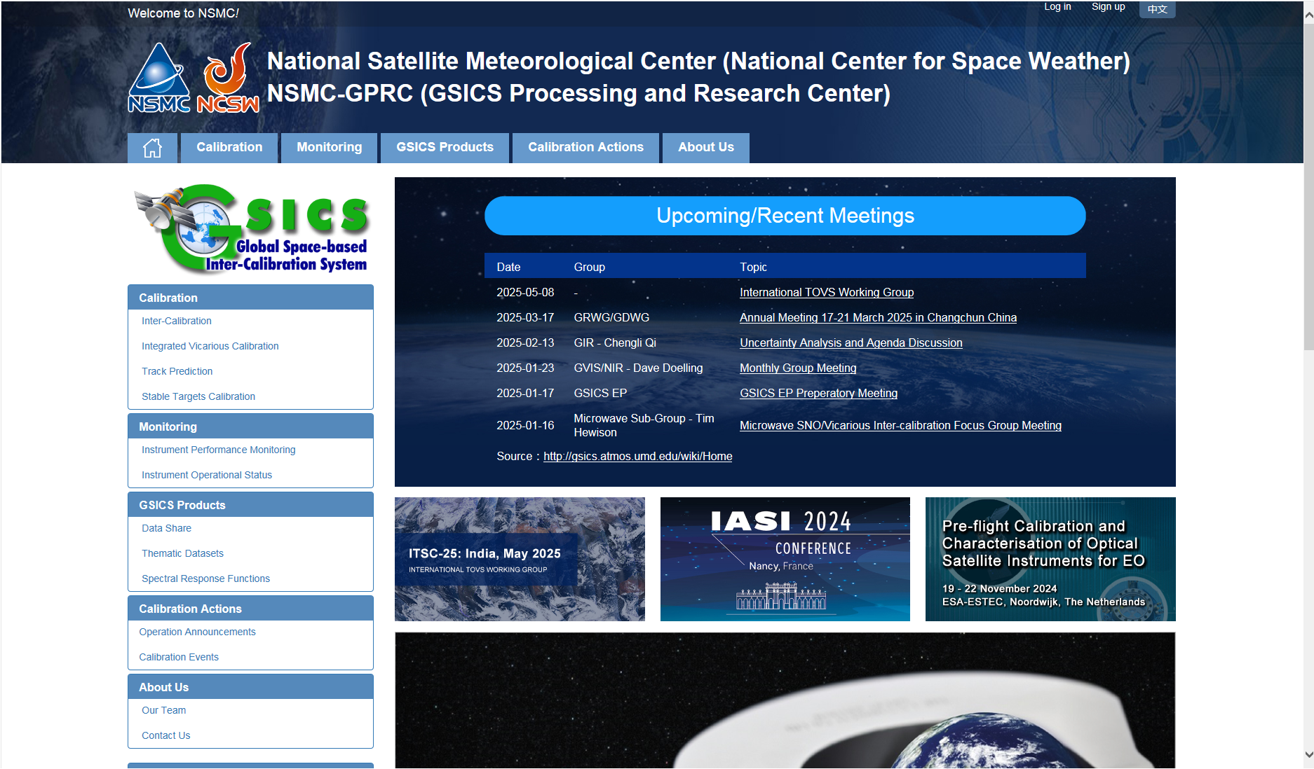
Agency’s support to GDWG Activites
Keep CMA GPRC Website Content updating:
  GPRC Information
  CMA GSICS product sharing (Thredds)
  FengYun Satellites Instrument Operation Status (Landing Pages）
CMA GDWG:
  Website construction and maintain
  New satellite data sharing
  NSMC-GPRC Website Upgrade

Slide 4
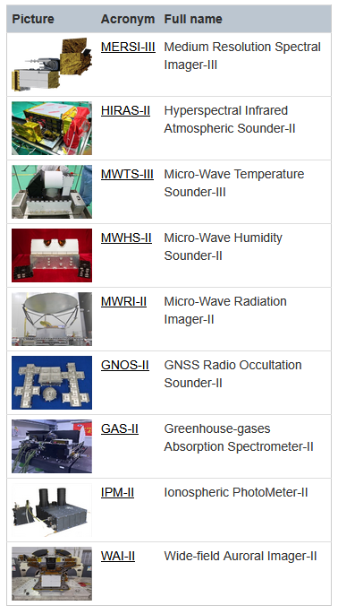
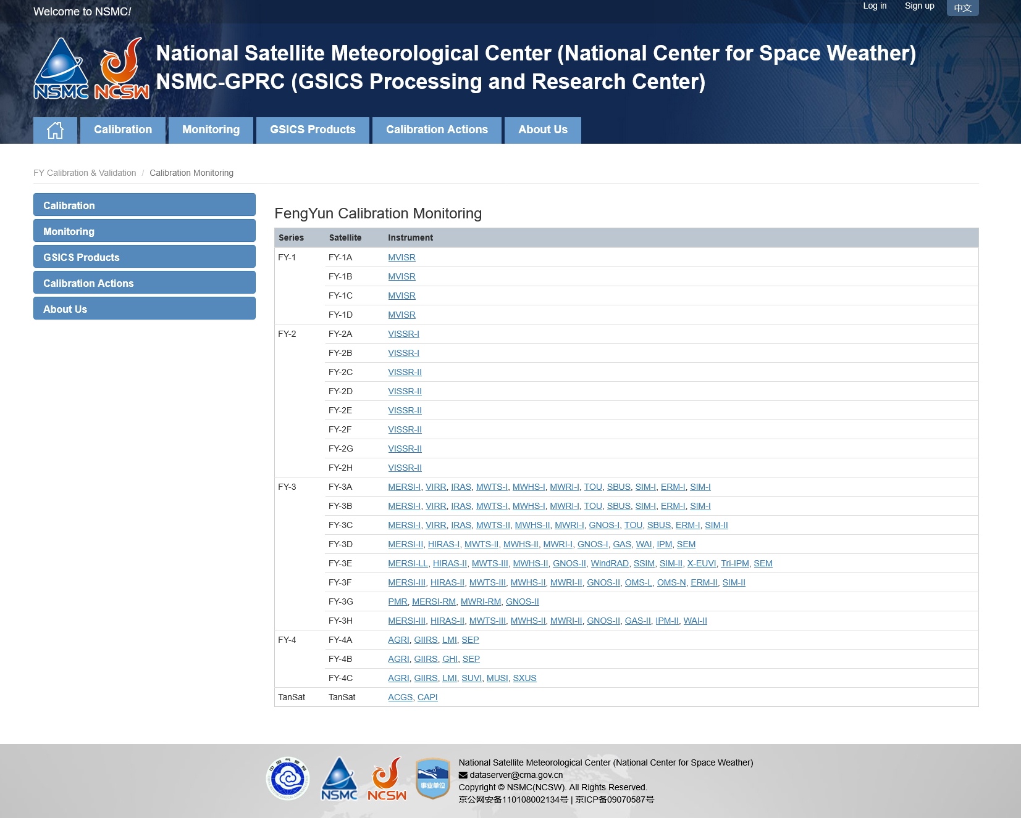
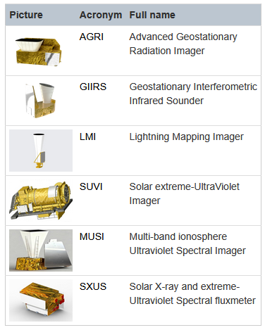
Landing pages for new FY-LEO / FY-GEO instruments
FY-3H: launched on 2025/09/27
FY-4C: launched on 2025/12/27
http://gsics.nsmc.org.cn/portal/en/fycv/monitoring.html

Slide 5
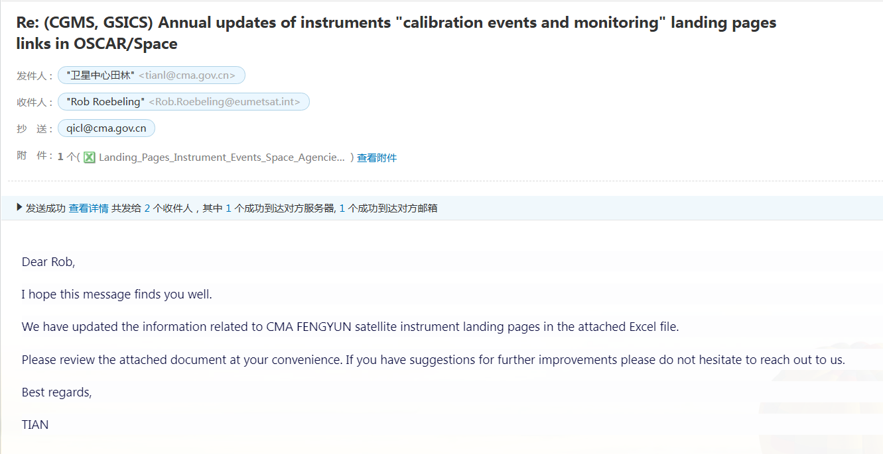
CMA GDWG TASK: Update of the Landing Pages for WMO-OSCAR
Updating the list of new Instrument Calibration and Monitoring Landing Page addresses:
  FY-3H: MERSI-III, HIRAS-2, MWTS-3, MWHS-2, MWRI-2, GNOS-2, GAS-L, IPM-2, WAI-2;
  FY-4C: AGRI, GIIRS-2, LMI, SUVI, MUSI, SXUS;
0 | CMA | FY-3H | MERSI-III | http://gsics.nsmc.org.cn/portal/en/fycv/monitoring.html#FY3H-MERSI | https://space.oscar.wmo.int/satellites/view/fy_3h | https://space.oscar.wmo.int/instruments/view/mersi_3
0 | CMA | FY-3H | HIRAS-II | http://gsics.nsmc.org.cn/portal/en/fycv/monitoring.html#FY3H-HIRAS | https://space.oscar.wmo.int/satellites/view/fy_3h | https://space.oscar.wmo.int/instruments/view/hiras_2
0 | CMA | FY-3H | MWTS-III | http://gsics.nsmc.org.cn/portal/en/fycv/monitoring.html#FY3H-MWTS | https://space.oscar.wmo.int/satellites/view/fy_3h | https://space.oscar.wmo.int/instruments/view/mwts_3
0 | CMA | FY-3H | MWHS-II | http://gsics.nsmc.org.cn/portal/en/fycv/monitoring.html#FY3H-MWHS | https://space.oscar.wmo.int/satellites/view/fy_3h | https://space.oscar.wmo.int/instruments/view/mwhs_2
0 | CMA | FY-3H | MWRI-II | http://gsics.nsmc.org.cn/portal/en/fycv/monitoring.html#FY3H-MWRI | https://space.oscar.wmo.int/satellites/view/fy_3h | https://space.oscar.wmo.int/instruments/view/mwri_2
0 | CMA | FY-3H | GNOS-II | http://gsics.nsmc.org.cn/portal/en/fycv/monitoring.html#FY3H-GNOS | https://space.oscar.wmo.int/satellites/view/fy_3h | https://space.oscar.wmo.int/instruments/view/gnos_2
0 | CMA | FY-3H | GAS-II | http://gsics.nsmc.org.cn/portal/en/fycv/monitoring.html#FY3H-GAS | https://space.oscar.wmo.int/satellites/view/fy_3h | https://space.oscar.wmo.int/instruments/view/gas_2
0 | CMA | FY-3H | IPM-II | http://gsics.nsmc.org.cn/portal/en/fycv/monitoring.html#FY3H-IPM | https://space.oscar.wmo.int/satellites/view/fy_3h | https://space.oscar.wmo.int/instruments/view/sws_ipm
0 | CMA | FY-3H | WAI-II | http://gsics.nsmc.org.cn/portal/en/fycv/monitoring.html#FY3H-WAI | https://space.oscar.wmo.int/satellites/view/fy_3h | https://space.oscar.wmo.int/instruments/view/sws_wai
0 | CMA | FY-4C | AGRI | http://gsics.nsmc.org.cn/portal/en/fycv/monitoring.html#FY4C-AGRI | https://www.wmo-sat.info/oscar/satellites/view/fy_4c | https://space.oscar.wmo.int/instruments/view/agri
0 | CMA | FY-4C | GIIRS-II | http://gsics.nsmc.org.cn/portal/en/fycv/monitoring.html#FY4C-GIIRS | https://www.wmo-sat.info/oscar/satellites/view/fy_4c | https://space.oscar.wmo.int/instruments/view/giirs_2
0 | CMA | FY-4C | LMI | http://gsics.nsmc.org.cn/portal/en/fycv/monitoring.html#FY4C-LMI | https://www.wmo-sat.info/oscar/satellites/view/fy_4c | https://space.oscar.wmo.int/instruments/view/lmi
0 | CMA | FY-4C | SUVI | http://gsics.nsmc.org.cn/portal/en/fycv/monitoring.html#FY4C-SUVI | https://www.wmo-sat.info/oscar/satellites/view/fy_4c | https://space.oscar.wmo.int/instruments/view/seuvi_fy_4
0 | CMA | FY-4C | MUSI | http://gsics.nsmc.org.cn/portal/en/fycv/monitoring.html#FY4C-MUSI | https://www.wmo-sat.info/oscar/satellites/view/fy_4c | https://space.oscar.wmo.int/instruments/view/musi
0 | CMA | FY-4C | SXUS | http://gsics.nsmc.org.cn/portal/en/fycv/monitoring.html#FY4C-SXUS | https://www.wmo-sat.info/oscar/satellites/view/fy_4c | https://space.oscar.wmo.int/instruments/view/sxus

Slide 6
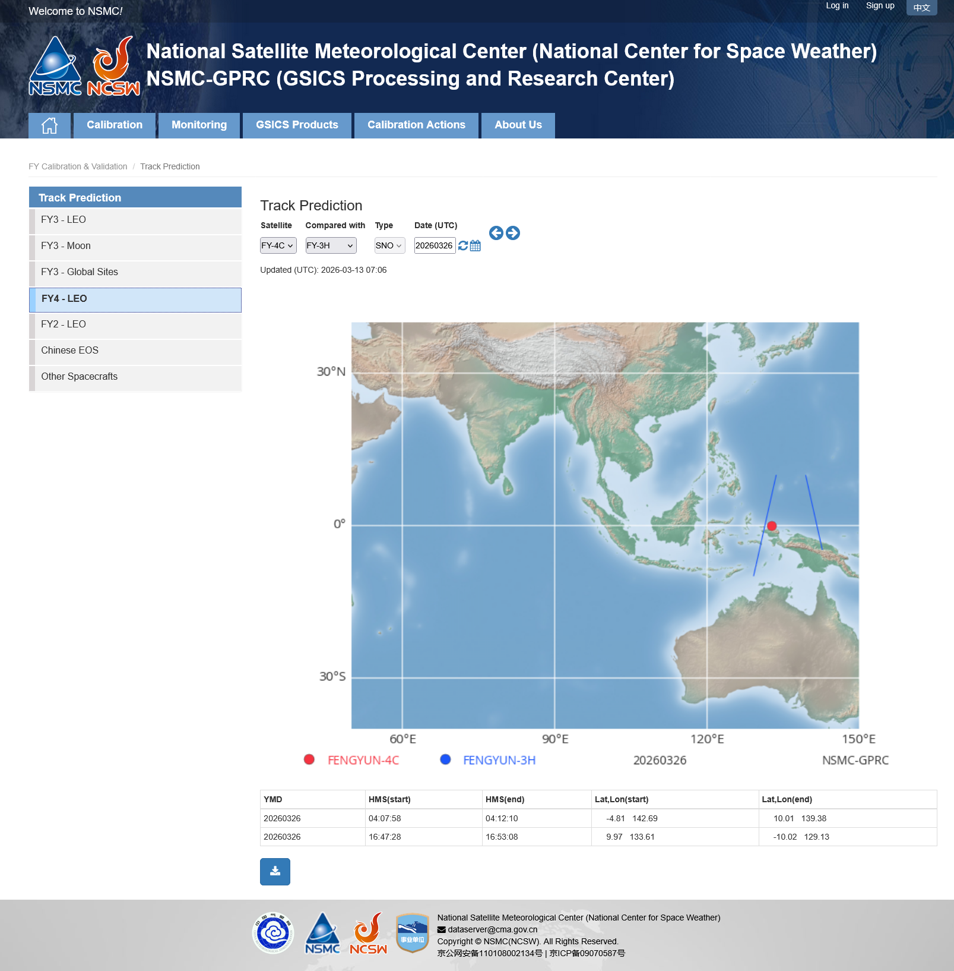

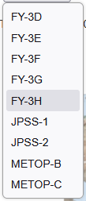
FY-4B/C calibration with new FY-LEO under development
Orbit prediction results have been added

Slide 7
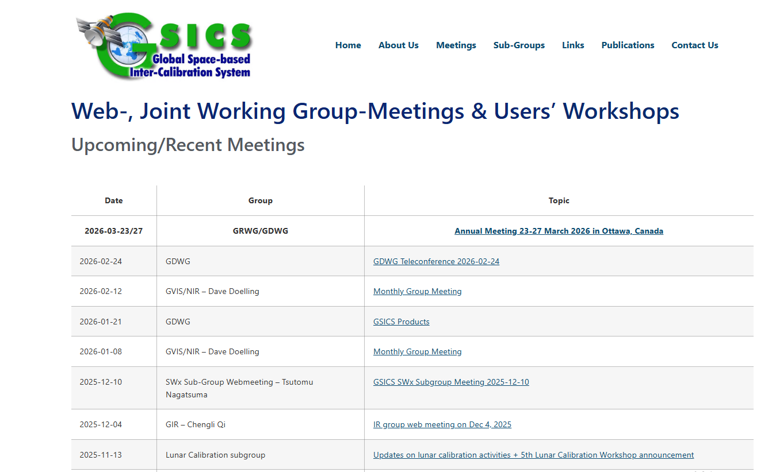
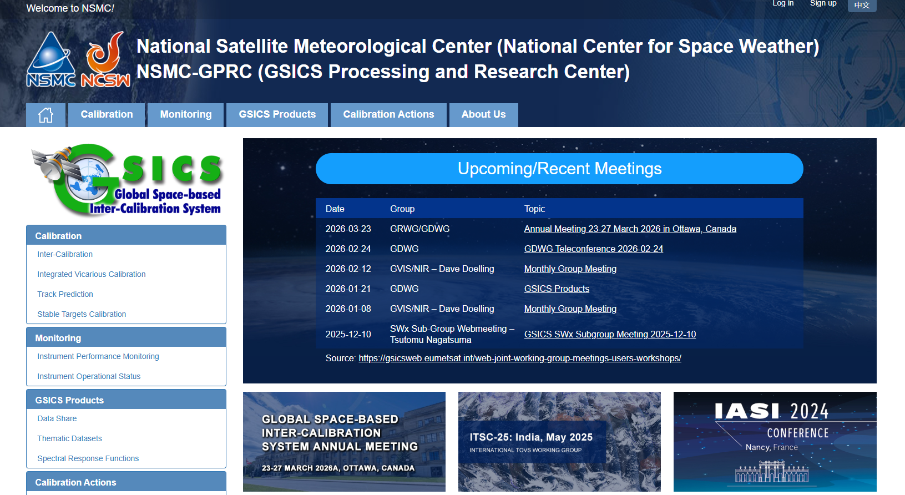
GSICS meeting information source updated
http://gsics.atmos.umd.edu/wiki/Home
https://gsicsweb.eumetsat.int/web-joint-working-group-meetings-users-workshops/

Slide 8



Thank you for your attention！
Email:
tianl@cma.gov.cn
Notes:
Thank you for your attention. I will stop here. For more information, please visit the following website.
And, if you have any problem, please contact me by email.

