Slide 1
KMA GDWG Activities
2026
Hanbyul Lee
KMA/NMSC

Slide 2
KMA’s GSICS Corrections
Current Status
  Near-Real Time Correction (NRTC)
    GK2A / AMI / IR with reference to IASI(Metop-B/-C) and CrIS(S-NPP and NOAA-20/21) : Demo. phase
    COMS / MI / IR with reference to AIRS(Aqua), IASI(Metop-A/-B): Demo. phase
  Re-analysis Correction (RAC)
    GK2A / AMI / IR with reference to IASI-B/-C and CrIS(S-NPP and NOAA-20/21) : Demo. phase
    COMS / MI / IR with reference to IASI-A : Demo. phase
  NRTC and RAC Correction Data were previously distributed through the EUMETSAT GSICS Server from Jan. 15, 2018

Slide 3
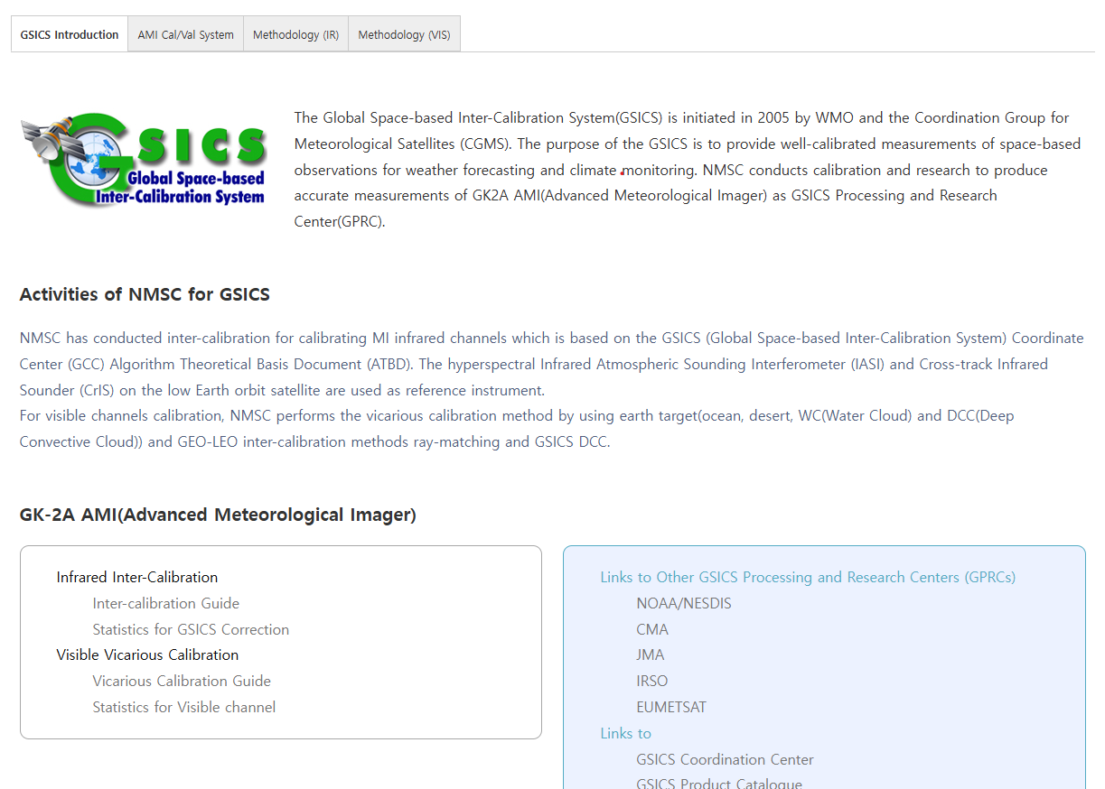
KMA GPRC web pages
Landing page (ACVs)
  https://nmsc.kma.go.kr/homepage/html/gsics/gsicsIntro.do (Korean, open)
  http://nmsc.kma.go.kr/enhome/html/main/main.do (English, open)
Menu(Taps)
    GSICS Introduction
    AMI Cal/Val System
    Methodology(IR)
    Methodology(VIS/NIR)
Monitoring page
  IR (Metop-a/b/c IASI, NOAA-20/21, S-NPP CrIS)
  VIS Ray Matching(S-NPP, NOAA-20/21 VIIRS)
  VIS Lunar(GIRO)

Slide 4
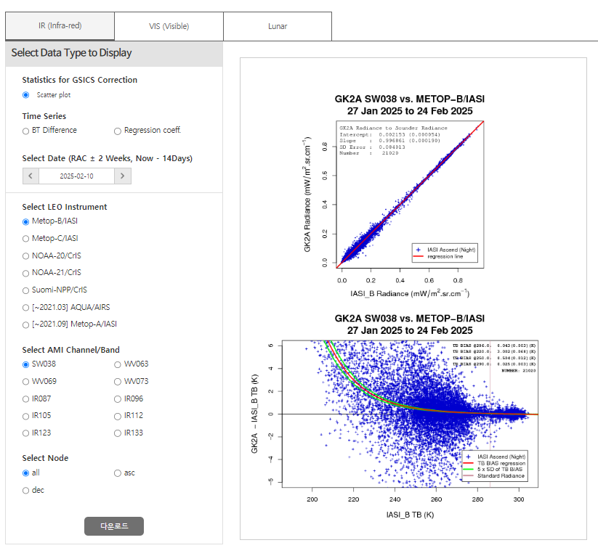
Monitoring page(IR)
IR Calibration (Scatter plot, Time series)
    Metop-B/C IASI, NOAA-20/21 CrIS, Suomi-NPP/CrIS
    Time series includes BT difference and Regression Coefficent

Slide 5
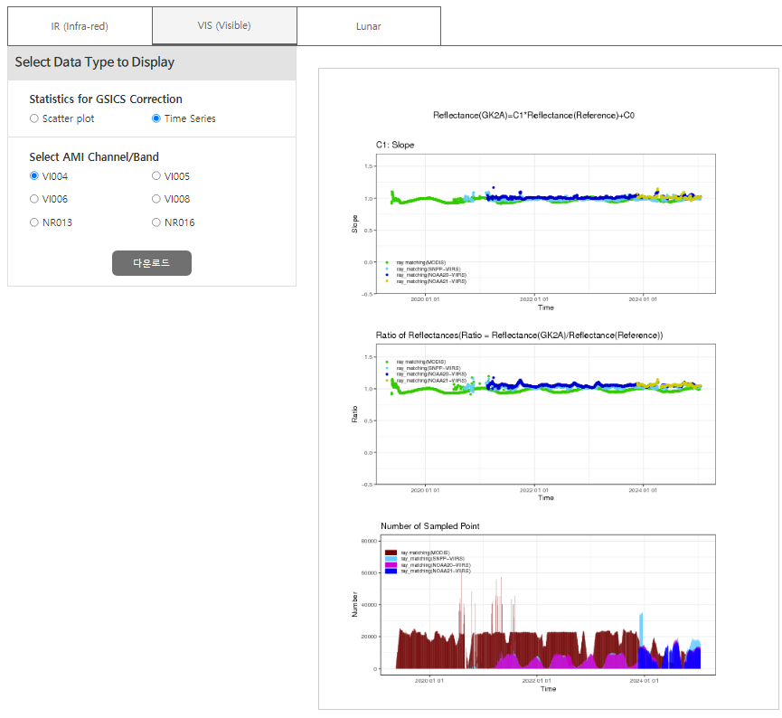
Monitoring page(VNIR)
VIS/NIR Calibration (Scatter plot, Time series)
    Ray-matching(S-NPP NOAA-/2021 VIIRS)
    Lunar calibration (GIRO)
    GSICS DCC and GEO-GEO open

Slide 6
Summary and Future Plan
The KMA GPRC provides AMI performance monitoring in the ACVs web portal
  ACVs includes time series and stability assessment of AMI
  User accessibility is supported
    CSV data download
    Figure/image download
Future plan
  KMA Align with GSICS Dashboard concept : ACVs already supports many elements
    Performance monitoring
    Assessment & Diagnostics
    Satellite system status
    Data and Product Access
  Provide GEO–GEO inter-comparison products (AMI–AHI) in the ACVs web portal

Slide 7
Thank you

