Slide 1
WMO GDWG Report
Heikki Pohjola

Slide 2
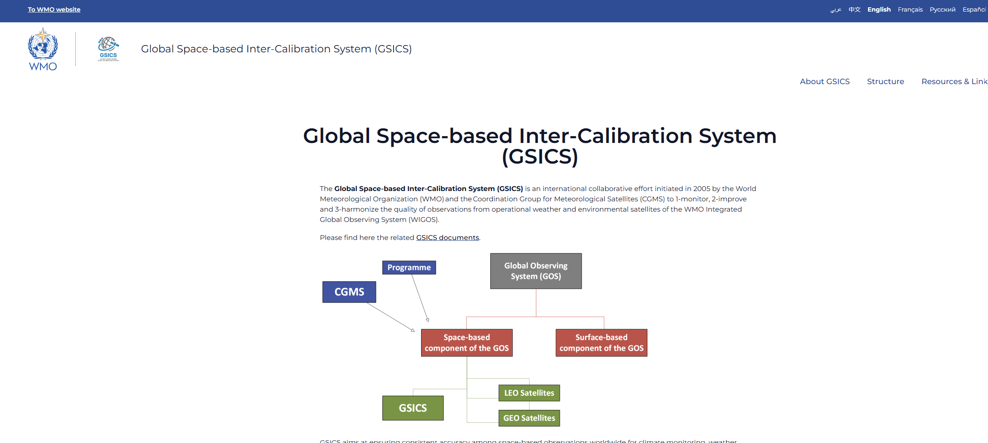
GSICS WMO Website https://gsics.wmo.int/
Links to the GSICS documents:
  Resources & Links
List of GSICS Members:
  Members
List of Focal points:
  Focal points
To be decided how to merge content with EUMETSAT GSICS website?
  Merge relevant content to EUMETSAT GSICS and shut down WMO site
    WMO access to EUMETSAT GSICS website needed!
  Run parallel: Remove other content and link from EUMETSAT GSICS to WMO site on Resources & Links, Members and Focal Points

Slide 3

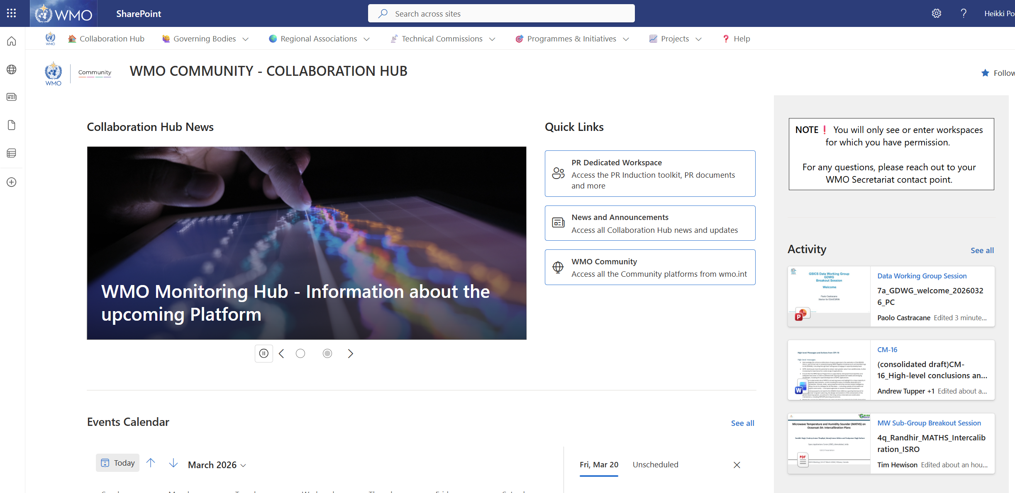
WMO SharePoint: WMO Community – Collaboration Hub https://wmoomm.sharepoint.com/sites/Collaboration/
The WMO Collaboration Hub is a platform where WMO Secretariat staff and the wider WMO community across governing bodies, technical commissions, programmes and initiatives, and projects, can share and work on documents together, as well as exchange information.

Slide 4
GSICS mailing lists
gsics-ep@groups.wmo.int
  EP Members, GCC, GDWG Chair, GRWG Chair, Space Programme (Heikki and Zoya)
  Maintained by Space Programme
gsics-dev@googlegroups.com
Needs for other mailing lists?

