Slide 1
JMA GDWG Report
TAKAHASHI Masaya
Japan Meteorological Agency / Meteorological Satellite Center

Slide 2
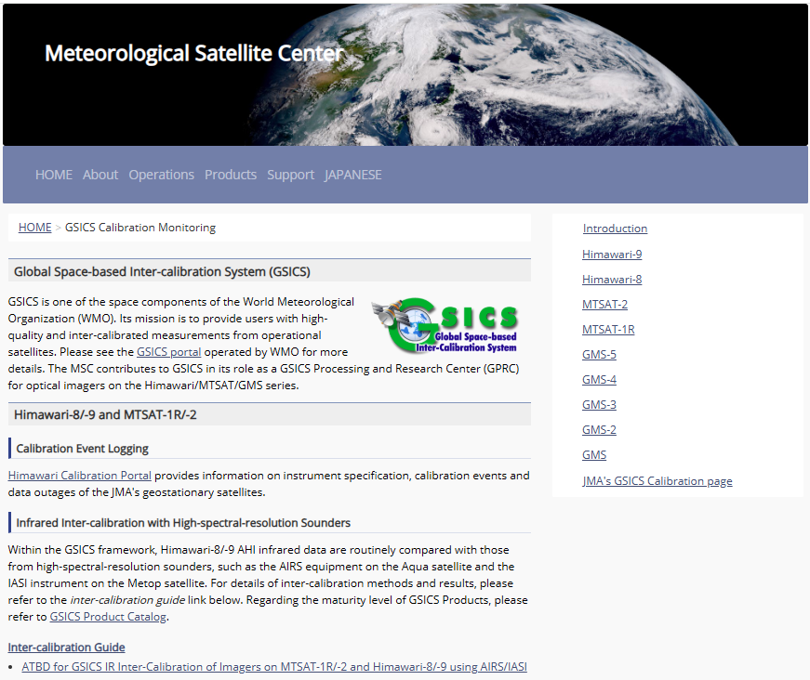
2025-2026 JMA GDWG Activities
Lunar calibration
  Development of I/O data Convention for new lunar calibration framework (LSICS)
Maintaining JMA GPRC webpage
  Calibration landing page
    Instrument info (e.g., SRF)
    Event logging
  Himawari-8/-9 AHI monitoring pages
    VNIR Ray-matching
    VNIR Vicarious calibration
    GEO-LEO-IR
No open actions
https://www.data.jma.go.jp/mscweb/data/monitoring/calibration.html

Slide 3
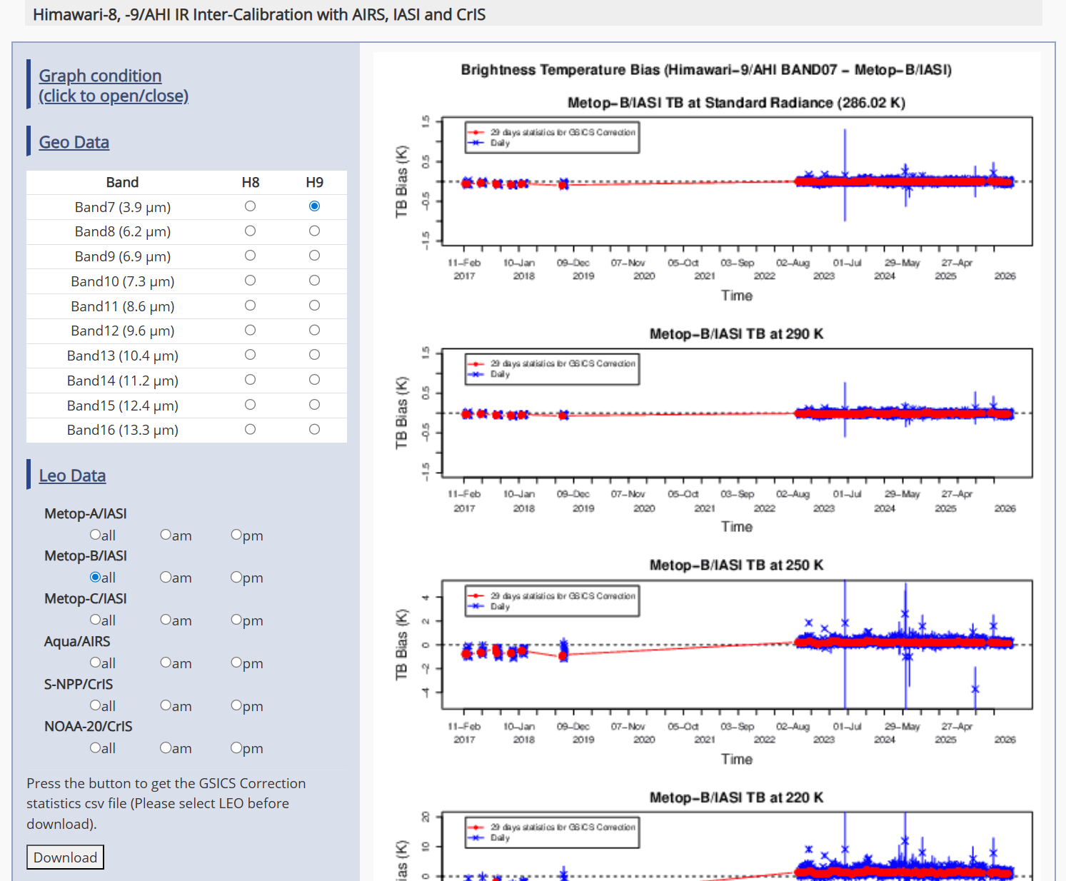
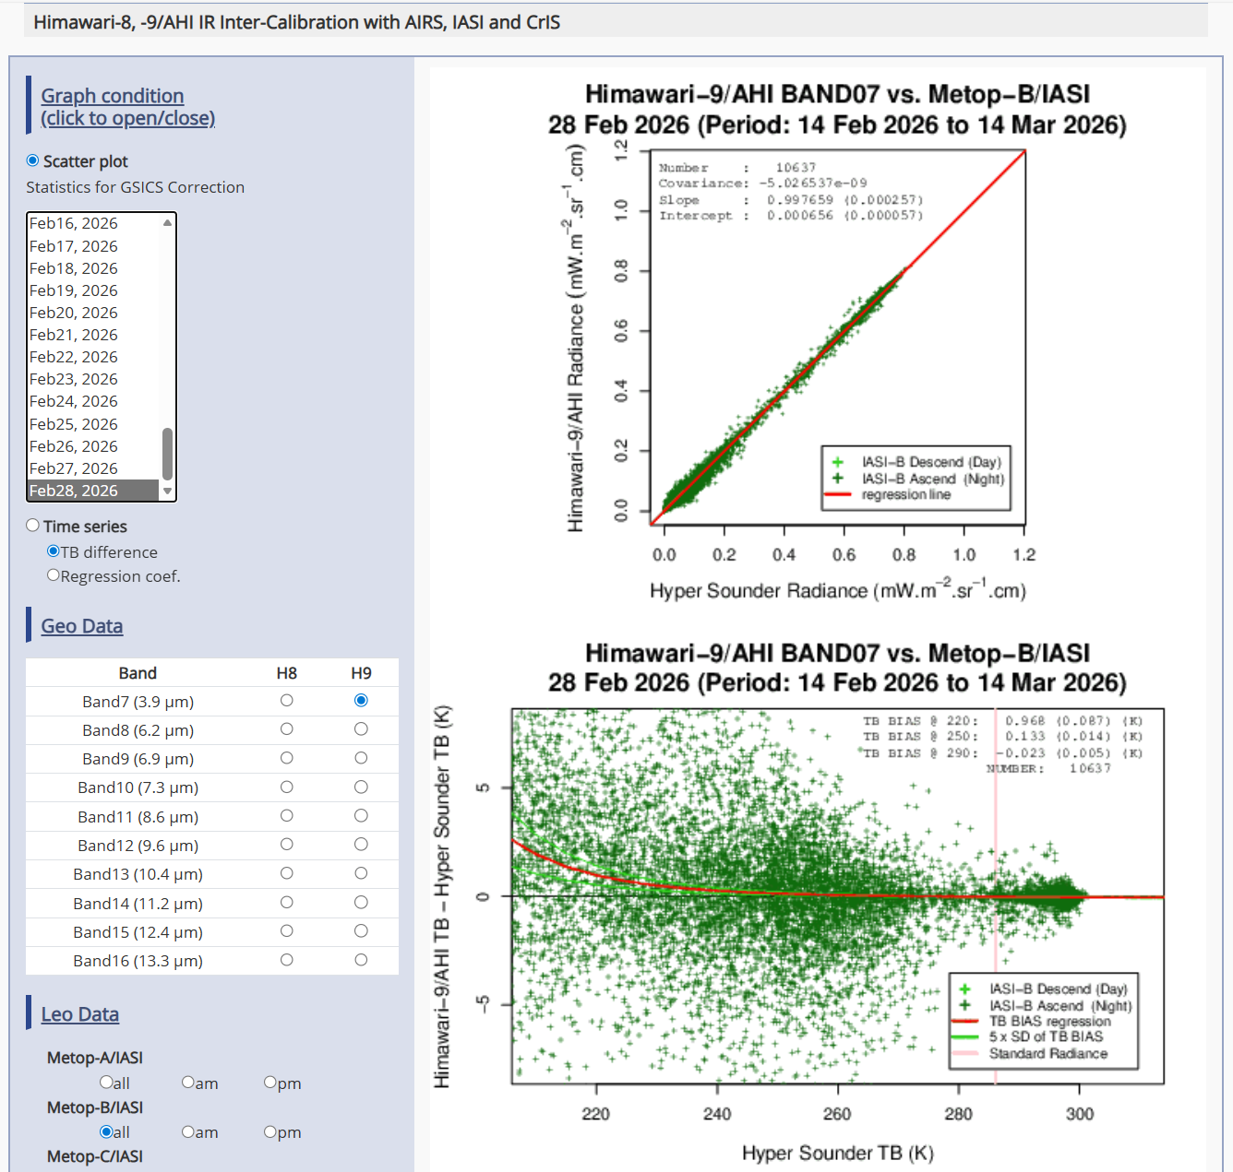
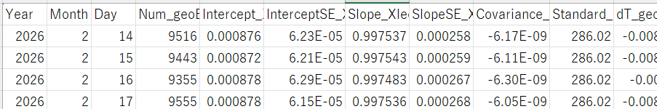
JMA GSICS Monitoring Page for Himawari Imagers
Static charts: time series and scatterplots
  Inter-calibration coefficients
  Monitored instrument’s biases against reference instruments (e.g., Himawari-9/AHI vs. Metop-B/IASI)
Users can inter-calibration results as csv files
  This may be related to “Dashboard” development
We started to develop new monitoring system for Himawari-10 mission (for internal use at this moment)
  GSICS member agencies’ systems like ICVS, MATRICS and MICMICS are very nice references

Slide 4
Discussion

Slide 5
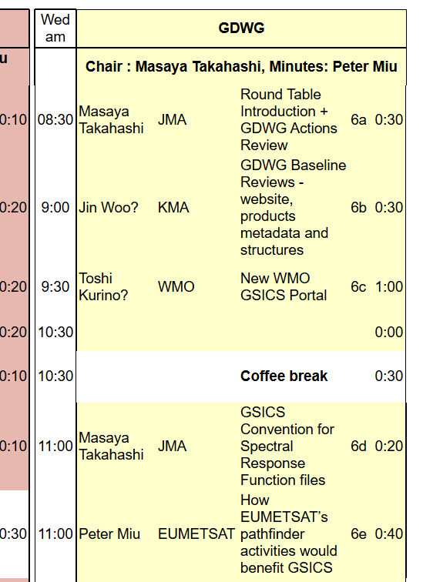
Proposal for Future GDWG Session
GDWG session agenda at 2019 Annual Meeting, Frascati
To have a slot to review GSICS baselines relevant to GDWG activities would be important to play our oles written in the (new) GDWG Terms of Reference.
Websites
  Each agency’s (GPRC’s) website, including Landing Page as a part of Event Logging activity
  GSICS Developers website
  WMO website
GSICS Conventions
  File naming Convention
  netCDF Convention for GSICS Deliverables (products, data file like SRF, tools, documents, …)

Slide 6
GDWG Terms of Reference (ver.3 draft)
Changes from ver.2 (2017) are shown in blue
GSICS Data Management Working Group (GDWG)
  3.1 Composition of the GDWG
The GSICS Data Management Working Group (GDWG) is an advisory body of the GSICS Executive Panel (EP) for data management and exchange issues. It is composed of Data Management experts designated by GSICS member organizations. Due to the technical nature of the working group’s discussions, Data Management experts shall have the following skills:
Software Development Life Cycle.
Data formats ideally used for the dissemination of satellite data.
Meta-data and software coding guidelines, conventions and standards.
Data archiving and distribution through Interoperable Infrastructure
All GSICS member organizations are expected to nominate at least one representative in the GDWG.

Slide 7
GDWG Terms of Reference (ver.3 draft)
Changes from ver.2 (2017) are shown in blue
3.2 Terms of Reference of GDWG
The GDWG shall:
Oversee and coordinate the data management activities of GSICS and advise the EP on questions related to GSICS data management including information delivery services;
Coordinate the specification, maintenance and evolution of data and metadata formats and procedures for data exchange between the satellite agencies, the GSICS Processing and Research Centers (GPRCs), and the GSICS Coordination Center (GCC);
Develop and promote the adoption of open, standardized, machine-readable data formats and metadata schemas to support the discoverability, integration, and reusability aligning with FAIR data principles.
Contribute to the definition and evolution of GSICS Product formats to support long-term sustainability, broader dissemination, and automated data services, including the use of persistent identifiers (e.g., DOIs)
Support the specification of GSICS systems administered by the GCC; GSICS product catalogue, GSICS User Messaging Service, GSICS Wiki, etc.
Support the specification of GSICS systems and tools administered by the GSICS member and observer organizations
Review and validate GSICS deliverables from a data management perspective, including adherence to metadata standards, version control, and long-term accessibility.
Guide the structure, content, and usability of GSICS web platforms (maintained by WMO, GCC, and GPRCs) with an emphasis on modern web presence, user-friendly design, outreach capability, and search engine optimization.
Maintain cooperation with the research and development activities at the GPRCs and assist with their data management activities, as appropriate;
Provide the GSICS Executive Panel with a report on GSICS data management activities including recommendations as appropriate. Submit report three weeks prior to the annual meeting of the GSICS Executive Panel, and present it to the Panel.
Build tools to support GSICS Activities. For ex Action Tracker, Alert System, GSICS Data Repository, WIS integration

Slide 8
GDWG Terms of Reference (ver.3 draft)
Changes from ver.2 (2017) are shown in blue
3.2 Terms of Reference of GDWG (cont.)
GDWG convenes at least annually, preferably in conjunction with GRWG, and more frequently if appropriate.
It is expected that GDWG members will contribute to GDWG activities at the level of at least one man month per year. This level of commitment does not include the development and operation of agreed GSICS related systems. GSICS member organizations are expected to commit additional resources for these systems to ensure developments are realized and systems operate at an acceptable level of service.
The GDWG is led by a Chair who is a participating GDWG member. The Chair is assisted by two vice-chairs, one being former char, and the other being the expected future chair can be assisted by at least one Vice Chair.
3.3 Role of the GDWG Chairpreson (skipped)

Slide 9
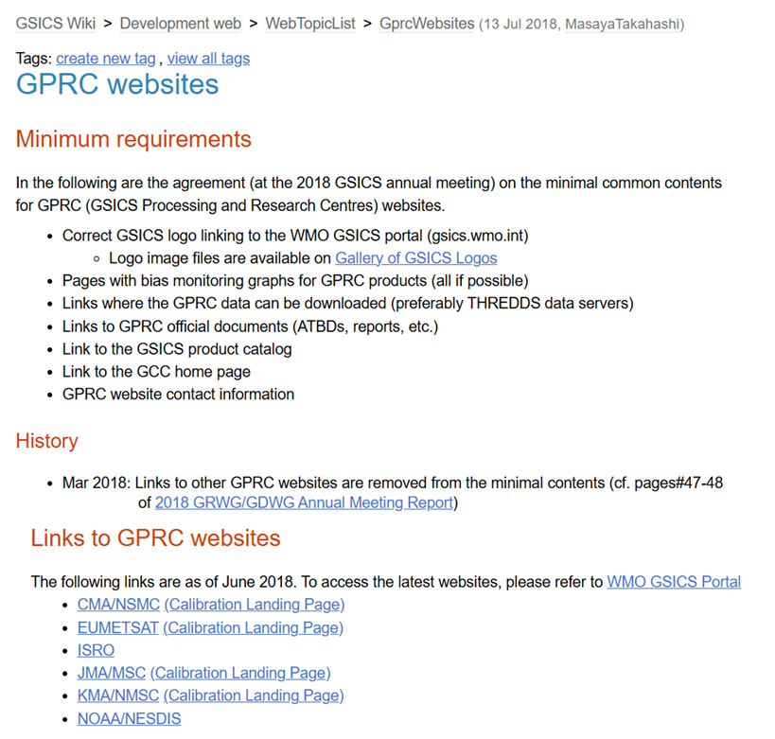
GPRC Websites
GPRC: GSICS Processing and Research Center
In the past (before COVID-19), one of the GSICS member agencies was asked
  to review each GPRC website if it meets the minimum requirements in advance, and;
  to report it at the Annual Meeting.
Don’t we need to resume such a review for the following updates?
  New GSICS logo
  Coming change of data access to GSICS deliverables such as GSICS Collaboration Servers (TREDDS)
  New URLs of GPRC websites

Slide 10
GSICS Conventions
It may not be needed every year, but it is important to review existing Conventions at least for the new GSICS Deliverables (when proposed by GRWG)
  to propose justifiable updates, and;
  to remove obsolete/unused versions.
GSICS Conventions
  File naming
  GSICS products
  SRF
  Lunar Calibration Framework (e.g., LSICS)
  …

Slide 11
Thanks for your attention!

