Slide 1
GSICS Data Working Group Annual Meeting Report from NOAA
March 26, 2026
Ninghai Sun¹, Banghua Yan², Changyong Cao²
        ¹ ERT ² NOAA/NESIDS/STAR
Disclaimer: The presentation contents are solely the opinions of the authors and do not constitute a statement of policy, decision, or position on behalf of NOAA or the U. S. Government.

Slide 2
Outlines
NOAA GDWG Actions and Status
NOAA STAR Activities Relevant to the GSICS Community
  Summary of NOAA Legacy Satellites Decommissioning
  NOAA vs. EUMETSAT Metop AMSU-A L1b Data Comparison
NOAA ICVS Inter-sensor Comparison Products to Support the GSICS Community
  Inter-Sensor Radiometric Calibration Bias Assessment (iSensor-RCBA) Monitoring Tool
  Key Showcases and Products
    ATMS Inter-sensor Bias through SNO and 32-Day Mean Methods
    ATMS Inter-sensor Bias through CRTM Simulation O-B Double Difference
    CrIS LEO-GEO/LEO-LEO Inter-sensor Bias through SNO
    CrIS Inter-sensor Bias through CRTM Simulation O-B and SNO Bias Double Difference
Path Forward
Acknowledgement
Page | 1

Slide 3
NOAA GDWG Action Status
Action ID | Summary | Lead | Expected Completion | Status
A.GDWG.2025.11k.3 | MB will upload an example of GSICS dataset to test the system | Manik | 3/1/2026 | Closed
Page | 2

Slide 4
Summary of NOAA Legacy Satellite Decommissioning
 | NOAA-19 | NOAA-18 | NOAA-15
AMSU-A | August 11, 2025 | June 6, 2025 | August 19, 2025
MHS | August 11, 2025 | October 21, 2018 | N/A
AVHRR | August 11, 2025 | June 6, 2025 | August 19, 2025
HIRS | August 11, 2025 | June 6, 2025 | August 19, 2025
Page | 3

Slide 5
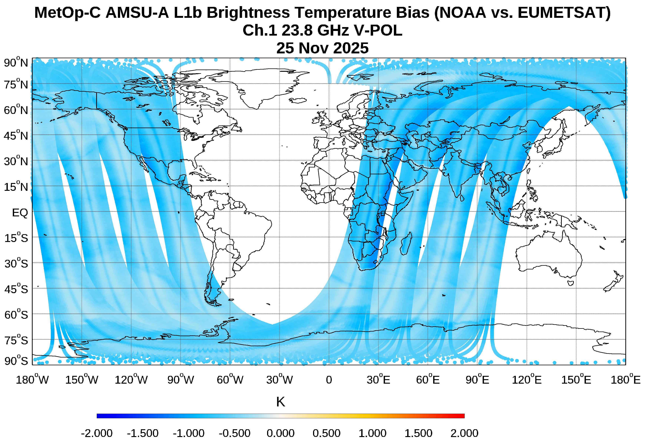
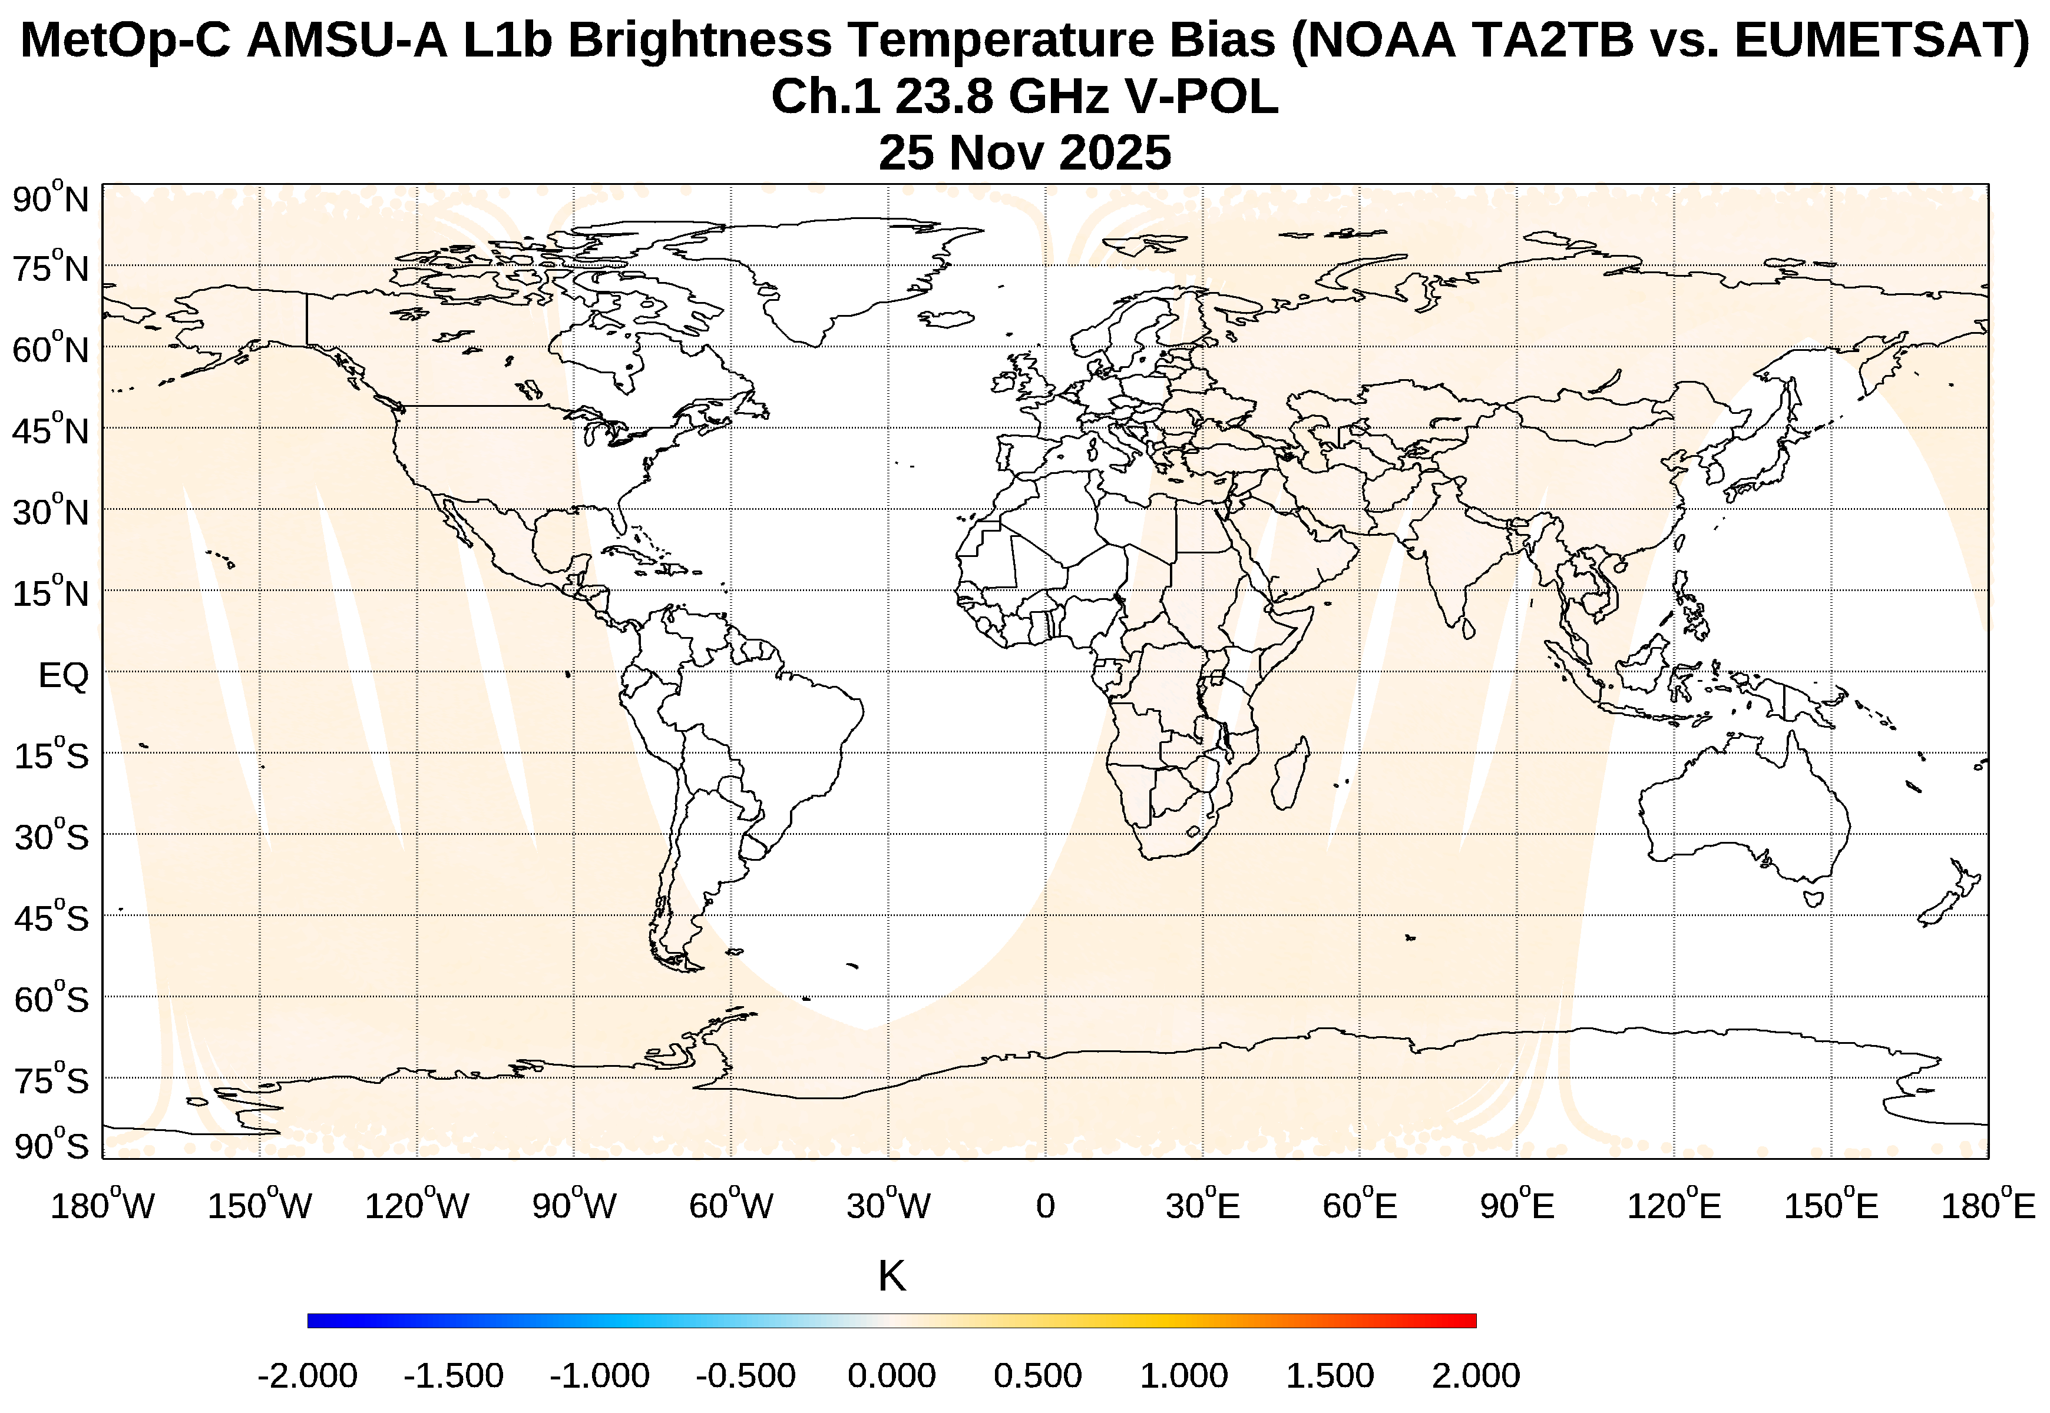
Comparison of EUMETSAT vs. NOAA MetOp AMSU-A L1b Data
FOV to FOV Bias Map
Bias between both original L1b data
Bias decreased after applying TA2TB correction to NOAA L1b data
EUMETSAT AMSU-A L1B data are antenna pattern corrected
Page | 4

Slide 6
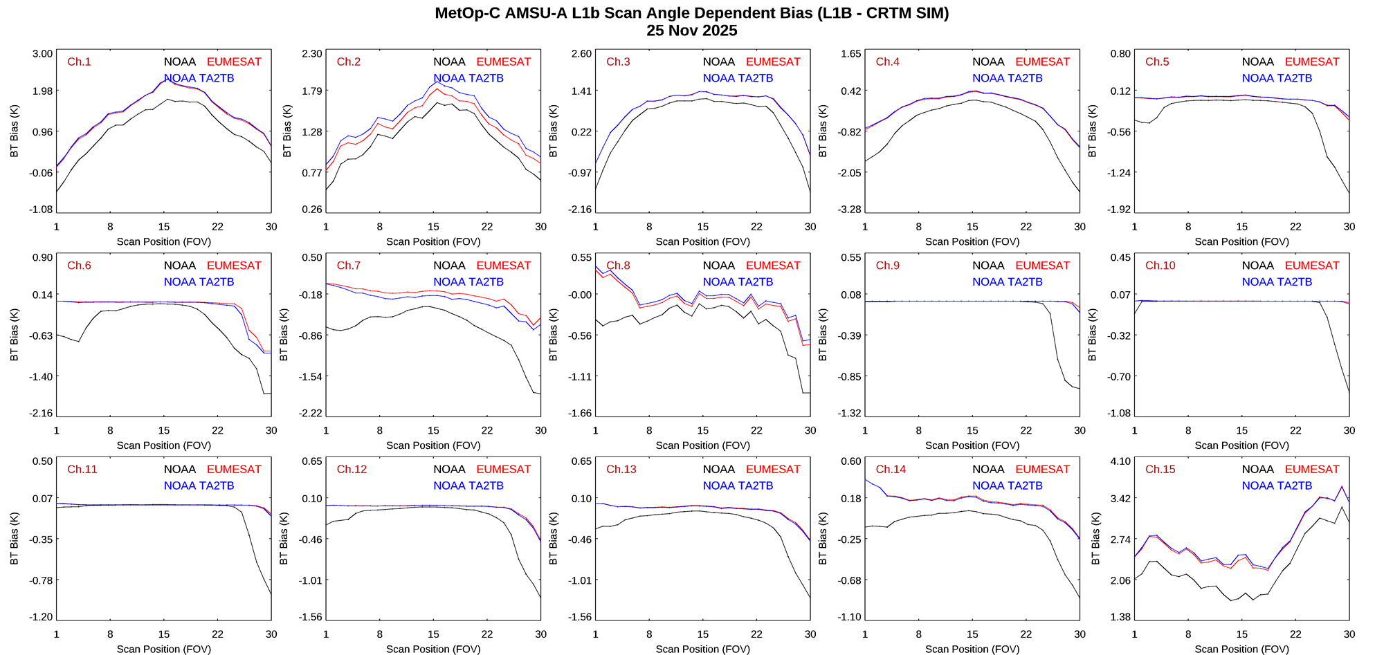
Comparison of EUMETSAT vs. NOAA MetOp AMSU-A L1b Data
Page | 5

Slide 7
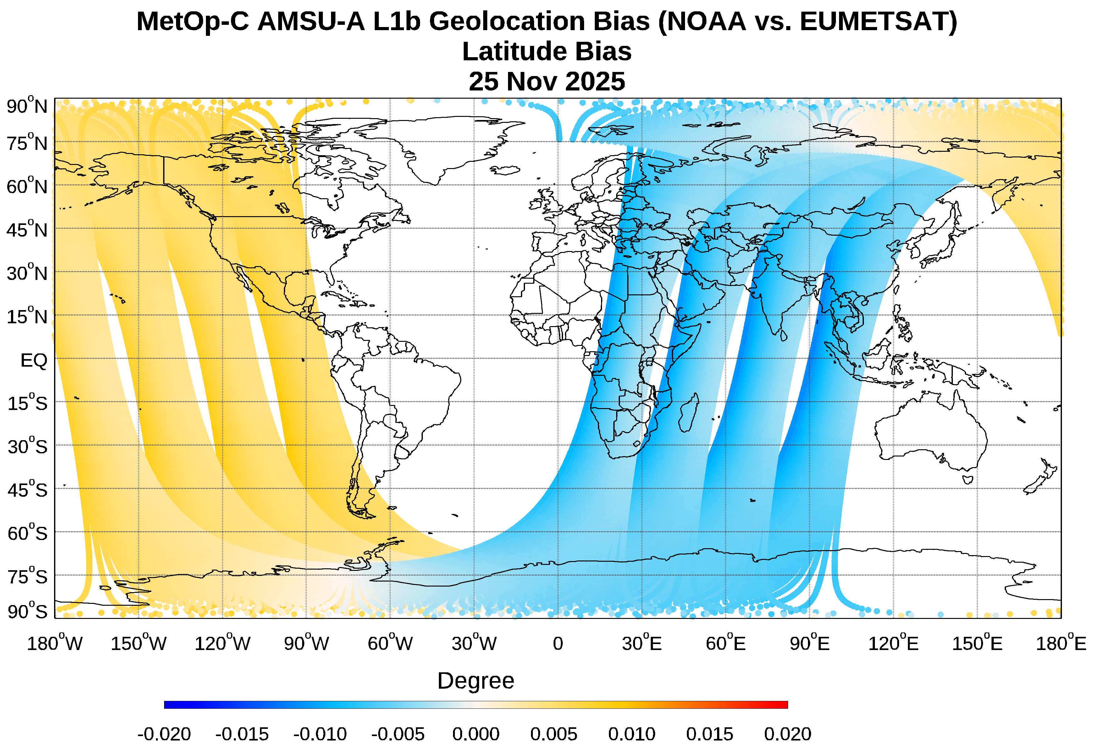
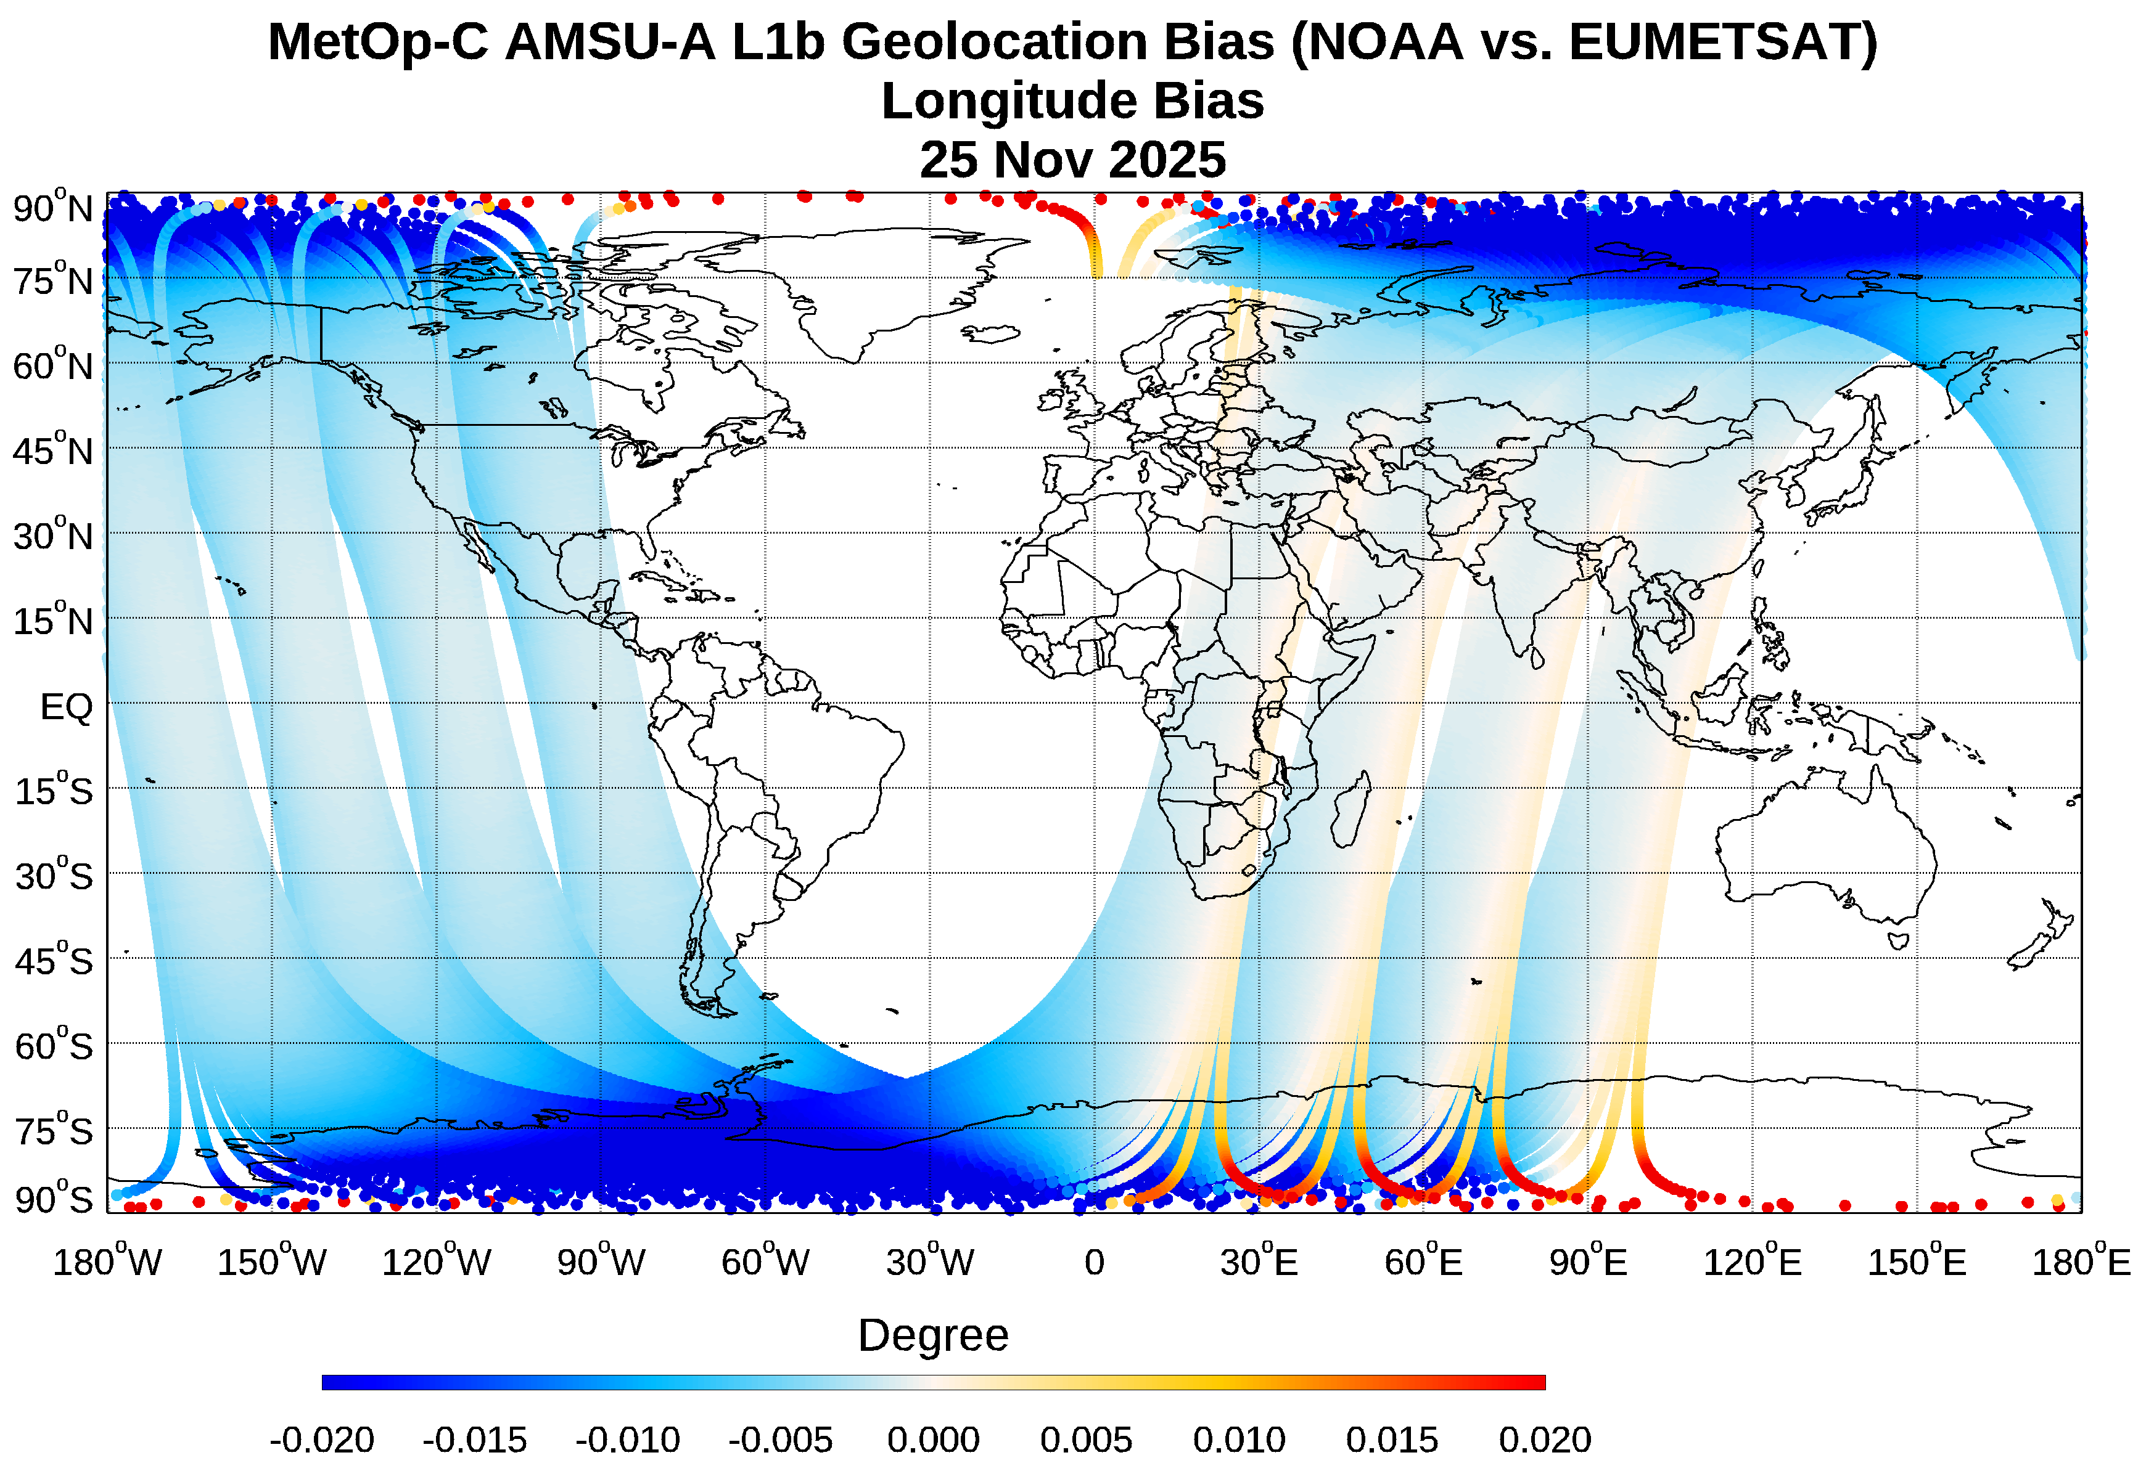
Comparison of EUMETSAT vs. NOAA MetOp AMSU-A L1b Data
Latitude
Longitude
FOV to FOV Bias Map
Small geolocation bias exists between two sets of L1b datasets
Page | 6

Slide 8
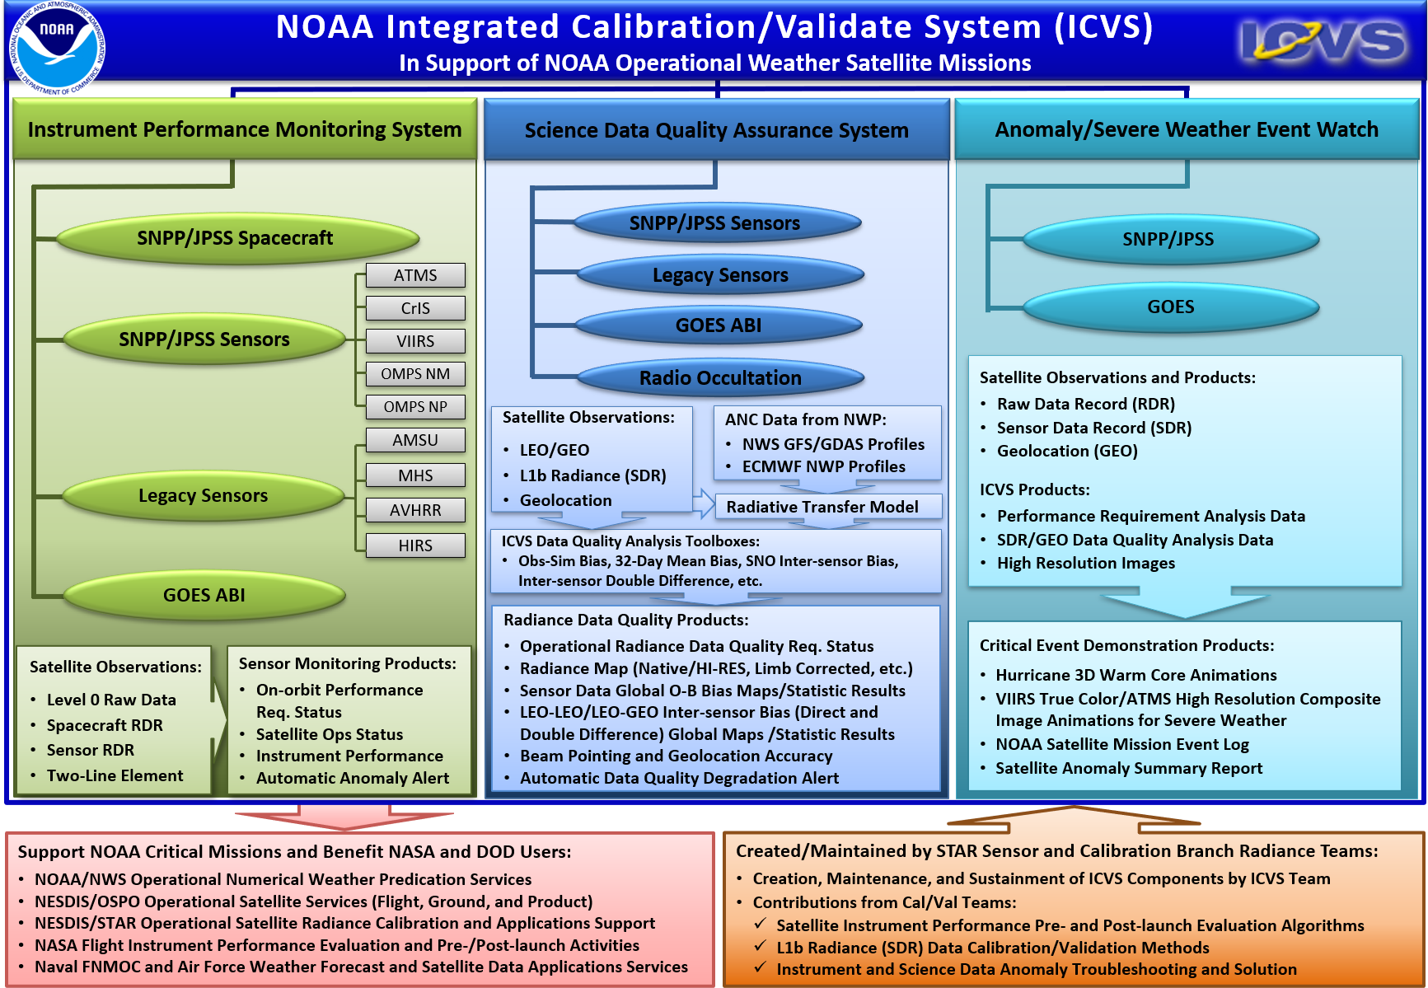
NOAA Integrated Calibration/Validation System (ICVS) Monitoring System
ICVS Inter-Sensor Radiometric Calibration Bias Assessment (iSensor-RCBA) Tool
What does ICVS do?
  An integrated calibration and validation system (ICVS) for Satellite Instrument Near-Real Time (NRT) Performance and Data Quality Monitoring to support all NOAA satellite missions
  ICVS is an important tool for level 1b or Sensor Data Records (SDR), and is used by OSPO, NWS, ECMWF, EUMETSAT, NASA, Air Force, NAVO, as well as STAR scientists (especially the radiance or SDR teams)
  Currently monitoring 24+ satellite instruments with more than 3000 parameters online (https://www.star.nesdis.noaa.gov/icvs/)
Page | 7

Slide 9
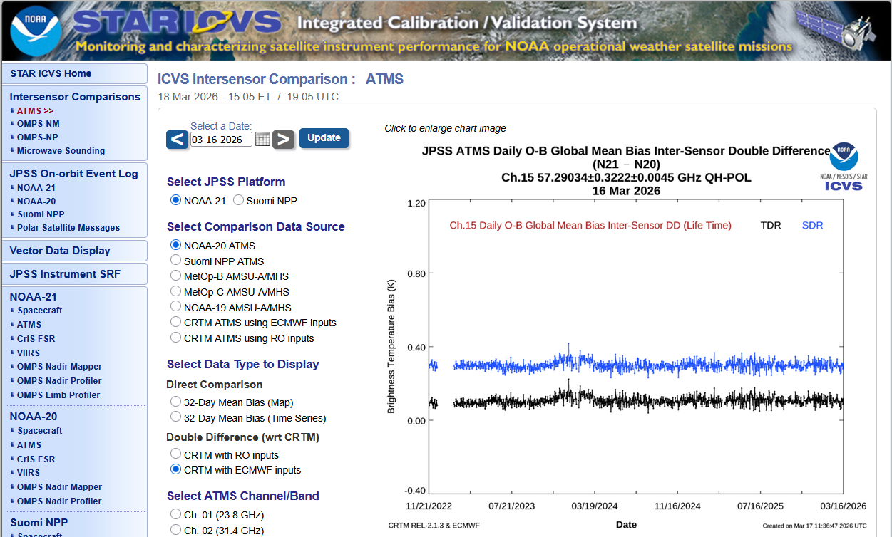
ICVS Long-Term Inter-Sensor Radiometric Calibration Bias Assessment (iSensor-RCBA) Monitoring Tool
iSensor-RCBA Inter-sensor Comparison Tool Key Features (Yan et al., 2025; 2026)
    Covering various instruments across several satellite programs, e.g., the ATMS, CrIS, VIIRS, and OMPS instruments onboard SNPP/NOAA-20/NOAA-21, the ABI instrument onboard GOES-18 and GOES-19; the AMSU-A, MHS, and IASI instruments onboard legacy Metop-B/C.
    Use multi-methods for inter-sensor radiometric calibration error assessments
      Use CRTM as a transfer (CRTM-Double Difference) (ECMWF forecasts and RO-derived profiles respectively)
      Use 3rd sensor as a transfer (SNO based)
      Direct comparison (32-day direct differences)
      Inter-sensor comparison via deep convective cloud targets
    Serves as a web-based dashboard for satellite instrument status (a publicly accessible website: https://www.star.nesdis.noaa.gov/icvs/comparison_ATMS.php)
An Example: ICVS Inter-sensor Comparison Website for ATMS
Currently provide ATMS and OMPS inter-sensor comparison monitoring
Page | 8

Slide 10
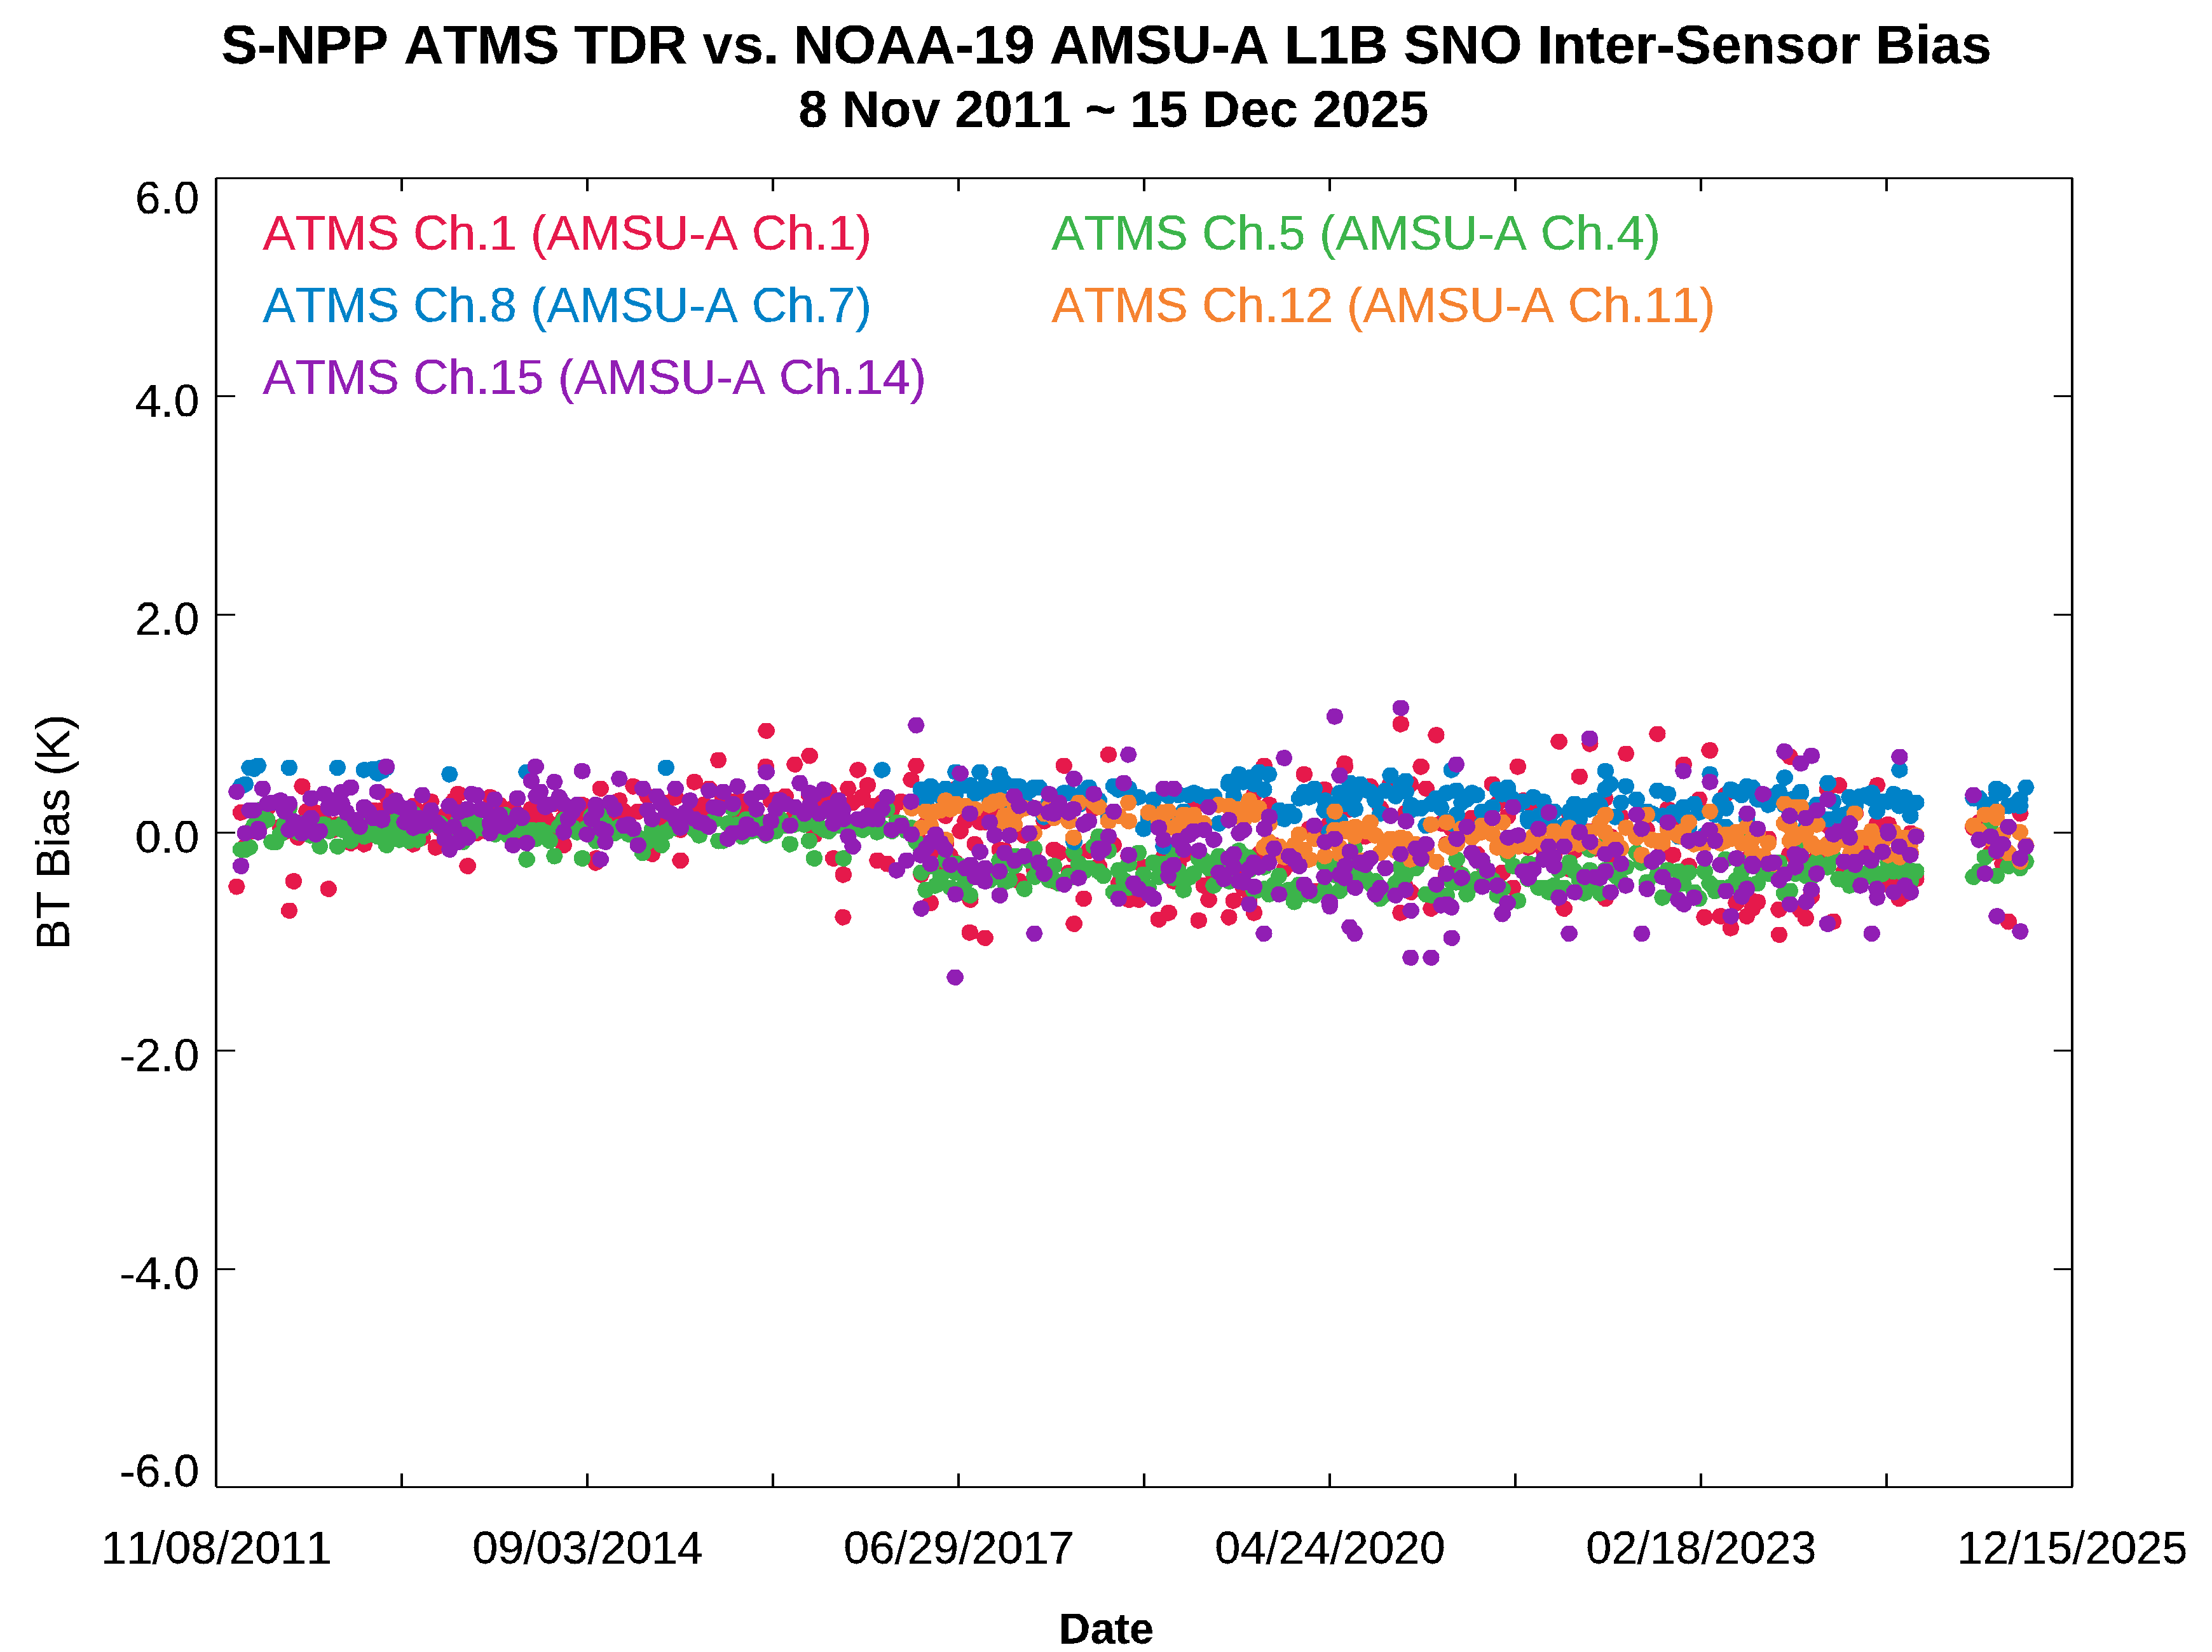
ATMS vs. N19 AMSU-A SNO Inter-sensor Bias
Bias systematic shift in 2017 due to the ATMS calibration algorithm change
Page | 9

Slide 11
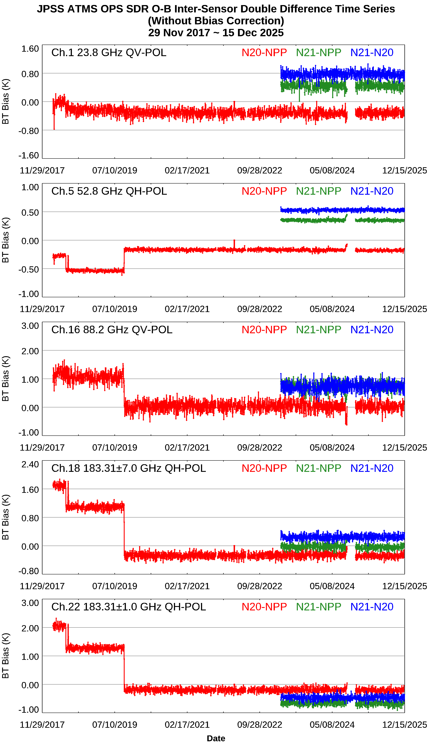
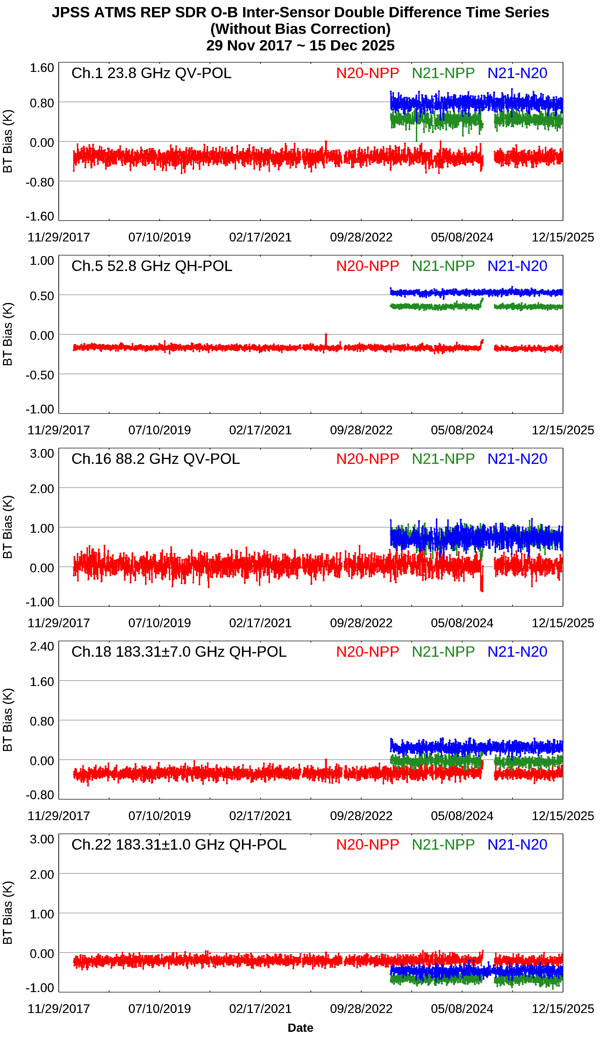
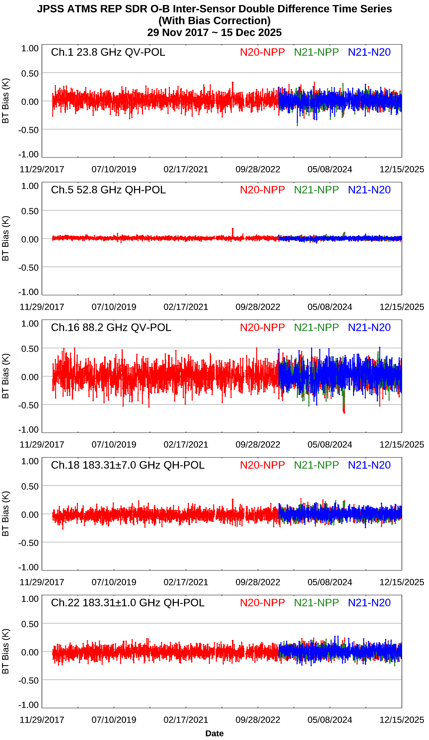
ATMS ECMWF Profile CRTM O-B Double Difference
Ops SDR O-B DD
Rep+Ops SDR O-B DD
Rep+Ops SDR O-B DD with bias correction
Page | 10

Slide 12
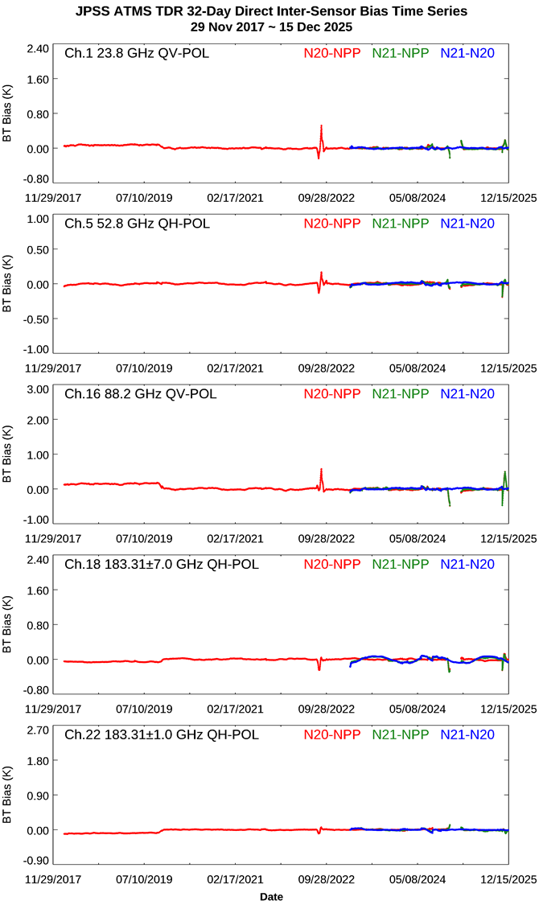
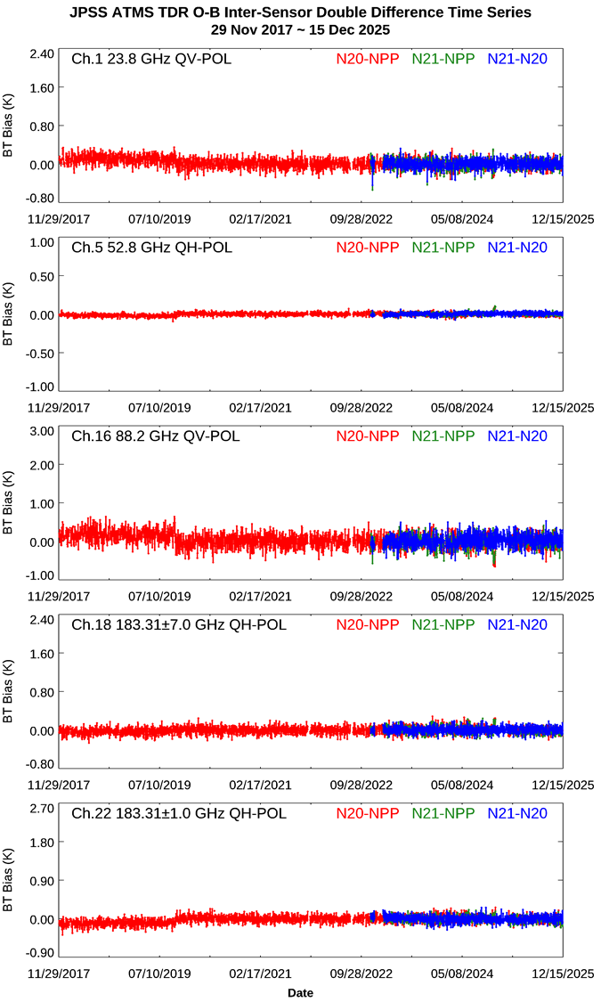
ATMS 32-Day Mean Direct Bias vs. O-B Double Difference
Results are consistent between two inter-sensor bias analysis methods
Page | 11

Slide 13
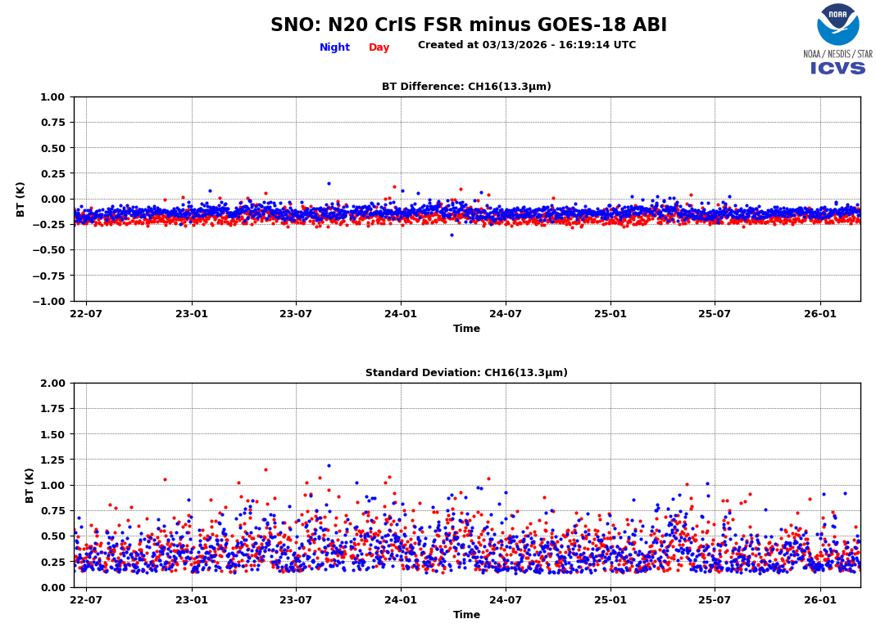
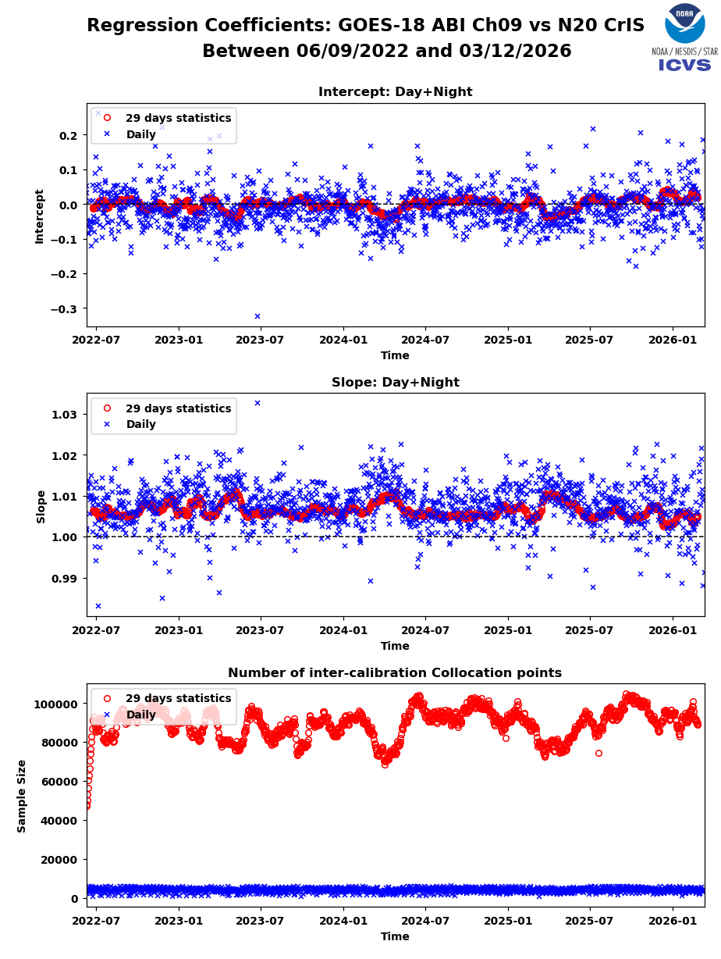
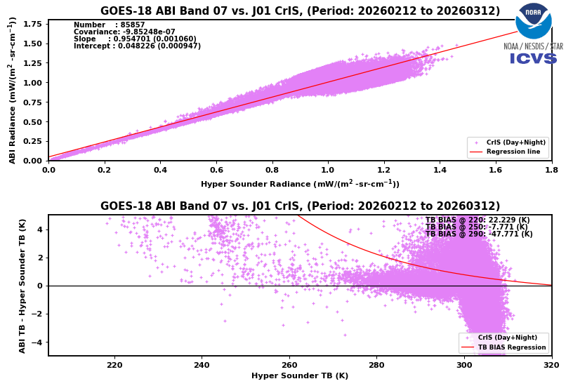
CrIS vs. GOES-18 ABI SNO Inter-sensor Bias
CrIS vs. GOES ABI inter-sensor bias monitoring provided in ICVS
Page | 12

Slide 14
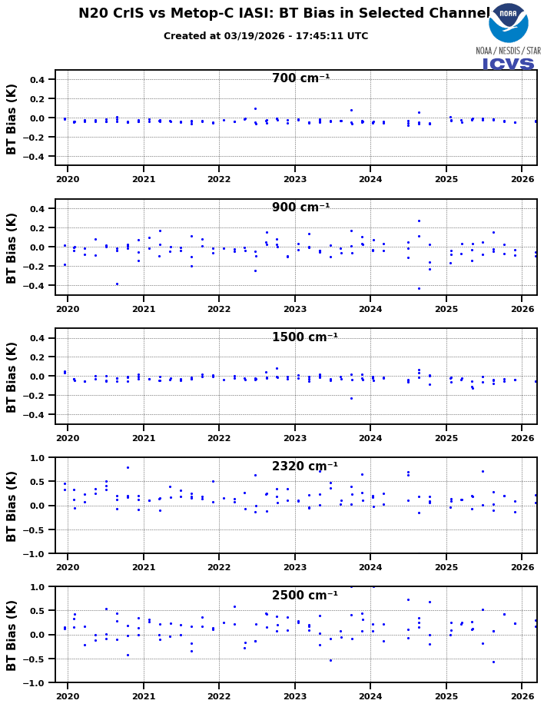
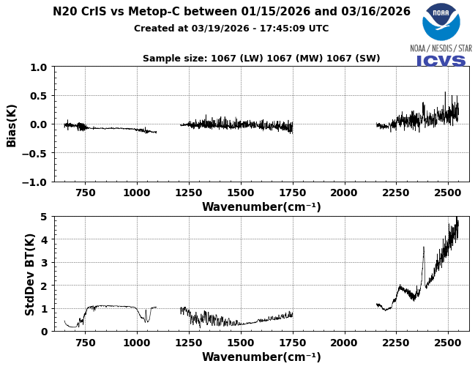
CrIS vs. IASI SNO Inter-sensor Bias
Daily and long term CrIS vs. IASI SNO inter-sensor bias products provided in ICVS
Page | 13

Slide 15
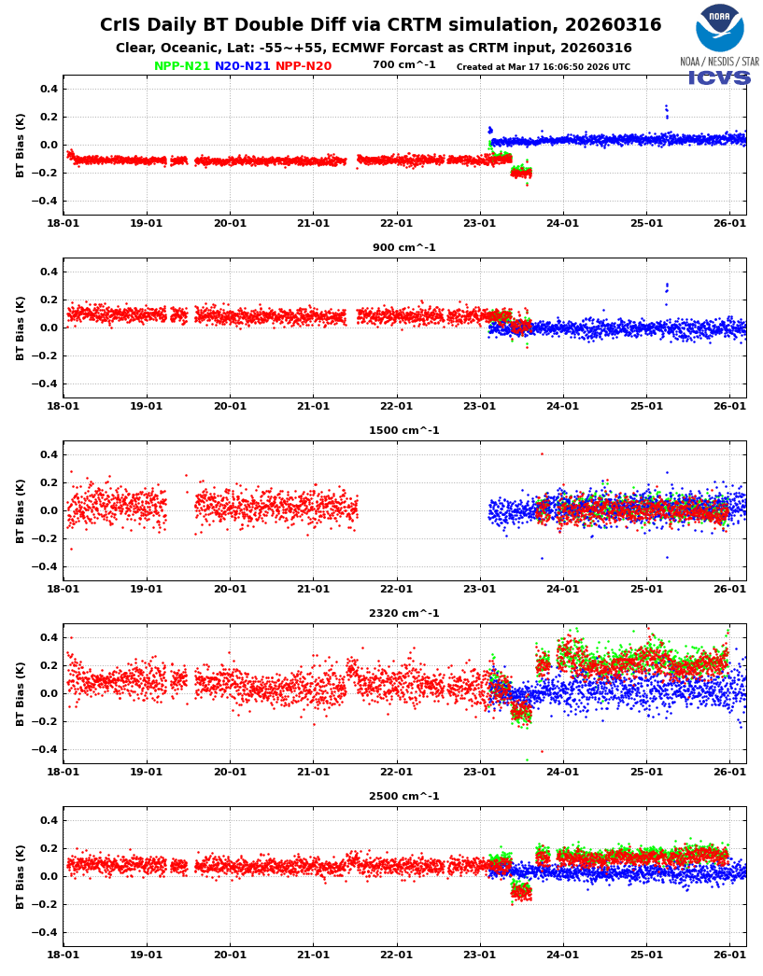
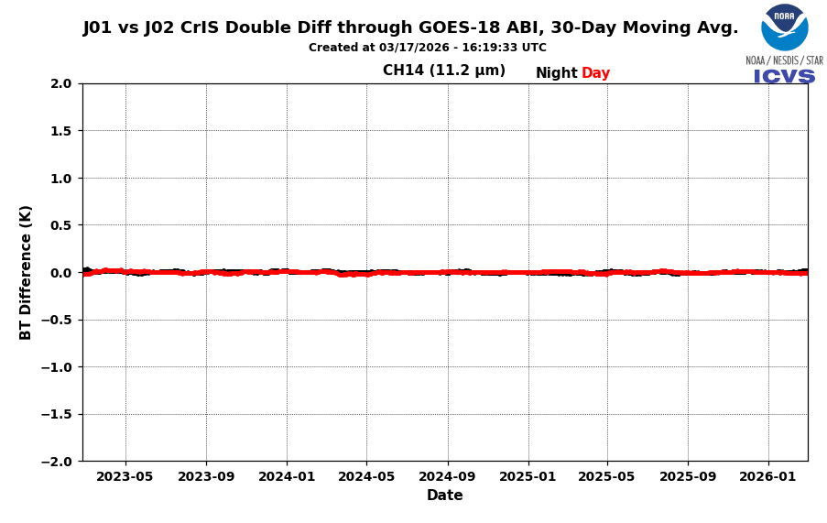
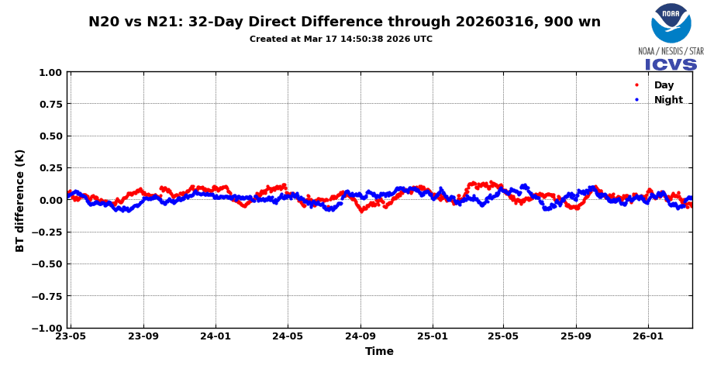
CrIS Inter-sensor Bias
Results are consistent among different inter-sensor bias analysis methods
Page | 14

Slide 16
Path Forward
Supporting the GSICS Data Working Group (GDWG)
  Sustaining active involvement in GDWG meetings and the timely execution of assigned action items.
Exploring New GSICS Data & Products Relevant to NOAA Satellite Instruments
  Explore new GOES ABI instrument-related GEO-LEO products in collaboration with STAR SDR teams
  Facilitate LEO-LEO and LEO-GEO inter-sensor comparison activities essential for NOAA and GSICS calibration standards.
Enhancing ICVS iSensor-RCBA Bias Monitoring Capabilities to Support of the GSICS User Community
  Developing advanced inter-sensor bias functions within the ICVS iSensor-RCBA tool to bridge JPSS instruments with non-JPSS platforms, such as Metop-SG and commercial data (e.g., Tomorrow.io).
  Modernizing the ICVS iSensor-RCBA inter-sensor comparison website interface to improve navigation, offering the GSICS community a more intuitive search and display experience.

Slide 17
Acknowledgment
Dr. Changyong Cao (STAR Radiance Team Lead): For continuous technical and management guidance
Dr. Banghua Yan (ICVS Team Lead): For ICVS and JPSS OMPS Cal/Val team guidance to support GSICS data product generation
Dr. Lawrence Flynn, Manik Bali: Long term support to NOAA GDWG activities
Dr. Xiangqian (Fred) Wu, Dr. Yong Chen, Dr. Flavio Iturbide-Sanchez: NOAA satellite instrument Cal/Val team guidance to support GSICS data product generation

