Slide 1
GSICS Data Working Group
GDWG
Report from ESA
Paolo Castracane
Starion for ESA/ESRIN

Slide 2
Table of Contents
Actions from GSICS 2025
EVDC updates
Pi-MEP Salinity
FRM4SM
Fiducial Reference Measurements

Slide 3
GDWG Actions for ESA
GSICS Actions 2024
Action Id | Summary | Lead | Actual Completion | Status | Proposed Status (to be updated)
A.GDWG.20240312.4 | Paolo Castracane (ESA) to lead discussion with GCC and WMO on possible enhancement of GSICS websites following WGCV Cal/Val Portal as example. | Paolo Castracane | Ongoing | Open | Closed in favor of new GSICS developers’ website
A.GDWG.20240313.4 | Paolo to coordinate with Manik on reducing overlap of webpage on solar radiance at ESA, NOAA/wiki and LASP. | Paolo Castracane | Ongoing | Open | Closed in favor of new GSICS developers’ website
No actions from 2025

Slide 4
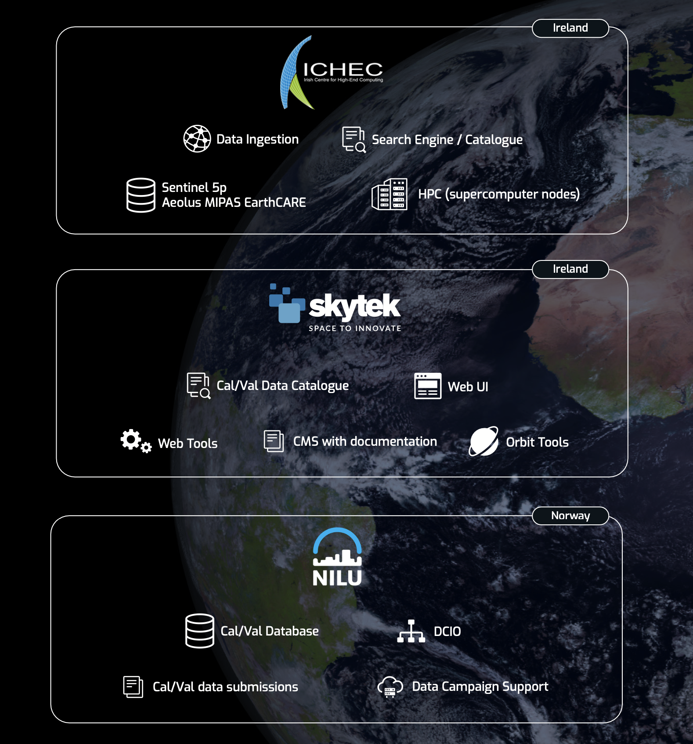
ATMOS
1-5 July | Bologna, Italy
EVDC Overview
The ESA atmospheric Validation Data Centre (EVDC) is the official ESA repository for correlative data in the atmospheric domain . It provides access to:
Groundbased, aircraft and balloon Cal/Val files and Fiducial Reference Measurements (FRMs)
Complete and up-to-date access of Sentinel 5P, Aeolus, MIPAS and EarthCARE products
Tools, processes and documentation for data submitters (GEOMS standarization activities, data sharing agreements)
Tools for data collection campaign planning (Orbit Prediction and Overpass Tool - OPOT)
Collocation Reference Database
Tools for processing data in the cloud (subsetting, merging, visualisation etc)
CWL Based processing system with visual workflow builder, including EarthCARE tools (e.g.: CIS, MSI, Lidar, Radar tools)

Slide 5
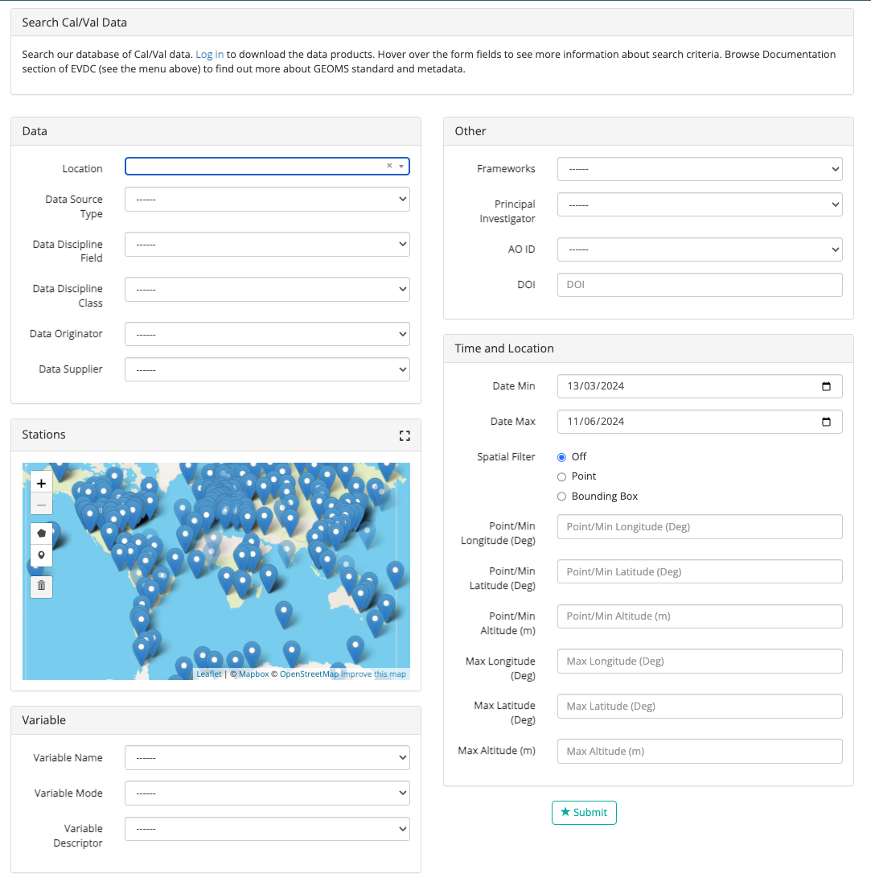
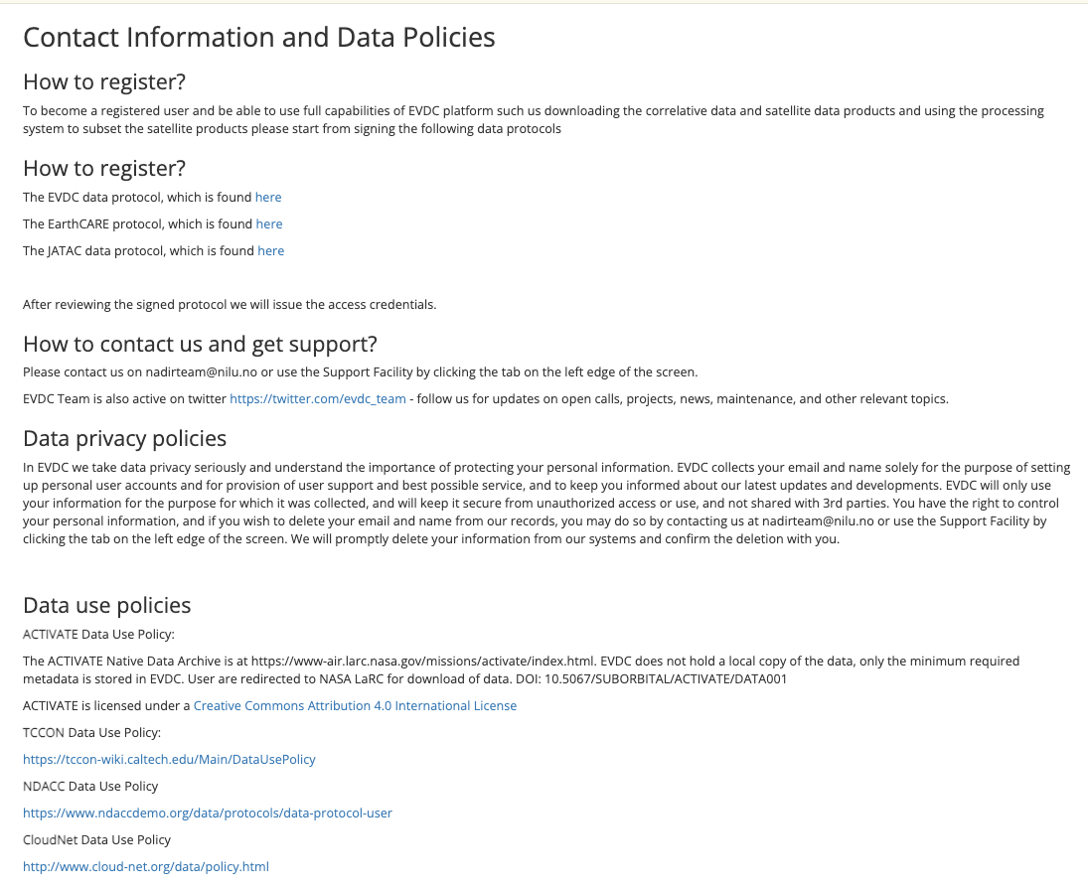
ATMOS
1-5 July | Bologna, Italy
EVDC Cal/Val Database
ESA atmospheric Validation Data Center (EVDC), ESAs in-house Cal/Val database covering:
Data from historical and ongoing campaigns
Remote sensing and in-situ measurements from ground-based and airborne stationary and mobile platforms (aircraft, balloon, bouy, drone, ship)
Operational data in near-real-time from research infrastructures in Europe and America such as ACTRIS (CloudNet, EARLINET), TOLNet, MPLNet, Pandonia Global Network.
Links to other data archives and network e.g. AVDC, NDACC
Data from 1965 until present
More than 1400 users where more than 200 for EarthCARE Cal/Val
Cal/Val search UI
Data Protocols

Slide 6
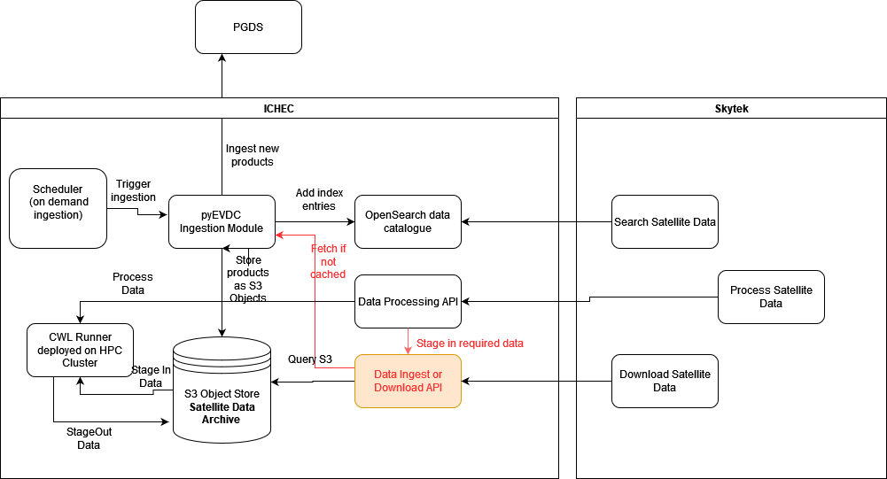
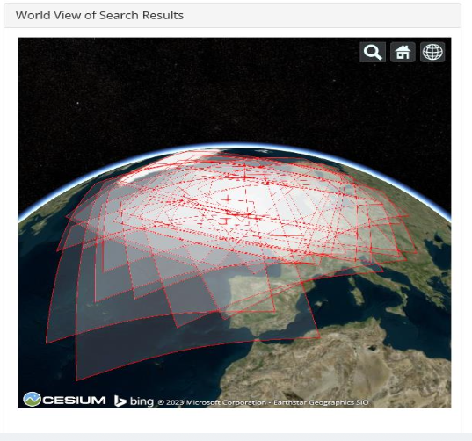
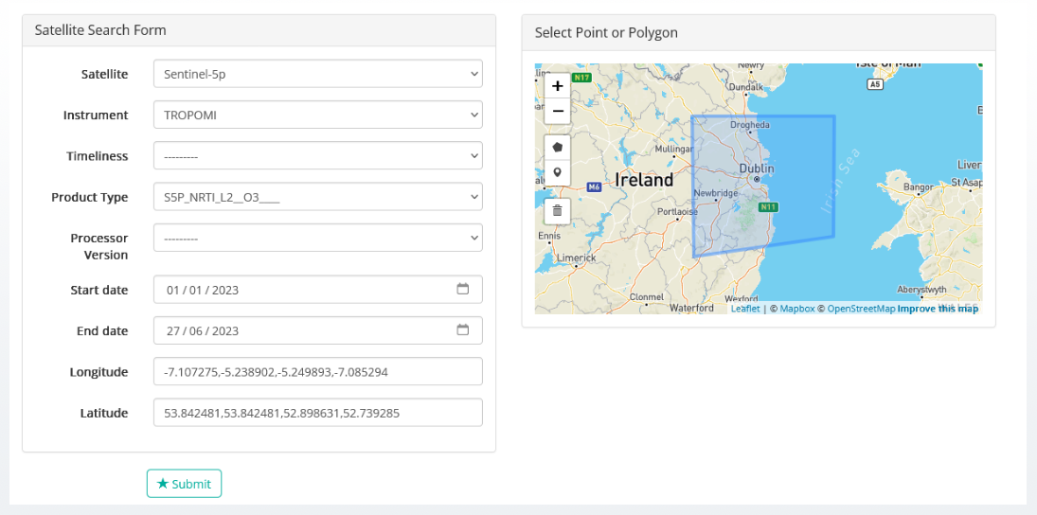
Satellite Element
The EVDC system also provides access to satellite data for specific missions, namely: Sentinel-5P, Aeolus, ENVISAT/MIPAS and EarthCARE.
EVDC – Satellite Data Search UI

Slide 7
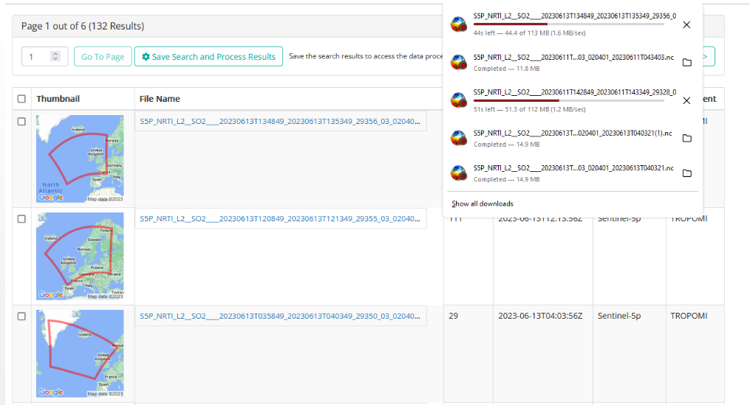
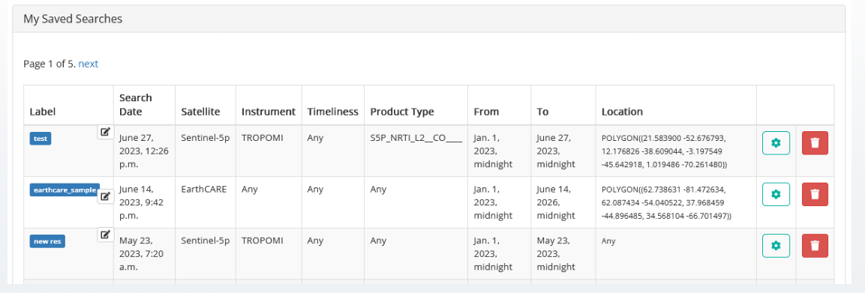
Satellite Element and processing
A set of basic operations are allowed over the satellite product: visualization, selection, download…and processing as subsetting and merging.
Saving files – a mechanism for grouping and tagging the files for further processing.
The processing system is deployed on High-Performance-Computing infrastructure supplied by ICHEC.

Slide 8
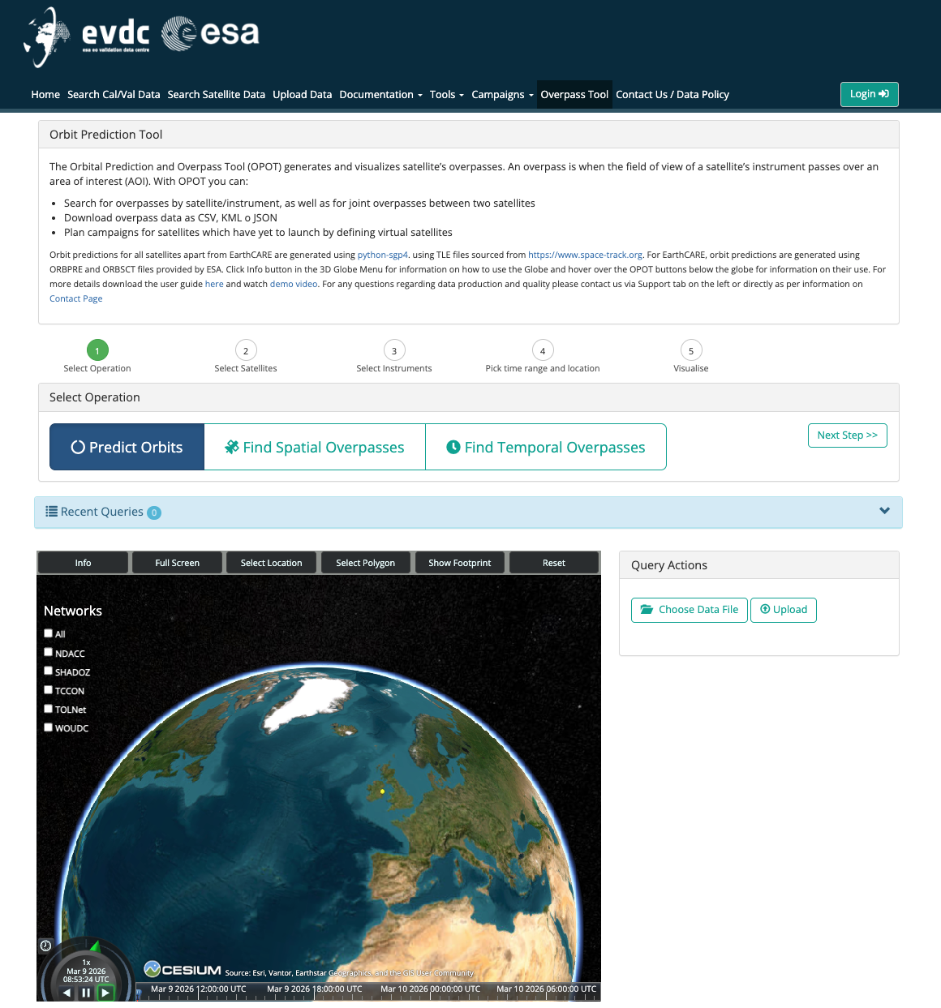
OPOT: Orbit Prediction and Overpass Tool
  The Orbital Prediction and Overpass Tool (OPOT) generates and visualizes satellite’s spatial overpasses. An overpass is when the field of view of a satellite’s instrument passes over an area of interest (AOI). With OPOT you can:
Predict Orbits
Search for spatial overpasses by satellite/instrument (in a time range)
Temporal Overpasses: i.e. joint overpasses between two satellites
Download overpass data as CSV, KML o JSON
Cal/Val Networks overlay and info
Plan campaigns for satellites which have yet to launch by defining virtual satellites
User guide and demo available =>https://evdc.esa.int/orbit/
Notes:
Orbit predictions for all satellites apart from EarthCARE are generated using python-sgp4. using TLE files sourced from https://www.space-track.org. For EarthCARE, orbit predictions are generated using ORBPRE and ORBSCT files provided by ESA.

Slide 9
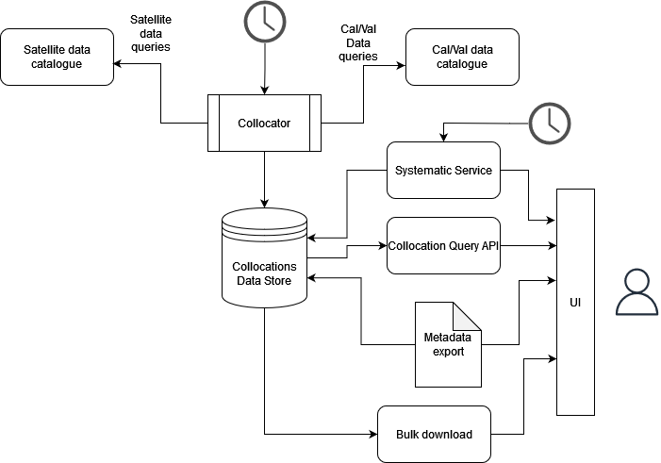
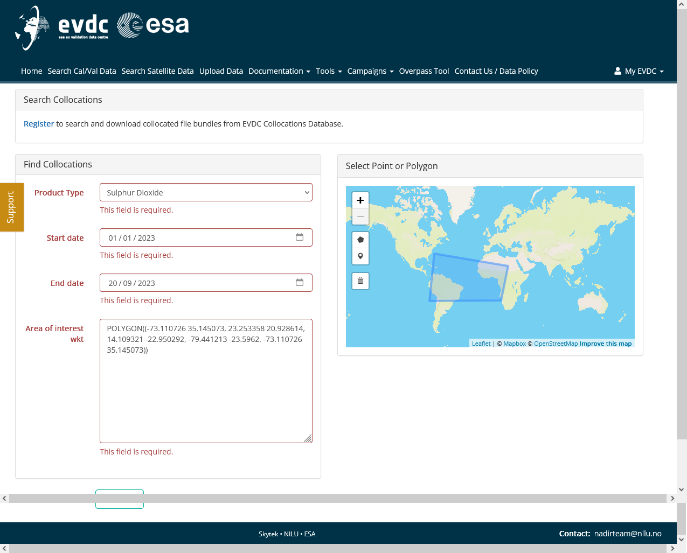
Collocation Reference Database
The Goal:
Automate the collection of broad collocations between satellite and correlative products
Provide users with tools to interact with the archive of pre-collocated data
Allow automated data deliveries based on custom (narrower) collocation criteria
The Architecture:
Collocator as a scheduled service searching for new collocations daily
Data store holding indexed metadata fields of both files (sat and cal/val file)
Query service for interacting with collocation data store
Configuration, variable mapping
Manual config for referencing satellite product variables to correlative variables
Common naming
Possible to configure more detailed mapping details (units, scaling, conversion formulas
Collocation Query API
The purpose is to filter the broad collocations to stricter collocation criteria.
It exposes a few endpoints: product type, start and end date, area of interest (e.g. polygon), max time difference (minutes)

Slide 10
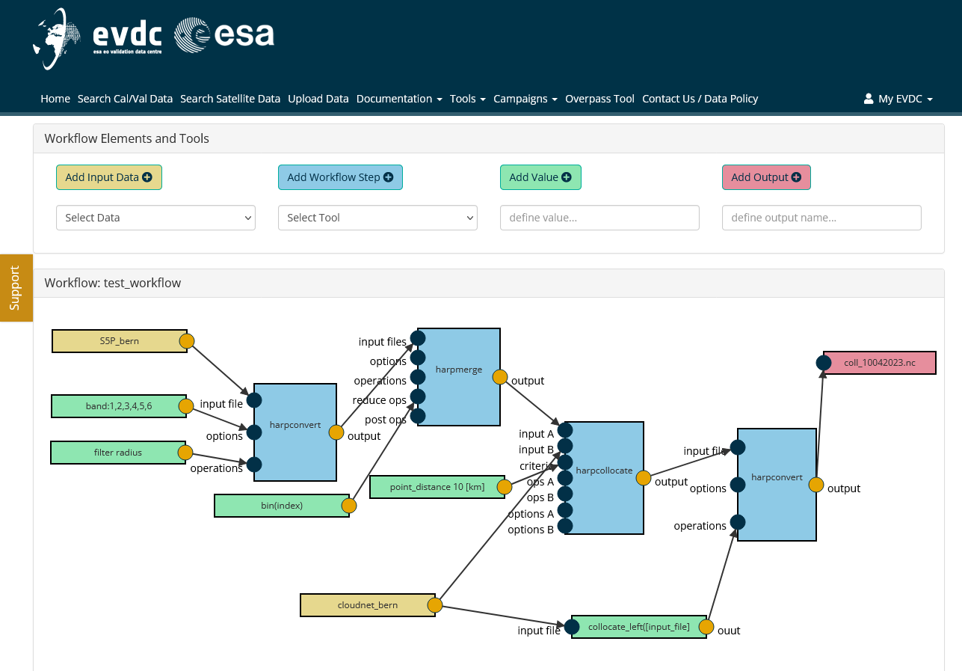
Workflow Builder
The Workflow Builder module allows creating processing graphs out of processing modules available in the system. Users can exploit a workspace for defining the connections between inputs and outputs of the modules or steps of the workflow. The module specifically allows users to:
Create/Save new workflow and export it as CWL script
View the list of available processing modules
Add workflow steps based on either processing modules or ad-hoc python or javascript scripts.
Add input data blocks based on saved search results
Add value blocks that set statically or dynamically the value of input parameters
Define outputs
Draw connections between inputs and outputs of processing modules
Select from product inputs available in the system by assessing:
  Satellite query results, Cal/Val query results
  Specified locations in the User File Storage
Specify locations of final outputs as locations in User File Storage
Test running individual components with provided inputs
Test running the processing workflow on singular inputs
Schedule operational processing workflow run – either as once off run or as a scheduled service.
Example of workflow visualization: several modules for EarthCARE cal/val activities are available (e.g.: CIS, MSI, Lidar, Radar tools)

Slide 11
Services and supporting materials
DOI and Landing Pages
The EVDC team has developed a new API that allows users to get a DOI for data made available in the data centre. This API generates landing pages automatically from xml input. Landing pages are essential for coining DOIs.
To coin a DOI for your dataset and to learn how to use the API, please contact the EVDC team at nadirteam@nilu.no. The EVDC team will assist you with the coining process and support you with setting up the landing pages.
Training Materials (pdf) Introduction to the EVDC Cal/Val database Data Formatting and Data Submission to EVDC EVDC For EarthCARE. Processing tools for Cal/Val. Webinar slides Data Search, Workflow Processing system, Collocation Database. Tutorials | Video Tutorials A set of video tutorials that cover most important functionalities and workflows in the EVDC platform: EVDC Platform overview How to search for Cal/Val data? How to search and process the satellite data? How to use Orbit Prediction Tool? How to format Cal/Val Data? Tutorials on using orbit tool and satellite data search based on real-life scenarios: Exploring Sentinel 5P and Aeolus data covering US west coast wildfires in 2020. Exploring Sentinel 5P SO2 data for Fuego volcano eruption

Slide 12


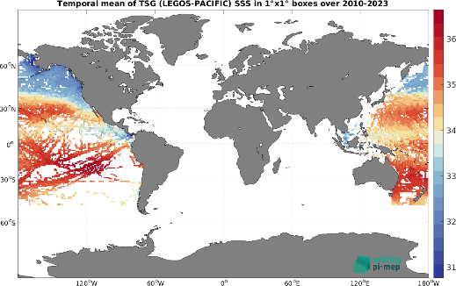
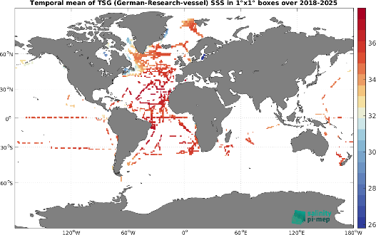
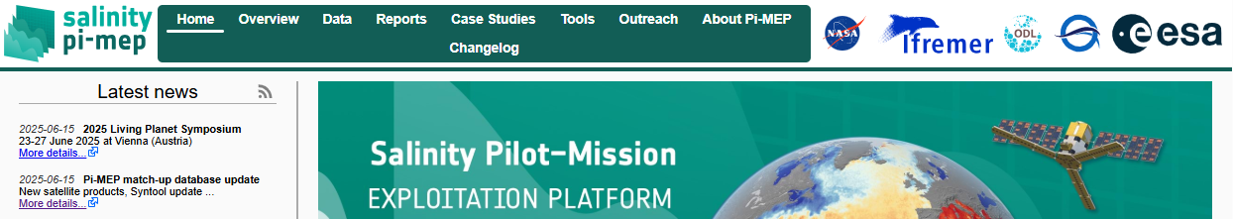
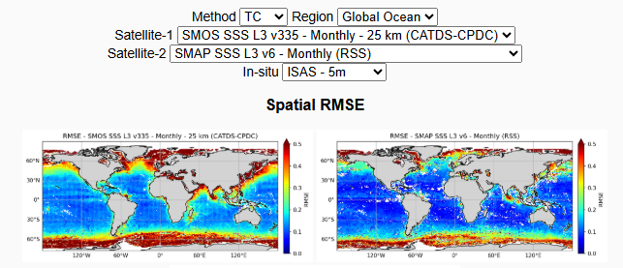
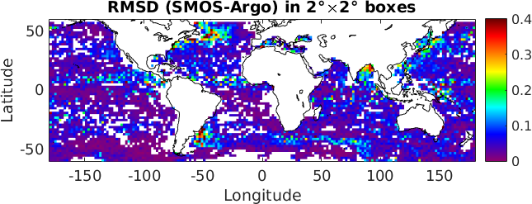
Pilot-Mission Exploitation Platform (Pi-MEP) Salinity
Web-based environment to visualize, validate, monitor, assess and exploit Satellite Salinity data (SMOS, SMAP, Aquarius)
Broad variety of online Tools to extract, inter-compare datasets and compute relevant statistics Major achievements since GSICS 2025:
www.salinity-pimep.org
Operations
Updated website
Platform updated up to June and December 2025
Inclusion of new in-situ datasets: LEGOS-PACIFIC and German TSG
LEGOS-Pacific
German TSG
New functionality: Triple Collocation and Correlated Triple Collocation implemented (SAT1 vs SAT2 vs Argo) with common reference
Characterization of temporal, horizontal and vertical sampling impact when comparing in-situ & satellite SSS
Factorizing this from RMSD(Satellite – In Situ) approximates true instrumental errors!
Factorizing this from RMSD(Satellite – In Situ) approximates true instrumental errors!
Journal paper under preparation
https://pimep.ifremer.fr/diffusion/analyses/triple-collocation/pimep-triple-collocation-report.pdf

Slide 13

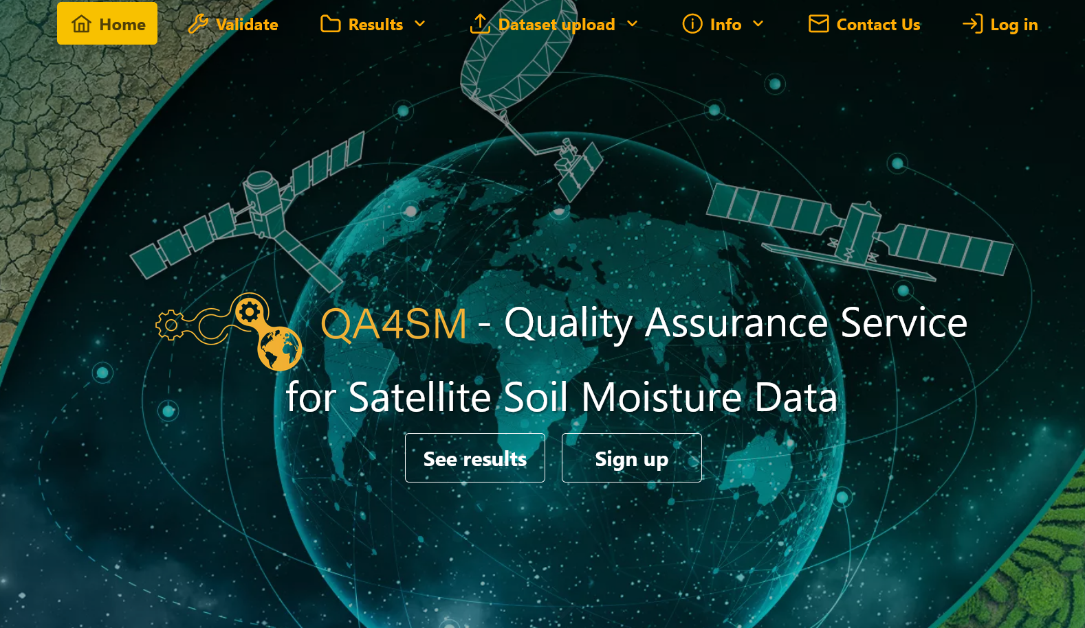
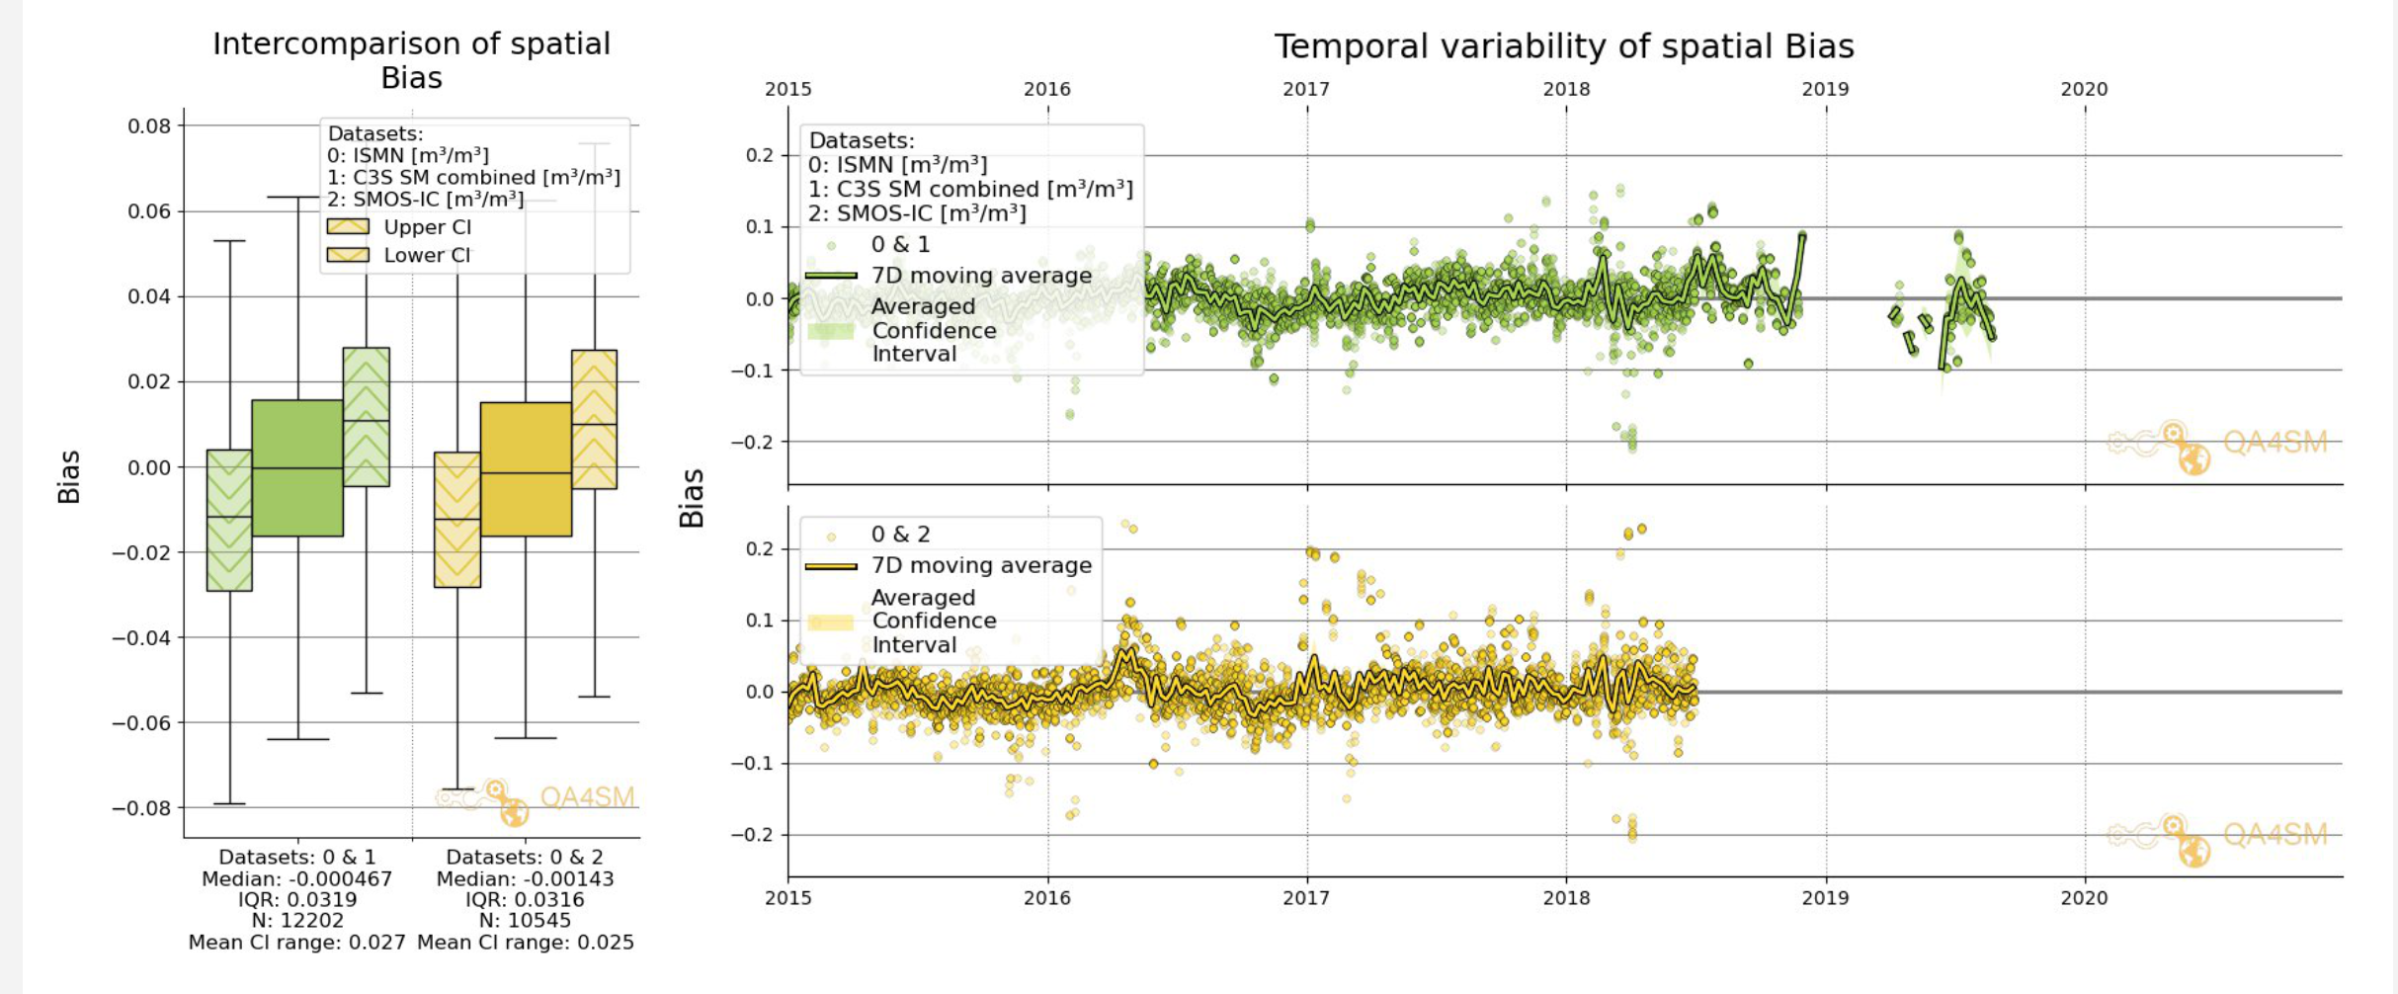
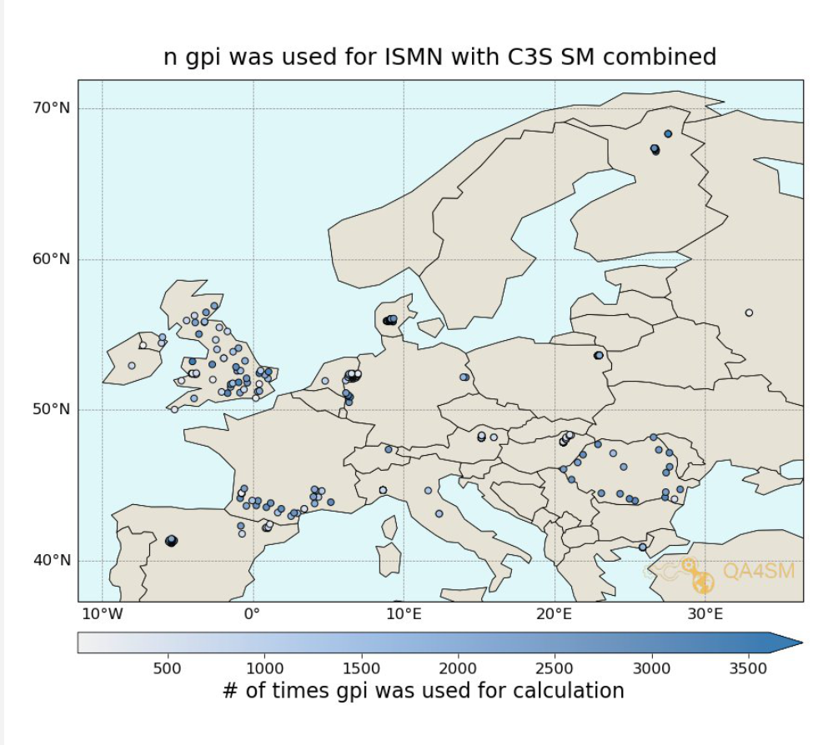
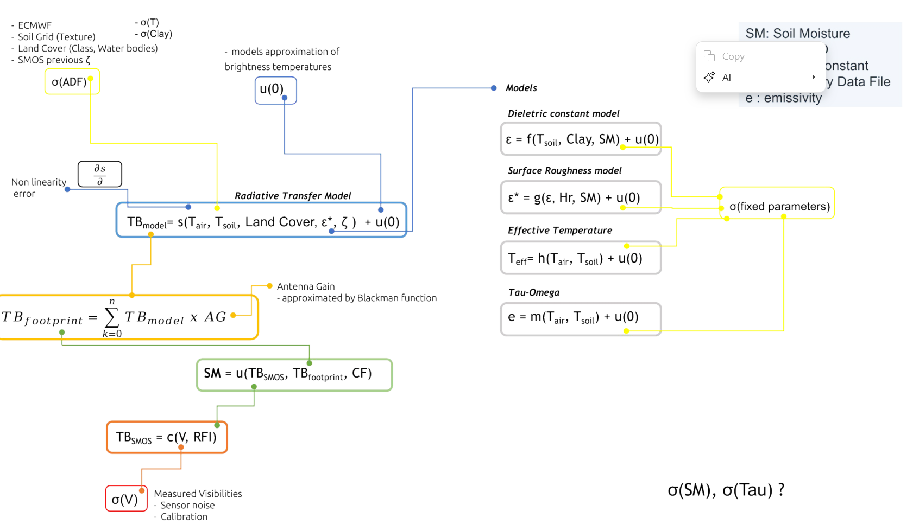
Fiducial Reference Measurements for Soil Moisture (FRM4SM)
FRM4SM
https://qa4sm.eu
FRM4SM Objectives:
defining procedures and protocols to qualify in situ soil moisture measurements as “FRMs”
addressing specific concerns intrinsic to the satellite soil moisture validation strategy (e.g. in situ measurement’s spatial representativeness, and the identification of committed areas for satellite soil moisture validation
The Quality Assurance for Soil Moisture (QA4SM) online validation service is developed as part of FRM4SM implementing qualified R&D outcomes.
Main achievements since GSICS 2025:
Phase-2 kick-off March 2025 two years extension till 2027
Focus on:
  high resolution satellite soil moisture validation
  Spatial validation metrics
  Root zone soil moisture validation
  Dedicated field campaign to assess sensor calibration uncertainties
  Establishing traceability for the SMOS L2 processor following the QA4EO guidelines, using a traceability diagram
Example of SMOS Validation results vs ERA5Land. (Credits: qa4sm)
QA4SM platform new release v4.0 in April 2026 including spatial metrics for SAR/GNSS-R soil moisture validation
SMOS, C3S validation results vs ERA5Land: bulk and seasonal. (Credits: qa4sm)

Slide 14
FRM Concept: Background and Objectives
The concept of a Fiducial Reference Measurement (FRM) has been developed to highlight the need for precise and well-characterised measurements tailored explicitly to the post-launch calibration and validation (Cal/Val) of Earth Observation satellite missions [1].
Recently, this need has been enhanced with the emergence of new commercial satellite operators to ensure that users have a transparent and fair means to judge the adequacy of data products to meet their needs.
The Committee on Earth Observation Satellites (CEOS) Working Group Cal/Val (WGCV) is putting in place a framework to assess the maturity and compliance of a “Cal/Val reference measurement” in terms of a set of community-agreed criteria which define it to be of CEOS-FRM quality. The assessment process is based on a maturity matrix that provides a visual assessment of the state of any FRM against each of a set of given criteria, making visible where it is mature and where evolution and effort are still needed. General information and the last version of the guidelines are available on the CEOS Cal/Val Portal [2].
[1] Goryl, P.; Fox, N.; Donlon, C.; Castracane, P. Fiducial Reference Measurements (FRMs): What Are They?
Remote Sens. 2023, 15, 5017. https://doi.org/10.3390/rs15205017
[2] FRMs Assessment Framework on CEOS Cal/Val Portal: https://calvalportal.ceos.org/web/guest/frms-assessment-framework
Slide 14

Slide 15


FRM Definition
Fiducial Reference Measurements (FRMs) are a suite of independent, fully characterised, and traceable (to a community agreed reference ideally SI) measurements, tailored specifically to address the calibration and validation needs of a class of satellite borne sensor and that follow the guidelines outlined by the GEO/CEOS Quality Assurance framework for Earth Observation (QA4EO).

Slide 16
FRM Principles
The mandatory defining characteristics for CEOS-FRMs are:
Traceability- FRMs should have documented evidence of their traceability to a community agreed reference, ideally tied to the International System of units, SI.
Independence from satellite under test- FRMs are independent from the satellite (under-comparison) geophysical retrieval process.
Uncertainty budget- A comprehensive uncertainty budget for all instruments used in deriving FRM of a particular measurand, including any transformation of the measurand to match that of the satellite product, is available and maintained.
Documented protocols- FRM protocols, procedures and community-wide quality management practices (measurement, processing, archive, documents, etc.) are defined, published and adhered to by FRM instrument deployments and usages.
Accessibility- FRM data, including metadata and documentation of processing, are accessible to other researchers allowing independent verification of processing systems. All data and information should be made available in a timely manner and in a form that is readily utilisable by a satellite operator.
Representativeness- FRM data allow the determination of the on-orbit uncertainty characteristics of satellite geophysical measurements via independent validation activities. It thus requires that the degree of representativeness of the FRM to that of the satellite observation and/or associated retrieval as well as the satellite vs FRM comparison process needs to be documented and the uncertainty assessed.
Adequacy of uncertainty- The uncertainty of the FRM measurements, including the comparison process, must be commensurate with the requirements of the class of satellite/instrument/measurand they are specified to support.
Utility (Return on Investment)- FRM data are designed to apply to a class of satellite missions (several). They should not be mission-specific.

Slide 17
FRM Endorsement process
The proposed framework takes a pragmatic approach relying on self-assessment and transparency/accessibility of evidence against a set of criteria which are subject to peer review through a board of experts led by CEOS WGCV
In order to be flexible, maximise inclusivity and encourage the development and evolution of FRM from new or existing teams compliance with criteria will be based on a gradation scaling rather than a simple pass/fail
The degree of compliance and associated gradation is presented in a Maturity Matrix model - to allow intended users of the FRM to assess suitability for their application and indeed funders to decide on where and what aspects to focus any investment. The matrix model provides a visual “simple” assessment of the state of any FRM for all given criteria making visible where it is mature and where evolution and effort needs to be expended.
In addition to this broad-based summary an overall classification of the degree of compliance will be provided based on meeting specific gradations for particular criteria.

Slide 18

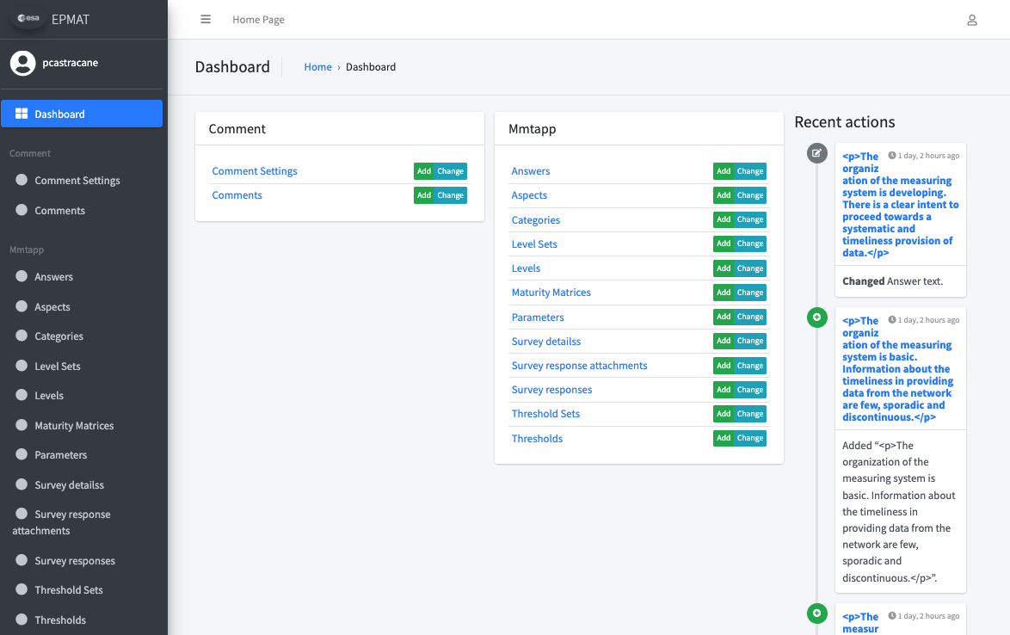
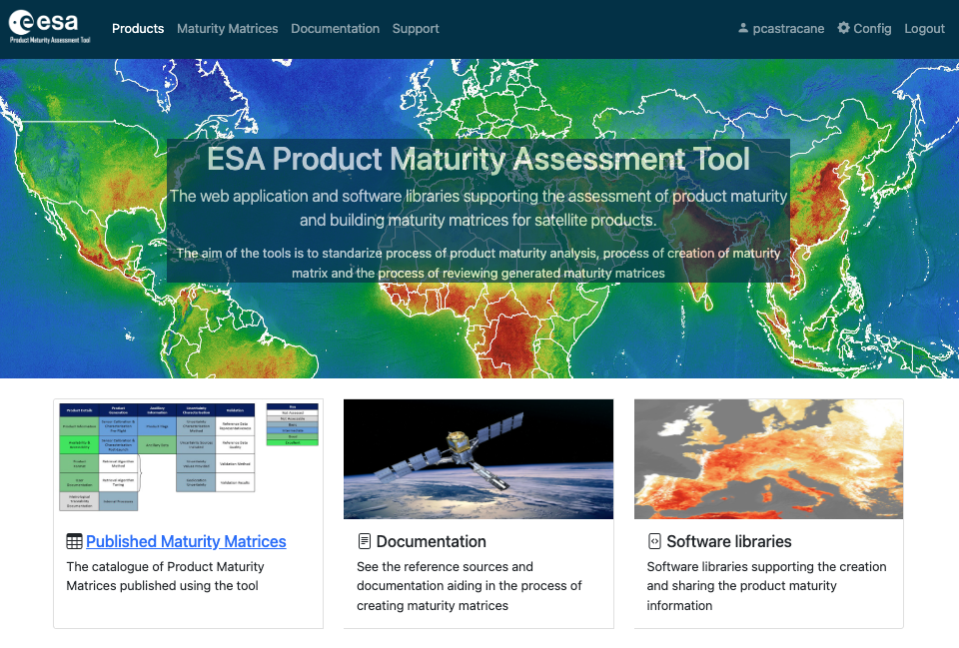
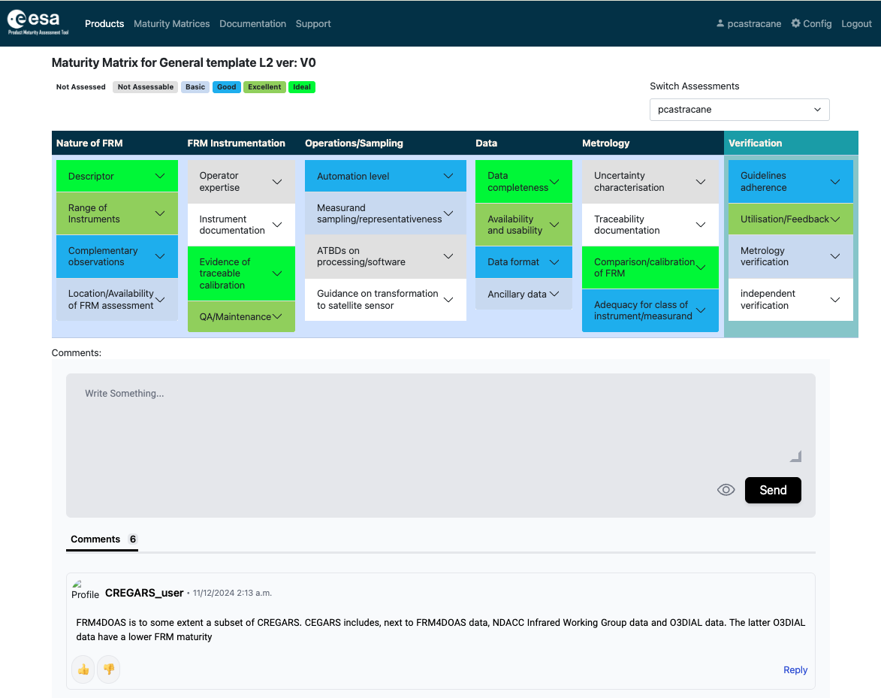
Maturity Matrix Tool

Slide 19
FRM Maturity Matrix
Self-Assessment |  |  |  |  |  | Independent Assessor
Nature of FRM | FRM Instrumentation | Operations/ Sampling (single instrument) | Data | Metrology | Completeness, coverage and distribution | Verification
Descriptor | Instrument documentation | Automation level | Data completeness | Uncertainty characterisation | Validation capacity | Guidelines adherence
Location/ availability of FRM | Evidence of traceable calibration | Measurand sampling/ representativeness | Availability and Usability | Traceability documentation | Geographical coverage | Utilisation/ Feedback
 |  |  |  |  | Temporal sampling
Range of sensors | QA Maintenance | ATBDs on processing/software | Data format | Comparison/ calibration of FRM | Centralized data, processing, quality assessment and adherence to community standards | Metrology verification
Complementary observations | Operator expertise | Guidelines on transformation to satellite sensor | Ancillary data | Adequacy for class of instrument/ measurand | Timeliness | Independent verification
FRM CLASSIFICATION |  |  |  |  |  | A B C D
Class A – Where the measurement fully meets all the criteria necessary to be considered an FRM for a particular class of instrument and measurand.
Class B – Where the measurement meets many of the key criteria and has a path towards meeting the Class A status in the near term.
Class C – Meets or has some clear path towards achieving the criteria needed to reach a higher class and provides some clear value to the validation of a class of satellite instruments/measurands.
Class D – Is a relatively basic adherence to the FRM criteria but there is a strategy and aspiration to progress towards a higher class. This can be considered an entry level class for those starting out on developing an FRM.
Grade
Not Assessed
Not Assessable
Basic
Good
Excellent
Ideal
Not Public

Slide 20
Summary for FRMs
The CEOS WGCV has implemented a framework to assess the maturity and compliance of a “Cal/Val reference measurement” in terms of a set of community-agreed criteria which define it to be of CEOS-FRM quality.
Information and Guidelines are available on CEOS Cal/Val Portal https://calvalportal.ceos.org/web/guest/frms-assessment-framework
The assessment process is based on a Maturity Matrix (MM) approach that provides a visual assessment of the state of any FRM against each of a set of given criteria. A tool has been developed to fill the MM according to a configurable questionnaire.
A first exercise was conducted by several selected pilots. It has led to improvements in both the approach (guidelines) and in the MM tool.
A second phase of exercises is started with the target of providing results for the next WGCV-56 meeting (20-24 April 2026).

