Slide 1
EUMETSAT GDWG Report: Decommissioning the GSICS Server.
Simon Elliott
Interagency Data Exchange Coordinator
GSICS Data Working Group, March 2026

Slide 2
Discussion points …
Distribution of IASI data and need for GSICS-format: being used by CMA – please give feedback on details
To be confirmed: no users of GOME data via GISCS server
Deadline for GSICS server decommissioning - after period of parallel operations (2 months) for all services (including visualisation etc)
GSICS Plotting Tool - to be replaced by MATRICS (covered later in presentation under TOP 7j, “GSICS Calibration Products Plotting Tool”, – here also 2 months
Decommissioning of EUMETSAT GSICS products as discussed
  No new ones, old ones stored in UMARF

Slide 3
IASI L1C data in GSICS format
EUMETSAT provides METOP-B IASI L1C data in a specific format for co-location with GEO satellites:
  Data are in netCDF;
  Reduced number of parameters compared to original L1C data;
  Has been tailored to users’ co-location area, i.e. +/- 30° latitude and longitiude from the sub-satellite points of the GEO satellites for which the data are required;
  Note, CMA regularly receives data between +30° and -30° latitude and +55° and +140° longitude (covering multiple CMA GEO satellites).

Slide 4
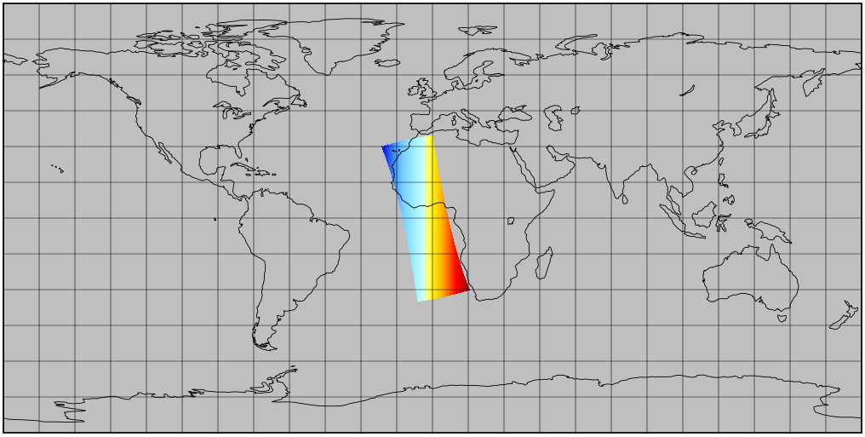
Example
Example of spatial coverage of variables produced by the GSICS conversion of IASI L1C data on the GSICS server for the EUMETSAT prime subsatellite position at 0° longitude

Slide 5
Replacement of IASI-L1C on GSICS server by EUMETSAT Data Store
Access to data via EUMETSAT Data Store (DS);
IASI L1C data will be available either as full orbits in various formats, including a generic netCDF format, or in the GSICS L1C netCDF format;
Generic full orbit L1C netCDF format is already operational;
GSICS netCDF format is to be installed in 2026;
Access can be done manually through DS or (strongly recommended) EUMETSAT Data Access Client (EUMDAC);
Support for defining the access is provided by EUMETSAT service desk (ops@eumetsat.int);
IASI L1C service via the GSICS server will be decommissioned after a 2-month overlap period with the GSICS L1C netCDF format on the DS.

Slide 6
Replacement of IASI-L1C on GSICS server by EUMETSAT DataStore
IASI Level 1C - All Spectral Samples - Metop - Global | EUMETSAT - User Portal
“Download Data” button (Log in if needed)
Set ROI and satellite choice
“Show Results” button
Put one in cart and go to cart (can see EUMDAC download command here)
Select item and choose “Customize Cart”
Select “Output format” and run order. This will run via API/CLI
See EUMETSAT Data Access Client (EUMDAC) guide | EUMETSAT - User Portal

Slide 7
Summary
EUMETSAT GSICS Server to be turned off in H2 2026
2 months advance notice to be given
Data available via EUMETSAT Data Store
Plotting available using MATRICS
Support available from ops@eumetsat.int

Slide 8
Thank you!
Questions are welcome.

