Slide 1
GSICS 2026 Agency Report
CMA
Chengli Qi，Junwei Wang, Lin Tian,
Shengli Wu, Xiuqing(Scott) Hu

Slide 2
Outlines
GSICS Activities (in support of GDWG and GRWG), Actions, and Achievements
Recent & Planned launches and Instrument Updates that are relevant to GSICS (stress new programs and significant accomplishments)
Calibration Major Updates (especially for reference sensors)
Reprocessing Updates
GSICS team Updates

Slide 3
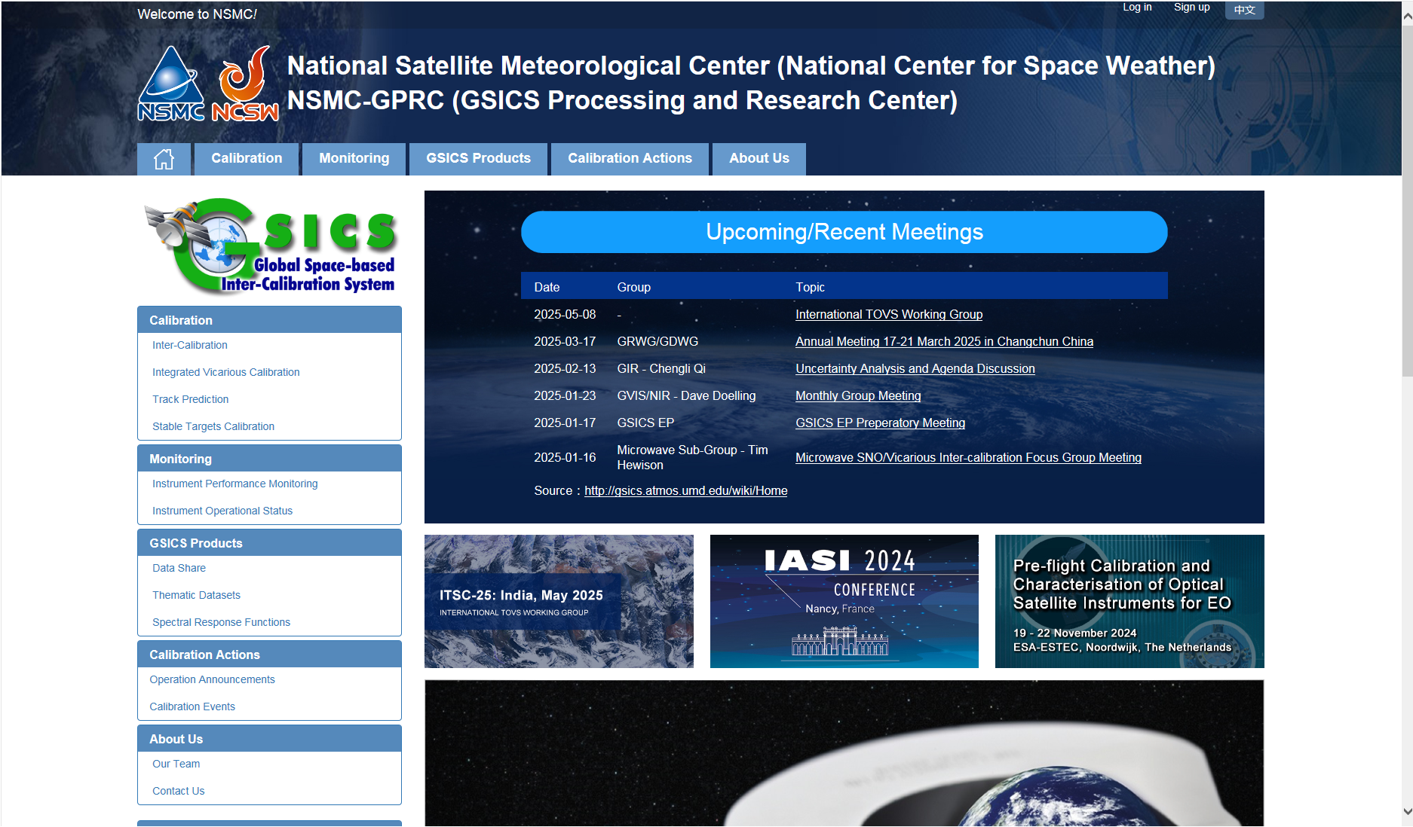
Agency’s support to GDWG Activites
1）GSICS Activities and Achievements
Keep CMA GPRC Website Content updating:
  GPRC Information
  CMA GSICS product sharing (Thredds)
  FengYun Satellites Instrument Operation Status (Landing Pages）
CMA GDWG:
  Website construction and maintain
  New satellite data sharing
  NSMC-GPRC Website Upgrade
Mar 2026
Notes:
Agency’s support to GDWG Activites

Slide 4
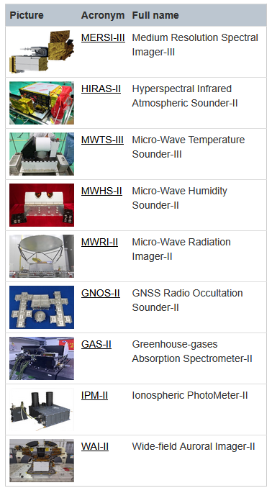
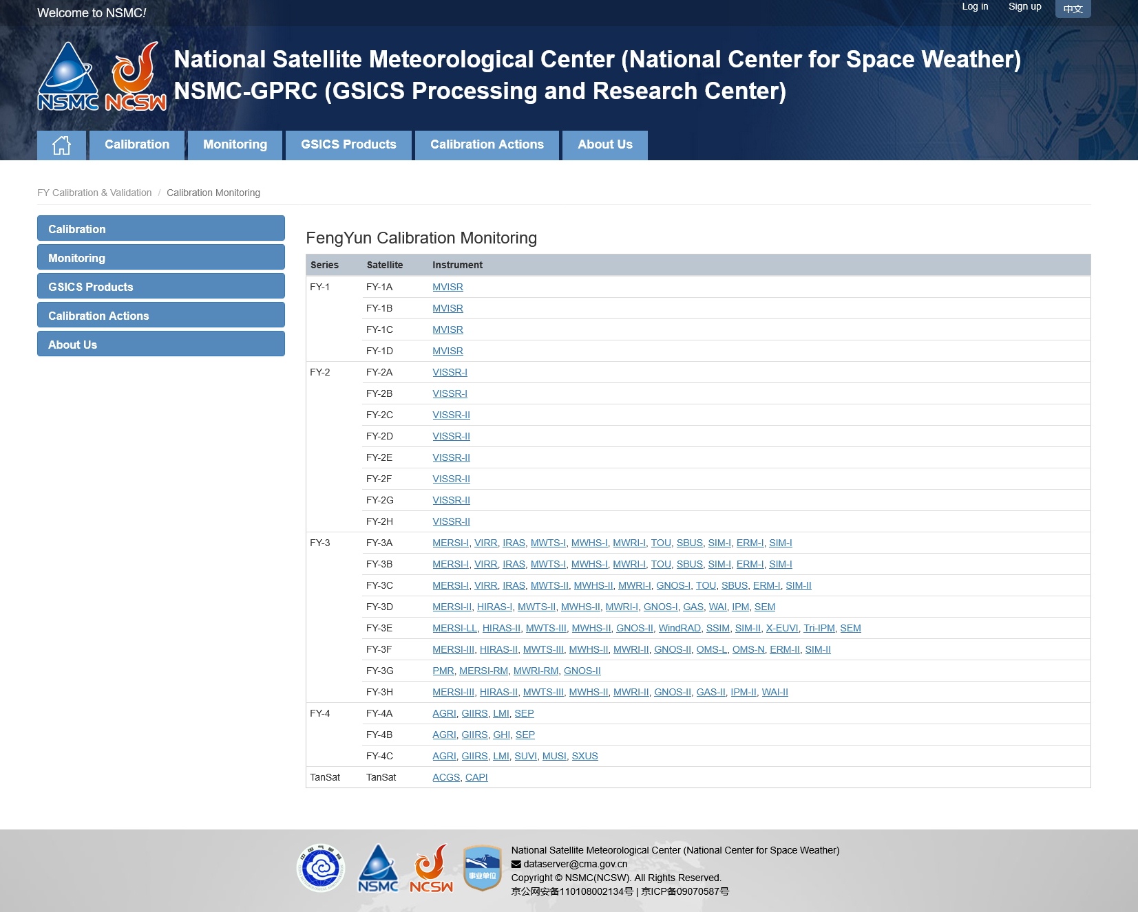
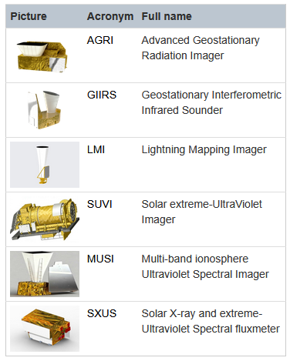
Agency’s support to GDWG Activites
FY-3H: launched on 2025/09/27
FY-4C: launched on 2025/12/27
Landing pages for new FY-LEO / FY-GEO instruments
http://gsics.nsmc.org.cn/portal/en/fycv/monitoring.html
Mar 2026
Notes:
Agency’s support to GDWG Activites

Slide 5
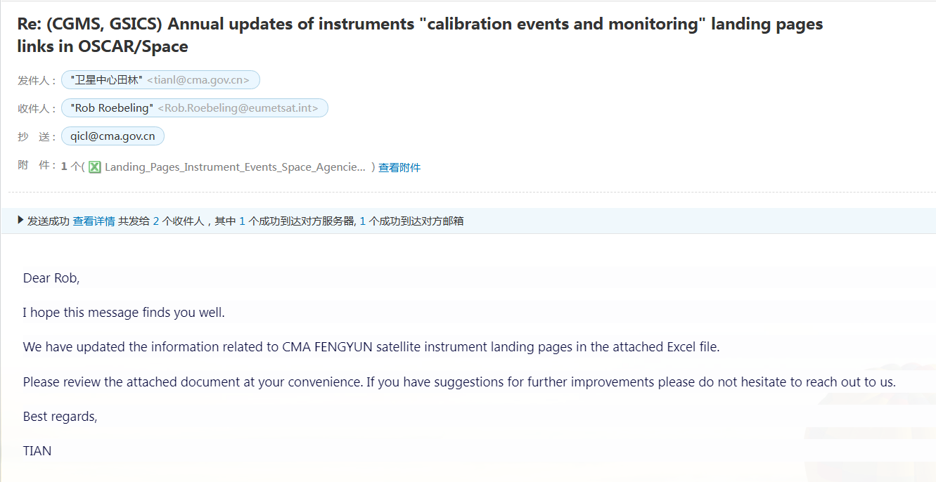
Agency’s support to GDWG Activites
CMA GDWG TASK: Update of the Landing Pages for WMO-OSCAR
Updating the list of new Instrument Calibration and Monitoring Landing Page addresses:
  FY-3H: MERSI-III, HIRAS-2, MWTS-3, MWHS-2, MWRI-2, GNOS-2, GAS-L, IPM-2, WAI-2;
  FY-4C: AGRI, GIIRS-2, LMI, SUVI, MUSI, SXUS;
0 | CMA | FY-3H | MERSI-III | http://gsics.nsmc.org.cn/portal/en/fycv/monitoring.html#FY3H-MERSI | https://space.oscar.wmo.int/satellites/view/fy_3h | https://space.oscar.wmo.int/instruments/view/mersi_3
0 | CMA | FY-3H | HIRAS-II | http://gsics.nsmc.org.cn/portal/en/fycv/monitoring.html#FY3H-HIRAS | https://space.oscar.wmo.int/satellites/view/fy_3h | https://space.oscar.wmo.int/instruments/view/hiras_2
0 | CMA | FY-3H | MWTS-III | http://gsics.nsmc.org.cn/portal/en/fycv/monitoring.html#FY3H-MWTS | https://space.oscar.wmo.int/satellites/view/fy_3h | https://space.oscar.wmo.int/instruments/view/mwts_3
0 | CMA | FY-3H | MWHS-II | http://gsics.nsmc.org.cn/portal/en/fycv/monitoring.html#FY3H-MWHS | https://space.oscar.wmo.int/satellites/view/fy_3h | https://space.oscar.wmo.int/instruments/view/mwhs_2
0 | CMA | FY-3H | MWRI-II | http://gsics.nsmc.org.cn/portal/en/fycv/monitoring.html#FY3H-MWRI | https://space.oscar.wmo.int/satellites/view/fy_3h | https://space.oscar.wmo.int/instruments/view/mwri_2
0 | CMA | FY-3H | GNOS-II | http://gsics.nsmc.org.cn/portal/en/fycv/monitoring.html#FY3H-GNOS | https://space.oscar.wmo.int/satellites/view/fy_3h | https://space.oscar.wmo.int/instruments/view/gnos_2
0 | CMA | FY-3H | GAS-II | http://gsics.nsmc.org.cn/portal/en/fycv/monitoring.html#FY3H-GAS | https://space.oscar.wmo.int/satellites/view/fy_3h | https://space.oscar.wmo.int/instruments/view/gas_2
0 | CMA | FY-3H | IPM-II | http://gsics.nsmc.org.cn/portal/en/fycv/monitoring.html#FY3H-IPM | https://space.oscar.wmo.int/satellites/view/fy_3h | https://space.oscar.wmo.int/instruments/view/sws_ipm
0 | CMA | FY-3H | WAI-II | http://gsics.nsmc.org.cn/portal/en/fycv/monitoring.html#FY3H-WAI | https://space.oscar.wmo.int/satellites/view/fy_3h | https://space.oscar.wmo.int/instruments/view/sws_wai
0 | CMA | FY-4C | AGRI | http://gsics.nsmc.org.cn/portal/en/fycv/monitoring.html#FY4C-AGRI | https://www.wmo-sat.info/oscar/satellites/view/fy_4c | https://space.oscar.wmo.int/instruments/view/agri
0 | CMA | FY-4C | GIIRS-II | http://gsics.nsmc.org.cn/portal/en/fycv/monitoring.html#FY4C-GIIRS | https://www.wmo-sat.info/oscar/satellites/view/fy_4c | https://space.oscar.wmo.int/instruments/view/giirs_2
0 | CMA | FY-4C | LMI | http://gsics.nsmc.org.cn/portal/en/fycv/monitoring.html#FY4C-LMI | https://www.wmo-sat.info/oscar/satellites/view/fy_4c | https://space.oscar.wmo.int/instruments/view/lmi
0 | CMA | FY-4C | SUVI | http://gsics.nsmc.org.cn/portal/en/fycv/monitoring.html#FY4C-SUVI | https://www.wmo-sat.info/oscar/satellites/view/fy_4c | https://space.oscar.wmo.int/instruments/view/seuvi_fy_4
0 | CMA | FY-4C | MUSI | http://gsics.nsmc.org.cn/portal/en/fycv/monitoring.html#FY4C-MUSI | https://www.wmo-sat.info/oscar/satellites/view/fy_4c | https://space.oscar.wmo.int/instruments/view/musi
0 | CMA | FY-4C | SXUS | http://gsics.nsmc.org.cn/portal/en/fycv/monitoring.html#FY4C-SXUS | https://www.wmo-sat.info/oscar/satellites/view/fy_4c | https://space.oscar.wmo.int/instruments/view/sxus
Mar 2026
Mar 2026
Notes:
Agency’s support to GDWG Activites

Slide 6
Agency’s support to GRWG Activites
Operational monitoring of data quality of FY-3 and FY-4 satellites and production，generate monthly quality reports.
Algorithm development of cross calibration of High Accuracy On-board Calibrator (HAOC) onboard FY-3G, with other instruments completed.
Algorithm development and demo dataset of FY-4/AGRI radiance correction according to GSICS unified framework are completed.
Operational software of GEO and LEO hyperspectral sounder comparison are in development .
Research on PCA based Hyperspectral data compress algorithm.

Slide 7
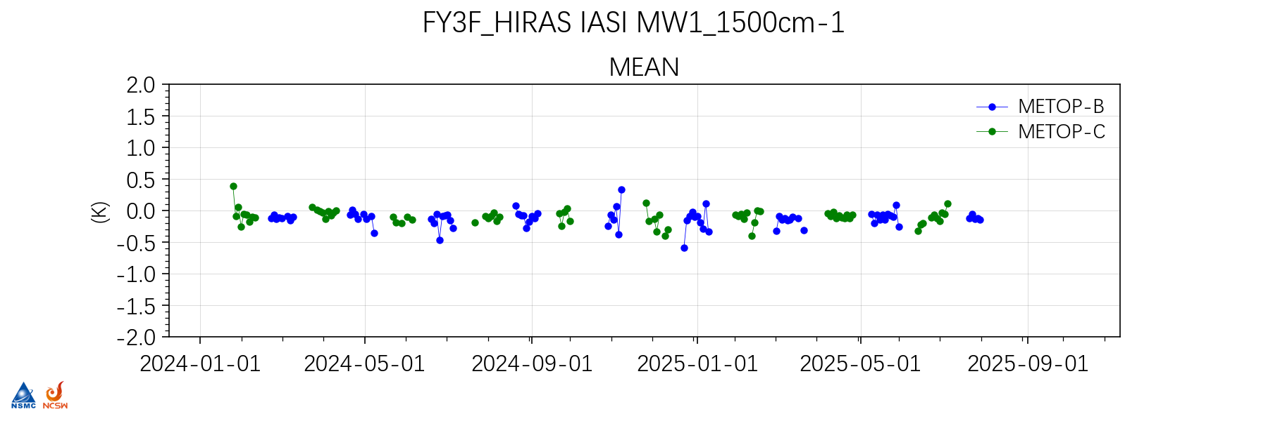
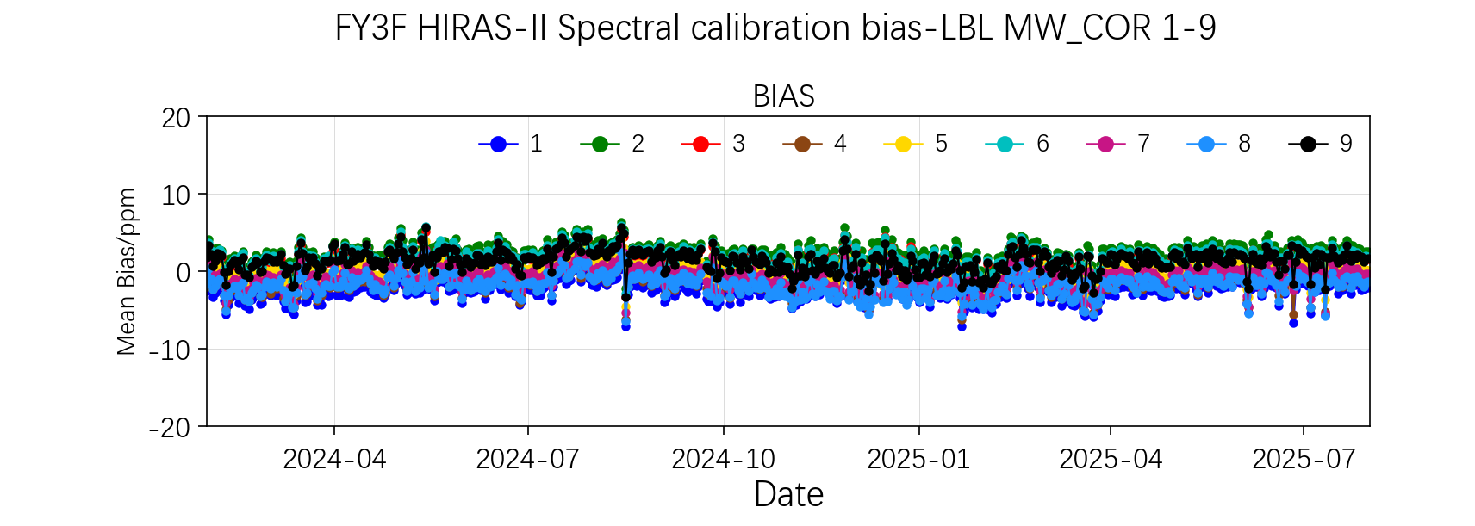
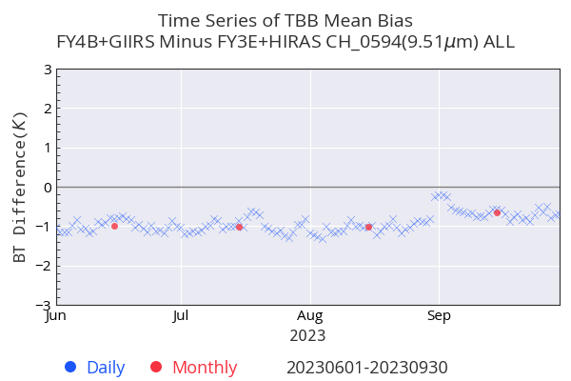
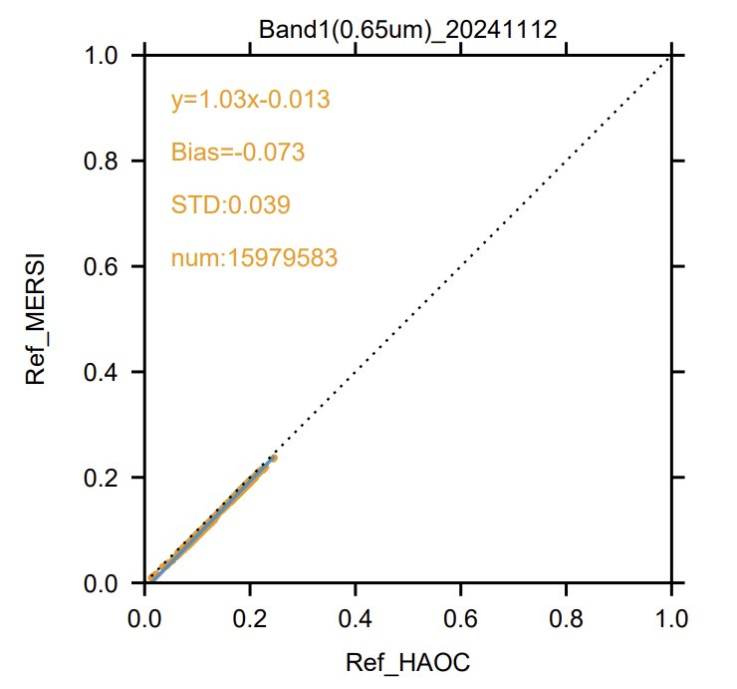
Monthly L1 data quality report
FY-3G/HAOC VS
FY-3G/MERSI

Slide 8
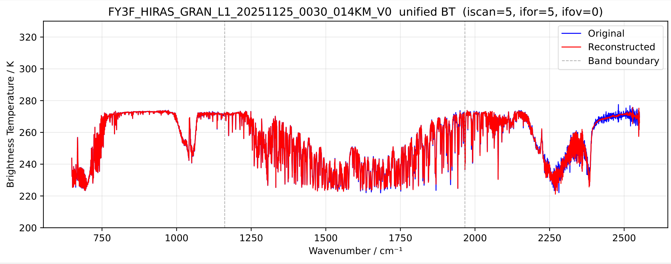
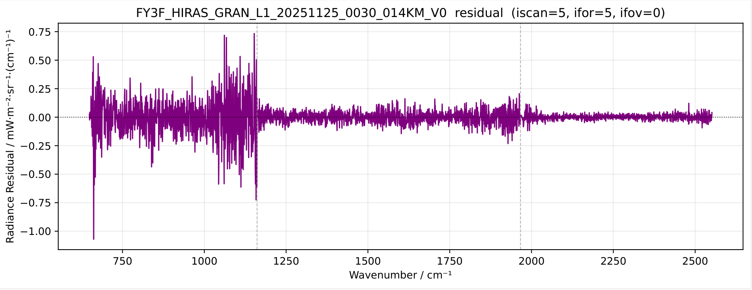
PCA based Hyperspectral data compress algorithm
BT comparison between the original and reconstructed data.
BT comparison Residual between the original and reconstructed data.

Slide 9
Actions
Action Id | Summary | Lead | Due | Notes | Status
A.GIR. 20230301.2 | GSICS correction | Chengli Qi | 3/1/2024 | Developped FY-4/AGRI demo dataset, Prepare the ATBD | Ongoing
A.GVNIR 20240313.11 | CMA to prepare an GSICS ATBD on the IR-MAD method. | Lin Tian | 3/1/2025 |  | Ongoing
A.GDWG. 20240313.1 | CMA to post daily instrument bias on GPRC website in machine readable form. | Lin Tian | 3/1/2025 | Completed bias results, to be posted | Ongoing
A.GMW. 20240314.4 | Juyang to coordinate request for agencies to include information in L1 data sets that are needed to retrieve data needed for Lunar calibration. | Juyang Hu | 3/1/2025 | Communicated with Tiger, to be discussed next | Ongoing
A.GMW. 20240314.6 | Juyang Hu/Martin/Tiger Hu to Collect 1-year calibrated lunar samples from FY3 MWTS/MWHS and compare with the Model and ATMS lunar observations | Juyang Hu | 3/1/2025 |  | Ongoing
A.GMW. 20240314.7 | Yang Guo to check the information in FY3 MWTS/MWHS level-1 dataset for lunar information | Yang Guo | 3/1/2025 |  | Ongoing
A.GIR. 20250301.2 | Group members test the software of SRF of FOV difference | Chengli Qi | 3/1/2026 |  | Ongoing

Slide 10
2）Recent & Planned launches
The FY-3H was successfully launched on Sep 27, 2025. It is equipped with 9 instruments, include a newly developed Greenhouse gases Absorption Spectrometer(GAS-II). It is currently undergoing in-orbit testing and most of instruments are scheduled to complete the first phase of in-orbit testing in April.
FY-4C was launched on Dec 27, 2025, and is also currently in the first phase of in-orbit testing.
The Fengyun-4 Microwave Satellite (FY-4M) and the second dawn-dusk satellite of the Fengyun-3 series (FY-3J) are scheduled for launch in the fourth quarter of this year.

Slide 11
2）Instruments Updates
Current FY satellite and instruments status on orbit
Satellite |  | Launch | EO instruments
FY-3D | (Op) | 2017-11-15 | MERSI | HIRAS | MWTS | MWHS | MWRI | IPM
 |  |  | GAS | WAI | SEM | GNOS
FY-3E | (Op) | 2021-07-05 | MERSI-LL | HIRAS-II | SIM-II | SSIM | MWTS-III | MWHS-II
 |  |  | WindRAD | GNOS-II | Tri-IPM | SEM-II | X-EUVI
FY-3G | (Op) | 2023-04-16 | MERSI-RM | MWRI-RM | PMR | GNOS-II
FY-3F | (Op) | 2023.08.03 | MERSI-III | HIRAS-II | SIM-II | ERM-II | MWTS-III | MWHS-II
 |  |  | MWRI-II | GNOS-II | OMS-N | OMS-L
Satellite Status
Op = Operational
Pre = Pre-operational
B = Back-up, secondary
L = Limited availability
Instrument Status
 | Operational(or capable of)
 | Operational with limitations(or Standby)
 | Operational with Degraded Performance
 | Not Operational
 | Functional, Turned Off
Satellite (status) |  | Location | Launch | EO instruments
FY-2G | (Op) | 99.2° E | 2014-12-31 | S-VISSR
FY-2H | (Op) | 79° E | 2018-06-05 | S-VISSR
FY-4A | (B) | 123.5° E | 2016-12-11 | AGRI | GIIRS | LMI | SEP
FY-4B | (Op) | 105° E | 2021-06-03 | AGRI | GIIRS | GHI
http://www.nsmc.org.cn/nsmc/en/operation/status.html

Slide 12
3）Calibration Major Updates
FY-4B
FY-3F
 | Date | Updates
1 | 2025.07.16 | Update of AGRI reflective band calibration coefficients of B1(470nm)、B2(650nm)、B3(825nm)、B5(1610nm)、B6(2225nm)
2 | 2025.08.08 | Operational update of crosstalk correction for GHI infrared bands. After the update, discontinuities in cloud top brightness temperature have been effectively corrected through crosstalk removal.
 | Date | Updates
1 | 2025.01 | The variational stripe removal module for MERSI has been put into operational service.
2 | 2025.07 | Optimization of the MERSI thermal infrared calibration algorithm: improved the smoothing algorithm for blackbody, cold space and temperature data, added threshold constraints, and excluded invalid observations from smoothing calculations.
3 | 2025.02.15 | The OMS-N L1 earth view radiance product exhibited left-right asymmetry in the cross-track direction; the earth view radiance calibration coefficients have been updated.
4 | 2025.11.19 | In response to spectral shift in the radiance wavelength for the left field of view in the cross-track direction of OMS-N, the spectral calibration coefficients have been updated
FY-3G
 | Date | Updates
1 | 2025.09.16 | HAOC has updated its solar calibration procedure, adding AB/FOV normalization coefficient files and static calibration coefficient files, and calculating solar irradiance to dynamically update the corresponding file.

Slide 13
4）GSICS team Updates
EP
Xiuqing (Scott) Hu
GRWG
IR: Chengli Qi (Chair), Junwei Wang, Hanlie Xu
MW: Shengli Wu(Co-chair), Yang Guo, Juyang Hu, Jian Shang
VIS/NIR: Ling Wang, Xingwei He, Bei Zhang
UVN: Yuan Li, Qian Wang, Jin Qi
Space Weather: Cong Huang, Yafen Yang
GDWG
Lin Tian
POC for Operational Matters
Chengli Qi

Slide 14
Thanks!

