Slide 1
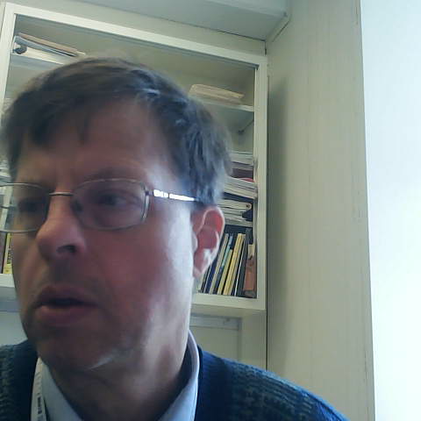
GSICS 2026 Agency Report
NIST (USA)
Eric L. Shirley and Michelle Stephens

Slide 2

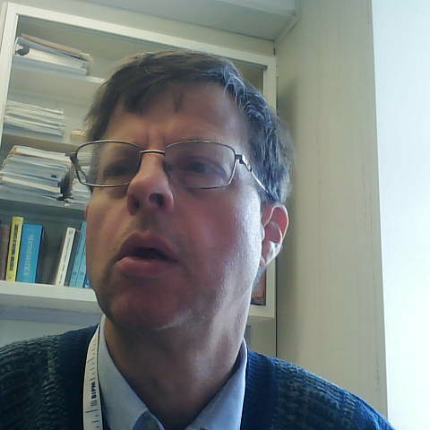
GSICS Activities (in support of GDWG and GRWG), Actions, and Achievements
NIST scientists Michelle Stephens, Maria Nadal and Eric Shirley are members of CCPR-WG-SP-TG17 [CCPR=Consultative Committee for Photometry and Radiometry, which meets regularly at the BIPM, and features multiple NMIs (including NIST, NPL, etc.) and other stakeholders].
Emma Woolliams (NPL) and Michelle Stephens (NIST) are the Co-Chairs.
The terms of reference of the task group (Task Group 17) are:
  To provide a consistent and coordinated response from the NMI radiometry community to the needs of the satellite-observation communities, particularly those related to climate change.
A long-term goal is to facilitate better and more coherent and effectual coupling of the NMIs and the remote-sensing (e.g., weather) satellite communities.
https://www.bipm.org/en/committees/cc/ccpr/wg/ccpr-wg-sp-tg17

Slide 3

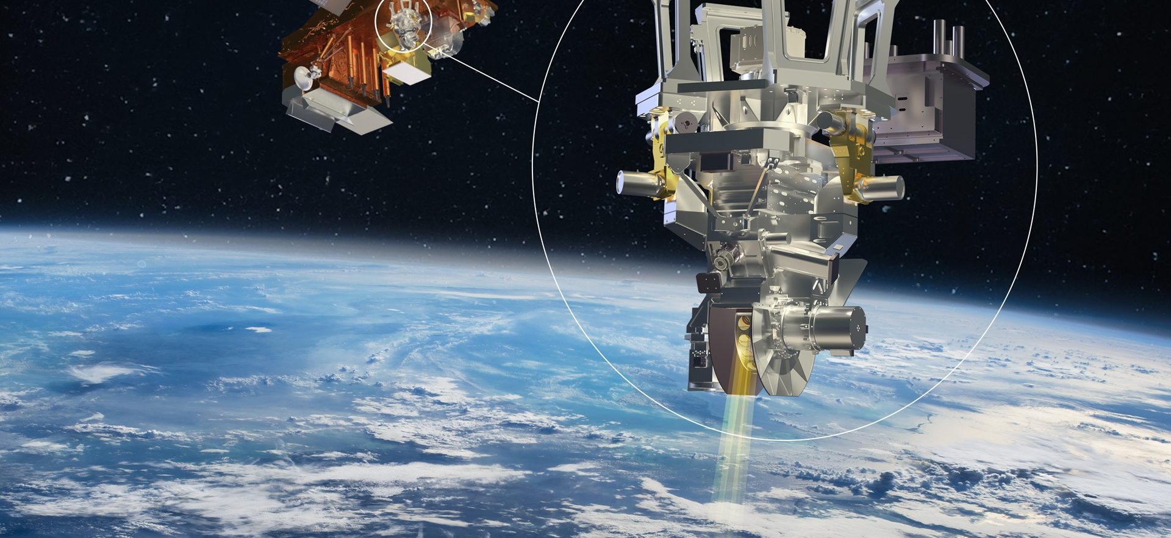
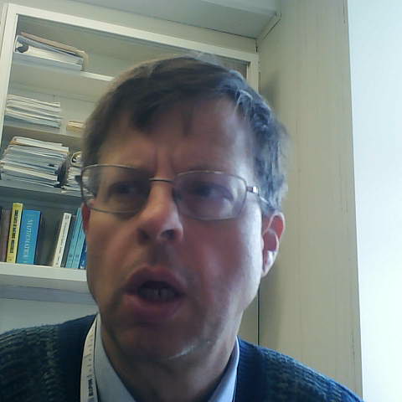
Recent & Planned launches and Instrument Updates that are relevant to GSICS
NIST is in discussions with NOAA for work in support of GeoXO cal/val (weather-related)
NIST built detector for the Libera Mission that will fly on the JPSS satellite targeted to launch in 2027. It will be named NOAA-22 once in orbit (weather-related)
JPSS Satellite with Libera instrument highlighted

Slide 4
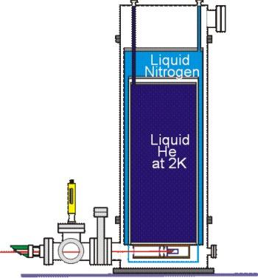
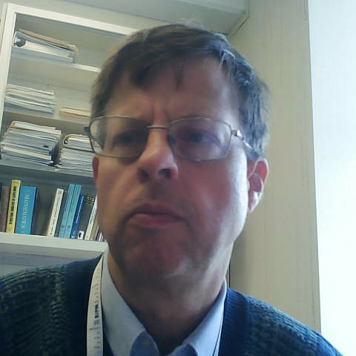
Calibration Major Updates (especially for reference sensors)
NIST is refurbishing and refreshing its primary radiometric standards [firstly, the Primary Optical Watt Radiometer (POWR)] including use of a new, closed-cycle cryocooler and laser technology.
This will ease radiometric scale transfers to NIST’s working standard detectors as well as field- and space-deployable transfer radiometers.
Currently, POWR uses a large He cryostat that needs refilling prior to each use.

Slide 5
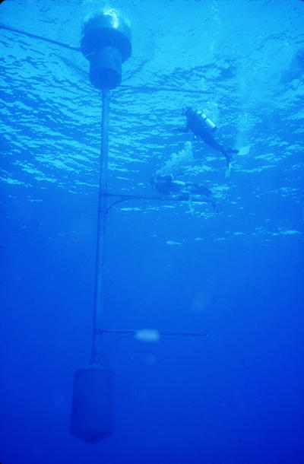
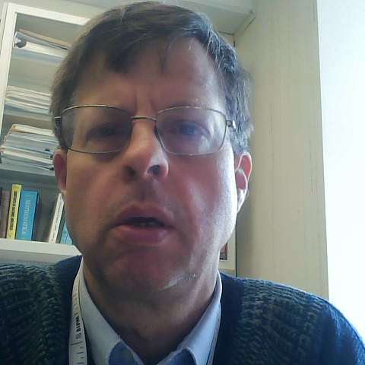
Reprocessing Updates
NIST does not reprocess much data itself. However, B. Carol Johnson (NIST Associate, formerly Employee, retired) continues activities related to ocean color time series’, that of MOBY in particular. (Helpful, for instance, in characterizing El Nino events that impact weather.)
Murtugudde, R. G., S. R. Signorini, J. R. Christian, A. J. Busalacchi, C. R. McClain and J. Picaut, 1999. Ocean Color Variability of the Tropical Indo-Pacific Basin Observed by SeaWiFS During 1997-1998. In press, J Geophys. Res., 2-27.
"Observing [the algae] in the oceans is much like putting dye in a tank and stirring it up to see where things are moving," Murtugudde said.
MOBY

Slide 6
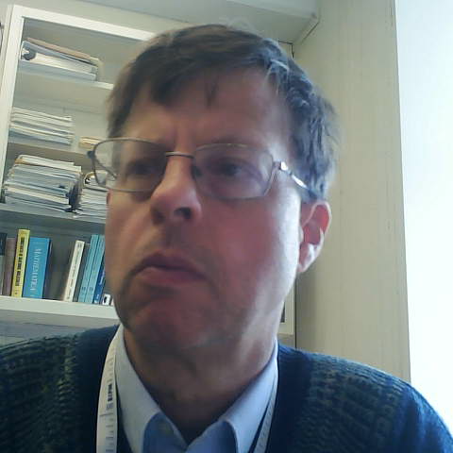
Team Updates
Nothing further to report.

