Slide 1

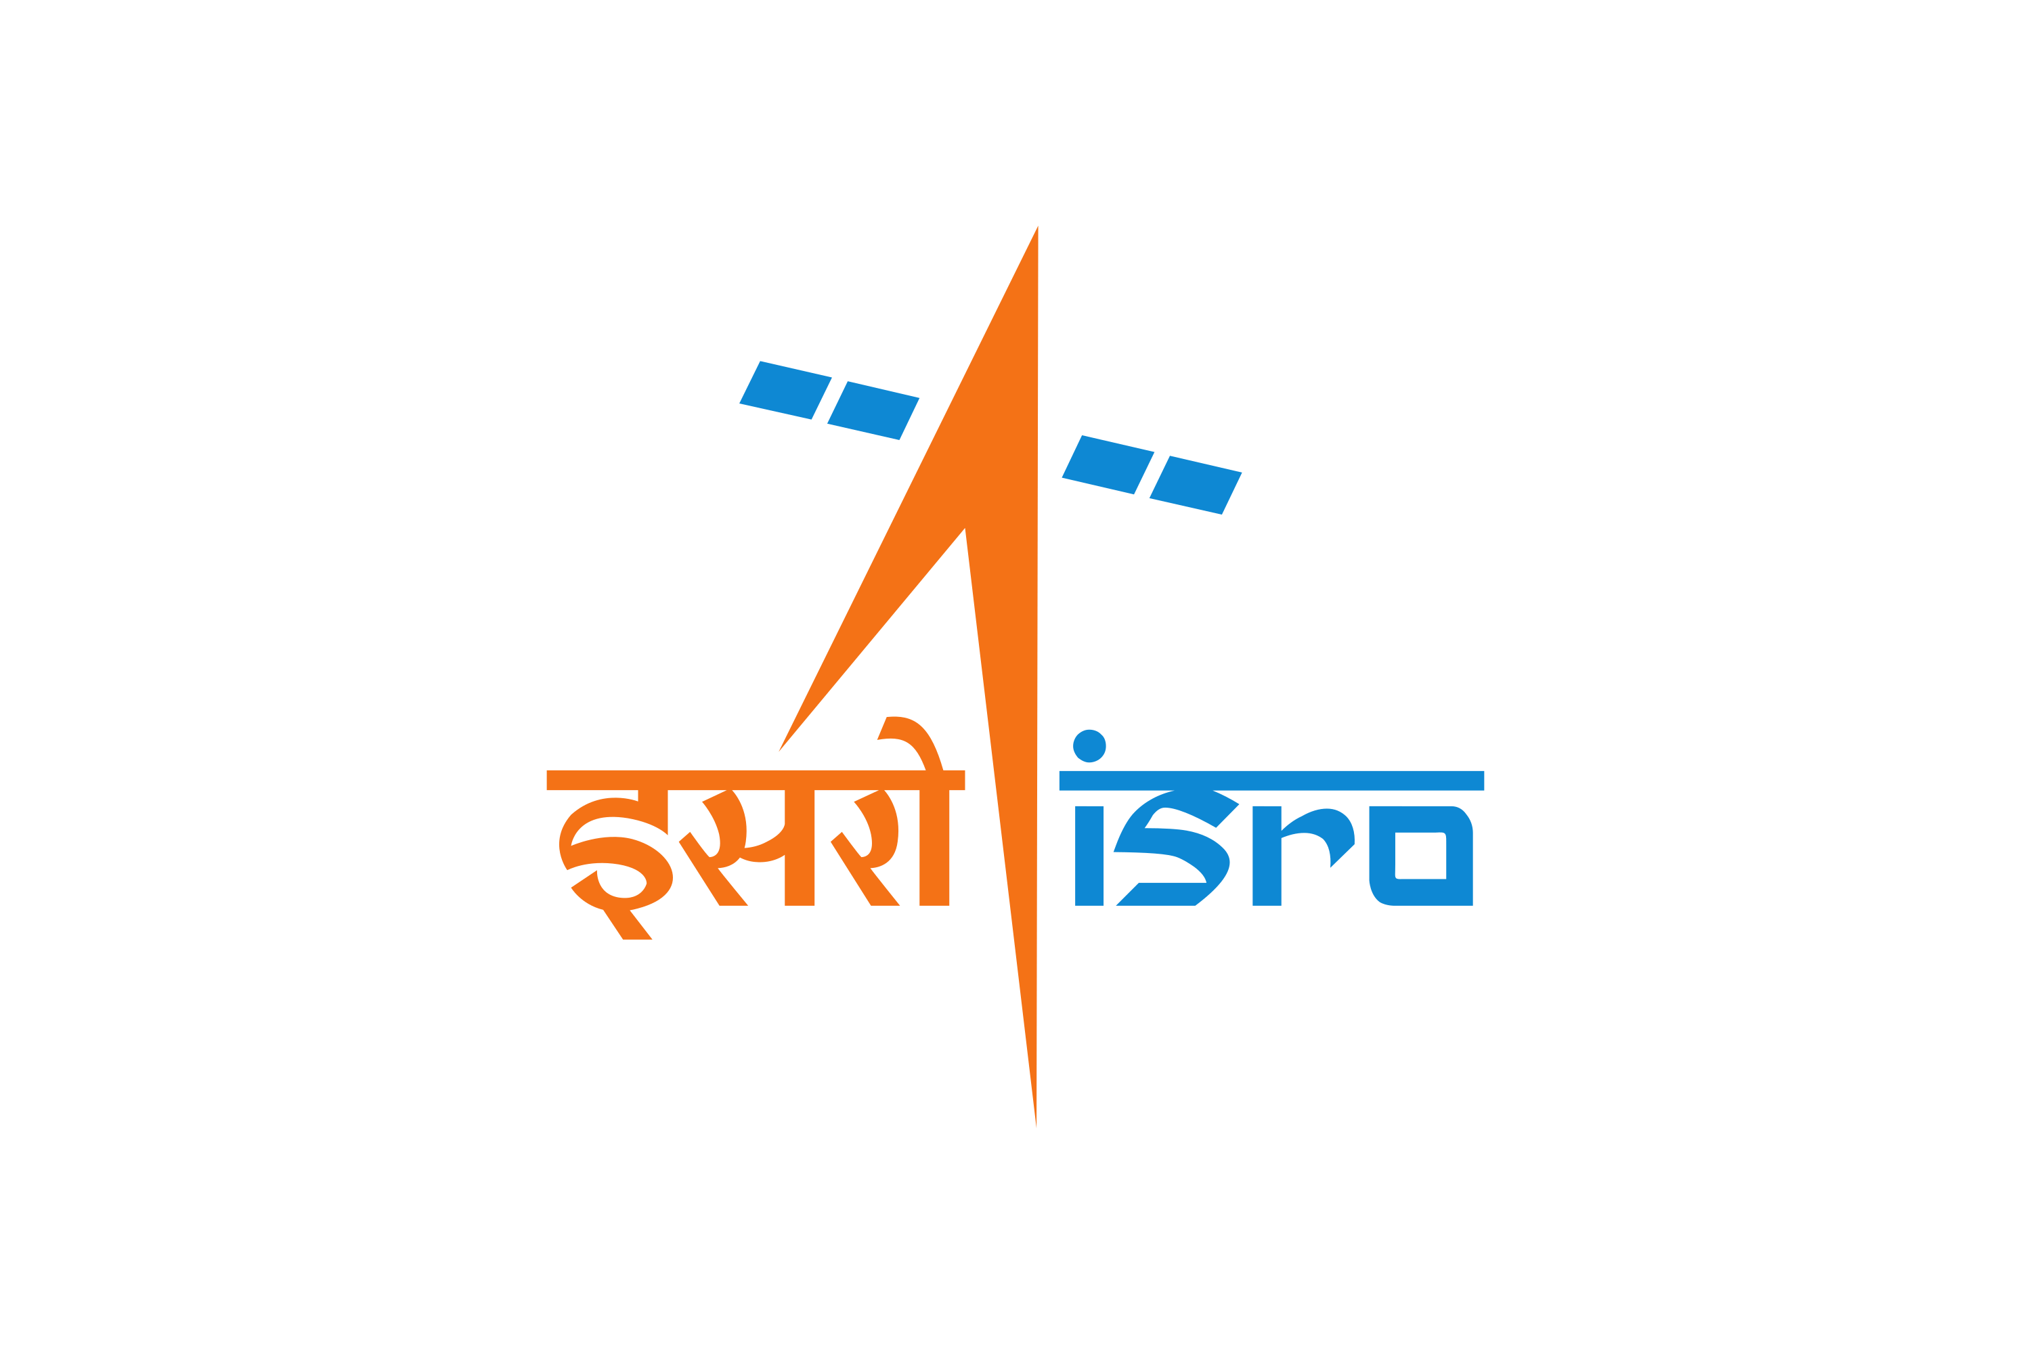
GSICS Agency Report - ISRO
Randhir Singh
Space Applications Centre (ISRO), Ahmedabad, India
GSICS Presentation
GSICS Agency Report GSICS Meeting |23-27 March 2026| Ottawa, Canada

Slide 2
Presentation Overview
Summary of Agency GSICS Activities, Actions, and Achievements
Updates on agency instruments and recent/planned launches relevant to GSICS
Agency support to GDWG and GRWG actives
Recent calibration updates
Details about future satellite missions
GSICS Agency Report GSICS Meeting |23-27 March 2026| Ottawa, Canada

Slide 3
Summary of ISRO’s GSICS Activities, Actions, and Achievements
Presently, INSAT-3DR (8-Sep-2016) at 74E and INSAT-3DS (17-Feb-2024) at 82E are operational in GEO.
INSAT-3DS has many improvements to mitigate the issues related to the blackbody calibration and mid-night sun-intrusion in INSAT-3D/3DR.
EOS-06 (Oceansat-3), launched on 26 Nov 2022 is operational with Ku-band scatterometer, and 13-band Ocean Color Monitor (OCM-3). Data is available to users through BHUVAN web-portal.
Oceansat-3A with OCM3, Ku-band SCAT, SSTM, and MATHS payloads will be launched this year.
Under GSICS, inter-calibration of IR channels are in demo phase with IASI-B/C and will be extended to CrIS.
Under GSICS, VIS/SWIR channels of INSAT-3DS were inter-calibrated against MODIS using a ray-matching method, with further extension planned using VIIRS aboard Suomi NPP.
GSICS Agency Report GSICS Meeting |23-27 March 2026| Ottawa, Canada

Slide 4
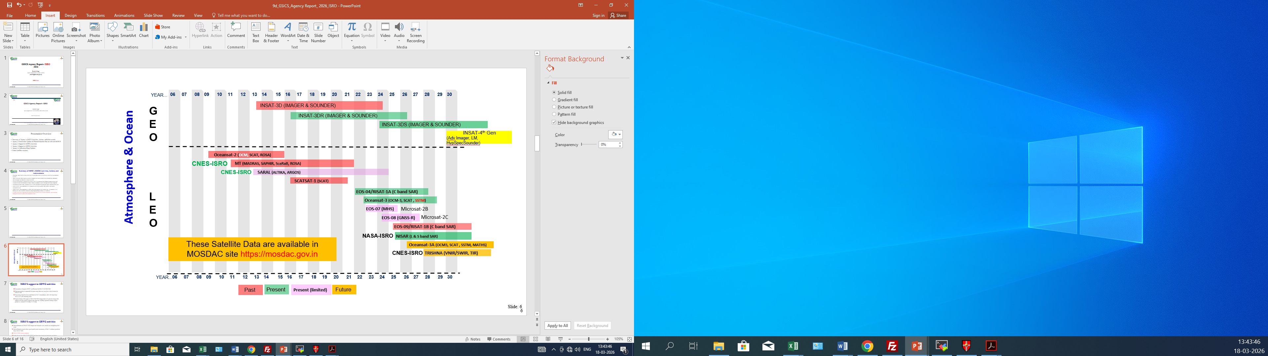
ISRO’s Met-Ocean Satellite Programme: Evolution and Future Roadmap
GSICS Agency Report GSICS Meeting |23-27 March 2026| Ottawa, Canada

Slide 5
ISRO’S support to GDWG activities
Generation of regular NRTC coefficients for INSAT-3D/3DR/3DS.
Data processing has been on hold for over a year due to commitments related to INSAT-3DS and major organizational restructuring.
Processing chain has been established at SAC Ahmedabad, with IASI data from NOAA-CLASS standing order.
Reprocessing of the gaps in INSAT-3D/3DR Imager data is in process along with efforts to fix the issues related to the Satellite Yaw-flip operation during eclipse period, i.e. around 21-24 Mar, 21-24 Sep.
GSICS Agency Report GSICS Meeting |23-27 March 2026| Ottawa, Canada

Slide 6
ISRO’S support to GRWG activities
Intercalibration of INSAT-3DS Imager IR channels with Metop-B/C IASI has been carried out.
Results show good quality and consistency in the radiance products from INSAT-3DS.
VIS/SWIR Intercalibration with MODIS shows a 10-15% radiance underestimation in INSAT-3DS; further analysis is ongoing
Software tool for INSAT-3DS NRTC has been developed and products are being generated. These will be hosted in the website after evaluation.
GSICS Agency Report GSICS Meeting |23-27 March 2026| Ottawa, Canada

Slide 7
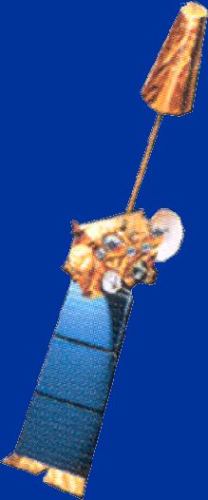
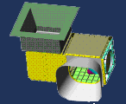
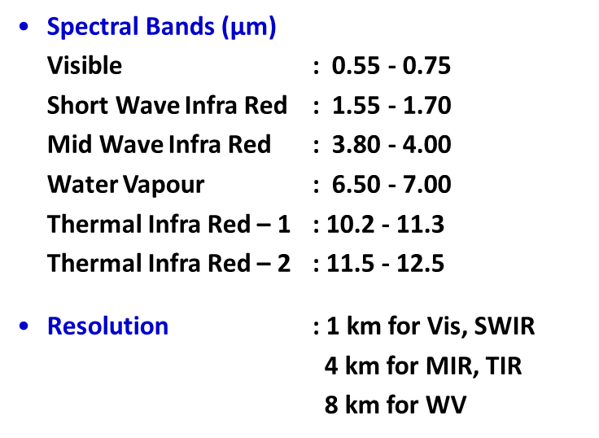
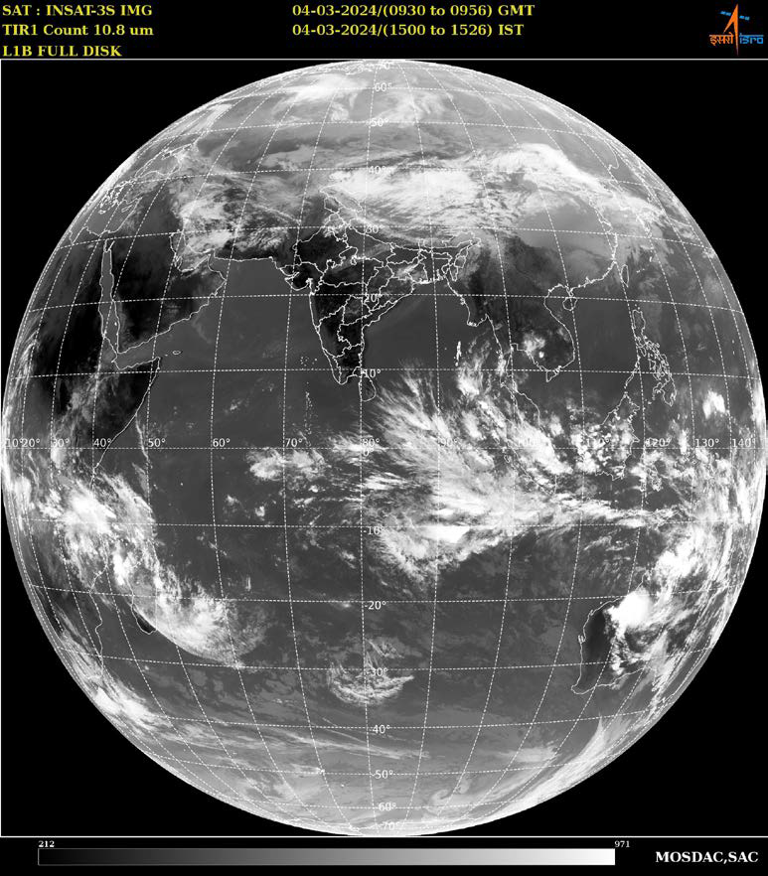
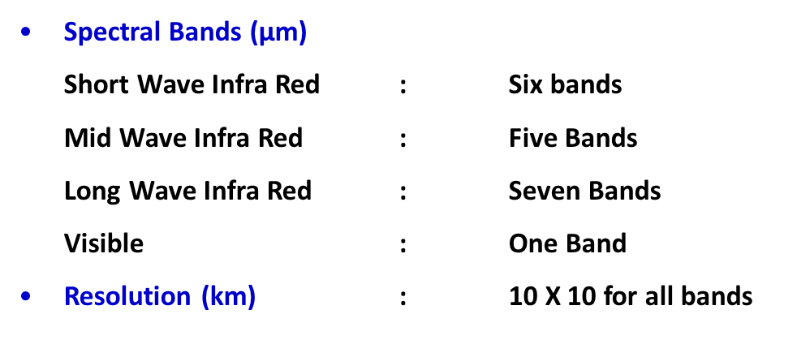
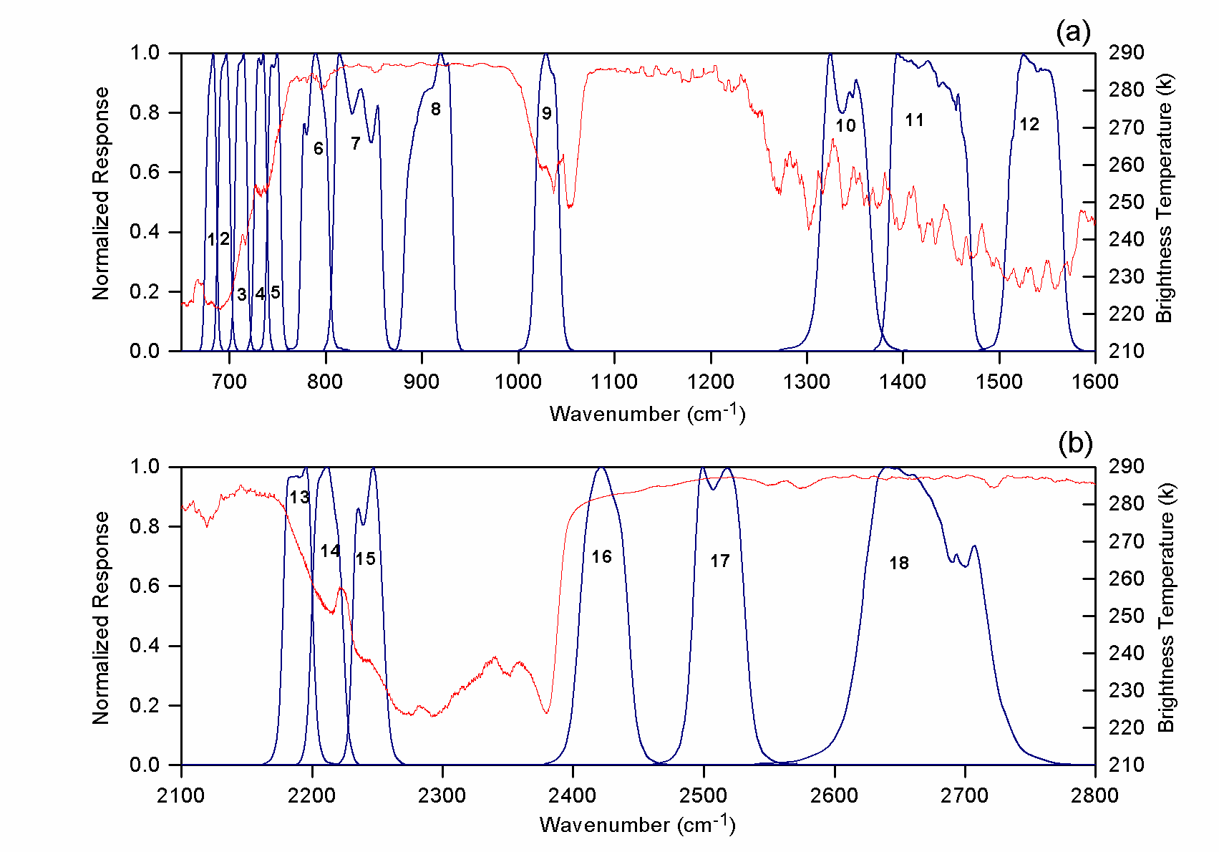
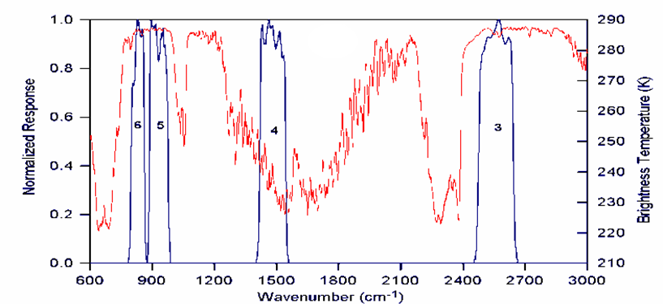
INSAT-3DS: Satellite Instruments Overview
Launched on 17-Feb-2024 using GSLV-F14 rocket, from Satish Dhawan Space Centre (SDSC/ISRO)
Improvements to mitigate the issues related to the blackbody calibration and mid-night sun-intrusion
INSAT-3DS replaced INSAT-3D at 82E
6 Channel IMAGER
19 Channel SOUNDER
GSICS Agency Report GSICS Meeting |23-27 March 2026| Ottawa, Canada

Slide 8
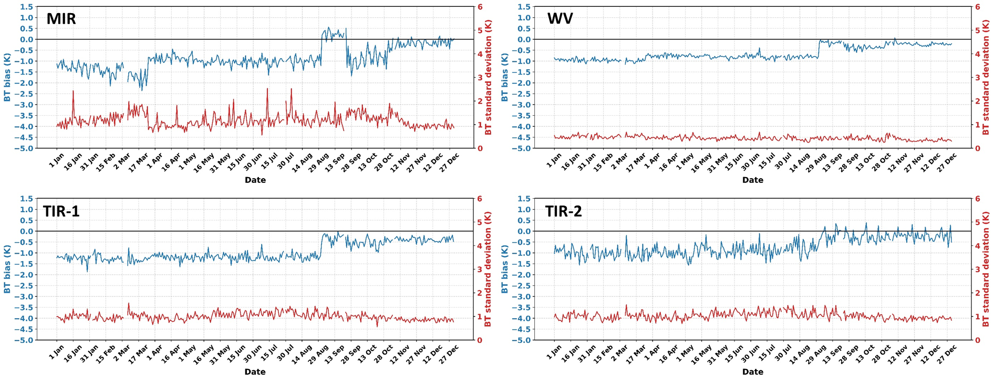
Inter-Calibration Results: INSAT-3DS vs IASI
Analysis for the year 2025
GSICS Agency Report GSICS Meeting |23-27 March 2026| Ottawa, Canada

Slide 9
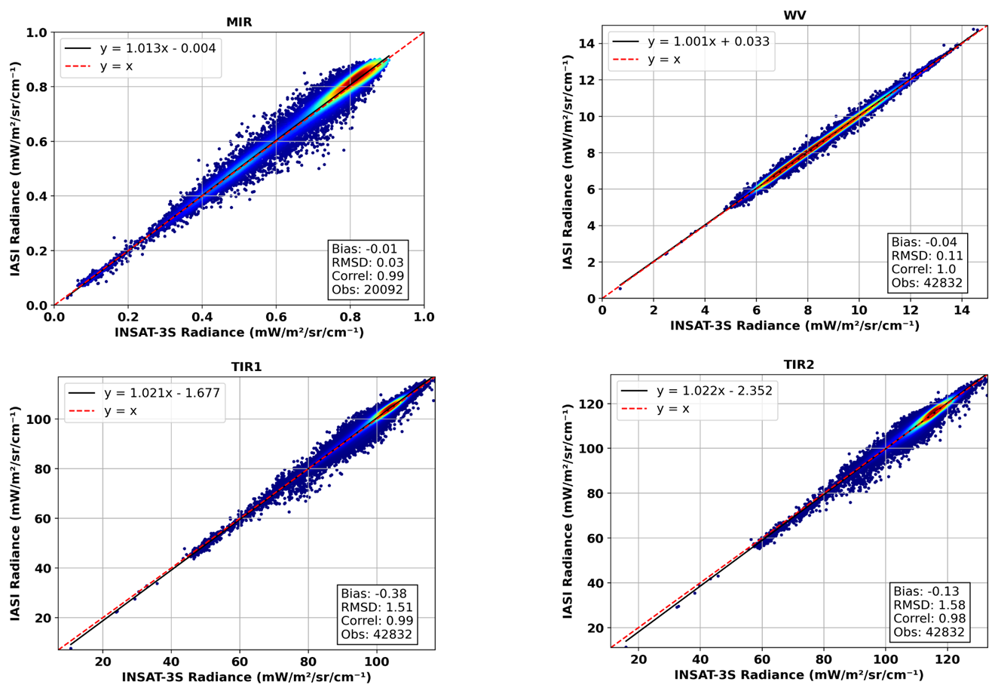
Inter-Calibration Results: INSAT-3DS vs IASI --cntd
GSICS Agency Report GSICS Meeting |23-27 March 2026| Ottawa, Canada

Slide 10
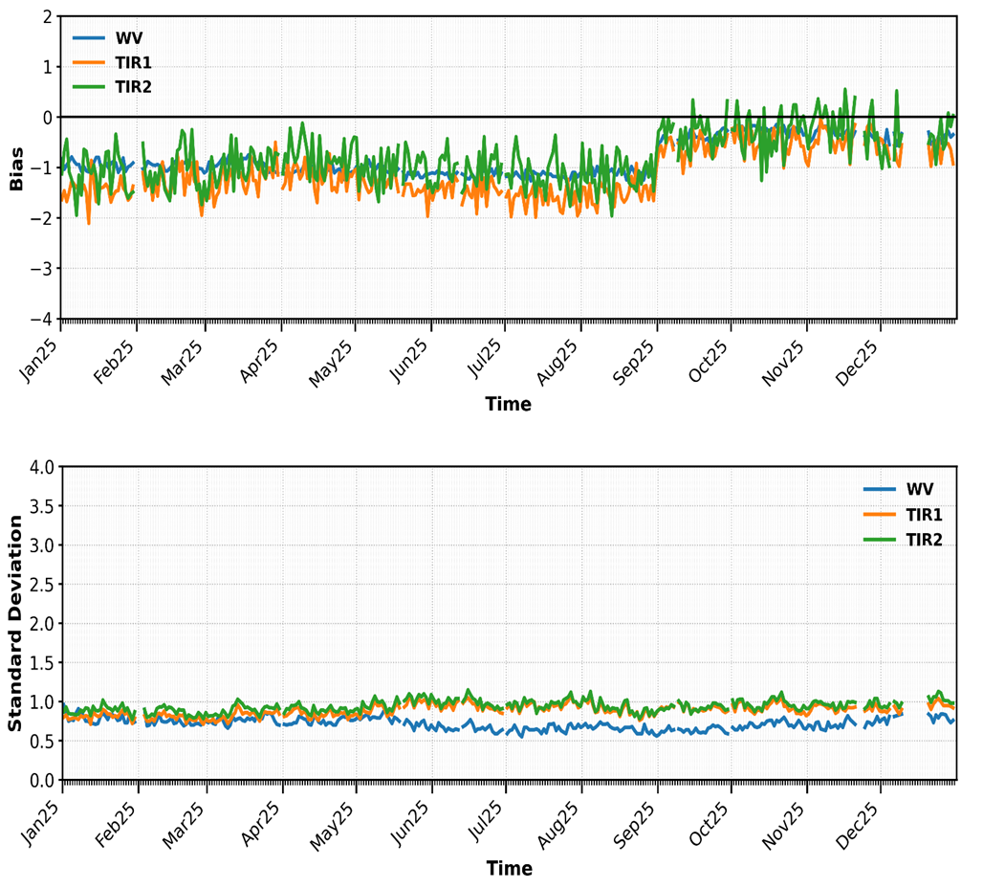
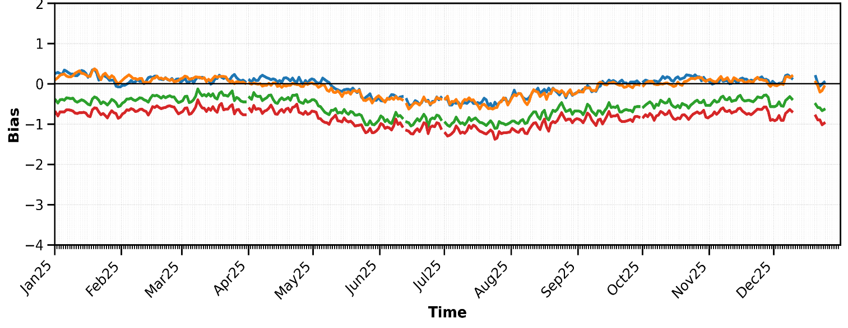
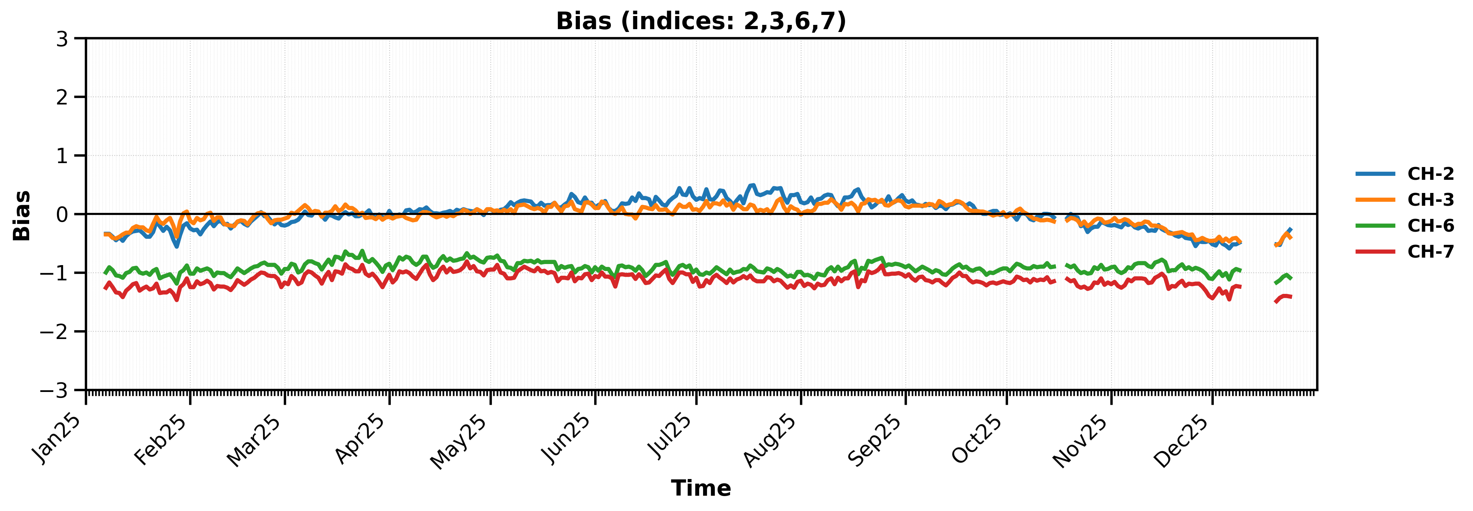
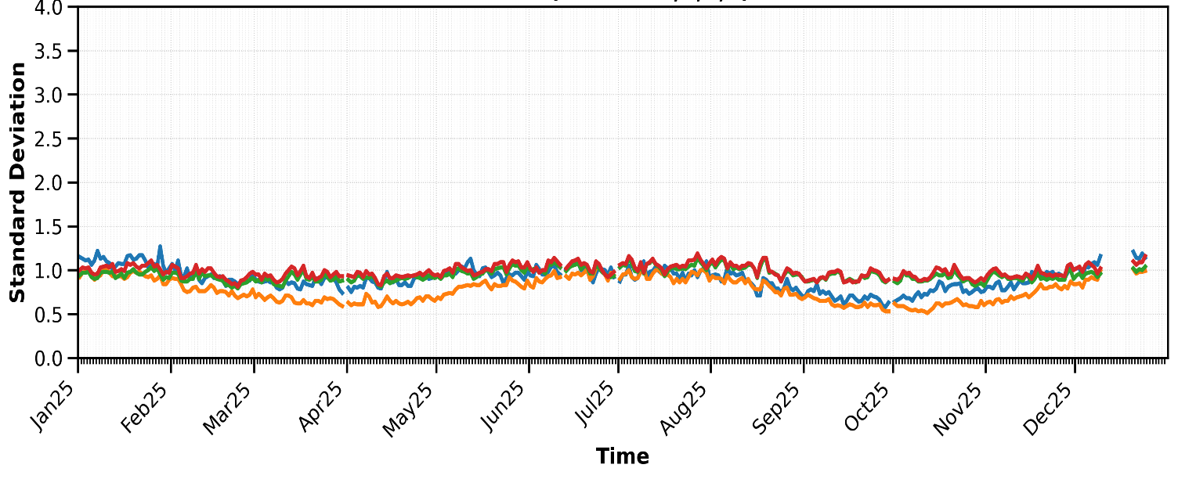
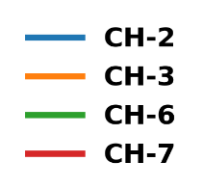
Radiative Transfer-Based Assessment of INSAT-3DS Radiances
ERA5 and CRTM in a GSICS Validation Context
INSAT-3DS 12UTC SEVIRI
GSICS Agency Report GSICS Meeting |23-27 March 2026| Ottawa, Canada

Slide 11
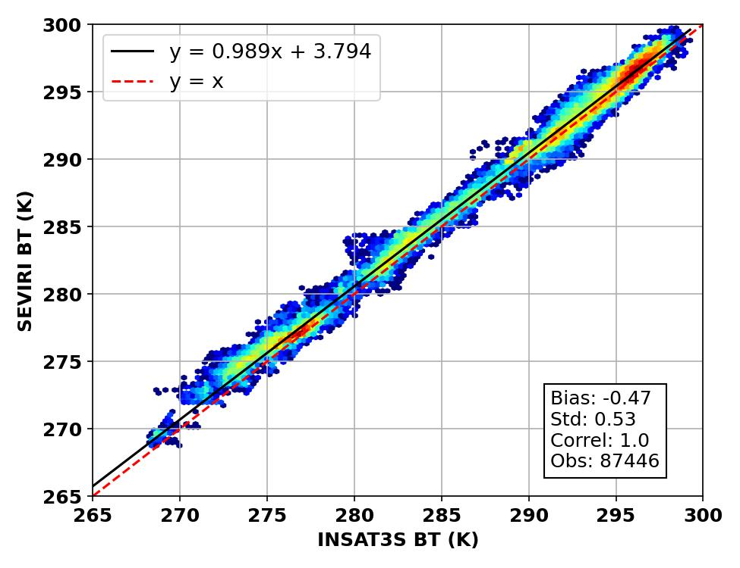
Results of GEO-GEO Inter-Calibration
SEVIRI (Ch6) vs. INSAT-3DS (TIR-1)
GSICS Agency Report GSICS Meeting |23-27 March 2026| Ottawa, Canada

Slide 12
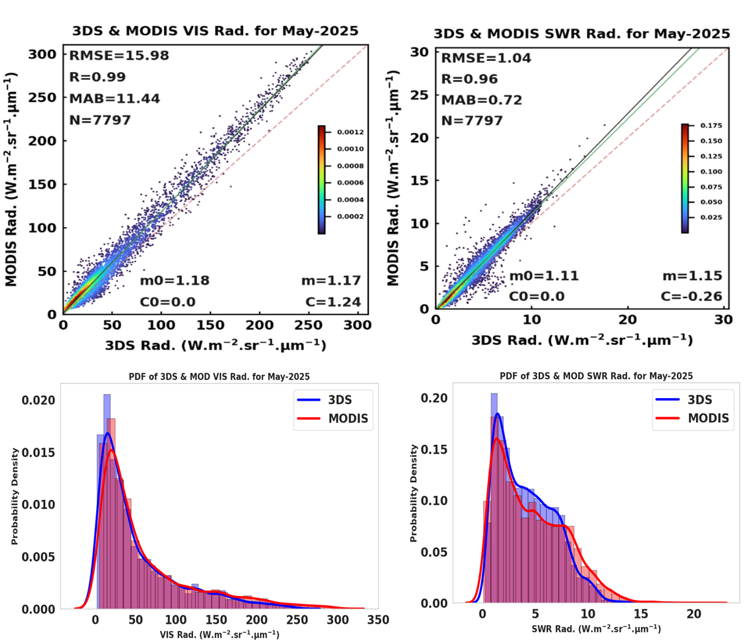
Calibration of INSAT-3DS Imager Visible and SWIR channels
GSICS Agency Report GSICS Meeting |23-27 March 2026| Ottawa, Canada

Slide 13
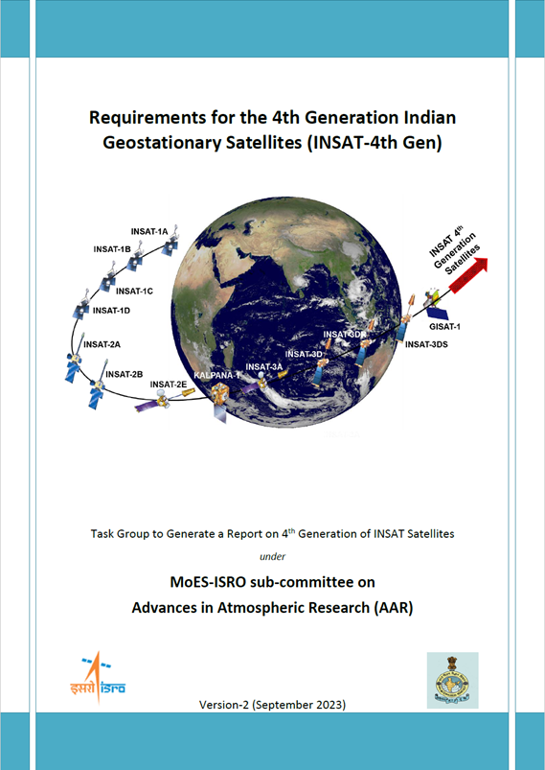
ISRO’s Future Met Satellites
INSAT-4th Generation Satellite Instrument
GEO: INSAT-4th Generation Satellite
a) Advanced Imager
    18 bands from 0.5 – 13.5 µm with spatial resolution 500m for VIS and 2 km for IR
    Faster scanning for nowcasting applications
    FD (Full Disk), India (3000 km x 3000 km) and Mesoscale (1000 km x 1000 km)
    Capability to provide FD image every 15 minute, Indian landmass every 5 minutes and Mesoscale images every 30 seconds.
b) Lightning Mapper
c) Hyperspectral Infrared Sounder
GSICS Agency Report GSICS Meeting |23-27 March 2026| Ottawa, Canada

Slide 14
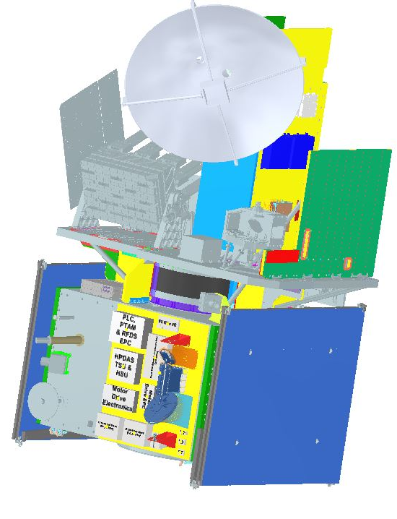
ISRO’s Future Met Satellites
Oceansat-3A will be launched in 2026
Millimeter-wave Atmospheric Temperature and Humidity Sounder (MATHS)
A 20-channel cross-track scanning Radiometer operating at 50-60 GHz and 183.31± 16.25 GHz bands
Atmospheric vertical Temperature & Humidity profiles with nadir spatial resolution of 25 km and 15 km, respectively.
Developed in-house at Space Applications Centre (ISRO)
MATHS Payload
GSICS Agency Report GSICS Meeting |23-27 March 2026| Ottawa, Canada

Slide 15
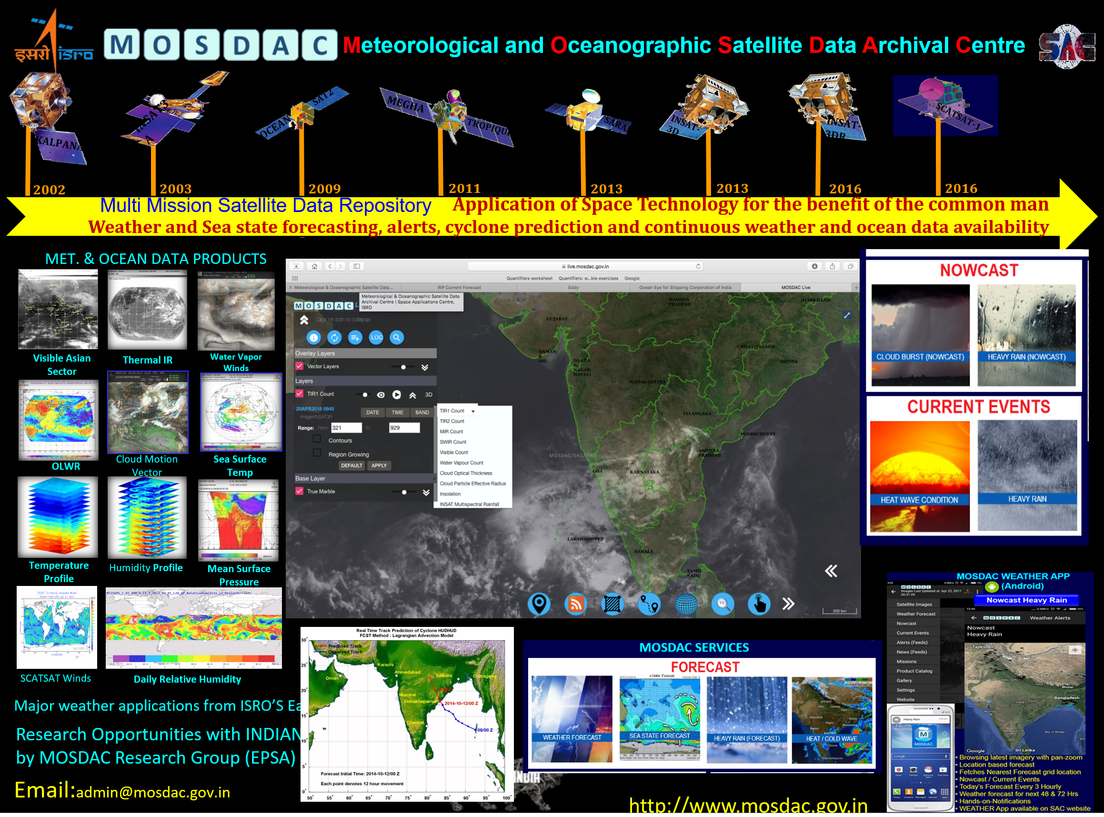
MOSDAC: ISRO’s Met-Ocean Satellite Data Dissemination Portal
GSICS Agency Report GSICS Meeting |23-27 March 2026| Ottawa, Canada

Slide 16
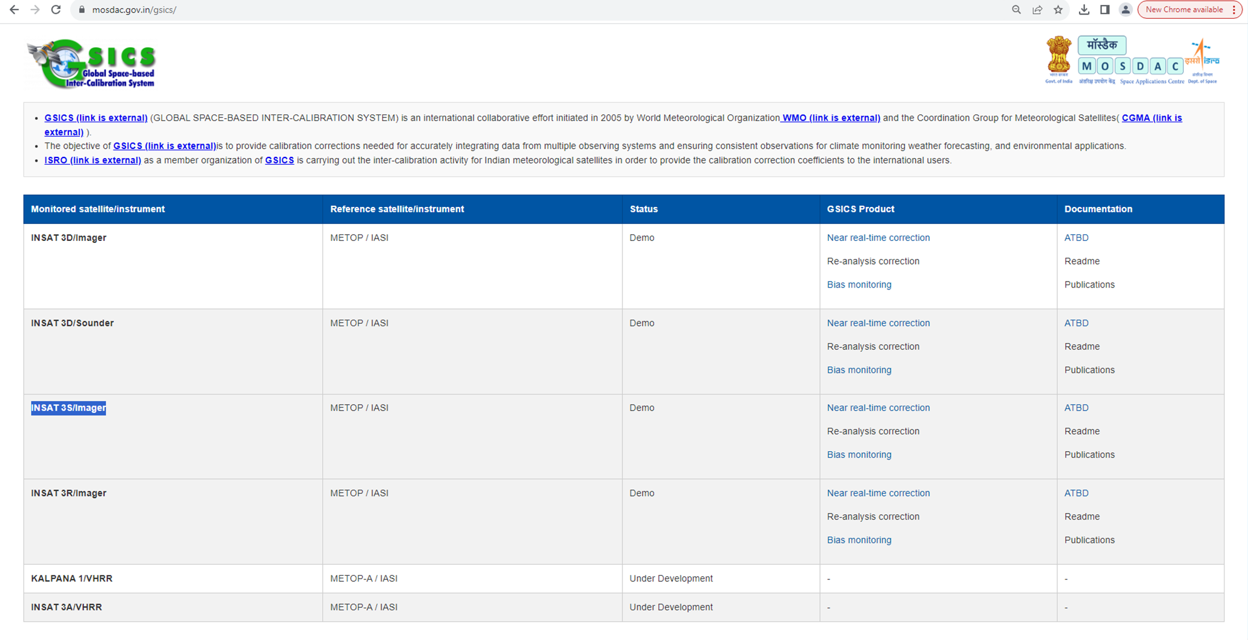
GSICS-Based Calibration and Bias Monitoring
GSICS Agency Report GSICS Meeting |23-27 March 2026| Ottawa, Canada

Slide 17
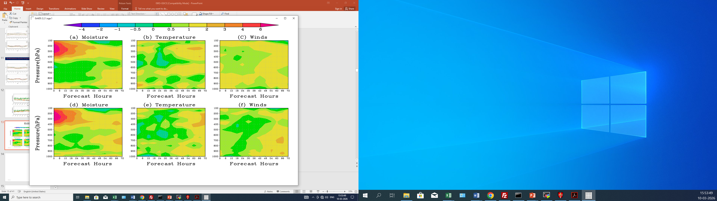
Impact of GSICS Correction on NWP Forecast Quality
Calibration → Forecast Improvement
Assimilation of WV radiances from INSAT-3DS in the WRF data assimilation system
Experiments were conducted over the Indian region at a spatial resolution of 9 km
Control experiment: Assimilation of conventional observations
No-GSICS experiment: Assimilation of WV radiances without GSICS correction
GSICS experiment: Assimilation of WV radiances corrected using GSICS
Assimilation of WV radiances improved humidity (6 to 7 %) in the upper troposphere
GSICS correction radiances produced slightly larger improvement
With GSICS Without GSICS
GSICS Agency Report GSICS Meeting |23-27 March 2026| Ottawa, Canada

Slide 18
Agency’s Personnel supporting GSICS
  Points of contacts/meeting participants:
  – EP: Dr Pradeep Thapliyal (pkthapliyal@sac.isro.gov.in)
  – GRWG: Dr Munn Vinayak Shukla (munnvinayak@sac.isro.gov.in)
  Dr Abhisek Chakraborty (abhisek1984@sac.isro.gov.in)
  – GDWG: Dr Nitant Dube, (nitant@sac.isro.gov.in)
  – GSICS Point of Contact for Operational Matters: Ms Shivani Shah (shivanishah@sac.isro.gov.in)
Thank You
GSICS Agency Report GSICS Meeting |23-27 March 2026| Ottawa, Canada

